Slide 1

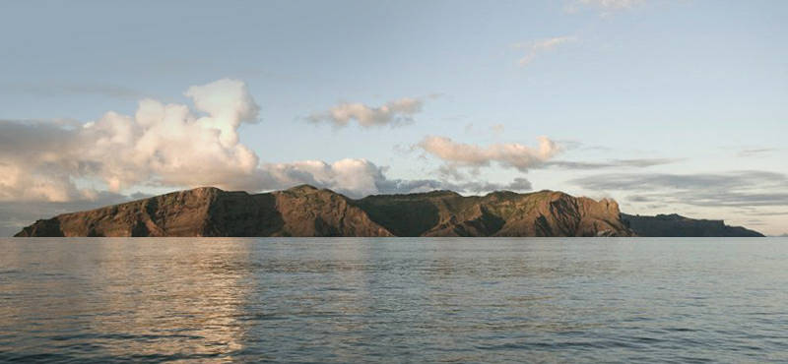



St Helena Island
Presented by the St Helena National Trust
In partnership with St Helena Government and Historic England

Slide 2
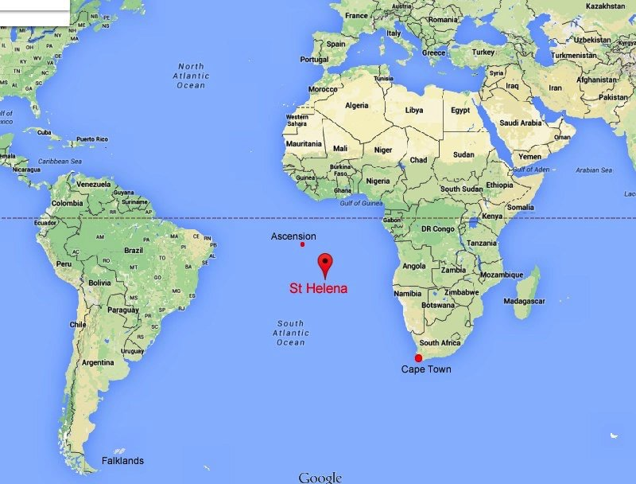

About St Helena Island
We are a British Overseas Territory, located in the South Atlantic Ocean. 1,950km from West Africa and 4,000km from South America.
We were discovered in 1502 by the Portuguese and was settled in 1659 by the British East India Company (EIC).
We identify as British and refer to ourselves as ‘Saints’. Our ethnic origin is a result of different nationalities coming to St Helena either seeking a new life, slavery, contract services, or were prisoners of war.
We have a total population of 4,319 of which 3,991 are Saints. We have an almost even ratio of males to females.
The only access from 1502 to 2017 was by sea. We have only been using air travel for the last 5 years.

Slide 3
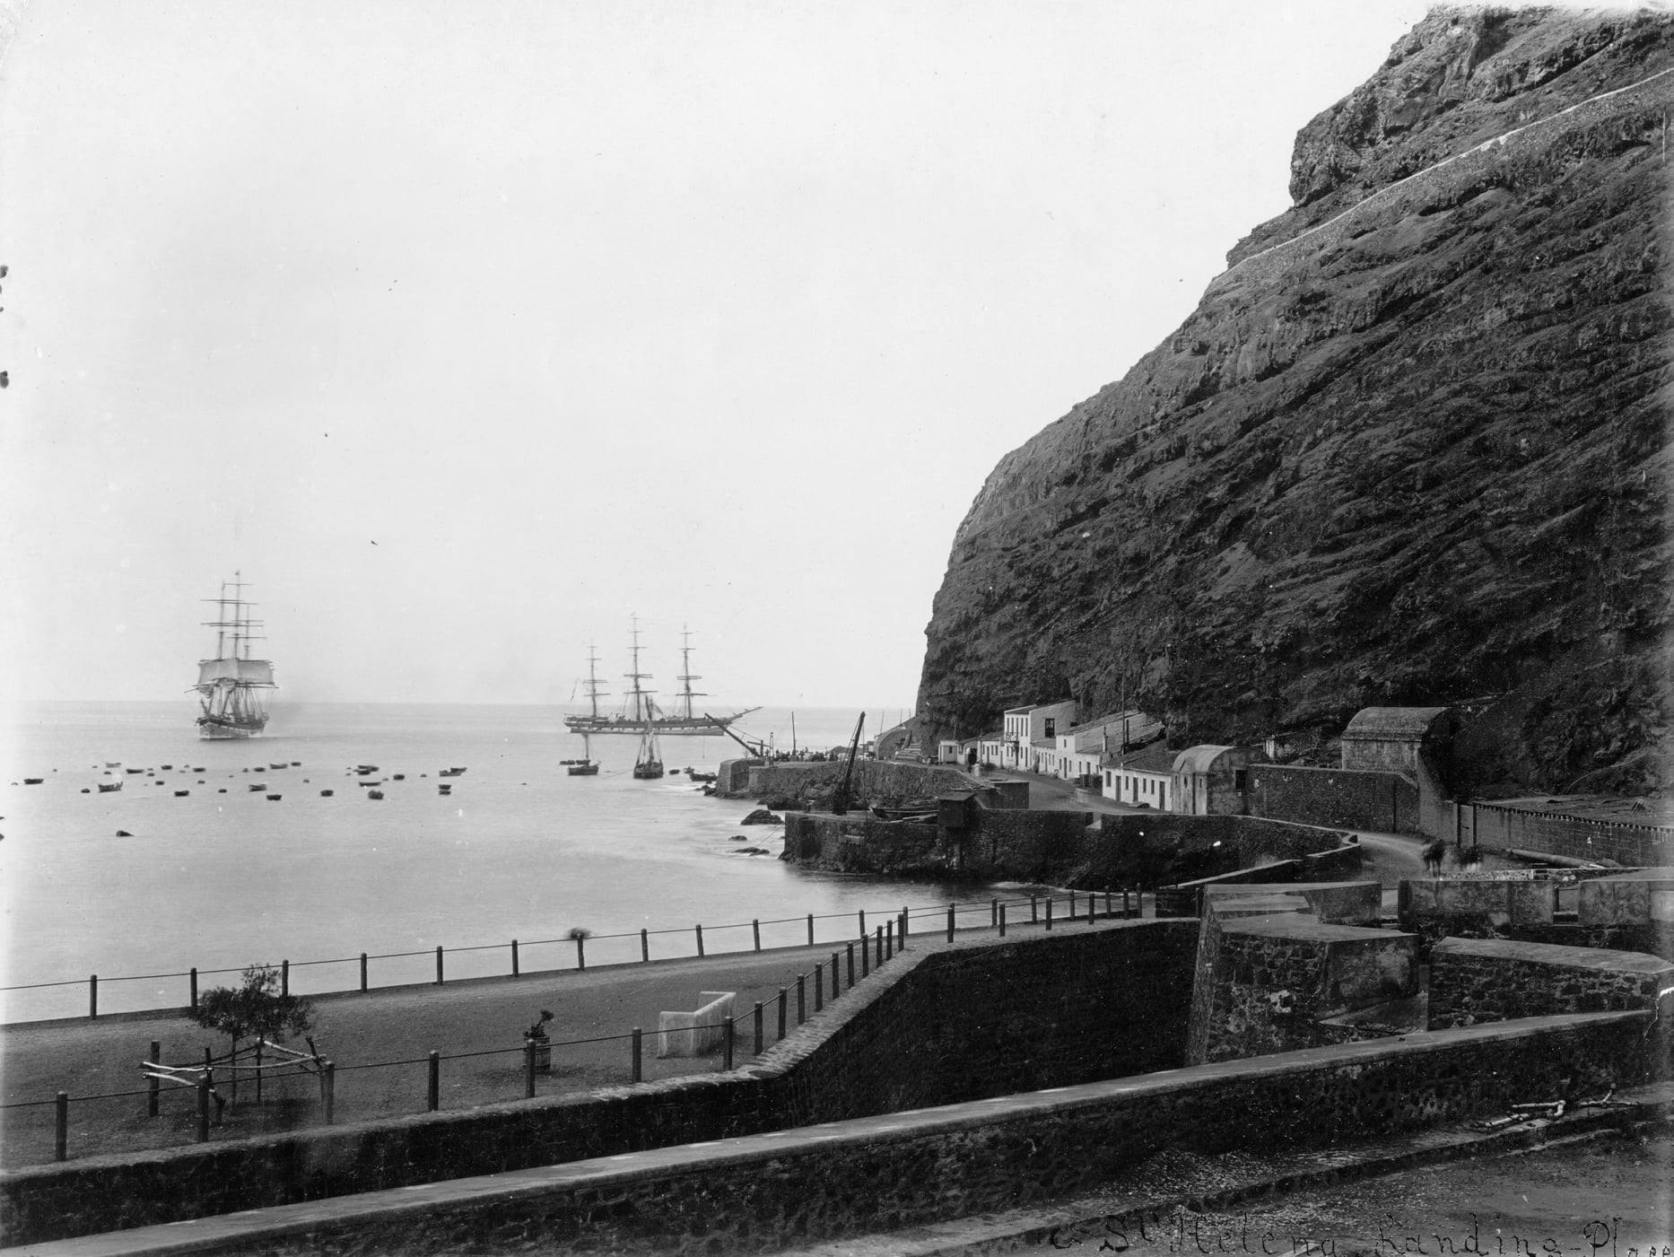
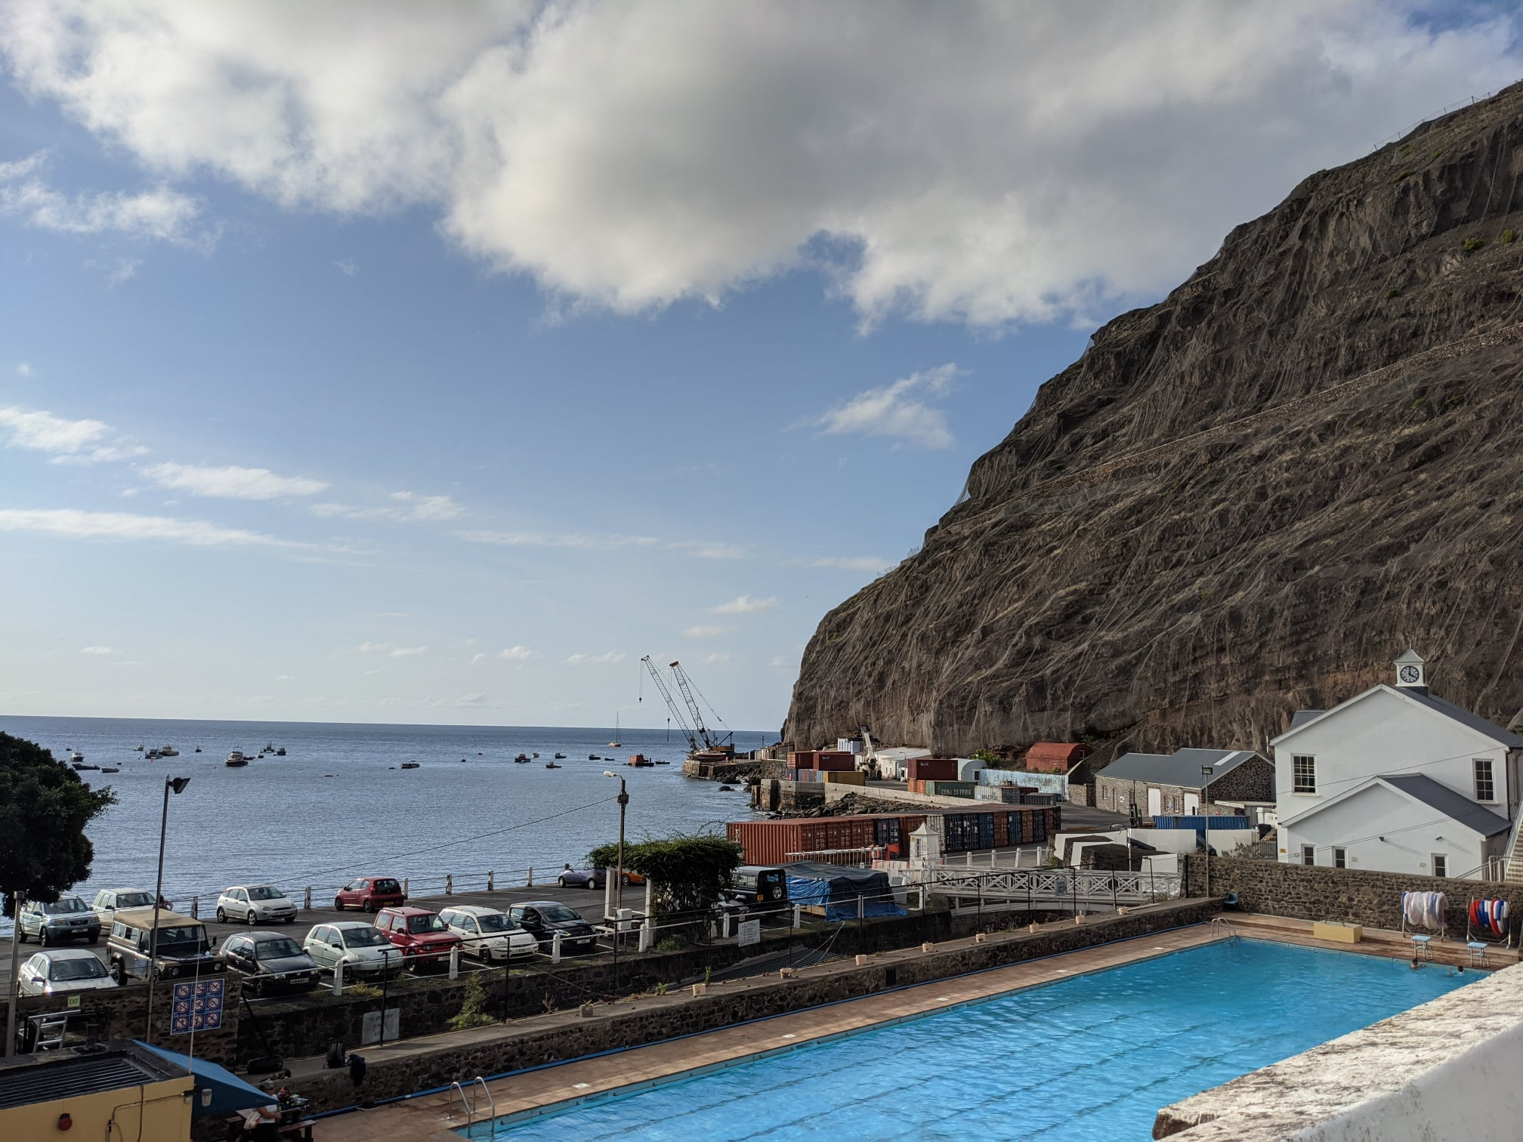
The British East India Company (EIC) was the world’s largest and most influential company and St Helena played a key role by being a provisioning stop in its successful missions to India.
Due to our isolated position, we were an ideal location for the exile of Napoleon, Zulu Chiefs, Boer Prisoners of War and other political prisoners.
The 89,208.74 mile perimeter of St Helena hosts military batteries, forts and outposts, all remnants of EIC defensive systems and later the British garrison.
Our wharf today, whilst being used for cargo operations and recreation has not changed its features since being built by the EIC in the late 1600s.
Signs of early settlement and growth as the island moved through the eras (from EIC to Crown Colony) remains with plantation houses, cottages and one of the largest first generation liberated African burial grounds.
About our Cultural Heritage

Slide 4
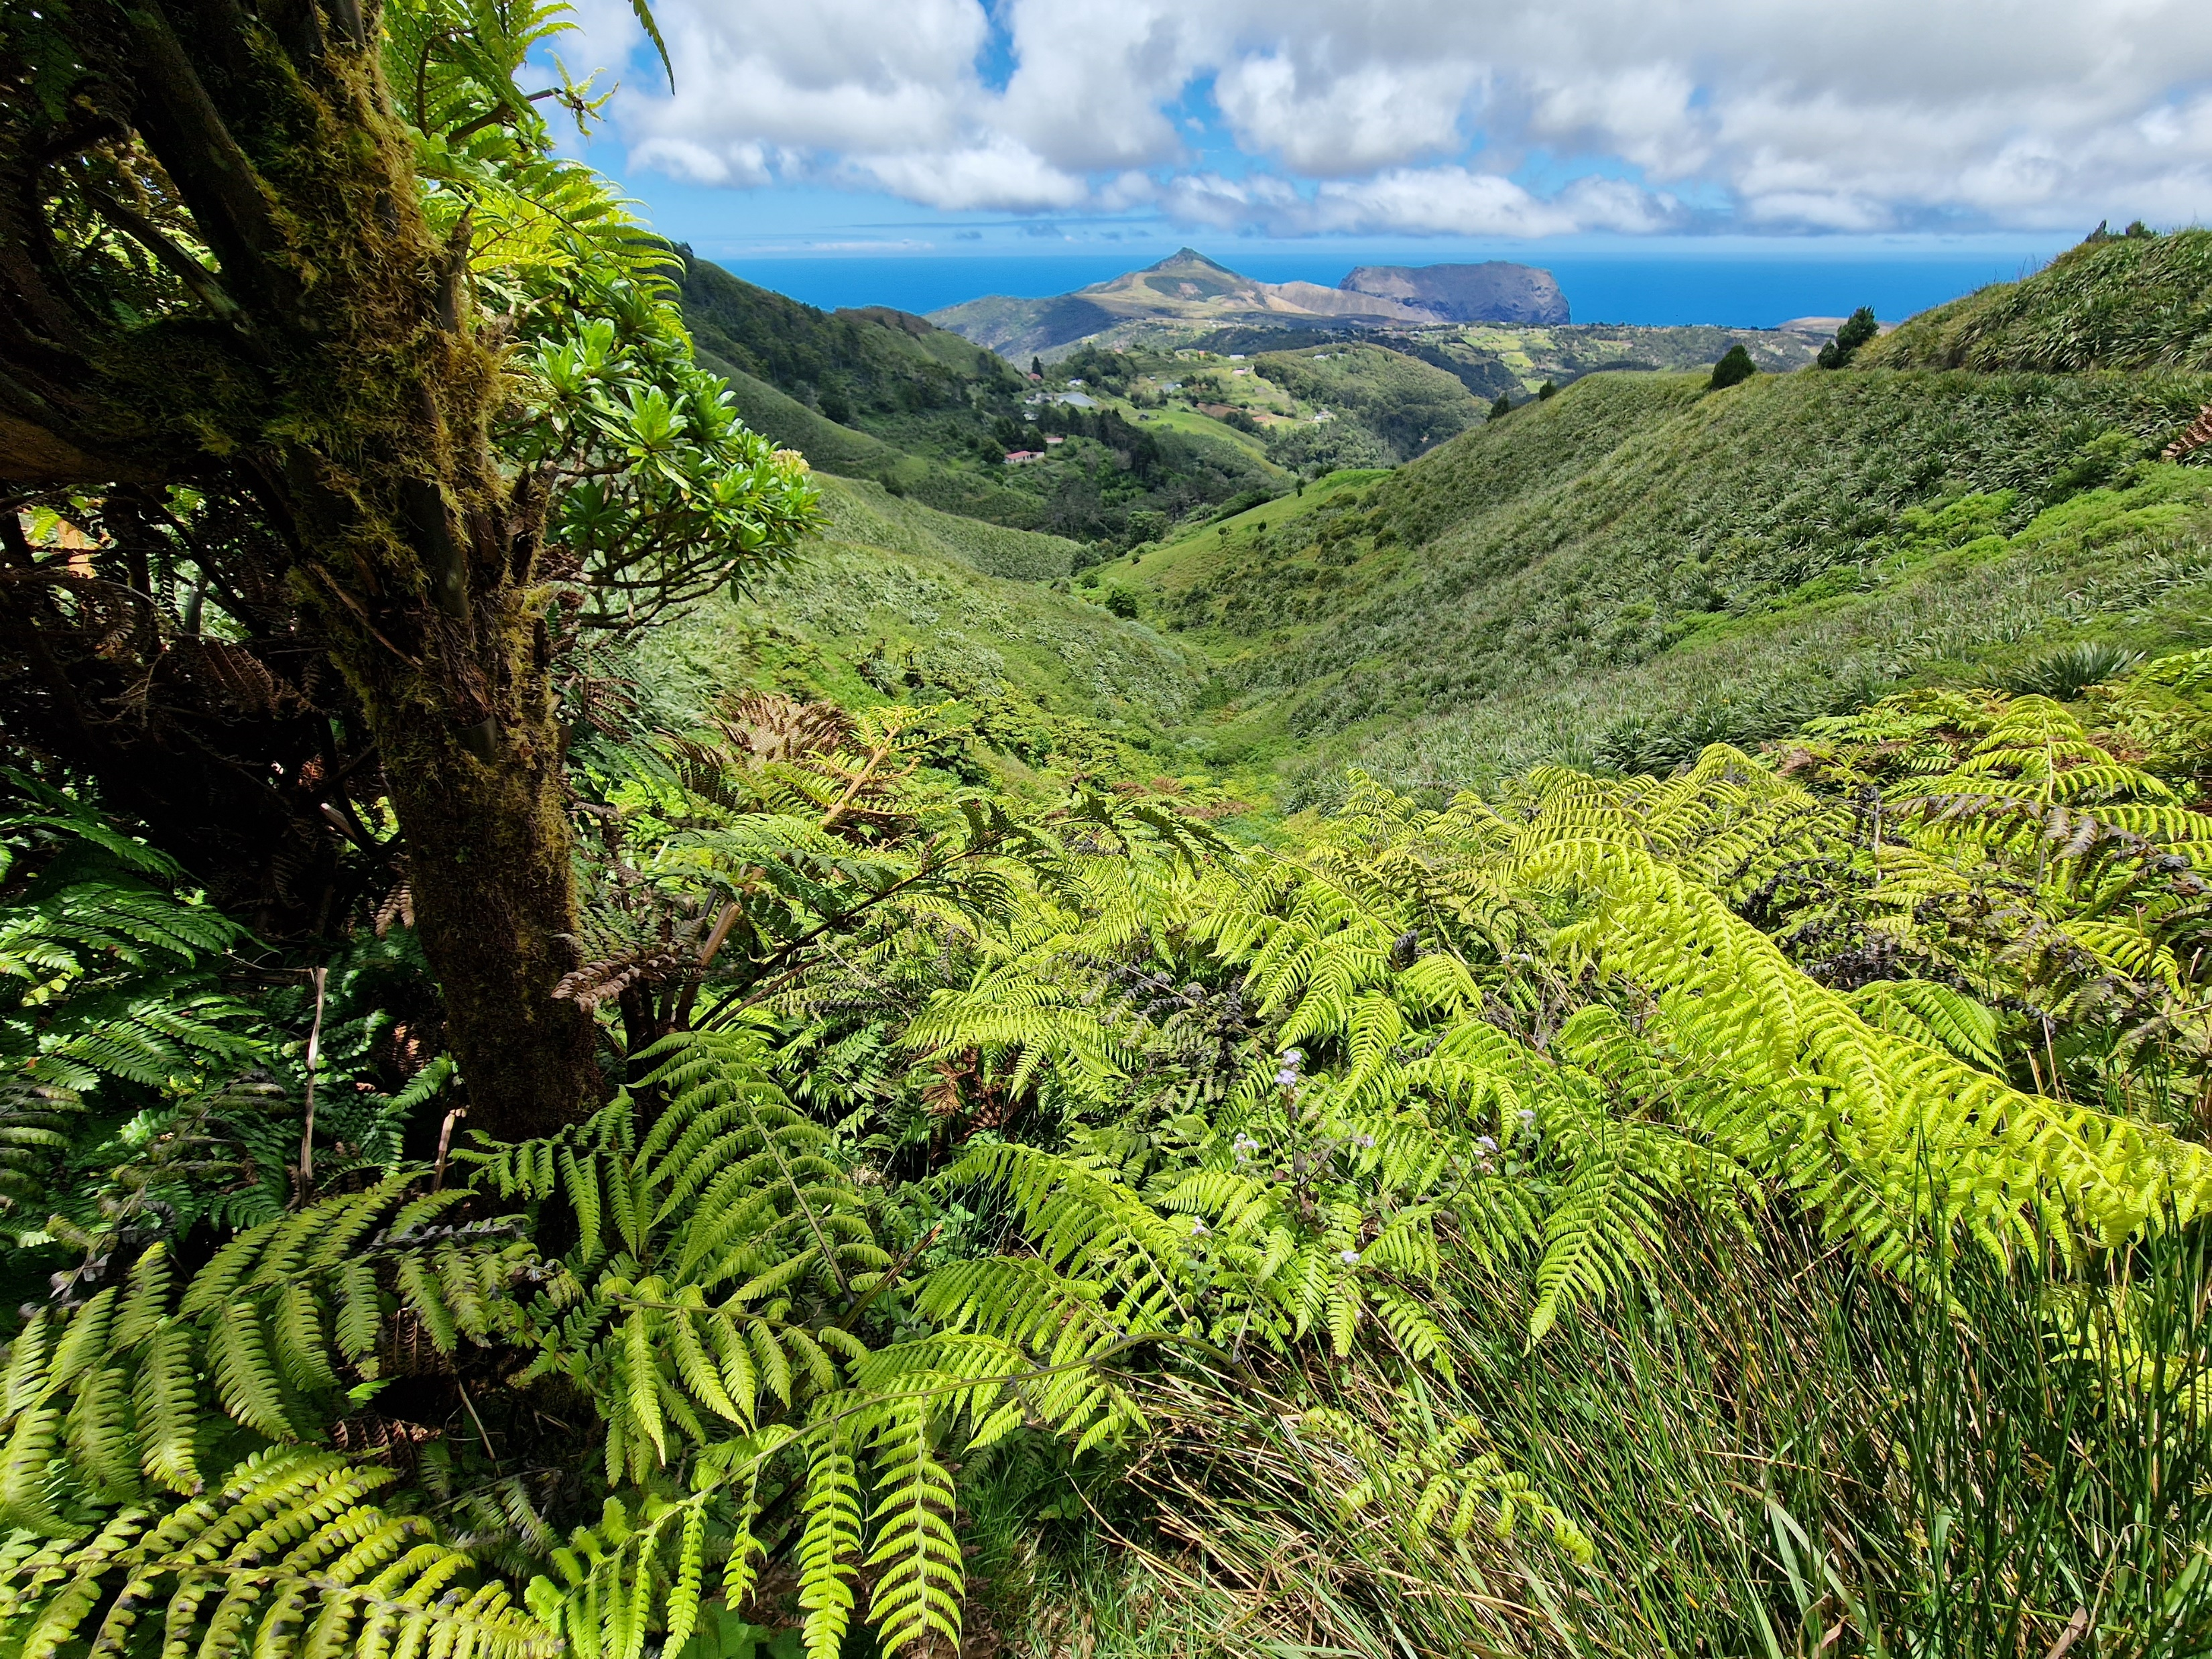
About our Natural Heritage
St Helena and its 200 nautical mile marine protected area is an evolutionary hotspot.
The island is home to almost 1/3rd of the UK and all its Overseas Territories endemic species.
45 vascular plants
26 bryophytes
10 lichens
455 terrestrial invertebrates
50 marine invertebrates
25 marine fish (including 16 species that are only found in St Helena and Ascension
1 vertebrate (soon to be 2)
Still counting!

Slide 5
St Helena’s World Heritage Site journey
2011 | St Helena submitted a tentative application of mixed site status But the UK Independent WHS expert Panel were not convinced by the case for cultural Outstanding Universal Value (OUV) and therefore St Helena was listed with natural OUV.
2019 | A Scoping Group was established to: *review St Helena’s current position in relation to the tentative status *to determine whether the island’s OUV would meet (or not) the WHS requirements *to determine what options are available to the island
2020 | A report was presented to the Island’s Executive Council, which summarised where St Helena was in terms of the WHS tentative listing and recommended: *Develop a full analysis of the implications and costs of WHS designation, and the nature of status (as a natural or mixed site) to determine whether or not the island should proceed from a tentative listing to a full application *Specific expertise is needed to determine the social, economic and environmental impacts of a WHS status for St Helena. This includes the opportunities and obligations around preservation, conservation, planning, costs, benefits, resources, legislative, regulatory or management changes
 | COVID-19 Pandemic

Slide 6
St Helena’s World Heritage Site journey
2021 | A business case was presented to the Executive Council presenting logistics and costing of the recommendations presented in the 2020 report. Whilst the business case was agreed in principle, funding would need to be sought to take the recommendations forward. With the island coming to a halt with the pandemic, this would have been difficult for the St Helena Government to budget.
2021 | St Helena voted for a ministerial government. In October, Elections were held, and the first ministerial government being formed.
2022 | Call for WHS UK tentative list review. St Helena did not put forward an application to keep its tentative listing.
2023 | Preparing St Helena for the next tentative list round.
2032 | To submit application for UNESCO World Heritage Site UK tentative list

Slide 7
Conserving St Helena’s heritage does not stop
2011 | An Historic Environment Register was developed listing all heritage sites on St Helena; assessing their importance, condition, and potential future tourism development. It was planned for the HER to identify essential restoration/maintenance priorities and costs. The HER would add layer to the GIS mapping system.
 | The HER was hosted on a publicly accessible Google server. However, Google had stopped supporting the platform. No resources available to update the current records and to continue identifying other historic features of the island. The HER is currently an under-utilised resource not fulfilling its original purpose.
2021 | St Helena National Trust was successful for a pilot project with Historic England to demonstrate innovative HER solutions for under-resourced UK Overseas Territories, update the HER and bring it back online as an accessible tool for conservation, planning and development.
2022 | St Helena National Trust and Historic England reviewed the first draft of Arches Instance database to determine how St Helena could maximise Arches Instance. Logistical issues were also discussed due to St Helena’s limited bandwidth capacity.
2023 | The St Helena National Trust currently updating the current historic features and continues to add records

Slide 8
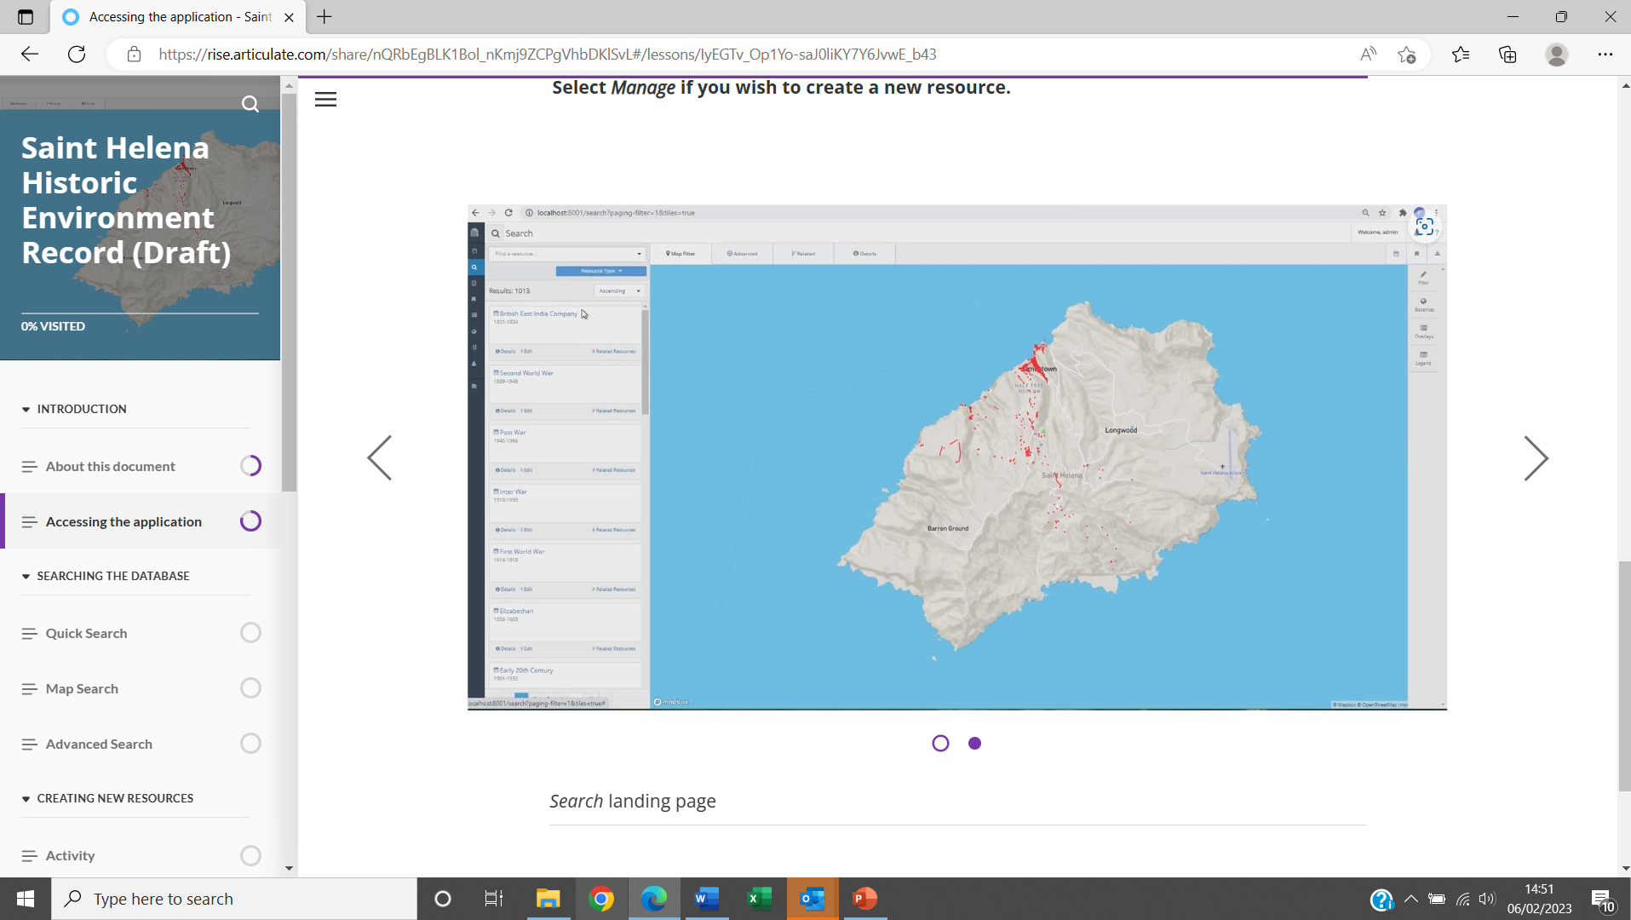
The HER will log all significant historic features on St Helena Island. From wrecks in the ocean (Dutch man-of-war, Witte Leeuw sank in 1613), to Plantation cottages, and historic fauna.
St Helena National Trust and Historic England will work to bring the HER online in 2024. It is intended to bring this online alongside of the fibre optic cable going live.
Work with our partner, Historic England to determine the feasibility of an application for St Helena’s WHS status; including resources and expertise to determine our Outstanding Universal Value and ability to maintain it.
We continue to develop management plans for our National Conservation Areas (both natural and historic).
We build local capacity to boost confidence in bidding for the tentative list and thereafter full application for World Heritage Site status.
St Helena’s next steps

