Slide 1

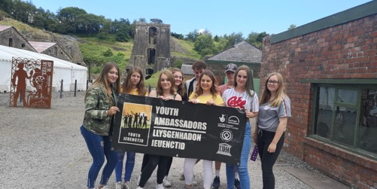
Notes:
1 MIN
Introduce Self.
Why am I presenting to you

Slide 2

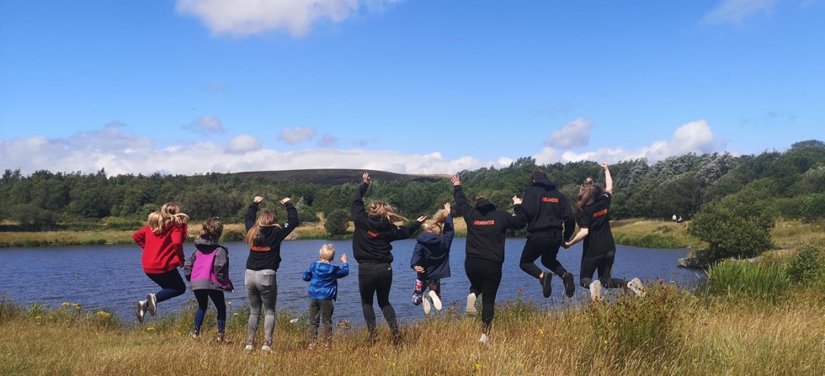
The vision of the award winning World Heritage Youth Ambassador program is to empower Young People to learn about and have an active and powerful voice in their own lives, their local communities and World Heritage
EMPOWERED
SUPPORTED
PARTICIPATIVE
INFLUENTIAL
ACTIVE

Slide 3
Why did we do this?
‘Young people are major human resource for development and key agents for sector change and innovation’
LOCALLY
Young people had a bad reputation locally
Inter-generational intolerance (increased since COVID).
No youth representation in Blaenavon, and no vehicle to enable it.
Industrial heritage was a ‘hard sell’ to young people. Not cool!
Lots of social issues faced by young people – heritage was not important.
NATIONALLY
Lack of national youth representation in WHS.
WHS struggle to engage teenagers
WHS wanted to be upskilled in working with teenagers
Lack of qualification in World Heritage
Mainly formal learning to engage
Notes:
Difficulty in youth engagement outside of formal education
Need to work with young people to address a gap in our demographic and
Address community perception
Young people (age 13-25) are major human resource for development and key agents for sector change and technical innovation.
Within a World Heritage context in the UK, young people are not capitalised on as a resource, despite making up 15% of the UK’s population and being a key demographic for sites to engage with http://www.indexmundi.com/united_kingdom/age_structure.html
Even with encouragement, information and support, World Heritage sites in the UK struggle to engage with the teenage audience. Despite their global importance, World Heritage Sites have no statutory funding available to support the achievement of the World Heritage Convention, or to support their management, preservation, promotion and transmission of their Outstanding Universal Value. They therefore have difficulty in engaging with young people exacerbated by lack of funding, opportunity, resources and knowledge of how to effectively engage with this age group.
Social problem within our local communities: Communities first area.
Lots of issues that affect young people – culture of dependency and long term unemployment,
Poorest communities, Low self esteem and low education.
Young people seen to be causing problems – antisocial behaviour
We wanted youth ambassadors to change this.
We want to address the gap in youth engagement across the UK WHS and roll our model out as we know it works.

Slide 4

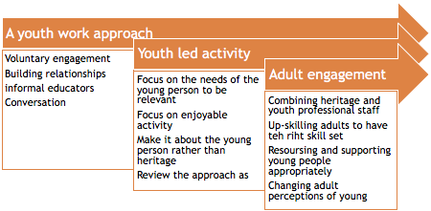
The Model of Engagement

Slide 5
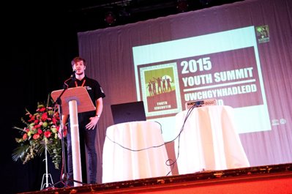
How did we engage?
The right skills and personalities
The right recruitment
Small numbers
Meaningful
Fun
Youth led
Adult training
THE RIGHT ENVIRONMENT
“the experiences will last a life time” Ruth. Age 17
Notes:
Combination of youth professional skill and heritage professional skill is needed to deliver
Engage with relatively small number of YP’s (40-50) but has been productive = Long term sustainable engagement
Dynamic approach needed – time intensive, you must build relationship up
Heritage is of secondary interest – skills, friends and the experience are more important for YP’s
Social media was not as effective as we wanted!
Residential and day trips are the way forward, but classroom based sessions are needed to bring the rest together
Variety of experience – NOT JUST HERITAGE!!
Long term approach for team bonding needed
Bringing “experts” in to speak is good.
Achievement and recognition of importance is needed

Slide 6
The Model of Engagement
Youth work Values and Principals
Voluntary Engagement
BUILD RELATIONSHIPS
INFORMAL EDUCATORS
Conversation

Slide 7
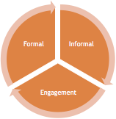
The Model of Engagement
2. Focus on the needs of the young person, NOT THE HERITAGE!
LEADING AND RESPONSIBILTY
SOCIAL TIME
FUN TEAM BUILDING DAYS
EXPERIENTIAL / INCIDENTAL
CONSULTATION
SUPPORT FOR PERSONAL ISSUES

Slide 8
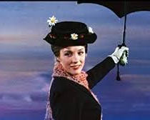
The Model of Engagement
3. ADULT SKILL
CAN HAVE A LAUGH
TRAINED AND UPSKILLED!
SUPPORTIVE AND CARING
HAVE A PERSONALITY!
TRUSTWORTHY
EMPATHY

Slide 9
DOES IT WORK?
500 + young people engaged
5000 volunteering hours
100+ accreditations
7 World Heritage Sites
Life skills gained
Influencing decisions
Valued community involvement
Recognition across the UK
Won Awards
70% care experienced
100% increased confidence
YES!

Slide 10
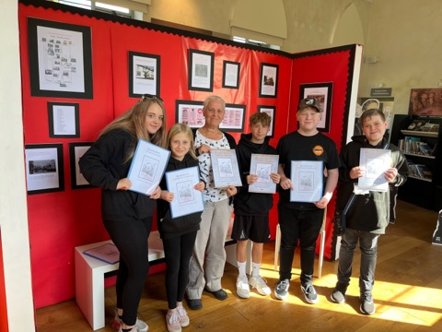
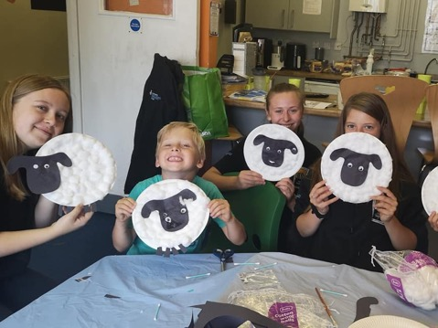
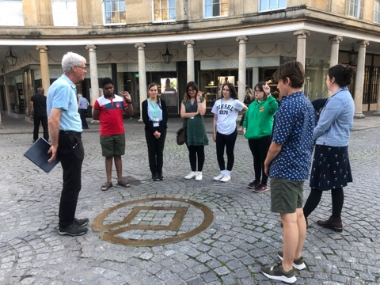
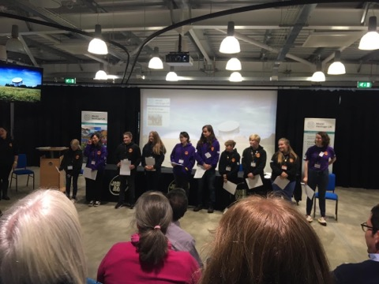
Meaningful Impact
Helping local communities
Leading Tours
Training other YP
Speaking out on what matters most

Slide 11
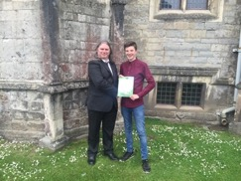
The Impact of our work
Kieran. Age 14-17.
Looked after Child
Difficulties in school
Hyperactive!
DURING YAMS
200+ volunteer hours
1x Qualification
Social Skills
Learned about heritage
Confidence
Public speaking
Post YAMS
BBC Rickshaw challenge
Employed
Living independently
University
Now volunteers for us!
I liked the residential the most as I got to learn a lot of new things and exciting things about the heritage and spent time with the group”

Slide 12
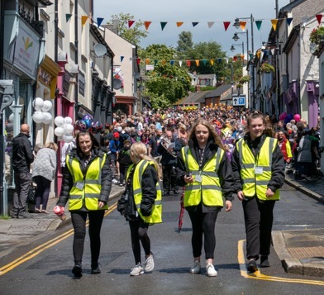
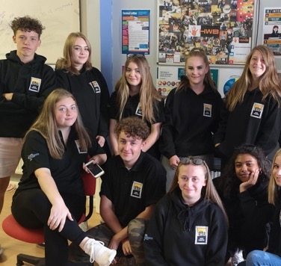
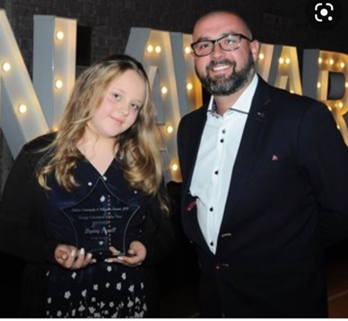
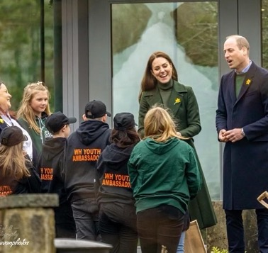
“My time in YAMS has been absolutely amazing, I have made new friends…developed new skills and I’m feeling more confident”
‘Before this group I felt hidden, now I feel seen”
“ Yams has given me a voice”

Slide 13
https://youtu.be/KtPhxVHn2KM

Slide 14
