Slide 1






Heritage Schools Evaluation 2025-26: final report
March 2026
Holly Collins, Senior Research Manager
hcollins@djsresearch.com
Michael Astakhov, Research Manager
mastakhov@djsresearch.com
Vicky Mullis, Associate Director
vmullis@djsresearch.com
Head office: 3 Pavilion Lane,
Strines, Stockport, Cheshire, SK6 7GH
Leeds office: Regus, Office 17.21, 67 Albion Street,
Pinnacle, 15th–18th Floors, Leeds, LS1 5AA
+44 (0)1663 767 857 | djsresearch.co.uk
JN10484
Notes:
A school local history exhibition in Oldham © Historic England

Slide 2
Contents
Page
3 | Objectives and methodology
7 | Teachers
9 | Attendee profile
18 | Session experience and outcomes
28 | Resources
36 | Future development
42 | Webinars
47 | Partners
57 | Youth leaders

Slide 3
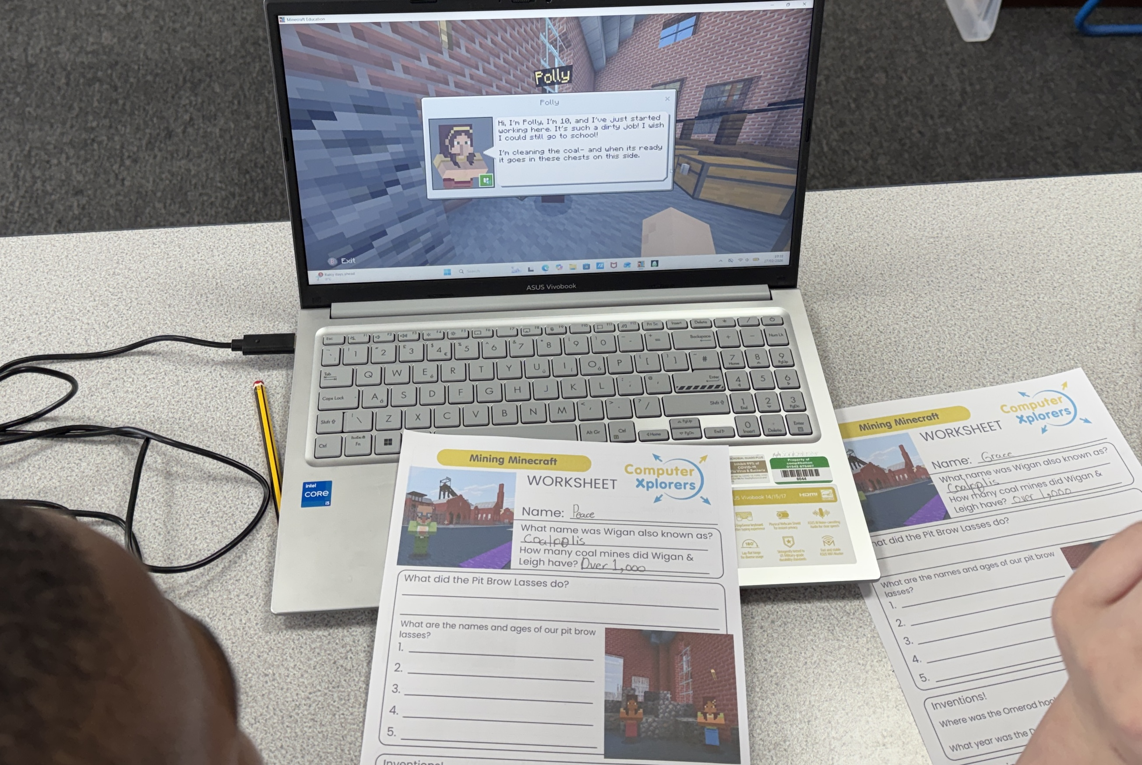

Objectives and methodology
Notes:
Image © Historic England

Slide 4
Background & Objectives
The Heritage Schools programme delivers continuous professional development (CPD) training, resources, advice and support to adults working with children and young people. The programme aims to improve access to, engagement with, and understanding of local heritage and its significance.
Until 2025, the programme was funded by the Department for Education, but from 1st April 2025, core funding will be provided by the Department for Culture, Media and Sport. There is the requirement to better understand the requirements of youth leaders/organisations who may benefit from future similar programmes.
The programme is grounded in an established evidence base showing that engagement with heritage delivers social value, including improved wellbeing, a stronger sense of identity and better life chances. It has been evaluated annually since 2016. A new evaluation is being conducted to assess the impact of the programme during the 2025/2026 funding period, reflecting both the expanded target audience and the revised delivery model. This report presents interim findings and provides an early assessment of the programme’s performance ahead of the final evaluation report, scheduled for publication in April 2026.
To evaluate the impact of the HS programme 2025/2026 in achieving its aims through training,
including webinars, and resources delivered to teachers, youth leaders and other adults supporting children and young people.
1
To assess the perceived social impact of the programme on children and young people.
2
To evaluate the effectiveness and perceived value of CPD training delivered online and in person.
3
To identify strengths, limitations and areas for improvement in the programme’s delivery model.
4
To provide actionable learning to inform future development, funding and strategic direction of the Heritage Schools programme.
5

Slide 5



Methodology: surveys with Teachers
In previous years, Historic England have conducted quantitative surveys across participant types. There has been a trend of falling response numbers from Partners, so this method was used for Teachers only in 2025/26.
Main survey:
Paper or online questionnaire
Online webinar surveys
Fieldwork period:
September 2025 –
February 2026
Historic England trainers invited attendees at CPD sessions to take part in research by completing the survey.
Participants completed the survey after their training session, either on paper or by following a link to an online survey.
This is a tracking survey, with key questions repeated since 2015/16. This provides longitudinal evidence of sustained CPD impact over a decade. We report comparative data where available.
A total of 530 surveys were completed.
At the end of surveys, Teachers were able to ‘opt in’ to being contacted for further qualitative research.
Similarly to the CPD training, Historic England moderators and partners circulated an online link to webinar attendees to a survey designed by Historic England.
Results from eight online webinars were analysed, but data from individual webinars are not reported separately due to small individual base sizes. Surveys received at each webinar varied between 7 and 37 responses. A total of 216 surveys were completed.
All percentages reported are rounded to the nearest integer. Consequently, some tables and charts may not sum to 100%.
Some subgroups have small base sizes (<50 respondents), which means the findings for these groups may be indicative only.
Due to the nature of the paper survey, respondents were able to skip questions; therefore, base sizes vary by question.

Slide 6

Methodology: deep-dive interviews
Depth interviews were used to dig deeper into Teacher and Partner experiences of being involved with the HS programme.
New target of Youth groups were identified for research, to understand their needs for future programme development.
Teachers:
45-minute depth interview
8 completed
February – March 2026
Youth group leaders
45-minute depth interview
5 completed
February – March 2026
Delivery Partners
30-minute depth interview
8 completed
February – March 2026
Online (phone/video) interviews conducted with Teachers who had opted in to be contacted in their survey.
2 x KS1 / 4 x KS2 / 2 x secondary school
3 x head of curriculum
3 x early years careers
3 x had been involved with Historic England before session / 5 x new to Historic England
Mix of locations
Contact information for Youth Group Leaders who had been involved with Historic England previously was passed on from HE.
Due to nature of participant, they represent a range of organisation types.
No quotas set to allow for best reach of research participation.
Contact information for programme delivery Partners was passed on from HE.
Due to nature of participant, they represent a range of organisation type.
No quotas set to allow for best reach of research participation.

Slide 7
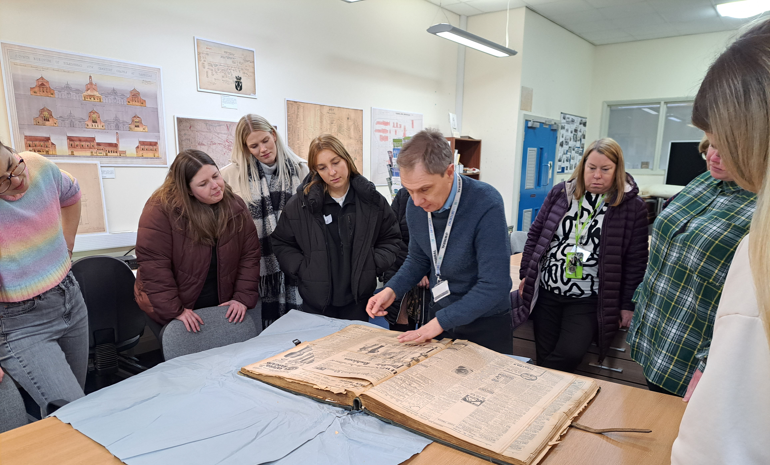
Teachers
Notes:
Teachers at Oldham archives © Historic England

Slide 8
Teachers: executive summary
The Heritage Schools (HS) programme continues to be highly valued by participants, with findings for 2025/26 consistent with positive results reported over the past decade.
Fundamentally, sessions receive overwhelmingly positive feedback. Teachers speak to the ‘excellent’ trainers, ‘high-quality’ and ‘relevant’ resources as the key highlights of the sessions. In many cases, the training doesn’t just meet, but it exceeds expectations. The Heritage Schools programme is an example of great CPD.
Teachers and other education professionals report immediate benefits gained from sessions. In particular, improved awareness of resources, a greater understanding of the value of local heritage and how it can be incorporated into the curriculum. They are positive about their experience, the impact it has had on them, and are keen to recommend it to others.
62% of attendees did not have any other history training during the last year. The Heritage Schools programme might be the only history training some teachers get, fulfilling a real need for more specialist learning.
This is especially important when considering the range of teacher types attending, from those with no history qualifications to those in charge of the curriculum, from newly qualified to experienced. All teacher types report benefits from the sessions, helping them bring heritage expertise into the classroom.
It is also telling – and positive – that those with responsibility for the history curriculum are consistently significantly more positive across almost all metrics. This suggests that the sessions will have a genuine impact on not just individual teachers, but entire schools.
Participants overwhelmingly agree that learning about local heritage has a positive impact on pupils, strengthening their sense of place and pride in the local area.
While many teachers are yet to apply the materials in lessons, they are enthusiastic about doing so, with the sessions leaving them confident about doing so. The clear examples from the sessions also help teachers feel confident in the positive outcomes they expect for their students.
Those who have already applied learnings are very positive about their experiences, referring to high student engagement and ease of applying materials in class.
When considering the resources available online, teachers are positive when they see them. However, they are less likely to be used vs. resources shared during CPD sessions, as there are no examples for them to be inspired by. Highlighting availability and use-cases for resources may help teachers use them.
Overall, the findings suggest that the programme continues to perform well and clearly demonstrates value for teachers.
Executive Summary

Slide 9
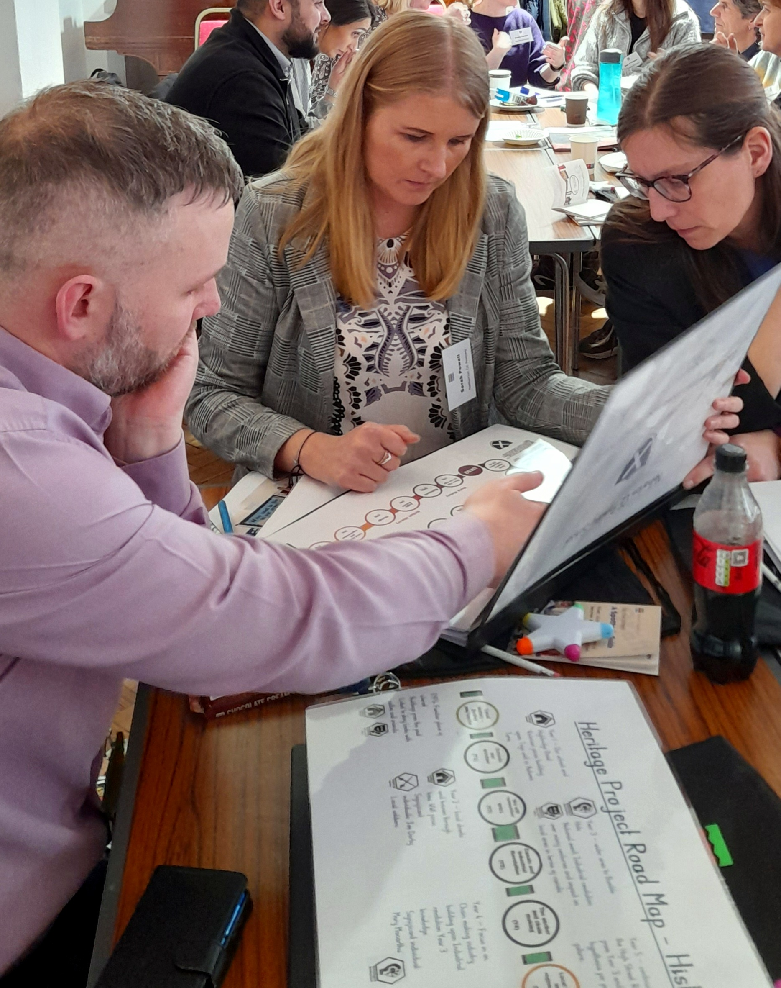
Attendee profile
Notes:
Teachers discussing resources in West Midlands © Historic England

Slide 10
Training appeals to both established and newly qualified educators
Even split between experienced teachers and ECT/ITT (47% both).
Of all teachers, more than half are responsible for the history curriculum within their schools (57%).

Slide 11
The profile of attendees has remained relatively stable year on year
Primary school teachers and trainee teachers continue to make up the majority of participants.
Attendee role | 2025/26 | 2024/25 | 2023/24 | 2022/23 | 2021/22 | 2020/21 | 2019/20 | 2018/19 | 2017/18 | 2016/17 | 2015/16
Initial Teacher Training | 44% | 33% | 27% | 33% | 46% | 23% | 35% | 48% | 49% | 45% | 45%
ECT/NQT | 3% | 3% | 3% | 4% | 2% | 2% | 3% | 2% | 2% | 3% | 5%
KS1 Teacher | 10% | 11% | 14% | 18% | 11% | 18% | 15% | 12% | 10% | 14% | –
KS2 Teacher | 30% | 30% | 34% | 30% | 26% | 36% | 28% | 19% | 18% | 22% | –
EYFS | 1% | 3% | 5% | 4% | 3% | 5% | 5% | 2% | 3% | 2% | –
Secondary Teacher | 2% | 6% | 5% | 3% | 3% | 2% | 1% | 3% | 4% | 2% | 3%
SLT (Head, Assistant Head, Deputy) | 2% | 3% | 4% | 3% | 3% | 6% | 7% | 3% | 2% | 2% | –
Teaching & Learning Assistant / Tutor | 4% | 6% | 4% | 2% | 3% | 5% | 7% | 7% | 4% | 4% | 3%
Heritage & Cultural Education Provider | 1% | 1% | 2% | 1% | 2% | 0% | 1% | 2% | 3% | 1% | 4%
Other | 7% | 1% | 2% | 7% | 3% | 2% | 2% | 2% | 5% | 4% | 5%

Slide 12
Attendees come from a range of history backgrounds and school sizes
Levels of history qualifications range across attendees.
Around half of attendees have a history GCSE/O level (52%), and almost a third have no formal history qualification (29%). Only 26% of those responsible for the history curriculum also have no formal history qualifications.
This highlights the importance of making any CPD accessible and relevant to teachers across a range of expertise levels.
Attendees also work across a wide range of school sizes, again indicating the programme must support staff across a variety of different school contexts.

Slide 13
Most have not attended history training sessions outside the HS programme
Most attendees have had limited engagement with heritage CPD or history training outside of the Heritage Schools programme; 62% have attended no other history training sessions during the last year.
This suggests that for some, the Heritage Schools programme is fulfilling teachers’ requirements for history training or offering it where none may have been available.

Slide 14
‘Good’ training sessions for teachers are practical, actionable, and offer something different
Teachers are busy, so any training must work hard to make the time and effort worthwhile. The best CPD/ training has relevant content.
Content
Practical, tangible outcomes. Teachers can immediately ‘take away’ something from the session. This might be practical or physical resources, or ways of thinking they can apply to their roles.
Can be adapted for real-life use. Teachers can see how learnings could be applied for them. Training that does not account for the realities of a classroom has limited use.
Designed with both teachers and young people in mind. Teachers want training sessions to consider not just their own skills, but how it will positively impact their learners.
Covers new ground. Positive for teachers and learners, as newness keeps both training sessions and classroom lessons ‘fresh’ and interesting.
‘Authentic and relevant to your role and responsibilities as a teacher. Not doing things for show, things that aren’t practical in a real class.’
Teacher
‘The best CPD is where you can action it, it’s tangible.’
Teacher
‘When it's something different, I feel like it's more fun for me and the students because it's something else that you can bring into the classroom that you haven't already done before.’
Teacher

Slide 15
‘Good’ training sessions for teachers are practical, actionable, and offer something different
Teachers are busy, so any training must work hard to make the time and effort worthwhile. The best CPD/ training also needs good delivery.
Delivery
Good trainer. This can be ‘make or break’. Ideally, teachers are looking for enthusiasm (for the session), expertise (for the subject) and experience (in education).
In-person. While acknowledging the higher investment (time, effort, money), in-person training is generally felt to be more positively impactful. In part because sessions can then include…
Hands-on activities. These keep teachers engaged and give examples of how CPD materials might transfer into a classroom.
Can be longitudinal or ‘periodic’. This allows for implementation across time, including continued access to trainers to help.
  The Heritage Schools programme was used as an example for this.
‘Practical sessions where you can run through how you might use it in a lesson…like the roleplaying we did in this training, actually!’
Teacher
‘Putting it bluntly, the trainer can make a big difference.’
Teacher
‘There’s nothing like doing training in-person. You feel so much more energised, it’s more practical because if reflects a classroom more. I know it’s harder, but it’s almost always worth it.’
Teacher

Slide 16
The Programme continues to reach new schools
Around a third of participants report that their school or organisation had previously been involved in the Heritage Schools programme (34%). This means that, even after a decade, most attendees are new to the Programme.
This suggests that not only has the reach continued to grow, but the relevance of the Programme has been sustained. Local heritage remains a draw for teachers.
The positive reputation of Historic England may support continued engagement. Even if they are not aware of their education offering, some teachers view Historic England as a ‘good’ organisation.
‘Positive impression of them, like any kind of organisation that's trying to protect the history of England… the buildings and places that are really important for us to look after.’
Teacher

Slide 17
Wide range of local history/heritage engagement across attendees
For some, this training is more of a top-up…
Some attendees come from schools that already prioritise/are embedding local history in classes
In some cases, this is due to previous engagement with the Heritage Schools programme
…but for some, it’s an area for development
Some recognise it’s something they could be doing more of
Especially important where there may be less of an inherited sense of ‘belonging’ in their local areas, i.e., families are newer to the area
‘In my last class, we had a local history week that was born off the back of the Historic England training sessions that they’d had before.’
Teacher
‘It's something we recognised we weren't doing as well as we could.’
Teacher
‘It’s always something we’re looking to do more of…making it relevant for our students, getting them interested.’
Teacher
‘Our school is predominantly Pakistani Muslim, so we felt learning about local history was really important for our children, bearing in mind that most of them are either first or second generational immigrants to the country.’
Teacher

Slide 18
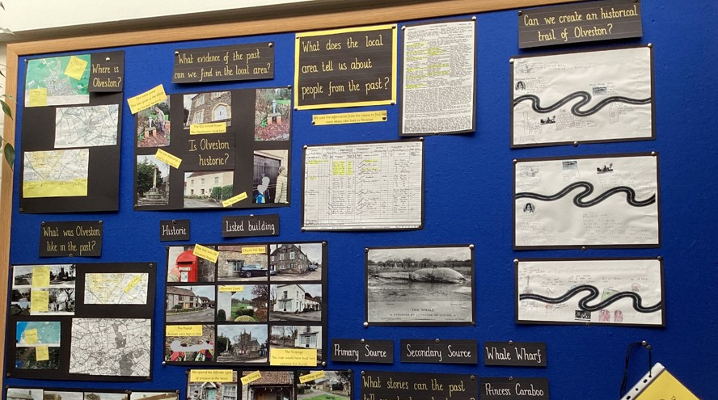
Session experience and outcomes
Notes:
School local history display in Olveston

Slide 19
Desired session outcomes; practical resources, clearly connected to local heritage
Teachers want to leave sessions with…
Practical resources
Practical teaching resources, e.g., maps, records – expert primary research they can trust
Ideas/examples around how to look at local history/heritage with students
Confidence in talking about the local area
Especially important if they are not from the area
A positive, different experience
Teachers want to be inspired to implement the learnings into their classes
Not more boring CPD!
‘Resources we could use in class.’
Teacher
‘Ideas for activities, ways to use primary resources with different levels of students…’
Teacher
‘I’m not local, so I wanted to experience it for myself, so I could pass it on to the students.’
Teacher
‘Things put together by an expert, that I could never do myself.’
Teacher
‘Something to enliven how I currently look at history.’
Teacher

Slide 20
Teachers report very positive outcomes, that align with their requirements for good CPD
Greater understanding of the value of using local heritage
in the curriculum
NET: Agree
At least 6 in 10 ‘strongly agree’ with all statements – a positive endorsement of the Heritage Schools training.
Considering what makes CPD useful for teachers, 98% agree that the training sessions increased their awareness of where to access useful resources.
This demonstrates that the Historic Schools training programme does fulfil teachers and trainees’ needs of practical, actionable training.
 | 97%
 | 97%
 | 96%
 | 96%
 | 96%
Developed skills that I could use in my teaching/work
Greater understanding that local heritage can connect to regional, national or global history
More aware of where to access useful resources
Greater understanding of how to embed local heritage into the curriculum

Slide 21
Overwhelmingly positive feedback about the sessions
Excellent, enthusiastic, expert session leaders
Continued availability of expertise in-between sessions
Useful, high-quality resources
Clear focus on outcomes for learners
Personalised/hyper-local relevance
‘Honestly, they were genuinely some of the best sessions I've been to. A really good mix of talking and doing.’
Teacher
‘Can’t say enough good things about the session leader.’
Teacher
‘With some CPD it's more about the teachers, and less about the children and their learning, almost like it's adding something onto a toolkit that a teacher has. But how is that actually benefiting the kids? This was not like that!’
Teacher
‘[They] spoke through several ways of embedding it into the curriculum. It felt very realistic, very achievable for me as a teacher.’
Teacher
‘[The trainer] has been great in between sessions, being able to answer emails if we've had questions…often you have that initial period of time with the trainer and then it's like, right, that's what you've paid for, anything else would be extra. This is above and beyond.’
Teacher
‘Coming away, we all felt that there were realistic, tangible things that we could use to improve the curriculum in school, which I think ultimately is what you go on these courses for.’
Teacher
‘I can’t get over how personal it was to our school.’
Teacher

Slide 22
Positive outcomes have been consistent
All measures have remained above 92% agreement since 2016/17. Overwhelming approval of training sessions for a decade points to their sustained relevance, consistent quality and long-term value in supporting teachers to embed local heritage in the curriculum.
Skills or knowledge acquired from CPD training (agree) | 2025/26* | 2024/25 | 2023/24 | 2022/23 | 2021/22 | 2020/21 | 2019/20 | 2018/19 | 2017/18 | 2016/17 | 2015/16
Greater understanding of the value of using local heritage in the curriculum | 97% | 99% | 98% | 99% | 98% | 98% | 96% | 97% | 97% | 98% | 97%
Greater understanding of how to embed local heritage into the curriculum | 96% | 97% | 97% | 98% | 97% | 96% | 95% | 96% | 95% | 96% | 96%
Greater understanding of how local heritage connects to regional, national or global history | 96% | 97% | 96% | 97% | 95% | 94% | 94% | 93% | 93% | 92% | 90%
More aware of where to access useful resources | 96% | 98% | 97% | 97% | 94% | 96% | 95% | 93% | 95% | 97% | 95%
Developed skills that will be used in teaching / work | 97% | 97% | 97% | 97% | 96% | 95% | 94% | 94% | 93% | 94% | 92%

Slide 23
Teachers are thinking about implementation of session learnings
Greater understanding of the value of using local heritage
in the curriculum
NET: Agree
Those responsible for the history curriculum are even more positive and significantly more likely to ‘strongly agree’ that they have a:
greater understanding of the value of using local heritage (75% vs. 66%)
greater understanding around linking local heritage to regional, national or global history (69% vs. 60%).
This is encouraging, it suggests the training sessions are more likely to be disseminated and will have a whole school impact; those with the power to implement the sessions have felt the greatest positive impact.
It also speaks to the long-term value that curriculum leads can see. The value of the sessions does not stop at the practical ‘resources’ – though these are positively received. There is also the strong, longer-term outcome of understanding the ‘value’ of local heritage.
97%
Greater understanding that local heritage can connect to regional, national or global history
96%

Slide 24
Attendees strongly believe that learning about local heritage positively impacts pupils
NET: Agree
99%
98%
94%
94%
Agreement consistently high across all four measures.
Again, history curriculum leads report even more positive outcomes, with significantly higher ‘strongly agree’ for all metrics (83% place, pride, 62% esteem, aspirations).
This continues to suggest that those who are in a position to have the greatest impact in their schools do see the value in the training – increasing the likelihood that learnings will be implemented.
Improve their sense of place
Increase their sense of pride in their local area
Raise their aspirations
Develop their self-esteem and/or confidence

Slide 25
This agreement is consistent with historic levels, with 2025/26 matching previous years
Perceived impact of learning about local heritage on pupils (agree) | 2025/26 | 2024/25 | 2023/24 | 2022/23 | 2021/22 | 2020/21 | 2019/20 | 2018/19 | 2017/18 | 2016/17
Improve their sense of place | 99% | 99% | 99% | 99% | 99% | 98% | 99% | 99% | 98% | 99%
Increase their sense of pride in their local area | 98% | 98% | 98% | 99% | 98% | 96% | 98% | 97% | 97% | 97%
Raise their aspirations | 94% | 92% | 93% | 94% | 89% | 87% | 91% | 93% | 91% | 91%
Develop their self-esteem and/or confidence | 94% | 92% | 91% | 93% | 86% | 83% | 92% | 90% | 88% | 87%

Slide 26
Strong positive outcomes for pupils also reported qualitatively
Despite many teachers not yet being able to apply training to the current year’s curriculum, they can see how it will positively impact students in the future. Teachers are confident the training sessions will positively contribute to how students see their local area and their place in it.
Improve their sense of place
Increase their sense of pride in their local area
Raise their aspirations
Develop their self-esteem and/or confidence
‘With a lot of industry gone, seeing from the maps, the richness of industry that was there is really important to us.’
Teacher
‘Maybe articulate it at home, or when they're out and about walking through town, being able to say ‘before that building was this other thing and it was a really important company’ – knowing how influential people were who lived down the road from them.’
Teacher
‘Some already have a sense of identity of the place, but it’s not always a nice one! This gives them another perspective about their hometown, which is an extension of themselves at this age.’
Teacher
‘It will be good for them to see how any normal street, any normal person, can be a part of history.’
Teacher
‘Sometimes history can be seen as something which is abstract. With this session, we can illustrate that it’s not, it's on your doorstep, and here's the evidence.’
Teacher

Slide 27
Teachers would not hesitate to recommend the sessions to others
This sentiment is shared across different types of teachers, from newly qualified to experienced teachers. This suggests that the training is quite unique, in the sense that a true range of teacher types benefit from it.
Applicable to a range of experience levels
Enthusiasm to spread the training wider
Relevant beyond ‘history’ – cross-curriculum links
‘100%. I even caught my old history lead at something recently and told them they must attend this training.’
Teacher
‘I’ve already recommended it! I’d recommend it to every teacher who touches on history in any way – through geography, religion, English, maybe even science?’
Teacher
‘It’s useful for ITTs like my colleague and existing teachers like me. It’s the practical methods, the resources you get, and the instructor passion – I wouldn’t hesitate to recommend.’
Teacher
‘We’re actually going to ask if they can come to our school to deliver it, it was so amazing we want as many staff as possible to experience this.’
Teacher
‘I’m a newer teacher…it was easily the best external training I’ve done.’
Teacher
‘I’d send anyone on this training, history lead or not…it was inspirational, as well as useful.’
Teacher

Slide 28
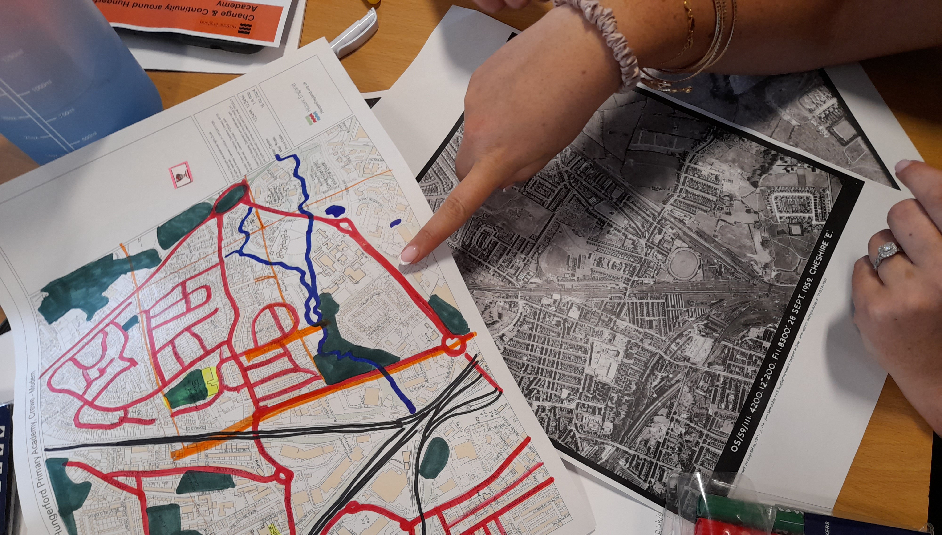
Teachers using Historic England resources
Notes:
Teachers using Historic England resources © Historic England

Slide 29
Resources and local examples are the most useful training elements
What is considered to be the most useful resource can be influenced by experience level.
Teachers are significantly more likely to identify resources as being the most useful part of the training (63%). This allows them to deploy them as required, and adapt them to their existing lesson plans.
ITT/NQTs are more likely to select specific activities and teaching strategies (47%, 37%). These are very useful for this group as they are less experienced, and benefit from seeing practical use-cases, that they can take forward in their career.
Qualitatively:
‘I don’t like prescribed lesson plans, I have to change them too much for them to be useful.’
Experienced teacher
‘I’m newer to the career so having these practical examples for future roles…invaluable.’
ITT

Slide 30
Almost all attendees intend to use the resources in their teaching
The resources are relevant for teachers. 75% of experienced teachers are ‘very likely’ to use them; this is even higher among those responsible for the history curriculum, 78%. Again, this suggests that those with the agency to use the materials do plan to do so.
Those who anticipate using the resources plan to:
Use them in the classroom (83%)
Use them in lesson planning (75%)
Use them in curriculum planning (70%)
  Rising to 91% for those responsible for the history curriculum
Share with staff at school (63%)

Slide 31
Use of resources is not immediate; most teachers need time to plan and implement
While teachers are positive about the training sessions, and the materials received, most can’t apply these in the short-term, as lessons are already planned. However, there is enthusiasm across teachers for using the materials and learnings from the training, as teachers feel more confident about using local history and heritage in the curriculum.
There are specific plans to use the resources in upcoming terms:
Very positive response materials and learnings have already been used:
‘I was very excited to put a proposal together for the headteacher based on this training. It’s going in the curriculum from next year.’
Teacher
‘One of the classes is trialling the activity this week, if it goes well we’ll apply it further next term, next year.’
Teacher
‘As the history lead I had the power to just start doing it, so I did! They responded really well to the map task, they could see the streets they knew on them…really engaged.’
Teacher
‘We’ve done the map task in one class so far…great, it applied in a real-world scenario really well.’
Teacher
‘We’ve been using it this term across year groups in different ways. It’s been incredible to see how easy it’s been for everyone to use really…used across the whole school.’
Teacher
‘We’re planning a suite of activities, including a walk around the area before using the maps in class.’
Experienced teacher

Slide 32
Over half either have, or intend to, download resources from the website
14% have already downloaded resources from the Historic England website, the same as last year. This is higher for those responsible for the curriculum (23%).
Of those who have, 73% have downloaded a teaching activity/classroom resource.

Slide 33
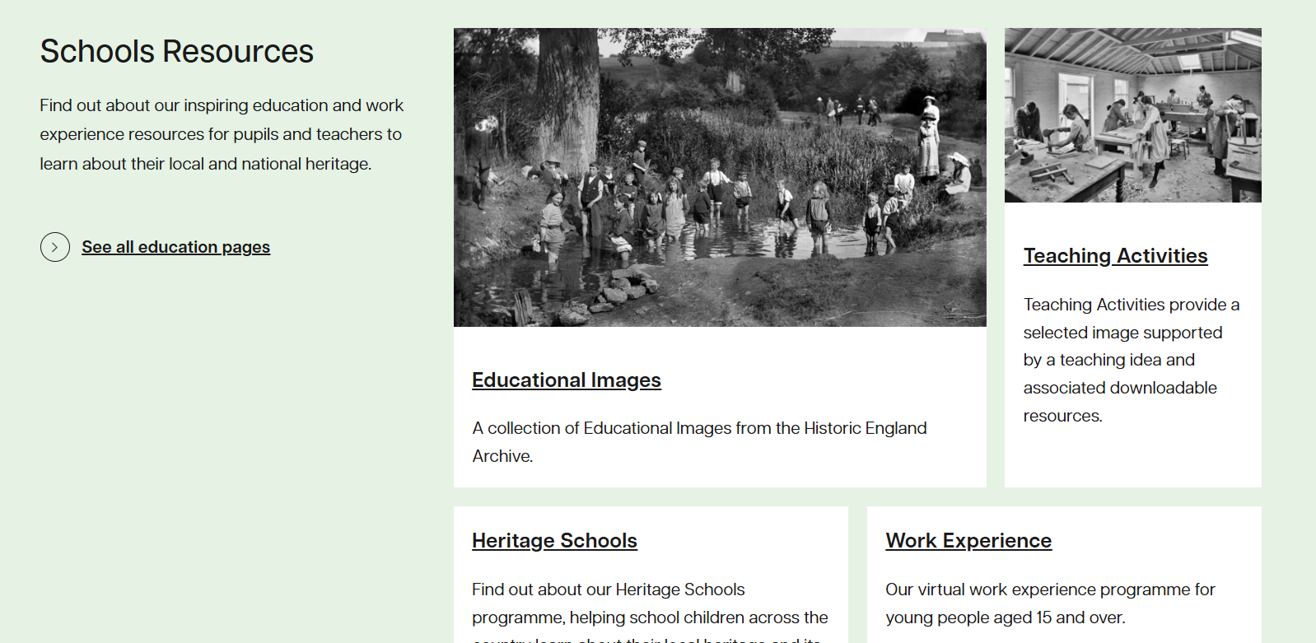
Website materials are appealing, but not as immediately useful as session materials
When looking at resources on the website, some teachers who attended the training were not aware of the breadth of the offering available. Many were ‘surprised’ and ‘delighted’ to see what was available – they had not investigated since the training.
Materials seem ‘trustworthy’, ‘good quality’, and cover a range of topics that might be relevant.
When considering why more teachers have not used online resources, despite the training being so good, and their positive response to the online materials when looking at them, this may be due to the clarity of use.
While teachers do not necessarily want ‘cookie-cutter’ activities, seeing materials used and demonstrated helps them envisage how they might use them. This is reflected in the most used resource on the website being teaching activities/classroom resources.
The self-serve materials require more thought to be used.

Slide 34
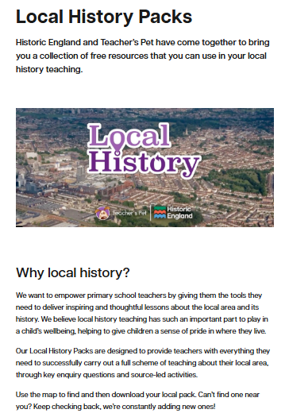
Local history packs are appealing, given their specificity to the area and quality of materials
For those in areas where local history packs are available, these do appeal. Teachers can see how these might act as an ‘extension’ to the training received in-session.
The locality is both the biggest benefit and the biggest barrier to use. Those in areas covered by the packs can see how they might be interesting to their students, and relevant to their schools. Meanwhile, it’s essentially a ‘non-starter’ for those in areas without packs.
The actual packs themselves seem ‘high quality’ and well prepared.
Including even more examples of how to use the materials in a classroom setting might further help teachers to consider their use, as again, clarity makes things easier for teachers.
‘I’ve not seen these…it’s quite near our school actually. I’ll definitely have a proper look after this call.’
Teacher
‘They’re all a bit too far away to be relevant to us I think.’
Teacher

Slide 35
Teachers want resources that are practical, and local – similar to materials shared in sessions
Materials used in sessions set the benchmark for ‘what teachers want’ from online resources. This is a high benchmark, given the positivity around the materials used in the sessions.
Suggestions for other online resources are directly informed by the materials they have already used.
Suggestions include:
Local walking trails (to complement maps)
Era-specific history packs, where it was significantly impactful on the local area (e.g., industrial revolution, WWI/II)
Detail on what key stage different materials are most useful for/are designed for
Personal delivery of materials – i.e., more sessions!
‘Something that links with what we’ve already had delivered…so we can build on what we have.’
Teacher
‘Our local area was very impacted by WWII, so if I’m thinking local history, it should be to do with that.’
Teacher
‘Could be good to be able to filter by age group, some of this might be a bit advanced for us [KS1].’
Teacher
‘I’d love to speak to [trainer] about these materials!’
Teacher

Slide 36
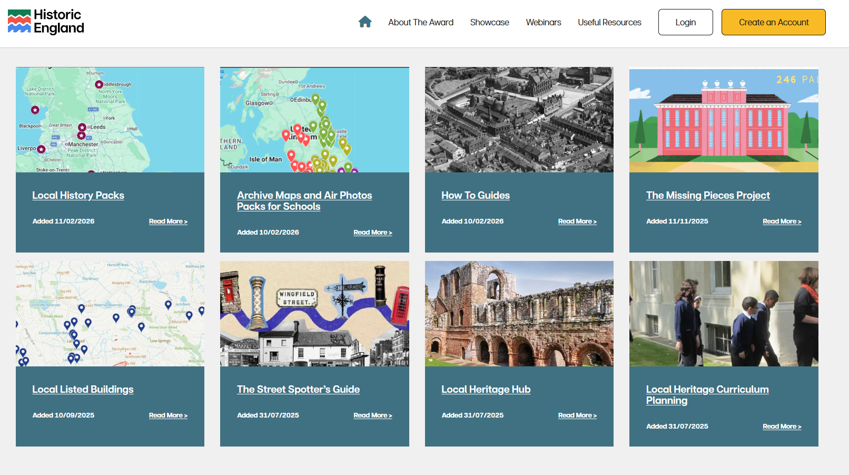
Future development
Notes:
Heritage Schools Award Hub resources © Historic England

Slide 37
Suggestions focus on tailored content, clearer curriculum application and managing pace
33% had ‘no’ ways to improve the impact and effectiveness of the training.
Suggestions for improvement mainly around getting more examples from the sessions and the volume of information shared being a challenge to take in.
Curriculum support
Pace and cognitive load
‘Examples of whole-school progression plans.’
Teacher
‘It's quite difficult to take everything in on a Teams meeting.’
Teacher
‘Needed to be longer, a full day.’
Teacher
‘It would be great to perhaps work together to create a scheme of work for a specific unit link with local history, such as the stone age or significant individuals.’
Teacher
‘Perhaps some time with the materials before the session, so we weren’t totally new to them?’
Teacher

Slide 38
Requests for additional support focus on curriculum planning and classroom application
Those responsible for the history curriculum are significantly more likely to be looking for curriculum
plans (30%). Again, this is a real positive, showing how the training is clearly relevant to those setting the agenda, who want help in implementing learnings from the sessions. This would not be looked for if the sessions were not of a high quality.
Generally, teachers want any additional resources/support to be practical and curriculum-ready – resources that they can really use in the classroom.
‘More ideas that can be used in a classroom without technology.’
Teacher
‘The practical bits were the best bits, so if I’m being picky I’ll have more of that, please!’
Teacher

Slide 39
Participants value the practical, locally relevant training and feel inspired and more confident
Final comments remain overwhelmingly positive.
Feedback consistently indicates that the CPD is successful, particularly in terms of the practical value of the training, trainer expertise and ways in which it can be applied in the classroom.
Any suggestions for improvement relate to future development of the programme, rather than dissatisfaction.

Slide 40
This positivity reflected qualitatively – teachers are keen to highlight how good the sessions are
Teachers are very happy with the sessions!
Their experience of attending the CPD generally meets or exceeds their expectations, due to the high quality of the materials provided and the enthusiasm and expertise of the trainers
They can see clear use-cases for the materials and activities provided, and many plan to use them in their schools going forwards – not just in history, but across subjects (e.g. geography)
Overall, they speak assertively about the positive impact the sessions have had on themselves and their own improved enthusiasm and confidence around implementing local history/heritage
Somewhat less clear about the impact on young people, given many have not yet had chance to implement materials – however, they are confident that there will be a positive impact on their students when they do
‘Much better than other CPD I’ve been to. Practical, interesting, high-quality. I feel lucky to have gone on it.’
Teacher
‘How many ways can I find to say thank you! Honestly it was great.’
Teacher
‘I wouldn’t have been able to write a plan for local history with such confidence without this training.’
Teacher
‘I know the students will love these activities when we get to them.’
Teacher

Slide 41
“[Trainer] was very knowledgeable and made our training very interesting. I am coming away feeling inspired and excited about teaching local history to our children. I also have more knowledge of resources and sites that can be used for planning. Thank you!”

Slide 42
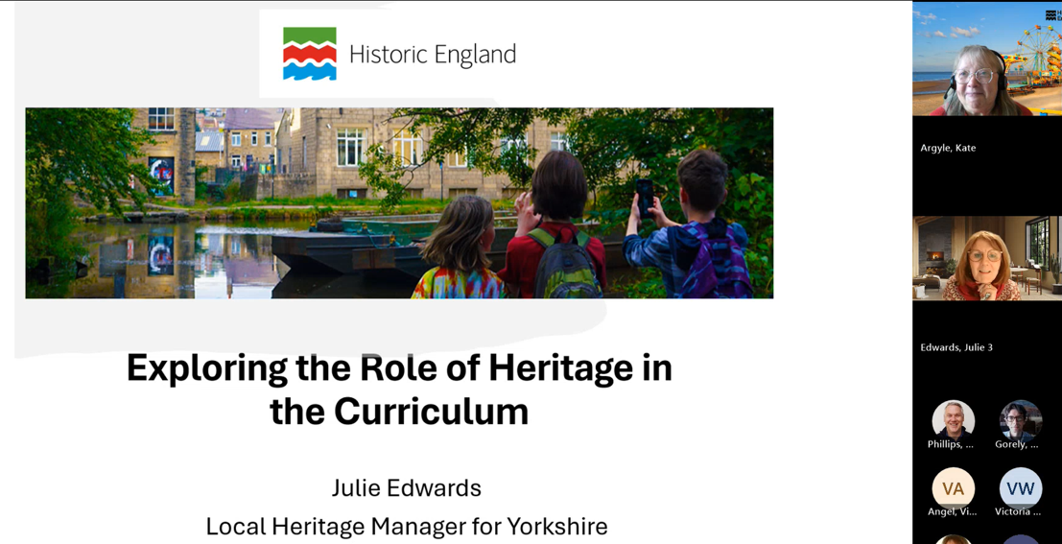
Webinars
Notes:
Heritage Schools webinar screenshot © Historic England

Slide 43
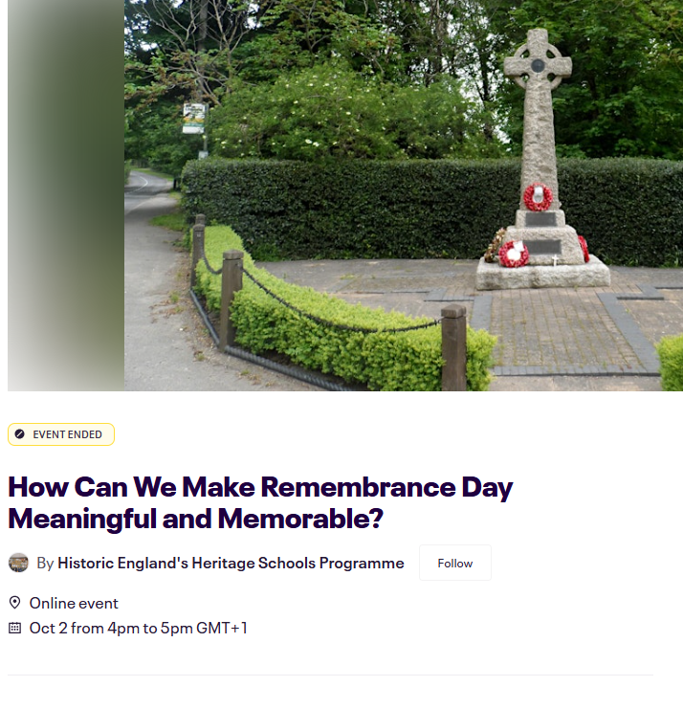
Webinars reach diverse audiences and are consistently rated as useful
How participants find out about the webinars varies by session, with the most common sources being Historic England emails, Eventbrite and social media.
Prior experience with Historic England varies across webinar attendees. Between a quarter and three quarters of attendees have previously participated in face-to-face or online CPD training. Some webinars attract participants with extensive prior involvement, while others appeal to those with no previous engagement with Historic England.
Despite the varied participant mix, a high proportion of attendees rate the session as useful, a finding that is consistent. Almost all attendees agree that the webinars are either useful or very useful, with only one participant reporting that it was not useful.

Slide 44
Attendees find practical classroom tools the most useful aspect of webinars
In response to the question ‘Which part of the webinar was most useful?’, very few participants refer to abstract heritage theory. Usefulness is defined in terms of what teachers can directly bring into the classroom.
Participants particularly value:
Practical ideas
Teaching strategies
Concrete classroom examples
Clear guidance on how to deliver, embed or use content in lessons
Similarly, participants appreciate signposting and guided use of HE resources, particularly when supported by demonstrations.
Participants most commonly mention:
Website links
Databases
Online tools
Maps, directories, census data
“Ways in which to use it in the classroom, such as working walls, vocab, use of enquiry questions to begin, traffic light ideas, local links from news etc. Yorkshire”
Substantive Concepts Trade Webinar
“Finding out about the different databases, especially the 1939 one. I really like the way starting with a name unveiled a whole story of a man.”
Remembrance Day Webinar

Slide 45
Attendees consider the webinars comprehensive
Most attendees describe the webinars as comprehensive. As per other sessions, suggestions for improvement are the exception rather than the norm.
Where requests are made, they tend to be specific to the webinar topic.
For example:
In local heritage webinars, some participants ask for content that is more relevant to their region or locality
In mapping webinars, some participants request clearer, step-by-step guidance on how to access and use resources
“Maybe split into different regions as unfortunately none relevant to Oxfordshire.”
Local Learning: English Heritage Webinar
“Maybe just an instructional PowerPoint for the site. I tried it out whilst we were in the webinar and it was tricky to use.”
Using Maps Webinar

Slide 46
Suggestions to support future delivery
Some participants identify additional resources, guidance or future webinars that would further support them in embedding local heritage and history into the curriculum.
These most commonly include:
More localised or region-specific support, with ready-to-use resources applicable to their local area
Curriculum planning support, such as whole-school plans, curriculum mapping and thematic ‘threads’
Improved access to resources and recordings, including past materials
EYFS/KS1 specific requests
“Guidance on how to create a whole school plan for history.”
Remembrance Day Webinar
“Maybe offering webinars focusing on the regions of English i.e. North East Local Heritage.”
Local Learning: English Heritage Webinar

Slide 47
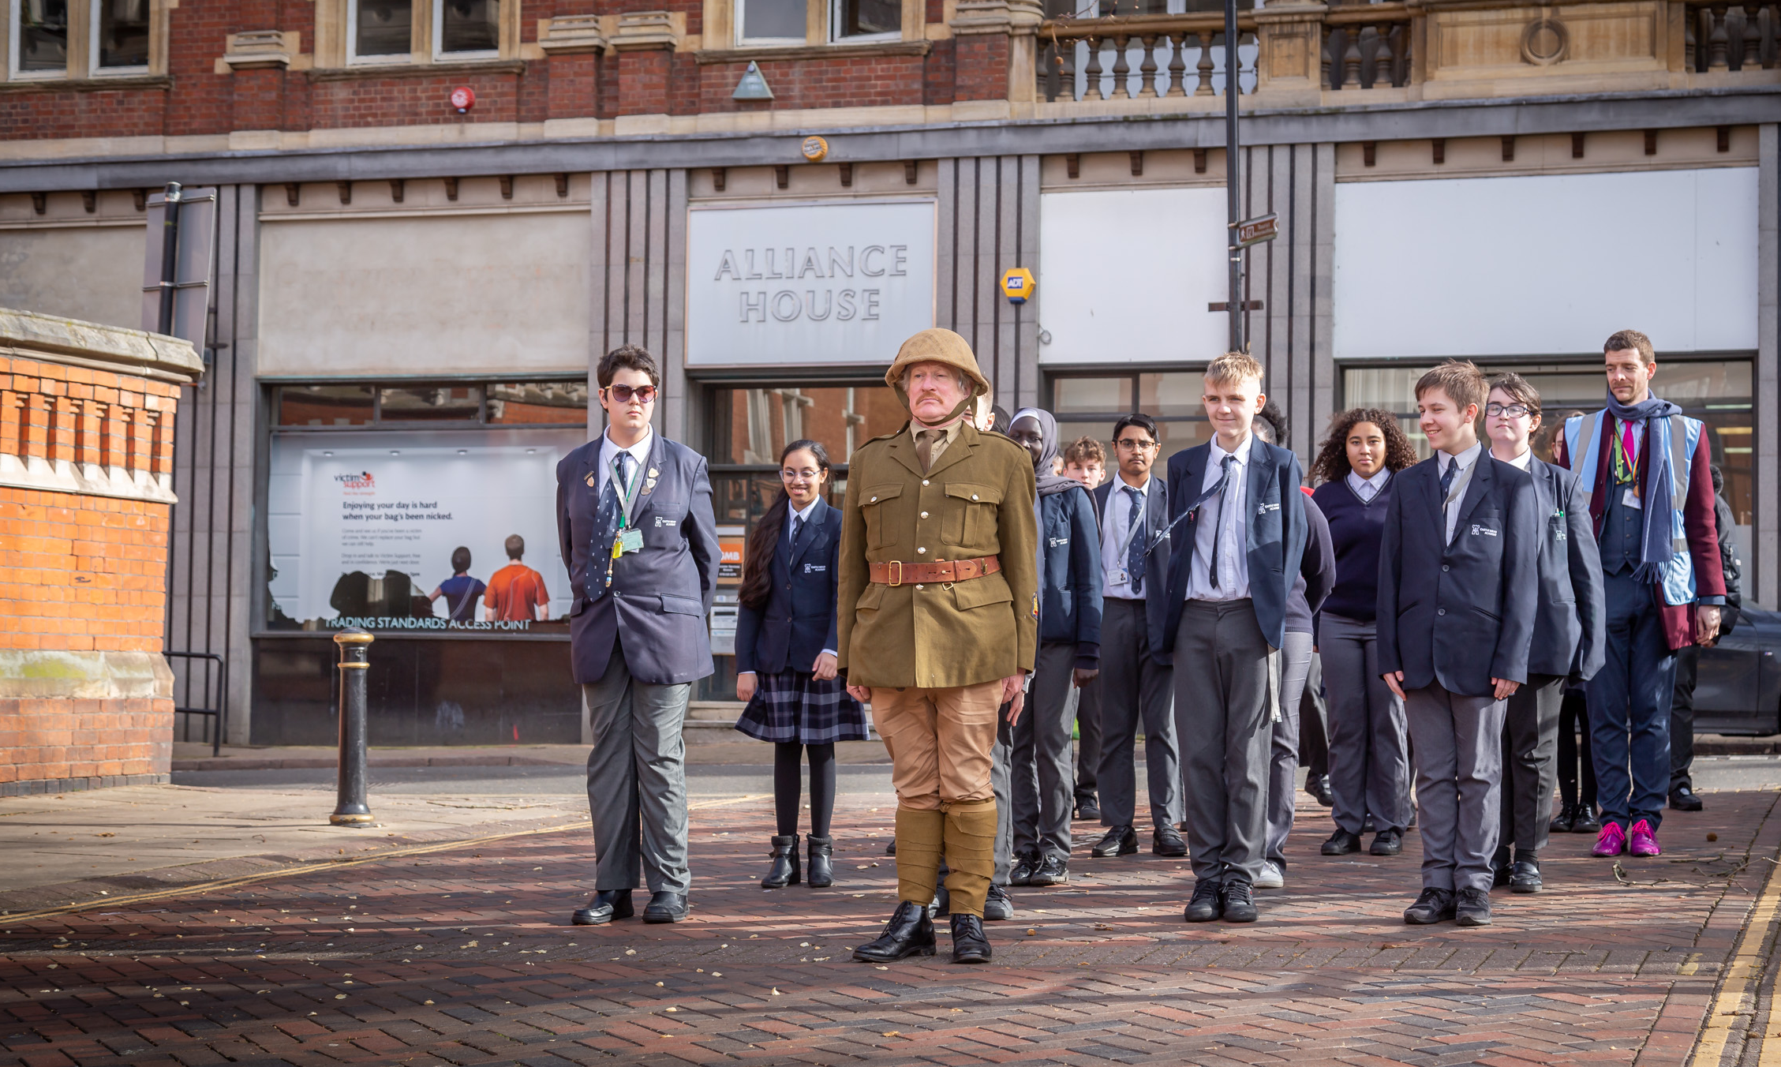
Delivery partners
Notes:
A local history trail with partners in Leicester © Historic England

Slide 48
Delivery partners: executive summary
Qualitative feedback aligns with the historic positive feedback gathered from programme delivery Partners. A range of Partners took part in the research, so not all metrics are applicable to all – e.g., those producing resources with Historic England are not in the same position as those delivering activation with schools.
Despite the range of organisations who are involved in delivering the programme, there is positivity from all Partners about the Heritage Schools programme. Involvement either meets or exceeds their expectations, and despite the range of experiences Partners will have had with the programme, all would recommend getting involved to others.
The working relationship with the Heritage Schools teams is a significant positive, as Partners feel they deliver – and in turn, help them to deliver – quality work, in a friendly and professional manner.
Where applicable, Partners are confident that they have increased the reach of their support – fundamentally, they reach more schools with involved with the Heritage Schools programme than they have done on their own.
The same Partners also feel they have developed better connections with schools. This is through the increased number of schools they’ve engaged with, and the deepening of the personal relationships between themselves and the schools. This allows for more open communication and feedback and helps them to develop their offering to be the best it can be for schools. This is important to them, as they want to make teachers’ time feel ‘worth it’.
Applicable Partners also report feeling more confident in working with schools and teachers as a result of the Heritage Schools programme. This is because they have had the opportunity to work with experts, helping them feel more comfortable with resources, and have been able to access practical examples and case studies to take forwards. Especially impactful for those who started with less confidence – seeing is believing!
Executive Summary

Slide 49
Delivery partners
Previously, Historic England has sent an online survey via Local Heritage Education Managers (LHEMs) to various organisations who had provided services to the Heritage Schools (HS) programme.
This year, a qualitative approach was taken. Outcomes aim to understand:
Impact on delivery partners from working with the HS programme, including:
  Impact on partnerships with schools and community groups
  Has their involvement with the programme changed their offer at all
What have they valued about the experience
How could the experience be improved
For this research, we spoke to 8 delivery partners. Partners represented a range of organisation types.
Contact details were provided by Historic England.

Slide 50
The joint working relationship is a real highlight for delivery Partners
A range of Partner types…
Partners participants came from a range of roles, with few shared ‘typical’ responsibilities.
They also had a range of involvement with the Heritage Schools programme, from being involved with training materials and providing opportunities for schools.
…but shared positive experiences
Partners generally report a positive experience when working with Historic England, regardless of organisation or involvement type.
Great team
Brand kudos
Practical help
Very high praise for the team. This includes:
Receiving a high level of expertise and quality from the team
Getting support and flexible ‘problem solving’ when required
The ‘Historic England’ brand = recognition, respect, trust.
This can help with buy-in, both internally (e.g., setting priorities /assigning resource) and externally (e.g., with schools).
Very Partner-specific, but can include:
Increasing access to relevant materials
Logistical help (e.g., understanding funding/applications, event facilitation)
Directly linked to good experiences with ‘the team’

Slide 51
The joint working relationship is a real highlight for delivery Partners
Great team
Brand kudos
Practical help
‘It’s great working with the Heritage Schools team. They’re supportive, flexible, really responsive when we need anything.’
Partner
‘I think it demonstrates the positive power of collaboration.’
Partner
‘The materials…could never have done it by ourselves.’
Partner
‘Having Historic England's name as part of the project really helped sell it to teachers.’
Partner
‘They could get things we couldn’t…they know all the ins and outs, all the behind the scenes!’
Partner
‘It’s like having an extra colleague who knows all the answers! They help us make the best of the resources available.’
Partner

Slide 52
Expectations of working on Heritage Schools meet or exceed expectations
Given the range of working relationships/histories with the Heritage Schools team, some knew what to expect from the experience, while it was brand new for some. However, Partners report that working on HS ‘continued to meet’ or ‘exceeded’ their expectations.
Known to the programme:
High expectations based on previous positive experience
High quality work continues to be delivered = expectations met
New to the programme:
Partnership exceeded just the academic; good experience of the whole project
Received more hours/effort than expected from HE
Can see benefits not just for schools, but for others (very organisation-dependant)
‘You hope that every time you get an external speaker in, it's going to be valuable. And [Heritage Schools] have never let us down.’
Partner
‘I have high expectations of the team…because we always deliver high-quality work.’
Partner
‘Wildly surpassed expectations…more days, connections not just to schools, significant curriculum embedding… benefits will continue.’
Partner
‘It’s been better than we expected…support beyond just the academic history side of things.’
Partner

Slide 53
Partners report increased awareness of uptake of their offerings from schools
Where applicable, Partners generally do feel they have successfully increased their reach, and the number of schools that are aware of, and therefore accessing, their services.
Yes, there is an increased awareness of the services/support offered by Partners, and more schools have accessed them…
Clear positive short-term impact. Easy to point to – the number of schools they’ve engaged with is now more than it was before!
Potential positive long-term impact, with some pointing out that increasing the number of teachers engaging now is the best way to get them to come back in the future, as they progress in careers/move around schools
…less clear that an increased range of schools have been accessed
Can be harder for some to confidently quantify
May be a longer-term goal
‘The partnership with the Heritage Schools programme has helped pick numbers that dropped off after COVID’.
Partner
‘Our reach has expanded to [number] of schools. The proof is on the paper!’
Partner
‘We’ve been able to run more sessions than ever before, because of Heritage Schools…will have real long-term benefits for the kinds of schools, and the number of schools, we can engage with.’
Partner

Slide 54
Better connections between Partners and schools leads to better curriculum delivery support
For some Partners, there is a direct link between the strength of connection with schools, and the service they can provide them to support curriculum delivery.
Practically, the programme facilitates increased interaction with schools:
More schools engaged with = more interactions = more opportunities for feedback, giving Partners the information they need to build on their offerings
HS facilitating direct contacts = building personal relationships = Partners can increase understanding of needs, including nuances between schools
This feedback can help Partners develop their offering:
Partners don’t know what they don’t know! So hearing directly from schools cam give them the information they need to develop
This is really important, as Partners are aware of the time and money investment required by schools to engage with programmes/services outside of school – they want to offer schools and teachers the best support possible
‘It’s nice to know who you're speaking to in a school. When you know who you're emailing, you’re more likely to get a response.’
Partner
‘Having a direct line with schools has let us improve our offer even more.’
Partner
‘Feels it is really important to make sure that what we’re offering [here] is worthwhile for schools, as transportation costs have gone up massively.’
Partner

Slide 55
More confidence in working with teachers and schools is a key outcome for some Partners
While not applicable for all Partners, some do report a real increase in how confident they are working with schools and teachers.
Factors that increase confidence…
Practical examples they can take forward.
Seeing/hearing about relevant examples/case studies of how things might be used increases confidence that they themselves will be able to do it.
Experience using materials and being ‘historians’.
More confidently be the ‘voice of authority’, and can better give teachers the full picture and answer questions about the materials.
Working with true experts.
Having an expert be involved to ‘sign off’ their work means Partners can be confident they are delivering at the highest level.
‘More confident with the materials…more confident using them with the schools after using them with Historic England.’
Partner
‘It’s significantly increased our confidence around engaging schools…[seeing] strong case studies, and a successful long-term example for talking to schools post‑COVID.’
Partner
‘So much more confident…having the practical experience.’
Partner

Slide 56
All types of Partners would not hesitate to recommend being involved with the programme
As with Teachers, this sentiment is shared across different types of Partners, who may have engaged with the Heritage Schools programme in a variety of ways. This highlights how positive the experience is from all angles.
Relevance for ‘local’ organisations is clear
Want the spread the benefits
Has the ‘feel good’ factor!
‘Any type of organisation with a local lens would benefit from it.’
Partner
‘I’ve already recommended it to a working group I’m in.’
Partner
‘I feel so happy that we can work on this programme with them. It’s really fulfilling. I can’t see who wouldn’t want to contribute to something like this.’
Partner
‘Absolutely I would recommend to other organisations involved with local heritage. The more that get involved, the better for everyone.’
Partner
‘100%. It's a way of developing your skills, confidence…it’s really nice to have support and someone to share ideas with.’
Partner
‘I bang on about it all the time! It’s one of the best projects I’ve worked on…especially useful for schools and heritage organisations due to the place‑based approach...unique.’
Partner

Slide 57

Youth Group Leaders
Notes:
Historic England’s Young Advisers © Historic England

Slide 58
Youth Group Leaders: expanding the programme
Historic England has the goal to include youth leaders in their Heritage Schools programme in the future.
The scope of this stage of the research has been exploratory. Outcomes aims to inform Historic England’s future plans for working with Youth Groups by examining:
Their experience of delivering a heritage project
What were the highlights? Any challenges, barriers?
Likelihood to use heritage to engage with young people again
Future training and support required to deliver heritage projects
For this research, we spoke to 5 leaders within youth groups who had delivered a project relating to heritage. Their roles ranged from founder to activities and program coordinators.
Contact details were provided by Historic England.

Slide 59
Youth Group Leaders: executive summary
When considering programming, ‘heritage’ projects may be one of many kinds of activities youth group leaders consider or undertake at their organisation – part of their ‘repertoire’.
Likelihood to engage in history/heritage projects impacted by personal interests and how closely it relates to their ‘core’ offering. These two things determine how likely it is that young people will request history/heritage activities.
All report positive impact on young people after being involved with history/heritage projects. Some of these aligned closely with expectations for any project, while some were heritage-specific. There were also some unexpected positive outcomes of projects, which are all heritage-specific.
This suggests that local history/heritage projects could be incredibly valuable for youth groups – perhaps even more so than they might realise.
Best ways to engage young people in local history/ heritage will vary between organisation and projects but fundamentally should align with the organisations’ current activities – feeling authentic to them, and their mission.
Mixed levels of training/support received. Some feelings that they don’t need it for history/heritage specifically, as it’s just another ‘part’ of their role. Support in project management/problem solving is looked for more.
If offered, history/heritage training should ideally be face to face, as it offers the most engaging experience. However, it is important the it remains accessible for a range of attendees – ideally, free, with expenses accounted for if travel is required.
Executive Summary

Slide 60
Any kind of project or programming must clearly benefit the young people they work with
Like teachers, youth workers are passionate about what they do and are looking for ways to positively contribute to their organisation and the young people they work with.
This is their motivation when considering what kind of projects/work to program. They might be looking to help young people:
Grow in confidence and exercise their agency (e.g., make decisions about how to spend their time, what kind of projects organisations should prioritise)
Build ’soft’/transferrable skills (e.g., teamwork, research, community engagement)
Develop specific skills (e.g., sports, arts)
All this speaks to how young people positively exist in and contribute to society.
Heritage/history projects can be a part of this.
‘Helping them gain extra skills and knowledge. Allowing them them to take the reins and design their own events.’
Youth group
‘We’re all about creating connections, nurturing trust. It's about empowering young people to take control or take responsibility of their mental health.’
Youth group
‘If you want to have responsible citizens of the future, then you need to accept that the young people are part of the community already. They don't just magically become that at 18 or 25 or 30 when people think it's a good idea to have them involved.’
Youth group

Slide 61
‘Community interests’ not necessarily main motivation for involvement with heritage projects…
Regardless of the topic, programming must have clear, positive outcomes for young people, supporting some kind of growth or development, including any local history/heritage project. Motivation to be involved with history/heritage projects is similar to other types of project.
The extent to which groups engage with history/local heritage specifically is influenced by a number of factors:
1. Personal interest of the program/group lead – how passionate they are about that topic, or if they have existing contacts or previous experience with history or heritage
‘I’d worked on heritage projects before, so brought that here when I started my role.’
Youth group
2. Link to the ‘core’ program – how cohesively history/heritage sits with their other activities. More natural links = more involvement
‘The heritage aspect linked in with what we’re focussing at the moment as an organisation.’
Youth group
3. Driven by the young people – who may work collaboratively with youth groups to guide the program/priorities (note: likely influenced significantly by points 1 and 2, as these impact their exposure to these types of projects)
‘The young people came up with the project…they drove it completely.’
Youth group

Slide 62
…but community engagement can be a major positive – and unexpected outcome
All youth group leaders report positive impacts for young people as a result of being part of a heritage project, as projects either met or exceeded expectations.
However, there were some unexpected positive outcomes for young people, which were a result of the ‘heritage’ nature of the projects specifically.
Expected outcomes |  | Unexpected outcomes
Similar to other projects Increased skills – both ‘soft’ and specific (e.g., arts, use of technology, teamwork, communications) Increased confidence in self – to be able to accomplish said skills | Heritage-specific Learning about local history… …and being able to apply new knowledge to an output Connecting with local communities – i.e., being able to see how their life might relate to local history/ communities For some, this included increasing sense of ‘place’ – very project-specific Exploring local spaces new to them | Extent of enjoyment of connecting to local communities Connecting communities to the young people – i.e., the local community becoming more aware of the group/their work in the area Overall strength of outcomes generally ‘exceeded’ expectations

Slide 63
Outcomes for young people – expected
Similar to other projects
Increased skills – both ‘soft’ and specific (e.g., arts, use of technology, teamwork, communications)
Increased confidence in self – to be able to accomplish said skills
‘Confidence…making their own decisions about what to focus on for the piece.’
Youth group
‘Their proficiency in the [artistic practice]…better by leaps and bounds.’
Youth group
‘They worked together as a team, that’s something we build into all our projects.’
Youth group
‘They took it and make it their own, it’s really exactly what you want to see.’
Youth group

Slide 64
Outcomes for young people – expected
Heritage-specific
Learning about local history…
…and being able to apply new knowledge to an output
Connecting with local communities – i.e., being able to see how their life might relate to local history/ communities
  For some, this included increasing sense of ‘place’ – very project-specific
Exploring local spaces new to them
‘Getting to learn about history outside of a school environment...not as forced, gives them another way to look at learning history.’
Youth group
‘I was surprised at how much they took in and were able to repeat back later on!’
Youth group
‘Not just doing the research but getting out and talking to people in the community…showing themselves that their stories aren’t so different, they also belong here.’
Youth group
‘They had the confidence to visit [the place] by themselves. They weren’t doing that before.’
Youth group
‘Since we finished the project, they’ve been back with their families. It’s more than we expected.’
Youth group

Slide 65
Outcomes for young people – unexpected
Extent of enjoyment of connecting to local communities
Connecting communities to the young people – i.e., the local community becoming more aware of the group/their work in the area
Overall strength of outcomes generally ‘exceeded’ expectations
‘Seeing them chat with people who had come to visit [project activation]…made me so proud. I think they got as much of that, as the whole project itself.’
Youth group
‘We did have people wanting to talk to [the young people] about [the display]. They were shy at first but at the end they were really proud.’
Youth group
‘It didn’t just go one way…people were interested in what we were doing.’
Youth group
‘The fact they want to do something similar again shows you how good it was for them.’
Youth group
‘It sounds bad but I didn’t think they’d like it as much as they did!’
Youth group

Slide 66
Best ways to engage with young people will vary, and can be bespoke per organisation and project
The ‘best’ ways to engage young people in heritage projects varies a lot depending on the organisation, the project, and the individuals! However, there are some overall ‘guidelines’ that apply across projects.
The best way to engage young people in youth/heritage projects…
Fundamentally: in a way that remains authentic to the organisation
Should feel aligned with the organisation and their goals/existing activities
Will vary by organisation
For example: highlighting ‘work’ skills if there is a career focus in the organisation, or focusing on outdoor activities for outdoor-centric organisations
Should: include a mix of ways to engage
Helps maintain interest in the project throughout
Allows for a range of people to be involved; can encourage inclusivity
Ideally: include some site-specific or ‘physical’ aspect
Can bring subject matter ‘to life’ for young people
Key for local history/heritage projects specifically
If possible: is informed by the young people
Most impactful for engagement
Requires high levels of existing engagement
Organisation-dependant

Slide 67
Best ways to engage with young people will vary, and can be bespoke per organisation and project
The ‘best’ ways to engage young people in heritage projects varies a lot depending on the organisation, the project, and the individuals! However, there are some overall ‘guidelines’ that apply across projects.
The best way to engage young people in youth/heritage projects…
Fundamentally: in a way that remains authentic to the organisation
Should: include a mix of ways to engage
Ideally: include some site-specific or ‘physical’ aspect
If possible: is informed by the young people
‘Anything we do has to link back to why they come here in the first place.’
Youth group
‘Anything that resembles a day trip works always works, but visiting [the site] was vital for this project…that also made it feel more special.’
Youth group
‘They were really invested in it because it had come from them. It wasn't just a project that they're asked to be involved in. Like, they've been part of developing it and seeing where it would go.’
Youth group
‘Doing lots of different things helped because some of them were more into one bit of it than others…long project, so didn’t want it to get repetitive for them.’
Youth group
‘We offer [activity], so doing [activity] as part of the project…that’s the point.’
Youth group

Slide 68
Training/support received during projects varied significantly across organisations
Mix of levels of training and support received
Some received ‘none’ – but generally, this was because they didn’t feel they needed any
Some considered regular check-ins to be ‘support’ enough, as they worked through challenges ‘together’
Some did organise training, but for specific skills rather than anything relating to ‘heritage’
Organisations may not feel they need training to deliver heritage projects
Some are confident enough in their existing skills already
Projects might be designed to align with existing skills in the organisation
Working with expert partners means lack of institutional knowledge not a problem, as it is provided externally
‘I’ve been doing this 20 years, I don’t need training!’
Youth group
‘We did have an artist in to teach us about [method]…nothing about history though.’
Youth group
‘It was a small-scale project, we didn’t need training.’
Youth group
‘At one point we were having monthly check-ins, which was so helpful as we were going through some changes internally.’
Youth group

Slide 69
There is an openness to receiving support, especially around project ‘mapping’ and delivery
While training/support was not generally actively looked for, there is an acknowledgement that ‘you don’t know what you don’t know’. As such, there is an openness around future training and support.
For some, support with project management is looked for. This includes:
Advice on project development – i.e., the ‘step by step’ of the project, from inception to delivery
Example projects/case studies to see how heritage has been applied across different types of organisations/for different groups
  This includes sharing learnings – what works well? What to avoid?
Potentially networking between different organisations to share progress
Advice on project evaluation
Ongoing contact to build relationships, especially when relating to future projects and funding
‘Some youth workers probably do struggle not really knowing how to build a project, it’s quite a specific skill set. Helping formalise it would have been useful to me 20 years ago!’
Youth group
‘Maybe something for the youth workers about what to do if things don't go to plan, a place to maybe share best practice?’
Youth group
‘How do you know that you have succeeded when you are doing something related to heritage? Do you measure knowledge? Do you measure feeling?’
Youth group

Slide 70
Resources with a clear, practical use/outcomes appeal the most
When asked about what kinds of resources would be most useful for future heritage projects, youth leaders consider those with a clear ‘practical’ use the most helpful. They want to understand how these things will fit into their roles; they are more positive about the ones they understand the most.
Funding: practical, immediate requirement
Including help finding and applying to funding opportunities, and long-term funding plans
More funding = more projects can be done = more positive impact on young people can be made
Level of ‘helpful’ funding varies significantly depending on size of organisation/scope of desired work
Partnerships: could be helpful if a specialism is needed
Helpful at project inception stage – to help shape project
Could make future projects more specialised
May help break down barriers between history/heritage organisations and young people
May increase project ‘prestige’ if working with recognised/respected organisation
Toolkits/resources: less obvious relevance
Not sure what these would include
Some thought they would be more project-specific

Slide 71
Training is best delivered face to face – though this needs to be balanced with access
Clear preference for face-to-face delivery…
Overwhelmingly, youth group leaders prefer the idea of face-to-face training
More engaging, practical and interactive, with the opportunity to do site-specific training – feels interesting and ‘unique’ to local history/heritage
Helps them imagine how to apply learnings ‘in real life’ for the young people they work with
…but cost must be considered
This includes both the financial and effort costs of attending in-person training
Training should have clear objectives, with goals that benefit both them as professionals, and the young people they work with
‘I think our youth workers are crying out for face-to-face, interactive sessions. They want to get together.’
Youth group
‘I think it's the cliché answer...in person, definitely in person trainings are better.’
Youth group
‘Face to face is always better, but it is more expensive.’
Youth group
‘You don’t need to try and enthuse and upskill the youth workers who already are interested. You want the other ones. And it's hard to gain that on an online session. Maybe taking them to a local heritage centre or museum and showing them how they could use it in a project?’
Youth group
‘You also have to consider the cost of actually getting there, being there.’
Youth group

Slide 72
Ideal timings for heritage projects – including training – vary by organisation
There is no one ‘best’ time to run heritage projects or related training sessions
The ‘best’ time varies between organisations:
Some have to fit it into seasonal/cyclical activities – some do not
Some have to consider availability of volunteers – some have a more consistent workforce
Would depend on the type of training offered/project being undertaken
Visibility of funding and training availability is more important
Having both available throughout the year is ideal, as it allows organisations the most flexibility
Accessibility of training likely more important than timings – ideal timings don’t matter if the training is too far/expensive, etc.
‘The timings that work here wouldn’t work in my previous job.’
Youth group
‘It’s hard to say without knowing what the training would entail.’
Youth group
‘Ideal to have things open continuously - or flagging when funding windows are going to be open - as sometimes projects can feel 'on hold for an unknown length of time before we get funds.'
Youth group

Slide 73
For more information
Michael Astakhov
mastakhov@djsresearch.com
Holly Collins
hcollins@djsresearch.com
Vicky Mullis
vmullis@djsresearch.com

