Slide 1
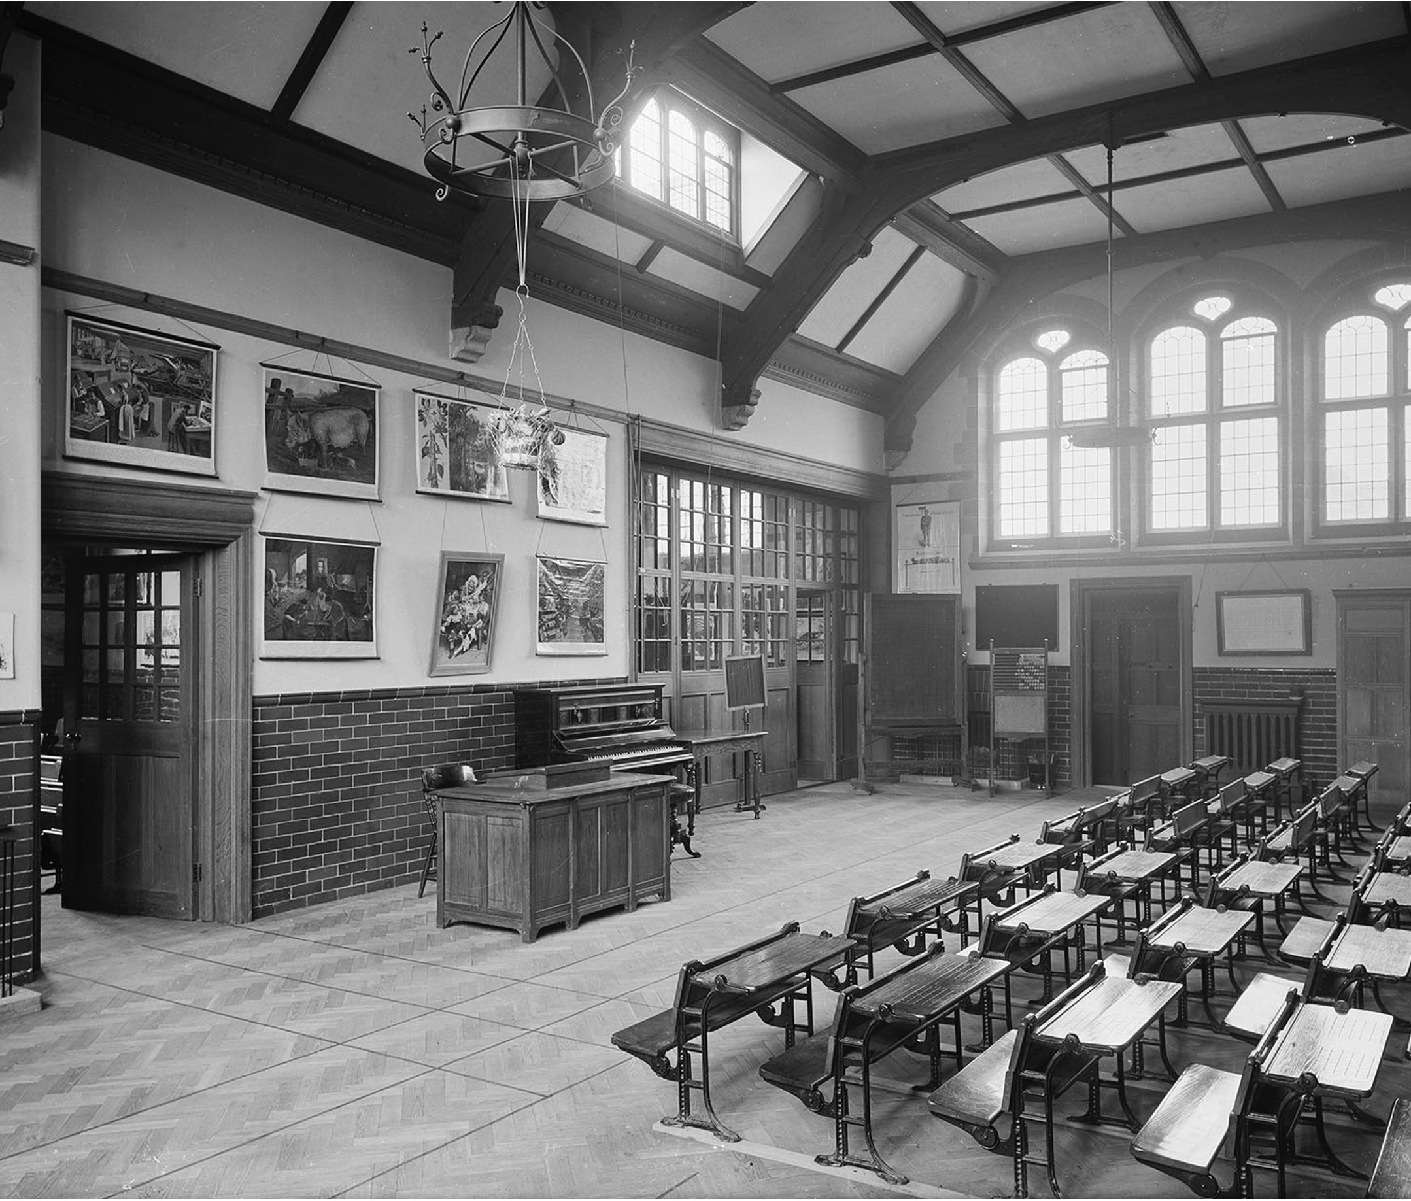
What was life like for Victorian School children?
What was life like for Victorian school children?
Notes:
Image: Source: Historic England Archive Ref: BL14041/034 Date: Apr 1897 - https://historicengland.org.uk/images-books/photos/item/BL14041/034

Slide 2
What was life like for Victorian School children? 1
Key Stage 2: History
Learning Aims and Outcomes
Suggest what life was like for children living in the past
Identify distinctive features of a Victorian school
Present information showing knowledge and an appreciation of the Victorian period
Make comparisons between lifestyles today and in the past

Slide 3

A Victorian Classroom
Notes:
Image: Source: Historic England Archive Ref: BL14041/034 Date: Apr 1897 - https://historicengland.org.uk/images-books/photos/item/BL14041/034

Slide 4


Activity 1
Same as today | Different from today
Make one list of all the things you can see in the photograph
(you can use the hints on the next slide to help you).
Spilt your list of things into the two columns in the table:
Write

Slide 5
Hints
Clue | Answer
You’d need chalk to write on me | Blackboard
You need to lean on me to write | Desk
You can use me to help you count | Abacus
You can use me to play songs | Piano
You need this to keep warm | Fireplace
These can help you learn by looking | Pictures/Posters
?
?
?
?
?
?
Click on the ? to delete the box and reveal some answers

Slide 6
Look!
Look at how the desks are laid out.
Several different lessons could be taught at the same time in the same room!
Imagine how noisy it must have been!
Look at how high the windows are.
This was so pupils wouldn’t be distracted by looking out of them!
Do you think this was a good way to learn?

Slide 7

Activity 2
Where would the desks go?
Would you have desks?
Would you have pictures on the walls?
Would you put other things on the walls?
Where would the teacher sit/stand?
In groups draw and label a design for a classroom - remember you to have to give reasons for what you choose to do!
Draw
Notes:
Find more teaching resources at: HistoricEngland.org.uk/Education

Slide 8

More resources
MORE RESOURSCES AT
HistoricEngland.org.uk/Education

