Slide 1
What was life like for Victorian children & did it get any better?
What was life like for Victorian children & did it get any better?
Notes:
Image: © Crown Copyright. Historic England Archive Ref: AA93/01061 Date: AA93/01061 - https://historicengland.org.uk/images-books/photos/item/AA93/01061

Slide 2
What was life like for Victorian children & did it get any better? 1
Key Stage 2: History
Learning Aims and Outcomes
Suggest what life was like for children living in the past
Present information showing knowledge and an appreciation of the Victorian period
Make comparisons between lifestyles today and in the past
Produce a simple narrative to illustrate what they know about the work done by Victorian children

Slide 3
How can we tell what life was like for Victorian children? Did it get any better?
Look carefully at the photograph of the Mining Memorial (gravestone) on the next slide.
What evidence does it give us about the lives of Victorian children?

Slide 4
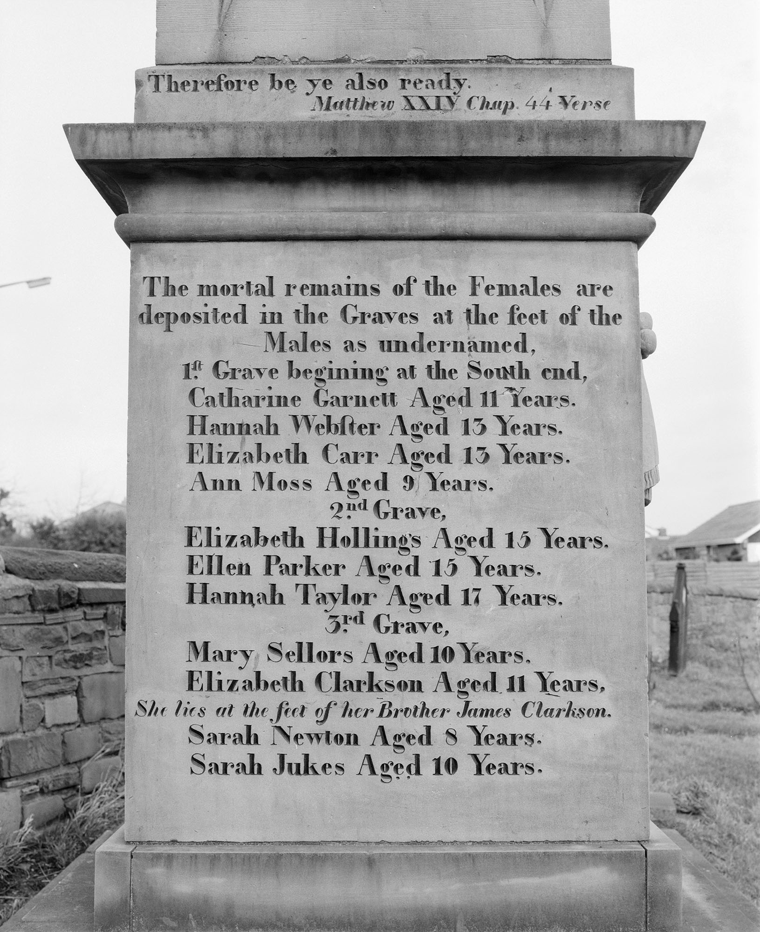
Huskar Pit
On the 4th of July 1838, 26 children were drowned when the Huskar Pit (mine), in South Yorkshire flooded.
Read the list of names.
Try to write them out in order of their age - oldest first.
Notes:
Image: © Crown Copyright. Historic England Archive Ref: AA93/01061 Date: AA93/01061 - https://historicengland.org.uk/images-books/photos/item/AA93/01061

Slide 5
Huskar Pit Memorial

Slide 6
Write your list in the table below
First Name | Surname | Age

Slide 7
How did you do?
First Name | Surname | Age
Hannah | Taylor | 17
Ellen | Parker | 15
Elizabeth | Hollings | 15
Elizabeth | Carr | 13
Hannah | Webster | 13
Elizabeth | Clarkson | 11
Catherine | Garnett | 11
Sarah | Jukes | 10
Mary | Sellers | 10
Ann | Moss | 9
Sarah | Newton | 8

Slide 8
What questions could we ask having looked at the memorial?
The memorial also tells us that:
'the Females are deposited in the Graves at the feet of the Males'.
What does this tell us about Victorian society?
Use the activity on the next slide to help answer your questions.
How old was the youngest victim?
Why weren't they at school?

Slide 9






Put these Acts (laws) into chronological order 1
10 Hour Factory Act - No one had to work more than 10 hours a day
1874
Climbing Boys Act - No chimney sweeps under 10
1864
Factory Act – Children under 12 to work no more than 6.5 hours
1844
Education is made free & compulsory for all 5-13 year olds
1891
Education Act - Children up to 12 have to go to school & pay!
1880
Mines Act - No women & no children under 10 to work in mines
1842
Victoria becomes
Queen 1837
Queen Victoria
Dies 1901

Slide 10





Put these Acts (laws) into chronological order 3
10 Hour Factory Act - No one had to work more than 10 hours a day
1874
Climbing Boys Act - No chimney sweeps under 10
1864
Factory Act – Children under 12 to work no more than 6.5 hours
1844
Education Act - Children up to 12 have to go to school & pay!
1880
Mines Act - No women & no children under 10 to work in mines
1842
Education is made free & compulsory for all 5-13 year olds
1891

Slide 11
Put these Acts (laws) into chronological order 4
Victoria becomes
Queen 1837
Queen Victoria
Dies 1901

Slide 12
ANSWERS: How did you do?
10 Hour Factory Act - No one had to work more than 10 hours a day
1874
Education is made free & compulsory for all 5-13 year olds
1891
Factory Act – Children under 12 to work no more than 6.5 hours
1844
Victoria becomes
Queen 1837
Queen Victoria
Dies 1901
Mines Act - No women & no children under 10 to work in mines
1842
Climbing Boys Act - No chimney sweeps under 10
1864
Education Act - Children up to 12 have to go to school & pay!
1880

Slide 13

ACTIVITY
Using the information from the timeline write a short paragraph about how life changed for Victorian children.
You must then decide based on this evidence whether or not life did get better for Victorian children?
Notes:
Find more teaching resources at: HistoricEngland.org.uk/Education

Slide 14
Teachers’ Notes
The information below is a brief history of Victorian laws relation to child labour and education
1837 - Victoria becomes queen.
1842 - Mines Act stopped women and children under 10 working in mines (this was prompted by the Huskar Pit disaster in 1838).
1847 - Factory Act stopped children between 8-12 from working more than 6½ hours a day, women and children 13-18 couldn’t work more than 12 hours a day!.
1864 - Boys under 10 were banned from being chimney sweeps.
1870 - Education Act set up school boards to provide schooling for 5-11 year olds.
1874 -The Ten Hour Factory Act meant that people could not be made to work for more than 10 hours a day and children under 14 could not be employed fulltime.
1878 - Factory and Workshop Act banned the employment of children under 10.
1880 - Education Act made it compulsory for children up to 12 to go to school, but most children had to pay.
1891 - Education is free and compulsory for all 5-13 year olds.
1901 - Queen Victoria dies

Slide 15

More resources
MORE RESOURSCES AT
HistoricEngland.org.uk/Education

