Slide 1
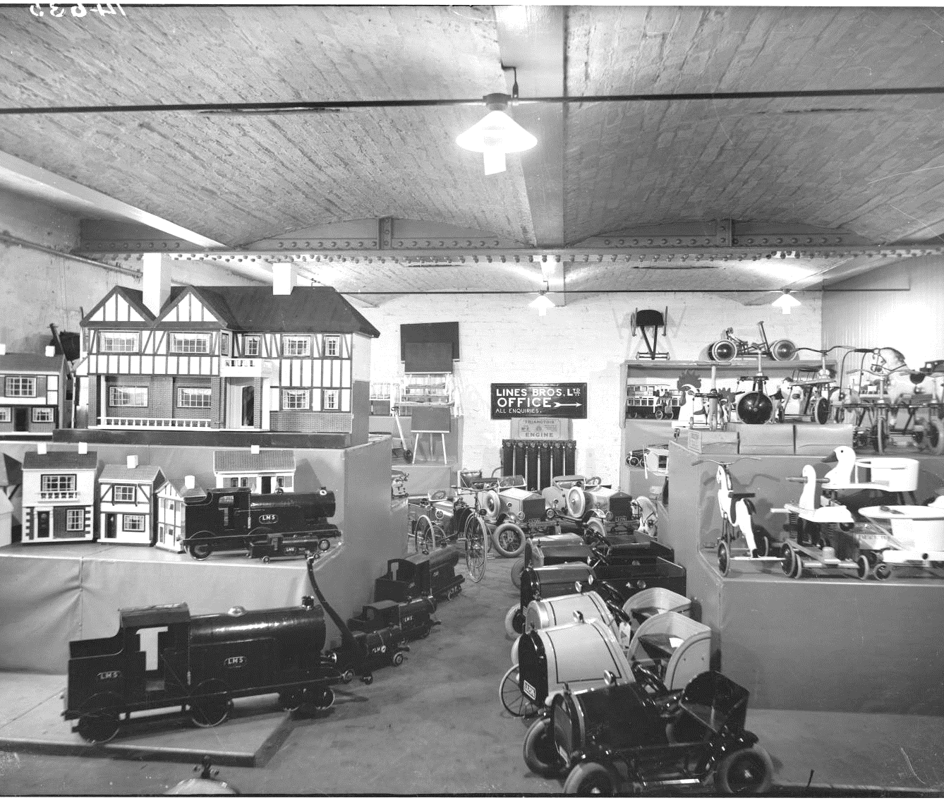
What sort of toys did my great grandparents play with? 1
What sort of toys did my great grandparents play with?
Notes:
Image: Source: Historic England Archive Ref: CC80/00296 Date: Nov 1927 - https://historicengland.org.uk/images-books/photos/item/CC80/00296

Slide 2
How to use this PPT
Contents
The slides in this PowerPoint are intended for use in the classroom. You will find opportunities for discussion, as well as writing and drawing activities to do with your class. You can use all, or some of the slides, and you can edit them to meet the needs of your pupils.
You will find some additional information for teachers on the final slide in the Powerpoint.
What sort of toys did children used to play with?
How are toy shops in the past similar and different to today?
Which old toys would you like to play with and why?
Information for teachers: A brief history of toys in Britain.

Slide 3
What sort of toys did my great grandparents play with? 2
Key Stage 1: History
Learning Aims and Outcomes
Describe the characteristics of old toys
Identify similarities and differences
Infer information from a picture or photograph
Speak about toys that belonged to their grandparents/great-grandparents
This activity relates to the ‘What sort of toys did my great grandparents play with?’ Teaching Activity

Slide 4
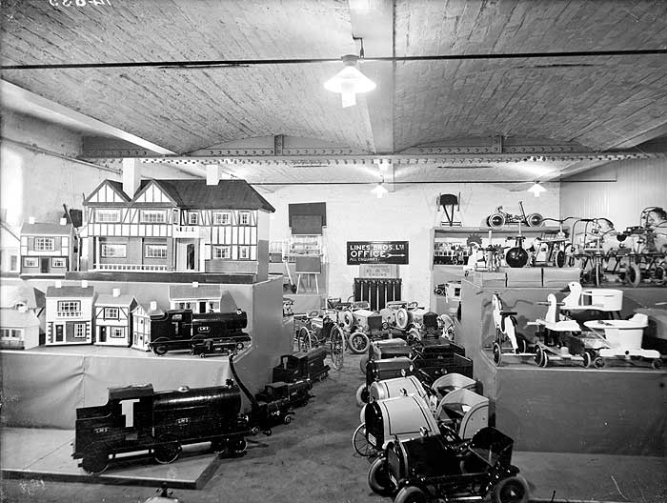
What sort of toys did children used to play with? 1
Look carefully at the photograph of a Toy Shop on the next slide.
It was taken in 1927.
What different types of toys you can see?
Can you write a list of three different toys?
Notes:
Image: Source: Historic England Archive Ref: CC80/00296 Date: Nov 1927 - https://historicengland.org.uk/images-books/photos/item/CC80/00296

Slide 5
What sort of toys did children used to play with? 2
Look carefully at the photograph of a Toy Shop. It was taken in 1927.
Can you write a list of the different types of toys you can see?
Notes:
Image: Source: Historic England Archive Ref: CC80/00296 Date: Nov 1927 - https://historicengland.org.uk/images-books/photos/item/CC80/00296

Slide 6
What sort of toys did children used to play with? 3
Write a list of three different toys that you can see in the photograph.
1______________
_______________
2_____________________________
3______________
_______________
Notes:
Image: Source: Historic England Archive Ref: CC80/00296 Date: Nov 1927 - https://historicengland.org.uk/images-books/photos/item/CC80/00296

Slide 7


What toys did you find?
Blackboards
Dolls houses
Ride-on ducks
Ride-on trains
Ride-in cars
Notes:
Image: Source: Historic England Archive Ref: CC80/00296 Date: Nov 1927 - https://historicengland.org.uk/images-books/photos/item/CC80/00296

Slide 8

How is this toy shop similar and different from a toy shop today?
Complete the table shown on the next slide
Notes:
Image: Source: Historic England Archive Ref: CC80/00296 Date: Nov 1927 - https://historicengland.org.uk/images-books/photos/item/CC80/00296

Slide 9
How is the toyshop in 1927 similar and different to a toy shop you might visit today?
Old Toy Shop | Toy Shop Today

Slide 10
Which toy would you most like to play with?
Draw a picture of yourself playing with that toy
Notes:
Find more teaching resources at: HistoricEngland.org.uk/Education

Slide 11
Draw a picture of yourself playing with the toy you would most like to play with from the old toy shop.
Which toy would you most like to play with?
………………………………………………………………………………………………………
Why did you choose this toy?
………………………………………………………………………………………......................

Slide 12
For teachers: a brief history of toys in Britain
The first documentary evidence of toys being sold in England appears in an engraving of 1632, showing a market stall selling toys.
1700s saw the first actual shops selling toys. These toys were handmade by skilled craftsmen.
1760s saw the first mass produced toy soldiers, made from lead and tin.
1767 the first jigsaw is invented (to teach children geography – it was a map)
From the 1850s there was an ever-growing demand for children’s toys, linked to the rise of the Victorian middle classes and changing attitudes towards children.
The first commercially manufactured toys became available in the Late Victorian period – Doll’s Houses in the 1880s.
Many Victorian children had few if any toys. The poorest often bought them from street sellers, but most play took place in the streets, using whatever came to hand!
1901 - Frank Hornby invents Meccano.
1902 - The ‘Teddy Bear’ is created when US President Theodore ‘Teddy’ Roosevelt refuses to shoot a bear cub whilst on a hunting trip.
1907 - The first Hornby Train made, although other makes were available earlier. The first wind-up toy cars were also made in this year.
1933 – The first ‘Dinky’ car is made (by Frank Hornby).
1950s – Lego is created.

