Slide 1
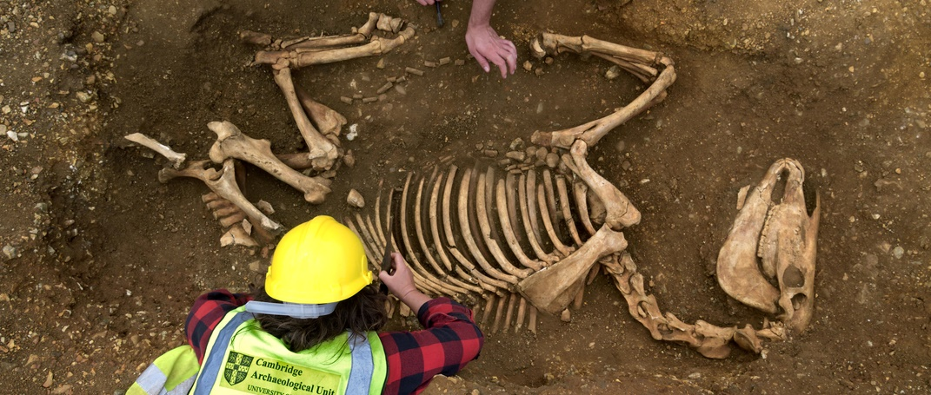
What is archaeology?

Slide 2
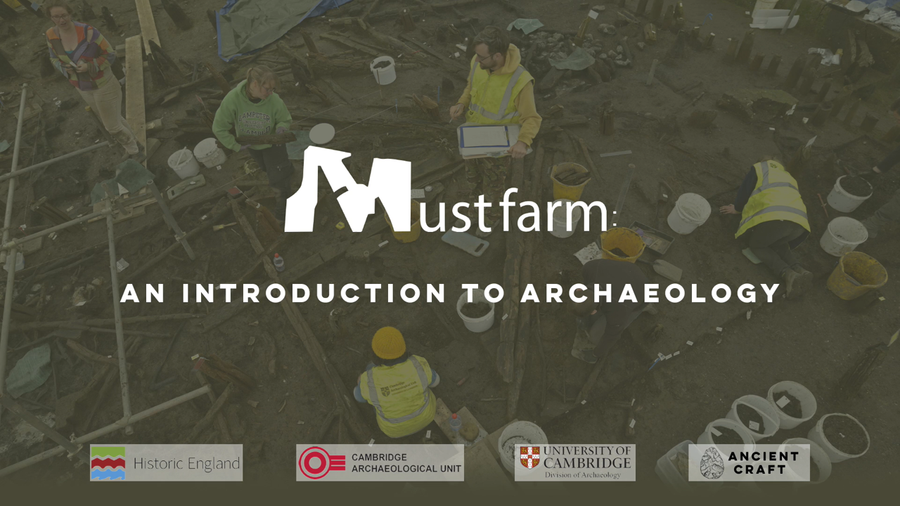
An introduction to archaeology?
Notes:
https://vimeo.com/1045004249#t=0m00s&end=3m01s

Slide 3
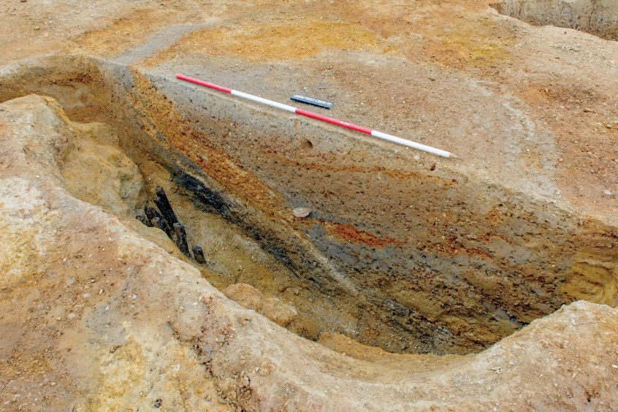
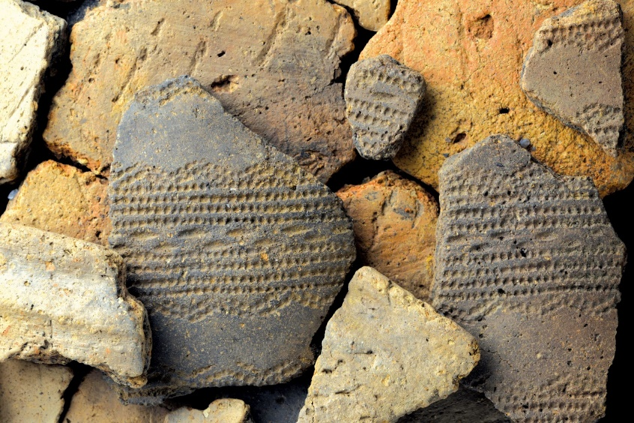
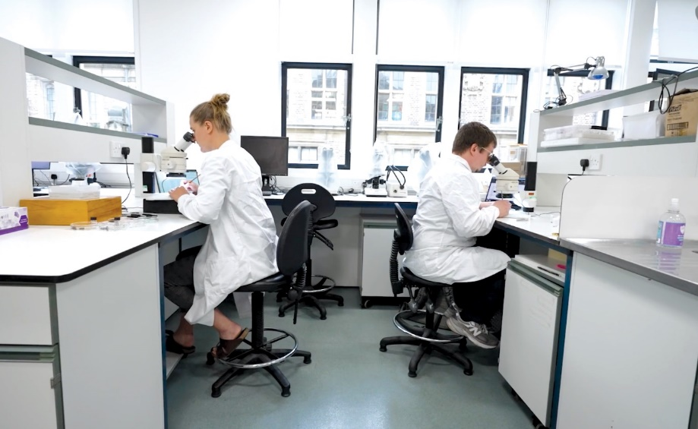
What does archaeology involve?
Archaeology is the study of the lives of people in the past and the things they left behind
Archaeologists can find out information from:
Archaeological features
Artefacts
Scientific Analysis
A prehistoric watering hole that is being dug by archaeologists
A collection of different prehistoric pottery sherds from an excavation
Archaeologists studying samples at the Department of Archaeology, University of Cambridge

Slide 4

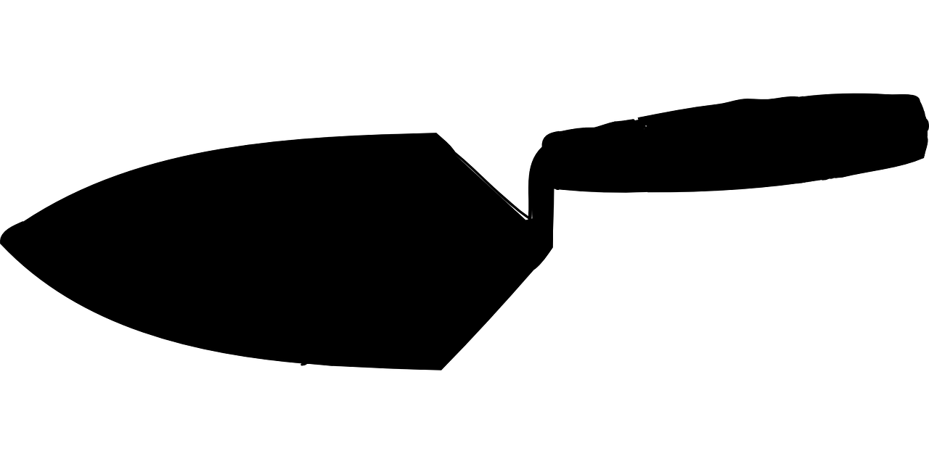

What questions do archaeologists ask?
One of an archaeologist’s jobs is to ask questions about the sites that they dig up and the people that lived there. They can use different scientific techniques to try and answer these questions.
  How did people do things in the past?
  When were people living at a site?
Technique: Studying artefacts to understand technology
C14
Technique: Radiocarbon dating
Who were the people living in the past?
What were people doing at a site in the past?
Where are archaeological sites?
Technique: Ancient DNA
Technique: Excavations
Technique:
Aerial photographs

Slide 5
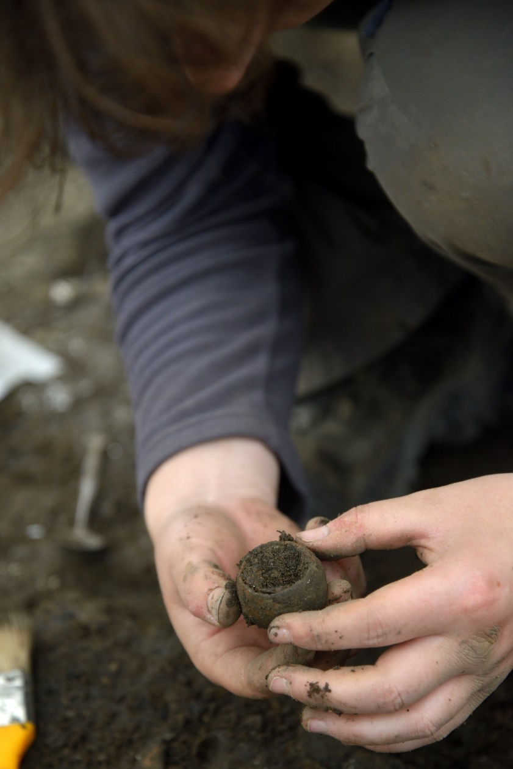
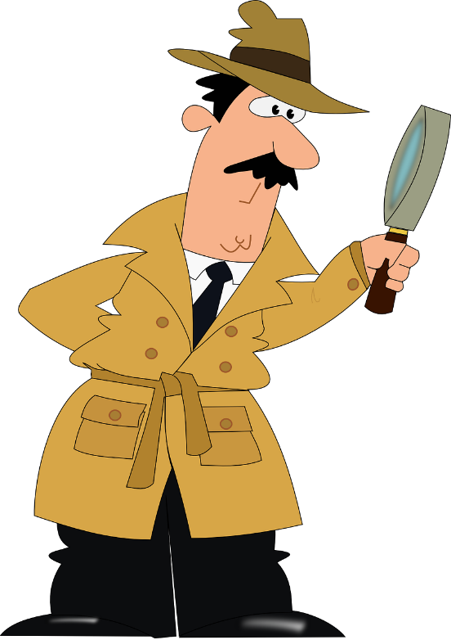
Understanding the past
The hardest question for archaeologists to answer is trying to understand why people did the things they did in the past.
This is very tricky for prehistory as people from this time in Britain didn’t leave any writing that could have given us explanations.
Why did people at a Bronze Age village make pots this tiny?
This means archaeologists must become detectives and use the evidence they discover to try and work out the reasons why things happened

Slide 6
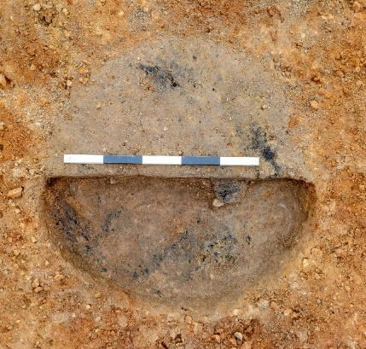
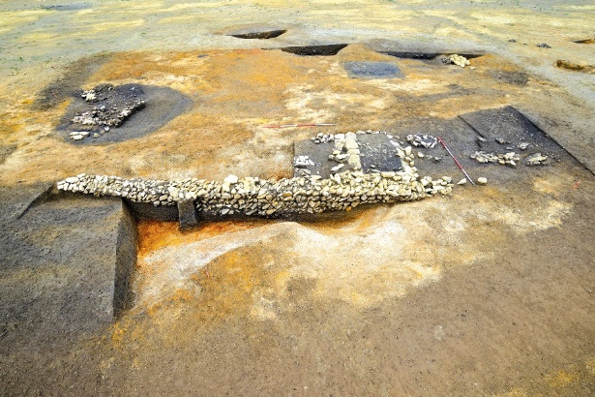
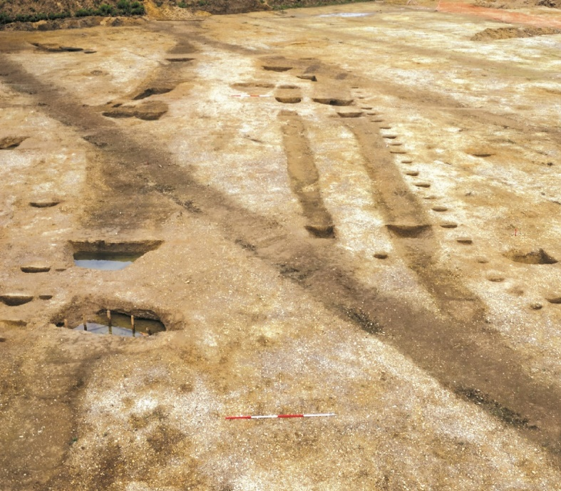
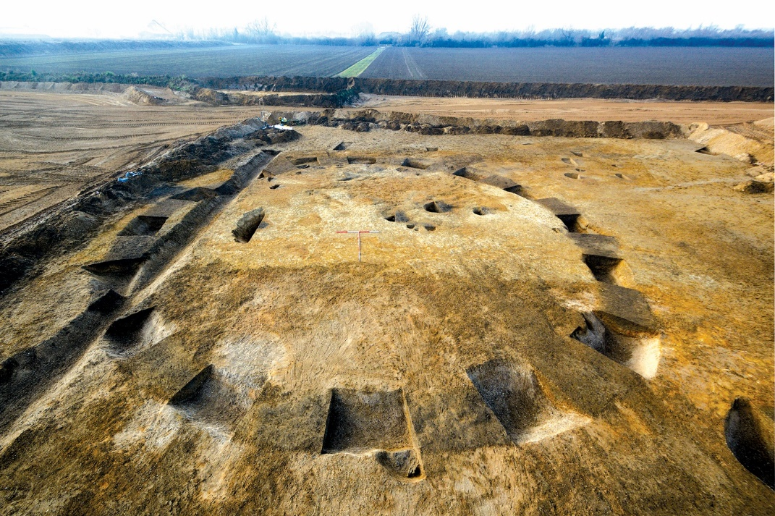
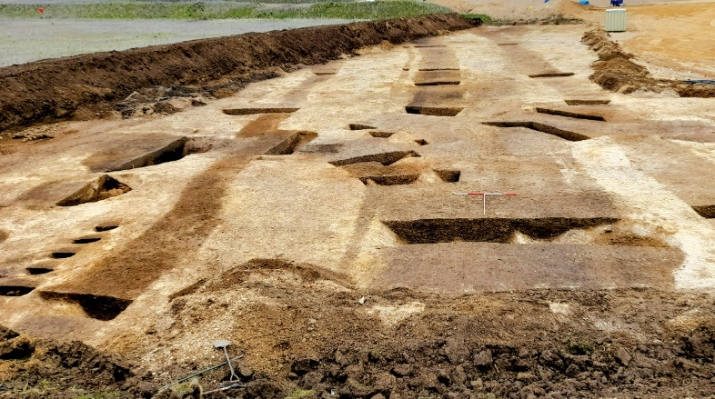
How do archaeologists know where to dig?
Archaeologists look for differences in the colour, texture and type of soils which can help them to find where to dig.
These differences can be caused by people’s actions in the past, for example digging pits and ditches.
Archaeologists can also use other techniques like aerial photographs and underground scanning called geophysics, to work out where archaeology is.
A pit
Different textures
Can you spot the ditches in the different coloured soils?
A ditch

Slide 7
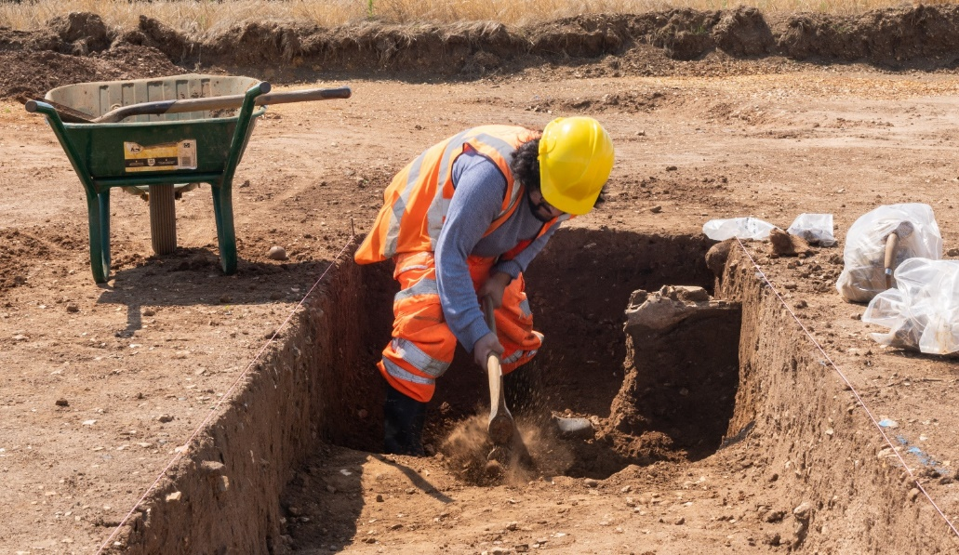
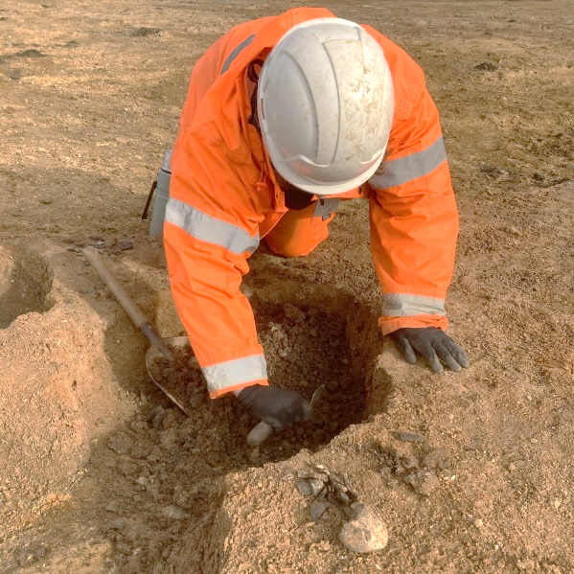
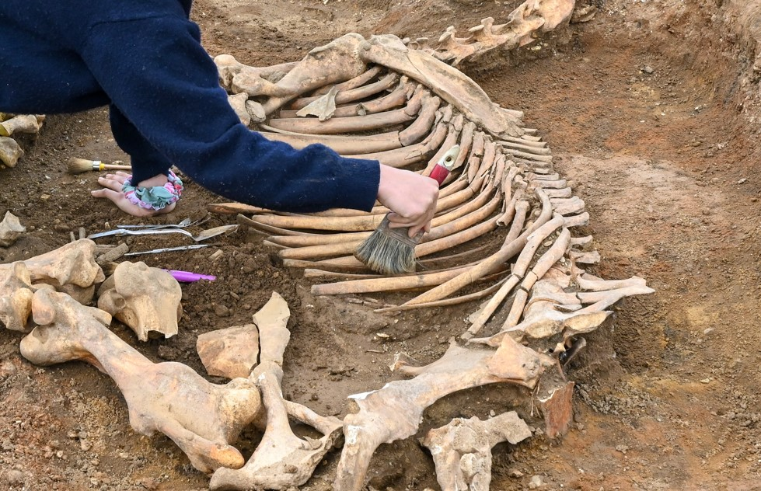
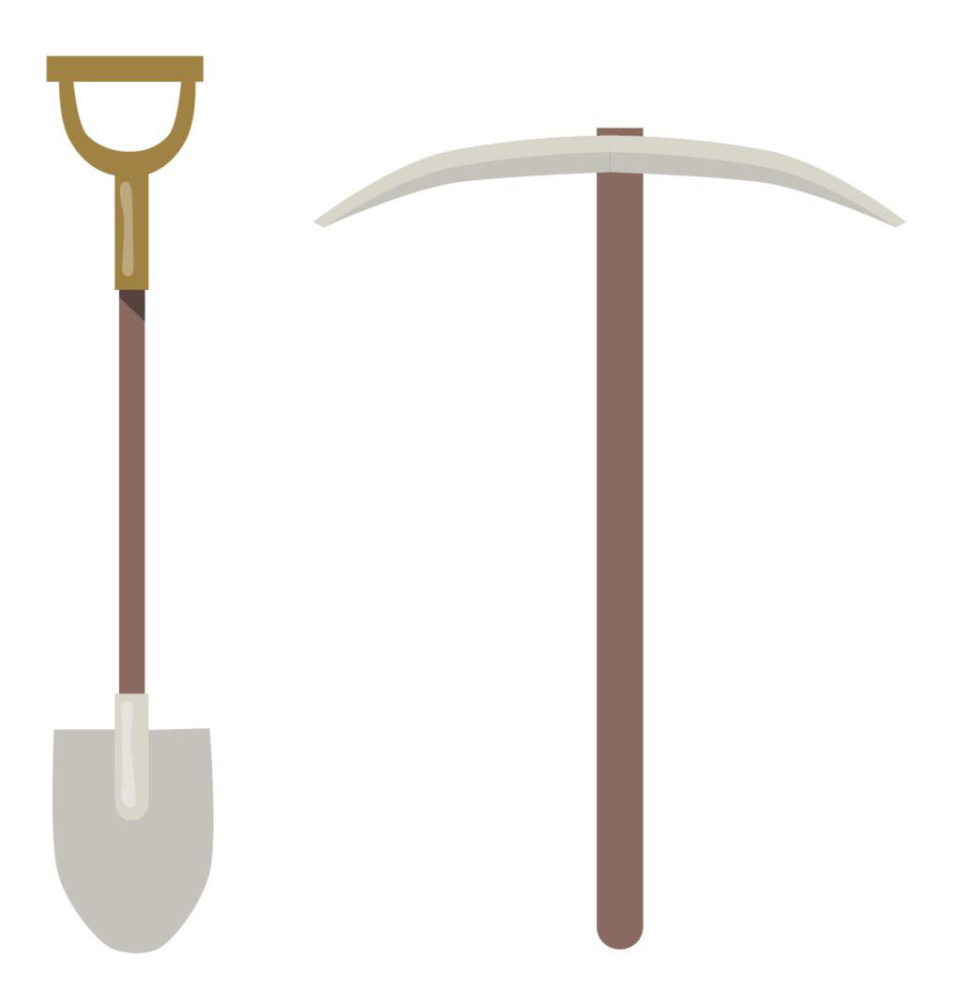
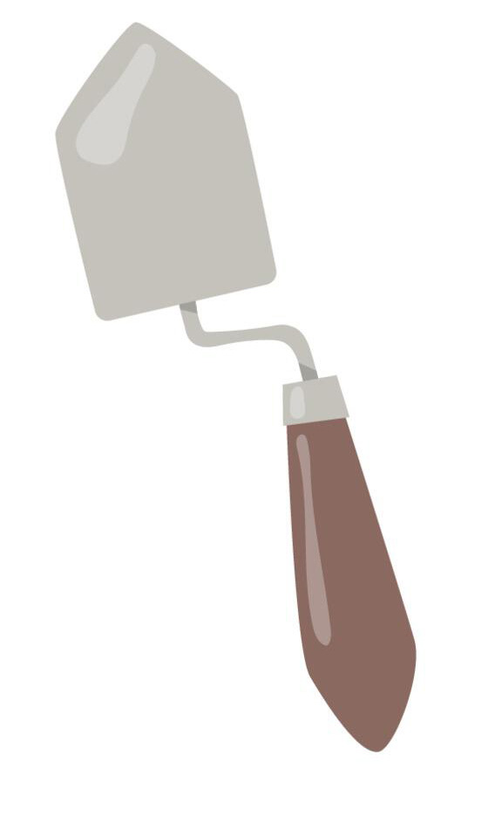
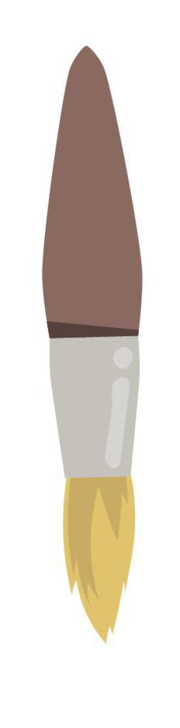
How do archaeologists excavate?
When archaeologists find where to work, they use several different tools to excavate (dig).
Archaeologists always try to dig very carefully using a range of tools for different jobs.
  Shovels and mattocks
  Trowels
  Brushes
Removing soil from features
Careful digging and cleaning
For delicate artefacts and work
Notes:
Image: Alamy 2J22KKP

Slide 8
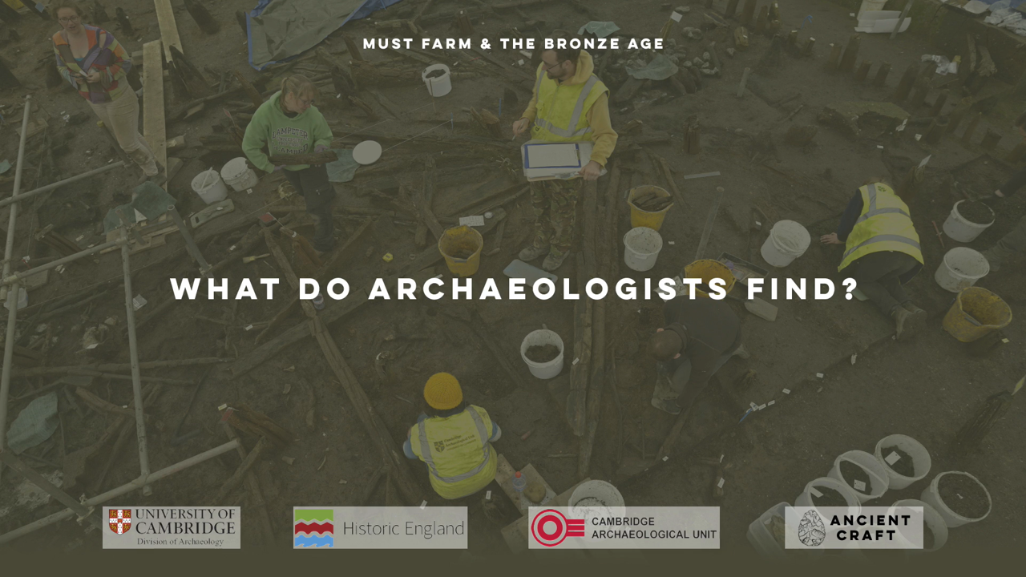
What do archaeologists find?
Notes:
https://vimeo.com/1045004249#t=5m54s&end=7m32s

Slide 9
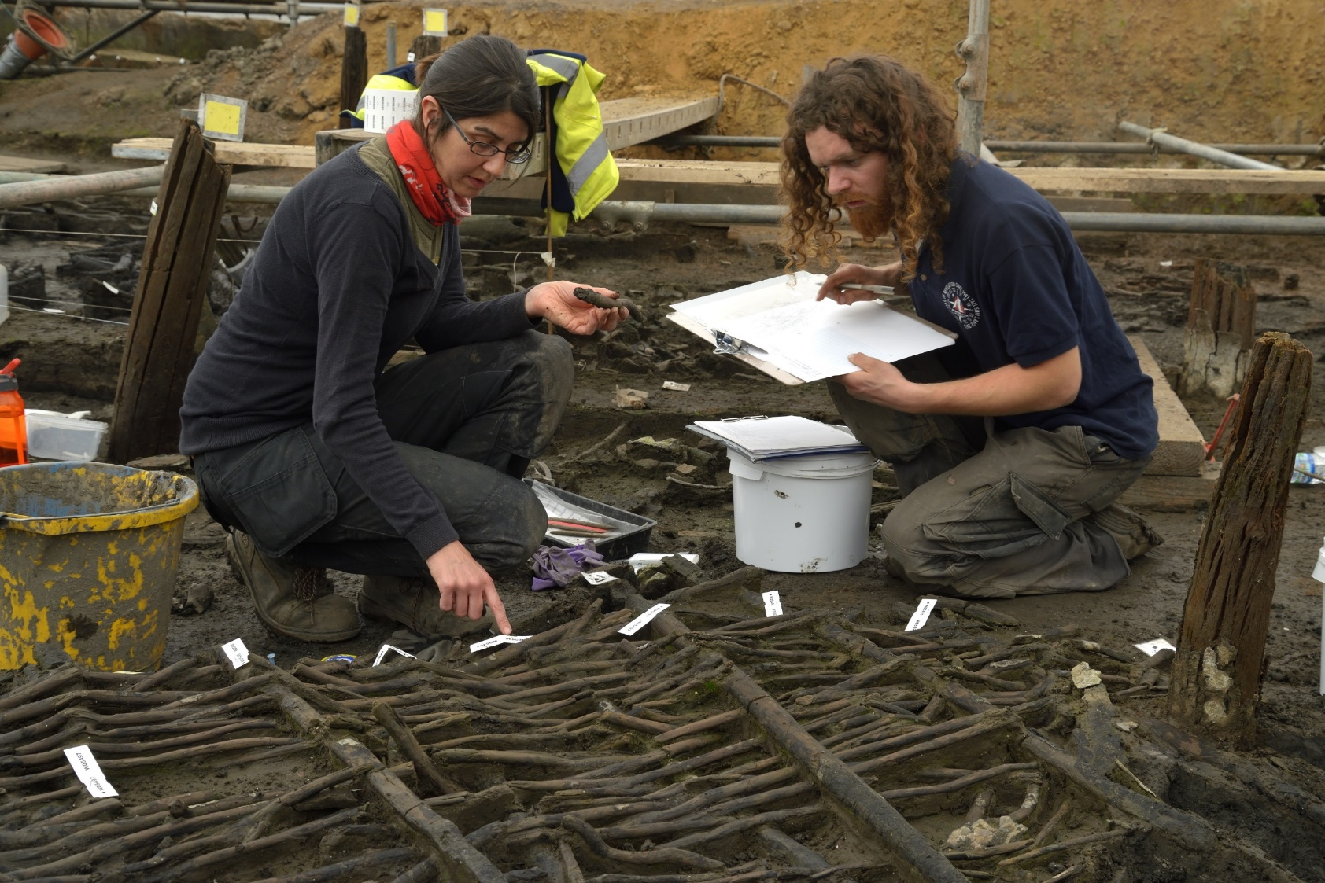
Recording archaeology
Archaeology is not just about digging objects up. Lots of very important information that helps us understand the past is found around the artefacts we find. This special information is called context.
Context includes where an object is found, what soil it is found in and how it is connected to other discoveries.
It is really important to record as much information as possible about archaeology and contexts. We only get one chance to dig things up and if we don’t make good records, it is easy to lose special details.

Slide 10
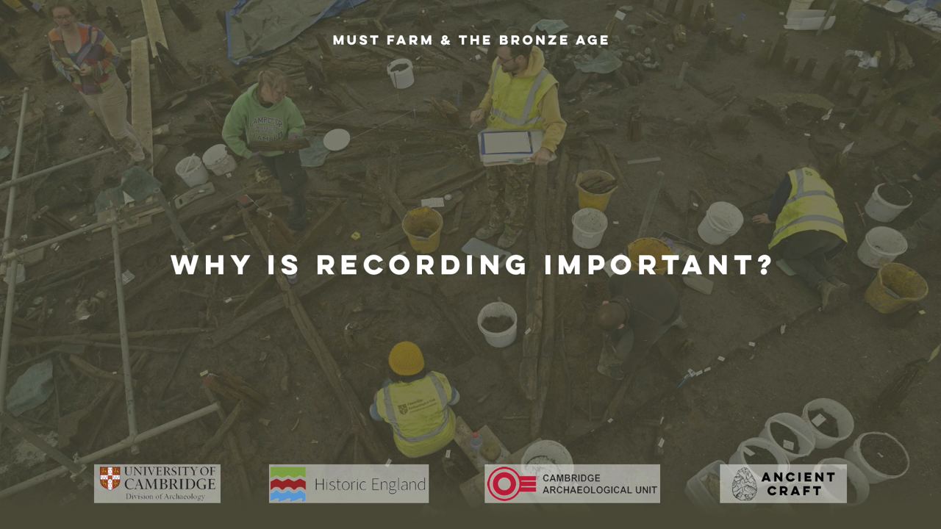
Why is recording important?
Notes:
https://vimeo.com/1045004249#t=3m04s&end=5m32s

Slide 11
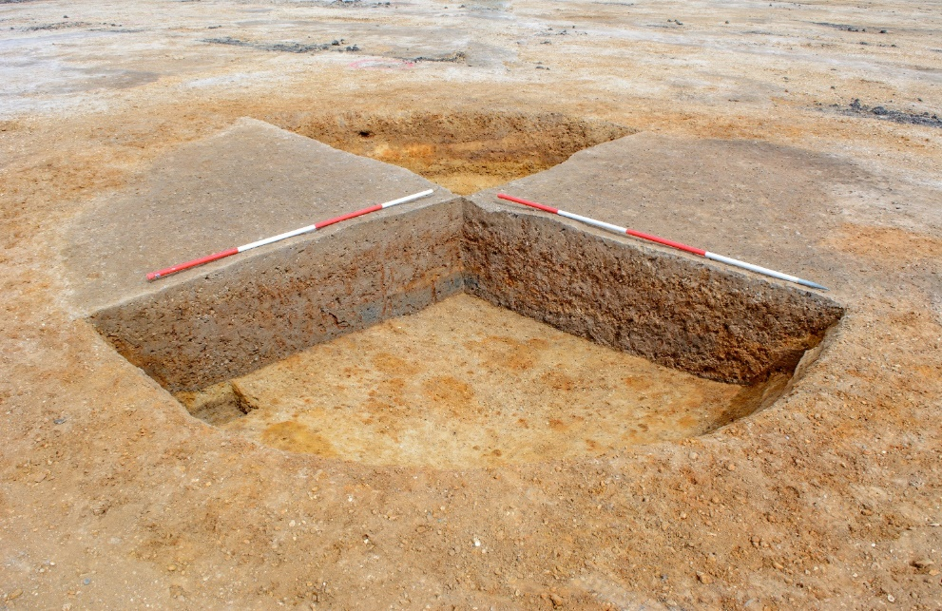
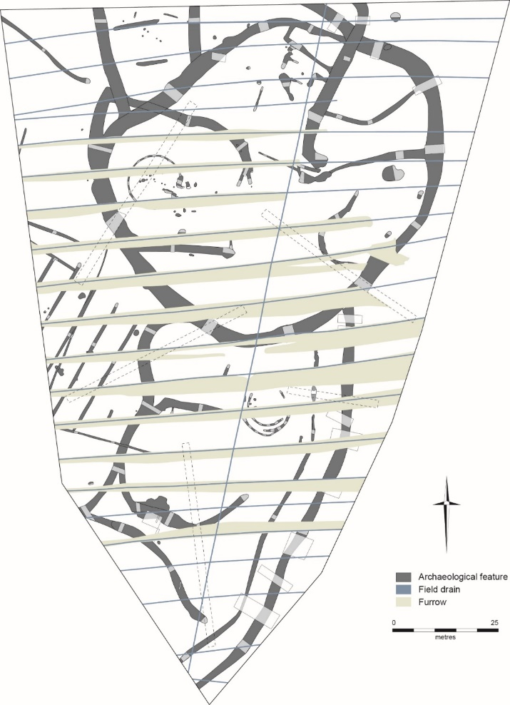
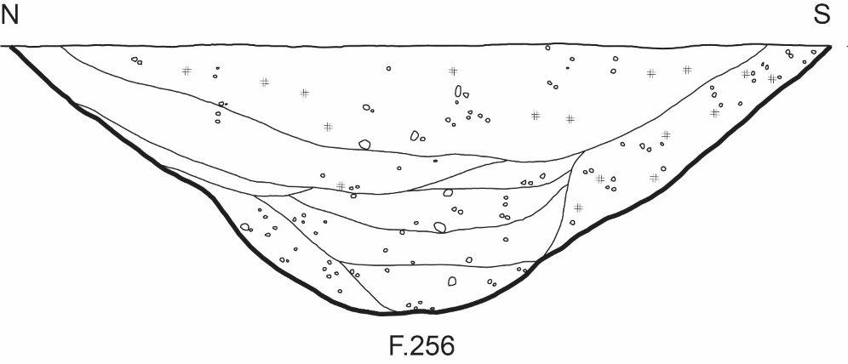
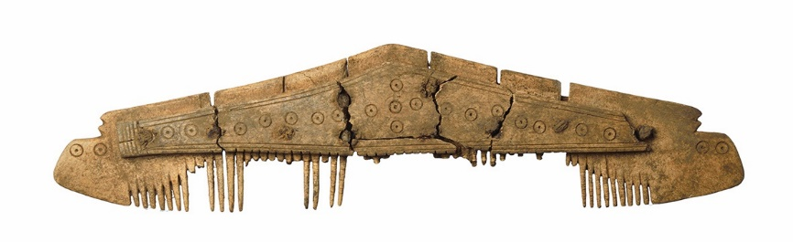
Recording techniques
Plans are like maps that show where archaeology is
Archaeologists use lots of different techniques to record information and preserve it for the future
Drawing sections shows the different layers in a feature
Photographs can record the archaeology at different stages

Slide 12
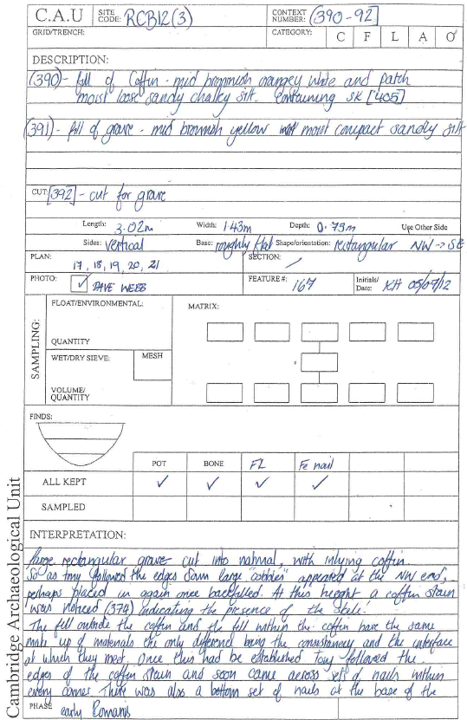
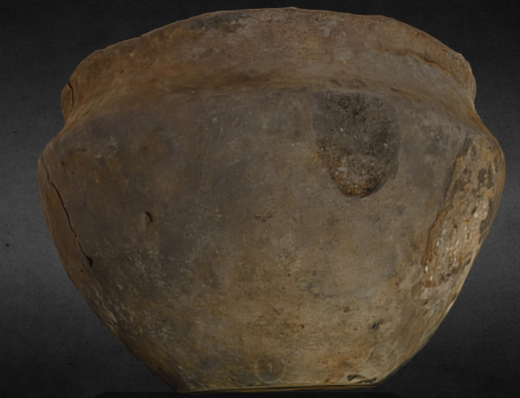
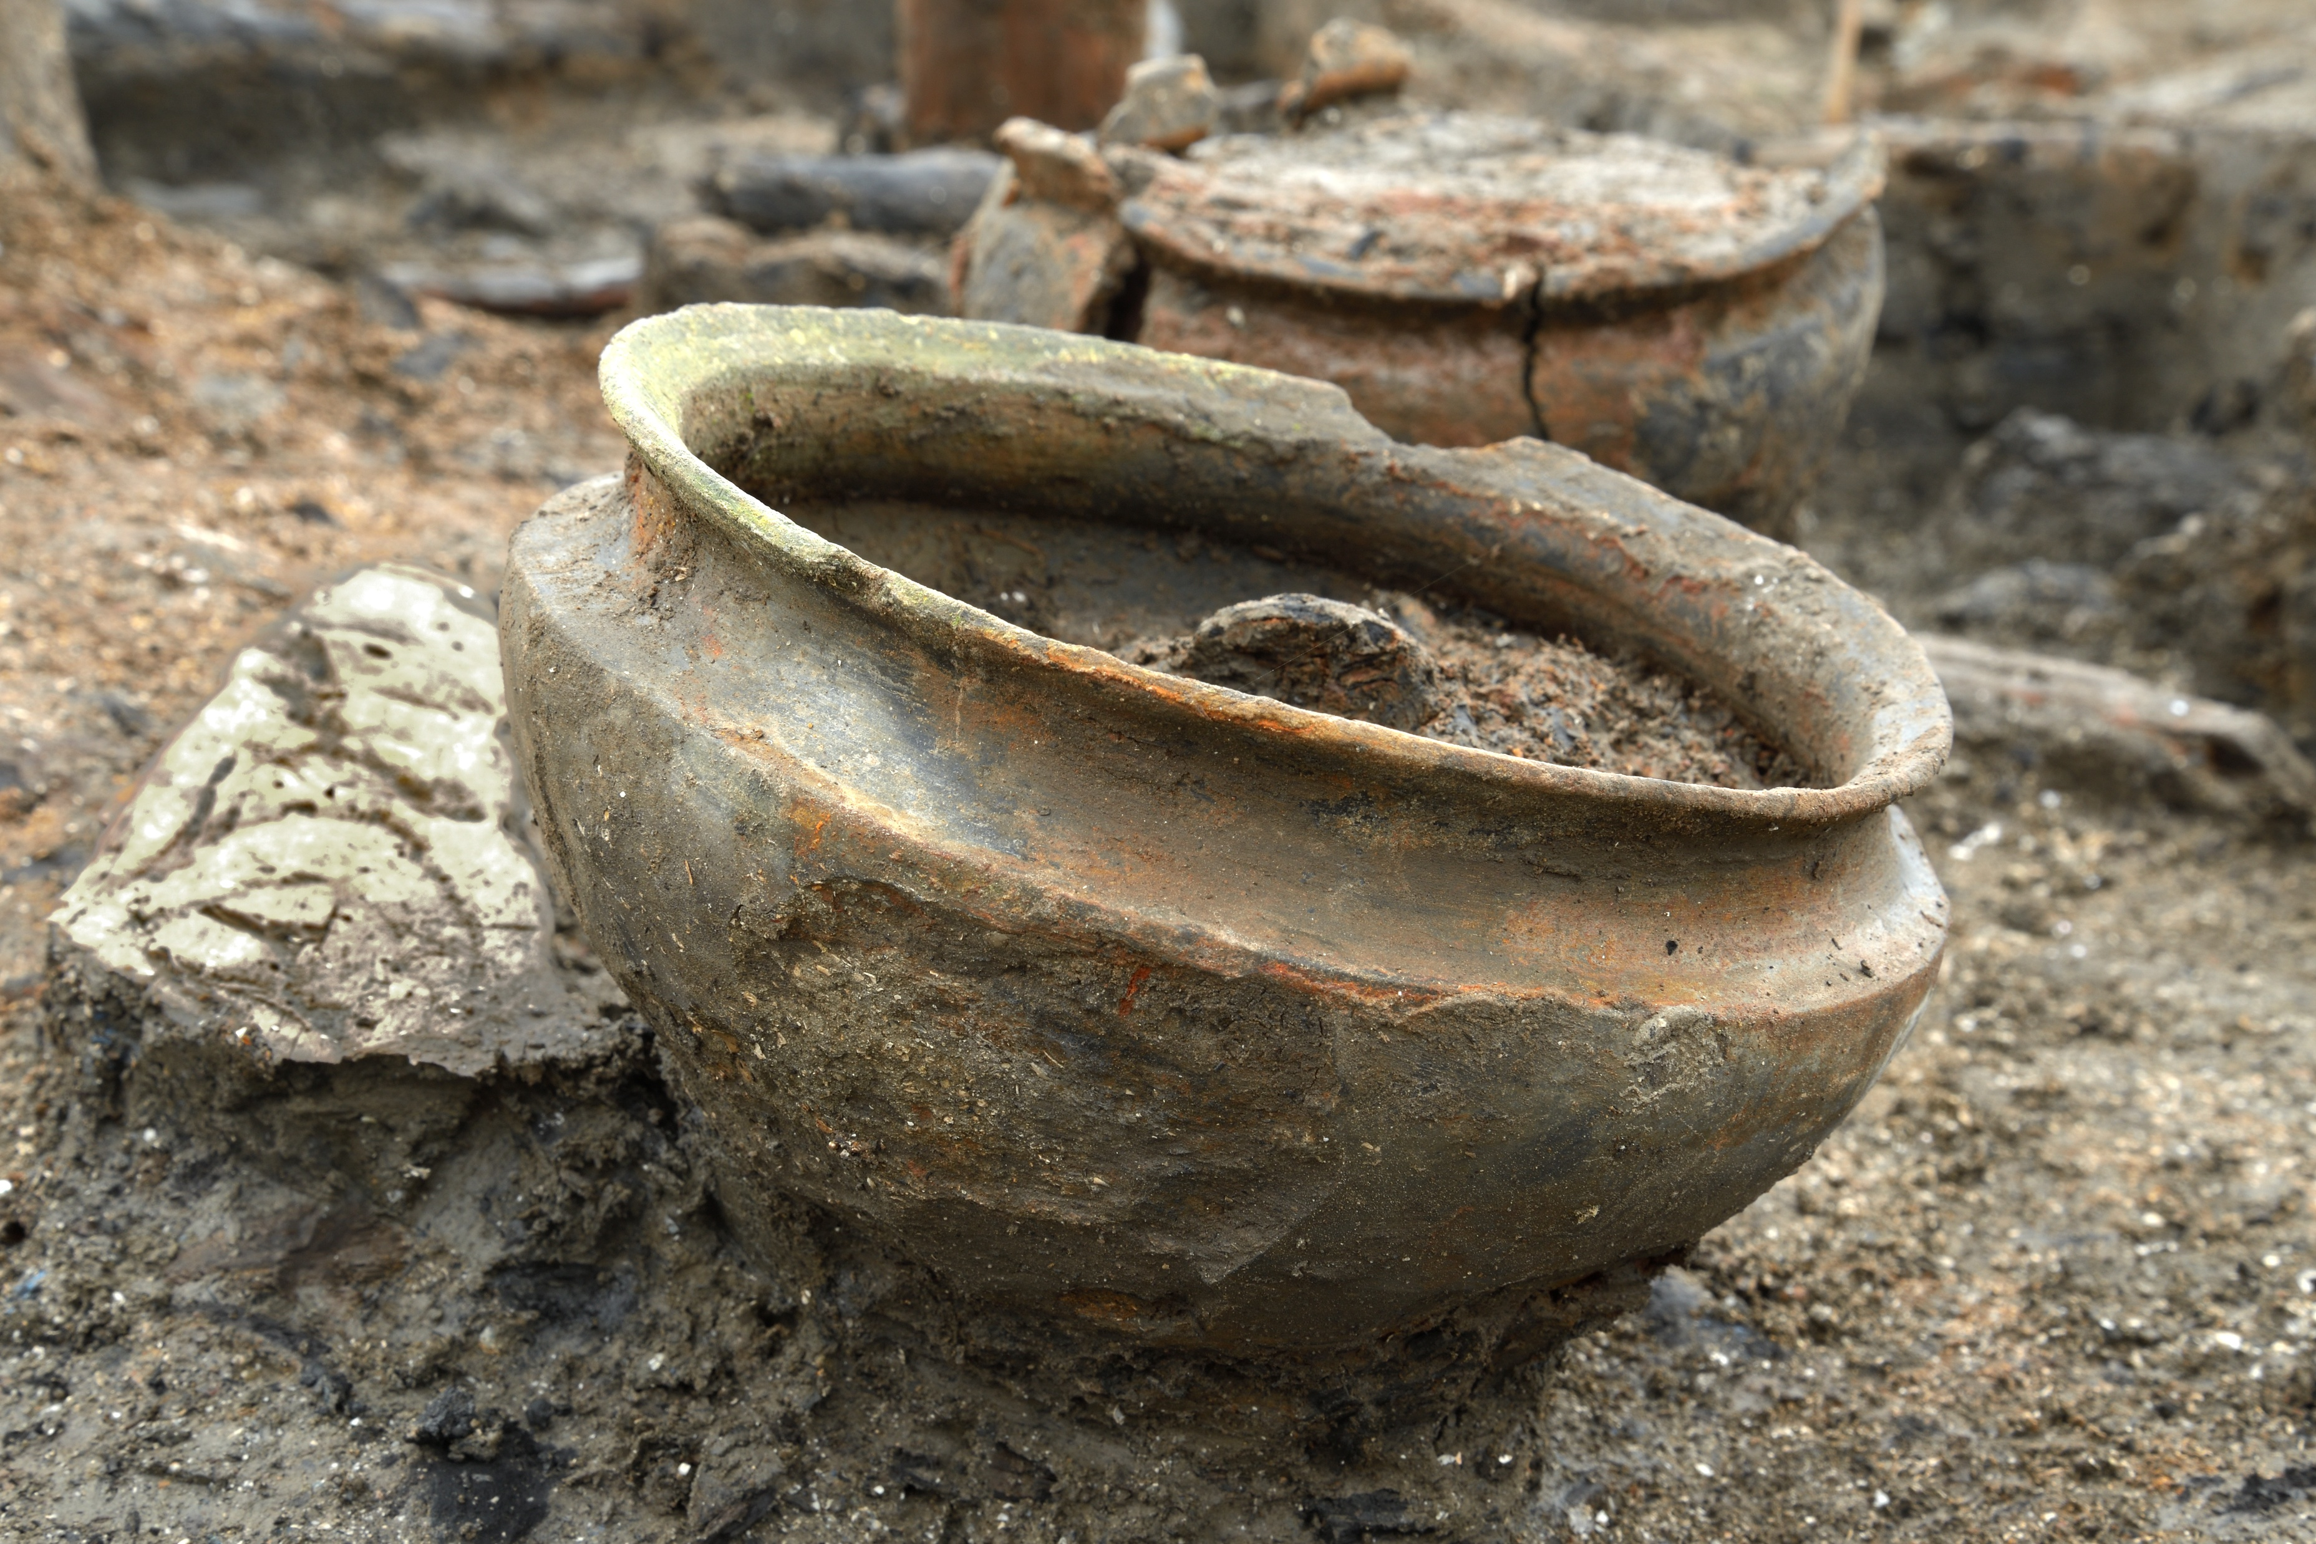
More recording techniques
Photographs can be made into 3D models
Context sheets are written records that describe the archaeology

Slide 13
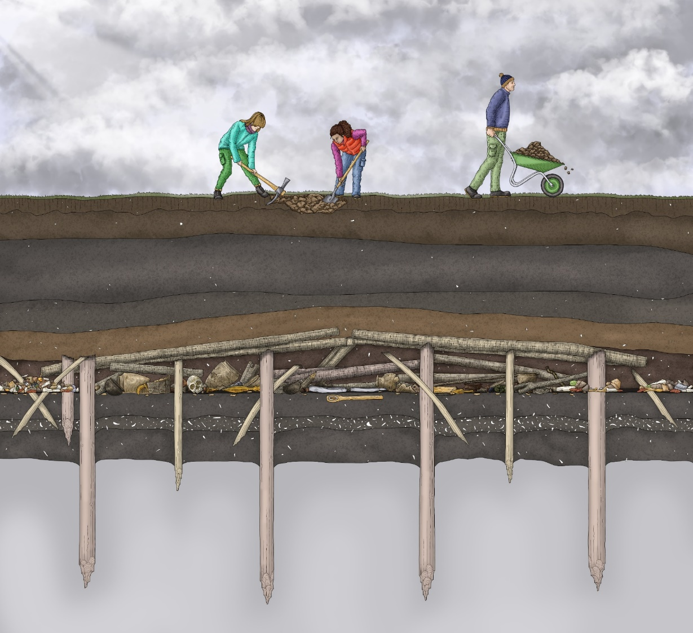
How do archaeologists understand what they find?
Archaeologists use the layers beneath the ground to help understand the archaeology they find.
Working out the order of these layers and how they connect is called stratigraphy.
Usually, layers that are found deep down are much older than the layers underneath our feet, which have formed much more recently.

Slide 14
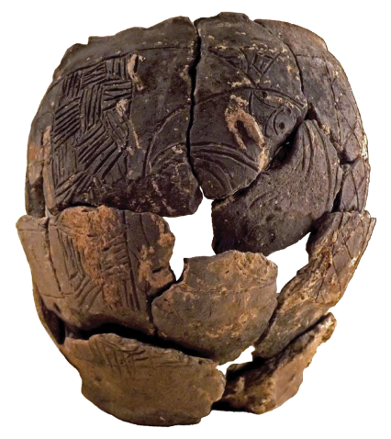
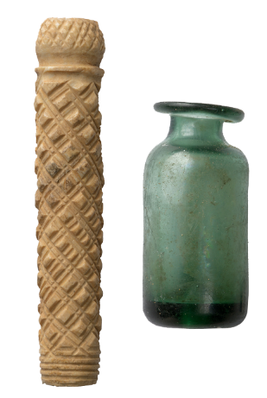
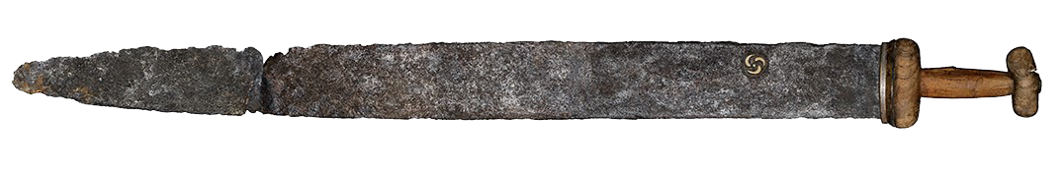
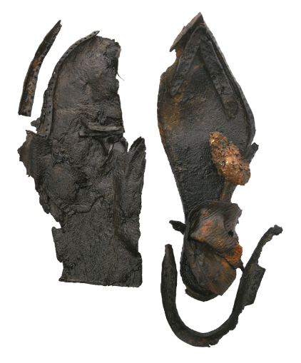
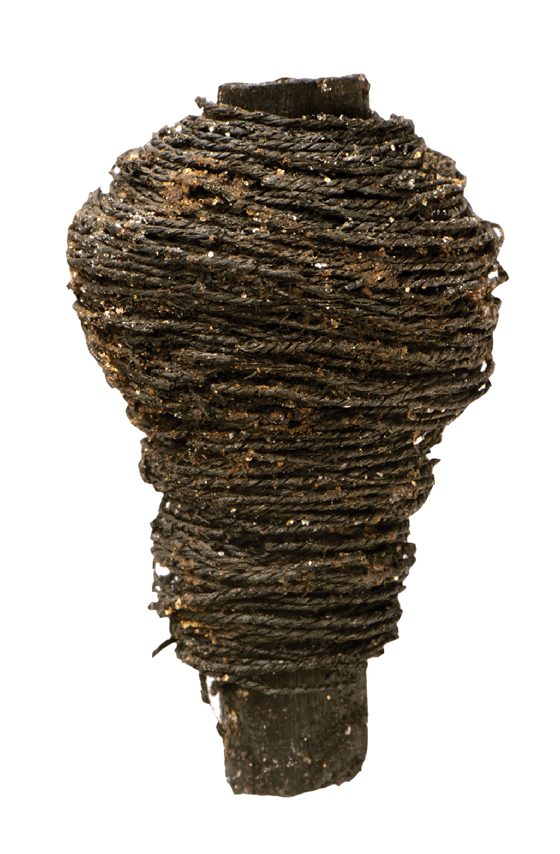
Processing and studying archaeological finds
Pottery
Once artefacts are found they are carefully washed and dried so that they can be studied.
Specialists, archaeologists who study different materials and techniques, will then look closely at the artefacts and use their knowledge to help work out how it fits into the story of the site.
Specialists can help to date when artefacts were from, where they might have been made and what they were used for.
Bone & Glass
Wood & Textile
Leather
Metal

Slide 15
Making theories
Finally, archaeologists must use all the information and evidence from their digs to make theories about what happened at sites.
Theories can change over time as more evidence is discovered, or new digging reveals more finds and archaeology.
Sometimes there can be two or more different theories about what might have happened in the past. When this happens, archaeologists must decide which one they think is better. This means there isn’t always a right and wrong answer in archaeology.
Archaeologists had to investigate what could have caused a Bronze Age village at Must Farm to burn down

Slide 16

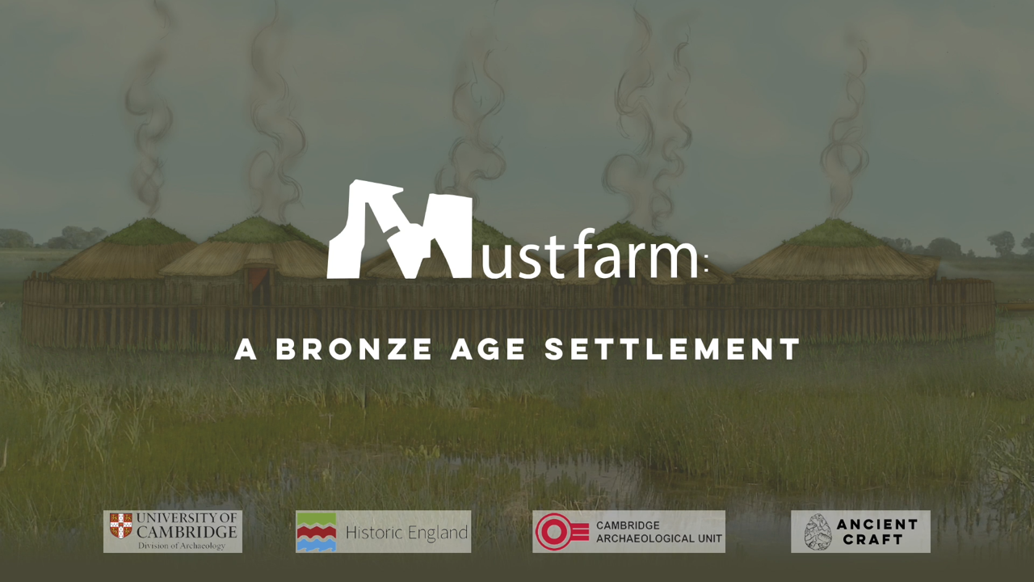
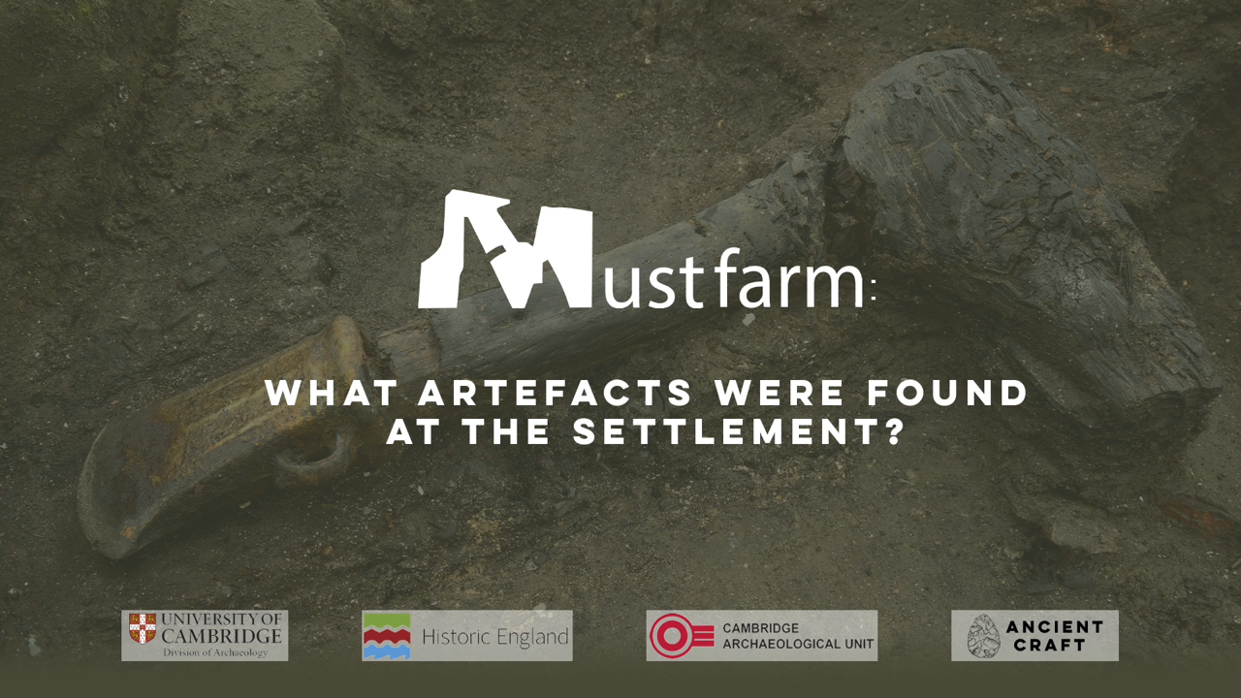
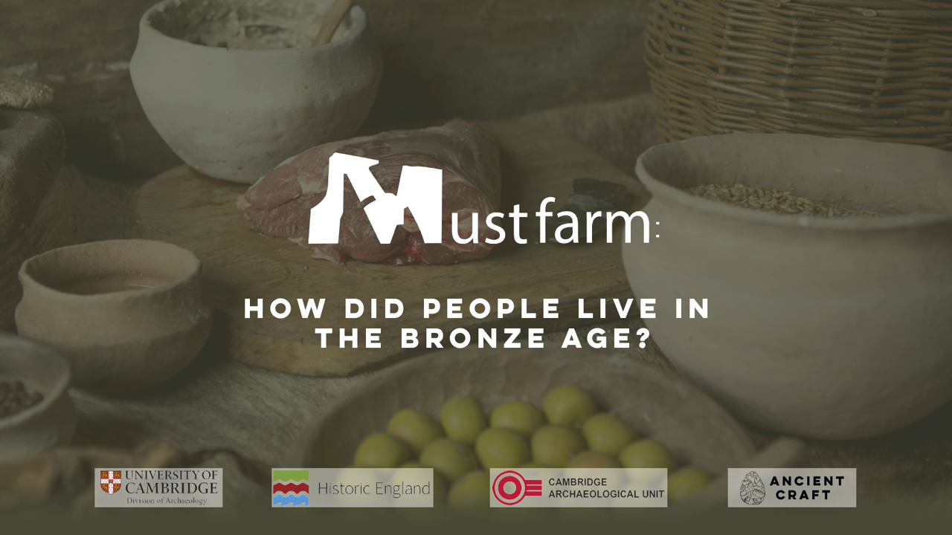
Find out more by watching the Must Farm videos
Notes:
https://vimeo.com/1045004249#t=3m04s&end=5m32s

