Slide 1
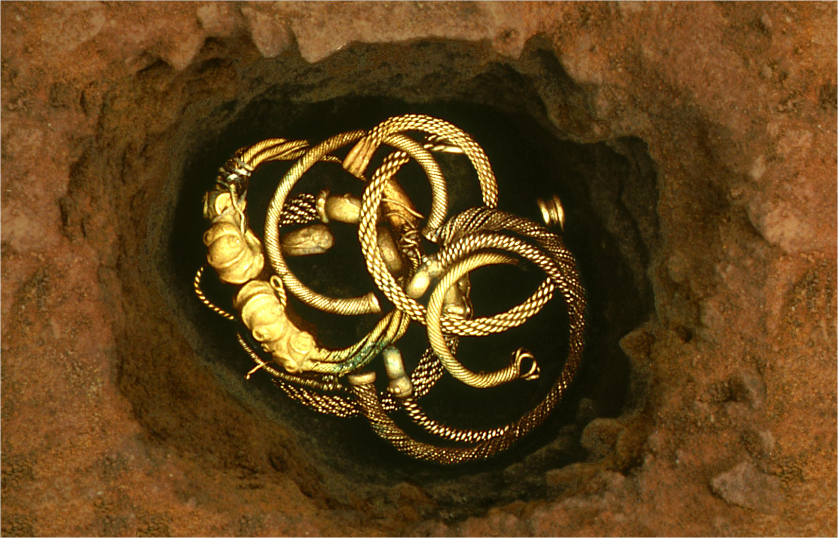
The Iron Age
Stone Age to Iron Age: Part 5
The Iron Age
Notes:
Use the first slides as an introduction to help pupils find out more about the Iron Age in general.
Then explore the map to find out more about specific archaeological sites in Britain.
IMAGE:
Torcs in the ground at Snettisham © The Trustees of the British Museum. - https://www.britishmuseum.org/collection/object/H_1991-0407-37?selectedImageId=33182001

Slide 2
The Iron Age
Learn about the types of technology used in the Iron Age
Learn about the everyday life of people in the Iron Age
Learn about changes in Britain from the Stone Age to the Iron Age
Assess the different types of archaeological evidence from the Iron Age
Establish clear narratives within and across the periods studied
Understand how knowledge of the past comes from a range of sources

Slide 3
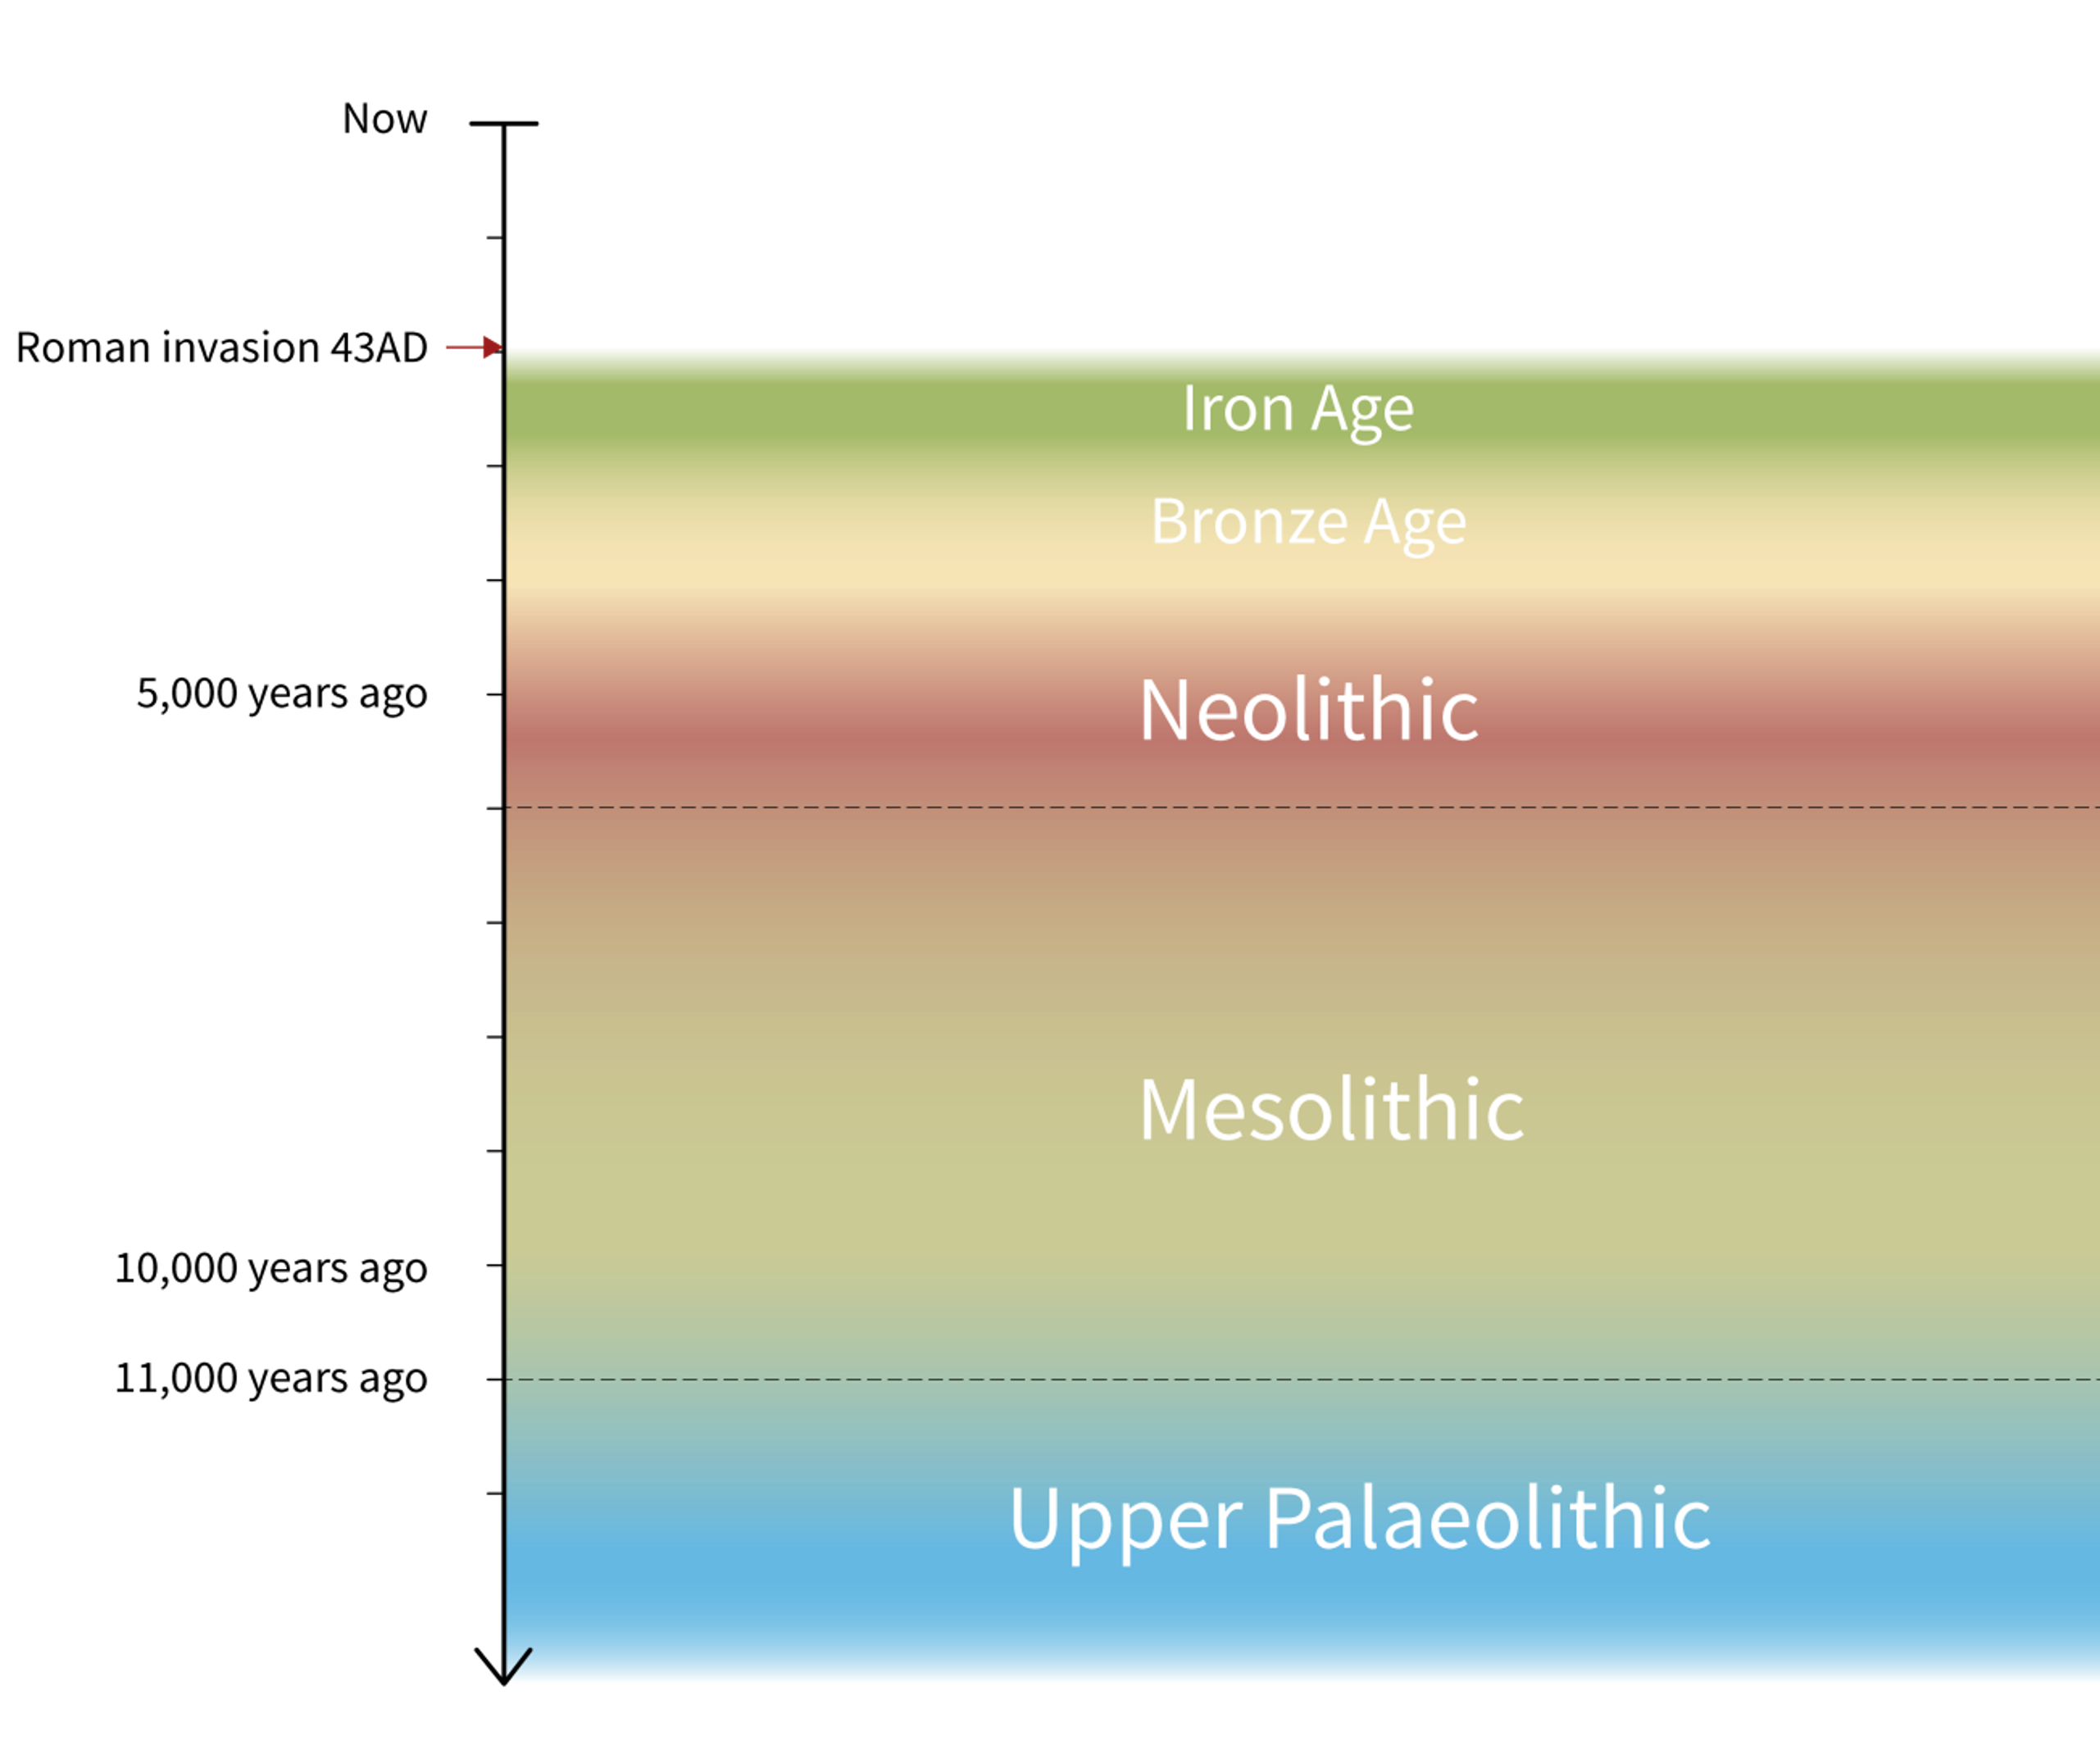
Stone Age to Iron Age Timeline – Iron Age in context
The Iron Age dates from the first appearance of iron in around 800 BC to the Roman invasion of AD 43.
Iron tools and weapons are found for the first time, but gold and other metals are still used for things like jewellery.
Towards the end of the period the first coins started to be made in Britain.
People lived in roundhouses like those of the Bronze Age, but settlements became bigger.
Some sites have evidence for defence, such as hillforts and brochs.
Stone Age to Iron Age Timeline

Slide 4
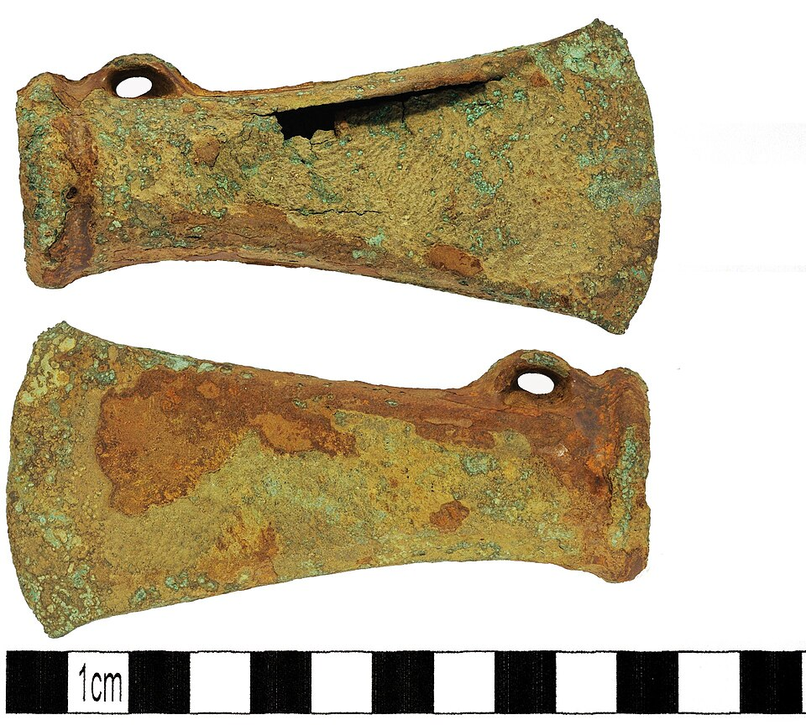
Metal working
Iron ore was easy to find across Britain, and archaeologists have found furnaces and lots of waste from melting iron, showing it was made in many places.
There is even more evidence of blacksmiths shaping iron into tools like axes, saws, chisels, and knives, as well as groups of blacksmith tools.
Bars of iron and other metal pieces show that people traded and moved iron around different areas.
Iron Axe Head
Notes:
IMAGE:
Iron Age, Socketed Axe Head. © The Portable Antiquities Scheme/ The Trustees of the British Museum, CC BY-SA 2.0, via Wikimedia Commons - https://commons.wikimedia.org/wiki/File:Iron_Age,_Socketed_Axe_Head,_(FindID_221126).jpg

Slide 5
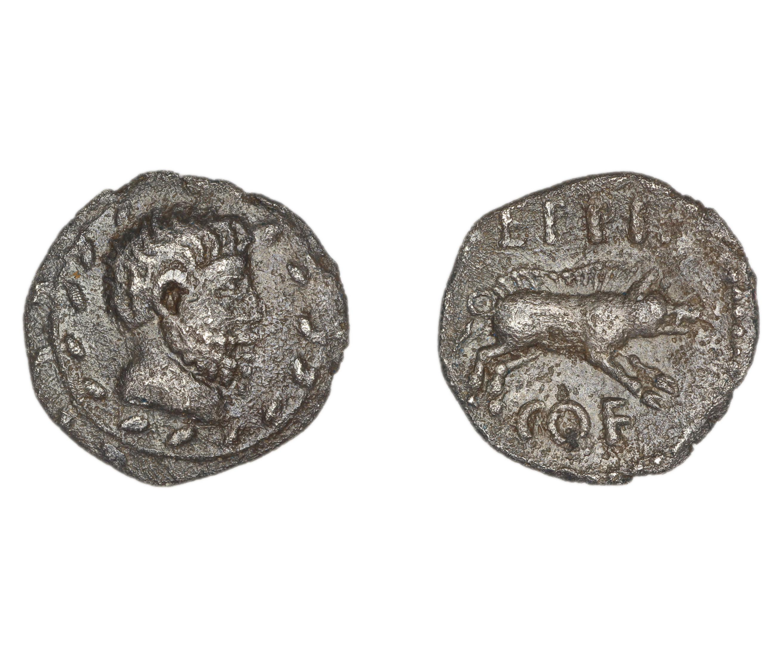
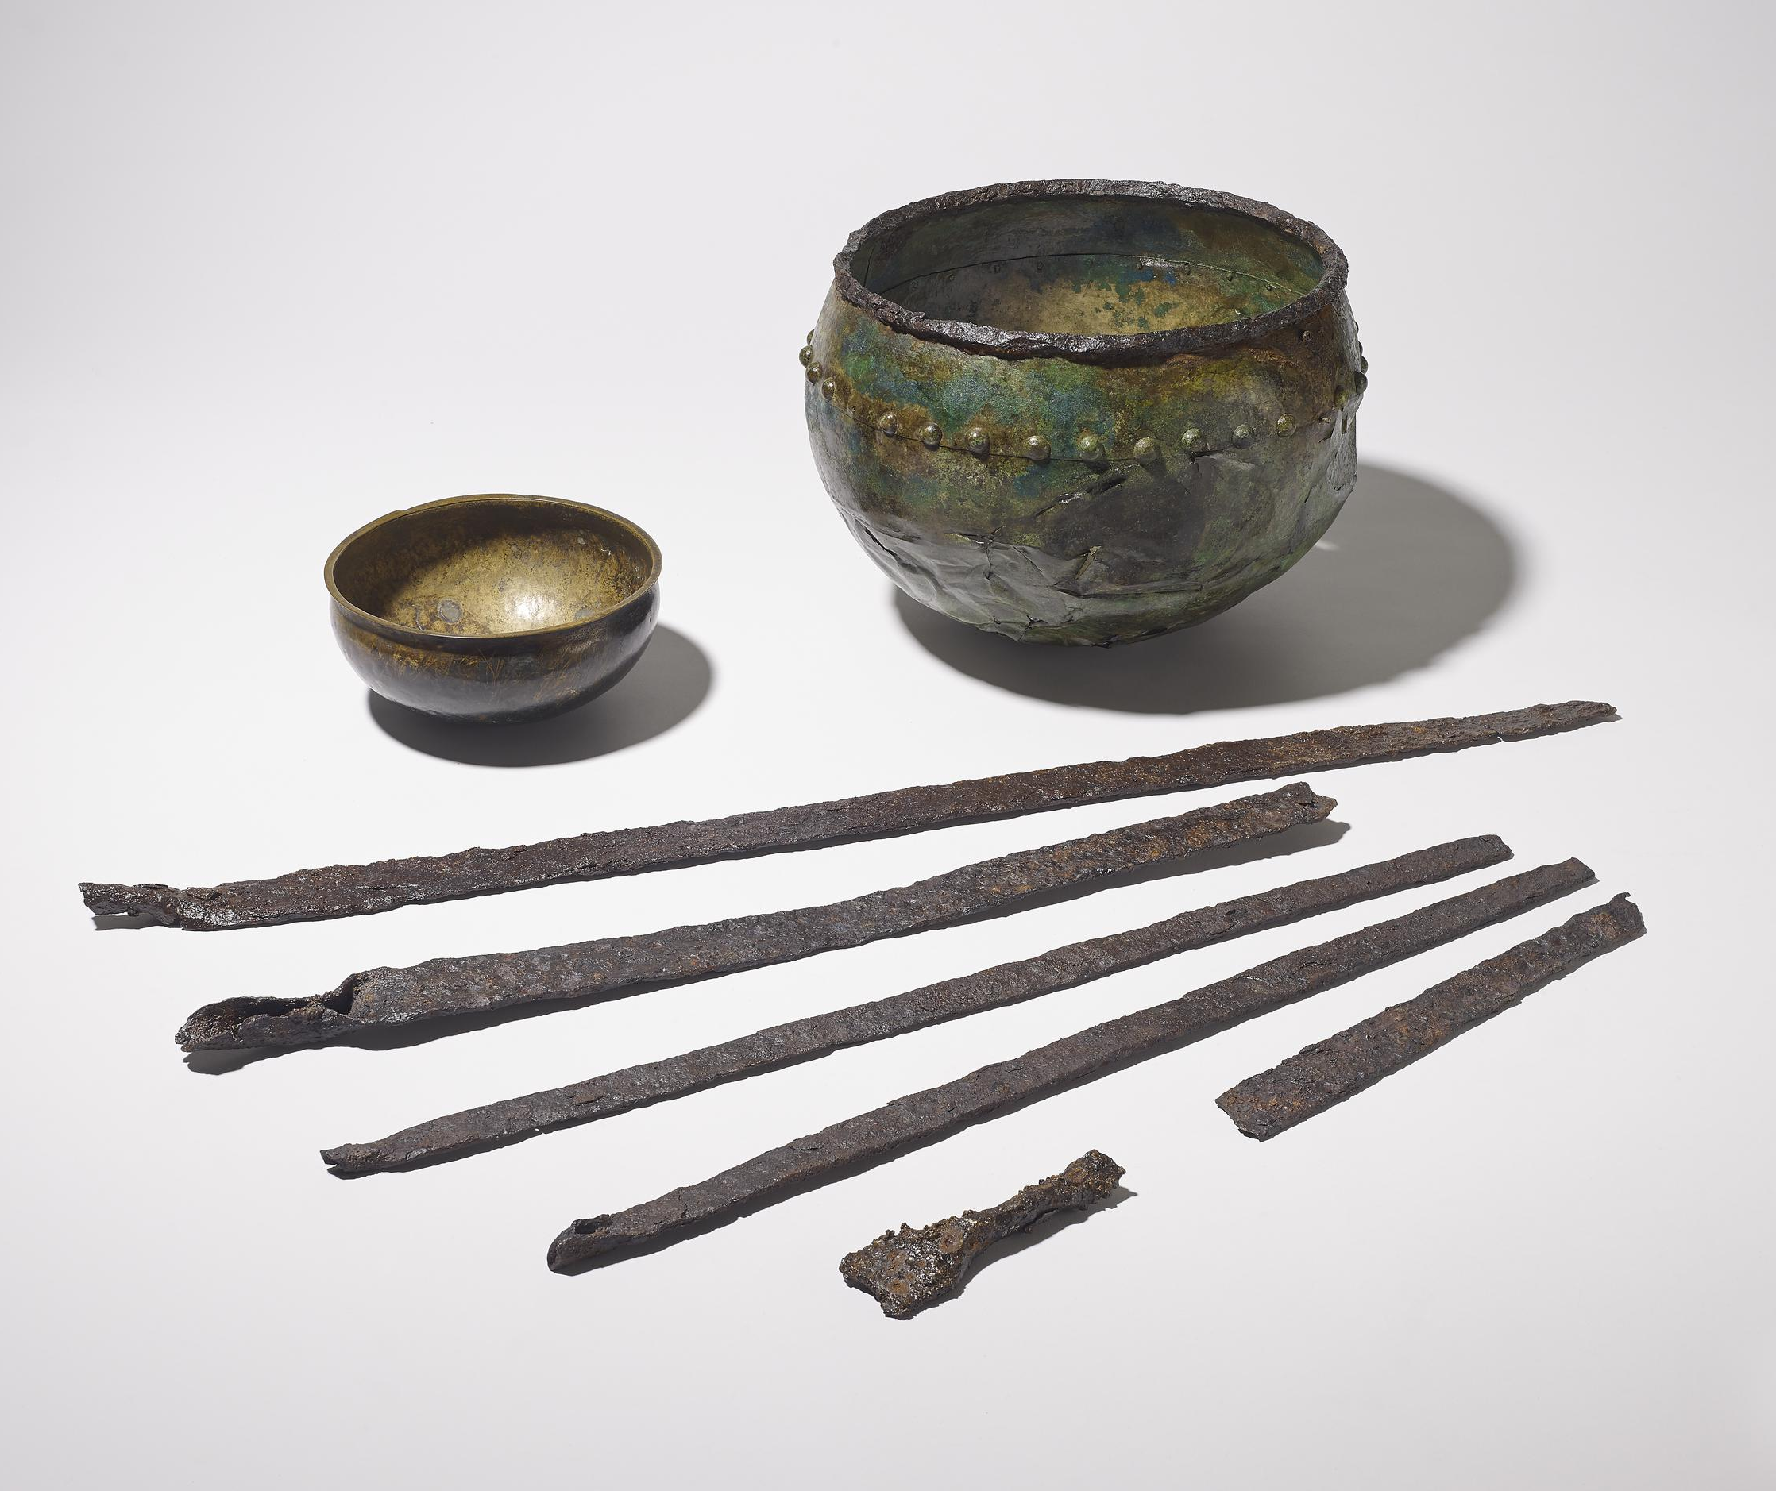
Metal working
Even though iron was now used the most, people still made things from brass and bronze (copper alloys).
Archaeologist have found lots of evidence for melting metal, and in some areas, people made these metals in large amounts.
Some places also made coins for the first time, especially in big towns.
New metal working techniques were added to Iron Age ones as Roman trade and influence increased.
Copper alloy cauldron and bowl with iron currency bars
Notes:
IMAGE:
Hoard of copper alloy cauldron and bowl and iron currency bars. © The Trustees of the British Museum. - https://www.britishmuseum.org/collection/object/H_1862-0627-1?selectedImageId=1613016329
Silver coin (whole), Bearded head within wreath, left Boar, right. Latin inscription ‘EPPI CO F’, meaning Eppillus, son of Commios. Eppilus was ruler of the Atrebates Tribe c 20-10 BC © The Trustees of the British Museum. - https://www.britishmuseum.org/collection/object/C_1988-0627-251

Slide 6
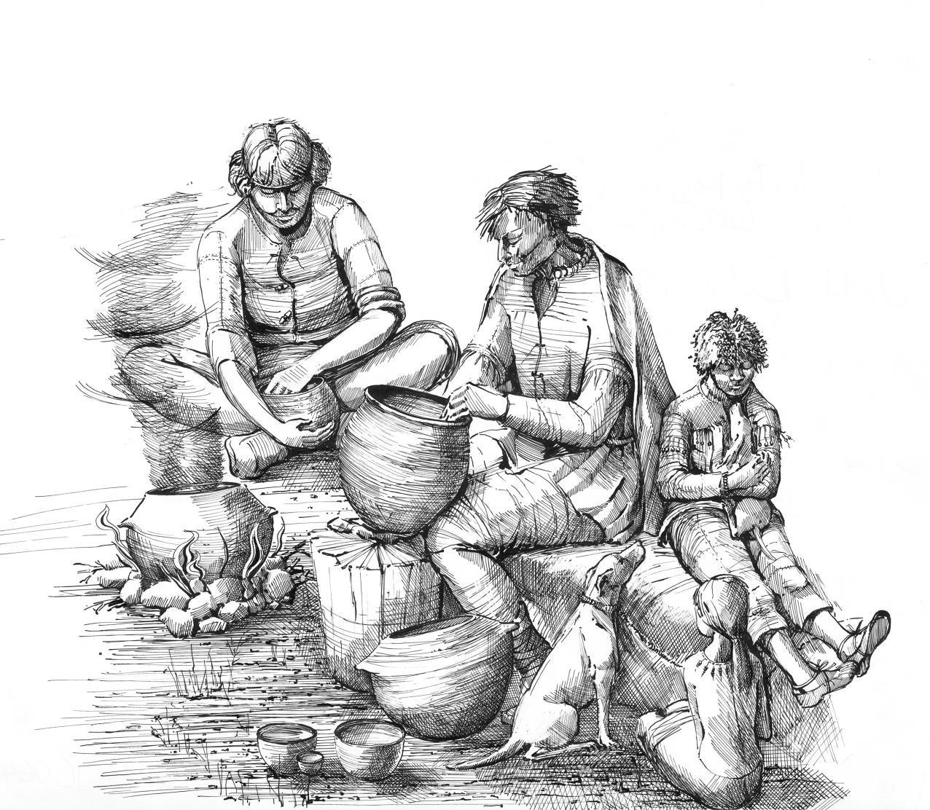
Pottery
Iron Age pottery in England was mostly handmade using coiling or slabs and fired at low temperatures.
Potters added materials like sand, shell, or flint to strengthen the clay and prevent cracking.
Archaeologists call the things added to the clay ‘temper’.
Early Iron Age pottery was simple, thick-walled, and mostly undecorated, continuing Bronze Age traditions.
Iron Age people making and using pottery
Notes:
IMAGE:
Reconstruction painting depicting Iron Age people as they may have appeared in everyday life at Maiden Castle hillfort © Historic England Archive. - https://historicengland.org.uk/images-books/photos/item/IC064/016

Slide 7
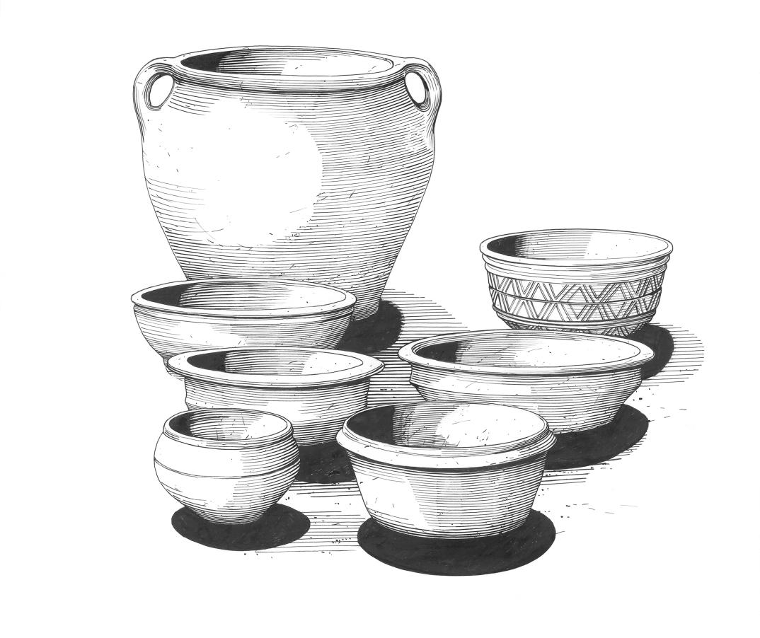
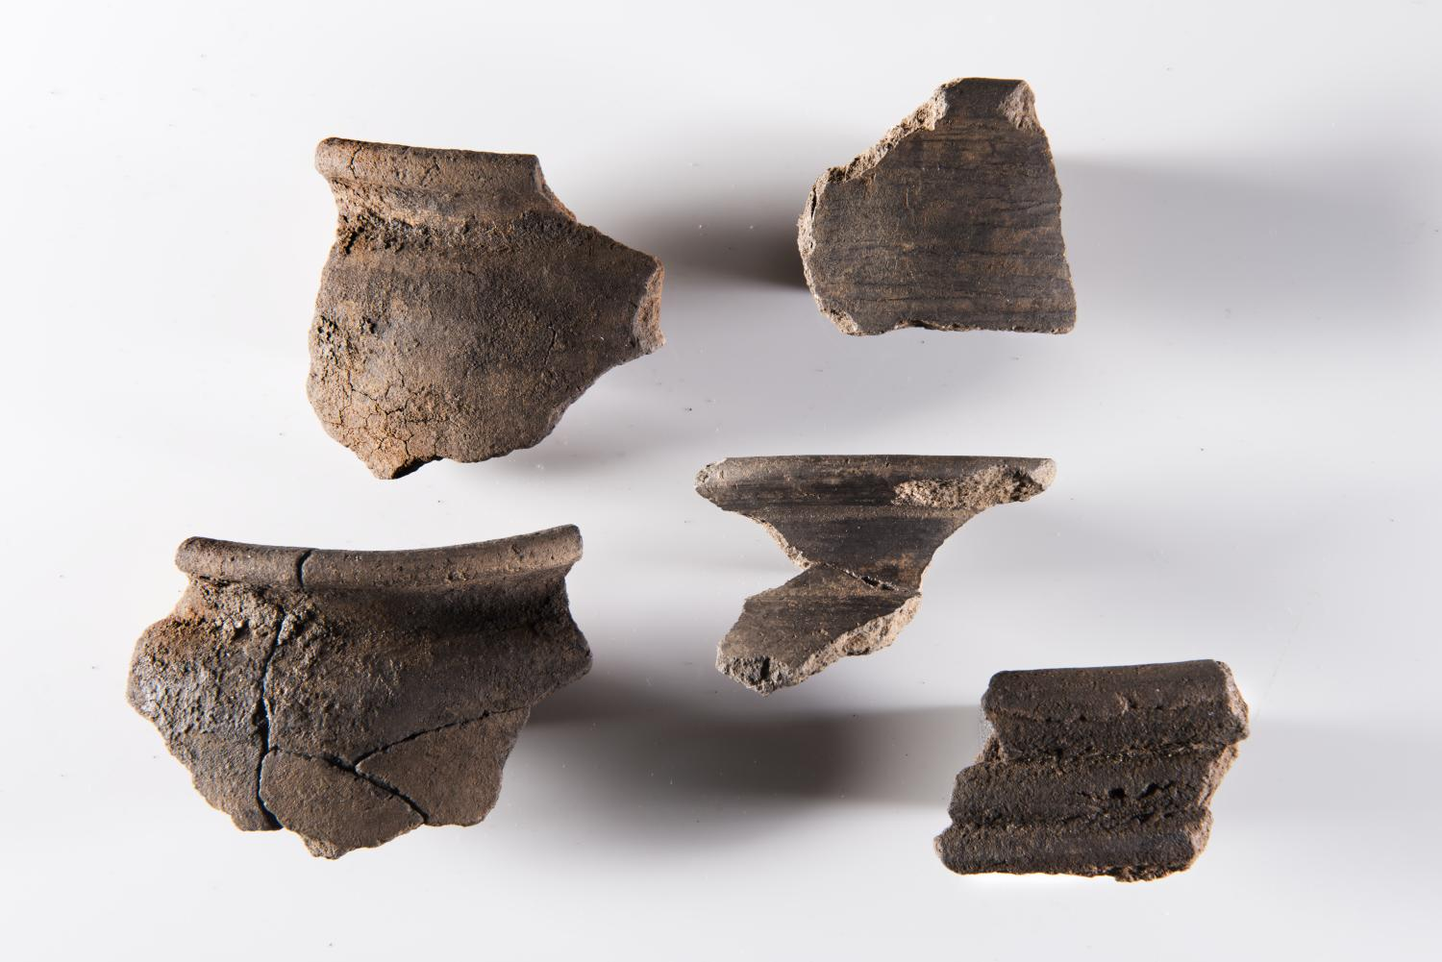
Pottery
During the Middle Iron Age, regional styles developed with new shapes and more decoration, including geometric patterns and ‘burnishing’ - rubbing the clay before it’s fired, to make it shiny.
In the Late Iron Age, the potter’s wheel was introduced from Europe, hugely changing the way pots were made.
An increase in imported pottery shows expanding trade and the beginnings of mass production before the Roman conquest.
Regional pottery from Chysauster Ancient Village, Cornwall
Notes:
IMAGE:
Illustration of pottery from Chysauster Ancient Village. © Historic England Archive. Ref: IC025/005 – https://historicengland.org.uk/images-books/photos/item/IC025/005
Detail of five rim sherds of Romano-British pottery from Houses 5 and 7 at Chysauster, held by the Royal Cornwall Museum. They include cooking and drinking pots – one of which is ‘burnished’ © Historic England Archive. Ref: DP181341 - https://historicengland.org.uk/images-books/photos/item/DP181341

Slide 8
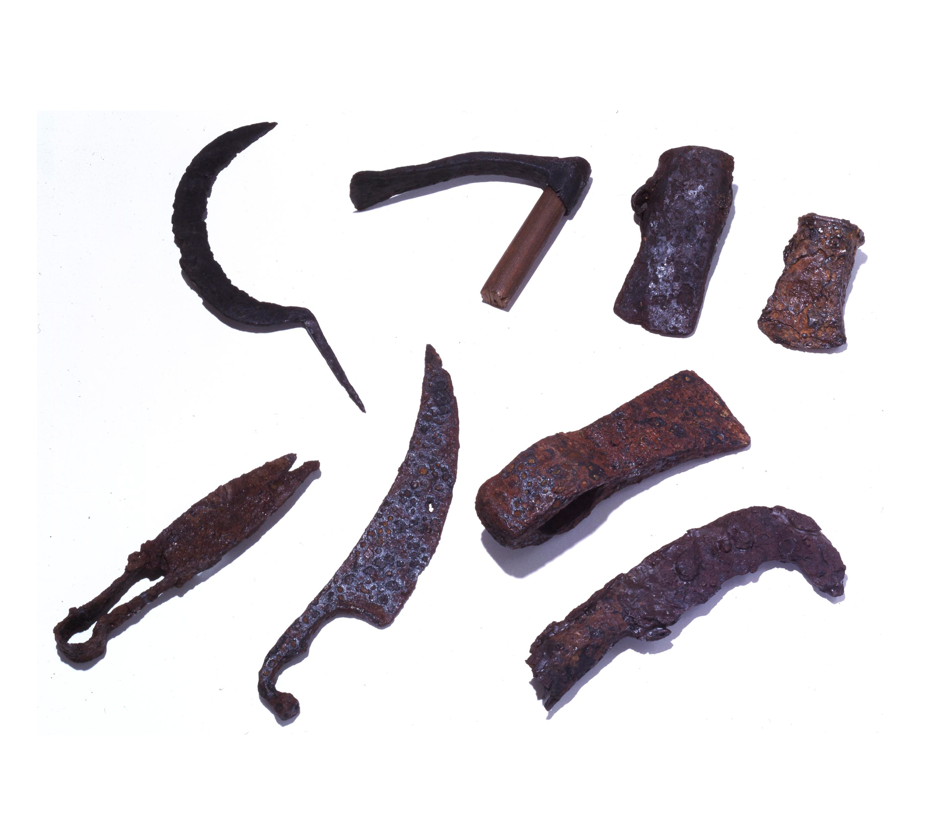
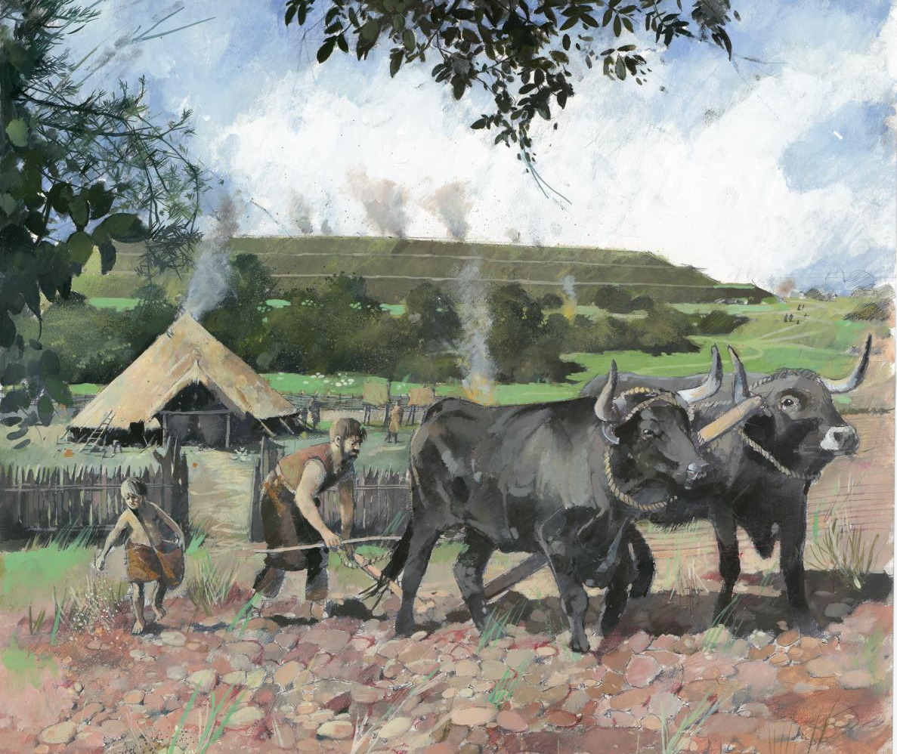
Farming
Farming improved greatly in the Iron Age with the use of iron-tipped ploughs. These made it quicker and easier to plough a field.
Iron could also be used to make other tools previously made from bronze, such as sickles, axes and shears.
‘Forged’ iron doesn’t make sharper or stronger tools than ‘cast’ bronze, but there was a lot more of it and it was easier to make and repair iron tools.
So, iron made metal ‘affordable’ to a much larger number or people.
Iron Age farming
Notes:
IMAGES:
Reconstruction painting showing a man ploughing a field with cattle and a young boy sowing seeds behind him, with roundhouses beyond and a view of Old Oswestry Hillfort in the distance © Historic England Archive Ref: IC073/004 - https://historicengland.org.uk/images-books/photos/item/IC073/004
Iron tools (clockwise from top left – sickle, adze, socket axes, billhook, axe, knife, sheers) © The Trustees of the British Museum. - https://www.britishmuseum.org/collection/object/H_1880-0802-119?selectedImageId=231636001

Slide 9
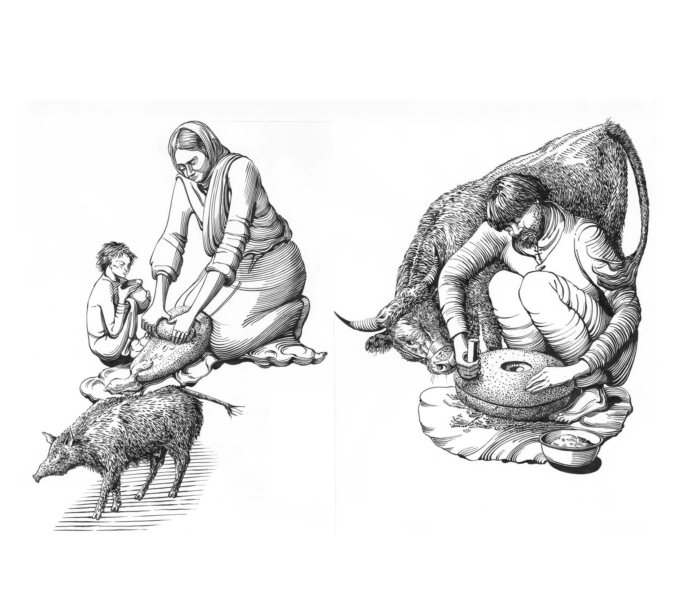
Farming
Technologies for processing crops or animal products also changed or became more easily available.
The new ‘rotary’ quern stones made it much quicker and easier to grind wheat into flour than the old type of ‘saddle’ querns. Though saddle querns were still used as well.
Archaeological evidence shows that Iron Age farmsteads were in areas that were under intensive arable cultivation.
Saddle
Quern
Rotary
Quern
Grinding Iron Age grain for flour
Notes:
IMAGES:
Reconstruction drawing showing an Iron Age woman using a saddle quern stone to grind grain into flour, watched by a child. © Historic England Archive Ref: IC022/005 - https://historicengland.org.uk/images-books/photos/item/IC022/005
Reconstruction drawing showing an Iron Age man using a rotary quern to grind grain into flour, watched by a cow. © Historic England Archive Ref: IC022/002 - https://historicengland.org.uk/images-books/photos/item/IC022/002

Slide 10
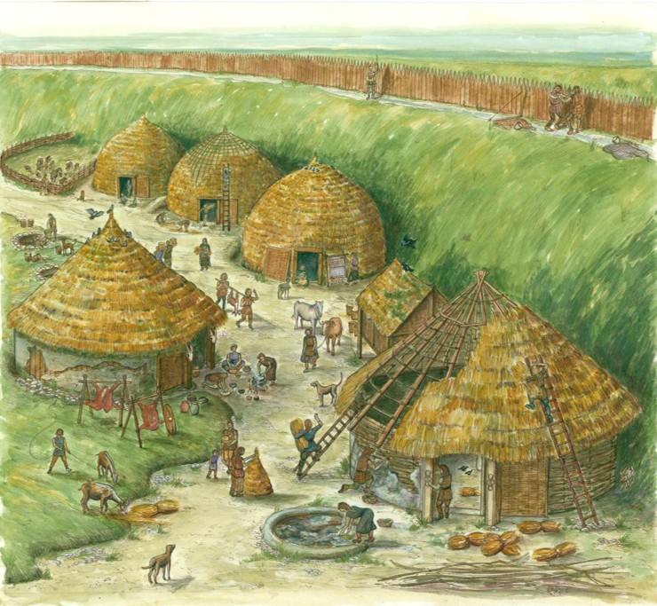
Hillforts
There are over 1,000 hillforts in England and Wales, usually built on hilltops and surrounded by ramparts.
Some were used for settlements, while others may only have been used occasionally, perhaps for special events, as a place of safety or for keeping animals.
Archaeologists disagree on whether they were mainly for defence or display, but building them required organisation, skills, labour, and leadership.
Danebury Hillfort, Hampshire
Notes:
IMAGE:
Reconstruction illustration showing everyday life in and around the round houses located in the quarry hollow below the rampart of Danebury Iron Age hillfort, as the scene may have appeared in the second century BC. © Historic England Archive Ref: IC030/003 - https://historicengland.org.uk/images-books/photos/item/IC030/003
LINK:
Video: Danebury Hill Fort – Hampshire County Council (5:17) - https://www.youtube.com/watch?v=Uu9bLT9I9fI

Slide 11
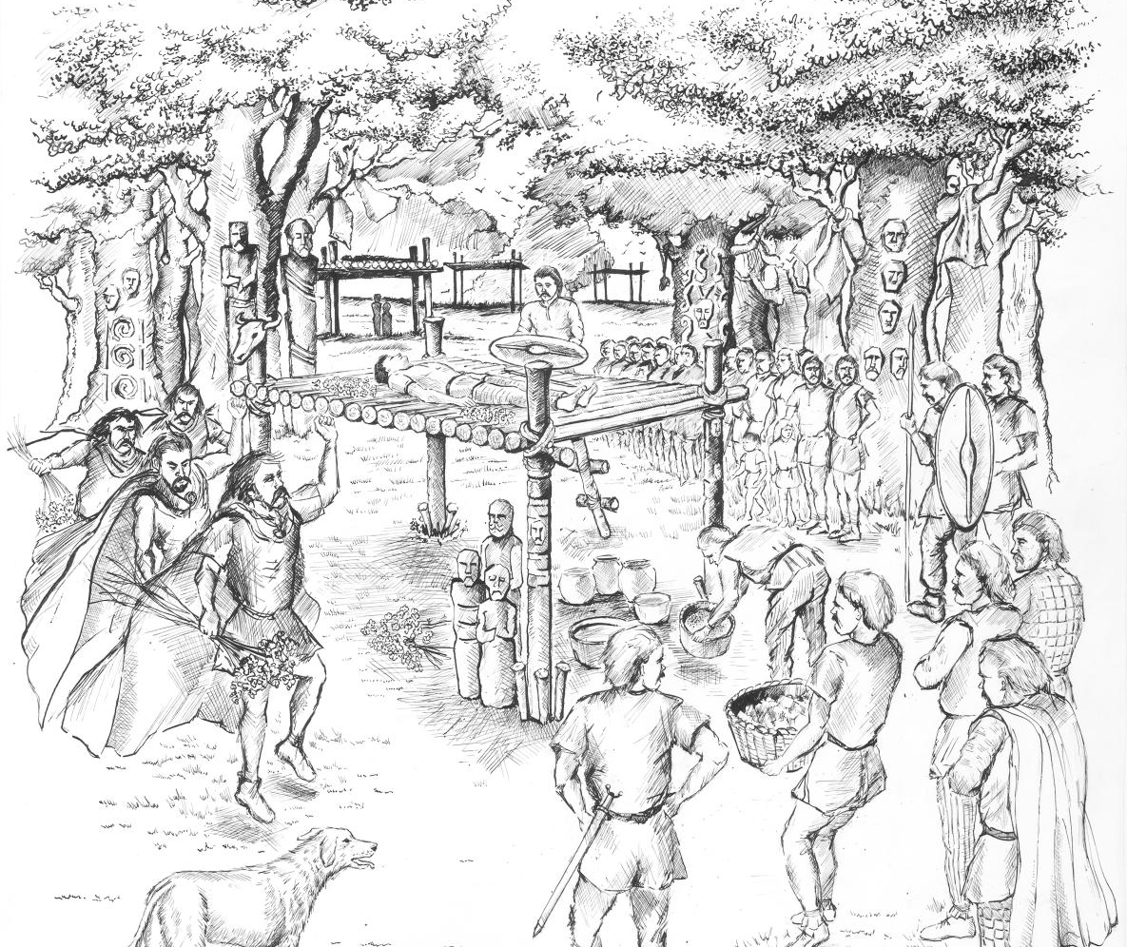
Death & Burial
Early and middle Iron Age Britain lacks cemeteries seen in earlier or later periods. The practice of excarnation is one possible explanation for this.
Excarnation is where a body is left exposed to the elements, allowing the fleshy parts to decay. It is sometimes called a ‘sky burial’.
However, some distinct regional burial traditions existed, such as square barrows.
Reconstruction of an Iron Age excarnation
Notes:
IMAGE:
Reconstruction illustration depicting an Iron Age excarnation in Britain © Historic England Archive Ref: IC129/004 - https://historicengland.org.uk/images-books/photos/item/IC129/004

Slide 12
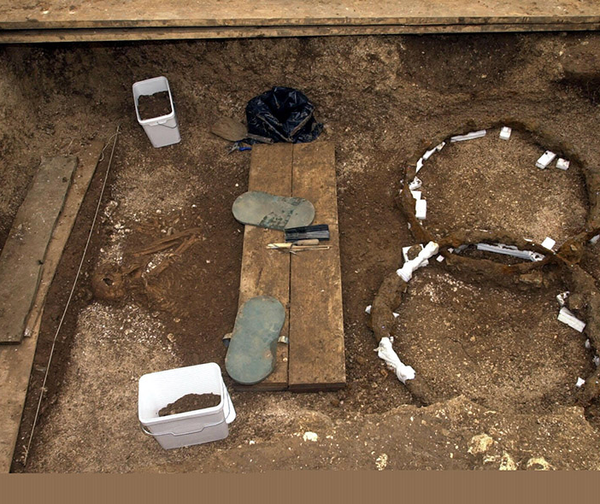
Death & Burial
Square barrows are Middle Iron Age burial monuments (c.500–50 BC), mainly found in Yorkshire between the Humber and North Yorkshire Moors.
They are square or rectangular earth mounds surrounded by ditches, usually covering centrally placed burials in grave pits.
The burials sometimes included grave goods, with the most elaborate, such as the ones at Wetwang, containing dismantled chariots.
Chariot burial at Wetwang, Yorkshire
Notes:
IMAGE:
The skeleton of what is thought to be a young tribal queen which was excavated at a site in the village of Wetwang, near York. The ancient burial site is thought to be the earliest of its kind ever found in Britain. * The skeleton of the queen, whose body had been placed in the third to fourth century BC grave with a dismantled state carriage reserved only for the elite, was found alongside decorative pieces of two horse harnesses.© Alamy Ref: G5ARD9 - https://www.alamy.com/stock-photo-the-skeleton-of-what-is-thought-to-be-a-young-tribal-queen-which-was-106573413.html
LINK:
More object in the British Museum online collection - https://www.britishmuseum.org/collection/object/H_2001-0401-20

Slide 13
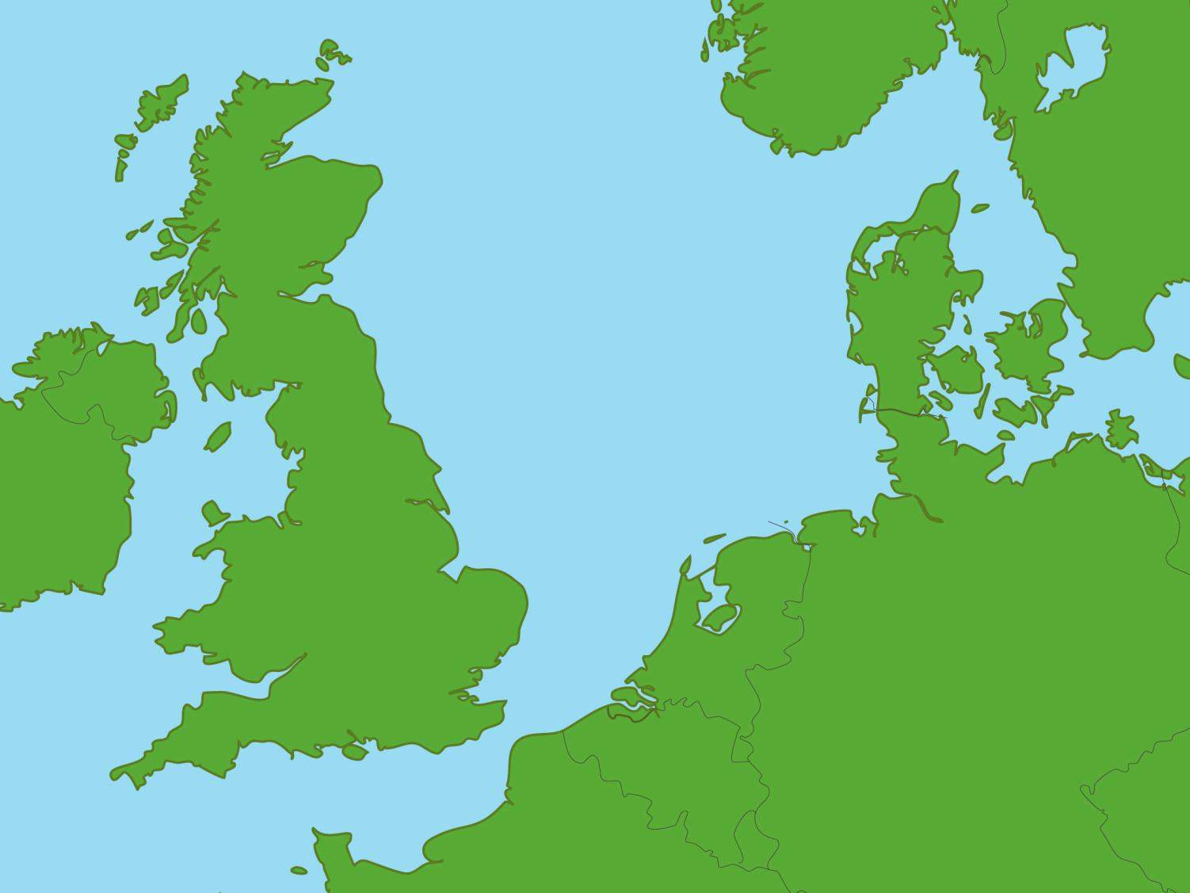
Map of Britain
Broch of Gurness
Click on the dots to learn about our Top 10 Iron Age sites
Wetwang
Lindow Moss
Hallaton
Snettisham
Glastonbury
Battersea
Uffington
Carn Euny
Maiden Castle

Slide 14
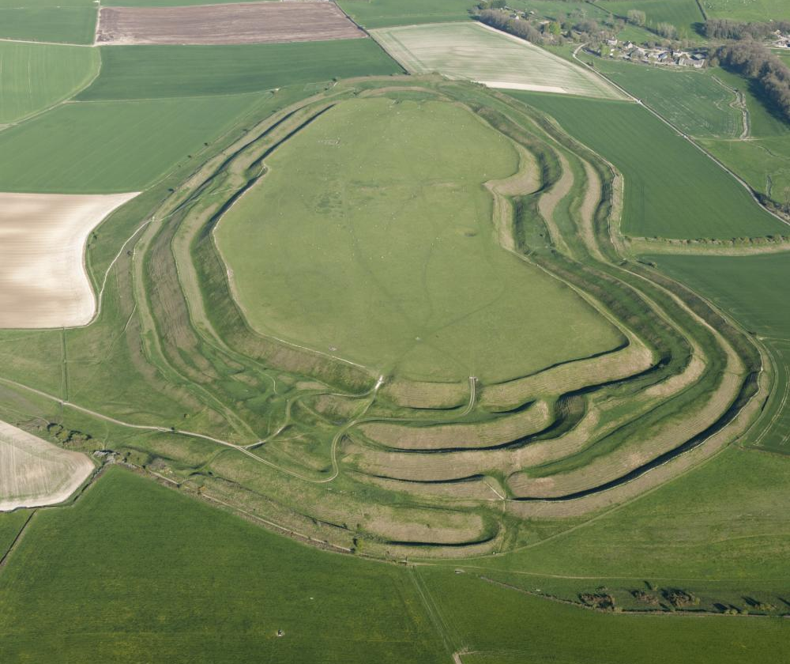
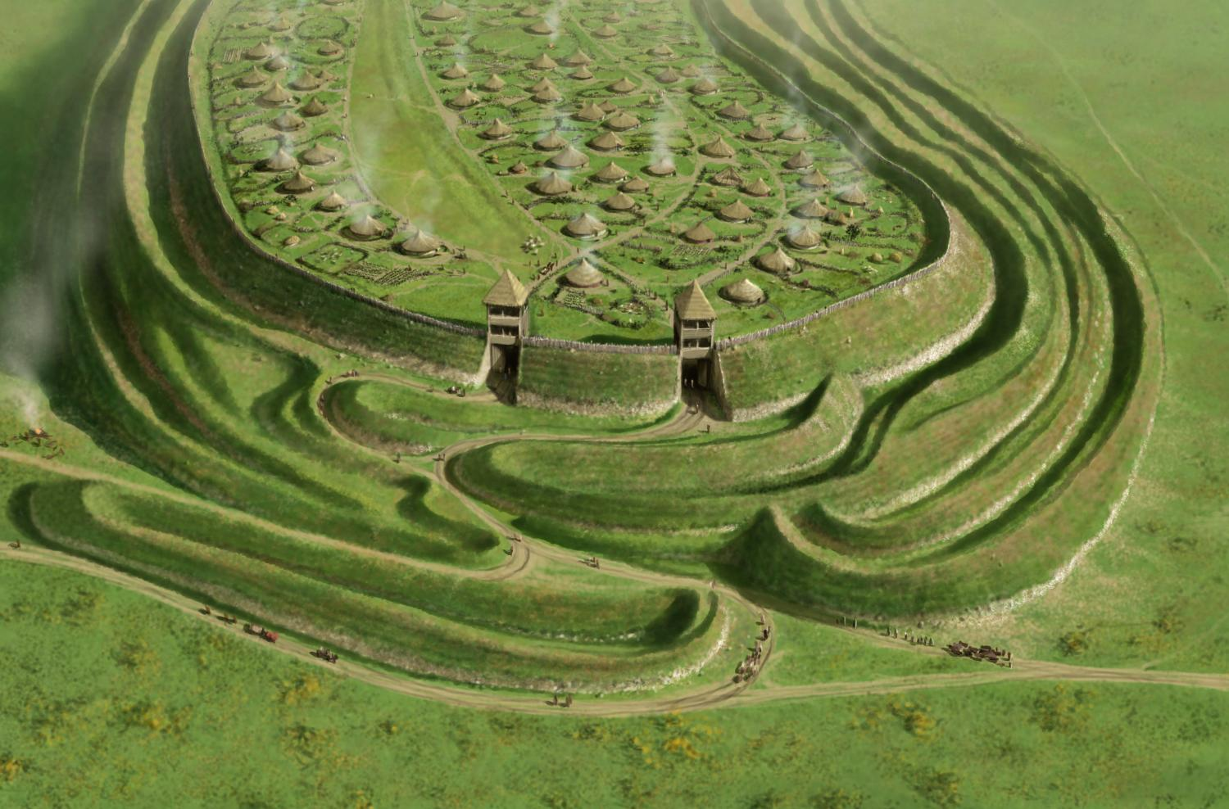
Maiden Castle, Dorset
Back to map
Maiden Castle is one of Europe’s largest Iron Age hillforts and is bigger than 50 football pitches.
It was built over earlier Neolithic and Bronze Age enclosures on the same hilltop.
It is surrounded by huge, hand-dug, defensive banks and ditches.
Building these complex defences began around 2,400 years ago and continued for about 300 years.
At its height, hundreds of people lived there.
Maiden Castle Iron Age Hillfort, Dorset
Notes:
IMAGES:
Aerial view of Maiden Castle Iron Age Hillfort. © Historic England Ref: 29548_016 - https://historicengland.org.uk/images-books/archive/collections/aerial-photos/record/29548_016
Oblique aerial reconstruction showing the western entrance of Maiden Castle in the middle Iron Age (400 –120 BC), the banks and ditches were formidable obstacles to attackers, but they may have been built for the purposes of display too, symbolizing the dominance and power of the hillfort community. © Historic England Archive Ref: IC064/021 https://historicengland.org.uk/images-books/photos/item/IC064/021
QUESTION:
Why might the Romans have attacked Maiden Castle?
LINK:
English Heritage – Maiden Castle History - https://www.english-heritage.org.uk/visit/places/maiden-castle/history/

Slide 15
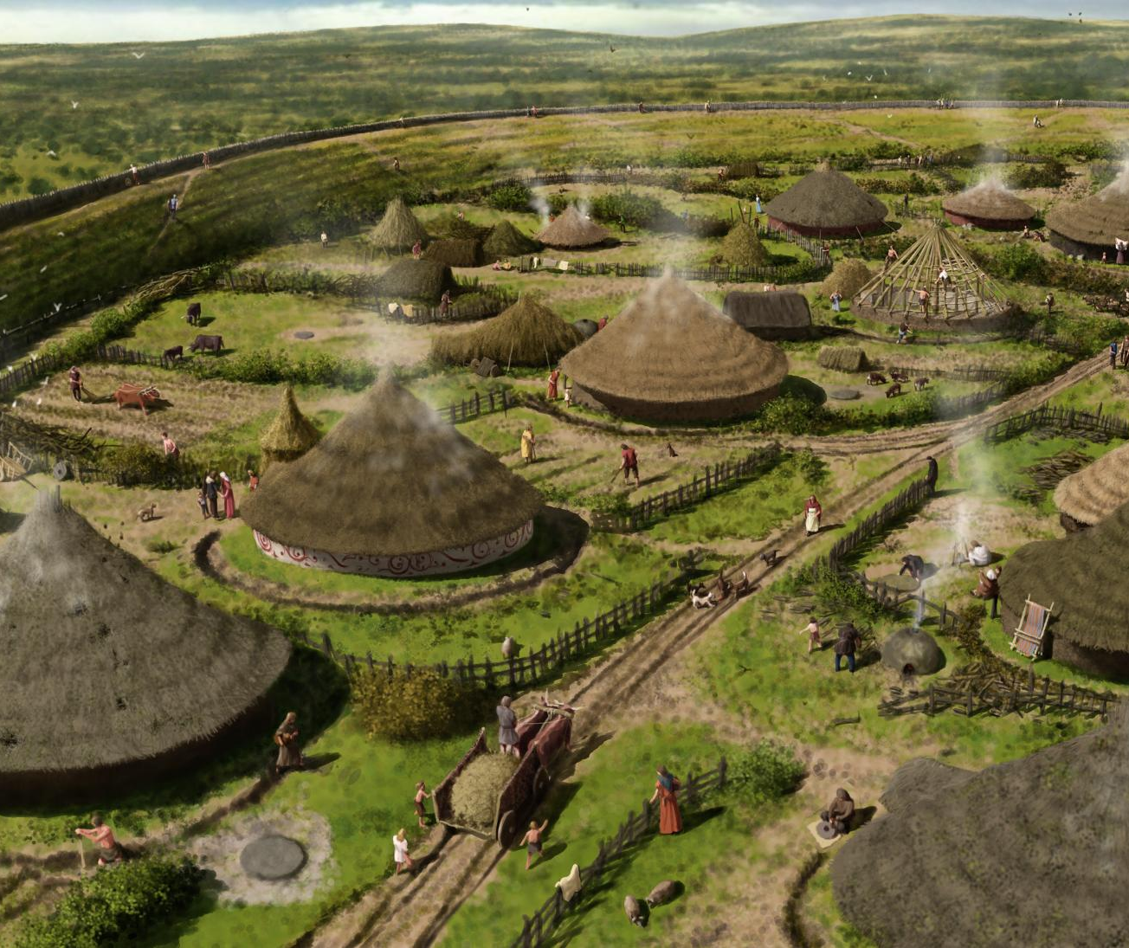
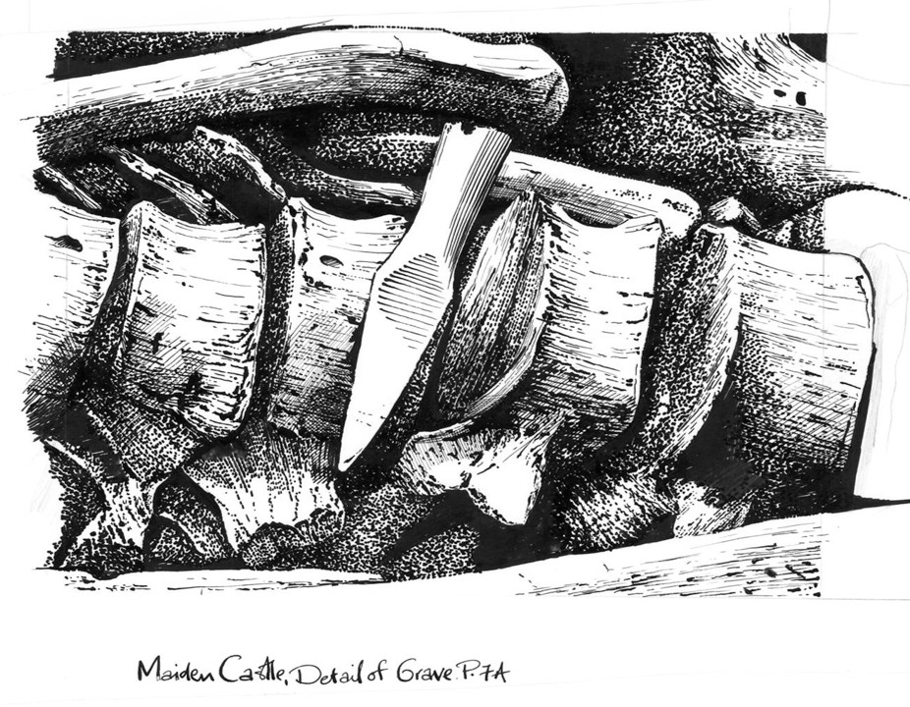
Maiden Castle, Dorset
Back to map
Maiden Castle was in use from the 4th century BC until the Roman conquest.
This reconstruction drawing shows how it might have looked in the middle Iron Age (400–120 BC), with over 100 round houses arranged in rows.
Fewer people lived there by the time the Romans arrived, but a small cemetery contains the bones of people who may have been killed fighting the Romans, including one skeleton with a catapult bolt in his spine.
QUESTION
Why might the Romans have attacked Maiden Castle?
Reconstruction drawing of Maiden Castle Iron Age Hillfort
Notes:
IMAGE:
A reconstruction drawing of Maiden Castle showing how the hillfort might have looked in the middle Iron Age (400–120 BC), with the houses arranged in rows. At the height of its occupation the site was densely populated and there were over 100 round houses within the defences © Historic England Archive Ref: IC064/022 - https://historicengland.org.uk/images-books/photos/item/IC064/022
Illustration showing a detail view of the Roman arrowhead or ballista bolt lodged in the spine of the skeleton from grave P7A in the 'War Cemetery' at Maiden Castle. © Historic England Archive Ref: IC064/007 - https://historicengland.org.uk/images-books/photos/item/IC064/007
QUESTION: Why might the Romans have attacked Maiden Castle?
LINK: English Heritage – Maiden Castle History - https://www.english-heritage.org.uk/visit/places/maiden-castle/history/

Slide 16
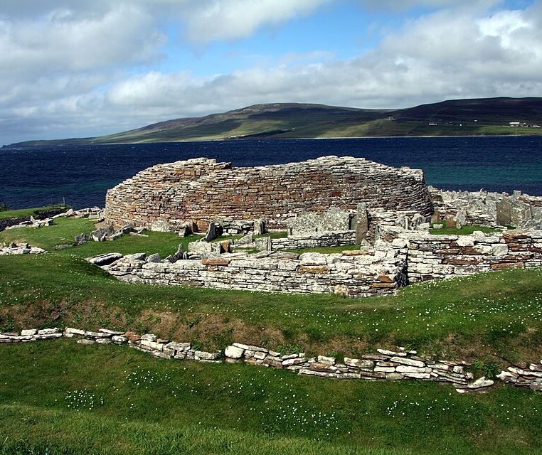
Broch of Gurness, Orkney
Back to map
In western Scotland, hillforts were not built in the Iron Age. Instead defended settlements with towers are found, they are called brochs.
The Broch of Gurness in Orkney is one of the best-preserved examples of this type of settlement.
The village began after 500 BC and was abandoned after AD 100.
It covered an area 45m in diameter and was surrounded by deep ditches and ramparts.
Broch of Gurness, Orkney
Notes:
IMAGE:
Broch of Gurness in summer 2012. © Chmee2, CC BY-SA 3.0, via Wikimedia Commons - https://commons.wikimedia.org/wiki/File:Broch_of_Gurness_in_summer_2012_(22).JPG
Reconstruction drawing showing an Iron Age man using a rotary quern to grind grain into flour, watched by a cow. © Historic England Archive Ref: IC022/002 - https://historicengland.org.uk/images-books/photos/item/IC022/002
QUESTION:
Why do you think some people lived in the broch tower and some people lived in the village?
What later type of building does the description of a broch sound like?

Slide 17
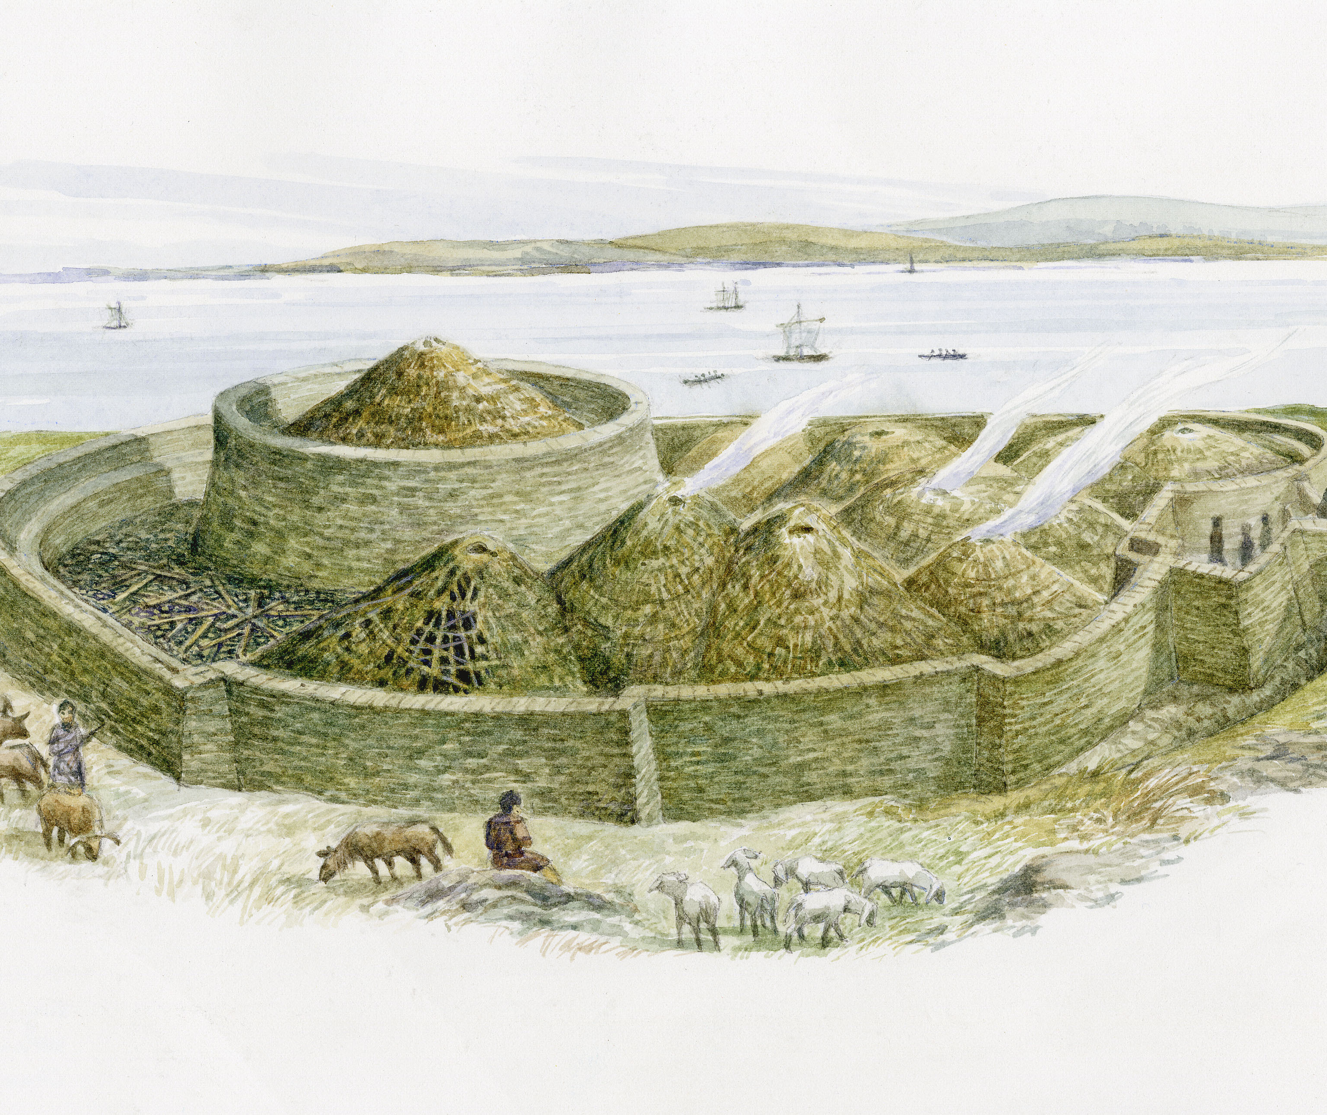
Broch of Gurness, Orkney
Back to map
A circular tower was later surrounded by stone houses with yards and sheds.
The tower was at least 8m tall and 20m in diameter inside. The walls were up to 4m thick.
The houses have a large central room with a central fire and stone furniture. There was also a well for fresh water.
The broch tower was probably the home of an important farming family.
No one knows exactly why the Broch was abandoned in 100AD.
QUESTION
Why do you think some people lived in the broch tower and some people lived in the village?
What later type of building does the description of a broch sound like?
Broch of Gurness, Orkney
Notes:
IMAGE:
Gurness Broch. © Historic Environment Scotland.
QUESTION:
Why do you think some people lived in the broch tower and some people lived in the village?
What later type of building does the description of a broch sound like?

Slide 18
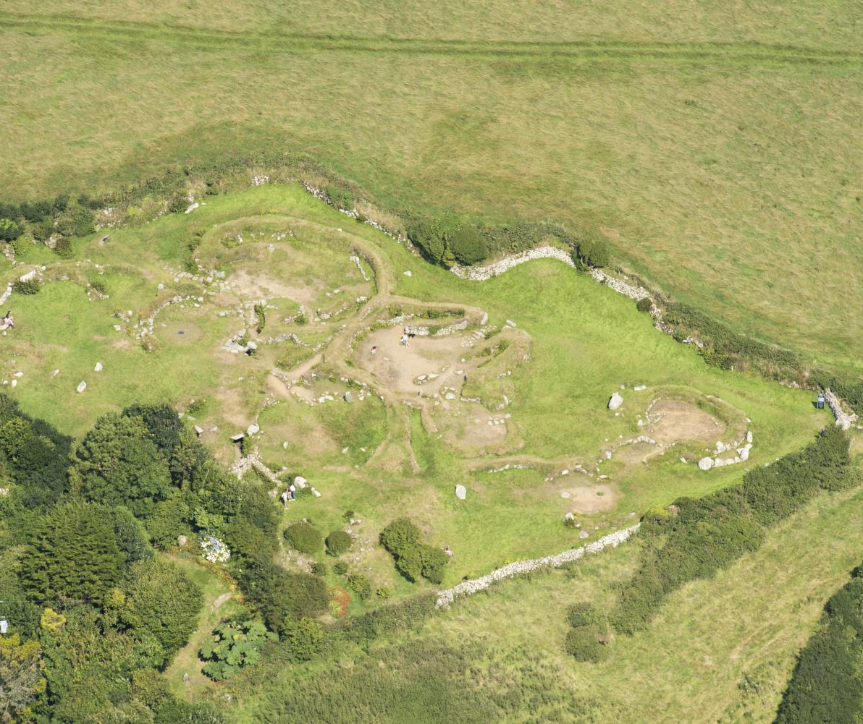
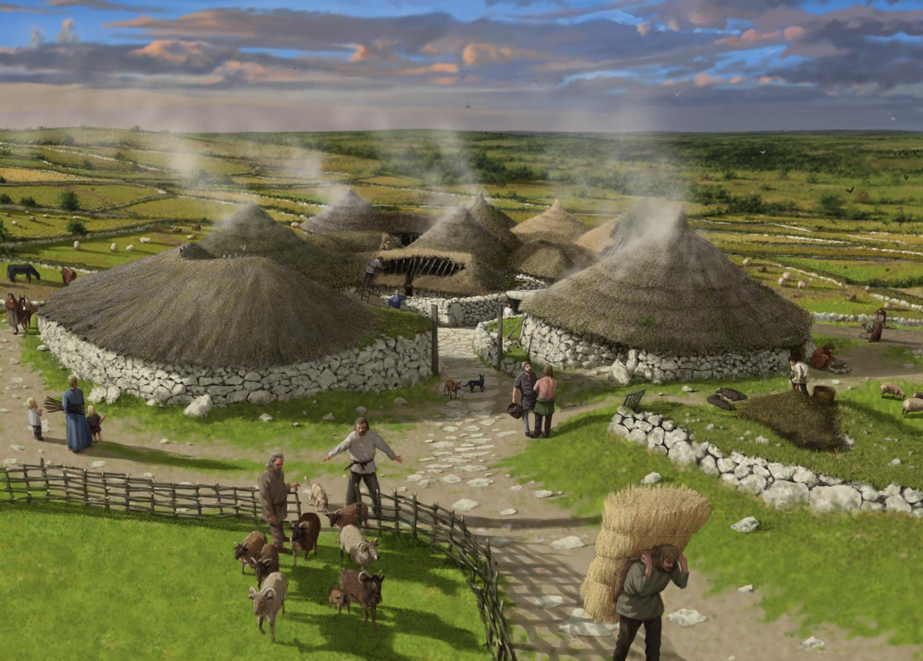
Carn Euny, Cornwall
Back to map
Carn Euny is an Iron Age village in Cornwall. It was lived in for about 500 years, from the 5th century BC.
People lived in roundhouses with stone foundations but walls made from woven wood panels covered in clay (‘wattle and daub’), and thatched roofs supported by wooden posts.
As well as the stone remains, you can also see drainage gullies and holes for the wooden posts that supported the roofs.
Carn Euny, Cornwall
Notes:
IMAGE:
Aerial view of Carn Euny ancient village © Historic England Ref: 33205_003 - https://historicengland.org.uk/images-books/archive/collections/aerial-photos/record/33205_003
Reconstruction drawing of Carn Euny Ancient Village in the Romano-British period, looking towards the entrance of House 1. © Historic England Archive Ref: IC022/008 - https://historicengland.org.uk/images-books/photos/item/IC022/008
QUESTION:
What do you think the fogou was used for?
LINK:
English Heritage – Carn Euny History - https://www.english-heritage.org.uk/visit/places/carn-euny-ancient-village/history/

Slide 19
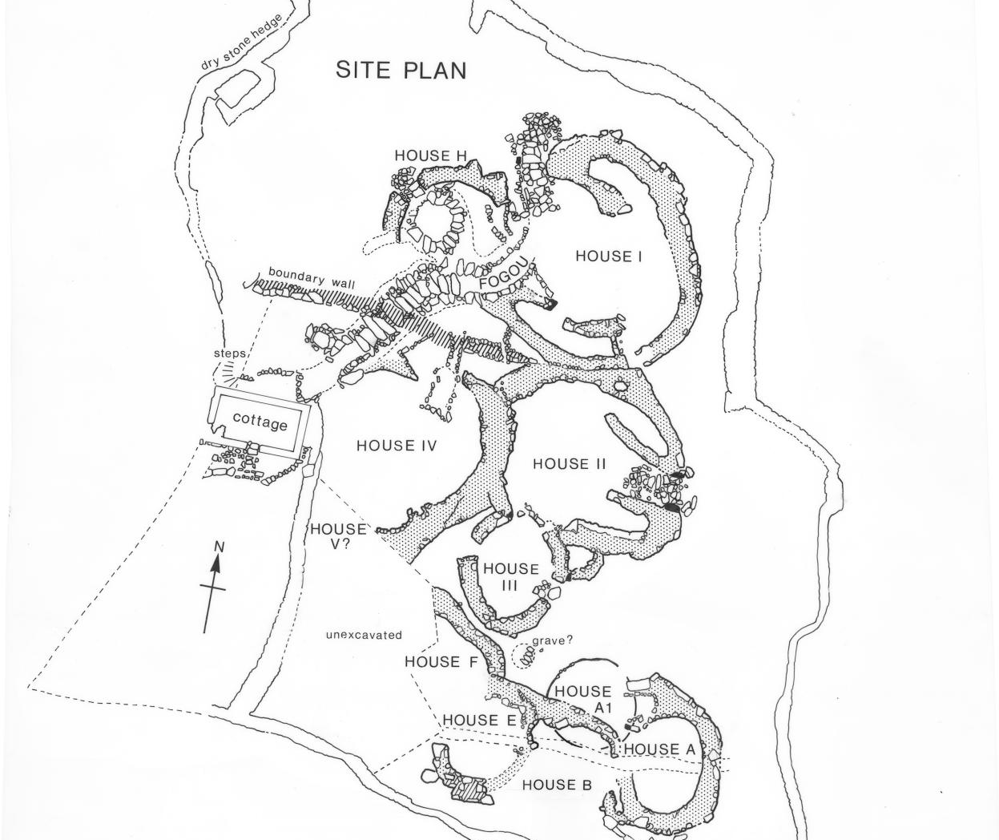
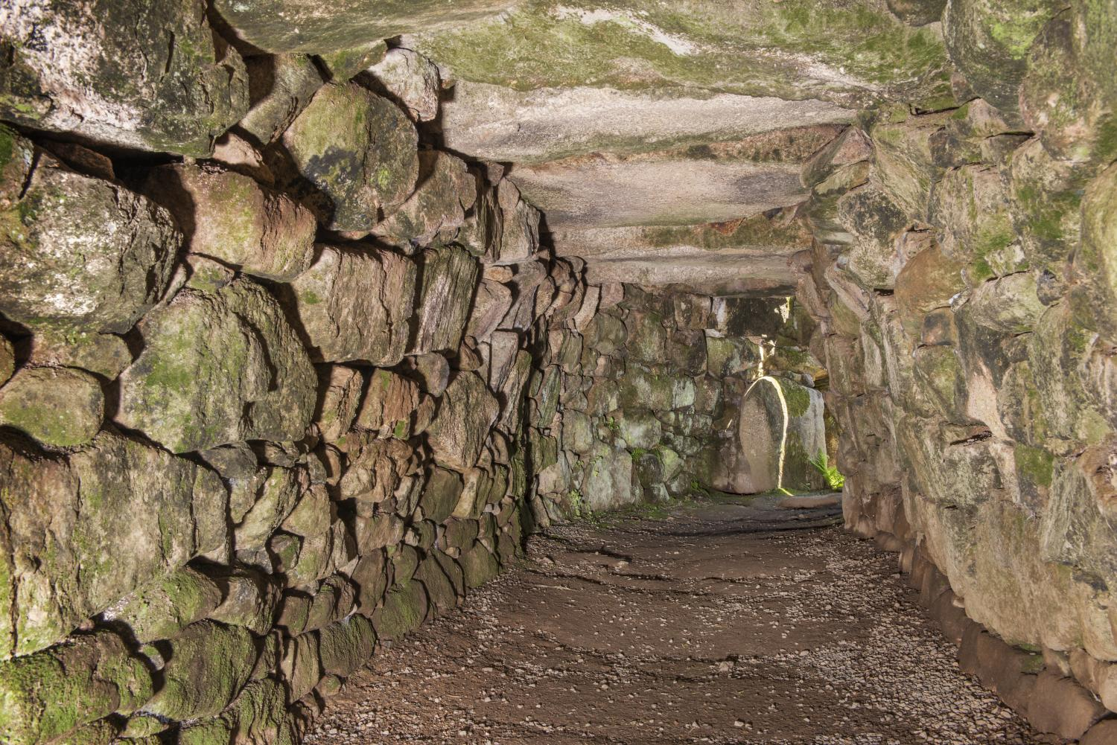
Carn Euny, Cornwall
Back to map
Carn Euny is unusual because of a well-preserved underground stone tunnel known as a ‘fogou’, which is roofed with large stone slabs.
We do not know what the tunnel was used for. It might have been for storage, or to hide in, or for special ceremonies.
Similar underground tunnels are found at Iron Age settlements in other parts of northwest Europe.
QUESTION
What do you think the fogou was used for?
Fogou at Carn Euny, Cornwall
Notes:
IMAGE:
Labelled site plan of Carn Euny ancient village © Historic England Ref: MP/CUV0036 - https://historicengland.org.uk/images-books/photos/item/MP/CUV0036
Interior view of a fogou on the ancient village site, looking along a passage from the west © Historic England Archive Ref: DP181532 - https://historicengland.org.uk/images-books/photos/item/DP181532
QUESTION:
What do you think the fogou was used for?
LINK:
English Heritage – Carn Euny History - https://www.english-heritage.org.uk/visit/places/carn-euny-ancient-village/history/

Slide 20
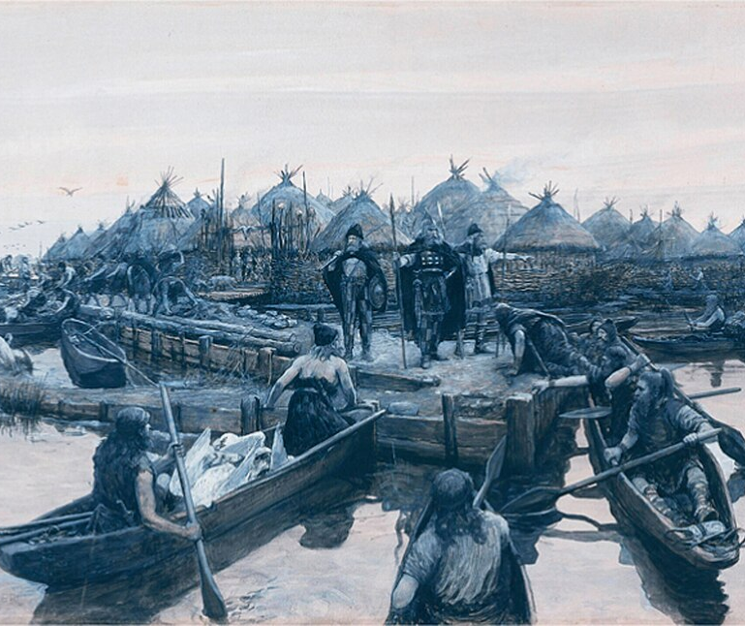
Glastonbury Lake Village, Somerset
Back to map
Glastonbury Lake Village was an Iron Age settlement in Somerset, occupied from about 250 to 80 BC.
Although called a “lake village,” it actually stood on raised ground within a swamp of reeds, waterways, and woodland, providing natural protection and access to resources.
The village had up to 14 roundhouses at any one time with about 200 people who farmed sheep and crops, while also fishing and hunting using canoes.
Reconstruction of Glastonbury Lake Village, Somerset
Notes:
IMAGE:
Glastonbury Lake Village landing stage by Forestier 1911 © A Forestier, Public domain, via Wikimedia Commons - https://commons.wikimedia.org/wiki/File:Glastonbury_Lake_Village_langing_stage_by_Forestier_1911.jpg
QUESTION:
If archaeologists excavated your house, what would they find?
LINK:
Glastonbury Lake Village History with videos - https://avalonmarshes.org/heritage/glastonbury-lake-village/
Lots more images - https://commons.wikimedia.org/wiki/Category:Glastonbury_Lake_Village

Slide 21
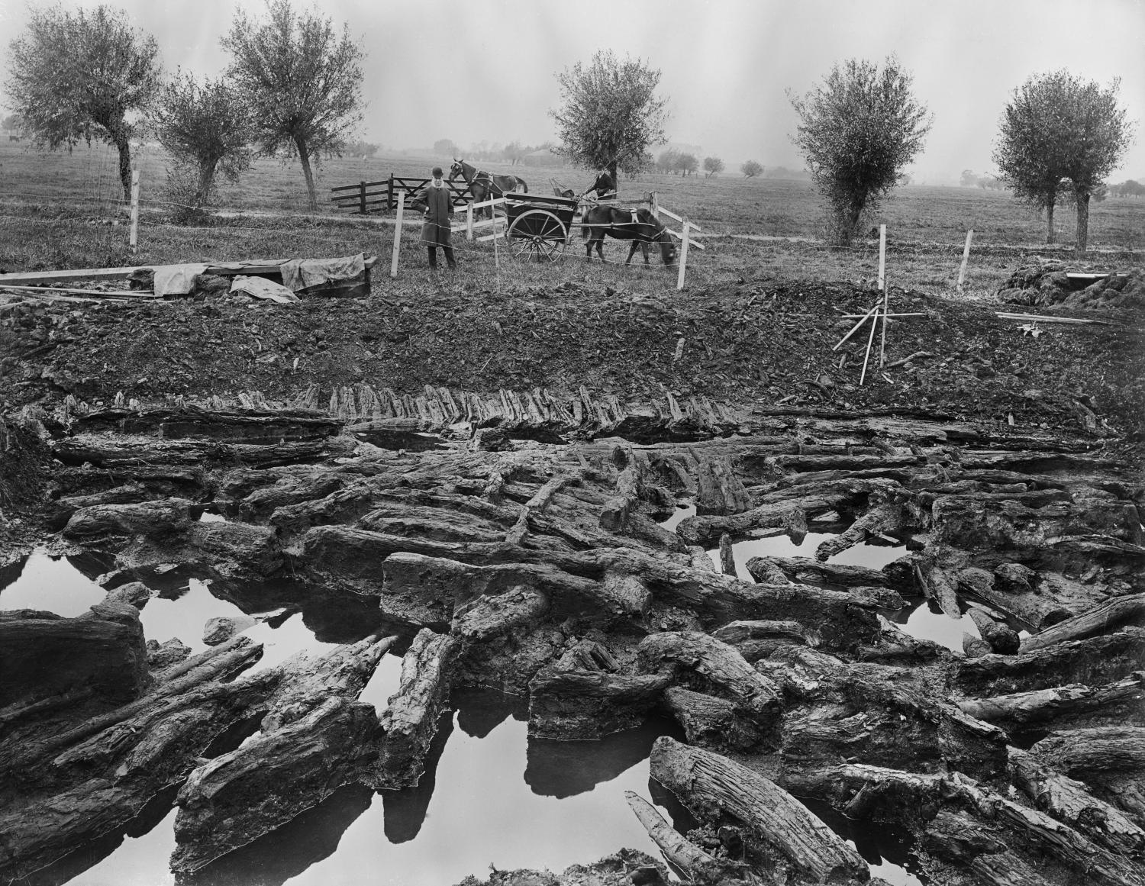
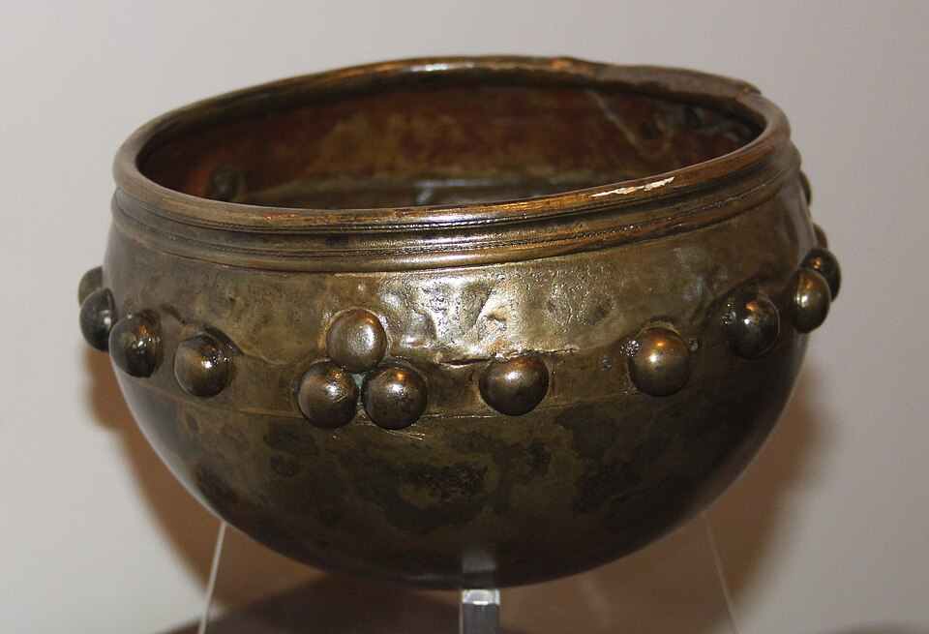
Glastonbury Lake Village, Somerset
Back to map
Archaeologists found wooden houses, fences, a landing stage, and many everyday objects, including tools, pottery, baskets, and items for weaving and metalworking.
One exceptional find was a bronze bowl with decorative studs, so good that it was included in A History of the World in 100 objects.
These finds show a skilled, self-sufficient community involved in craft production, trade, farming, and varied daily activities.
Glastonbury Lake Village, Somerset
Notes:
IMAGE:
Glastonbury Lake Village when it was first excavated in 1907. © Historic England Archive Ref:BB72/02822 - https://historicengland.org.uk/images-books/photos/item/BB72/02822
Glastonbury Bowl. Rodw, CC BY-SA 4.0, via Wikimedia Commons - https://commons.wikimedia.org/wiki/File:Glastonbury_Bowl_10.JPG
QUESTION:
If archaeologists excavated your house, what would they find?
LINK:
Glastonbury Lake Village History with videos - https://avalonmarshes.org/heritage/glastonbury-lake-village/
Lots more images - https://commons.wikimedia.org/wiki/Category:Glastonbury_Lake_Village

Slide 22
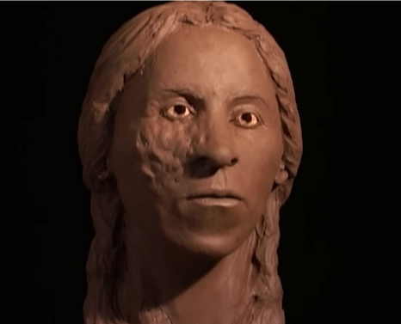
Wetwang, Yorkshire
Back to map
In 2001, an Iron Age chariot burial was discovered in a Square Barrow at Wetwang in Yorkshire.
Although only metal parts of the chariot survived, archaeologists were able to work out what it looked like. They based the wheels on examples from Glastonbury Lake Village.
The burial belonged to a woman aged around 35–45 who lived about 2300 years ago (c200 BC). She was unusually tall for the period and had a facial disfigurement.
Excavating the Chariot burial at Wetwang, Yorkshire
Notes:
IMAGES:
The skeleton of what is thought to be a young tribal queen which was excavated at a site in the village of Wetwang, near York. The ancient burial site is thought to be the earliest of its kind ever found in Britain. * The skeleton of the queen, whose body had been placed in the third to fourth century BC grave with a dismantled state carriage reserved only for the elite, was found alongside decorative pieces of two horse harnesses.© Alamy Ref: G5ARD9 - https://www.alamy.com/stock-photo-the-skeleton-of-what-is-thought-to-be-a-young-tribal-queen-which-was-106573413.html
Screenshot of reconstructed face with disfigurement taken from ‘Who Was The Mysterious 'Chariot Queen' That Stunned Archaeologists? | BBC Timestamp’ - https://youtu.be/pWZElie-tDE?si=mPUL5w-3GNd4aN84
QUESTION:
Why do you think the Wetwang Slack lady was buried with these things?
LINK:
Video - Who Was The Mysterious 'Chariot Queen' That Stunned Archaeologists? | BBC Timestamp (plays from 1:45) - https://youtu.be/pWZElie-tDE?list=PLPItERt69I2rTMUWK2SmGKSCBbsrZZNGM&t=105
https://www.britishmuseum.org/collection/object/H_2001-0401-20

Slide 23
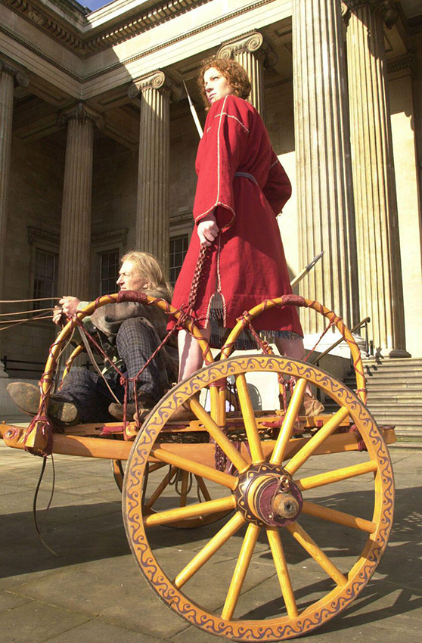
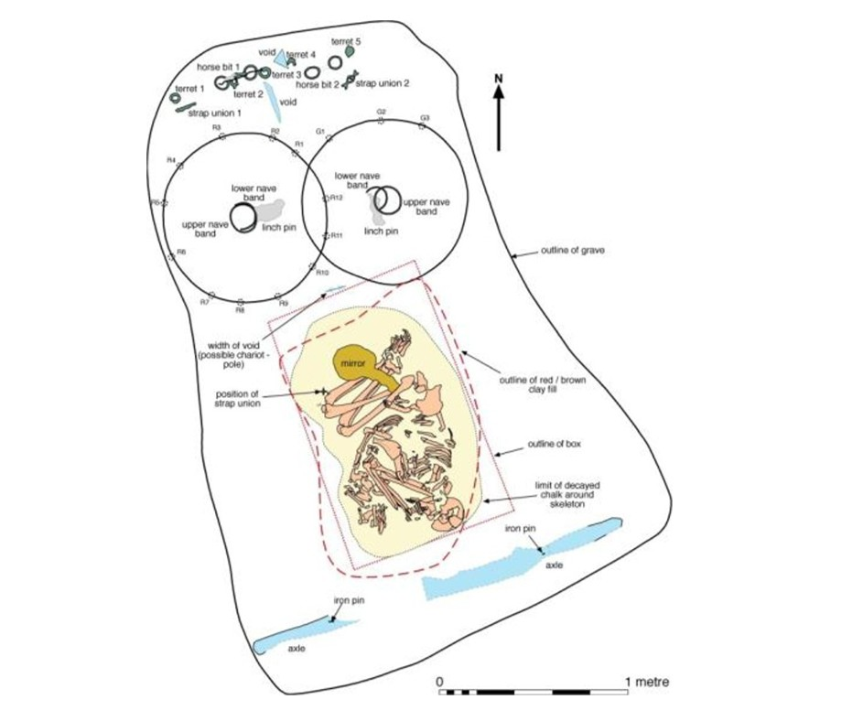
Wetwang, Yorkshire
Back to map
She was buried in a crouched position inside a grave, with grave goods: an iron mirror, pork joints placed on her body, and the dismantled chariot arranged around her.
Earlier in life, she had suffered a severe shoulder injury that was never healed, meaning she would not have been able to drive the chariot herself.
Archaeologists believe this woman held an important or unusual role in society—possibly as a leader, religious figure, or someone special.
QUESTION
Why do you think the Wetwang lady was buried with these things?
Plan of the Chariot burial at Wetwang, Yorkshire
Notes:
IMAGE:
The skeleton of what is thought to be a young tribal queen which was excavated at a site in the village of Wetwang, near York. The ancient burial site is thought to be the earliest of its kind ever found in Britain. * The skeleton of the queen, whose body had been placed in the third to fourth century BC grave with a dismantled state carriage reserved only for the elite, was found alongside decorative pieces of two horse harnesses.© Alamy Ref: G5ARD9 - https://www.alamy.com/stock-photo-the-skeleton-of-what-is-thought-to-be-a-young-tribal-queen-which-was-106573413.html
QUESTION:
Why do you think the Wetwang Slack lady was buried with these things?
LINK:
Video - Who Was The Mysterious 'Chariot Queen' That Stunned Archaeologists? | BBC Timestamp (plays from 1:45) - https://youtu.be/pWZElie-tDE?list=PLPItERt69I2rTMUWK2SmGKSCBbsrZZNGM&t=105
https://www.britishmuseum.org/collection/object/H_2001-0401-20

Slide 24
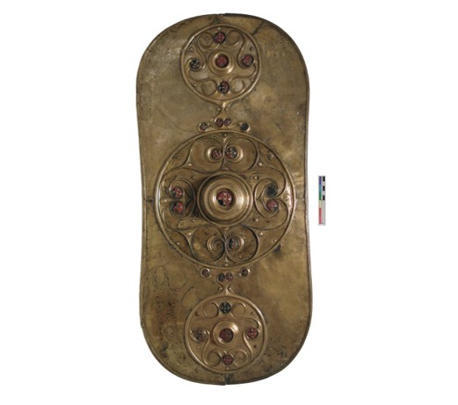
The Battersea Shield, London
Back to map
The Battersea Shield is a beautifully decorated piece of bronze that once covered a wooden shield.
It was found in the River Thames by a workman in 1857.
It was made in Britain over 2,000 years ago (around 350 - 50 BC).
The bronze was carefully put together from several pieces and decorated using a special technique where metal is hammered from the back to create raised patterns on the front.
The Battersea Shield
Notes:
IMAGE:
Battersea Bronze shield. © The Trustees of the British Museum - https://www.britishmuseum.org/collection/object/H_1857-0715-1?selectedImageId=1234330001
QUESTION:
Having watched the film, what do you think the shield was for?
LINK:
London Museum page on the shield with a film - https://www.londonmuseum.org.uk/blog/battersea-shield-river-thames/

Slide 25
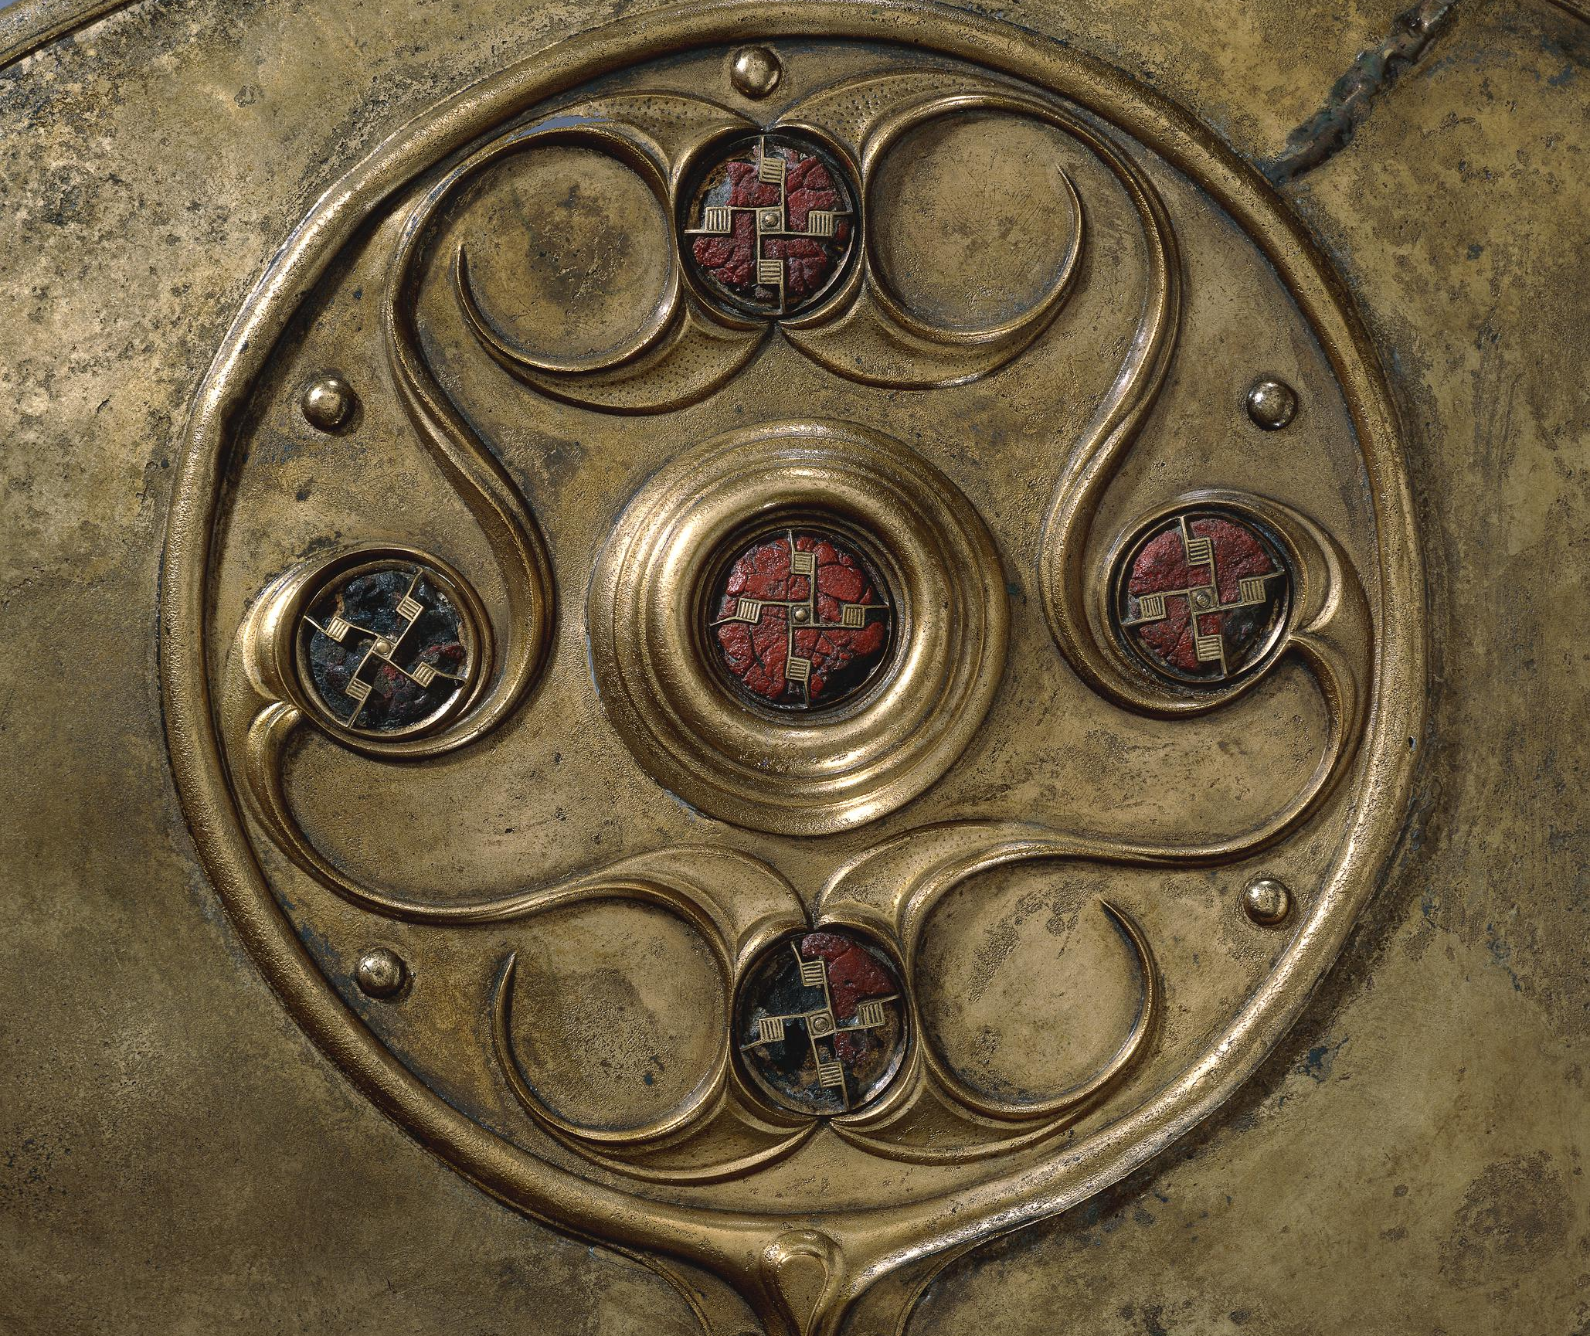
The Battersea Shield, London
Back to map
The design is made up of three main circular sections, with a raised middle part where the handle was.
It is decorated with swirling patterns and set with 27 bright red glass studs.
Although it could have worked as a shield with its wooden backing, there is no evidence it was used in battle.
Many archaeologists believe it was placed in the river as a special offering.
Watch this film to find out more.
QUESTION
Having watched the film, what do you think the shield was for?
The Battersea Shield – close-up detailing
Notes:
IMAGE:
Close-up of details on the Battersea Bronze shield. © The Trustees of the British Museum – https://www.britishmuseum.org/collection/object/H_1857-0715-1?selectedImageId=80784001
QUESTION:
Having watched the film, what do you think the shield was for?
LINK:
London Museum page on the shield with a film - https://www.londonmuseum.org.uk/blog/battersea-shield-river-thames/

Slide 26
Snettisham hoards, Norfolk
Back to map
In the Iron Age, people continued to bury groups of valuable objects, called hoards, just like they had in the Bronze Age.
Some hoards were placed in special sites used for rituals, where lots of impressive items have been found.
At Snettisham in Norfolk, for example, 11 hoards were discovered inside a large enclosed area.
The Snettisham hoards were buried around 70 BC.
Snettisham hoards, Norfolk
Notes:
IMAGE:
Torcs in the ground at Snettisham. © The Trustees of the British Museum - https://www.britishmuseum.org/collection/object/H_1991-0407-37?selectedImageId=33182001
QUESTION:
Why do you think people did not come back for these hoards?
LINK:
BBC article on the Snettisham Hoards, including audio clip - https://www.bbc.co.uk/news/articles/cx2n2vj7neyo

Slide 27
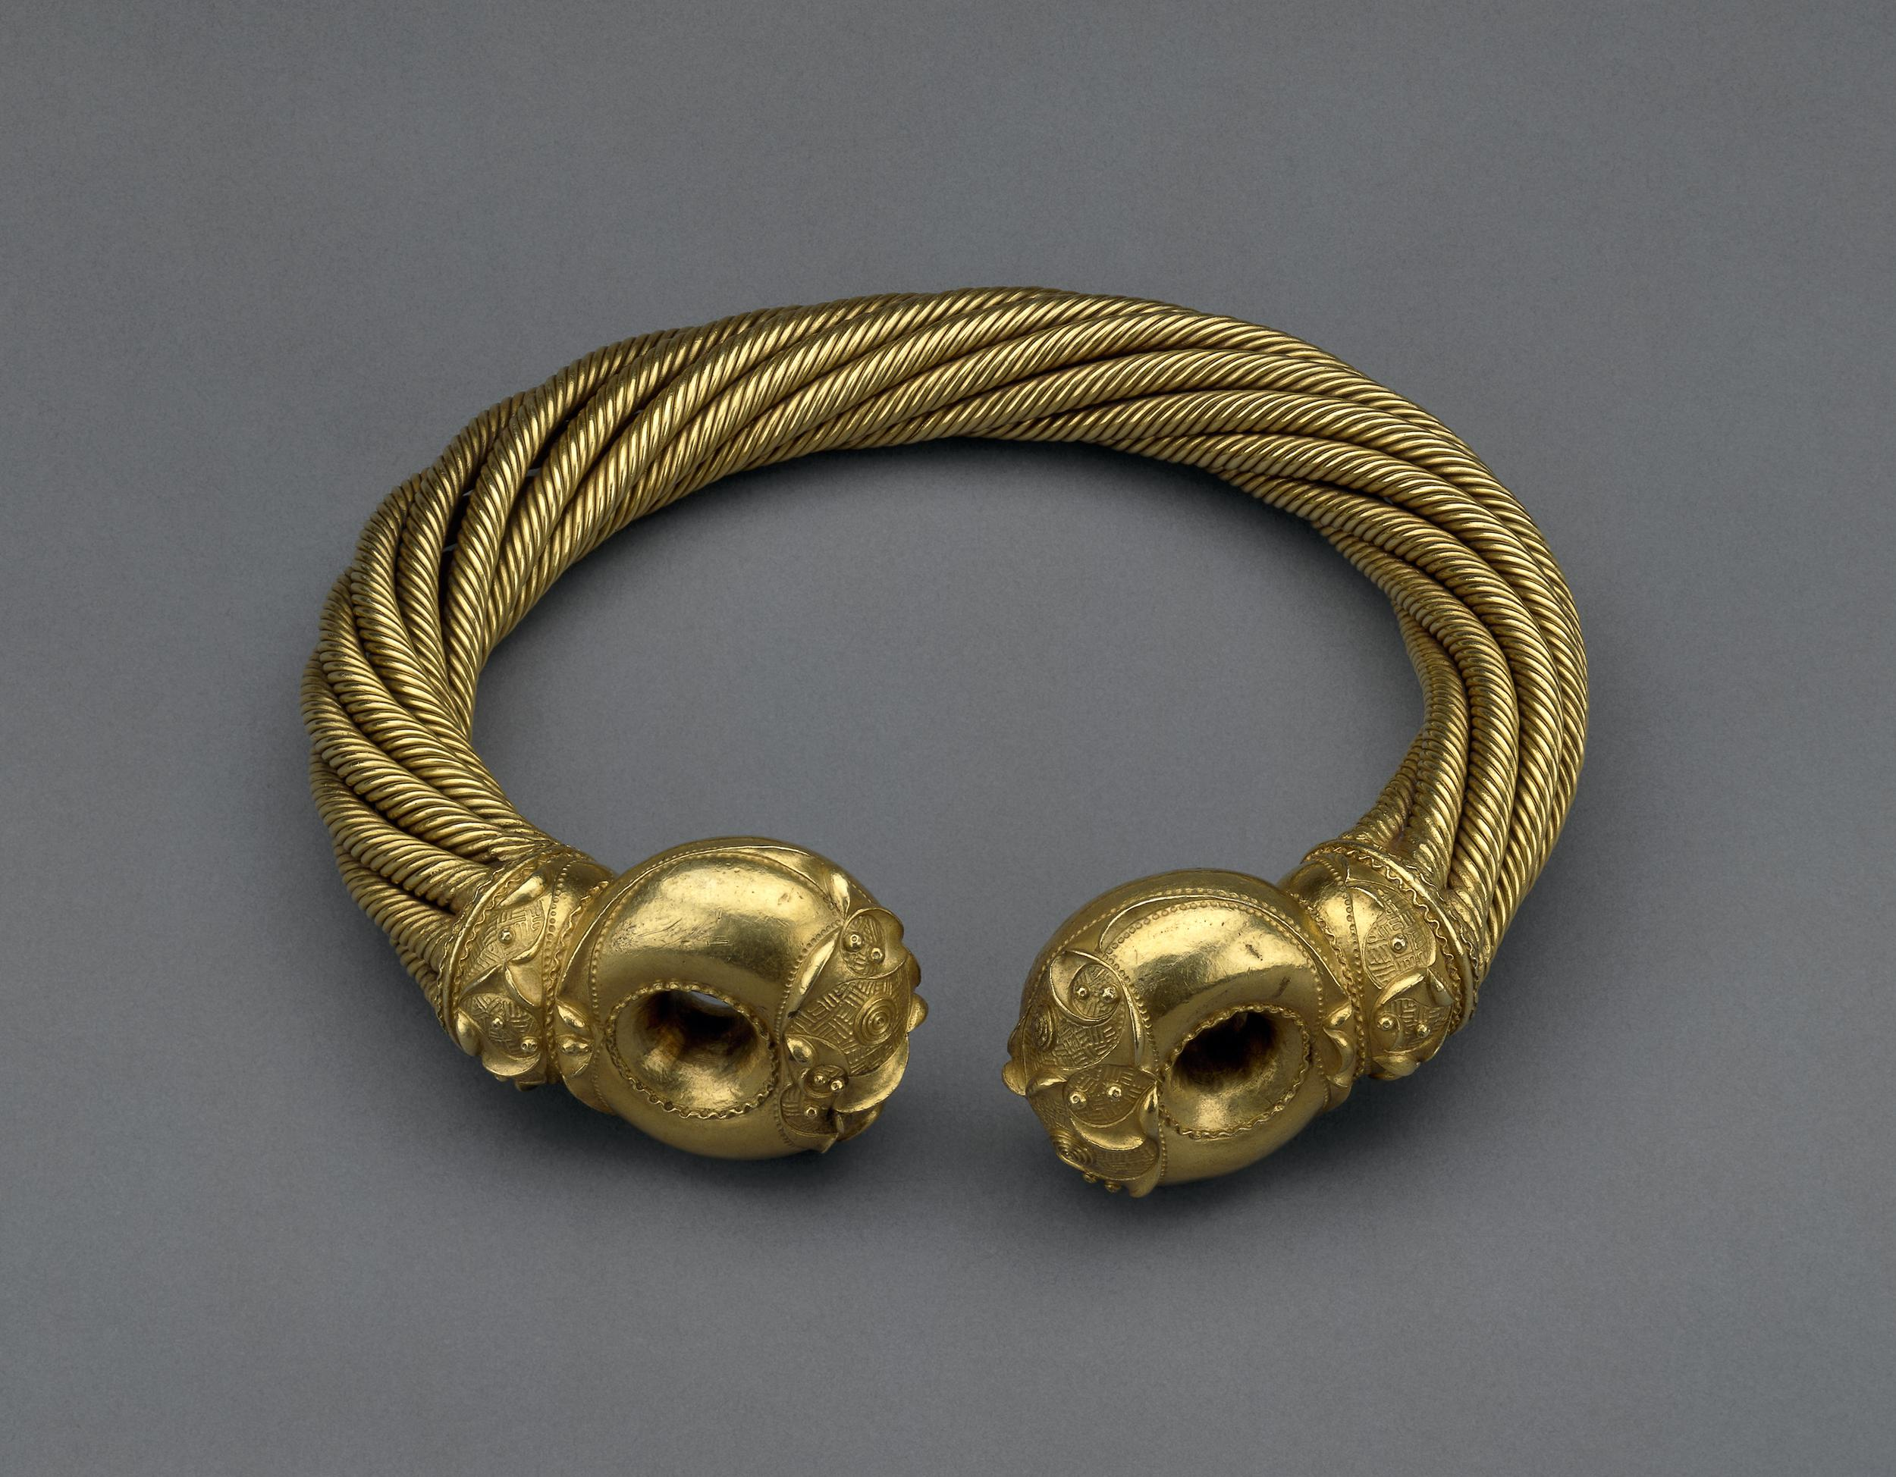
Snettisham hoards, Norfolk
Back to map
The hoards included gold and silver neck rings called torcs, coins, and metal bars (ingots) that may have been used as money.
Torcs were worn around the neck, but unlike modern necklaces, they were hard to put on or take off.
One, the ‘Great Torc’, was made from over 1 kg of twisted gold and silver!
The objects were buried in a careful order, suggesting a special ceremony or offering.
QUESTION
Why do you think people did not come back for these hoards?
Snettisham ‘Great Torc’
Notes:
IMAGE:
Snettisham ‘Great Torc’ © The Trustees of the British Museum - https://www.britishmuseum.org/collection/object/H_1951-0402-2
QUESTION:
Why do you think people did not come back for these hoards?
LINK:
BBC article on the Snettisham Hoards, including audio clip - https://www.bbc.co.uk/news/articles/cx2n2vj7neyo

Slide 28
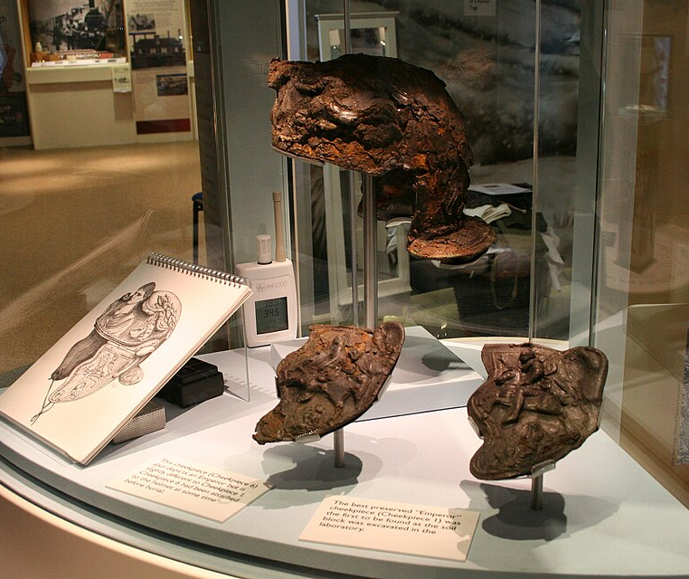
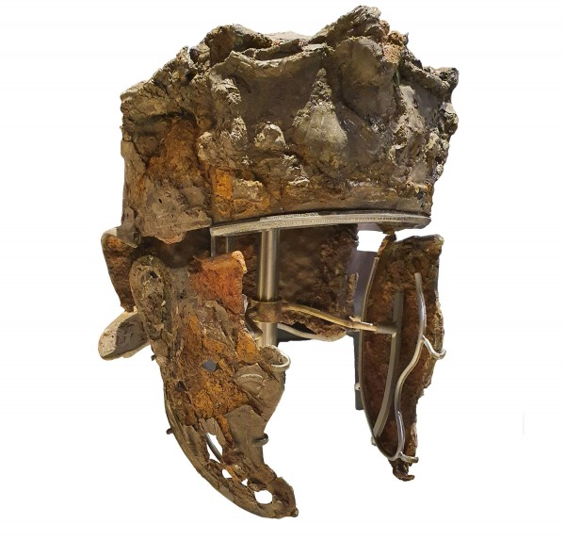
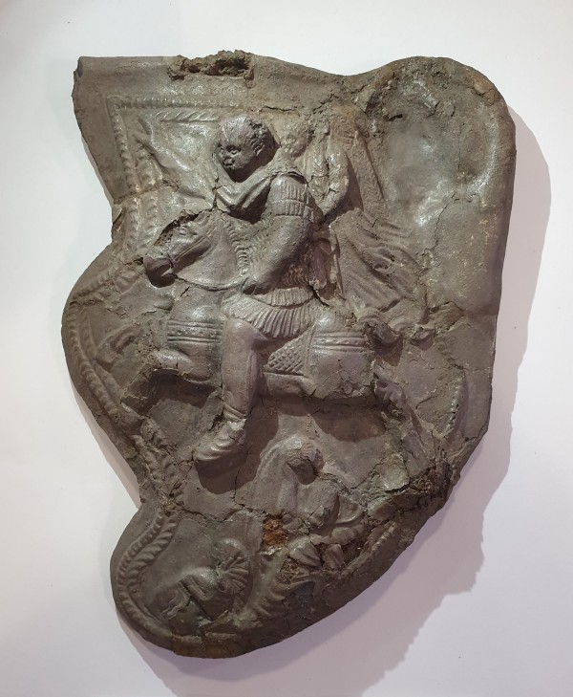
Hallaton Treasure, Leicestershire
Back to map
The Hallaton Treasure was found at an Iron Age hilltop shrine dating from 50 BC to just after the Roman invasion.
The site hosted rituals, feasting—evidenced by thousands of animal bones, mainly pigs—and sacrifices, including a few dog burials thought to be spiritual guardians of the site.
One find was a unique, richly decorated, Roman cavalry helmet that probably belonged to an important soldier. It showed symbols of victory and power.
Roman Cavalry Helmet on Display
Notes:
IMAGE:
Hallaton helmet exhibition. © Prioryman, CC BY-SA 4.0, via Wikimedia Commons - https://en.wikipedia.org/wiki/Hallaton_Helmet#/media/File:Hallaton_helmet_exhibition.jpg
Hallaton Helmet. © With kind permission of Leicestershire County Council Museums - https://leicestershirecollections.org.uk/gallery/hallaton-treasure
Hallaton Helmet Cheekpiece 1. © With kind permission of Leicestershire County Council Museums - https://leicestershirecollections.org.uk/gallery/hallaton-treasure
QUESTION:
What did people do before they had coins and why did Iron Age people now start to use coins?
LINKS:
3D Models of the Hallaton Treasure - https://sketchfab.com/lcc/collections/hallaton-treasure-5db33ac7f6a24ca7b1b892c6da034e24
Online Exhibition of Hallaton Treasure - https://www.harboroughmuseum.org.uk/the-museum/collections/the-hallaton-treasure/

Slide 29
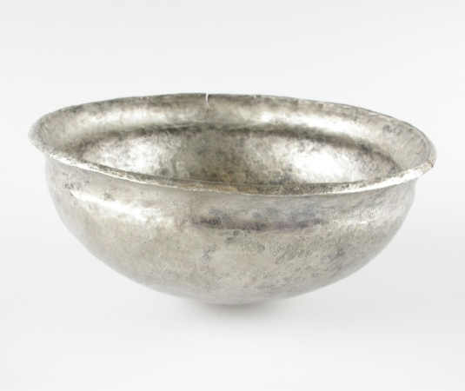
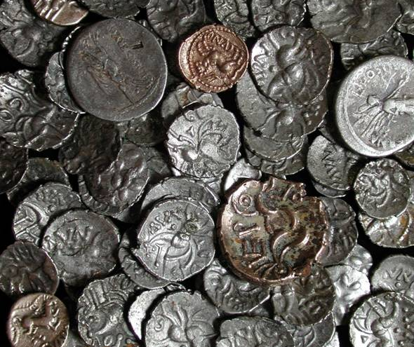
Hallaton Treasure, Leicestershire
Back to map
Over 5,000 coins were also found, most from the first century AD. Most, 4,835 were made by a local Celtic tribe called the Corieltauvi, with some from other Celtic rulers such as Cunobelin.
Other coins were Roman, mostly from the same time as the local Celtic ones. However, one was from 211 BC making it the oldest Roman coin found in Britain!
There was also jewellery, a unique silver bowl, and many other objects, meaning this is one of the most important Iron Age discoveries ever made in Britain.
QUESTION
What did people do before they had coins and why did Iron Age people now start to use coins?
Hallaton Coins
Notes:
IMAGE:
Hallaton hoard. © Portable Antiquities Scheme, CC BY-SA 3.0, via Wikimedia Commons - https://commons.wikimedia.org/wiki/File:Hallaton_hoard.jpg
Hallaton Silver Bowl. © With kind permission of Leicestershire County Council Museums - https://leicestershirecollections.org.uk/gallery/hallaton-treasure
QUESTION:
What did people do before they had coins and why did Iron Age people now start to use coins?
LINKS:
3D Models of the Hallaton Treasure - https://sketchfab.com/lcc/collections/hallaton-treasure-5db33ac7f6a24ca7b1b892c6da034e24
Online Exhibition of Hallaton Treasure - https://www.harboroughmuseum.org.uk/the-museum/collections/the-hallaton-treasure/

Slide 30
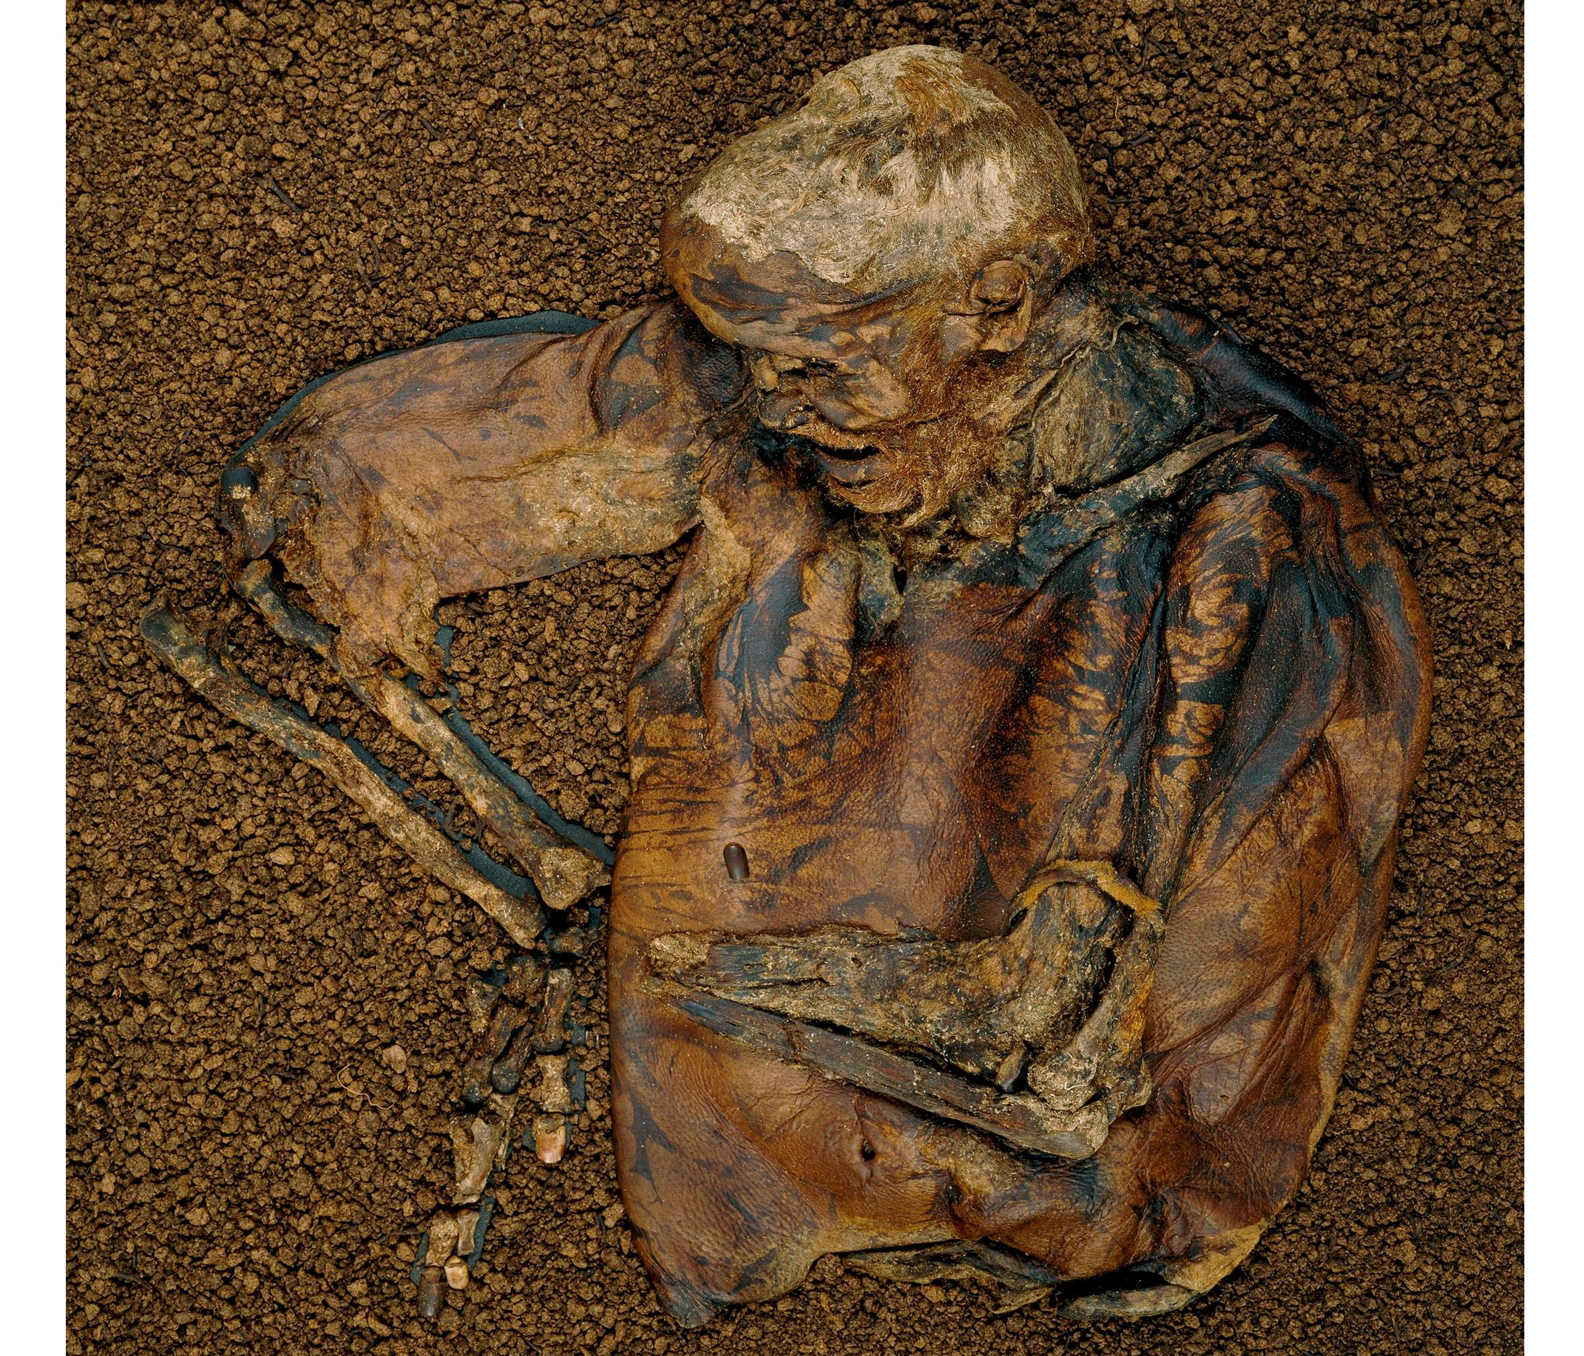
Lindow Man, Cheshire
Back to map
The body of a late Iron Age man was found in Lindow bog, Cheshire.
It is very unusual to find human remains, except bones, but in this case the bog preserved the skin, hair, and insides of the man.
He was about 25 years old when he died. He had a beard and a moustache, and neat fingernails.
Food preserved in his stomach included bread made from wheat and barley.
Lindow Man
Notes:
IMAGE:
Upper half of human male body, aged approximately 25 years at death. Found preserved in a bog. Hair and skin well-preserved. Remains of a fur armband around left arm and a garrotte of animal sinew around neck. © The Trustees of the British Museum - https://www.britishmuseum.org/collection/object/H_1984-1002-1
QUESTION:
Can you find out about other examples of bog bodies and what happened to them?
LINKS:
Oak Academy Lesson on Lindow Man - https://www.thenational.academy/teachers/programmes/history-primary-ks2/units/iron-age-britain-what-have-historians-learnt-about-iron-age-britain/lessons/the-discovery-of-lindow-man
Welcome to the story about Tollund Man - https://www.museumsilkeborg.dk/welcome-to-the-story-about-tollund-man

Slide 31
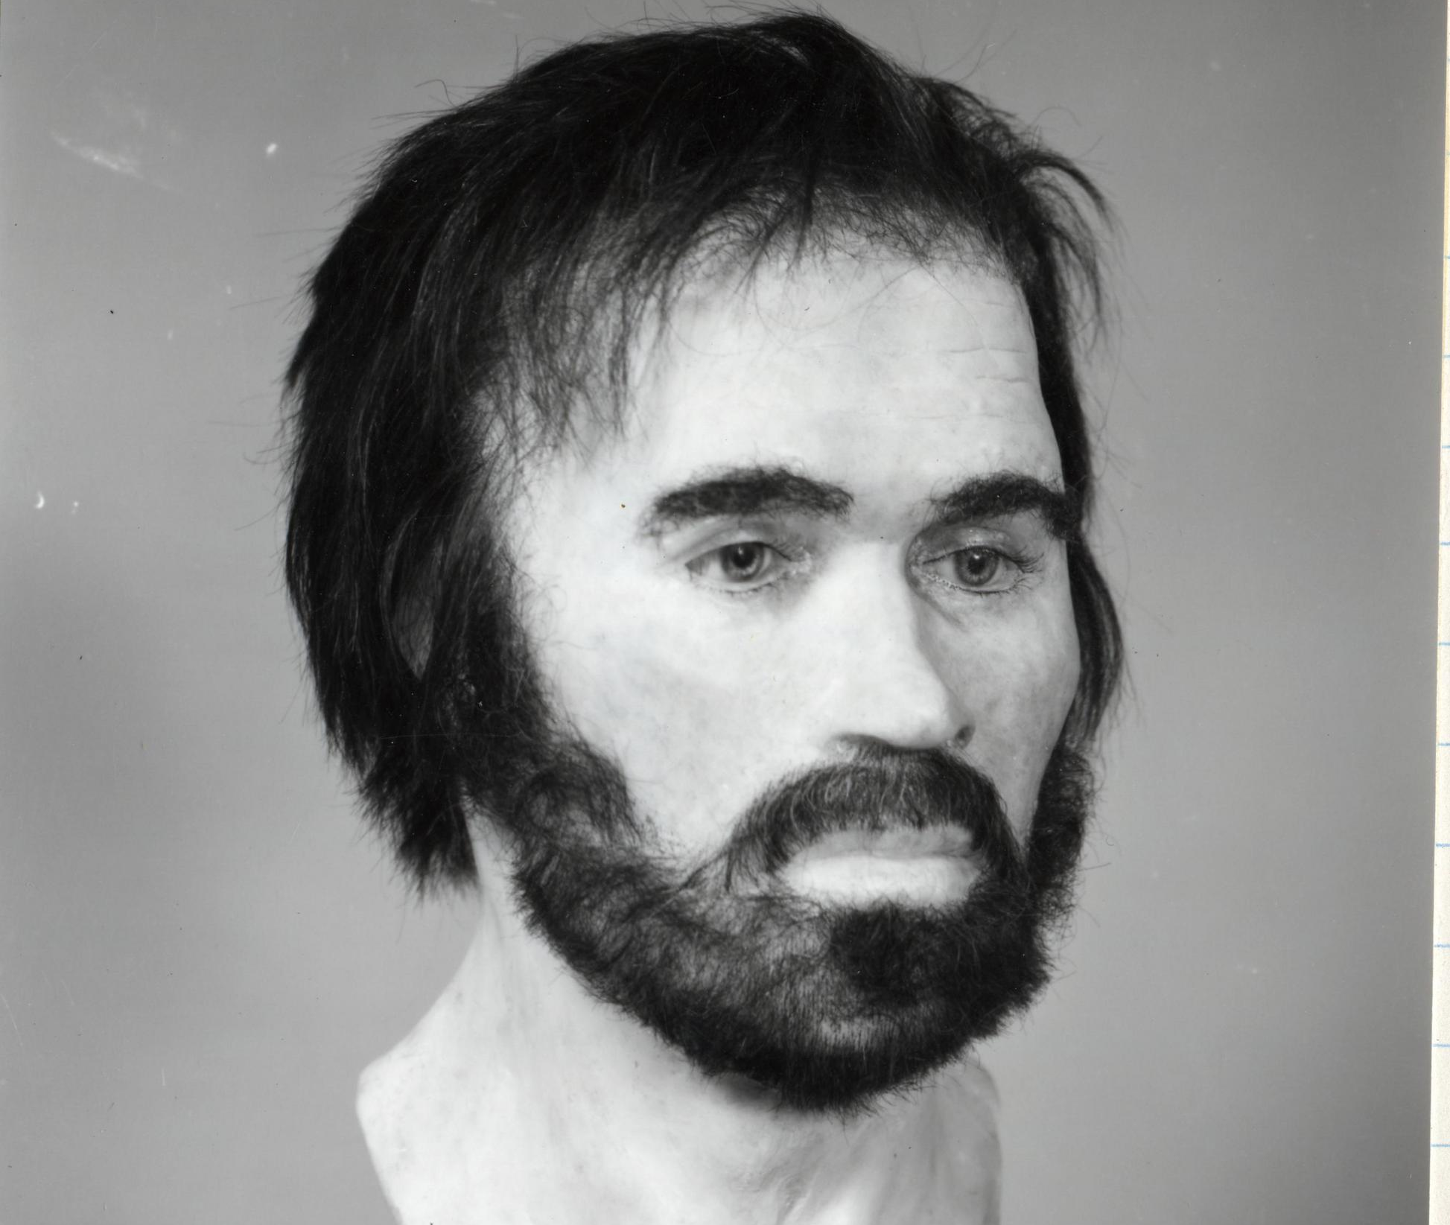
Lindow Man, Cheshire
Back to map
Other ‘bog bodies’ have been found at Lindow and elsewhere in Britain, but they are more common in Ireland and Denmark, such as Tollund Man.
Some people found in bogs died naturally, but others, including Lindow man, had suffered violent deaths.
Someone hurt him by hitting his head and injuring his back. Something was put around his neck, which may have stopped him from breathing. After he died, his body was placed face down in a small pool in the bog.
QUESTION
Can you find out about other examples of bog bodies and what happened to them?
Lindow Man Reconstruction
Notes:
IMAGE:
Reconstruction of Lindow Man’s Head. © The Trustees of the British Museum - https://www.britishmuseum.org/collection/image/1284949001
QUESTION:
Can you find out about other examples of bog bodies and what happened to them?
LINKS:
Oak Academy Lesson on Lindow Man - https://www.thenational.academy/teachers/programmes/history-primary-ks2/units/iron-age-britain-what-have-historians-learnt-about-iron-age-britain/lessons/the-discovery-of-lindow-man
Welcome to the story about Tollund Man - https://www.museumsilkeborg.dk/welcome-to-the-story-about-tollund-man

Slide 32
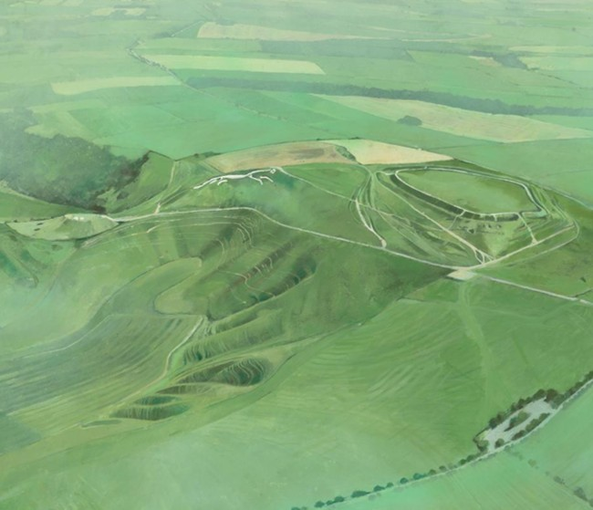
Uffington White Horse, Oxfordshire
Back to map
Prehistoric hill figures are large designs, often animal shapes, created by cutting into the ground to reveal lighter chalk or soil.
They were likely made in the Iron Age and designed to be seen from far away, possibly for religious purposes.
They were part of a landscape with other ancient sites, showing how people used the area for thousands of years.
Very few survive today, making them especially important.
Drawing of the landscape around the Uffington White Horse
Notes:
IMAGE:
Illustration depicting an aerial view of Uffington Castle univallate Iron Age hillfort on Whitehorse Hill, as it appears in the present day, shown from the north-west, with Uffington White Horse chalk hill figure to its left © Historic England Archive Ref: IC104/001 - https://historicengland.org.uk/images-books/photos/item/IC104/001
QUESTION:
Why do you think people might have carved giant pictures onto the hillside?
LINKS:
Further information about the White Horse - https://www.oxfordarchaeology.com/uffington-white-horse

Slide 33
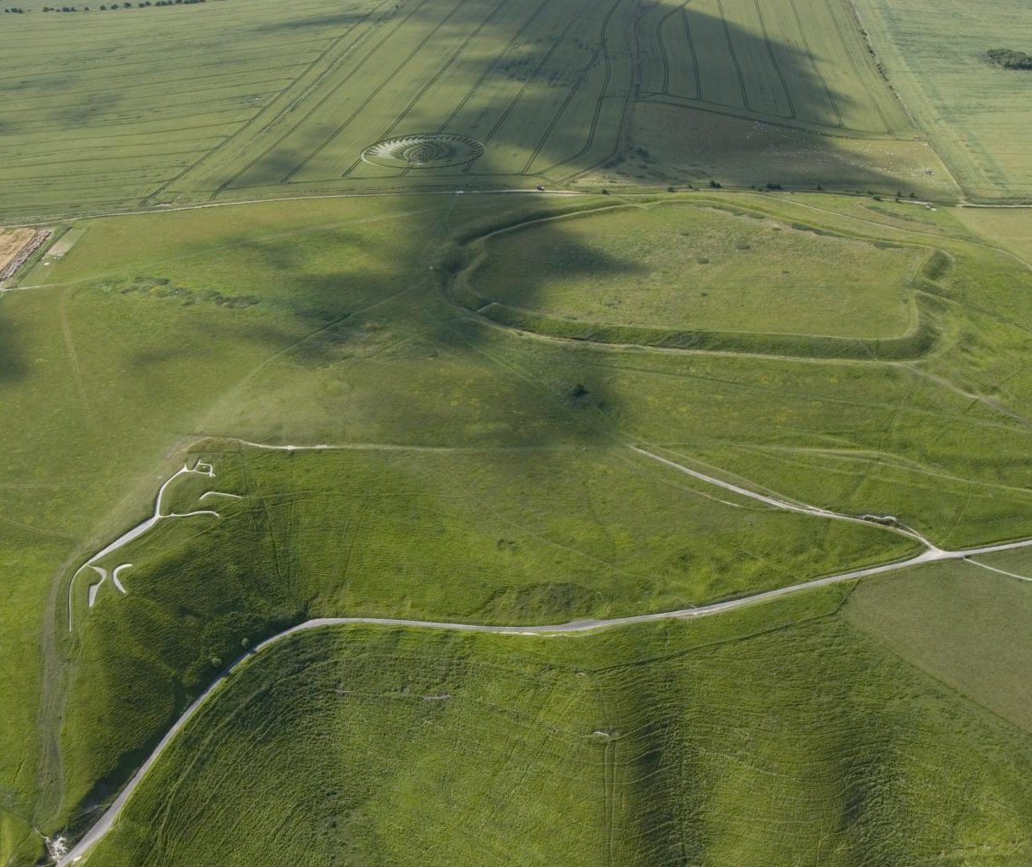
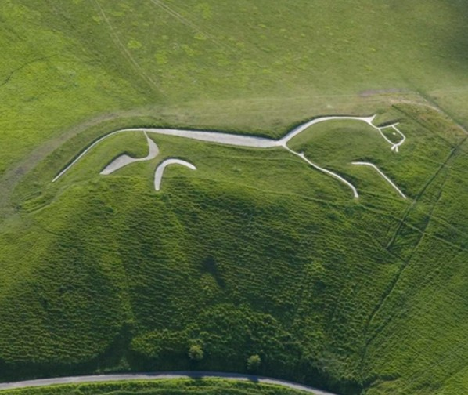
Uffington White Horse, Oxfordshire
Back to map
The Uffington White Horse is a huge chalk horse carved into a hillside. It is thought to date to the Iron Age, like the nearby hillfort.
It is over 100 metres long and about 40 metres high!
The first documentary record of the horse is from the 12th century when it was made clear that the area had become known as ‘White Horse Hill’ in the reign of William I (1066-1087).
Traditions such as regular cleaning helped keep it visible over time.
QUESTION
Why do you think people might have carved giant pictures onto the hillside?
Uffington White Horse and hillfort from the air
Notes:
IMAGES:
Uffington White Horse and hillfort from the air. © Historic England - https://historicengland.org.uk/images-books/archive/collections/aerial-photos/record/24849_001
Uffington White Horse from the air. © Historic England - https://historicengland.org.uk/images-books/archive/collections/aerial-photos/record/24849_002
QUESTION:
Why do you think people might have carved giant pictures onto the hillside?
LINKS:
Further information about the White Horse - https://www.oxfordarchaeology.com/uffington-white-horse

