Slide 1
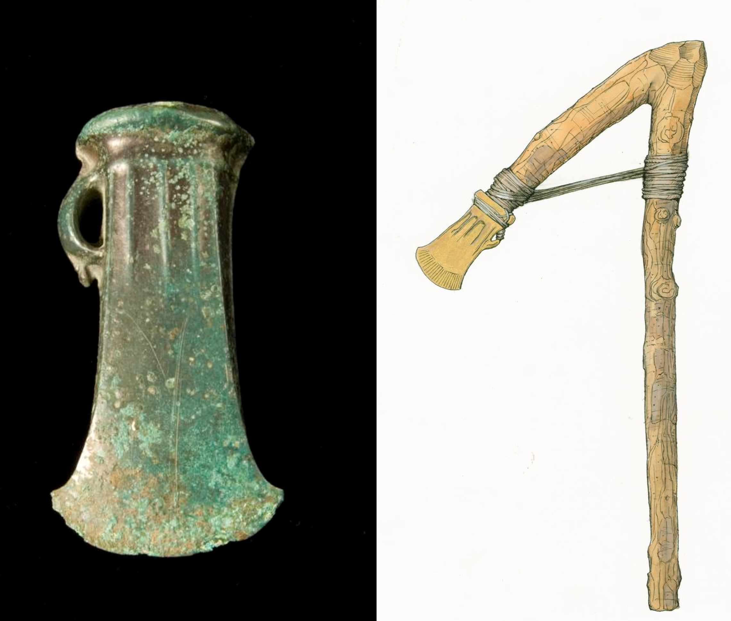
The Mesolithic (Middle Stone Age)
Stone Age to Iron Age: Part 4
The Bronze Age
Notes:
IMAGE:
Socketed Bronze Age axe head, found at Beeston Castle © Historic England Archive Ref: DP029569 - https://historicengland.org.uk/images-books/photos/item/DP029569
Reconstruction illustration showing how a Bronze Age axe blade excavated at Beeston Castle may have been attached to a wooden handle to form an axe © Historic England Archive Ref: IC009/008 – https://historicengland.org.uk/images-books/photos/item/IC009/008
People still used stone tools, but bronze was increasingly used for weapons and tools, and gold for jewellery. Different types of pottery were also introduced.
In the early Bronze Age some people were buried with valuable and exotic things.
Later on, people started to live in round houses and lay out field systems.
The origins of the countryside we see today lie in the later Bronze Age.
Use the first slides as an introduction to help pupils find out more about the Bronze Age in general.
Then explore the map to find out more about specific archaeological sites in Britain.

Slide 2
The Bronze Age
Learn about the types of technology used in the Bronze Age
Learn about the everyday life of people in the Bronze Age
Learn about changes in Britain from the Stone Age to the Iron Age
Assess the different types of archaeological evidence from the Bronze Age
Establish clear narratives within and across the periods studied
Understand how knowledge of the past comes from a range of sources

Slide 3
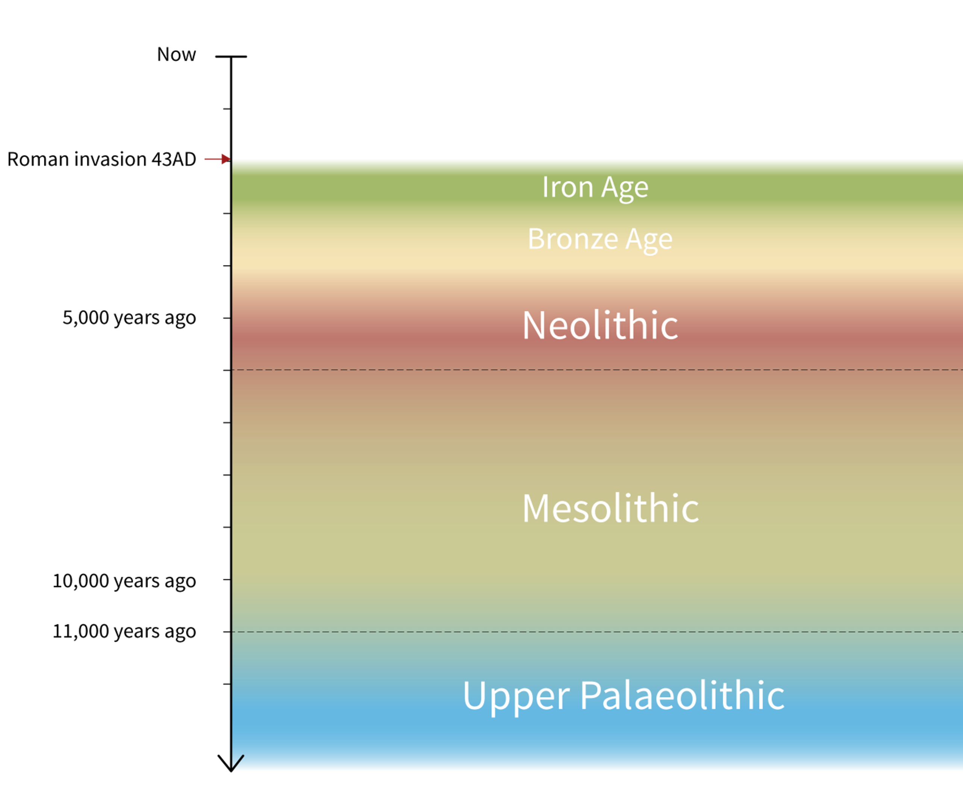
Stone Age to Iron Age Timeline – Bronze Age in context
The Bronze Age dates from the first appearance of bronze in around 2200 BC to the introduction of iron around 800 BC.
Bronze is a mixture of copper and tin, making it much harder and more useful than pure copper, like the blade found with the Amesbury Archer.
People still used stone tools, but bronze was increasingly used for weapons and tools, and gold for jewellery.
Different types of pottery were also introduced.
Stone Age to Iron Age Timeline

Slide 4
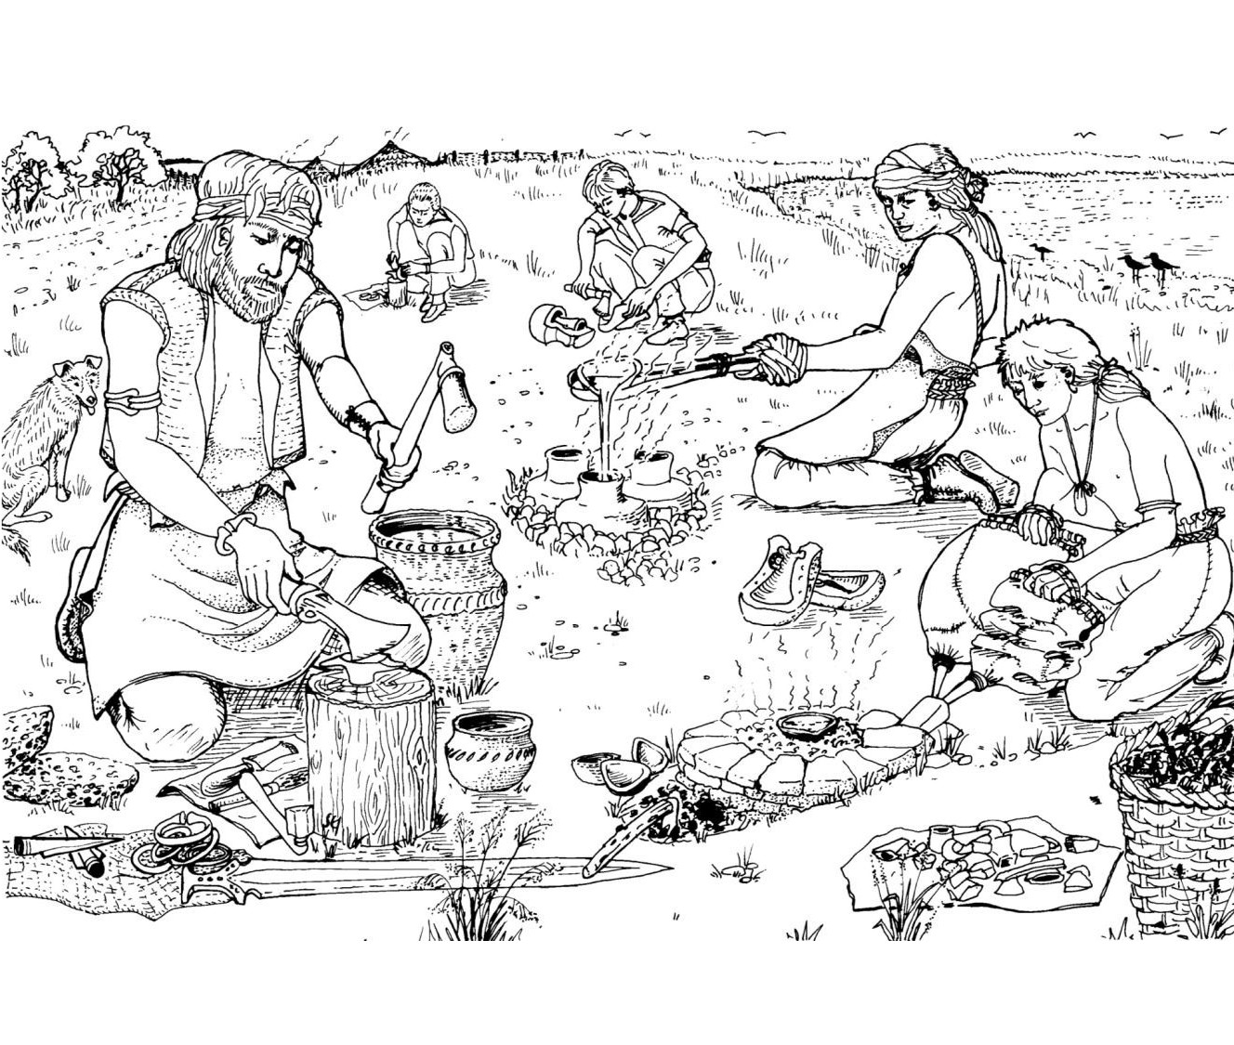
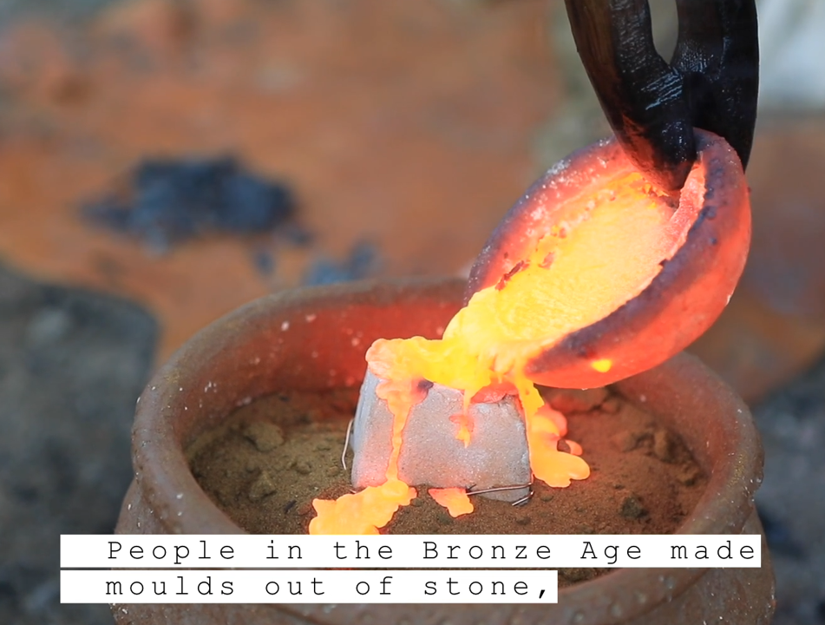
Metal working
Metal tools like axes, as well as weapons and jewellery, were made by pouring hot melted metal into special shapes called moulds.
To make bronze, they melted copper and tin together and poured the liquid metal into the mould.
Britain was one of the few places in north‑west Europe where both copper and tin could be found. Mines in Devon and Cornwall traded tin with other parts of Europe during the Bronze Age.
Watch: How to make Bronze Tools
Bronze Age Metalworking
Notes:
IMAGE:
Experimental bronzeworking. © Wessex Archaeology
Experimental bronzeworking. © CAU (from video - https://vimeo.com/1045257023)
Link:
How to make Bronze Tools - https://vimeo.com/1045257023

Slide 5
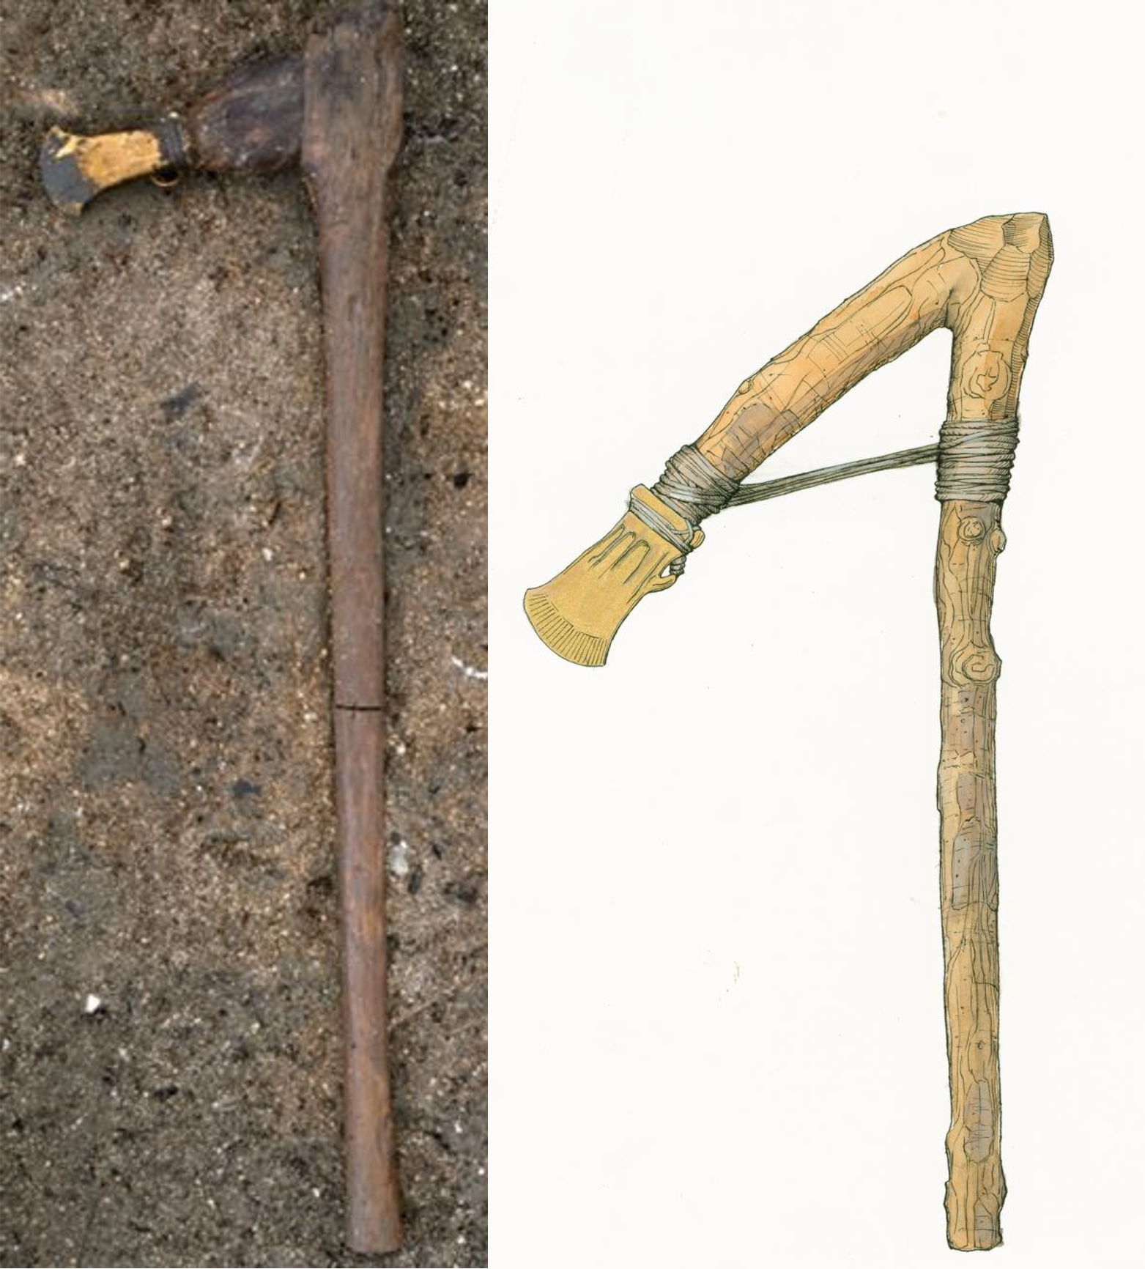
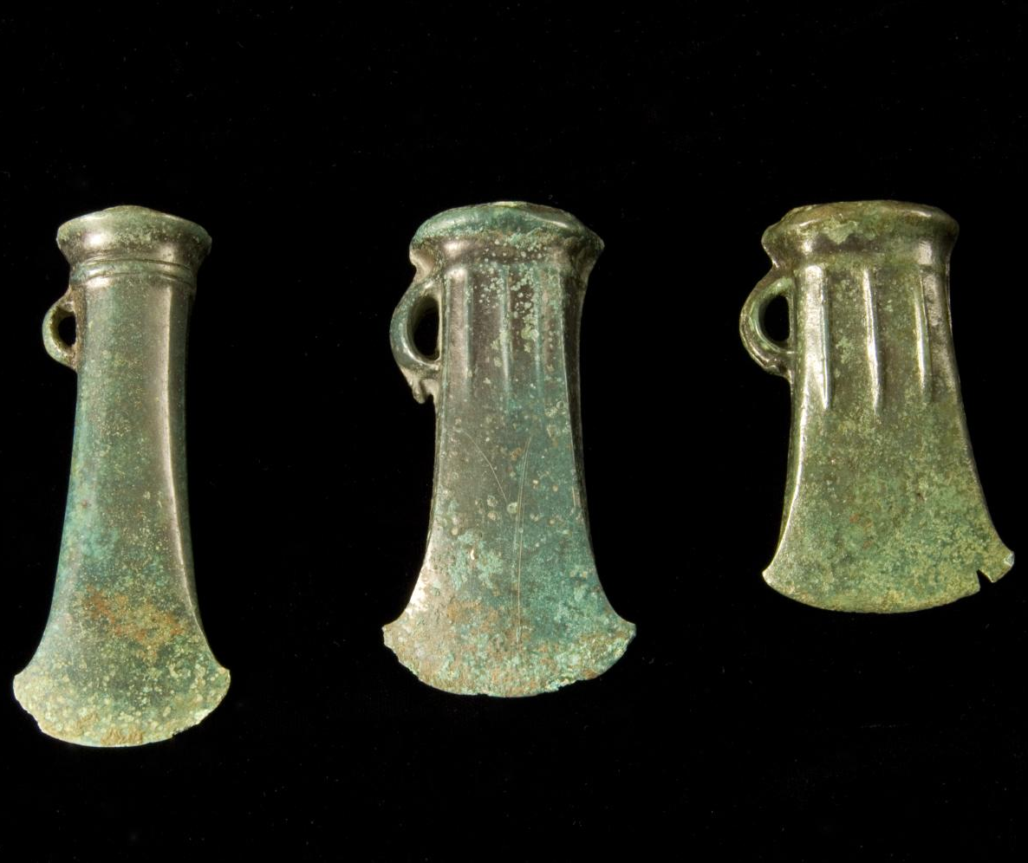
Metal working
Bronze axes look very different to the stone axes produced in the Mesolithic and Neolithic and were much sharper.
There were many different shapes of bronze axe head and different ways of fixing them to wooden handles.
As well as axes, a range of other items were made from bronze, including tools (chisels, sickles), weapons (swords, spearheads) and ornaments (pins, rings).
QUESTION
Ask members of your family if they can tell you about any new kinds of technology that have changed their lives?
Bronze axes
Notes:
IMAGES:
Socketed Bronze Age axe head, found at Beeston Castle © Historic England Archive Ref: DP029569 - https://historicengland.org.uk/images-books/photos/item/DP029569
Socketed axe with two-piece haft. © CAU
Reconstruction illustration showing how a Bronze Age axe blade excavated at Beeston Castle may have been attached to a wooden handle to form an axe © Historic England Archive Ref: IC009/008 – https://historicengland.org.uk/images-books/photos/item/IC009/008

Slide 6
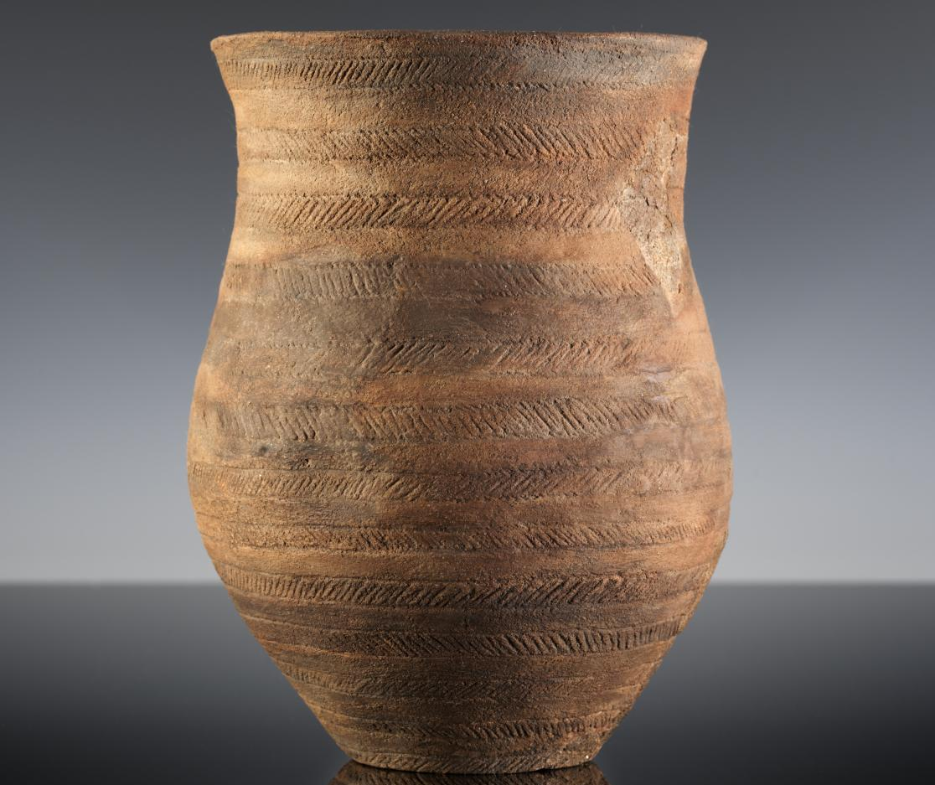
Pottery
Lots of different types of pottery were used throughout the Bronze Age.
One of the most important – and the earliest - is Beaker pottery, which is usually highly decorated.
Beakers are so-called because they are thought to have been used for drinking, possibly beer!
This type of pottery first appeared in the Late Neolithic period in western Europe, eventually arriving in Britain – one was found in the grave of the Amesbury Archer who came from the Alps.
QUESTION
What can Beaker pottery tell us about trade and peoples’ relationship with mainland Europe at this time?
A Beaker pot
Notes:
IMAGE:
Detail of a beaker, found at Stonehenge and held by the Wiltshire Museum in Devizes © Historic England Archive Ref: DP158771 - https://historicengland.org.uk/images-books/photos/item/DP158771

Slide 7
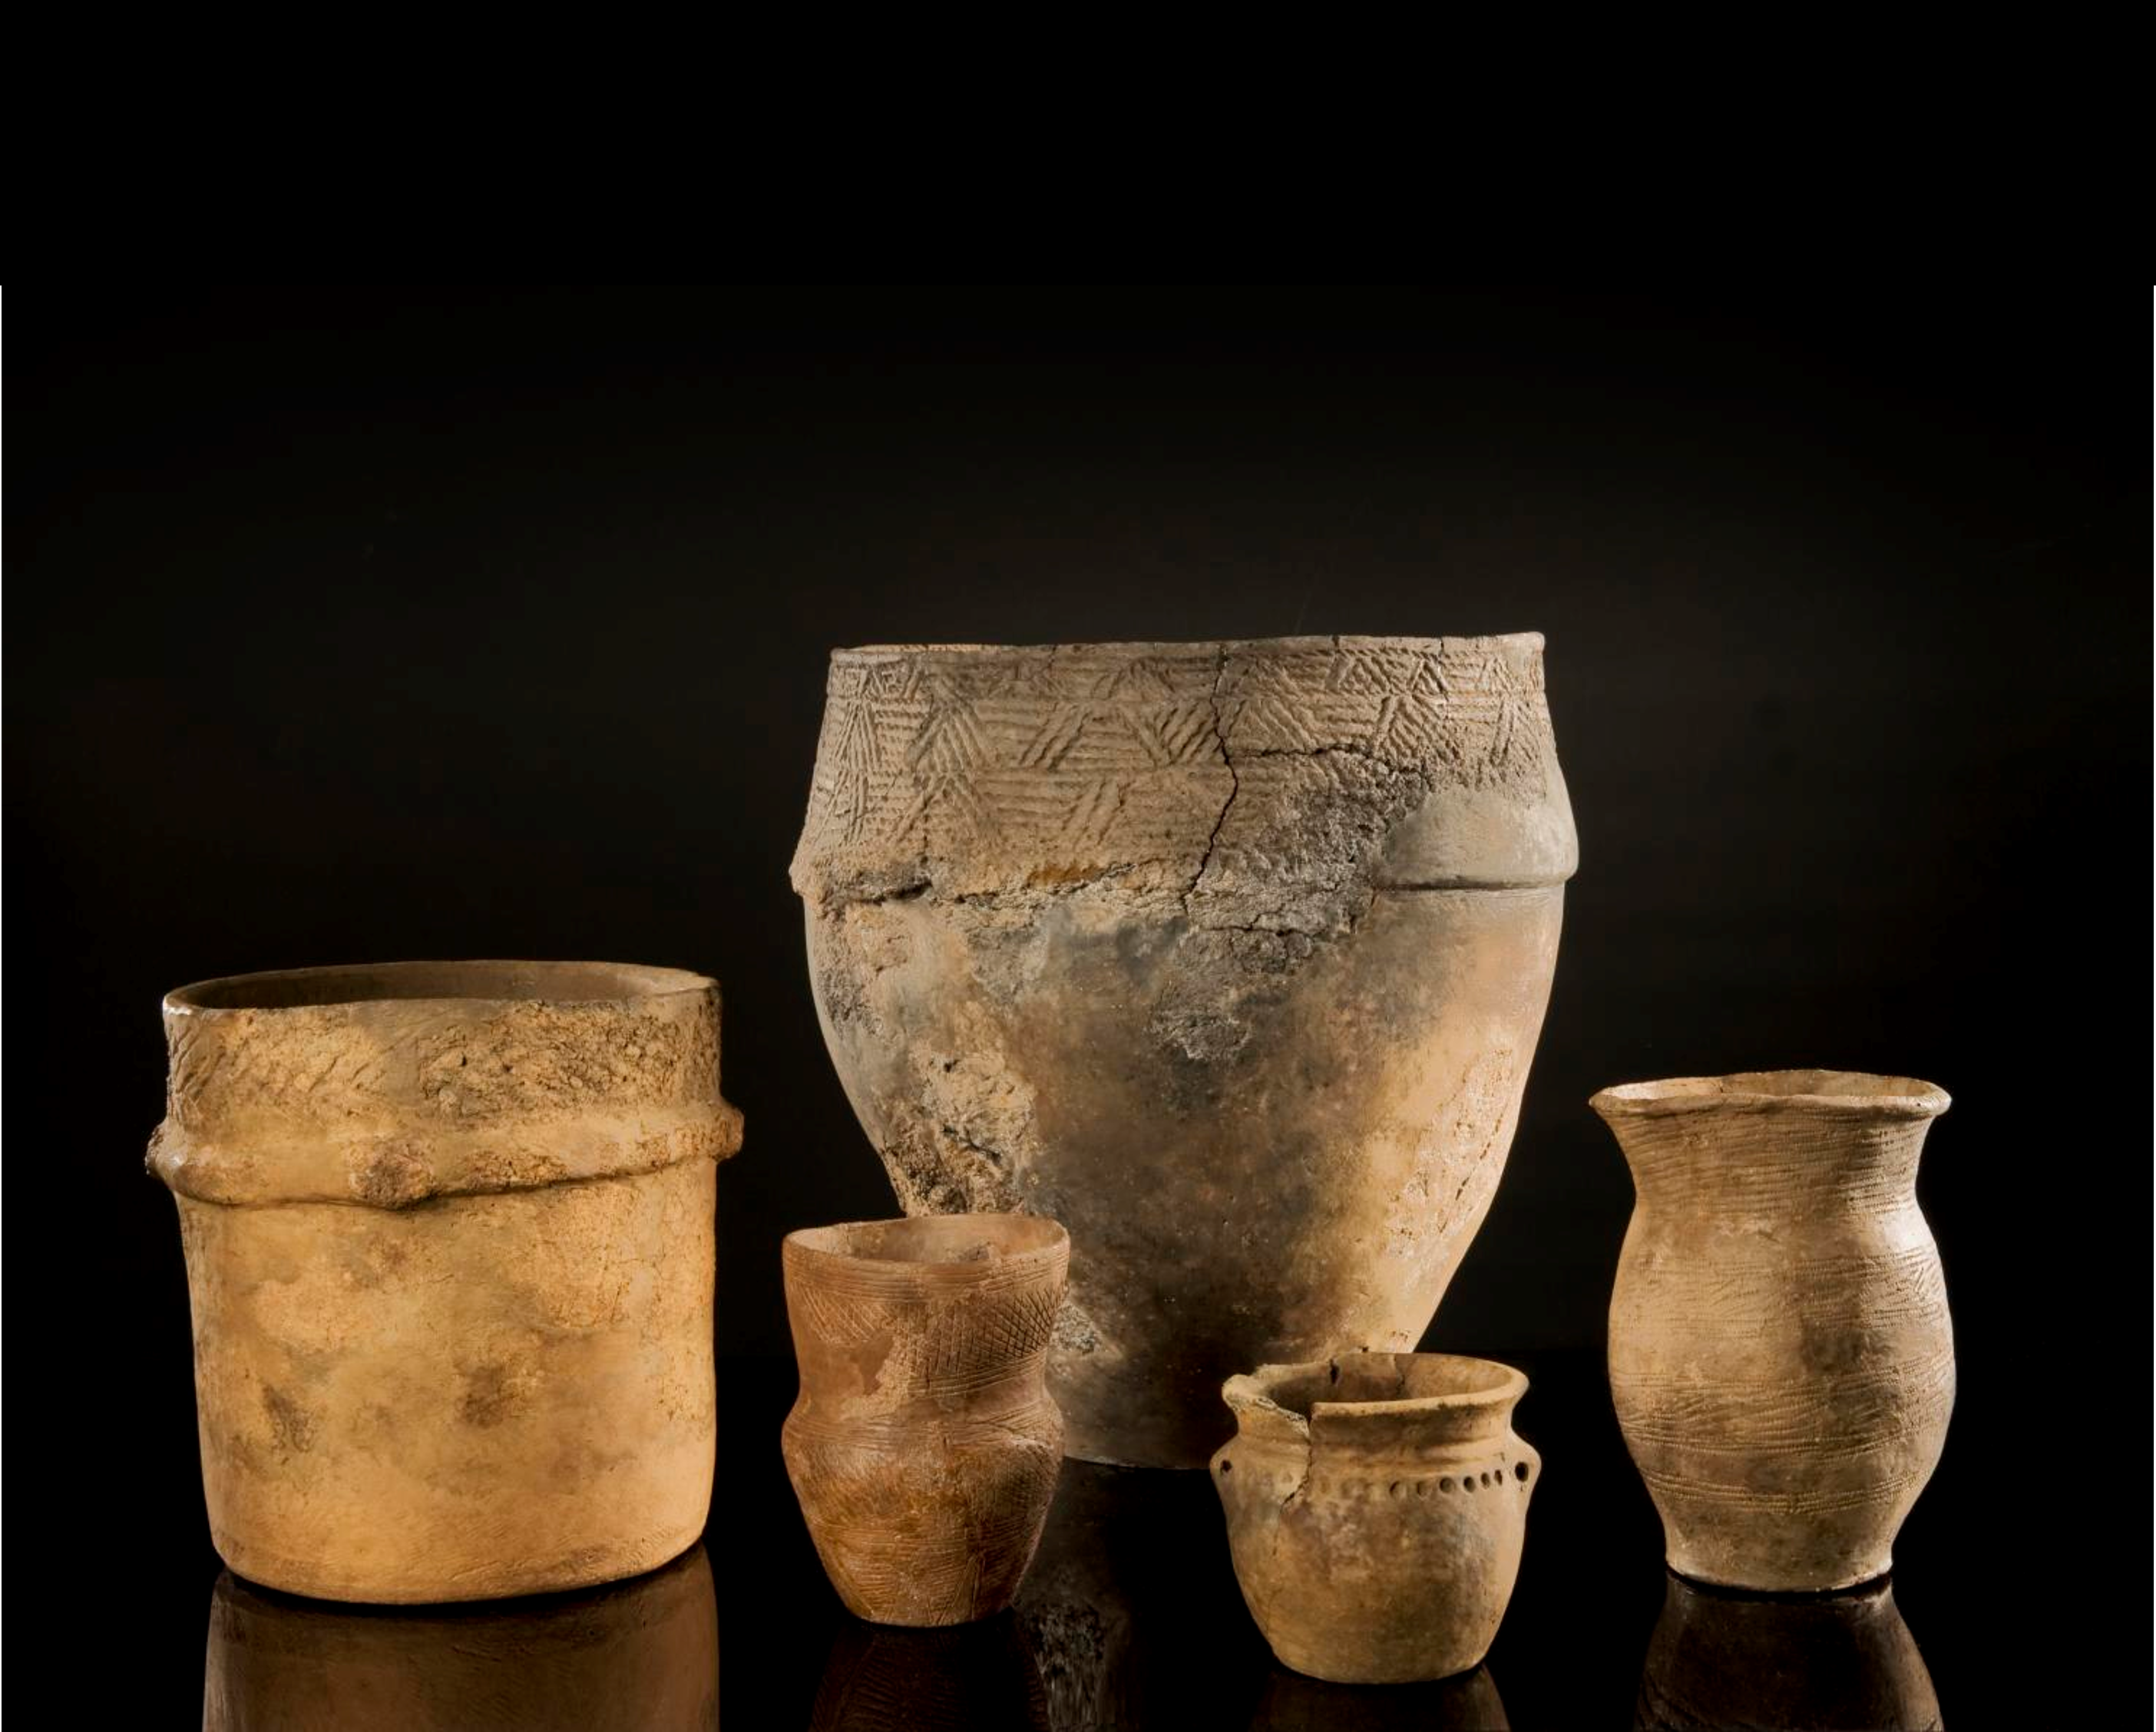
Pottery
In Bronze Age Britain local styles of Beaker pottery developed. They are mainly found in graves, rather than in places where people lived everyday.
Later, Bronze Age people used other types of pottery, which archaeologists have named after either:
their shapes (e.g. Collared Urns)
what they may have been used for (e.g. Food or Storage Vessels)
the places they were discovered (e.g. ‘Trevisker’ ware from Cornwall).
ACTIVITY
Could you use clay to make a Bronze Age ‘Beaker’?
Bronze Age Pottery
Notes:
IMAGE:
Detail of a group of (Bronze Age) artefacts from Dartmoor held by Plymouth City Art Gallery and Museum, an urn, a large ceramic beaker decorated with a scored pattern, a necked beaker with comb-stamping, a domestic 'Trevisker'-style urn, and a bronze age urn from Hurston Ridge near Chagford © Historic England Archive Ref: DP099395 - https://historicengland.org.uk/images-books/photos/item/DP099395

Slide 8
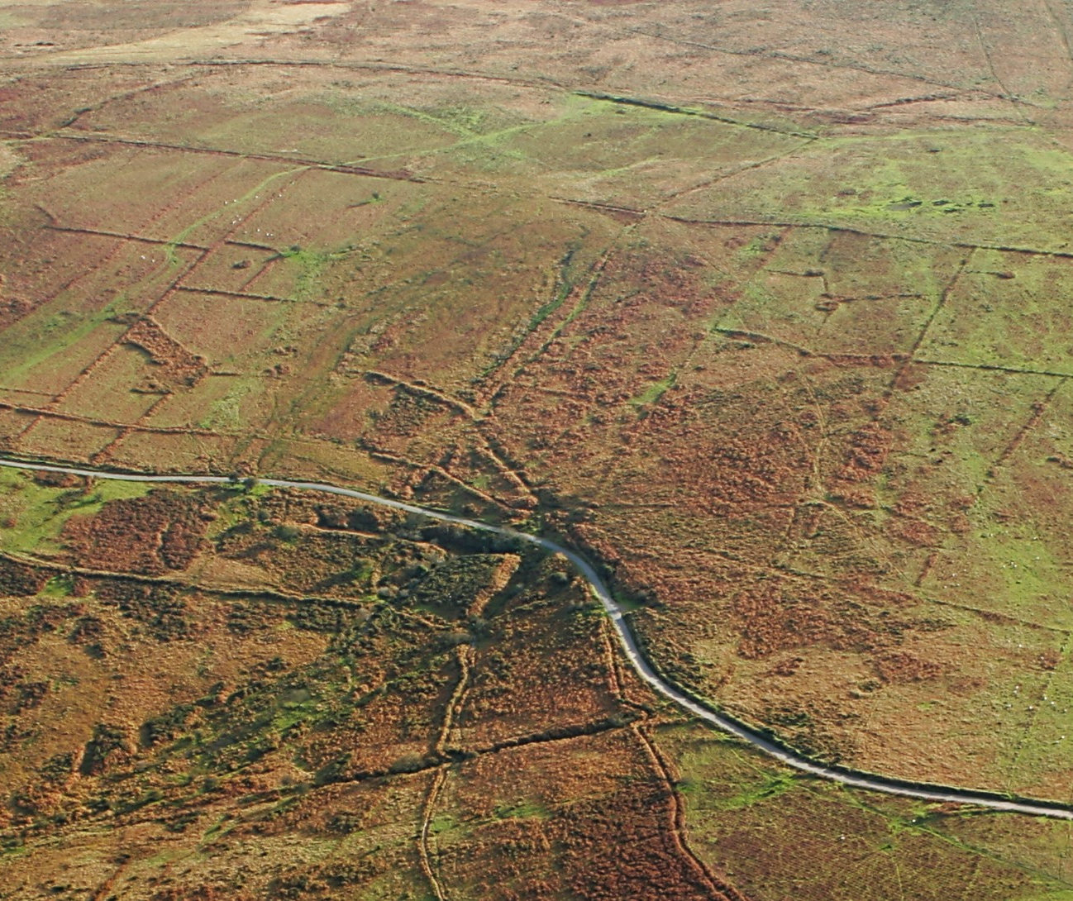
Farming & Fields
Farming in Britain began in the Neolithic but it wasn’t until the Bronze Age that organised fields, like we’d recognise today, were created.
These fields show that farming became more intensive and that people began to think differently about land ownership and movement.
In most places, these early fields have disappeared. Over time, they were replaced by later farming methods. However, in some places, prehistoric field patterns still survive.
Bronze Age fields, Devon
Notes:
IMAGE:
Bronze Age fields, Devon © Historic England Archive Ref: 24102_014 - https://historicengland.org.uk/images-books/archive/collections/aerial-photos/record/24102_014

Slide 9
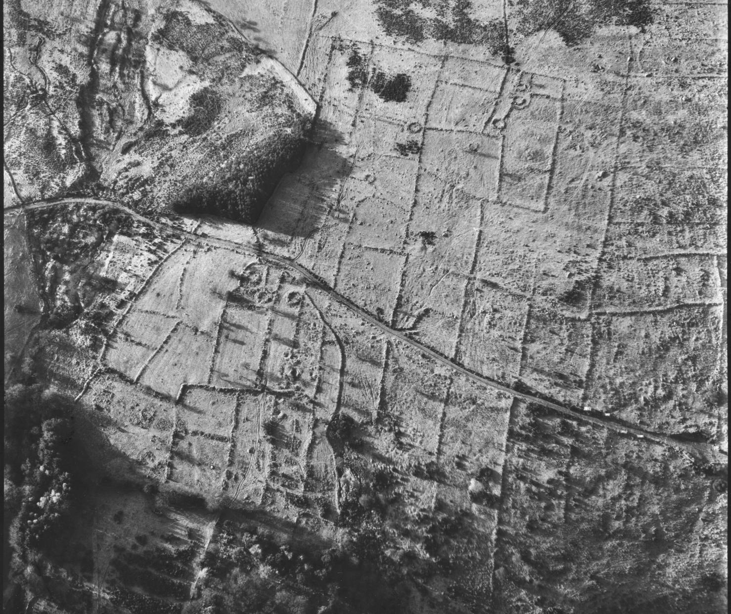
Farming & Fields
One site is Halshanger Common in Devon, where the remains of Bronze Age fields can still be seen as long, parallel banks.
These strips are divided into smaller fields, creating a pattern that looks similar to brickwork.
Within the fields are the remains of seven settlements (villages). The largest settlement, Grimspound, had at least 24 stone roundhouses, showing that these communities were well established.
QUESTION
Why do you think Bronze Age people divided the land into fields?
Bronze Age fields, Halshanger Common, Devon
Notes:
IMAGE:
Bronze Age fields, Devon © Historic England Archive Ref: 24102_014 - https://historicengland.org.uk/images-books/archive/collections/aerial-photos/record/24102_014

Slide 10
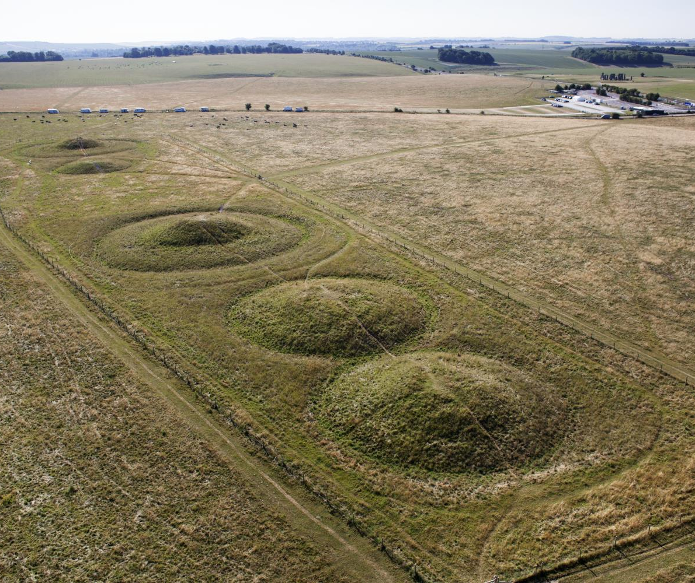
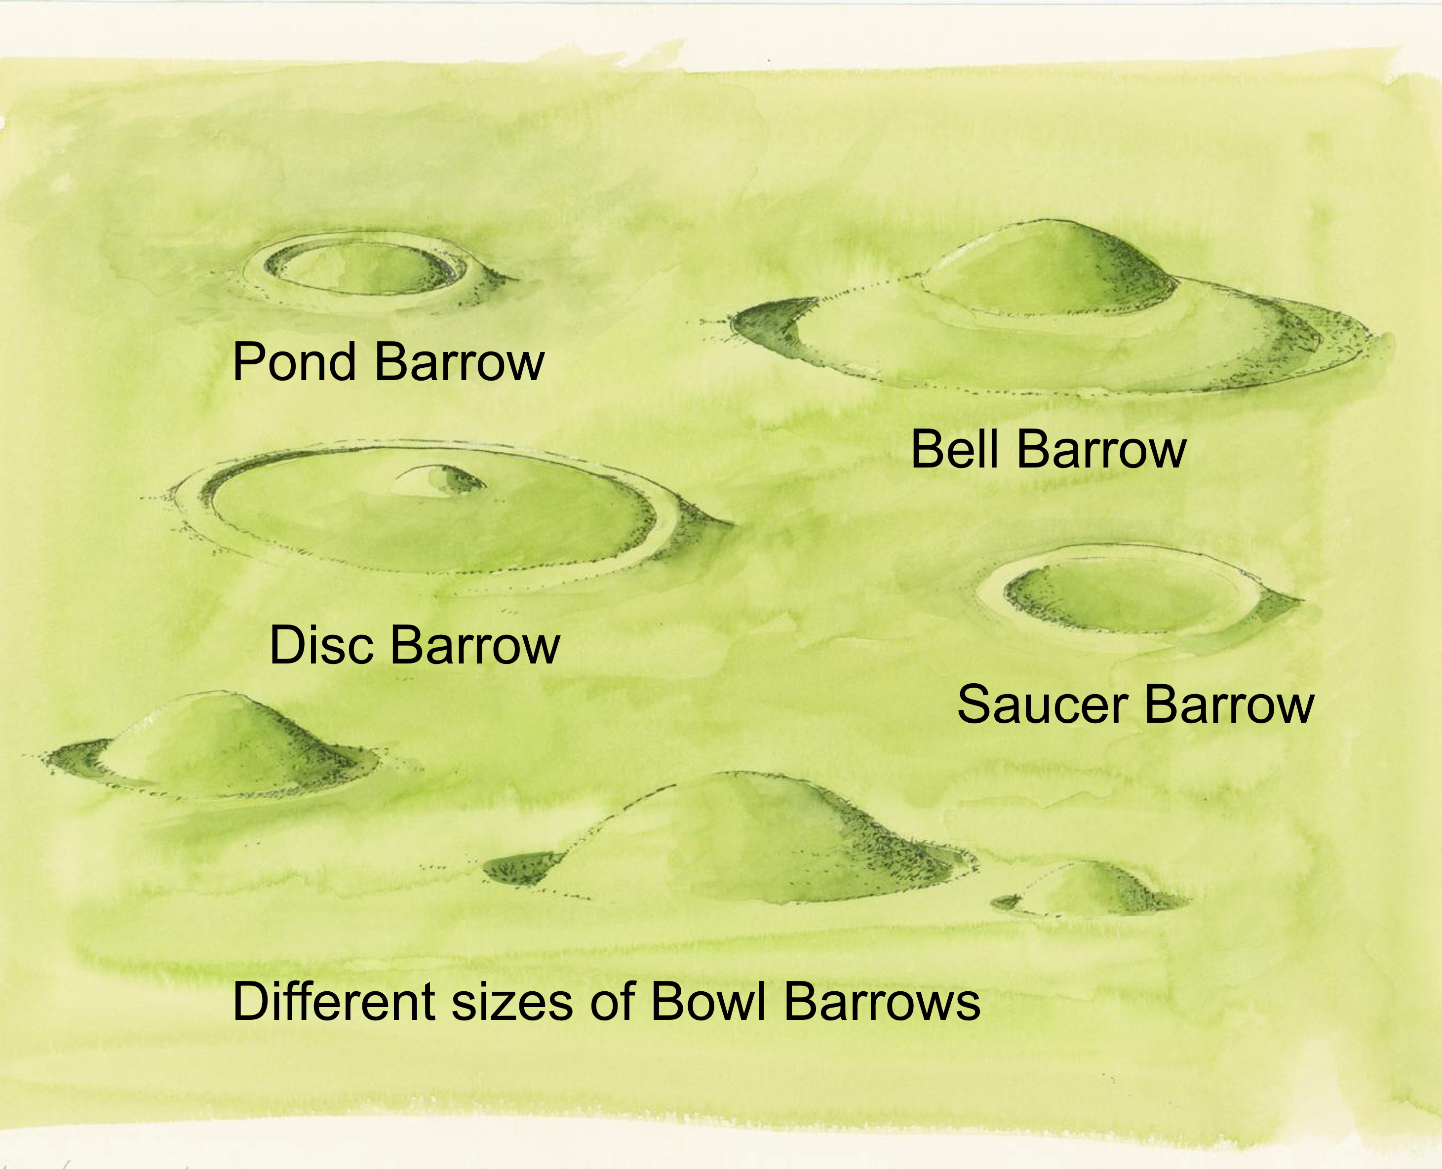
Death & Burial - Round Barrows
In the early Bronze Age human burials were often covered by large circular mounds of earth or stone, which archaeologists call Round Barrows.
On maps they are often called ‘tumulus’ (plural tumuli). This is from Latin and means mound or small hill.
There are different types, but the most common type are called Bowl Barrows – because they look like upside-down pudding bowls!
There are over 350 barrows in the landscape around Stonehenge alone.
Bronze Age Barrows, Stonehenge
Notes:
IMAGES:
Oblique aerial view of the Cursus Barrow Group at Stonehenge © Historic England Archive Ref: DP162546 - https://historicengland.org.uk/images-books/photos/item/DP162546
Reconstruction depicting a generic group of various types of Bronze Age burial mounds, known as barrows, similar to those found within the Stonehenge landscape © Historic England Archive Ref: IC095/025 - https://historicengland.org.uk/images-books/photos/item/ic095/025

Slide 11
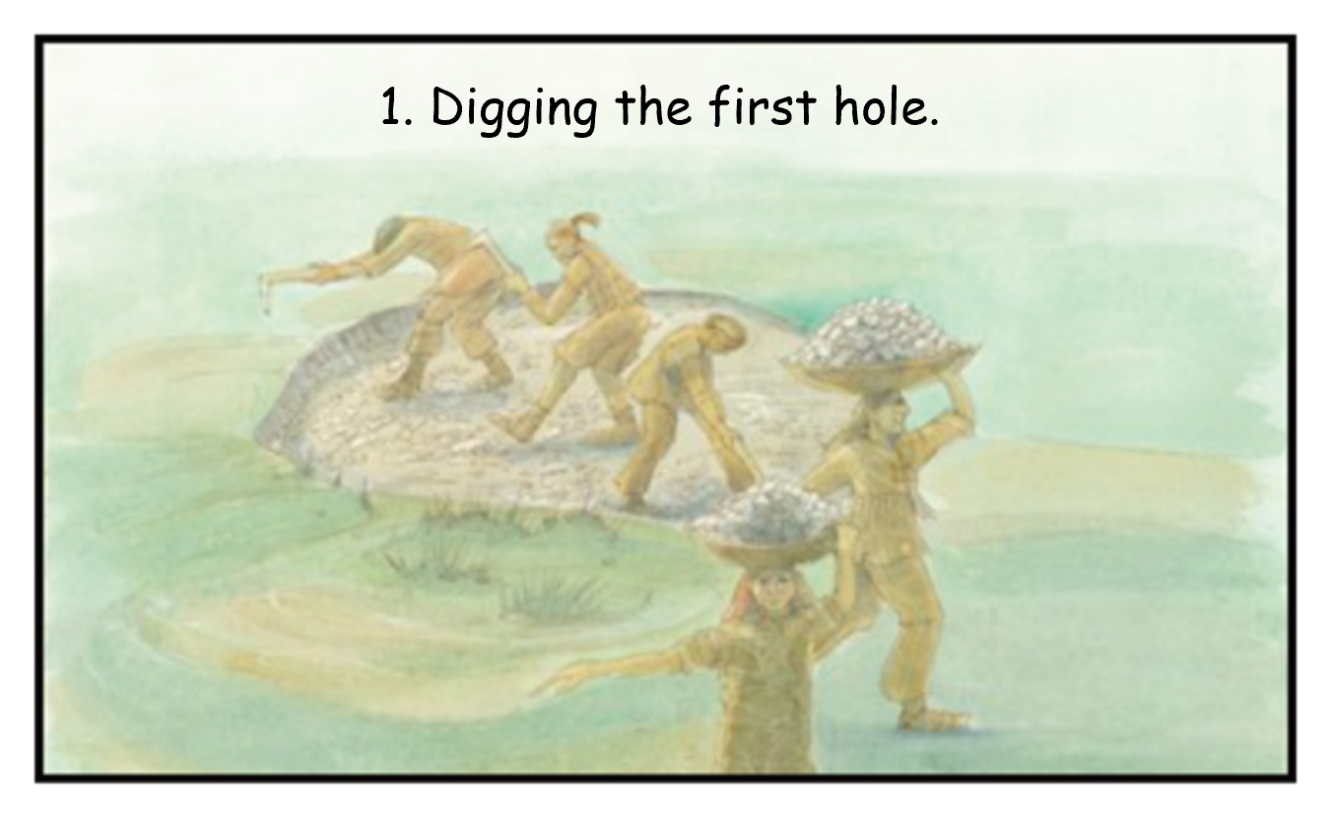
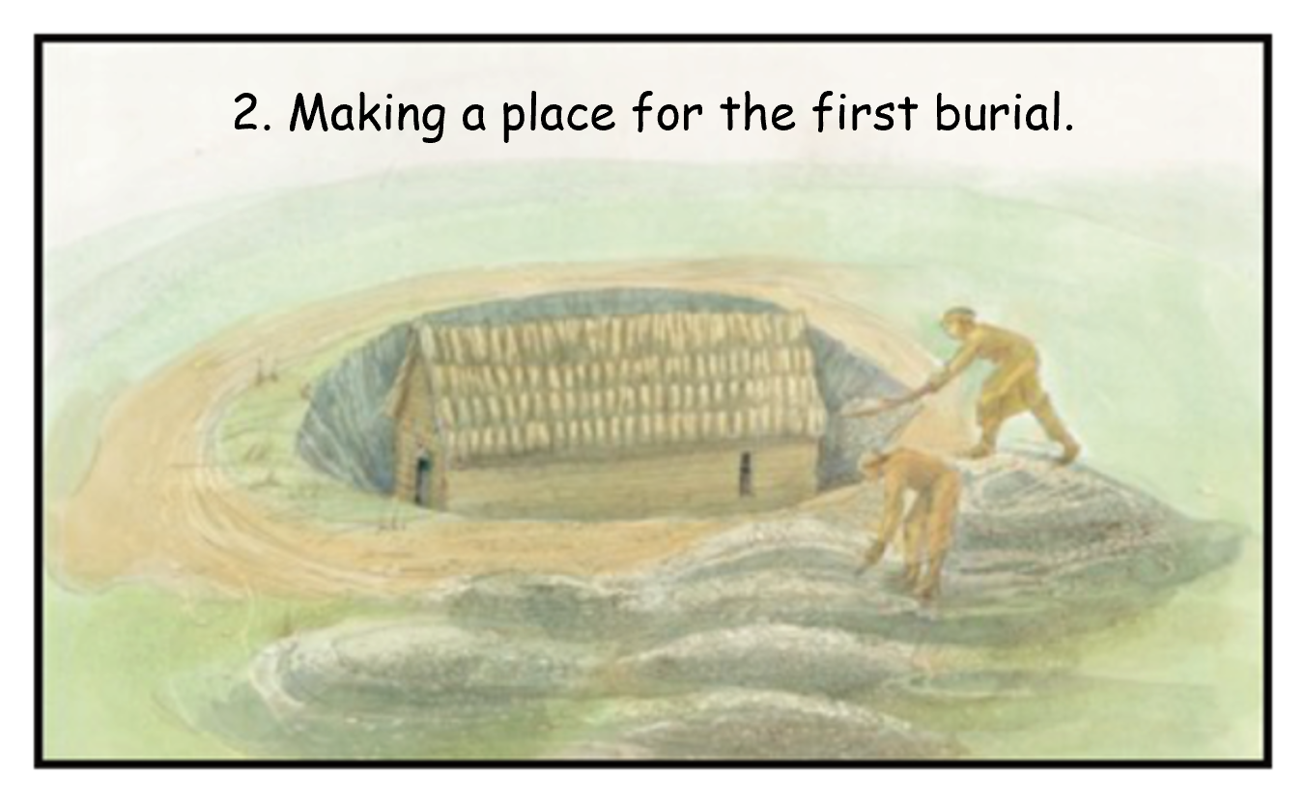
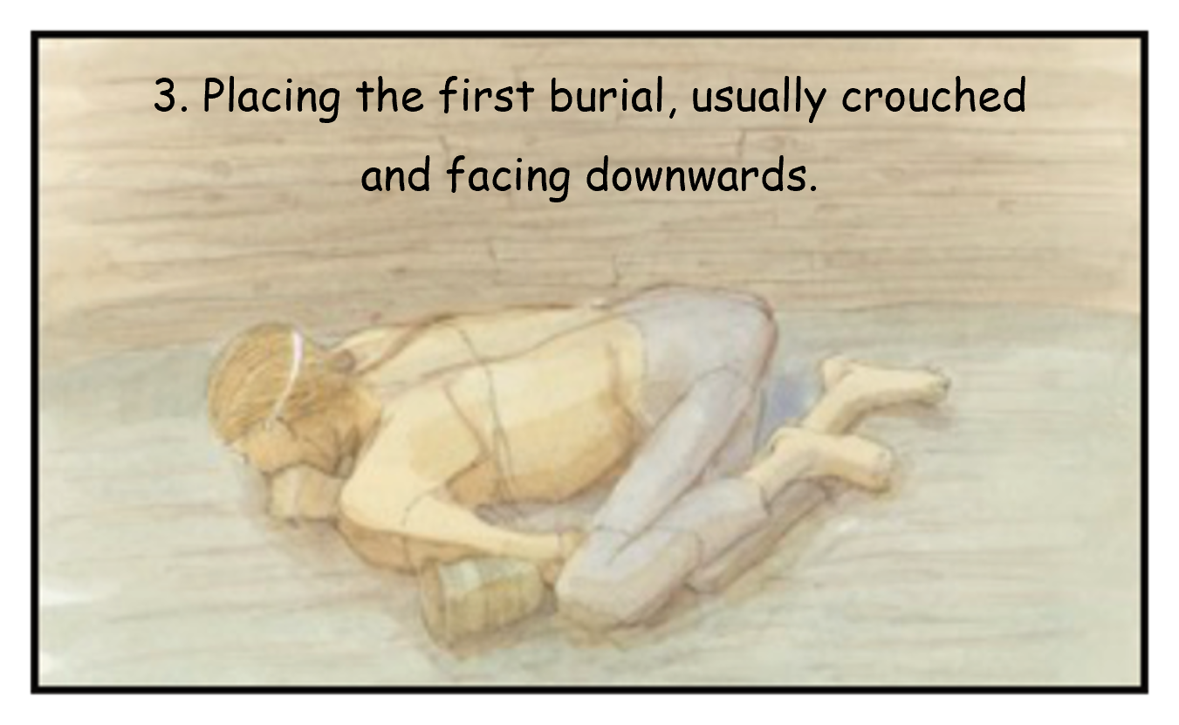
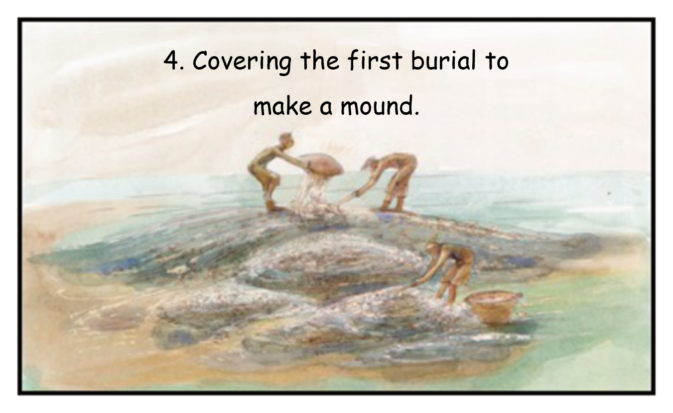
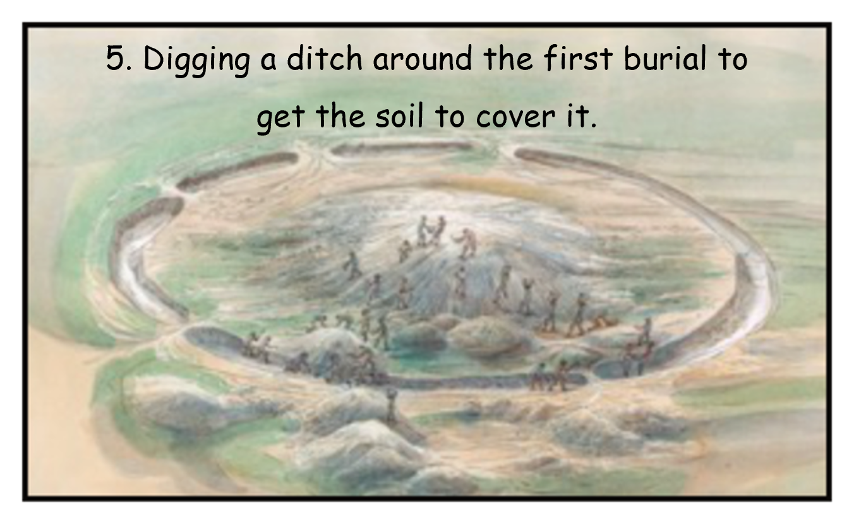
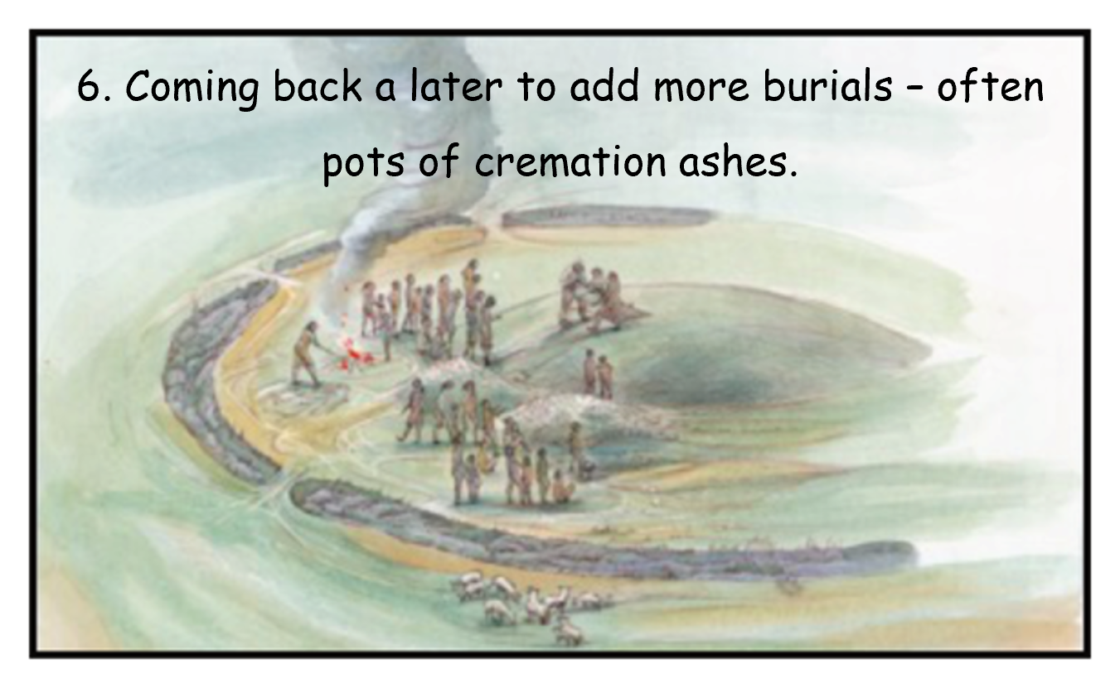
Death & Burial - Round Barrows
At first most of the people buried under round barrows were buried as whole bodies in a crouched position, sometimes in a coffin. Over time cremation became more common, with the ashes being collected and put in a pottery urn, which was often placed upside down within the barrow.
Stages of a Round Barrow
Notes:
IMAGES:
A reconstruction illustration showing Bronze Age figures digging the primary grave. © Historic England Archive Ref: IC095/098 - https://historicengland.org.uk/images-books/photos/item/IC095/098
A reconstruction illustration showing two Bronze Age figures constructing the mortuary house. © Historic England Archive Ref: IC095/099 - https://historicengland.org.uk/images-books/photos/item/IC095/099
A reconstruction illustration showing a (crouched) body in the mortuary house. © Historic England Archive Ref: IC095/100 - https://historicengland.org.uk/images-books/photos/item/IC095/100
A reconstruction illustration showing figures building the barrow mound. © Historic England Archive Ref: IC095/101 - https://historicengland.org.uk/images-books/photos/item/IC095/101
A reconstruction illustration showing figures digging the ditch. © Historic England Archive Ref: IC095/102 - https://historicengland.org.uk/images-books/photos/item/IC095/102
A reconstruction illustration showing figures digging a (later) grave in the top of the mound to place a pottery cremation urn. © Historic England Archive Ref: IC095/103 - https://historicengland.org.uk/images-books/photos/item/IC095/103

Slide 12
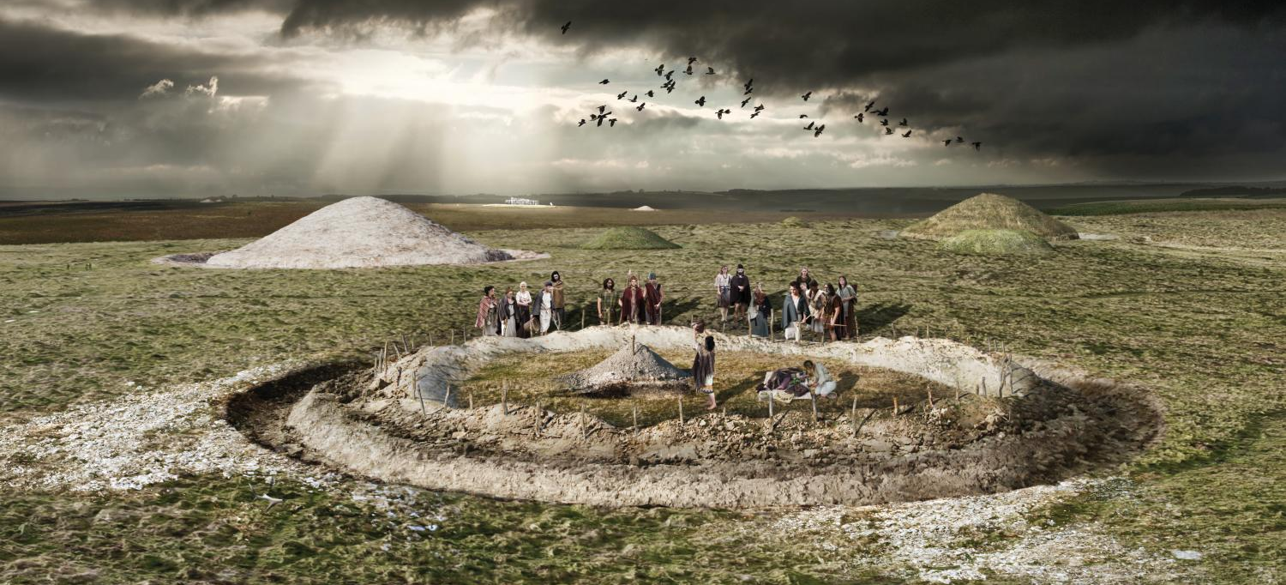
Death & Burial - Round Barrow Burial Reconstruction
Notes:
IMAGE:
Reconstruction drawing depicting the burial of a woman within a round barrow at the Normanton Down Barrow Group near Stonehenge in about 1900BC, during the Early Bronze Age. After burial, the mound of the barrow would have been built over the grave. © Historic England Archive Ref: IC095/081 - https://historicengland.org.uk/images-books/photos/item/IC095/081

Slide 13
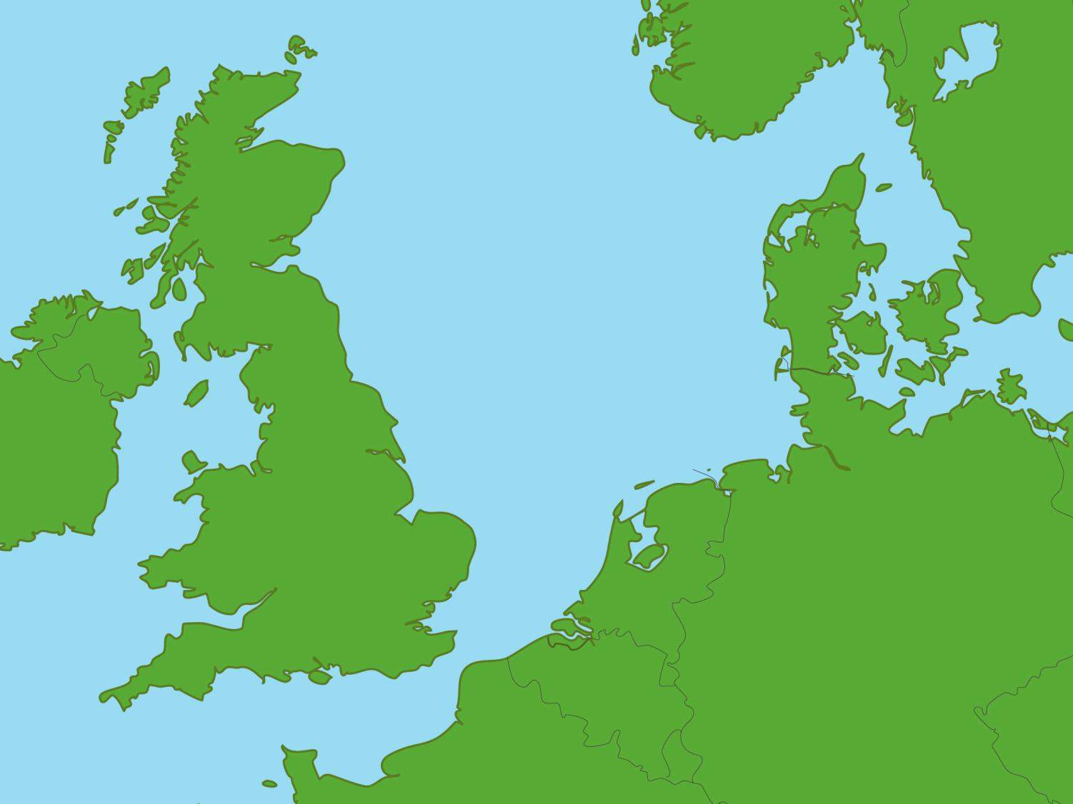
Bronze Age settlements
Click on the dots to learn about our Top 8 Bronze Age sites
Mold
Seahenge
Must Farm and Flag Fen
Dover
Whitehorse Hill
Near Lewes
Cliffs End Farm
Grimspound
Notes:
Click on the red dots to learn more about each location

Slide 14
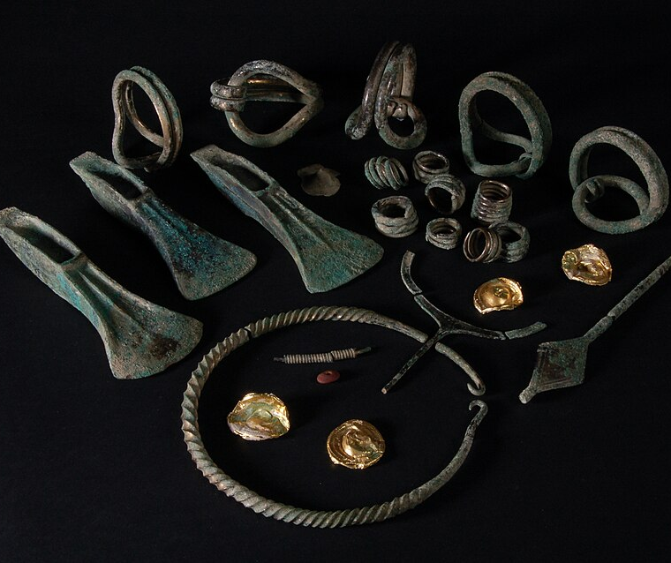
Near Lewes Hoard, East Sussex
Back to map
This group of objects was found ‘near Lewes’ in Sussex. Dating to around 1400-1250 BC, it is known as a ‘hoard’. Hoards are collections that archaeologists believe were buried together as ceremonial offerings, or to keep valuable things safe.
At Lewes more than 50 objects — bronze axes, bronze torcs (neck or arm rings), finger rings, gold discs, pins, bracelets and necklaces with amber and ceramic beads — were buried in a pot.
The ‘Near Lewes Hoard’
Notes:
IMAGE:
The ‘Near Lewes’ hoard. © Portable Antiquities Scheme from London, England, CC BY 2.0, via Wikimedia Commons - https://commons.wikimedia.org/wiki/File:Near_Lewes_Hoard.jpg
QUESTION:
What would you bury as your most important objects and why?
LINKS:
Loop Bracelet 3D Model - https://sketchfab.com/3d-models/loop-bracelet-1903-6-251-08c12513f176468d8b598a0a079efb9b
Palstave Axe 3D Model - https://sketchfab.com/3d-models/bronze-age-palstave-p1991-3-3-8-a160a430fbfd468fb54cd34350752af0

Slide 15
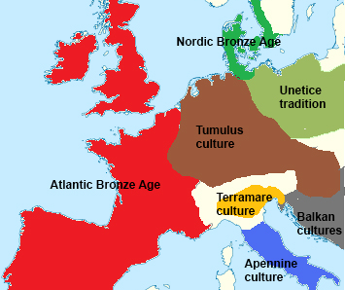
Near Lewes Hoard, East Sussex
Back to map
The gold discs came from France. The amber beads, and spiral-shaped rings, came from countries such as France, Germany, Poland, and Austria – then part of the Tumulus culture.
The way the objects were found is also unusual. They were placed inside a clay pot, which was not common in Britain at that time, but was more normal in places like northern France.
The hoard shows us that people in Britain were trading, travelling, or sharing ideas with people far away.
QUESTION
What would you bury as your most important object and why?
Several objects came from the Tumulus culture
Notes:
IMAGE:
Middle Bronze Age Europe (simplified). © Xoil, CC BY-SA 3.0, via Wikimedia Commons - https://commons.wikimedia.org/wiki/File:Middle_Bronze_Age_Europe_%28simplified%29.jpg
QUESTION:
What would you bury as your most important objects and why?
LINKS:
Loop Bracelet 3D Model - https://sketchfab.com/3d-models/loop-bracelet-1903-6-251-08c12513f176468d8b598a0a079efb9b
Palstave Axe 3D Model - https://sketchfab.com/3d-models/bronze-age-palstave-p1991-3-3-8-a160a430fbfd468fb54cd34350752af0

Slide 16
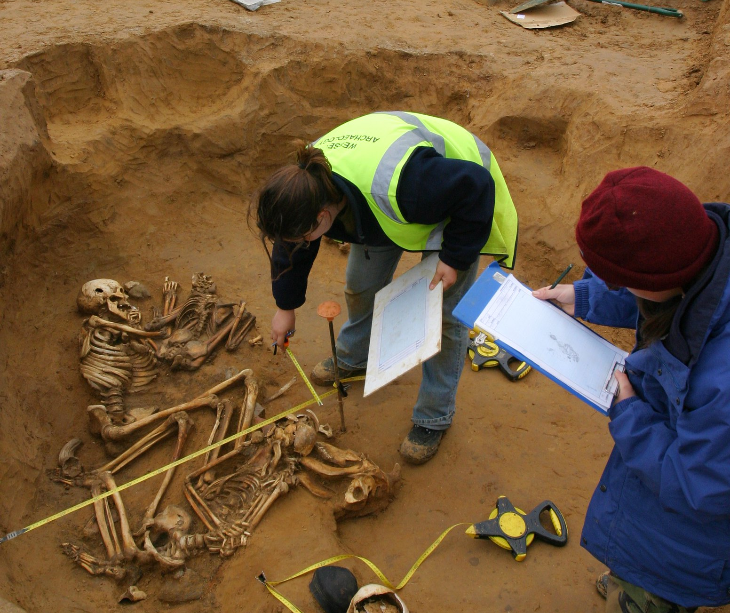
Cliffs End Farm, Kent
Back to map
During excavations at Cliffs End Farm, Ramsgate, Kent, a group of burials were found in a large pit. The first burial in the pit was that of an elderly woman who had been killed, perhaps as a sacrifice.
There were several other complete skeletons as well as just scattered bits of human bone. There were also the bones of cattle, lambs and a buzzard.
All these people lived – and died, in the late Bronze Age, around 3000 years ago.
Drawing the pit burial at Cliffs End Farm
Notes:
IMAGE:
Cliffs End Farm – drawing the pit burial. © Wessex Archaeology, via Flikr -https://www.flickr.com/photos/wessexarchaeology/118766024/
QUESTION:
How and why do you think people travelled across prehistoric Europe?
LINKS:
Question1 PPT & Activity in - https://historicengland.org.uk/education/schools-resources/teaching-activities/ramsgate-local-history/
More photos of the site – https://www.flickr.com/search/?user_id=32884265%40N00&view_all=1&text=cliffs+end
Site info - http://www.wessexarch.co.uk/projects/kent/ramsgate/cliffs_end

Slide 17
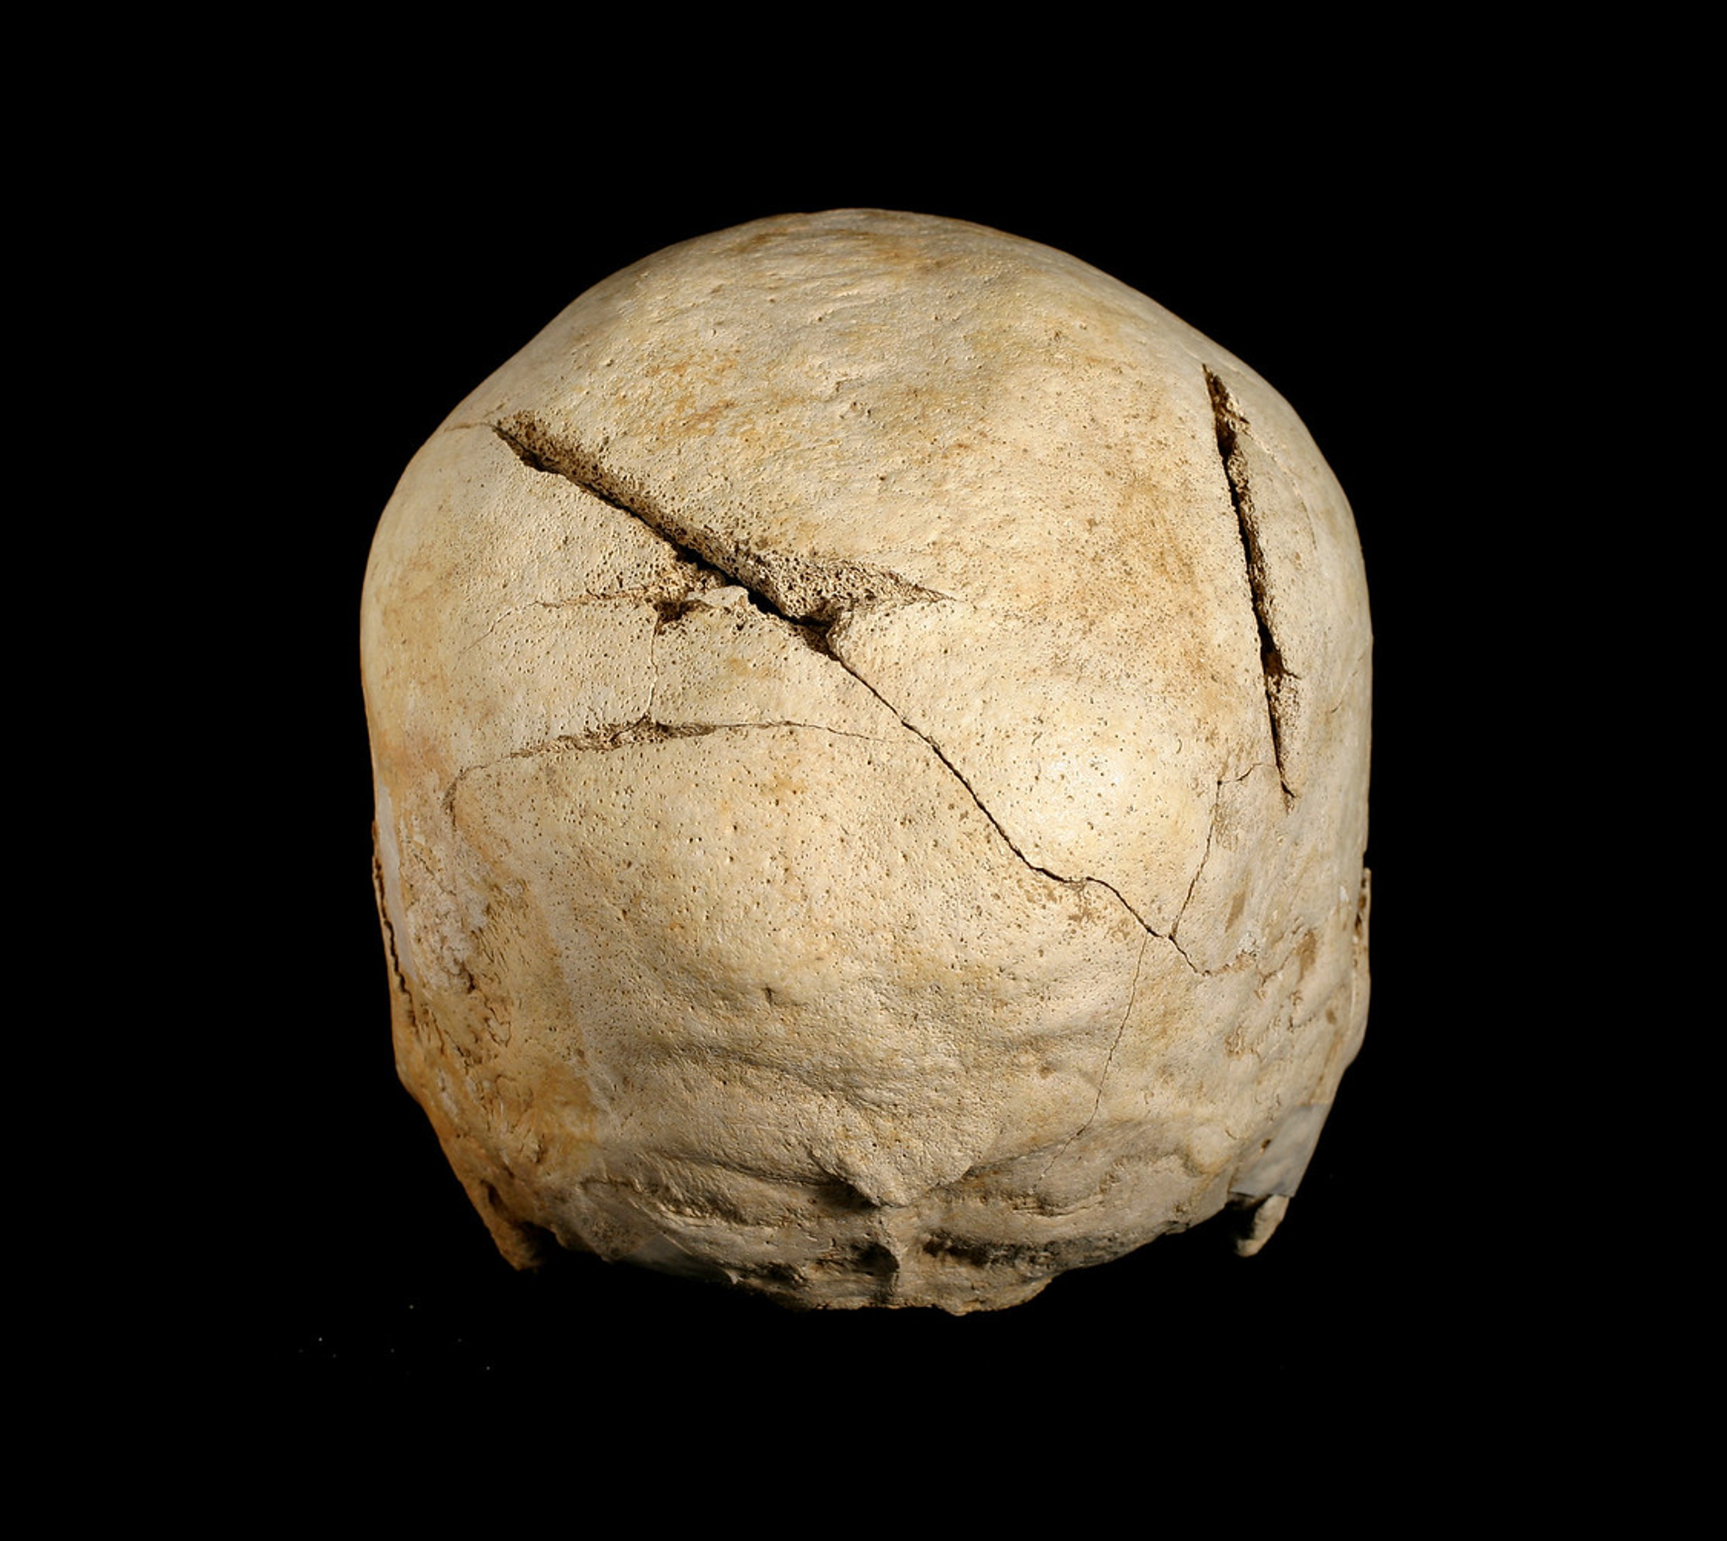
Cliffs End Farm, Kent
Back to map
Some were buried with their hands tied behind their backs and others had signs of a violent death, such as blows to the head with a sharp weapon.
Scientific analysis of the human bones has shown that there were three groups of people: some were local, some came from Scandinavia and some from southern Europe.
This shows that some people travelled long distances across Europe in the Bronze Age.
QUESTION
How and why do you think people travelled across prehistoric Europe?
Skull with cut marks at Cliffs End Farm
Notes:
IMAGE:
Cliffs End - skull detail 2. © Wessex Archaeology, via Flikr - https://www.flickr.com/photos/wessexarchaeology/2804993889/
QUESTION:
How and why do you think people travelled across prehistoric Europe?
LINKS:
Question1 PPT & Activity in - https://historicengland.org.uk/education/schools-resources/teaching-activities/ramsgate-local-history/
More photos of the site – https://www.flickr.com/search/?user_id=32884265%40N00&view_all=1&text=cliffs+end
Site info - http://www.wessexarch.co.uk/projects/kent/ramsgate/cliffs_end

Slide 18
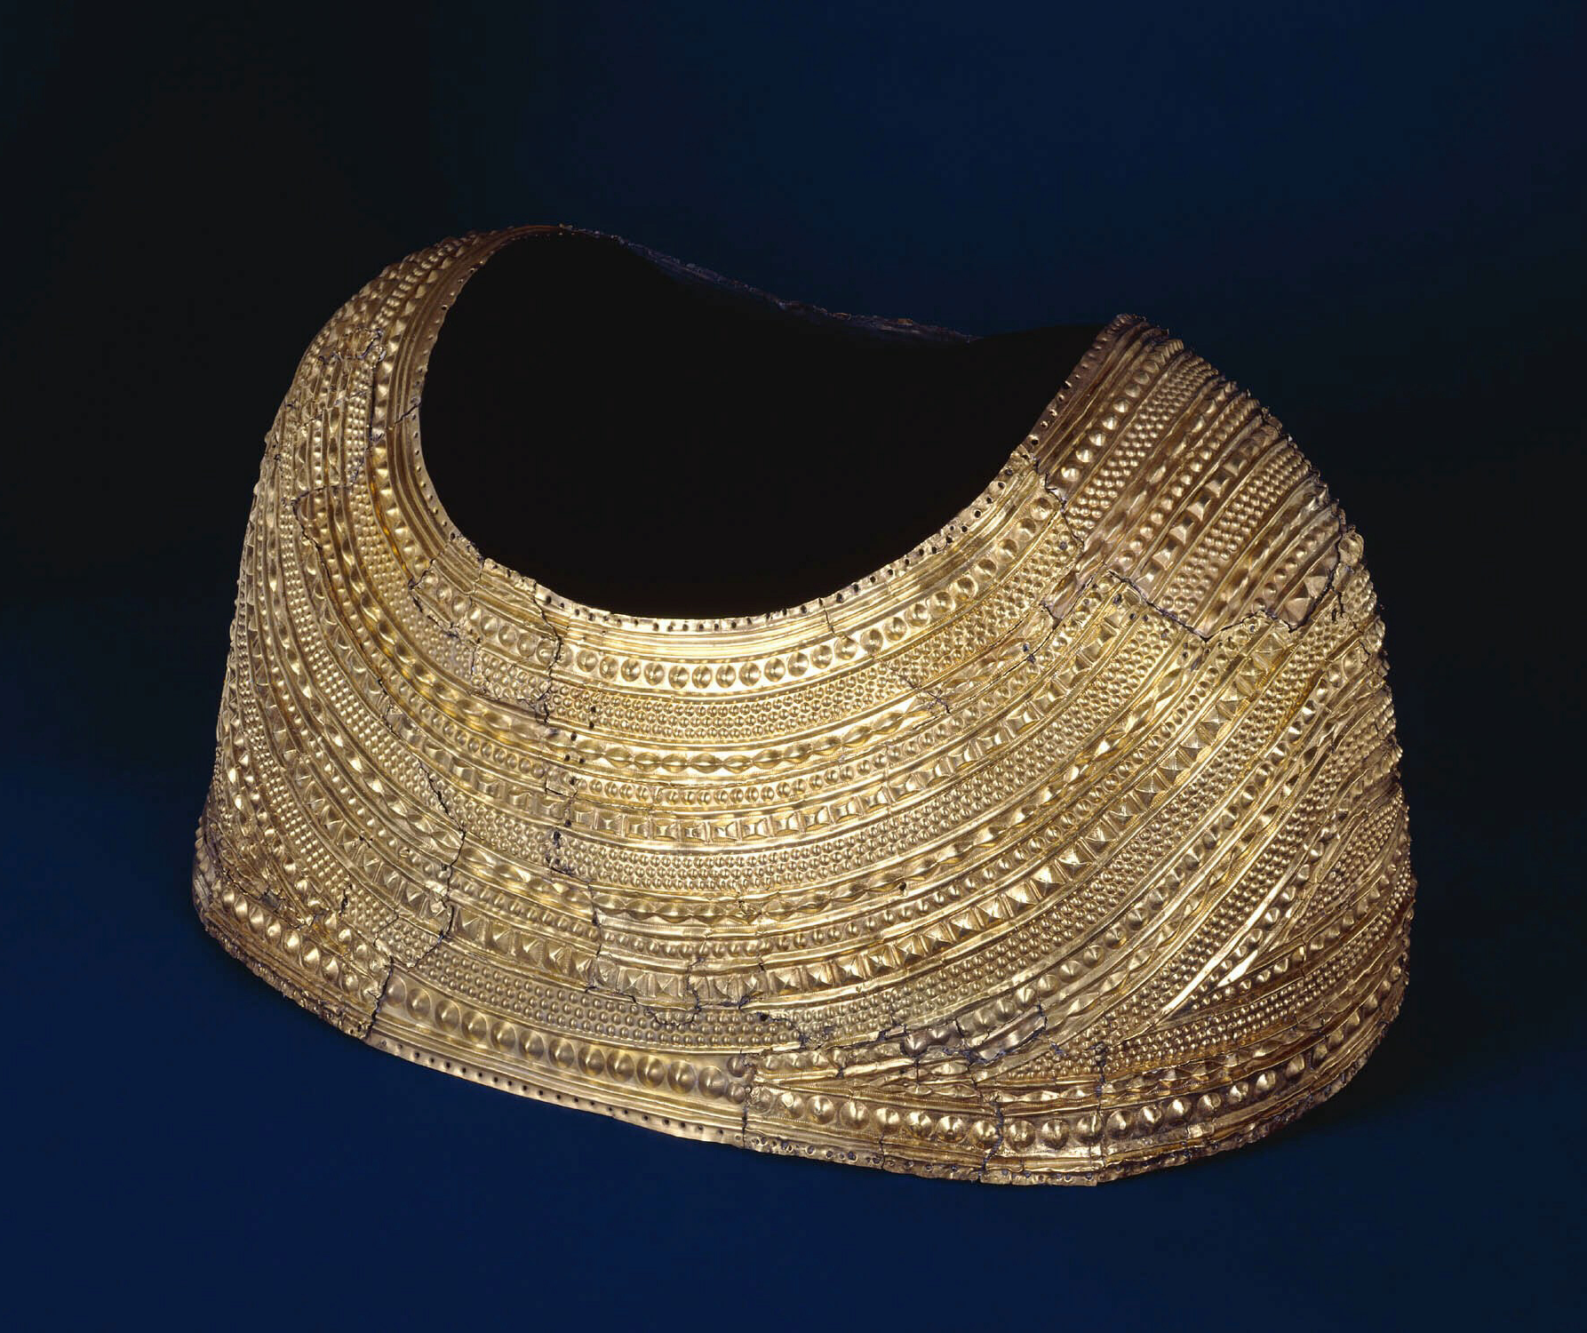
The Mold Cape, Flintshire
Back to map
The cape was found by workmen in 1833, digging for stone in an old burial mound in Mold, Flintshire, Wales.
It is 3900 to 3600 years old. The shape means that you would not be able to move your arms very well, so it was probably used for ceremonies, rather than everyday wear!
The cape is quite small – it wouldn’t fit a normal man. It was probably made for a woman or a child. Whoever wore it must have been very important.
Gold cape
Notes:
IMAGE:
The Mold gold cape. © Trustees of the British Museum - https://www.britishmuseum.org/collection/object/H_1883-1207-1
QUESTION:
Who do you think the Mold Cape was made for? Why was it buried?
LINKS:
Google Arts & Culture: The Mold Cape - https://artsandculture.google.com/story/the-mold-cape-the-british-museum/VgVRiXmzf05eLw?hl=en
Mold Cape 3D model - https://sketchfab.com/3d-models/mold-gold-cape-9866e9b8f8c94fa3890c137516861241

Slide 19
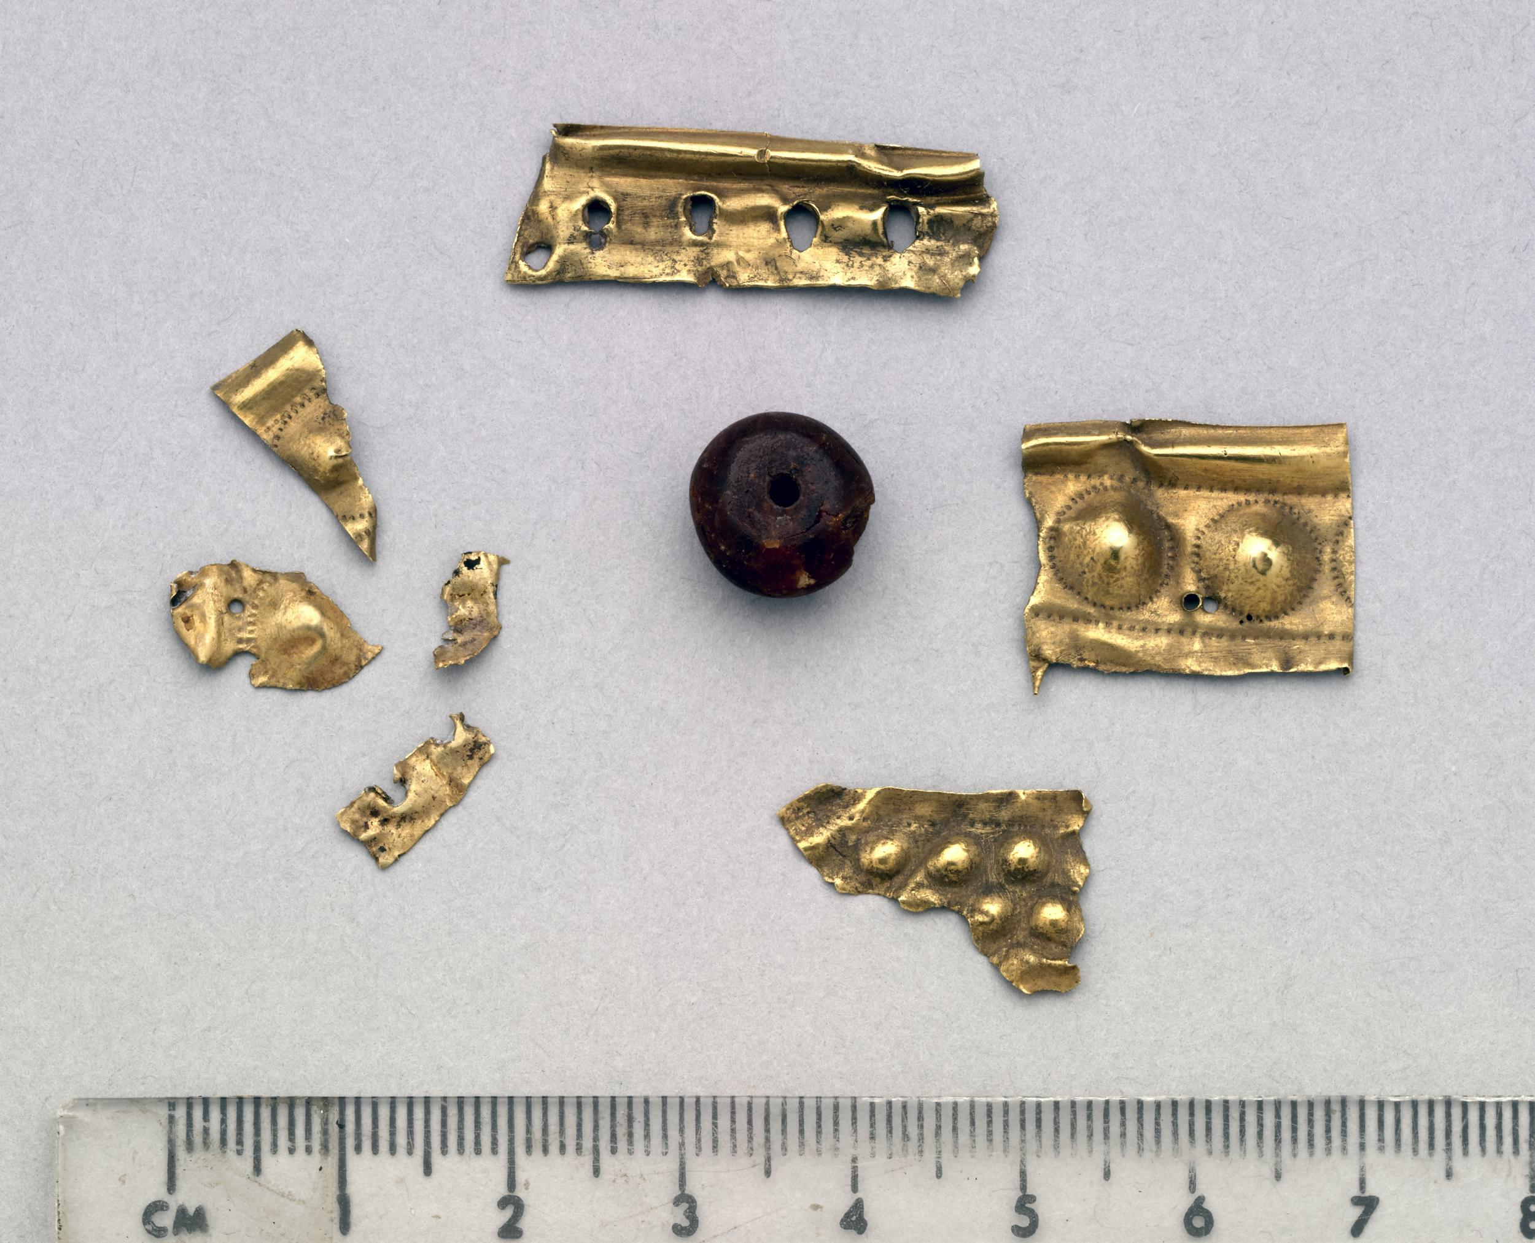
The Mold Cape, Flintshire
Back to map
The cape is one of the best examples of prehistoric sheet-gold working and is unique in shape and design. It was hammered out of a single gold lump.
The decoration looks like strings of jewellery or folds of cloth and was hammered into the gold sheet. It was once attached to a lining, perhaps of leather, which has decayed.
Lots of amber beads, maybe between 200 and 300, were also in the grave, but many of these and the bones from the grave have been lost.
QUESTION
Who do you think the Mold Cape was made for? Why was it buried?
Amber bead and gold decoration
Notes:
IMAGE:
Gold fragments and amber bead. © Trustees of the British Museum - https://www.britishmuseum.org/collection/object/H_1852-0615-1
QUESTION:
Who do you think the Mold Cape was made for? Why was it buried?
LINKS:
Google Arts & Culture: The Mold Cape - https://artsandculture.google.com/story/the-mold-cape-the-british-museum/VgVRiXmzf05eLw?hl=en
Mold Cape 3D model - https://sketchfab.com/3d-models/mold-gold-cape-9866e9b8f8c94fa3890c137516861241

Slide 20
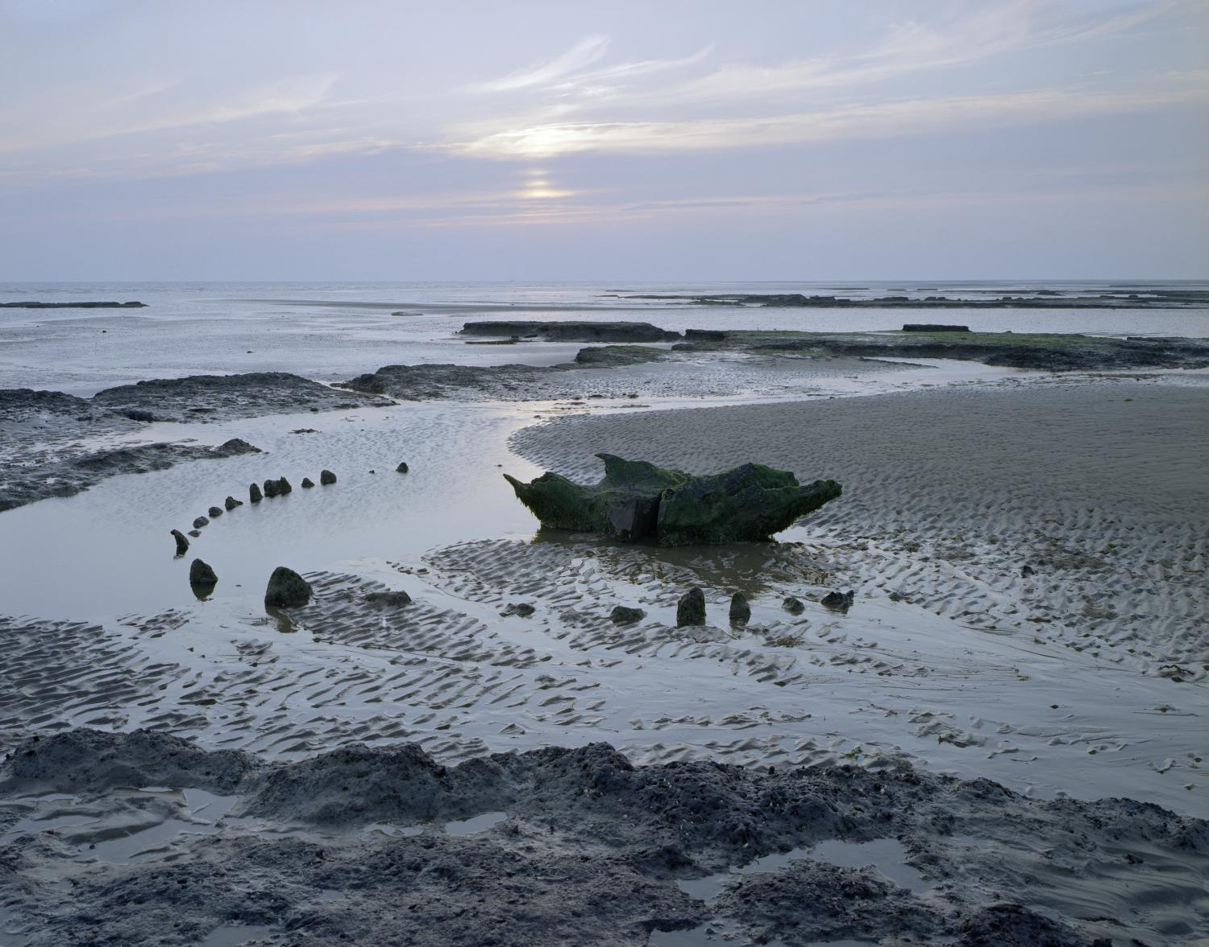
Seahenge, Norfolk
Back to map
‘Seahenge’, on the north coast of Norfolk, is a timber circle of 55 wooden posts surrounding a huge, upturned tree stump.
Because the site was waterlogged archaeologists were able to work out that the ropes used to move the tree trunk into place were made from twisted stands of honeysuckle.
The outer ring of posts was built of split oak tree trunks, with the bark facing outwards. A ‘Y’ shaped timber formed the entrance to the circle.
Seahenge at sunrise
Notes:
IMAGE:
Sunrise At The (Seahenge) Timber Circle. © Historic England Archive Ref: BB99/06280 - https://historicengland.org.uk/images-books/photos/item/BB99/06280
QUESTION:
Why do you think people turned a tree upside down at Seahenge?
LINKS:
Google Arts & Culture: Seahenge - https://artsandculture.google.com/story/pwVhBxecshzaMQ

Slide 21
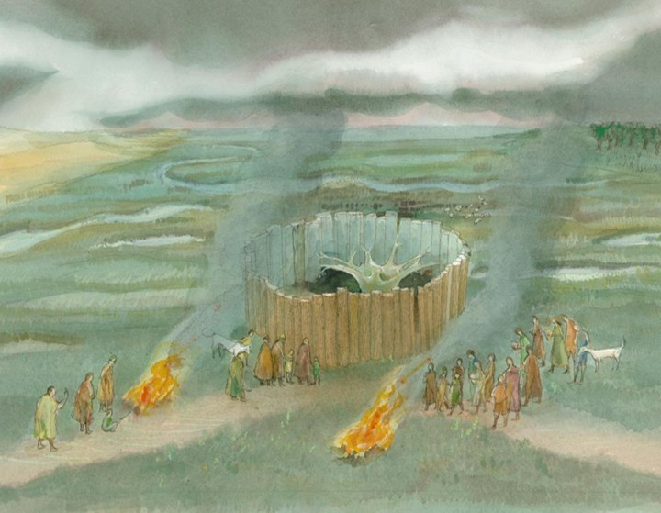
Seahenge, Norfolk
Back to map
Tree-ring and radiocarbon dating show that the circle was built in 2049 BC.
Marks from at least 50 different bronze axes have been found on the timbers.
The size of the circle, 6.6m in diameter, with the outer posts being up to 3m high, suggests the act of building the circle brought a wide community of people together.
Archaeologists will never know why it was built but one theory is that the upturned stump supported the body of an important person before burial.
QUESTION
Why do you think people turned a tree upside down at Seahenge?
Seahenge reconstruction drawing
Notes:
IMAGE:
Reconstruction illustration depicting Seahenge as it may have appeared when newly constructed in about 2049BC. People are shown gathered beside the monument, with fires lit in the foreground. © Historic England Archive Ref: IC222/003 - https://historicengland.org.uk/images-books/photos/item/IC222/003
QUESTION:
Why do you think people turned a tree upside down at Seahenge?
LINKS:
Google Arts & Culture: Seahenge - https://artsandculture.google.com/story/pwVhBxecshzaMQ

Slide 22
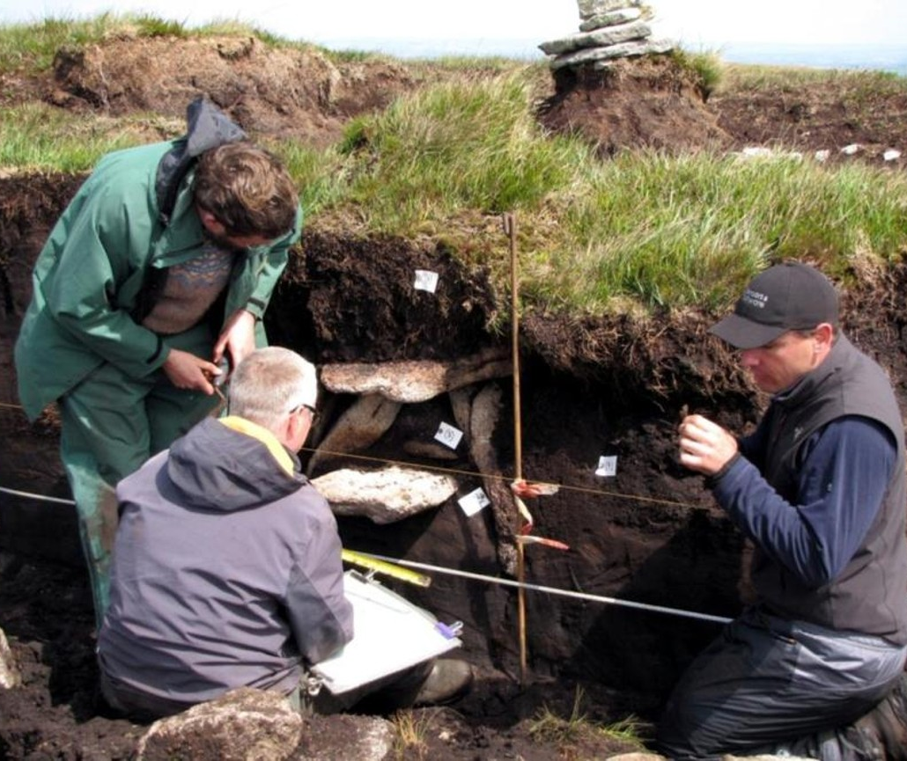
Whitehorse Hill, Devon
Back to map
In 2011 a very well-preserved set of grave goods was found in a square stone burial chest (‘cist’) within a natural peat mound on Dartmoor.
The cist also contained the cremated bones of a 15–25-year-old person, probably a female, who died between 3900 and 3700 years ago.
The cremated bones had been wrapped in a bearskin and placed on a layer of purple moor grass.
Excavating the burial ‘cist’
Notes:
IMAGE:
Excavating the cist (burial) at Whitehorse Hill. © Dartmoor National Park Authority
QUESTION:
What do you think the different things in the grave tell us about the person buried here?
LINKS:
Film – The Life of Marghwen - https://youtu.be/lqieJmIuR14?t=295 (Play from 4:55)
Whitehorse Hill webpage - https://www.dartmoor.gov.uk/wildlife-and-heritage/heritage/bronze-age/whitehorse-hill

Slide 23
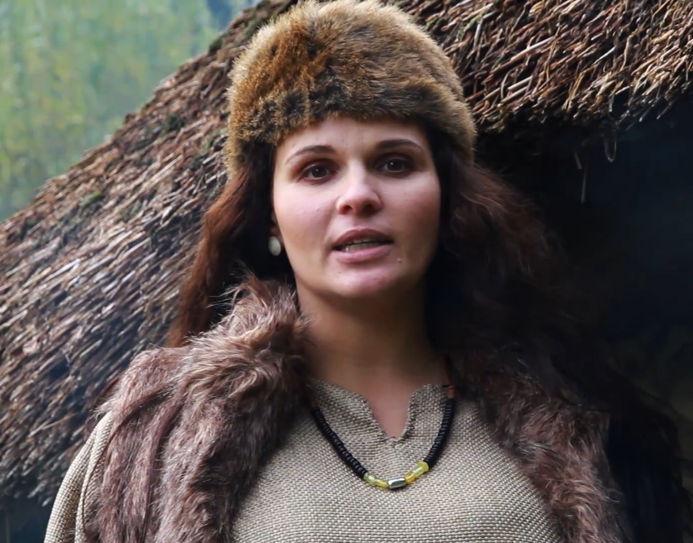
Whitehorse Hill, Devon
Back to map
There was also a woven bag containing a woven bracelet with tin studs, 200 beads of shale, amber, clay and tin (which most likely formed a necklace), two pairs of turned wooden ear studs and a flint tool.
These objects are very rare, and many came from a long way off or abroad.
Although young, the person buried here was clearly very important, perhaps part of a leader’s family.
Watch this film to see a reconstruction of this young woman’s life.
Screenshot from ‘The Life of Marghwen’ film
Notes:
IMAGE:
Screenshot from ‘The Life of Marghwen’ film. © Dartmoor National Park Authority
QUESTION:
What do you think the different things in the grave tell us about the person buried here?
LINKS:
Film – The Life of Marghwen - https://youtu.be/lqieJmIuR14?t=295 (Play from 4:55)
Whitehorse Hill webpage - https://www.dartmoor.gov.uk/wildlife-and-heritage/heritage/bronze-age/whitehorse-hill

Slide 24
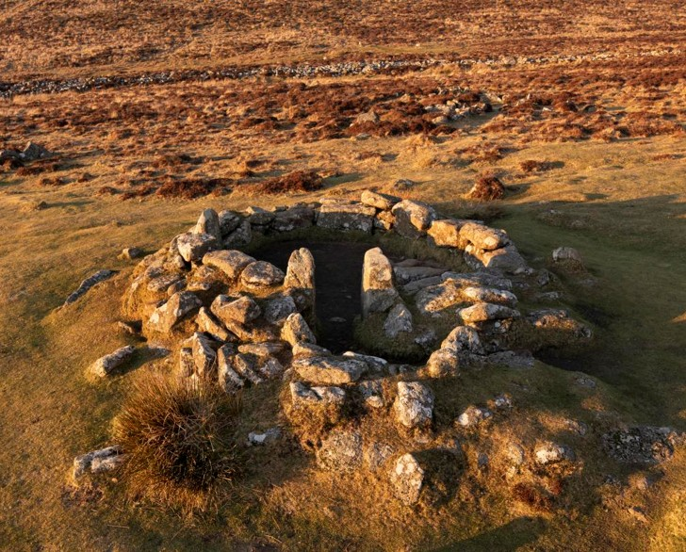
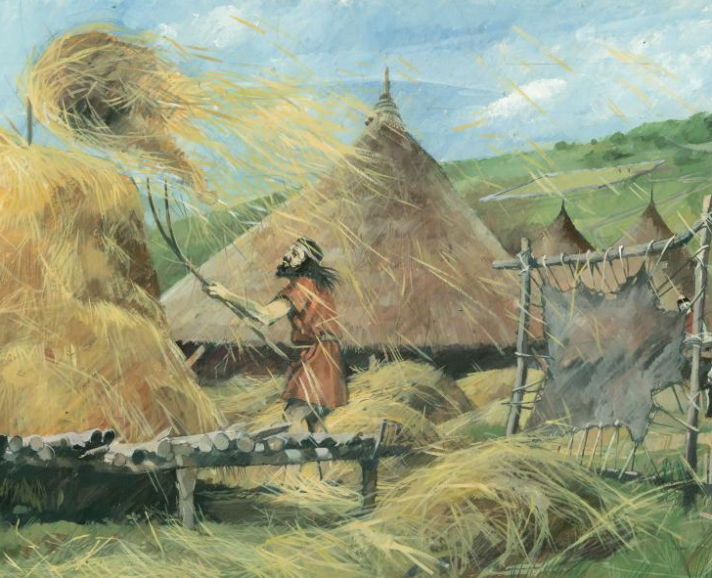
Grimspound, Devon
Back to map
Grimspound, on Dartmoor in Devon is a later Bronze Age village, lived in between 3500 and 3000 years ago.
The stone foundations of 24 round huts (roundhouses) that were excavated at the end of the 19th century are still visible today.
These huts would have been covered with conical roofs of turf or thatch.
Inside people would have cooked on a central fireplace and used clay pots and flint tools. The huts also had paved floors and raised benches.
Remains of stone roundhouse
Notes:
IMAGES:
General view of a bronze age stone-based round house at Grimspound, from the south-west. © Historic England Archive Ref: DP349102 - https://historicengland.org.uk/images-books/photos/item/DP349102
Reconstruction illustration showing agricultural activities within the late Bronze Age settlement of Grimspound. A man is building a haystack, animal skins are being processed, and a complex of roundhouses are shown in the background. © Historic England Archive Ref: IC047/001 https://historicengland.org.uk/images-books/photos/item/DP349101
QUESTION:
Why do you think the houses survive at Grimspound?
LINKS:
English Heritage – Grimspound History - https://www.english-heritage.org.uk/visit/places/grimspound/history/

Slide 25
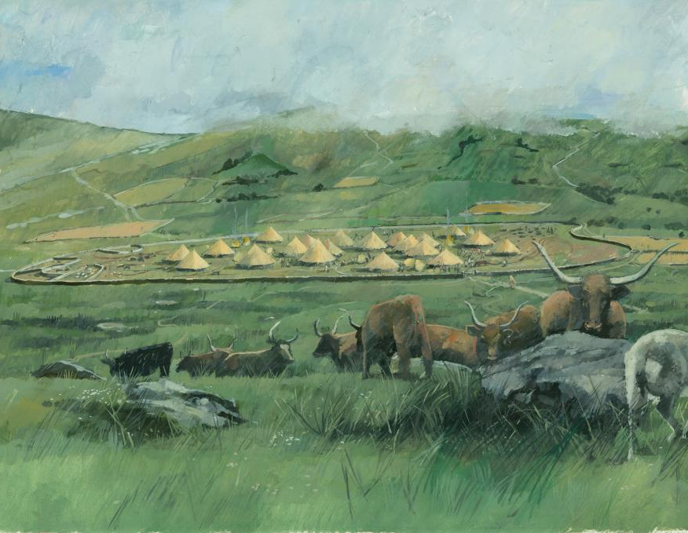
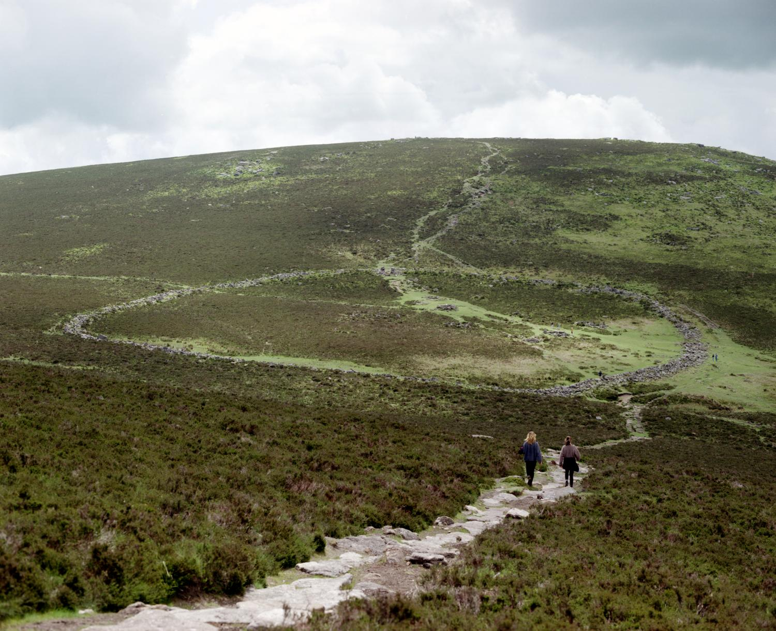
Grimspound, Devon
Back to map
The village was surrounded by a large boundary wall enclosing an area about 150m across. It is more likely to have been used to keep animals in or out than for defence.
The people living at Grimspound were farmers who kept livestock and grew crops. At this time the soils on Dartmoor were more fertile than they are today.
Elsewhere roundhouses were usually built of timber, rather than stone, so do not survive as visible features today.
QUESTION
Why do you think the houses at Grimspound survive today?
Remains of Grimspound Bronze Age village
Notes:
IMAGES:
(Grimspound) Exterior Enclosure From North. © Crown Copyright. Historic England Archive Ref: AA008409 - https://historicengland.org.uk/images-books/photos/item/AA008409
Reconstruction illustration showing the late Bronze Age settlement of Grimspound on Dartmoor, and its surrounding landscape, as seen from the south-west. © Historic England Archive Ref: IC047/002 - https://historicengland.org.uk/images-books/photos/item/IC047/002
QUESTION:
Why do you think the houses survive at Grimspound?
LINK:
English Heritage – Grimspound History - https://www.english-heritage.org.uk/visit/places/grimspound/history/

Slide 26
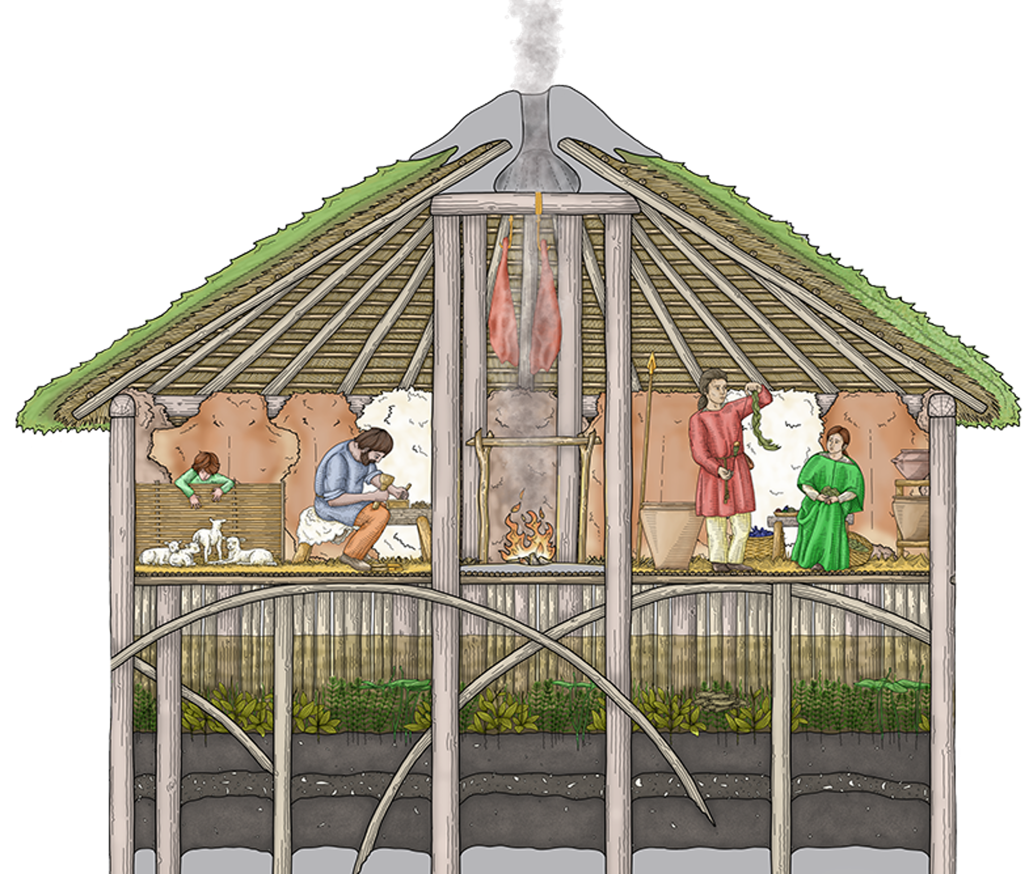
Must Farm & Flag Fen, Cambridgeshire
Back to map
Some of the most remarkable Bronze Age finds have come from the Fens near Peterborough.
At Must Farm, known as ‘Britain’s Pompei’, a settlement was built on timber platforms over a river.
Around 900-800 BC it burnt down and fell into the river channel, preserving many fragile objects, such as pots which still contained food, metalwork, fabric and wooden objects – including the oldest wheel ever found in Britain.
Download the Classroom Resources.
Must Farm Reconstruction Drawing
Notes:
IMAGE:
Must Farm House Reconstruction © Vicky Herring, via CAU
QUESTION:
Why might people have built houses over a river?
LINKS:
Classroom Resources - Must Farm: What was life like in the Bronze Age? - https://historicengland.org.uk/education/schools-resources/teaching-activities/must-farm-life-in-the-bronze-age/
Flag Fen Archaeology Park - https://flagfen.org.uk/

Slide 27
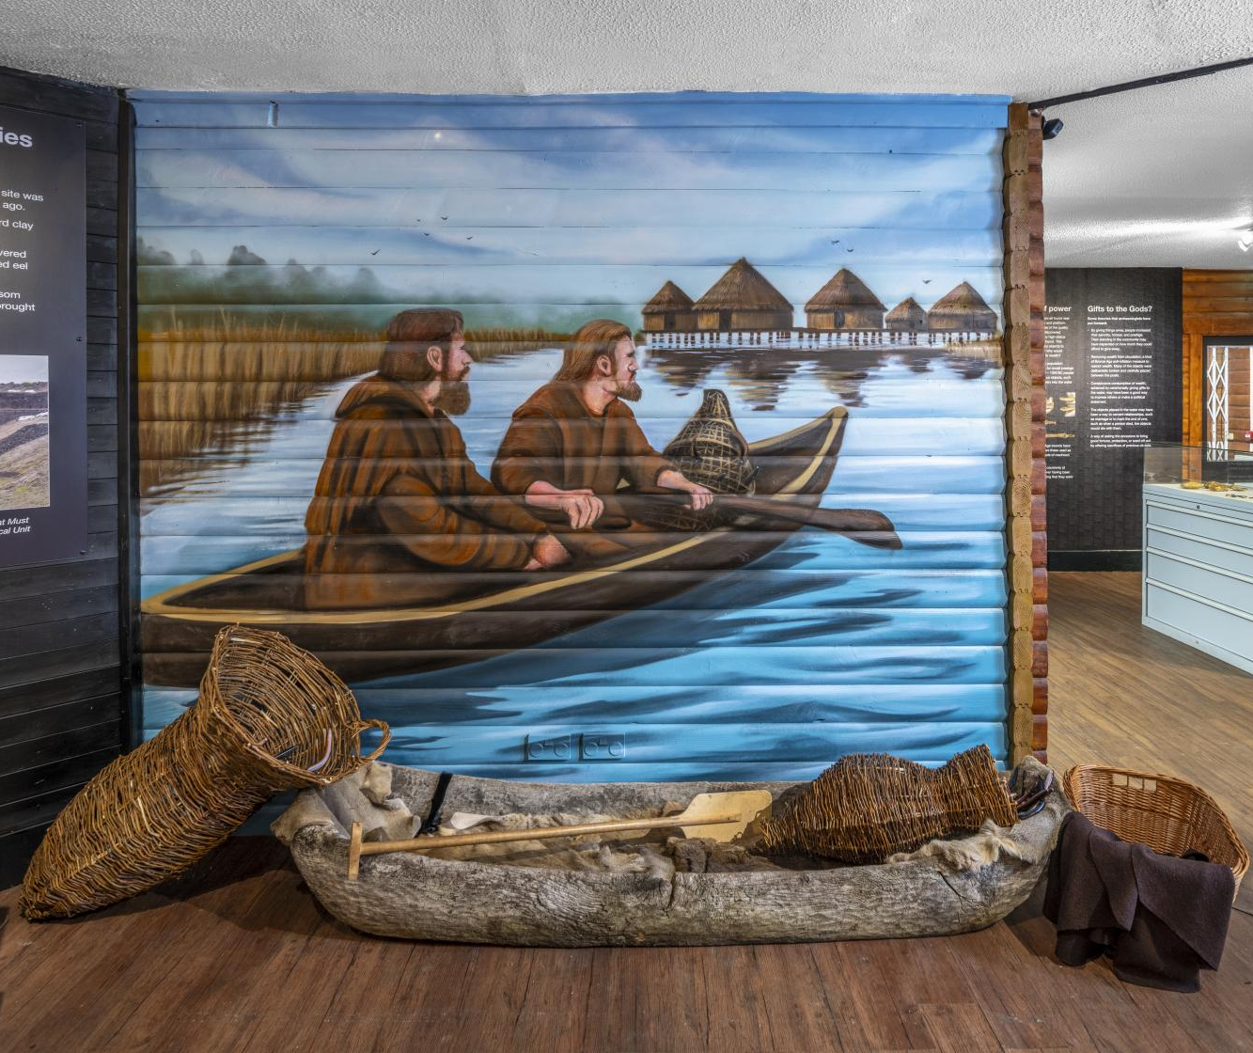
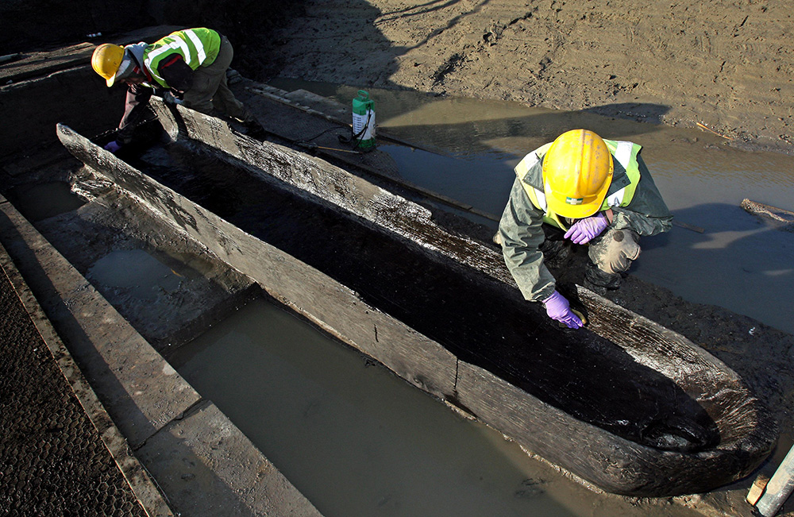
Must Farm & Flag Fen, Cambridgeshire
Back to map
Further along the river a group of nine Bronze Age log boats were found, along with fish traps. Each boat was hollowed out from a single tree trunk.
Nearby at Flag Fen a 1km-long timber causeway was built across the wetland. Part of this was made into a wooden platform, around which hundreds of pots, metal and stone objects were deposited, probably for ceremonial reasons.
Visit the Flag Fen Archaeology Park to find out more about Bronze Age life.
QUESTION
Why might people have built houses over a river?
Mural and replicas at Flag Fen Archaeology Park
Notes:
IMAGES:
Detail of a mural by a local artist on display in the visitor centre at Flag Fen Archaeology Park, depicting bronze age people in a boat, with the hut village in the background. © Historic England Archive Ref: DP529675 - https://historicengland.org.uk/images-books/photos/item/DP529675
Site Assistants Emma Rees (right) and Iona Robinson work on a Bronze Age long boat unearthed along the old course of the River Nene at Must Farm quarry in Whittlesey, Cambridgeshire. © Alamy Ref: G4RF4A - https://www.alamy.com/stock-photo-site-assistants-emma-rees-right-and-iona-robinson-work-on-a-bronze-106237610.html
QUESTION:
Why might people have built houses over a river?
LINKS:
Classroom Resources - Must Farm: What was life like in the Bronze Age? - https://historicengland.org.uk/education/schools-resources/teaching-activities/must-farm-life-in-the-bronze-age/
Flag Fen Archaeology Park - https://flagfen.org.uk/

Slide 28
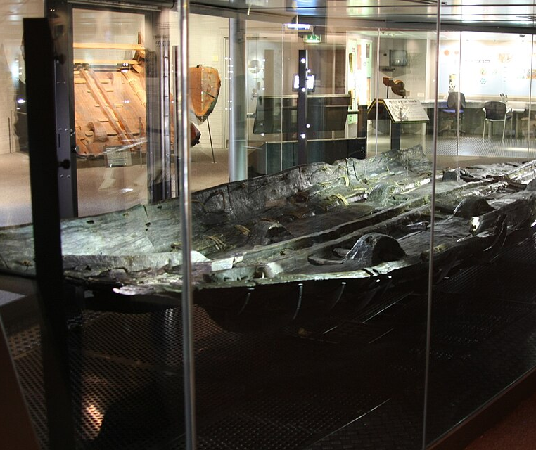
The Dover Boat, Kent
Back to map
The Dover Boat is over 3500 years old and was built to cross the sea.
Only part of the boat was found during excavation, but it is estimated to have been up to 15m long.
It would have been propelled by paddles and may have travelled along the coast and across the English Channel to trade goods such as bronze, shale, pottery or livestock.
Its construction was very different from the log boats found at Must Farm.
Dover Bronze Age Boat
Notes:
IMAGE:
Dover Bronze Age Boat. © Hiyotchi, CC BY-SA 4.0, via Wikimedia Commons - https://commons.wikimedia.org/wiki/File:Dover_Bronze_Age_Boat_2011.jpg
QUESTION:
What things might be taken across the Channel in boats like these?
LINKS:
Video: Discovering a 3,500 Year Old Boat in a Kent Underpass | BBC Timestamp (3:51) -https://www.youtube.com/watch?v=ZsCbDvKMgc8

Slide 29
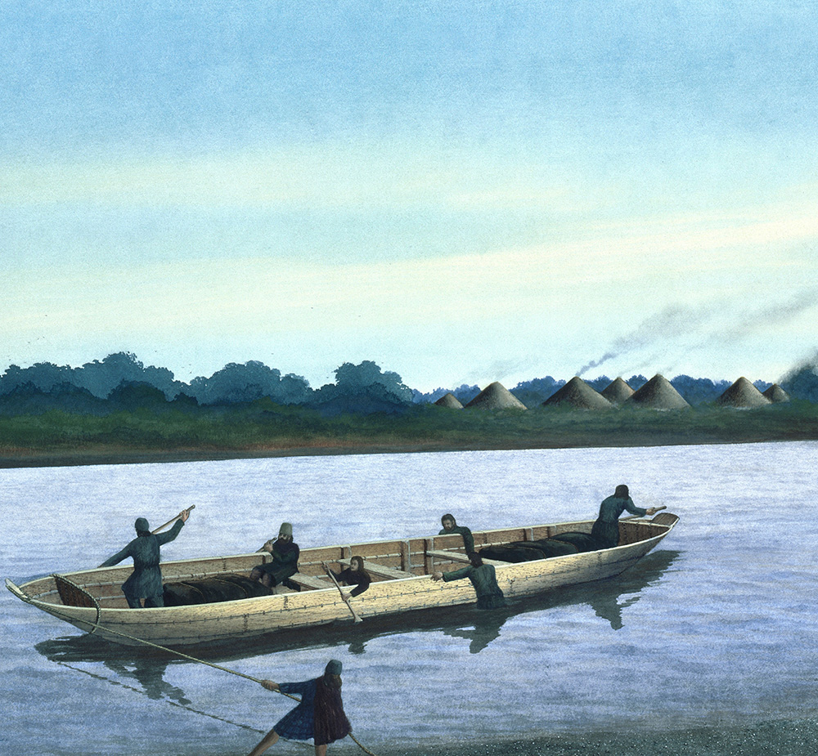
The Dover Boat, Kent
Back to map
The boat was made of wooden planks, which were held/sewn together by thin twisted pieces of wood (‘withies’) and wedges.
This meant the boat was much wider than log boats from Must Farm.
The trees used to make the Dover Boat were about 350 years old when they were cut down.
Similar types of boat have also been found in the Humber estuary in Yorkshire.
Reconstruction Drawing of Bronze Age ‘Plank’ Boat
Notes:
IMAGE:
This artist's impression shows a Bronze Age boat transferring cargo and passengers from one side of the river to the other. © Alamy Ref: BHYKCT - https://www.alamy.com/stock-photo-bronze-age-boat-on-the-river-thames-artist-frank-gardiner-28267480.html
QUESTION:
What things might be taken across the Channel in boats like these?
LINKS:
Video: Discovering a 3,500 Year Old Boat in a Kent Underpass | BBC Timestamp (3:51) -https://www.youtube.com/watch?v=ZsCbDvKMgc8

