Slide 1
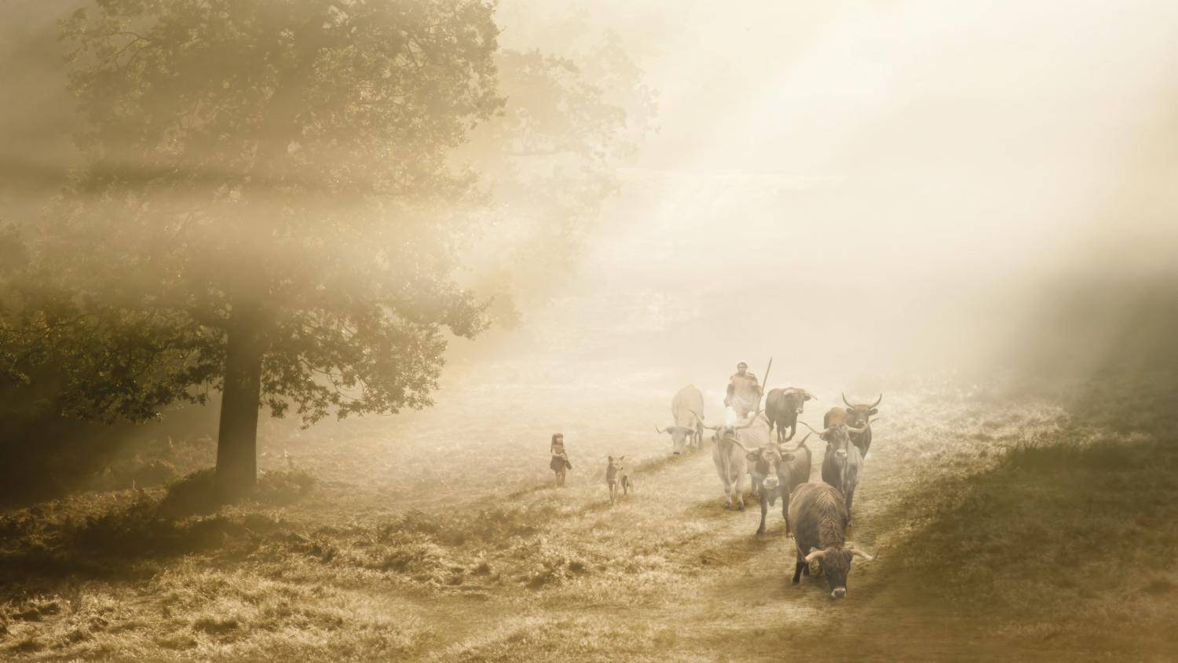
The Mesolithic (Middle Stone Age)
Stone Age to Iron Age: Part 3
The Neolithic
(New Stone Age)
Notes:
IMAGE:
Reconstruction illustration depicting cattle being herded through the mist, in the Stonehenge landscape during the Early Neolithic period, circa 3700BC © Historic England Archive Ref:IC095/075 - https://historicengland.org.uk/images-books/photos/item/IC095/075

Slide 2
The Neolithic (New Stone Age)
Learn about the types of technology used in the Stone Age
Learn about the everyday life of people in the Stone Age
Learn about changes in Britain from the Stone Age to the Iron Age
Assess the different types of archaeological evidence from the Stone Age
Establish clear narratives within and across the periods studied
Understand how knowledge of the past comes from a range of sources

Slide 3
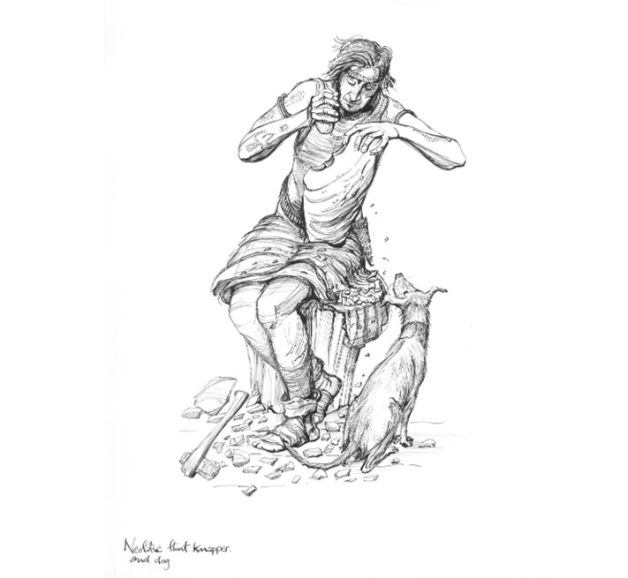
The Neolithic
Greek:
νέος (néos) “new"
+
λίθος (lithos) "stone"
=
“new age of the stone"
or
“New Stone Age”
Neolithic man knapping flint
Notes:
IMAGE:
Reconstruction drawing showing a Neolithic man knapping flint with a dog sitting beside him © Historic England Archive Ref:IC005/037 - https://historicengland.org.uk/images-books/photos/item/IC005/037

Slide 4
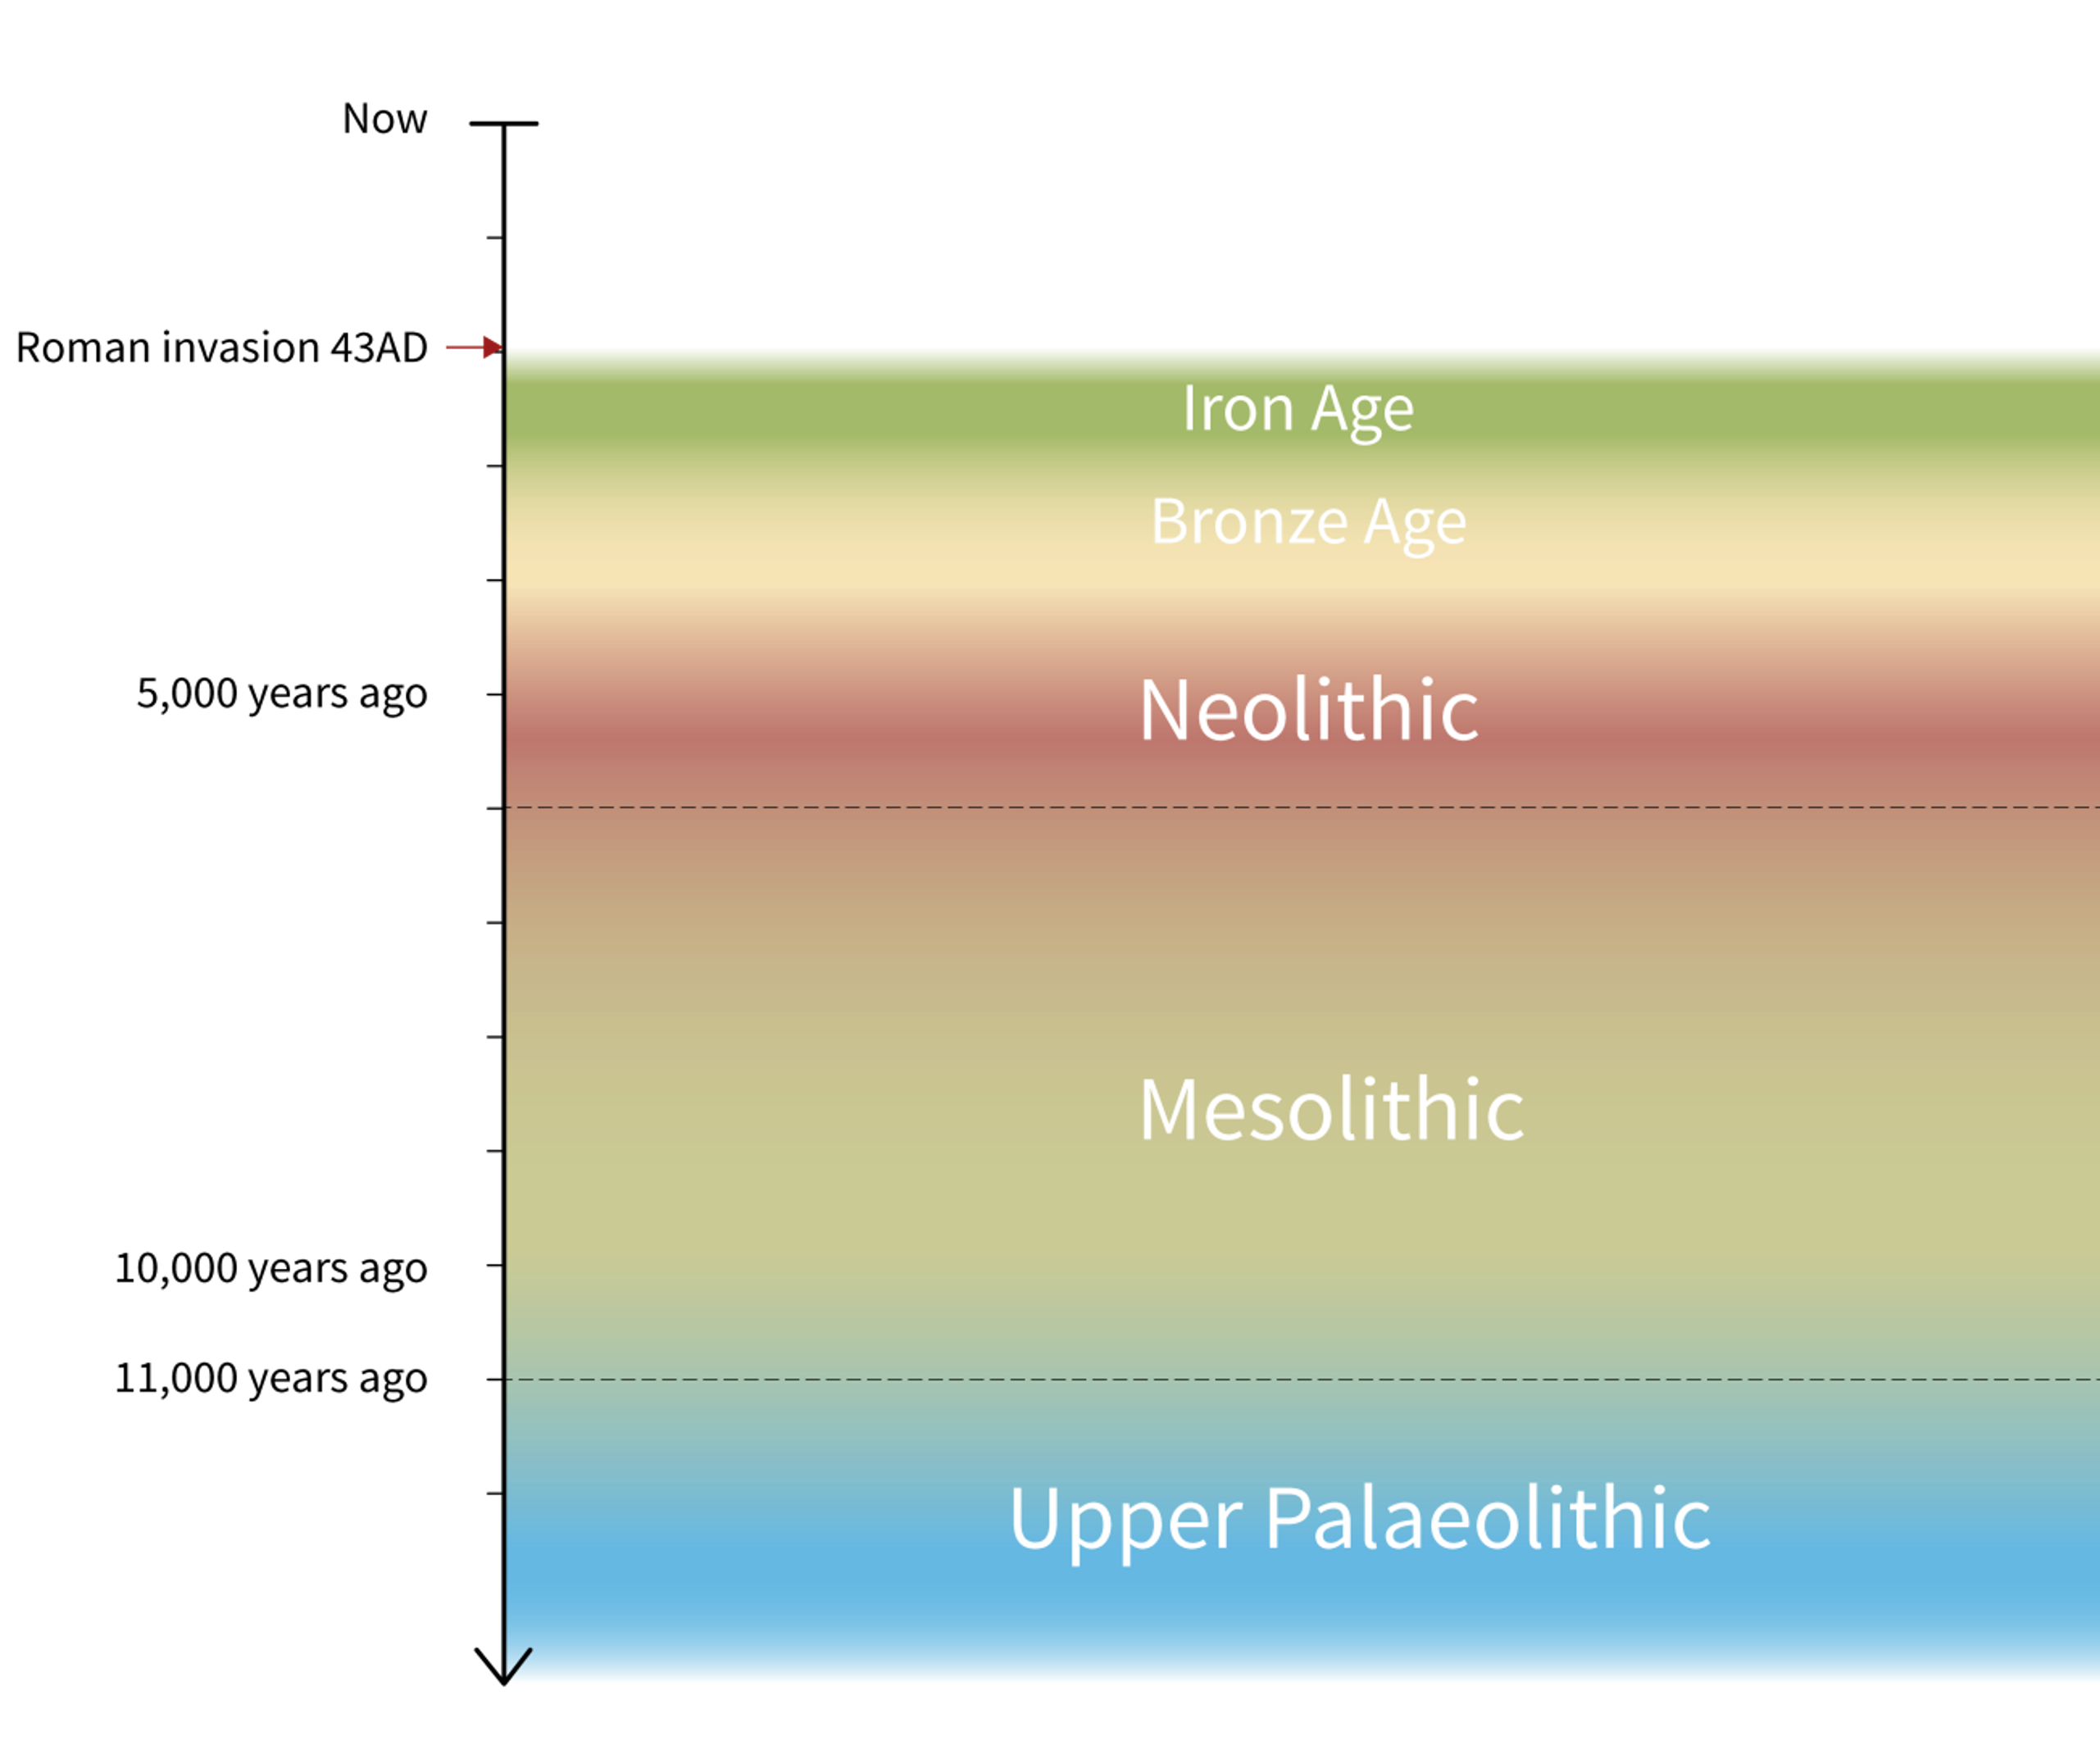
Stone Age to Iron Age Timeline – Neolithic in context
The Neolithic marks the beginning of farming in Britain, around 4000 BC, and ends with the appearance of bronze-working around 2200 BC.
People used stone tools, many of them beautifully polished. They lived in permanent settlements.
They began to build large burial and ceremonial monuments in the landscape.
Stone Age to Iron Age Timeline

Slide 5
Farming: animals
Farming in Neolithic Britain depended mainly on livestock (cattle, sheep and pigs) and grains (wheat and barley). There were no chickens or turkeys!
All these domestic species were brought over from continental Europe in small boats.
Archaeologists still debate how many people came over with them, and where they came from.
People probably followed their herds in a nomadic fashion, not too different from Mesolithic hunter-gatherers.
Neolithic cattle farming
Notes:
IMAGE:
Reconstruction illustration depicting cattle being herded through the mist, in the Stonehenge landscape during the Early Neolithic period, circa 3700BC © Historic England Archive Ref:IC095/075 - https://historicengland.org.uk/images-books/photos/item/IC095/075

Slide 6
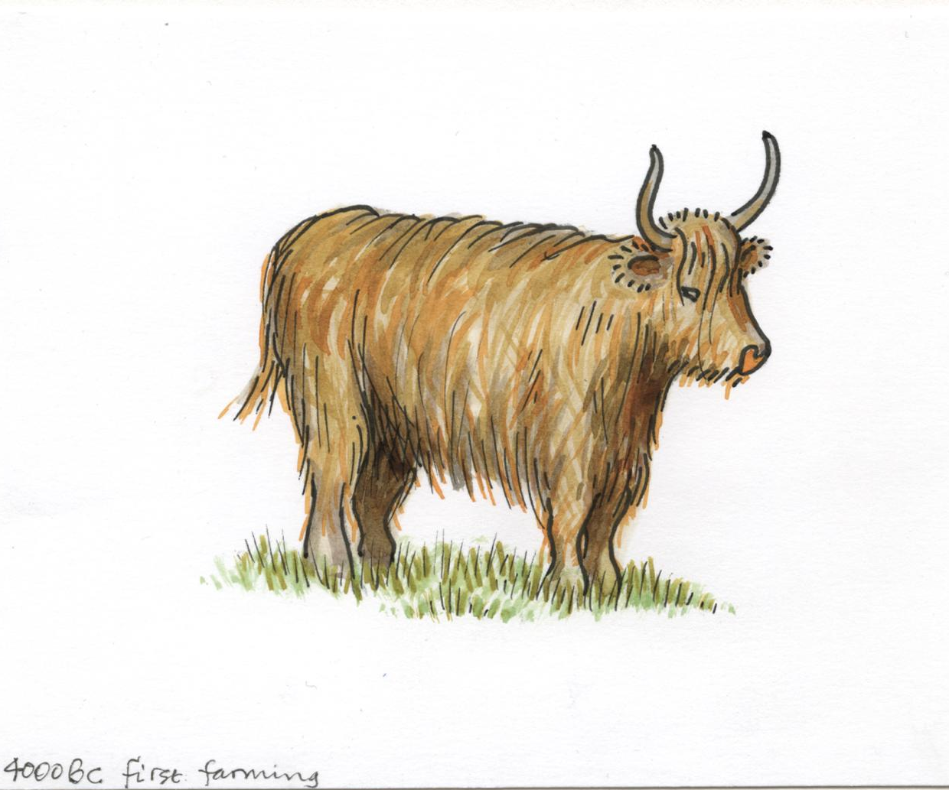
Farming: animals
We know from animal bones found during excavations that in the early Neolithic cattle were the most important species.
In the later Neolithic, pigs became more important. In contrast to the Mesolithic, wild animals were rarely exploited, although antler was used to make picks for digging and tools for flint-knapping.
People ate very little fish, and some archaeologists believe there was a taboo because rivers were sacred.
QUESTION
As well as food, what other useful products might Neolithic farmers have made from their animals?
Neolithic cattle
Notes:
IMAGE:
Simple reconstruction illustration of a cow from the early Neolithic period in Britain, intended to represent the first farming in southern Britain in around 4000BC © Historic England Archive Ref: IC095/041 - https://historicengland.org.uk/images-books/photos/item/IC095/041

Slide 7
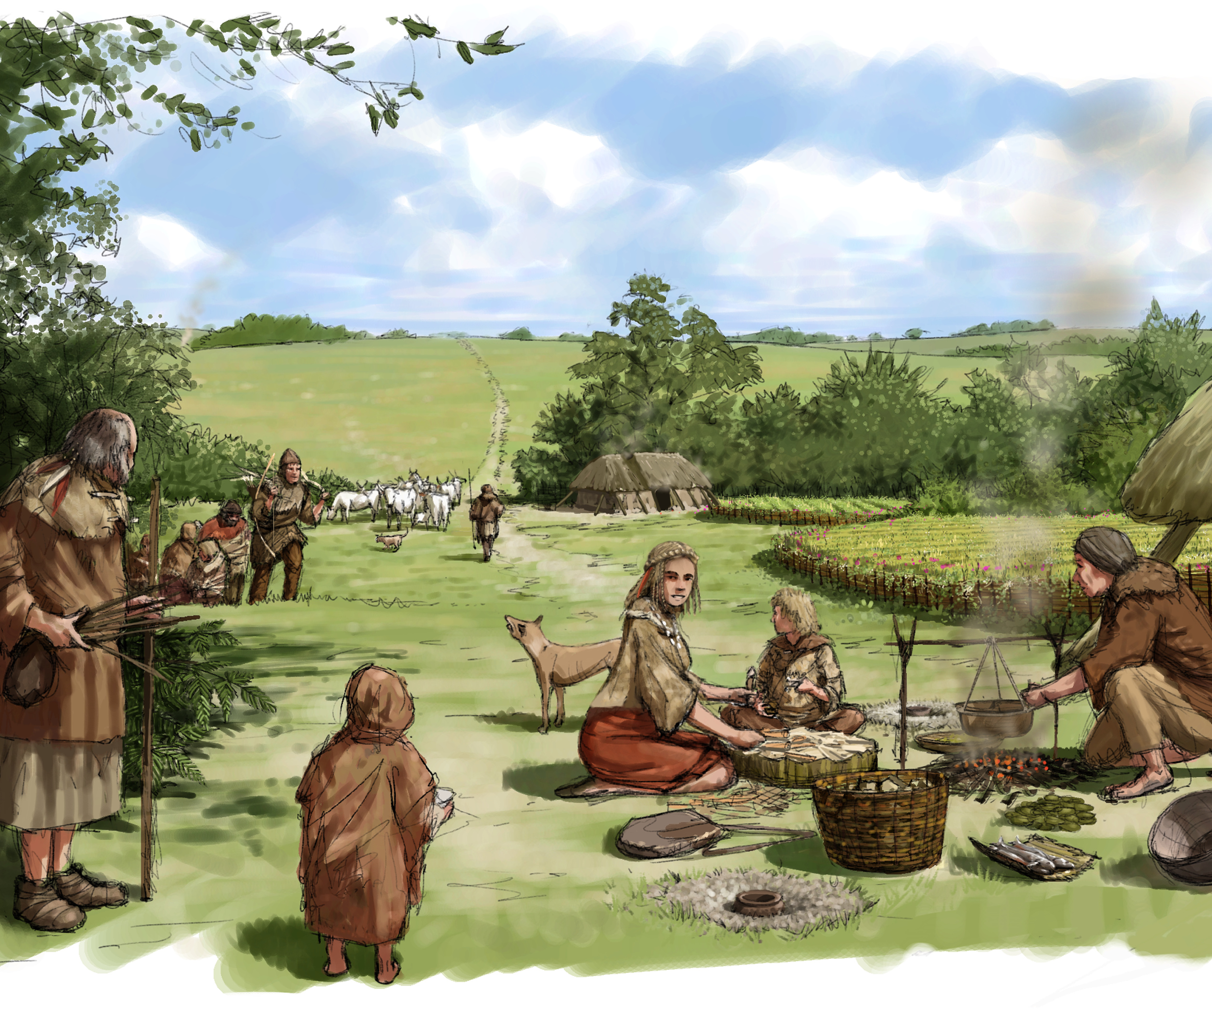
Farming: plants
It is the first time that people start deliberately planting and harvesting crops.
However, growing crops appears to have been less important in the Neolithic than herding animals, though there are a few sites where large quantities of grain have been found.
People also ate a lot of wild hazelnuts, as they had done in the Mesolithic.
Early Neolithic farming – daily life
Notes:
IMAGE:
Reconstruction illustration depicting cattle being herded through the mist, in the Stonehenge landscape during the Early Neolithic period, circa 3700BC © Historic England Archive Ref:
IC095/107 - https://historicengland.org.uk/images-books/photos/item/IC095/107

Slide 8
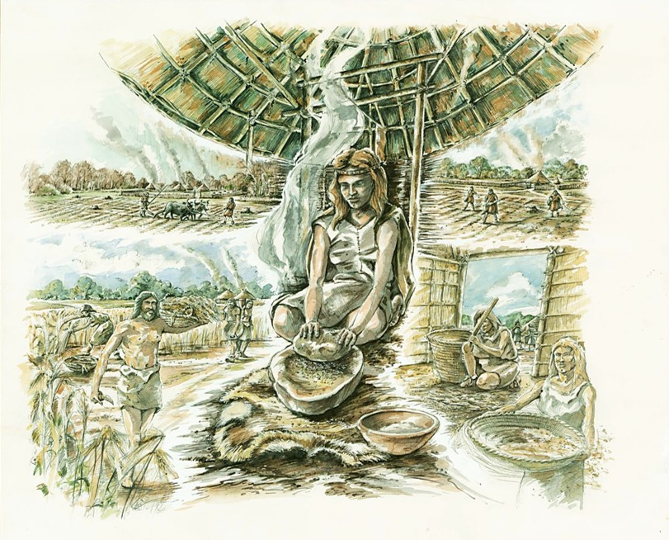
Farming: plants
Eating cereals required a lot of hard work; ploughing, planting seeds, harvesting the grains, cleaning and processing them, finally grinding them to make flour.
People needed new tools for this such as sickles for harvesting and grinding (quern) stones to turn the grain into flour.
They may also have made beer using grains for the first time.
QUESTION
What different foods can you make using flour?
Stages needed to make flour
Notes:
IMAGE:
A reconstruction illustration depicting the process of grain and flour production in the Neolithic period. Ploughing, sowing, harvesting and threshing grain are depicted, with a woman grinding grain into flour in the centre of the image. © Historic England Archive Ref: IC046/004 - https://historicengland.org.uk/images-books/photos/item/IC046/004
QUESTION:
What different foods can you make using flour?
ACTIVITY:
Try using a stone and some wheat grains to see how much effort it takes to make flour.

Slide 9
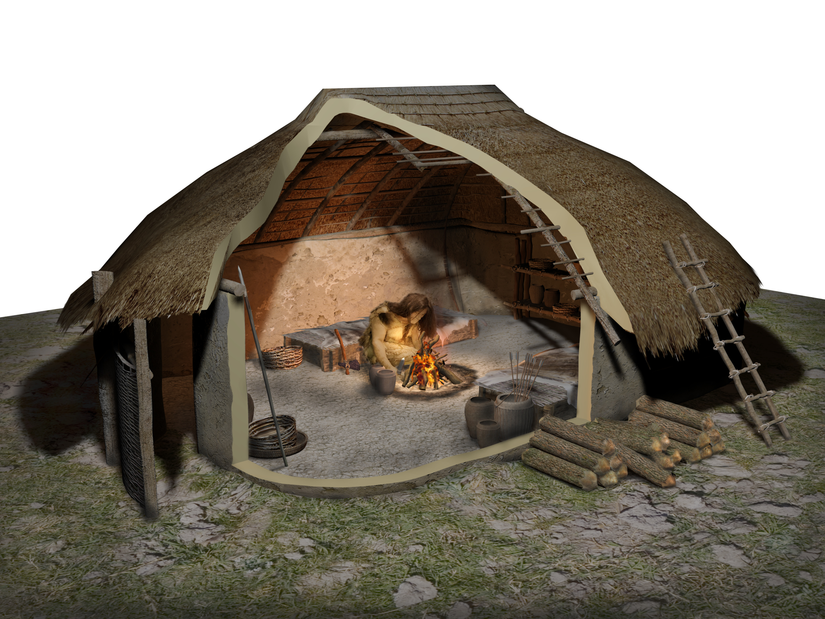
New technologies
People did more than just start farming with plants and animals for the first time. They also began making pottery for the first time.
They still used stone tools, but they learned new ways to make axes by polishing the stone, so it was smoother and sharper.
We know more about Neolithic houses, and people also built new places for burials, meetings, and special ceremonies. Archaeologists call these places monuments.
Reconstruction of a neolithic house at Durrington Walls
Notes:
IMAGE:
Cutaway reconstruction drawing showing cooking on an open hearth within one of the houses at Durrington Walls near Stonehenge during the Neolithic period © Historic England Archive Ref: IC095/113 - https://historicengland.org.uk/images-books/photos/item/IC095/113

Slide 10
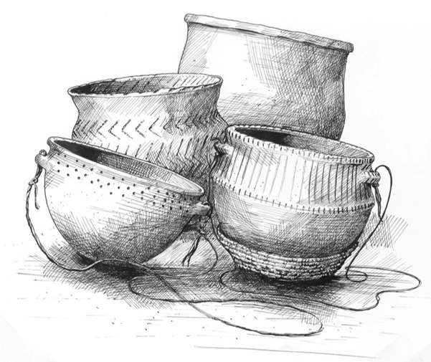
Pottery
People started making and using pottery for the first time in the Neolithic.
The pots were handmade (not on wheels) and fired in simple pits or bonfires.
Bits of stone or shell were added to strengthen the clay and help stop it breaking when it was fired. These can help archaeologists tell where pottery came from.
Early pottery was weak and was easily broken but it meant people could now cook and store food in different ways.
Neolithic pottery from Windmill Hill
Notes:
IMAGE:
A reconstruction drawing of Neolithic pottery from Windmill Hill. © Historic England Archive. Ref: IC005/038 - https://historicengland.org.uk/images-books/photos/item/IC005/038
QUESTION:
What could people have used to store things in and eat from before they had pottery?

Slide 11
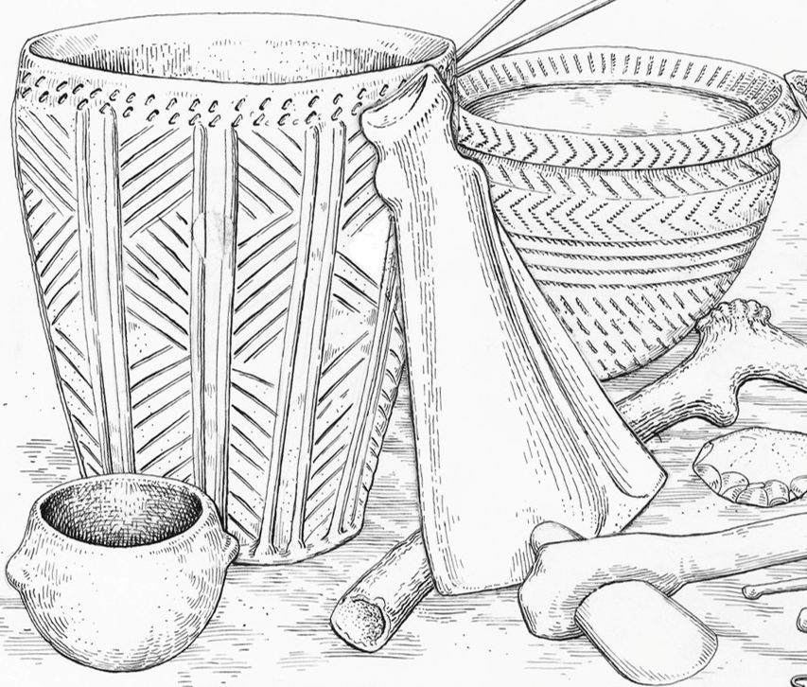
Pottery
Neolithic pottery was often decorated, which might have been an important way of showing which groups people belonged to.
Microscopic residues extracted from pottery fragments show that many pots contained dairy products.
Sometimes pottery fragments and other rubbish were disposed of in special ways, usually in small pits.
These traditions reflected important beliefs which are very different from our modern treatment of ‘rubbish’.
QUESTION
What could people have used to cook with and eat from before they had pots?
Decorated Neolithic pottery and other artefacts
Notes:
IMAGE:
Reconstruction illustration showing a variety of Early Neolithic goods, including pottery, arrows and flint weapons © Historic England Archive. Ref: IC005/032 - https://historicengland.org.uk/images-books/photos/item/IC005/032
QUESTION:
What could people have used to store things in and eat from before they had pottery?

Slide 12
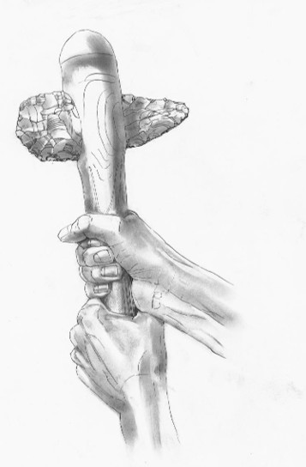
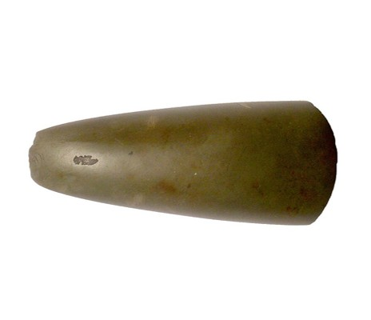
Stone Tools: polished axes
Neolithic people made stone and flint axes differently from Mesolithic people.
First, they used hammer stones to chip the rock into a rough shape. Then they ground and polished it to make it smooth and sharp.
They put the axe onto a wooden handle so it could be used for chopping and cutting.
These axes were also special objects. Having one might have made others think you were important, strong, brave, or wise.
Neolithic polished stone axe
Notes:
IMAGE:
Neolithic polished stone axe. © The Portable Antiquities Scheme/ The Trustees of the British Museum, CC BY-SA 2.0, via Wikimedia Commons - https://commons.wikimedia.org/wiki/File:Neolithic_polished_axe_(FindID_85870).jpg
A drawing depicting a reconstruction of Flint Axe F.III, excavated at Grime's Graves © Historic England Archive - https://historicengland.org.uk/images-books/photos/item/IC046/028
QUESTION:
What sort of things in modern life could be called status symbols - having importance attached to them beyond how well they do a job?

Slide 13
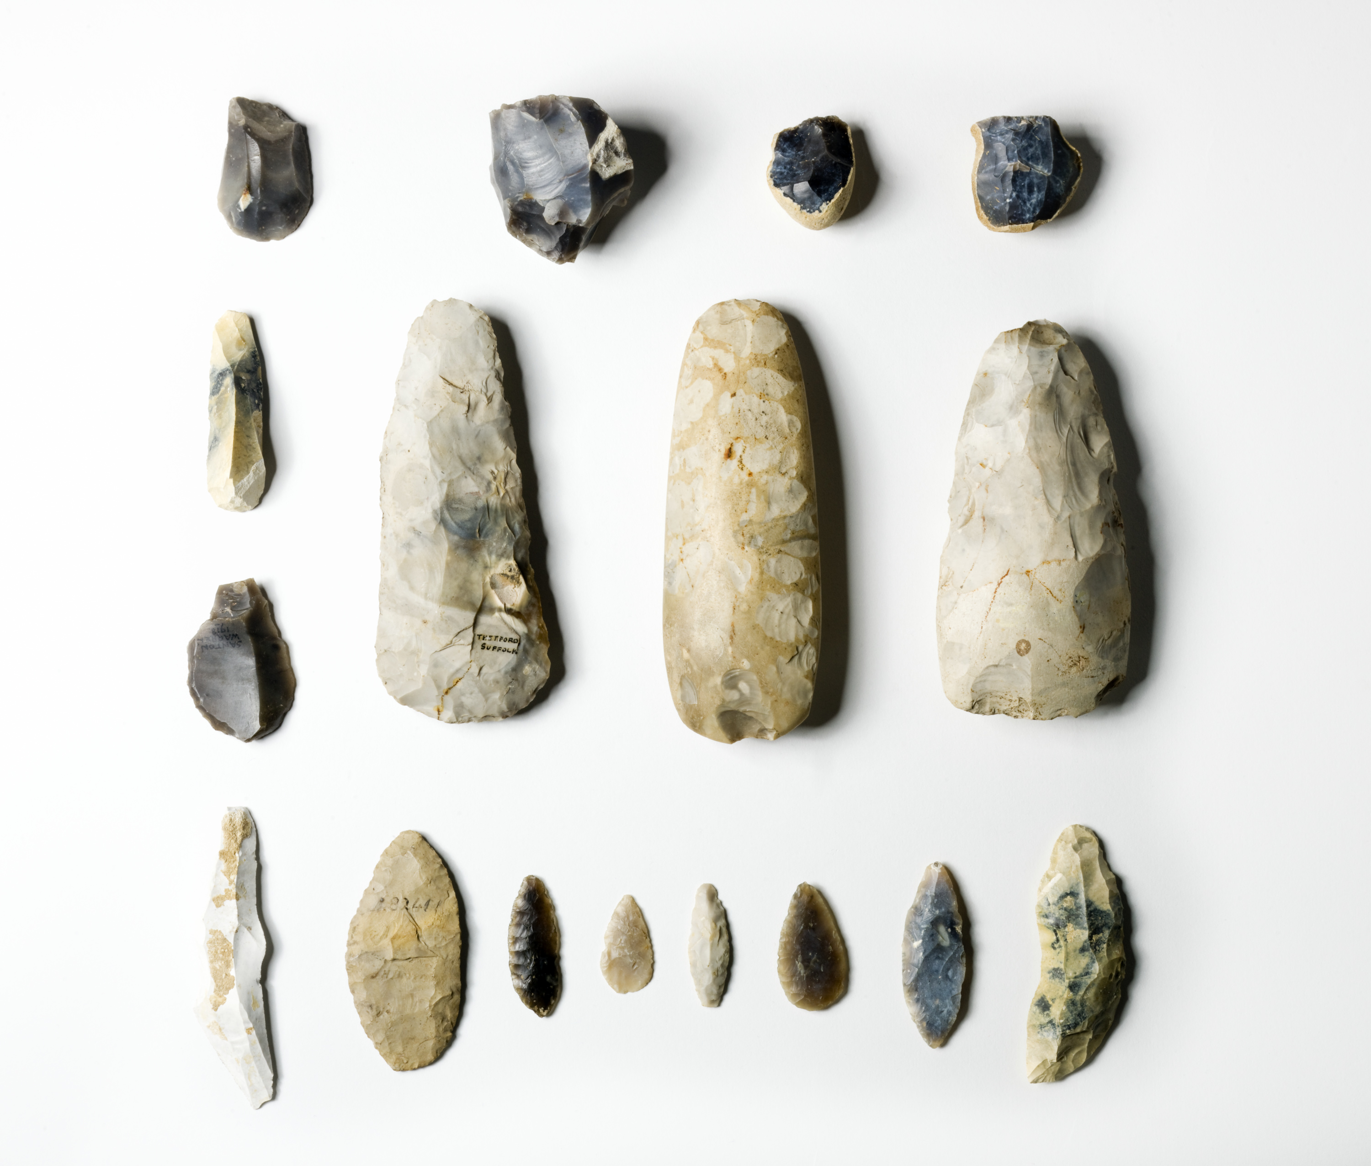
Stone Tools: Early Neolithic ‘Tool Kit’
This collection of flints shows a variety of stone tools used in the early Neolithic.
Scrapers were used to clean animal skins for leather.
Axes were hafted onto wooden handles.
Blades served as knives.
Leaf-shaped arrowheads were mounted on shafts for hunting.
Multiple sickle blades were set into curved wood, or antler handles for harvesting crops.
Cores were struck to make new tools.
Early Neolithic ‘Tool Kit’
Notes:
IMAGE:
Detail of a set of early neolithic tools © Historic England Archive Ref: DP081192 - https://historicengland.org.uk/images-books/photos/item/DP081192
QUESTION:
What sort of tools might a modern ‘tool kit’ have?

Slide 14
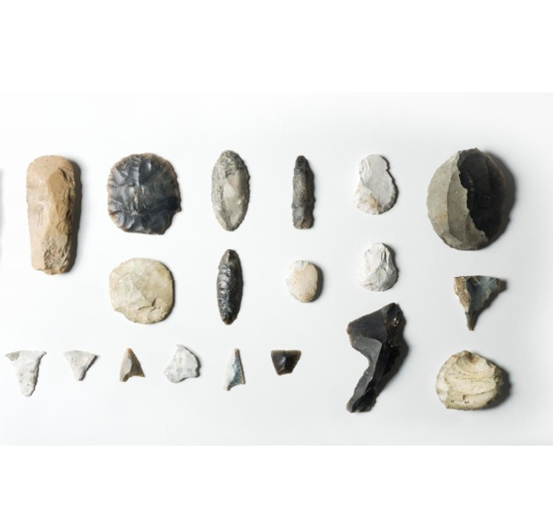
Stone Tools: Late Neolithic ‘Tool Kit’
This collection of flints shows a variety of stone tools used in the late Neolithic.
Whilst tools such as axes, and scrapers stayed roughly the same, other tools become more sophisticated.
Blades evolved into different shaped knives for different tasks.
Arrowheads changed shape to be more efficient at different types of hunting.
Specialist tools for piercing holes were developed.
This ‘notched’ tool clearly had a specialist use, but we can’t be 100% sure what!
Late Neolithic ‘Tool Kit’
Notes:
IMAGE:
Detail of a set of late neolithic tools © Historic England Archive. Ref: DP081192 - https://historicengland.org.uk/images-books/photos/item/DP081192
QUESTION:
What sort of tools might a modern ‘tool kit’ have?

Slide 15
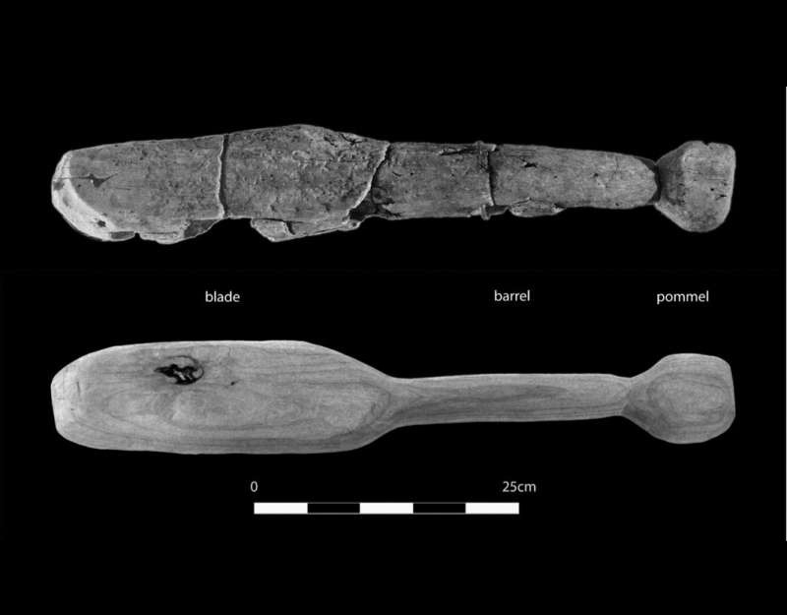
Woodworking
Neolithic people would have made objects out of wood and other organic materials, but these rarely survive.
One example is the 'Thames Beater’, found in the river's waterlogged soil near Chelsea, London. It dates to the Early Neolithic (3530–3340 BC).
Experiments using a replica showed it could have produced fatal injuries, matching skull damage found in European Neolithic skeletons. This suggests its use as a deadly, short-range weapon.
The Thames Beater (top) and the replica club used for experimentation (bottom) Credit: Meaghan Dyer
Notes:
IMAGE:
The Thames Beater (top) and the replica club used for experimentation (bottom) Credit: Meaghan Dyer
QUESTION:
How might climate change affect delicate archaeological sites like the Sweet Track?
LINK:
https://phys.org/news/2017-12-neolithic-thames-beater-person.html

Slide 16
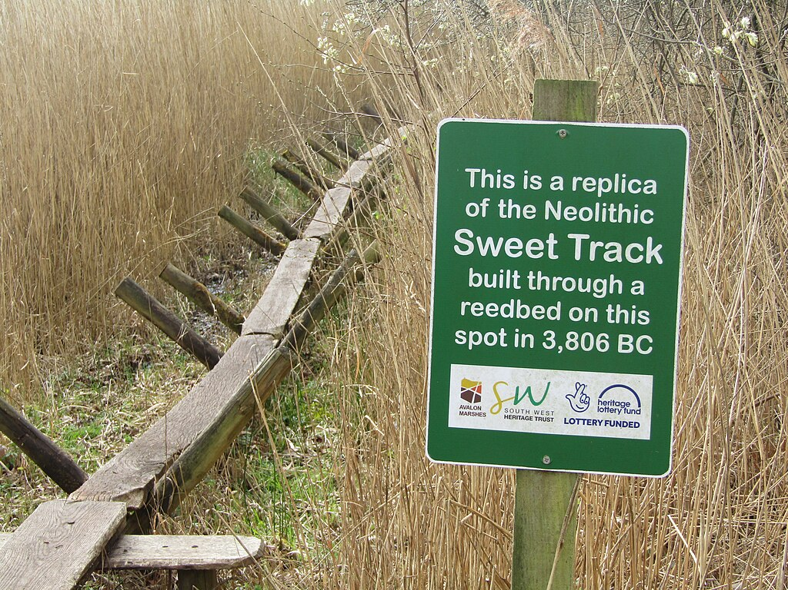
Woodworking
The Sweet Track is a Neolithic wooden walkway (c 3800 BC). It crossed a long, wet swamp near Glastonbury in Somerset.
People walked on a single wooden plank for 2km to get from the hills to an island.
Near the track, people left many objects, such as stone axes, pottery, arrowheads, and wooden items like a bowl and even a toy axe. Some special objects, like a jade axe from far away, were probably left as gifts or offerings.
QUESTION
How might climate change affect delicate waterlogged archaeological sites like the Sweet Track?
The Sweet Track
Notes:
IMAGE:
Shapwick Heath - Sweet Track by Colin Smith, via Wikimedia Commons - https://commons.wikimedia.org/wiki/File:Shapwick_Heath_-_Sweet_Track_-_geograph.org.uk_-_7152543.jpg
QUESTION:
How might climate change affect delicate archaeological sites like the Sweet Track?

Slide 17
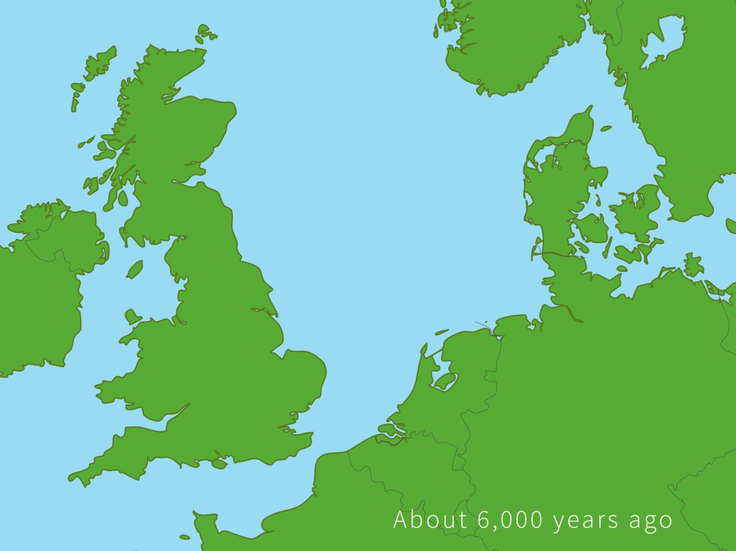
Neolithic Sites in the UK
Skara Brae
Click on the dots to learn about our Top 14 Neolithic sites
West Kennet long barrow
Doddington Moor
Windmill Hill causewayed enclosure
Stonehenge Cursus
Langdale
Avebury and Silbury Hill
Durrington Walls & Woodhenge
Thornborough
Stonehenge
The Amesbury Archer
Grimes Graves
The Sweet Track
Horton
Trethevy Quoit
Notes:
Click the red dots to find out more about each location

Slide 18
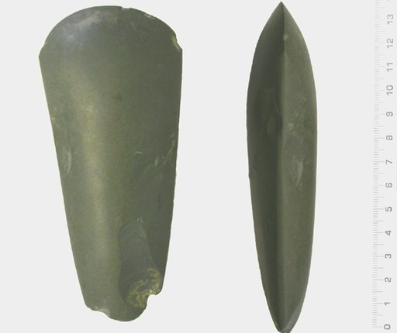
The Langdales, Cumbria
Back to map
The Langdales in the Lake District were home to Neolithic stone quarries, known as axe factories.
Thousands of polished stone axe heads have been found there. The stone is a distinctive green colour.
They were traded across Britain, showing their importance.
Some are so delicate they must never have been used. In these cases, the practical usefulness of these objects might have been less important than using them as status symbols.
QUESTION
What sort of things in modern life could be called status symbols - having importance attached to them beyond how well they do a job?
Green Neolithic ‘Langdale’ axe
Notes:
IMAGE:
Neolithic polished stone axe. © The Portable Antiquities Scheme/ The Trustees of the British Museum, CC BY-SA 2.0, via Wikimedia Commons - https://commons.wikimedia.org/wiki/File:Neolithic_Polished_Axe_(FindID_127713-107614).jpg
QUESTION:
What sort of things in modern life could be called status symbols - having importance attached to them beyond how well they do a job?

Slide 19
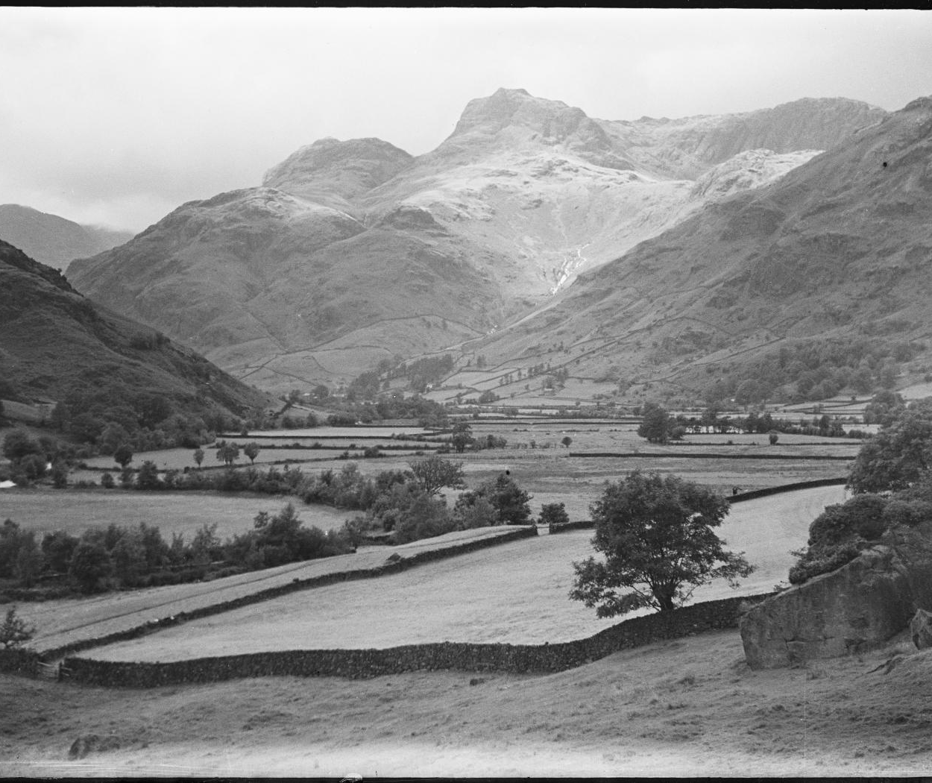
The Langdales, Cumbria
Back to map
Getting to the axe quarries up in the hills would have been risky and dangerous, and the stories about your adventures getting there would have impressed people.
The journey might have been as important as the stones you brought back!
A green axe from the Alps, Switzerland, had been brought all the way to the Sweet Track in Somerset, so the colour and other properties of Langdale axes were probably important too.
The Langdales
Notes:
IMAGE:
Neolithic polished stone axe. © The Portable Antiquities Scheme/ The Trustees of the British Museum, CC BY-SA 2.0, via Wikimedia Commons - https://commons.wikimedia.org/wiki/File:Neolithic_Polished_Axe_(FindID_127713-107614).jpg
QUESTION:
What sort of things in modern life could be called status symbols - having importance attached to them beyond how well they do a job?

Slide 20
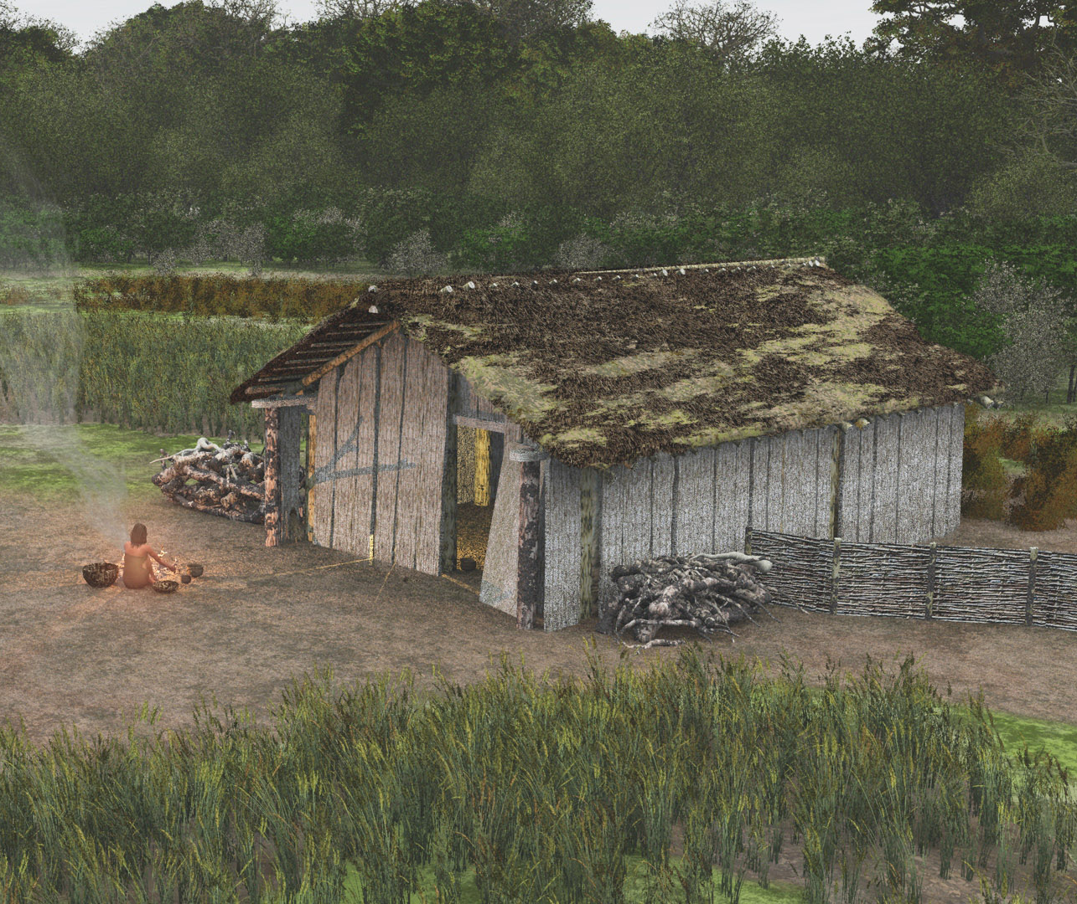
Horton, Berkshire
Back to map
In the early Neolithic period, about 5,700 years ago, people in Horton, Berkshire built some of the earliest rectangular houses in England.
Archaeologists found the remains of at least four houses. They were long and rectangular, a bit like big wooden sheds. Some were as long as a bus!
The houses were made from wooden posts stuck into the ground, with walls made from a mix of timber planks and wattle and daub. They probably had thatched roofs.
Reconstruction drawing of Horton Neolithic house
Notes:
IMAGE:
Reconstruction of one of the houses at Horton. © Wessex Archaeology - https://flic.kr/p/dZzWZu
QUESTION:
Why do you think some Neolithic houses were so big?
IMAGE:
Reconstruction of one of the houses at Horton. © Wessex Archaeology - https://flic.kr/p/dZzWZu
LINK:
Wessex Archaeology Project Page with video - https://www.wessexarch.co.uk/our-work/kingsmead-quarry-horton

Slide 21
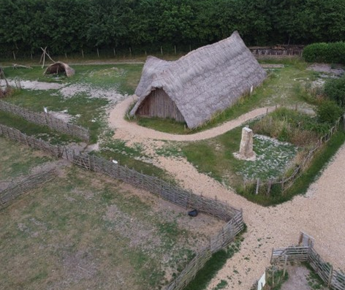
Horton, Berkshire
Back to map
Inside archaeologists found pottery, flint tools and arrowheads, a rubbing stone for grinding grain and charred food remains.
Some archaeologists think one family and possibly some of their animals would have lived in each house, but others have suggested that because of their size, they might have been more like village halls or community centres.
A replica of one of the houses has been built at Butser Ancient Farm.
QUESTION
Why do you think some Neolithic houses were so big?
Replica Horton house at Butser Ancient Farm
Notes:
IMAGE:
Reconstruction of one of the houses at Horton. © Wessex Archaeology - https://flic.kr/p/dZzWZu
QUESTION:
Why do you think some Neolithic houses were so big?
What type of activities happen in village halls today – do you think any of them are similar to what people did when they gathered together in Neolithic time? (dancing, eating, selling things, parties…)
LINK:
Wessex Archaeology Project Page with video - https://www.wessexarch.co.uk/our-work/kingsmead-quarry-horton

Slide 22
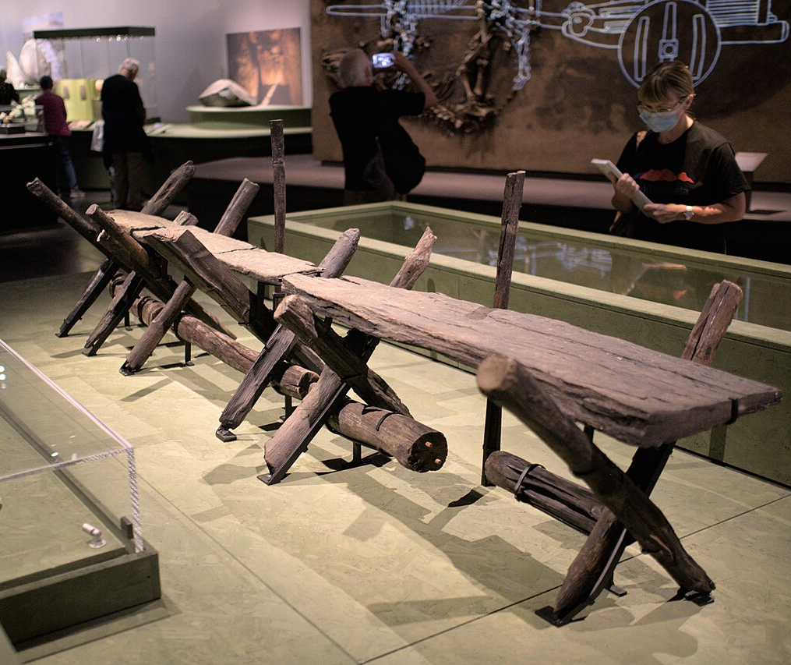
The Sweet Track, Somerset
Back to map
The Sweet Track is the oldest wooden walkway found in Britain. It was named after Mr Sweet, who discovered it while digging peat.
It was built across a wet, muddy marsh in Somerset. It is about 2km long and joined an island in the marshes to a range of nearby hills.
Archaeologists used tree rings to work out it was built in the winter of 3807–3806 BC, nearly 6000 years ago!
Sweet Track on display at British Museum
Notes:
IMAGE:
Sweet Track. © Bob Harvey / Oak causeway from the Somerset levels via WikiMedia Commons - https://commons.wikimedia.org/wiki/File:Sweet_track.jpg
QUESTION:
How might climate change to affect the preservation of waterlogged archaeological sites?
LINK:
Avalon Marshes Project page with video - https://avalonmarshes.org/heritage/sweet-track/

Slide 23
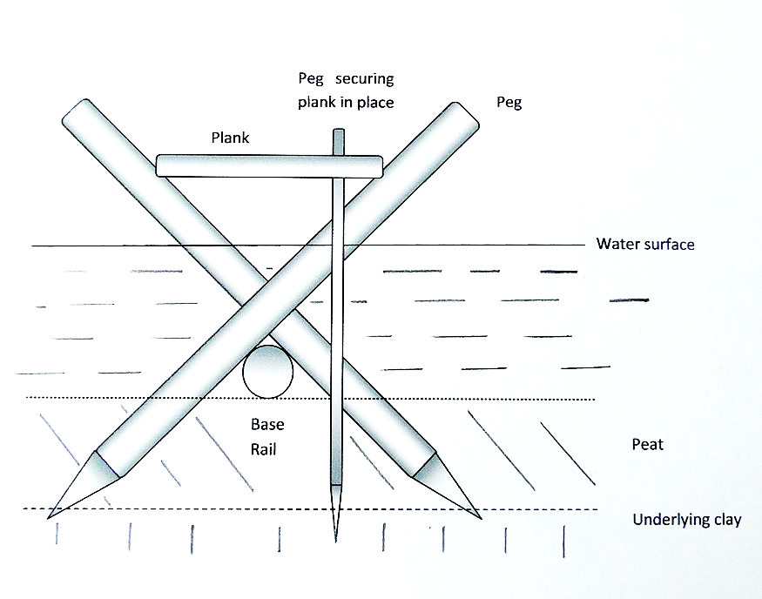
The Sweet Track, Somerset
Back to map
Long poles were pushed into the ground to hold up wooden planks so people could walk across.
Surprisingly, archaeologists think it didn’t take long to build—small groups of adults could have made it in just a day using lots of wood.
Objects found nearby, like a green stone axe from the Alps, pottery, and a wooden bowl, suggest people may have held special ceremonies there.
Due to changing water levels, it was probably only used for about 10 years.
QUESTION
How might climate change to affect the preservation of waterlogged archaeological sites?
Replica of the Sweet Track
Notes:
IMAGE:
© Shapwick Heath - Sweet Track by Colin Smith, CC BY-SA 2.0, via Wikimedia Commons - https://commons.wikimedia.org/wiki/File:Shapwick_Heath_-_Sweet_Track_-_geograph.org.uk_-_7152543.jpg
Sweet track cross section2 © Richerman at English Wikipedia, CC BY-SA 3.0, via Wikimedia Commons - https://commons.wikimedia.org/wiki/File:Sweet_track_cross_section2.jpg
QUESTION:
How might climate change to affect the preservation of waterlogged archaeological sites?
LINK:
Avalon Marshes Project page with video - https://avalonmarshes.org/heritage/sweet-track/

Slide 24
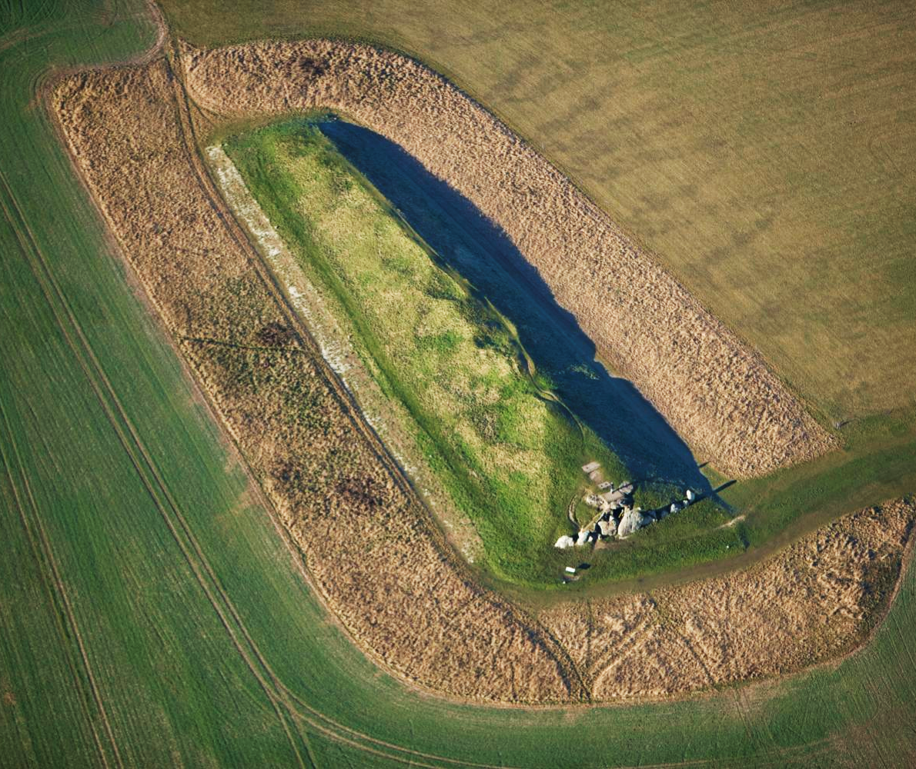
West Kennet, Wiltshire
Back to map
In the Neolithic people buried their dead in special places called long barrows.
These were long mounds made of earth or stones with rooms inside.
People didn’t have metal tools back then, so they built them using things like deer antlers and animal bones.
Some long barrows were very big. For example, West Kennet Long Barrow is about 100 metres long — around the length of a football pitch!
Aerial view of West Kennet Long Barrow
Notes:
IMAGE:
West Kennet long barrow. © Historic England Ref: 24861_021 - https://historicengland.org.uk/images-books/archive/collections/aerial-photos/record/24861_021
QUESTION:
People have different spiritual beliefs. What do you think the people who buried their dead at West Kennet believed? Follow the link to more images to help you answer the question.
LINK:
English Heritage - https://www.english-heritage.org.uk/visit/places/west-kennet-long-barrow/history/

Slide 25
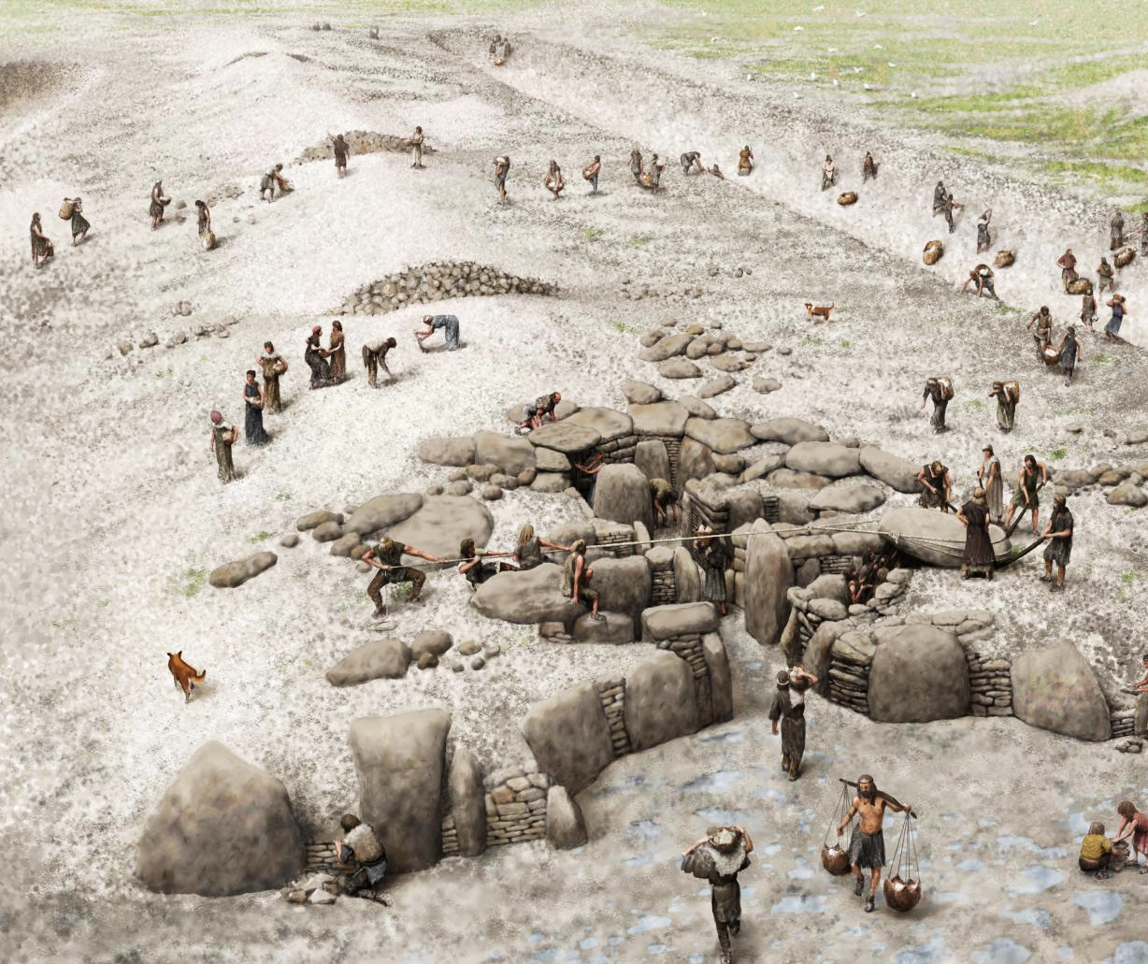
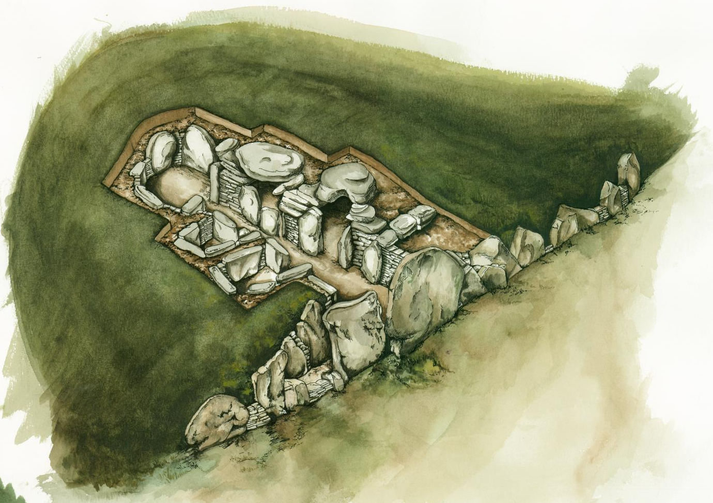
West Kennet, Wiltshire
Back to map
Inside, some barrows had wooden parts, while others (like West Kennet) had stone rooms.
They weren’t for just one person — lots of people were buried together in them. Sometimes, only parts of a person’s body (like bones) were buried.
At West Kennet, the bones of at least 36 people were carefully placed inside over about 10–30 years before it was finally closed.
QUESTION
People have different spiritual beliefs.
What do you think the people who buried their dead at West Kennet believed?
Reconstruction of building of West Kennet Long Barrow
Notes:
IMAGE:
Reconstruction drawing showing the construction of West Kennet Long Barrow © Historic England Archive Ref: IC005/049 - https://historicengland.org.uk/images-books/photos/item/IC005/049
Illustration depicting an aerial, cut-away view of West Kennet Long Barrow, showing the internal structure of the stone chambered tombs © Historic England Archive Ref: IC005/031 - https://historicengland.org.uk/images-books/photos/item/IC005/031
QUESTION:
People have different spiritual beliefs. What do you think the people who buried their dead at West Kennet believed? Follow the link to more images to help you answer the question.
LINK:
English Heritage - https://www.english-heritage.org.uk/visit/places/west-kennet-long-barrow/history/

Slide 26
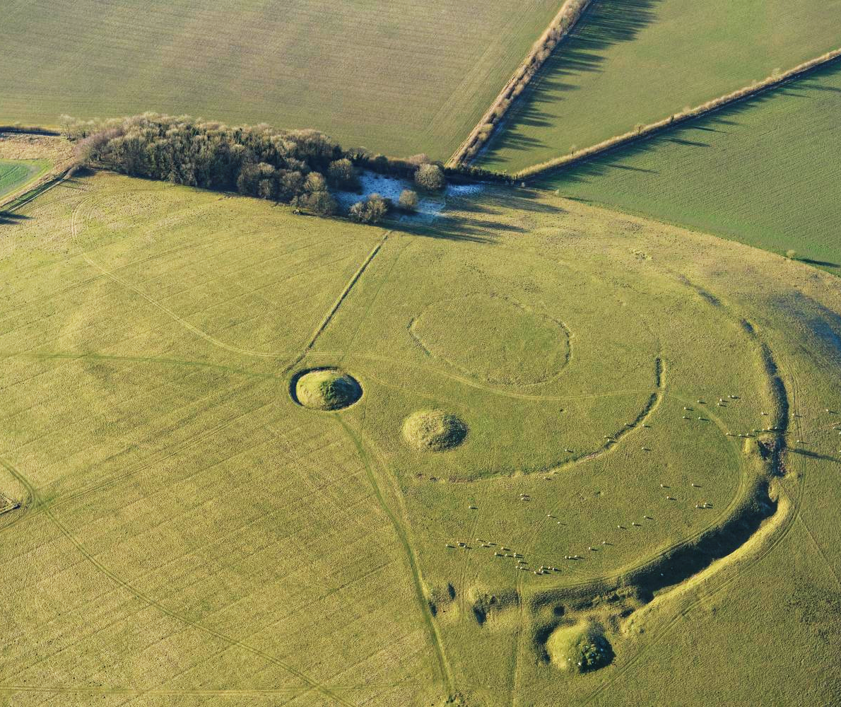
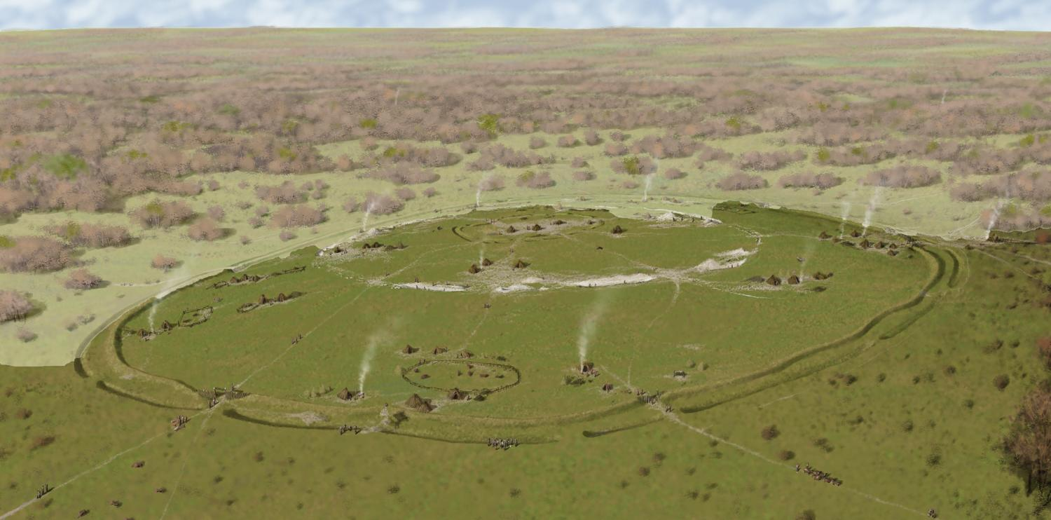
Windmill Hill, Wiltshire
Back to map
Neolithic people built large areas surrounded by earth banks and ditches. They left gaps, called causeways, so people and animals could pass through.
That’s why these sites are called Causewayed Enclosures. Windmill Hill Causewayed Enclosure has three rings of banks and ditches.
It probably took lots of people many years to build, possible because they were now settled farmers with enough spare food and time to do it.
Aerial view of Windmill Hill Causewayed Enclosure
Notes:
IMAGE:
Windmill Hill Causewayed Enclosure. © Historic England Ref: 35582_047 - https://historicengland.org.uk/images-books/archive/collections/aerial-photos/record/35582_047
Reconstruction drawing showing an oblique aerial view of Windmill Hill © Historic England Archive Ref: IC005/050 - https://historicengland.org.uk/images-books/photos/item/IC005/050
QUESTION:
Where do you go when you want to mark a special occasion? Is it anything like a causewayed enclosure?
IMAGE:
Windmill Hill Causewayed Enclosure. © Historic England Ref: 35582_047 - https://historicengland.org.uk/images-books/archive/collections/aerial-photos/record/35582_047
Reconstruction drawing showing an oblique aerial view of Windmill Hill © Historic England Archive Ref: IC005/050 - https://historicengland.org.uk/images-books/photos/item/IC005/050
LINK:
English Heritage - https://www.english-heritage.org.uk/visit/places/windmill-hill/history/

Slide 27
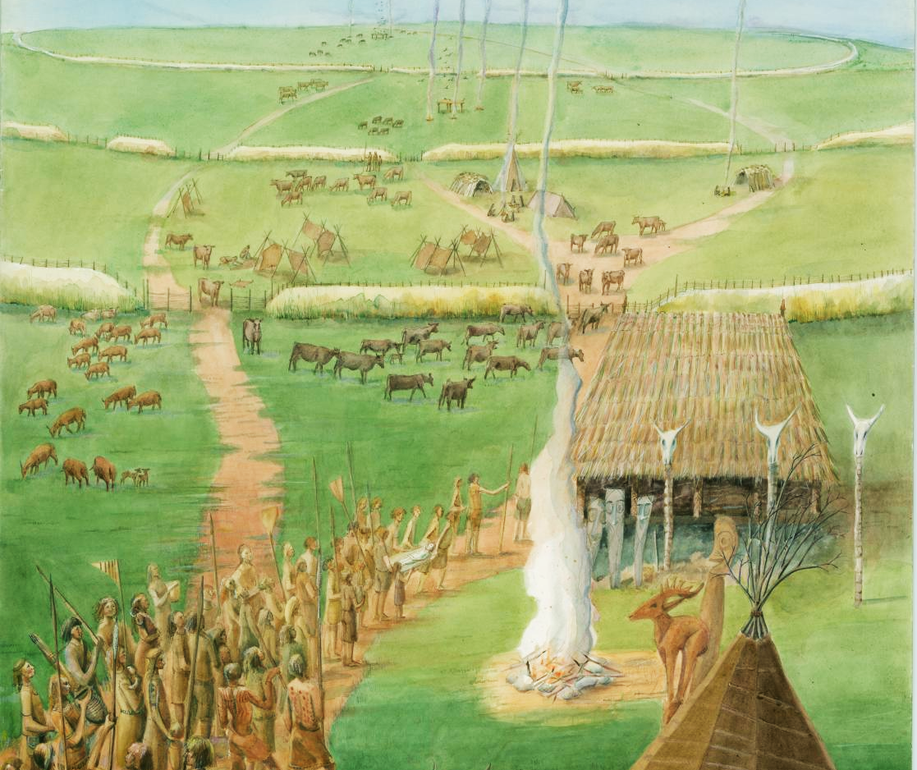
Windmill Hill, Wiltshire
Back to map
The enclosure was in use for hundreds of years, but people didn’t use it all the time.
They probably met there seasonally to trade, settle arguments, get married, or honour their dead.
When archaeologists dug the site in the 1920s, they found flint tools, animal bones, ceremonial cups, and a type of pottery called Windmill Hill pottery, as it was first found at this site.
It is now part of the Avebury World Heritage Site.
QUESTION
Where do you go when you want to mark a special occasion?
Is it anything like a causewayed enclosure?
Reconstruction of Windmill Hill Causewayed Enclosure
Notes:
IMAGE:
Reconstruction painting showing people involved in a funerary procession at the late Neolithic Windmill Hill causewayed enclosure near Avebury. © Historic England Archive Ref: IC005/015 - https://historicengland.org.uk/images-books/photos/item/IC005/015
QUESTION:
Where do you go when you want to mark a special occasion? Is it anything like a causewayed enclosure?
LINK:
English Heritage - https://www.english-heritage.org.uk/visit/places/windmill-hill/history/

Slide 28
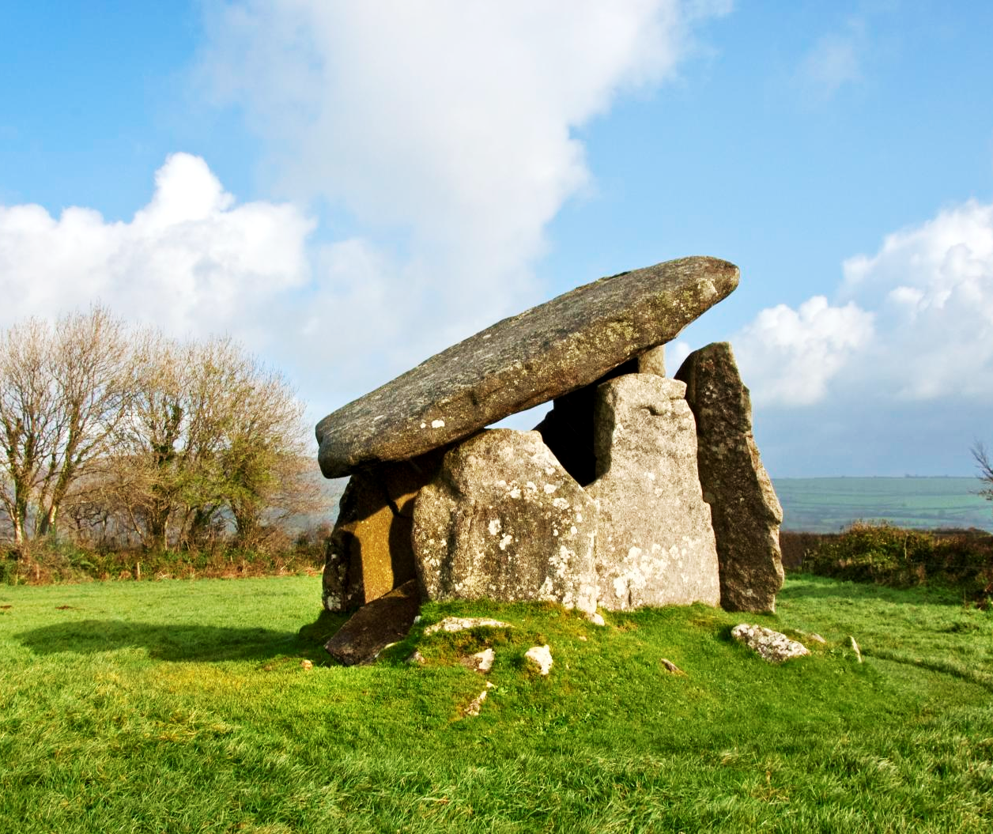
Trethevy Quoit, Cornwall
Back to map
Trethevy Quoit is a very old stone tomb in Cornwall, built about 5,000 years ago by early farmers.
It is one of the best-preserved examples of a portal dolmen, a rare type of burial monument. People used it to bury their dead and for ceremonies.
The tomb has a small rectangular chamber made of big upright stones, with a huge flat stone on top called a capstone. Most of the stones are still in their original positions.
Trethevy Quoit
Notes:
IMAGE:
General view of Trethevy Quoit. © Historic England Ref: DP087250 - https://historicengland.org.uk/images-books/photos/item/DP087250
QUESTION:
How do you think they could have lifted the 20-tonne capstone on top?
LINK:
English Heritage - https://www.english-heritage.org.uk/visit/places/trethevy-quoit/history/

Slide 29
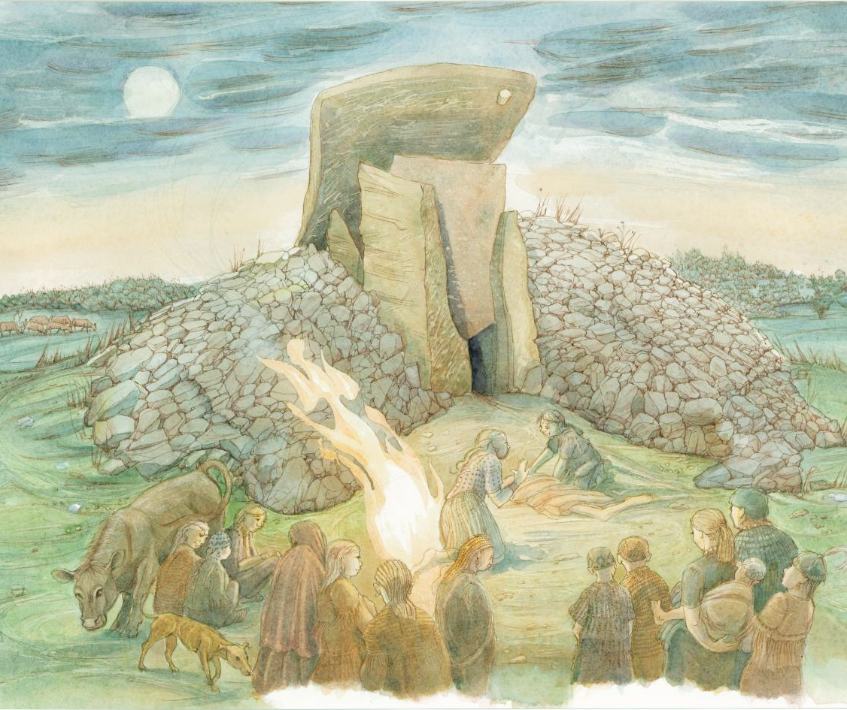
Trethevy Quoit, Cornwall
Back to map
This reconstruction illustration shows a burial ceremony taking place during the Neolithic period - a crowd watches a body being prepared for interment in the stone chamber.
People have been writing about it since 1584, and it is one of Cornwall’s most famous prehistoric monuments.
Its stones and mound are still very clear today, making it an important example of how people built and used tombs in the Neolithic period.
QUESTION
How do you think they could have lifted the 20-tonne capstone on top?
Reconstruction of a burial ceremony at Trethevy Quoit
Notes:
IMAGE:
Reconstruction illustration showing a burial ceremony taking place at Trethevy Quoit, a 'dolmen' type burial chamber, during the Neolithic period. A crowd watches a corpse being prepared for interment in the stone chamber. © Historic England Archive Ref: IC250/001 - https://historicengland.org.uk/images-books/photos/item/IC250/001
QUESTION:
How do you think they could have lifted the 20-tonne capstone on top?
LINK:
English Heritage - https://www.english-heritage.org.uk/visit/places/trethevy-quoit/history/

Slide 30
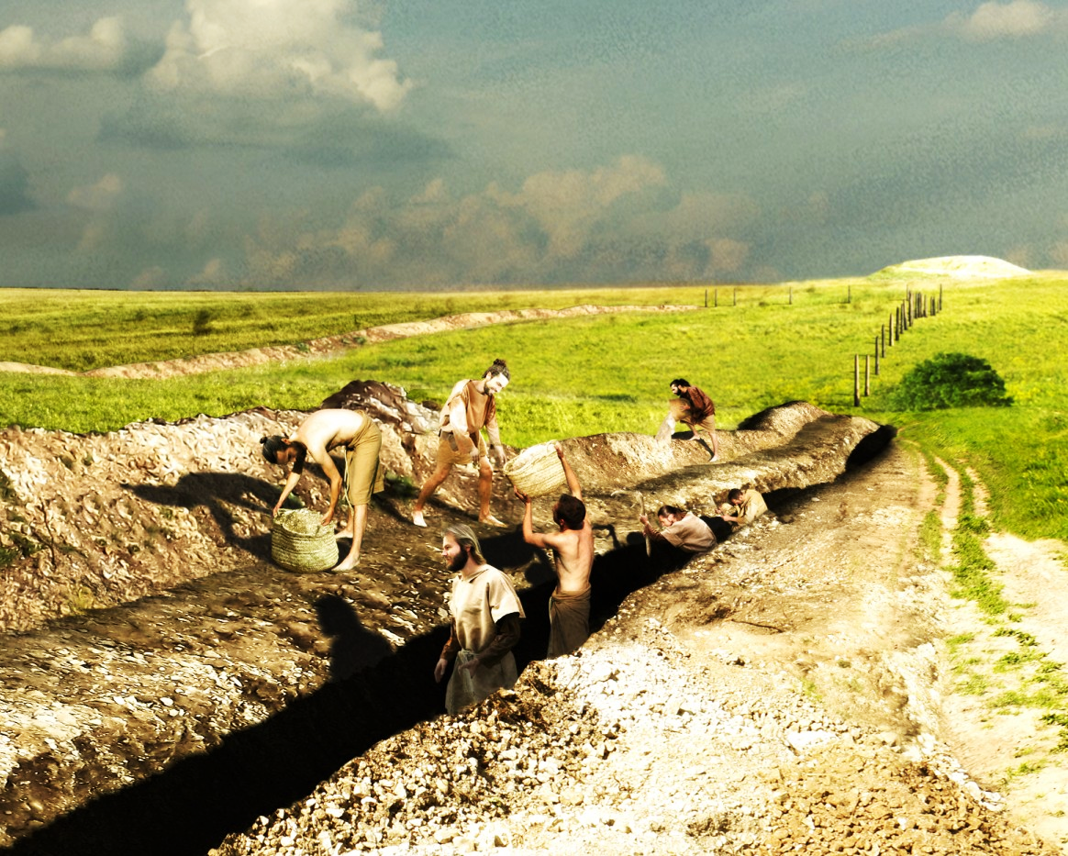
Stonehenge Cursus, Wiltshire
Back to map
Cursus monuments are very long, and narrow earthworks built a long time ago, between 3600 and 3000 BC.
People dug deep ditches using tools made from deer antlers and carried the soil away in woven baskets.
These monuments can be quite different in size. Some are about 100 metres long, while others can stretch for almost 10 kilometres!
Archaeologists don’t find many objects inside them, so it is hard to know exactly what they were used for.
Reconstruction of digging Stonehenge Cursus
Notes:
IMAGE:
Reconstruction illustration showing the construction of the Stonehenge cursus in about 3700BC, during the Early Neolithic period, looking east towards a long barrow (Amesbury 42) from a point midway along the southern side of the Greater Cursus © Historic England Archive Ref: IC095/076 - https://historicengland.org.uk/images-books/photos/item/IC095/076
QUESTION:
Can you think of occasions today when processions take place?
LINK:
English Heritage - https://www.english-heritage.org.uk/visit/places/stonehenge/history-and-stories/history/

Slide 31
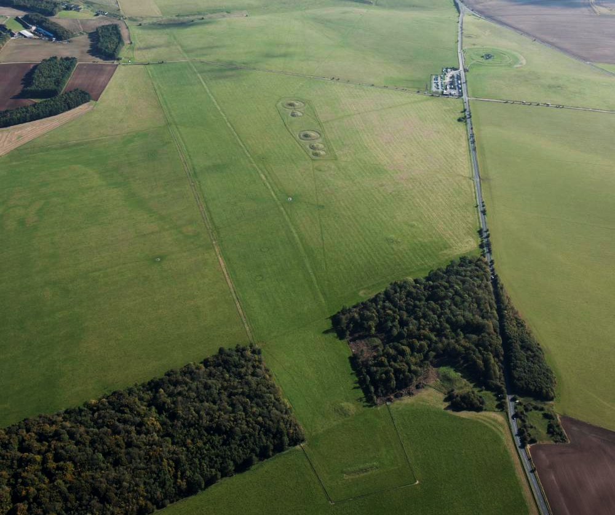
Stonehenge Cursus, Wiltshire
Back to map
Archaeologists think they were special pathways. People may have walked along them during special ceremonies or when travelling across sacred land.
Very few are easily seen today, but one famous example still exists. It is called the Greater Stonehenge Cursus and is about 3 kilometres long.
In the 1700s, an archaeologist named William Stukeley discovered it. He thought it looked like a Roman sports arena and named it “cursus,” the Latin word for a chariot racetrack.
QUESTION
Can you think of occasions today when processions take place?
Aerial view of the Stonehenge Cursus
Notes:
IMAGE:
Stonehenge Cursus. © Historic England Archive Ref: 27527_029 - https://historicengland.org.uk/images-books/archive/collections/aerial-photos/record/27527_029
QUESTION:
Can you think of occasions today when processions take place?
LINK:
English Heritage - https://www.english-heritage.org.uk/visit/places/stonehenge/history-and-stories/history/

Slide 32
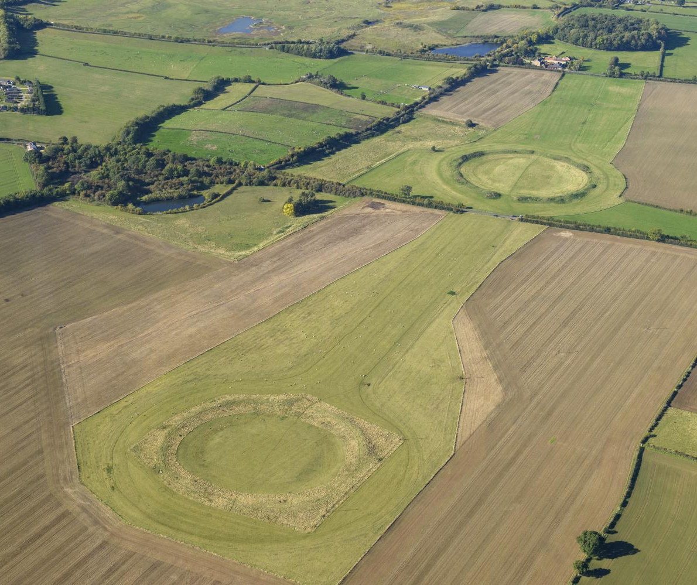
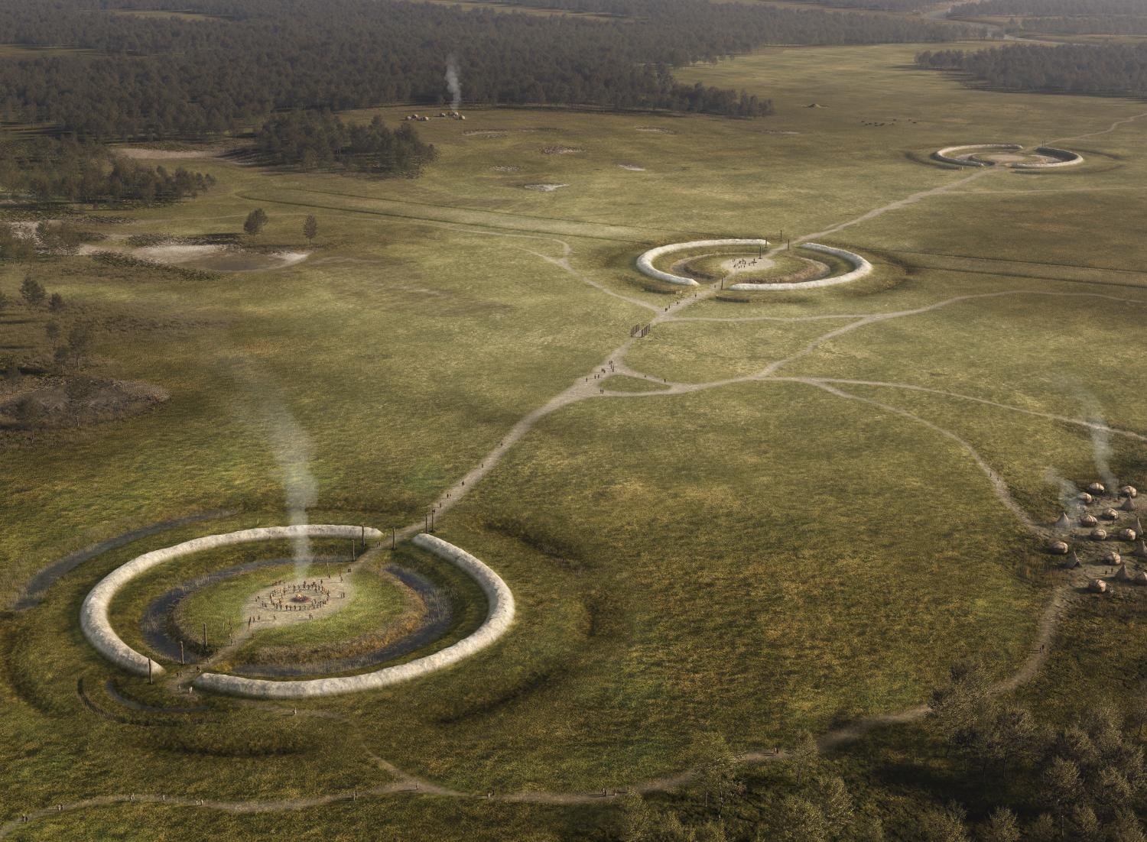
Thornborough Henges, Yorkshire
Back to map
The Thornborough Henges are three huge circles, built about 4,500 years ago and stretching over 1 km. Each is about 240 metres wide.
Henges are round earthworks with a ditch inside and an outer bank. Unlike causewayed enclosures, they usually only had a few entrances, which may have been used to control who could go inside them.
The area around them may have been sacred, as archaeologists found no settlement or everyday activity here.
The henges today and a reconstruction of what they may have looked like at the time they were built
Notes:
IMAGE:
A reconstruction showing what Thornborough henges may have looked like at the time they were built, around 4,500 to 5,000 years ago © Historic England Archive Ref: IC338/001 - https://historicengland.org.uk/images-books/photos/item/IC338/001
QUESTION:
Can you think of occasions today when processions take place?
LINK:
English Heritage - https://www.english-heritage.org.uk/visit/places/thornborough-henges/history/

Slide 33
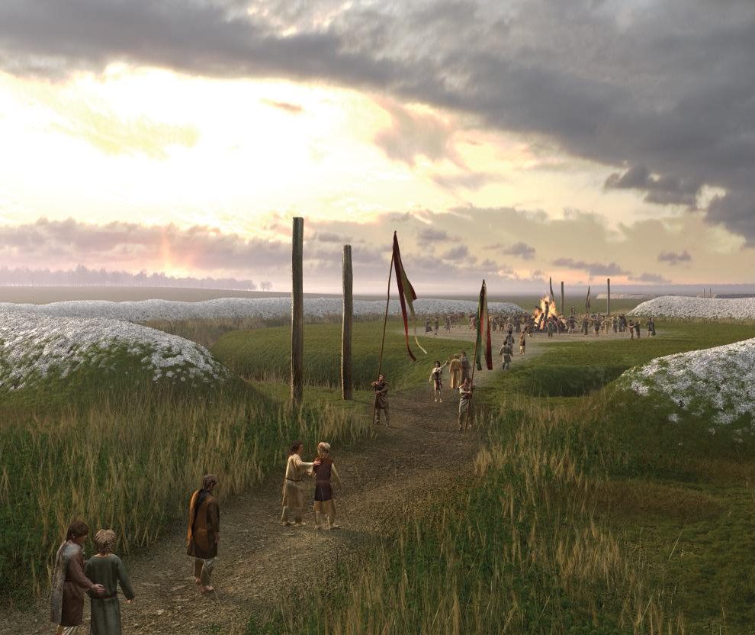
Thornborough Henges, Yorkshire
Back to map
They were not built for defence, so they were probably used for special events like ceremonies or gatherings.
They’re close to the River Ure & people may have used it to travel here.
We don’t know exactly what happened inside, but other henges sometimes had wooden or stone structures.
Some people think the henges may line up with the sun, moon or stars, but we aren’t sure, but they show how important this place was to people thousands of years ago.
QUESTION
Can you think of occasions today when processions take place?
A reconstruction of how the central henge at Thornborough may have looked during a seasonal ceremony
Notes:
IMAGE:
A reconstruction showing what Thornborough henges may have looked like at the time they were built, around 4,500 to 5,000 years ago © Historic England Archive Ref: IC338/002 - https://historicengland.org.uk/images-books/photos/item/IC338/002
QUESTION:
Can you think of occasions today when processions take place?
LINK:
English Heritage - https://www.english-heritage.org.uk/visit/places/thornborough-henges/history/

Slide 34
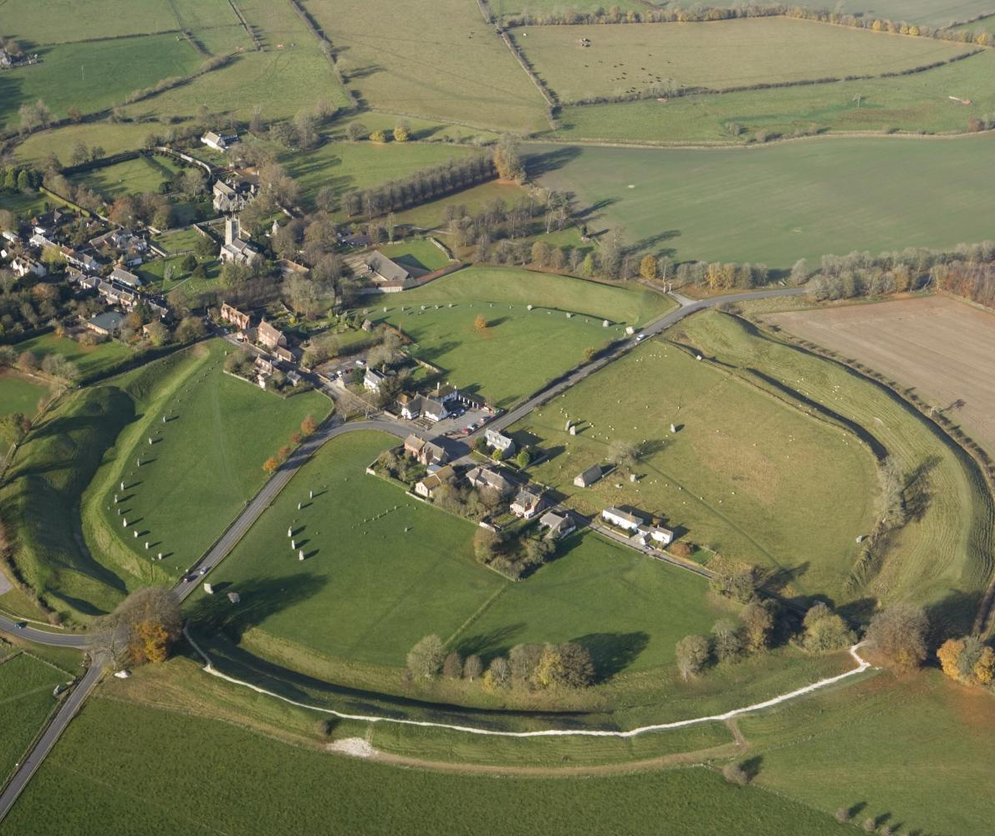
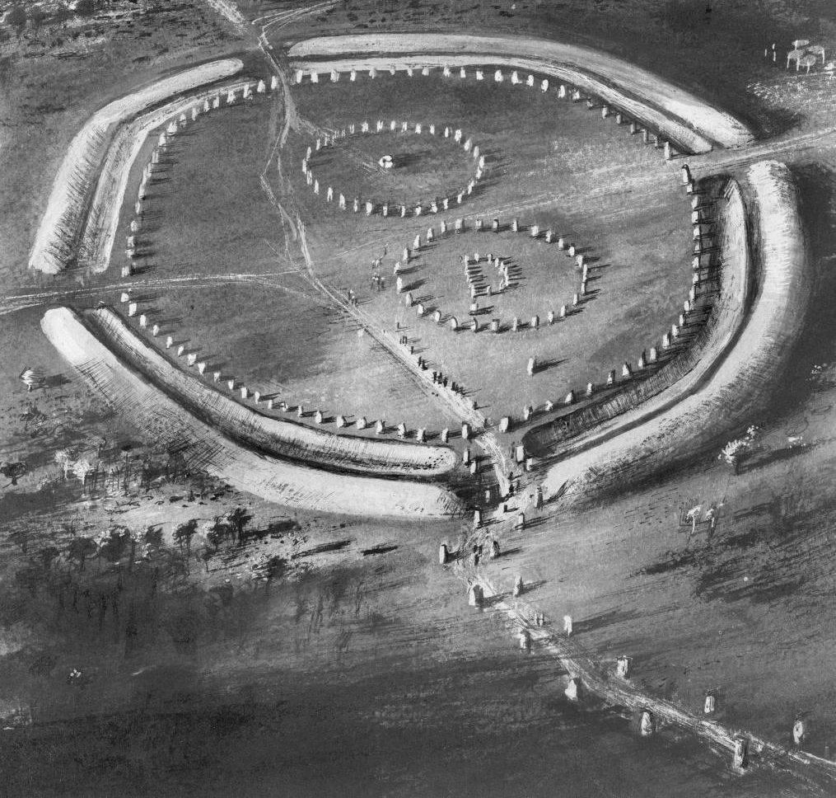
Avebury and Silbury Hill, Wiltshire
Back to map
The henge bank and ditch at Avebury enclose an area of over 400m across and the ditch is 11m deep.
Britain’s, possibly the world’s, largest stone circle follows the inner edge of the ditch. It’s about 10 times larger in diameter than Stonehenge!
Archaeologists think there were also originally two inner circles of stones.
It is part of a landscape of related monuments, including two avenues of standing stones that would have guided visitors to the henge entrances.
An aerial view of Avebury Henge
Notes:
IMAGE:
An aerial view of Avebury Henge © Historic England Archive Ref: 24815_002 - https://historicengland.org.uk/images-books/archive/collections/aerial-photos/record/24815_002
Photograph of a reconstruction illustration depicting an aerial view of Avebury stone circle. © Historic England Archive Ref: P/Y02836/001 - https://historicengland.org.uk/images-books/photos/item/P/Y02836/001
QUESTION:
Why do you think communities worked together on such a huge project?
LINK:
English Heritage - https://www.english-heritage.org.uk/visit/places/avebury/history/

Slide 35
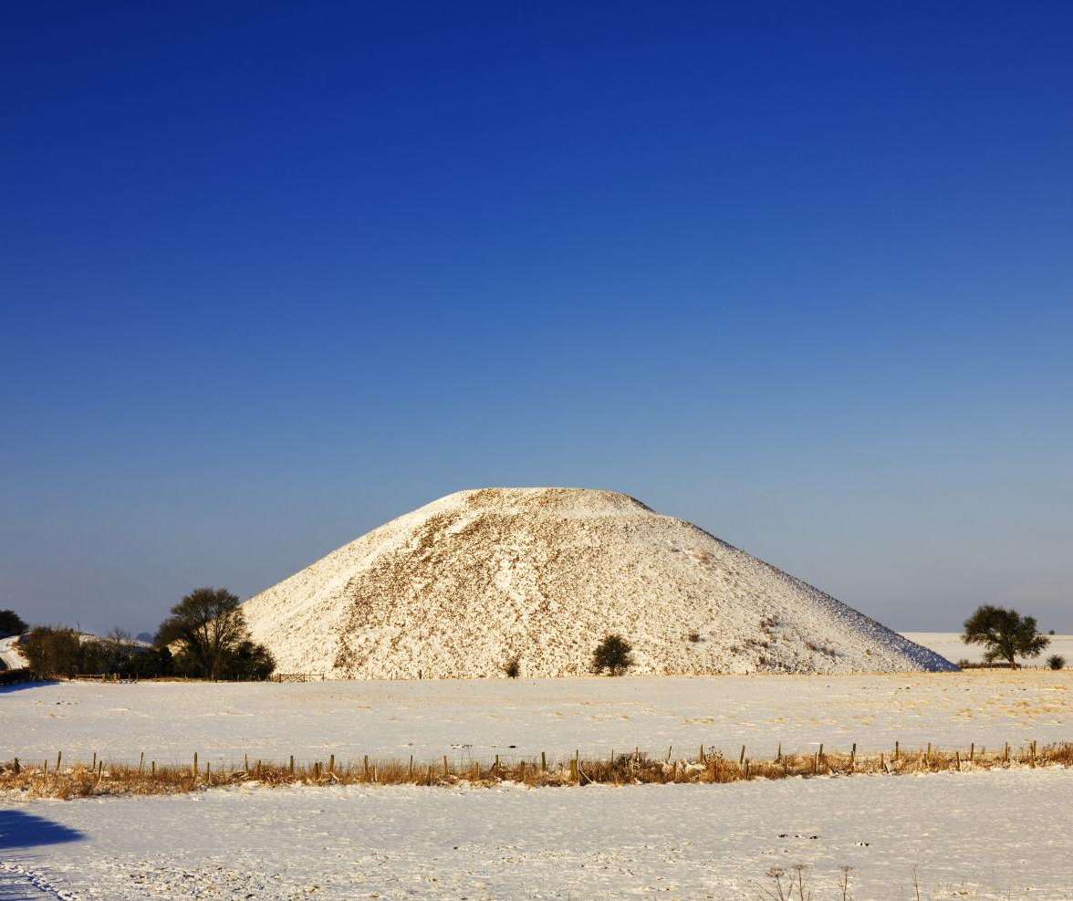
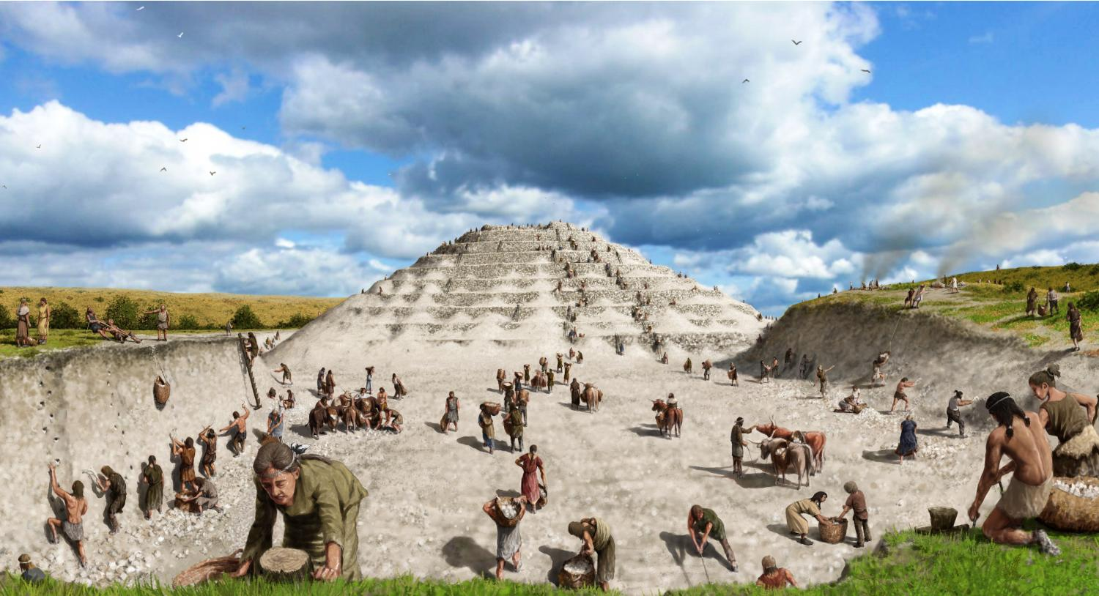
Avebury and Silbury Hill, Wiltshire
Back to map
1 km south of Avebury is the great mound of Silbury Hill, which was built around 2400 BC, a few hundred years after the henge.
It’s nearly 40 metres high and 167 metres wide. It was built before metal tools, using antler picks, bone shovels and probably wicker baskets to move the tonnes of chalk and soil.
While we know a lot about how and when Silbury Hill was constructed no-one is sure why it was built.
QUESTION
Why do you think communities worked together on such a huge project?
An aerial view of Avebury Henge
Notes:
IMAGE:
A general view showing Silbury Hill under snow © Historic England Archive Ref: DP147629 – https://historicengland.org.uk/images-books/photos/item/DP147629
Reconstruction drawing showing the final stages of construction of Silbury Hill in around 2300 BC. © Historic England Archive Ref: IC005/048 - https://historicengland.org.uk/images-books/photos/item/IC005/048
QUESTION:
Why do you think communities worked together on such a huge project?
LINK:
English Heritage - https://www.english-heritage.org.uk/visit/places/avebury/history/

Slide 36
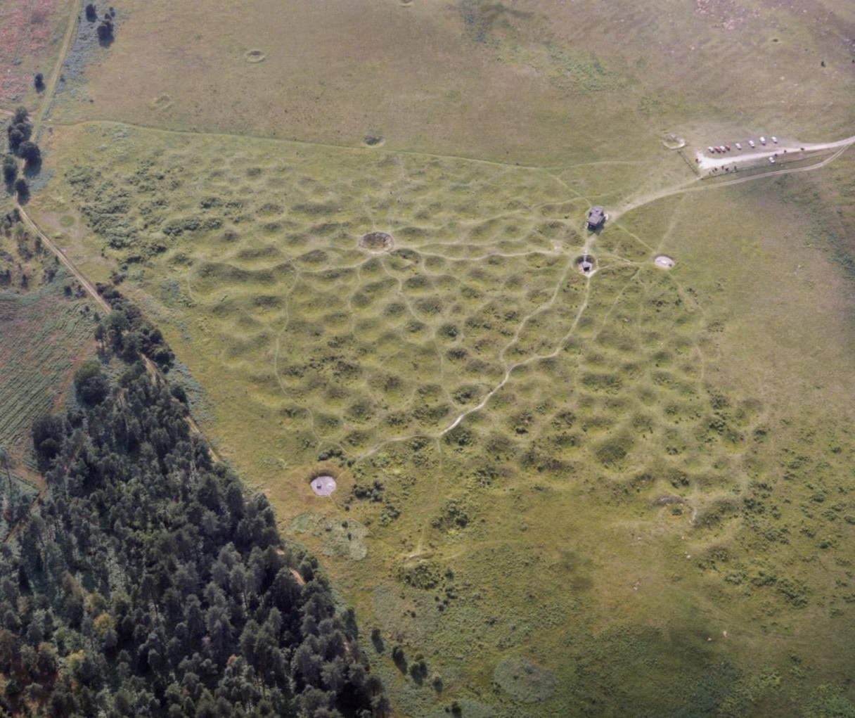
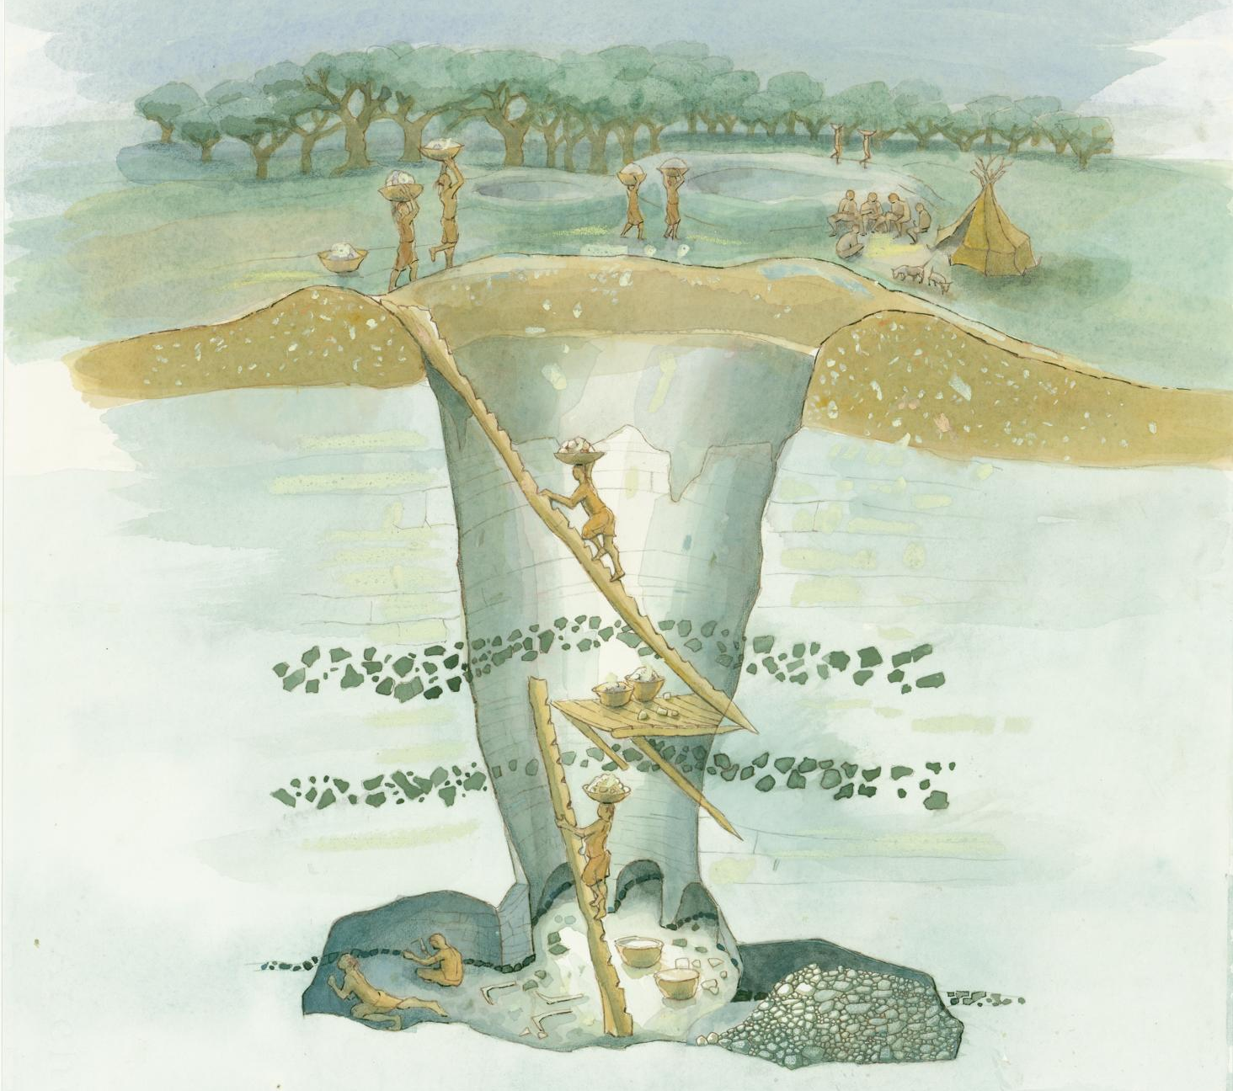
Grimes Graves, Norfolk
Back to map
This is an aerial photograph of the Grimes Graves flint mines in Norfolk.
You can see how big the site is by looking at the cars in the car park on the right. Each of the depressions to the left of these is a Neolithic mine.
At least 433 mine shafts were dug to mine flint from deep underground. The biggest were 14m deep and 12m wide.
Most of the mining at Grimes Graves took place between 2600 - 2400 BC.
An aerial view of prehistoric mine shafts at Grimes Graves
Notes:
IMAGE:
An aerial view of prehistoric mine shafts at Grimes Graves © Historic England Archive Ref: nmr_15717_027
Sectional reconstruction drawing of a Neolithic mine shaft at Grimes Graves, showing miners at work in the galleries at the lowest level, other workers carrying mined material to the surface, and others working flint near a temporary camp. © Historic England Archive Ref: IC046/020 - https://historicengland.org.uk/images-books/photos/item/IC046/020
QUESTION:
A lot of effort was put into digging flint at this site. Why do you think Neolithic people wanted it so much?
LINK:
English Heritage - https://www.english-heritage.org.uk/visit/places/grimes-graves-prehistoric-flint-mine/school-visits/

Slide 37
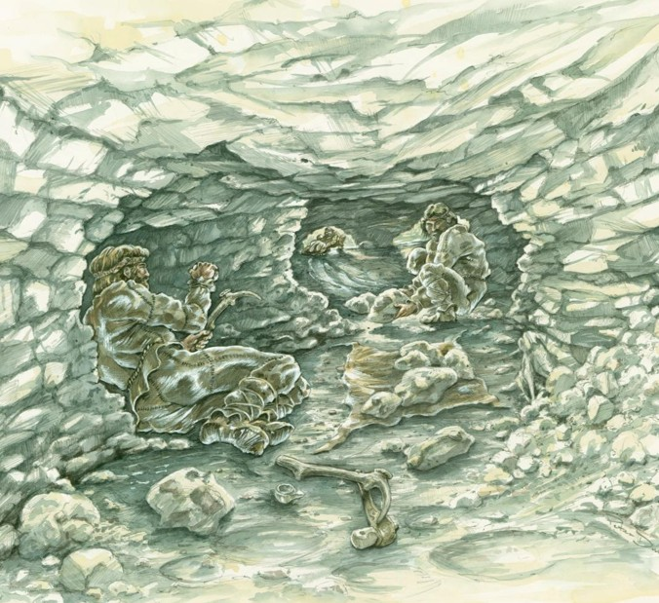
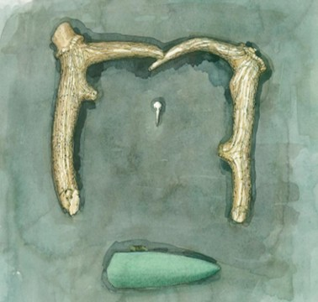
Grimes Graves, Norfolk
Back to map
Neolithic people had no metal tools and used antler picks and stone tools to dig. They may have used torches of burning branches and animal fat to see inside the dark mine shafts.
The flint dug out of the mine shafts would have been used for making stone tools, including polished axes.
Mining flint would have been very dangerous. Some of the shafts seem to have been the sites of ceremonies with ritually-deposited objects , perhaps to ensure success or luck.
QUESTION
A lot of effort was put into digging flint at this site. Why do you think Neolithic people wanted it so much?
Reconstruction of Neolithic people mining in one of the shafts
Notes:
IMAGE:
Reconstruction illustration depicting flint miners working in a gallery off a main pit shaft at Grimes Graves during the Late Neolithic period. The nearest miner uses an antler pick and hammerstone, and others remove mined flint and waste. © Historic England Archive Ref: IC046/002 - https://historicengland.org.uk/images-books/photos/item/IC046/002
Reconstruction illustration showing the arrangement of ritually-deposited objects excavated from a gallery off Greenwell's Pit at Grime's Graves flint mine; two deer antler picks, the skull of a phalarope wading bird, and a polished greenstone axe. © Historic England Archive Ref: IC046/011 - https://historicengland.org.uk/images-books/photos/item/IC046/011
QUESTION:
A lot of effort was put into digging flint at this site. Why do you think Neolithic people wanted it so much?
LINK:
English Heritage - https://www.english-heritage.org.uk/visit/places/grimes-graves-prehistoric-flint-mine/school-visits/

Slide 38
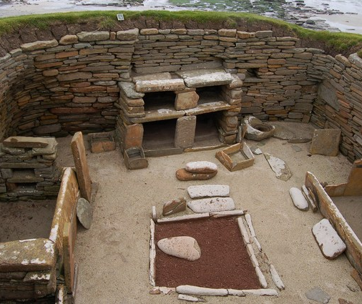
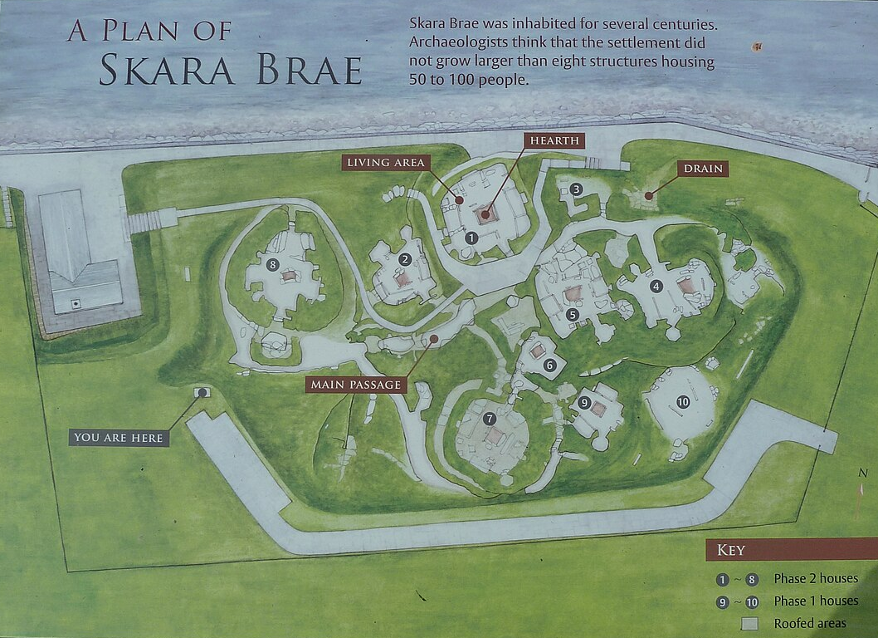
Skara Brae, Orkney
Back to map
Skara Brae is a village that was built over 4,500 years ago. It is one of the best-preserved ancient villages in Europe, where we can clearly see how people lived at that time.
The village is in Orkney, Scotland. About 28 buildings were found, and 10 houses are still easy to see today.
The houses were made from stone and connected to each other by covered passageways. Inside they still had stone furniture like beds, shelves (called dressers), and fireplaces.
View of the stone-built furniture inside one of the houses
Notes:
IMAGE:
© John Allan / Inside a house at Skara Brae, via Wikimedia Commons - https://commons.wikimedia.org/wiki/File:Inside_a_house_at_Skara_Brae_-_geograph.org.uk_-_582971.jpg
© Skara Brae - Plan on plinth by Rob Farrow, CC BY-SA 2.0, via Wikimedia Commons - https://commons.wikimedia.org/wiki/File:Skara_Brae_-_Plan_on_plinth_-_geograph.org.uk_-_6943560.jpg
QUESTION:
What features of the Skara Brea houses do we still have today?
LINK:
BBC Bitesize – Skara Brae: https://www.bbc.co.uk/bitesize/articles/z883g7h#z3s7m39

Slide 39
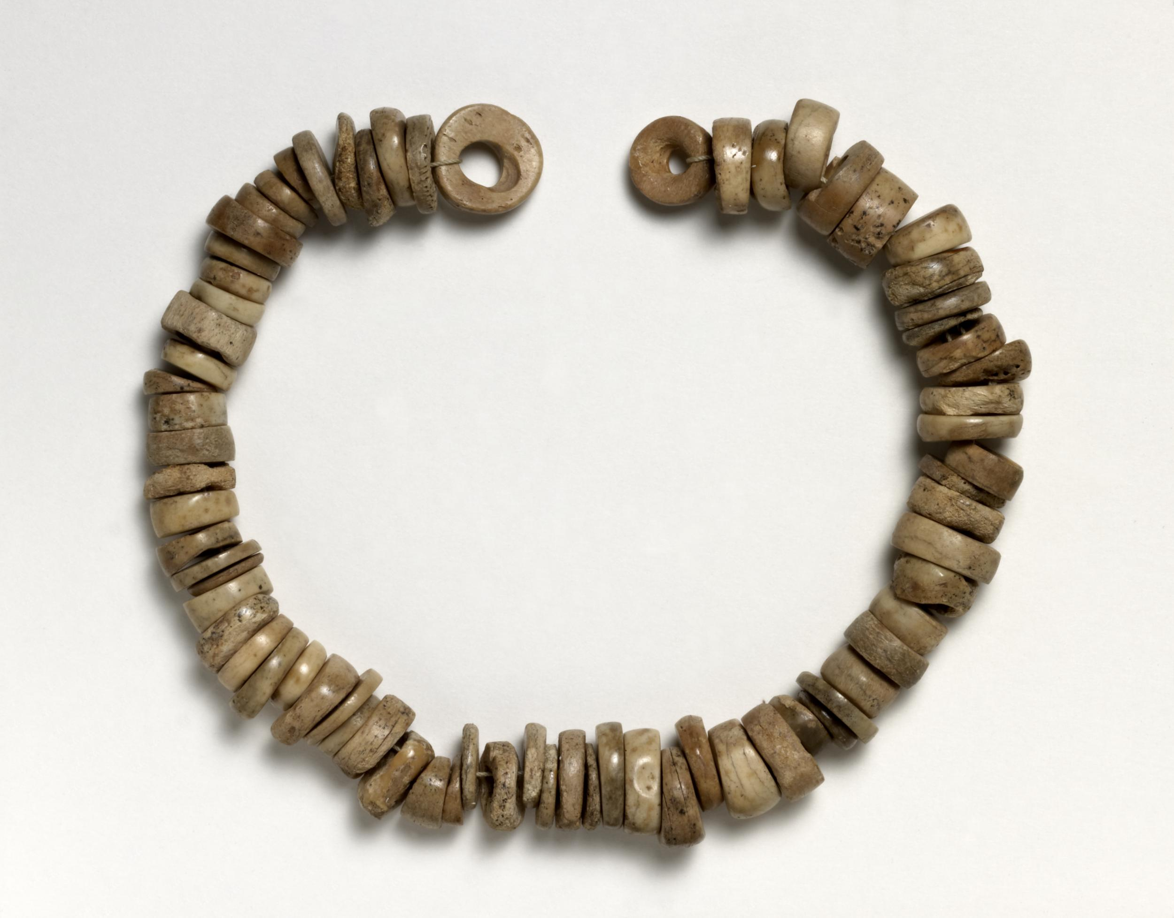
Skara Brae, Orkney
Back to map
The people who lived there were farmers, hunters, and fishers. They made tools, pottery, jewellery, and even small carved objects.
No weapons were found, so they likely lived peacefully.
No one knows exactly why the village was abandoned around 2500 BC. It might have been buried by a big sandstorm or slowly covered by sand over time.
QUESTION
What features of the Skara Brea houses do we still have today?
Necklace found at Skara Brae made from 72 flat bone beads
Notes:
IMAGE:
© The Trustees of the British Museum. Ref: 15384001 - https://www.britishmuseum.org/collection/object/H_1938-0101-62
QUESTION:
What features of the Skara Brea houses do we still have today?
LINK:
https://www.nessofbrodgar.co.uk/skarabrae/

Slide 40
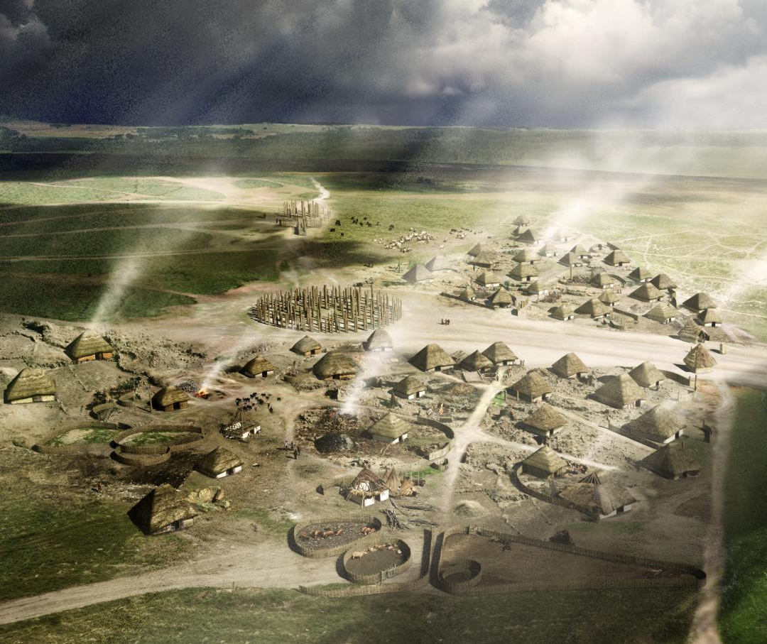
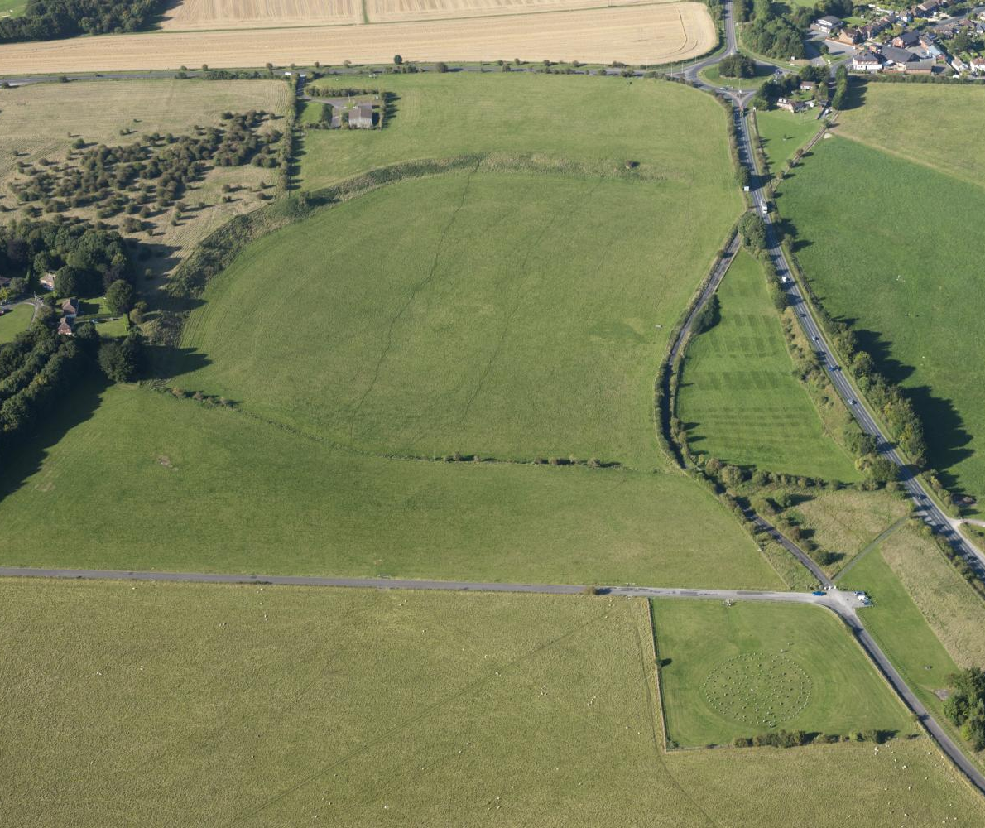
Durrington Walls & Woodhenge, Wilts
Back to map
Durrington Walls was a big Neolithic henge and settlement close to Stonehenge.
It was a special place for ceremonies, feasting, and temporary living.
People from all over Britain came here, bringing animals (especially pigs) for huge communal meals, likely related to rituals at Stonehenge.
Woodhenge was connected to Durrington Walls and also used for ceremonies as part of the same system of beliefs or religion.
Durrington Walls
& Woodhenge
Durrington Walls & Woodhenge, Wiltshire
Notes:
IMAGE:
Aerial photo of Durrington Walls & Woodhenge © Historic England. Ref: 27522_037 - https://historicengland.org.uk/images-books/archive/collections/aerial-photos/record/27522_037
Reconstruction drawing showing the settlement at Durrington Walls near Stonehenge in about 2500BC, looking north, in summer. The image shows the timber monuments of the southern circle and northern circle, an avenue or roadway, and houses. © Historic England Archive. Ref: IC095/082 - https://historicengland.org.uk/images-books/photos/item/IC095/082
QUESTION:
What types of transport might people have used to get to Durrington Walls & Woodhenge?
LINK:
English Heritage - https://www.english-heritage.org.uk/visit/places/woodhenge/history/

Slide 41
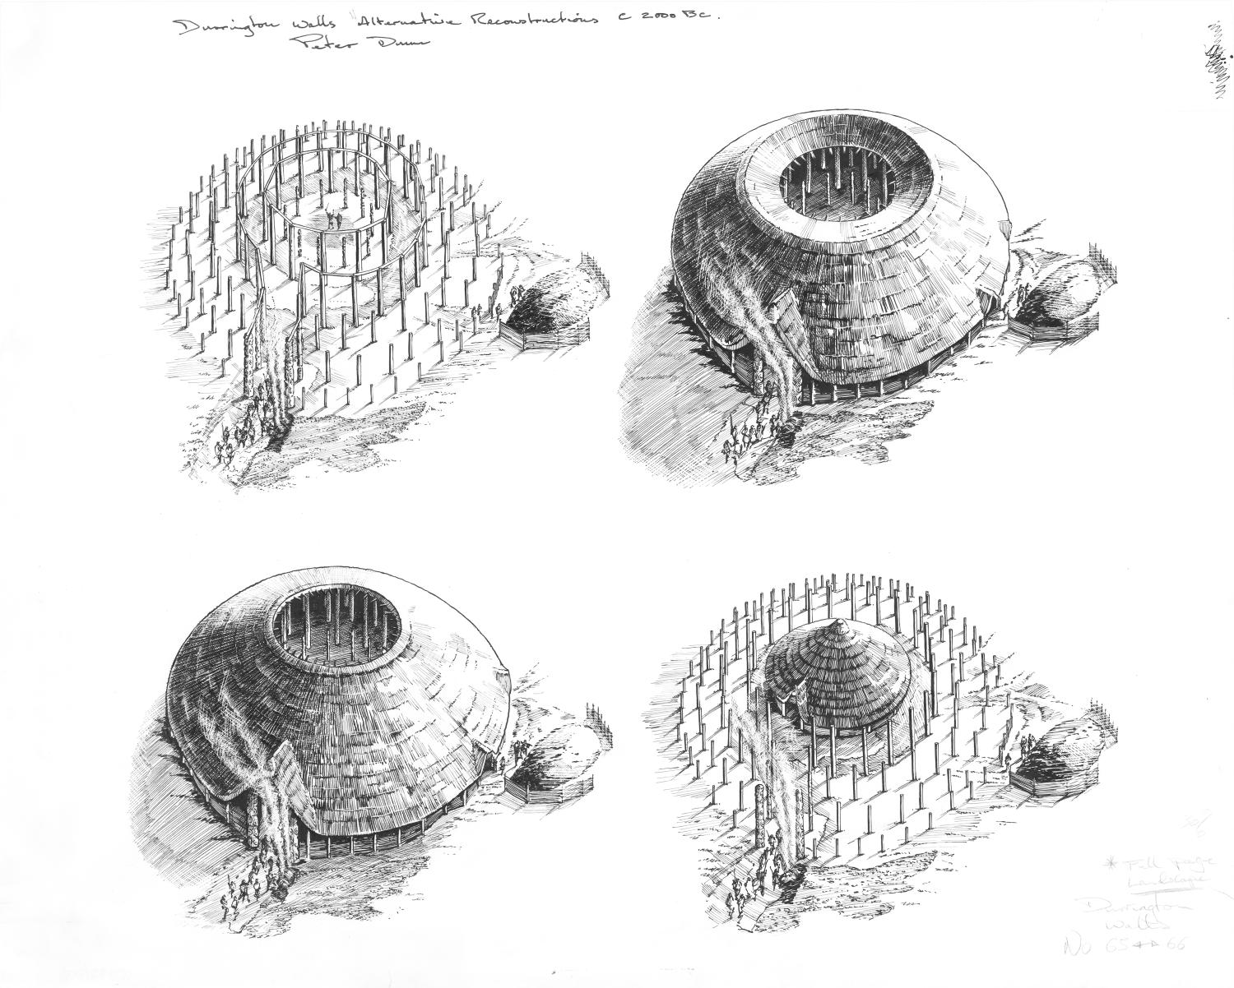
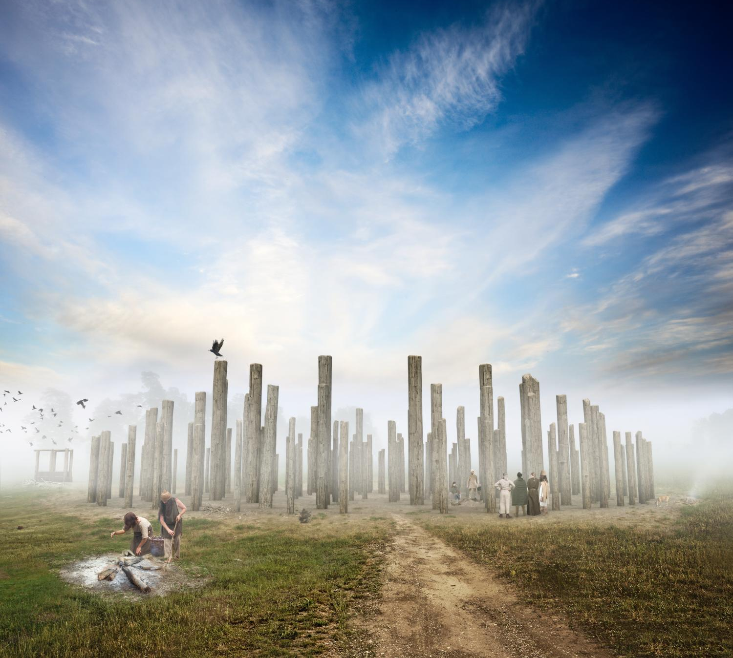
Durrington Walls & Woodhenge, Wilts
Back to map
Both places had wooden circles. We don’t know exactly what they would have looked like, so artists have used the evidence to draw different possible reconstructions.
Archaeologists think Woodhenge was a more focused and formal ritual space than the timber structures within Durrington Walls and that it was used for very special ceremonies.
It’s 6 concentric rings of posts are oval, with the long axis pointing to the rising sun on Midsummer Day - the longest day of the year.
QUESTION
What types of transport might people have used to get to Durrington Walls & Woodhenge?
Four alternative reconstruction drawings of the southern timber circle at Durrington Walls
Notes:
IMAGE:
Four alternative reconstruction drawings of the southern timber circle at Durrington Walls, each depicting a different interpretation of the excavated evidence © Historic England Archive. Ref: IC035/003 - https://historicengland.org.uk/images-books/photos/item/IC035/003
Reconstruction illustration showing Woodhenge to the north-east of Stonehenge, as it may have appeared in about 2500BC, looking south-west towards the 'entrance'. The upright timbers may have been quite simple, or elaborately carved and decorated. © Historic England Archive. Ref: IC095/085 - https://historicengland.org.uk/images-books/photos/item/IC095/085
QUESTION:
What types of transport might people have used to get to Durrington Walls & Woodhenge?
LINK:
English Heritage - https://www.english-heritage.org.uk/visit/places/woodhenge/history/

Slide 42


Stonehenge, Wiltshire
Back to map
Work began on Stonehenge about 5,000 years ago, but it was built in stages. The stone circle dates from around 2500 BC, in the late Neolithic.
We don’t know exactly how the stones were transported, but some—the bluestones—came from the Preseli Hills in south-west Wales, over 150 miles (250 km) away.
Its purpose is still uncertain, but its alignment with the sun suggests it may have been a kind of prehistoric temple linked to the seasons.
Stonehenge as it may have appeared in the Late Neolithic
Notes:
IMAGE:
Reconstruction illustration depicting a detailed aerial view of Stonehenge as it may have appeared when complete, in the Late Neolithic around circa 2200BC. This view shows the stones aligned with the midsummer solstice sun rise in the north-east. © Historic England Archive Ref: IC095/073 - https://historicengland.org.uk/images-books/photos/item/IC095/073
Reconstruction illustration depicting a celebration of the midwinter solstice at Stonehenge in about 2200BC during the Late Neolithic period, looking south-west towards the sunset beyond the aligned sarsen circle. © Historic England Archive Ref: IC095/079 - https://historicengland.org.uk/images-books/photos/item/IC095/079
QUESTION:
Why might people have celebrated the longest and shortest days of the year?
LINK:
Trilithon icon - Play the Stonehenge Game to help you find out:
http://www.english-heritage.org.uk/visit/places/stonehenge/school-visits/education-game/
Take the Stonehenge Virtual Tour inside the stones:
https://www.english-heritage.org.uk/visit/places/stonehenge/history-and-stories/stonehenge360/
To find out more about monuments in the surrounding landscape take a look at the interactive map:
https://www.english-heritage.org.uk/visit/places/stonehenge/history-and-stories/stonehenge-landscape/

Slide 43


Stonehenge, Wiltshire
Back to map
The builders used advanced stone-working techniques, including joints more typical of woodworking, making it one of the most sophisticated stone circles in the world.
Stonehenge was also part of a wider prehistoric landscape of connected sites across Wiltshire such as nearby Durrington Walls and Woodhenge, as well as Avebury, West Kennet Longbarrow and Silbury Hill.
It gets over one million visitors each year and is still a focus for mid-summer and mid-winter sunrises.
Tongue-and-groove joint
QUESTION
Why might people have celebrated the longest and shortest days of the year?
Mortice-and-tenon joint
‘Woodworking type’ joints carved in stone at Stonehenge
Notes:
IMAGE:
Diagrammatic detail illustration showing how the stone lintels of the sarsen circle at Stonehenge were stabilised with worked tongue-and-groove joints, and rested on worked mortice-and-tenon joints atop the sarsen uprights © Historic England Archive Ref: IC095/023 - https://historicengland.org.uk/images-books/photos/item/IC095/023
Reconstruction illustration depicting the raising of a huge upright stone of the sarsen circle at Stonehenge using ropes and weights, in the Late Neolithic, circa 2500BC. In the background, a stone lintel is being raised on wooden scaffolding. © Historic England Archive Ref: IC095/078 - https://historicengland.org.uk/images-books/photos/item/IC095/078
QUESTION:
Why might people have celebrated the longest and shortest days of the year?
LINK:
Trilithon icon - Play the Stonehenge Game to help you find out:
http://www.english-heritage.org.uk/visit/places/stonehenge/school-visits/education-game/
Take the Stonehenge Virtual Tour inside the stones:
https://www.english-heritage.org.uk/visit/places/stonehenge/history-and-stories/stonehenge360/
To find out more about monuments in the surrounding landscape take a look at the interactive map:
https://www.english-heritage.org.uk/visit/places/stonehenge/history-and-stories/stonehenge-landscape/

Slide 44


The Amesbury Archer, Wiltshire
Back to map
The Amesbury Archer was buried near Stonehenge at the end of the Neolithic.
He was likely a high-status individual, possibly a metalworker.
His grave contained Beaker pots, copper knives metalworking tools, such as a cushion stone and two gold hair ornaments, the earliest evidence of gold in Britain.
He also had lots of flint arrowheads and archery equipment, such as wrist guards, hence his name!
Flint arrowheads
Gold ornaments
Copper knives
Stone wrist guards
All the artefacts from the Amesbury Archer burial
Notes:
IMAGE:
Finds from the grave of the Amesbury Archer © Wessex Archaeology - https://flic.kr/p/7hXLBM
QUESTION:
How and why do you think people travelled in prehistoric Europe?
LINK:
BBC Bitesize: https://www.bbc.co.uk/bitesize/articles/z874kqt#zqgx6g8
The Amesbury Archer: pilgrim or magician?:https://www.wessexarch.co.uk/news/amesbury-archer-pilgrim-or-magician

Slide 45

The Amesbury Archer, Wiltshire
Back to map
At this time, metalworking was a rare and specialised skill, sometimes seen as mysterious or magical.
Scientific study shows he was a strong 35–45-year-old but had a limp.
It also tells us he grew up in the Alps, not in Britain. Intriguingly, a nearby burial was probably a relative of his, yet they grew up in Britain.
This tells us that people travelled long distances which may have increased their status and brought new skills.
QUESTION
How and why do you think people travelled in prehistoric Europe?
An artist's interpretation of the Amesbury Archer
Notes:
IMAGE:
Amesbury Archer - an artist's interpretation © Wessex Archaeology - https://flic.kr/p/aoHqa
QUESTION:
How and why do you think people travelled in prehistoric Europe?
LINK:
BBC Bitesize: https://www.bbc.co.uk/bitesize/articles/z874kqt#zqgx6g8
The Amesbury Archer: pilgrim or magician?:https://www.wessexarch.co.uk/news/amesbury-archer-pilgrim-or-magician

Slide 46


Doddington Moor, Northumberland
Back to map
In some areas of Britain, where suitable rocks are exposed, Neolithic rock art is found.
One good example is on Doddington Moor in Northumberland.
There are several rock art sites here, where Late Neolithic people carved patterns and motifs.
They are mostly what archaeologists call ‘cup and ring marks’ - where carved rings surround one or more small depressions or cups.
Cup And Ring Marked Rock, Doddington Moor
Notes:
IMAGE:
Cup And Ring Marked Rock, Doddington. © Historic England Archive Ref: AA045828 – https://historicengland.org.uk/images-books/photos/item/AA045828
Cup And Ring Marked Stone With About 60 Markings, Doddington. Source: Historic England Archive (W F T Pinkney) Ref: 2C/3/8 - https://historicengland.org.uk/images-books/photos/item/2C/3/8
QUESTION:
Archaeologists do not know what cup and ring marks were meant to show. What do you think? Why do you think they didn’t carve other designs?
LINK:
Prehistoric Rock Art - Make your own Rock Art: https://historicengland.org.uk/education/schools-resources/teaching-activities/prehistoric-rock-art-make-your-own-rock-art/

Slide 47

Doddington Moor, Northumberland
Back to map
These types of motif are found across Britain, and from countries along the Atlantic coast of Europe.
Over 5000 cup and ring mark sites are known from Britain.
As far as we can tell, the rock art does not depict actual things, such as humans or animals, maps or the stars.
They may have served as signposts in the landscape or held some unknown, possibly sacred, meaning for the prehistoric people who made and looked at them.
QUESTION
Archaeologists do not know what cup and ring marks were meant to show. What do you think? Why do you think they didn’t carve other designs?
Cup And Ring Marked Rock, Prudhoe Castle
Notes:
IMAGE:
Drawing of the stone marked with a cup and ring design, excavated at Prudhoe Castle. © Historic England Archive Ref: IC180/006 - https://historicengland.org.uk/images-books/photos/item/IC180/006
QUESTION:
Archaeologists do not know what cup and ring marks were meant to show. What do you think? Why do you think they didn’t carve other designs?
LINK:
Prehistoric Rock Art - Make your own Rock Art: https://historicengland.org.uk/education/schools-resources/teaching-activities/prehistoric-rock-art-make-your-own-rock-art/

