Slide 1
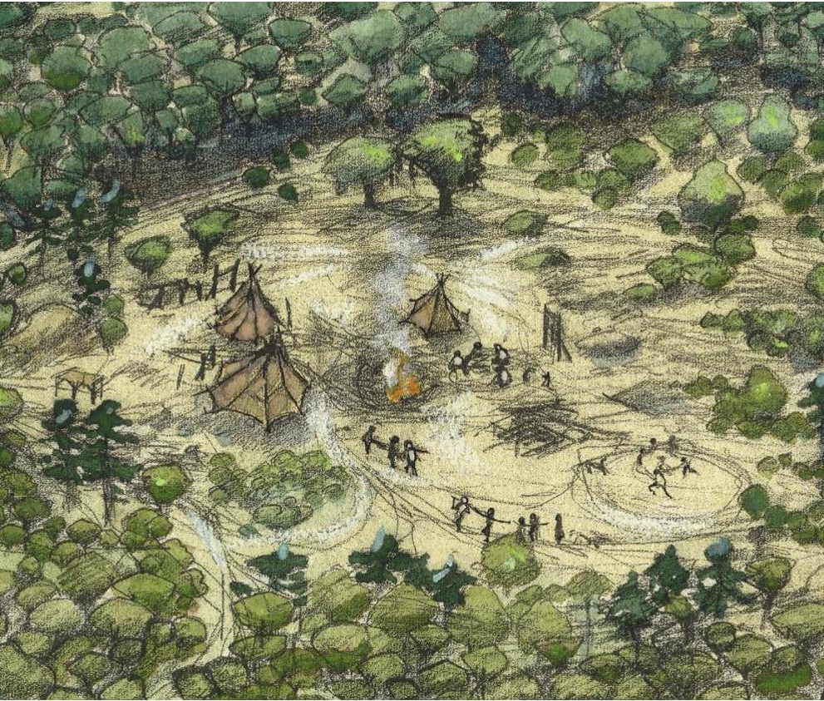
The Mesolithic (Middle Stone Age)
Stone Age to Iron Age: Part 2
The Mesolithic
(Middle Stone Age)

Slide 2
The Mesolithic (Middle Stone Age)
Learn about the types of technology used in the Stone Age
Learn about the everyday life of people in the Stone Age
Learn about changes in Britain from the Stone Age to the Iron Age
Assess the different types of archaeological evidence from the Stone Age
Establish clear narratives within and across the periods studied
Understand how knowledge of the past comes from a range of sources

Slide 3
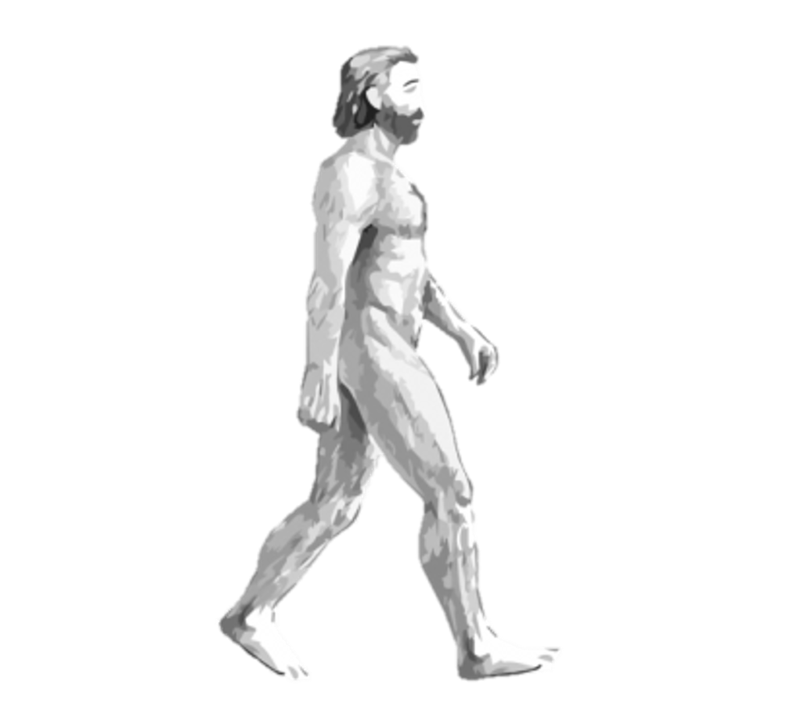
The Mesolithic
Greek:
μεσος (mesos) “middle"
+
λίθος (lithos) "stone"
=
“middle age of the stone"
or
“Middle Stone Age”
Modern man (Homo sapiens)

Slide 4
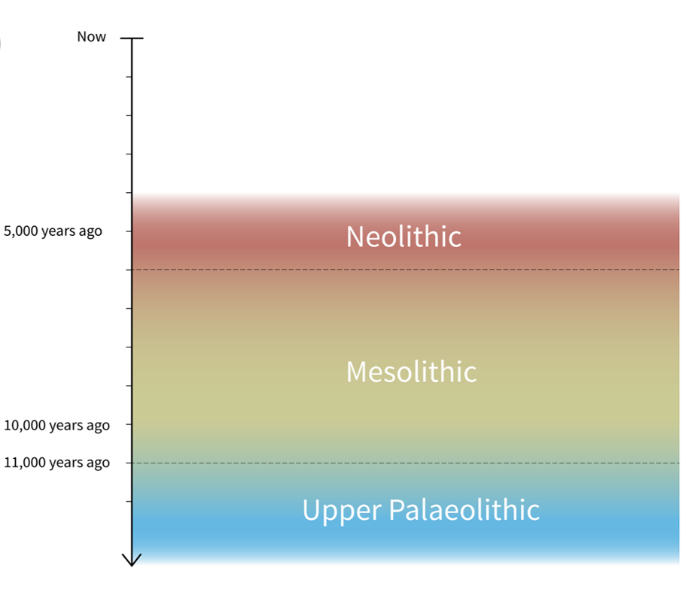
Stone Age Timeline
The Mesolithic was from the end of the last ice age, about 11,000 years ago, until people in Britain started farming around 5,000 years later.
People used stone tools, many of them very tiny, called microliths. They moved around to hunt animals and gather food.
There is some evidence for the houses and campsites they lived in, and a few structures that could be described as monuments.
Three parts of the Stone Age

Slide 5
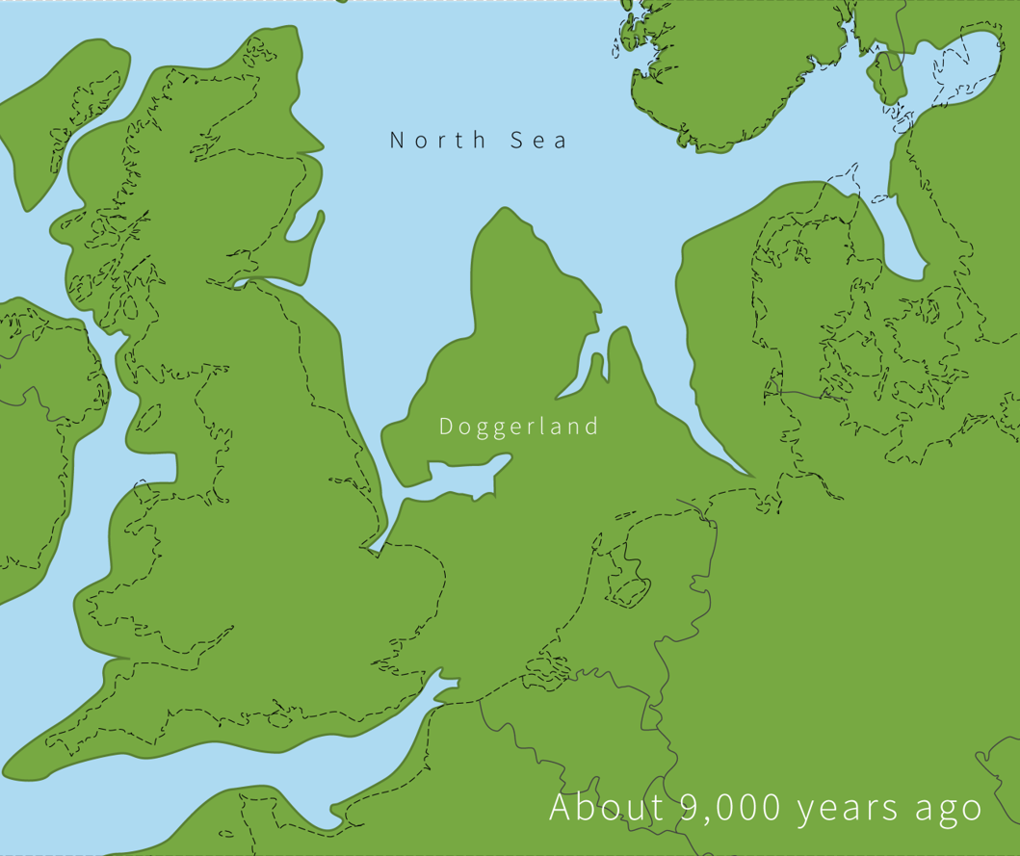
Climate change: UK 9,000 years ago
This shows what Britain looked like at the start of the Mesolithic, when sea levels were rising.
Doggerland was a very large area of land linking Britain with parts of Europe.
It would have been lived in by numerous groups of people.
Due to climate change, it slowly flooded, as glaciers melted after the last ice age.
Early Mesolithic landscape
Notes:
IMAGE:
Europe about 9,000 years ago. © Historic England

Slide 6
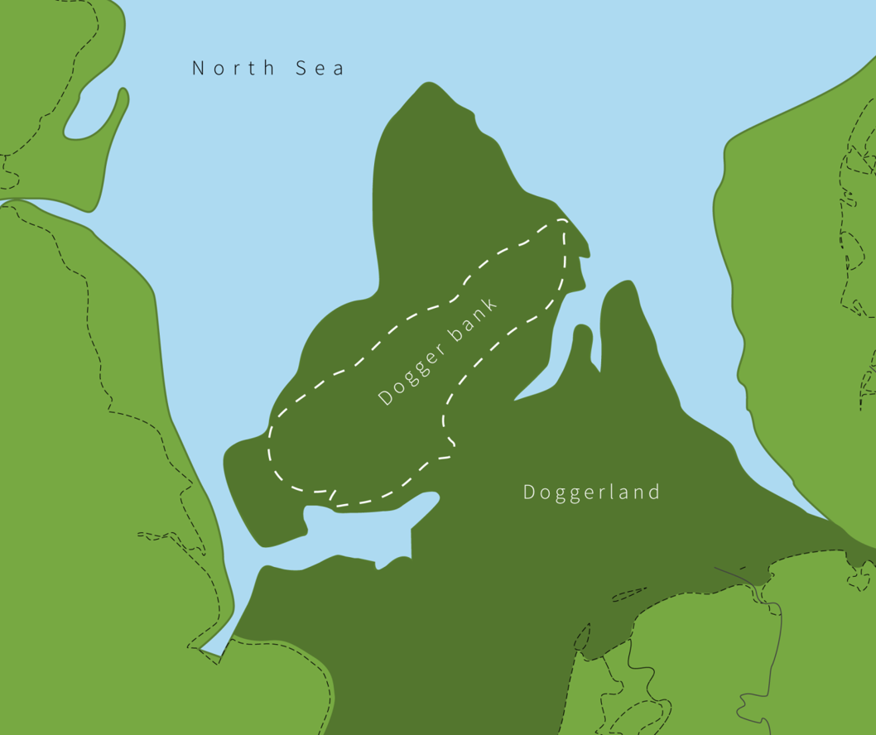
Climate change: UK 7,500 years ago
Doggerland flooded slowly and finally disappeared about 7,500 years ago.
Before this it allowed people to travel, trade, and have a shared culture. People may even have spoken the same language.
After Britain became an island, you needed a boat to reach mainland Europe.
QUESTION
How did climate change affect Mesolithic people?
What things can we do today to prevent climate change that were not possible in the Mesolithic?
Area that flooded during the Mesolithic
Notes:
IMAGE:
Doggerland about 9,000 years ago. © Historic England
QUESTION:
How did climate change affect Mesolithic people?
What things can we do to prevent climate change that were not possible in the Mesolithic?

Slide 7
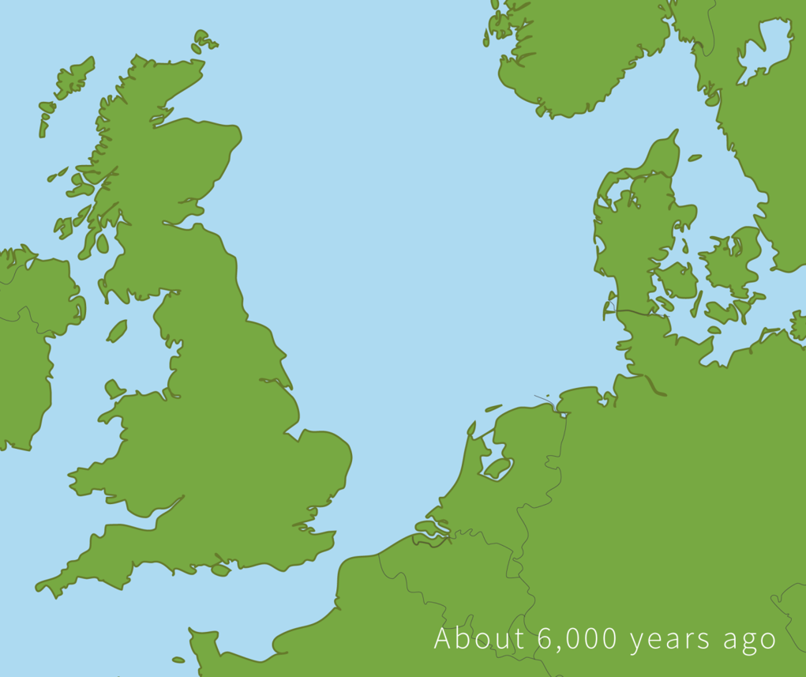
Climate change: UK 6,000 years ago
By about 6,000 years ago, Britain’s coastline looked much like it does today.
Archaeologists find less evidence of contact with mainland Europe, though log boats and traded items show some links always remained.
From this time, Britain began to develop its own distinct island culture.
Late Mesolithic landscape
Notes:
IMAGE:
Europe about 6,000 years ago. © Historic England

Slide 8
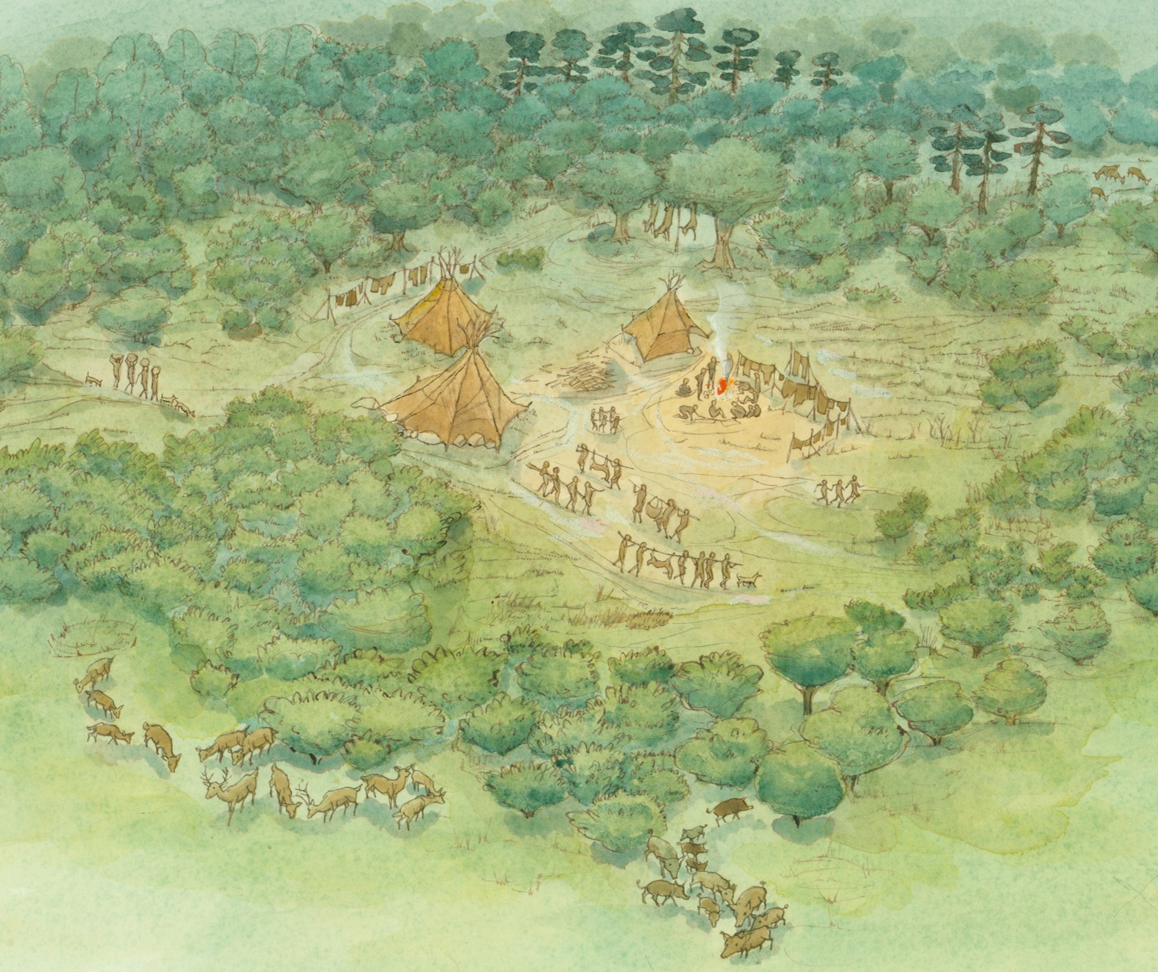
Mesolithic camps
Mesolithic people hunted wild animals, fished and gathered wild plants.
They moved widely, based on when and where different resources were available. Some sites have evidence for use only in particular seasons.
They ranged from small campsites, used for a few hours or months, to larger sites where groups gathered seasonally.
Mesolithic camp
Notes:
IMAGE:
Mesolithic camp. © Historic England Archive Ref: IC046/018 - https://historicengland.org.uk/images-books/photos/item/IC046/018
QUESTION:
What types of wild food would you try and collect if you were a hunter-gatherer?
ACTIVITY:
Plan (and have?) a Mesolithic picnic.
LINK: Foods in the Mesolithic - Star Carr - http://www.starcarr.com/schools-assets/lessons/Foods.pdf

Slide 9
Mesolithic camps
Most archaeological evidence comes from these camps, that are now marked only by scatters of stone tools.
These can be very informative about how old the site is and what tasks took place there.
However, first evidence for actual houses in Britain also comes from this period, at Howick, in Northumberland and Star Carr in Yorkshire.
ACTIVITY
Plan a Mesolithic picnic.
QUESTION
What types of wild food would you try and collect if you were a hunter-gatherer?
Mesolithic camp
Notes:
IMAGE:
Mesolithic camp. © Historic England Archive Ref: IC046/018 - https://historicengland.org.uk/images-books/photos/item/IC046/018
QUESTION:
What types of wild food would you try and collect if you were a hunter-gatherer?
ACTIVITY:
Plan (and have?) a Mesolithic picnic.
LINK: Foods in the Mesolithic - Star Carr - http://www.starcarr.com/schools-assets/lessons/Foods.pdf

Slide 10
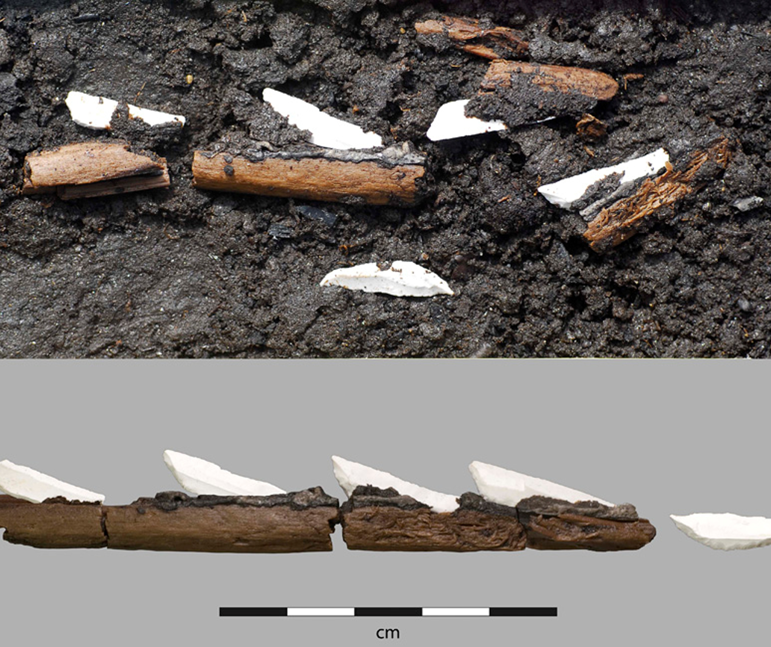
Stone tools: Microliths
The most famous Mesolithic stone tools are called “microliths,” which means “small stones.”
They could be tiny, just a few millimetres, or up to 5 cm long.
People made them by chipping pieces off longer flint blades, and they came in shapes like narrow rods, triangles and crescents.
Microliths ‘glued’ to arrow shaft
Notes:
IMAGE:
Mesolithic flint-tipped arrow from Sweden, showing how microliths were hafted © Antiquity - https://antiquity.ac.uk/projgall/larsson330
QUESTION:
Why might Mesolithic people have made tools from lots of little flints, rather than large stones?

Slide 11
Stone tools: Microliths
Microliths were glued onto wooden handles or shafts to make tools.
Archaeologists have even found arrowheads made by sticking several tiny triangles onto a wooden arrow.
They were stuck on using tar made by heating up the bark from birch tress – it was like a prehistoric type of superglue!
QUESTION
Why might Mesolithic people have made tools from lots of little flints, rather than large stones?
Microliths ‘glued’ to arrow shaft
Notes:
IMAGE:
Mesolithic flint-tipped arrow from Sweden, showing how microliths were hafted © Antiquity - https://antiquity.ac.uk/projgall/larsson330
QUESTION:
Why might Mesolithic people have made tools from lots of little flints, rather than large stones?

Slide 12
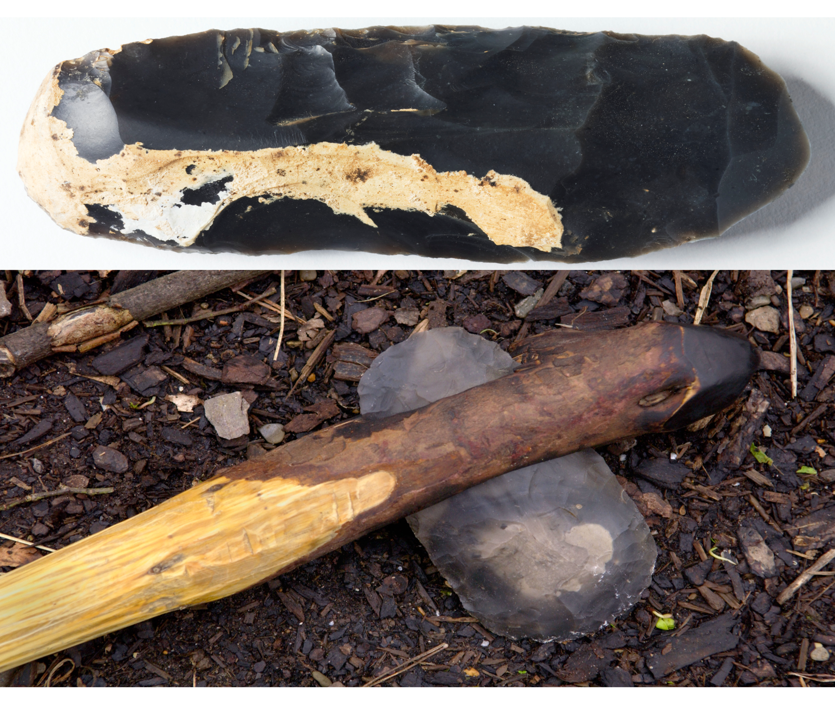
Stone tools: Axe
In addition to microliths, Mesolithic people used larger stone tools, like axes, for woodworking.
When the cutting edges of these axes became blunt, they could quickly be resharpened by striking another flake off the edge.
Unlike earlier handaxes, these axe heads were attached to wooden handles.
QUESTION
What sort of tasks would Mesolithic people have used stone axes for?
Mesolithic axe head and replica axe
Notes:
IMAGE:
Mesolithic tranchet stone axe. © Historic England Archive. Ref: DP081187 - https://historicengland.org.uk/images-books/photos/item/DP081187
Prehistoric Flint axe made by Stone age reenactor at The Museum of Welsh Life St Fagans Cardiff Wales UK © Alamy - A2PJED
QUESTION:
What sort of tasks would Mesolithic people have used stone axes for?

Slide 13
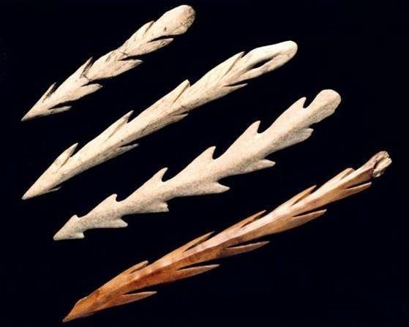
Bone and antler objects
Barbed points are one of the most famous Mesolithic artefact types.
They are long rods of antler or bone with ‘barbs’ (points projecting backwards from the main point) down one or both sides.
They might have been used as harpoons for fishing, or as spears for hunting large animals on the land.
Barbed bone points
Notes:
IMAGE:
Barbed bone points. © Nation Museum of Scotland

Slide 14

Mesolithic Locations
Click on the dots to learn about our Top 7 Mesolithic sites
Oronsay
Howick
Star Carr
March Hill
Aveline’s Hole
Stonehenge and
Blick Mead
Bouldnor Cliff,
Isle of Wight
Notes:
Click on each red dot to find out more about each location’

Slide 15
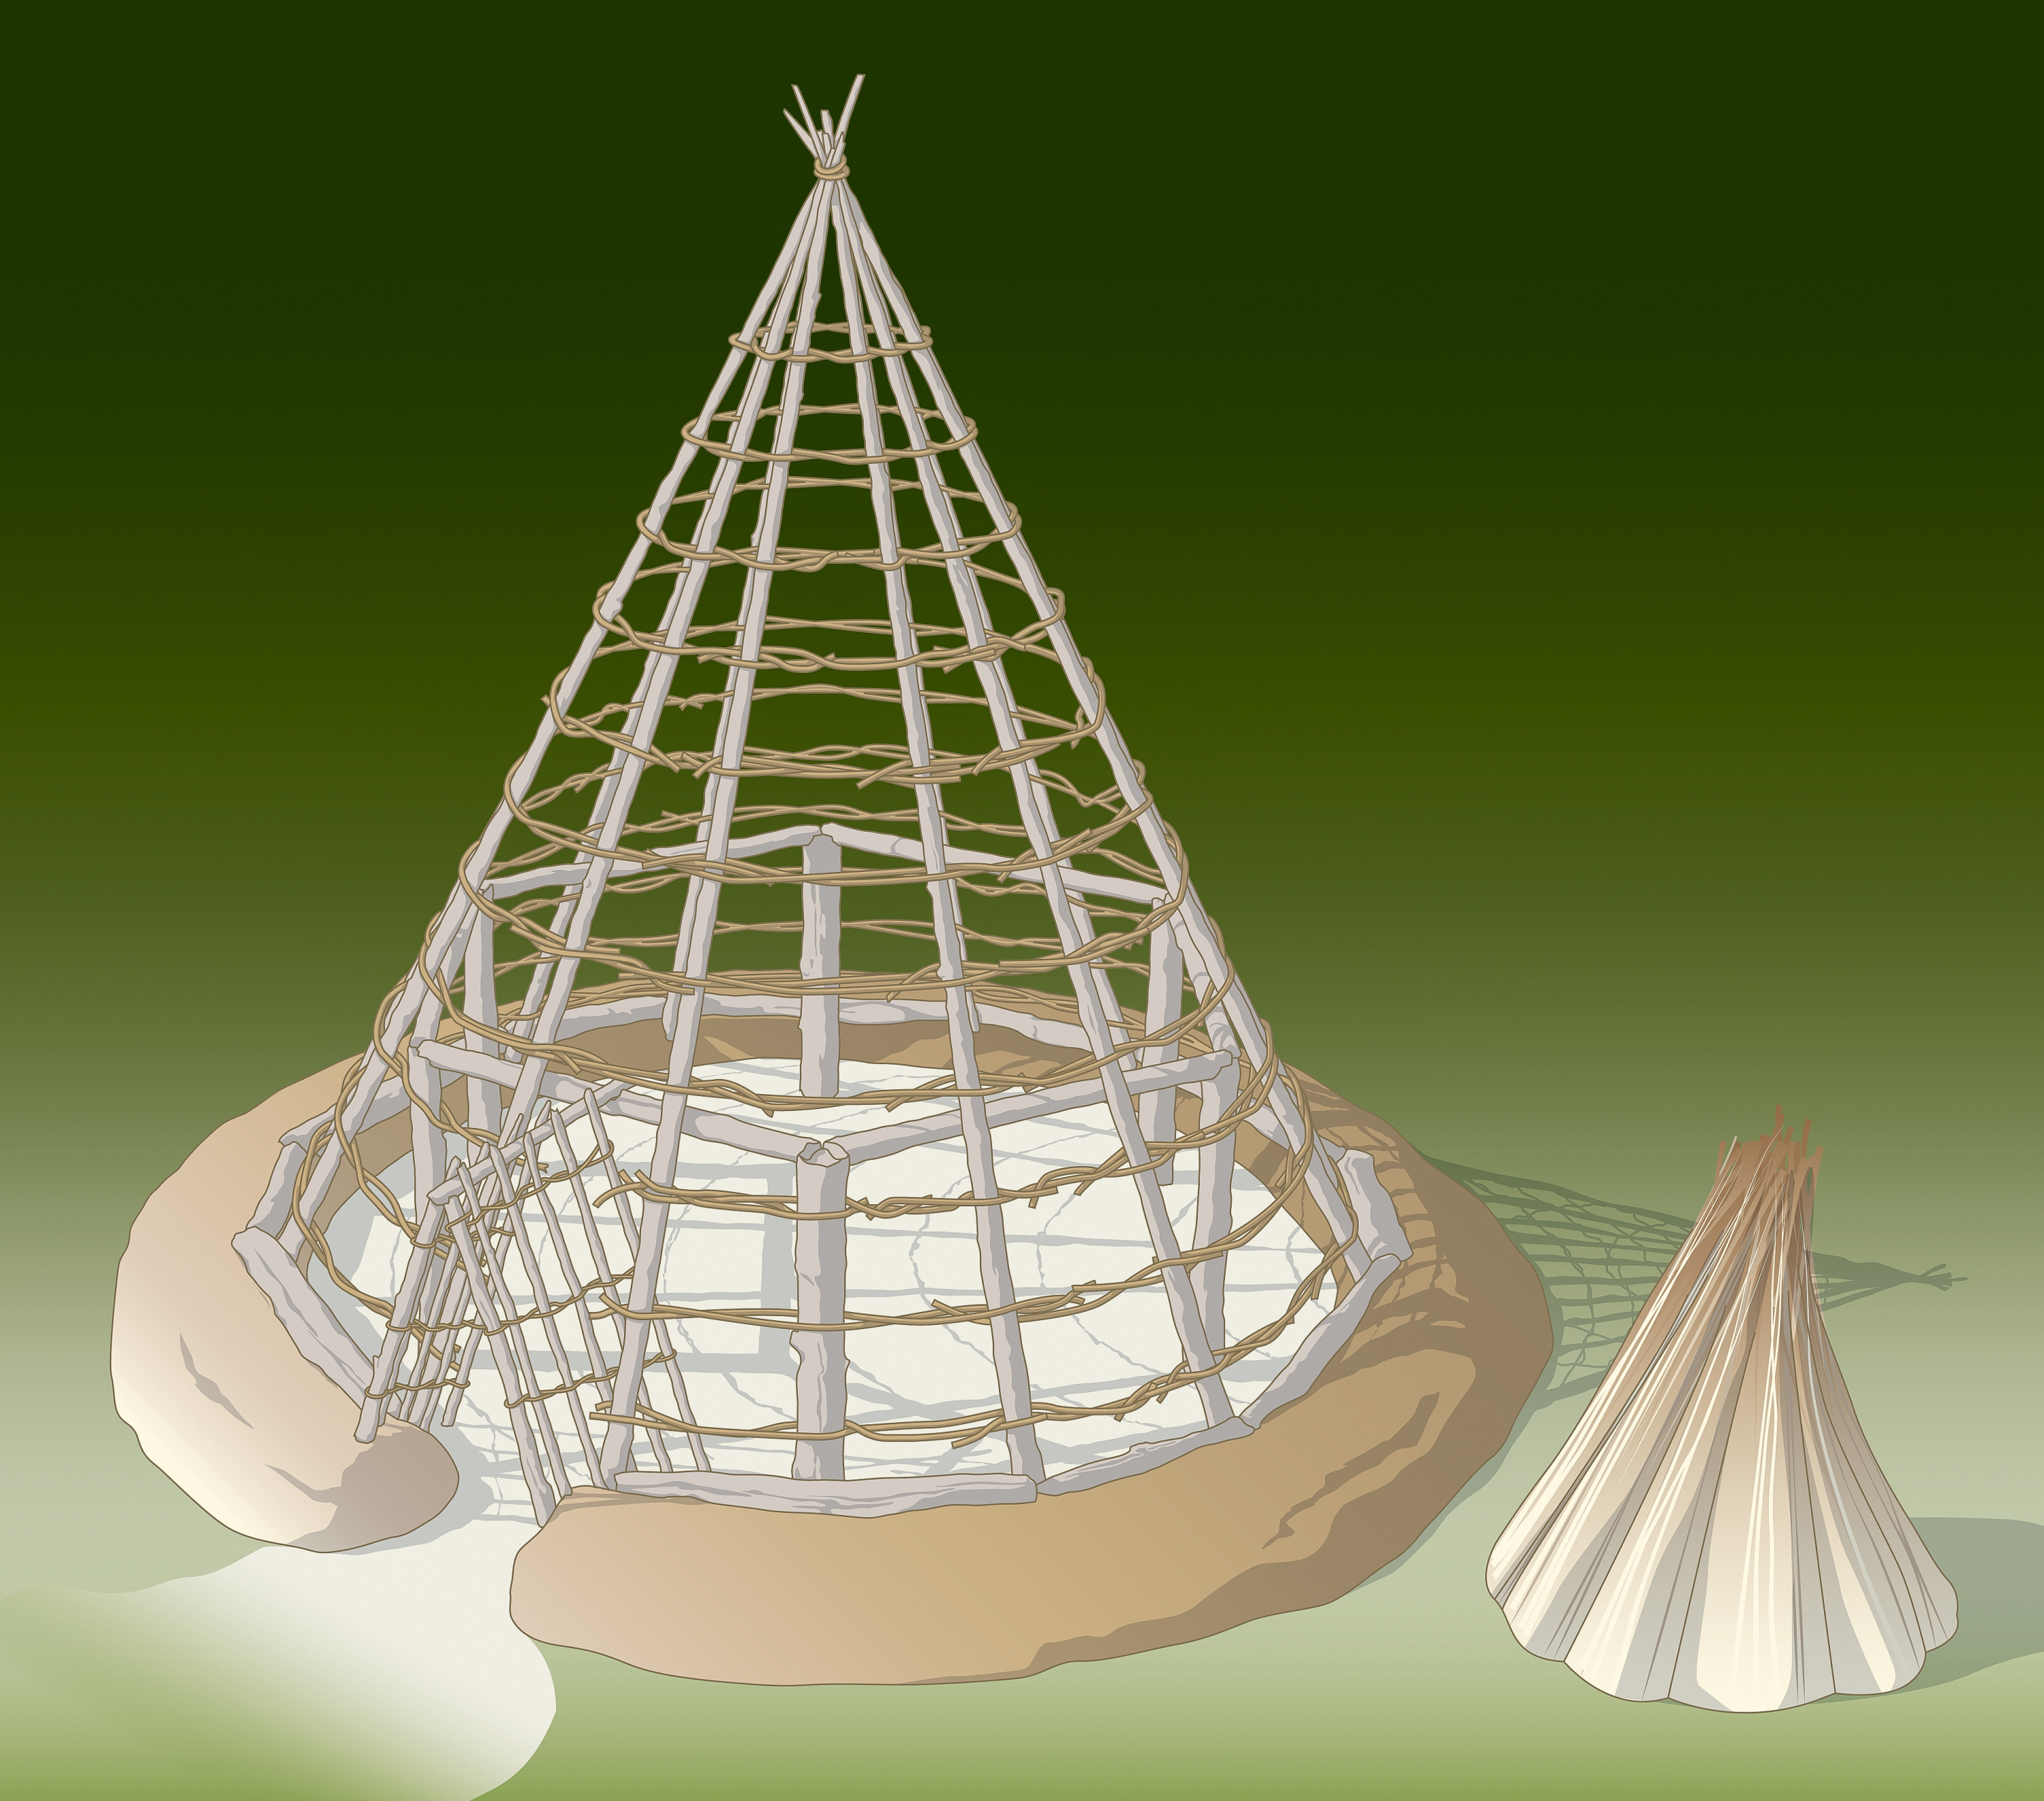
Howick, Northumberland
Back to map
Occasionally, Mesolithic people stayed in one place long enough to build substantial huts or houses.
Most evidence comes from northern Britain, such as Howick in Northumberland and Star Carr in Yorkshire, where people lived nearly 10,000 years ago.
These circular houses were made from wooden posts and likely housed extended families, including children and older relatives.
Mesolithic Hut
Notes:
IMAGE:
Schematic reconstruction illustration showing a possible construction method for a Mesolithic house based on evidence from Star Carr © Historic England Archive Ref: IC330/005 - https://historicengland.org.uk/images-books/photos/item/IC330/005
QUESTION:
What do you think the roof and walls of the Mesolithic house would have been made of?
How does it compare to where you live?
LINK:
Archaeological Research Services site about the Howick excavations - https://archaeologicalresearchservices.com/projects/howick/

Slide 16
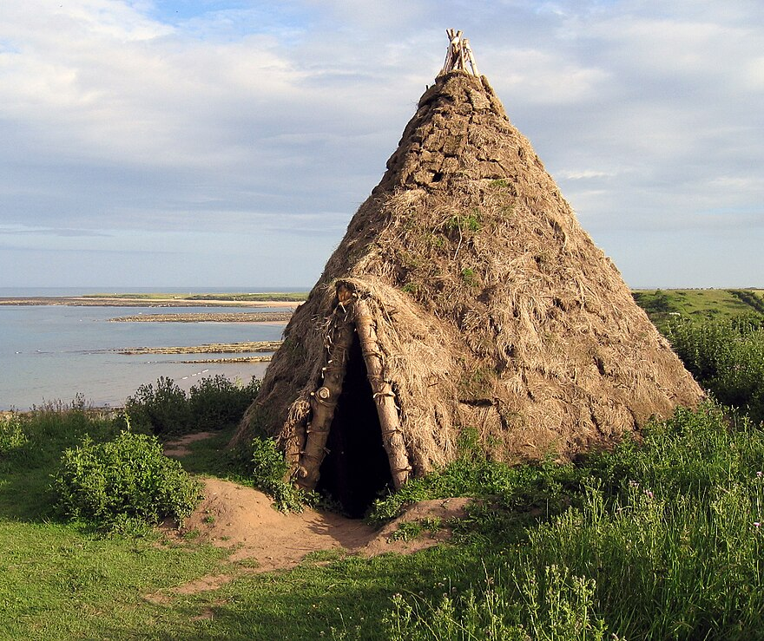
Howick, Northumberland
Back to map
At Howick, the hut was 6 metres wide, with a central fireplace and a ring of postholes supporting the roof and walls.
Artefact locations within the hut show areas for cooking, toolmaking, and sleeping.
Thousands of burnt hazelnuts were found, likely roasted and stored for winter food.
QUESTION
What do you think the roof and walls of the Mesolithic house would have been made of? How does it compare to where you live?
Replica Howick Hut
Notes:
IMAGE:
Reconstructed Mesolithic round-house - geograph.org.uk - 1091110.jpg © Andrew Curtis / Reconstructed Mesolithic round-house - https://commons.wikimedia.org/wiki/File:Reconstructed_Mesolithic_round-house_-_geograph.org.uk_-_1091110.jpg
QUESTION:
What do you think the roof and walls of the Mesolithic house would have been made of?
How does it compare to where you live?
LINK:
Archaeological Research Services site about the Howick excavations - https://archaeologicalresearchservices.com/projects/howick/

Slide 17
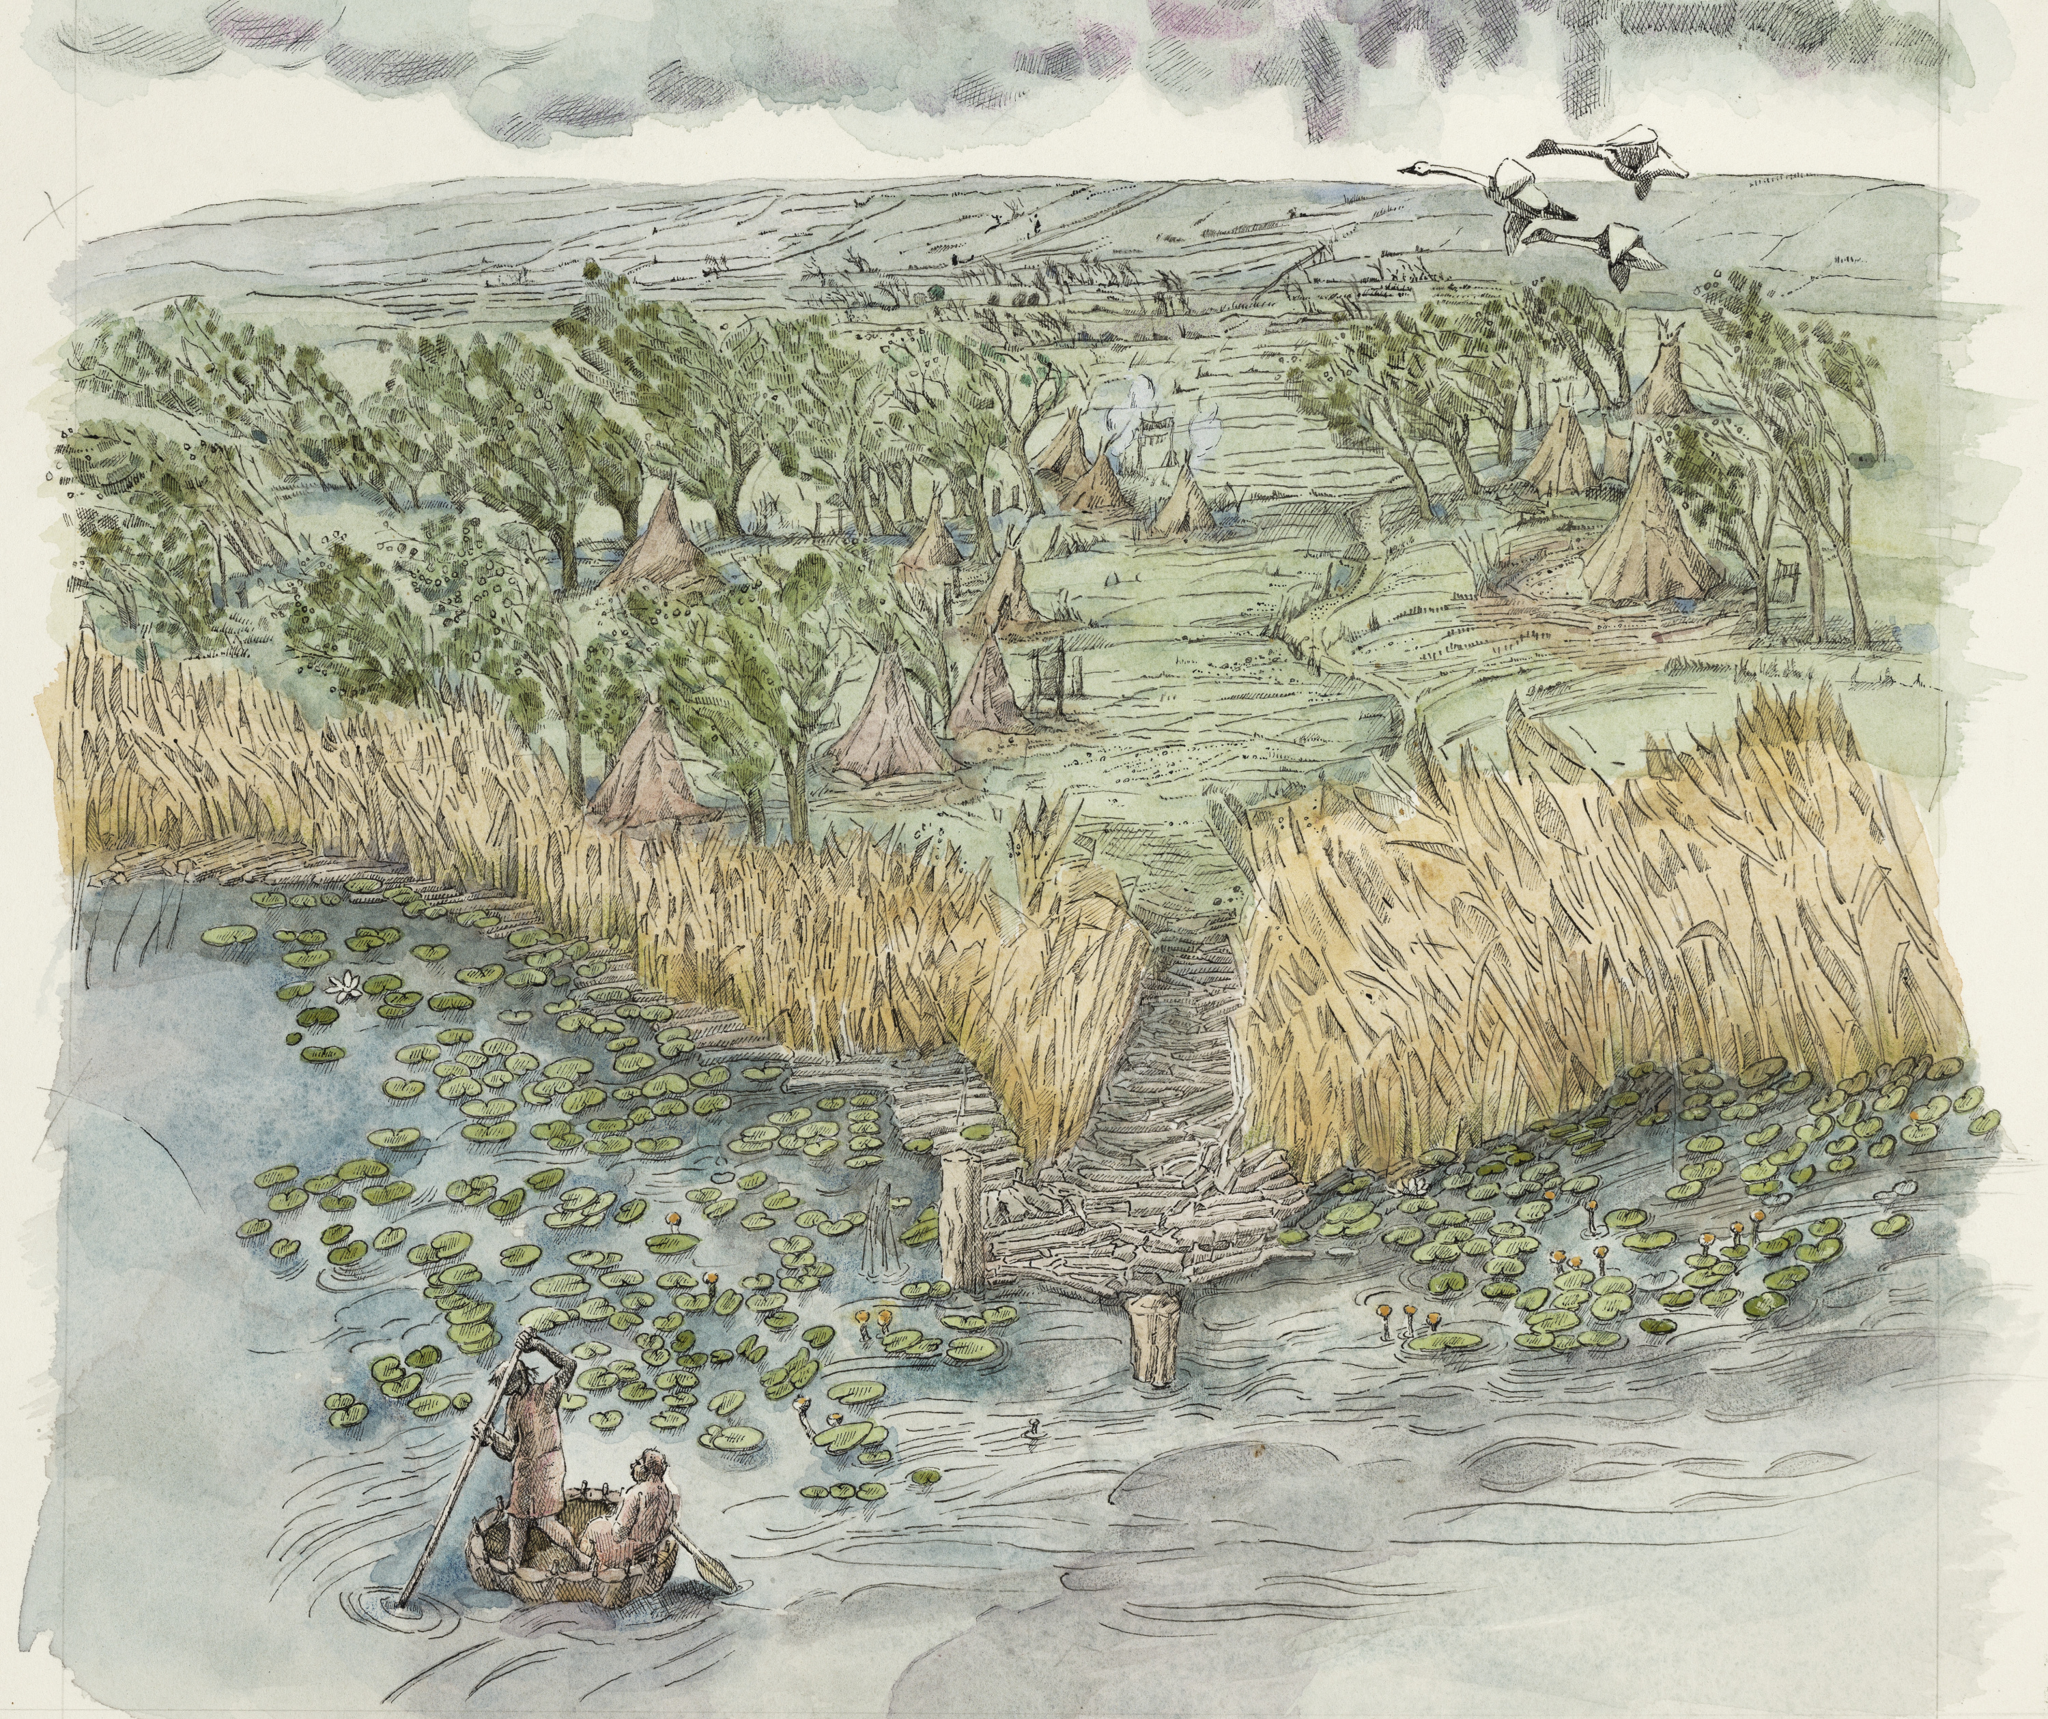
Star Carr, Yorkshire
Back to map
Star Carr, near Scarborough in North Yorkshire, is an early Mesolithic site from about 11,000 years ago.
At the end of the last Ice Age, it was beside a lake and people built wooden platforms and structures there.
They travelled widely to hunt, gather plants and antlers, and collect flint for tools. This would have been on land and using rivers and waterways.
Star Carr lakeside settlement
Notes:
IMAGE:
Colour reconstruction drawing depicting the Mesolithic lake settlement, with people in a coracle in the foreground © Historic England Archive Ref: IC330/002 - https://historicengland.org.uk/images-books/photos/item/IC330/002
QUESTION:
Why do you think the people who came to Star Carr chose to live by a lake?
LINK:
Star Carr schools’ resources - http://www.starcarr.com/schools.html

Slide 18
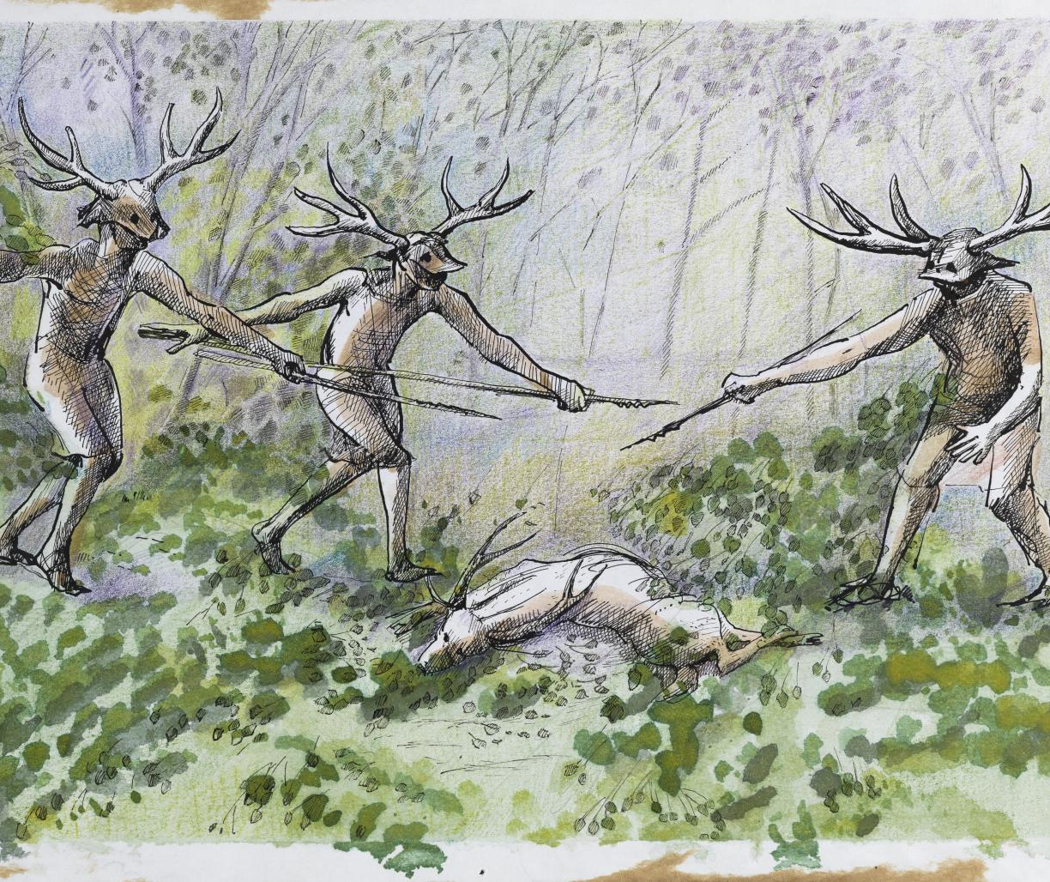
Star Carr, Yorkshire
Back to map
Star Carr is unusual in several ways:
It is larger than most Mesolithic sites, which are small hunting camps.
The wet conditions at the edge of the lake have preserved objects of wood and bone which do not normally survive on very old sites.
These objects include barbed points and antler frontlets.
QUESTION
Why do you think the people who came to Star Carr chose to live by a lake?
People wearing ‘antler frontlets’
Notes:
IMAGE:
Colour reconstruction drawing depicting people in antlered head-dresses around the body of a deer © Historic England Archive Ref: IC330/004 - https://historicengland.org.uk/images-books/photos/item/IC330/004
QUESTION:
Why do you think the people who came to Star Carr chose to live by a lake?
LINK:
Star Carr schools’ resources - http://www.starcarr.com/schools.html

Slide 19
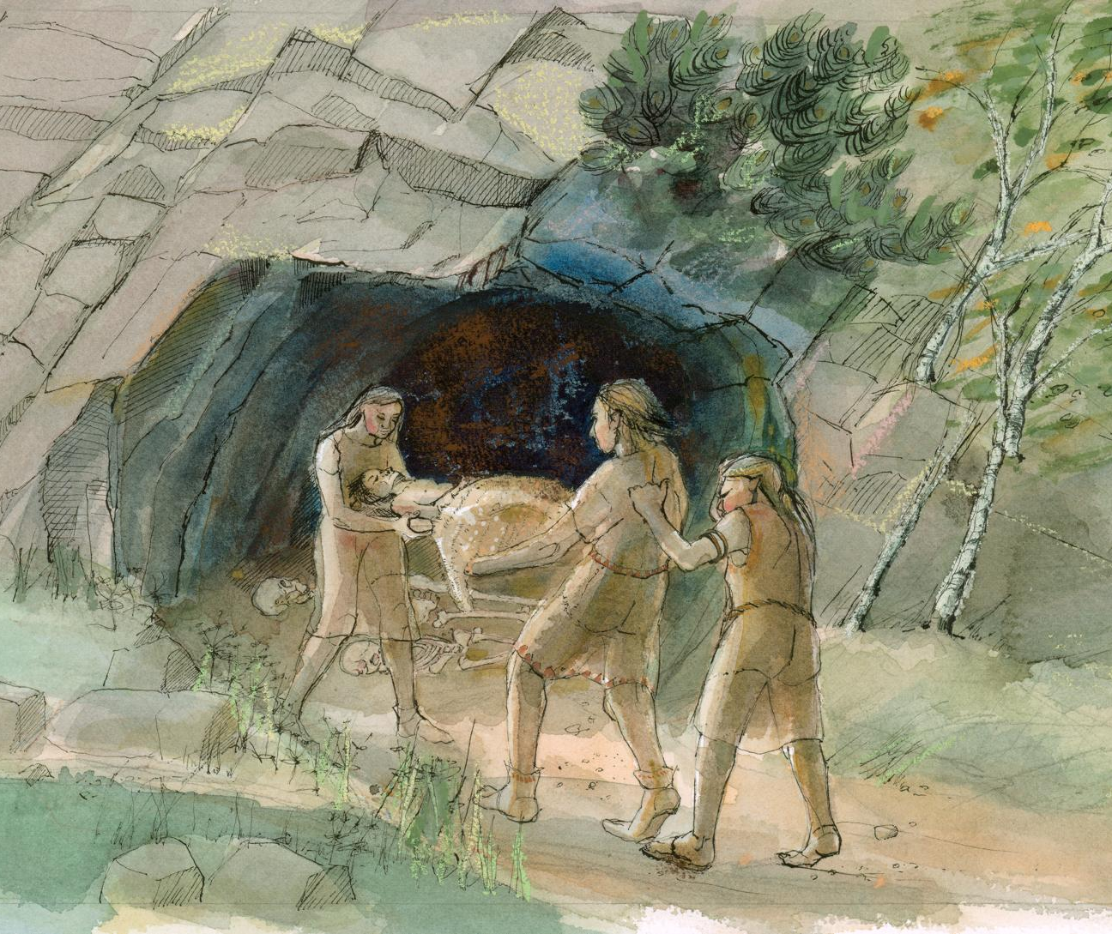
Aveline’s Hole cave, Somerset
Back to map
Aveline’s Hole cave in Somerset is the largest Mesolithic cemetery in Britain. It was used between about 8400 and 8200 BC.
The cave was excavated in the 19th century when skeletons of 50 or more Mesolithic people were found, although many of the remains have since been lost.
QUESTION
Why do you think Mesolithic people chose a cave to bury their dead in?
Carrying a burial to the cave
Notes:
IMAGE:
Mesolithic burial practices at Aveline’s Hole imagined by an artist. © Historic England Archive Ref: IC035_016 - https://historicengland.org.uk/images-books/photos/item/IC035/016
QUESTION:
Why do you think Mesolithic people chose a cave to bury their dead in?

Slide 20
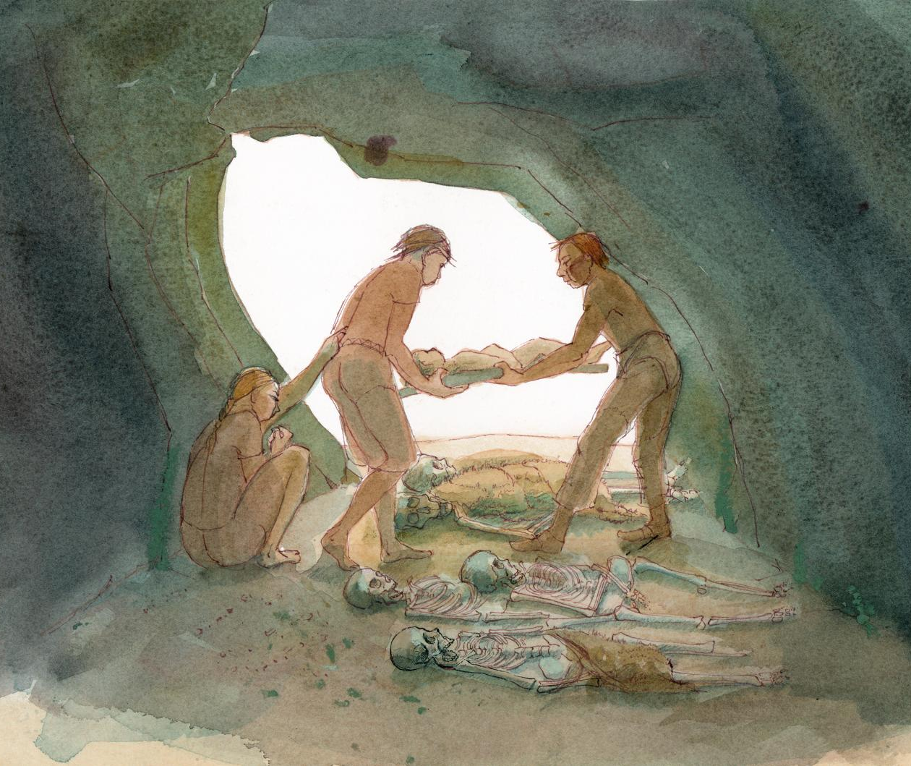
Aveline’s Hole cave, Somerset
Back to map
As well as the bones of people, beads made from animal teeth and shells, a red mineral, and fossils were recovered.
These may be from the clothes or jewellery of the people buried in the cave or might have been specially selected to be buried with them.
Recently discovered carved rock art from the cave may also belong to the Mesolithic period.
A burial in the cave
Notes:
IMAGE:
Mesolithic burial practices at Aveline’s Hole imagined by an artist. © Historic England Archive Ref: IC035_015 - https://historicengland.org.uk/images-books/photos/item/IC035/015
QUESTION:
Why do you think Mesolithic people chose a cave to bury their dead in?

Slide 21
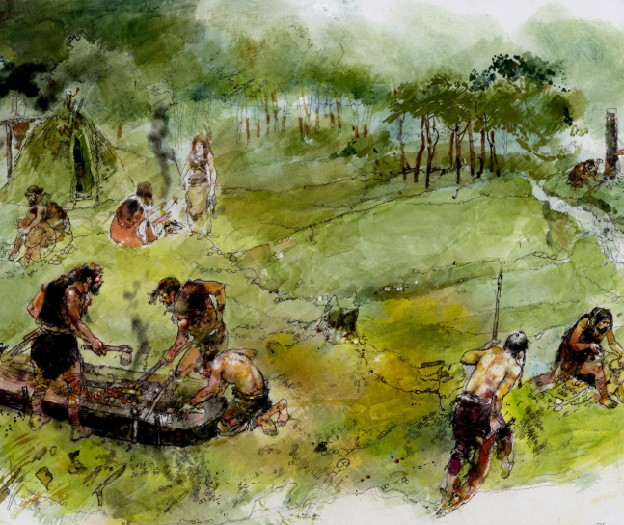
Bouldnor Cliff, Isle of Wight
Back to map
Bouldnor Cliff is a Stone Age site under the sea near the Isle of Wight. People lived there during the Mesolithic (Middle Stone Age).
It is 11 metres underwater and was once dry land about 8,000 years ago.
Archaeologists have found stone tools, hearths, wooden platforms, and even parts of boats or tools made of wood.
Reconstruction drawing of Bouldnor Cliff site by Mike Greaves
Notes:
IMAGE:
Underwater remains from the Mesolithic site at Bouldnor Clliffs under excavation. © Maritime Archaeology Trust and Mike Greaves
QUESTION:
How would you feel about working underwater?
LINK:
Maritime Archaeology Trust webpage with 3D model - https://maritimearchaeologytrust.org/projects-research/bouldnor-cliff/

Slide 22
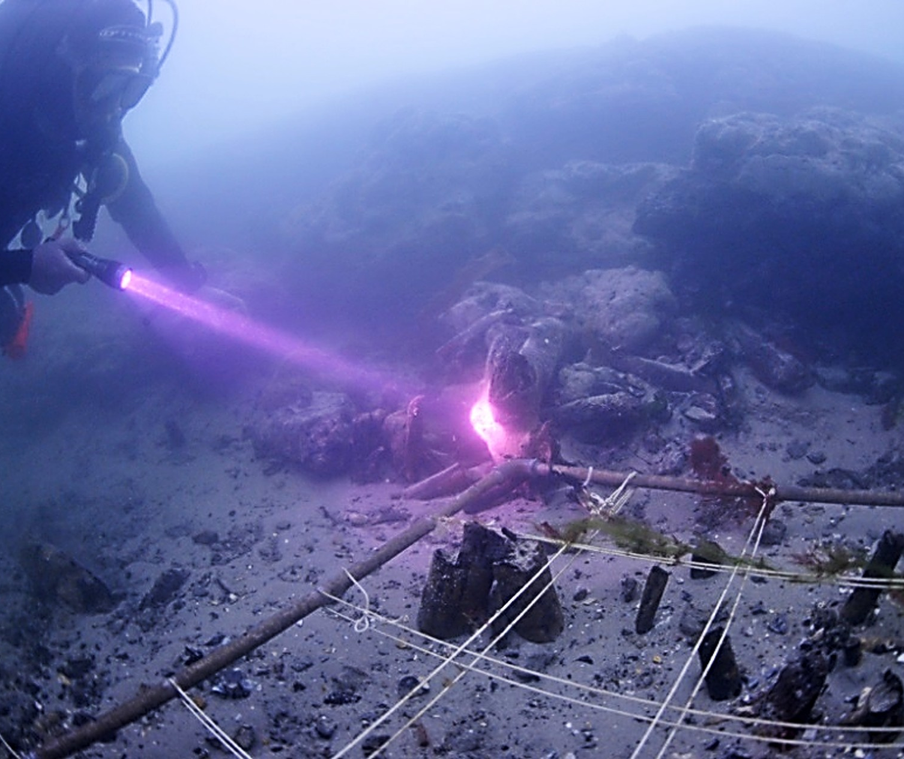
Bouldnor Cliff, Isle of Wight
Back to map
Special mud and peat kept things very well preserved, even wood and plant remains.
Scientists found evidence of forests, nuts people ate, and early wheat, showing it’s use in the UK much earlier than expected.
It is the only known underwater Mesolithic site in the UK. However, the site is slowly being destroyed by sea erosion, so archaeologists are racing to save what they can.
QUESTION
How would you feel about working underwater?
An underwater archaeologist at one of the Bouldnor Cliff sites
Notes:
IMAGE:
Underwater remains from the Mesolithic site at Bouldnor Clliffs under excavation. © Maritime Archaeology Trust and Roland Brooks
QUESTION:
How would you feel about working underwater?
LINK:
Maritime Archaeology Trust webpage with 3D model - https://maritimearchaeologytrust.org/projects-research/bouldnor-cliff/

Slide 23
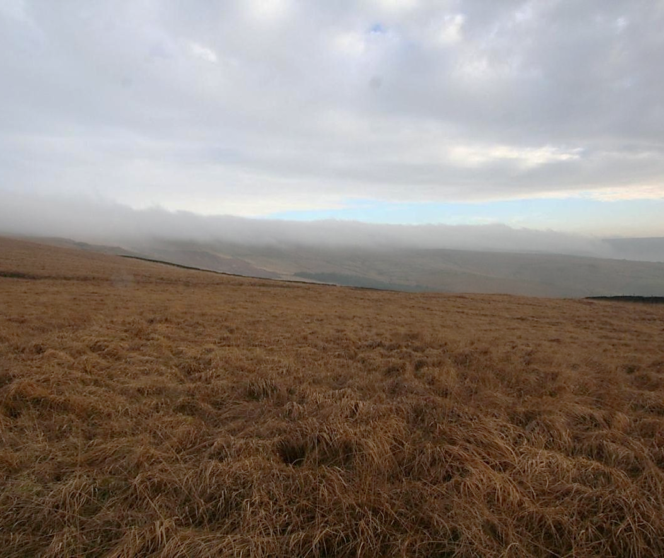
March Hill, West Yorkshire
Back to map
At March Hill Carr, in an aera of just 1 square kilometre, archaeologists have found 132 Mesolithic sites.
People came here between 7,000 and 6,000 years ago and used the area for about 1,000 years, but they did not live here all the time. They likely camped here seasonally.
Excavations found hearths (fireplaces) and places where people sat making stone tools, giving a rare snapshot of daily life.
March Hill, West Yorkshire
Notes:
IMAGE:
March Hill. © Seren Griffiths
QUESTION:
If you were a Mesolithic person, what could you swap for good stone to make tools?

Slide 24
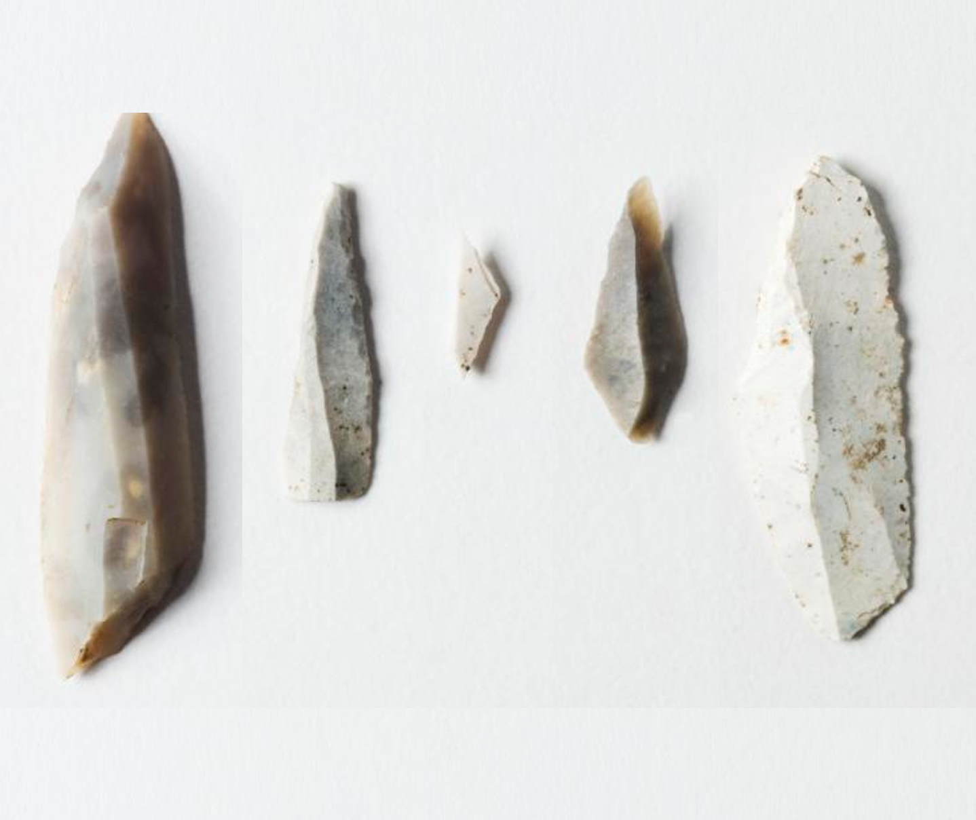
March Hill, West Yorkshire
Back to map
The stone tools are very tiny—about 1.25 cm long—which makes them hard to find.
Thousands of these tiny tools are scattered across the hills, especially on hilltops overlooking valleys, which were probably good hunting lookouts.
The stone used to make the tools came from both the east and west coasts of northern England, showing that Mesolithic people travelled long distances or traded with other groups.
Mesolithic Microlith flints
Notes:
IMAGE:
Detail of five Mesolithic microliths. © Historic England Archive Ref: DP081188 - https://historicengland.org.uk/images-books/photos/item/DP081188
QUESTION:
If you were a Mesolithic person, what could you swap for good stone to make tools?

Slide 25
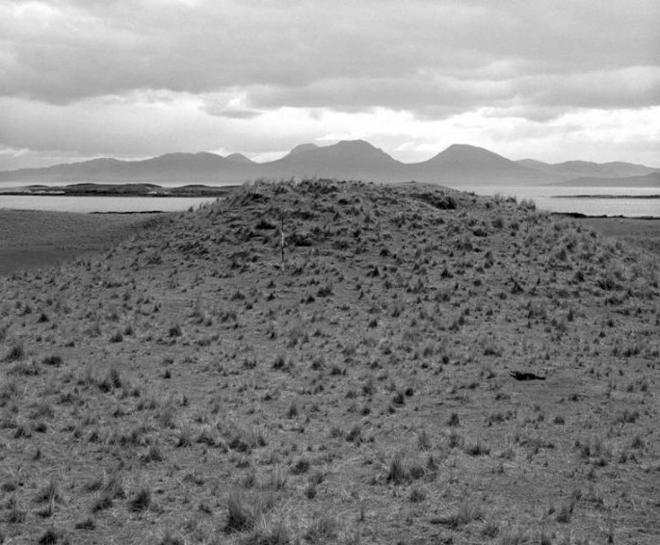
Oronsay, Inner Hebrides
Back to map
Mesolithic people who lived by the sea often collected shellfish to eat.
Afterward, they threw the empty shells into large rubbish piles called shell middens.
Most middens are small, but on the island of Oronsay in the Inner Hebrides there are several very large ones.
These were made between 6000 and 3500 BC – 8000 to 5500 years ago.
QUESTION
What do you do with your food waste and rubbish?
Where does it end up?
Mesolithic Shell Middens
Notes:
IMAGE:
Oronsay midden © Crown Copyright: HES Ref: SC 575742 - https://www.trove.scot/image/575742
QUESTION:
What do you do with your food waste and rubbish? Where does it end up?

Slide 26
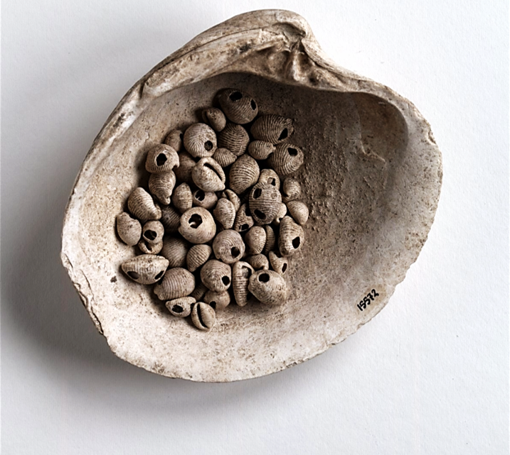
Oronsay, Inner Hebrides
Back to map
The middens are mostly made of limpet shells, but archaeologists have also found bones from seals, dolphins, fish and seabirds.
Some cowrie shells were used as jewellery, making them some of the oldest jewellery found in Scotland.
Human bones have also been found, which suggests the middens may have been used for special ceremonies or burials.
Shell beads from Oronsay
Notes:
IMAGE:
Oronsay midden © Licensed by National Museums Scotland (Records of the Scottish Cultural Resources Access Network (SCRAN), Edinburgh, Scotland) Ref: DP 510206 - https://www.trove.scot/image/2894455
QUESTION:
What do you do with your food waste and rubbish? Where does it end up?

Slide 27
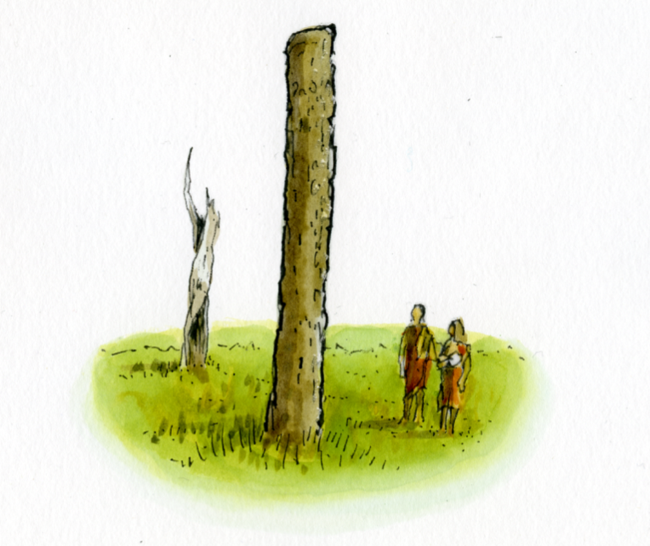
Stonehenge & Blick Mead, Wiltshire
Back to map
The area where Stonehenge was later built was already important during the Mesolithic period, which may help explain why it became a special place in later times.
Archaeologists discovered several large post-holes near the stones while building a car park.
These once held tall pine posts during the Mesolithic, which may have been carved like totem poles.
Wooden ‘totem’ pole
Notes:
IMAGE:
Simple reconstruction illustration depicting new and old timber posts erected to the north-west of Stonehenge in the Mesolithic era, between circa 8500BC and circa 7000BC. © Historic England Archive - Ref: IC095/068 - https://historicengland.org.uk/images-books/photos/item/IC095/068
QUESTION:
Why do you think Mesolithic people might have raised large posts?

Slide 28
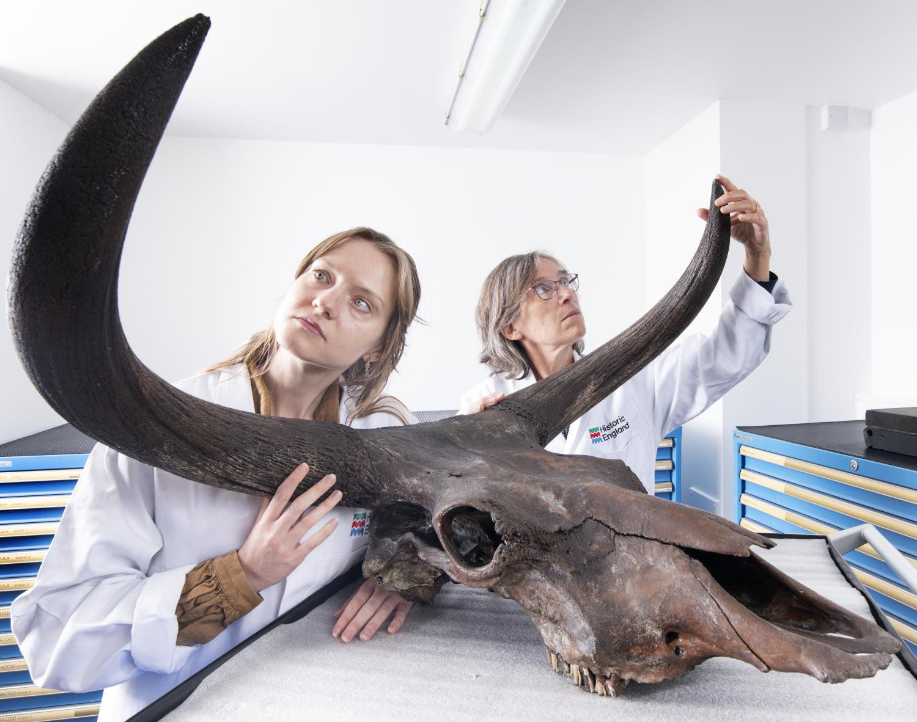
Stonehenge & Blick Mead, Wiltshire
Back to map
Nearby, at a site called Blick Mead, many thousands of stone tools, including Britain's only known slate tool, have been found.
It was in use from around 9600 BC to 4000 BC, making it one of Europe's longest-occupied Mesolithic sites.
The site also shows hunter-gatherers followed aurochs (giant wild cattle), with preserved hoofprints found under a stone platform.
An auroch skull
Notes:
IMAGE:
Historic England's Senior Zooarchaeologist and Collections Access Manager posed with an aurochs' skull © Historic England Archive Ref: DP571492 - https://historicengland.org.uk/images-books/photos/item/DP571492
QUESTION:
Why do you think Mesolithic people might have raised large posts?

