Slide 1
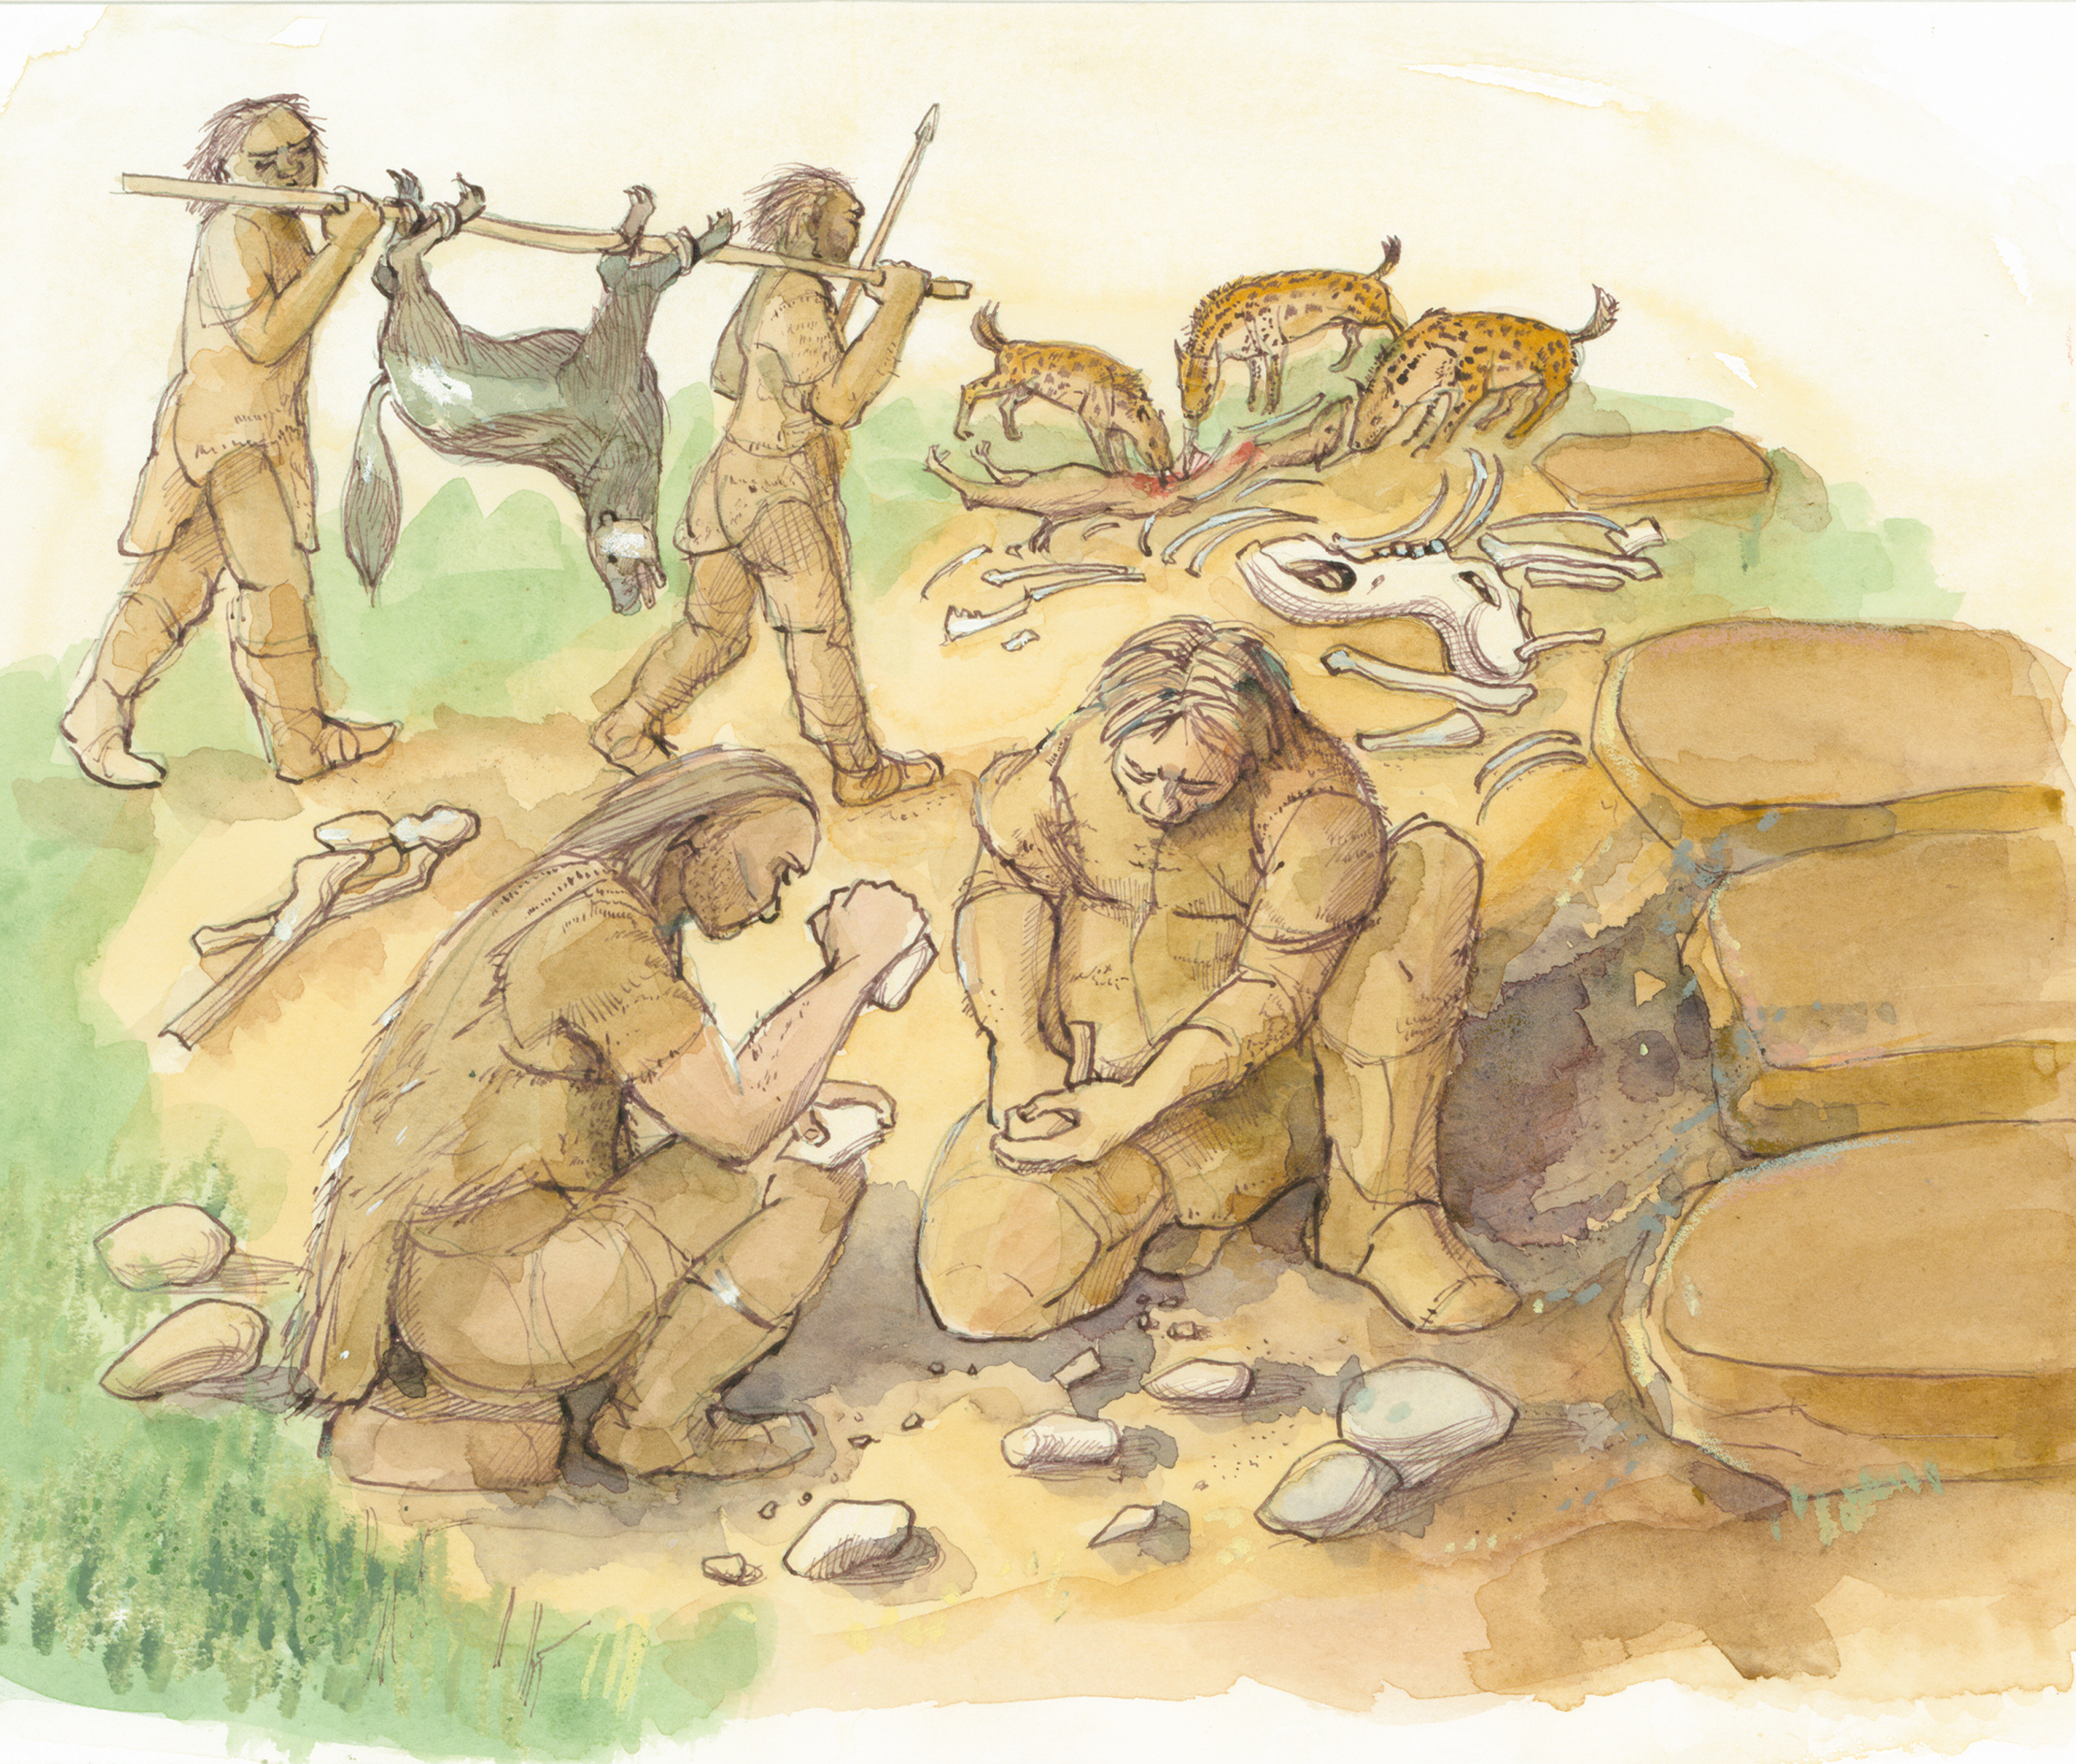
Stone Age to Iron Age – Part 1
Stone Age to Iron Age: Part 1
The Palaeolithic
(Old Stone Age)
Notes:
IMAGE:
Reconstruction illustration giving an artist's impression of tool-making at an early Upper Palaeolithic hyena den, excavated near Oakham in Rutland, as it may have appeared 30,000 - 40,000 years ago.
Artist: Judith Dobie. c.1995 - c.1999. © Historic England Archive. Ref: IC126/008 - https://historicengland.org.uk/images-books/photos/item/IC126/008

Slide 2
The Palaeolithic (Old Stone Age)
Learn about the types of technology used in the Stone Age
Learn about the everyday life of people in the Stone Age
Learn about changes in Britain from the Stone Age to the Iron Age
Assess the different types of archaeological evidence from the Stone Age
Establish clear narratives within and across the periods studied
Understand how knowledge of the past comes from a range of sources

Slide 3
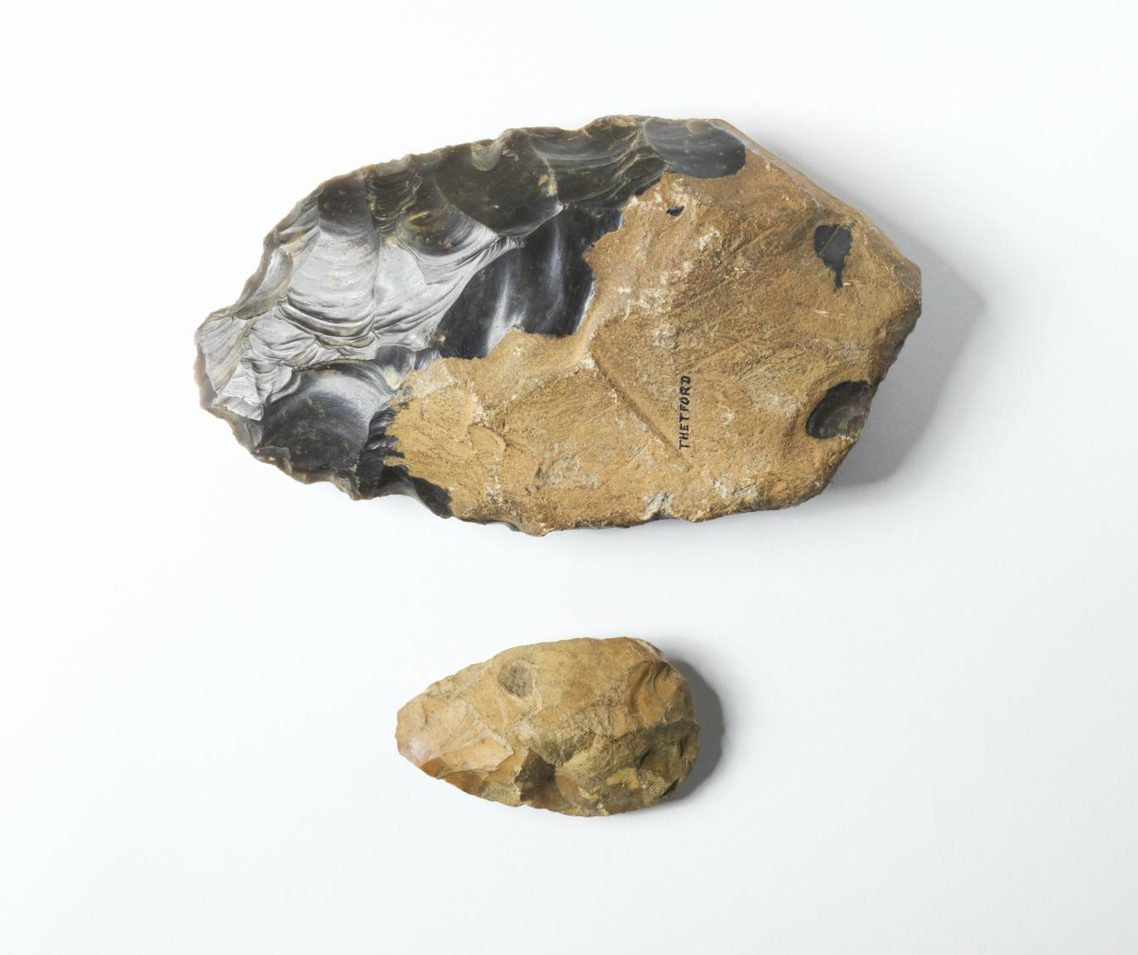
Palaeolithic
Greek
παλαιός (palaios) "old"
+
λίθος (lithos) "stone"
=
"old age of the stone"
or
"Old Stone Age”
Palaeolithic stone tools
Notes:
Image: © Historic England Archive ref: DP081190
Taken from the Greek, Palaeo means ‘old’ and lithic means ‘stone’ – so the Palaeolithic is the Old Stone Age.
Use the first slides as an introduction to help pupils find out more about the Palaeolithic in general.
Then explore the map to find out more about specific archaeological sites in Britain.

Slide 4
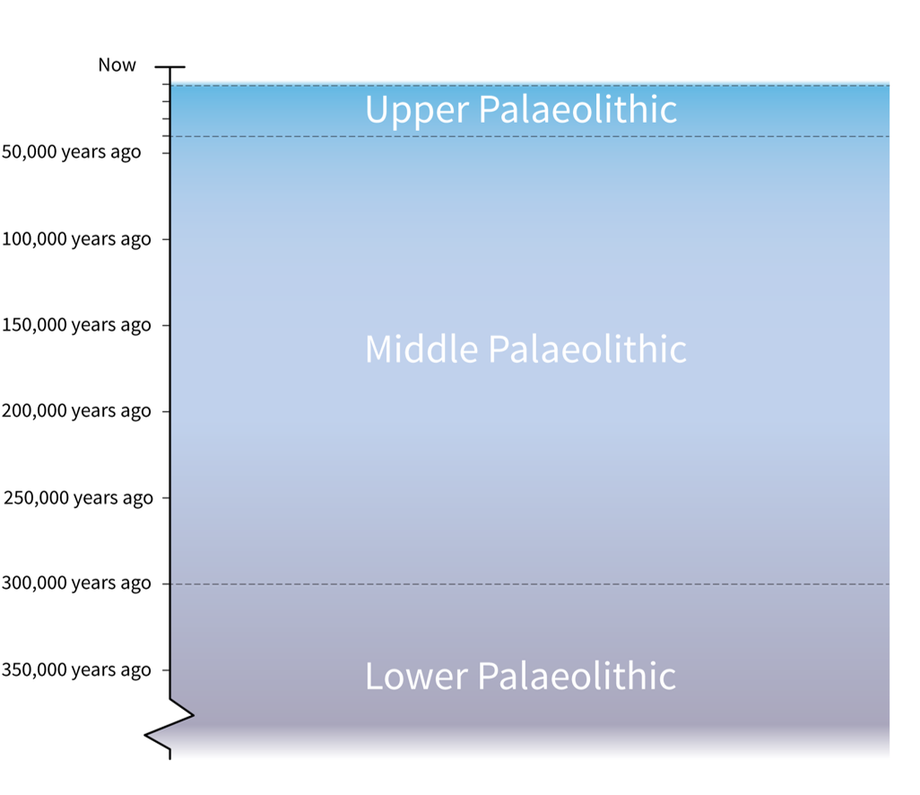
The Palaeolithic
The Palaeolithic is a very long period of prehistory. It tells the exciting story of our earliest ancestors.
It is divided into three parts:
Lower Palaeolithic
(before about 300,000 years ago)
Middle Palaeolithic
(300,000 to 40,000 years ago)
Upper Palaeolithic
(40,000 to 11,000 years ago)
Three phases of the Palaeolithic
Notes:
The Palaeolithic is an extremely long and ancient period of prehistory that tells the exciting story of our earliest ancestors.
It is divided into three parts:
the Lower Palaeolithic (before about 300,000 years ago),
Middle Palaeolithic (300,000 to 40,000 years ago)
and Upper Palaeolithic (40,000 to 11,000 years ago).

Slide 5
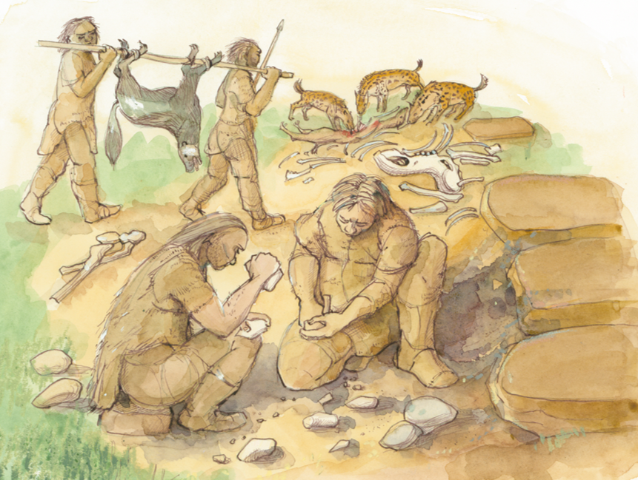
Hunter-gatherers
The people who lived during the Palaeolithic were nomadic hunter-gatherers who used stone tools.
They have left behind no large buildings or permanent settlements.
Remains from this period are very hard to find and often in caves.
Upper Palaeolithic camp
Notes:
IMAGE:
Reconstruction illustration giving an artist's impression of tool-making at an early Upper Palaeolithic hyena den, excavated near Oakham in Rutland, as it may have appeared 30,000 - 40,000 years ago.
Artist: Judith Dobie. c.1995 - c.1999. © Historic England Archive. Ref: IC126/008 - https://historicengland.org.uk/images-books/photos/item/IC126/008

Slide 6
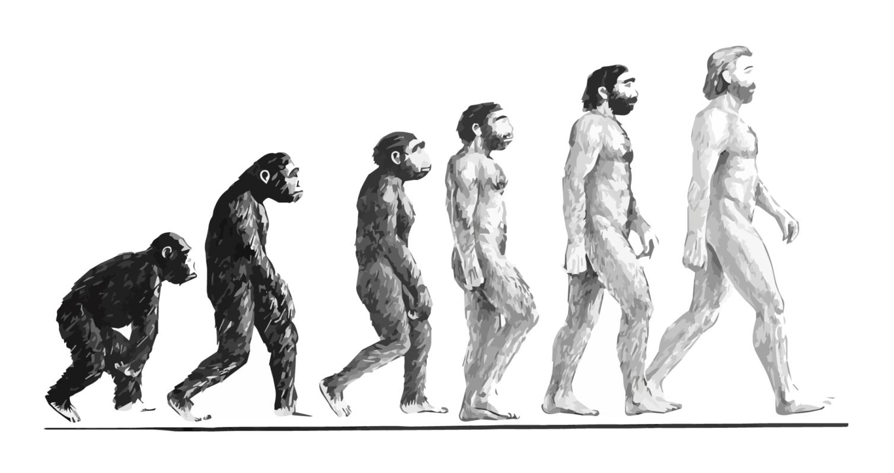
Human Species
Several different species of human existed at different times during the Palaeolithic, sometimes overlapping.
Our own species (Homo sapiens sapiens) arrived in Europe just before another human species, the Neanderthals (Homo neanderthalensis), became extinct.
Neanderthals
(Homo neanderthalensis)
Modern man
(Homo sapiens)

Slide 7
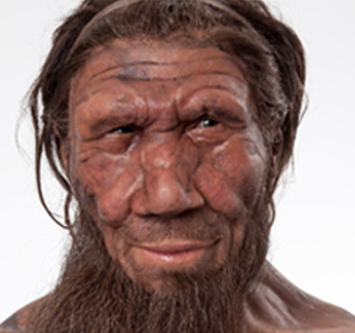
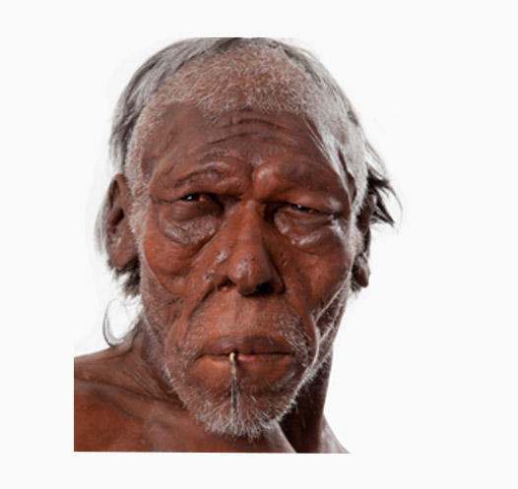
Neanderthals
Neanderthal
Neanderthals were early humans who lived a very long time ago. They were shorter and stronger than people today, which helped them live in the icy cold weather.
Neanderthals lived at the same time as early Homo sapiens (people like us). They eventually disappeared, but scientists have found that many of us still have a little Neanderthal DNA.
They were smart, could communicate, had special rituals, and even made art.
Modern human
Notes:
IMAGE:
Models of a Neanderthal (left) and an early modern human (right) © Natural History Museum
ACTIVITY:
Imagine you are meeting someone from a different culture, who doesn’t speak the same language as you. How would you try to communicate with them?

Slide 8

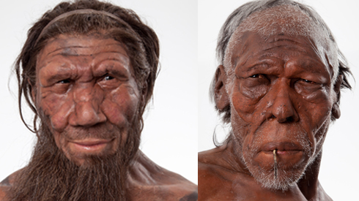
Neanderthals
ACTIVITY:
Imagine you are meeting someone from a different culture, who doesn’t speak the same language as you.
How would you try to communicate with them?
Notes:
IMAGE:
Models of a Neanderthal (left) and an early modern human (right) © Natural History Museum
ACTIVITY:
Imagine you are meeting someone from a different culture, who doesn’t speak the same language as you. How would you try to communicate with them?

Slide 9
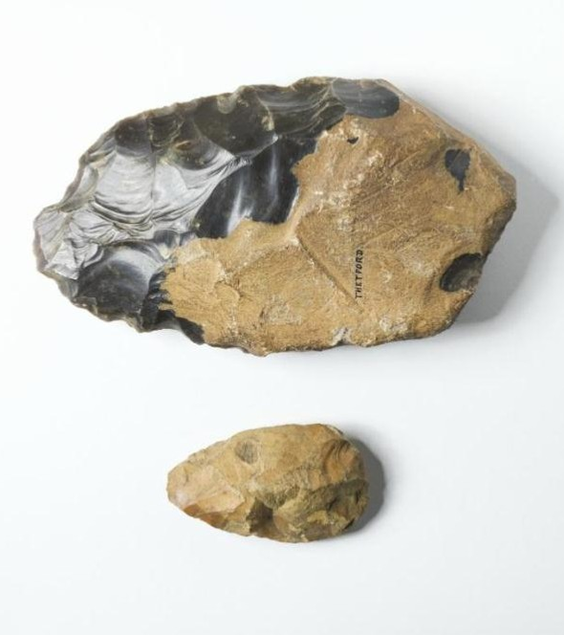
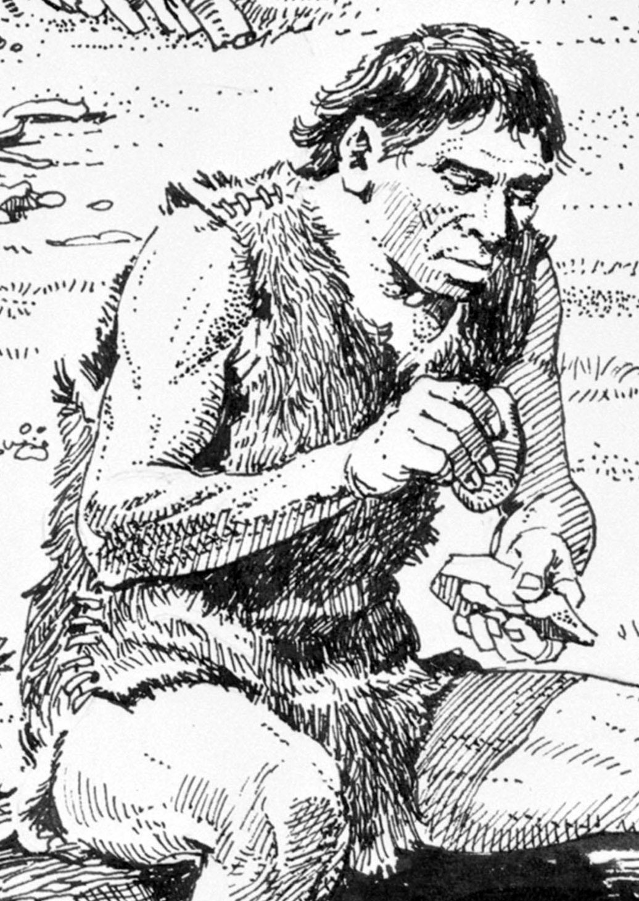
Stone tools: hand axes
People made handaxes by hitting stones with other stones, antlers, or bones. This was called knapping.
They often used flint because it breaks easily into sharp pieces, but they used other rocks too.
Some hand axes look very beautiful, which shows that the humans who made them cared about more than just making a tool — they liked making nice things, just like we do.
Handaxes
Notes:
IMAGE :
Palaeolithic hand axes. © Historic England Archive. Ref: DP081190 - https://historicengland.org.uk/images-books/photos/item/DP081190
Prehistoric people in a settlement, Swanscombe, Kent, c350,000 BC © Alamy DDKJCF

Slide 10

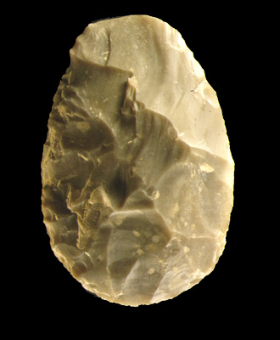

Stone tools: hand axes
Apart from humans, are there other species alive today who make tools?
ACTIVITY
Find a natural flint and describe its colour and feel
Notes:
IMAGE :
Palaeolithic hand axes. © Historic England Archive. Ref: DP081190 - https://historicengland.org.uk/images-books/photos/item/DP081190
Palaeolithic flint handaxe from Boxgrove. © AHOB
QUESTION:
Apart from humans, are there other species alive today who make tools?
ACTIVITY:
Find a natural flint and describe its colour and feel
LINK:
http://www.wessexarch.co.uk/files/Learning/pdf/activity_sheet_flint.pdf

Slide 11
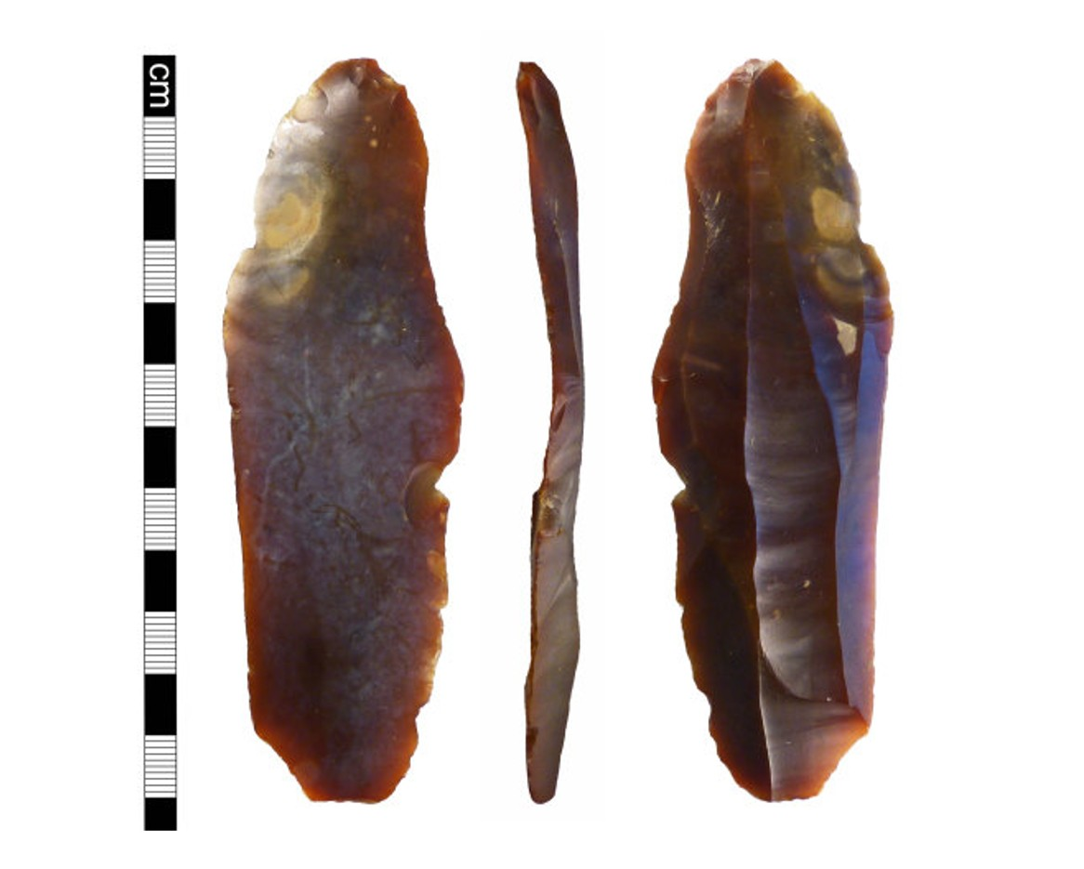
Stone tools: flint blades
Handaxes were used for a very long time, but when modern humans appeared, they learned new ways to shape stone.
Instead of shaping a whole flint nodule at once, they first made a special “core.” From this core, they hit off long, thin pieces called blades.
Blades had longer sharp edges and could be tied onto handles to make better tools.
Three sides of a flint blade
Notes:
IMAGE:
Late Upper Palaeolithic flint blade from Norfolk © The Portable Antiquities Scheme/The Trustees of the British Museum

Slide 12
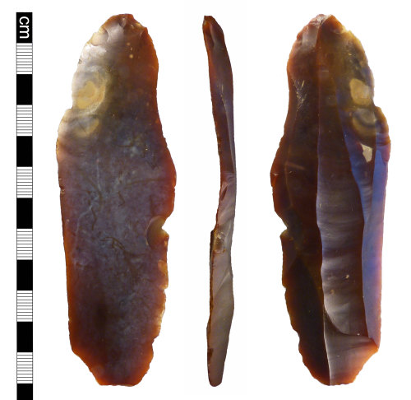
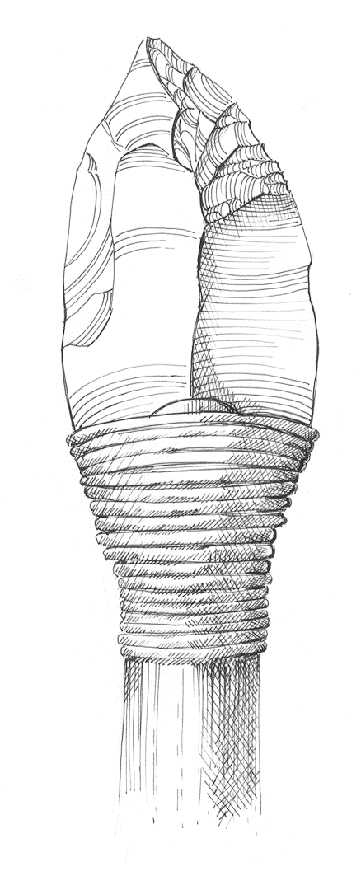
Stone tools: flint blades
Stone tools are often the only artefacts from very old sites to survive because they do not rot.
What might archaeologists be missing from sites where only stone tools survive?
Notes:
IMAGE:
Late Upper Palaeolithic flint blade from Norfolk © The Portable Antiquities Scheme/The Trustees of the British Museum
Reconstruction illustration showing a 30,000 - 40,000 year old leaf-point flint tool found at an early Upper Palaeolithic hyaena den near Oakland in Rutland,
shown bound to a spear shaft or wooden tool handle and as it may have looked when in use. © Historic England Archive. Ref: IC126/010 - https://historicengland.org.uk/images-books/photos/item/IC126/010
QUESTION:
What might archaeologists be missing from sites where only stone tools survive?

Slide 13
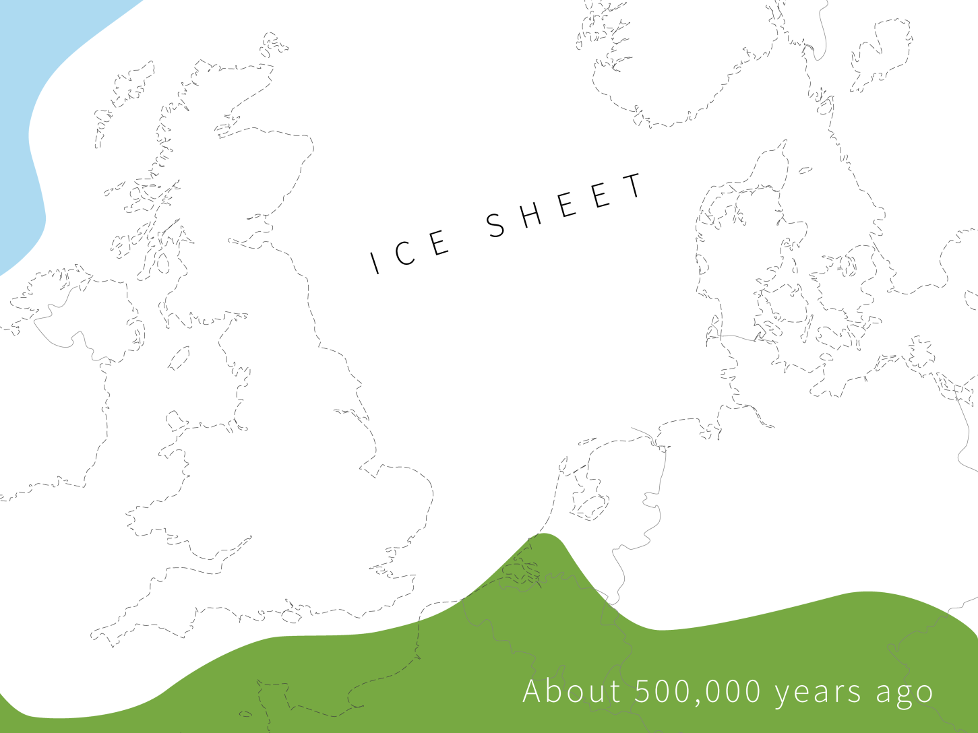
Changing geography
Britain hasn’t always looked the way it does today. During the Palaeolithic, there were some very cold times called ice ages and warmer times in between.
Huge sheets of ice changed the land, and rising or falling seas changed the shape of the coast and rivers.
Notes:
IMAGE :
Europe c 500,000 years ago © Historic England
Changing geography:
Britain has not always looked as it does now. During the Palaeolithic there was a succession of cold periods called ice ages or ‘glaciations’, interspersed with warmer periods or ‘interglacials’.
As well as the climatic effects, the appearance of Britain was altered by the physical impact of the glaciers and changing sea levels linked to the expansion or melting of the ice. Not only did the plants and animals that lived here change as it became warmer and colder, but the shape of our coast and the course of our rivers have also changed.
During the Lower Palaeolithic Britain was not an island, it was connected to other European countries: France, the Netherlands, Germany and Denmark

Slide 14
Changing geography
The kinds of plants and animals living here also changed as the weather got colder or warmer.
In the early Palaeolithic, Britain wasn’t an island at all — it was joined to the Netherlands, France, Germany, and Denmark.
Notes:
IMAGE :
Europe c 500,000 years ago © Historic England
Changing geography:
Britain has not always looked as it does now. During the Palaeolithic there was a succession of cold periods called ice ages or ‘glaciations’, interspersed with warmer periods or ‘interglacials’.
As well as the climatic effects, the appearance of Britain was altered by the physical impact of the glaciers and changing sea levels linked to the expansion or melting of the ice. Not only did the plants and animals that lived here change as it became warmer and colder, but the shape of our coast and the course of our rivers have also changed.
During the Lower Palaeolithic Britain was not an island, it was connected to other European countries: France, the Netherlands, Germany and Denmark

Slide 15
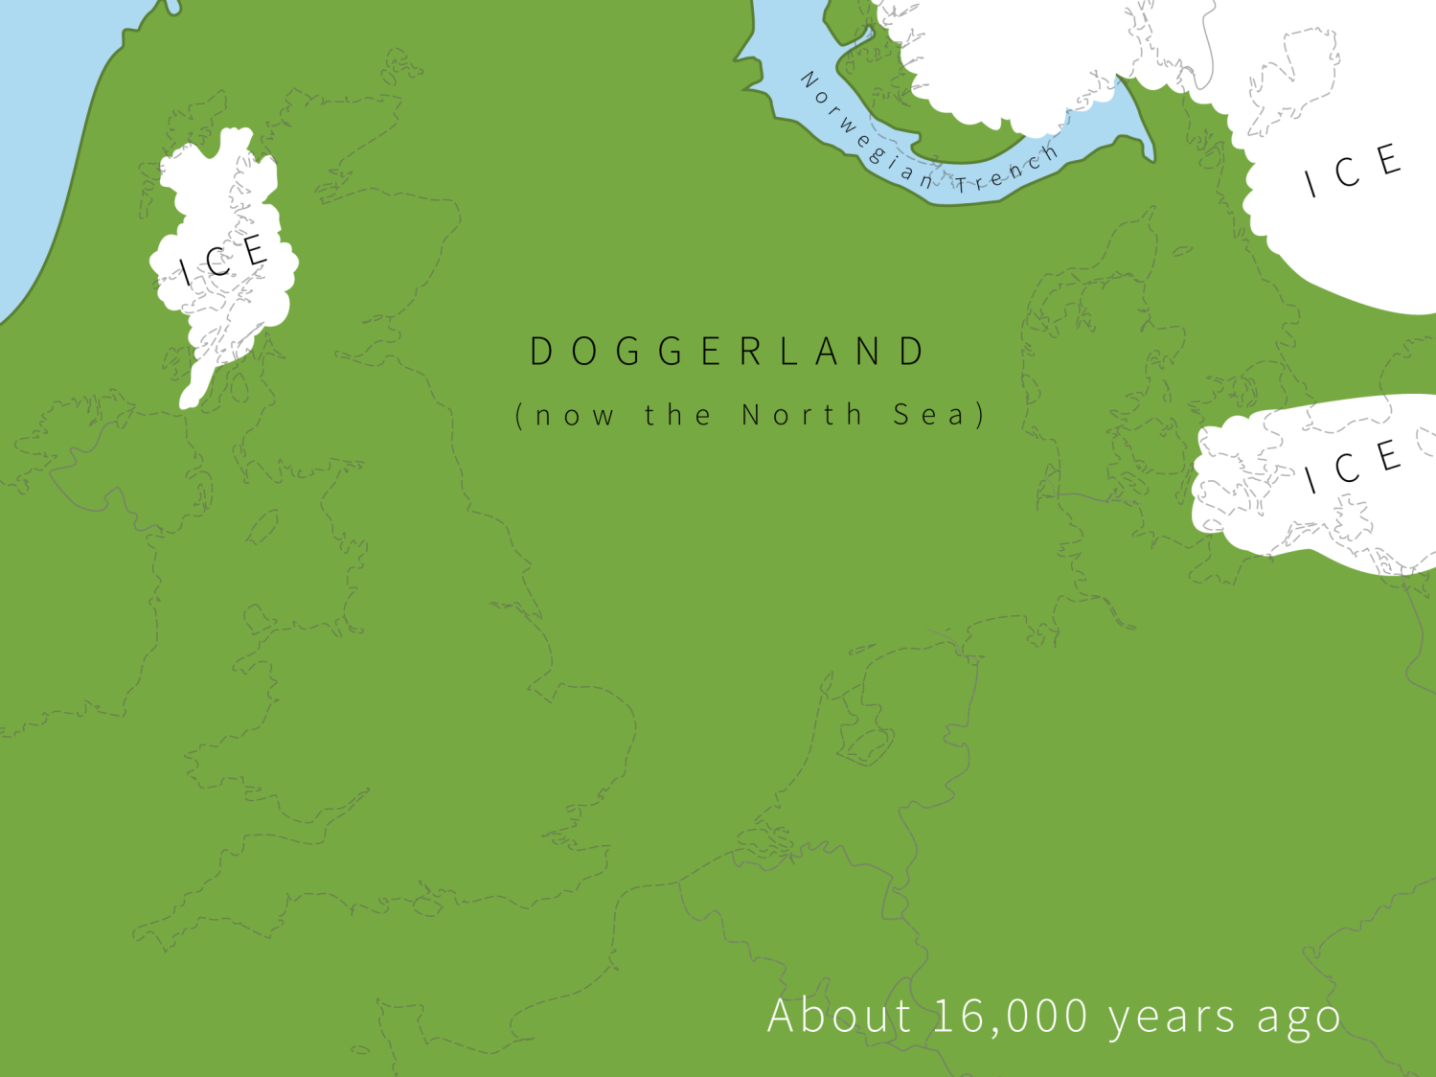
16,000 years ago
Archaeologists call the area that joined Britain to the Netherlands, Germany and Denmark ‘Doggerland’.
What do you think our ancestors did when the climate became colder?
How is the climate changing today, what effects might it have on us?
Notes:
IMAGE :
Europe c 16,000 years ago © Historic England
QUESTION:
How do archaeologists find out about climate and vegetation in the past?

Slide 16
16,000 years ago continued
Click on the dots to learn about our Top 10 Palaeolithic sites
Creswell
Crags
Happisburgh
Lynford
Paviland
Gough’s
Cave
Beeches Pit
Swanscombe
Kent’s Cavern
Boxgrove
Hengistbury
Head
Notes:
Click on the red dots to learn more about each location
After exploring the red dots (to finish)
We have looked at sites ranging from nearly a million years old to about 12,000 years ago.
These represent ‘snapshots’ from an immensely long period of time.
However, at other times during the Palaeolithic, no-one lived in Britain at all.
This was either because it was too cold or because it was an island and early humans did not have boats to get here.
Ice ages occur when there are changes in the earth’s orbit around the sun.
One very cold period occurred about half a million years ago, between the occupation of Britain by Homo heidelbergensis and the first Neanderthals.
Glaciers rolled (‘moved’ rather than rolled?) across Britain and changed the courses of many rivers.
The last Ice Age started about 100,000 years ago. During this period people were only here during the brief warmer periods.
But after the Ice Age finished, around 11,000 years ago, humans returned to Britain for the last time – we have been here ever since!
QUESTION:
What do you think our ancestors did when the climate became colder?
QUESTION:
How is the climate changing today, what effects might it have on us?

Slide 17
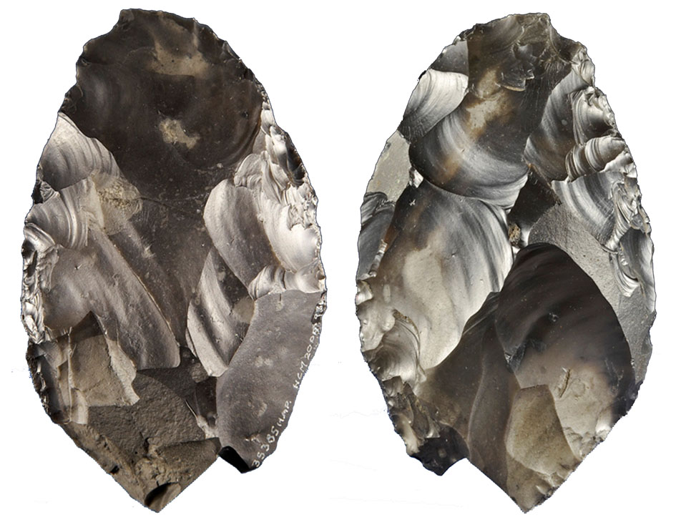
Happisburgh, Norfolk
Back to map
The Happisburgh (pronounced ‘Hays-borough’), on the Norfolk coast, is the site of the oldest human footprints in Europe, and the earliest evidence for humans in Britain.
Stone tools discovered here, such as handaxes, date from between 950,000 and 800,000 years ago.
The footprints have now been destroyed by the sea.
Happisburgh Handaxe
Notes:
IMAGE:
Happisburgh handaxe © Portable Antiquities Scheme, CC BY-SA 3.0, via Wikimedia Commons - https://commons.wikimedia.org/wiki/File:Happisburgh_handaxe.jpg
QUESTION:
What other kinds of evidence might archaeologists find on beaches?
ACTIVITY:
Make your own footprints. Can you measure your foot size and stride?
LINK:
BBC article with clip about the footprints - https://www.bbc.co.uk/news/science-environment-26025763

Slide 18
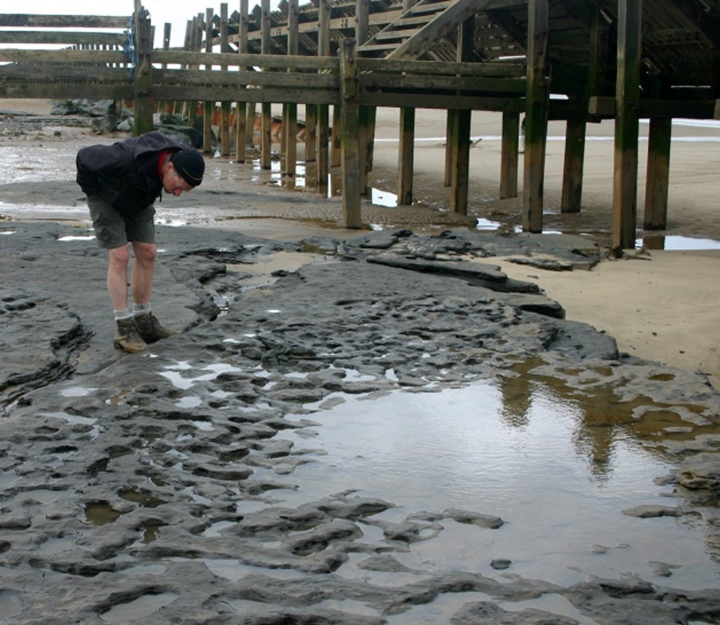
Happisburgh, Norfolk
Back to map
Analysis of the prints suggests they were made by a group of five people - probably three adults and two children.
They were probably a family group, walking in a muddy estuary.
They may belong to an early human species known as Homo antecessor.
ACTIVITY
Make your own footprints.
Can you measure your foot size and stride?
What other kinds of evidence might archaeologists find on beaches?
Happisburgh Footprints
Notes:
IMAGE:
An archaeologist inspects the human footprints on the beach at Happisburgh. © Martin Bates
QUESTION:
What other kinds of evidence might archaeologists find on beaches?
ACTIVITY:
Make your own footprints. Can you measure your foot size and stride?
LINK:
BBC article with clip about the footprints - https://www.bbc.co.uk/news/science-environment-26025763

Slide 19
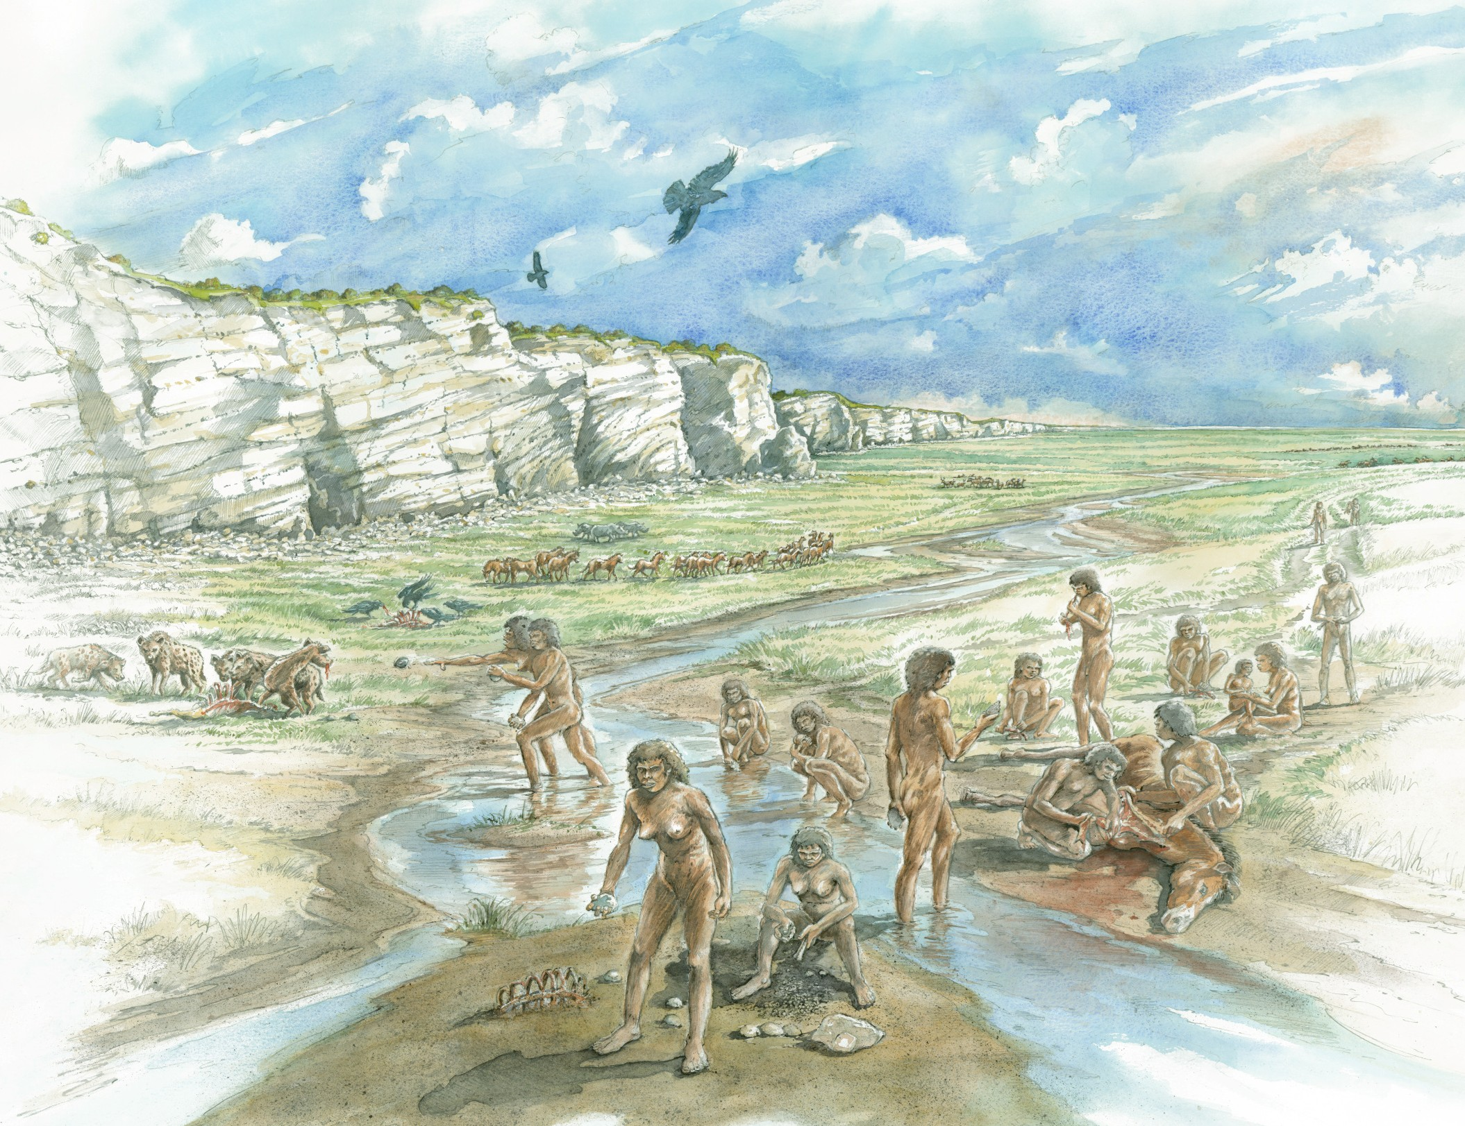
Boxgrove, Sussex
Back to map
The oldest human bones from Britain were found at Boxgrove in Sussex. They are about 500,000 years old.
They belong to a human species called Homo Heidelbergensis, an ancestor of the Neanderthals. They were tall and muscular.
Stone handaxes were found, as well as animal bones with marks where they had been chopped up, indicating that humans were butchering the animals.
Boxgrove watering hole
Notes:
IMAGE:
A reconstruction drawing showing a group of Homo heidelbergensis humans in the Boxgrove landscape around 500,000 years ago. Artist Peter Dunn. © Historic England Archive Ref: IC015/005 - https://historicengland.org.uk/images-books/photos/item/IC015/005
QUESTION:
If you had to survive in the wild without modern technology, what would you need to consider?

Slide 20
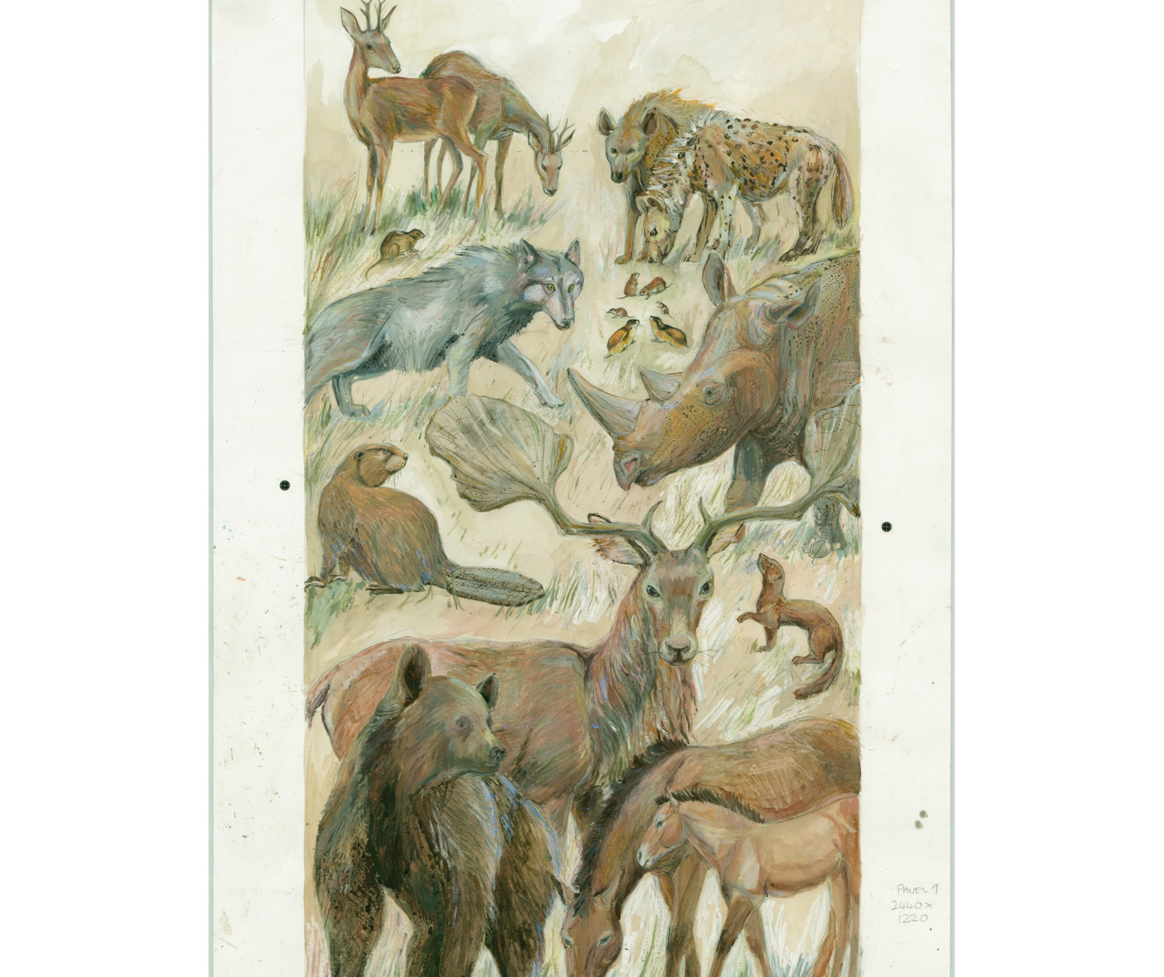
Boxgrove, Sussex
Back to map
The site was a watering hole which attracted animals as well as people.
Although the climate was like today, the animals living around Boxgrove included species now found in Africa, such as lions, hyenas and rhinos, as well as extinct species like giant deer.
The people who used this site would have risked animal attacks!
If you had to survive in the wild without modern technology, what would you need to consider?
Boxgrove watering hole
Notes:
IMAGE:
Reconstruction illustration showing the types of animals whose remains were excavated at Boxgrove Quarry, also known as Eartham Pit, near Boxgrove in West Sussex © Historic England Archive Ref: IC015/001 - https://historicengland.org.uk/images-books/photos/item/IC015/001
QUESTION:
If you had to survive in the wild without modern technology, what would you need to consider?

Slide 21
Beeches Pit, Suffolk
Back to map
The first humans came from Africa. When they moved to colder places like Britain, they lived in dark, cold forests.
They needed fire and clothes to stay warm. At Beeches Pit, scientists found signs of fires from about 400,000 years ago.
People also made stone tools, like handaxes, there. We don’t have proof of their clothes, but they probably wore animal skins or fur to keep warm.
Upper Palaeolithic hyena den
Notes:
IMAGE:
Reconstruction illustration giving an artist's impression of tool-making at an early Upper Palaeolithic hyena den, excavated near Oakham in Rutland, as it may have appeared 30,000 - 40,000 years ago.
Artist: Judith Dobie. c.1995 - c.1999. © Historic England Archive. Ref: IC126/008 - https://historicengland.org.uk/images-books/photos/item/IC126/008
QUESTION:
What things do you think our ancestors might have done while sitting by the fire?
ACTIVITY:
What story would you tell if you were sat around a campfire?
Can you imagine the stories that the people at Beeches Pit might have told?

Slide 22
Beeches Pit, Suffolk
Back to map
ACTIVITY
What story would you tell if you were sat around a campfire?
Can you imagine the stories that the people at Beeches Pit might have told?
What things do you think our ancestors might have done while sitting by the fire?
Upper Palaeolithic hyena den
Notes:
IMAGE:
Reconstruction illustration giving an artist's impression of tool-making at an early Upper Palaeolithic hyena den, excavated near Oakham in Rutland, as it may have appeared 30,000 - 40,000 years ago.
Artist: Judith Dobie. c.1995 - c.1999. © Historic England Archive. Ref: IC126/008 - https://historicengland.org.uk/images-books/photos/item/IC126/008
QUESTION:
What things do you think our ancestors might have done while sitting by the fire?
ACTIVITY:
What story would you tell if you were sat around a campfire?
Can you imagine the stories that the people at Beeches Pit might have told?

Slide 23
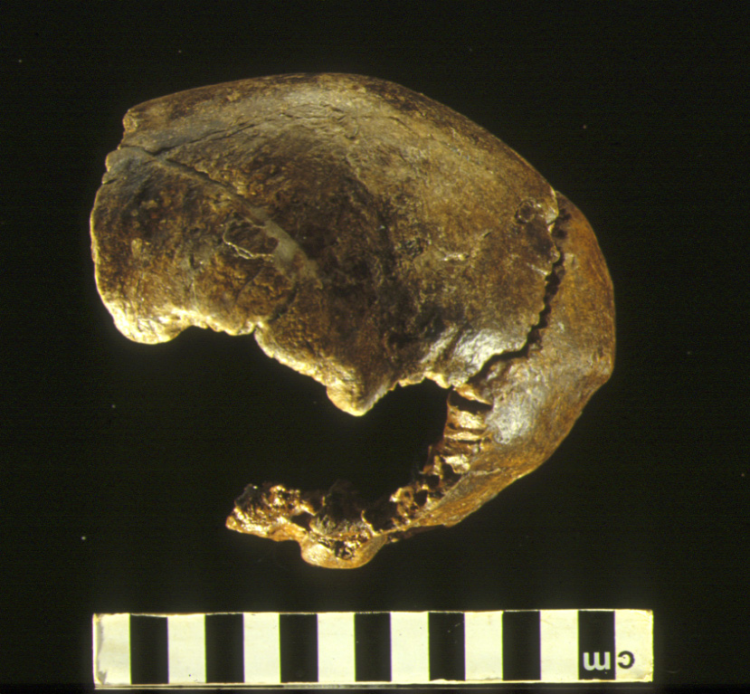
Swanscombe, Kent
Back to map
Three pieces of a Neanderthal skull were found at Swanscombe in Kent.
The skull is not very muscular, so scientists think it belonged to a woman.
She lived in a relatively warm period, about 400,000 years ago, between the worst ice ages.
The size of this skull shows that Neanderthals had brains just as big as ours.
Swanscombe Skull
Notes:
IMAGE:
Swanscombe skull © Natural History Museum - http://www.ahobproject.org/Picture_Library/hoxnian/Full_Size/Swanskull.jpg
QUESTION:
How might archaeologists work out what people looked like from their bones?
LINK:
http://www.swanscombeheritagepark.co.uk/interpretation.htm

Slide 24
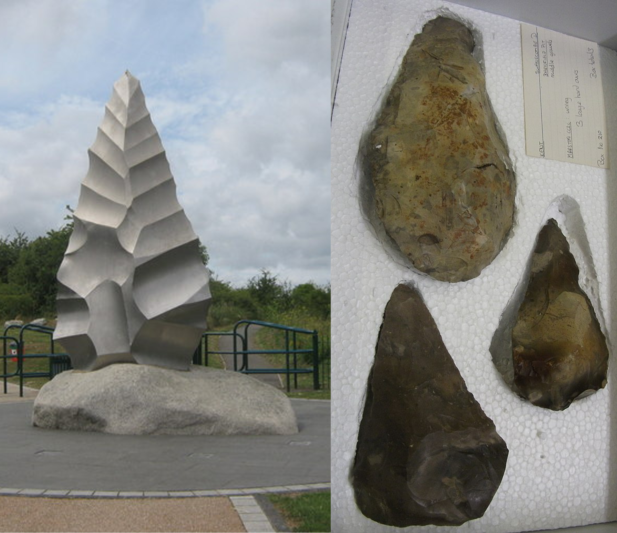
Swanscombe, Kent
Back to map
Thousands of stone handaxes were also discovered in the same area as the skull.
The landscape had marshes and grassy fields, where rhinos and wild cattle ate the grass
Nearby woods were home to deer and huge straight-tusked elephants.
How might archaeologists work out what people looked like from their bones?
Swanscombe park sculpture & real flints
Notes:
IMAGE:
Hand Axe Sculpture in Swanscombe Heritage Park
© David Anstiss / Hand Axe Sculpture in Swanscombe Heritage Park - https://commons.wikimedia.org/wiki/File:Hand_Axe_Sculpture_in_Swanscombe_Heritage_Park_-_geograph.org.uk_-_1417150.jpg
3 hand axes from Barnfield Pit, Swanscombe, Kent
© Johnbod, CC BY-SA 3.0 <https://creativecommons.org/licenses/by-sa/3.0>, via Wikimedia Commons - https://commons.wikimedia.org/wiki/File:Franks_HouseDSCF7155.jpg
QUESTION:
How might archaeologists work out what people looked like from their bones?
LINK:
http://www.swanscombeheritagepark.co.uk/interpretation.htm

Slide 25
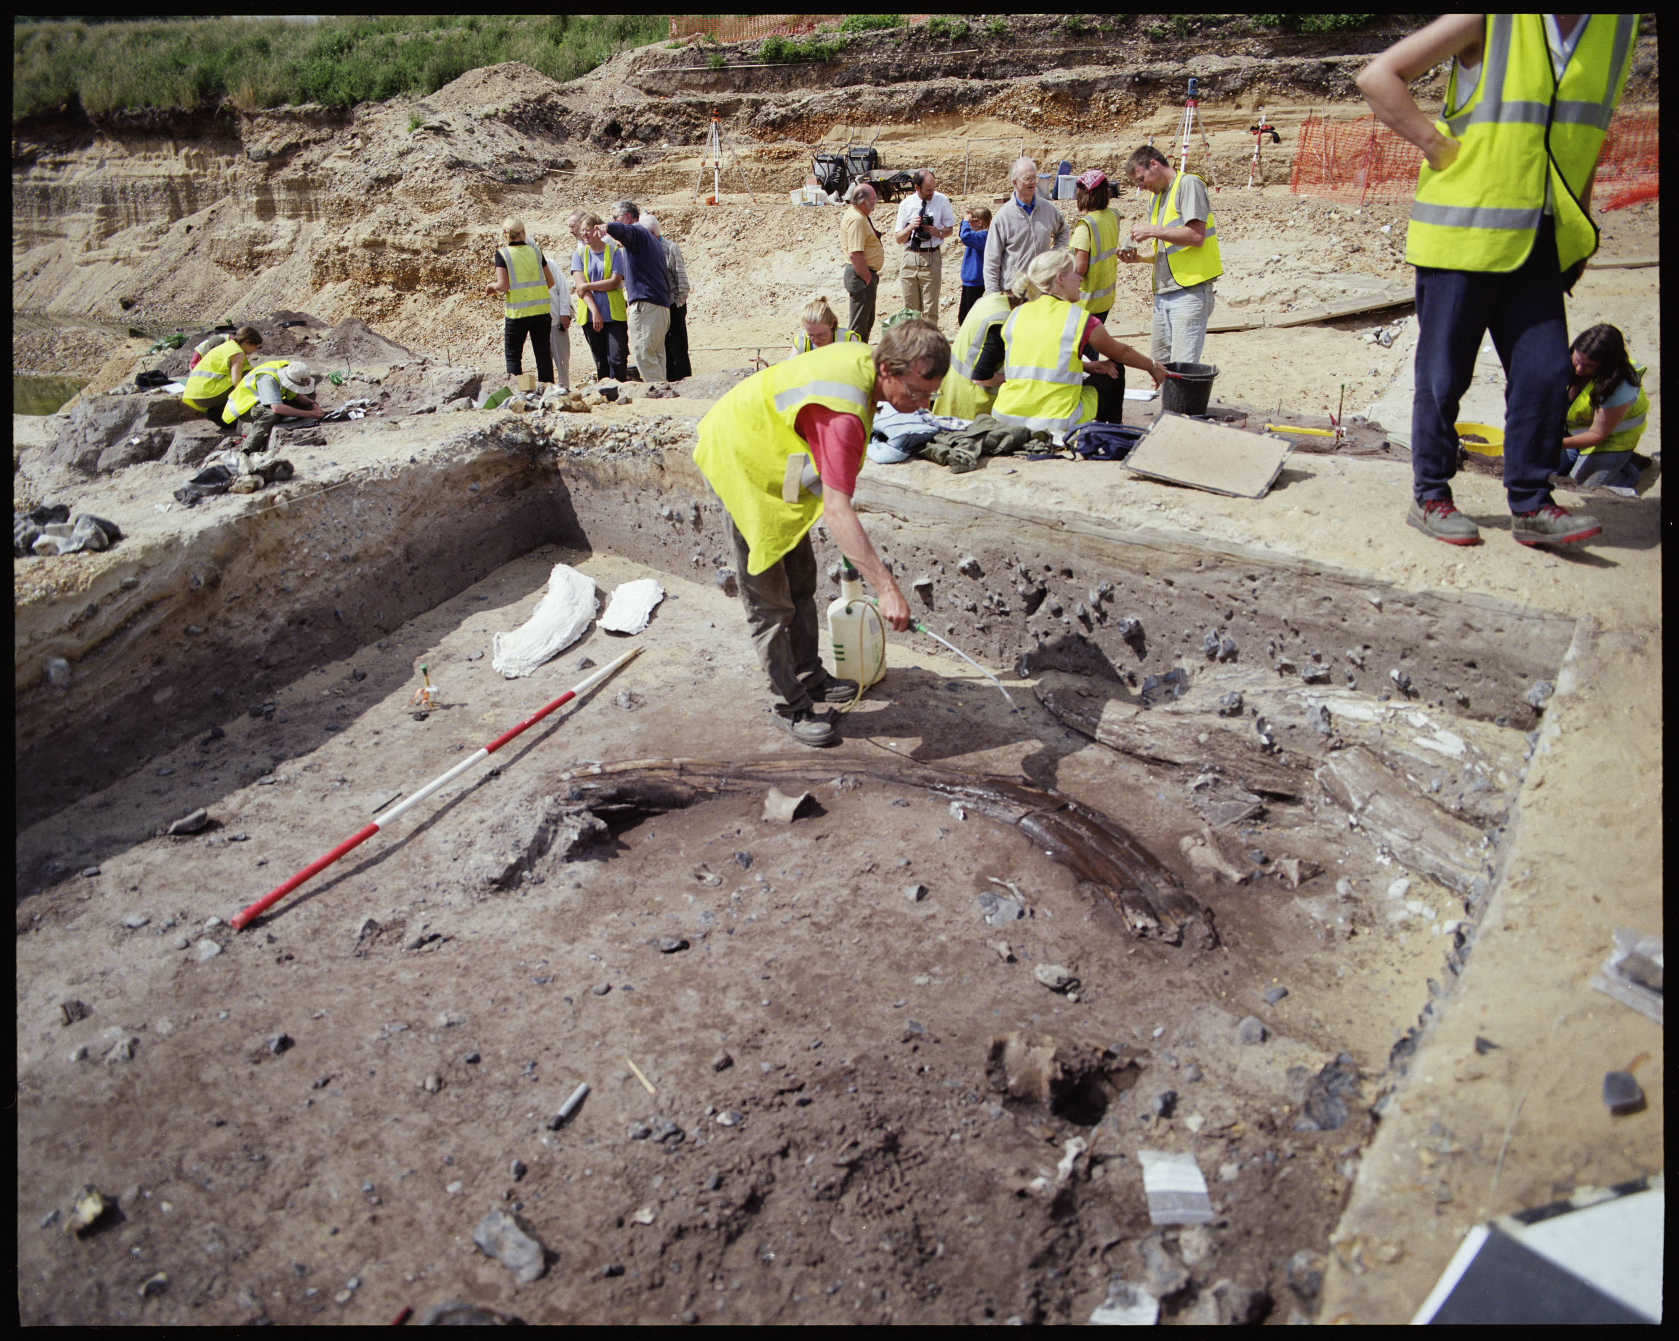
Lynford, Norfolk
Back to map
At Lynford quarry in Norfolk, archaeologists found an old stream with woolly mammoth bones and Neanderthal stone tools from about 60,000 years ago.
Bones from at least 11 mammoths, mostly big males, were found.
People had broken some bones for marrow and taken others away for their meat.
Archaeologist spraying a mammoth tusk
Notes:
IMAGE:
Mammoth tusks in the stream channel at Lynford during excavation. © Historic England Archive Ref: AA028489 - https://historicengland.org.uk/images-books/photos/item/AA028489
QUESTION:
How do you think Neanderthal people might have gone about hunting a mammoth?

Slide 26
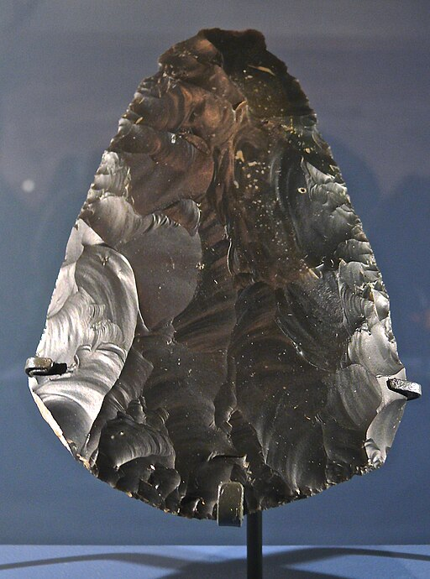
Lynford, Norfolk
Back to map
Forty-seven handaxes were found at the site, tools well-suited to cutting meat.
However, we do not know whether people were hunting the mammoths or scavenging animals that had died naturally or been killed by other predators.
Other animals found at Lynford include brown bear, hyena, woolly rhino, reindeer and bison.
How do you think Neanderthal people might have gone about hunting a mammoth?
A close-up of a flint handaxe
Notes:
IMAGE:
Lynford Hand axe-Cordiform © José-Manuel Benito Alvarez, CC BY-SA 4.0, via Wikimedia Commons - https://commons.wikimedia.org/wiki/File:Lynford_Hand_axe-Cordiform.jpg
QUESTION:
How do you think Neanderthal people might have gone about hunting a mammoth?

Slide 27
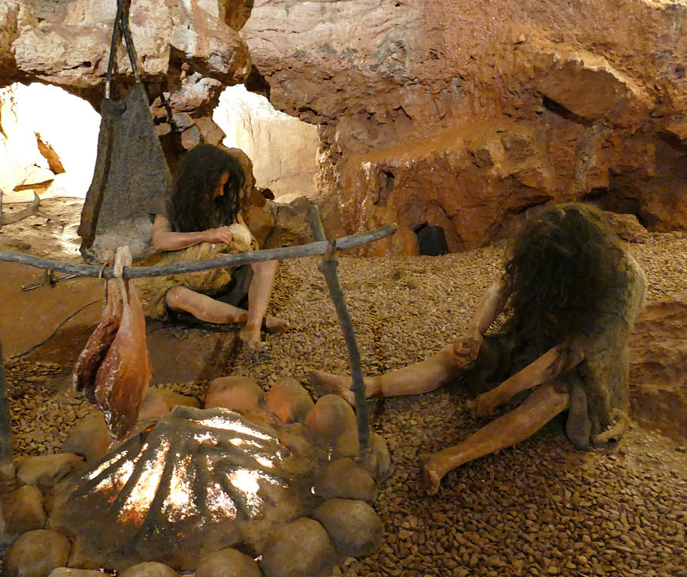
Kent’s Cavern, Devon
Back to map
Kent’s Cavern is a very big cave that people have used for hundreds of thousands of years.
Archaeologists have found stone tools, bones, and human remains from as far back as 350,000 years ago.
Human bones from 31,000 years ago are the oldest modern humans found in northern Europe.
Models of cave people
Notes:
IMAGE:
Cave dwellers reconstructed, Kents Cavern © Cave dwellers reconstructed, Kents Cavern by Stephen Craven, CC BY-SA 2.0, via Wikimedia Commons - https://commons.wikimedia.org/wiki/File:Cave_dwellers_reconstructed,_Kents_Cavern_-_geograph.org.uk_-_6309394.jpg
QUESTION:
Why did people sometimes choose to live in caves?
ACTIVITY:
Imagine what would it be like to stay in a cave without electricity, modern clothes and tools?
LINK:
http://www.kents-cavern.co.uk/main.cfm?main=535

Slide 28
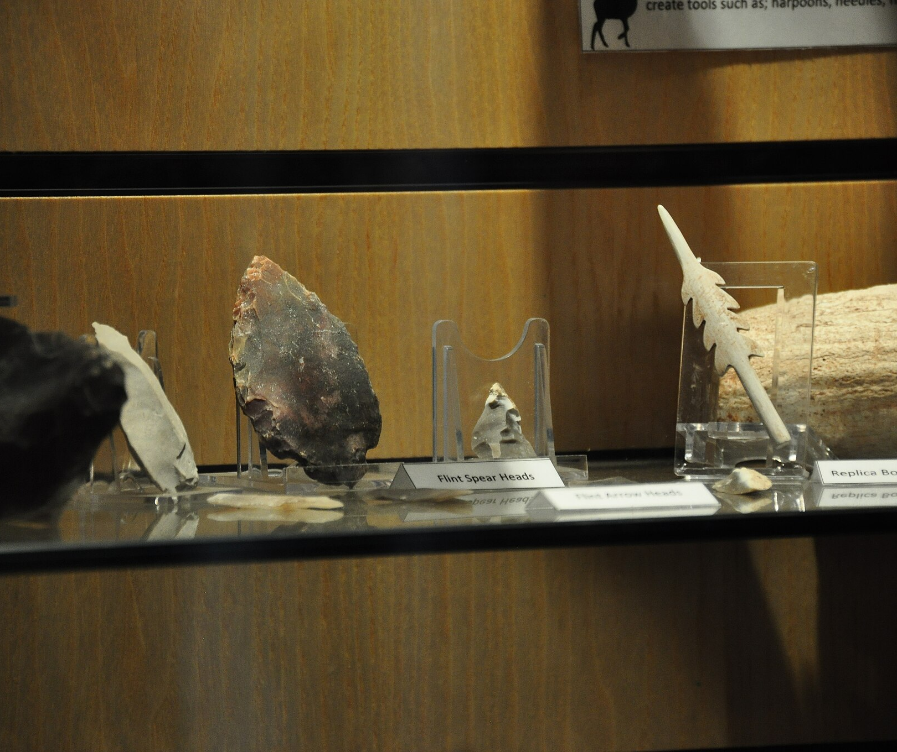
Kent’s Cavern, Devon
Back to map
Tools from Kent’s Cavern and Creswell Crags are very similar, suggesting they may have been made by the same people.
This implies that Upper Palaeolithic people travelled across Britain and didn’t live in caves permanently.
Other finds in the cave date from a later occupation, 14,000 years ago.
These include a rod of mammoth ivory, antler harpoons, bone needles, and various types of stone tools.
Tools found at Kent’s Cavern
Notes:
IMAGE:
Display case, Kents Cavern © Nilfanion, CC BY-SA 4.0, via Wikimedia Commons - https://commons.wikimedia.org/wiki/File:Kents_Cavern_(6982).jpg
QUESTION:
Why did people sometimes choose to live in caves?
ACTIVITY:
Imagine what would it be like to stay in a cave without electricity, modern clothes and tools?
LINK:
http://www.kents-cavern.co.uk/main.cfm?main=535

Slide 29
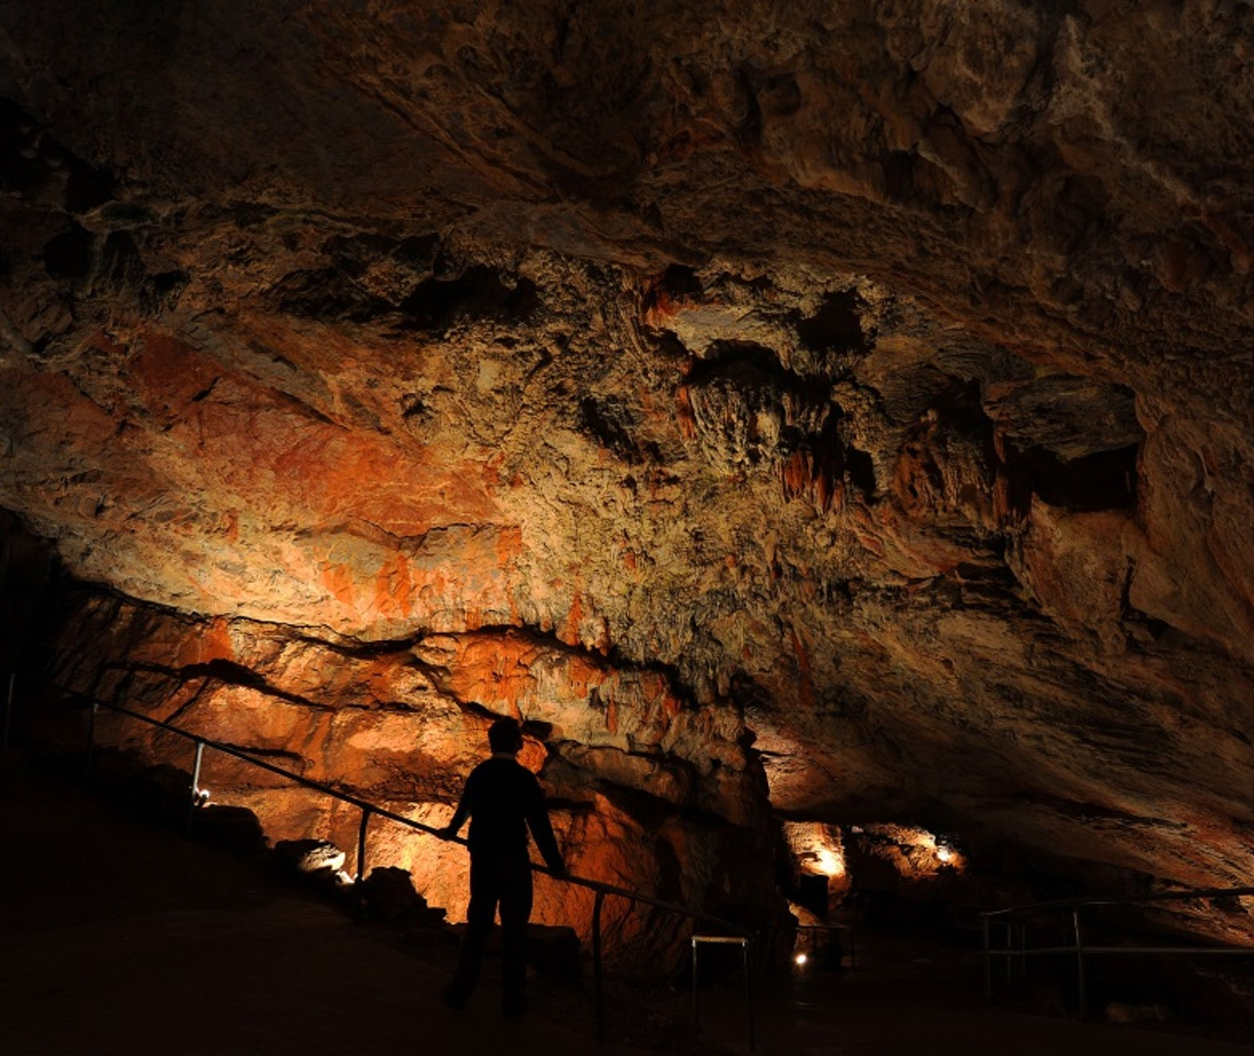
Kent’s Cavern, Devon
Back to map
ACTIVITY
Imagine what would it be like to stay in a cave without electricity, modern clothes and tools?
Why did people sometimes choose to live in caves?
Inside Kent’s Cavern
Notes:
IMAGE:
The interior of the cave system at Kent’s Cavern, Devon. © Kent’s Cavern Ltd
QUESTION:
Why did people sometimes choose to live in caves?
ACTIVITY:
Imagine what would it be like to stay in a cave without electricity, modern clothes and tools?
LINK:
http://www.kents-cavern.co.uk/main.cfm?main=535

Slide 30
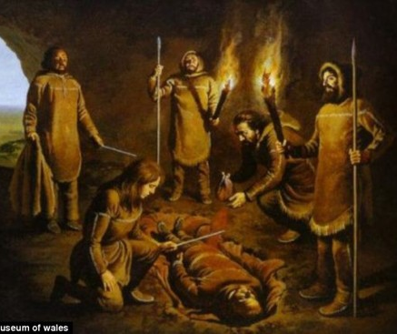
'Red Lady' of Paviland, Gower
Back to map
Inside a cave in Gower, south Wales, a young man was buried about 34,000 years ago. His bones are still in very good condition, which makes the site very important.
The cave was found nearly 200 years ago by a man called William Buckland. At first, he thought the bones belonged to a woman from Roman times because the body was wearing jewellery—but he was wrong!
Reconstruction of the burial
Notes:
IMAGE:
Reconstruction of the burial of the ‘Red Lady’ of Paviland © National Museums Wales - http://i.dailymail.co.uk/i/pix/2013/11/25/article-2513128-19A22BCF00000578-779_634x434.jpg
QUESTION:
Why do you think the ‘Red Lady’ was buried in the way he was?

Slide 31
'Red Lady' of Paviland, Gower
Back to map
The person was buried in a special way, showing that Palaeolithic people had beliefs and traditions.
The body was covered in red powder made from stone (red ochre), and shells and jewellery made from mammoth ivory were buried with him too.
Why do you think the ‘Red Lady’ was buried in the way he was?
Reconstruction of the burial
Notes:
IMAGE:
Reconstruction of the burial of the ‘Red Lady’ of Paviland © National Museums Wales - http://i.dailymail.co.uk/i/pix/2013/11/25/article-2513128-19A22BCF00000578-779_634x434.jpg
QUESTION:
Why do you think the ‘Red Lady’ was buried in the way he was?

Slide 32
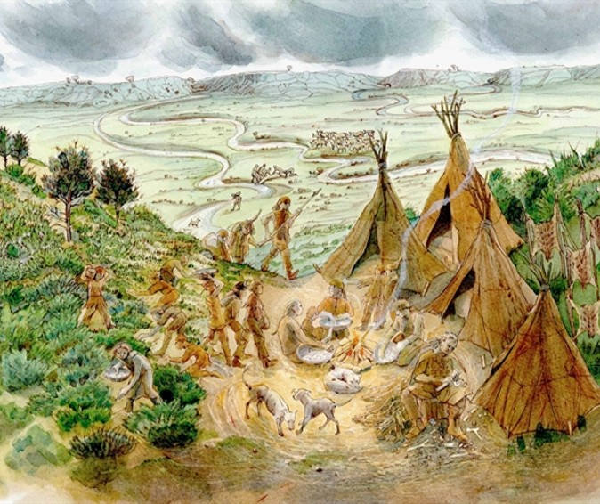
Hengistbury Head, Dorset
Back to map
Hengistbury Head in Dorset dates to the late Palaeolithic, around 14,000 years ago.
Unlike many sites of this period found in caves, it was an open-air campsite overlooking hunting grounds.
Although today it overlooks the sea, this would have been dry land in the Upper Palaeolithic.
Palaeolithic camp
Notes:
IMAGE:
A reconstruction of the Upper Palaeolithic campsite on Hengistbury Head. © Judith Dobie, via Historic England
QUESTION:
How do archaeologists use stone tools to work out what people were doing in the past?

Slide 33
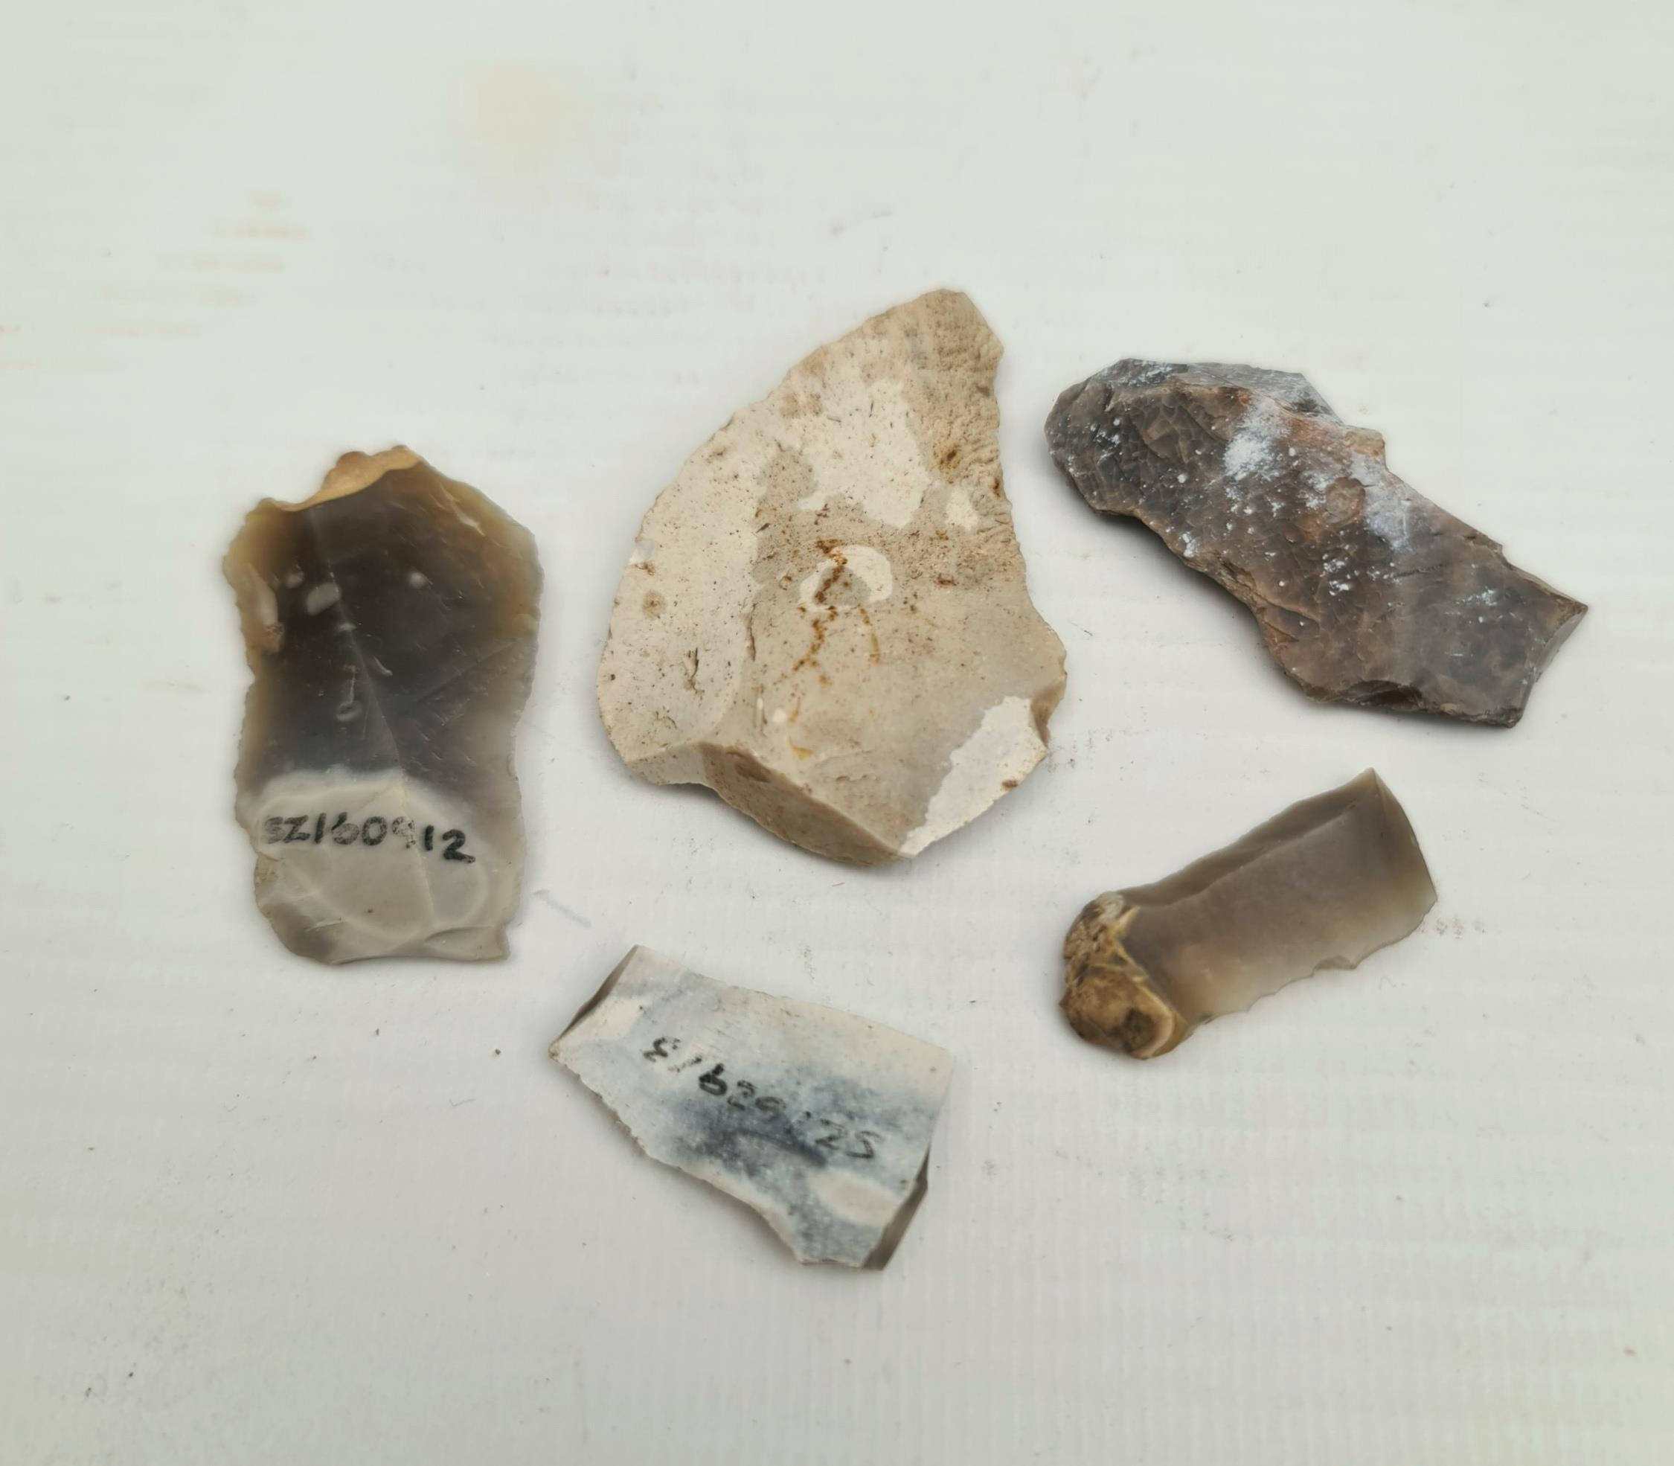
Hengistbury Head, Dorset
Back to map
Hundreds of stone tools have been found here, including types common across northern Europe.
By refitting flakes to their cores, archaeologists can reconstruct how the tools were made.
The distribution of tools and debris shows that different parts of the site were used for specific activities, such as toolmaking and hide preparation.
Late Palaeolithic flint tools
Notes:
IMAGE:
Antique Late Palaeolithic Flint Weapons 5 Arrow Heads. Excavated in the late 1980's on Hengistbury Head by Oxford University. Believed made at least 10,000 years ago these are fascinating items. The longest measures 4.5cm. - https://www.easyliveauction.com/catalogue/lot/257781f68588b5a0aa0298998dc906b7/0af8d24542e81eb9357e7ef448a6646f/estate-and-property-clearance-sale-all-lots-start-at-5-vi/
QUESTION:
How do archaeologists use stone tools to work out what people were doing in the past?

Slide 34
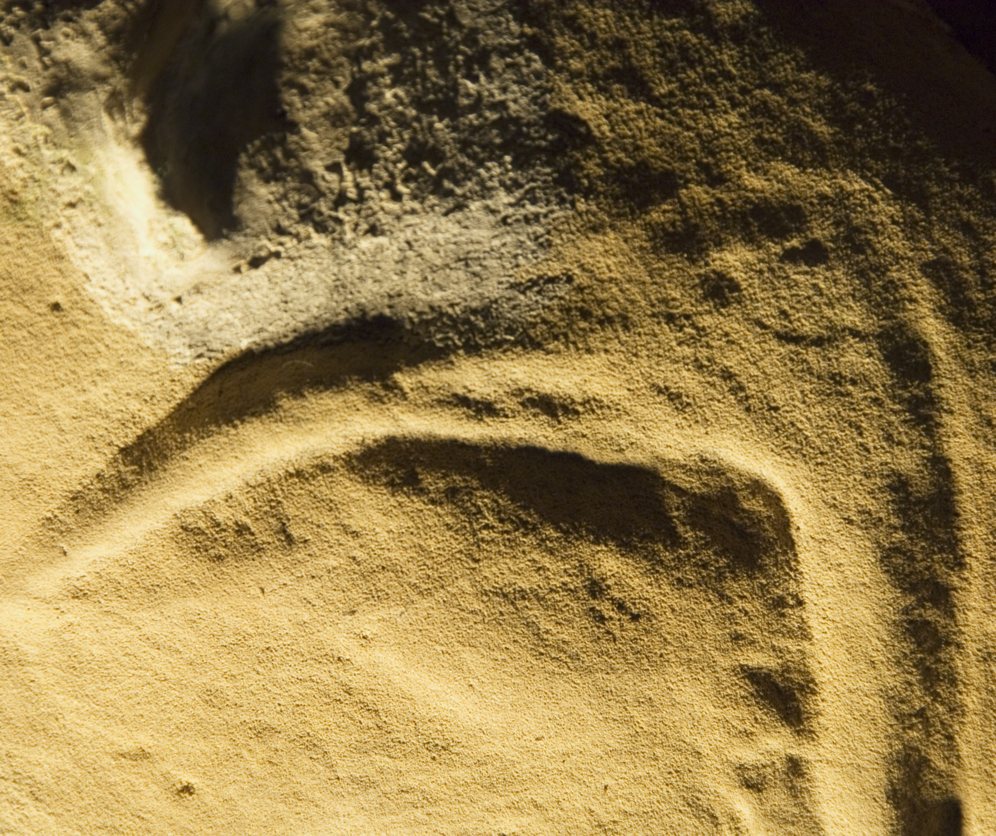
Creswell Crags, Derbyshire
Back to map
Creswell Crags, on the Derbyshire –Nottinghamshire border, is a network of caves showing Middle and Upper Palaeolithic activity by Neanderthals and modern humans.
In Church Hole Cave, over 20 carvings of animals, birds, and symbols date to at least 12,800 years ago, making them Britain’s oldest known art.
Carving of a bird
Notes:
IMAGE:
Creswell Crags cave art. Probably the head of a bird (an Ibis?). © Historic England Archive. Ref: DP030334 - https://historicengland.org.uk/images-books/photos/item/DP030334
QUESTION:
Why do you think people carved pictures of animals in the caves? Which animals would you choose?
ACTIVITY:
Make your own cave art using paint or charcoal
LINK:
http://www.creswell-crags.org.uk/learning-resources.aspx

Slide 35
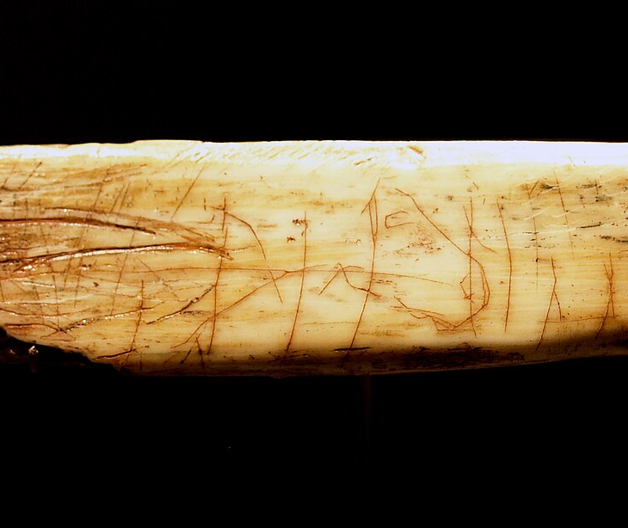
Creswell Crags, Derbyshire
Back to map
Other Palaeolithic art from the caves includes a beautiful carving of a horse on an animal bone.
The large mammals carved on the cave walls include wild cattle, horse and red deer.
Animal bones found in the caves show that modern humans were also trapping Arctic hare for their fur.
Why do you think people carved pictures of animals?
Carving of a horse on a bone
Notes:
IMAGE:
The Ochre Horse © Dave from Nottingham, England, CC BY 2.0 ,via Wikimedia Commons - https://commons.wikimedia.org/wiki/File:Ochre_Horse.jpg
QUESTION:
Why do you think people carved pictures of animals in the caves? Which animals would you choose?
ACTIVITY:
Make your own cave art using paint or charcoal
LINK:
http://www.creswell-crags.org.uk/learning-resources.aspx

Slide 36
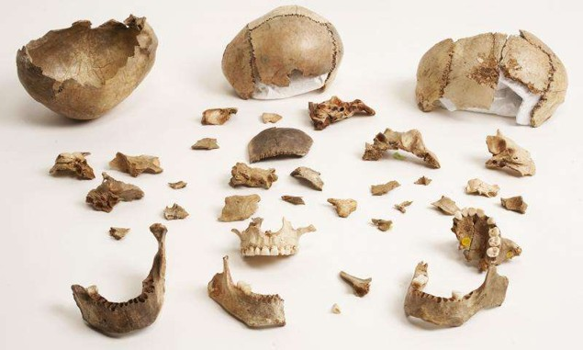
Gough’s Cave, Somerset
Back to map
The remains of modern humans from Gough’s Cave in Somerset have revealed a grisly secret.
Around 15,000 years ago, some human bodies were being butchered, the bones chewed and cracked for the marrow. Cups were made from people’s skulls.
ACTIVITY
Different cultures have always had different ways of dealing with death – can you find out about the rituals of other ancient cultures, such as the Egyptians?
Skull fragments
Notes:
IMAGE:
Human remains from Gough’s Cave. © The Trustees of the Natural History Museum, London
ACTIVITY:
Different cultures have always have different ways of dealing with death – can you find out about the rituals of other ancient cultures, such as the Egyptians?

Slide 37
Gough’s Cave, Somerset
Back to map
Archaeologists think the cannibalism and skull cups may have been part of funerary rituals, though it is unclear whether they involved loved ones or enemies.
Finds from Gough’s Cave show that Palaeolithic people did not always behave like we do today.
People’s beliefs and customs have changed over time just as much as their tools and technology.
Skull fragments
Notes:
IMAGE:
Human remains from Gough’s Cave. © The Trustees of the Natural History Museum, London
ACTIVITY:
Different cultures have always have different ways of dealing with death – can you find out about the rituals of other ancient cultures, such as the Egyptians?

