Slide 1
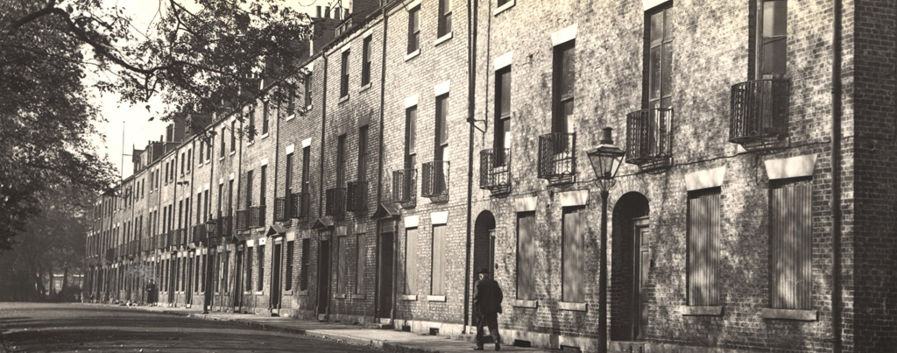
Newcastle City Centre Walk - North
Teacher’s Guide
This guide has been designed in collaboration with African Lives in Northern England.
Notes:
Image © Newcastle City Library, Local Studies and Family History Centre

Slide 2
How to use this PPT
Contents
A map of the walking route
A link to a PDF document of a suggested script for each point on the walk
Suggested pictures to show at each point
Guidance on where to stand safely with children at each point on the route.
The What3Words location for each point on the map.
(What3Words uses 3 word combinations to mark the entire world into 3 meter squares. It’s free to use either on the web or you can download the app at Google Play Store or IOS App Store)
This PPT and associated script is designed to provide you, as the teacher, with enough information to lead a walk around Newcastle City Centre.
Please pick and choose the slides you find most useful. You can select additional images from the accompanying StoryMap.
You may also wish to look at the KS 2 version of the walk to find additional information and locations.
We hope to help you create the perfect walking tour for your class.

Slide 3
How did people from Africa contribute to and enrich our region?
Key Stage 3: History and PSHE
A study testing how far sites in their locality reflect aspects of national history
To learn about the contribution people of African descent have made to the North East and begin to build appreciation of the diversity of the region.
To raise awareness of some of the stories of individuals who came from Africa and the impact they had on the North East and our heritage
To highlight the way in which people of African descent have influenced significant historical events and are linked to our local buildings in Newcastle upon Tyne
To gain an improved understanding of enslavement, discrimination and racism, whilst exploring the ways they can, and have, been challenged throughout history.
This PowerPoint has an accompanying script for every point on the map and is part of the Teaching Activity: How did people from Africa contribute to and enrich our region? KS3

Slide 4
Content Warning
This trail, StoryMap and associated resources cover some topics that may be sensitive and could be upsetting. These include, but are not limited to:
Point 3 - Early African Exhibitions at The Hatton Gallery and references to the ‘human zoo’
Point 4 - Martin Luther King Jnr at Kings Hall, Newcastle University and references to his assassination.​
Point 8 - Ida B Wells at Brunswick Methodist Chapel and references to ‘lynching’
Please read the introduction on the StoryMap before embarking on this walk.

Slide 5
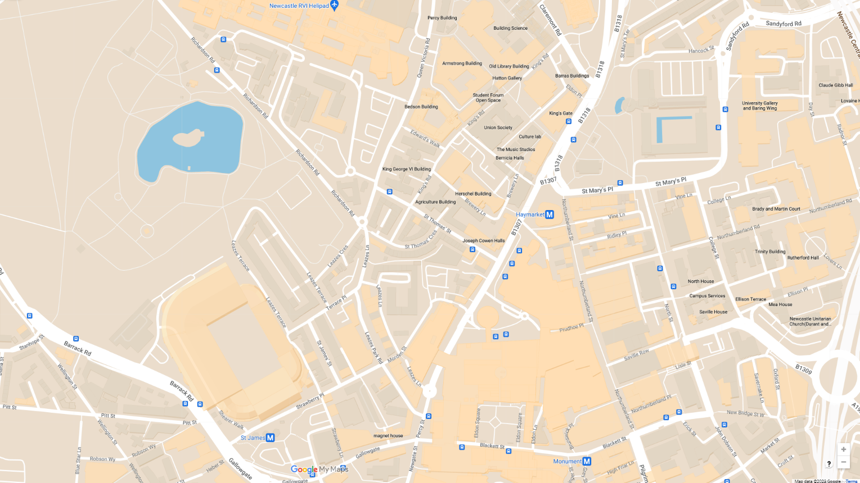
Route Map
Paul Robeson - City Hall
Colonial Seamen - West Indies House
Early African Exhibitions - Hatton Gallery
Martin Luther King Jr. - Armstrong Building
West African Doctors & Nurses - Royal Victoria Infirmary
The Colonial Students’ Club - 40 Leazes Terrace
Frederick Douglass - 23 Leazes Park Road
Ida B Wells - Brunswick Methodist Chapel
1
2
3
4
4
3
5
6
5
2
7
8
1
6
7
8
Notes:
Route Map

Slide 6
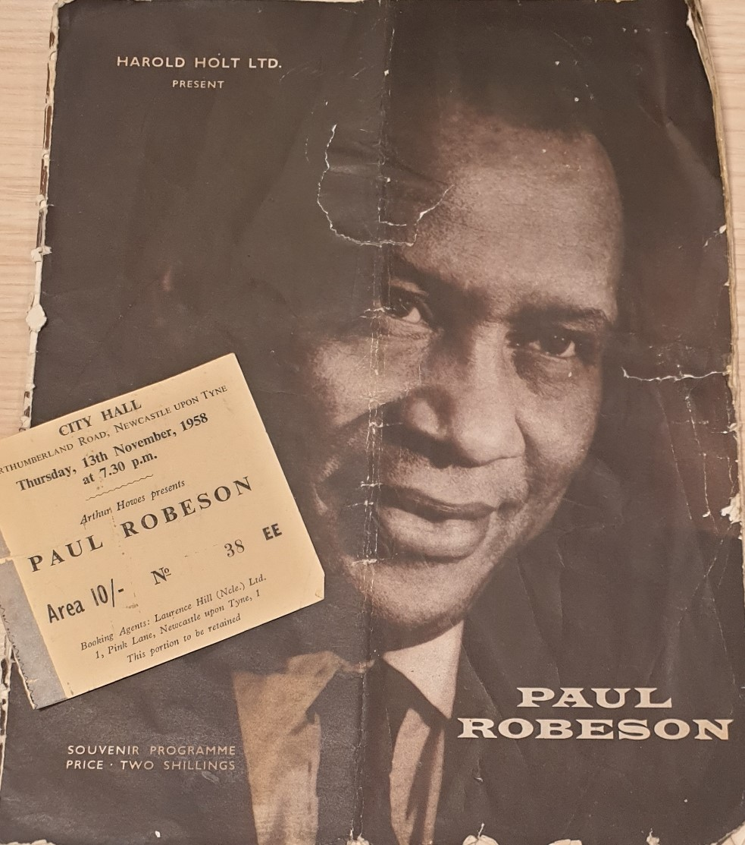
Point 1 - Paul Robeson at Newcastle City Hall
There are 2 suggested images on the following slides. These can be used to illustrate your walk.
Read the script for Paul Robeson.
Children can stand directly in front of Newcastle City Hall but may need to move out of the way for pedestrians.
The location code from What3Words is storm.until.lived
Ticket for a Paul Robeson concert at Newcastle City Hall in 1958
Notes:
Image: Newcastle City Library, Local Studies and Family History Centre

Slide 7
Programme & ticket from Paul Robeson concert at City Hall
Notes:
Image: Newcastle City Library, Local Studies and Family History Centre

Slide 8
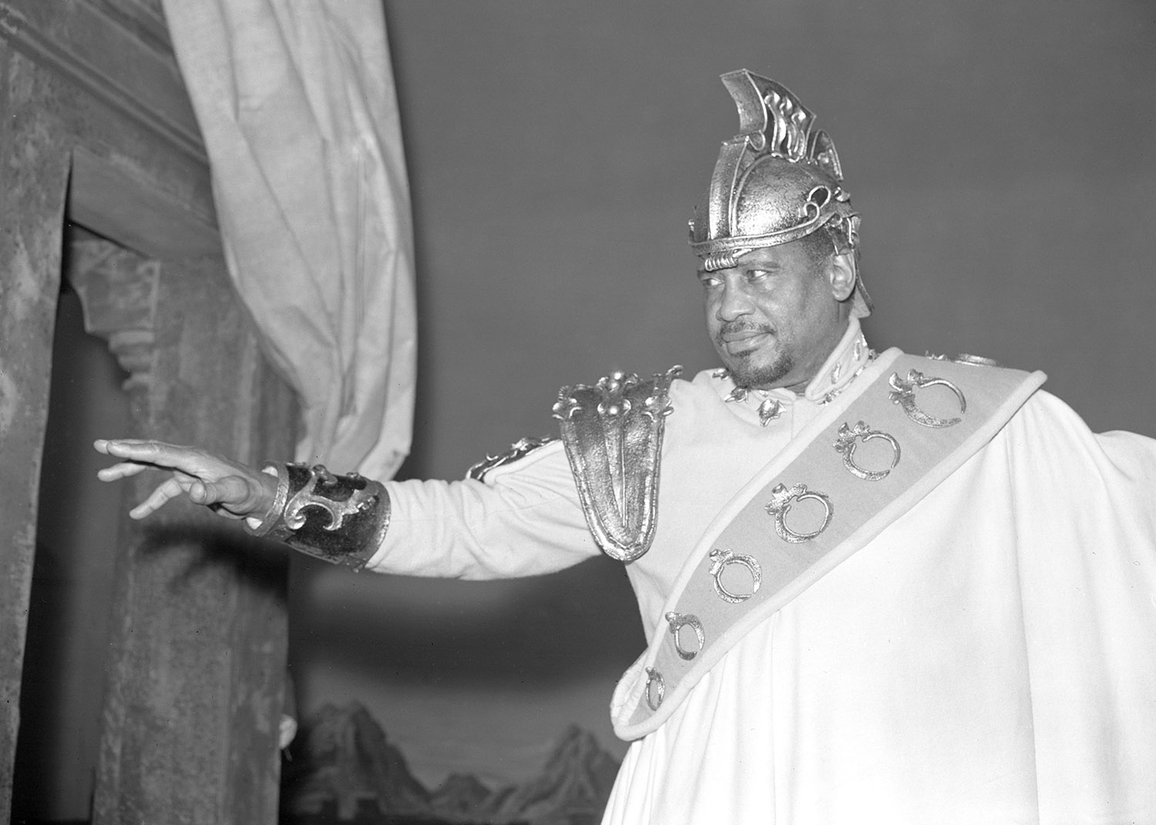
Paul Robeson as Othello
Notes:
Image: Alamy Ref: H8PC00 Date: 6 March 1959

Slide 9
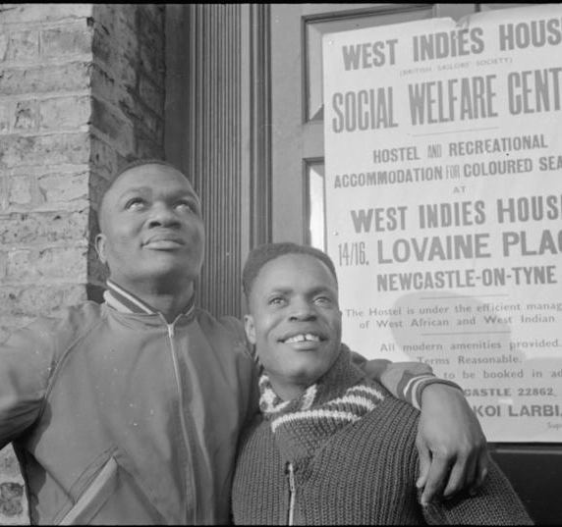
Point 2 - West Indies House at Newcastle Civic Centre
There are 3 suggested images on the following slides. These can be used to illustrate your walk.
Read the script for West Indies House.
Children can stand in front of Newcastle Civic Centre beside ‘The Response’ War Memorial. The pavements here are wide. You will be away from the road and any traffic noise.
The location code from What3Words is palace.gates.moral
Residents standing outside West Indies House
Notes:
Image: IWM D 5763

Slide 10
Houses on Lovaine Place prior to demolition, 1957
Notes:
Image: Newcastle City Library, Local Studies and Family History Centre - Accession Number : 008227 – Taken 1957

Slide 11
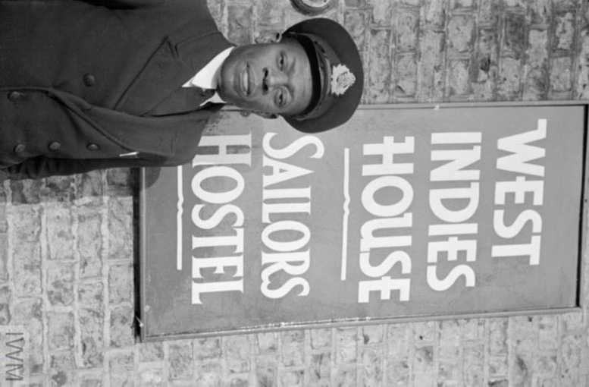
Koi Obuadabang Larbi, West Indies House, 1941
Notes:
Image: © IWM D 5768

Slide 12
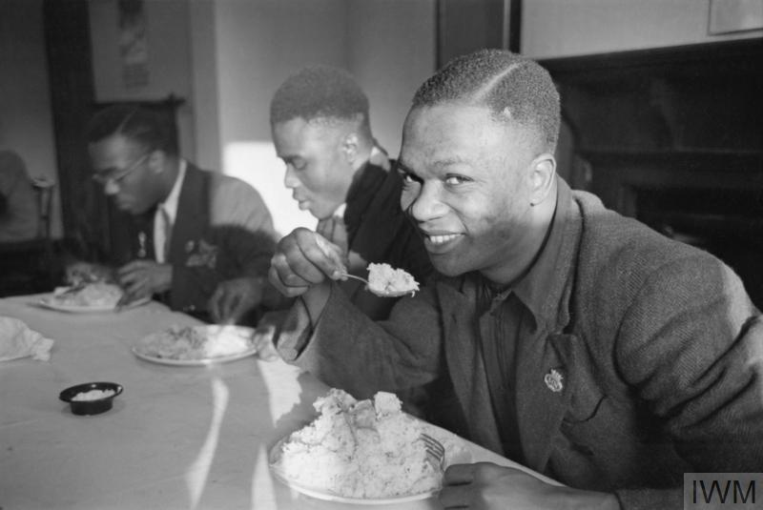
Mealtime at West Indies House, 1941
Notes:
Image: © IWM D 5757

Slide 13
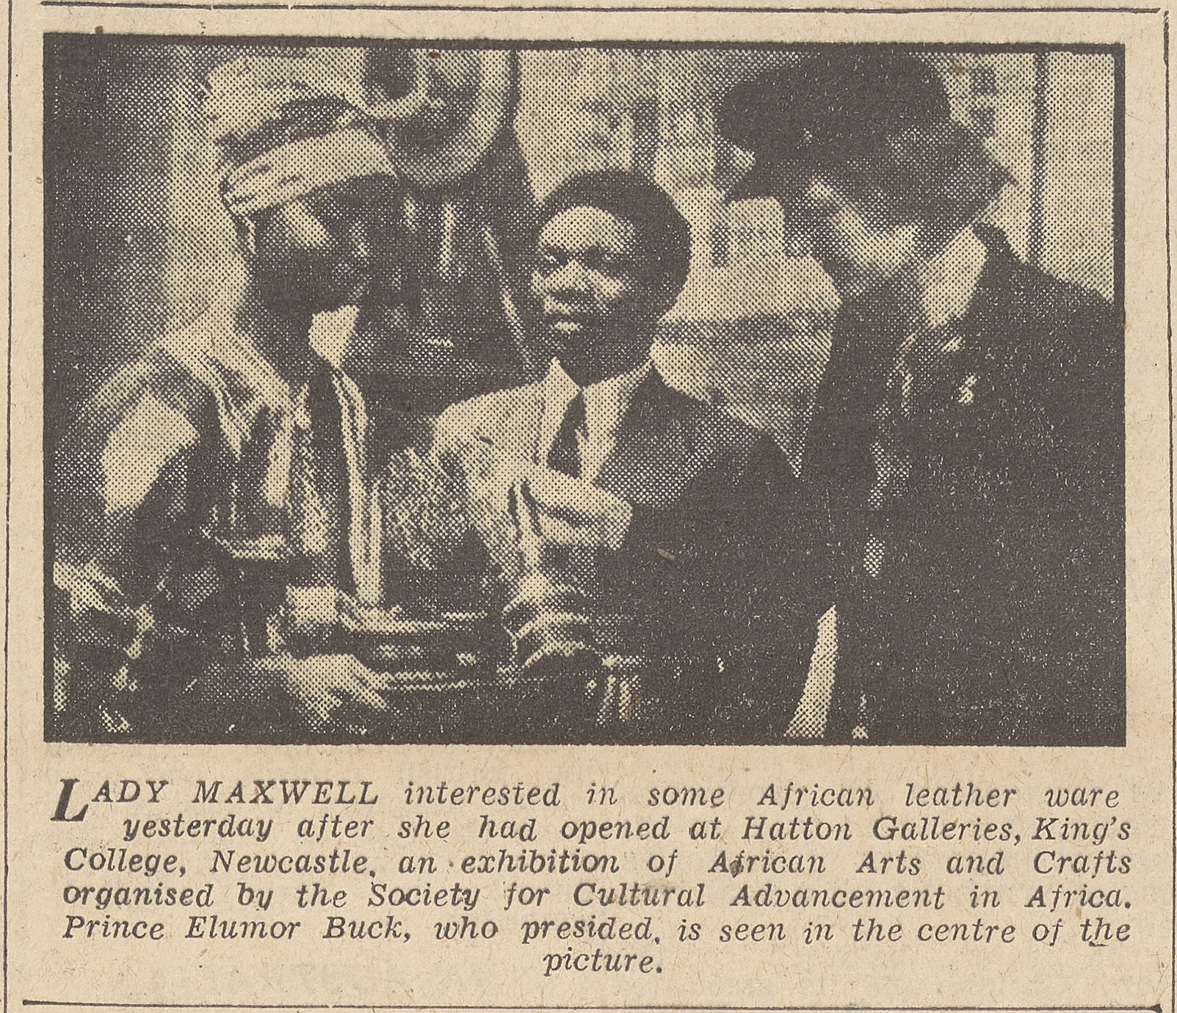
Point 3 – Early African Exhibitions at The Hatton Gallery
There are 3 suggested images on the following slides. These can be used to illustrate your walk.
Read the script for Early African Exhibitions.
Children can stand directly in front of The Hatton Gallery. It is located on Newcastle University campus and is away from traffic noise and is a safe place.
The location code from What3Words is formed.doors.ties
Newspaper article about the opening of the exhibition “Africa to Tyneside”at The Hatton Gallery by Lady Maxwell
Notes:
Image: © British Library Board Ref: news_13585_newcastle_journal_tuesday_june_1st_1943_p003

Slide 14
“Africa to Tyneside” exhibition at The Hatton Gallery
Notes:
Image: © British Library Board Ref: news_13585_newcastle_journal_tuesday_june_1st_1943_p003

Slide 15
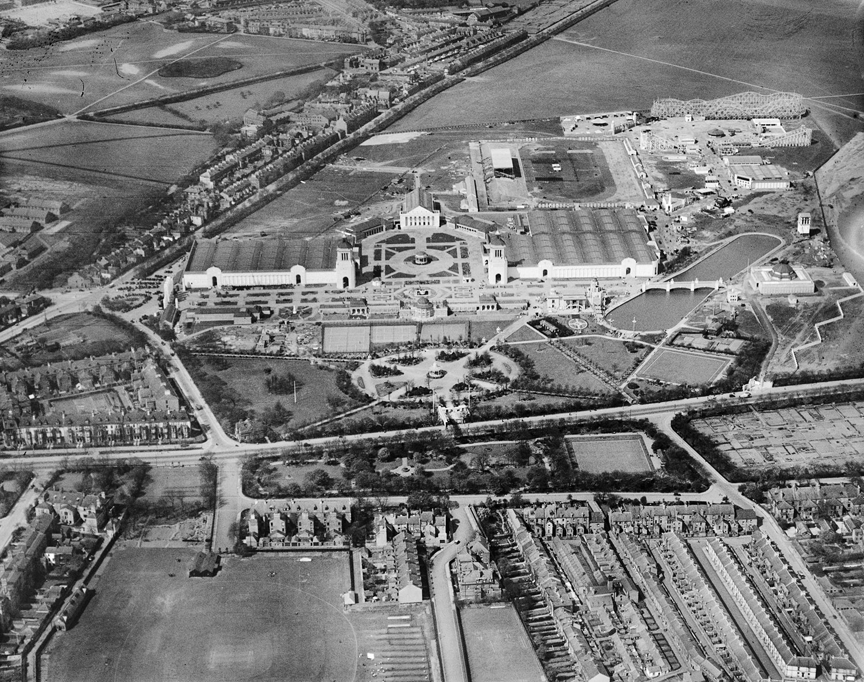
North Coast Exhibition, Town Moor, 1929
Notes:
Image: © Historic England Archive (Aerofilms Collection) Ref:epw026666 - May 1929

Slide 16
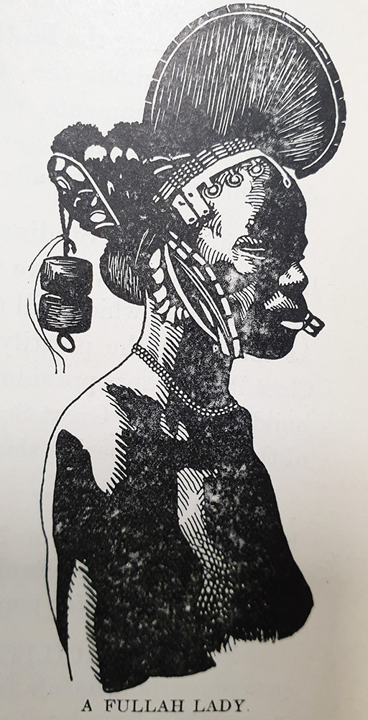
Engraving of a Fullah Lady
Notes:
Image: Newcastle City Library, Local Studies and Family History Centre

Slide 17
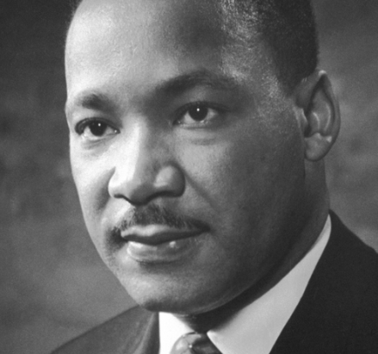
Point 4 - Martin Luther King Jr. at Kings Hall, Newcastle University
There are 2 suggested images on the following slides. These can be used to illustrate your walk.
Read the script for Martin Luther King Jnr.
Children can stand in front of The Armstrong Building opposite the Students Union. After the talk, children can go through to the inner courtyard of The Armstrong Building to view his statue.
The location code from What3Words is hired.transers.rising
Martin Luther King Jnr.
Notes:
Image: Nobel Foundation, Public Domain via Wikimedia Commons

Slide 18
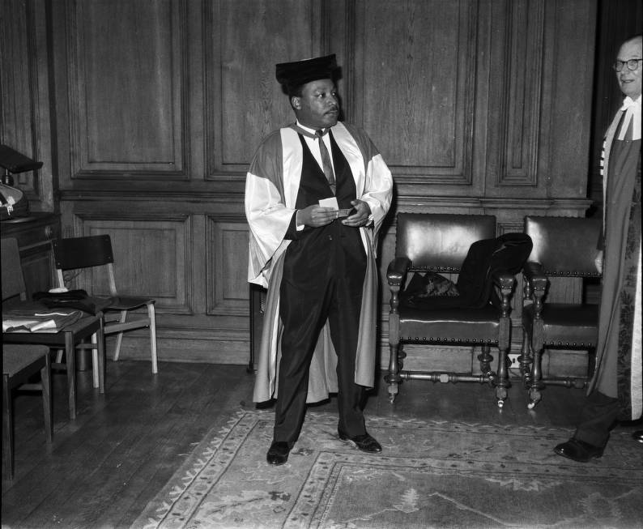
Martin Luther King Jr. at Newcastle University, 1967
Notes:
Image: Newcastle University., CC BY-SA 4.0 , via Wikimedia Commons

Slide 19
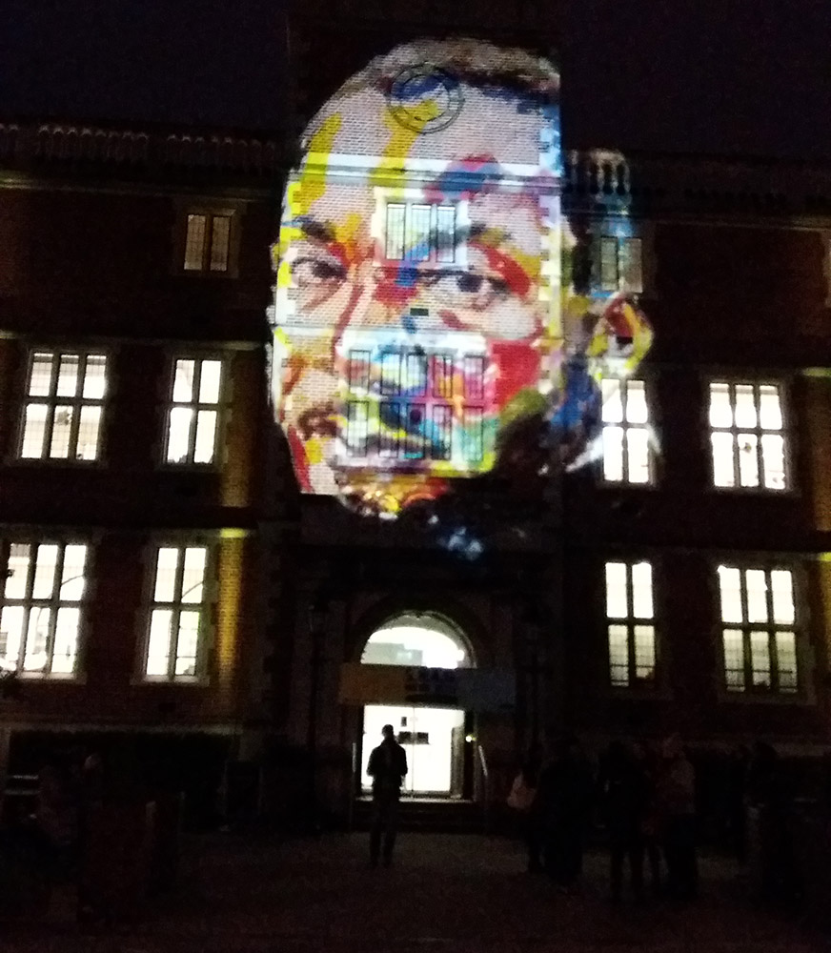
50th anniversary light display at Newcastle University
Notes:
Image: Beverley Prevatt-Goldstein

Slide 20
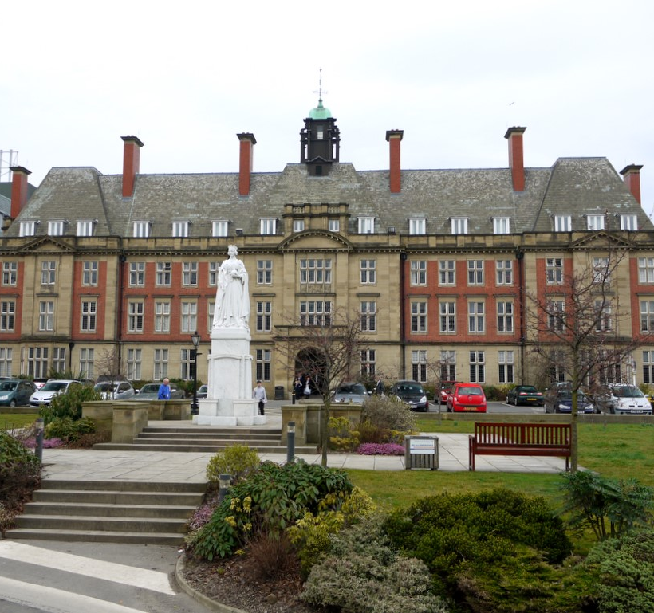
Point 5 - Royal Victoria Infirmary and Early African Doctors
There are 3 suggested images on the following slides. These can be used to illustrate your walk.
Read the script for Royal Victoria Infirmary.
Children can stand in front of Peacock Hall near to the statue of Queen Victoria.
The location code from What3Words is passes.rising.safe
Peacock Hall
Notes:
Image: Wikimedia Commons

Slide 21
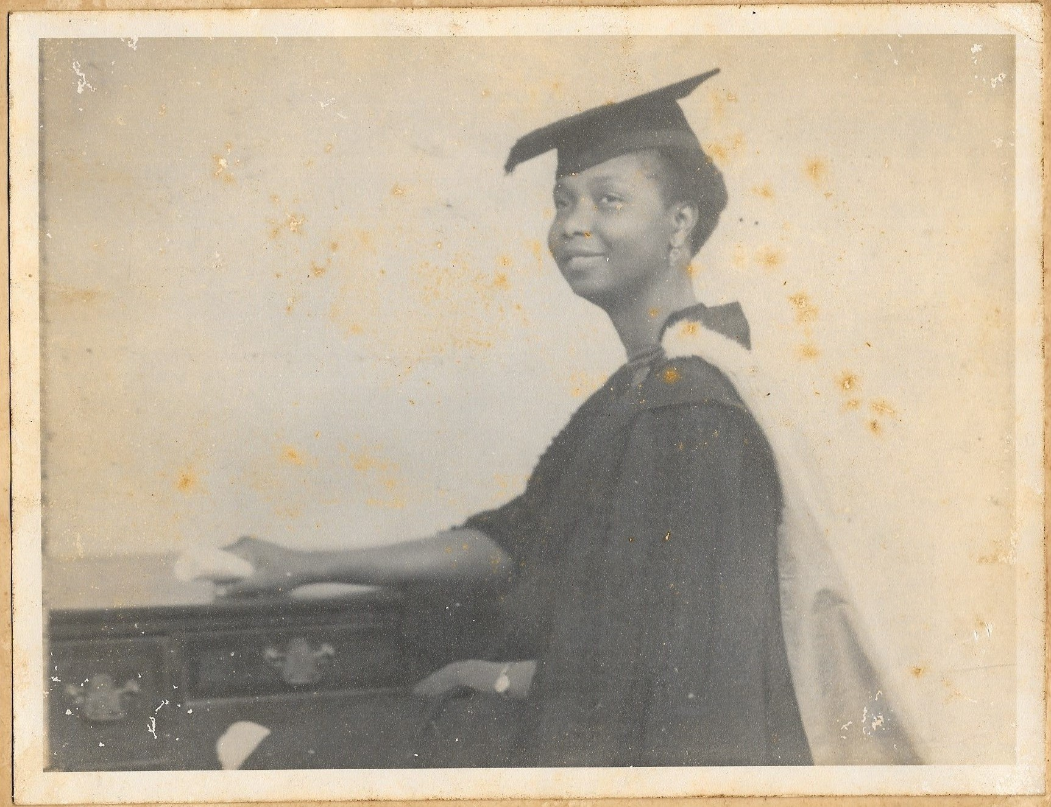
Irene Cole (Ighodaro) in graduation robes
Notes:
Image: Family of Robert Wellesley-Cole

Slide 22
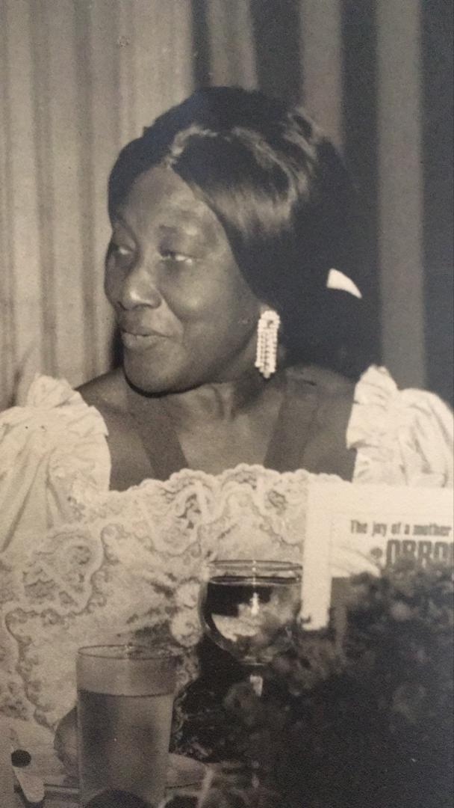
Irene Moduepolo Thomas
Notes:
Image: Courtesy of the family of Irene Moduepolo Thomas

Slide 23
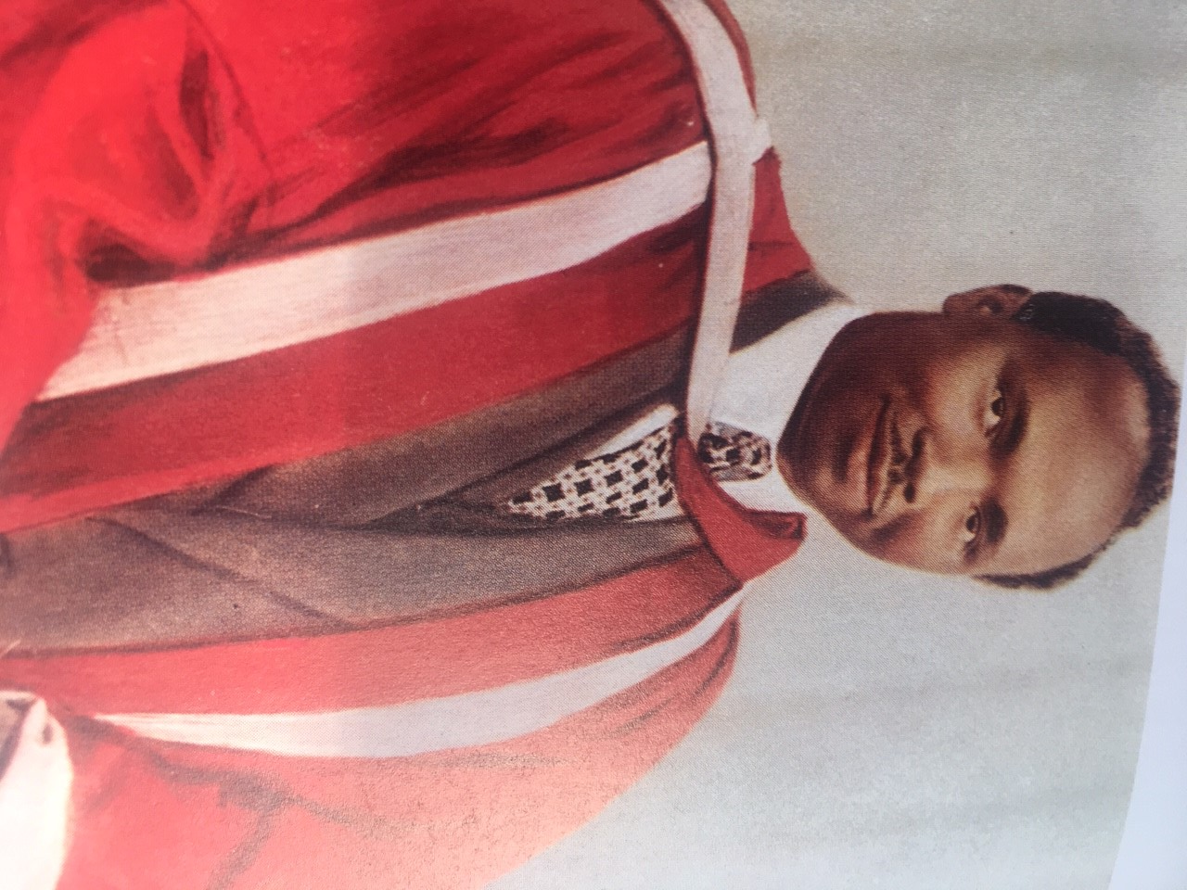
Robert Wellesley-Cole in graduation robes
Notes:
Image: Family of Robert Wellesley-Cole

Slide 24
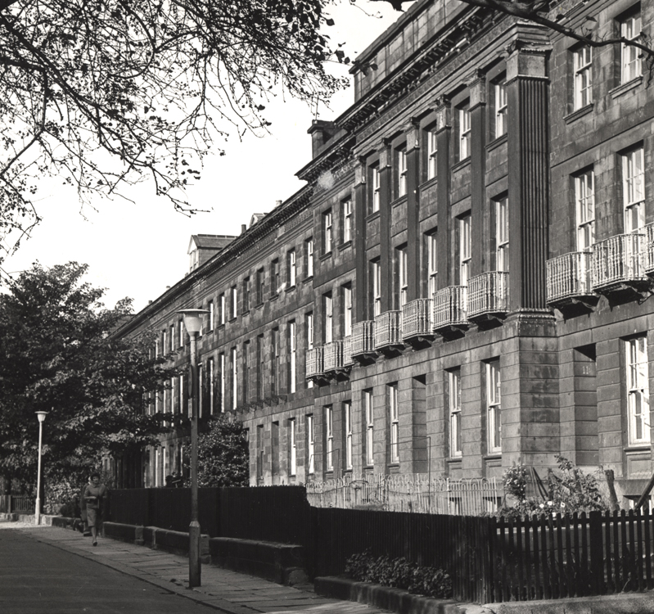
Point 6 - The Colonial Students’ Club and its Residents
There are 2 suggested images on the following slides. These can be used to illustrate your walk.
Read the script for The Colonial Student’s Club and its residents.
Children can stand on the pavement, directly in front of 40 Leazes Terrace. The path is quite narrow.
The location code from What3Words is jaws.learns.tools
The Colonial Students' Club at 40 Leazes Terrace
Notes:
Image: Courtesy of Newcastle Libraries and Archives - Accession Number: 013981

Slide 25
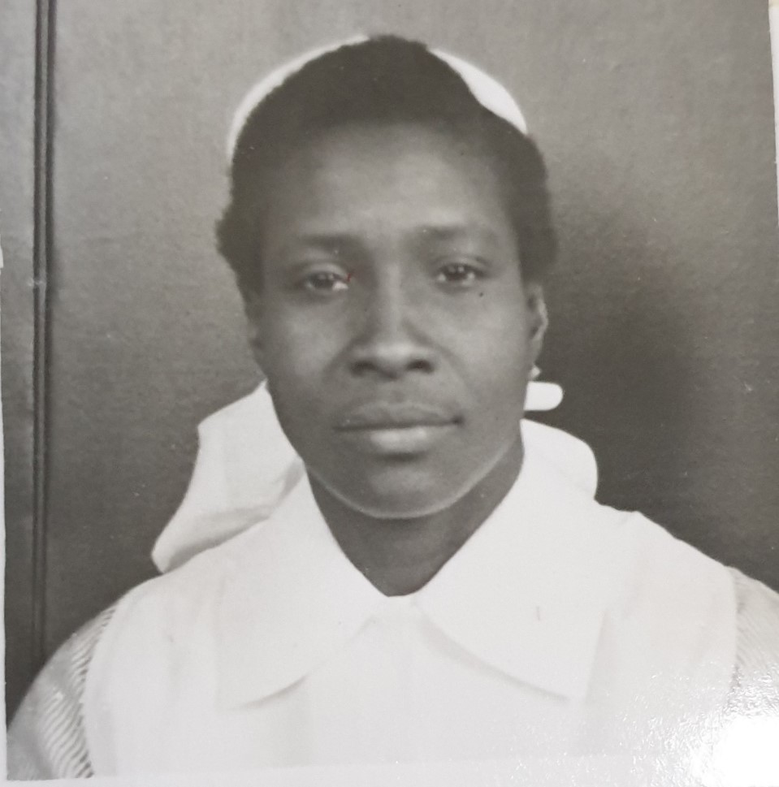
Lois Bola Jones in nurses’ uniform
Notes:
Image: Courtesy of Tyne & Wear Archives and Museums

Slide 26
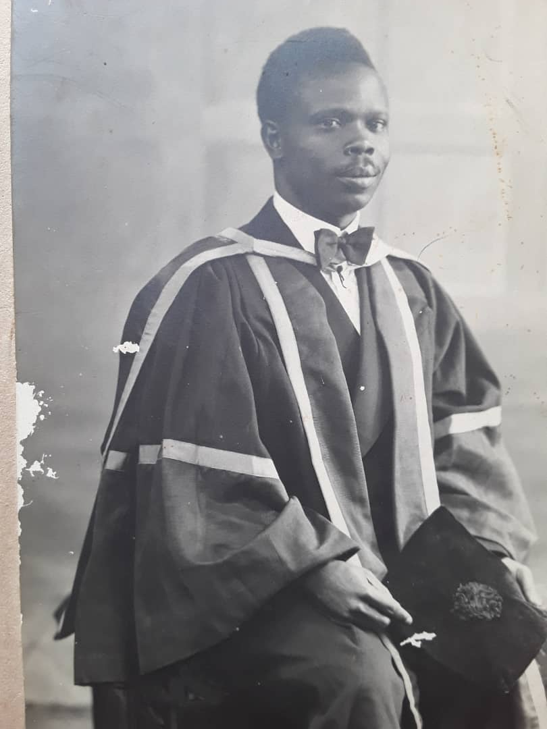
Victor Oyenuga in graduation robes
Notes:
Image: Courtesy of the Oyenuga family

Slide 27
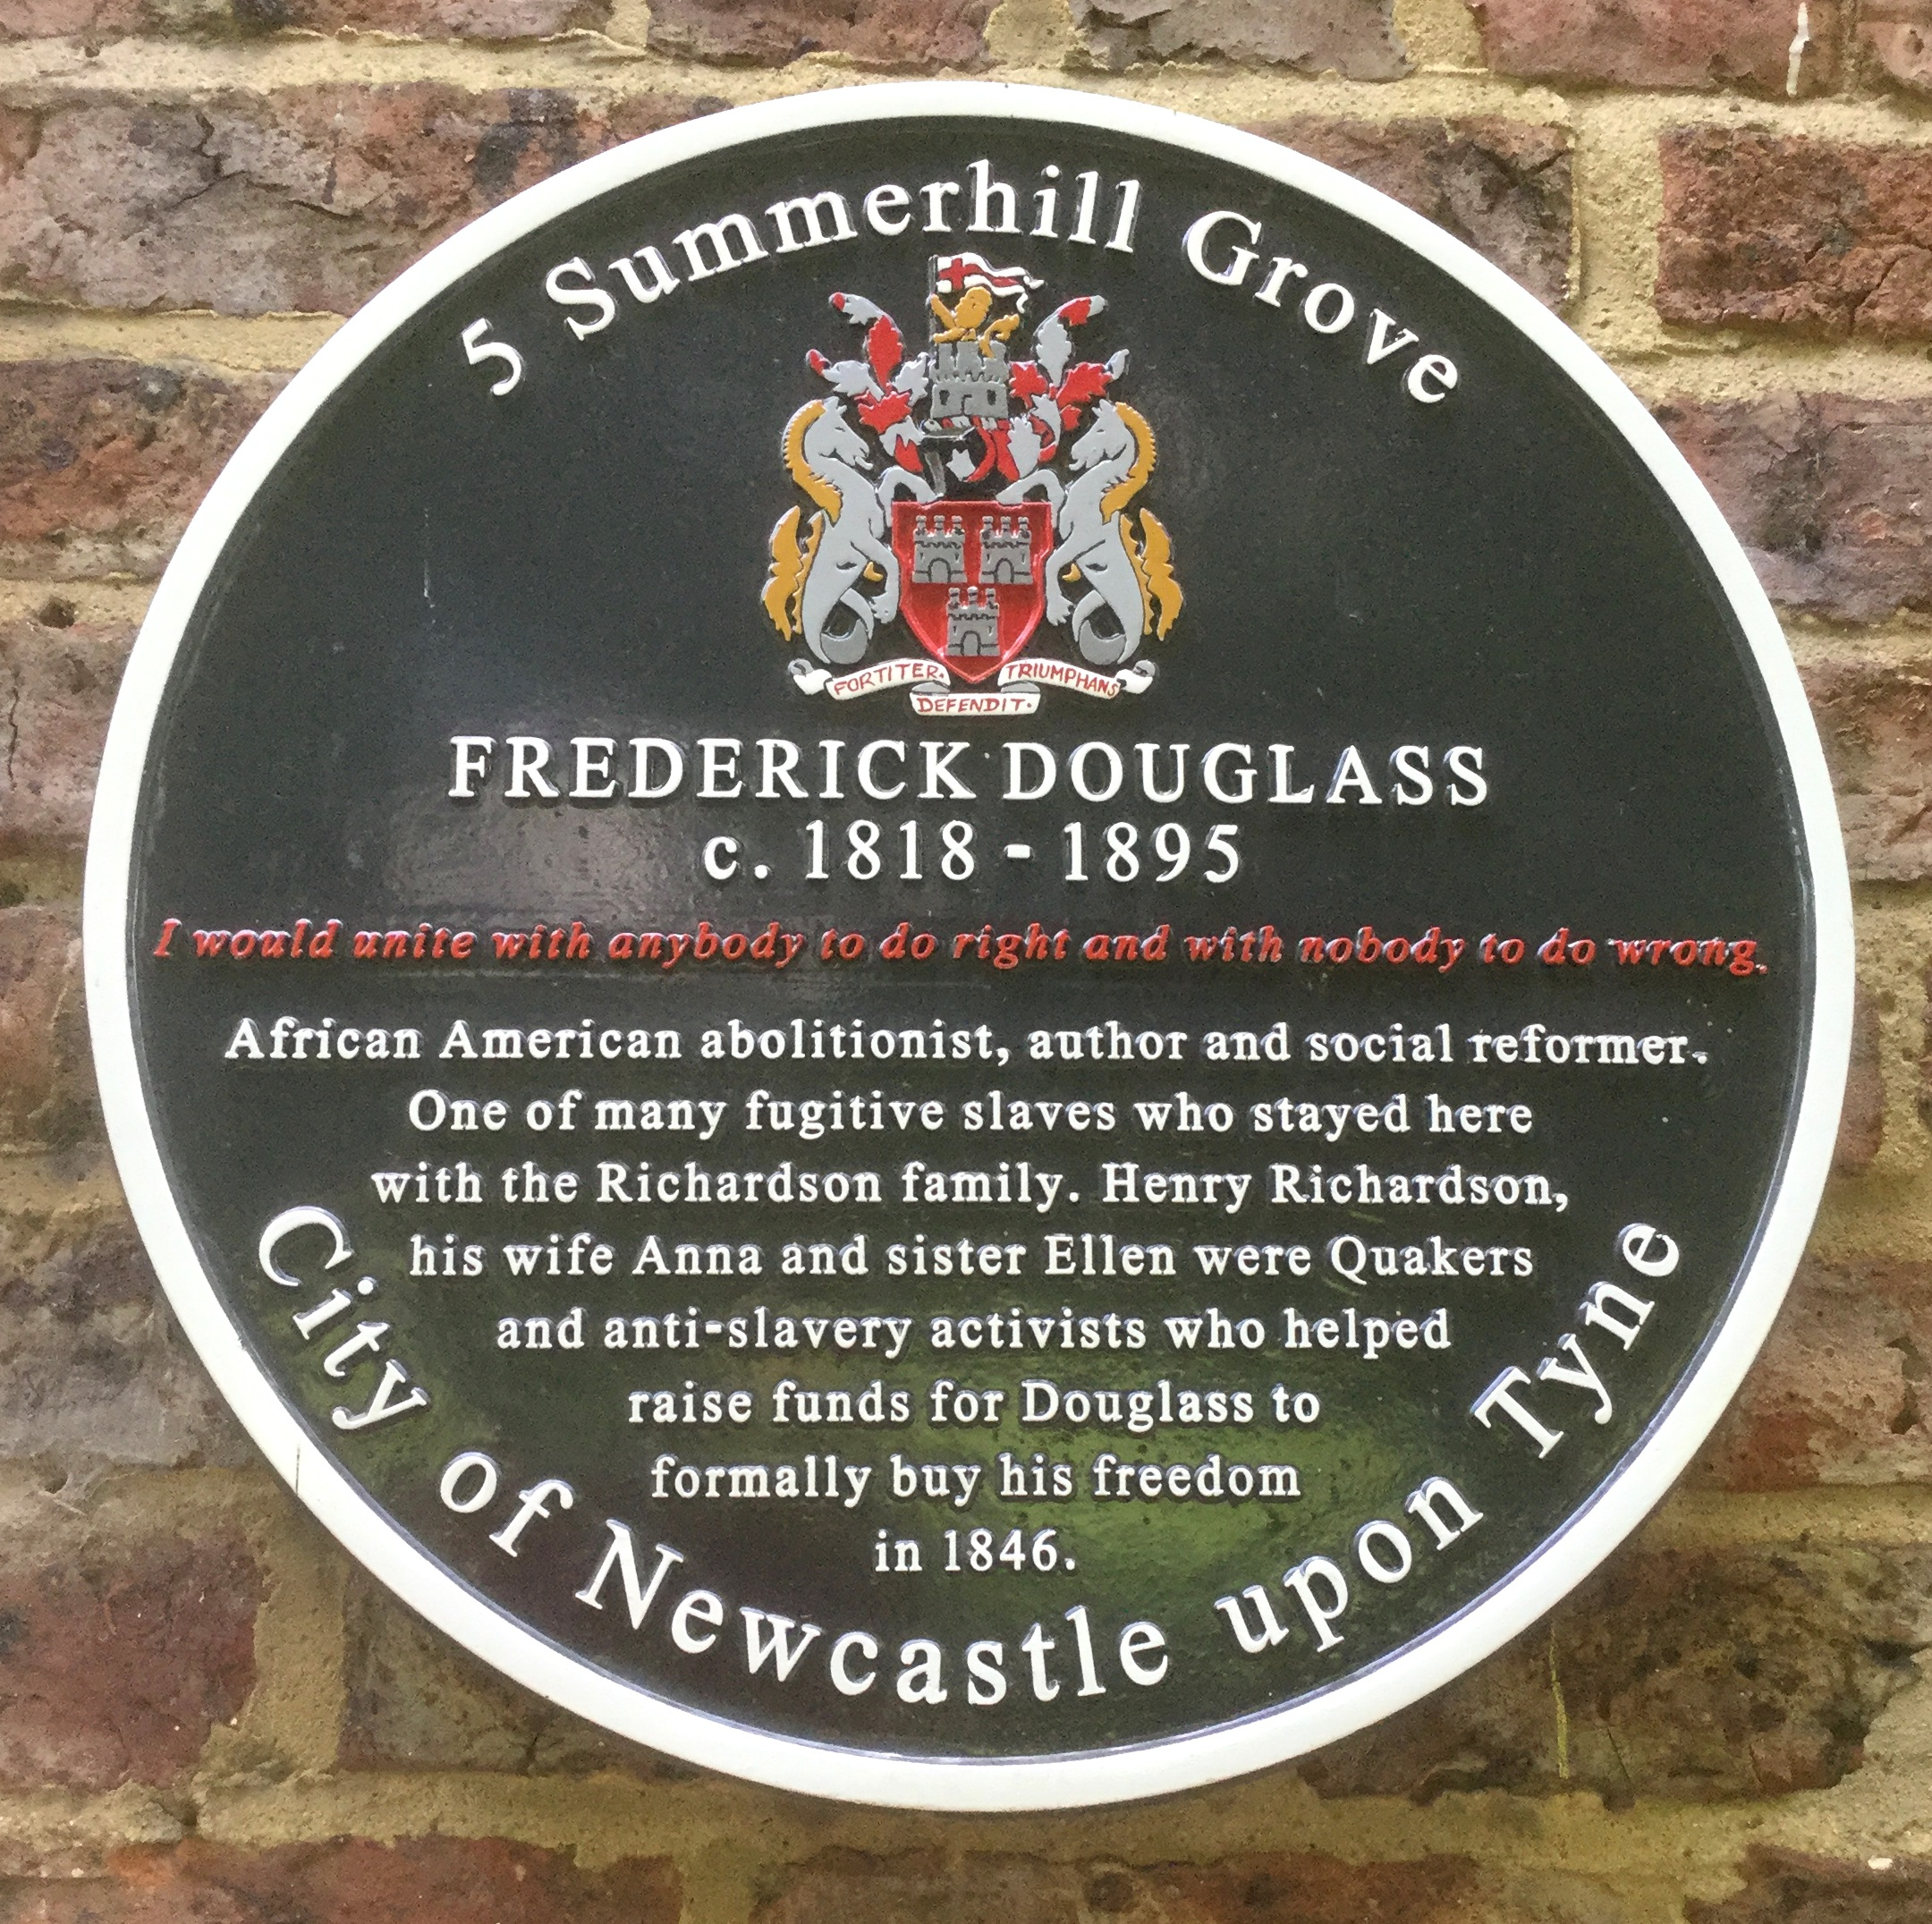
Point 7- Frederick Douglass at Albion Street
(now Leazes Park Road)
There are 2 suggested images on the following slides. These can be used to illustrate your walk.
Read the script for Frederick Douglass.
Children can stand beside Central Station near the entrance to the Metro Station. The pavements are wide here.
The location code from What3Words is supply.monks.taped
Plaque for Frederick Douglass at 5 Summerhill Square
Notes:
Image: With courtesy of Nicky Waters

Slide 28
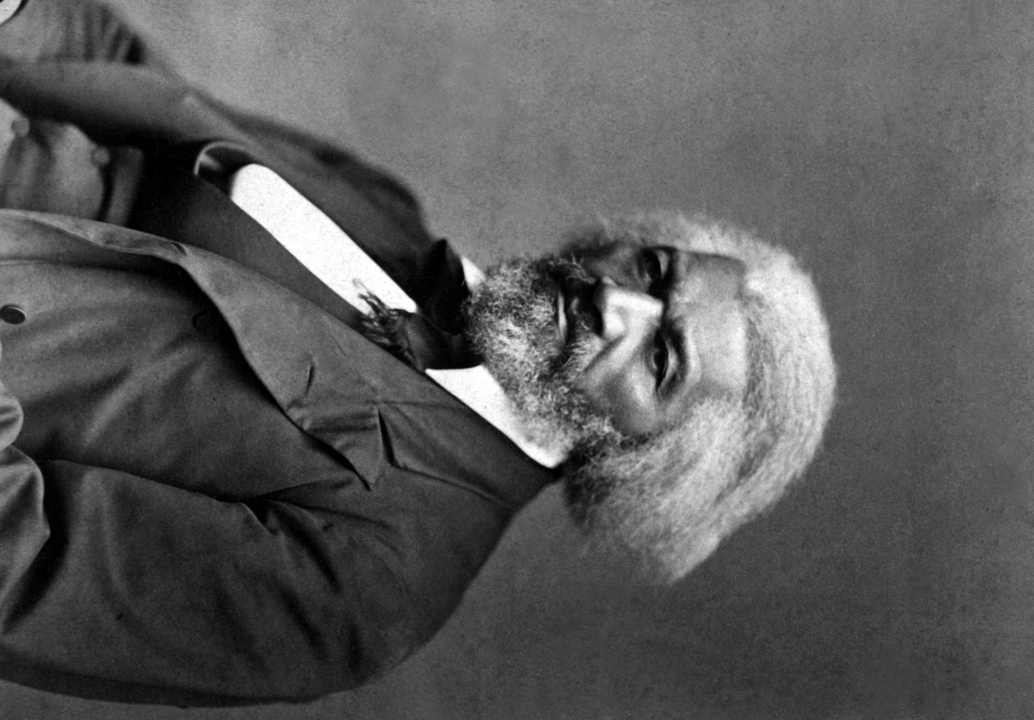
Frederick Douglass
Notes:
Image: George Kendall Warren, Public domain, via Wikimedia Commons

Slide 29
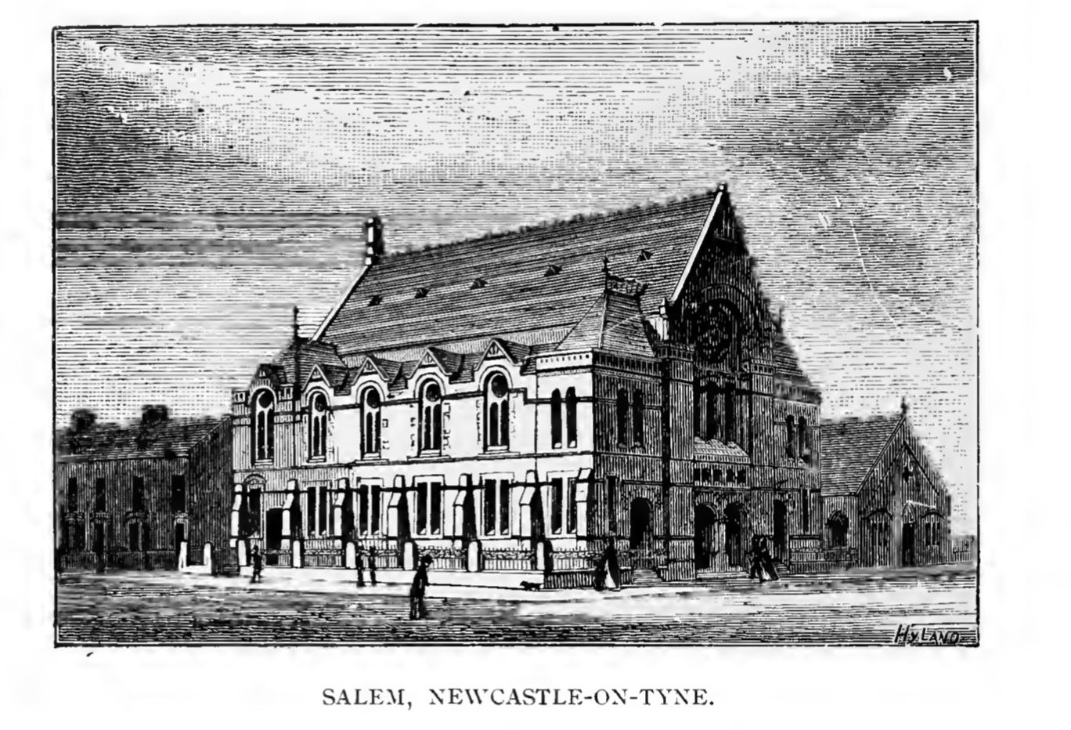
Salem Chapel, Hood Street, Newcastle
Notes:
Image: Public Domain - The centenary of the Methodist New Connexion 1797-1897 by T.D. Crothers et al.

Slide 30
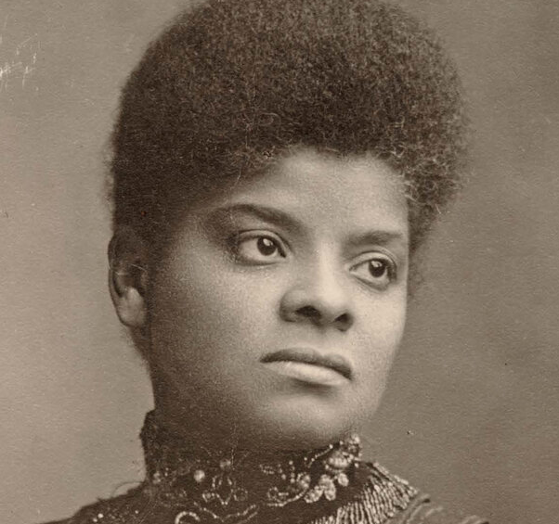
Point 8 - Ida B Wells at Brunswick Methodist Chapel
There are 2 suggested images on the following slides. These can be used to illustrate your walk.
Read the script for Ida B. Wells.
Children can stand directly in front of Brunswick Methodist Chapel at Brunswick Place. Please be mindful of cars. This area can get busy.
The location code from What3Words is grand.reader.radio
Ida B. Wells
Notes:
Image: Cihak and Zima, Public domain, via Wikimedia Commons

Slide 31
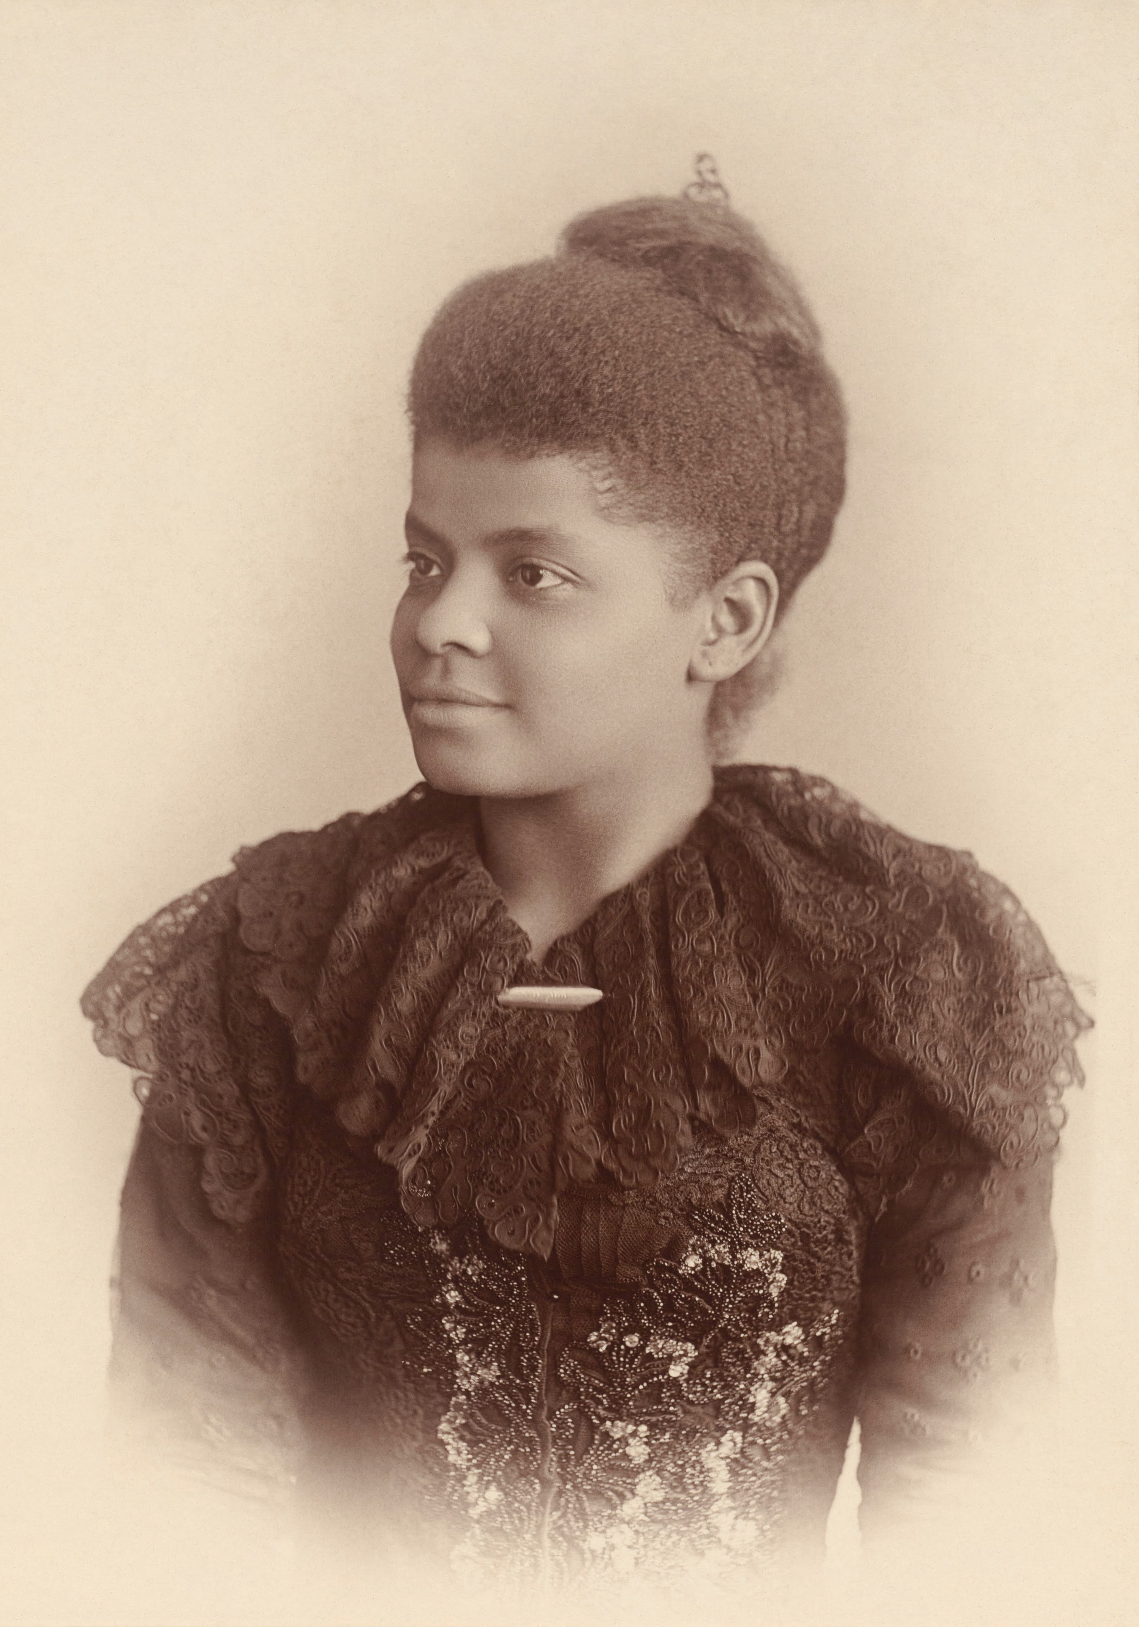
Ida B Wells
Notes:
Image: Mary Garrity, Public domain, via Wikimedia Commons

Slide 32
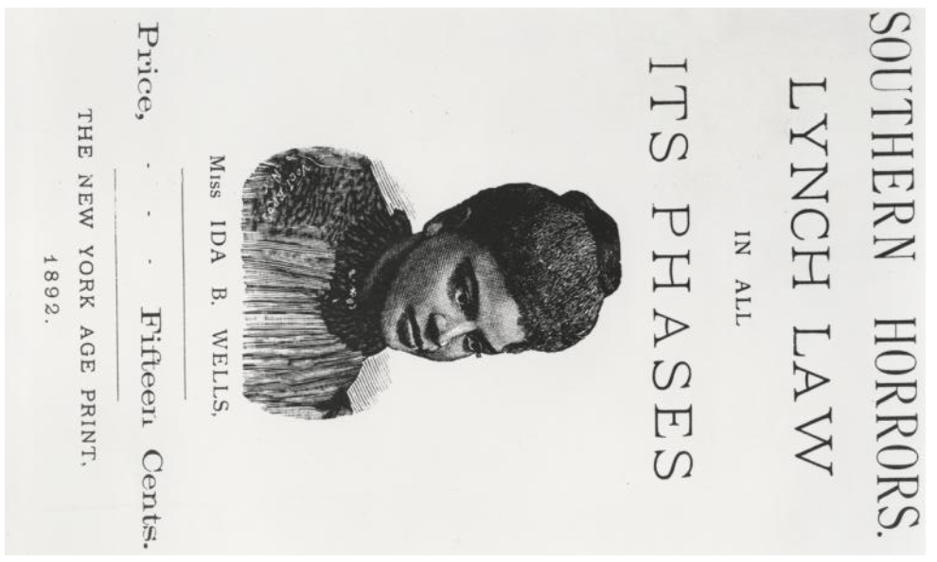
Southern Horrors book cover
Notes:
Courtesy of The New York Public Library. Wells-Barnett, Ida B., “Southern horrors : lynch law in all its phases,” https://dp.la/primary-source-sets/ida-b-wells-and-anti-lynching-activism/sources/1115

