Slide 1
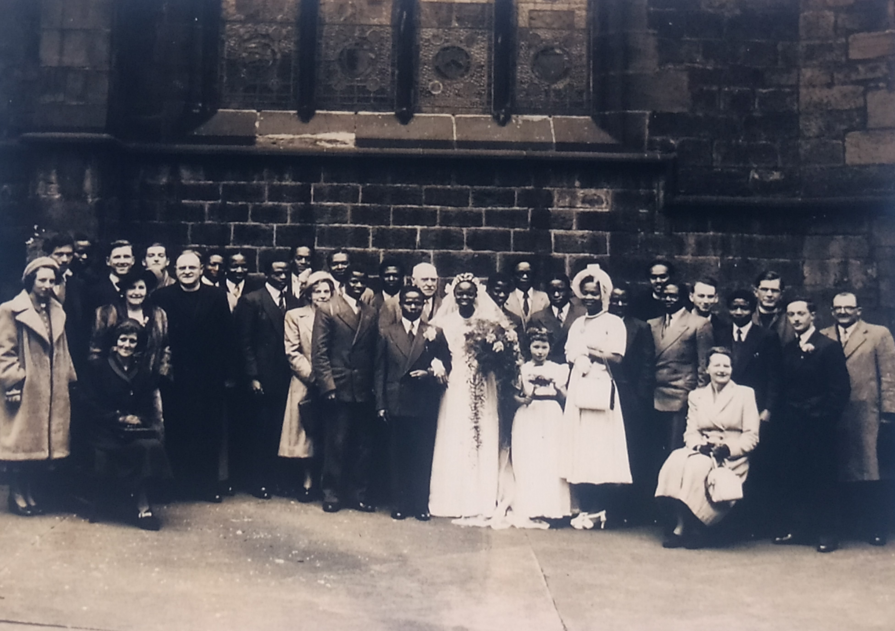
Newcastle City Centre Walk - Central
Teacher’s Guide
This guide has been designed in collaboration with African Lives in Northern England.
Notes:
Image; Courtesy of the family of Victor Oyenuga and Sabinah Onabajo

Slide 2
How to use this PPT
Contents
A map of the walking route
Links to a PDF document of a suggested script for each point on the walk
Suggested pictures to show at each point
Guidance on where to stand safely with children at each point on the route.
The What3Words location for each point on the map.
(What3Words uses 3 word combinations to mark the entire world into 3 meter squares. It’s free to use either on the web or you can download the app at Google Play Store or IOS App Store)
This PPT and associated script is designed to provide you, as the teacher, with enough information to lead a walk around Central Newcastle.
Please pick and choose the slides you find most useful. You can select additional images from the accompanying StoryMap.
You may also wish to look at the KS 3 version of the walk to find additional information and locations.
We hope to help you create the perfect walking tour for your class.

Slide 3
How did significant people from Africa contribute to and enrich our region?
History and PSHE
A study of an aspect of history that is significant in the locality
To learn about the contribution people of African descent have made to the North-East and begin to build appreciation of the diversity of the region.
To raise awareness of some of the stories of individuals who came from Africa and the impact they had on the North-East and our heritage
To highlight the way in which people of African descent have influenced significant historical events and are linked to our local buildings in Newcastle upon Tyne
To gain an improved understanding of enslavement, discrimination and racism, whilst exploring the ways they can, and have, been challenged throughout history.
This PowerPoint has an accompanying suggested script for each point on the map and is part of the Teaching Activity: How did significant people from Africa contribute to and enrich our region?

Slide 4
Content Warning
This trail, StoryMap and associated resources cover some topics that may be sensitive and could be upsetting. These include, but are not limited to:
Point 2 - Ida B Wells at Brunswick Methodist Chapel and references to ‘lynching’
Point 4 - Olaudah Equiano and references to enslavement and the murder of 131 enslaved Africans in the Zong massacre.​
Please read the introduction on the StoryMap before embarking on this walk.

Slide 5
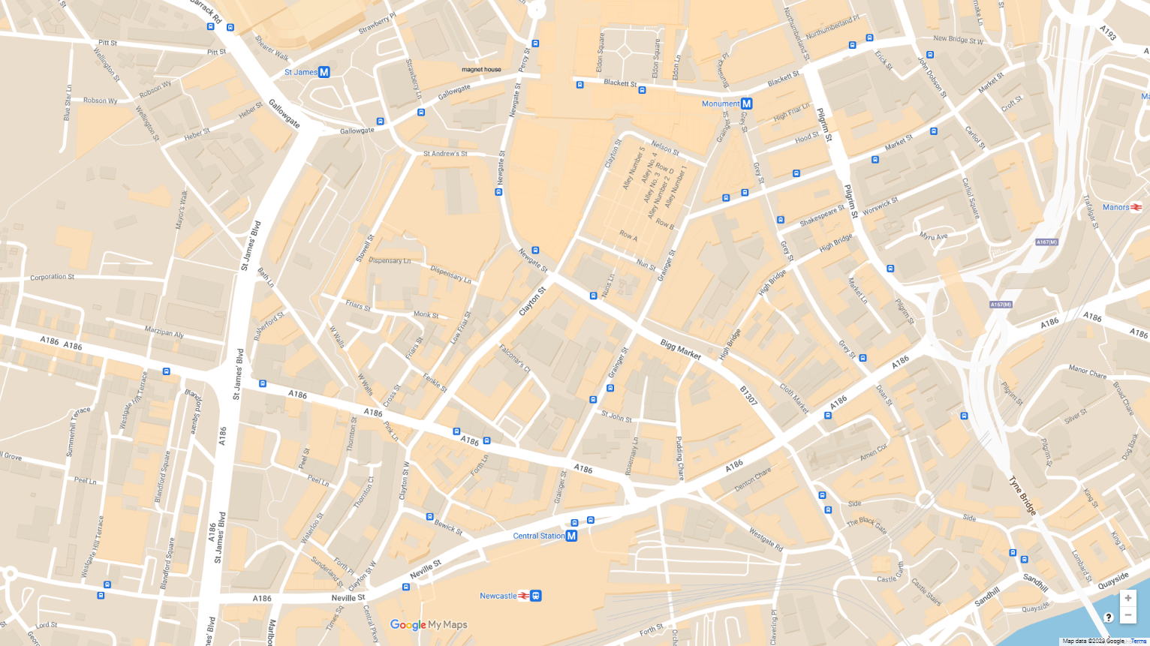
Route Map
Muhammad Ali - Eldon Recreation Centre
Ida B Wells - Brunswick Methodist Chapel
E. Craft & H. 'B'. Brown - Nelson St. Music Hall
Olaudah Equiano - Turk’s Head, Bigg Market
V. Oyenuga and S. Onabajo - St John the Baptist Church
Frederick Douglass - Central Station
William Fifefield - The Black Gate
Ira Aldridge - Theatre Royal
1
2
1
3
2
4
5
3
6
8
7
8
4
5
7
6

Slide 6
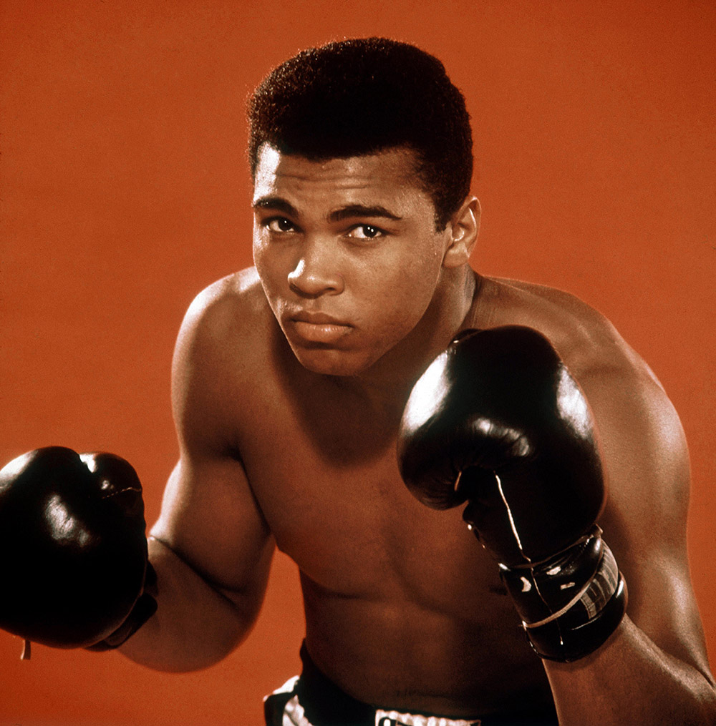
Point 1 - Muhammad Ali at the Eldon Recreation Centre.
There are 3 suggested images on the following slides. These can be used to illustrate your walk.
Read the script for Muhammad Ali.
Children can stand in front of Eldon Square near Grey’s Monument.
The location code from What3Words is grain.snake.pulse
Muhammad Ali
Notes:
Image © Alamy Ref: ERJKFK Date: 1 January 1966

Slide 7
Muhammad Ali
Notes:
Image © Alamy Ref: ERJKFK Date: 1 January 1966

Slide 8
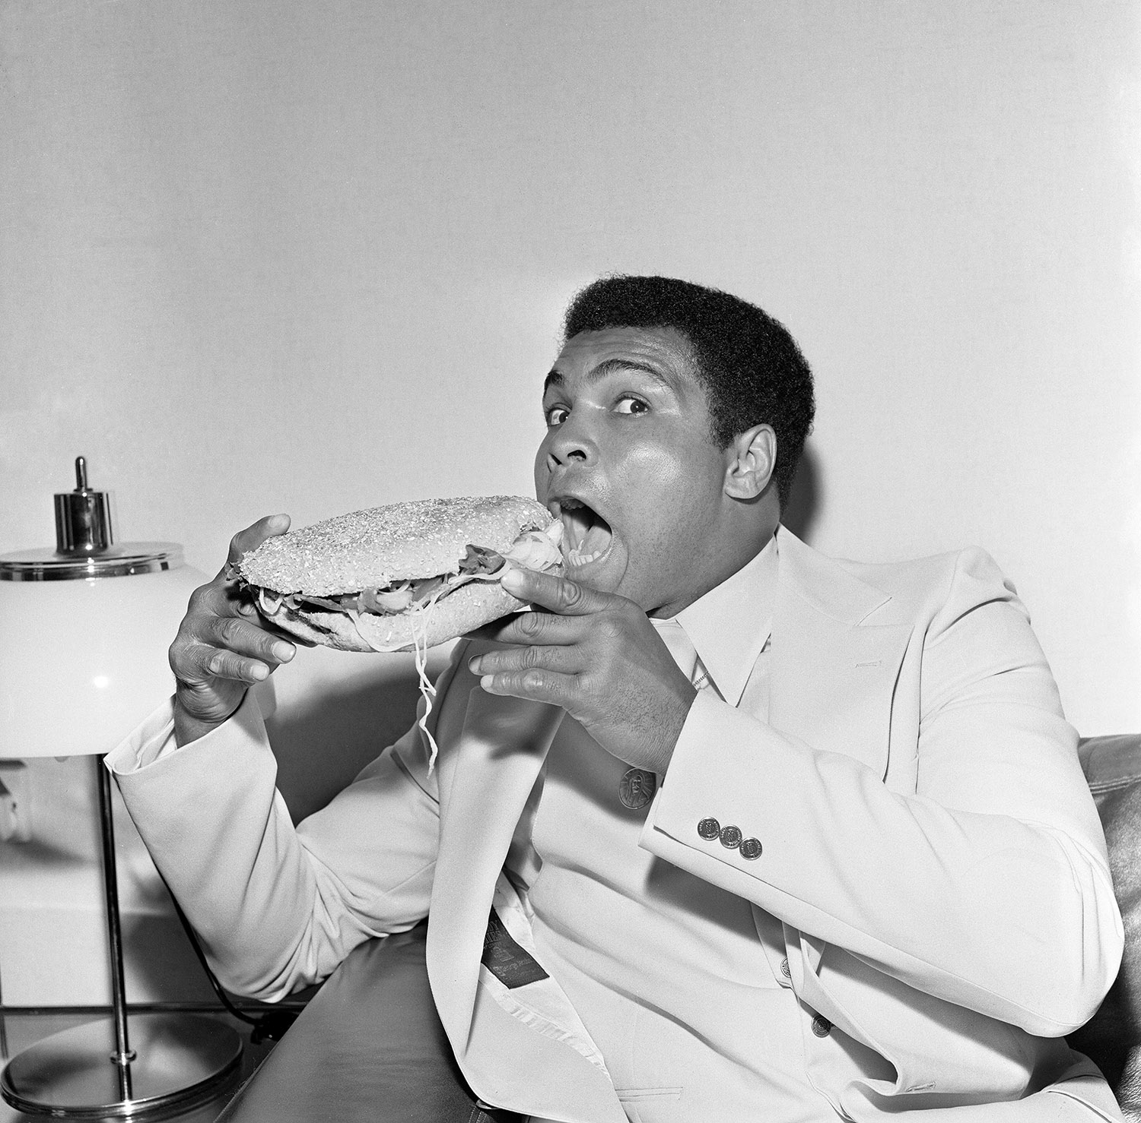
Muhammad Ali easting a stottie
Notes:
Image: Alamy Ref: ERD1JF

Slide 9
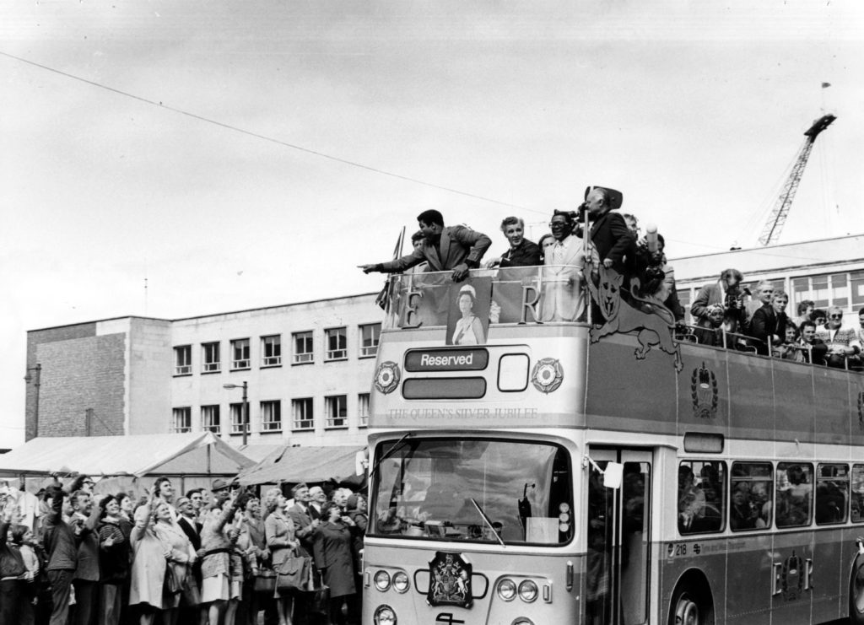
Muhammad Ali on an open top bus tour
Notes:
Image: Freddie Mudditt of Fietscher Fotos Ltd, South Tyneside Libraries

Slide 10
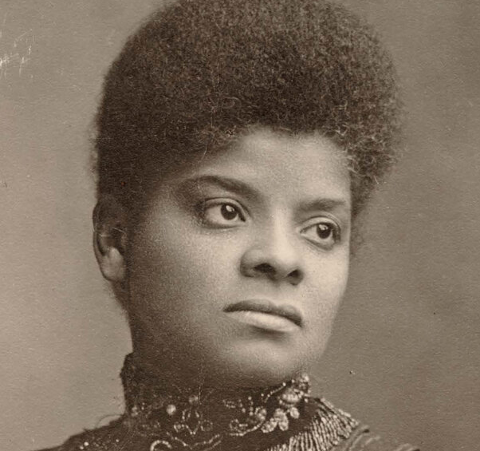
Point 2 - Ida B Wells at Brunswick Methodist Chapel
There are 2 suggested images on the following slides. These can be used to illustrate your walk.
Read the script for Ida B. Wells.
Children can stand directly in front of Brunswick Methodist Chapel at Brunswick Place. Please be mindful of cars. This area can get busy.
The location code from What3Words is grand.reader.radio
Ida B. Wells
Notes:
Image: Cihak and Zima, Public domain, via Wikimedia Commons

Slide 11
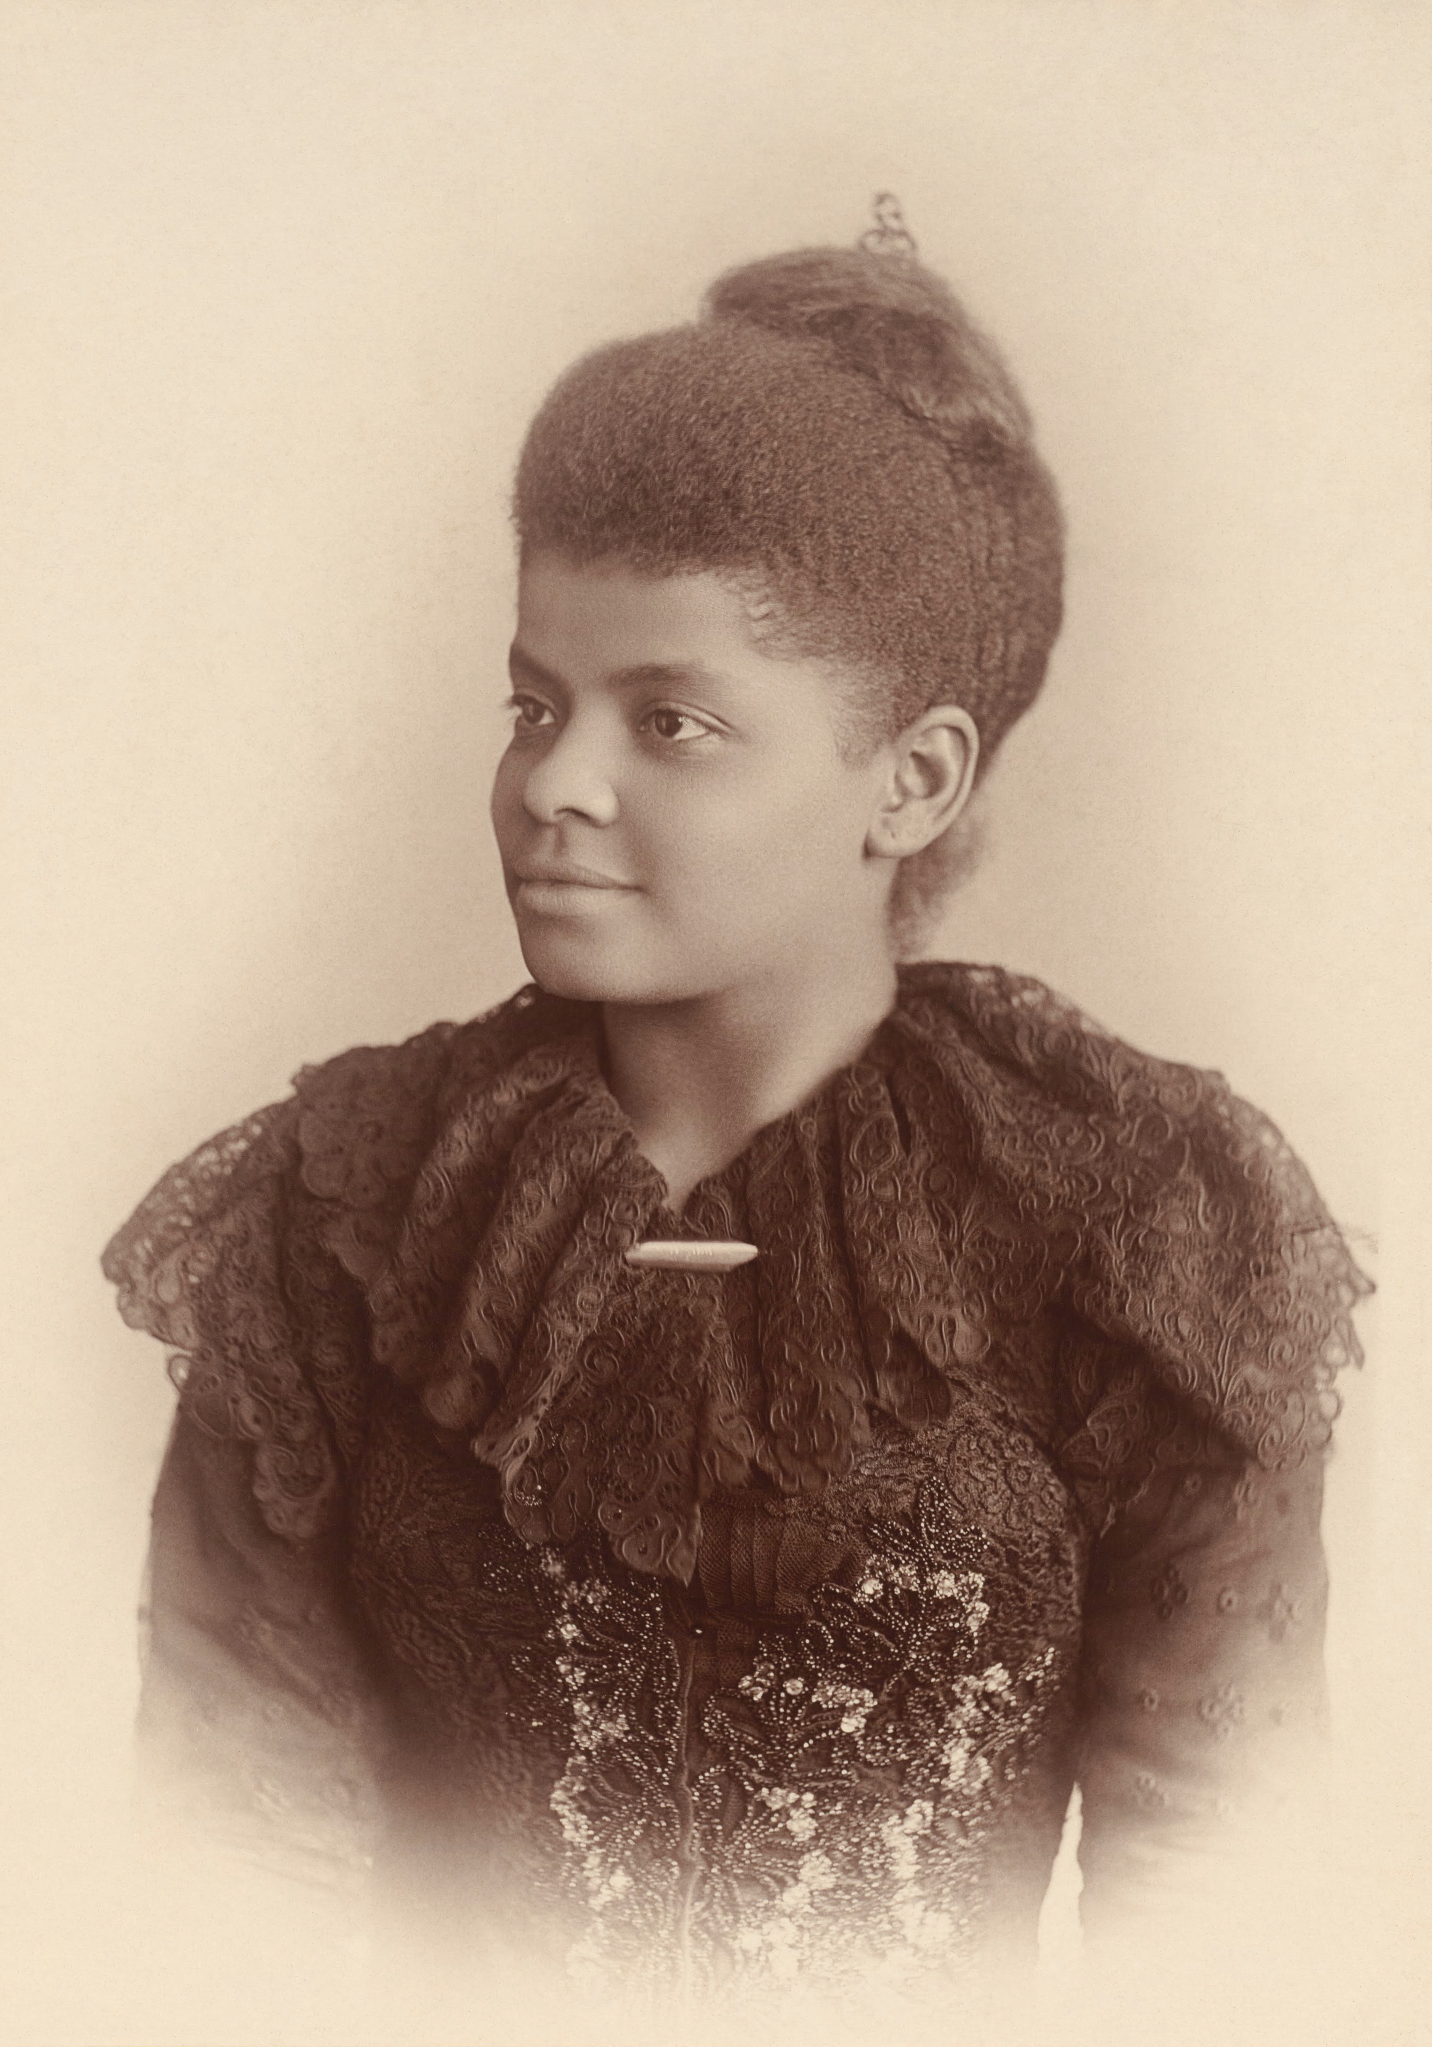
Ida B Wells
Notes:
Image: Mary Garrity, Public domain, via Wikimedia Commons

Slide 12
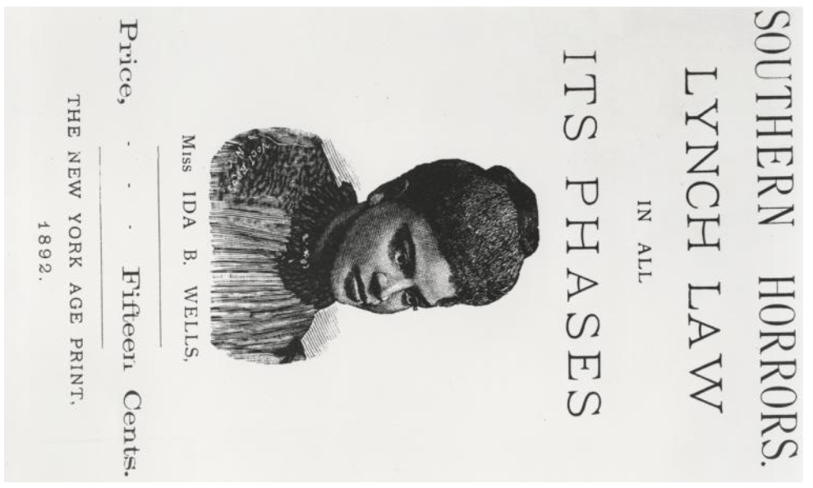
Southern Horrors book cover
Notes:
Courtesy of The New York Public Library. Wells-Barnett, Ida B., “Southern horrors : lynch law in all its phases,” https://dp.la/primary-source-sets/ida-b-wells-and-anti-lynching-activism/sources/1115

Slide 13
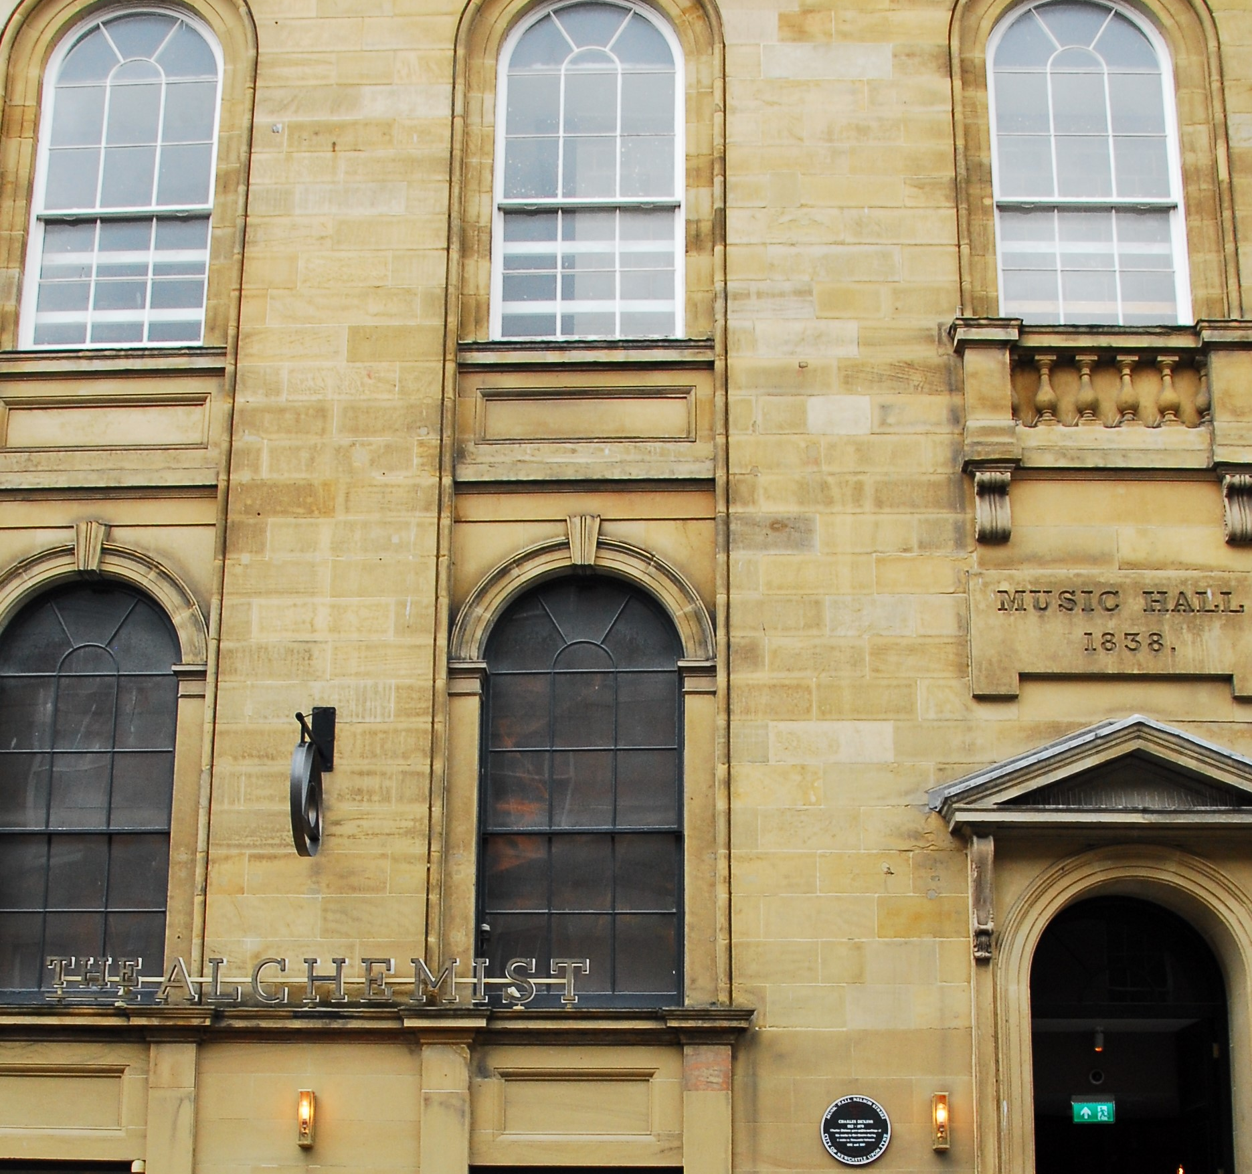
Point 3 - E. Craft & H. 'B'. Brown at The Music Hall
There are 2 suggested images on the following slides. These can be used to illustrate your walk.
Read the script for E. Craft & H. 'B'. Brown at The Music Hall.
Children can stand opposite the old Music Hall. Please be aware of passing traffic.
The location code from What3Words is occurs.margin.manual
The Music Hall on Nelson Street
Notes:
Image: Courtesy of Don O'Meara

Slide 14
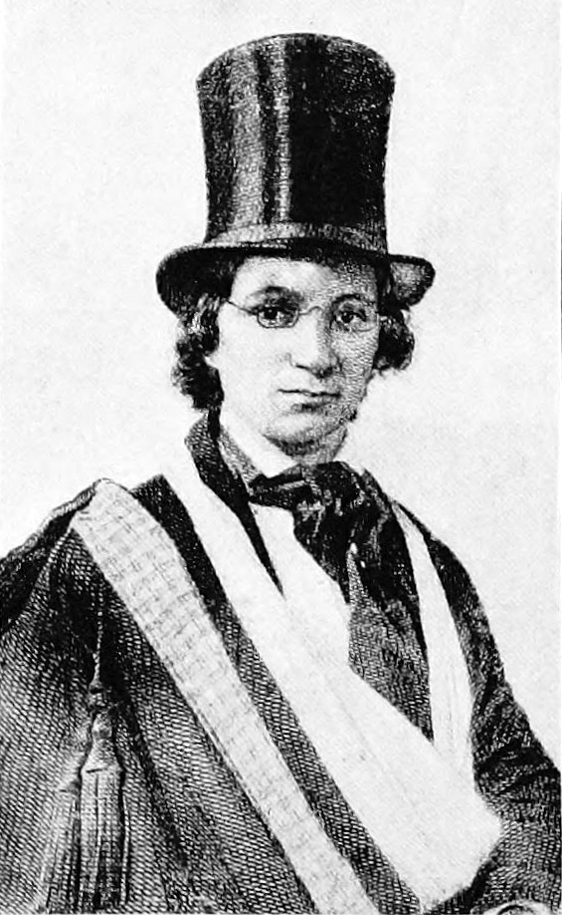
Ellen Craft
Notes:
Image: Macmillan, publisher, Public domain, via Wikimedia Commons

Slide 15
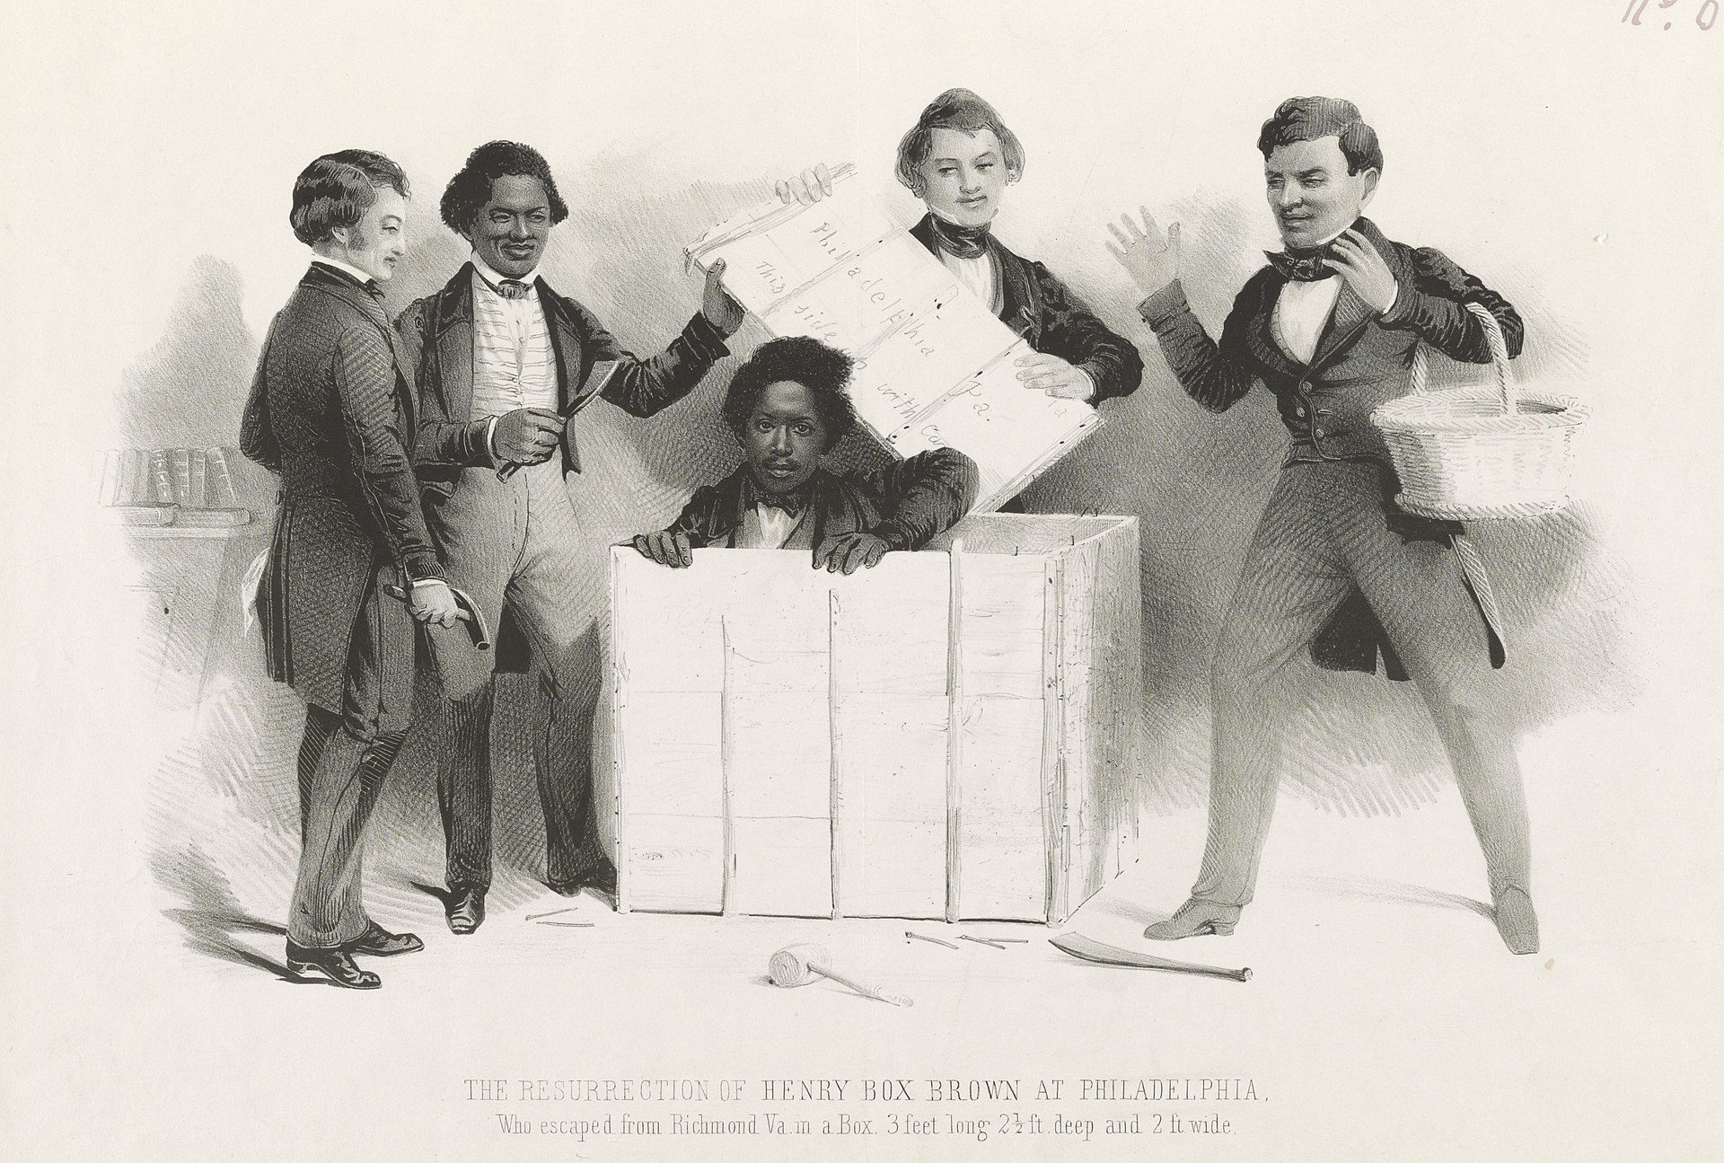
Henry ‘Box’ Brown
Notes:
Image: Samuel W. Rowse, Public domain, via Wikimedia Commons

Slide 16
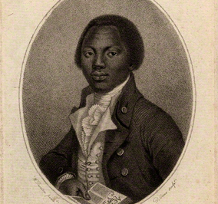
Point 4 - Olaudah Equiano
There are 2 suggested images on the following slides. These can be used to illustrate your walk.
Read the script for Olaudah Equiano.
Children can stand at the top of the Bigg Market near Grainger Street. There is a wide pavement here.
The location code from What3Words is cliff.teach.bolts
Olaudah Equiano
Notes:
Image: Daniel Orme, after W. Denton, Public domain, via Wikimedia Commons

Slide 17
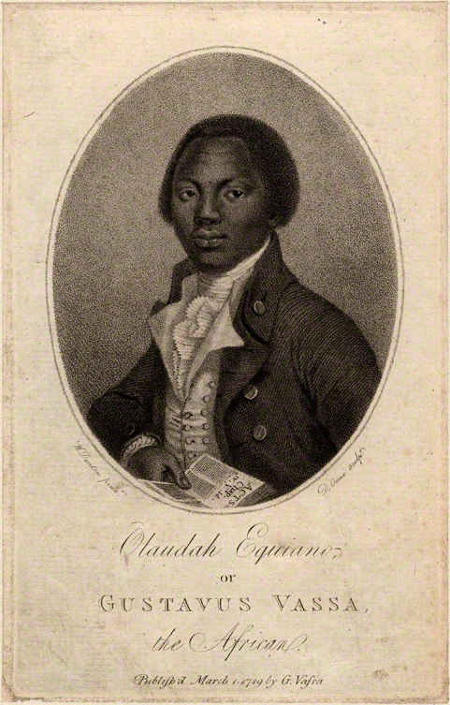
Olaudah Equiano
Notes:
Daniel Orme, after W. Denton, Public domain, via Wikimedia Commons

Slide 18
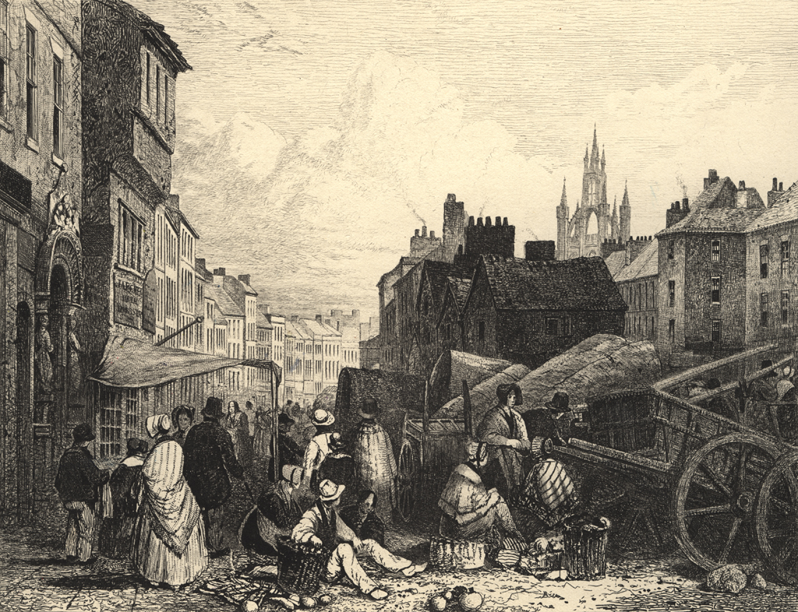
Bigg Market, Newcastle-upon-Tyne, 1820
Notes:
Public Domain, Newcastle Libraries - CoCurate

Slide 19
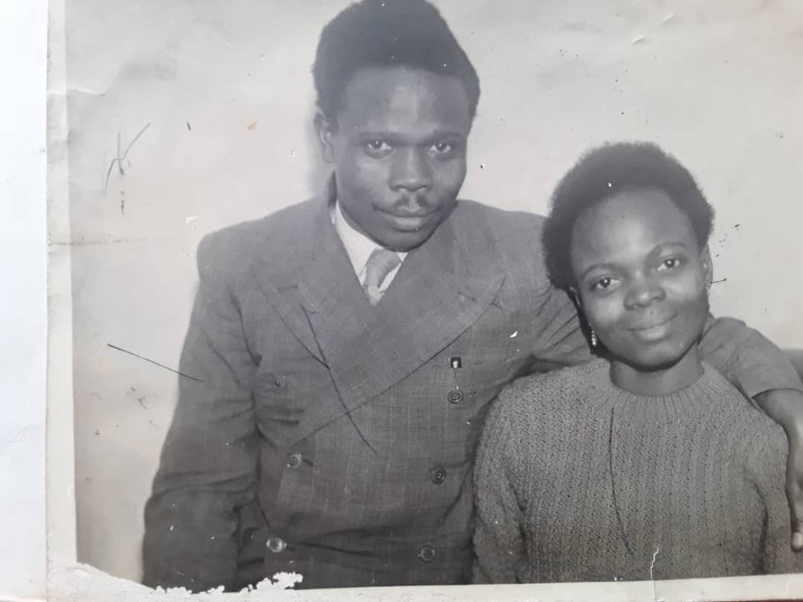
Point 5 - V. Oyenuga and S. Onabajo at St John's Baptist Church
There are 2 suggested images on the following slides. These can be used to illustrate your walk.
Read the script for V. Oyenuga and S. Onabajo at St John's Baptist Church.
Children can stand in front of the St John’s Church near Westgate Road.
The location code from What3Words is curve.paid.bride
V. Oyenuga and S. Onabajo
Notes:
Image: Courtesy of the family of Victor Oyenuga and Sabinah Onabajo

Slide 20
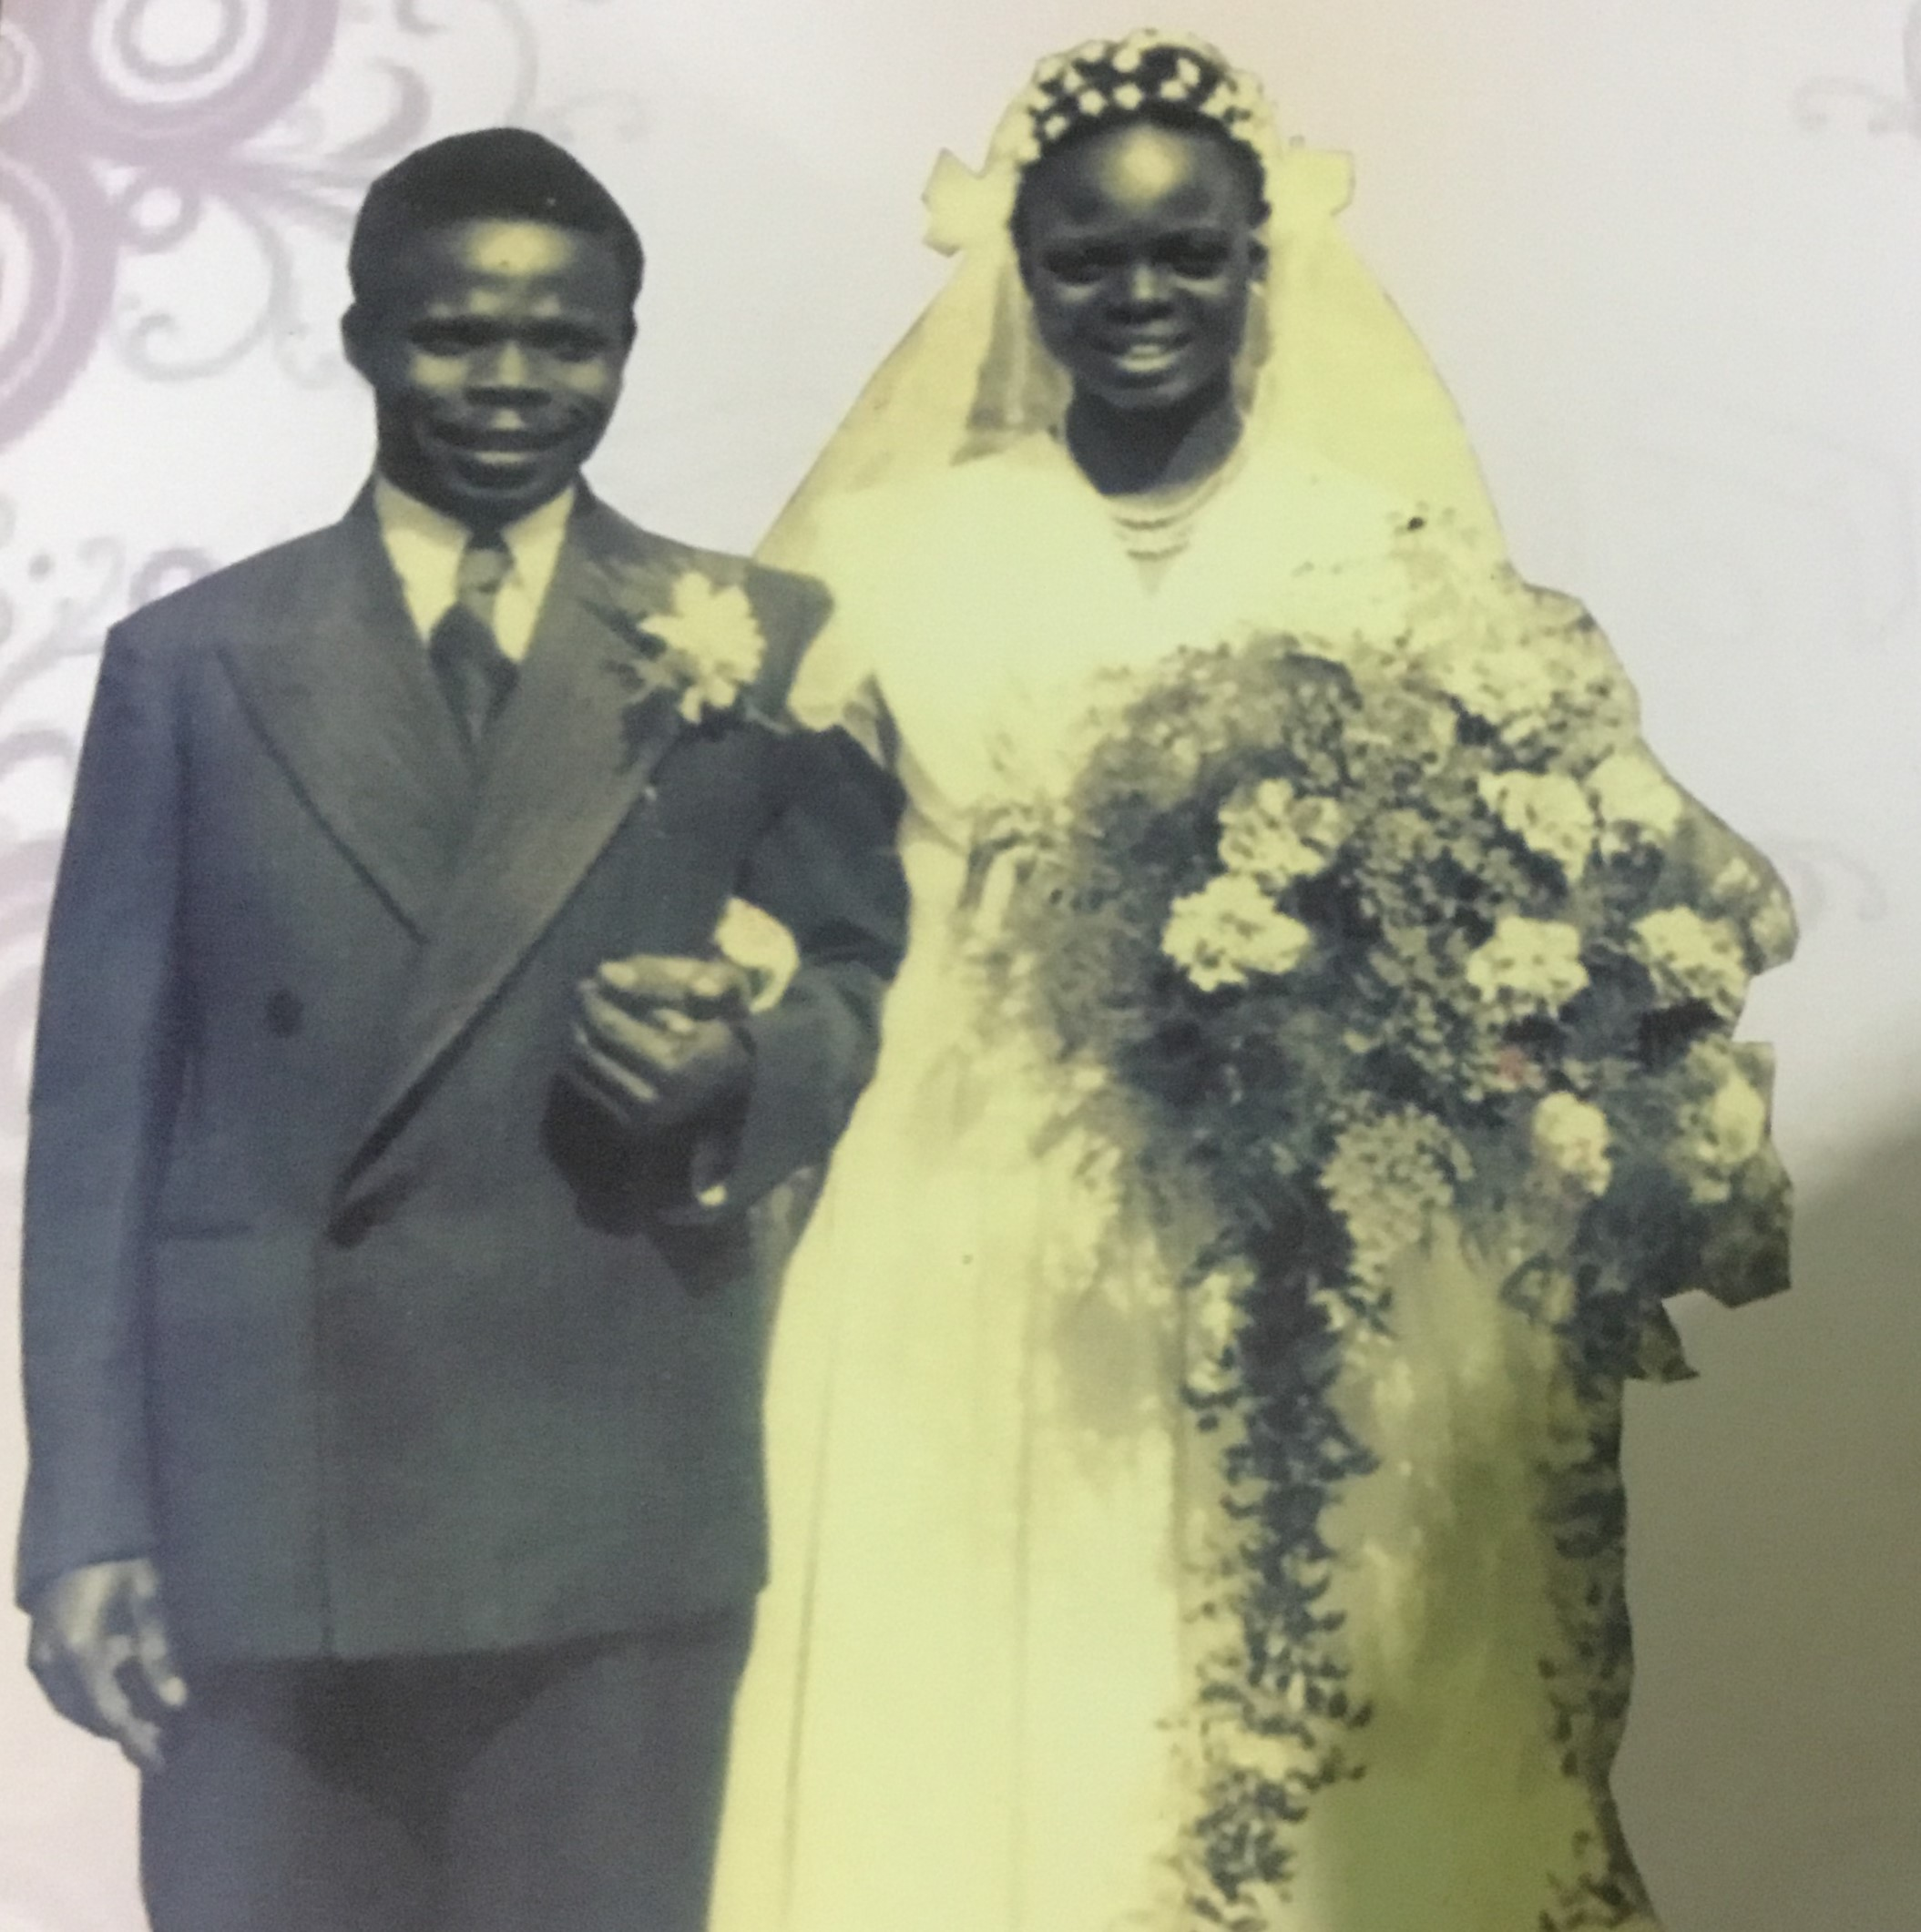
Victor and Sabinah on their wedding day
Notes:
Courtesy of the family of Victor Oyenuga and Sabinah Onabajo

Slide 21
Wedding party outside St John’s Church
Notes:
Courtesy of the family of Victor Oyenuga and Sabinah Onabajo

Slide 22
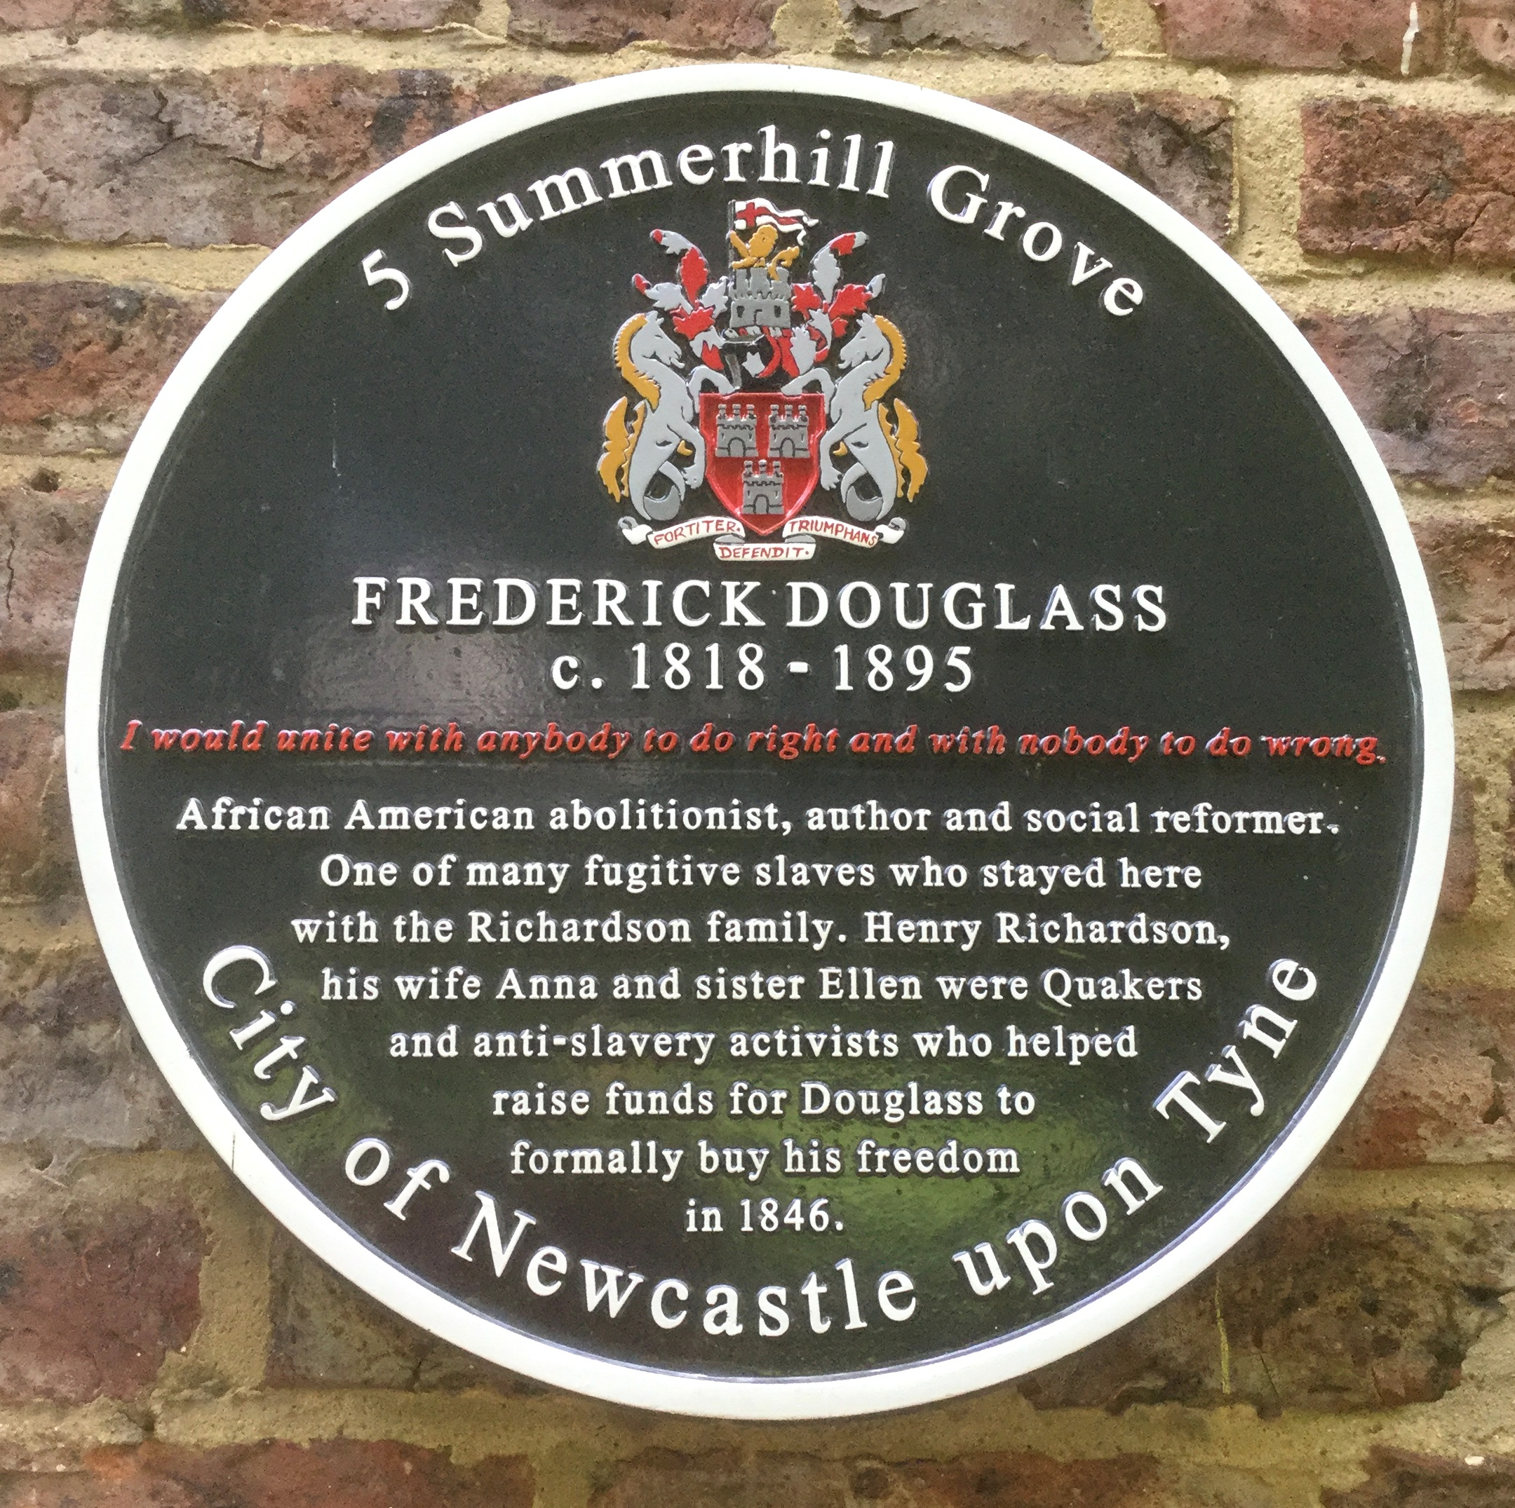
Point 6- Frederick Douglass at Central Station
There are 2 suggested images on the following slides. These can be used to illustrate your walk.
Read the script for Frederick Douglass.
Children can stand beside Central Station near the entrance to the Metro Station. The pavements are wide here.
The location code from What3Words is gear.laws.clots
Plaque for Frederick Douglass at 5 Summerhill Square
Notes:
Image: With courtesy of Nicky Waters

Slide 23
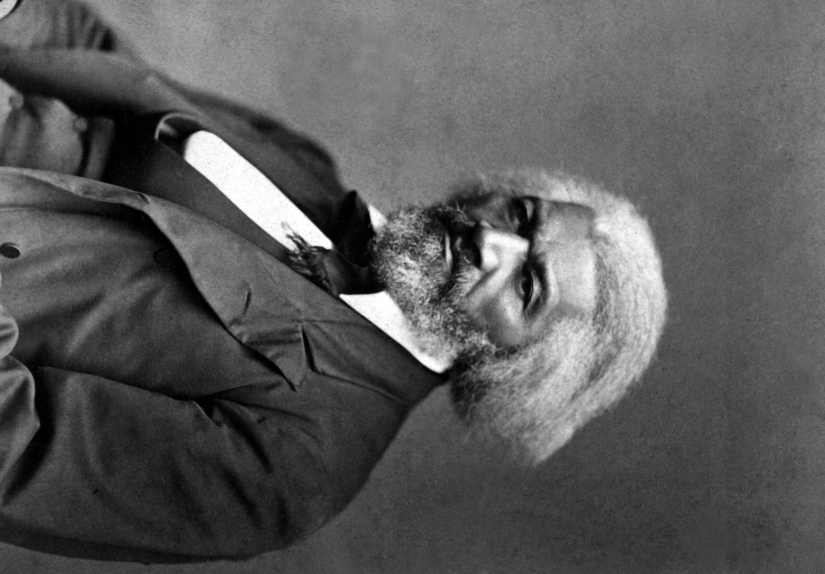
Frederick Douglass
Notes:
Image: George Kendall Warren, Public domain, via Wikimedia Commons

Slide 24
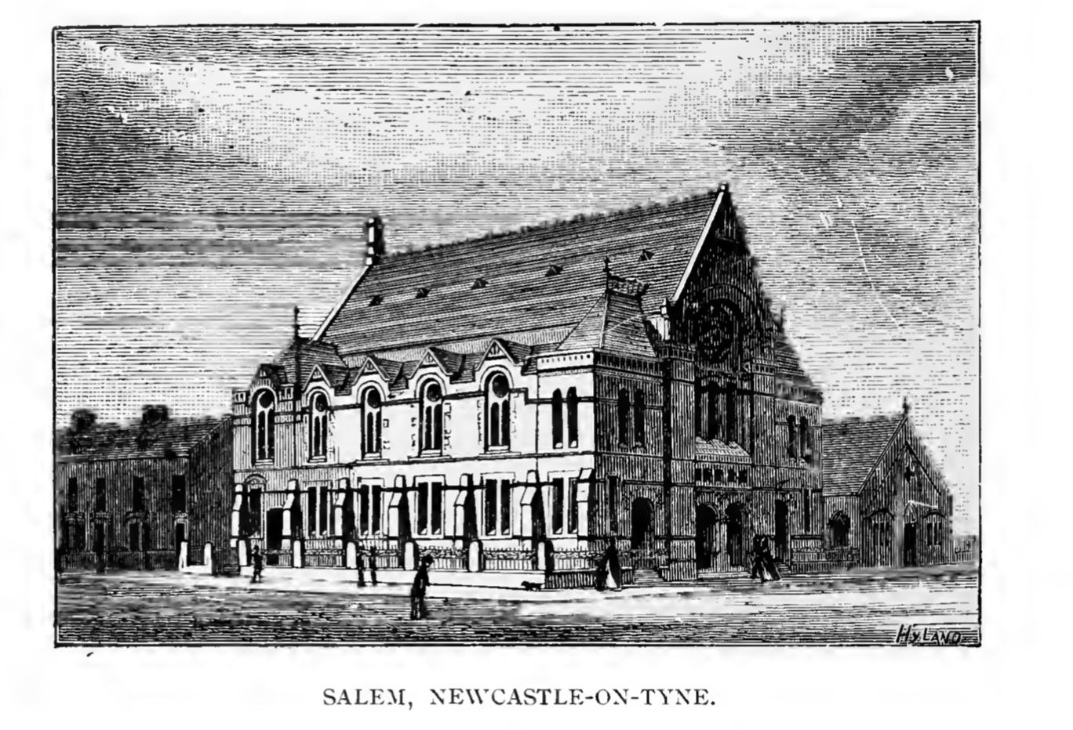
Salem Chapel, Hood Street, Newcastle
Notes:
Image: Public Domain - The centenary of the Methodist New Connexion 1797-1897 by T.D. Crothers et al.

Slide 25
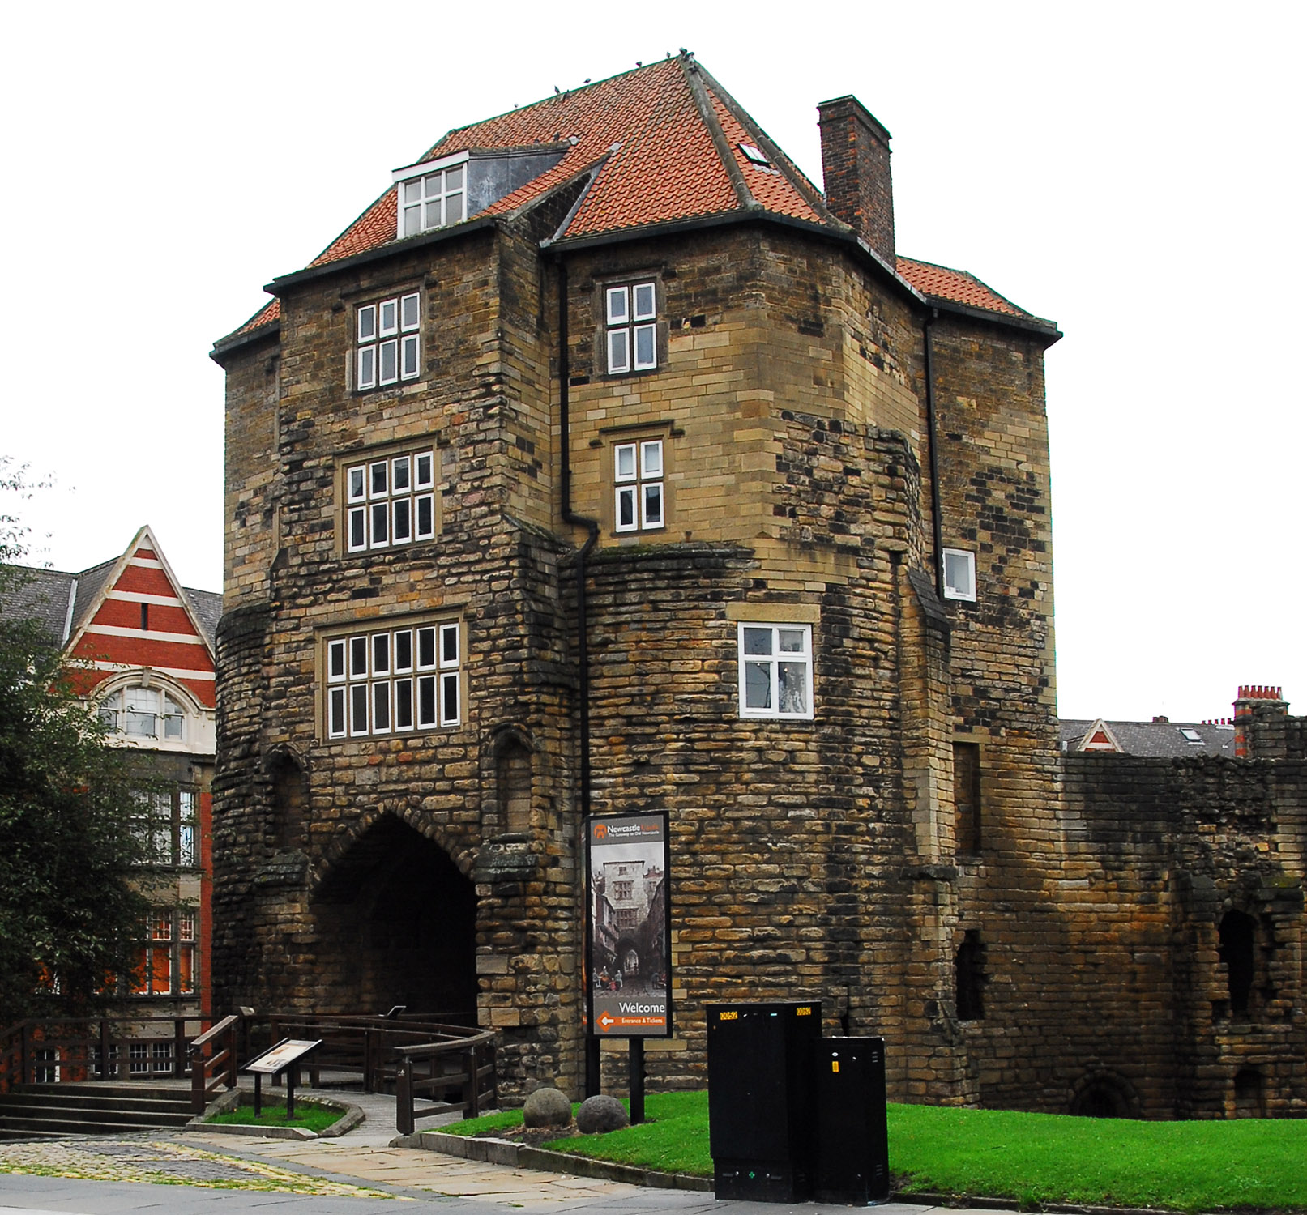
Point 7 - William Fifefield at The Black Gate
There are 2 suggested images on the following slides. These can be used to illustrate your walk.
Read the script for William Fifefield.
Children can stand between The Black Gate and High Level Bridge where the pavements are wide.
The location code from What3Words is legs.shine.sock
The Black Gate
Notes:
Image: Courtesy of Don O'Meara

Slide 26
‘The Mayor’s Barge on the Tyne’ by W. Carmichael, 1828 The two smaller boats were known as ‘comfortables’
Notes:
The Laing Art Gallery, Newcastle Upon Tyne, Tyne & Wear Archives and Museum
This painting called The Mayor’s Barge on the Tyne by W. Carmichael shows the Tyne around this time, with the smaller boats being the ‘comfortables’.

Slide 27
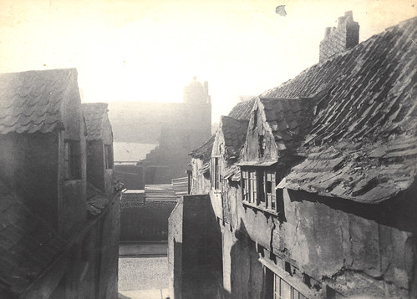
Tuthill Stairs, Newcastle upon Tyne, 1885
Notes:
Courtesy of Newcastle Libraries and Archives - Accession Number : 052608

Slide 28
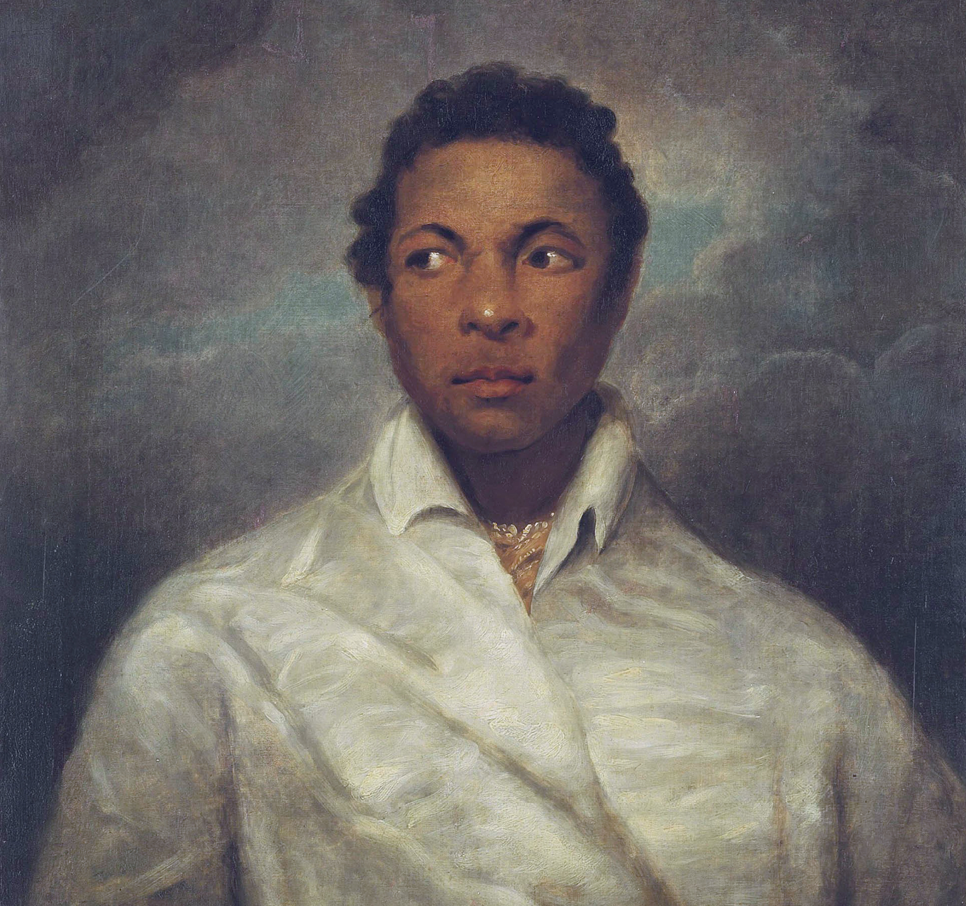
Point 8 -Ira Aldridge at Theatre Royal
There are 2 suggested images on the following slides. These can be used to illustrate your walk.
Read the script for Ira Aldridge.
Children can stand in front of The Theatre Royal on Grey Street.
The location code from What3Words is keen.thigh.gears
Ira Aldridge in the character of Othello
Notes:
Image: James Northcote, Public domain, via Wikimedia Commons

Slide 29
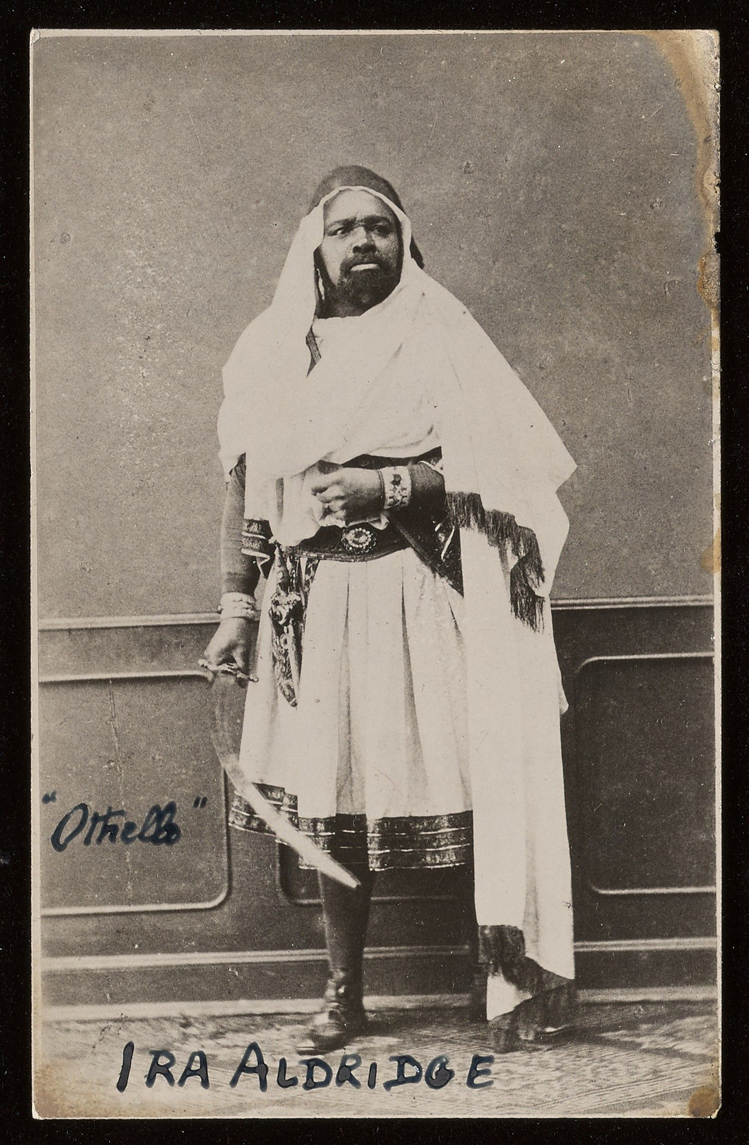
Ira Aldridge as Othello
Notes:
Image: Permission from Beinecke Rare Book and Manuscript Library.

Slide 30
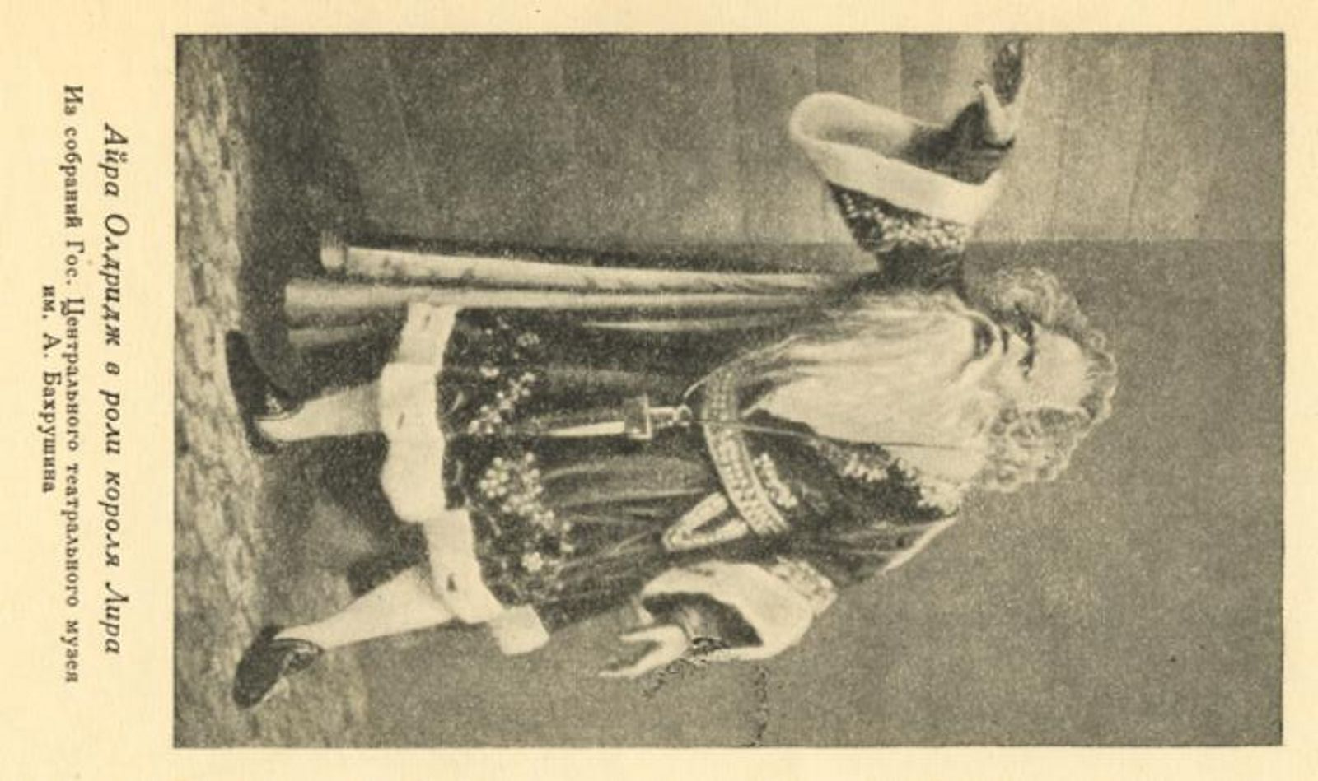
Ira Aldridge as King Lear
Notes:
New York Public Library Digital Collections - https://digitalcollections.nypl.org/items/bbaea7b7-dce9-9018-e040-e00a18067704

