Slide 1
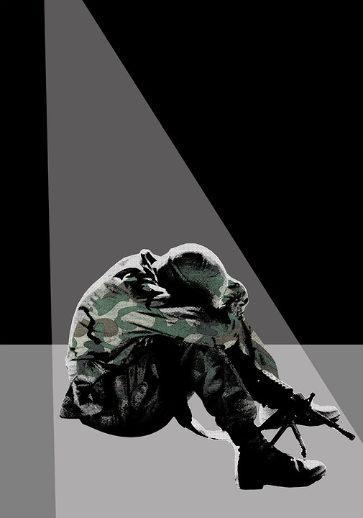
To what extent were the First & Second World Wars factors in the understanding and treatment of Post Traumatic Stress Disorder (PTSD)?
To what extent were the First & Second World Wars factors in the understanding and treatment of Post Traumatic Stress Disorder (PTSD)?

Slide 2
To what extent were the First & Second World Wars factors in the understanding and treatment of Post Traumatic Stress Disorder (PTSD)?
Key Stage 3 and 4: History
Learning Aims and Outcomes
Students will examine sources to identify attitudes, understanding and treatment of PTSD from both the First World War and the Second World War.
Students will be able to demonstrate skills in comparing attitudes by making a comparison of their findings on the two World Wars.
Students will evaluate the progress made in the two World Wars by comparing with the contemporary view of PTSD.
Notes:
This Power Point Relates to: Edexcel Medicine Through Time and AQA Health and the People.
It relates to the Teaching Activity: To what extent was the Second World War a factor in the development of medical knowledge?

Slide 3


To what extent were the First & Second World Wars factors in the understanding and treatment of Post Traumatic Stress Disorder (PTSD)? 2
Key Stage 3 and 4: History
Learning Aims and Outcomes
Students will examine sources to identify attitudes, understanding and treatment of PTSD from both the First World War and the Second World War.
Students will be able to demonstrate skills in comparing attitudes by making a comparison of their findings on the two World Wars.
Students will evaluate the progress made in the two World Wars by comparing with the contemporary view of PTSD.
Content Warning
This presentation contains graphic images of medical conditions. It also shows the original captions used for images, some of which might now be considered to include inappropriate terminology for medical conditions.
Notes:
This Power Point Relates to: Edexcel Medicine Through Time and AQA Health and the People.
It relates to the Teaching Activity: To what extent was the Second World War a factor in the development of medical knowledge?

Slide 4

PTSD – What do you know or think you know about it?

Slide 5
PSTD
Post Traumatic Stress Disorder is well documented in today’s society. It is a mental health disorder that can affect anyone who has been through a traumatic experience. Many soldiers are diagnosed with PTSD following their service in war zones and the trauma that combat can have on individuals. The term PTSD only developed in the 1980s, but the reality of it has been inexistence probably since time began.
But how was it recognised in the wars of the 20th Century? If a real understanding of the condition did not exist until the 1980s, how were soldiers and civilians with the condition treated before its official acknowledgement? Was progress made between the First and the Second World War?

Slide 6



Activity 1
THIS SIDE OF THE ROOM
THIS SIDE OF THE ROOM
You are going to research PTSD during the First World War.
Your task is to explain what your sources show you about treatment of patients and rehabilitation after trauma.
You are going to research PTSD during the Second World War.
Your task is to explain what your sources show you about treatment of patients and rehabilitation after trauma.
Use the worksheet provided to record your findings.

Slide 7
Table1
Source | What can you learn from the source | How much does it show that people understood about PTSD? | In 3 words describe the treatment and rehabilitation of soldiers
1
2
3
4
5
6

Slide 8

Teacher notes on the sources:
Due to copyright
the sources for the First World War
have far fewer images than for
the Second World War.
Please feel free to add any images you have the rights to use to enhance the sources presented in this lesson.

Slide 9
Activity 1 – WW1 Sources
First World War Sources

Slide 10
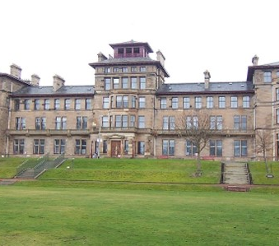
Craiglockhart War Hospital
First World War – Source 1
William Rivers worked at Craiglockhart War Hospital for Officers near Edinburgh (pictured). He took a very different approach in treating shell shock. He felt that the “weak deserter” view was damaging and that soldiers could not return to the front line unless they could talk about their experiences and face the fear and horror that they had been subjected to. He developed something called the “talking cure” with some now saying that he revolutionised the treatment of psychological conditions developed in war situations. Siegfried Sassoon, the war poet, was treated at this hospital by William Rivers.
Notes:
Image: Public domain, via Wikimedia Commons - https://commons.wikimedia.org/wiki/File:Craiglockhart_Hydropathic_main_view.JPG

Slide 11
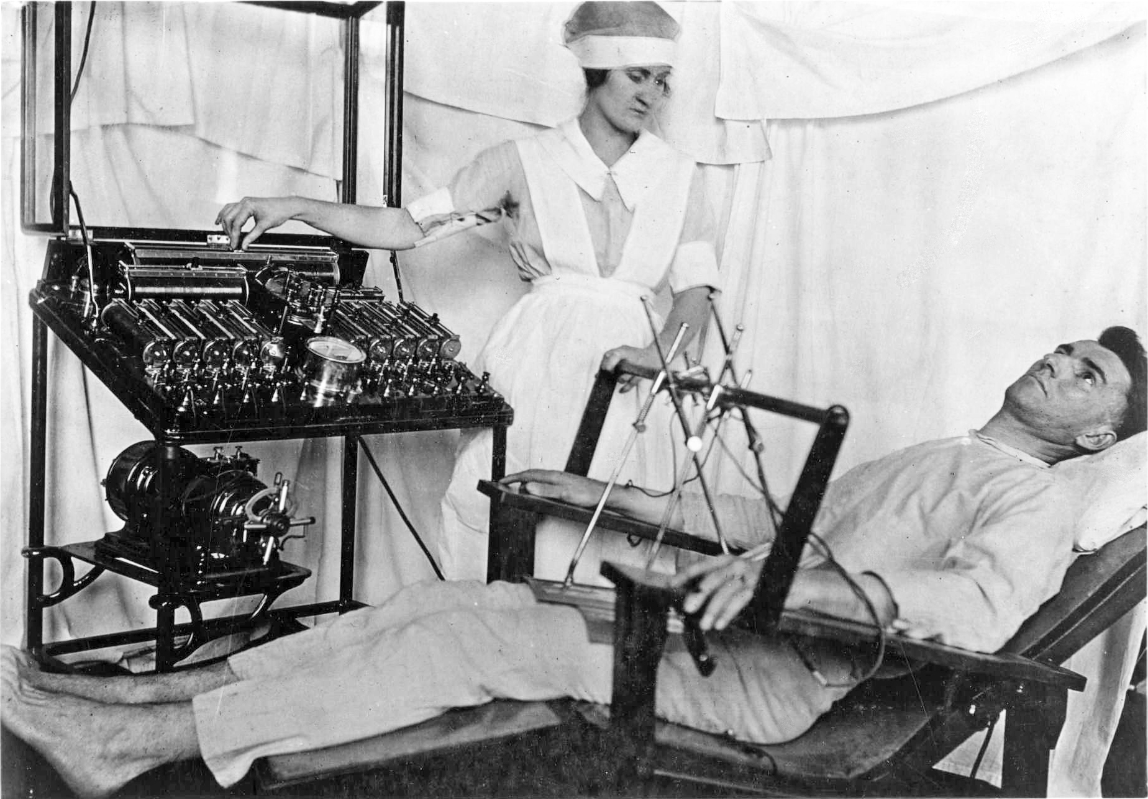

Photo 1
First World War – Source 2
Use of electrical apparatus. Bergonic chair for giving general electric treatment for psychological effect, in psycho-neurotic cases.
Notes:
Image: Public domain, via Wikimedia Commons - https://commons.wikimedia.org/wiki/File:Bergonic_chair.jpg

Slide 12
Electric shock treatment
First World War – Source 3
The treatments of Shellshock were many and varied. Disciplinary treatment was the most common at the time. The doctors involved with this form of treatment had harsh moral views of hysteria and stressed quick cures as the goal of wartime psychiatry was to keep men fighting. Shaming, physical re-education and the infliction of pain were the main methods used. Electric Shock Treatment was very popular. This involved an electric current being applied to various body parts to cure the symptoms of Shellshock. For example, an electric current would be applied to the pharynx of a soldier suffering from mutism or to the spine of a man who had problems walking. Another form of treatment consisted of "finding out the main likes and dislikes of patients and then ordering them to abstain from the former and apply themselves diligently to the latter". Patients who had a fear of noise were given rooms looking onto a main road, men who had been teachers or writers before the war were refused access to the library and men who feared being alone were put into isolation.
Taken from https://spartacus-educational.com/FWWmental.htm

Slide 13
Electric shock treatment 1
First World War – Source 4
It was clear to everyone that large numbers of combatants could not cope with the strain of warfare. By the end of World War One, the army had dealt with 80,000 cases of 'shell shock'. As early as 1917, it was recognised that war neuroses accounted for one-seventh of all personnel discharged for disabilities from the British Army. Once wounds were excluded, emotional disorders were responsible for one-third of all discharges. Even more worrying was the fact that a higher proportion of officers were suffering in this way. According to one survey published in 1917, while the ratio of officers to men at the front was 1:30, among patients in hospitals specialising in war neuroses, the ratio of officers to men was 1:6. What medical officers quickly realised was that everyone had a 'breaking point': weak or strong, courageous or cowardly - war frightened everyone witless.
Taken from www.bbc.co.uk/history/worldwars/wwone/shellshock_01.shtml

Slide 14
Electric shock treatment 2
First World War – Source 5
No doubt they’ll soon get well; the shock and strain
Have caused their stammering, disconnected talk.
Of course they’re ‘longing to go out again,’—
These boys with old, scared faces, learning to walk.
They’ll soon forget their haunted nights; their cowed
Subjection to the ghosts of friends who died,—
Their dreams that drip with murder; and they’ll be proud
Of glorious war that shatter’d all their pride...
Men who went out to battle, grim and glad;
Children, with eyes that hate you, broken and mad.
October, 1917. Siegfried Sassoon, Craiglockart Hospital

Slide 15
Further information
First World War – Source 6
Senior military commanders would not accept a soldier’s failure to return to the front line as anything other than desertion. They also believed that if such behaviour was not harshly punished, others might be encouraged to do the same and the whole discipline of the British Army would collapse. Some men faced a court martial for other offences but the majority stood trial for desertion from their post, “fleeing in the face of the enemy”. A court martial itself was usually carried out with some speed and the execution followed shortly after.
Taken from https://www.historylearningsite.co.uk/world-war-one/the-western-front-in-world-war-one/world-war-one-executions/

Slide 16
Activity 1 – WW2 Sources
Second World War Sources

Slide 17
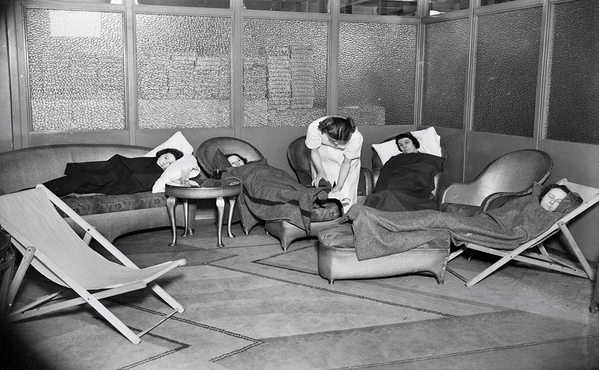
Photo 2
Second World War – Source 1
The caption on the reverse of the photograph reads: “Industrial nursing. Picture shows sufferers from air raid shock resting in a corner of the rest room of a manufacturing concern.”
‘Air raid shock’ is believed to have been similar to shell shock, along with ‘civilian war neuroses’.
Notes:
Image: Source: Historic England Archive Ref: MED01/01/1042 Date: 10 Oct 1940 - https://historicengland.org.uk/images-books/photos/item/MED01/01/1042

Slide 18
Additional image information
Second World War – Source 1
A view of women suffering from shock under blankets on sofas and armchairs, attended to by a nurse
A view of women suffering from shock under blankets on sofas and armchairs, attended to by a nurse, in the rest room of a factory. ‘Air raid shock’ is believed to have been similar to shell shock, along with ‘civilian war neuroses’. The term was introduced in 1917 after a mother murdered her child during an air raid, claiming that the psychological distress of bombing raids had caused her to have a nervous breakdown. Historically, ‘hysteria’ was predominantly a female condition – thus ‘shell shock’ was coined to distance soldiers from “effeminate associations”. ‘Air raid shock’ and ‘civilian war neuroses’ sustained this dichotomy; the terms continued the division between the battlefield and the home front. It resulted in “hysteria” and increasingly difficult behaviour in children, and psychological symptoms such as temporary deafness, stammer, suicidal thoughts, depression, and exhaustion. In 1942 it was suggested that the “ideal treatment” for a patient suffering from air raid shock were plasma and blood transfusions, but women were often not diagnosed or treated for the trauma they were suffering. Today, the symptoms of ‘air raid shock’ and ‘shell shock’ are recognised as post-traumatic stress disorder.

Slide 19
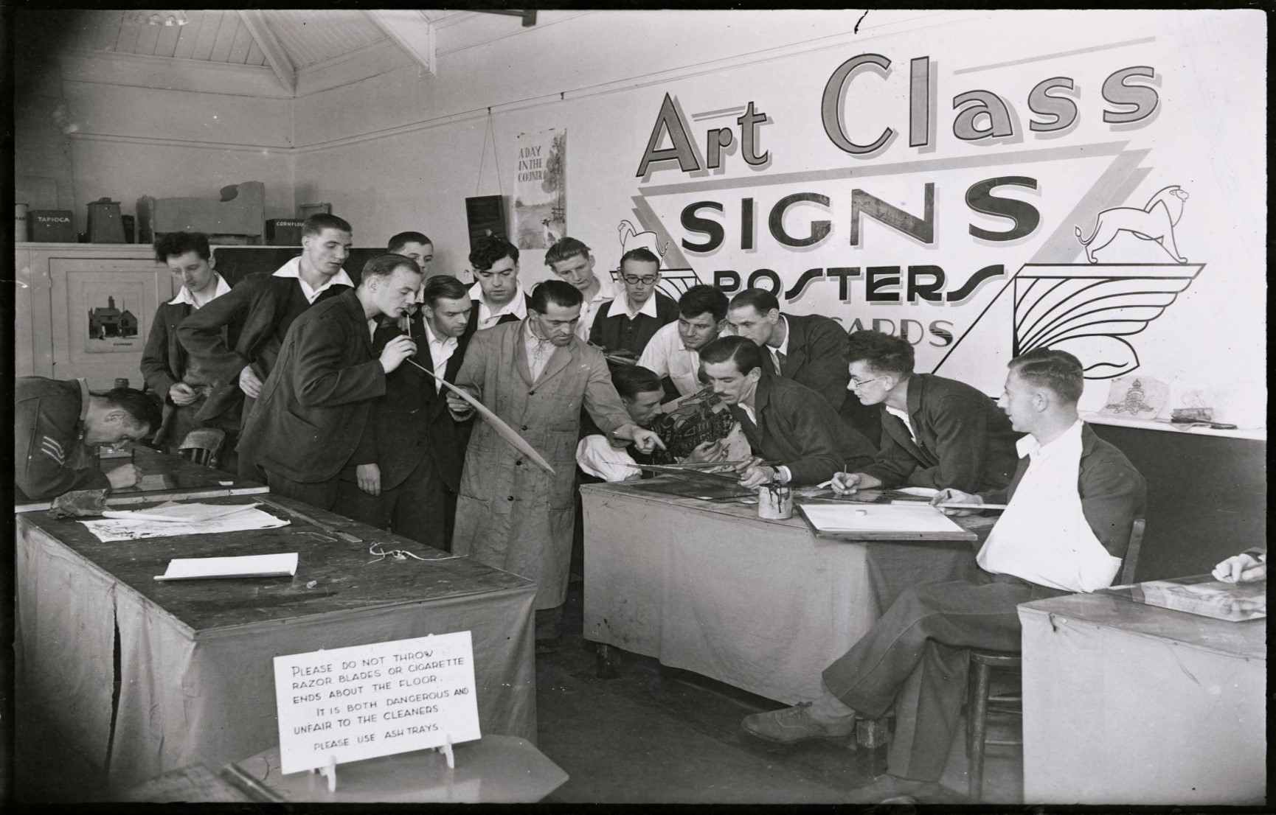
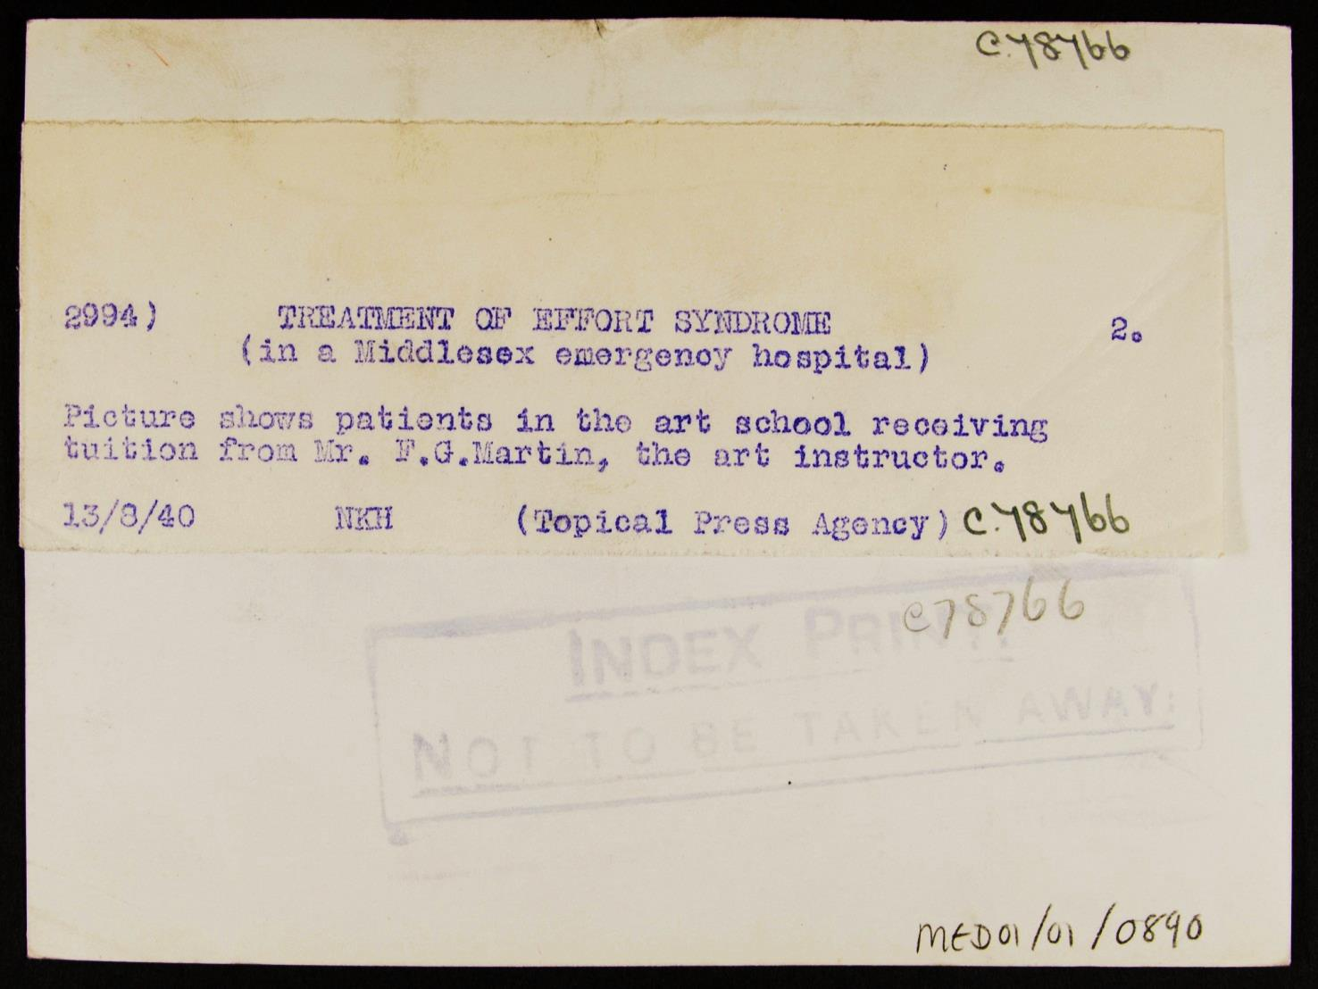
Photo 3
Second World War – Source 2
Notes:
Image: Source: Historic England Archive Ref: MED01/01/0890 Date: 13 Aug 1940 - https://historicengland.org.uk/images-books/photos/item/MED01/01/0890

Slide 20
Additional image information 1
Second World War – Source 2
Treatment of Effort Syndrome, Mill Hill Emergency Hospital, The Ridgeway, Mill Hill, Barnet, Greater London
Patients suffering from Effort Syndrome receiving tuition from Mr. F. G. Martin, the art instructor at Mill Hill Emergency Hospital. Effort Syndrome was first described during the American Civil War and later by doctor Jacob Mendes Da Costa in 1871, and was thereafter also known as Da Costa’s syndrome. The condition presents symptoms including shortness of breath, palpitations, fatigue, and dizziness – namely symptoms which limit a patient’s “capacity for effort”. During WWI, approximately 60,000 cases of “effort syndrome” were reported amongst British Forces. Treatment varied: some prescribed complete bed rest, while others argued that hospital stays should be kept short, as these were seen as redundant or even harmful due to the lack of discipline and its effect on a soldier’s morale. Switching to lighter responsibilities and occupational therapy was also recommended, and physical fitness was promoted through drills and games. Now, Da Costa’s syndrome is considered to be a manifestation of an anxiety disorder, and treatment is largely behavioural.

Slide 21
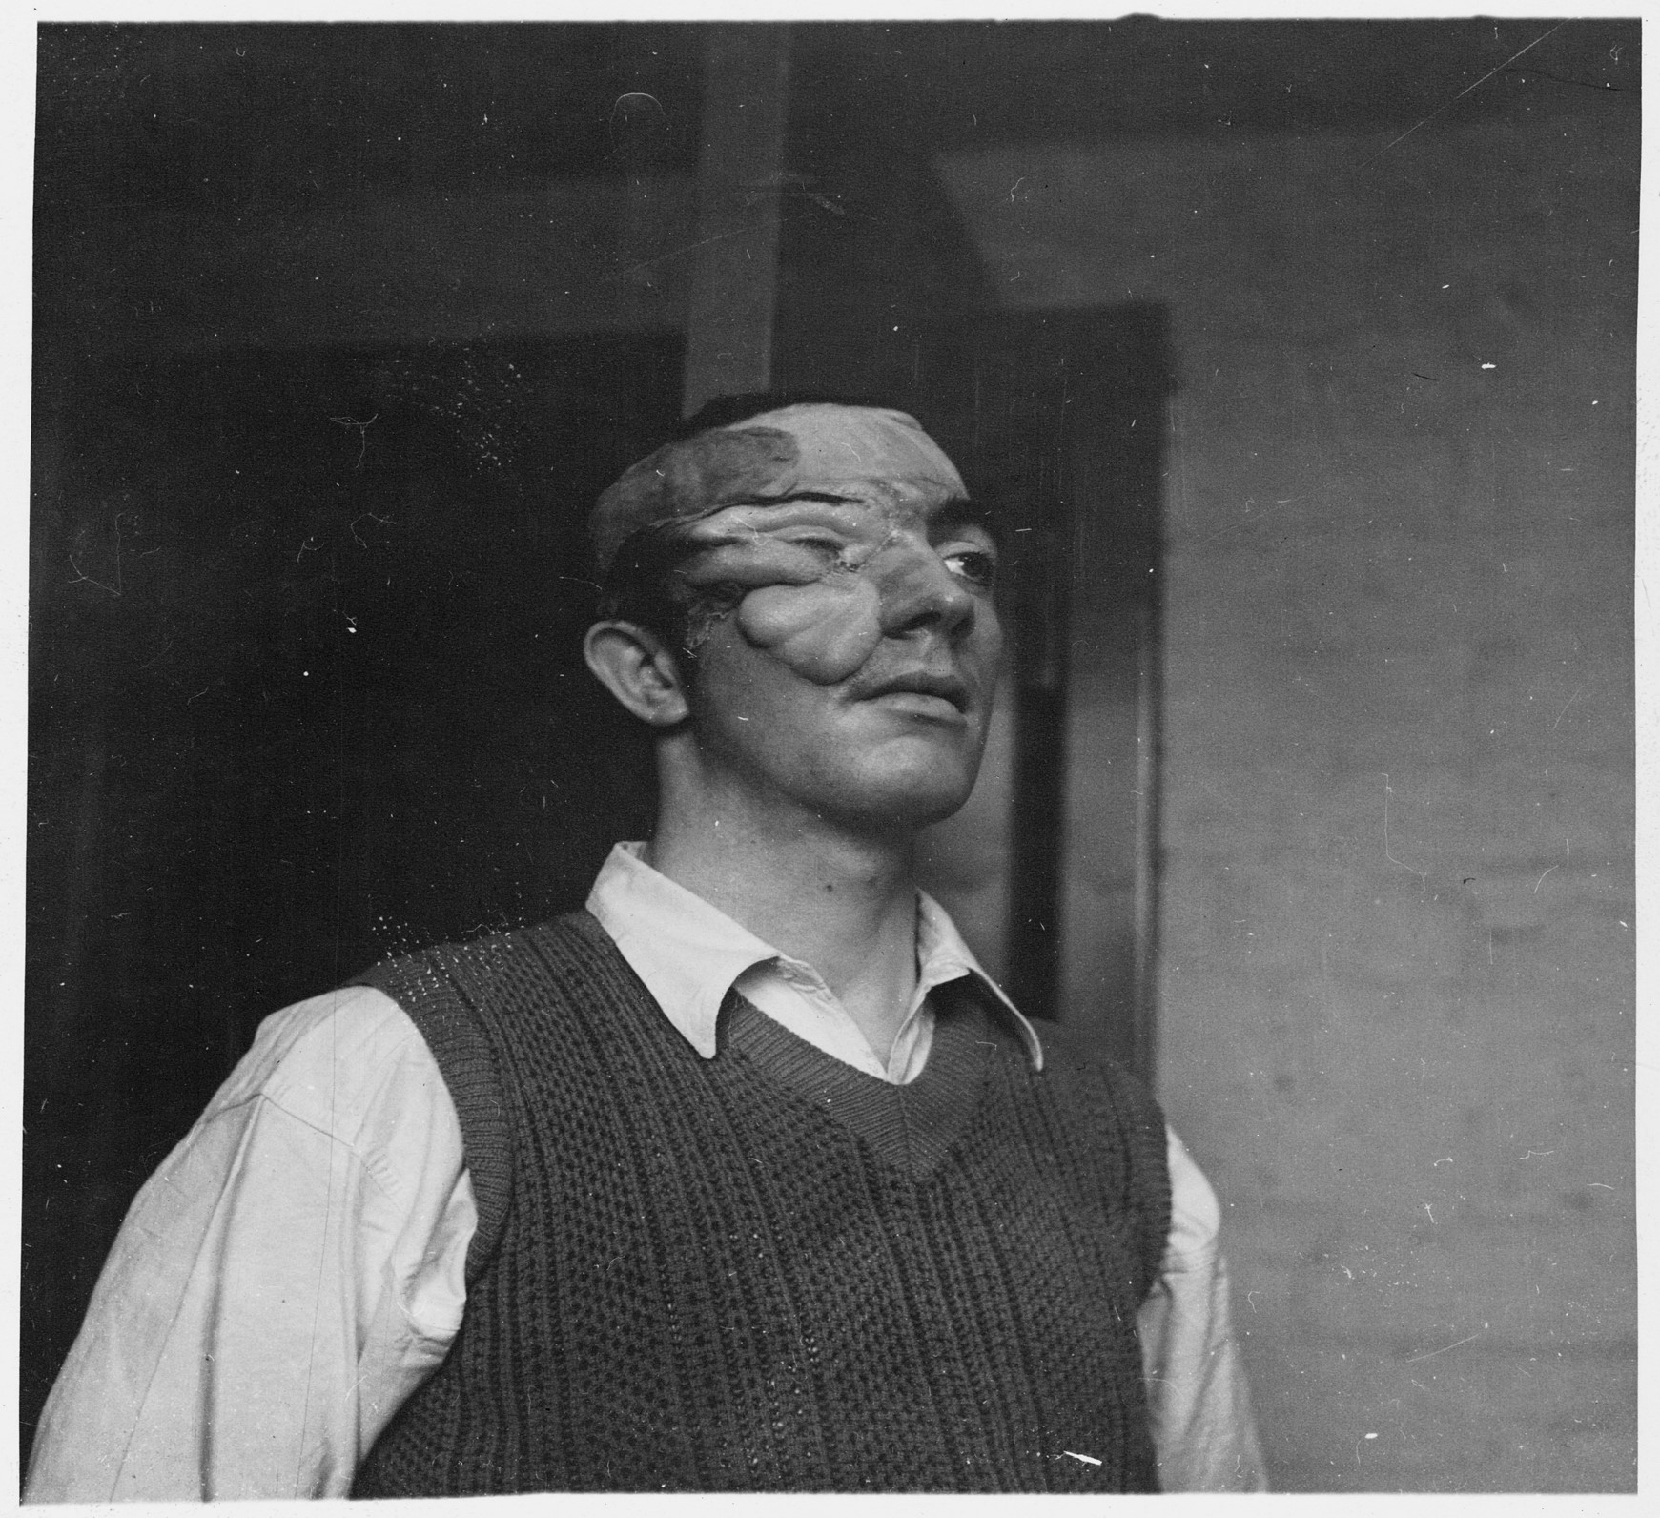
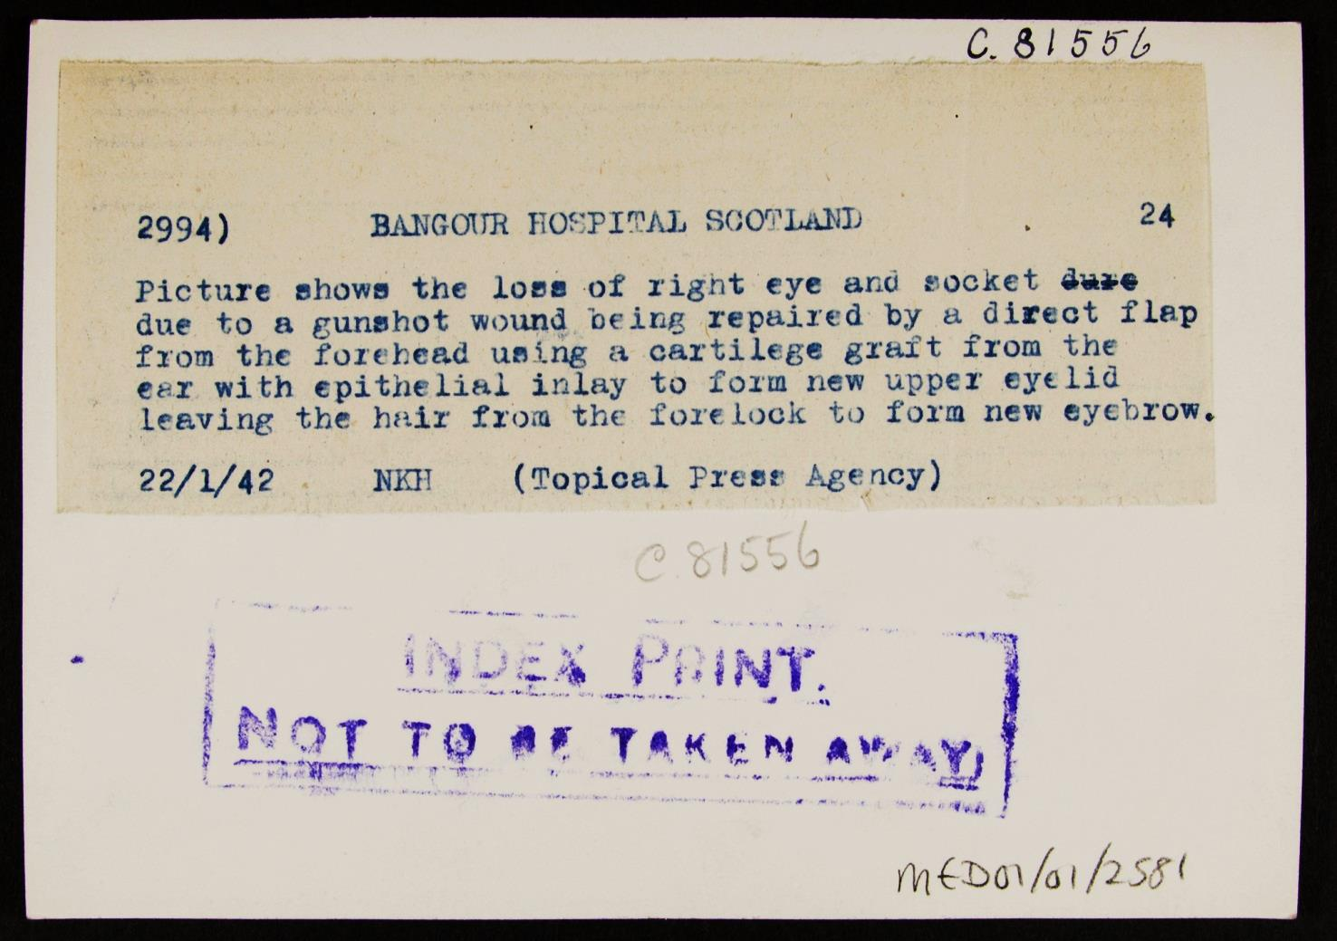
Photo 4
Second World War – Source 3
When patients were released and entered the public domain after having plastic surgery by the famous McIndoe, “the town that did not stare” were welcoming of his patients and this helped with their psychological recovery. His patients even formed “The Guinea Pig” club that gave each other emotional support and morale after surgery.
Notes:
Image: Source: Historic England Archive Ref: MED01/01/2581 Date: 22 Jan 1942 - https://historicengland.org.uk/images-books/photos/item/MED01/01/2581

Slide 22
Additional image information 2
Second World War – Source 3
A patient whose eye socket is being repaired with a cartilege graft, Bangour Hospital, Broxburn, Edinburgh, Scotland
A portrait of a gunshot patient whose missing eye and socket is being repaired with a cartilege graft at Bangour Hospital. Bangour General Hospital was built during the Second World War as an annexe to Bangour Village Hospital for Mental Diseases and was run by the Department of Health for Scotland under the Emergency Hospitals Scheme. The Lothian Regional Plastic Surgery Service began at the hospital in 1941 and a Plastic Surgery Unit remained based in Bangour until 1992. It is likely that this photo shows the work of Alexander "Alister" Burns Wallace CBE FRSE FRCSE (1906–1974), a Scottish plastic surgeon. He was a founding member and president (1951) of the British Association of Plastic Surgeons, and the first editor of the British Journal of Plastic Surgery. He served as plastic surgeon at the Scottish Emergency Medical Hospital at Bangour from 1940–45.

Slide 23
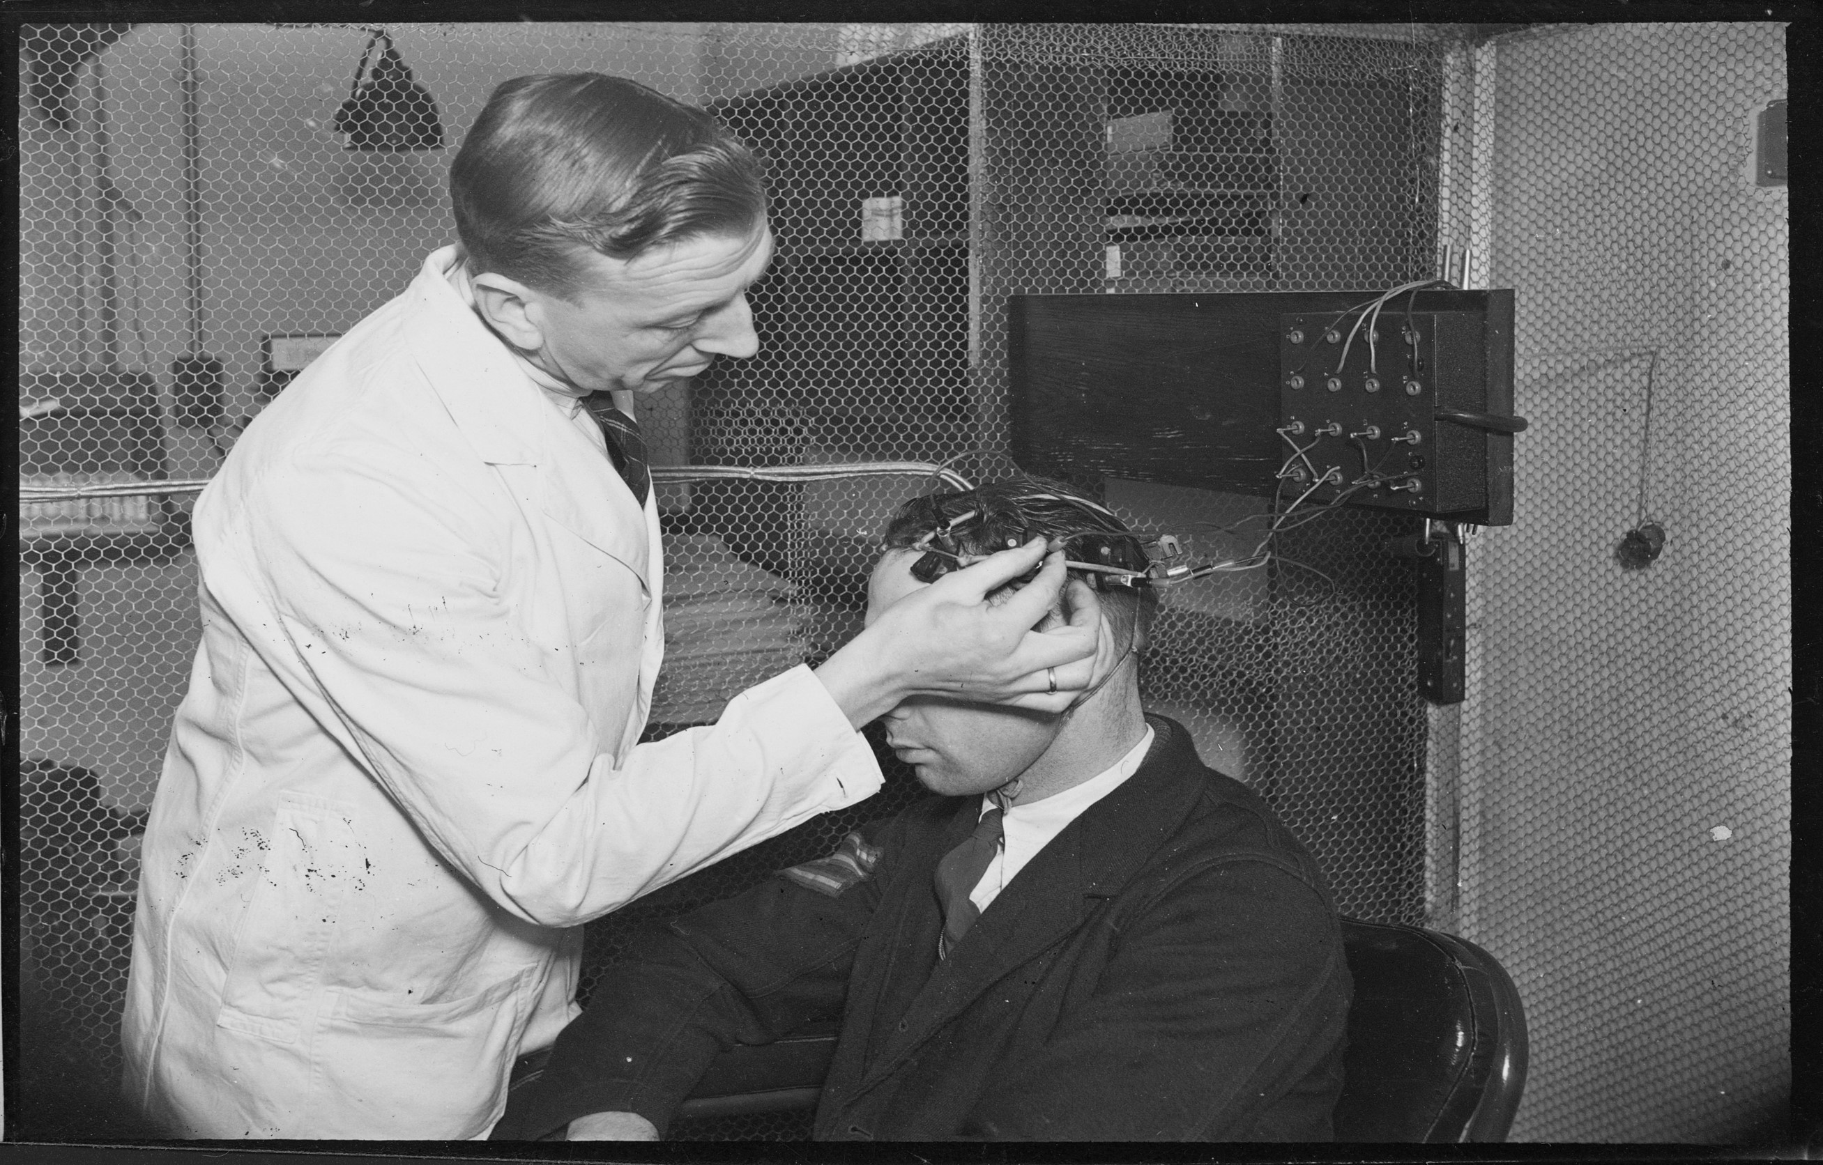
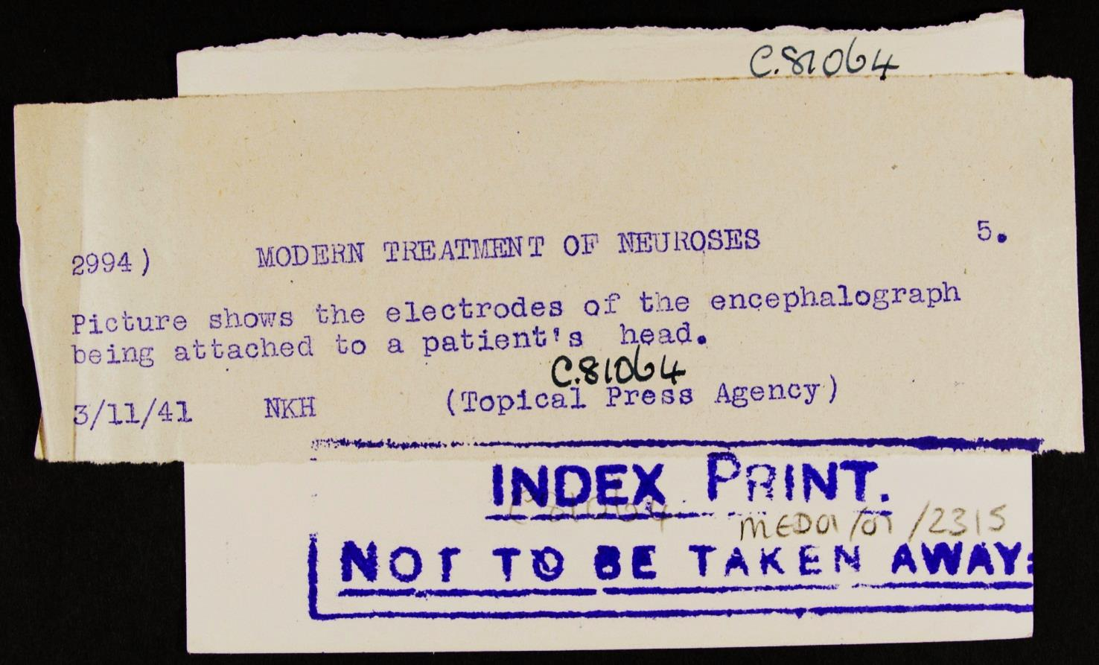
Photo 5
Second World War – Source 4
Notes:
Image: Source: Historic England Archive Ref: MED01/01/2315 Date: 3 Nov 1941 - https://historicengland.org.uk/images-books/photos/item/MED01/01/2315

Slide 24
Additional image information 3
Second World War – Source 4
Attaching electrodes to the head of a patient, Sutton Emergency Hospital, Sutton, Greater London
A man attaching electrodes to the head of a patient at Sutton Emergency Hospital. Prior to World War One the buildings that became the hospital were part of a workhouse. During World War One the workhouse was used as a hospital for German prisoners of war, with 92 beds for officers and 1,175 for other ranks. It was also an internment camp with 90 beds for civilian 'enemy aliens' awaiting repatriation. After World War One it returned to being a workhouse for unemployed men. In 1930 it was taken over by London City Council and turned into a training centre for unemployed men. It was at the start of World War Two that it became Sutton Emergency Hospital. The government feared mass hysteria at the start of the war so it was designated a neurosis unit - the Sutton Neurosis Centre. This was not the case and they treated a wide variety of casualties as well as those with neurological issues. In 1946 it was renamed the Belmont Hospital, specialising in psychiatric medicine. It remained an Emergency Hospital until July 1948, when it joined the NHS.

Slide 25
Second World War – Source 5
Second World War – Source 5
Behind these stories of successful treatment lies a scheme which the British War Office has instituted to mobilise psychological experts throughout the country for this work. Shellshock exacted a heavy toll in the last War. Today, the most advanced treatment, including hypnotism, suggestion and other forms of psychotherapy are used.
They are also interested in prevention as well as cure. Every recruit undergoes a minor form of psychoanalysis at his medical examination to discover if he has any history or symptom of nervous disorder which might affect his discipline in the frontline.
Thus, men who might crack up under strain or, as in the last War, might run the risk of being shot for cowardice, in reality due to some neurosis, will be found in time.
Taken from an article in The Lancet, 1940

Slide 26
Second World War – Source 6
Second World War – Source 6
Between the Wars in fact, 1919 to 1939, it is fair to say that British military psychiatry more or less stagnated. By 1939, there were only six British doctors in the British military who really had any kind of psychiatric training at all.
After the War broke out, this situation did improve. In 1942, for example, a dedicated directorate of psychiatry was set up in the War Office, and by 1944, as opposed to six psychiatrists at the beginning, there were over 200 working for the British Army, about half of which were attached to British units overseas. But in 1940, when the British expeditionary force went to France, it had just a couple of psychiatrists attached to it and there was no system of providing forward advance psychiatry – that was the system that had been found to be effective in some ways in the First World War.
The Second World War: Shellshock to Psychiatry, Dr Roderick Bailey 2014

Slide 27
Activity 2
THIS SIDE OF THE ROOM
THIS SIDE OF THE ROOM
You are now going to teach someone on the other side about First World War views
on PTSD.
You are now going to teach someone on the other side about Second World War views on PTSD
FOCUS ON THESE THREE AREAS
Attitudes to PTSD - Understanding of PTSD - Treatment of PTSD

Slide 28

Activity 3
What are the similarities between the two wars
and their views
on PTSD?
What are the differences between the two wars
and their views
on PTSD?
What can we learn
about the impact
of the wars and
Developing
Understanding
of PTSD?
Was progress
made in
understanding
and treating
PTSD by 1945?

Slide 29
Activity 4
How much progress in attitude, understanding and treatment
towards PTSD was made
from the First World War
to the Second World War?

Slide 30





Words and phrases to describe progress
improving
gained ground
developing/developed
getting better
made strides
evolved
building on
advancing
leapfrog
growth
expanded
breakthrough
flourished

Slide 31

More resources
MORE RESOURSCES AT
HistoricEngland.org.uk/Education

