Slide 1
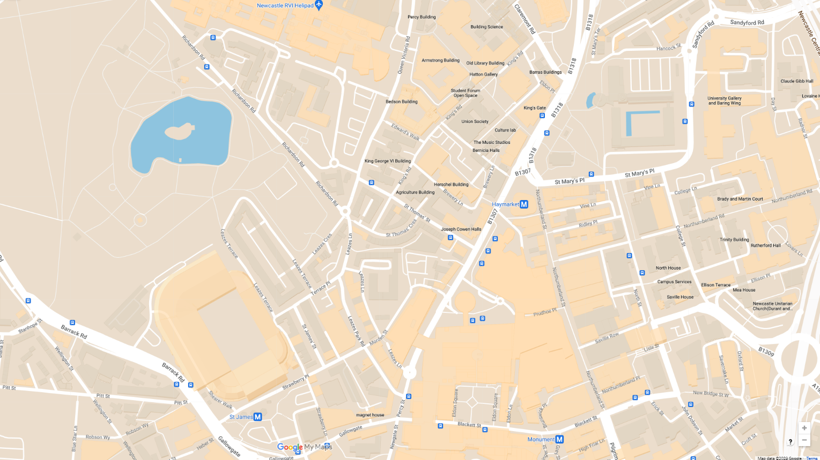
Route Map
Paul Robeson - City Hall
Colonial Seamen - West Indies House
Early African Exhibitions - Hatton Gallery
Martin Luther King Jr. - Armstrong Building
West African Doctors & Nurses - Royal Victoria Infirmary
The Colonial Students’ Club - 40 Leazes Terrace
Frederick Douglass - 23 Leazes Park Road
Ida B Wells - Brunswick Methodist Chapel
1
2
3
4
4
3
5
6
5
2
7
8
1
6
7
8
Notes:
Route Map

