Slide 1
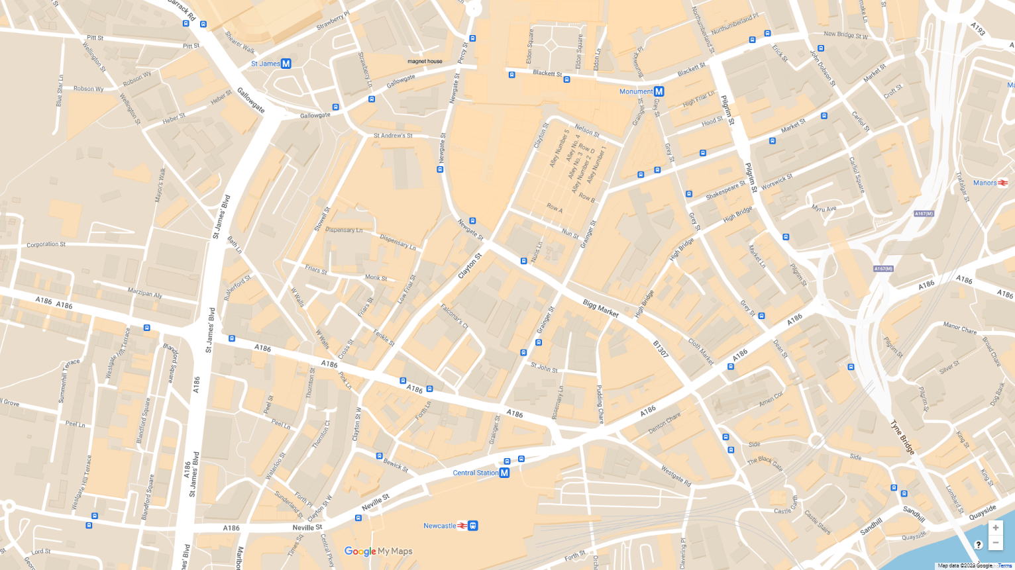
Route Map
Muhammad Ali - Eldon Recreation Centre
Ida B Wells - Brunswick Methodist Chapel
E. Craft & H. 'B'. Brown - Nelson St. Music Hall
Olaudah Equiano - Turk’s Head, Bigg Market
V. Oyenuga and S. Onabajo - St John the Baptist Church
Frederick Douglass - Central Station
William Fifefield - The Black Gate
Ira Aldridge - Theatre Royal
1
2
1
3
2
4
5
3
6
8
7
8
4
5
7
6

