Slide 1
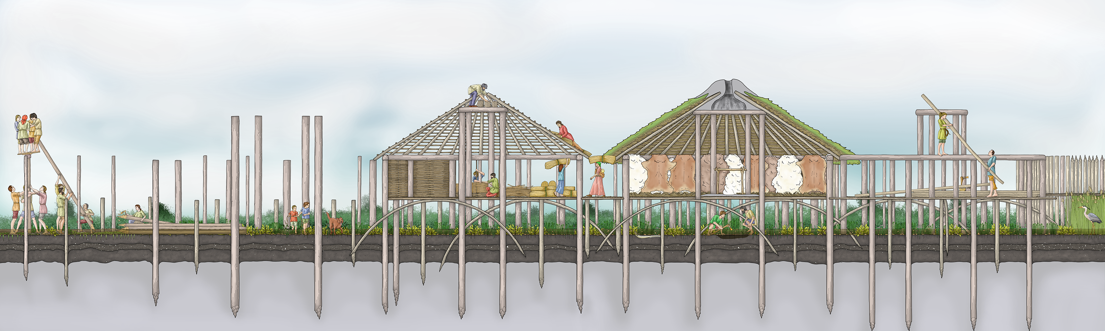
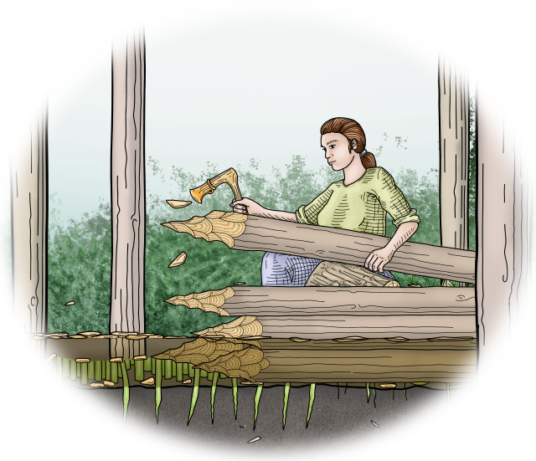
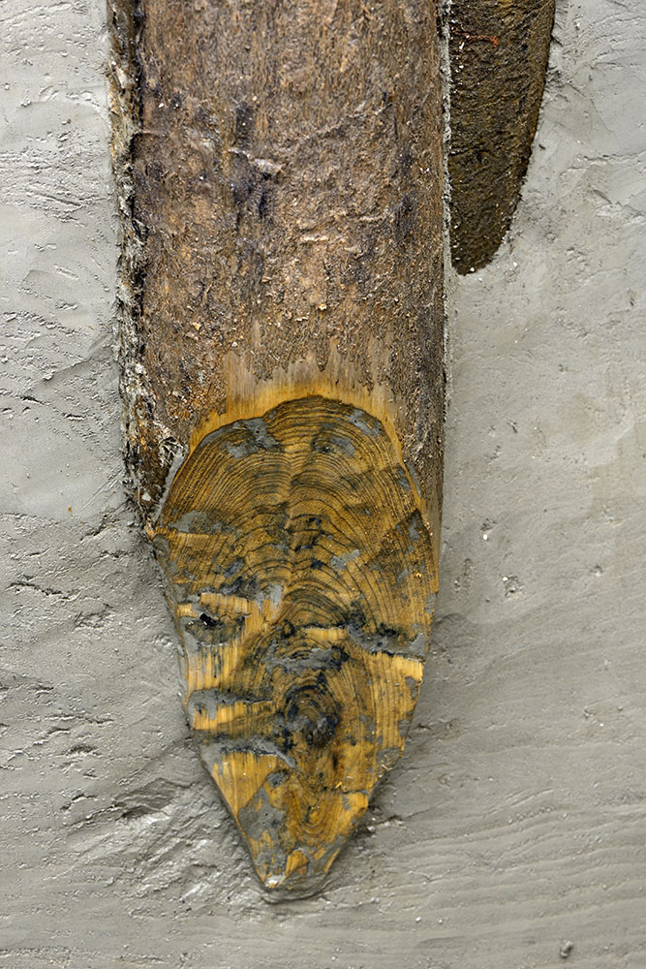
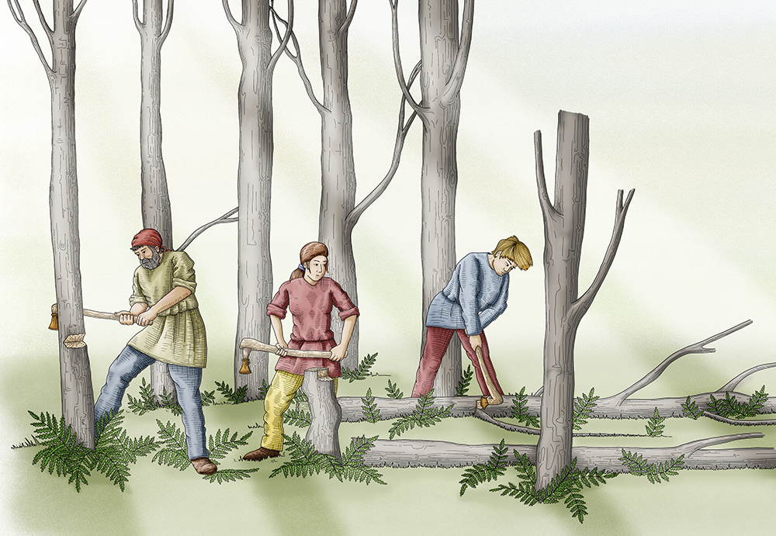
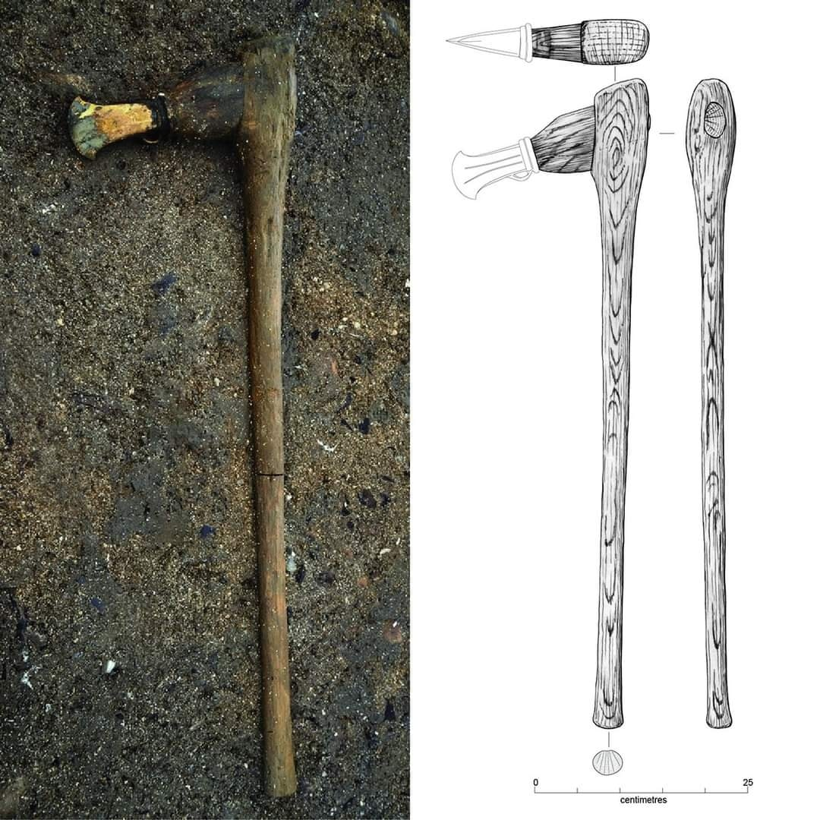
Must Farm
Bronze Age Village
Activity 3: How did they build the Bronze Age Village at Must Farm?
Notes:
All images © Vicki Herring.

Slide 2
Activity 3: How did they build the Bronze Age Village at Must Farm?
Key Stage 2 History
Pupils will weigh evidence and draw conclusions
Pupils will develop their understanding of the methods of historical enquiry, including how evidence is used rigorously to make historical claim.
Pupils should understand how our knowledge of the past is constructed from a range of sources.
KS2 Unit: Changes in Britain from the Stone Age to the Iron Age: Bronze Age religion, technology and travel

Slide 3
How to use this PowerPoint Accompanying Resources
Match up the real artefact from the excavation with the reconstruction drawing.
Work out the steps involved in building the Must Farm Bronze Age Village.
Class Discussion focussing on technology and drawing conclusions.
Label a reconstruction drawing of the Bronze Age Village.
Video 2: Must Farm: A Bronze Age Settlement (Duration 8.20 mins)
PPT: Building Must Farm Bronze Age Village
ZIP Folder: Images – 8 themed PPTs with high quality images of artefacts and reconstruction illustrations
Timelapse model of how one house was constructed (Slide 20-21)

Slide 4
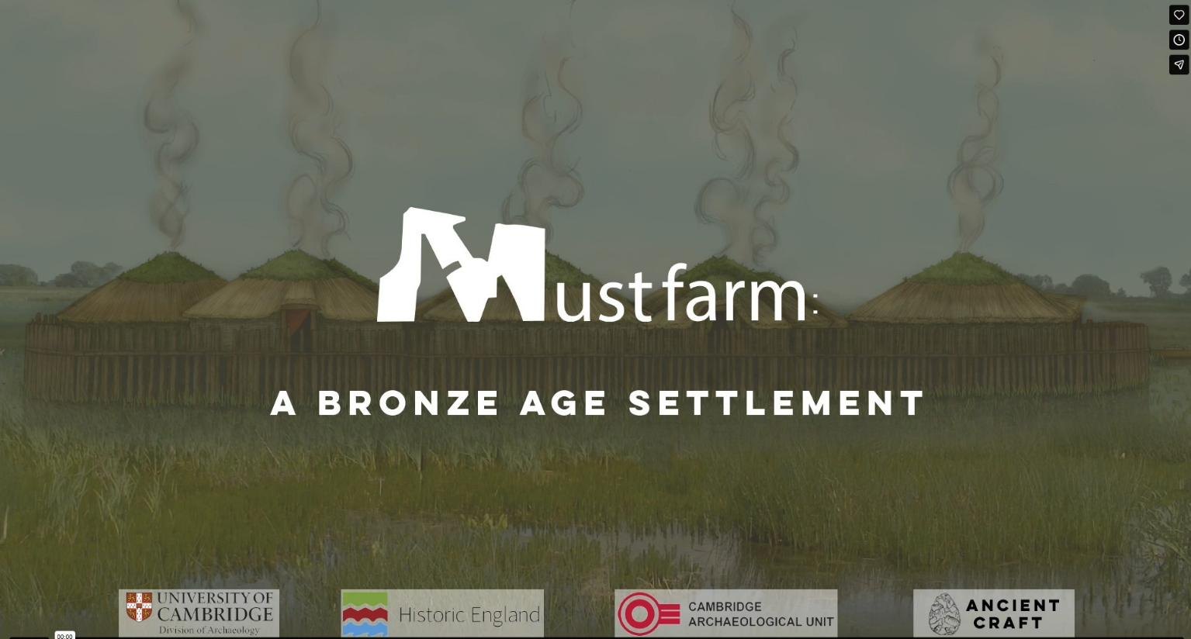
Must Farm: A Bronze Age Settlement
Notes:
https://vimeo.com/1045053069
Duration 8.20 mins
See Teacher Pack for transcription

Slide 5



Reconstruction Drawing of the building of the Bronze Age Village at Must Farm.
How did the
artist know?
Think
Notes:
Images © Vicki Herring.

Slide 6

Chopping down trees
How did the artist know they used axes like these?
Notes:
Images © Vicki Herring.

Slide 7
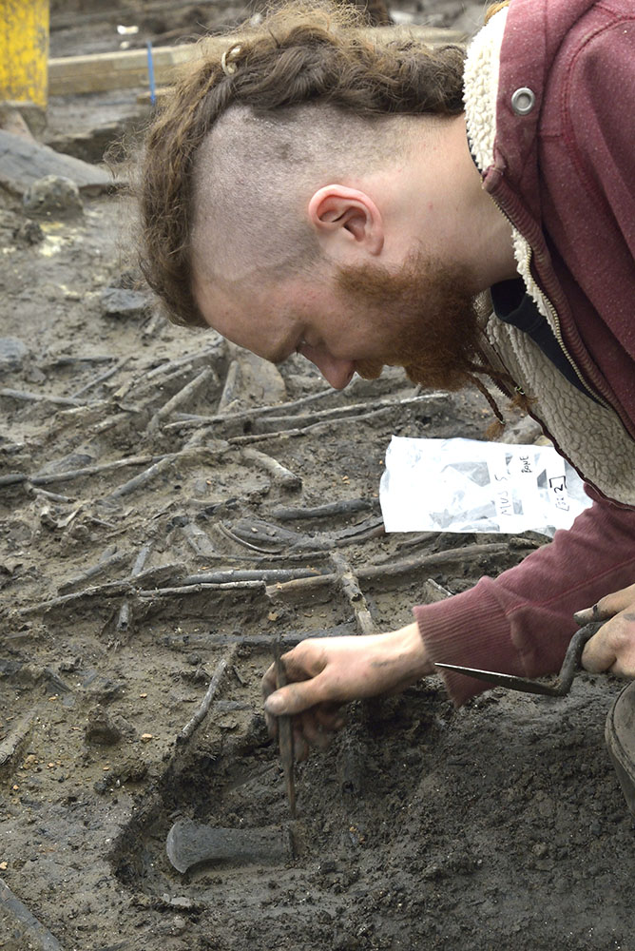
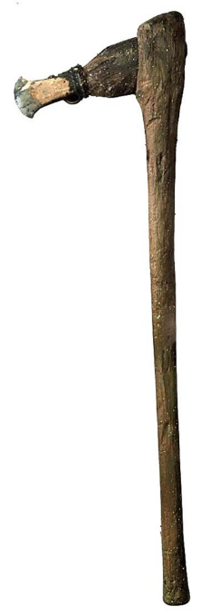
Axes found during excavation of the Must Farm Bronze Age Village
Notes:
Images ©CAU
https://www.mustfarm.com/progress/site-diary-38-announcing-our-finds/

Slide 8
Reconstruction of how points were made with axes in end of wooden pile
How did the artist know they used axes to shape the wooden posts into a point at one end?
Notes:
Images © Vicki Herring.

Slide 9
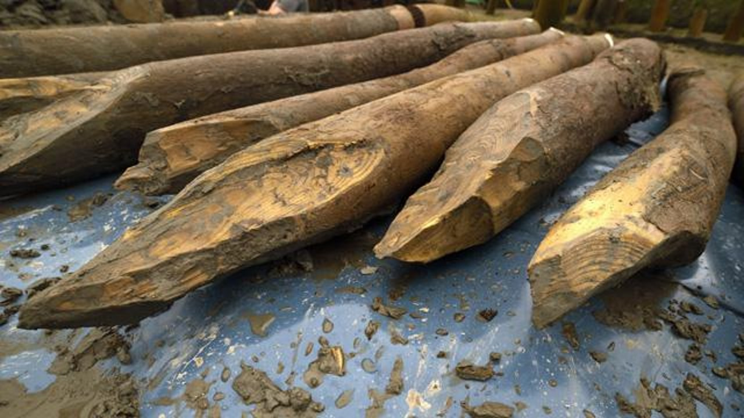
Wooden piles found during excavation of the Must Farm Bronze Age Village
Notes:
Images ©CAU
https://www.mustfarm.com/post-dig/post-ex-diary-10-specialist-analyses-part-three/

Slide 10
Pushing in the wooden piles
How did the artist know that this was how they pushed the large, heavy wooden posts called piles deep into the muddy riverbed?
Notes:
Images © Vicki Herring.

Slide 11
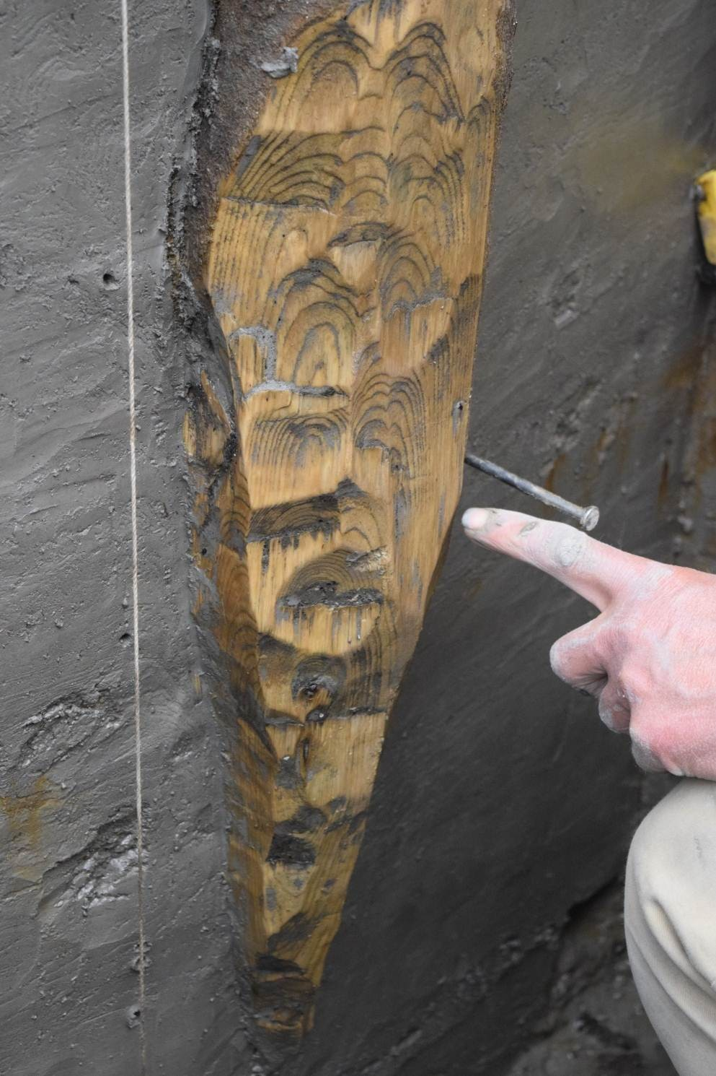
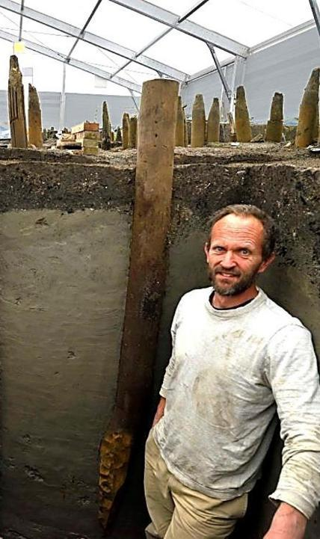
Piles pushed into the riverbed found during excavation of the Must Farm Bronze Age Village
Notes:
Images ©CAU
https://www.mustfarm.com/progress/site-diary-42-the-archaeology-of-the-settlements-construction/
https://www.mustfarm.com/progress/site-diary-31-moving-towards-the-end-of-excavation/

Slide 12
Adding the Rafters
How did the artist know that the houses were round and had conical roofs supported by wooden poles as rafters ?
Notes:
Images © Vicki Herring.

Slide 13
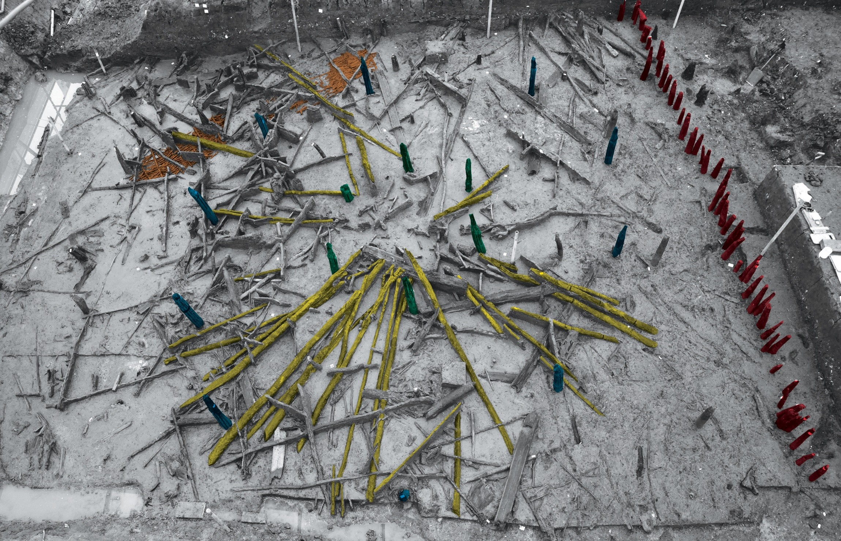
Position of the wooden piles from the excavation of the Must Farm Bronze Age Village
Palisade
Inner Ring
Outer Ring
Rafters
Notes:
Images ©CAU
https://www.mustfarm.com/progress/site-diary-12-discovering-our-first-house/
https://www.mustfarm.com/post-dig/post-ex-diary-14-exploring-structure-4-part-one/

Slide 14
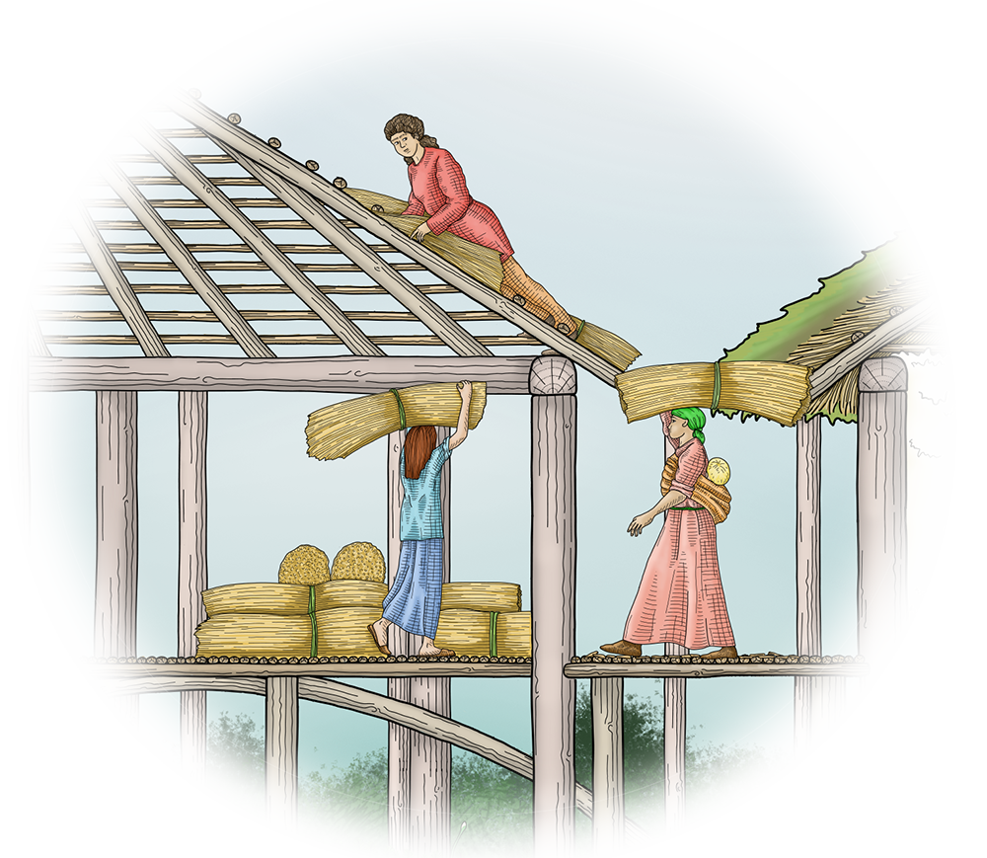
Adding the roof
How did the artist know they used straw and turf to make the roof waterproof?
Notes:
Images © Vicki Herring.

Slide 15
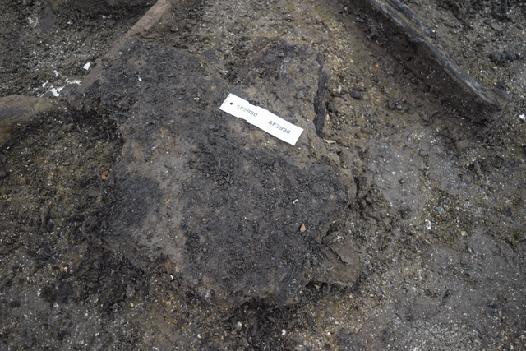
Lots of burnt turf was found during the excavation at Must Farm Bronze Age Village
Notes:
Image © CAU
https://www.mustfarm.com/progress/site-diary-30-our-houses-what-we-know-and-what-we-dont-part-three/

Slide 16
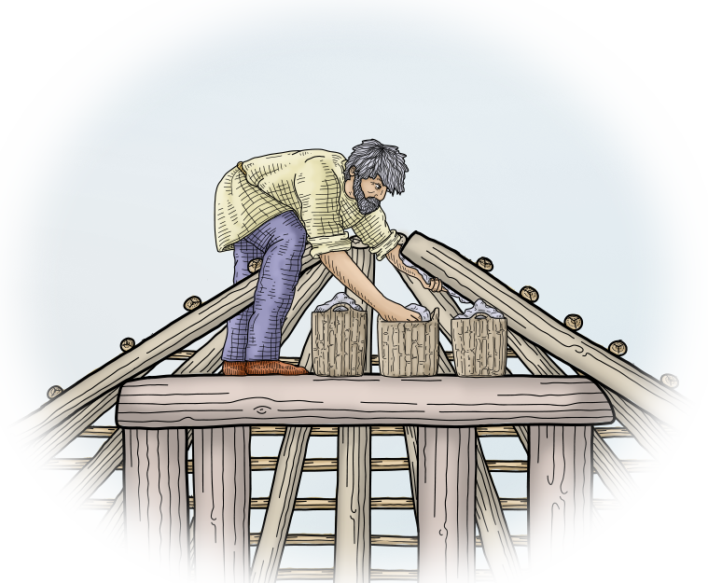
Adding clay to the roof
How did the artist know they added clay to the top of the roof to act as a sort of chimney?
Notes:
Images © Vicki Herring.

Slide 17
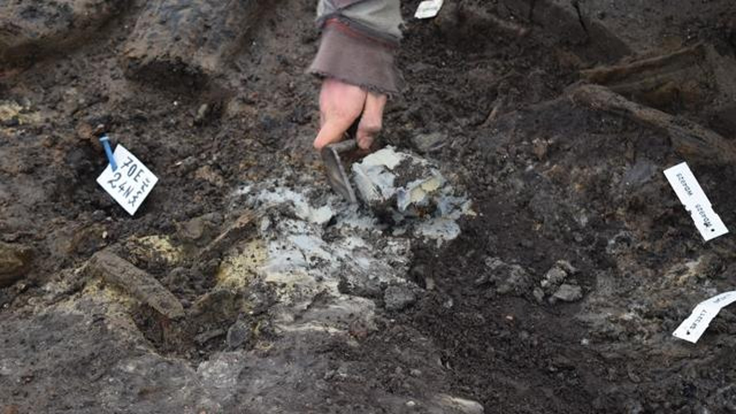
Large lumps of clay were also found during the excavation at Must Farm Bronze Age Village
Notes:
Image © CAU
https://www.mustfarm.com/progress/site-diary-30-our-houses-what-we-know-and-what-we-dont-part-three/

Slide 18
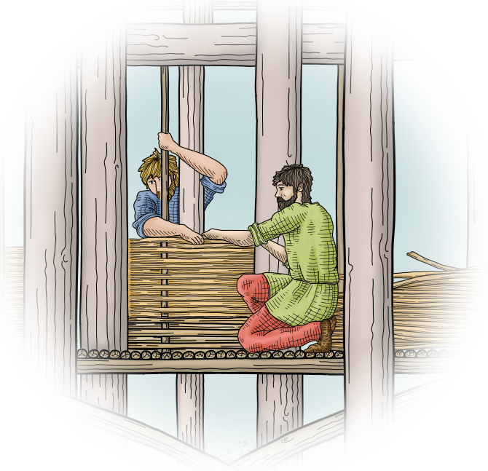
Wattle panels for the walls, floors and walkways
How did the artist know they used wattle panels for the walls, floors and walkways?
Notes:
Images © Vicki Herring.

Slide 19
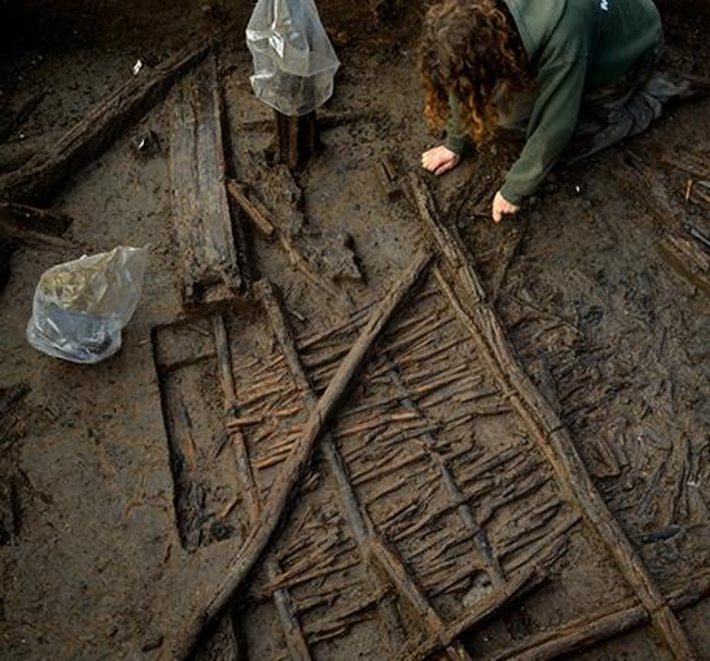
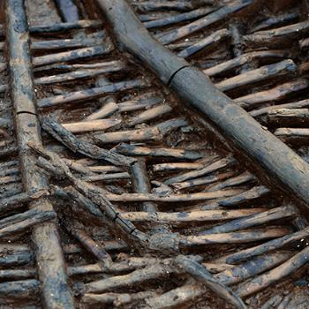
Large quantities of wattle panels were found during the excavation at Must Farm Bronze Age Village
Notes:
Images ©CAU
https://www.mustfarm.com/post-dig/post-ex-diary-21-the-importance-of-visualisation-photography-part-two/
https://www.mustfarm.com/progress/site-diary-7-what-is-the-timber-platform/
https://www.mustfarm.com/post-dig/post-ex-diary-13-the-must-farm-pile-dwelling-settlement-open-access-antiquity-article/

Slide 20
Building a Roundhouse in 12 steps
One of the archaeologists who worked on the excavation, made a model to explain how they think the houses were built …

Slide 21
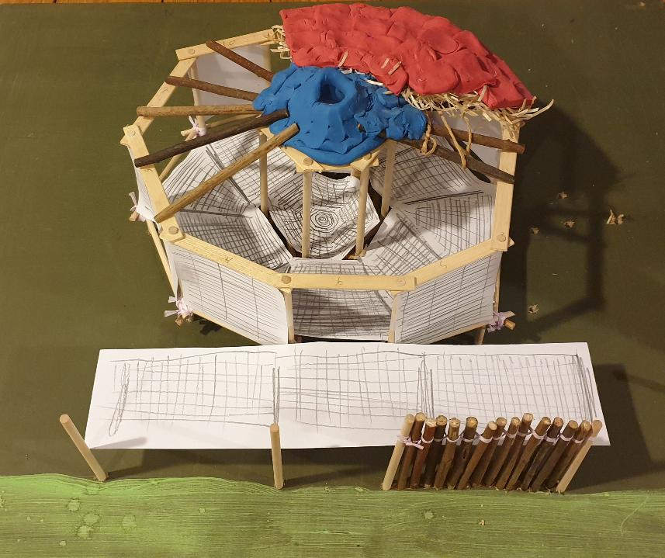
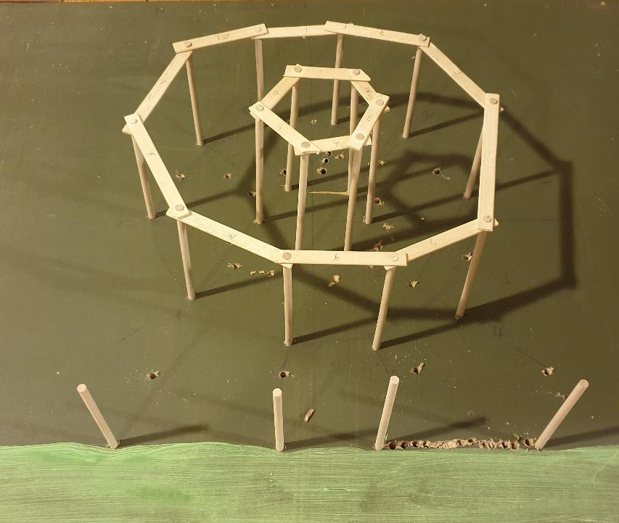
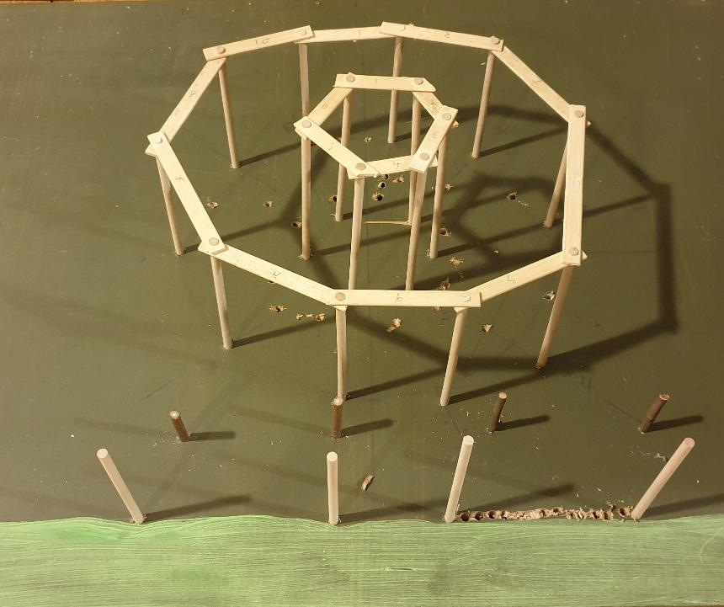
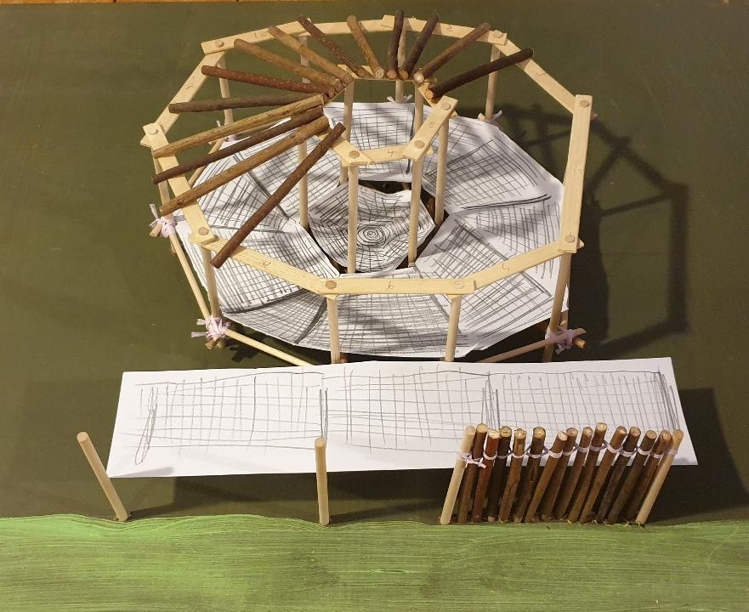
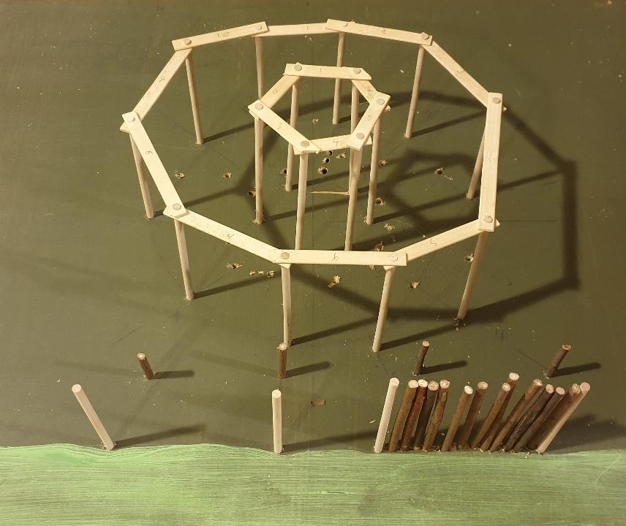
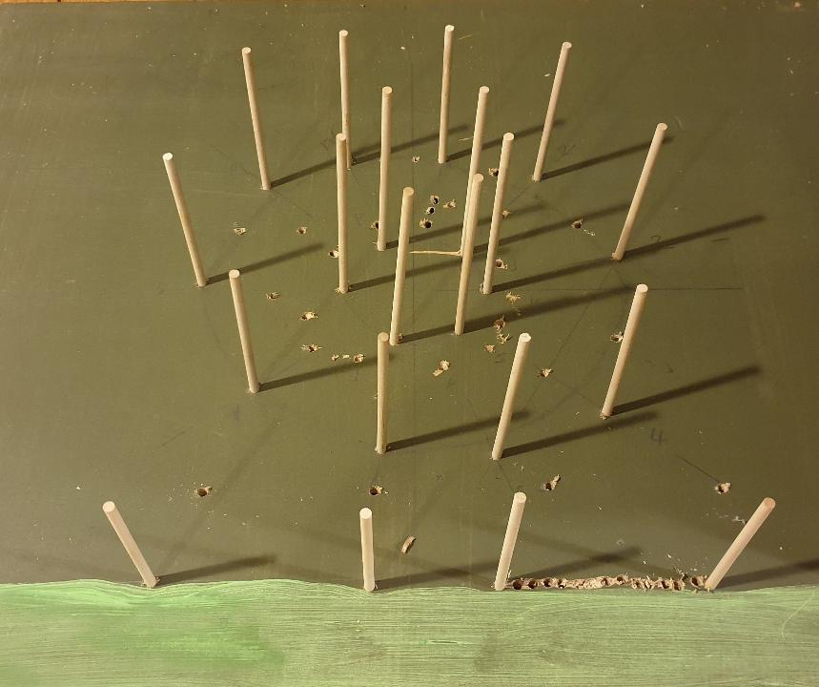
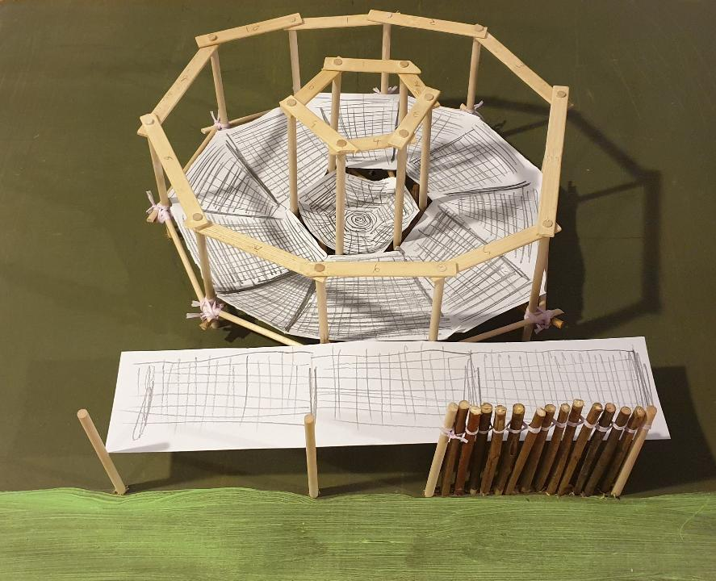
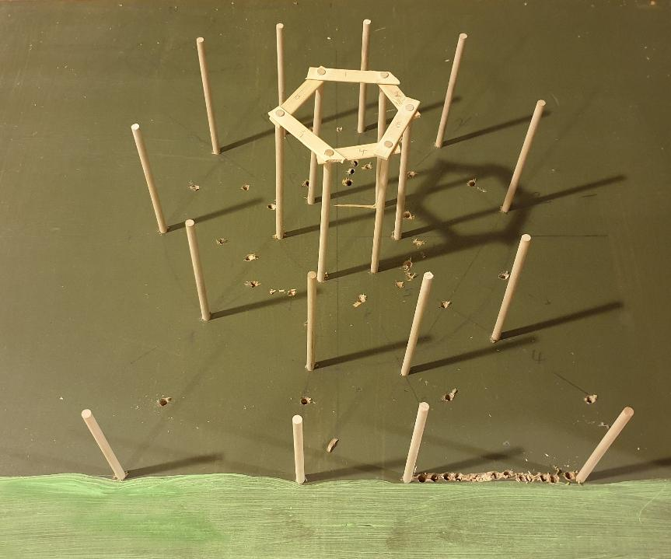
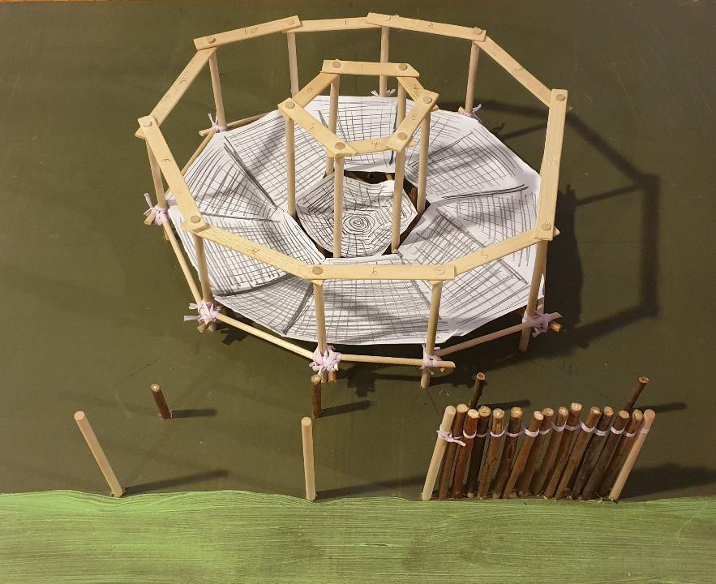
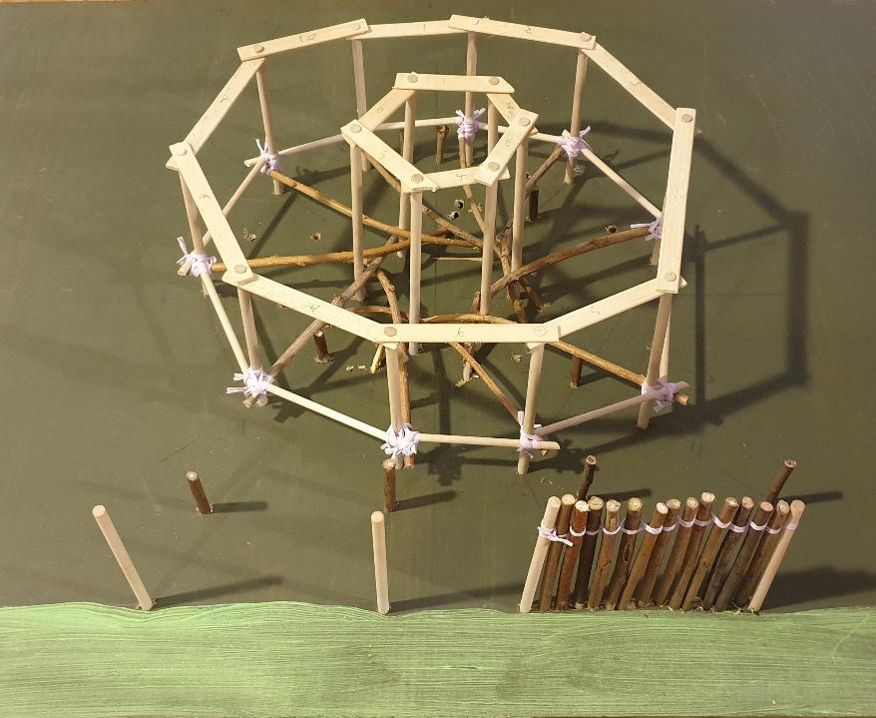
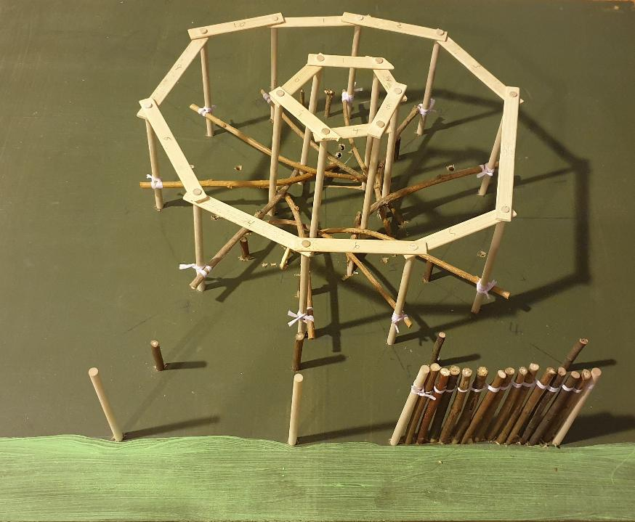
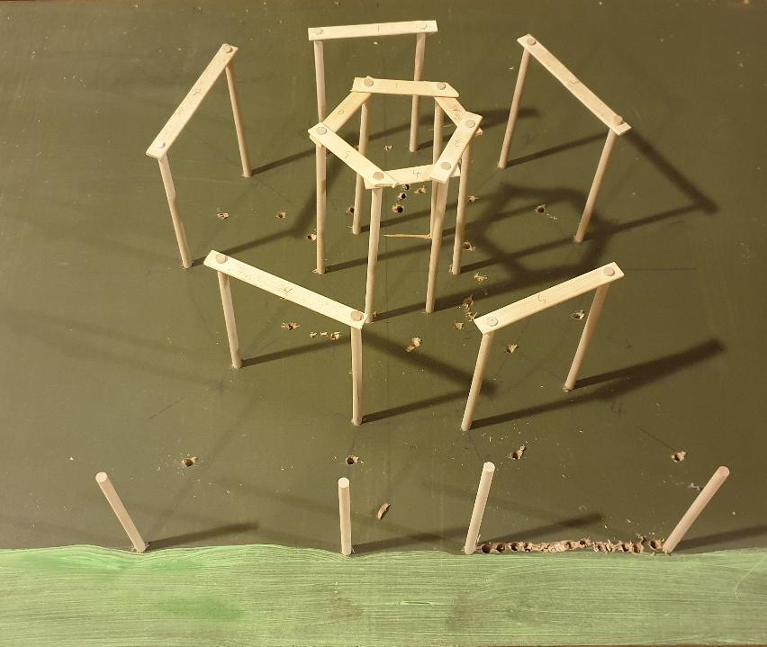
Building a Roundhouse in 12 steps.
Step 1: big wooden posts called piles were pushed into the mud
Building a Roundhouse in 12 steps a
Step 2: wooden planks joined the tops of the inner circle of piles
Step 3&4: wooden planks joined the tops of the outer circle of piles
Step 5: shorter piles were added inside the palisade (defensive fence)
Step 6: more piles were added to create the palisade
Step 7: curved posts to support the floor are tied with rope to the piles
Step 8: the frame is strengthened
Step 9: wattle panels are added to make the floor inside the house
Step 10: wattle panels are added to make walkways inside the palisade
Step 11: wooden poles called rafters are added to support the roof
Step 12: wattle panels are added to make the walls and layers of straw, turf and clay are added to the roof
Notes:
Images © CAU

Slide 22
‘How did they build the Bronze Age Village at Must Farm?’
Match up the reconstruction illustration with the evidence from the site that supports it.
Put the images into a chronological sequence to show the stages in the construction of the Bronze Age Village at Must Farm.
Label your own diagram of the Construction of the village

Slide 23
Building Must Farm Bronze Age Village c.850BC
Building Must Farm Bronze Age Village c.850BC
Where did they find enough wood?
Evidence that they used an axe
Some of the trees, like oak and ash, grow in drier ground so the builders would have had to travel further away to find them and cut them down. After they had chopped the trees down people would have dragged them to the nearest river. They could have floated the logs on the water making it easier to move them to where they needed to be.
Not only did they find ….. bronze axe heads during the excavation of the Must Farm Bronze Age Village but they found many that were still attached to their wooden handles or haft. This is very rare as wood normally decays.
Notes:
Image © Vicki Herring.
Image ©CAU
https://www.mustfarm.com/progress/site-diary-38-announcing-our-finds/

Slide 24
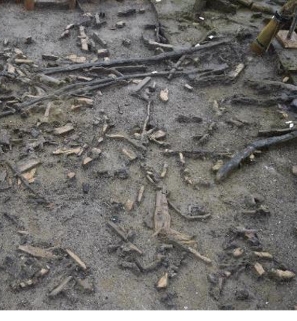
Building Must Farm Bronze Age Village c.850BC a
Building Must Farm Bronze Age Village c.850BC
How did they get the posts in the ground?
Evidence of woodchips
Houses were built from two circles of posts which people then added walls, floors and roofs. Once they got the large tree trunks to the site, people would have used axes to chop them into shape and create sharp points on their tips.
Archaeologists found hundreds of woodchips left behind when people used axes to shape the wood used to build the village. As the river was shallow and slow in the summer, the woodchips didn’t get washed away.
Notes:
Image © Vicki Herring.
Images ©CAU
https://www.mustfarm.com/progress/site-diary-31-moving-towards-the-end-of-excavation/
https://www.mustfarm.com/progress/site-diary-32-the-lifespan-of-the-must-farm-settlement/

Slide 25
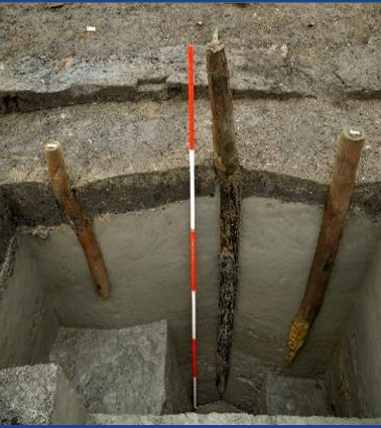
Building Must Farm Bronze Age Village c.850BCb
Building Must Farm Bronze Age Village c.850BC
How were the house supported over the river?
Evidence for piles!
At Must Farm the big wooden posts that raised the houses out of the water are called piles. There are very important as they held up the buildings and supported the roofs. A group of people would then have pushed the piles into the firm mud at the bottom of the river to hold it in place.
The piles were made from oak and ash trees that were chosen because they were straight and already close to the right size. In this photo taken during the excavation, we can see how deep they pushed the post into the mud helped by the pointed tip.
Notes:
Image © Vicki Herring.
Images ©CAU
https://www.mustfarm.com/progress/site-diary-33-the-palisade-and-its-construction/

Slide 26
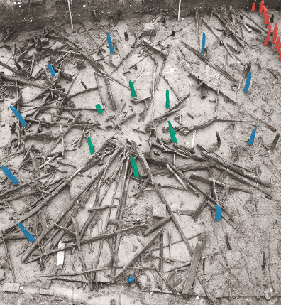
Building Must Farm Bronze Age Village c.850BCc
Building Must Farm Bronze Age Village c.850BC
What shape were the houses?
Evidence for the two circles of posts
Houses were built from two circles of posts which people then added walls, floors and roofs to. The buildings at Must Farm are circular in shape and are called roundhouses. Archaeologists find lots of roundhouses but the ones at Must Farm are special because they were built on stilts over a river.
Overhead shot showing the outer (BLUE) and inner rings (GREEN) of posts, plus the fence around the settlement (RED). The outer rings and inner rings are made up of very similar oak posts that are roughly the same diameter. These are substantial posts and must have provided the main support for the raised building.
Notes:
Image © Vicki Herring.
Images ©CAU
https://www.mustfarm.com/progress/site-diary-12-discovering-our-first-house/

Slide 27
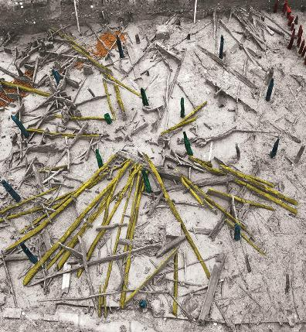
Building Must Farm Bronze Age Village c.850BCd
Building Must Farm Bronze Age Village c.850BC
How did they make the roof waterproof?
Evidence for rafters and turf
The roundhouses would have had roofs made from a framework of wooden rafters joined in an apex in the centre of the building. The other end of the rafters would have formed eaves over the walls and helped water to run off the roof and into the river. A bottom layer of straw and a top layer of turf were added to help make the buildings waterproof.
The rafters (yellow). Chunks of burnt turf were found and it seems likely that the roof was covered with turf rather than reeds or straw. If the roof was made of turf, then it would have been very heavy – probably upwards of a tonne.
Notes:
Image © Vicki Herring.
Images ©CAU
https://www.mustfarm.com/progress/site-diary-12-discovering-our-first-house/

Slide 28
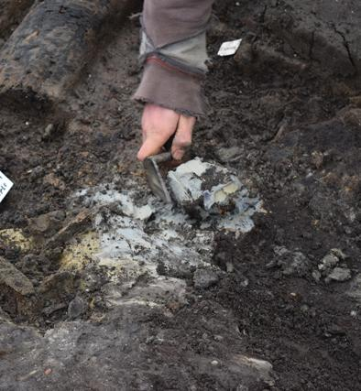
Building Must Farm Bronze Age Village c.850BCe
Building Must Farm Bronze Age Village c.850BC
Did the houses have a chimney?
Evidence for a smoke hole
Each of the houses had a fire inside, called a hearth, that would have been used for cooking and to provide warmth for the animals and people living there. Clay was also added around the top of the roof which could have been used to help release smoke and keep the rain out.
Finds of unburnt clay containing small pockets of burnt turf material led the archaeologists to think that this would have been used at the apex of the roof, maybe making a sort of chimney.
Notes:
Image © Vicki Herring.
Images ©CAU
https://www.mustfarm.com/progress/site-diary-30-our-houses-what-we-know-and-what-we-dont-part-three/

Slide 29
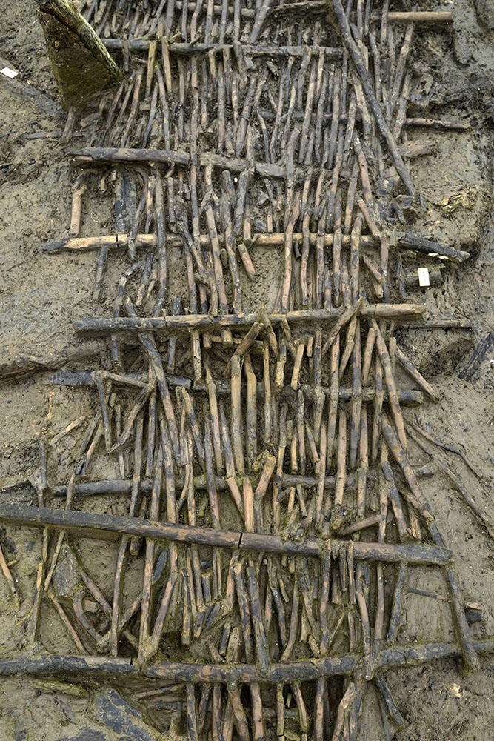
Building Must Farm Bronze Age Village c.850BCf
Building Must Farm Bronze Age Village c.850BC
What were the walls and floors made from?
Evidence for wattle panels
The floors and walkways were made by weaving together thinner pieces of wood to make wattle panels. The walls would also have been made from wattle. Archaeologists think that the people living at Must Farm might have hung animal skins or textiles on the inside of the walls to keep them warmer and block the wind.
Wattle panels are made by weaving willow around ash uprights, like some fence panels are made today. Bundles of willow formed the floor These would have created quite a springy floor made of panels held in place by wall plates running round at this level.
Notes:
Image © Vicki Herring.
Images ©CAU
https://www.mustfarm.com/post-dig/post-ex-diary-21-the-importance-of-visualisation-photography-part-two/
https://www.mustfarm.com/progress/site-diary-7-what-is-the-timber-platform/
https://www.mustfarm.com/post-dig/post-ex-diary-13-the-must-farm-pile-dwelling-settlement-open-access-antiquity-article/

Slide 30



Class Discussion
How clever were the people who built the Bronze Age Village at Must Farm?
How skilled were the people who built the Bronze Age Village at Must Farm?
Do you think women would have been involved in building the village?
How well organised were the people who built the Bronze Age Village at Must Farm?
Are the Reconstruction Images completely accurate?

Slide 31
Building the Bronze Age Village at Must Farm c.850BC
Add labels to explain what is happening in the reconstruction illustration.
Notes:
Image © Vicki Herring.

Slide 32
Find and label these features on your reconstruction drawing of the Construction of the Must Farm Bronze Age Village
Large tree trunks were chopped into shape with sharp points on their tips | Tree trunks
Big wooden posts called piles were pushed into the mud creating inner and outer rings | Piles
Curved posts to support the floor were tied with rope to the piles | Curved posts
Wattle panels were added to make the walls | Walls
Wooden planks and wattle panels were added to make the floor inside the house | Wooden planks
Wooden poles called rafters were added to support the roof | Rafters
An axe was buried under the village possibly as an offering | Axe
Layers of straw and turf were added to the roof | Straw and turf
Clay was added around the opening at the apex (top) of the roof | Clay
Animal skins may have been hung on the inside walls for warmth | Animal skins
More piles and posts were added to create the palisade | Palisade

Slide 33
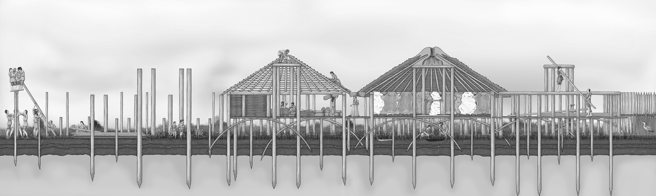
Building the Bronze Age Village at Must Farm c.850BC
Add labels to explain what is happening in the reconstruction illustration. a
Notes:
Image © Vicki Herring.

Slide 34
Building the Bronze Age Village at Must Farm c.850BC
Add labels to explain what is happening in the reconstruction illustration - Answers
straw and turf
clay
animal skins
palisade
tree trunks
piles
curved posts
walls
wooden planks
rafters
axe
Notes:
Image © Vicki Herring.

Slide 35
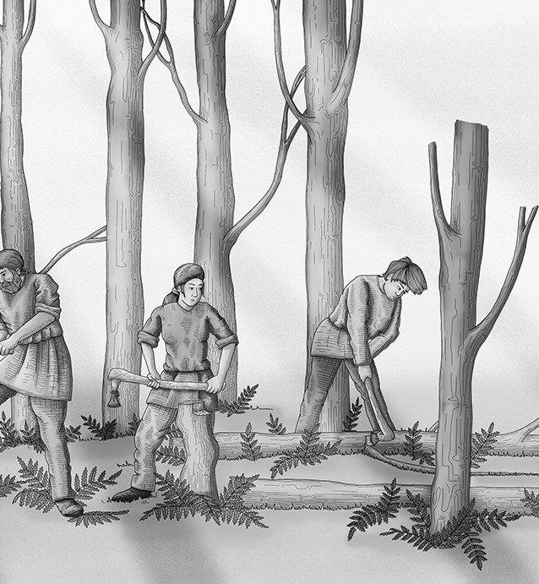
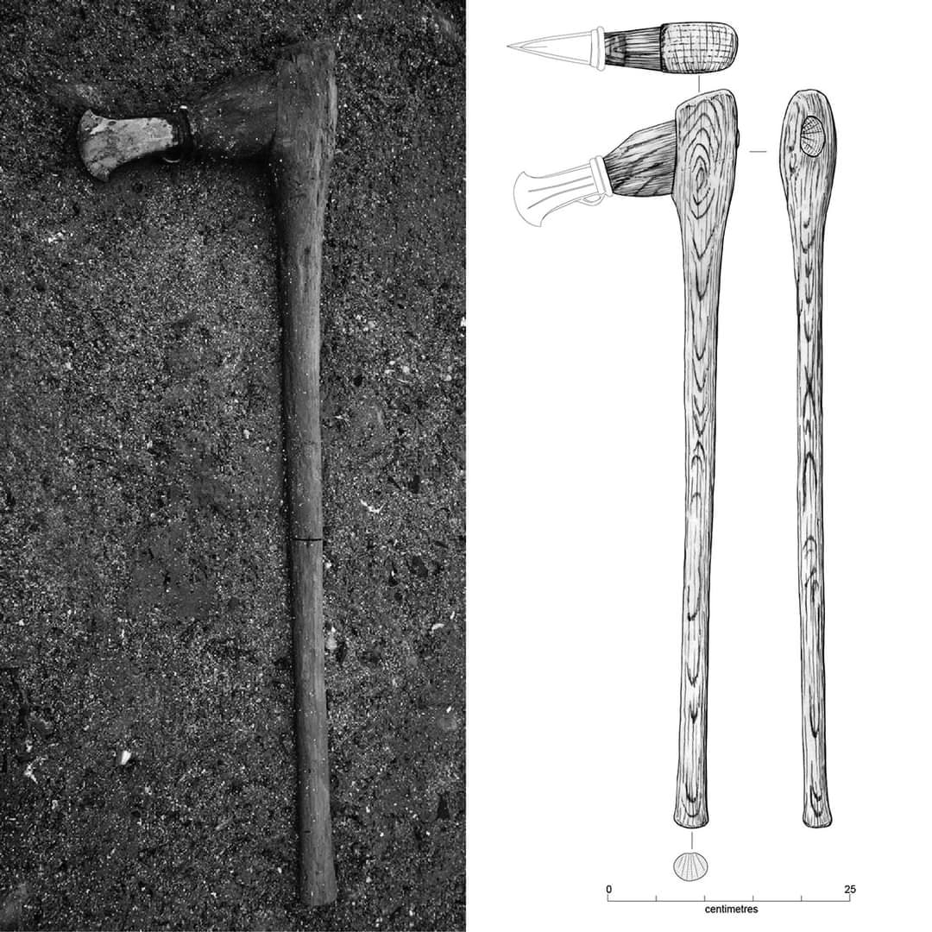
Building Must Farm Bronze Age Village c.850BC
Building Must Farm Bronze Age Village c.850BC
Where did they find enough wood?
Evidence that they used an axe
Some of the trees, like oak and ash, grow in drier ground so the builders would have had to travel further away to find them and cut them down. After they had chopped the trees down people would have dragged them to the nearest river. They could have floated the logs on the water making it easier to move them to where they needed to be.
Not only did they find ….. Bronze axe heads during the excavation of the Must Farm Bronze Age Village but they found many that were still attached to their wooden handles or haft, This is very rare as wood normally decays,
Notes:
Image © Vicki Herring.
Images ©CAU
https://www.mustfarm.com/progress/site-diary-38-announcing-our-finds/

Slide 36
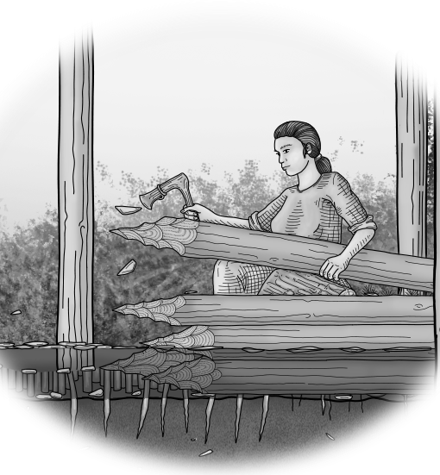
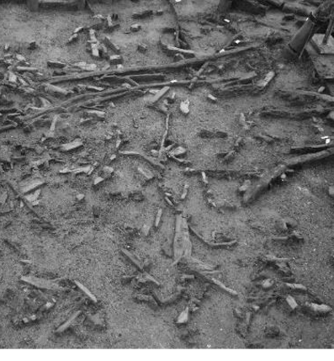
Building Must Farm Bronze Age Village c.850BC ba
Building Must Farm Bronze Age Village c.850BC
How did they get the posts in the ground?
Evidence of woodchips
Houses were built from two circles of posts which people then added walls, floors and roofs to. Once they got the large tree trunks to the site, people would have used axes to chop them into shape and create sharp points on their tips.
Archaeologists found hundreds of woodchips left behind when people used axes to shape the wood used to build the village. As the river was shallow and slow in the summer, the woodchips didn’t get washed away.
Notes:
Image © Vicki Herring.
Images ©CAU
https://www.mustfarm.com/progress/site-diary-31-moving-towards-the-end-of-excavation/
https://www.mustfarm.com/progress/site-diary-32-the-lifespan-of-the-must-farm-settlement/

Slide 37
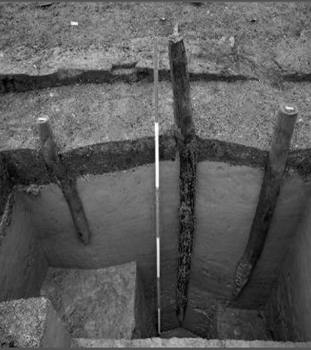
Building Must Farm Bronze Age Village c.850BCbe
Building Must Farm Bronze Age Village c.850BC
How were the house supported over the river?
Evidence for piles!
AAt Must Farm the big wooden posts that raised the houses out of the water are called piles. There are very important as they held up the buildings and supported the roofs. A group of people would then have pushed the piles into the firm mud at the bottom of the river to hold it in place.
The piles were made from oak and ash trees that were chosen because they were straight and already close to the right size. In this photo taken during the excavation, we can see how deep they pushed the post into the mud helped by the pointed tip.
Notes:
Image © Vicki Herring.
Images ©CAU
https://www.mustfarm.com/progress/site-diary-33-the-palisade-and-its-construction/

Slide 38
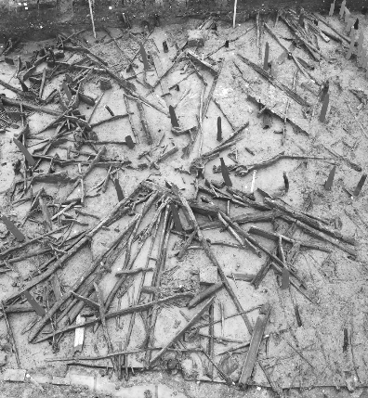
Building Must Farm Bronze Age Village c.850BCcd
Building Must Farm Bronze Age Village c.850BC
What shape were the houses?
Evidence for the two circles of posts
Houses were built from two circles of posts which people then added walls, floors and roofs to. The buildings at Must Farm are circular in shape and are called roundhouses. Archaeologists find lots of roundhouses but the ones at Must Farm are special because they were built on stilts over a river.
Overhead shot showing the outer (BLUE) and inner rings (GREEN) of posts, plus the fence around the settlement (RED). The outer rings and inner rings are made up of very similar oak posts that are roughly the same diameter. These are substantial posts and must have provided the main support for the raised building.
Notes:
Image © Vicki Herring.
Images ©CAU
https://www.mustfarm.com/progress/site-diary-12-discovering-our-first-house/

Slide 39
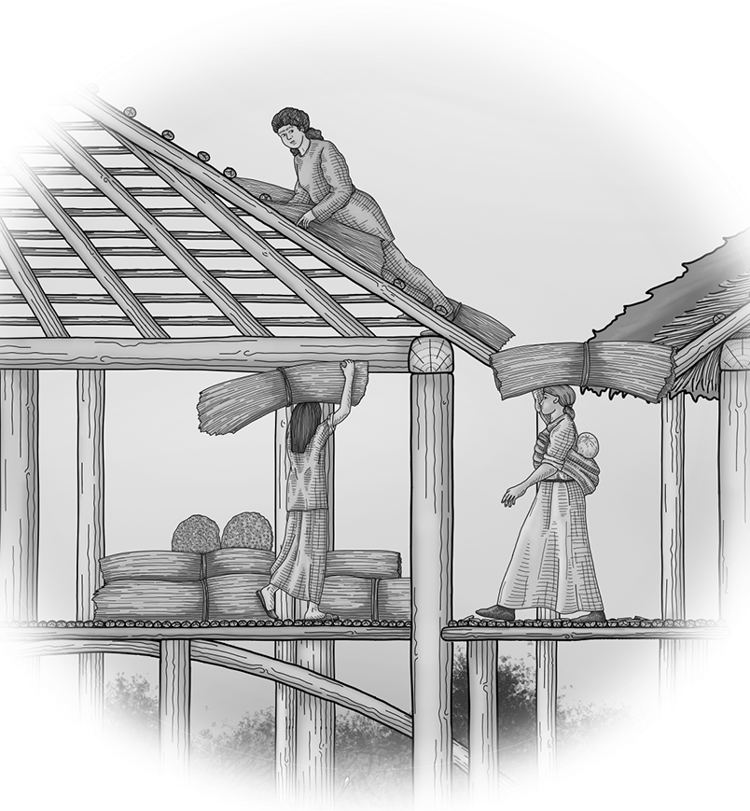
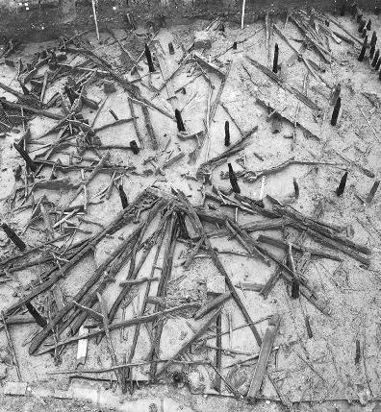
Building Must Farm Bronze Age Village c.850BCdc
Building Must Farm Bronze Age Village c.850BC
How did they make the roof waterproof?
Evidence for rafters and turf
The roundhouses would have had roofs made from a framework of wooden rafters joined in an apex in the centre of the building. The other end of the rafters would have formed eaves over the walls and helped water to run off the roof and into the river. A bottom layer of straw and a top layer of turf were added to help make the buildings waterproof.
The rafters (yellow). Chunks of burnt turf were found and it seems likely that the roof was covered with turf rather than reeds or straw. If the roof was made of turf, then it would have been very heavy – probably upwards of a tonne.
Notes:
Image © Vicki Herring.
Images ©CAU
https://www.mustfarm.com/progress/site-diary-12-discovering-our-first-house/

Slide 40
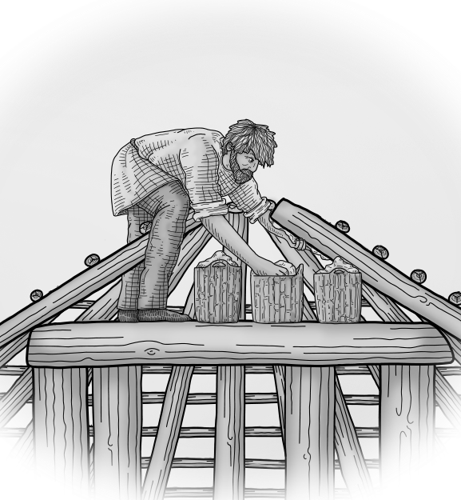
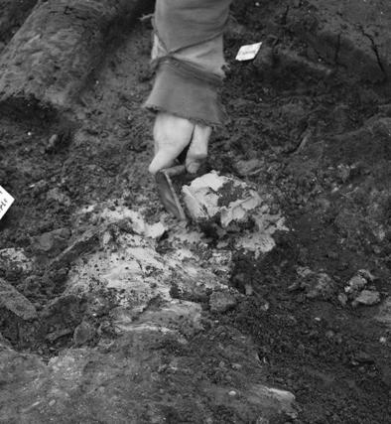
Building Must Farm Bronze Age Village c.850BCef
Building Must Farm Bronze Age Village c.850BC
Did the houses have a chimney?
Evidence for a smoke hole
Each of the houses had a fire inside, called a hearth, that would have been used for cooking and to provide warmth for the animals and people living there. Clay was also added around the top of the roof which could have been used to help release smoke and keep the rain out.
Finds of unburnt clay containing small pockets of burnt turf material led the archaeologists to think that this would have been used at the apex of the roof, maybe making a sort of chimney.
Notes:
Image © Vicki Herring.
Images ©CAU
https://www.mustfarm.com/progress/site-diary-30-our-houses-what-we-know-and-what-we-dont-part-three/

Slide 41
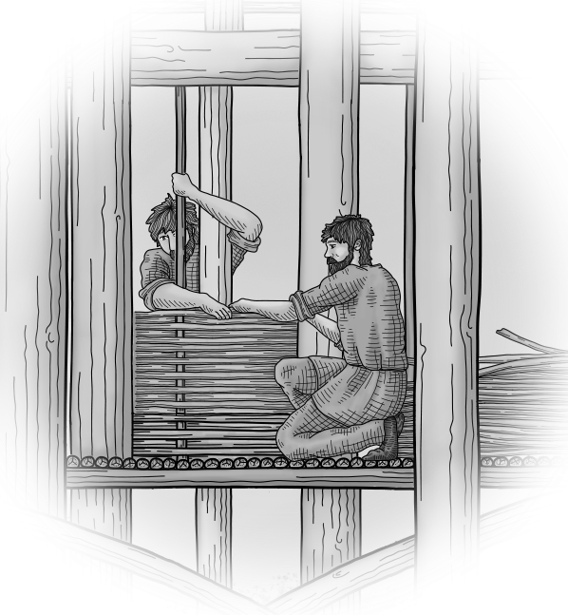
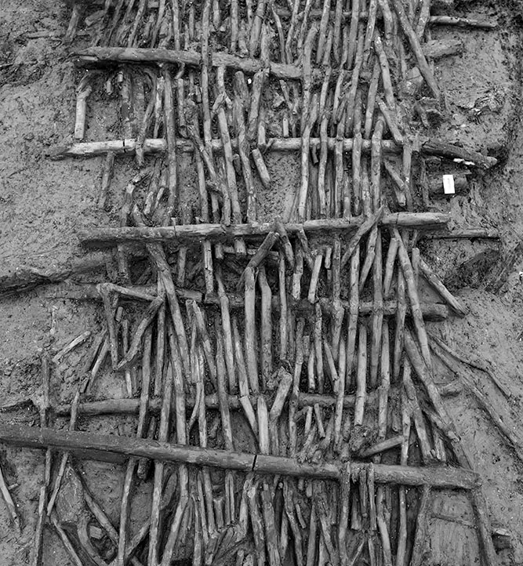
Building Must Farm Bronze Age Village c.850BCfb
Building Must Farm Bronze Age Village c.850BC
What were the walls and floors made from?
Evidence for wattle panels
The floors and walkways were made by weaving together thinner pieces of wood to make wattle panels. The walls would also have been made from wattle. Archaeologists think that the people living at Must Farm might have hung animal skins or textiles on the inside of the walls to keep them warmer and block the wind.
Wattle panels are made by weaving willow around ash uprights, like some fence panels are made today. Bundles of willow formed the floor These would have created quite a springy floor made of panels held in place by wall plates running round at this level.
Notes:
Image © Vicki Herring.
Images ©CAU
https://www.mustfarm.com/post-dig/post-ex-diary-21-the-importance-of-visualisation-photography-part-two/
https://www.mustfarm.com/progress/site-diary-7-what-is-the-timber-platform/
https://www.mustfarm.com/post-dig/post-ex-diary-13-the-must-farm-pile-dwelling-settlement-open-access-antiquity-article/

