Slide 1
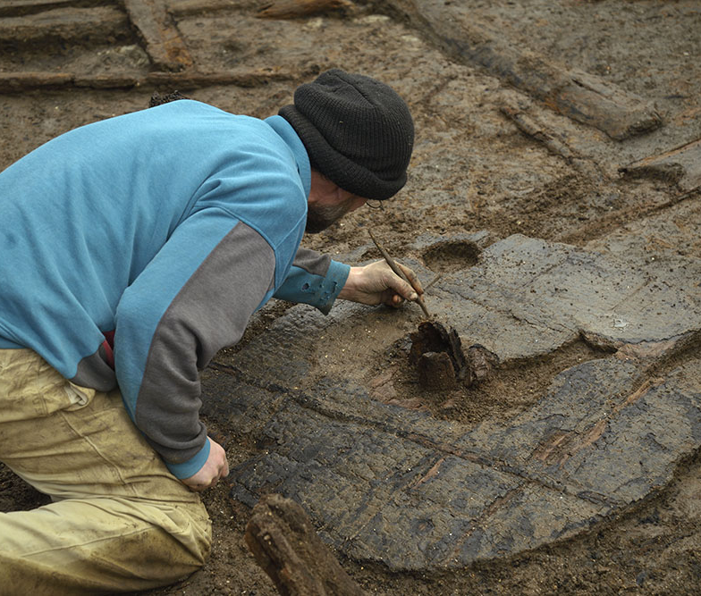
Must Farm
Bronze Age Village
Activity 1
Rot or Not?
Must Farm
Bronze Age Village
Activity 1: Rot or Not?
Why is the Must Farm Bronze Age Village a remarkable archaeological site?
Notes:
Image ©CAU

Slide 2
Why is the Must Farm Bronze Age Village such a remarkable and significant archaeological site?
Key Stage 2 History
Pupils will weigh evidence and draw conclusions
Pupils will develop their understanding of the methods of historical enquiry, including how evidence is used rigorously to make historical claims.
Pupils should understand how our knowledge of the past is constructed from a range of sources.
KS2 Unit: Changes in Britain from the Stone Age to the Iron Age: Bronze Age religion, technology and travel

Slide 3
How to use this PowerPoint
Accompanying Resources
This is a whole class activity although some sections could be organised for smaller groups by making printed copies of slide 6 and/or the objects slides 11-15 for them to do individually or in groups first.
Some understanding of fractions and percentages is needed for slide 20
Video: What do archaeologists find?
Video: Introducing Must Farm
PPT: What is Archaeology?
ZIP Folder: Images – 8 themed PPTs with high quality images of artefacts and reconstruction illustrations from Must Farm Bronze Age Village

Slide 4
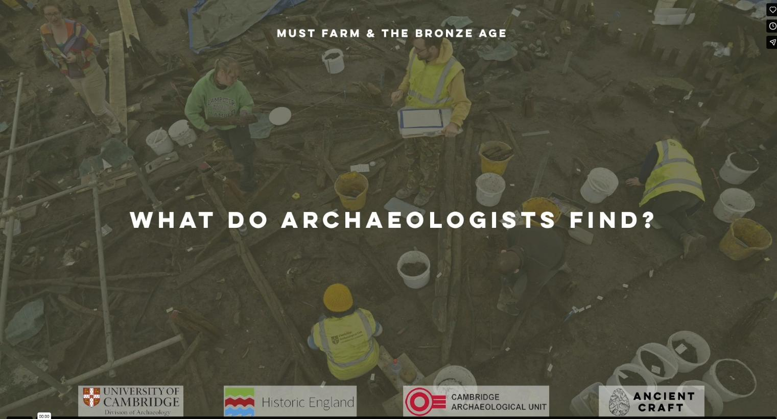
What do archaeologists find?
Notes:
https://vimeo.com/1045048298
Duration 2.06 mins
See Teacher Pack for transcription

Slide 5
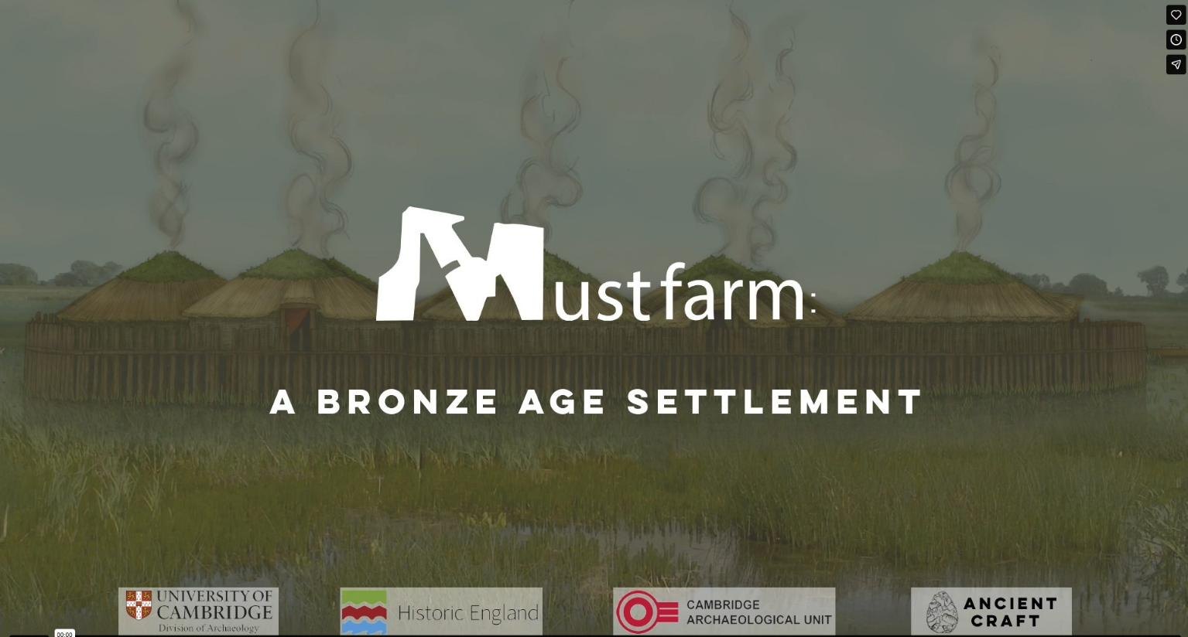
Must Farm: A Bronze Age Settlement
Notes:
https://vimeo.com/1045053069
Duration 8.20 mins
See Teacher Pack for transcription

Slide 6
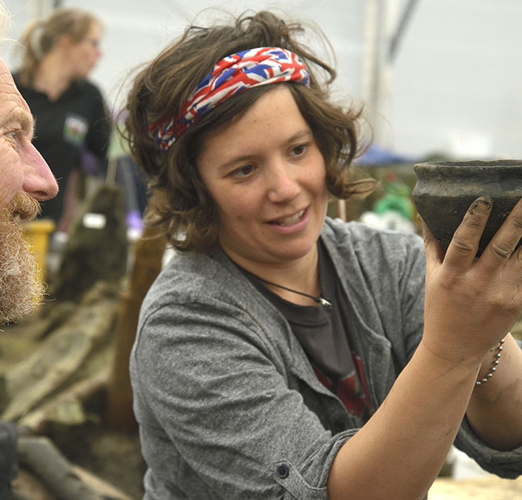
An archaeologist’s job
We can find out lots about the past by looking at archaeological evidence
It's an archaeologist’s job to look at evidence, such as artefacts and buildings, from the past and to try and interpret them.
Could YOU be an archaeologist?
Two archaeologist discuss a pot recently excavated from the mud at the Must Farm Bronze Age Village
Notes:
Image ©CAU

Slide 7

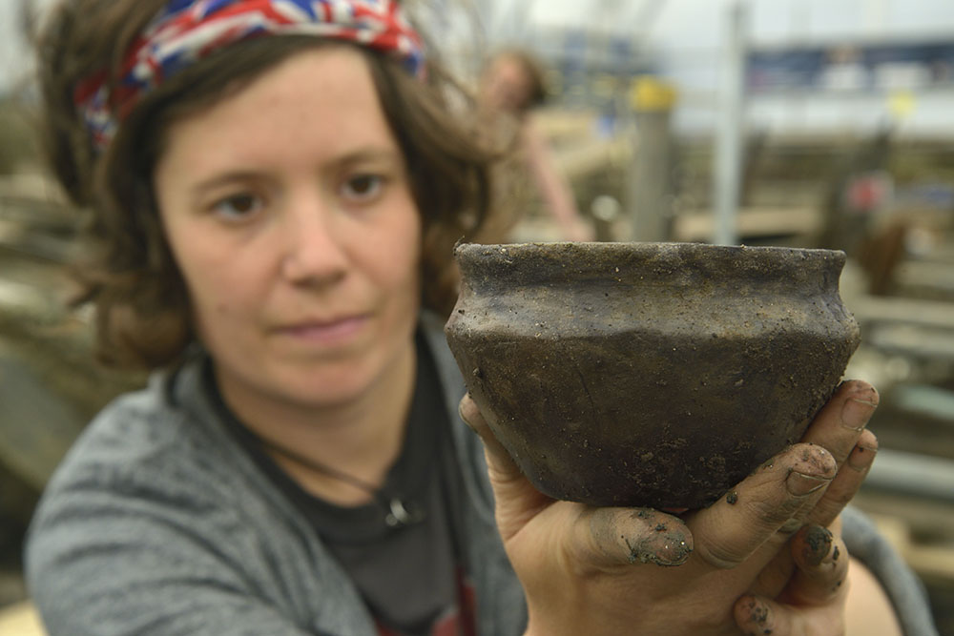




Learn to speak ‘archaeologist’.
To be an archaeologist you need to learn some new words
Archaeology:
The study of the lives of people in the past
Excavate:
To dig up and record archaeological remains
Interpret:
To try and explain what something means
Artefact:
Any object made or
changed by people
Evidence:
Information to support an idea/interpretation
Notes:
Image ©CAU

Slide 8







Why do archaeologists find some artefacts and not others?
Not everything that people used in the past survives for archaeologists to find.
Many things simply rot away. Archaeologists call these things ORGANIC.
To an archaeologist organic means anything made from something living. So, things made from wood, animal skins, wool or plants are all made from organic material.
Organic material eventually rots away because BACTERIA eats it.
Bacteria are living things, and they need food (organic things), water and air to survive just like we do.
This is what happens on most archaeological sites.

Slide 9
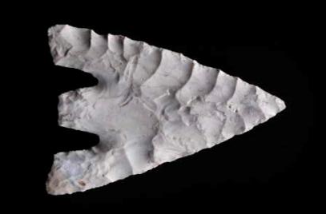
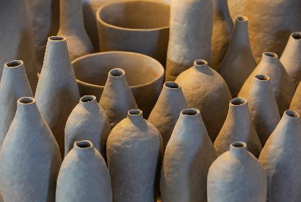
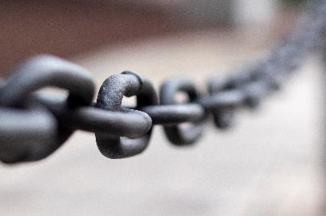

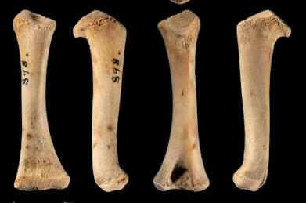
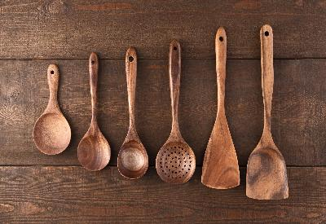
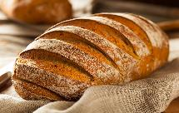

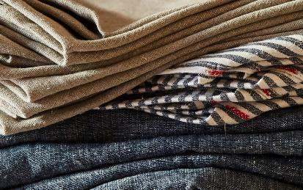
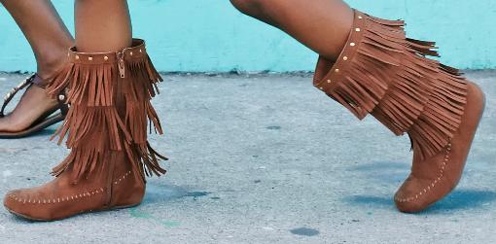

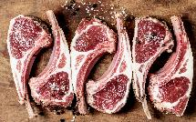
Imagine you are excavating a typical archaeological site in Britain
Do you think these artefacts would Rot or Not?
Pottery
Flint
Metal
Bones
Wood
Food
Fabric
Leather
Notes:
Pottery Image: Collection of pottery vessels: ©Microsoft 365 Stock Image
Metal Image: metal chain links: ©Microsoft 365 Stock Image
Flint Image: Flint Arrowhead ©Historic England https://historicengland.org.uk/images-books/photos/item/DP348483
Bones Image: collection of animal bones ©Historic England https://historicengland.org.uk/images-books/photos/item/DP439889
Wood Image: Wooden spoons of various shapes and sizes laid on wood table ©Microsoft 365 Stock Image
Food Image: 4 image group Bread, fruit and vegetables, eggs, meat ©Microsoft 365 Stock Image
Fabric Image: A person (cropped holding folds of fabric ©Microsoft 365 Stock Image
Leather Image: A young person cropped wearing a pair of leather boots ©Microsoft 365 Stock Image

Slide 10
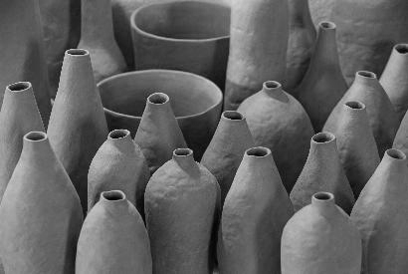
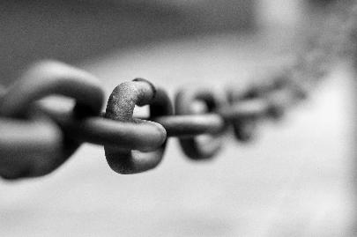

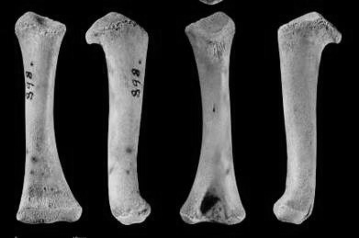
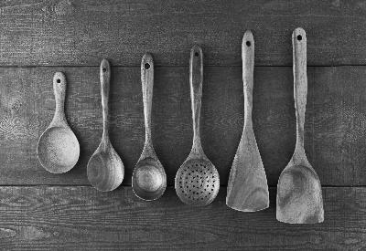

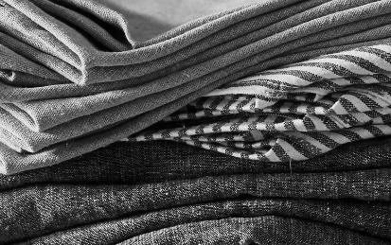
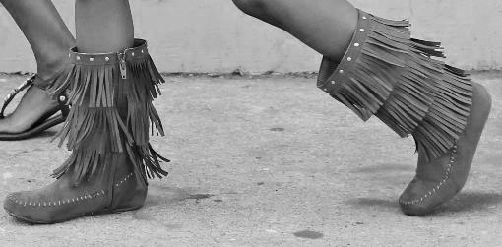
Imagine you are excavating a typical archaeological site in Britain
Do you think these artefacts would Rot or Not? a
Pottery
Flint
Metal
Bones
Wood
Food
Fabric
Leather
Notes:
Pottery Image: Collection of pottery vessels: ©Microsoft 365 Stock Image
Metal Image: metal chain links: ©Microsoft 365 Stock Image
Flint Image: Flint Arrowhead ©Historic England https://historicengland.org.uk/images-books/photos/item/DP348483
Bones Image: collection of animal bones ©Historic England https://historicengland.org.uk/images-books/photos/item/DP439889
Wood Image: Wooden spoons of various shapes and sizes laid on wood table ©Microsoft 365 Stock Image
Food Image: 4 image group Bread, fruit and vegetables, eggs, meat ©Microsoft 365 Stock Image
Fabric Image: A person (cropped holding folds of fabric ©Microsoft 365 Stock Image
Leather Image: A young person cropped wearing a pair of leather boots ©Microsoft 365 Stock Image

Slide 11
You are excavating a typical archaeological site in Britain
Which artefacts would Rot or Not?
ROT
NOT

Slide 12

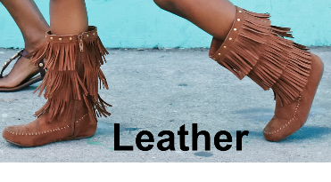
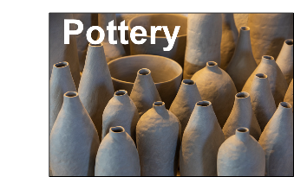
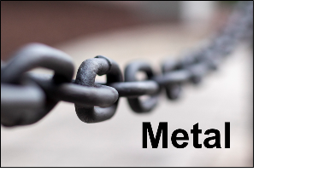

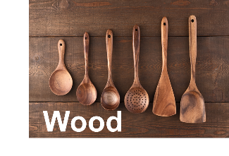
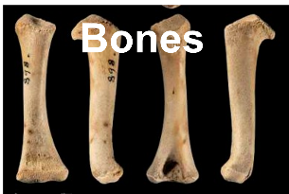
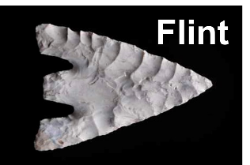
How did you do?
ROT
NOT
Notes:
Pottery Image: Collection of pottery vessels: ©Microsoft 365 Stock Image
Metal Image: metal chain links: ©Microsoft 365 Stock Image
Flint Image: Flint Arrowhead ©Historic England https://historicengland.org.uk/images-books/photos/item/DP348483
Bones Image: collection of animal bones ©Historic England https://historicengland.org.uk/images-books/photos/item/DP439889
Wood Image: Wooden spoons of various shapes and sizes laid on wood table ©Microsoft 365 Stock Image
Food Image: 4 image group Bread, fruit and vegetables, eggs, meat ©Microsoft 365 Stock Image
Fabric Image: A person (cropped holding folds of fabric ©Microsoft 365 Stock Image
Leather Image: A young person cropped wearing a pair of leather boots ©Microsoft 365 Stock Image

Slide 13

So why do archaeologists find some artefacts and not others??
At Must Farm Bronze Age Village, the wood and other organic material was buried in soft silty mud in a riverbed.
There is no air underwater or in the muddy riverbed so the bacteria couldn’t live.
This meant that lots of the organic materials such as wood, fabric and plants survived for the archaeologists to find.
This is very rare.
This is why Must Farm Bronze Age Village is such a special archaeological site
Not

Slide 14
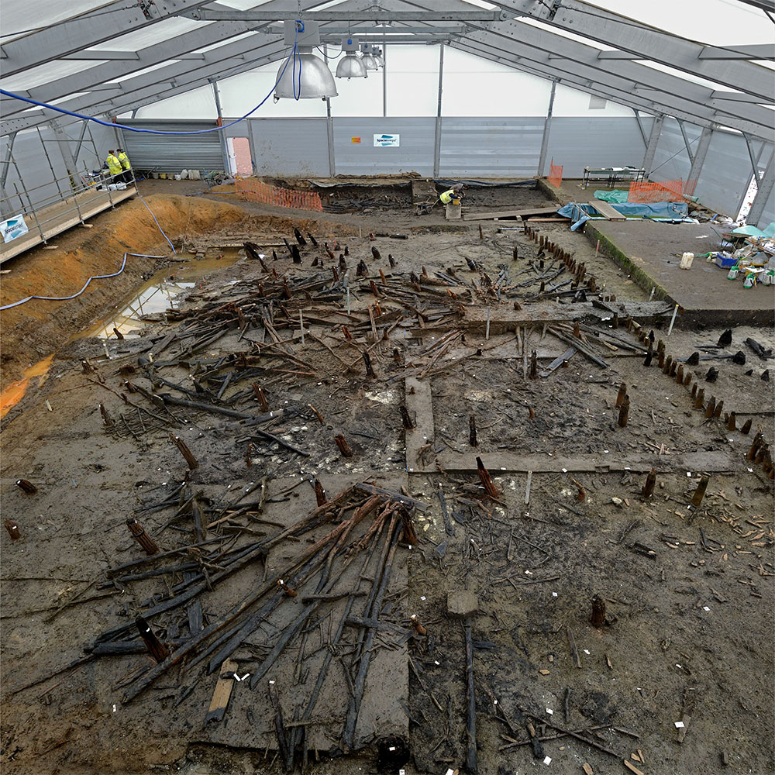

Focus on Must Farm: What would usually rot?
Look at the photographs of artefacts from the excavation at Must Farm on the following slides.
For each one decide what would have happened to it on a NORMAL archaeological site.
Would it rot or not?
The Excavation of the Bronze Age Village at Must Farm, Cambridgeshire began in 2016
Class discussion
Notes:
Image ©CAU

Slide 15
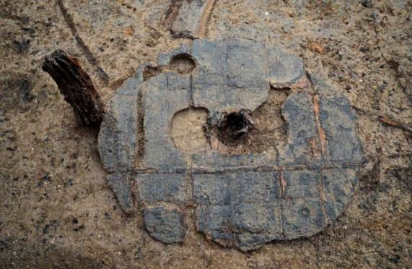
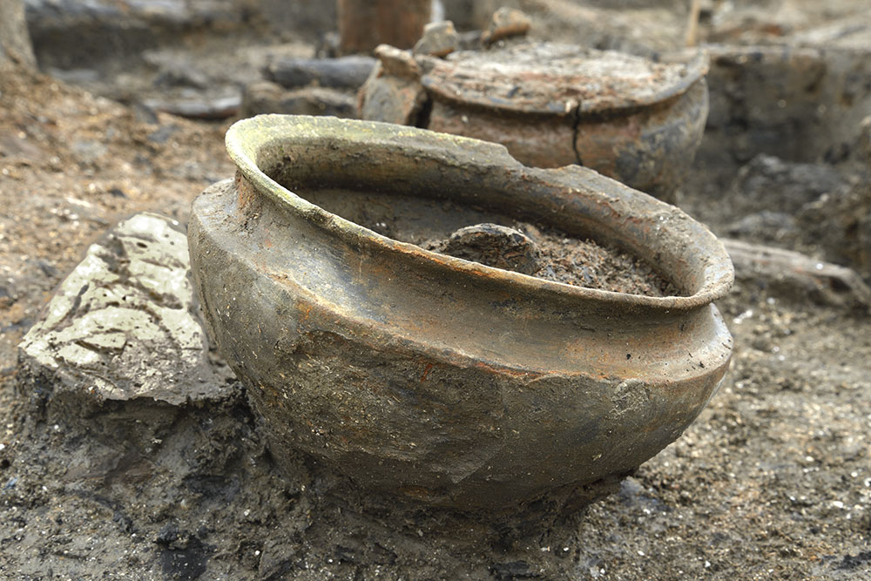
Focus on Must Farm: What would usually rot? flower
 | A wheel made of wood | Rot or Not?
 | A pottery bowl | Rot or Not?
Notes:
Images ©CAU
https://www.mustfarm.com/progress/site-diary-19-discovering-britains-oldest-complete-wheel/
https://historicengland.org.uk/whats-new/news/earliest-complete-bronze-age-wheel-discovered/
Image ©CAU
https://www.arch.cam.ac.uk/news/must-farm-volumes
https://www.forterra.co.uk/forterra-funding-uncovers-remarkable-bronze-age-settlement/

Slide 16
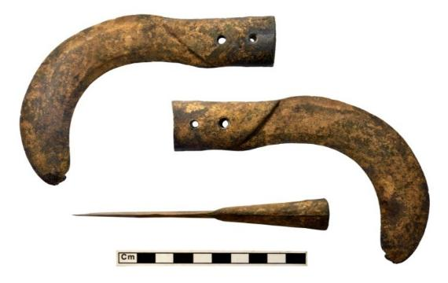
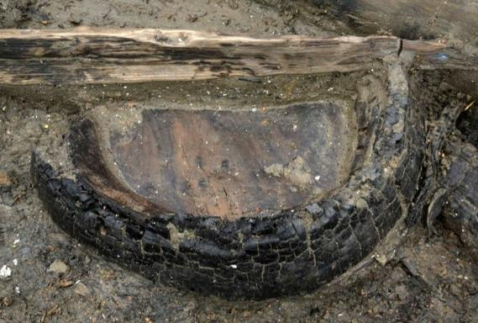
Focus on Must Farm: What would usually rot? treacle
 | Bronze (metal) sickles for cutting | Rot or Not?
 | Part of a wooden bucket | Rot or Not?
Notes:
Images ©CAU
https://www.mustfarm.com/progress/site-diary-25-wooden-objects/

Slide 17
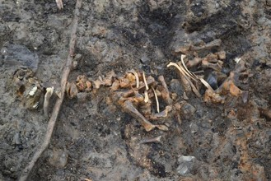
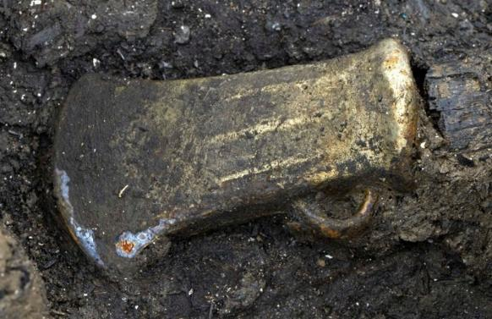
Focus on Must Farm: What would usually rot? sweetie
 | Animal bones | Rot or Not?
 | A bronze (metal) axe head | Rot or Not?
Notes:
Images ©CAU
https://www.mustfarm.com/post-dig/post-ex-diary-17-stable-isotope-analyses-and-must-farm/
https://www.mustfarm.com/progress/site-diary-35-the-must-farm-menu/
https://www.mustfarm.com/progress/site-diary-38-announcing-our-finds/

Slide 18
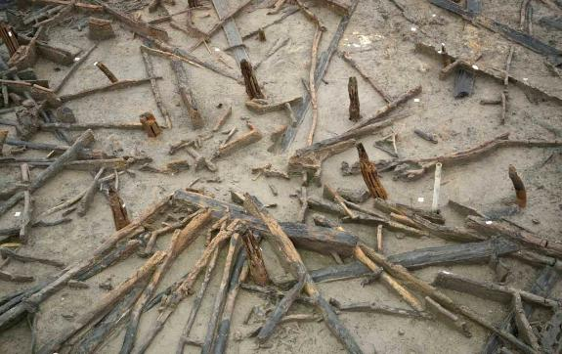
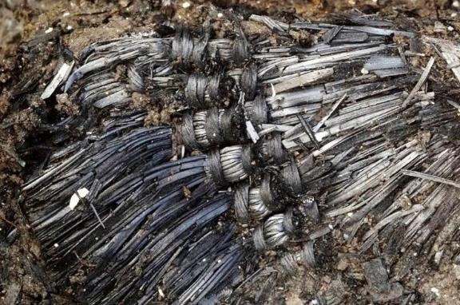
Focus on Must Farm: What would usually rot? sunbeam
 | Parts of the wooden roof | Rot or Not?
 | Fabric made from tree fibres | Rot or Not?
Notes:
Images ©CAU
https://www.mustfarm.com/progress/site-diary-6-textiles/

Slide 19
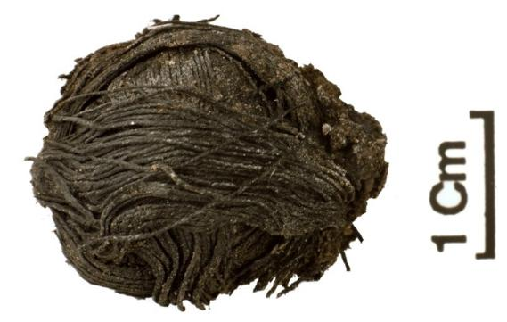
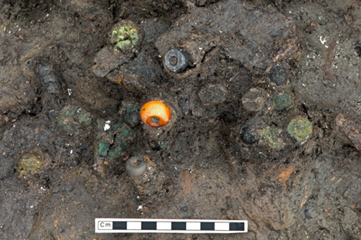
Focus on Must Farm: What would usually rot? lovely
 | Plant fibres spun into thread | Rot or Not?
 | Beads made from amber, glass & jet | Rot or Not?
Notes:
Images ©CAU
https://www.facebook.com/cambridgearchaeologicalunit/posts/occasionally-we-find-archaeology-that-is-hard-to-comprehend-when-we-first-starte/903536206423733/
https://www.mustfarm.com/1041/remains-of-a-necklace/

Slide 20
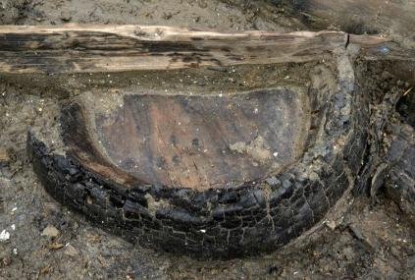


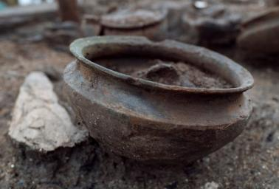


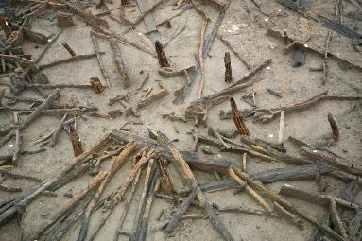

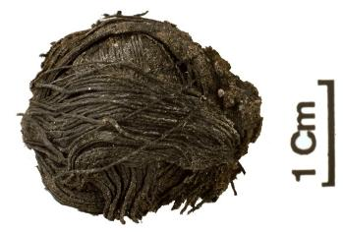
Focus on Must Farm: What would usually rot?
How did you do?
ROT
NOT
Notes:
Images ©CAU

Slide 21






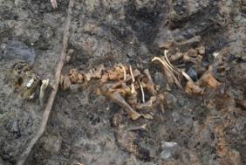

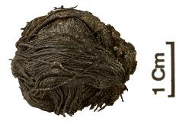

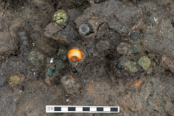


How much less evidence would the archaeologists have had if Must Farm had been a normal site?
How do you think losing half
of their evidence would affect the
archaeologist's interpretation of
what went on at Must Farm
in the Bronze Age?
ROT
NOT
5/10 = ½ = 50%
5/10 = ½ = 50%
5/10 =
5/10 =
Consider
Notes:
Images ©CAU

Slide 22
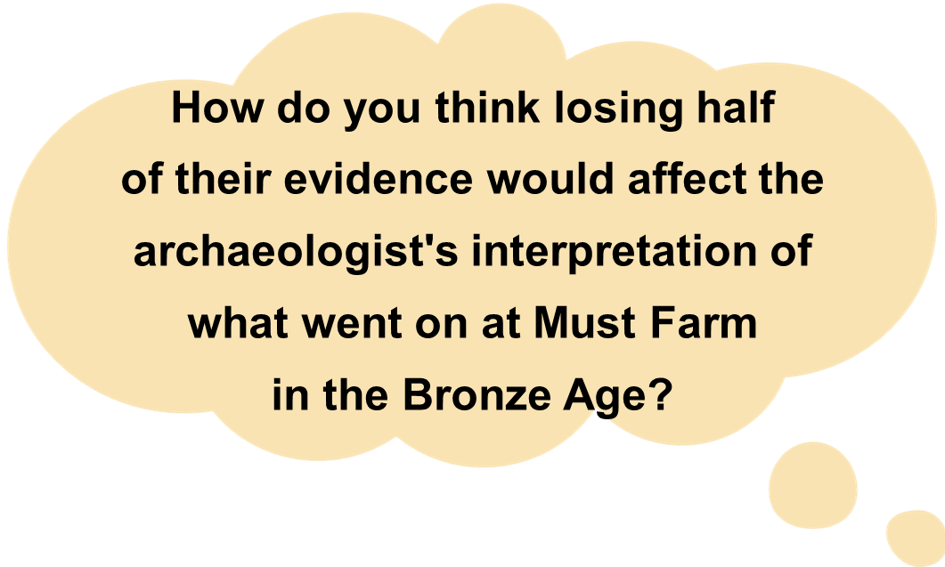

Think, pair, share
What would they still know about?
What would they not know about at all?

Slide 23

Why is the Must Farm Bronze Age Village such a remarkable and significant archaeological site? 1
Why is the Must Farm Bronze Age Village such a remarkable and significant archaeological site? 2
Archaeologists have found _ _ % more artefacts than from a normal Bronze Age site because …
The archaeological site at Must Farm is not like most Bronze Age sites because Archaeologists found artefacts made of …
These are called O_ _ _ _ _ _
This means we know a lot more about …
Archaeologists have found _ _ % more artefacts than from a normal Bronze Age site because …
The archaeological site at Must Farm is not like most Bronze Age sites because Archaeologists found artefacts made of …
These are called O_ _ _ _ _ _
This means we know a lot more about …

Slide 24
Extension Activity 1: The ‘Rubbish Bag Game’
All archaeologists are detectives – for the Rubbish Bag Game select clean, safe pieces of ‘rubbish’ and place them in a black bin bag.
Pupils take it in turns to pick out a piece of ‘rubbish’, then the whole class have to work out what it is and who might have used it/thrown it away.
Deliberately choose bits of ‘rubbish’ so that pupils can build up a picture of the person/family that threw them away.
Once the rubbish bag is empty ask pupils to think about which items would survive being buried in the ground for 1000s of years – would it Rot or Not?
Any items that they don’t think would survive get taken away, so you now have a much smaller pile of ‘rubbish’.
Pupils then reassess the evidence and start to understand that archaeologists can only work with what they’ve got – there’s a lot that they don’t know, but have to make ‘educated guesses’ about.

Slide 25
Extension Activity 2:
Our classroom: An archaeological site of the future?
Ask pupils to look around the classroom and make a list of its contents (you could just choose a corner of the room to help focus this). Ask them to note the material each item is made from and whether the material is organic or not.
Make sure you include some items such as clothes (coats for example), books, pencils as well as more durable materials. You could sit yourself or another adult in the area and ask children to think about what you are wearing and what they are made from.
Now ask them to think what they would find in 10 years, 50 years, 100 years and 1000 years. You could use the table on the next slide to help them capture the information. For younger pupils it may be easier to ask them to just think about one time period such as 100 years and edit the table accordingly.
To extend this activity children can discuss what different items might tell archaeologists of the future. Will they know what spectacles or jewellery are? Would they be able to read the books and understand them? What evidence will be lost from material which won’t survive?

Slide 26
Extension Activity 2: Worksheet
Our classroom: An archaeological site of the future?
Archaeological Artefacts of the Future
Would archaeologists find this in-
Object | What is it made from? | 10 years? | 50 years? | 100 years? | 1000 years?

