Slide 1
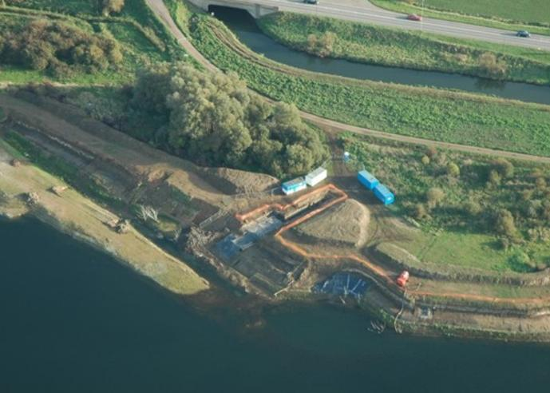
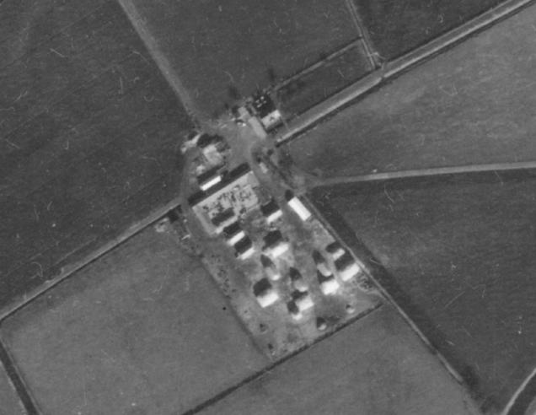
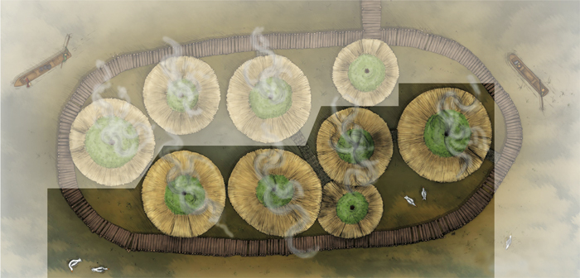
Must Farm Bronze Age Village
Activity 2: Then and Now - the Story of Must Farm over time
Must Farm Bronze Age Village Activity 2: Now and Then: Why is it called the ‘Must Farm’ Bronze Age Village?
Notes:
Image ©Ben Robinson
Image ©Historic England RAF_82_865_F21_0144
Image ©CAU

Slide 2
Activity 2: Now and Then.
Why is it called the Must Farm Bronze Age Village?
Key Stage 2 History
Pupils develop their understanding of the process of change.
Pupils know and understand the history of these islands as a coherent, chronological narrative, from the earliest times to the present day.
Pupils continue to develop a chronologically secure knowledge and understanding.
Pupils interpret a range of sources of geographical information, including maps, diagrams, globes, aerial photographs and Geographical Information Systems (GIS).
KS2 Unit: Changes in Britain from the Stone Age to the Iron Age: Bronze Age religion, technology and travel

Slide 3
How to use this PowerPoint Accompanying Resources
The activity begins by using maps and aerial photos to explain why it is called Must Farm and the role of quarrying and luck in the discovery.
The activities are designed as group work and progress through the steps in developing chronological understanding: sequencing (simple then more complex); then using a timeline and concurrence
Video 2: Must Farm: A Bronze Age Settlement (Duration 8.20 mins)
PPT: Introducing Must Farm Bronze Age Village
Timeline cards​ and wall display timeline and labels​ (Slides 21-28)
Links to information for concurrence activity

Slide 4
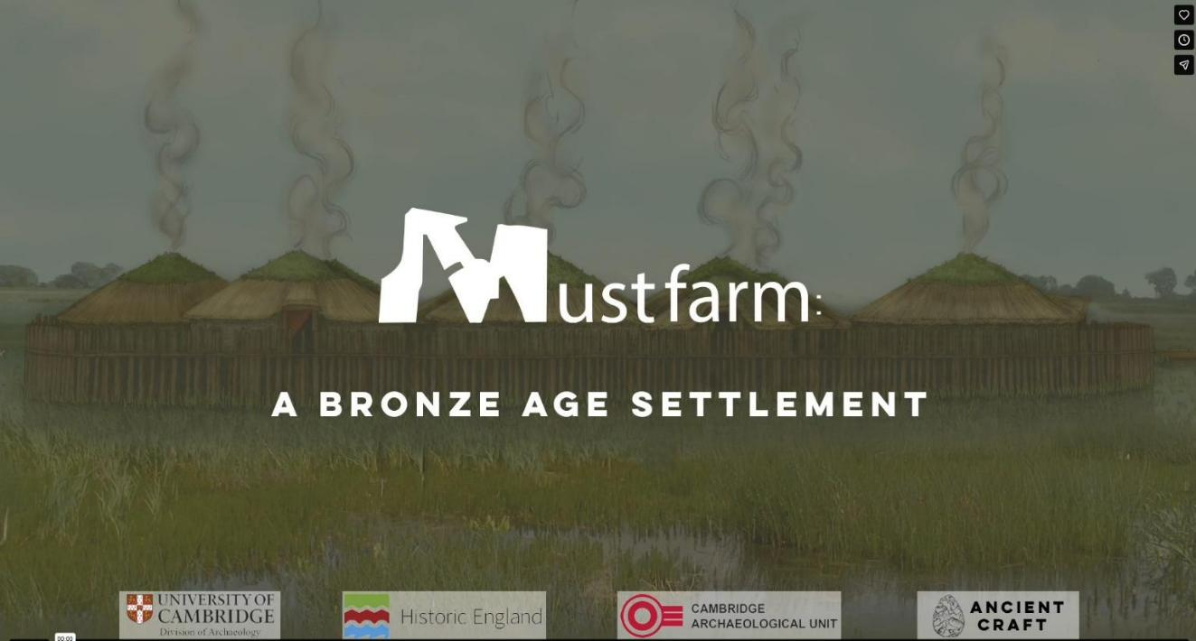
Must Farm: A Bronze Age Settlement
Notes:
https://vimeo.com/1045053069
Duration 8.20 mins
See Teacher Pack for transcription

Slide 5
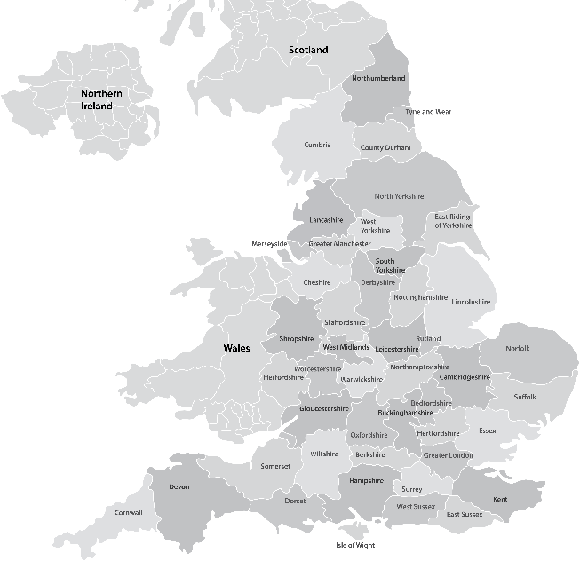
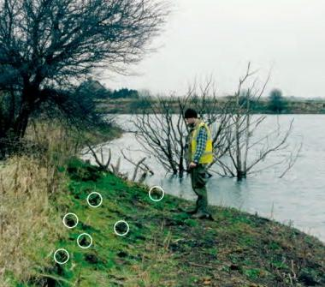

Where was the Must Farm Bronze Age Village?
In 1999, an archaeologist was walking along the edge of a quarry near Must Farm when he saw some interesting wooden posts sticking out of the ground.
The posts were found to be almost 3,000 years old, from a period called the Late Bronze Age.
.
Must Farm
The Archaeologist
Edge of the flooded quarry
Location of Must Farm Bronze Age Village
Notes:
Image ©Ben Robinson
Many thanks to Ben Robinson for giving permission for us to use this photograph he took in 1999 and for sharing the incredible story of the discovery and excavation of Must Farm Bronze Age village

Slide 6
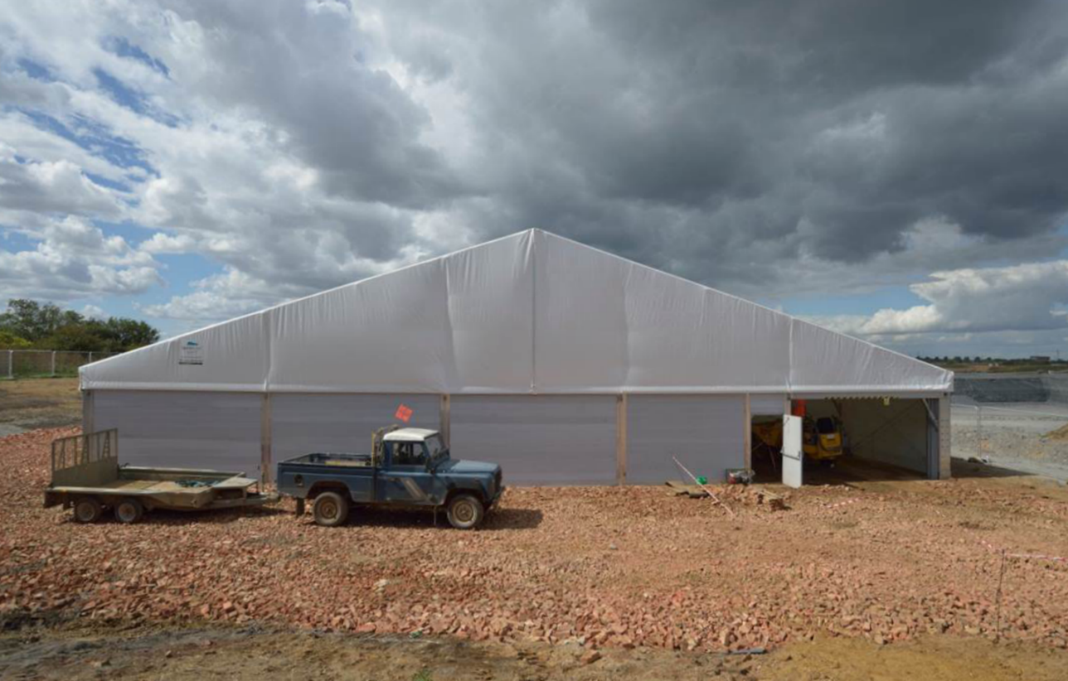
A temporary building was put up to allow the archaeologists to work throughout the winter and to protect the delicate archaeological site as it was uncovered.
Notes:
Image ©CAU

Slide 7
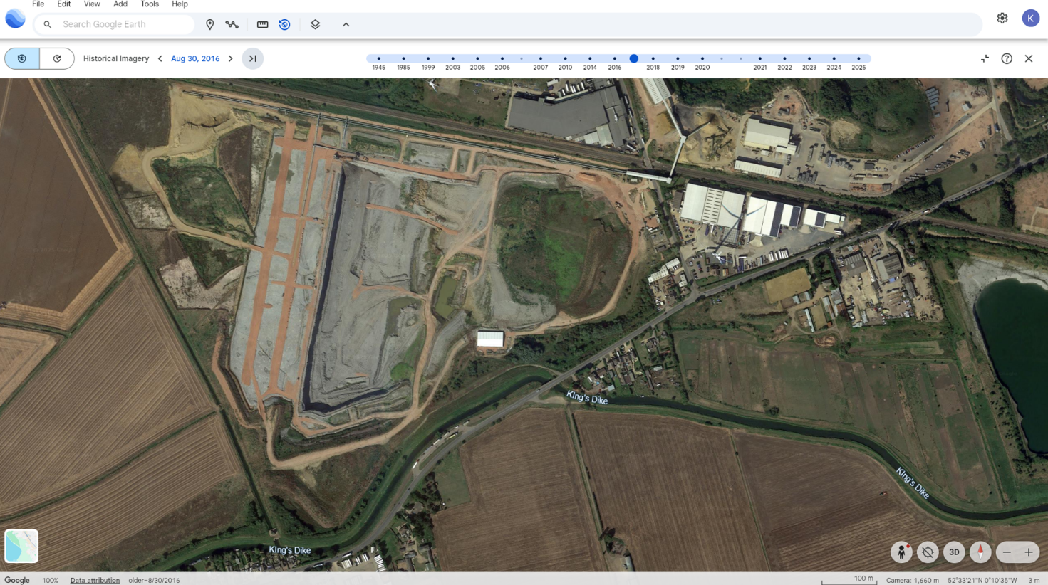
Position of the tent during the 2016 excavation
The tent was removed once the site had been excavated but it can be seen very clearly, if briefly, on the historic imagery on Google Earth in 2016
Notes:
Image ©Google Earth https://earth.google.com/web/@52.55532022,-0.18191209,-1.00887685a,2171.18794978d,35y,0h,0t,0r/data=ChYqEAgBEgoyMDE2LTA4LTMwGAFCAggBOgMKATBCAggASg0I____________ARAA?authuser=0 Google earth historic imagery 2016 December

Slide 8
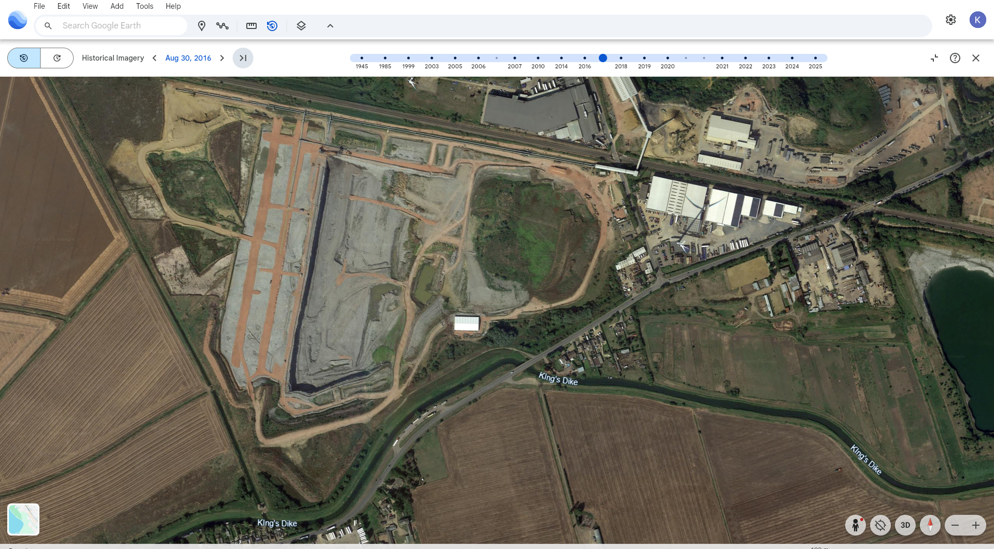
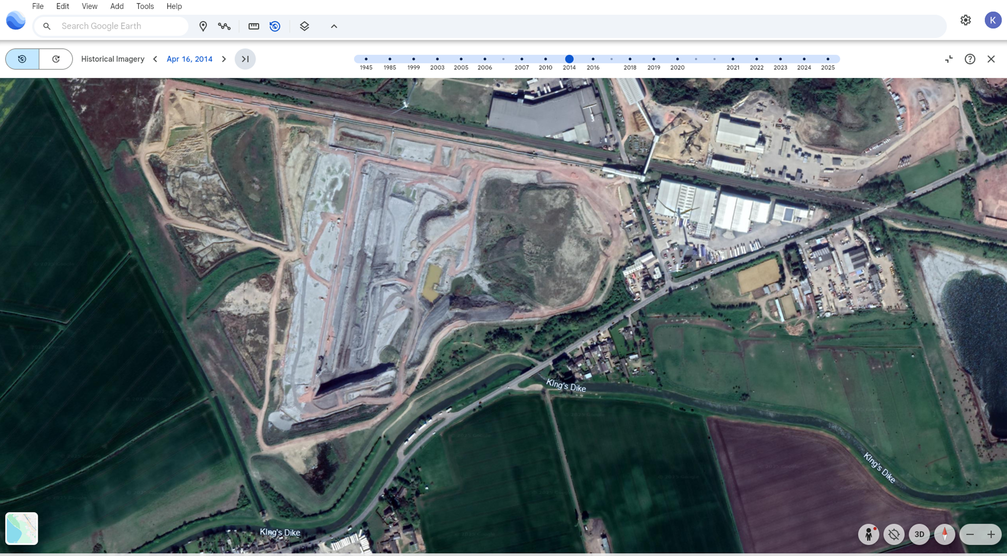
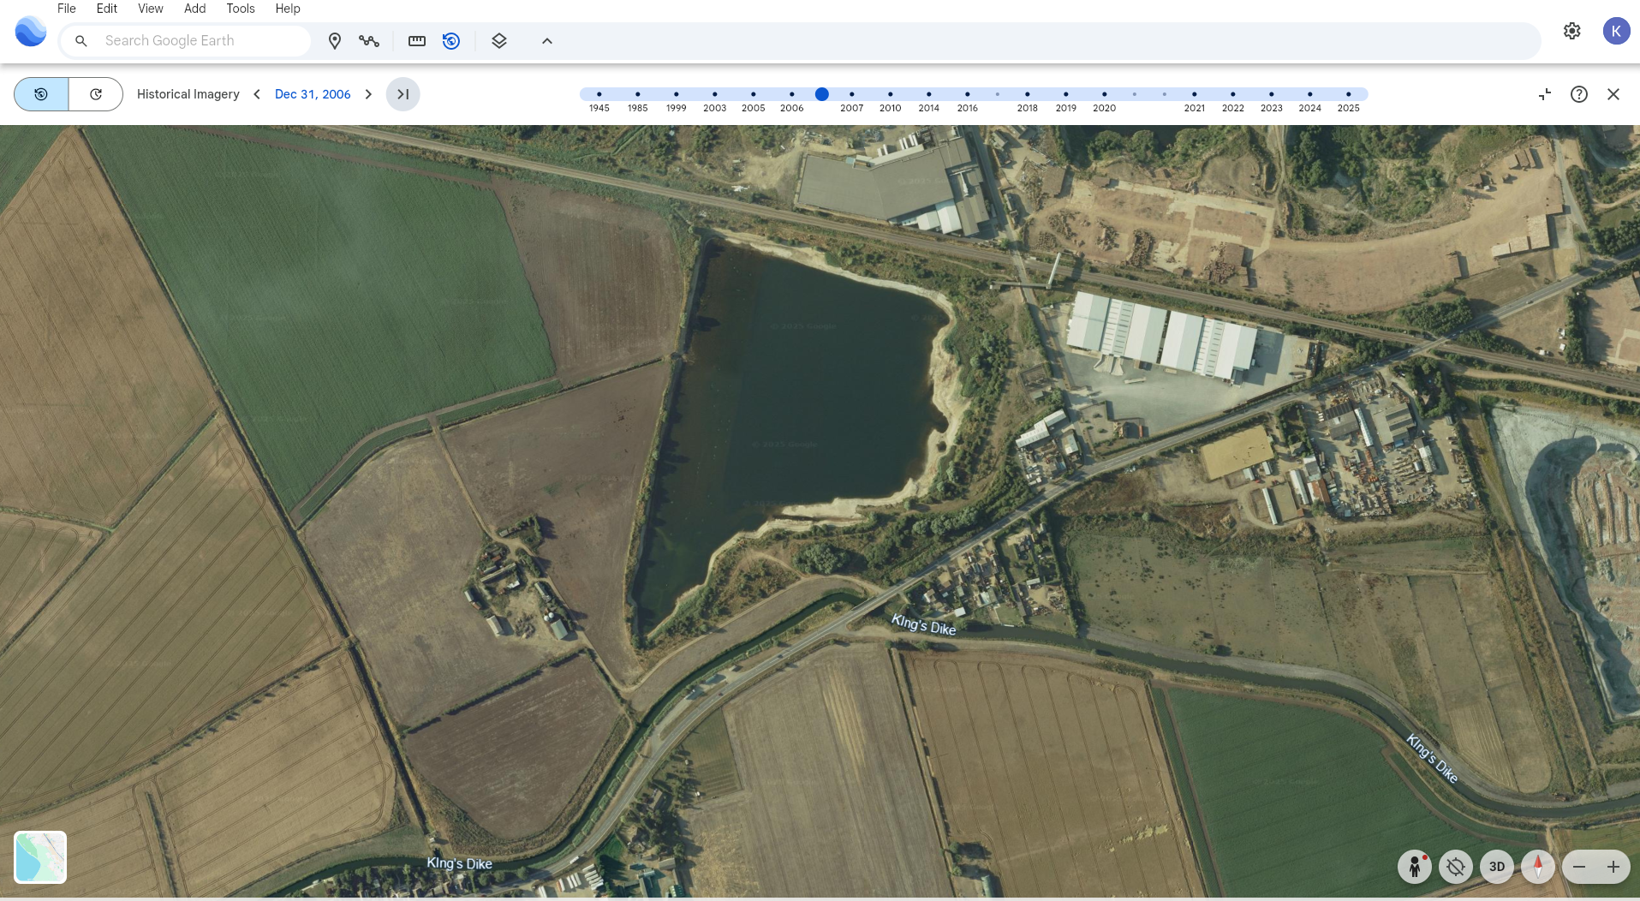
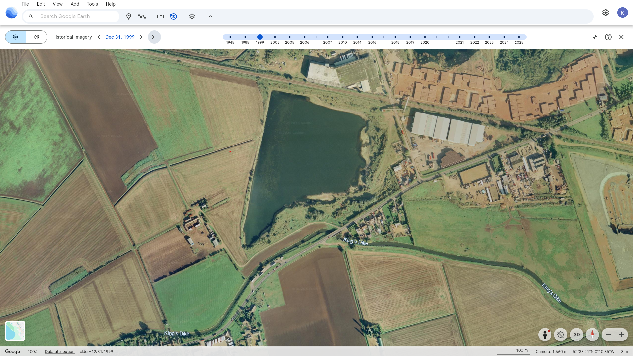
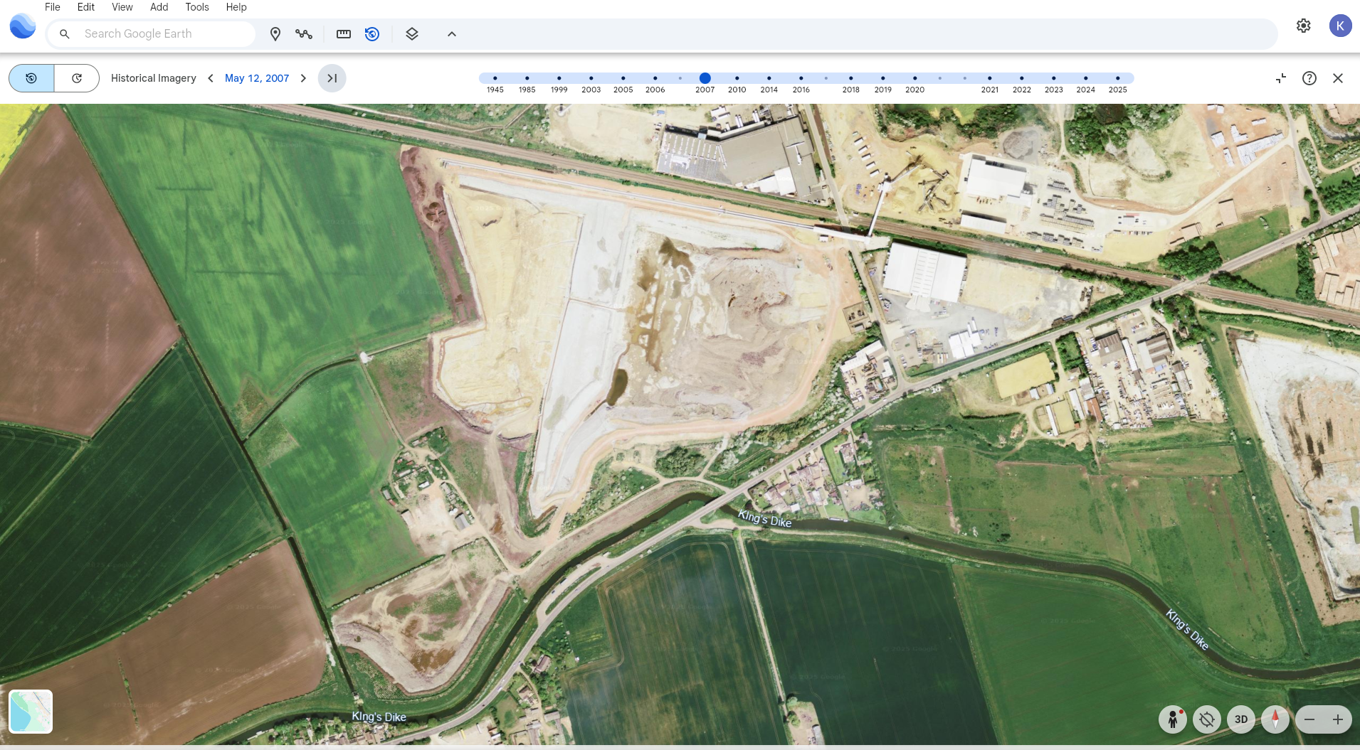
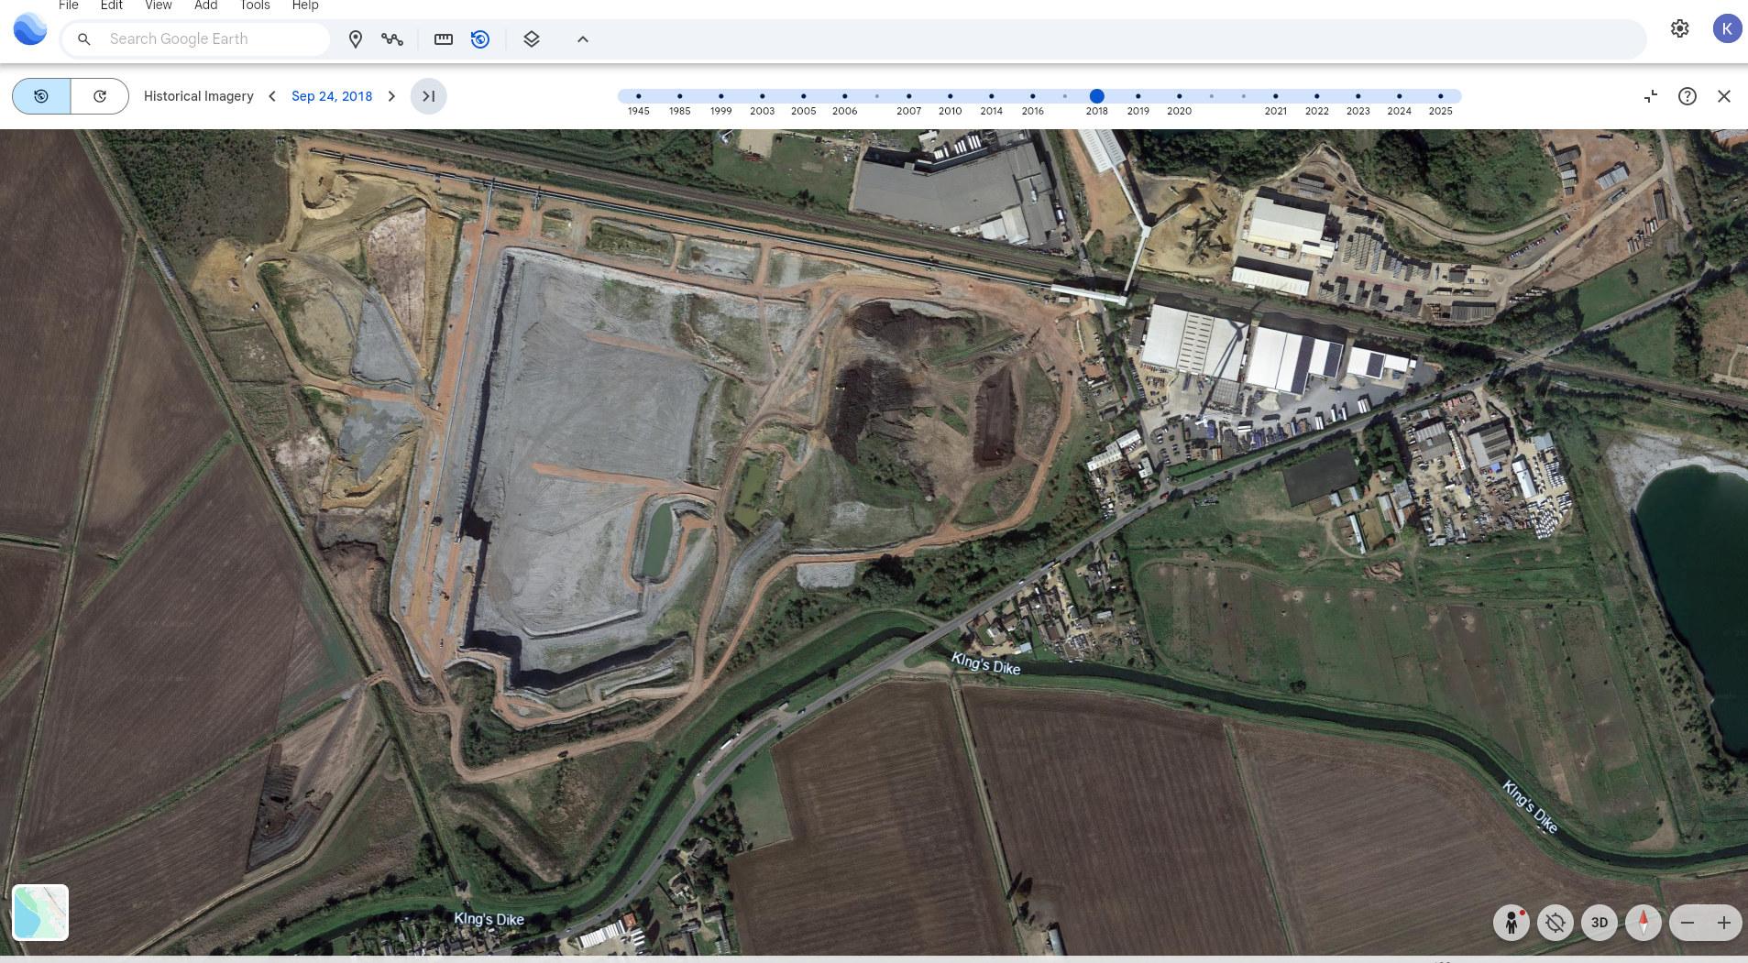
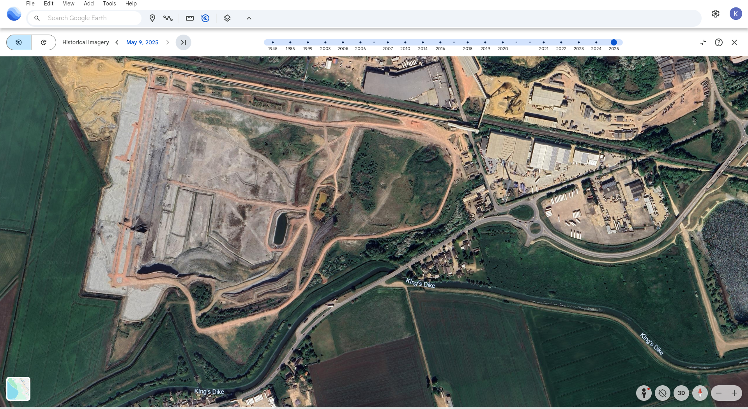




Google Earth Historical Imagery
1999
2014
2016
2006
2007
2018
2025
We can see how the Quarry has changed over the past 25 years by using Google Earth Historical Imagery – view in slideshow and watch out for the tent!
Position of the tent during the 2016 excavation
The tent shows where the Bronze Age Village once existed long before the quarry or the other buildings or the fields or even the road
What is this?
Notes:
Image ©Google Earth
https://earth.google.com/web/@52.55532022,-0.18191209,-1.00887685a,2171.18794978d,35y,0h,0t,0r/data=ChYqEAgBEgoyMDE2LTA4LTMwGAFCAggBOgMKATBCAggASg0I____________ARAA

Slide 9
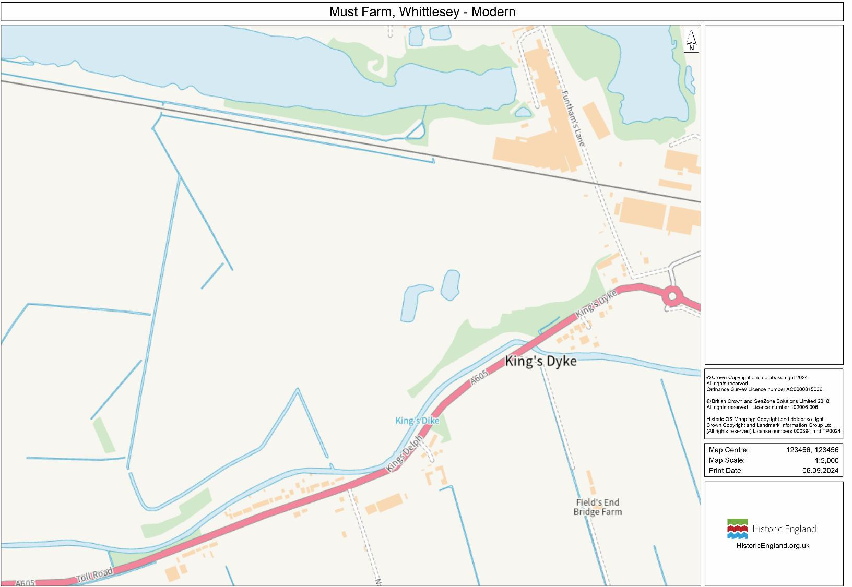
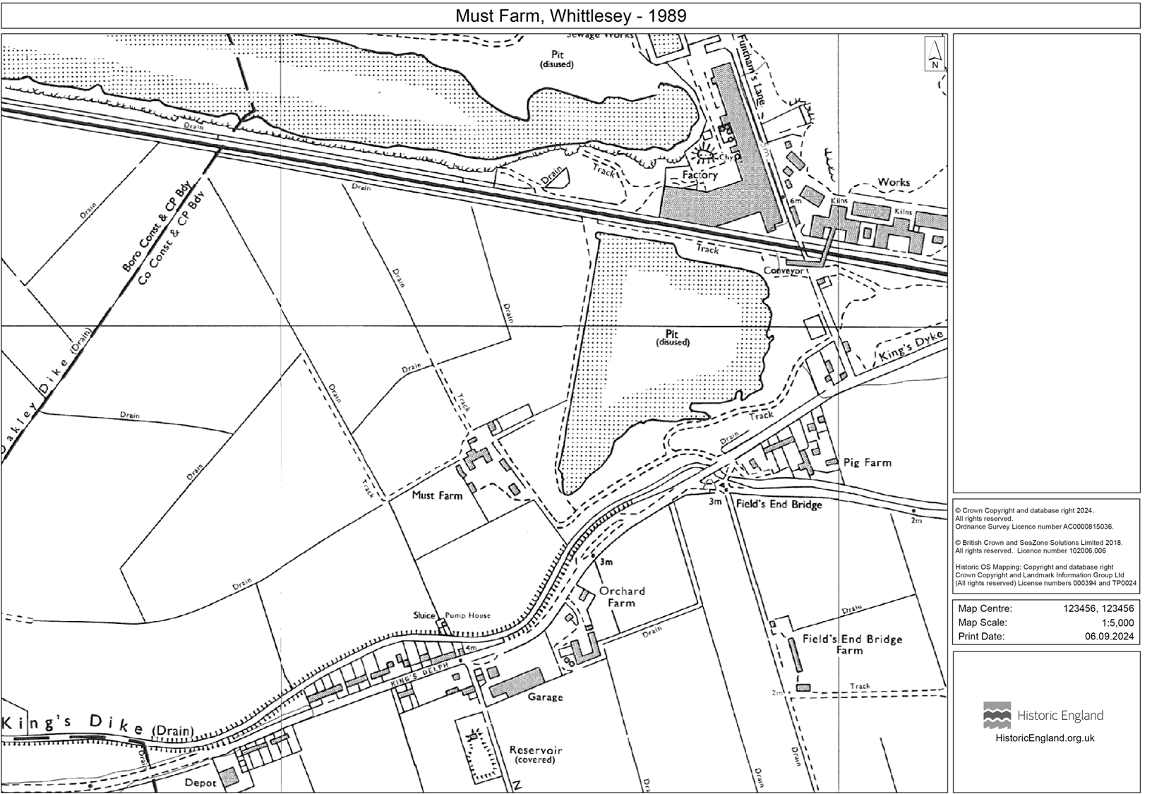
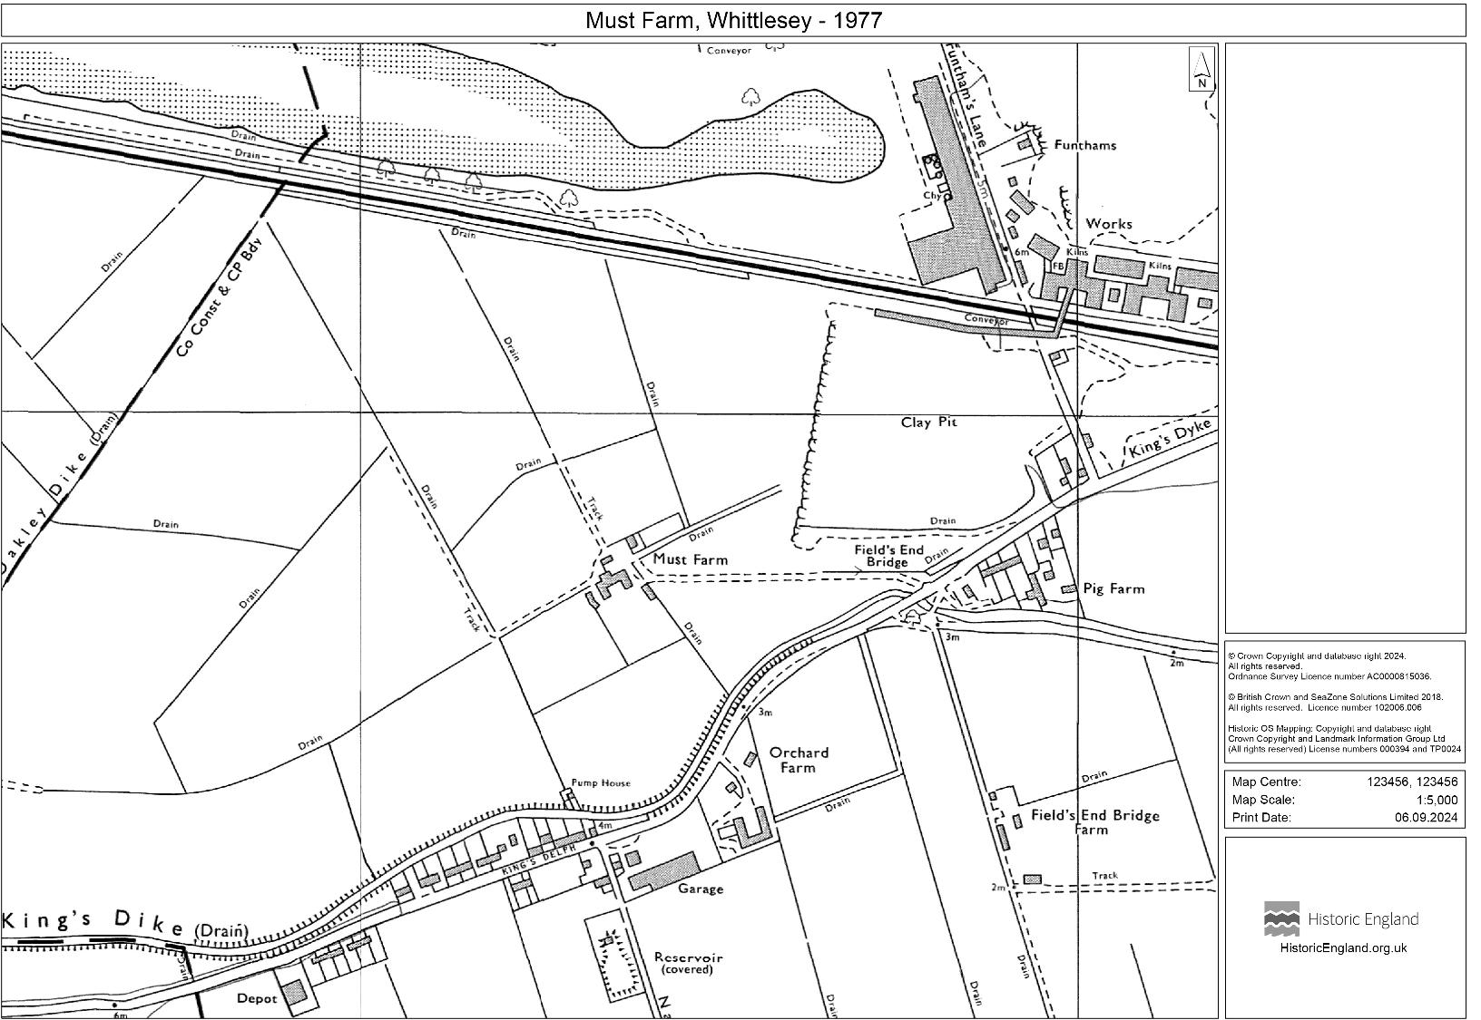
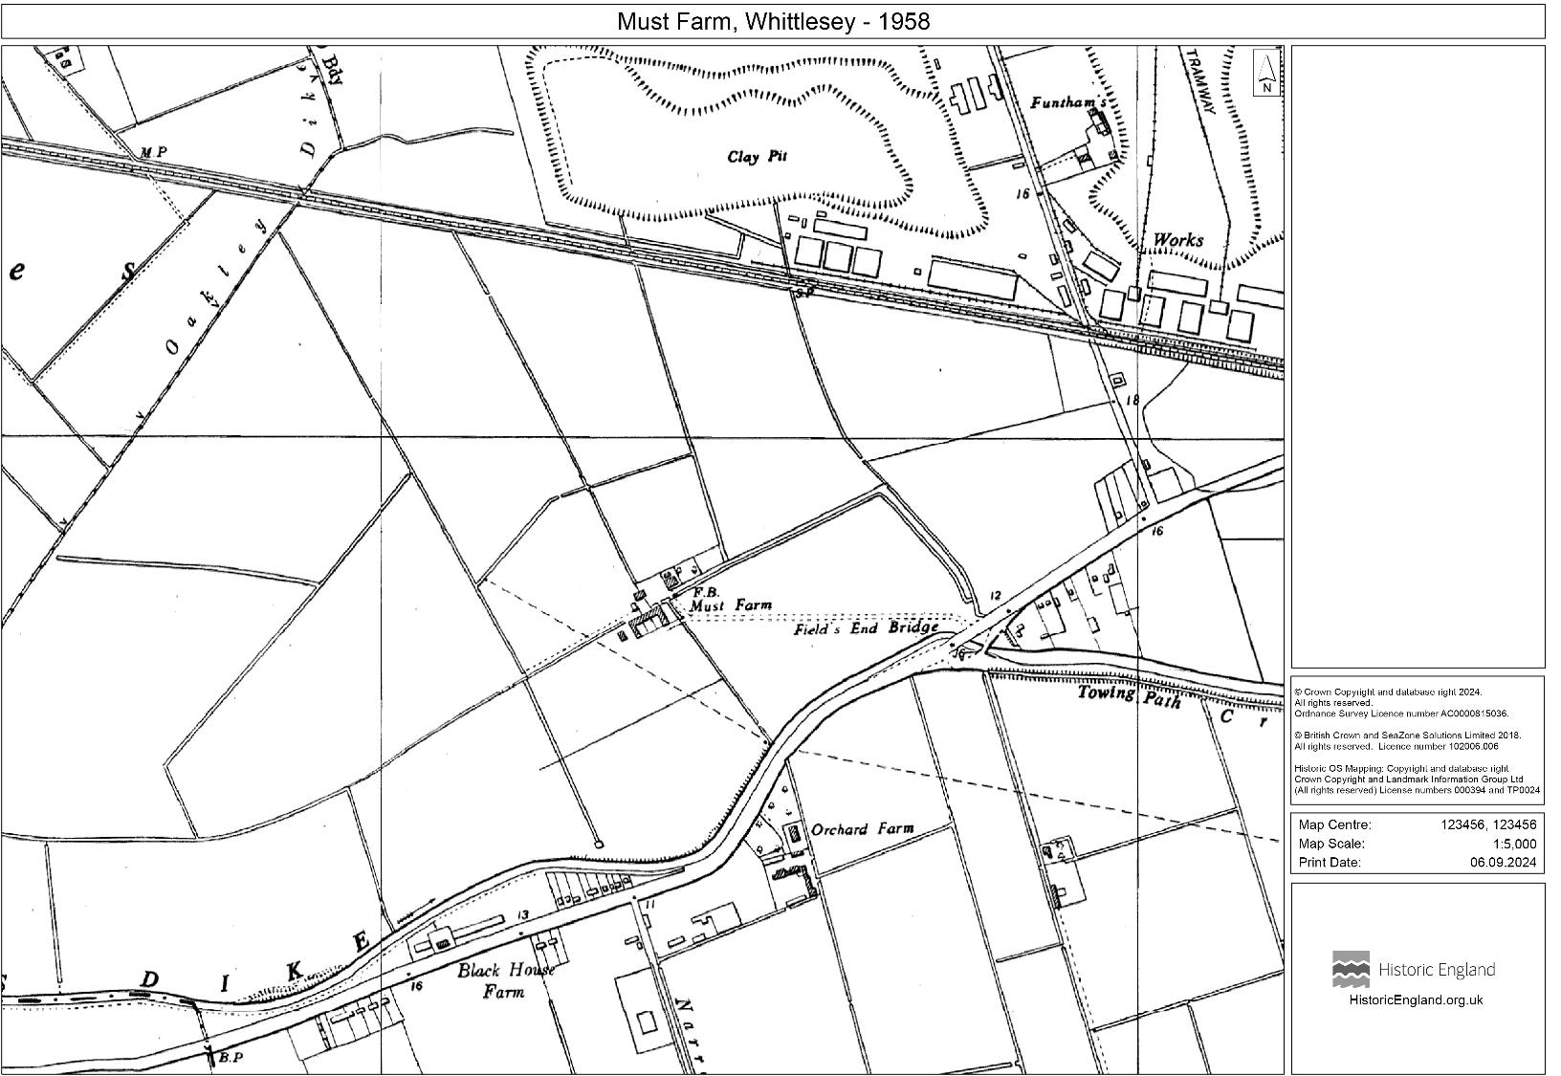
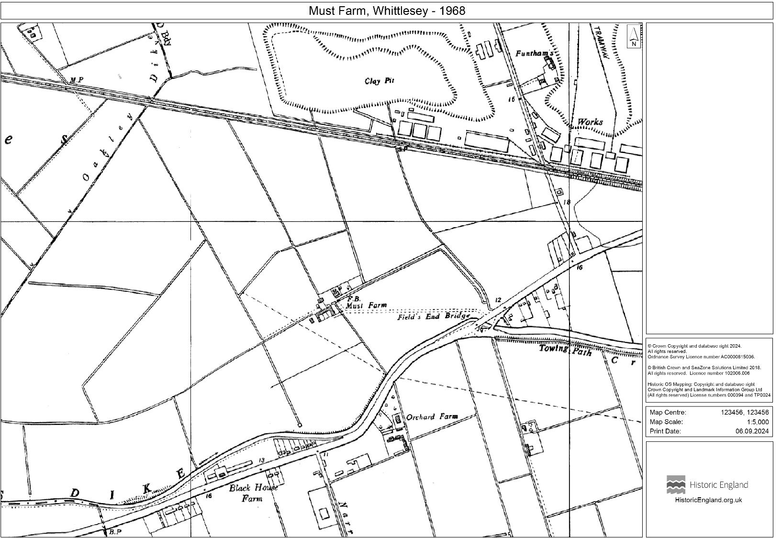
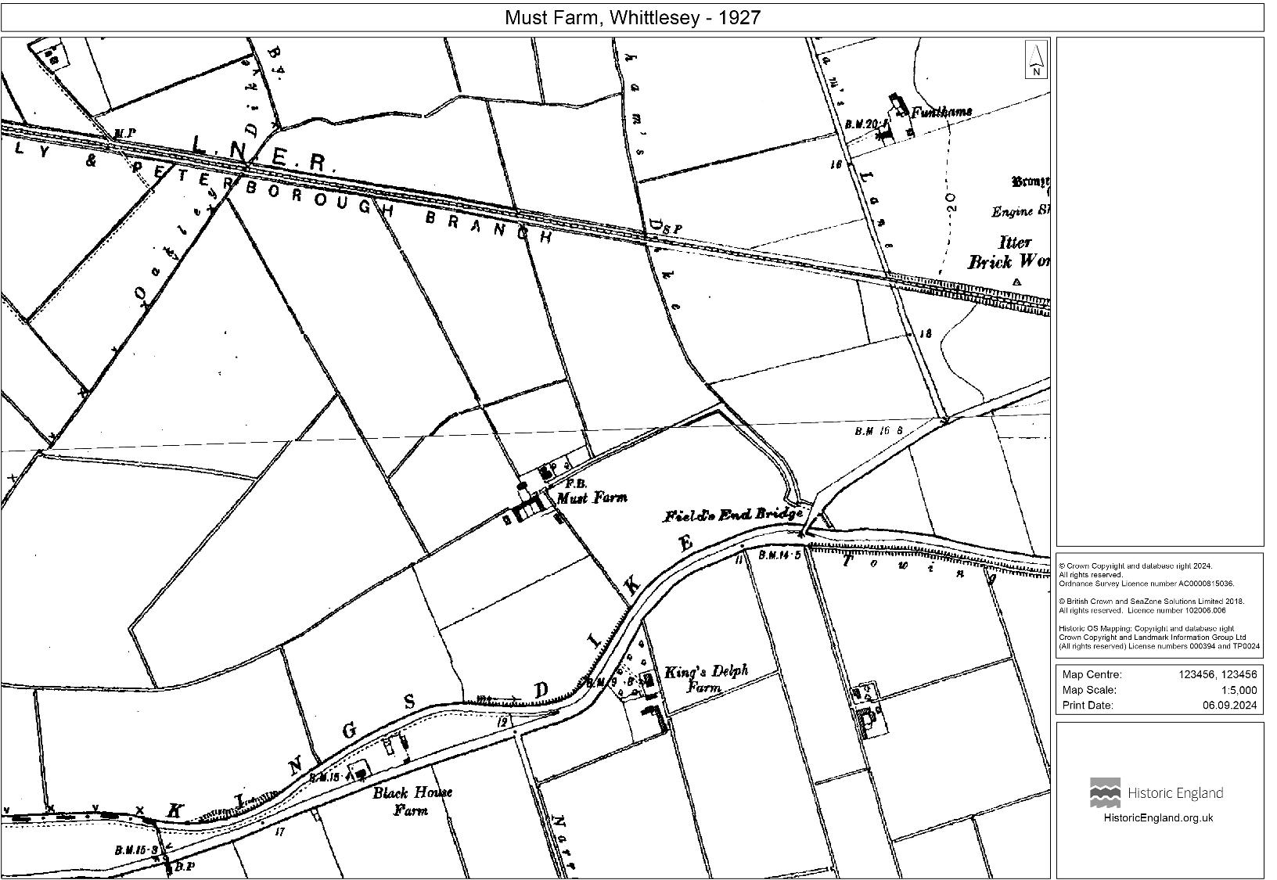
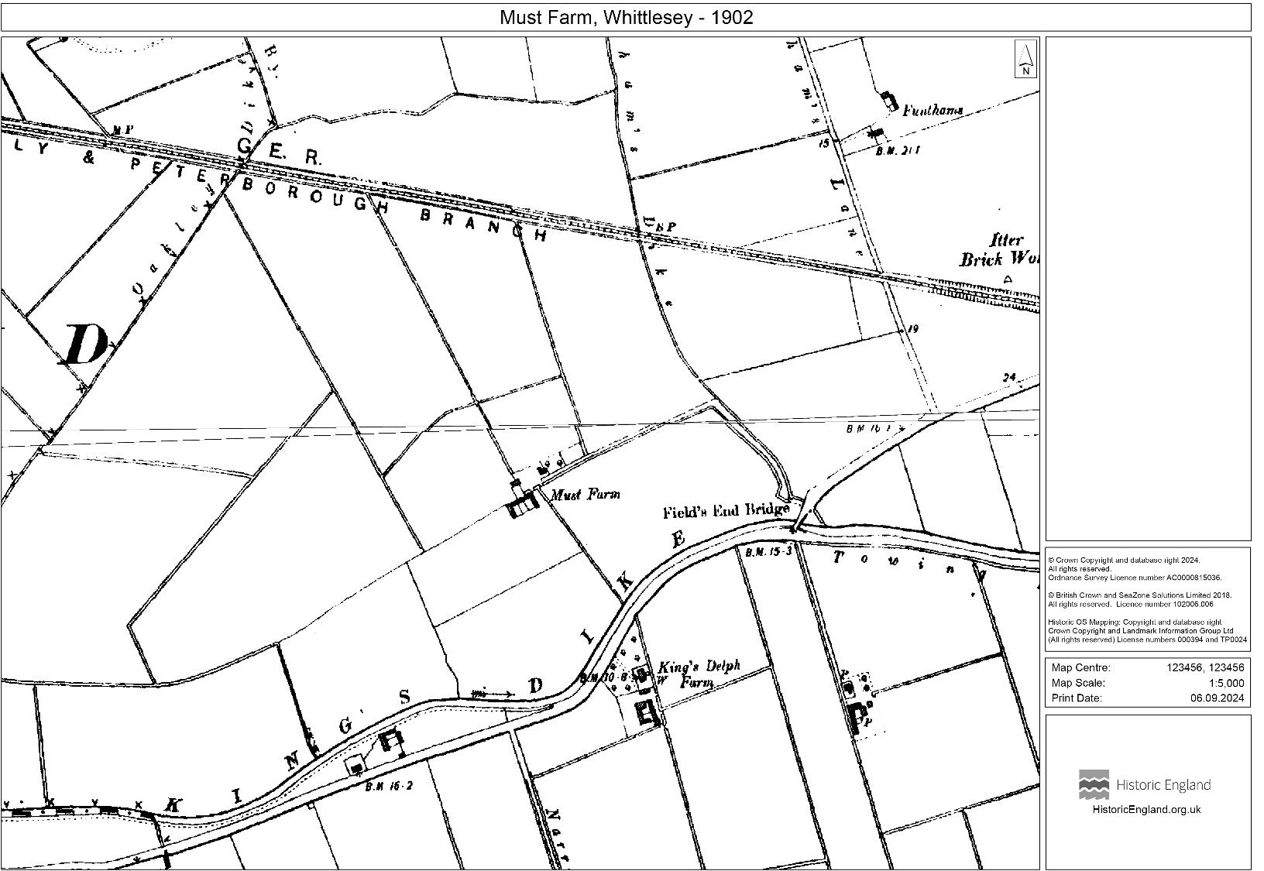
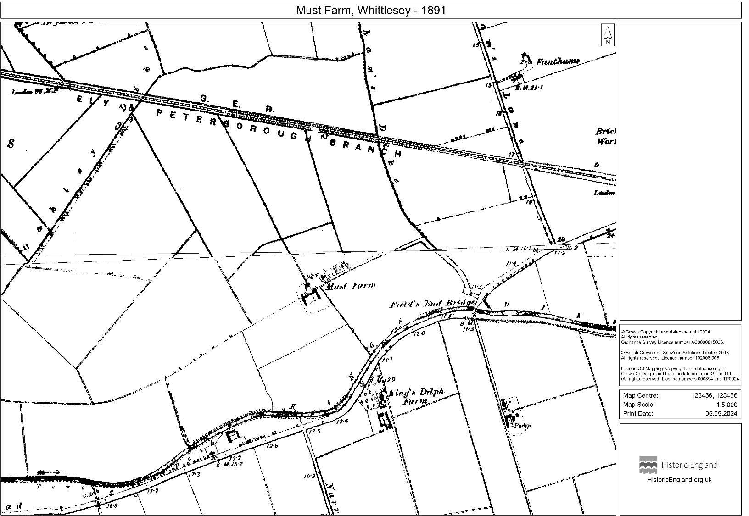

Maps of Must Farm
Those buildings have been demolished, and the land has been quarried but we can find out what they once were by looking on historic maps.
View in slideshow
This area becomes part of a quarry in the 1960s.
This is the location of the tent in 2016.
The maps show us why this is called the Must Farm Bronze Age Village. The site of the village is on land that once belonged to Must Farm.
Notes:
Image ©Historic England or Ordnance Survey

Slide 10
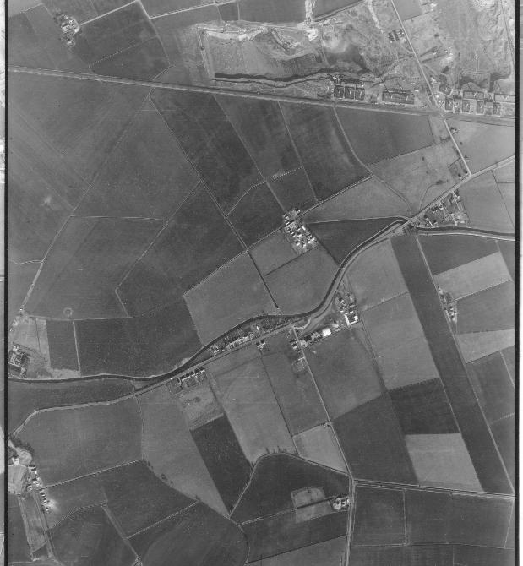
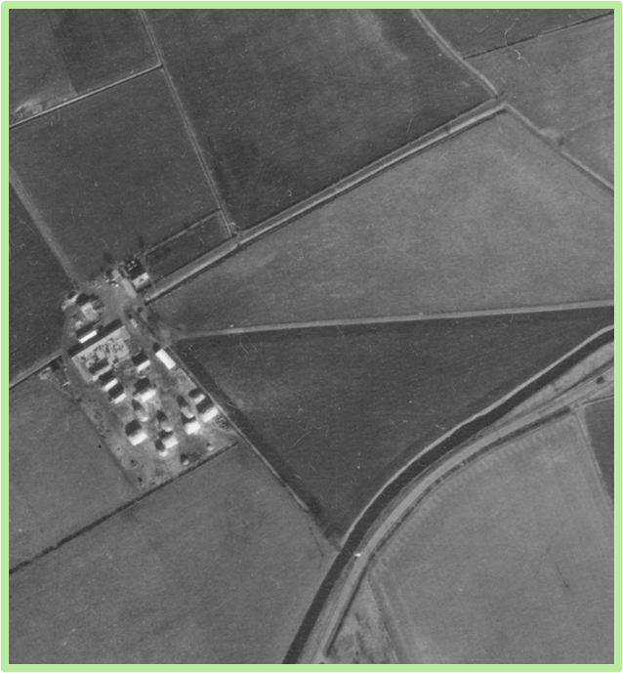
Must Farm and the undiscovered Bronze Age Village
This aerial photo taken by the RAF in 1954 shows what the area looked like before it became part of the quarry. Must Farm was growing crops, like many other farms in the Fens.
In this close-up, we can work out where the tent covered the excavation in 2016. This is where the Bronze age Village lay undiscovered beneath the fields for 3000 years.
Notes:
Image ©Historic England RAF_82_865_F21_0144
Images ©CAU
https://www.cam.ac.uk/stories/must-farm-prehistoric-stilt-house-dwellers

Slide 11
Only part of the Bronze Age Village at Must Farm survived, but the settlement may originally have been larger: this reconstruction estimates how many more buildings could have existed.?
Notes:
Images ©CAU
https://www.cam.ac.uk/stories/must-farm-prehistoric-stilt-house-dwellers

Slide 12
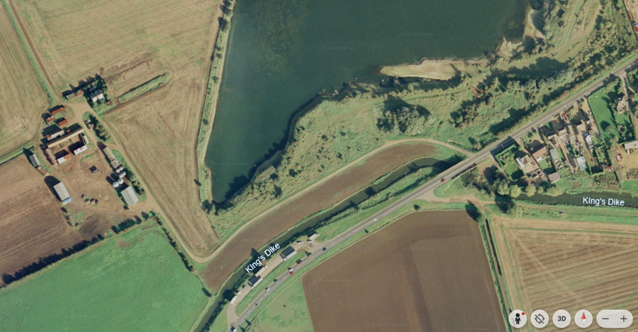


1999: Must Farm & Must Farm Bronze Age Village
Must Farm was a normal farm when the archaeologist first spotted the wooden posts, as we can see in the Google Earth image and the photo from1999. In the 1960s, quarrying had created the ‘lake’ we can see in both photos. In 2016, the tent was put up over the remains of the Bronze Age Village.
What do you think happened to the other half of the Bronze Age Village?
Notes:
Image ©Google Earth
https://earth.google.com/web/@52.55532022,-0.18191209,-1.00887685a,2171.18794978d,35y,0h,0t,0r/data=ChYqEAgBEgoyMDE2LTA4LTMwGAFCAggBOgMKATBCAggASg0I____________ARAA
Images ©CAU
https://www.cam.ac.uk/stories/must-farm-prehistoric-stilt-house-dwellers
Image ©Ben Robinson

Slide 13
The Story of Must Farm: Now and Then
The following activities are based on a progression of skills to develop chronological understanding.
Model how to create a simple sequence of two satellite images and use the opportunity to look at change over time
Working in small groups, pupils repeat this first step with 2 random cards from the pack of 8 that tell the Story of Must Farm: Now and Then
They progress to make a more complex sequence by adding more cards until all have been used.
You might want to move to placing the cards onto a timeline. This will show interval and can show scale and duration
The activities can be a mix of whole-class, group, pair or individual work as best suits your pupils
There are resources for creating a wall display at the end of the PPT

Slide 14
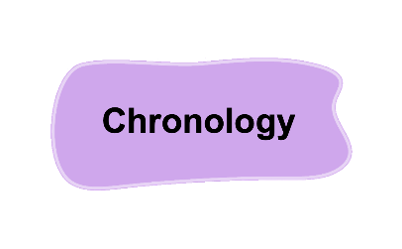

Chronological Understanding: Progression
 | EYFS | KS1 | Lower KS2 | Upper KS2
Sequencing | Introduce | Practise in new context | Practise in new context | Independently apply to work
Scale* |  | Introduce | Practise in new context | Independently apply to work
Duration* |  | Introduce | Practise in new context | Independently apply to work
Interval* |  | Introduce | Practise in new context | Independently apply to work
Concurrence |  |  | Introduce | Practise in new context
*Using a timeline
Notes:
Based on Stuart Tiffany Chronological Progression Session at HA Conference May 2021

Slide 15
The Story of Must Farm: Now and Then 1
Sequencing – start with the aerial view from 2024 and 1999 and put these into Chronological order – place the older image on the left
Compare the two images and spot the differences &/or similarities between them; add labels of significant features or coloured dots for differences; written labels or summaries could be produced
Develop a sequence – sort the cards into a sequence placing them after older and before more recent/newer events
Discuss how the area has changed over time
Add a timeline: and then add them to a timeline. There are a range of options for you to print off or this can be done very effectively using a long tape-measure in a corridor or as a living timeline outside where each step is 100 years/a century; you could add other historic events familiar to the children – eg The Great Fire of London - to bring in prior learning
Create a display of the timeline; add details of how the environment changed as a result of key events in history
Extension Activity 2: Concurrence – Meanwhile, elsewhere … Look at the civilizations in other parts of the world c.850BC – Ancient Greece; Ancient Mesopotamia & Egypt; Ancient China; Ancient Peru etc.

Slide 16

The Story of Must Farm: Now and Then 2a
Sequencing
Start with the aerial view from 2024 and 1999 and put these into chronological order – place the older image on the left
Compare
Look at the two images and spot the differences &/or similarities between them; add labels of significant features or coloured dots for differences; written labels or summaries could be produced

Slide 17
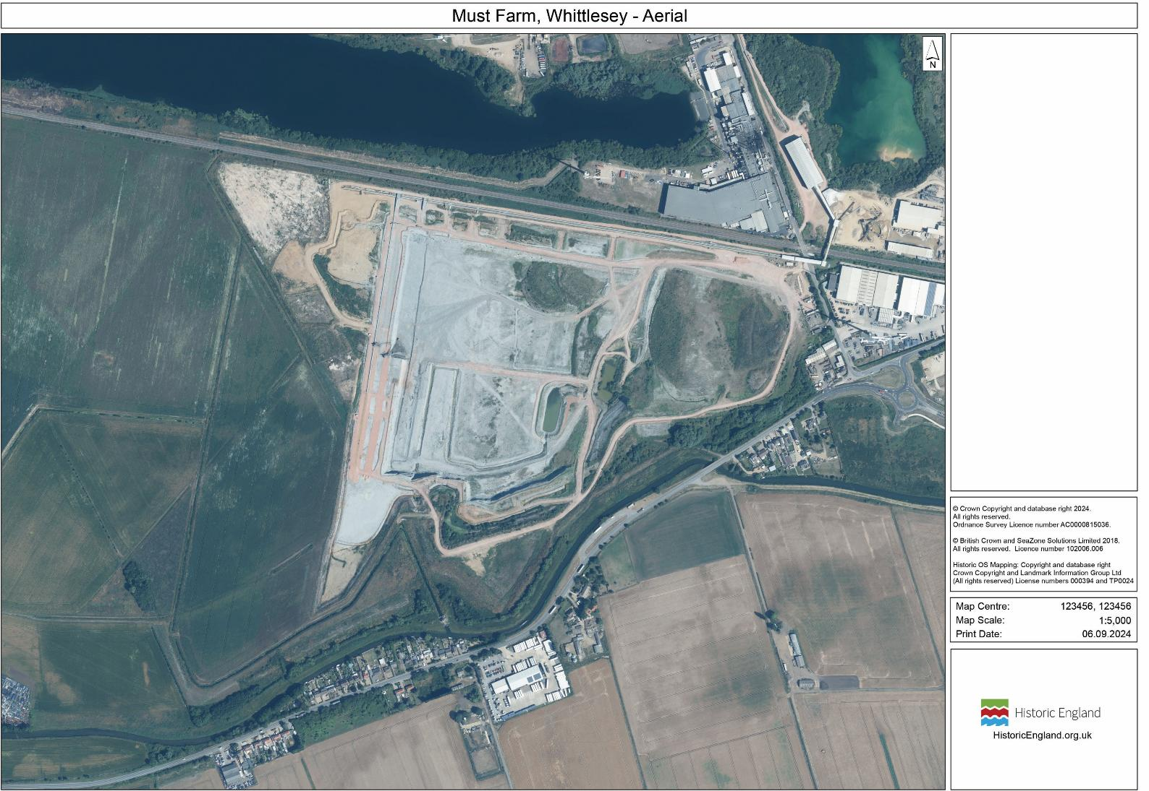
2024
Notes:
Map pack Image ©Historic England

Slide 18

Google Earth Image 1999
Notes:
Image ©Google Earth
https://earth.google.com/web/@52.55532022,-0.18191209,-1.00887685a,2171.18794978d,35y,0h,0t,0r/data=ChYqEAgBEgoyMDE2LTA4LTMwGAFCAggBOgMKATBCAggASg0I____________ARAA

Slide 19
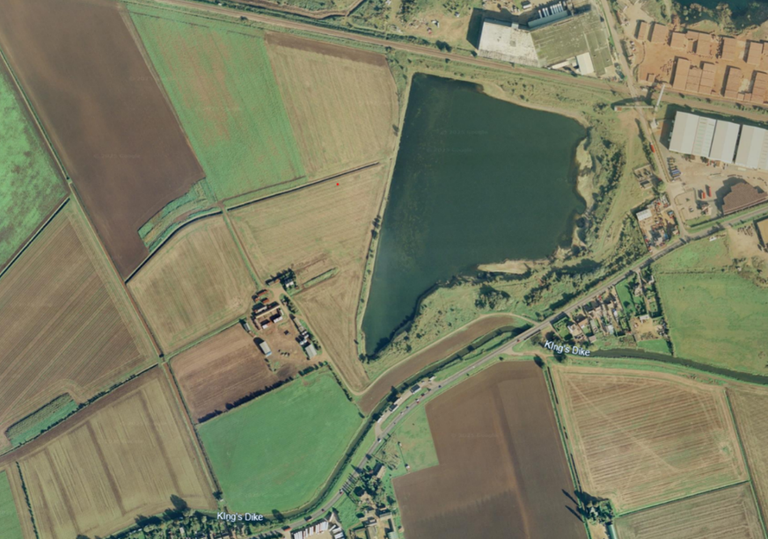
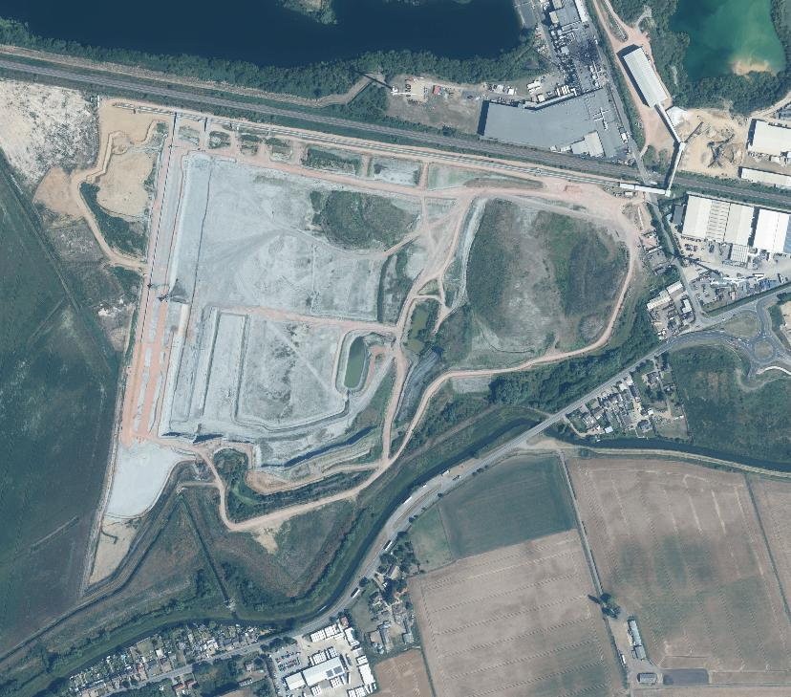
2. Compare the two images and spot the similarities &/or differences between them
1999
2024
Notes:
Image ©Google Earth
https://earth.google.com/web/@52.55532022,-0.18191209,-1.00887685a,2171.18794978d,35y,0h,0t,0r/data=ChYqEAgBEgoyMDE2LTA4LTMwGAFCAggBOgMKATBCAggASg0I____________ARAA
Map pack Image ©Historic England

Slide 20
The Story of Must Farm: Now and Then abc
Develop a sequence
Pick any 2 cards from the 8 that tell the story of Must Farm
Place them in chronological order with the oldest on the left
Add the remaining 6 cards to your sequence by working out if the event came before (older) or after (newer/more recent) the events on the other cards
How has the area changed over time

Slide 21
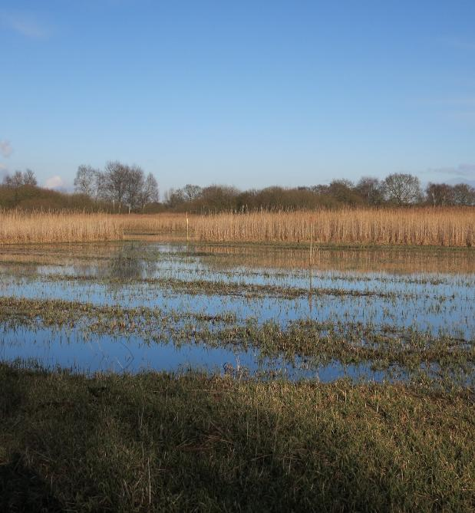
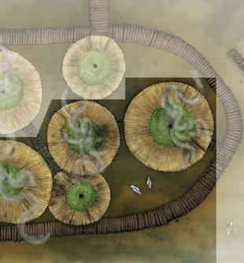
Must Farm Bronze Age Village Activity 2: Now and Then x2
Must Farm Bronze Age Village Activity 2: Now and Then
Fens formed about 8000BC
Must Farm Bronze Age Village c.850BC
The Cambridgeshire Fens began forming around 10,000 years ago, following the end of the last Ice Age, when rising sea levels caused by melting glaciers flooded the area.
Archaeologists know from scientific tests, like radiocarbon dating, that the village at Must Farm was built around 850BC, a time called the Late Bronze Age.
Notes:
Image ©Wikipedia https://commons.wikimedia.org/wiki/File:Cut_area,_Woodwalton_Fen_-_geograph.org.uk_-_4361129.jpg
Image ©CAU

Slide 22
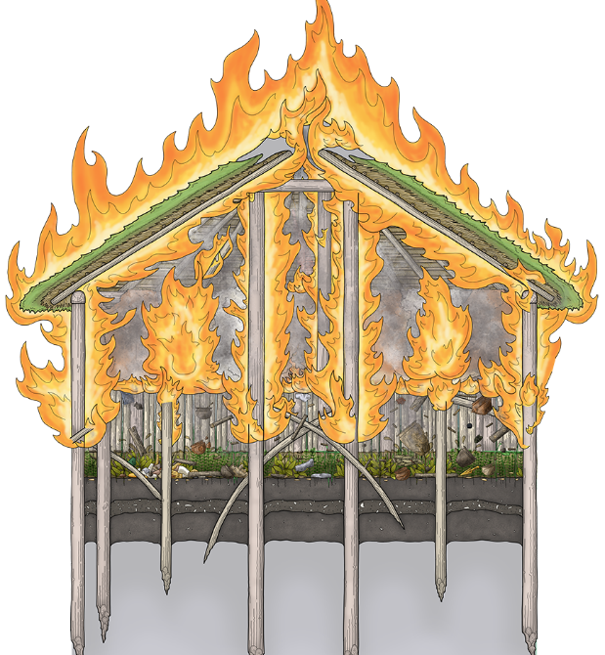
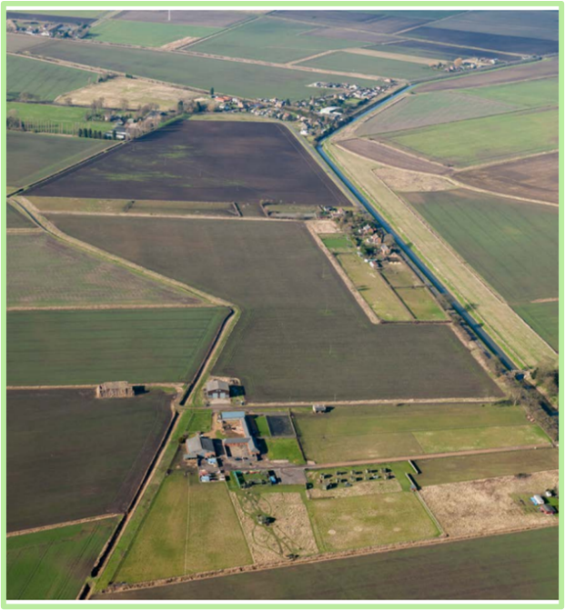
Must Farm Bronze Age Village Activity 2: Now and Then
Must Farm Bronze Age Village Activity 2: Now and Then
Fire destroys the Village c.849BC
The Drainage of the Fens 17 Century
At some point, when the settlement was still probably less than a year old, it was destroyed. Archaeologists found lots of burnt wood, which showed that it had burnt down in a big fire.
After the Fens were drained in the 17th century, the Fenland became a major agricultural region for growing grains and vegetables. New farms began to appear all over the Fens in the 19th century as the landowners used new methods to grow more food.
Notes:
Image © Vicki Herring
Image ©Historic England https://historicengland.org.uk/research/results/reports/8063/TheFensEasternArable

Slide 23
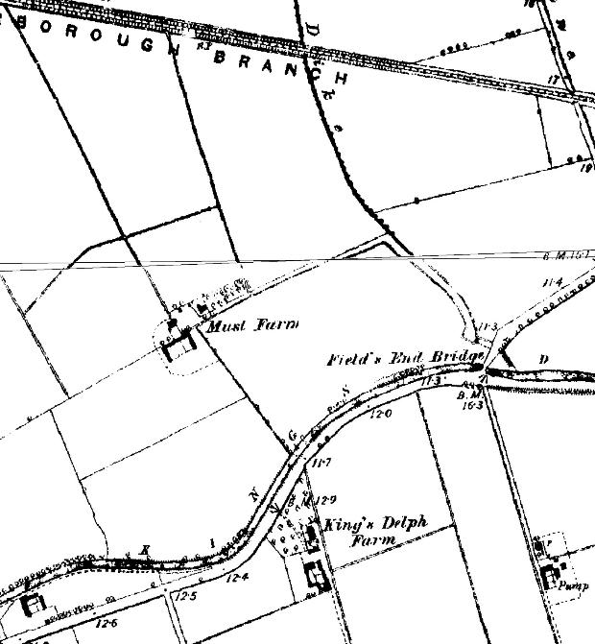
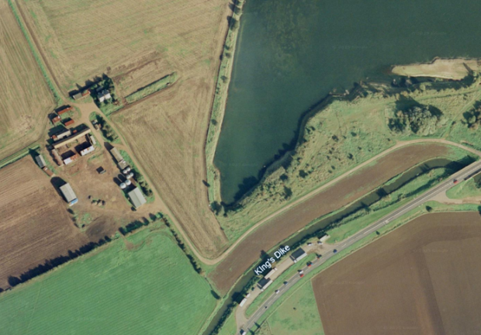

Must Farm Bronze Age Village Activity 2: Now and Then x3
Must Farm Bronze Age Village Activity 2: Now and Then
19th Century: Must Farm
1960: The growth of the Quarry
Must Farm, the place that gives the Bronze Age Village its name, appears for the first time on a map from the 1860s. We know that there are 2 families living at Must Farm in the 1841 Census.
The Victorian demand for bricks meant the land around Must Farm was dug up for clay. In the 1960s, some of the Bronze Age Village was probably unknowingly destroyed by this quarrying.
Notes:
Image ©Historic England or Ordnance Survey
Image ©Google Earth
https://earth.google.com/web/@52.55532022,-0.18191209,-1.00887685a,2171.18794978d,35y,0h,0t,0r/data=ChYqEAgBEgoyMDE2LTA4LTMwGAFCAggBOgMKATBCAggASg0I____________ARAA
Image ©CAU

Slide 24
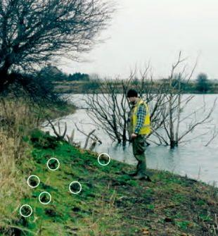
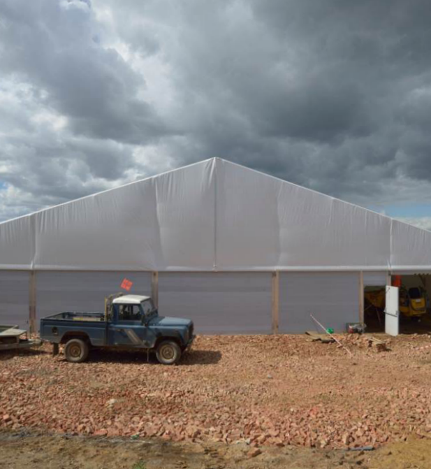
Must Farm Bronze Age Village Activity 2: Now and Then x4
Must Farm Bronze Age Village Activity 2: Now and Then
1999: Discovery of the Bronze Age Village
2016: Excavation of the Bronze Age Village
In 1999, an archaeologist was walking along the edge of a quarry next to Must Farm, when he saw some interesting wooden posts sticking out of the ground. The posts were studied carefully and were found to be almost 3,000 years old, from a period called the Late Bronze Age.
A temporary building was put up to allow the archaeologists to work throughout the winter and to protect the delicate archaeological site as it was uncovered. Archaeologists found five houses at Must Farm, half of the village. Archaeologists found lots of Late Bronze Age wood and artefacts like pots, tools, textiles, weapons and jewellery.
Notes:
Image ©Ben Robinson
Image ©CAU

Slide 25
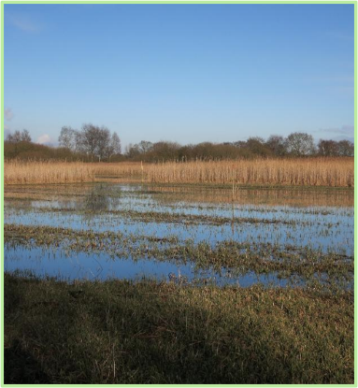
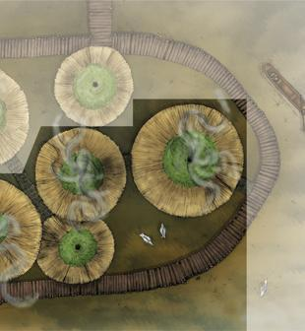
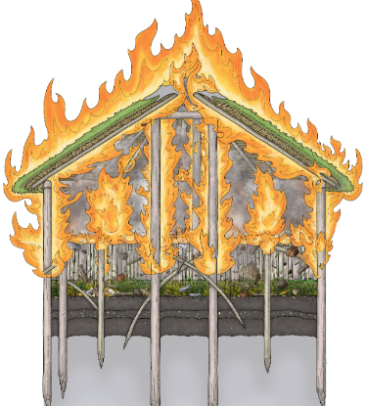
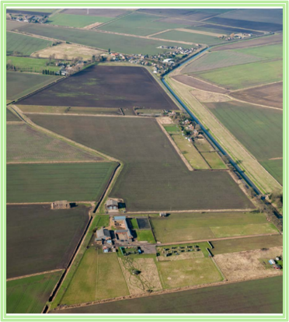

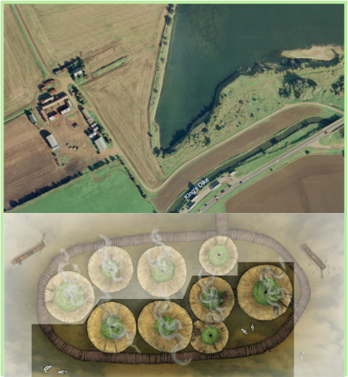
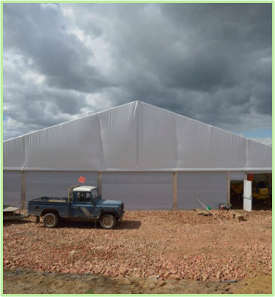
Chronological Sequence: 10000 B.C to 2025 A.D.
1. 10,000 B.C.
2. c.850 B.C.
3. c.849 B.C.
4. 17th Century A.D.
5. 1891
6. 1960s
7. 1999
8. 2016
Notes:
Image ©Wikipedia https://commons.wikimedia.org/wiki/File:Cut_area,_Woodwalton_Fen_-_geograph.org.uk_-_4361129.jpg
Images ©CAU
https://www.cam.ac.uk/stories/must-farm-prehistoric-stilt-house-dwellers
Image © Vicki Herring
Image ©Historic England https://historicengland.org.uk/research/results/reports/8063/TheFensEasternArable
Image ©Historic England or Ordnance Survey
Image ©Google Earth
https://earth.google.com/web/@52.55532022,-0.18191209,-1.00887685a,2171.18794978d,35y,0h,0t,0r/data=ChYqEAgBEgoyMDE2LTA4LTMwGAFCAggBOgMKATBCAggASg0I____________ARAA
Image ©CAU
Image ©Ben Robinson
Image ©CAU

Slide 26
The Story of Must Farm: Now and Then
Add the events to a timeline
Must Farm Bronze Age Village - 850 BC
4000 BC
3500 BC
3000 BC
2500 BC
2000 BC
1500 BC
1000 BC
0500 BC
0000 AD
0500 AD
1000 AD
1500 AD
2000 AD
2500 AD
Neolithic
4000 – 2200 BC
Bronze Age
2200-800 BC
Iron Age
800BC-43AD
Roman
43-410 AD
Anglo-Saxons & Vikings
410-1066 AD
Middle Ages
1066-1485
Tudors Stuarts Georgians
Victorians
1485-1901
20/21 Century

Slide 27
Printable timeline
4000 BC
3500 BC
3000 BC
2500 BC
2000 BC
1500 BC
1000 BC
0500 BC
0000 AD
0500 AD
1000 AD
1500 AD
2000 AD
2500 AD
Neolithic
4000 – 2200 BC
Bronze Age
2200-800 BC
Iron Age
800BC-43AD
Roman
43-410 AD
Anglo-Saxons & Vikings
410-1066 AD
Middle Ages
1066-1485
Tudors Stuarts Georgians
Victorians
1485-1901
20/21 Century

Slide 28
The Story of Must Farm Timeline answers a
1960s: The growth of the Quarry
19th Century: Must Farm
1999: Discovery of the Bronze Age Village
Must Farm Bronze Age Village destroyed by fire c.849BC
c.8000BC: The Fens
formed
17th Century: King’s Dyke Draining of the Fens
Must Farm Bronze Age Village c.850BC
2016: Excavation Begins
4000 BC
3500 BC
3000 BC
2500 BC
2000 BC
1500 BC
1000 BC
0500 BC
0000 AD
0500 AD
1000 AD
1500 AD
2000 AD
2500 AD
Neolithic
4000 – 2200 BC
Bronze Age
2200-800 BC
Iron Age
800BC-43AD
Roman
43-410 AD
Anglo-Saxons & Vikings
410-1066 AD
Middle Ages
1066-1485
Tudors Stuarts Georgians
Victorians
1485-1901
20/21 Century
The Romans build the Fen Causeway &
Car Dyke
1066
Battle of Hastings
1666
Great Fire oof London
WWII1939-1945

Slide 29
Extension Activity 1: How did the environment at Must Farm change over Time? Match up the beginning and end to make a sentence
Beginning (Cause) | End (Consequence/Result)
1. Around 10,000 years ago, following the end of the last Ice Age, sea levels rose … | A…because a big fire burnt it down and the houses and their contents fell into the muddy river below.
2. The Bronze Age village at Must Farm was destroyed within one year of it being built … | B…because of the demand for bricks
3. The Fenland changed to a farming region growing grains and vegetables... | C…because an archaeologist saw some interesting wooden posts sticking out of the ground.
4. New farms began to appear all over the Fens in the 19th century… | D…because of melting glaciers which flooded the area and formed the Cambridgeshire Fens.
5. Must Farm gives the Bronze Age Village its name… | E…because the Fens were drained in the 17th century exposing the fertile soil.
6. In the 1960s, the land around Must Farm was dug up for clay (quarrying) … | F…. because the landowners used new methods to grow more food.
7. In 1999, The remains of a Bronze Age Village was discovered… | G…because in the 19th century the land above the buried village became one of the fields belonging to Must Farm.

Slide 30
Extension Activity 1: How did the environment at Must Farm change over Time? Match up the beginning and end to make a sentence – answers
Beginning (Cause) | End (Consequence/Result)
1. Around 10,000 years ago, following the end of the last Ice Age, sea levels rose … | A…because a big fire burnt it down and the houses and their contents fell into the muddy river below.
2. The Bronze Age village at Must Farm was destroyed within one year of it being built … | B…because of the demand for bricks
3. The Fenland changed to a farming region growing grains and vegetables... | C…because an archaeologist saw some interesting wooden posts sticking out of the ground.
4. New farms began to appear all over the Fens in the 19th century… | D…because of melting glaciers which flooded the area and formed the Cambridgeshire Fens.
5. Must Farm gives the Bronze Age Village its name… | E…because the Fens were drained in the 17th century exposing the fertile soil.
6. In the 1960s, the land around Must Farm was dug up for clay (quarrying) … | F…. because the landowners used new methods to grow more food.
7. In 1999, The remains of a Bronze Age Village were discovered… | G…because in the 19th century the land above the buried village became one of the fields belonging to this new Farm.

Slide 31
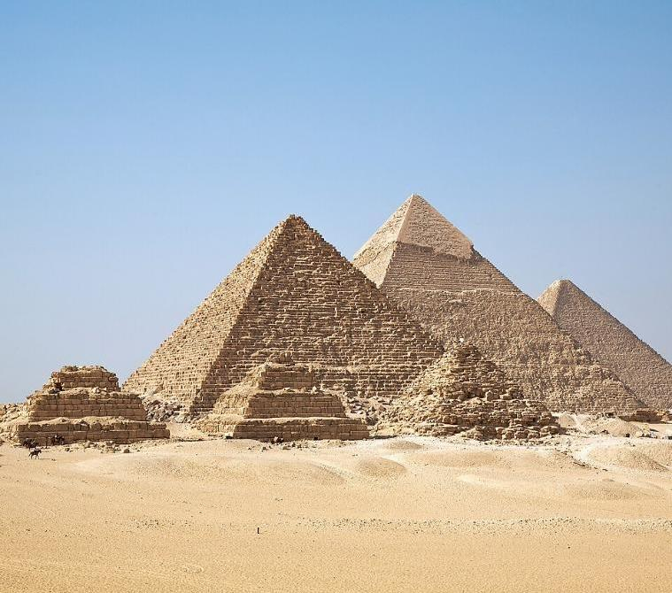

Extension Activity 2 : Meanwhile, Elsewhere …
What was life in other parts of the world like c.850BC?
Use information from here or from your own research to find out about life in …
Ancient Greece
Ancient Egypt
Ancient Mesopotamia
Ancient China
Ancient Peru
Ancient India
Chronology
The Pyramids of Giza
Notes:
Image ©Wikipedia
https://en.wikipedia.org/wiki/New_Kingdom_of_Egypt#/media/File:All_Gizah_Pyramids.jpg By Ricardo Liberato - All Gizah Pyramids, CC BY-SA 2.0, https://commons.wikimedia.org/w/index.php?curid=2258048
https://meanwhileelsewhereinhistory.wordpress.com/pre-1066/

Slide 32
The Story of Must Farm: Now and Then Display Timeline
Create a wall display of the timeline; add details of how the environment changed as a result of key events in history.
Create a wall Timeline using the next 3 slides
Cut out and add the labels
Add the maps, aerial photos and key event cards, using string to link each event to the date on the timeline
Add your own events, illustrations, research, photos

Slide 33
Must Farm Timeline part 1
2500 BC | 2000 BC | 1500 BC
Neolithic
4000 – 2200 BC
Bronze Age
2200-800 BC

Slide 34
Must Farm Timeline part 2
1000 BC | 500 BC | 0 | 500 AD
Bronze Age
2200-800 BC
Iron Age
800BC-43AD
Roman
43-410 AD
Anglo-Saxons & Vikings
410-1066 AD

Slide 35
Must Farm Timeline part 3
1000 AD | 1500 AD | 2000 AD
Anglo-Saxons & Vikings
410-1066 AD
Middle Ages
1066-1485
Tudors, Stuarts. Georgians, Victorians
1485-1901

Slide 36

Labels for your own timeline
2500 BC | 2000 BC | 1500 BC | 1000 BC | 500 BC
0 | 500 AD | 1000 AD | 1500 AD | 2000 AD
Neolithic
4000 – 2200 BC
Iron Age
800BC-43AD
Anglo-Saxons & Vikings
410-1066 AD
Bronze Age
2200-800 BC
Romans
43-410 AD
Middle Ages
1066-1485
Tudors, Stuarts, Georgians, Victorians
1485-1901

Slide 37

Historic event Labels for timeline
c.8000BC:
The Fens
formed
Must Farm Bronze Age Village c.850BC
1490: Morton’s Leam
17th Century: King’s Dyke
Drainage of the Fens
Bronze Age Village destroyed by fire c.850BC
1066
Battle of Hastings
18th and 19th Century: Farming flourishes in the Fens
The Romans build Fen Causeway &
Car Dyke
1666
Great Fire oof London
1820s: Steam pumping stations
19th Century: Must Farm
World War II
1939-1945
1960s: The growth of the Quarry
1999: Discovery of the Bronze Age Village
2016: Excavation Begins
Labels for your own timeline

