Slide 1
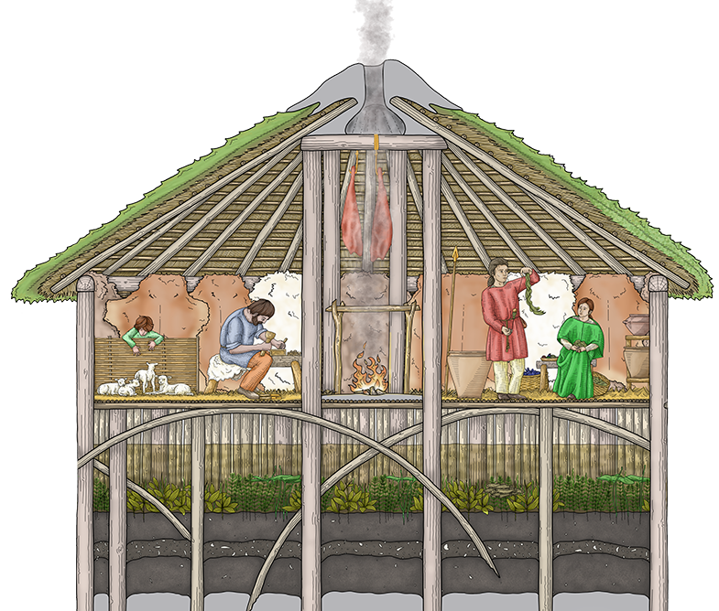
Must Farm
Bronze Age Village
Activity 6: Homes Then and Now
Notes:
Image © Vicki Herring.

Slide 2
Do our houses have anything in common with the round houses of Must Farm Bronze Age Village c.850BC?
Key Stage 2 History
Pupils will develop understanding of the process of change and the diversity of societies as well as their own identity.
Pupils will develop their knowledge and understanding of the history of these islands from the earliest times to the present day; of historical concepts such as continuity, change, similarity, difference; and of connections between local, regional, national.
Pupils will note connections, contrasts and trends over time and develop the appropriate use of historical terms. They will develop their understanding of change, cause, similarity, difference.
KS2 Unit: Changes in Britain from the Stone Age to the Iron Age: Bronze Age religion, technology and travel
KS2 Geography: Human and physical geography: types of settlement.

Slide 3
How to use this PowerPoint Accompanying Resources
Analyse a modern home (external and internal) to identify features, materials and rooms.
Recap KS1 unit on Homes through time or around the world
Label the reconstruction diagram of the roundhouse from Must Farm Bronze Age Village
Look at the diagrams drawn by the archaeologists showing where the artefacts were found. From this label a vertical plan of a roundhouse
Fill in the chart comparing a roundhouse from 850BC with a modern house/home in UK
Video 2: Must Farm: A Bronze Age Settlement (Duration 8.20 mins)
PPT: Introducing Must Farm Bronze Age Village (Slides 7-11)
PPT: Building Must Farm Bronze Age Village
PPT: Life At Must Farm Bronze Age Village (Slides 1-5)
ZIP Folder: Images – 8 themed PPTs with high quality images of artefacts and reconstruction illustrations
3D models of the site and the artefacts https://sketchfab.com/mustfarm

Slide 4
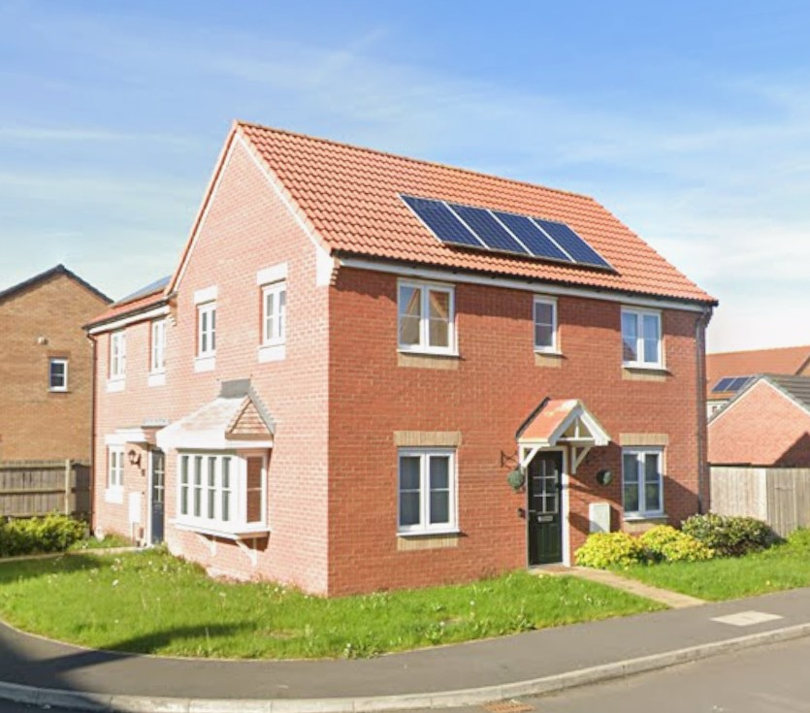






A Modern House
Look closely at this house in Whittlesey – a town close to the site of Must Farm Bronze Age Village
What features does it have?*
What type of house is it?*
What materials is the house built from?*
Look
What shapes can you see?*
*See notes for vocabulary
Notes:
Image ©Google Street View
What type of house is it? - detached, semi-detached; terraced; bungalow; flat; maisonette; how many floors or storeys
What features does it have? - roof, walls, windows, doors, garden, fence, porch, solar panels (gabel end, window lintel and cill/sill)
What materials is the house built from? – brick; clay; wood; glass; metal; plastic; concrete
What shapes can you see? - square; rectangle; cube; cuboid; circle; triangle; prism

Slide 5
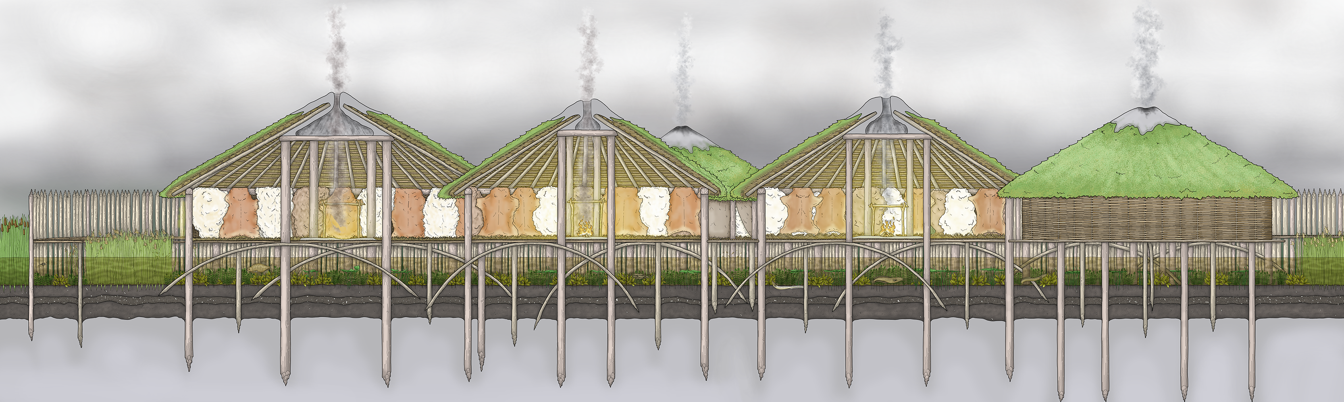
A Must Farm Roundhouse c850BC
Look closely at this artists impression of one of the roundhouses from Must Farm Bronze Age Village. The houses are just a few fields but nearly 3000 years apart
What features does it have?*
What materials is the house built from?*
What shapes can you see?*
What type of house is it?*
Look
*See notes for vocabulary
Notes:
Image © Vicki Herring.
What type of house is it? - roundhouses; huts; stilt houses: how many floors or storeys
What features does it have? - conical roof, walls, no windows, door, pallisade, smoke opening in roof
What materials is the house built from? –clay; wood; wattle; turf; thatch; rope from plant fibres
What shapes can you see? - square; rectangle; cube; cuboid; circle; triangle; prism; cone/conical

Slide 6
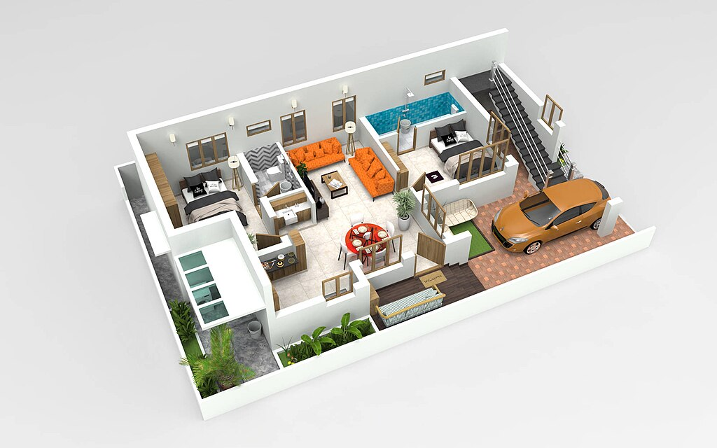

Inside a House in 2025
Look closely at the 3D image of a modern home.
What type of house is this?*
How many rooms does it have?
What rooms can you see?*
*See notes for vocabulary
Notes:
Image © wikpedia https://commons.wikimedia.org/wiki/File:Back-view-2000x1250.jpg
What type of house is this? detached, semi-detached; terraced; bungalow; flat; maisonette; how many floors or storeys, is it open plan?
How many rooms does it have?
What rooms can you see? - hall, kitchen, sitting room, dining room, bedroom, bathroom, utility room, office, workshop, garage, storeroom, pantry, ensuite

Slide 7
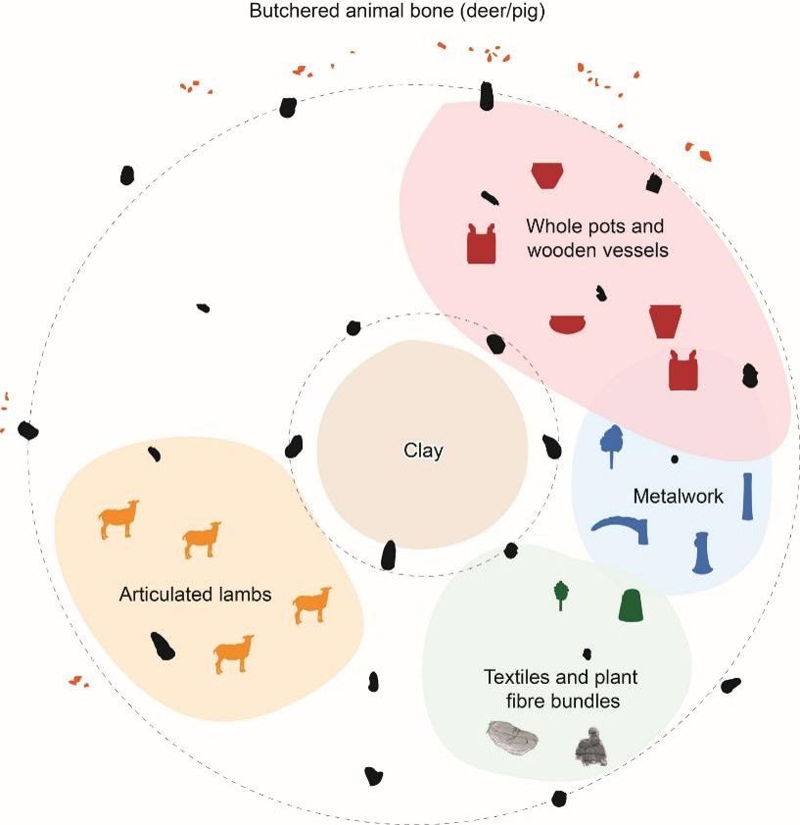
Inside a Must Farm Roundhouse c850BC 1
Look closely at the archaeologists plan of the finds from one of the Must Farm Bronze Age roundhouses.
How many rooms does it have?
What type of house is this?*
What rooms can you see?*
*See notes for vocabulary
Notes:
Image ©CAU
What type of house is this? detached, hut; how many floors or storeys, is it open plan?
How many rooms does it have? One but divided into areas
What ‘rooms’ can you see? - kitchen, sitting room, dining room, bedroom, bathroom, utility room, office, workshop, garage, storeroom, pantry, ensuite

Slide 8
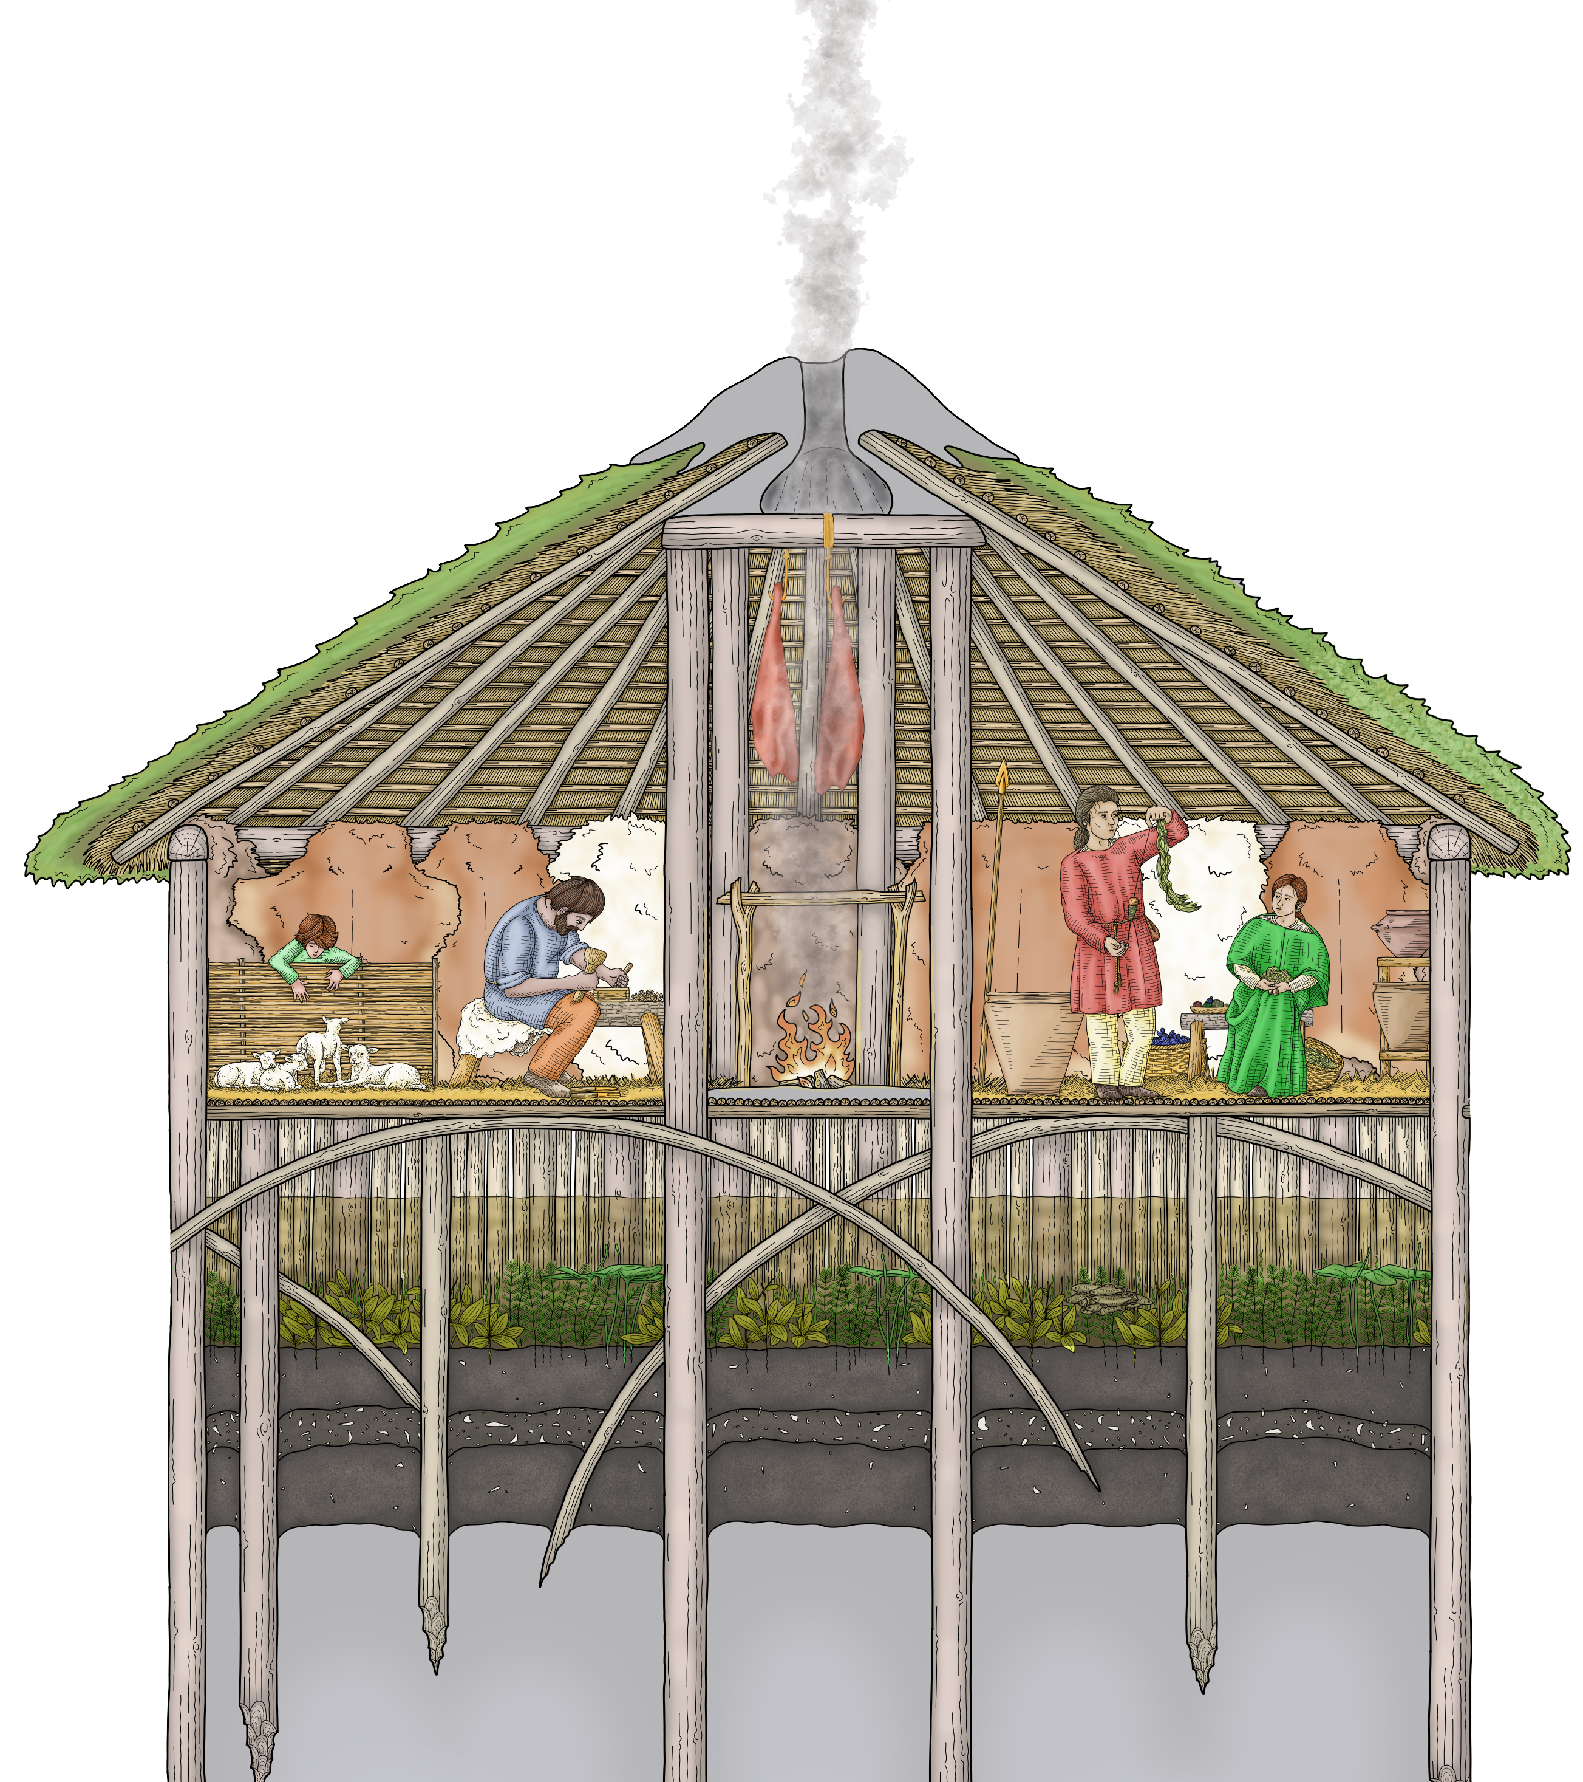
Inside a Must Farm Roundhouse c850BC 2
Look closely at this artists impression of one of the roundhouses from Must Farm Bronze Age Village.
The houses are just a few fields away but built nearly 3000 years apart.
Notes:
Image © Vicki Herring.

Slide 9
Example of print out table
Feature Outside | THEN Must Farm Bronze Age Village c.850BC | NOW Modern House Or My House
What type of house is it?
What is the basic shape of the house
How many windows?
How many doors?
What materials is it made of?
What sort of roof does it have?
How close are the neighbours?
Does it have a garden, drive, outside space?
Does it have a fence or hedges around it?

Slide 10
Inside features worksheet
Feature Inside | Then Must Farm Bronze Age Village c.850BC | NOW Modern House Or My House
How many floors does the house have?
How many rooms does it have?
Is there a kitchen? Is there a special place to store food?
Is there a sitting Room? Dining Room?
Are there bedrooms? How many?
Is there a place to work? Office, workshop
How is the house kept warm
Where does the rubbish go?
How many people live in this house?

Slide 11
Add your own features worksheet
Feature Inside/Outside Add you own | Then Must Farm Bronze Age Village c.850BC | NOW Modern House Or My House

Slide 12
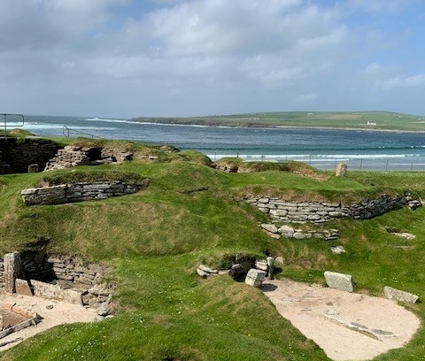
Extension Activity: Meanwhile elsewhere in Prehistoric Britain
Was every prehistoric village like the one found at Must Farm?
Notes:
Image © https://en.wikipedia.org/wiki/File:Skarabrae5.jpg

Slide 13
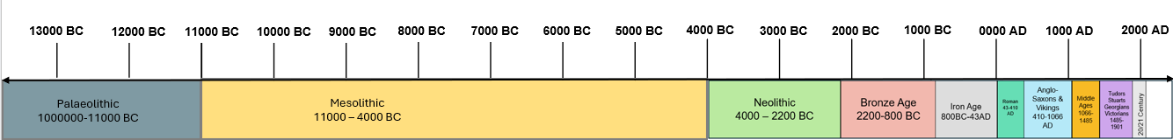

Must Farm Bronze Age Village Extension Activity:
Was every prehistoric village like the one found at Must Farm?
Prehistoric Houses and Settlements
Sort the cards into a chronological sequence. Use the timeline to help you.
Prehistory
(Archaeological Records)
History
(Written Records)
Notes:
https://historicengland.org.uk/education/schools-resources/teaching-activities/timeline-stone-age-to-iron-age/

Slide 14
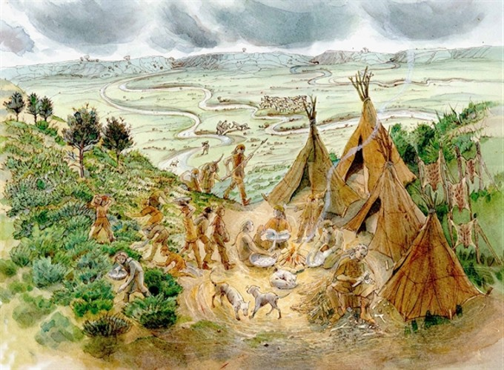
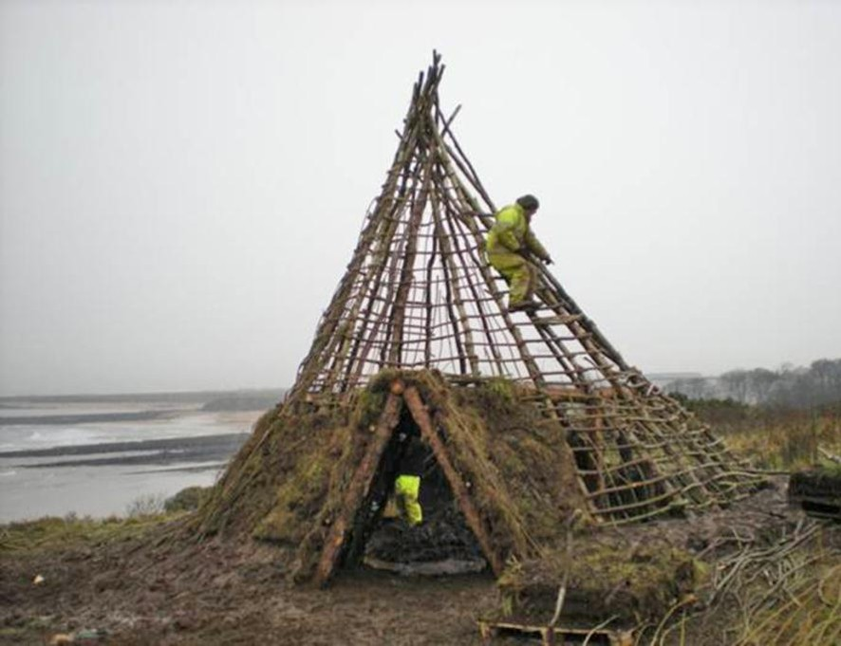
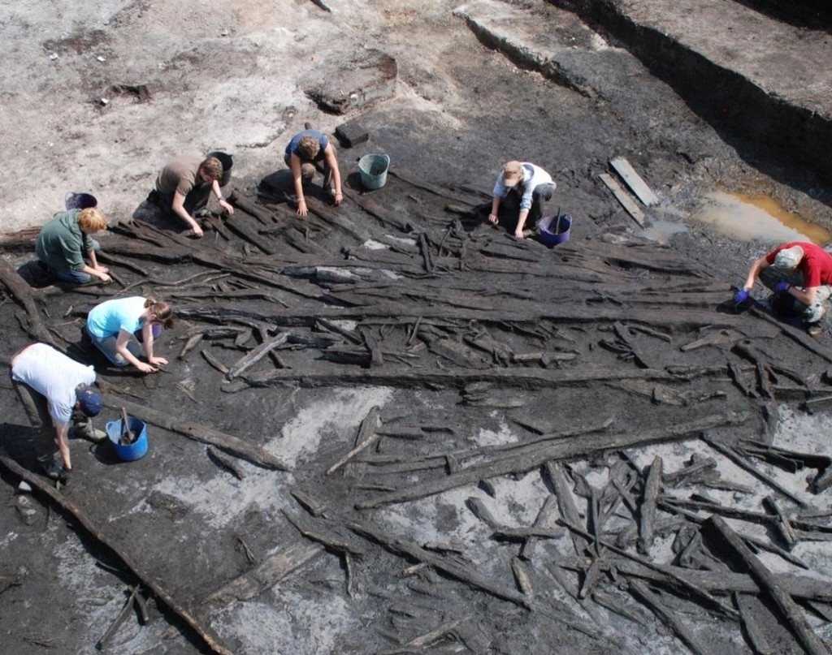
‘Was every prehistoric village like the one found at Must Farm?’ 1
Hengistbury Head, Dorset
Howick, Northumberland
Star Carr, Yorkshire
Hengistbury Head in Dorset which dates to the end of the Palaeolithic period, about 14,000 years ago. It was used by nomadic hunters who camped on the higher ground next to what was then a river and made tools from stone, bone and antler.
Occasionally, Mesolithic people built more substantial houses. Much of our evidence for these comes from northern Britain, such as Howick on the coast of Northumberland. Mesolithic people were living here almost 10,000 years ago.
Star Carr is an early Mesolithic site in North Yorkshire, inhabited not long after the end of the last ice age, around 11,000 years ago. It lies on the shore of a former lake where Mesolithic people built a wooden platform and other structures.
Notes:
Images © Historic England https://historicengland.org.uk/education/schools-resources/teaching-activities/timeline-stone-age-to-iron-age/

Slide 15
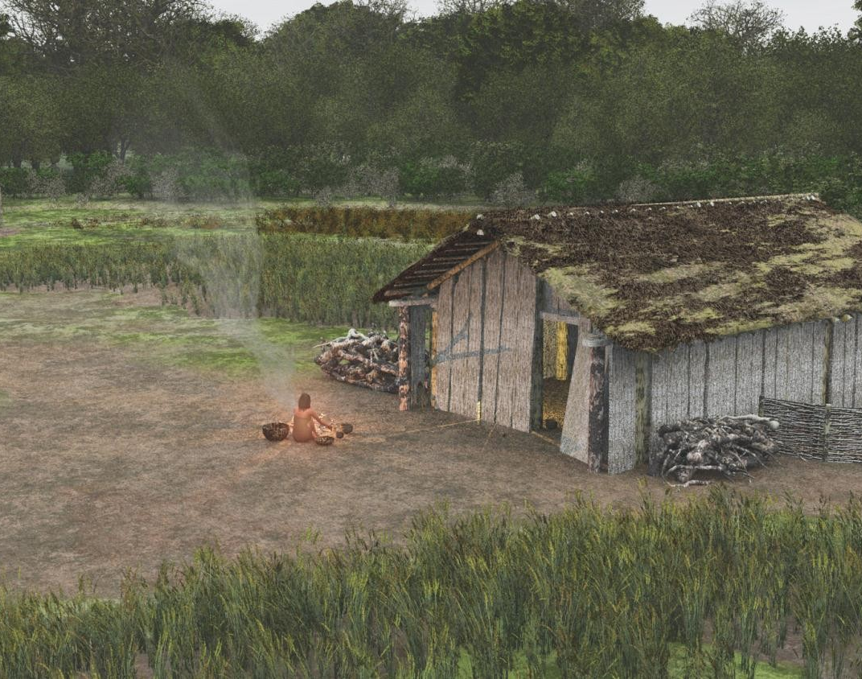
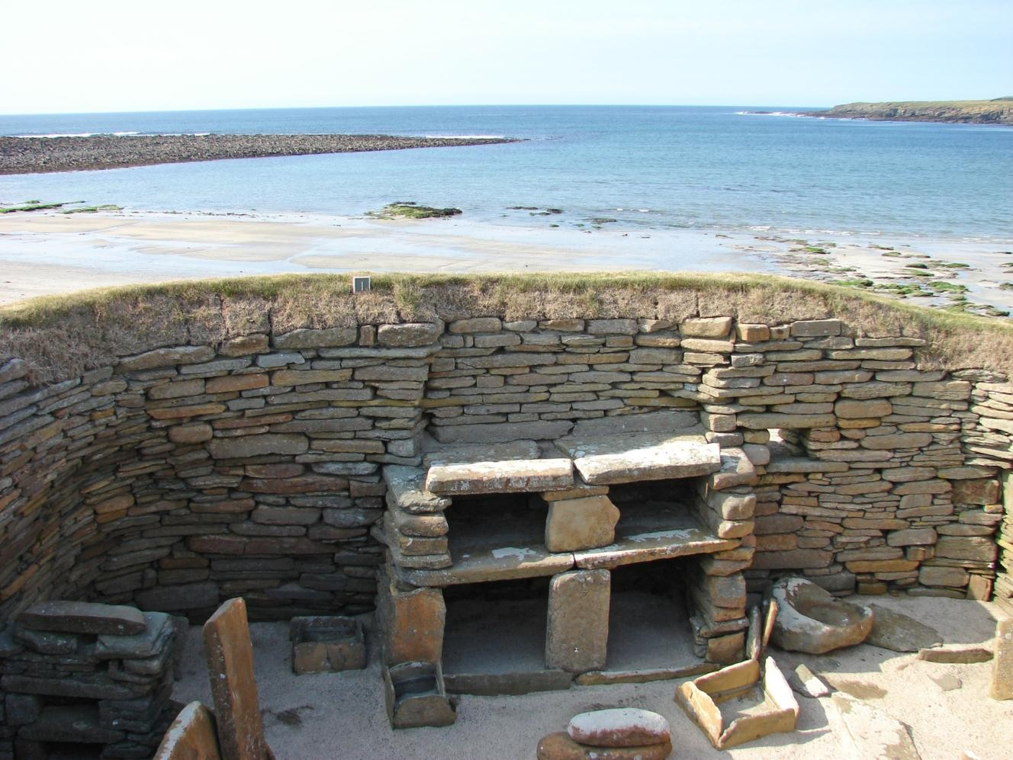
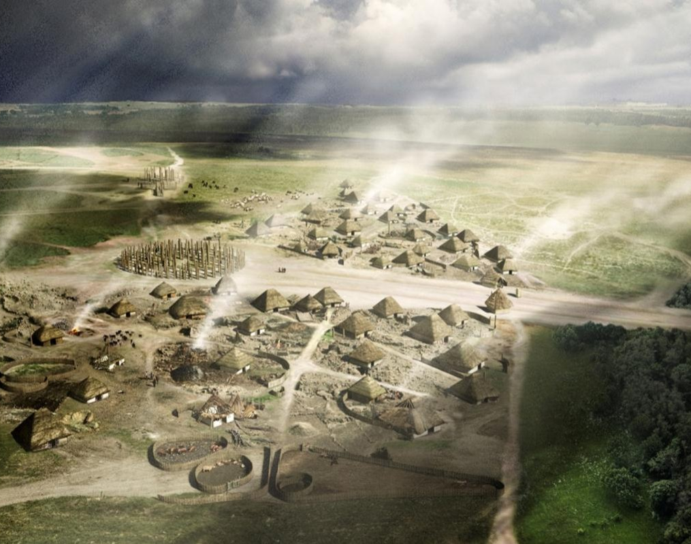
‘Was every prehistoric village like the one found at Must Farm?’ 2
Horton, Berkshire
Skara Brae, Orkney
Durrington Walls, Wiltshire
In the early Neolithic, some people built timber halls or longhouses which were rectangular in shape, and sometimes very big! It seems likely that these large buildings were more like village halls or community centres.
At Skara Brae in Orkney, the well-preserved houses of the later Neolithic were built of stone and connected by passageways. They also had stone furniture, including cupboards, box ‘beds’ at either side, and a central square fireplace.
At Durrington Walls in Wiltshire the Neolithic houses were made of timber and chalk. Their size and shape were like the houses on Orkney. So, we know people built similar-looking homes but in the materials available to them.
Notes:
Images © Historic England https://historicengland.org.uk/education/schools-resources/teaching-activities/timeline-stone-age-to-iron-age/

Slide 16
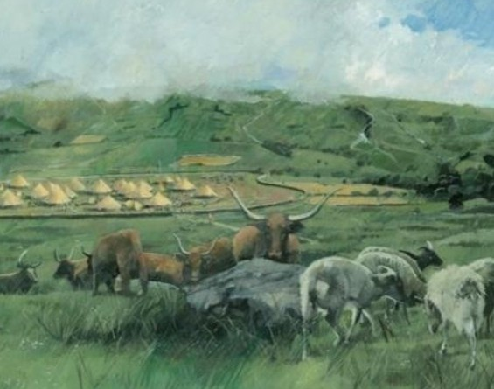
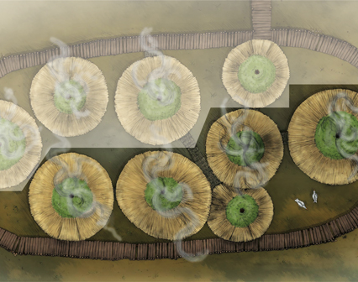
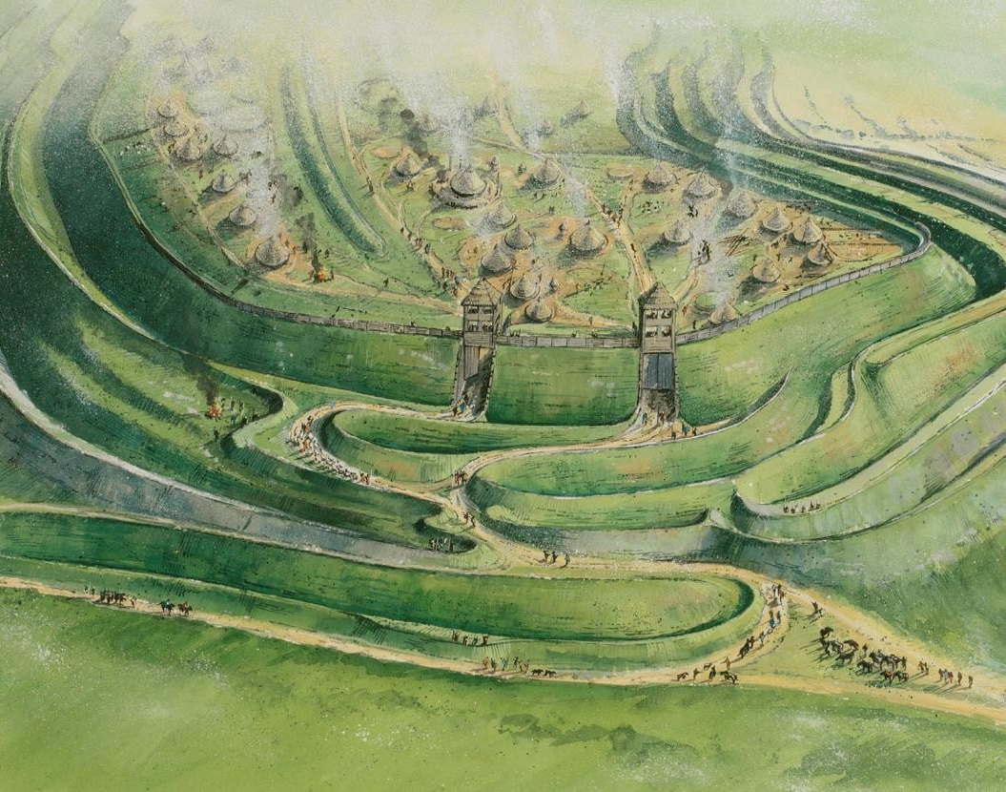
‘Was every prehistoric village like the one found at Must Farm?’ 3
Grimspound, Devon
Must Farm, Cambridgeshire
Maiden Castle, Dorset
Grimspound, on Dartmoor in Devon is a later Bronze Age village, lived in between about 1450–700 BC. The stone foundations of 24 round huts excavated at the end of the 19th century are still visible.
Around 850 BC, the settlement was built on stilts over a slow-moving river, not far from the Bronze Age ceremonial site at Flag Fen. The village of at least five wooden roundhouses, was surrounded by a palisade of sharpened stakes.
There were over 1000 hillforts in Iron Age Britain. Maiden Castle in Dorset is the largest. It was in use from the 4th century BC until the Roman conquest.
Notes:
Images © Historic England https://historicengland.org.uk/education/schools-resources/teaching-activities/timeline-stone-age-to-iron-age/

Slide 17
‘Was every prehistoric village like the one found at Must Farm?’ 4
Hengistbury Head, Dorset
Howick, Northumberland
Star Carr, Yorkshire
Hengistbury Head in Dorset which dates to the end of the Palaeolithic period, about 14,000 years ago. It was used by nomadic hunters who camped on the higher ground next to what was then a river and made tools from stone, bone and antler.
Occasionally, Mesolithic people built more substantial houses. Much of our evidence for these comes from northern Britain, such as Howick on the coast of Northumberland. Mesolithic people were living here almost 10,000 years ago.
Star Carr is an early Mesolithic site in North Yorkshire, inhabited not long after the end of the last ice age, around 11,000 years ago. It lies on the shore of a former lake where Mesolithic people built a wooden platform and other structures.
Notes:
Images © Historic England https://historicengland.org.uk/education/schools-resources/teaching-activities/timeline-stone-age-to-iron-age/

Slide 18
‘Was every prehistoric village like the one found at Must Farm?’ 5
Horton, Berkshire
Skara Brae, Orkney
Durrington Walls, Wiltshire
In the early Neolithic, some people built timber halls or longhouses which were rectangular in shape, and sometimes very big! It seems likely that these large buildings were not ordinary dwellings but more like village halls or community centres
At Skara Brae in Orkney, the well-preserved houses of the later Neolithic were built of stone and connected by passageways. They also had stone furniture, including cupboards, box ‘beds’ at either side, and a central square fireplace.
At Durrington Walls in Wiltshire the Neolithic houses were made of timber and chalk. Their size and shape were like the houses on Orkney. So, we know people built similar-looking homes but in the materials available to them.
Notes:
Images © Historic England https://historicengland.org.uk/education/schools-resources/teaching-activities/timeline-stone-age-to-iron-age/

Slide 19
‘Was every prehistoric village like the one found at Must Farm?’ 6
Grimspound, Devon
Must Farm, Cambridgeshire
Maiden Castle, Dorset
Grimspound, on Dartmoor in Devon is a later Bronze Age village, lived in between about 1450–700 BC. The stone foundations of 24 round huts excavated at the end of the 19th century are still visible.
Around 850 BC, the settlement was built on stilts over a slow-moving river, not far from the Bronze Age ceremonial site at Flag Fen. The village of at least five wooden roundhouses, was surrounded by a palisade of sharpened stakes.
There were over 1000 hillforts in Iron Age Britain. Maiden Castle in Dorset is the largest. It was in use from the 4th century BC until the Roman conquest.
Notes:
Images © Historic England https://historicengland.org.uk/education/schools-resources/teaching-activities/timeline-stone-age-to-iron-age/

Slide 20




Must Farm Bronze Age Village Extension Activity: 1
Was every prehistoric village like the one found at Must Farm?
Prehistoric Houses and Settlements
In what ways are some of them different from the Must Farm Bronze Age Village?
Which of the other prehistoric houses or settlements have similarities with the Must Farm Bronze Age Village?
What do you think was the biggest or most significant change in the houses or settlements prehistoric people lived in?
Group discussion

Slide 21
Must Farm Bronze Age Village Extension Activity: 2
Was every prehistoric village like the one found at Must Farm?
The Tale of Two Villages
Draw two large circles that overlap on a large sheet of paper to create a Venn diagram and label the areas – see slide 16
Look at the fact cards about Skara Brae Neolithic Settlement and the Must Farm Bronze Age Village.
Place facts that are similar in the overlapping area of the two circles of the Venn Diagram
Place the others in the outer part of the circles

Slide 22

Venn diagram
Differences or no evidence
Differences or no evidence
Facts about
Skara Brae Neolithic Settlement Orkney,
Facts about Must Farm Bronze Age Village Fire c.850BC
Similarities

Slide 23
Cards for Skara Brae (print on yellow card)
Skara Brae was the home of a Neolithic farming community. They grew crops and kept animals | The settlement is very well preserved; there is even furniture inside the houses and a wealth of Stone Age artefacts | The door was lockable from the inside. We think a bone, or a piece of wood, could have been used to hold the door in place | There are eight houses that are linked together by a series of low passageways
Skara Brae is near the sea. People would have been able to catch fish and collect shellfish. They also hunted wild animals | It was discovered in 1850 when a big storm blew away some of the sand covering the Stone Age houses | The people cooked on the fire. Smoked meat was stored in the smoky roof space | The settlement was inhabited for about 600 years until the beginning of the Bronze Age
Skara Brae is by the sea in the Orkney Islands off the north coast of Scotland. Behind Skara Brae is the Loch (lake) of Skaill | Skara Brae is a Neolithic village. It was probably inhabited between 3200 BC and 2200 BC | The houses are made of stone, and each one is just one single room with furniture such as beds and dressers | Huge storage jars were buried in the corner of the house. Their tops were beautifully decorated

Slide 24
Cards for Must Farm Bronze Age Village (print on green card)
All the houses were made of wood, wattle panels for floors and walls, dry straw on the roof | The people who lived at Must Farm were both farmers and hunters: they grew some grain crops and kept animals. They also hunted and fished for food | The settlement was built on stilts over a slow-moving river in Cambridgeshire, not far from the Bronze Age ceremonial site at Flag Fen | Around 850 BCE, a fire destroyed the Must Farm settlement. The roundhouses and all their contents fell into the muddy riverbed perfect for preservation.
Each of the houses had a fireplace inside, called a hearth, used for cooking and to provide warmth | Wood was the main material for building the houses, the furniture and everyday objects at Must Farm. Archaeologists found over 18,000 pieces of wood. | The village was destroyed between 9 months to a years after it was built in about 850 BC- the late Bronze Age | Archaeologists found lots of Late Bronze Age wood and artefacts like pots, tools, weapons and jewellery
Part of the village was quarried away in the 1960s. This left some of the wooden posts in the open which an archaeologist spotted in 1999 | The walkways over the river at Must Farm Bronze Age village would have been made by weaving together wood to make wattle panels. | There were probably nine or ten houses and around 50 people living alongside animals like dogs and sheep. | Archaeologists found that different parts of the roundhouses were "zoned" for specific activities, similar to rooms in a modern hom

Slide 25
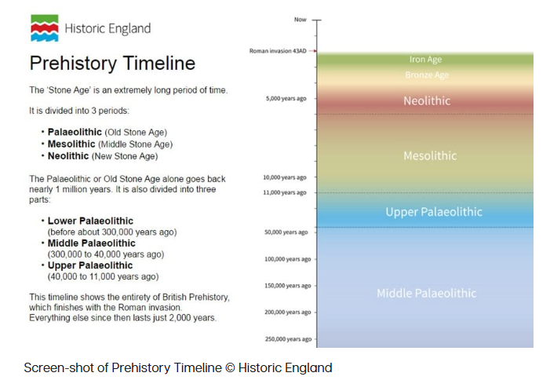
Find more Prehistory resources from Historic England
Notes:
https://historicengland.org.uk/education/schools-resources/teaching-activities/timeline-stone-age-to-iron-age/

