Slide 1
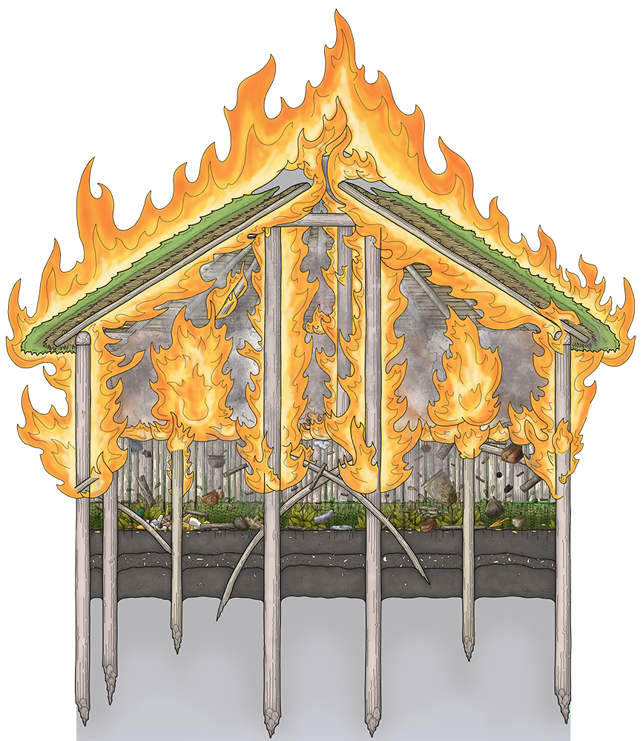
Must Farm Bronze Age Village Activity 5: Fire! Fire! What caused the fire that destroyed Must Farm Bronze Age Village c850BC?
Notes:
Image © Vicki Herring.

Slide 2
‘What could have caused the fire that destroyed the Must Farm Bronze Age Village c850BC?’
Key Stage 2 History
Pupils will be equipped to ask perceptive questions, think critically, weigh evidence, sift arguments and develop perspective and judgement.
Pupils will develop their understanding of historical concepts such as cause and consequence, similarity, difference and significance, and use them to make connections and draw contrasts.
Pupils will develop their understanding of the methods of historical enquiry, including how evidence is used to make historical claims, and discern how and why contrasting arguments and interpretations of the past have been constructed.
Pupils will address historically valid questions about cause, similarity and difference.
KS2 Unit: Changes in Britain from the Stone Age to the Iron Age: Bronze Age religion, technology and travel
KS1 Unit recap: Pupils learn about events beyond living memory that are significant nationally or globally, for example, the Great Fire of London.

Slide 3
How to use this ppt
How to use this PowerPoint
Use the photos and information from the archaeological site report to draw conclusions about the causes of the fire that destroyed the Must farm Bronze Age Village just a few months after it had been built in c.859BC
The extension activity looks at the similarities and differences between this fire and the Great Fire of London 1666.
Video 2 – Q4: What could have caused the fire that destroyed Must Farm? (Duration 2.13 mins)
PPT: Life At Must Farm Bronze Age Village
Fact Cards from Fire Investigator Report (Slide 12)
Fact Cards for Great Fire of London & Must Farm comparison activity (Slides 20-21)

Slide 4
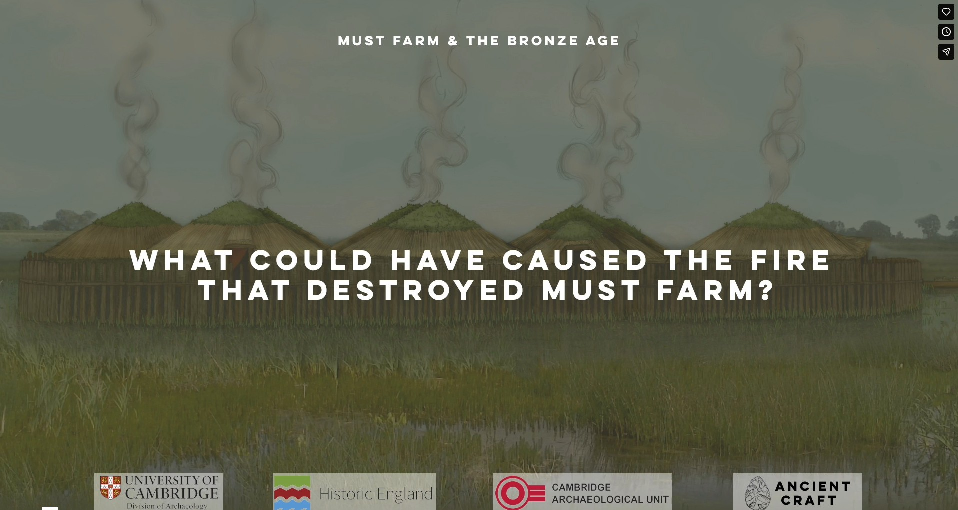
What could have caused the fire that destroyed Must Farm?
Notes:
https://vimeo.com/1045079609?share=copy&fl=cl&fe=ci

Slide 5
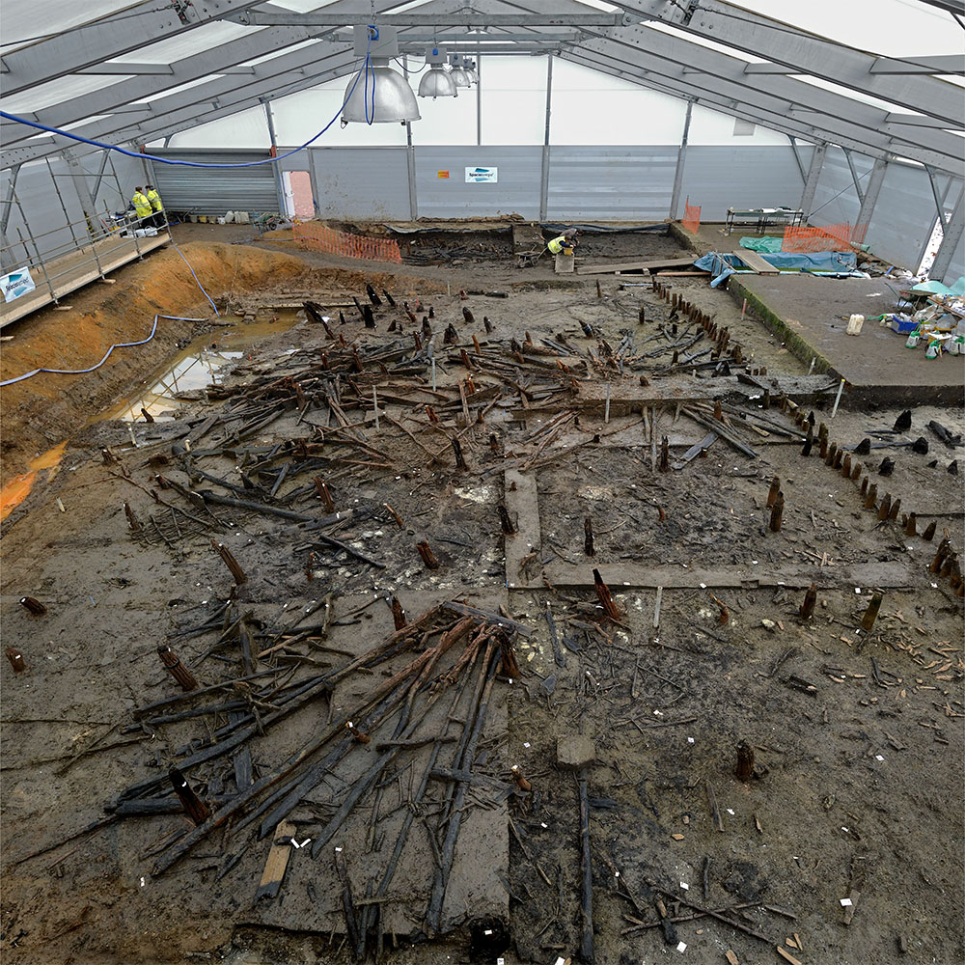
What destroyed the Must Farm Bronze Age Village c850BC?
At some point, when the settlement was still probably less than a year old, it was destroyed.
Archaeologists found lots of burnt wood, which showed that it had burnt down in a big fire.
Notes:
Image ©CAU

Slide 6

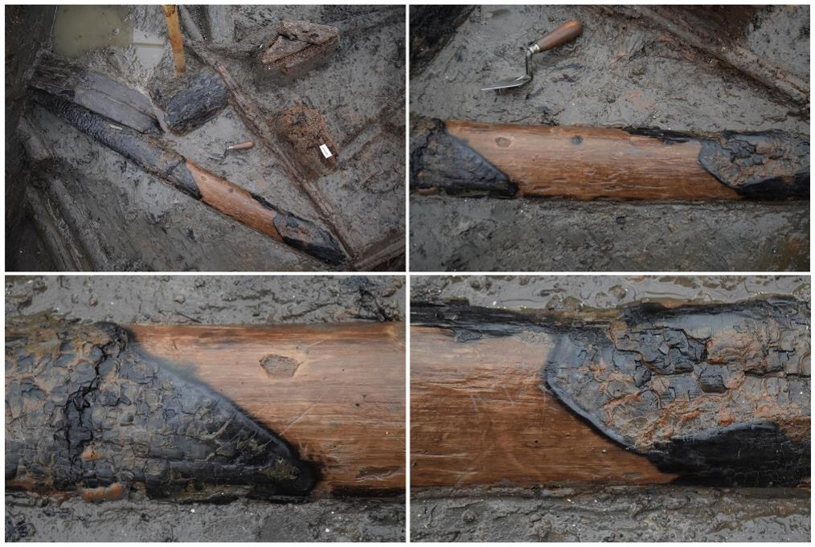

Evidence that it had burnt down in a big fire
Charring (carbonisation) caused by the fire
A wooden post from one of the round houses
Carbonisation happens when extreme heat causes the wood (organic) to become carbon (inorganic)
Part of the wooden post protected from the flames by another post before the house collapsed into the riverbed
Notes:
Image ©CAU
https://www.mustfarm.com/progress/site-diary-11-the-importance-of-the-wood-record/

Slide 7
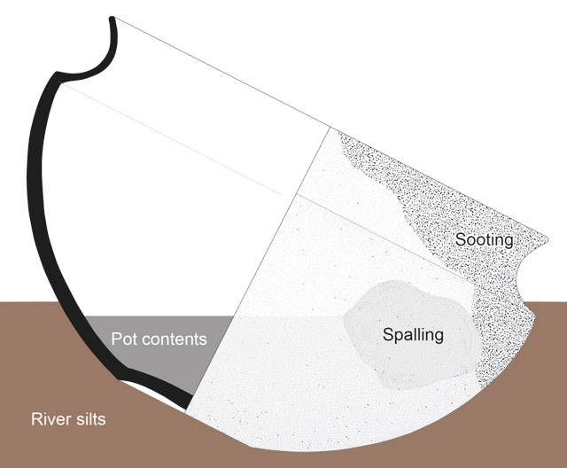
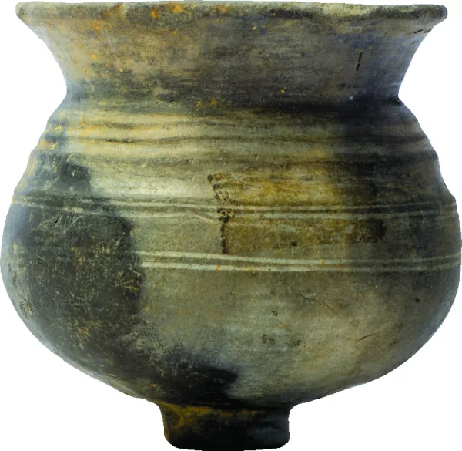
Evidence that it had burnt down in a big fire: Pottery
Black marks caused the flames from a fire called sooting
These pictures show the condition in which many of the pots were found
Damage caused by really high temperature called spalling
Notes:
Images ©CAU
https://www.mustfarm.com/progress/site-diary-27-pottery/
Diagram showing how vessels can come to rest in the river sediments. The position of the sooting and spalling show where the outside of the pot was damaged by the fire that caused the houses to burn down. Where this damage is found on the pot is likely to reflect where the pot was positioned in the building when it caught fire. The pots contents often come to rest at odd angles; a result of the vessel falling unevenly into the silt.

Slide 8
What destroyed the Must Farm Bronze Age Village?
As the houses burnt, they broke apart and lots of the wood and material used to make them fell into the river below.
The conditions preserved the wood so archaeologists can work out how the houses were made and destroyed.
Fire investigators were called in to look at the evidence. Was the fire an accident or was it started deliberately?
Notes:
Image © Vicki Herring.

Slide 9
What do modern fire investigators think?
Having studied the evidence, they say the fire had two clear phases.
1. Combustion – The fire seems to start close to the floor in one of the houses. In a matter of seconds, flames spread upwards to the roof. Within minutes all the roofs were on fire. There would have been a lot of heat and smoke, visible for miles around.
Notes:
Image © Vicki Herring.

Slide 10
What do modern fire investigators think?b
Having studied the evidence, they say the fire had two clear phases.
2. Smouldering - The wattle walls, floors and walkways were destroyed quite quickly along with the roof coverings, but the large posts burnt more slowly. The fire was almost invisible, with no flames and only a little smoke.
Notes:
Image © Vicki Herring.

Slide 11
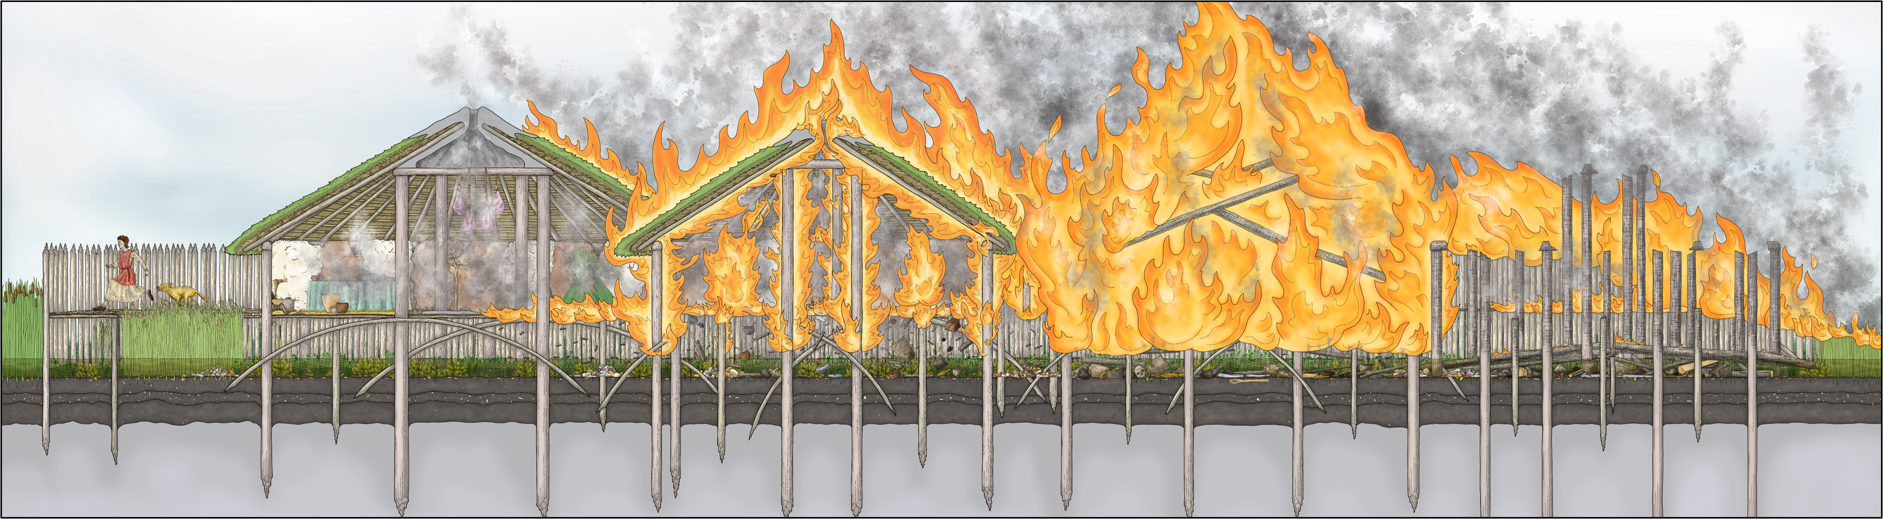
What caused the Must Farm fire?
Archaeologists will probably never know exactly what happened at Must Farm.
Even with this much well-preserved material, it is difficult to understand what caused the fire and what happened to the people who lived there.
Archaeologists have different theories about the fire at Must Farm.
They must use the evidence they found to suggest ideas about what might have happened.
Notes:
Image © Vicki Herring.

Slide 12
Information from the Fire Investigators Report
1. All the houses were made of wood, wattle panels for floors and walls, dry straw on the roofs | 2. The remains of textiles made from plants like flax and nettles were found. These were charred by the fire. No woollen cloth or thread was found. Wool burns much faster than plant fibres | 3. Each of the houses had a fireplace inside, called a hearth, used for cooking and to provide warmth for the animals and people living there
4. The houses were built very close together and their roofs, made of straw, turf and clay, were touching | 5. There is no evidence that anybody was killed in the fire. No one seems to have returned or tried to recover any of the objects | 6. The fire started on one place and spread very quickly
7. The village had a big wooden fence, called a palisade, built around it. These are usually for protection | 8. Animal skins or textiles might have been hung on the walls. Beds may have been made from dry bracken. There were lots of wooden objects in the buildings. | 9. Weapons like spears and swords, as well as metal tools like axes and sickles were found in large quantities. These could have been for hunting or fighting as well as woodwork or harvesting.

Slide 13
What do you think could have caused the fire at Must Farm Bronze Age Village c850BC?
Use evidence to support your answer
Cause of the Fire Add details | Possible evidence add the numbers of the statements. Some might go in both boxes | Explanation How does the evidence prove your theory?
An accident
Deliberately burned down

Slide 14
Example of print out table
What caused the fire at Must Farm Bronze Age Village c850BC?
Do you think the fire was started accidentally or deliberately?
My theory is that the fire that destroyed the Must Farm Bronze Age Village in about 850BC was probably …
Explain how you think the fire started and then spread so quickly.
The fire might have started when…
It may have spread rapidly because …
Explain how the Evidence supports your theory.

Slide 15
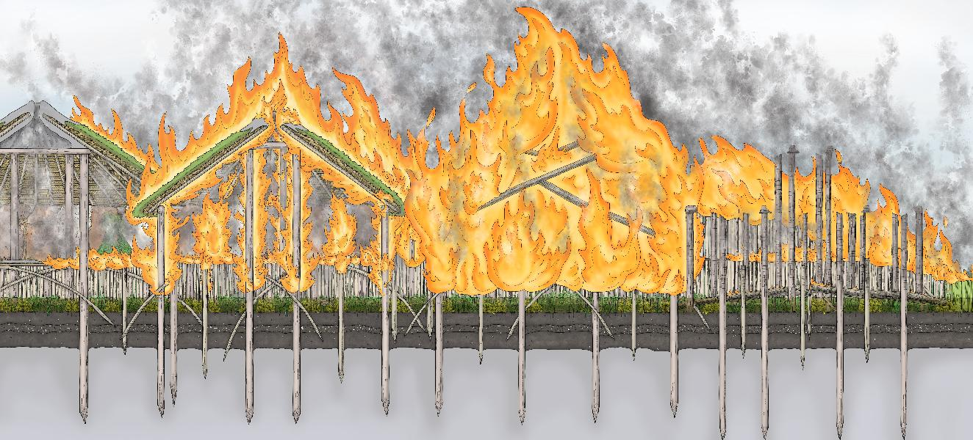
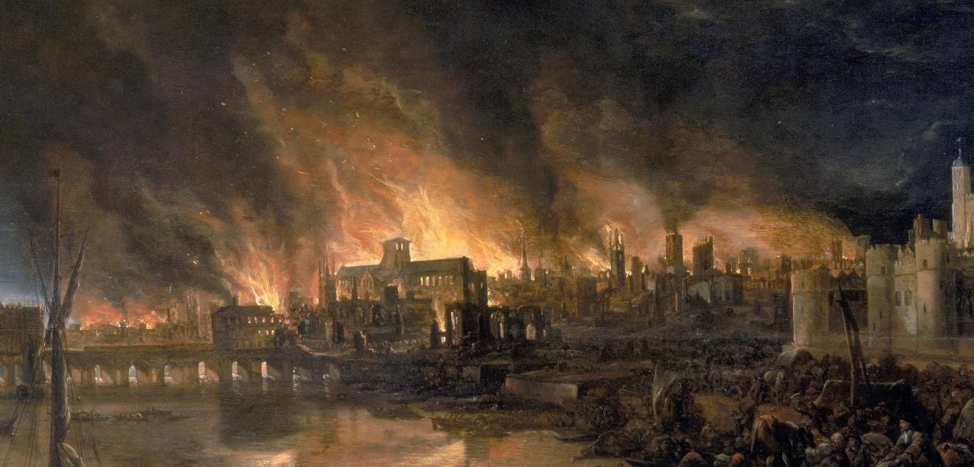
Must Farm Bronze Age Village
Activity 5: The Tale of Two Fires
‘Although more than 2500 years apart, were these fires similar in any way?’
Must Farm
Bronze Age Village
Extension Activity: The Tale of Two Fires
Notes:
Image © Vicki Herring.
image copyright Wikipedia https://commons.wikimedia.org/wiki/File:Great_Fire_London.jpg

Slide 16
How to use this PowerPoint Accompanying Resources
Pupils recall what they remember of Great Fire of London (GFOL), so they can compare it with Must Farm Bronze Age Village (MFBAV)
Activity:
Cut out the fact cards about GFOL and MFBAV fires (use different coloured paper). Add more if your wish
Pupils sort into similar and different/no evidence by arranging in a simple Venn Diagram to compare the two events
Write a short summary answering the question ‘Although the Great Fire of London happened more than 2500 years after the fire at Must Farm Bronze Age Village, were they similar in any way. What are the main differences?’
Video 2 – Q4: What could have caused the fire that destroyed Must Farm? (Duration 2.13 mins)
PPT: Life At Must Farm Bronze Age Village
Fact Cards from Fire Investigator Report (Slide 12)
Fact Cards for Great Fire of London & Must Farm comparison activity (Slides 20-21)
Suggested links for recap: https://www.bbc.co.uk/bitesize/articles/z4msn9q

Slide 17
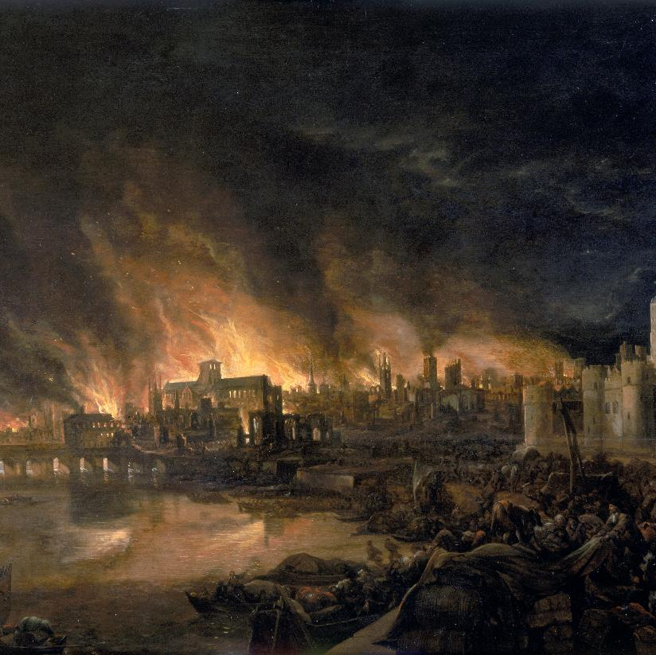

What do you know about The Great Fire of London 1666?
What do you remember about the Great Fire of London?
Notes:
image copyright Wikipedia https://commons.wikimedia.org/wiki/File:Great_Fire_London.jpg

Slide 18
Although the Great Fire of London 1666 happened more than 2500 years after the fire at Must Farm Bronze Age Village, were they similar in any way?
Draw two large circles that overlap on a large sheet of paper to create a Venn diagram and label the areas – see slide 19
Look at the fact cards about the Great Fire of London and the Must Farm Bronze Age Village Fire.
Place facts that are similar in the overlapping area of the two circles of the Venn Diagram
Place the others in the outer part of the circles

Slide 19

Venn diagram
similarities
Differences or no evidence
Differences or no evidence
Facts about
the Great Fire of London 1666AD
Facts about Must Farm Bronze Age Village Fire c.850BC
similarities

Slide 20
Cards for Must Farm Bronze Age Village (print on green card)
All the houses were made of wood, wattle panels for floors and walls, dry straw on the roofs | Archaeologists found lots of burnt wood, which showed that the Bronze Age village at Must Farm had burnt down in a big fire | The fire probably in late summer. At this hotter and drier time of the year, there was less water in the river (now called the Nene) | We do not know if the fire was an accident possibly caused by a spark from the fire or was deliberately, perhaps enemy attack
Each of the houses had a fireplace inside, called a hearth, used for cooking and to provide warmth | The fire started in one place but in just minutes the whole village was on fire. | There is no evidence that anybody was killed in the fire. No one seems to have returned or try to recover any of the objects or rebuild | Archaeologists found lots of Late Bronze Age wood and artefacts like pots, tools, weapons and jewellery. .
The houses were built very close together and their roofs, made of straw, turf and clay, were touching | As the houses burnt, they broke apart and lots of the wood and material used to make them fell into the river below. | There were probably nine or ten houses and around 50 people living alongside animals like dogs and sheep. | It was not long before the houses collapsed into the river below. However, the wooden posts smouldered for hours

Slide 21
Cards for Great Fire of London (print on yellow card)
Houses were built from wood with thatched roofs and walls made from wattle panels. | Samuel Pepys kept a diary. He wrote all about the Great Fire in it | It had been a long, dry summer and the river level was low | They used horse-drawn carts to bring water up from the river Thames
People used fires for heating, cooking and lighting. | The fire swept through London for four days. | The fire only stopped when the strong wind dropped, and gunpowder was used to create firebreaks. | People escaped to outside of the city, trying to save their most precious possessions.
A spark from an oven in the owned by Thomas Farriner near Pudding Lane on the night of 2nd September 1666 probably started the fire. | The fire destroyed half the city of London including​ 13,200 houses, 87 churches, and even St Paul’s Cathedral.​ | Although many homes were destroyed, not many people died. The city was rebuilt with stone and brick. | Houses in London in 1666 were built very close together

Slide 22
The Tale of Two Fires: Similar facts
Must Farm Bronze Age Village Fire c849BC | The Great Fire of London 1666
All the houses were made of wood, wattle panels for floors and walls, dry straw on the roofs | Houses were built from wood with thatched roofs and walls made from wattle panels.
Each of the houses had a fireplace inside, called a hearth, used for cooking and to provide warmth | People used fires for heating, cooking and lighting.
The houses were built very close together and their roofs, made of straw, turf and clay, were touching | Houses in London in 1666 were built very close together
The fire probably in late summer. At this hotter and drier time of the year, there was less water in the river (now called the Nene) | It had been a long, dry summer and the river level was low
The fire started on one place but in just minutes the whole village was on fire. | The fire swept through London for four days.

Slide 23
The Tale of Two Fires: Different facts or no evidence
We do not know if the fire was an accident possibly caused by a spark from the fire or was deliberately, perhaps enemy attack | A spark from an oven in the owned by Thomas Farriner near Pudding Lane on the night of 2nd September 1666 probably started the fire.
Archaeologists found lots of burnt wood, which showed that the Bronze Age village at Must Farm had burnt down in a big fire | Samuel Pepys kept a diary. He wrote all about the Great Fire in it
There is no evidence that anybody was killed in the fire. No one seems to have returned or try to recover any of the objects or rebuild | Although many homes were destroyed, not many people died The city was rebuilt with stone and brick.
As the houses burnt, they broke apart and lots of the wood and material used to make them fell into the river below. | They used horse-drawn carts to bring water up from the river Thames
It was not long before the houses collapsed into the river below. However, the wooden posts smouldered for hours | The fire only stopped when the strong wind dropped, and gunpowder was used to create firebreaks.
There were probably nine or ten houses and around 50 people living alongside animals like dogs and sheep. | The fire destroyed half the city of London including​ 13,200 houses, 87 churches, and even St Paul’s Cathedral
Archaeologists found lots of Late Bronze Age wood and artefacts like pots, tools, weapons and jewellery. | People escaped to outside of the city, trying to save their most precious possessions.

