Slide 1
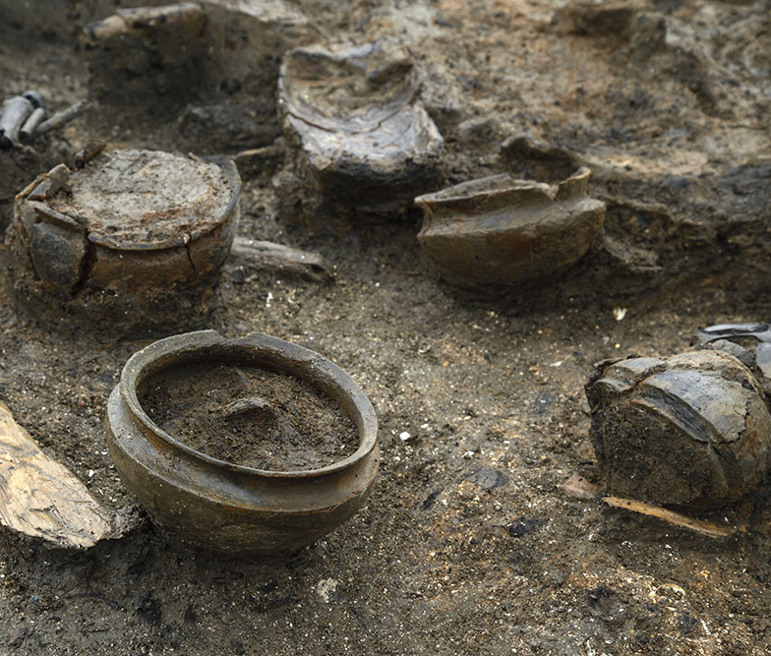
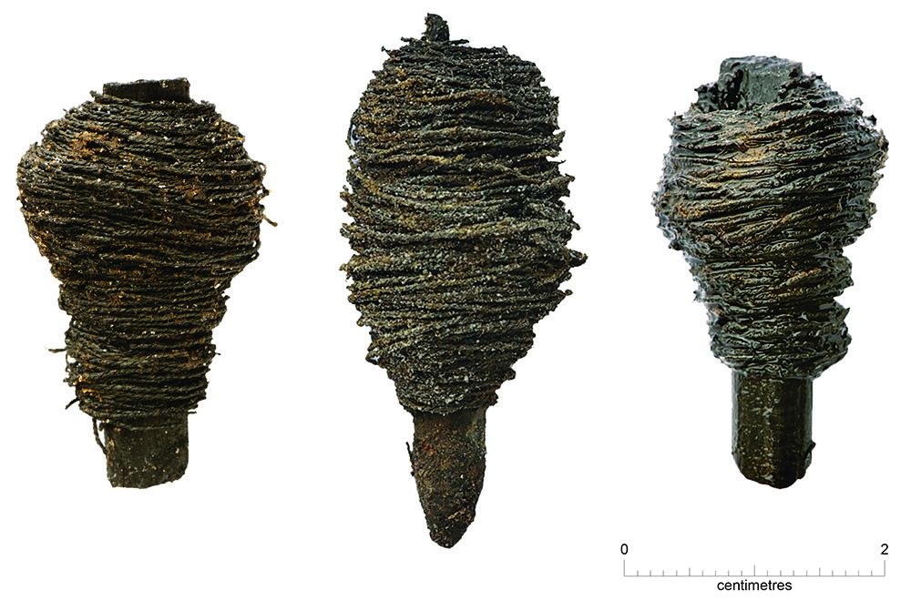
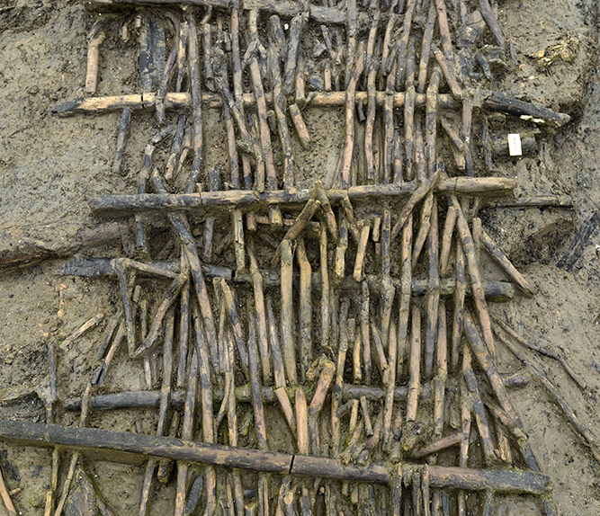
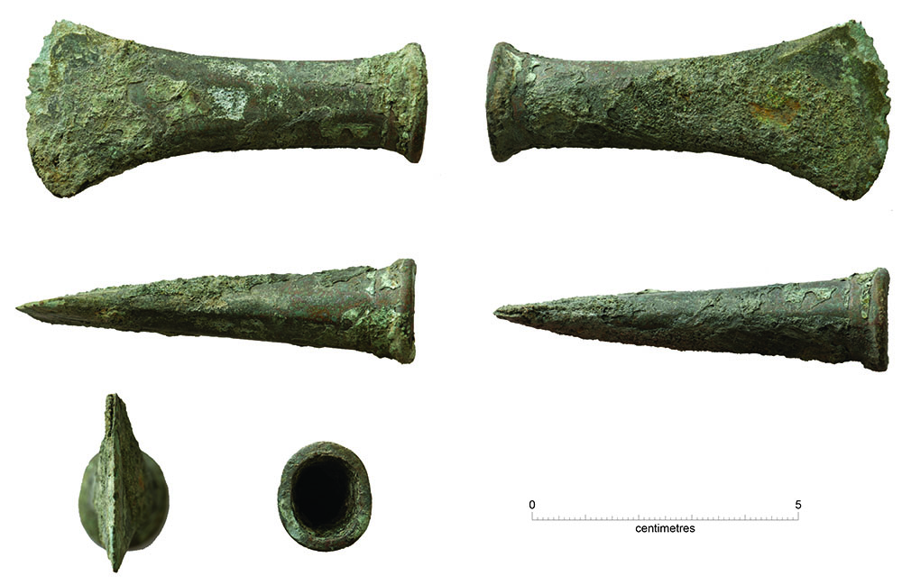
Must Farm Bronze Age Village Activity 4: Artefacts as Evidence What do the artefacts tell us about the people who lived there?
Notes:
Images ©CAU
From folder Must Farm HE Resource Images

Slide 2
‘What do the artefacts found at the Must Farm Bronze Age Village tells us about the people who lived there in c 850BC?’
Key Stage 2 History
Pupils will weigh evidence and draw conclusions
Pupils will develop their understanding of the methods of historical enquiry, including how evidence is used rigorously to make historical claims.
Pupils should understand how our knowledge of the past is constructed from a range of sources.
KS2 Unit: Changes in Britain from the Stone Age to the Iron Age: Bronze Age religion, technology and travel

Slide 3
How to use this PowerPoint Accompanying Resources
Group activity organised by themes from everyday life: Clothes and Textiles; Pottery and Food; Animals; Tools and Weapons; Wooden Objects; Transport.
Model how to analyse an artefact using an inference square.
Select and print out images from the themed PPTs – these could be ‘hidden’ around the room for children to ‘find’.
Pupils add descriptions and then make inferences, using modal verbs like ‘may have’, ‘might have’, ‘could be’ or adverbs such as ‘possibly’ or ‘probably’.
Groups present their findings to the whole class followed by class discussion to draw conclusions.
Video 4: How did people live in the Bronze Age? (Duration 10.07 mins)
PPT: Life At Must Farm Bronze Age Village
ZIP Folder: PPTs of images by theme (These also include vocabulary lists and information sheets)
Print-out Squares of inference
3D models of the site and the artefacts https://sketchfab.com/mustfarm

Slide 4
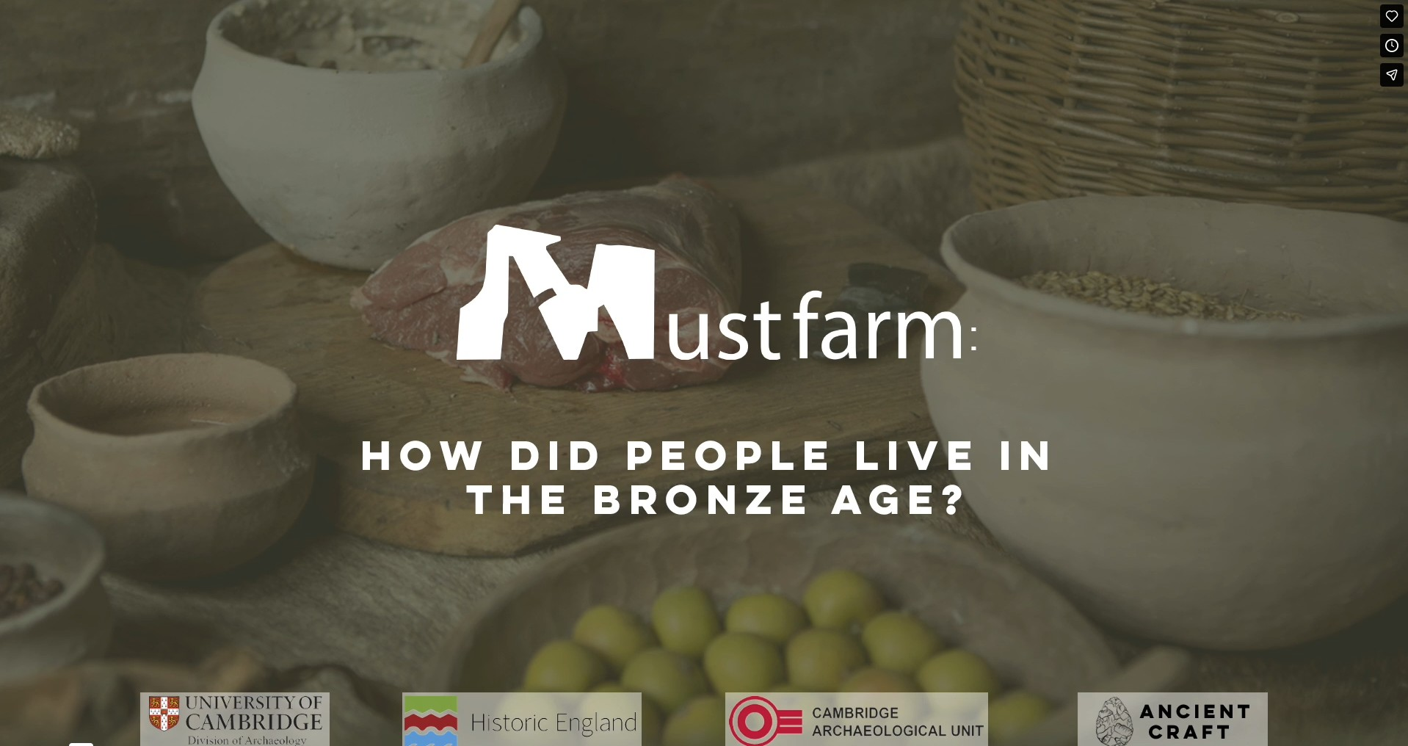
How did people live in the Bronze Age?
Notes:
https://vimeo.com/1045260274?share=copy&fl=cl&fe=ci

Slide 5
Inference Squares

Slide 6

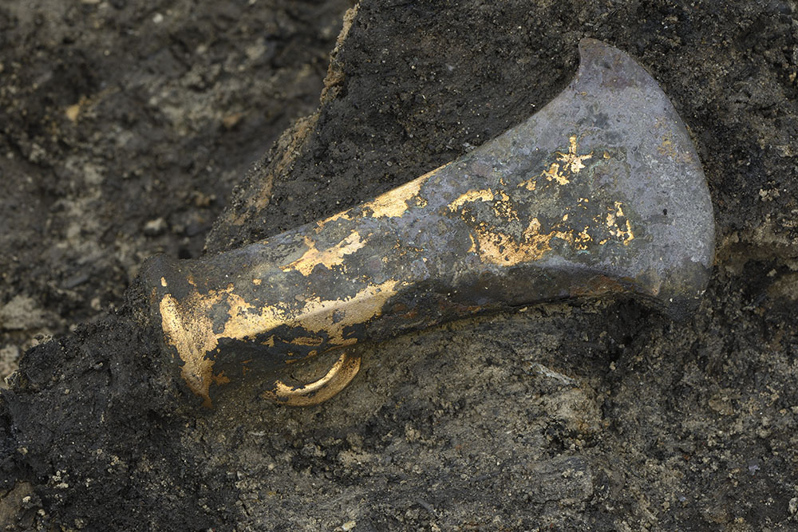




DESCRIBE: What can you see?
2D or 3D?
Round or square or straight or curved or pointed?
Metal? Wood? Plastic? Glass? Textile? Pottery?
Big or Small?
Heavy or Light?
Rough or smooth or soft?
Man-made? Hand-made? Machine- made?
Sharp or blunt?
Organic or Inorganic?
Cold or warm?
Describe
Colourful or colourless?
Complete or bits missing?
Broken or whole?
Smelly or odourless?
Old, used or new?
Shiny or dull?

Slide 7

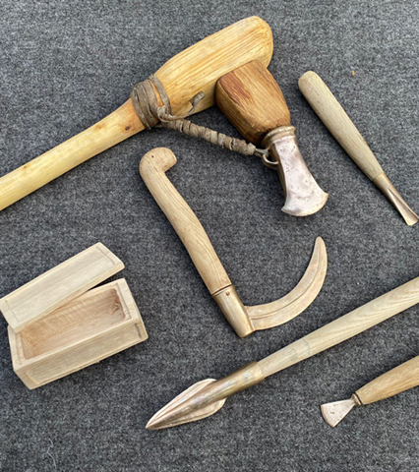
Information Sheet 7: Tools and Weapons
Bronze was first made in Britain around 2100 BC to 2200 BC. People migrated here from more advanced parts of Europe and who brought the knowledge of smelting bronze from copper and tin.
Approximately 90 to 95 pieces of metalwork were found at Must Farm, which included a variety of tools and weapons such as axes, sickles, knives, gouges, chisels and spears.
Sickles were used for cutting and harvesting crops
Spears could have been used for fishing, hunting or fighting.
Gouges and chisels are used in carpentry
The nearby site of Flag Fen has evidence of metal items such as weapons and jewellery being thrown, or placed, into water. Most of these objects were deliberately broken before they were placed.
Not all of the possible weapons found at Must Farm were broken.
Axes were found with wooden handles (or hafts) still attached but few of the weapons had handles suggesting that they may have been broken.
All the houses had contained axes – some as many as 7.
Replicas of the items found at Must Farm
Notes:
Images ©Ancient Craft

Slide 8
Example of how to use a square of inference Step 1 Describe
Describe: What can you see?:
Shape, size, weight, colour, texture, feel, material, features, smell, condition.
Add facts from scientific analysis.
Shaped like an axe
Thinner (Sharper) along the edge
Loop on one side
Bright shiny yellow in places; muddy or tarnished in others
No handle
Made of metal – copper and tin = Bronze
All the houses had contained axes – some as many as 7
Notes:
Image ©CAU
From folder Must Farm HE Resource Images

Slide 9




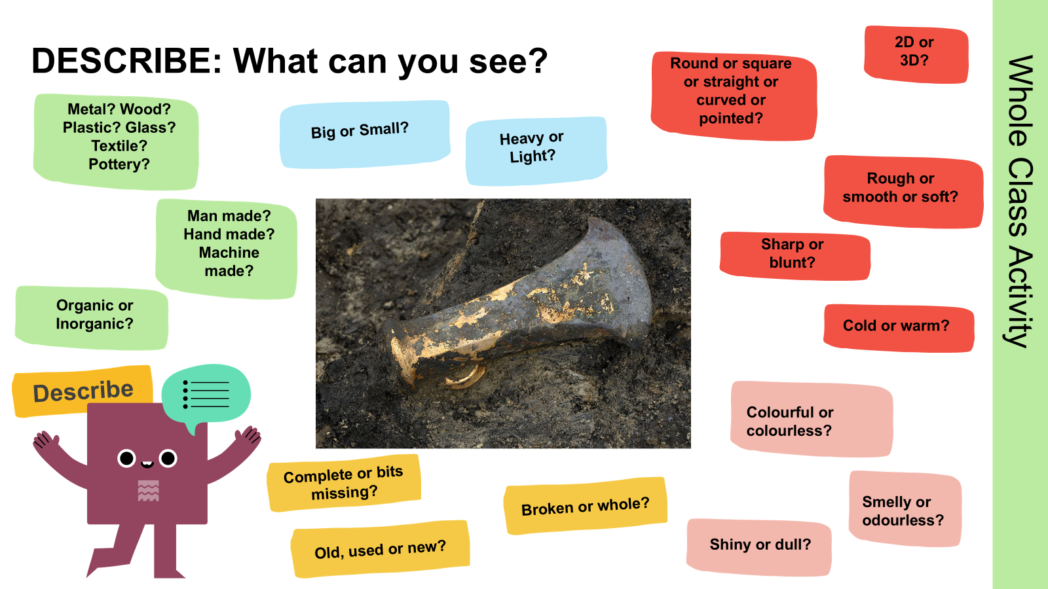


INFER: What can you work out or guess about the objects or the people who made them?
Axes were probably very important to them because all the houses had contained axes – some as many as 7
They might have bought it from someone else
This axe head could show that these people knew how to make metal tools and weapons from Bronze.
We think that the people who made this may have been very skilful because it is difficult to make things in metal
Infer
Explain

Slide 10
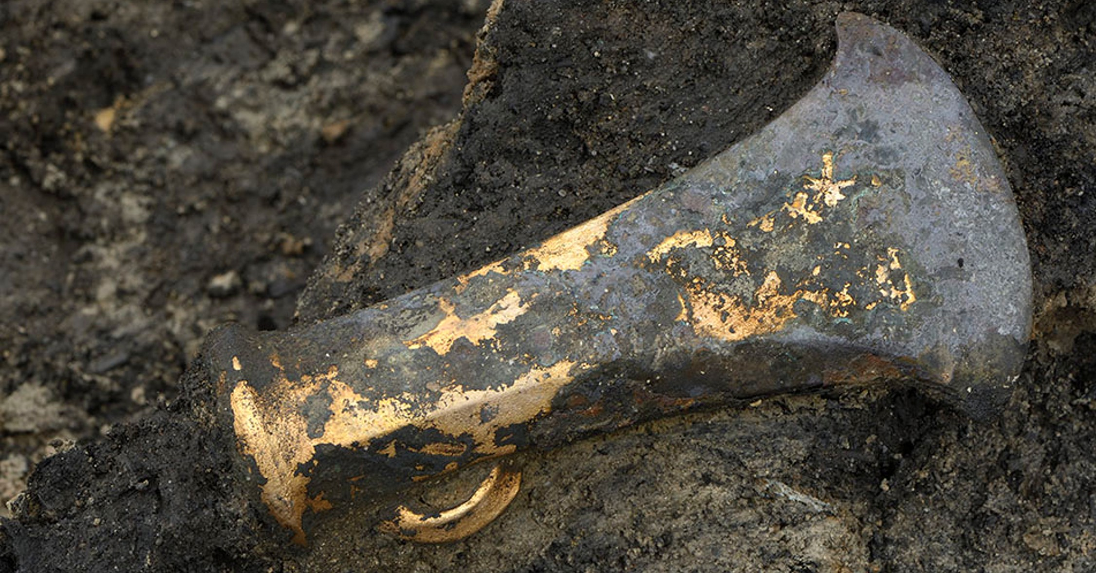
Example of how to use a square of inference Step 2 Infer
What can you infer?
This axe head could show that these people knew how to make metal tools and weapons from Bronze.
They might have bought it from someone else
What can you see?: Shape, size, weight, colour, texture, feel, material, features, smell, condition.
Add facts from scientific analysis.
Axes were probably very important to them because all the houses had contained axes – some as many as 7
We think that the people who made this may have been very skilful because it is difficult to make things in metal
Shaped like an axe
Thinner (Sharper) along the edge
Loop on one side
Bright shiny yellow in places; muddy or tarnished in others
No handle
Made of metal – copper and tin = Bronze
All the houses had contained axes – some as many as 7
Notes:
Image ©CAU
From folder Must Farm HE Resource Images

Slide 11





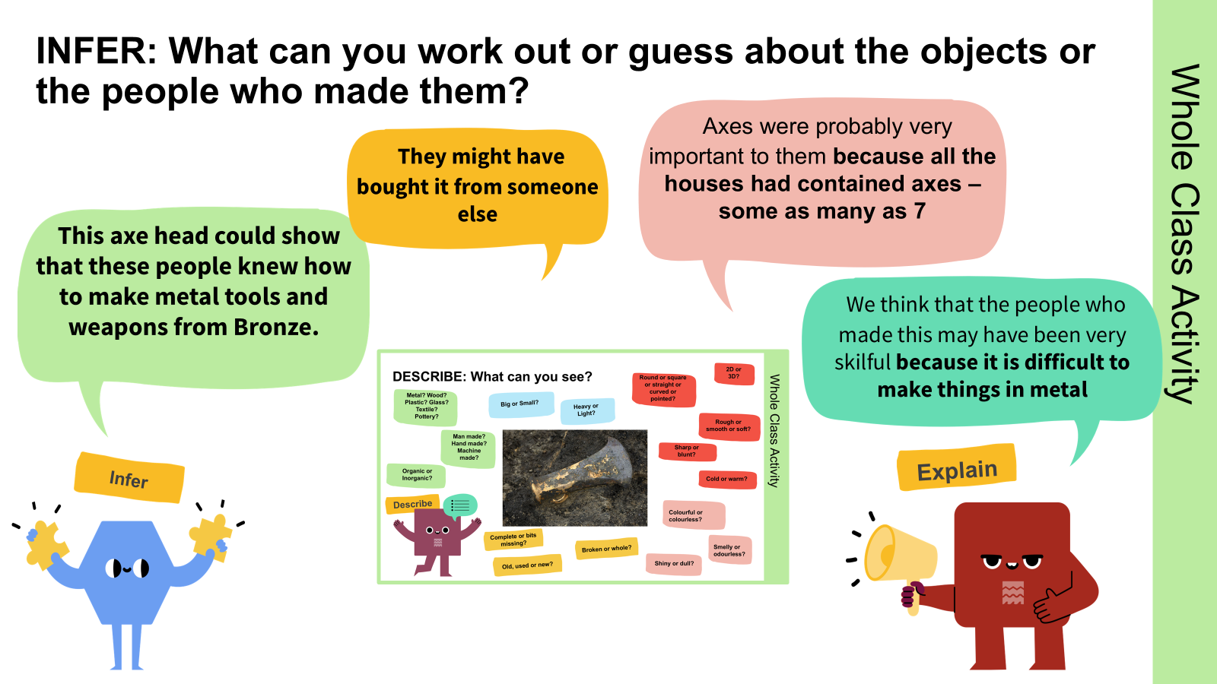


QUESTION: What questions do you want to ask?
Who made it?
What was it made from?
Where was it made?
Where did the metal come from?
Was it a weapon or a tool?
Where is the handle(haft)?
Ask Questions

Slide 12
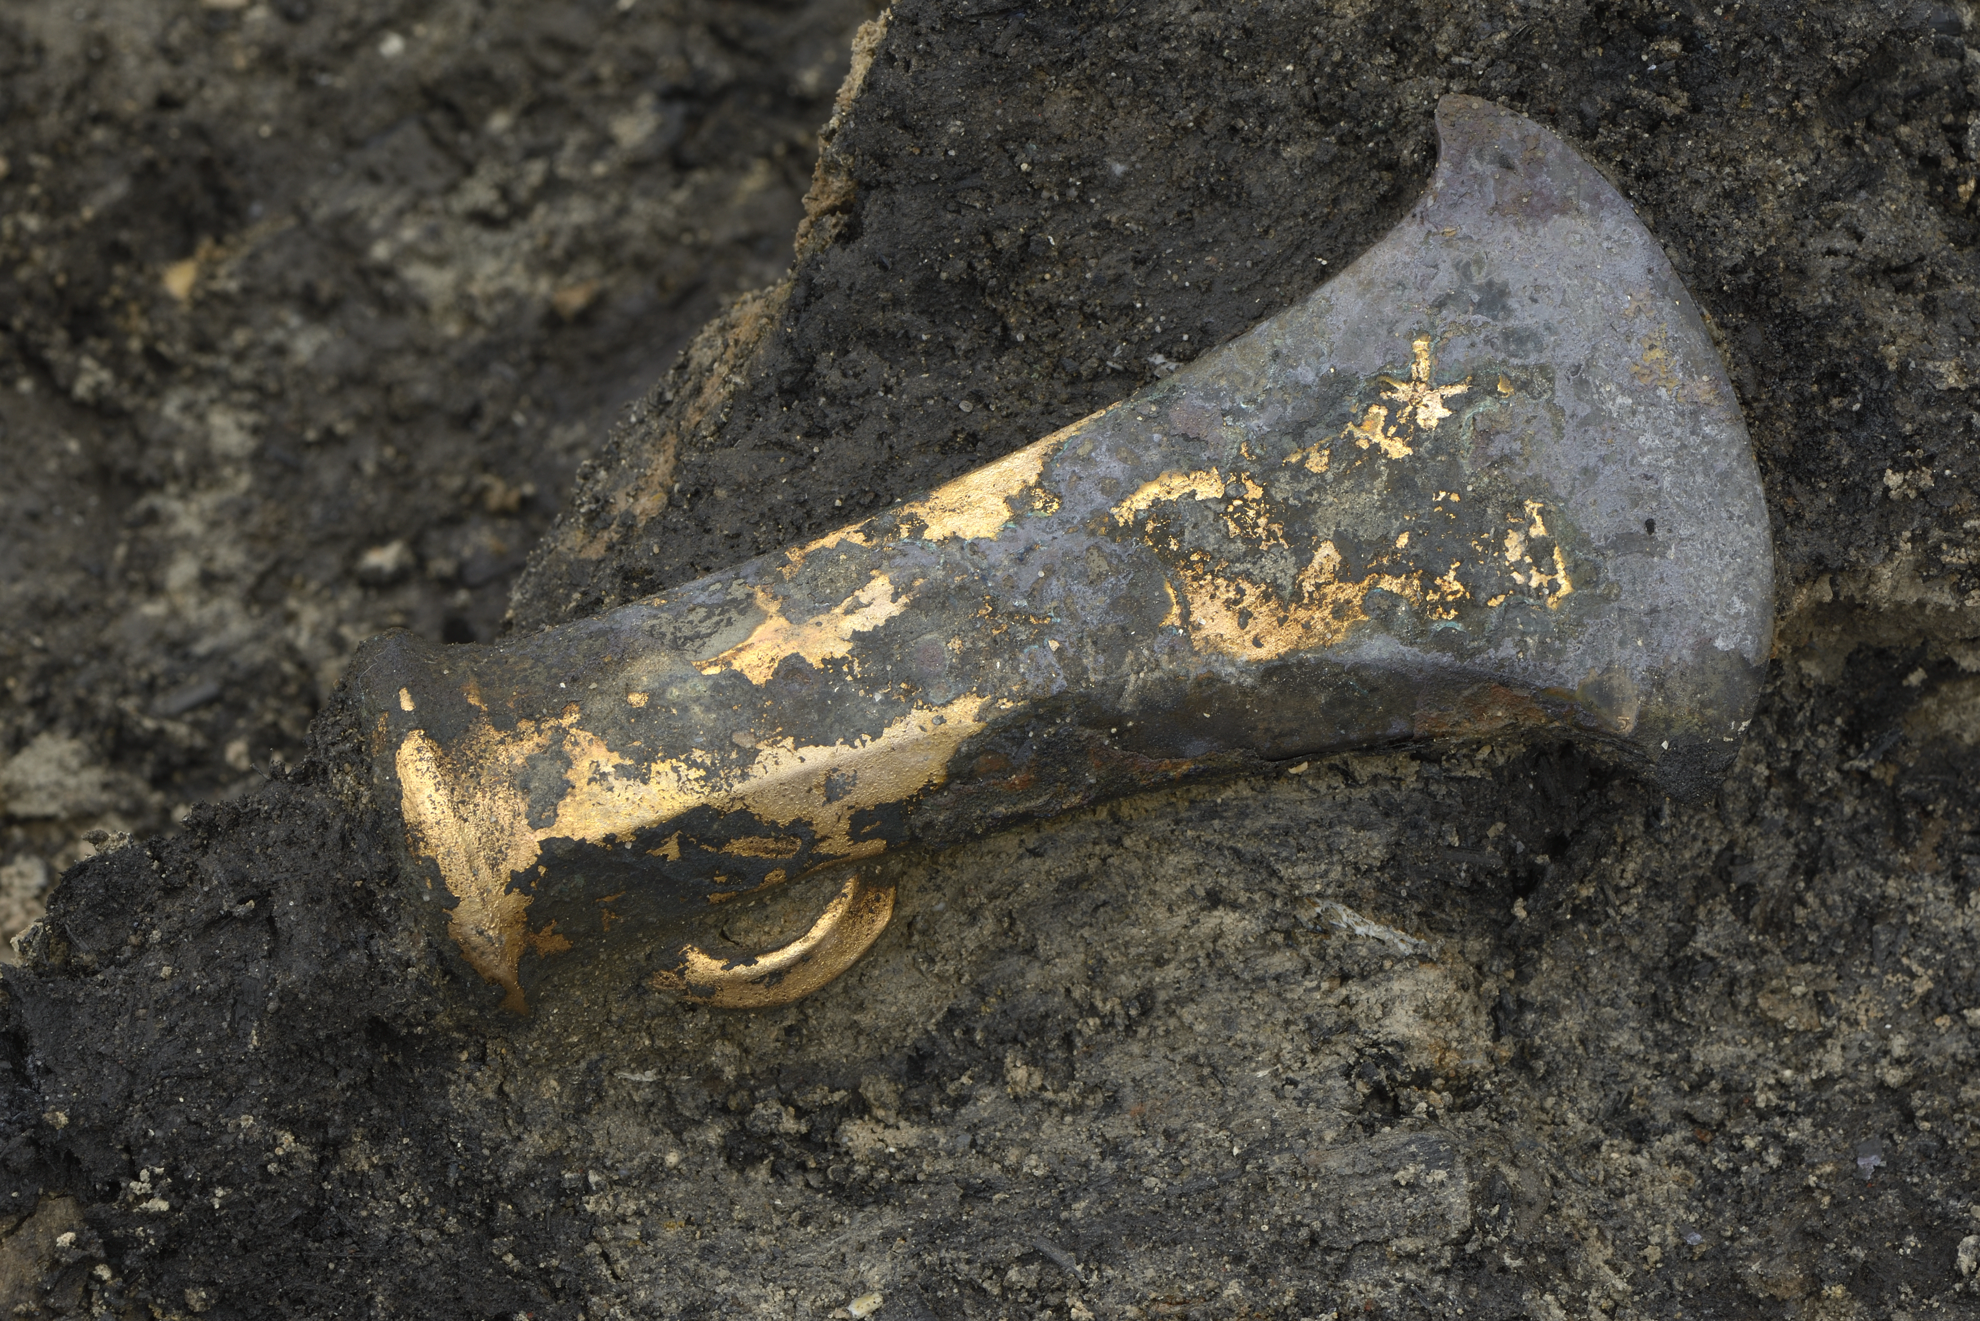
Example of how to use a square of inference Step 3 Questions
What questions do you want to ask?
Was it a weapon or a tool? Who made it? What was it made from? Where did the copper and tin come from? Where was it made? Where is the handle (Haft)?
What questions can you answer?
What can you infer?
They might have bought it from someone else
This axe head could show that these people knew how to make metal tools and weapons from Bronze.
We think that the people who made this may have been very skilful because it is difficult to make things in metal
What can you see?: Shape, size, weight, colour, texture, feel, material, features, smell, condition.
Add facts from scientific analysis.
Axes were probably very important to them because all the houses had contained axes – some as many as 7
Shaped like an axe
Thinner (Sharper) along the edge
Loop on one side
Bright shiny yellow in places; muddy or tarnished in others
No handle
Made of metal – copper and tin = Bronze
All the houses had contained axes – some as many as 7
Notes:
Image ©CAU
From folder Must Farm HE Resource Images

Slide 13


What do the artefacts found at Must Farm Bronze Age Village tells us about the people who lived there in c 850BC?
Find an artefact (picture) from the Must Farm Bronze Age Village linked to your group’s theme
Clothes and Textiles; Pottery and Food; Animals; Tools and Weapons; Wooden objects; Transport.
In the centre square, DESCRIBE the artefact: shape, size, weight, colour, texture, feel, material, features, smell, condition.
Add facts from the information sheet.
Research
Describe
Using
evidence

Slide 14
Inference Squares.

Slide 15
What do the artefacts found at Must Farm Bronze Age Village tell us about the people who lived there in c 850BC?a
As a group, discuss what you can INFER – work out or guess - from the artefact and write it in the middle square. Use modal verbs (may, might, could ) and adverbs (possibly probably).
Add an explanation (…because …) using features you described or information you have found.
In the outer ring, add the questions you can now answer and any others you still do not have an answer for.
Infer
Explain
Ask Questions
Using
evidence

Slide 16
Sample Questions
Animals: What animals do we know lived with the people in the Must Farm Bronze Age Village? Did they have any pets? What animals did they catch for food? How well did they look after their animals?
Clothes and textiles: What did people wear in the Bronze Age? What were their clothes made from? Where were their clothes made? How did they make fabric and thread? Did they wear jewellery? Were their clothes colourful? How would they be fastened?
Pottery and Food: What did they eat? How did they cook their food? How did they store food? What did they do with their rubbish? Were they skilled craftsmen? Were they skilled hunters? Were they skilled farmers?
Tools and Weapons: What weapons did they have? What tools did they have? What were they made from? Where did the copper and tin come from? Where were they made? Were they skilled craftsmen? Were they soldiers or warriors?
Transport: How did they travel around in the Fens at this time? What other form of transport was found? How far could they travel? What do we learn about these people from these finds?
Wooden Objects: What were the houses made from? How did they get the materials? What shape were the houses? How difficult were they to make? What else could they make from wood? Were they skilled craftsmen? Were they well organized?

Slide 17


What do the artefacts found at Must Farm Bronze Age Village tells us about the people who lived there in c 850BC? b
What do we use today?
Do we make our own or get them some other way?
What are our things made of?
Where do they come from?
Each group reports their findings to the whole class (optional: fill in recording chart)
Clothes and Textiles; Pottery and Food; Animals;
Tools and Weapons; Wooden objects; Transport.
Think
Compare
Using
evidence

Slide 18
What do the artefacts found at Must Farm Bronze Age Village tells us about the people who lived there in c 850BC? d
Theme | Description of Artefacts | What we can infer
Clothes and Textiles
Pottery and Food
Animals
Tools and Weapons
Houses and Wooden Objects
Transport

Slide 19

What do the artefacts found at Must Farm Bronze Age Village tells us about the people who lived there in c 850BC?e
How would you describe life for the people who lived in the Must Farm Bronze Age Village?
What jobs did they do?
Were Bronze Age people as clever as people today?
Using
evidence
Class discussion

Slide 20
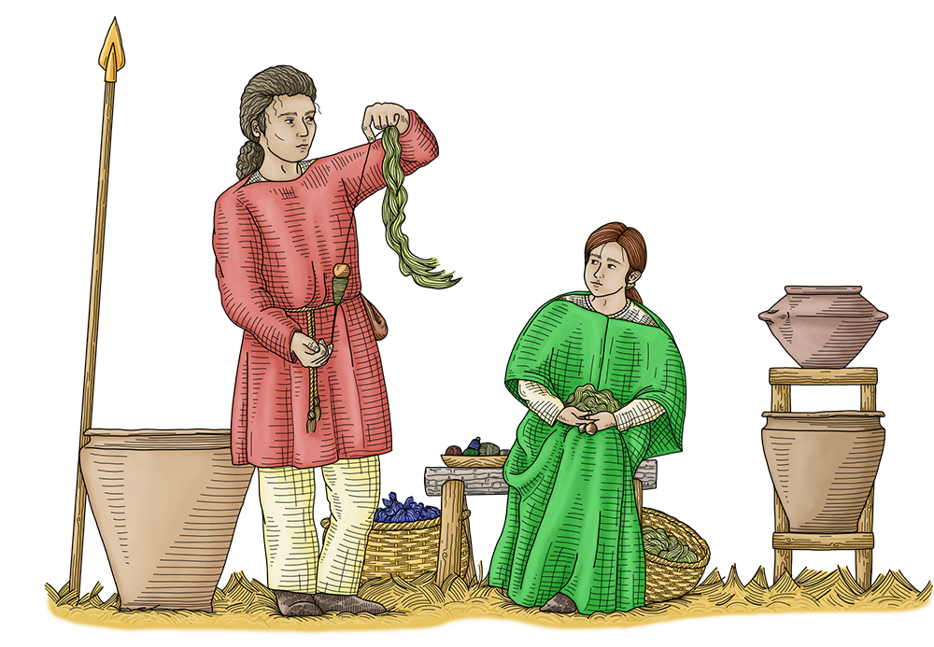
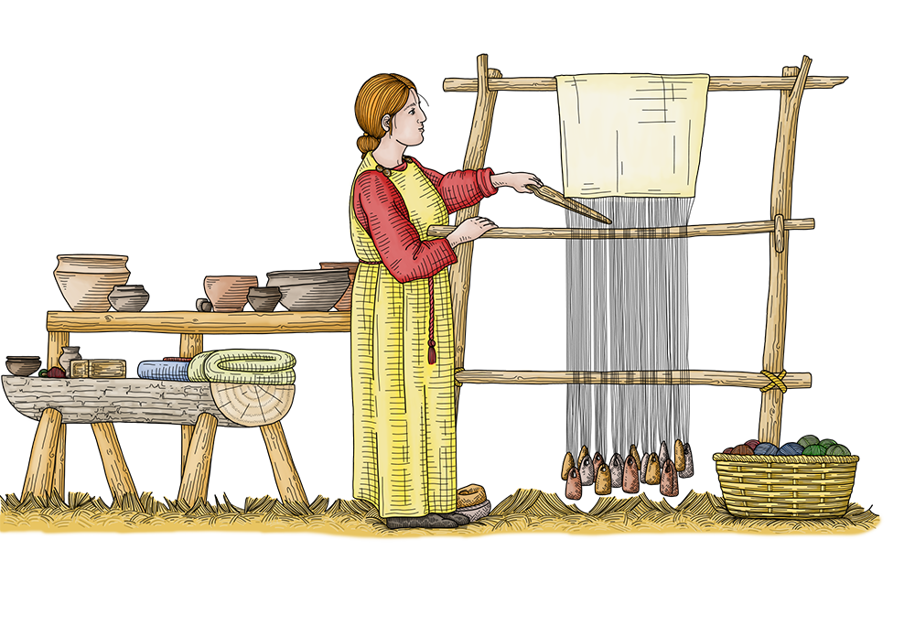
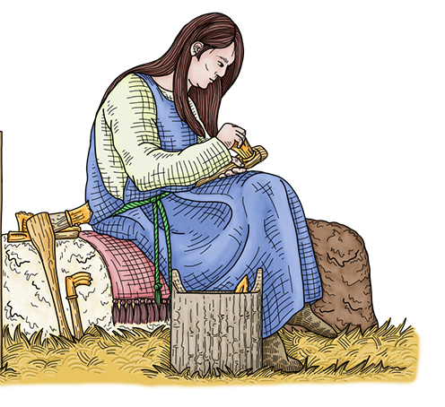
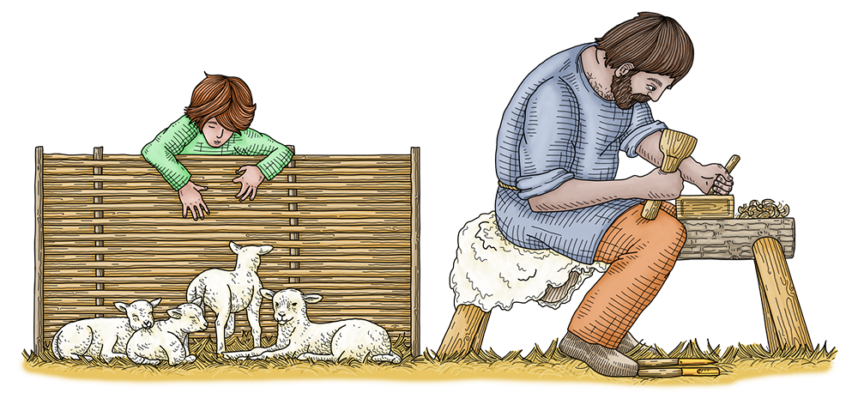
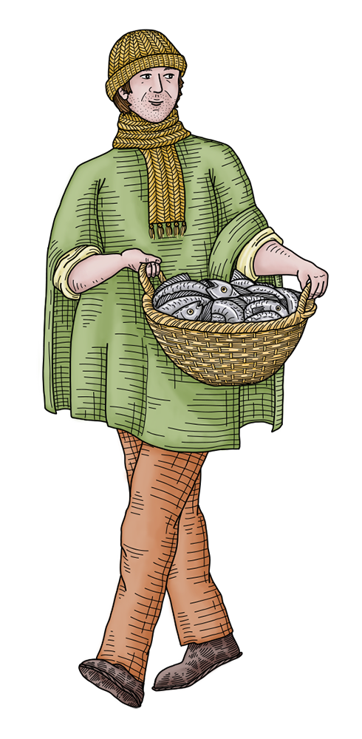
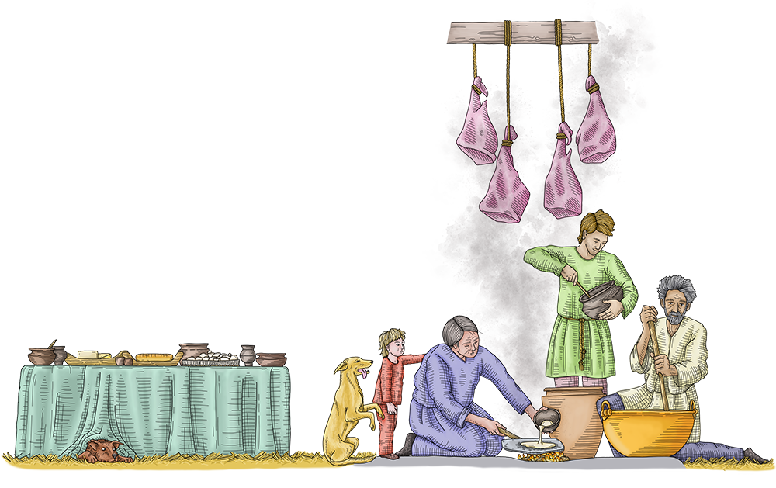
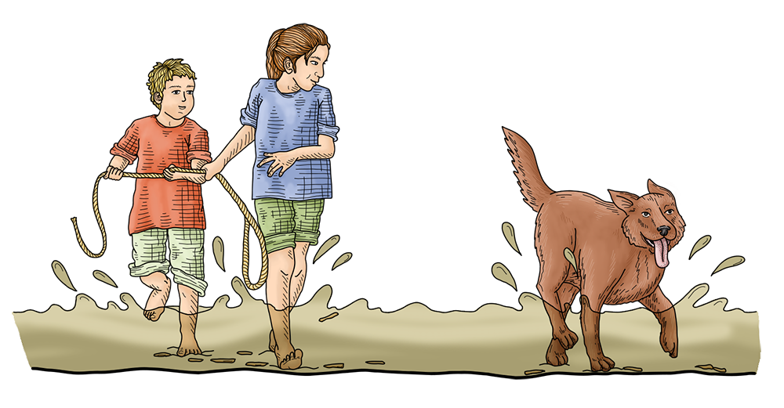
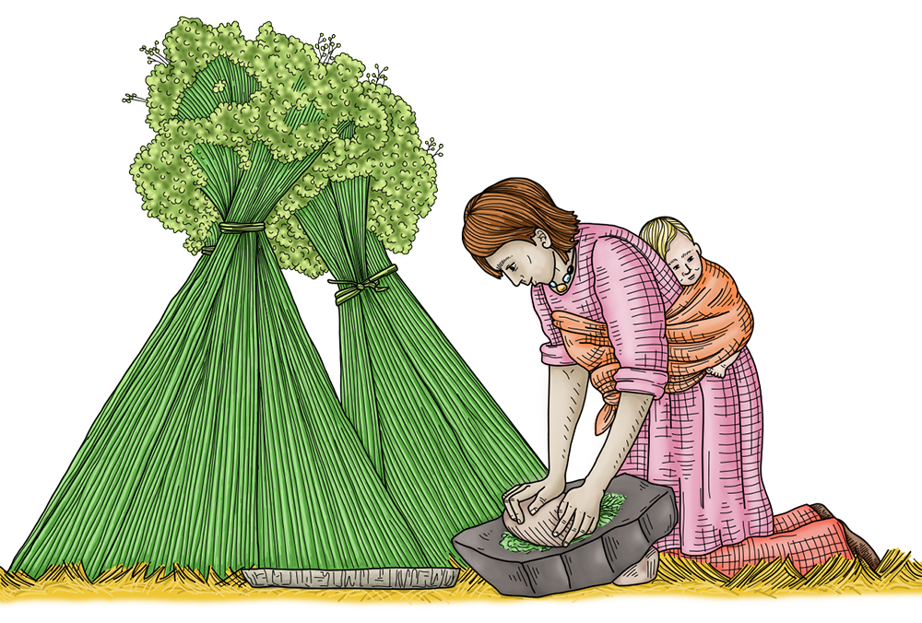
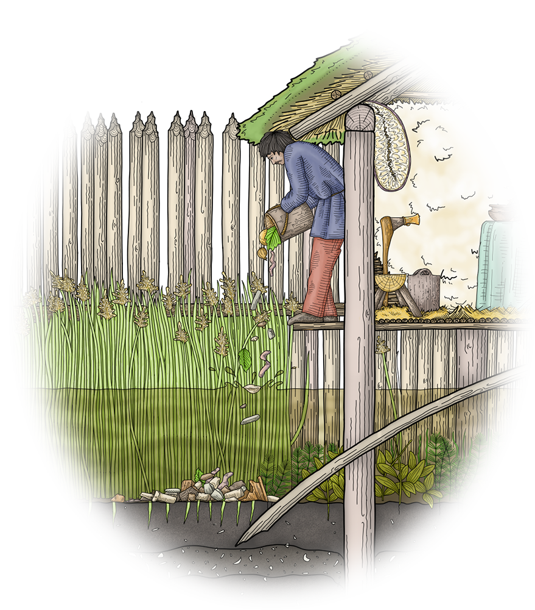
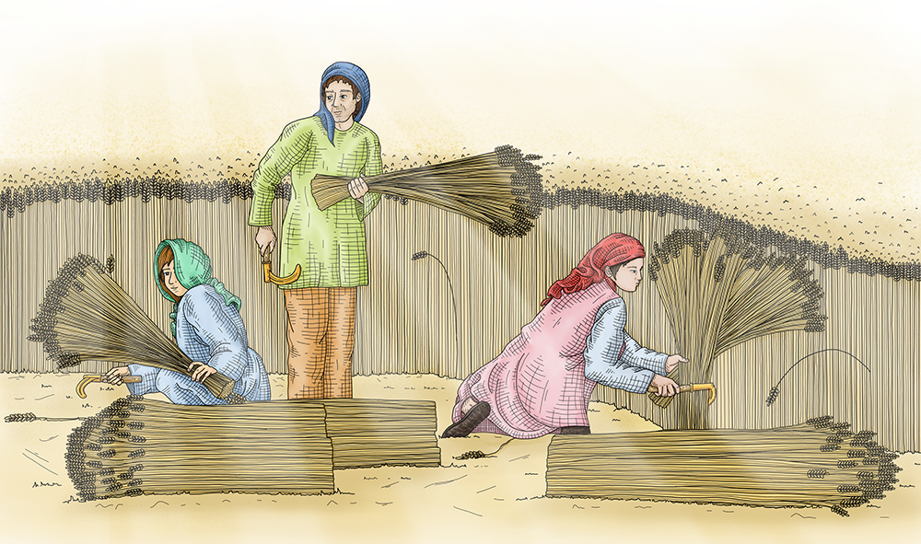
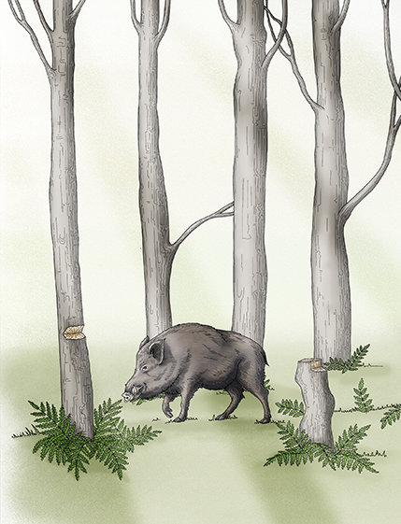
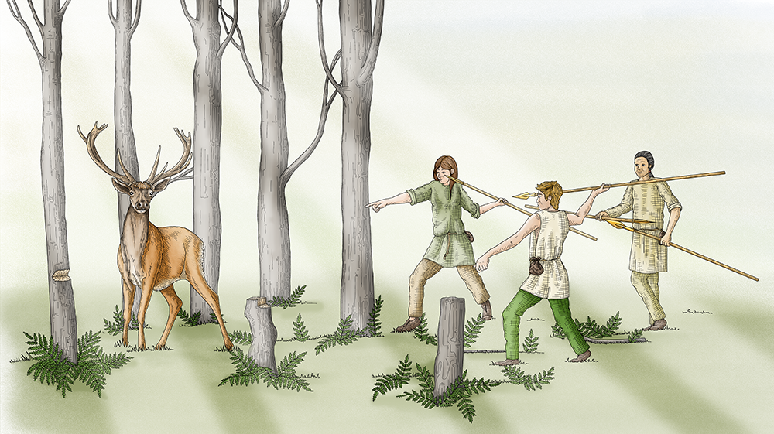
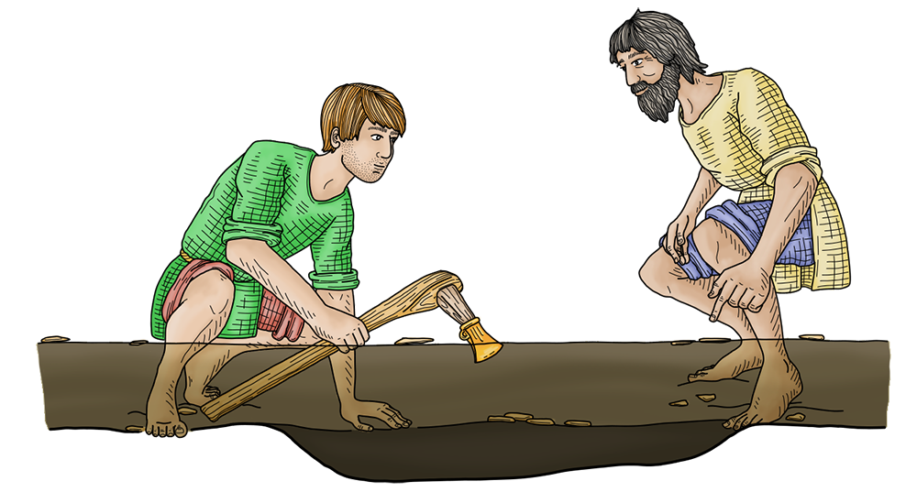
Extension Activity: Describe life in Must Farm Bronze Age Village
Imagine what life was like for the people who built and lived in the Bronze Age Village discovered at Must Farm. Pick one of the characters from the reconstruction drawings and describe life in the village from their point of view: their clothes, meals, homes, possessions, jobs they had to do, skills they had learnt or were learning.
Notes:
Images © Vicki Herring

