Slide 1

What can buildings tell us about the history of Bradford?
Key Stage 2: History
Learning Aims and Outcomes
Pupils will read and recorded information about six individual historic buildings in Bradford from the interactive map
Pupils will discuss the extent to which each particular building has changed over time
Pupils will discuss which buildings have changed most and least
Pupils will use evidence to show how the histories of particular buildings support historical claims about the history of Bradford
This activity relates to the Teaching Activity: Stories in Stone - How & why has Bradford changed over time?
Notes:
What can buildings tell us about the history of Bradford?
Learning Objective
To test historical claims about the history of a place from the individual histories of historic buildings within it
Learning Outcomes
Pupils will have:
Read and recorded information about six individual historic buildings in Bradford from the interactive map
Discussed the extent to which each particular building has changed over time
Discussed which buildings have changed most and least
Discussed how the histories of particular buildings support historical claims about the history of Bradford

Slide 2
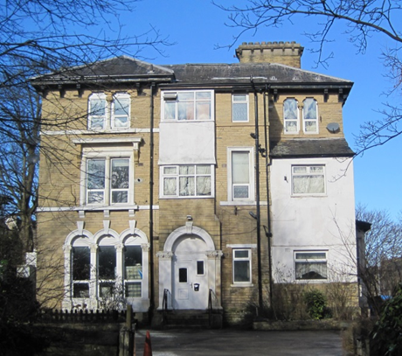
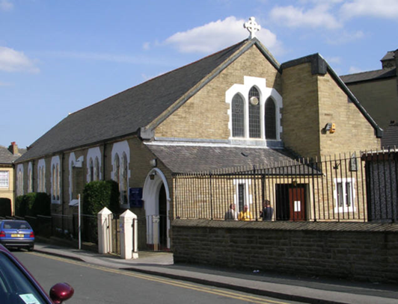
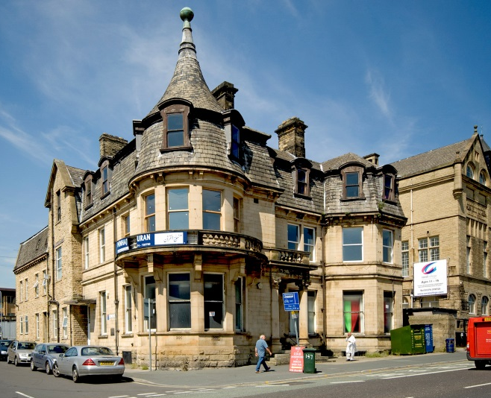
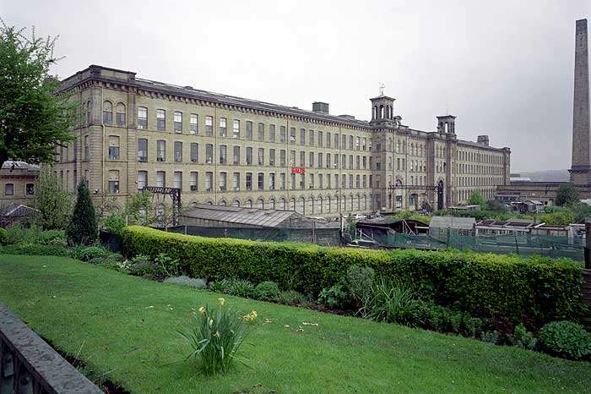
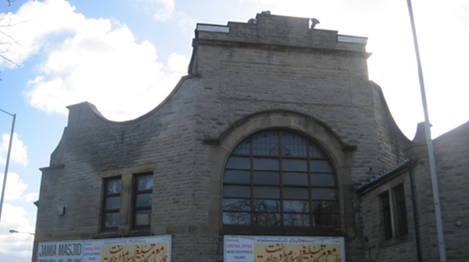
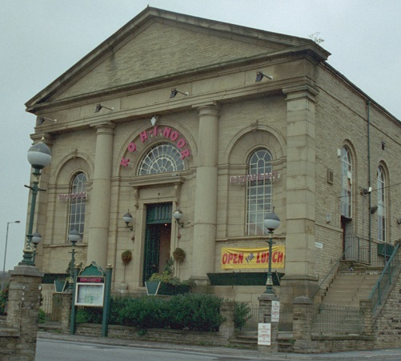
What can buildings tell us about the history of Bradford?
Notes:
Starter Activity
Display the image of a local building that is known to have changed its use over time
e.g. The school building itself if it once had a former use, a former cinema that is now a bingo hall, a former factory that is now a place of worship etc.
Explain its history and ask pairs to briefly discuss what this might reveal about the history of the locality e.g. that people go to the cinema less now, that a once important industry has declined, that a particular religion has become important. Lead discussion, taking comments from pairs.

Slide 3
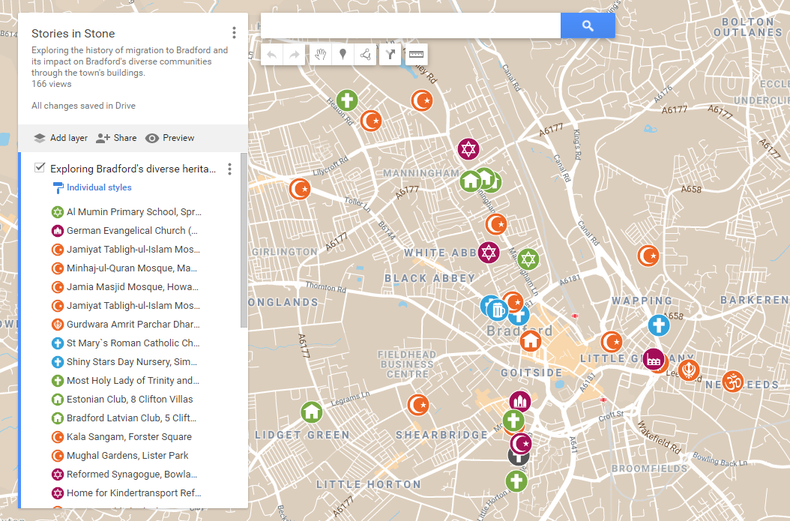
What can buildings tell us about the history of Bradford?
Notes:
As a whole class briefly show pupils to the Stories in Stone interactive map on the whiteboard - https://www.google.com/maps/d/edit?mid=1Yuai_EaS1QHN6C3buNJwlttUnYY

Slide 4
Building | When was it built? | How was it first used? | How many times has it changed its use? | List what else it has been used for with the date in brackets after e. g. mosque (1976). | What might this building tell us about the history of Bradford?
1
2
3
4
5
6
Notes:
Activity One
Ensure that pupils have easy access to the digital map of Bradford with hotspots giving details of particular buildings role in the history of migration into the city.
https://www.google.com/maps/d/edit?mid=1Yuai_EaS1QHN6C3buNJwlttUnYY
Print and give out copies of the table on this slide.
Choose a sample hotspot from the map and display the image and details of the building.
Talk through how pairs should fill in the first line of the table from the hotspot text.
Allow time for pupils to select five other buildings from the map and fill in the rest of the table. (Pairs could be left to select buildings at random or could be directed to different hotspots to ensure that different pairs include different buildings and that all hotspots have definitely been used).

Slide 5
Building ………. How much has it changed? Circle the statement you agree with
Not at all
Not much
Quite a lot
Very much
We think this because
………………………………………………………………………
………………………………………………………………………
Notes:
Activity Two
Display this slide and also print and give out 6 copies of it to pairs.
Explain that pairs fill in a different sheet for each building they chose, circling the statement they agree with on the continuum and completing the sentence starter in each case.
Once complete ask pairs to select the buildings that have changed most and least from their six buildings. Ask selected pairs to display the relevant hotspot image of their buildings and explain their reasoning behind their choices e.g. we think this building has changed most because it has had three uses, this one has only had one change and the building is much the same both inside and out.

Slide 6







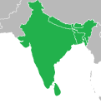


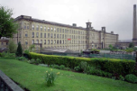
Christianity (the Christian religion) has become less important in Bradford.
Islam (the Muslim religion) has become more important in Bradford.
Sikhism (the Sikh religion) has become more important in Bradford
Judaism (the Jewish religion) has become less important in Bradford.
Hinduism (the Hindu religion) has become more important in Bradford.
German migrants changed Bradford
Irish migrants changed Bradford
Jewish migrants changed Bradford
South Asian migrants (from modern India, Pakistan and Bangladesh) changed Bradford
East European migrants (from Poland, Hungary, Latvia, Estonia etc.) changed Bradford
Caribbean migrants changed Bradford
The textile industry (making cloth /clothes) was once important to Bradford
Notes:
Activity Three
Display the claims about the history of Bradford as a whole as shown on this slide. Print and give out a copy of the slide to each pair, along with a copy of the table on the next slide (slide 7)
Ask pairs to read each claim in turn and jot down the name of any building they have researched that appears to support that claim.
Discuss each claim in turn, taking comments from pairs about available supporting evidence from particular buildings.
Plenary
Lead discussion about why some pairs will have evidence of a particular claim while others may have little or none (The answer to this is that it depends which six buildings from the map that particular pairs have researched- some buildings give evidence of particular claims where others do not ).

Slide 7
Bradford History Statements | Buildings which support the statement | Supporting Evidence
Christianity (the Christian religion) has become less important in Bradford over time.
Notes:
Discuss each claim in turn, taking comments from pairs about available supporting evidence from particular buildings.
Conclude the lesson by returning to the initial enquiry question and asking pupils: What can buildings tell us about the history of Bradford?

