Slide 1
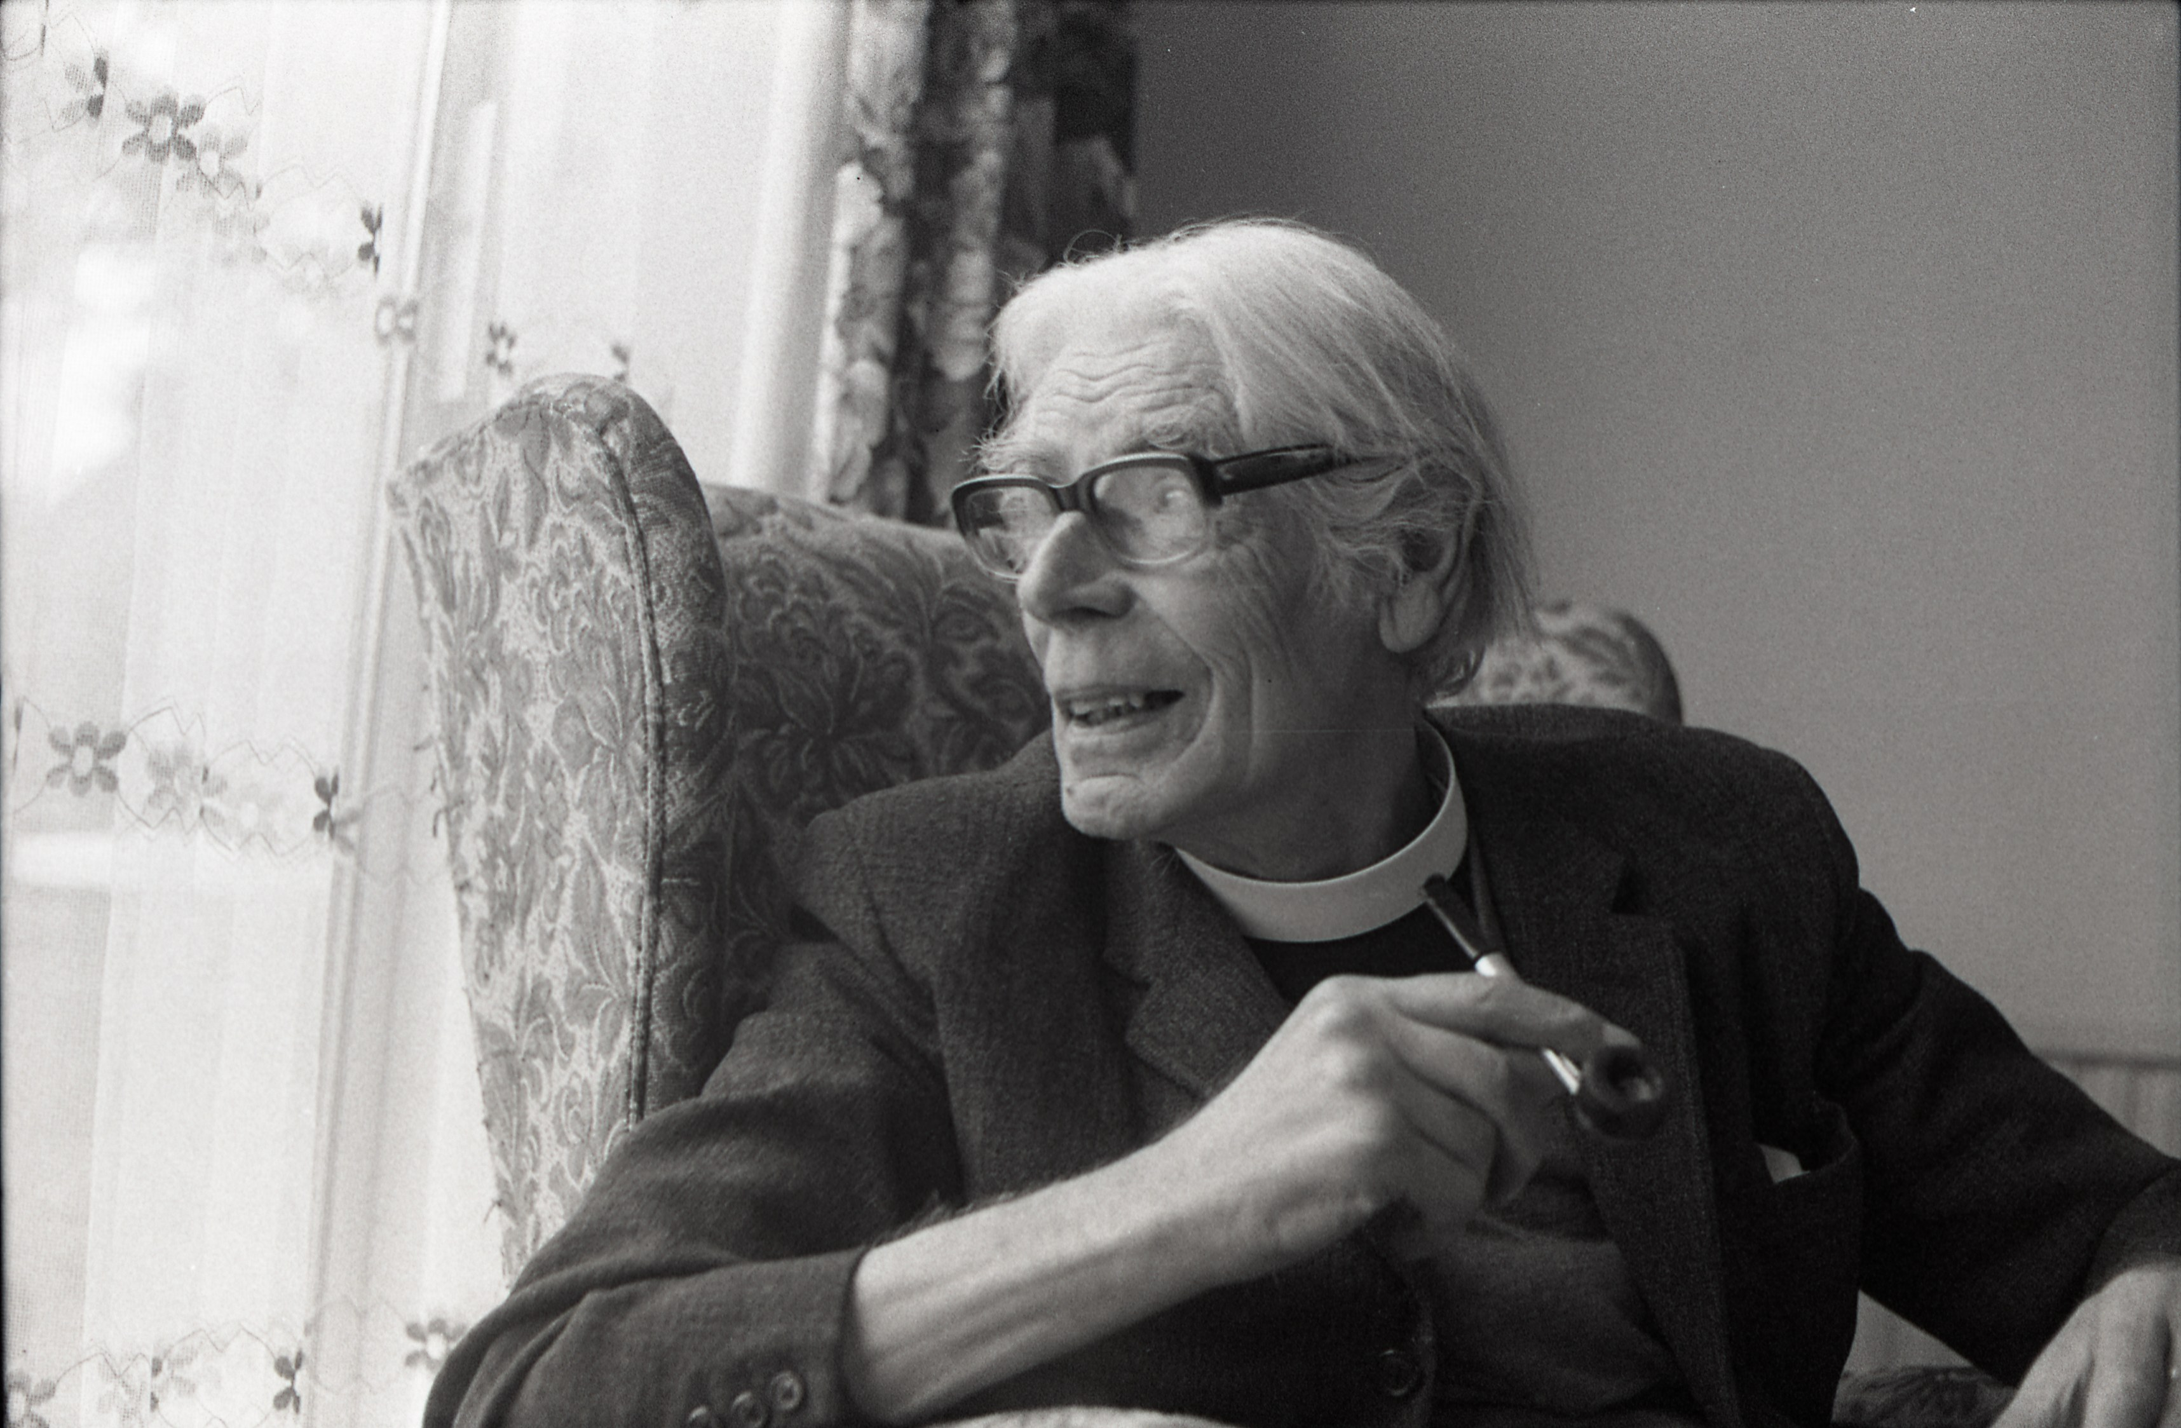
Reverend Wilbert Awdry
Local Significant People:
Reverend Wilbert Awdry
Notes:
Image: © Awdry Family

Slide 2
Local Significant People: Reverend Wilbert Awdry
Key Stage 1: History
To learn about significant events, people and places in their own locality
Changes within living memory
Exploring the history of people and places in the children's local area.
Study an aspect of history dating from a period beyond 1066 that is significant in the locality
Gain understanding of historical concepts such as significance
Make connections and draw contrasts with previous learning

Slide 3


What makes a person significant?
What makes a person significant?
Questions to ask about a person.
Did they:
make big changes in their lifetime?
make a lot of people’s lives better or worse?
change the way people think about something?
have a lasting impact on their locality, the country or the world?
set a really good/bad example to people about how to live and behave?
Consider

Slide 4
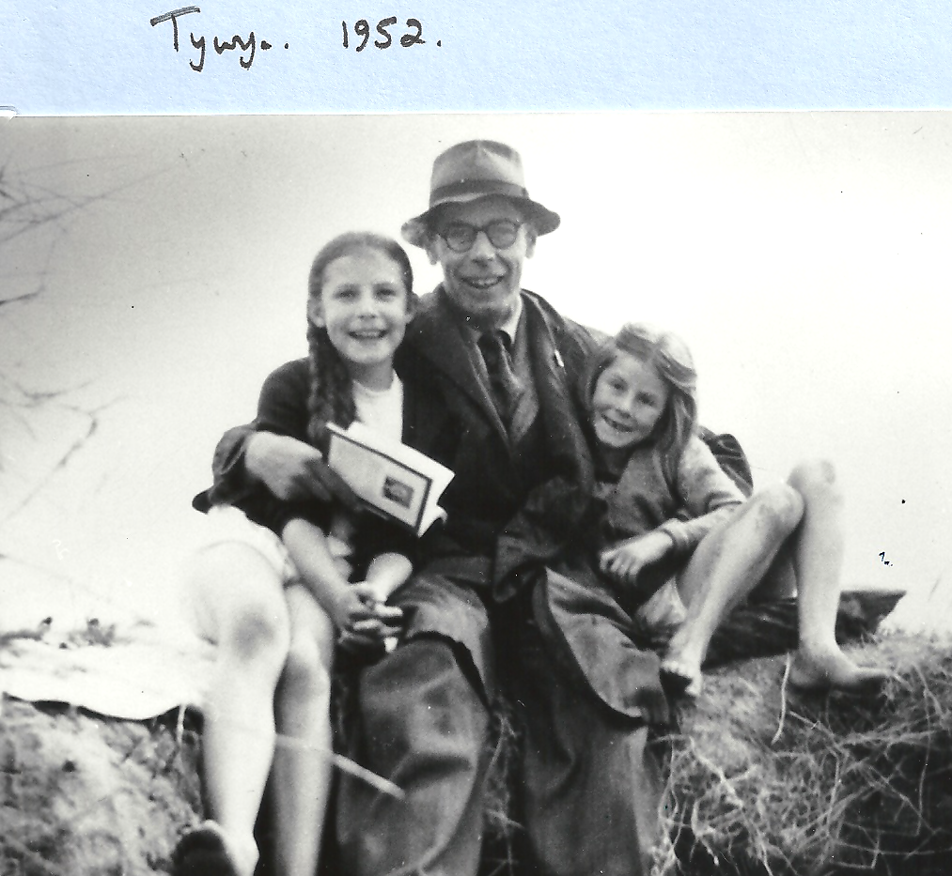



How can we find out about local significant people?
Speak
Ask people who might know about them
Use books and the internet to research them
Research
Investigate
Find buildings and places connected to them
Notes:
Image: © Awdry Family

Slide 5
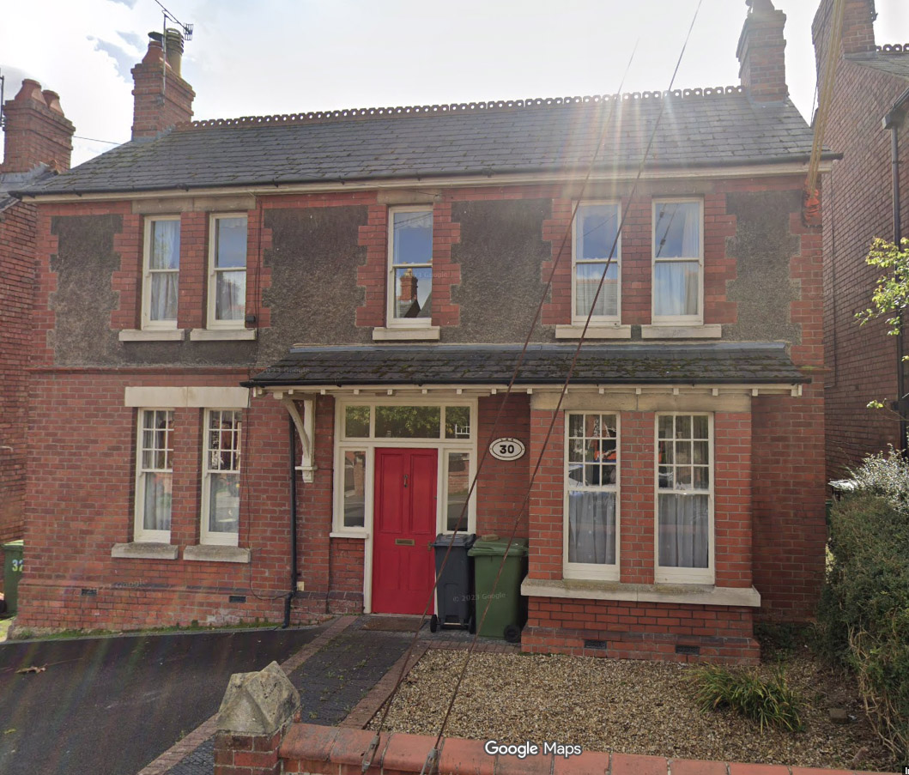
30, Rodborough Avenue
Investigate
This is 30, Rodborough Avenue in Stroud. It is connected to Reverend Wilbert Awdry; our local significant person.
Find Rodborough Avenue on Google Maps
How far is it from your school?
Do you or any of your friends live on Rodborough Avenue?
Notes:
Image: © Google Maps 2025

Slide 6
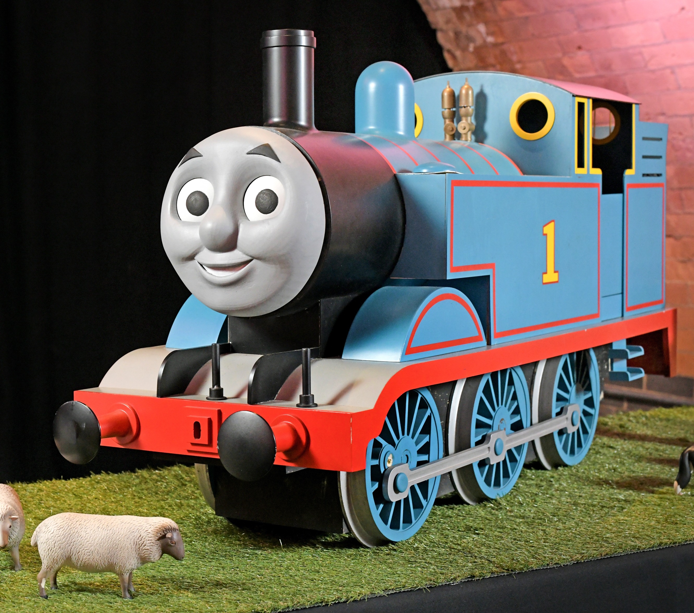

Thomas the Tank Engine
Reverend Wilbert Awdry lived at 30 Rodborough Avenue for 30 years, after he retired in 1965.
He was already famous for having written over 20 books about Thomas the Tank Engine and he continued to write them when he lived in Stroud.
Have you read any of Reverend Awdry’s books?
Thomas the Tank Engine
Notes:
Image: © Mattel 2025

Slide 7
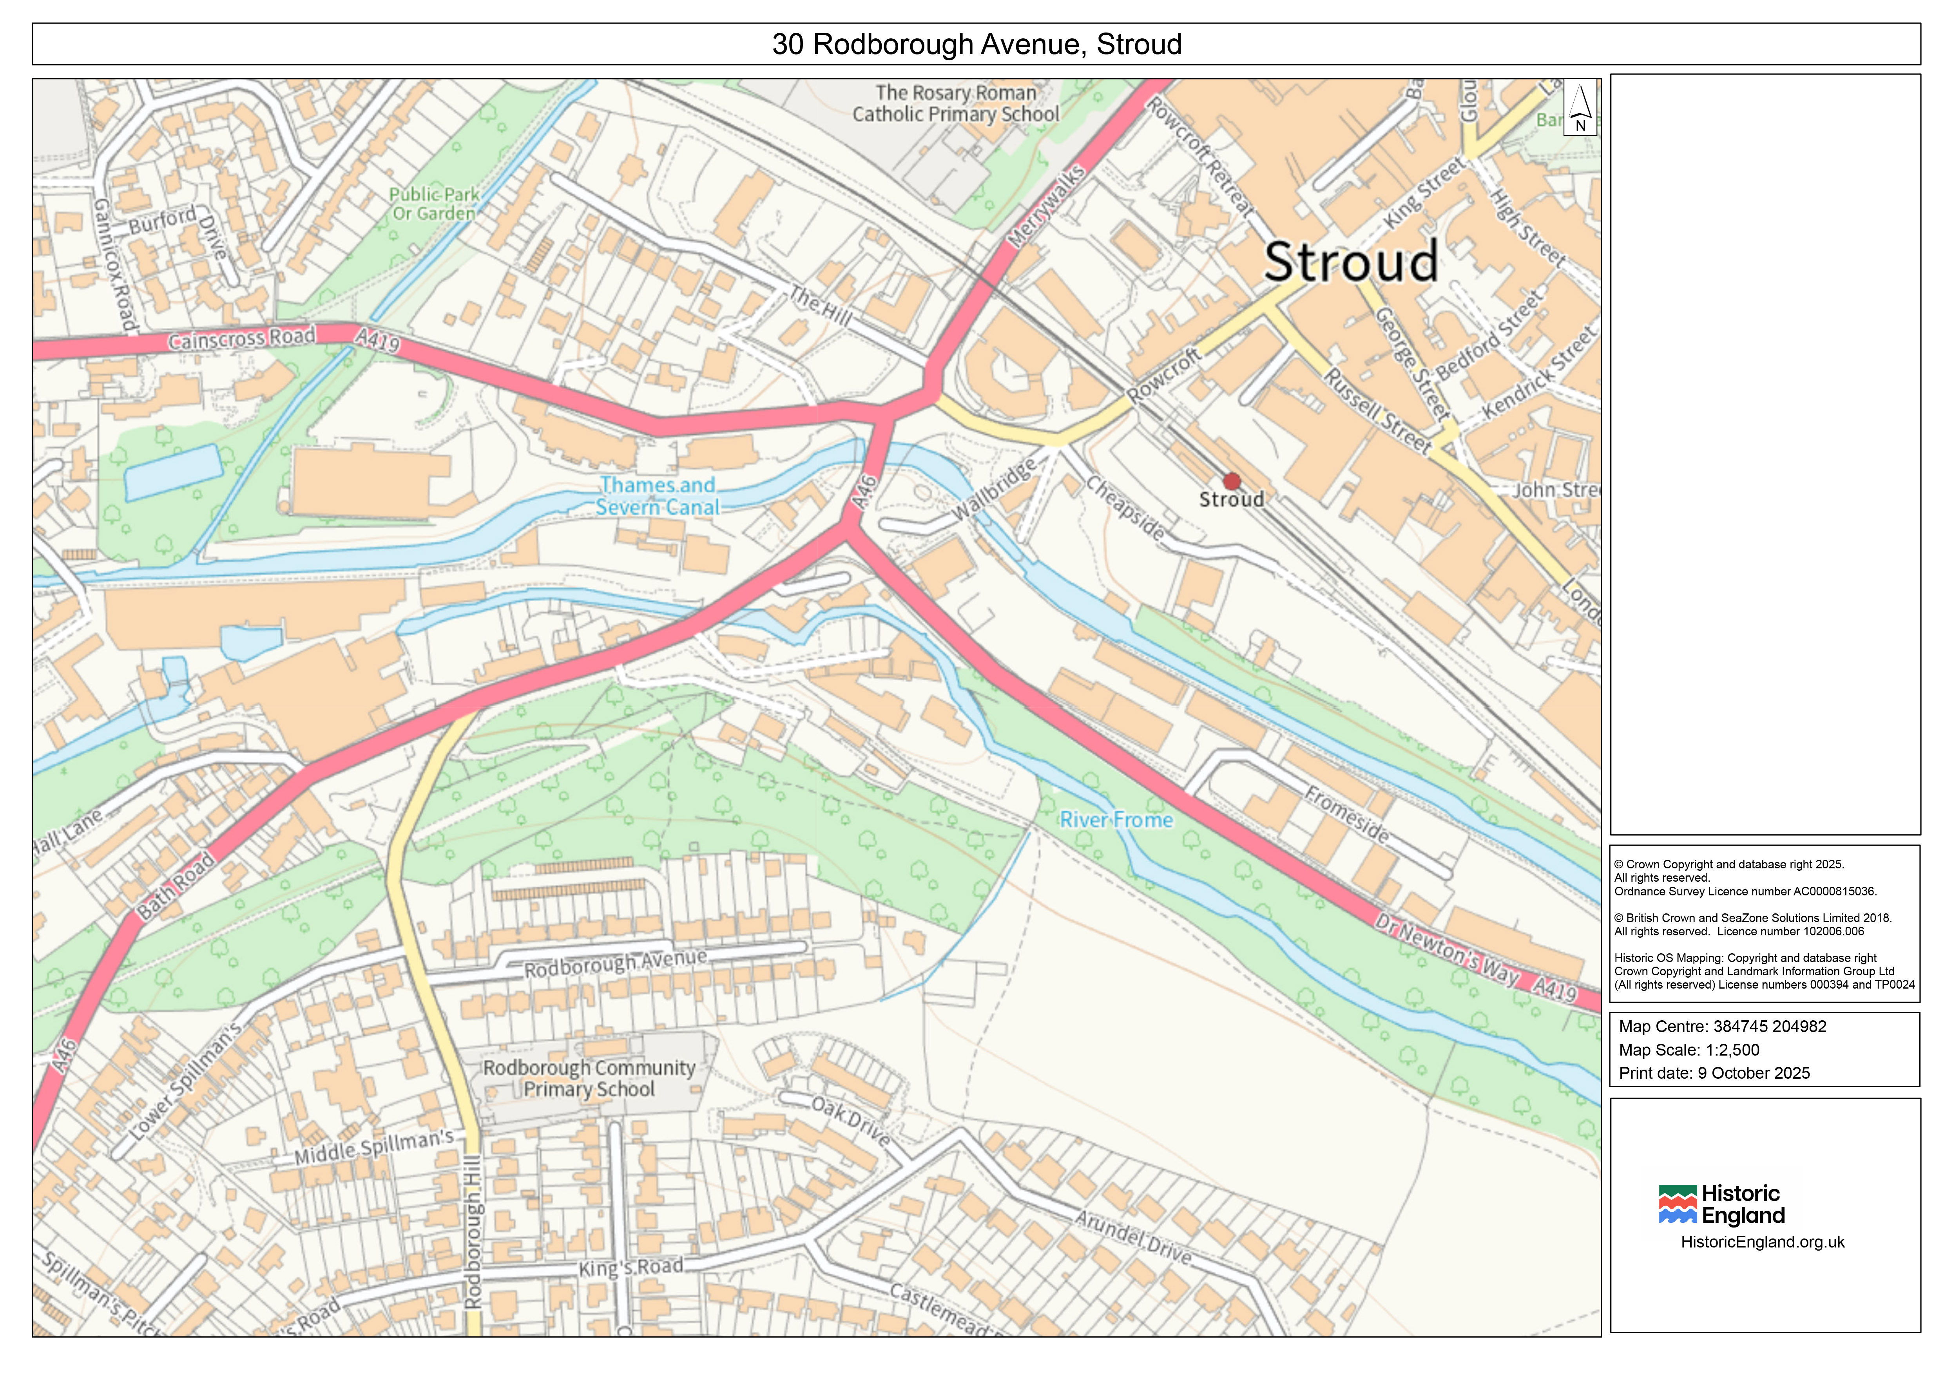
Listening to the trains in Stroud
Stroud Railway Station
Rev. W. Awdry
Sitting in his favourite chair in his Rodborough Ave. house, Reverend Awdry would have been able to hear the trains coming and going from Stroud Station.
Rev. W. Awdry’s house
Notes:
Map © Crown Copyright and database right 2025. All rights reserved. Ordnance Survey Licence number AC0000815036. Historic OS Mapping: Copyright and database right Crown Copyright and Landmark Information Group Ltd (All rights reserved) License numbers 000394 and TP0024
Image: © Awdry Family

Slide 8
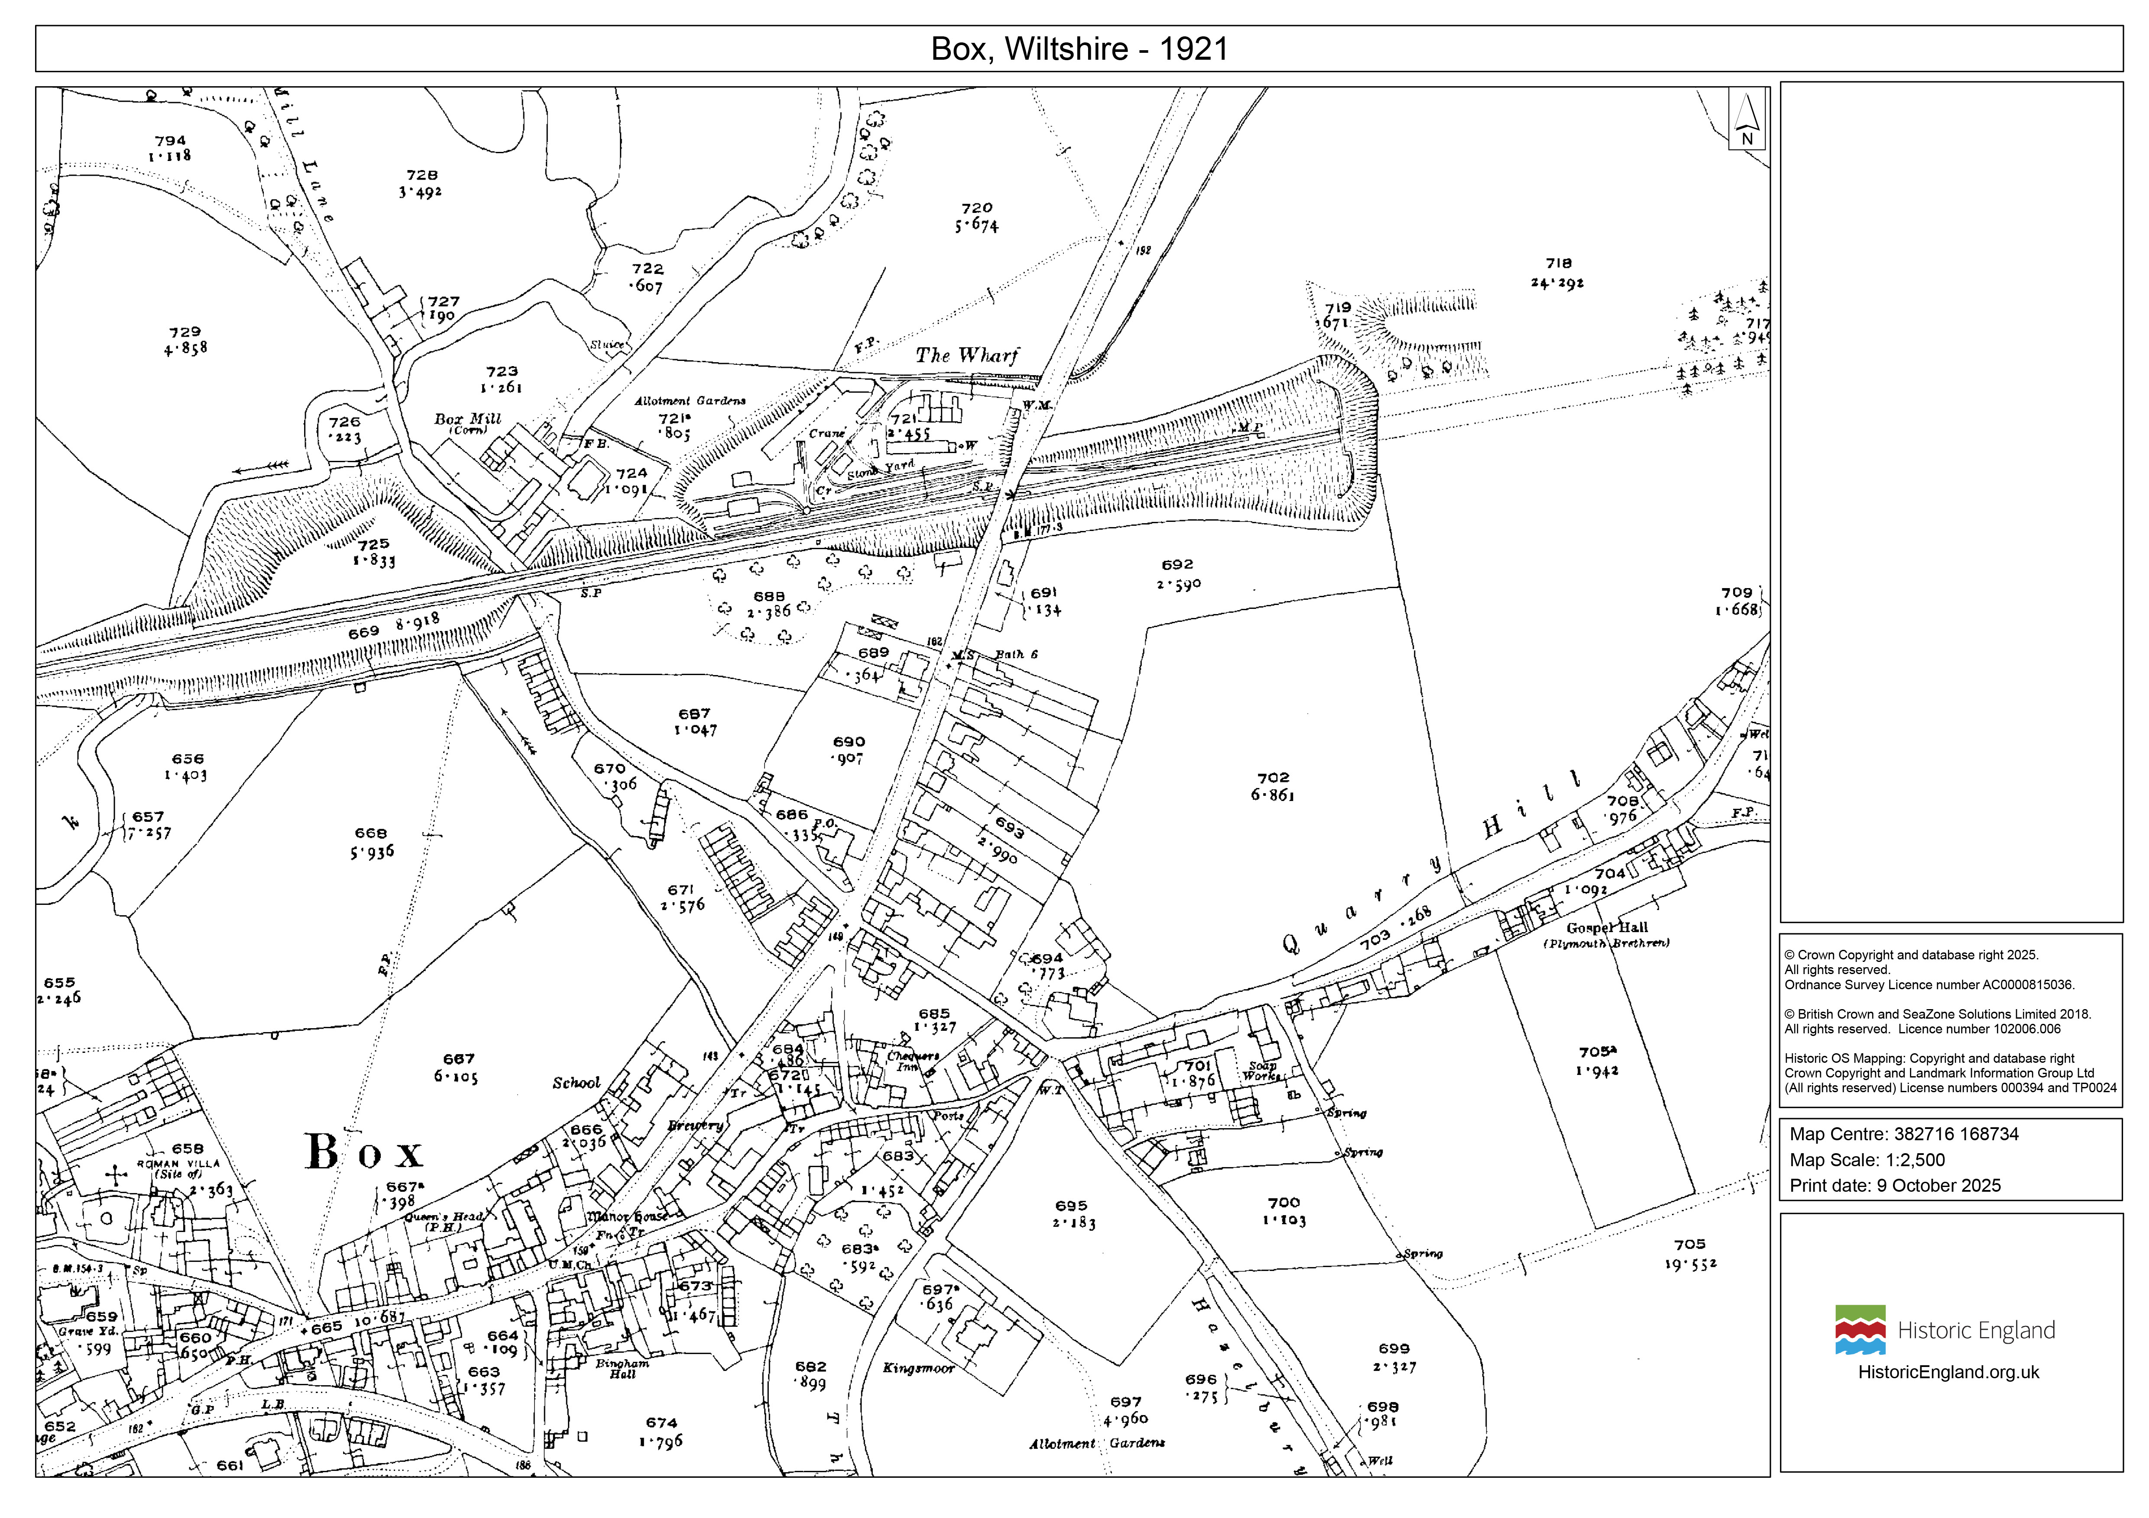
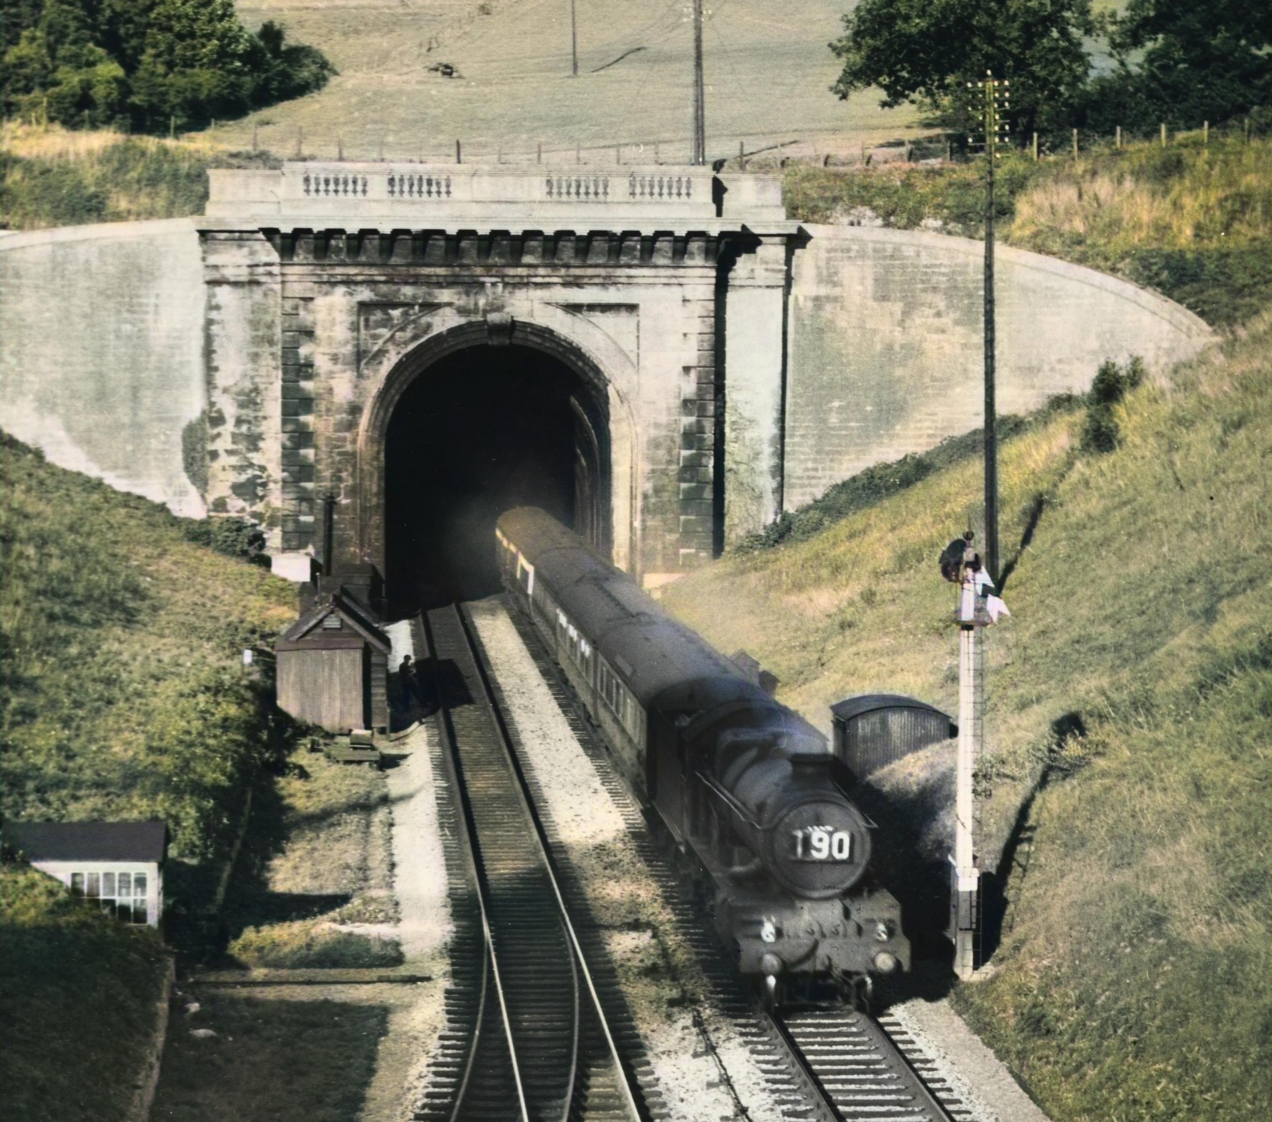

Listening to the trains in Box
Box Railway Tunnel
Box Tunnel
Rev. W. Awdry’s house
When he was a small boy, Wilbert lived in the village of Box in Wiltshire.
At night in bed, he would listen to the trains on the nearby railway line and imagine that the whistles that they made were the trains speaking to each other.
Did you know?
Box Tunnel was designed by Isambard Kingdom Brunel. It took 5 years (1836- 41) to build. At two miles long, it was the longest railway tunnel in Europe when it opened!
Notes:
Map © Crown Copyright and database right 2025. All rights reserved. Ordnance Survey Licence number AC0000815036. Historic OS Mapping: Copyright and database right Crown Copyright and Landmark Information Group Ltd (All rights reserved) License numbers 000394 and TP0024
Image: © Alamy Ref: 2JD6EC2

Slide 9
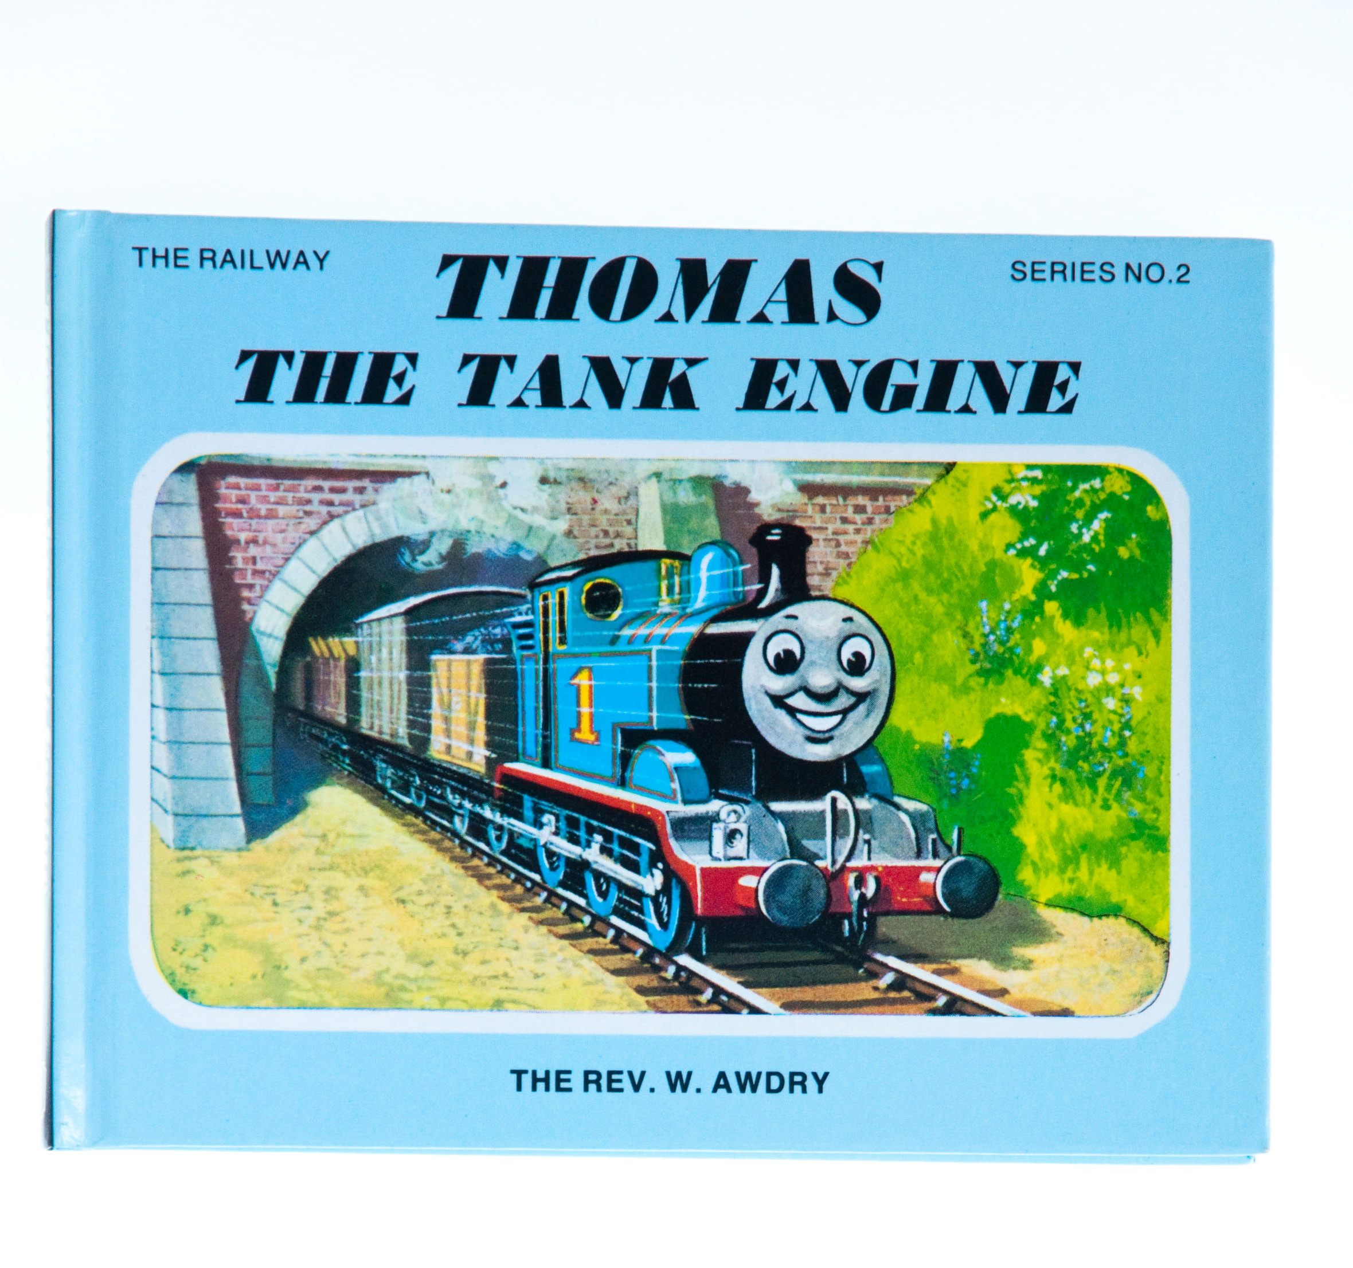

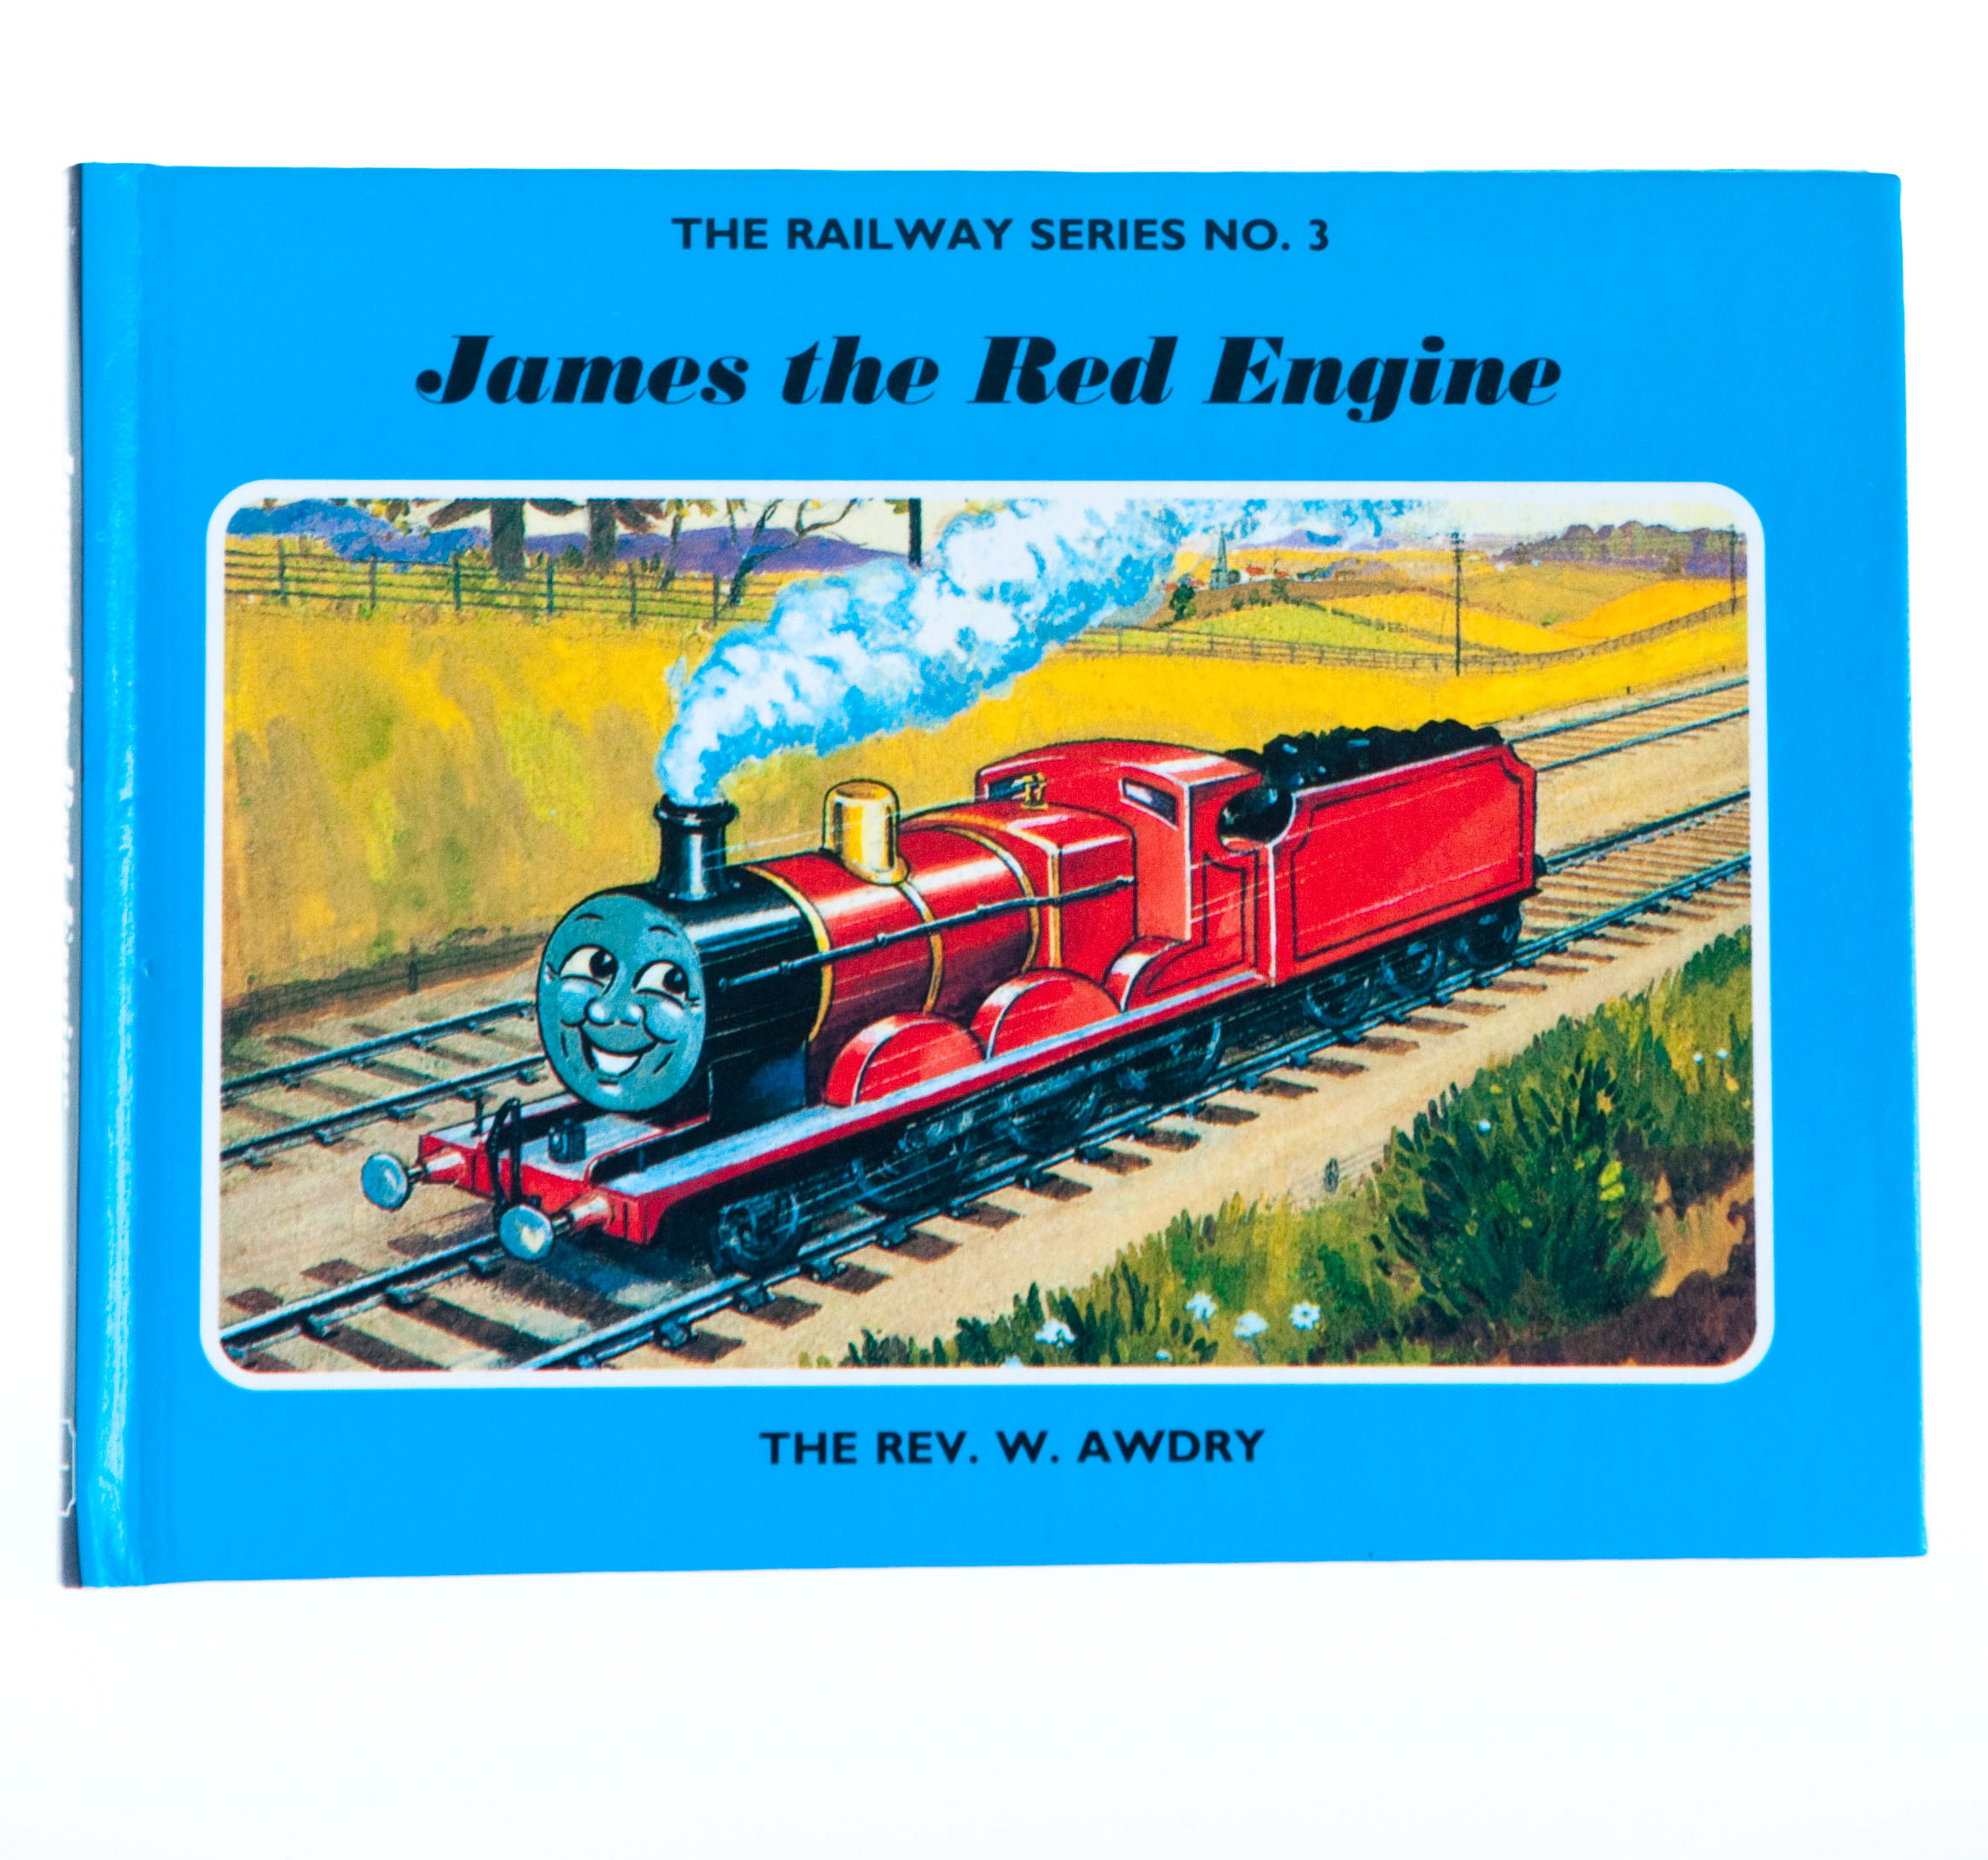
The Railway Series
Can you think of other machines that might talk to each other today?
What would they say to each other?
Reverend Awdry used the idea of talking trains in his story books.
He first created the characters in bedtime stories for his own children. Edward, Gordon and Henry were first engines.
Thomas, who became the main character, came a little later. There are many other named engines in the Thomas & Friends series of books.
Book covers
Notes:
Image: © Alamy Ref: D2R3A8

Slide 10
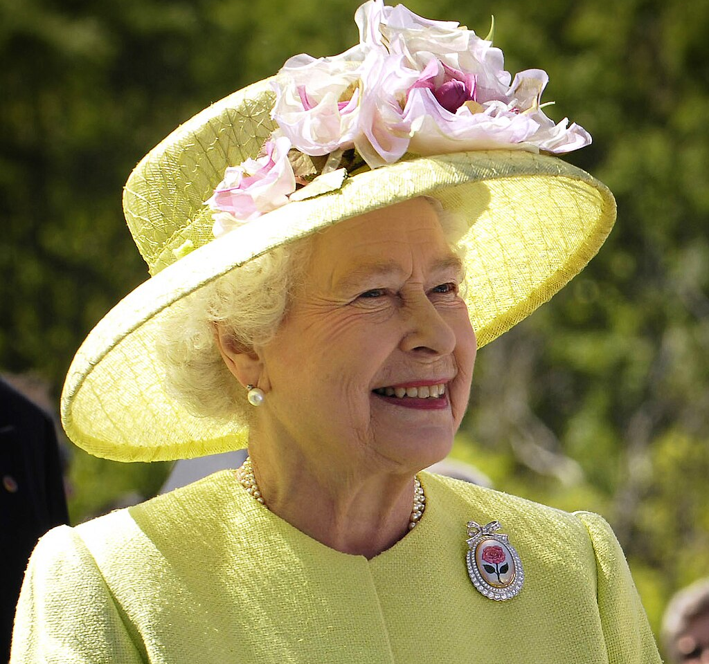
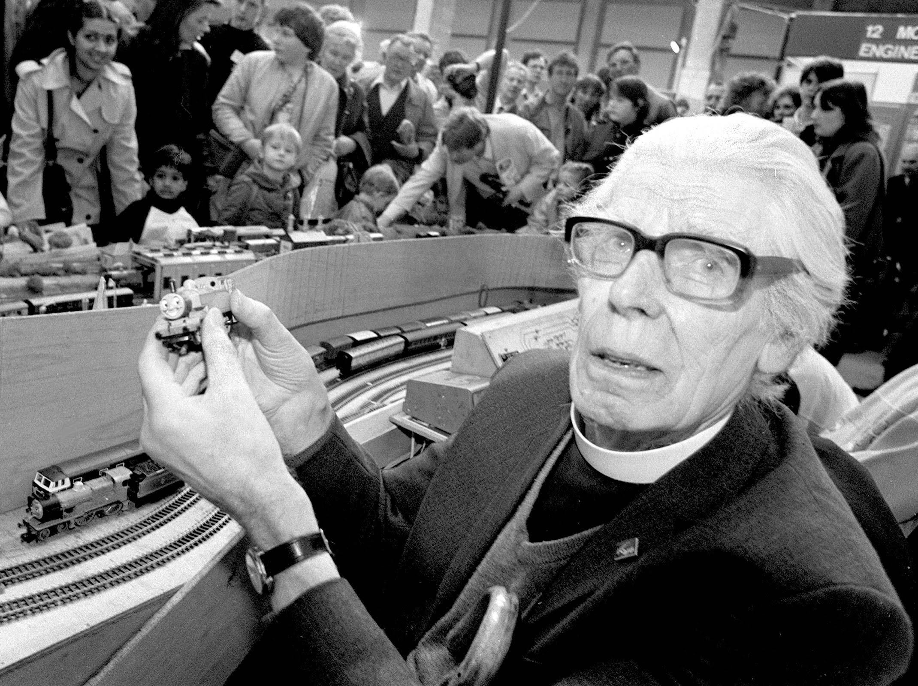
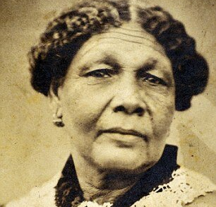
Comparing significant people
Queen Elizabeth II
What makes Reverend Awdry significant?
Can you compare him to another significant person you’ve studied?
Mary Seacole
Notes:
Image1: © Alamy Ref: G46ACB
Image 2: Bill Ingalls, Public domain, via Wikimedia Commons - https://commons.wikimedia.org/wiki/File:Elizabeth_II_greets_NASA_GSFC_employees,_May_8,_2007_edit.jpg
Image 3: See page for author, Public domain, via Wikimedia Commons - https://commons.wikimedia.org/wiki/File:Mary_Jane_Seacole.jpeg

Slide 11
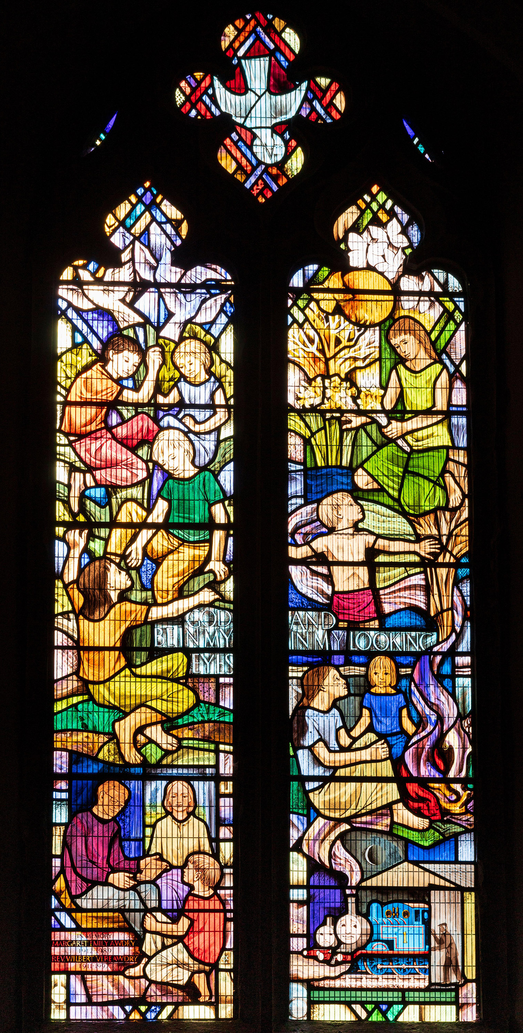

How do we remember?
This is a stained-glass window in the church of St Mary Magdalene, Rodborough, where Reverend Awdry lived when he retired.
Reverend Awdry paid for this window to be put in the church in to honour and remember his late wife, Margaret, who died in 1989.
It shows children, including his son Christopher, being read to and Reverend Awdry himself, in the bottom right corner, closing the doors to an engine shed with Thomas the Tank Engine inside.
Can you think of any other ways we remember people?
Can you find a stained-glass window with a story near your school?
Notes:
Image: © Alamy Ref: 2YM2P32

Slide 12
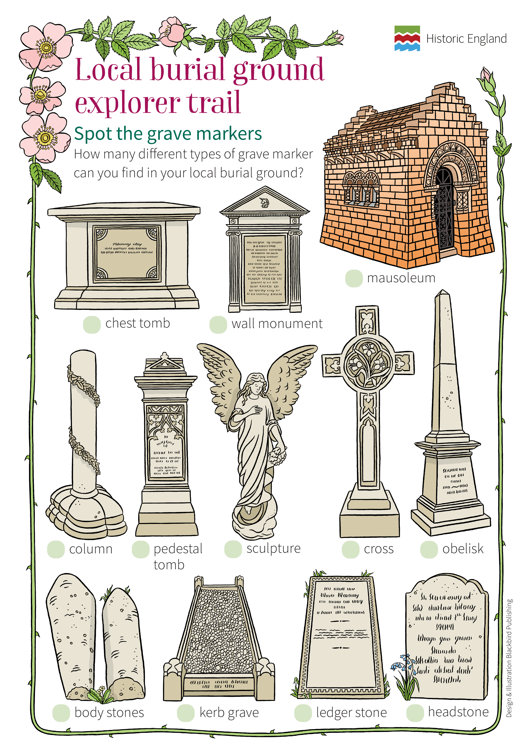
Types of memorial
As well as the window, there are memorial plaques in the churchyard that commemorate Reverend Wilbert Awdry and his wife Margaret.
Use our ‘What can we learn by investigating our local cemetery or churchyard?’ to explore your local churchyard.
Notes:
Image: © Historic England & Blackbird Publishing

