Slide 1
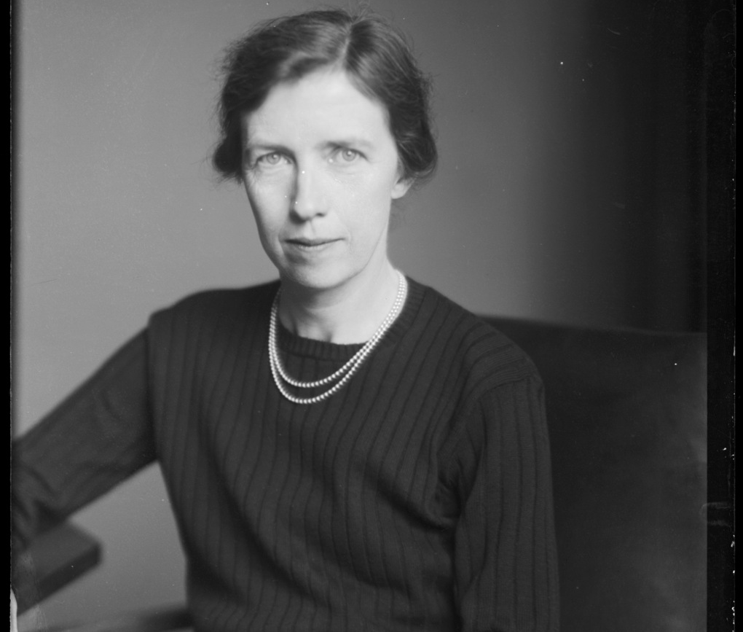
Local Significant People
Mary Cartwright
Education
Notes:
Image: © National Portrait Gallery, London - Dame Mary Lucy Cartwright by Walter Stoneman, half-plate glass negative, May 1947, NPG x188708

Slide 2
Local Significant People: Mary Cartwright
Key Stage: 2 - History & Geography
To learn about significant historical events, people and places in their own locality
To study an aspect of history dating from a period beyond 1066 that is significant in the locality
To gain historical perspective by placing their growing knowledge into different contexts, understanding the connections between local, regional, national and international history

Slide 3

What makes a person significant?
Questions to ask about a person.
Did they:
make big changes in their lifetime?
make a lot of people’s lives better or worse?
change the way people think about something?
have a lasting impact on their locality, the country or the world?
set a really good/bad example to people about how to live and behave?
Notes:
For this activity we’re using Ian ‘Dawson’s Model’ for significance criteria.

Slide 4
How can we find out about local significant people?
?
Ask people who might know about them
Use books and the internet to research them
Find buildings and places connected to them
Who’s local to me?

Slide 5

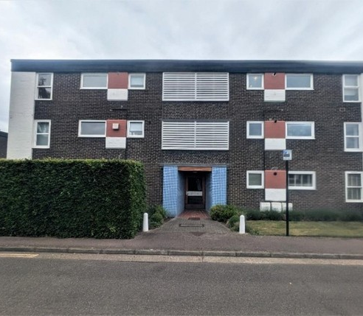
An ordinary block of flats?
Investigate
This is 38 Sherlock Close, Cambridge.
It is connected to Mary Cartwright; our local, significant person.
Find 38 Sherlock Close, Cambridge on Google Maps.
How many miles away is it from your school?
How long would it take you to walk or drive?
Would you say this building is local to your school?
38 Sherlock Close

Slide 6
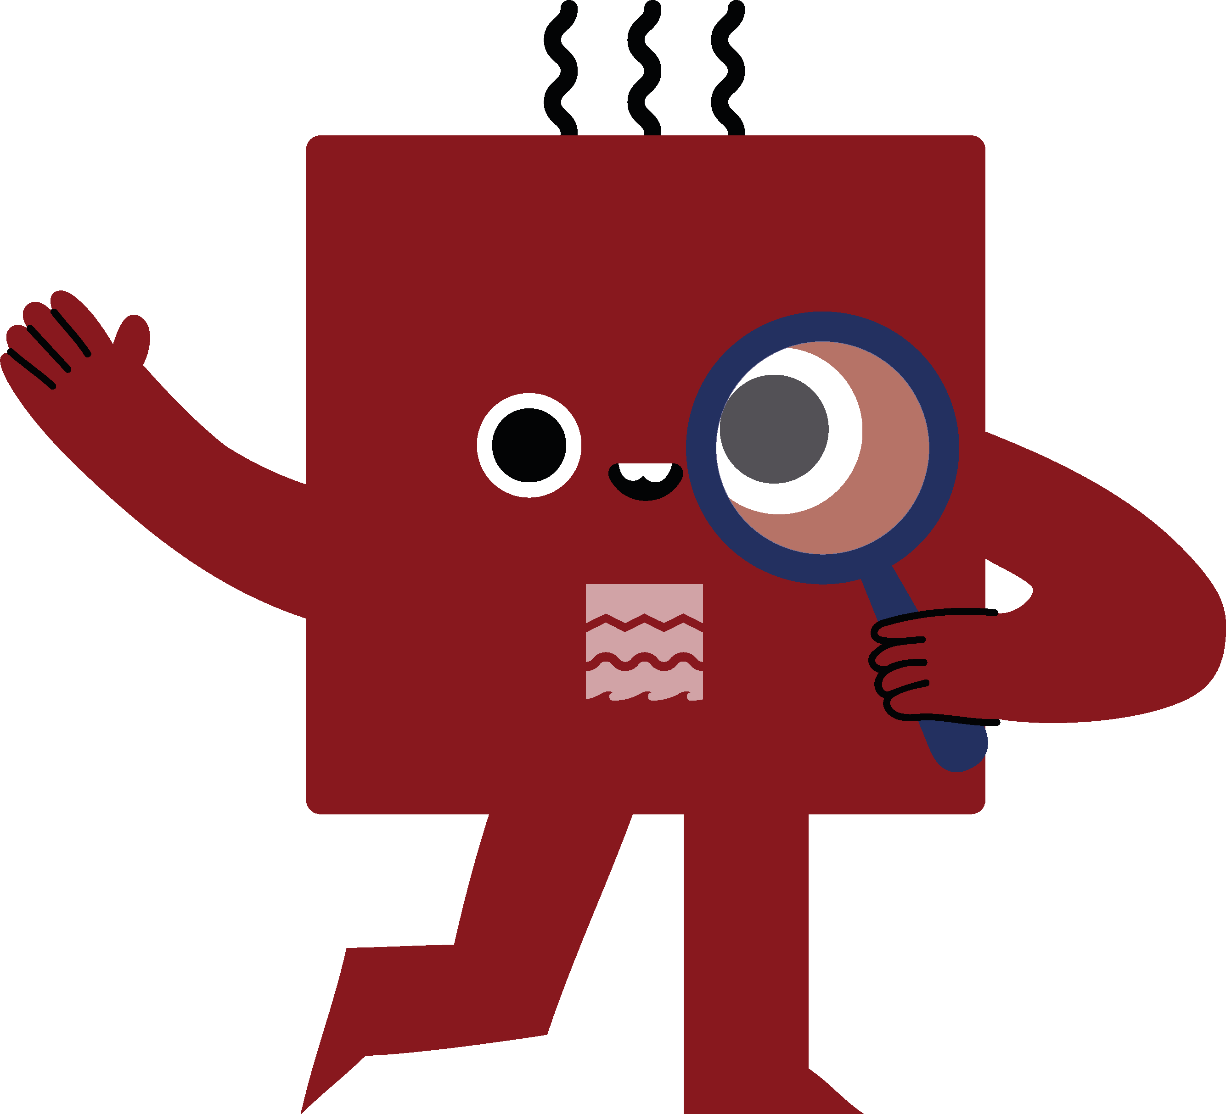
What can a building tell us?
History detectives!
Complete the inference grid on the next page to explore what this building can tell you…..

Slide 7
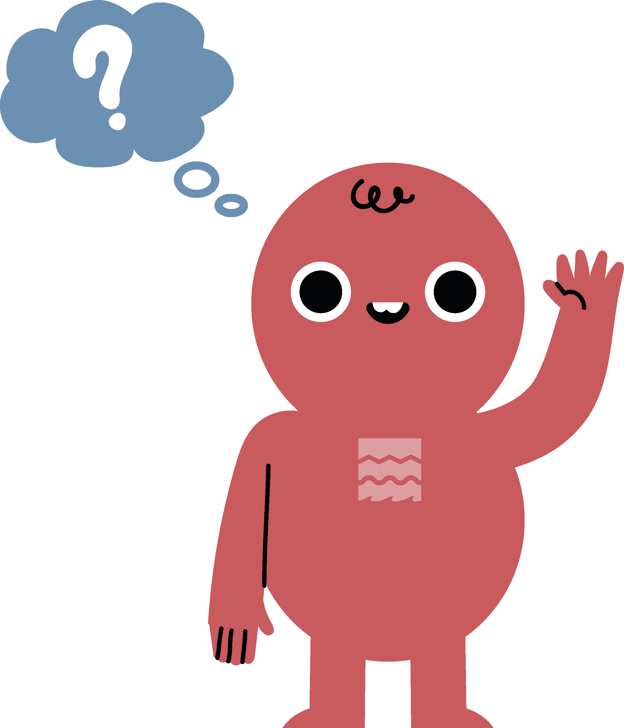

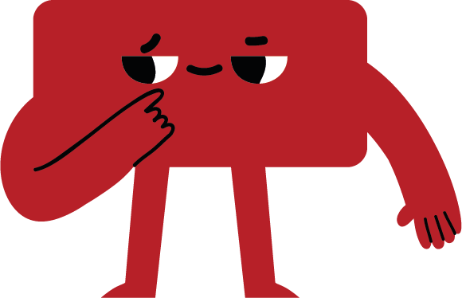

What can buildings tell us?
(I think….because)
Notes:
Image: © Historic England?
In HE research on MC

Slide 8
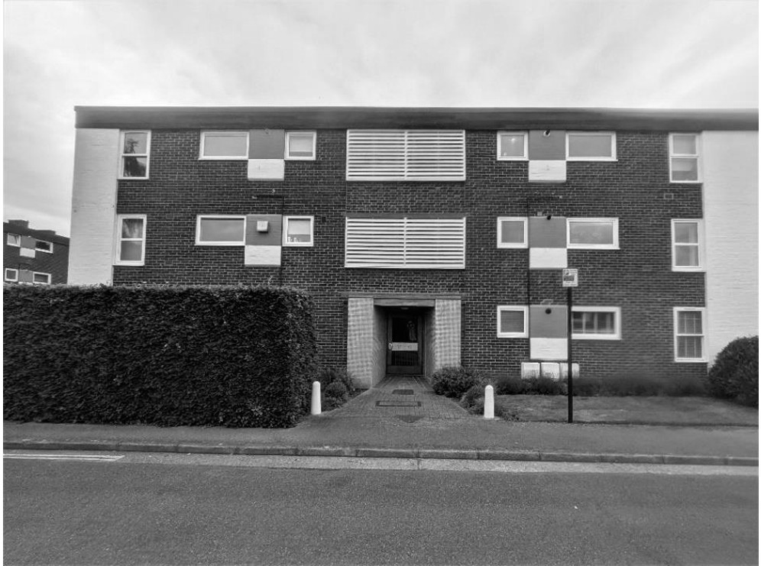
Print out inference square

Slide 9
38 Sherlock Close, Cambridge
Investigate
This is 38 Sherlock Close, Cambridge.
38 Sherlock Close looks like an ordinary flat, on an ordinary street in Cambridge.
But it is actually very special….
Flat or Apartment - a self-contained residential unit occupying part of a larger building, typically covering a single floor.
38 Sherlock Close

Slide 10
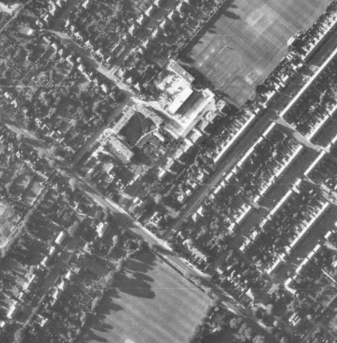
38 Sherlock Close, Cambridge
38 Sherlock Close was the home of Mary Cartwright, our significant local person.
She lived there for over 20 years, from 1971 until 1994.
Have you heard of Mary Cartwright?
Do you know anything about her?
Aerial view of Sherlock Close
Notes:
Image: © Historic England raf_58_4438_f21_0033
In HE research on MC

Slide 11
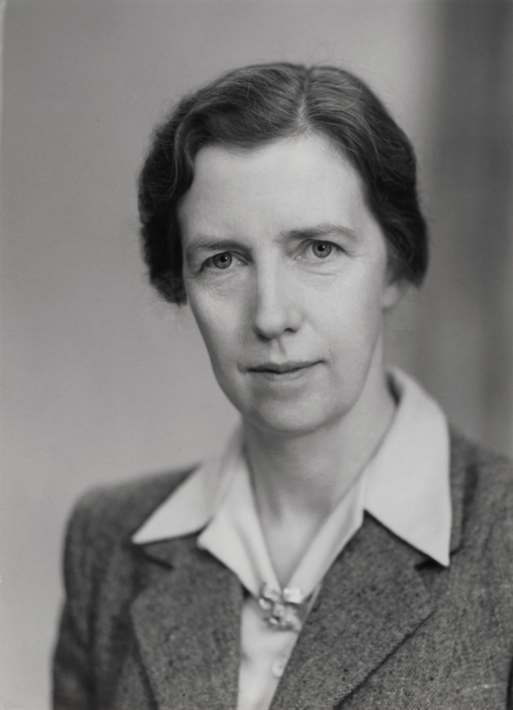
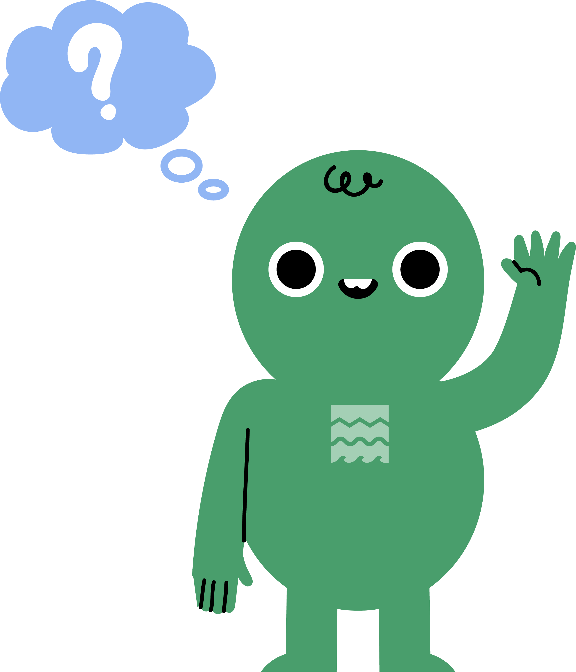

Meet Mary Cartwright
Mary was born on 17 December 1900 in Aynho, Northamptonshire.
Her father was a vicar, and her family was quite well off.
Mary loved learning and asking questions.
Ask
Mary Cartwright in 1950
Notes:
Image: © National Portrait Gallery, London
Dame Mary Lucy Cartwright, by Elliott & Fry, bromide print, 1950, NPG x86637
Teacher Notes Mary Cartwright was born on 17 December 1900 in Aynho, Northamptonshire
Her father, Rev. William Digby Cartwright was born in 1865 in Aynho, where he later became the vicar
Her mother, Lucy Harriette Maud Bury, was born in 1868 in Kensington, London

Slide 12
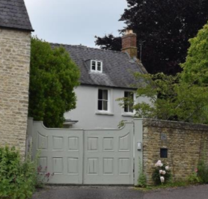
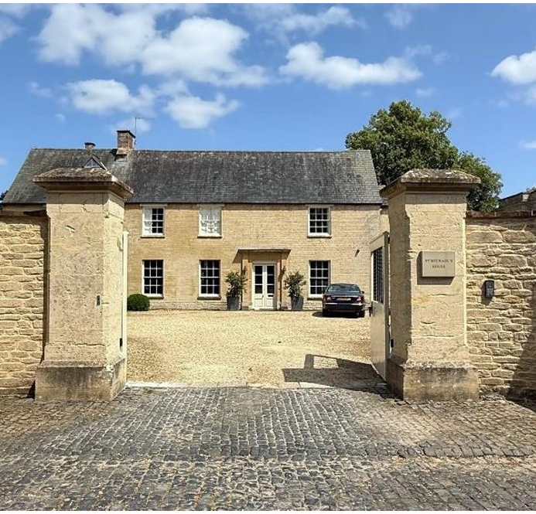
Mary’s childhood homes
Church Cottage, now known as Catton House Aynho
Mary’s first home was called Church Cottage in Aynho.
It was one of the few houses with clean running water.
When Mary was six, her father became rector (an important Vicar) and they moved to The Rectory, a big old house. They lived there until her father died in 1926.
The Rectory, now known as St Michael’s House, Aynho
Notes:
Images: ©Historic England
Teacher notes:
Mary Cartwright’s first home was Church Cottage in Aynho.
The family lived here until Mary was 6 years old, while her father served as curate to his uncle the rector.
It was one of only four properties in the village with tap water and drainage
It was known as ‘Church Cottage’ at that time and likely dates to the eighteenth century.
Mary’s father became the rector in 1906. The family moved to The Rectory, Aynho.(The property is now called St Michael’s House)
St Michael’s House is a Grade II listed building, dating to the seventeenth century and remodelled in the nineteenth.
The Rectory remained the family home until Cartwright’s father died in 1926.

Slide 13
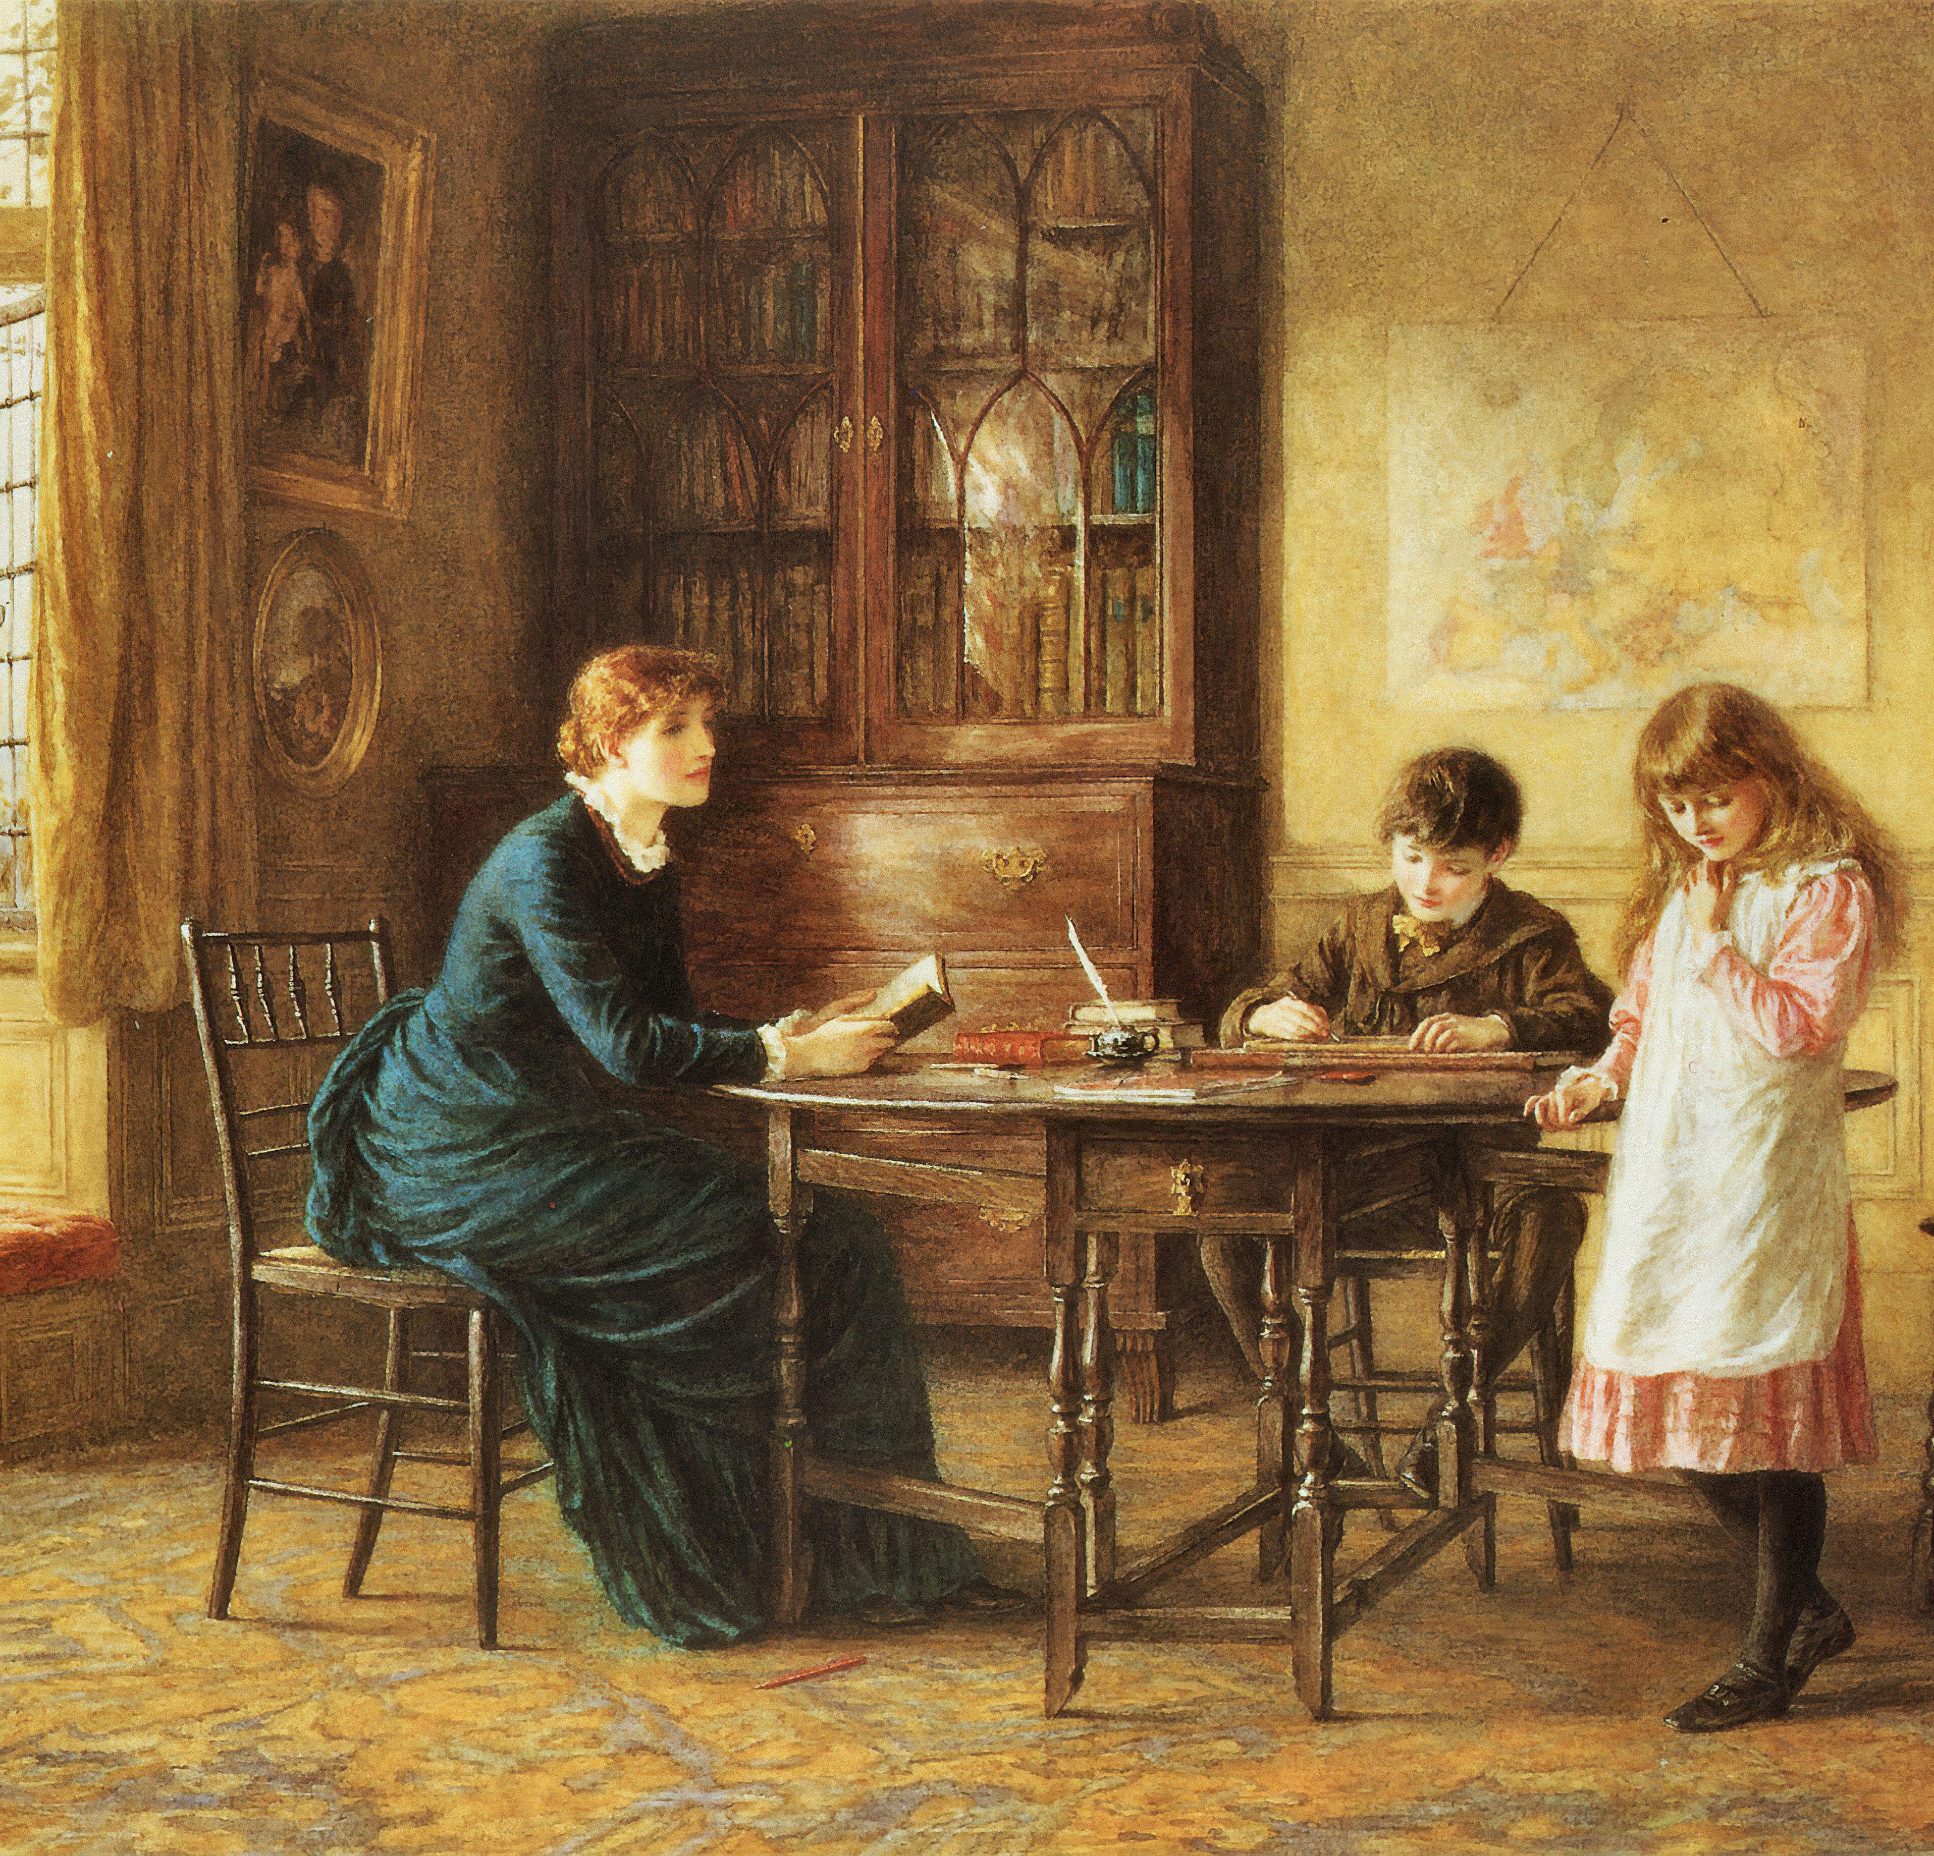
Mary’s Childhood
Reflection:
When she was in her 90s, Mary remembered being given a book for her eleventh birthday, It had the motto:
‘be good, sweet maid, and let who can be clever’ (meaning boys and men!)
Mary was one of 5 children. She had 2 older brothers (John & Nigel), a younger sister (Jane) and a younger brother (William).
Her family didn’t mix much with the other children in the village.
She was taught at home by a governess until she was eleven.
Girls were expected to learn music and sewing, not serious subjects.
A painting of a governess teaching two children
Notes:
Image: © Alamy Ref: 2CEW3EA
Teacher Notes:
Mary was descended from the poet John Donne and William Mompesson, the Vicar of Eyam.
She was the third of five children in a rich upper-middle-class family. They were not allowed to play with the poorer village children or go to the village school because they were from a lower class
Mary was taught by a governess until she was eleven.
Many wealthy families hired governesses to teach their daughters at home.
She taught reading, writing, maths, history, geography, and sometimes music or French.
She also helped the children learn good manners and took them for walks each day.
Life as a governess could be lonely. The pay wasn’t always good. Some were treated kindly, but others found the work hard and uncertain.
Reflection: Women were expected to leave the intellectual feats to men. The fact that Mary remembered this detail after 80 years suggests it stuck in her mind as funny or because she strongly disagreed. Mary was a clever child with a great thirst for knowledge and learning and reading. Perhaps the relative who gave her this was worried she would become too clever and not marry well! It shows us how much the attitudes towards education for girls has changed over the last 1`00 years and reminds us of the huge barriers Mary cartwright face.

Slide 14
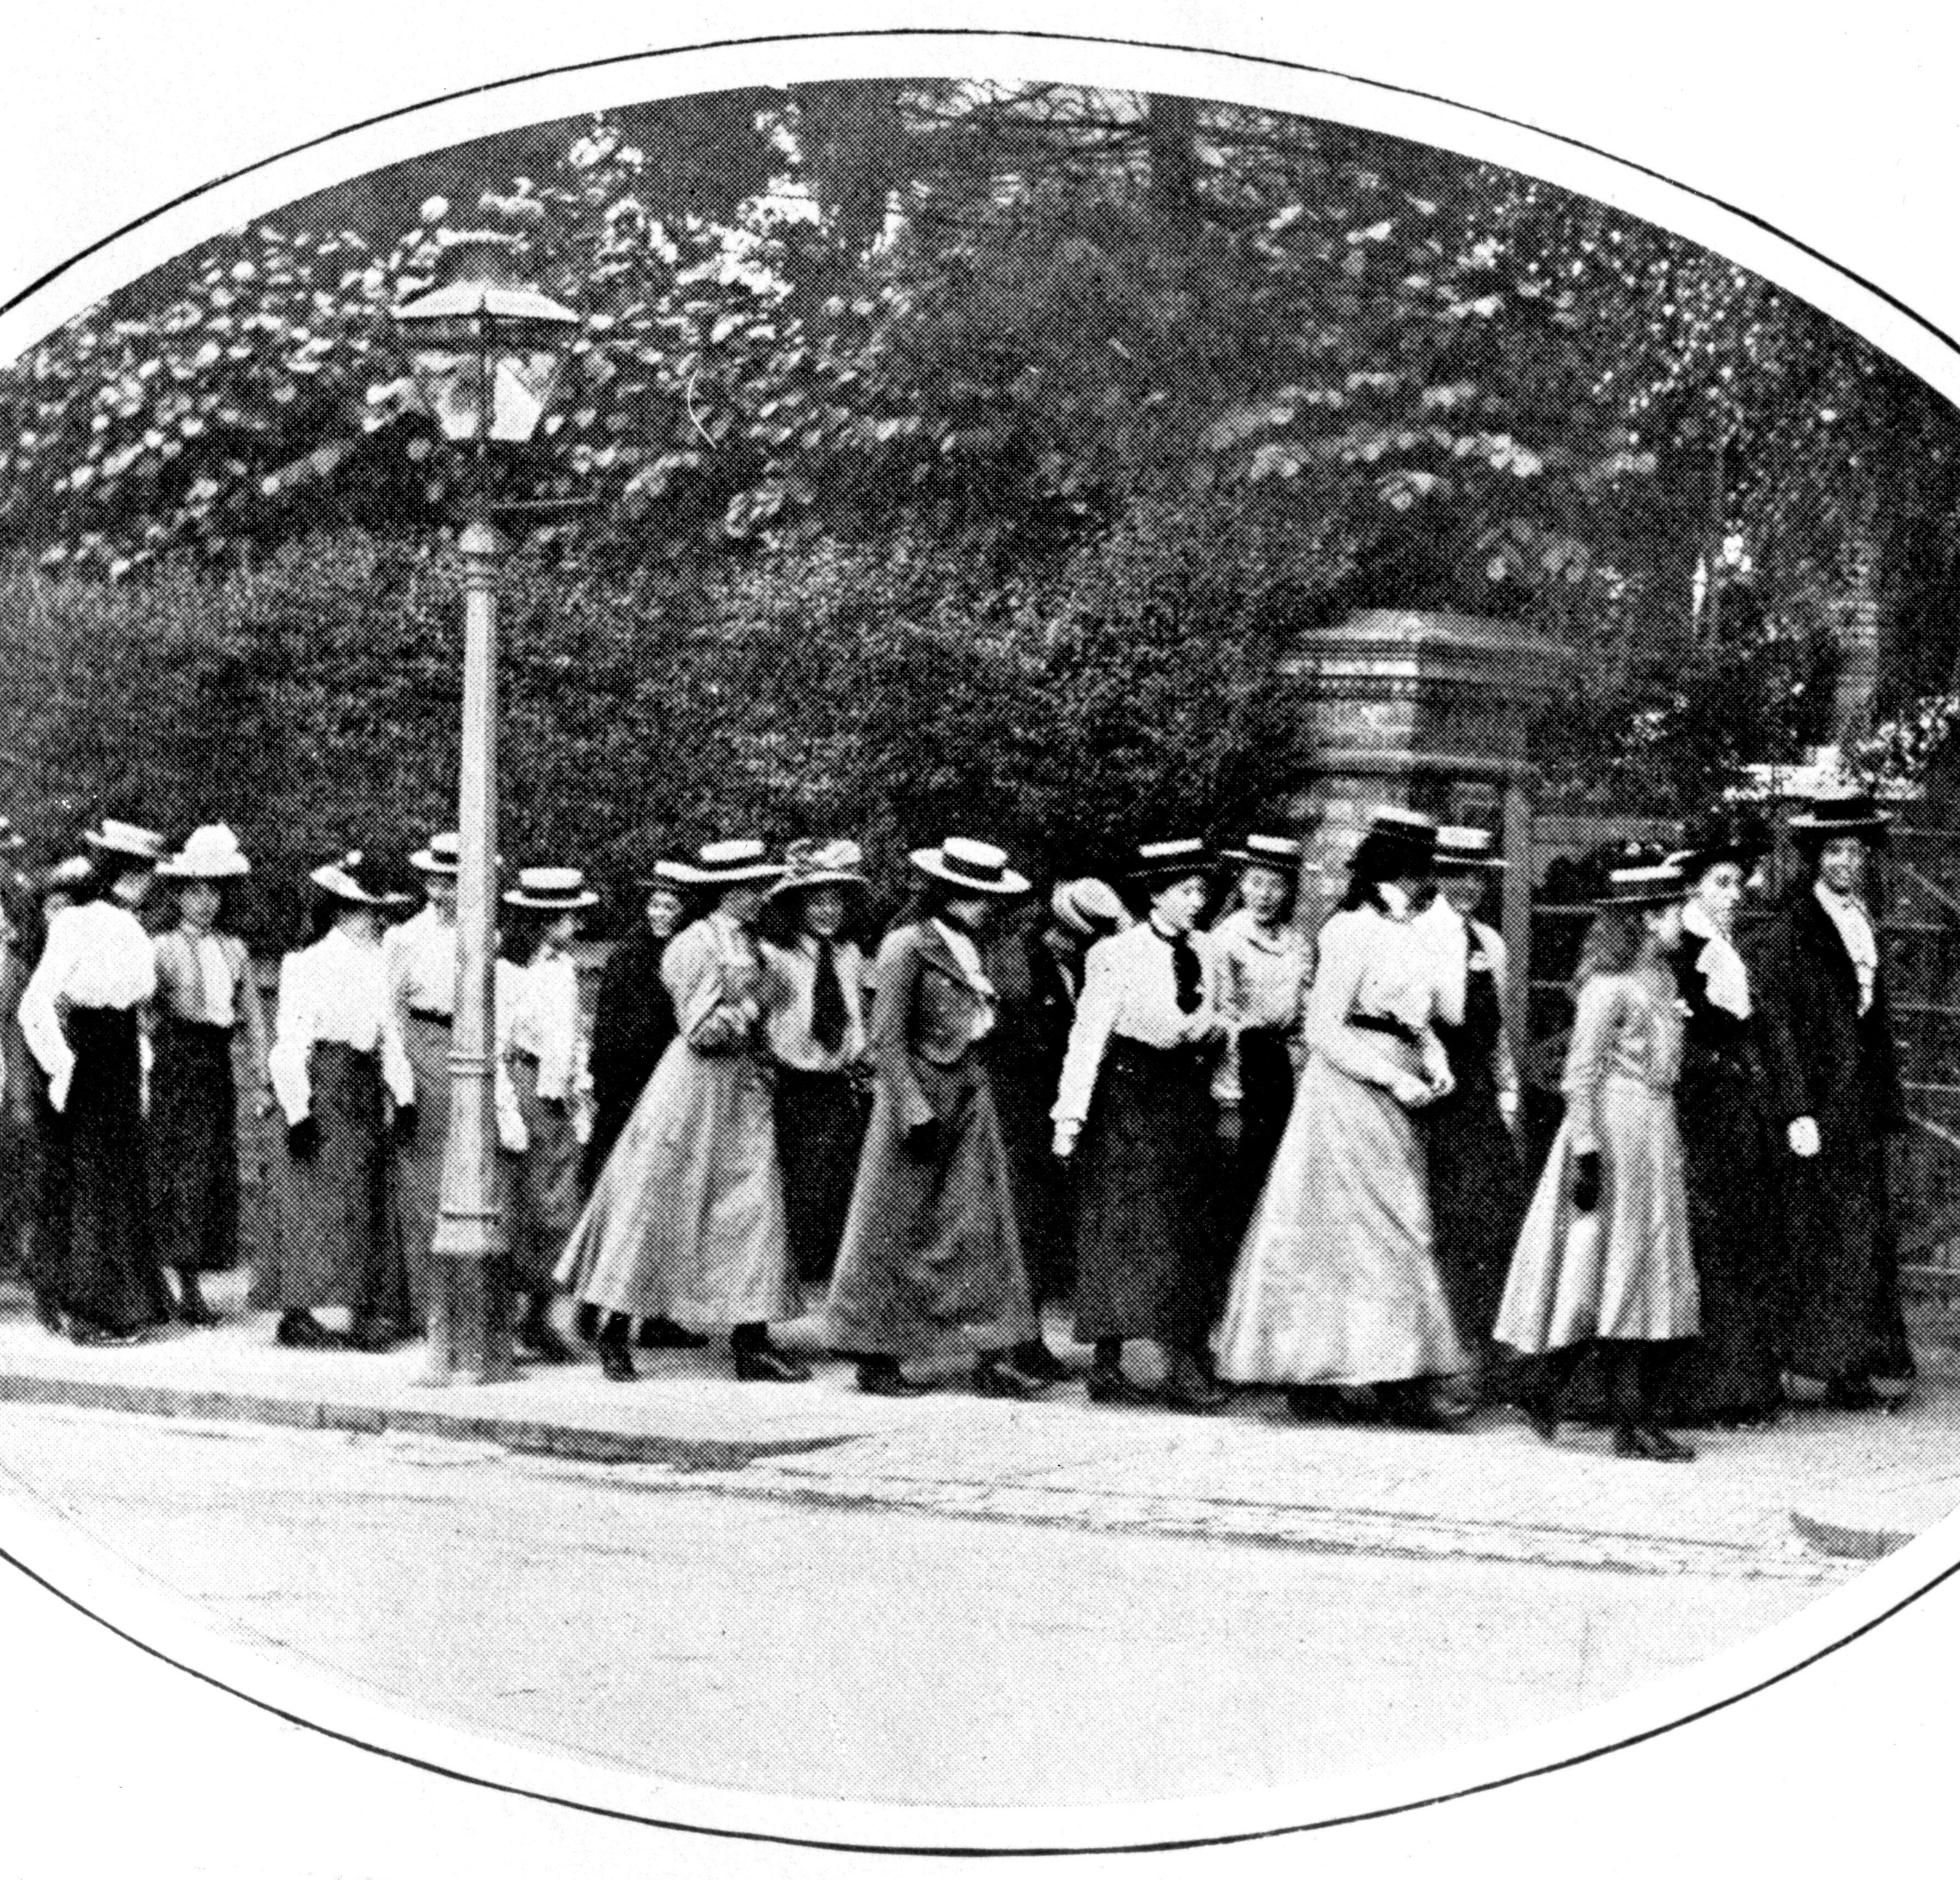
Mary at School
In 1911, Mary left home to go to an all-girls’ boarding school.
Until 1919, Mary lived at a boarding school during the term, only coming home for the holidays.
By Mary’s time, these schools offered real education as well as etiquette and accomplishments.
Reflection:
How do you think Mary might have felt when she was sent away to a girls’ boarding school?
Girl's private school out for a walk c1910
Notes:
Image: © Alamy Ref: 3C70KK6 –
Teacher Notes
At this time, education for girls was changing. In the Victorian-era. women were not expected to be clever but ‘accomplished’ in things like needlework, art or music.
By 1910, more girls' schools provided an academic education. Mary was sent to a number of different girl’s boarding schools from from 1911 to 1919.

Slide 15


Write a postcard from Mary to her family in Aynho
Write
Notes:
Image: © Alamy Ref: T4XYC9
Teacher Notes: This task could be repeated at different places/times/events or different groups asked to send a postcard at different times – during From Salisbury, during WWI, at Oxford; teaching

Slide 16

Write a postcard from Mary to her family in Aynho2
Notes:
Image: © Alamy Ref: T4XYC9

Slide 17
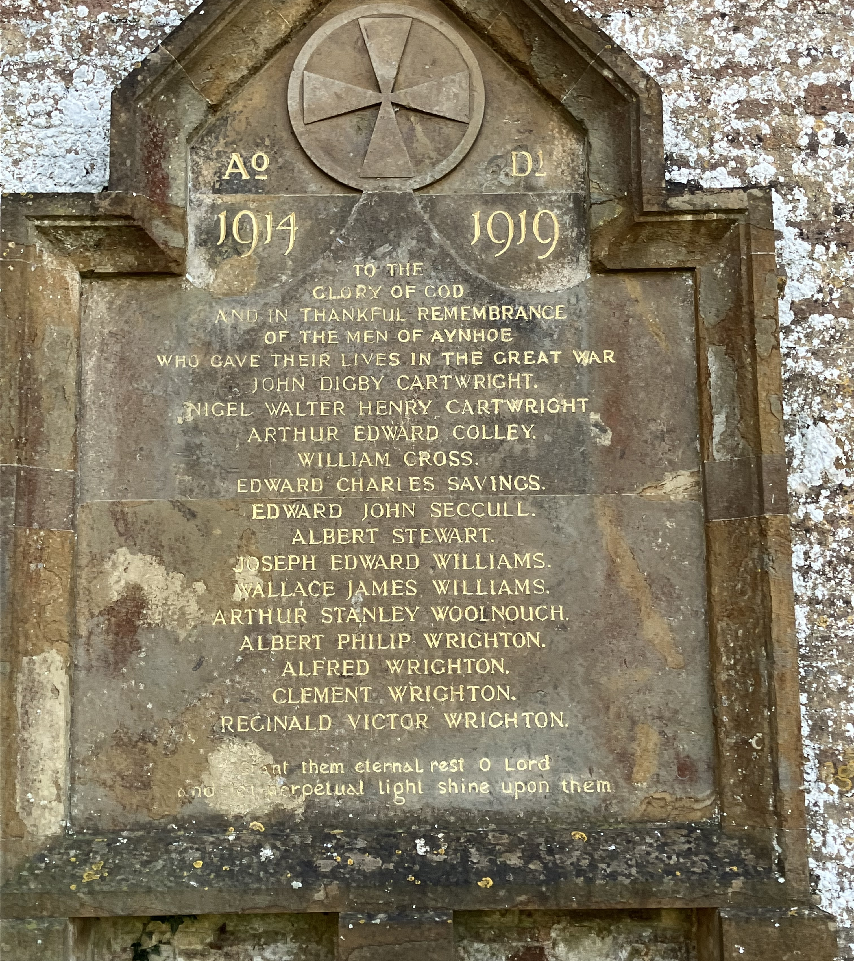
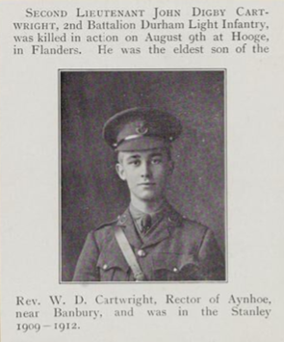
The Impact of the First World War (1914-1918)
Mary’s two older brothers, John and Nigel, died in the First World War.
Their names are on Aynho’s war memorial.
There is a photo of John in the records of the Imperial War Museum.
This was a very sad time for Mary and her family and for many other families too.
Suggestion:
Can you find out about a War Memorial near your school?
Aynho War Memorial Tablet
Notes:
Image: © https://www.warmemorialsonline.org.uk/memorial/195922
Image: © IWM (HU 119679) https://www.iwm.org.uk/collections/item/object/205291917
Teacher Notes:
Mary’s oldest brother, John, was killed in 1915 fighting the early months of the First World War (1914-1918)
In 1917, tragedy struck again when her remaining older brother, Nigel, was killed in the First World War
They are both named on Aynho’s WWI memorial. Find out more here
https://www.iwm.org.uk/memorials/item/memorial/15058
https://astreetnearyou.org/#lat=51.994988568645674&lon=-1.2503707408905032&zoom=17

Slide 18
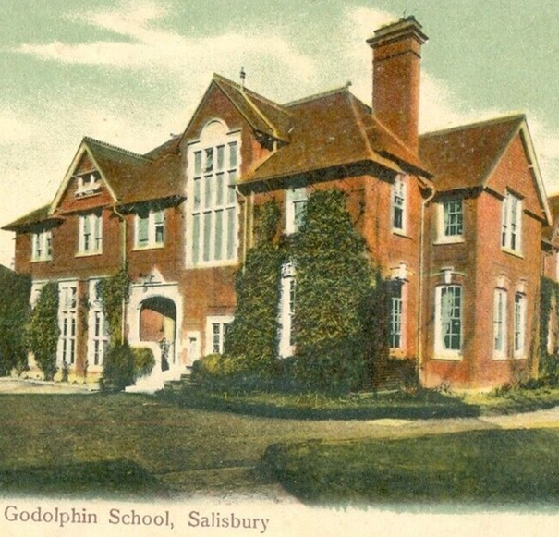
Discovering Maths
In 1916 Mary, now 16, started at the Godolphin School in Salisbury.
She loved history and also met Miss Hancock, an inspiring maths teacher.
She showed Mary new maths ideas like geometry and calculus.
Mary began to love maths and wanted to study it further.
Miss Hancock encouraged Mary to apply to Oxford University!
Reflection:
Has someone ever inspired you?
What would you inspire someone to try?
Godolphin School, Salisbury. 1906
Notes:
Image: © https://commons.wikimedia.org/wiki/File:Godolphin_School_Salisbury_-_Mabbett_postcard_-_obverse.jpg
Teacher Notes:
In 1916, Mary moved to the Godolphin School, Salisbury.
Her favourite subject was History
However, Mary had an inspiring mathematics teacher, Miss Hancock, who was largely self taught. She introduced Mary to calculus, analytical geometry, and uniform convergence.

Slide 19
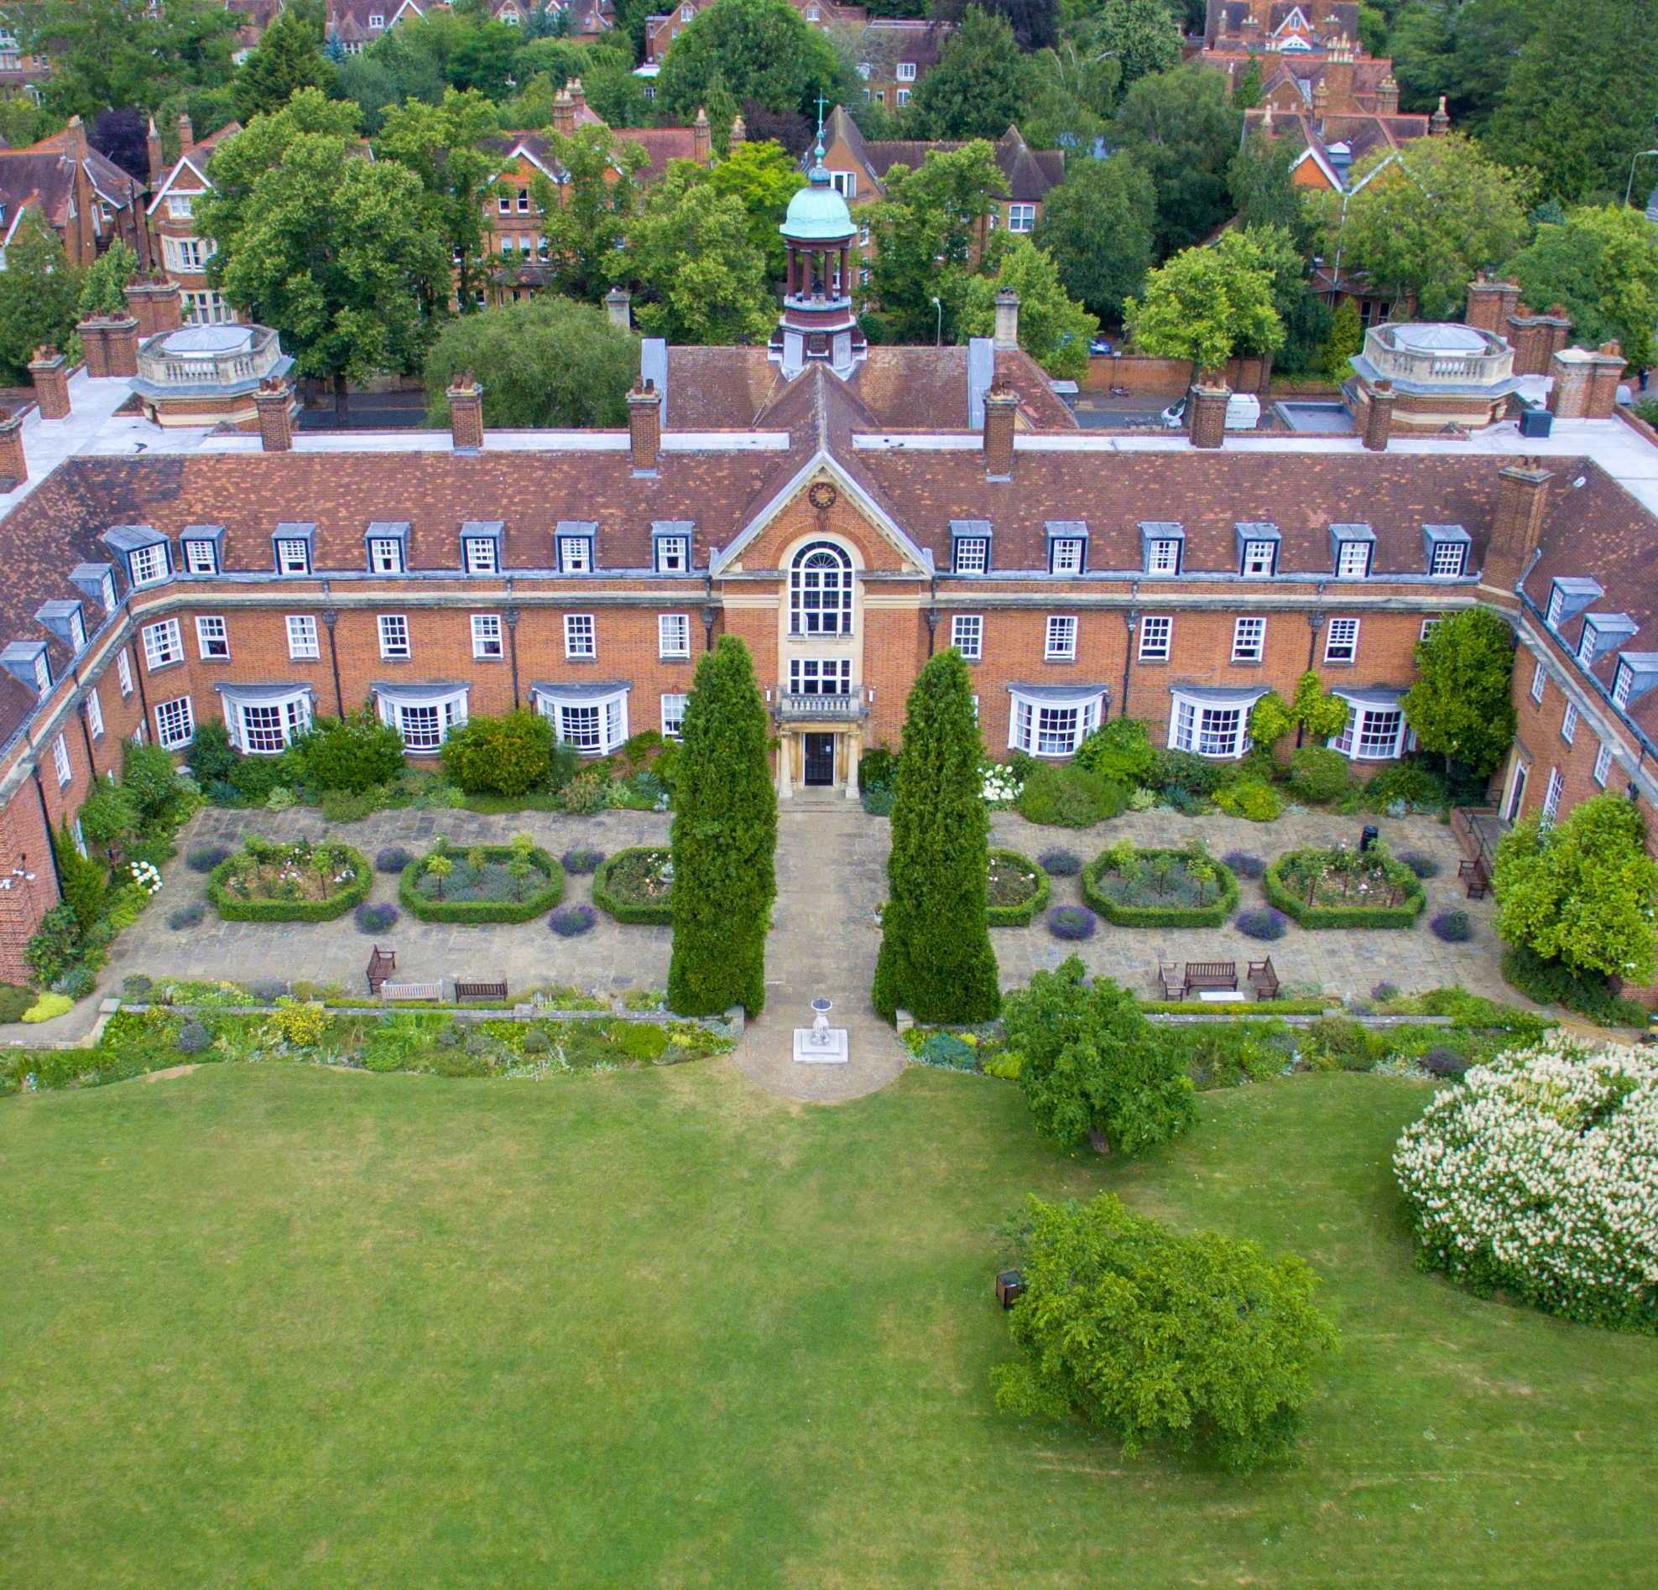
Mary at Oxford University 1919–1923
Reflection:
Mary later reflected: ‘most upper-class girls were brought out, presented at Court, and spent a year or two attending all the fashionable functions […] they did not usually go to University’.
What does this tell us about Mary?
In 1919 she won a place to study maths at St Hugh’s College, Oxford.
There were only four other women studying maths at the same time.
Mary worked hard and didn’t give up, even when the maths was tough.
In 1923, she became the first woman at Oxford to earn a top‑class maths degree!
St Hugh’s College, Oxford
Notes:
Image: © https://commons.wikimedia.org/wiki/File:St._Hugh%27s.jpg
Teacher Notes
Miss Hancock also encouraged Mary to apply to read mathematics at the University of Oxford.
Mary later reflected: ‘most upper-class girls were brought out, presented at Court, and spent a year or two attending all the fashionable functions […] they did not usually go to University’.
She sat the entrance paper in pure mathematics and earned a place at St Hugh’s College (then a women’s college).
Mary ‘went up’ to Oxford in 1919 one of only five women studying maths. She felt ‘ill-prepared’ but persevered.
Mary met fellow student, Vernon Morton and through him, Professor G. H. Hardy, one of her most important mentors: ‘I owe my career to Morton’ she later wrote.
In 1923, Mary became the first woman to graduate from Oxford with a first‑class degree in mathematics.

Slide 20
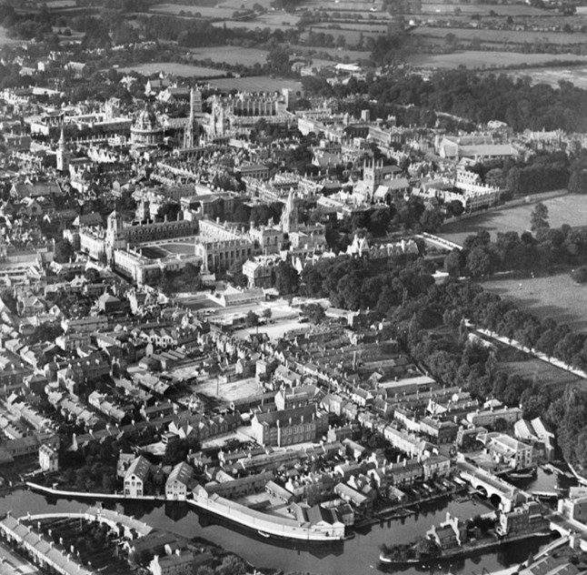
Bored with Teaching
After university, Mary taught maths but found it boring.
She wanted to learn and discover new things.
So, in 1928 she went back to Oxford to study for a doctorate (like a PhD).
Mary studied tricky maths using “imaginary numbers”.
These help solve problems ordinary numbers can’t.
Oxford in 1928
Notes:
Image: © Historic England https://historicengland.org.uk/images-books/archive/collections/aerial-photos/record/EPW022530 Aerial Photo - EPW022530
Teacher Notes
Mary became a teacher and taught at a number of girls’ boarding schools between 1923–1927.
She was soon bored: ‘I had to teach mathematics exactly in the way the senior mathematics mistress said’.
Therefore, she returned to the University of Oxford in 1928 to pursue a doctorate supervised by G.H.Hardy and E.C.Titchmarsh published in The Quarterly Journal of Mathematics in 1930.
Mary Cartwright studied a special kinds of maths that explores how one number can change another — even using imaginary numbers, which are numbers that help solve problems that normal numbers can’t: $i=\sqrt{−1}$

Slide 21
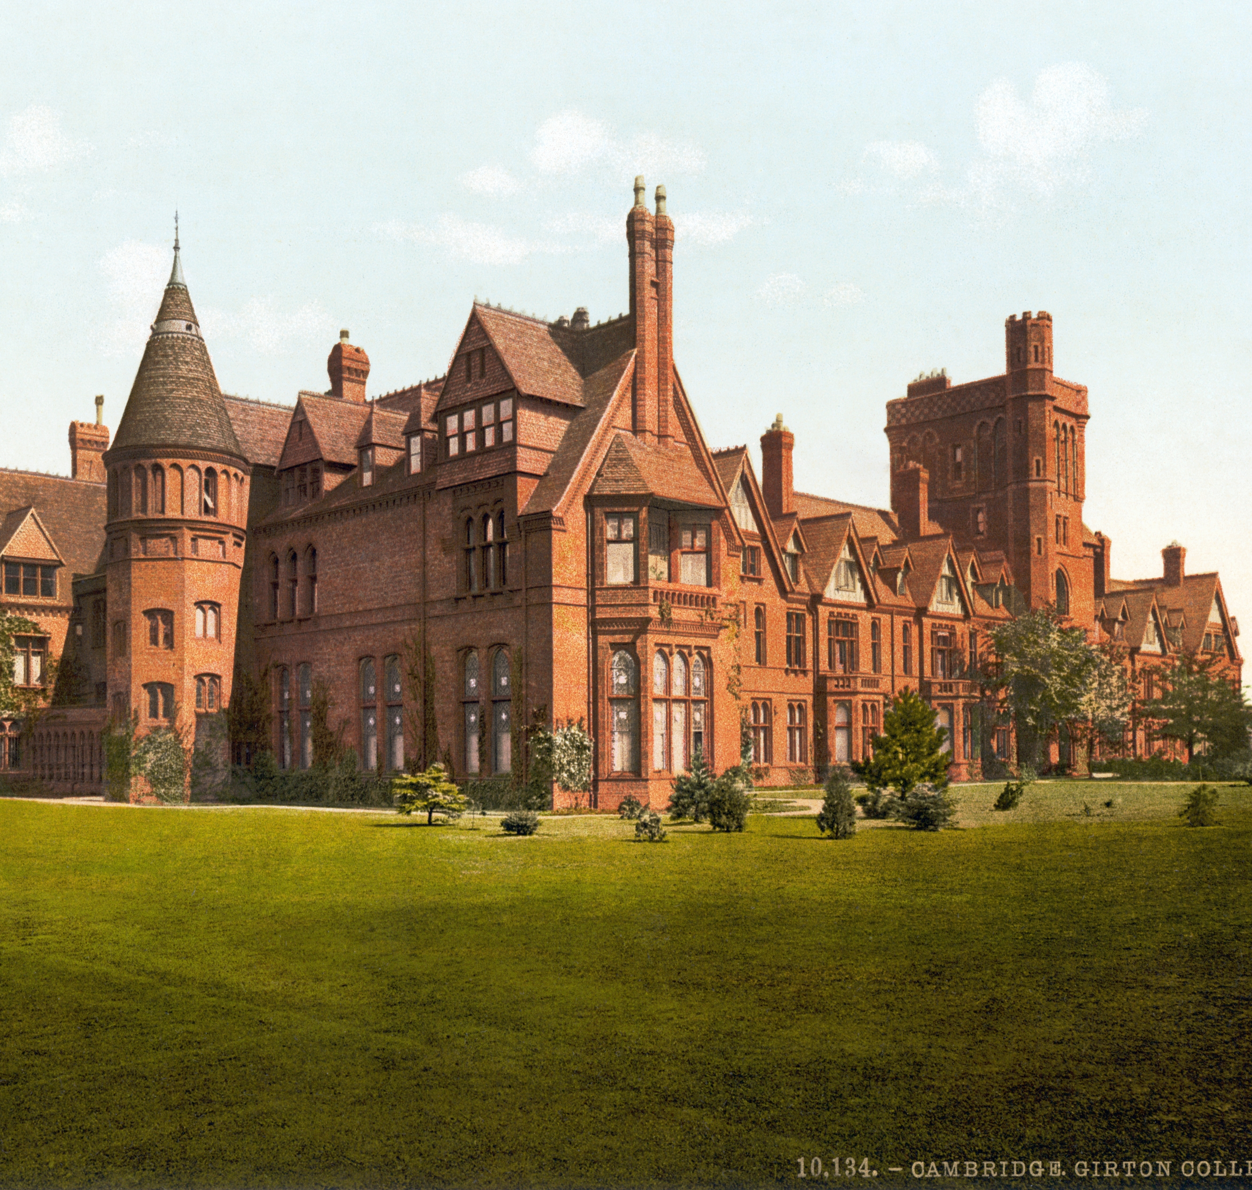
A big move to Cambridge
In 1930, Mary moved to Girton College in Cambridge.
She became a lecturer, then a leader for maths teaching.
It was a big step in her career.
Whilst here she solved important maths problems herself and worked out a useful rule (theorem) that made hard maths problems much easier for other people to solve too.
Girton College Cambridge
Notes:
Image: ©https://en.wikipedia.org/wiki/File:Girton_College,_Cambridge,_England,_1890s.jpg
Teacher Notes
In 1930, Mary Cartwright moved to Girton College in Cambridge to start a research job.
Over the next six years, she earned several promotions — she became a fellow of the college, the person in charge of maths teaching there, and also a lecturer at the university.
Mary Cartwright discovered her theorem regarding the maximum modulus of an analytic function in the early 1930s while working at Girton College, Cambridge. She solved an open problem posed by J.E. Littlewood regarding multivalent functions, with her findings published in 1935 and 1931

Slide 22
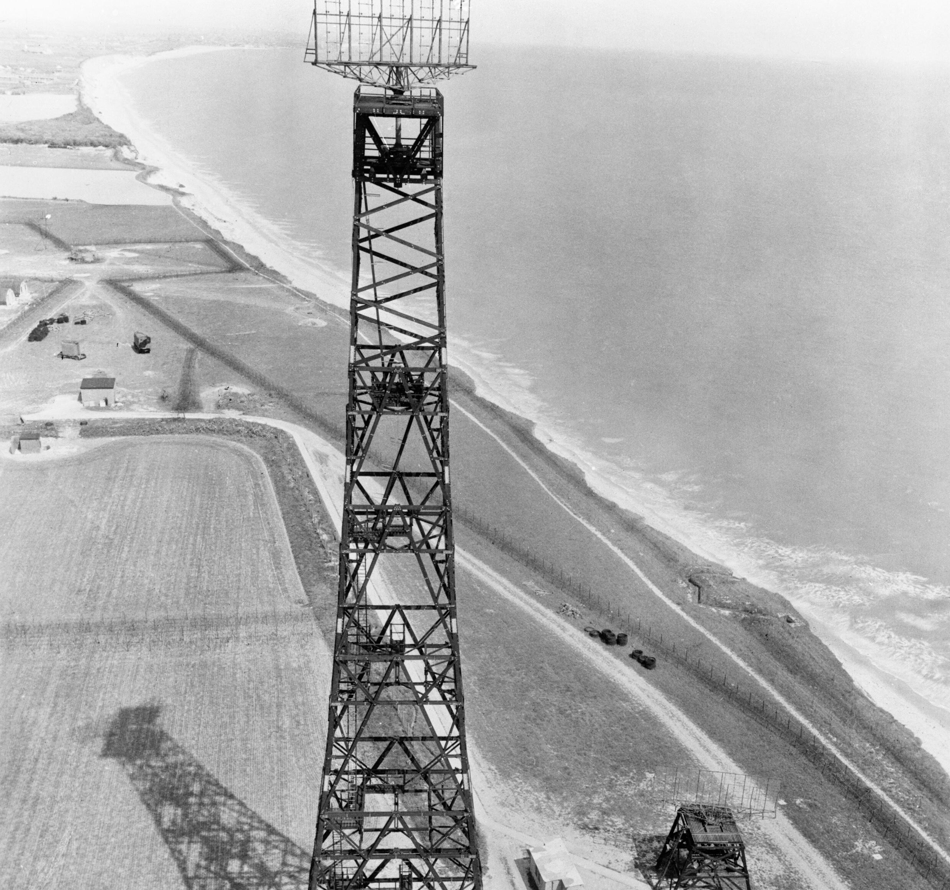
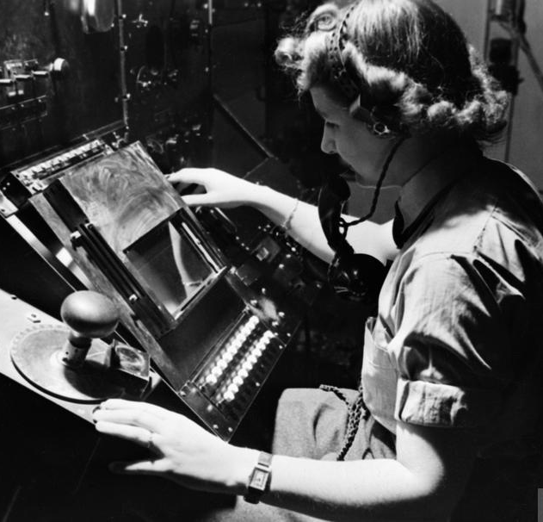
World War II - Radar
Chain Home Radar Station
During World War II, Mary helped with secret work on radar, which detects planes using radio waves.
Her research helped scientists understand why radar sometimes behaved unpredictably.
She was also commandant of the college’s Red Cross detachment and helped packing parachutes for men sent into enemy territory.
Female Radar Operator
Notes:
Image 1: © https://commons.wikimedia.org/wiki/File:The_Chain_Home_Low_radar_installation_at_Hopton-on-Sea,_1945._CH15183.jpg
Image 2: © https://www.iwm.org.uk/collections/item/object/205196699
Teacher Notes
During the Second World War, she was commandant of the college’s Red Cross detachment.
Like many staff and students at Cambridge, Mary undertook special war work for the Government and was bound by the Official Secrets Act.
She rarely spoke of her important scientific contributions. Even years later she said her most useful war work had been packing parachutes for men sent into enemy territory
During the Second World War, a vital new technology that used radio waves to detect enemy aircraft and ships – RADAR - had a problem.
Mary Cartwright and J. E. Littlewood investigated and discovered that as radio wave lengths got shorter, the waves became more unpredictable. This meant that the usual equations didn’t always work.
It would take many more years to solve the problem with Radar.

Slide 23
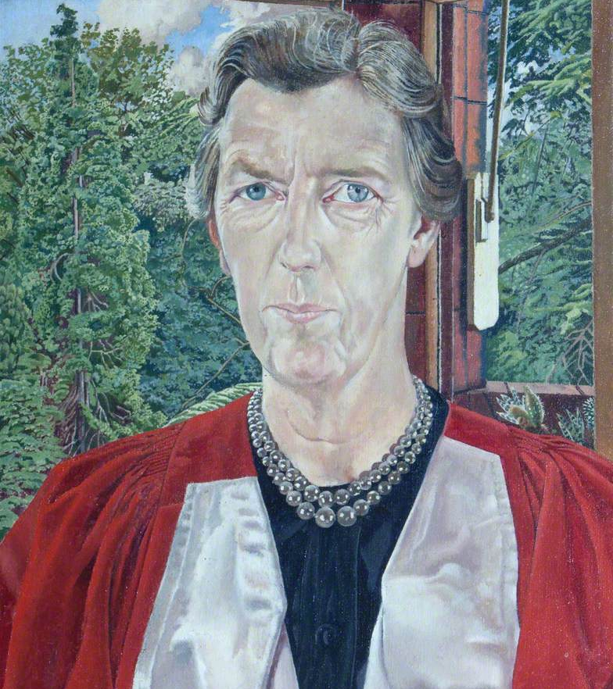
Head of Girton College
Reflection:
One student commented: ‘she was always there’.
What might that tell us about Mary?
In 1948, Mary became Mistress (Head) of Girton College.
She was known for working hard and caring about her students.
In 1956, famous artist Stanley Spencer painted her portrait.
She stayed as Mistress of the college for 20 years, until 1968.
Mary Lucy Cartwright 1958 by Stanley Spencer (1891–1959)
Notes:
Image: © © the estate of Stanley Spencer. All rights reserved / Bridgeman Images. Image credit: Girton College, University of Cambridge
https://artuk.org/discover/artworks/mary-lucy-cartwright-195239
Teacher Notes
In 1948, she was elected Mistress (Head) of Girton, remaining in post until 1968.
Mary was a careful and dutiful leader; she was a constant presence in Girton (‘she was always there’), known for her detailed management of college affairs.
In the 1950s, it caused some excitement in college when the artist Stanley Spencer (1891 1959) came to paint her portrait as Mistress.

Slide 24
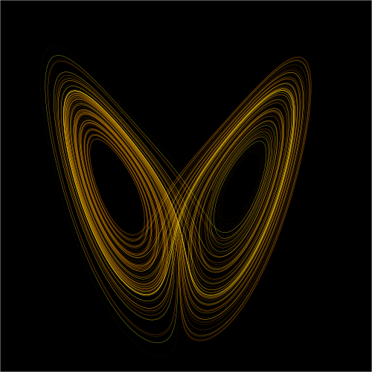
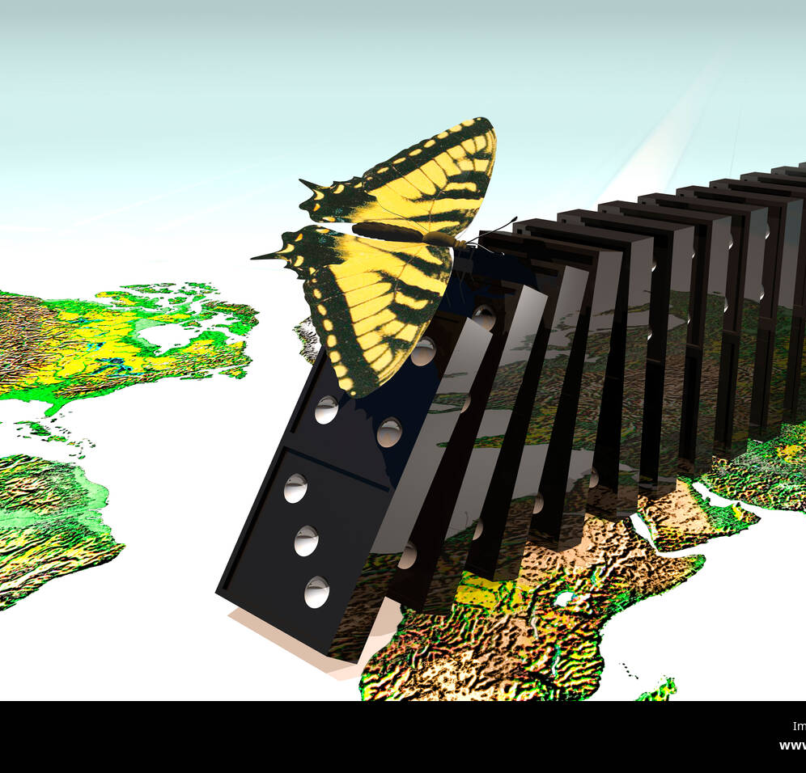
Chaos Theory and The Butterfly effect
Chaos Theory diagram
Mary’s maths helped other scientists discover chaos theory — how small changes can create big effects.
Example: a butterfly flapping its wings might lead to a storm much later!
Chaos theory helps scientists understand unpredictable events like the weather or traffic jams.
The Butterfly effect
Notes:
Image 1: © Wikimol, Dschwen - https://en.wikipedia.org/wiki/File:Lorenz_attractor_yb.svg
Image 2: © https://www.alamy.com/stock-photo-butterfly-effect-21439557.html
Link 1: https://youtu.be/mZv5xMIdaMo
Link 2: https://www.bbc.co.uk/reel/video/p0gn8kps
Teacher Notes
Although her work on unpredictable radio waves wasn’t recognised as a new field at the time, other scientists built on her ideas.
Stephen Smale created the horseshoe map, showing how simple actions like stretching and folding can lead to complex, unpredictable patterns.
This shows how chaos can come from simple actions. There is a really good explanation using bread dough!
Soon after, Edward Lorenz discovered the “butterfly effect” while running early weather simulations.
This idea shows that in some systems, tiny changes can lead to completely different results.
The Metaphor: A butterfly flapping its wings in one part of the world could theoretically trigger a chain of events that leads to a tornado weeks later in another part of the world.
It shows how chaos begins and turns messy behaviour into simple codes.
Weather changing quickly, sudden traffic jams, and swirling paint colours are all examples of simple things becoming chaotic.
It helps scientists and professionals' model unpredictable phenomena like weather, stock markets, and pandemics, allowing better risk assessment and understanding.

Slide 25
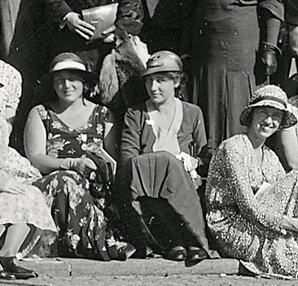
Global Recognition
Mary became famous around the world for her maths.
In 1947 Mary was elected a Fellow of the Royal Society, later becoming the first woman in their over 300-year history to serve on their Council of the Society.
She worked with scientists from other countries, including doing top secret work for the United States Navy in 1949.
She showed that women could reach the very top of science.
Mary Cartwright (far right) at the International Congress of Mathematicians in Zurich in 1932.
Notes:
Image: © Johannes Meiner, Public domain, via Wikimedia Commons - https://commons.wikimedia.org/wiki/File:Young_Skewes_Schieldrop_Tricomi_Cartwright_Zurich1932.tif?page=1
Teacher Notes:
Mary became famous around the world for her brilliant maths.
In 1949 she was asked to help with important maths projects for the United States Navy- an impressive achievement at the time, especially for a woman.
She travelled to many countries, including the USSR, for meetings and shared her ideas with other scientists, creating ‘a more international outlook among British mathematicians’.

Slide 26
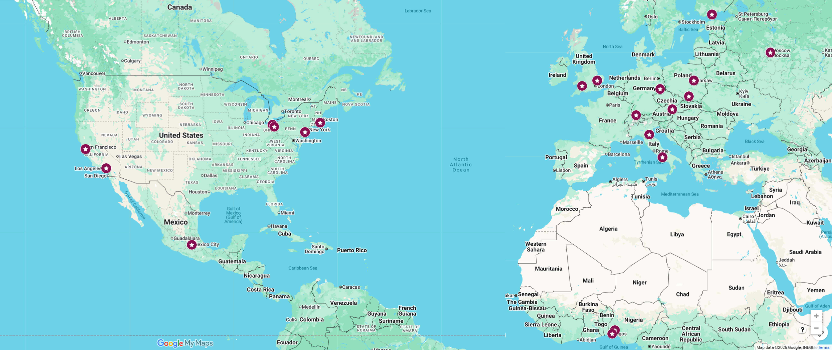
Global Travel
Mary’s dedication to maths meant she travelled to many countries

Slide 27
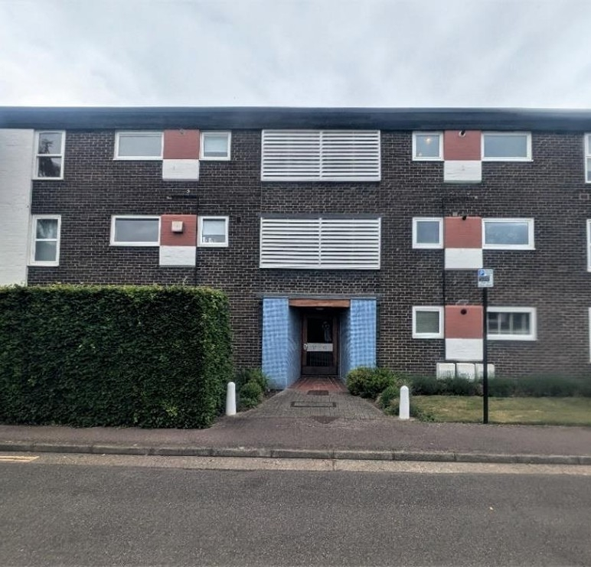
Later Life
Mary retired in 1968 but kept doing maths for fun.
In 1971 she moved into a flat at 38 Sherlock Close, Cambridge.
She was still doing maths research when she was in her 90s!
In 1995 she decided to move to a nursing home, Midfeld Lodge, where family members would visit.
She lived near Girton College until she died in 1998.
38 Sherlock Close
Notes:
Image: ©Historic England
Teacher Notes:
When Mary retired in 1968, she spent a few years teaching in different countries.
In the 1970s she moved into a flat in Cambridge and kept doing maths even when she wasn’t very well.
She stayed close to Girton College for the rest of her life and passed away in 1998.
When she felt she might become a burden to people in Sherlock Close, she decided to move to the nursing home at Midfeld Lodge, where a member of the family would visit her at least once a month

Slide 28
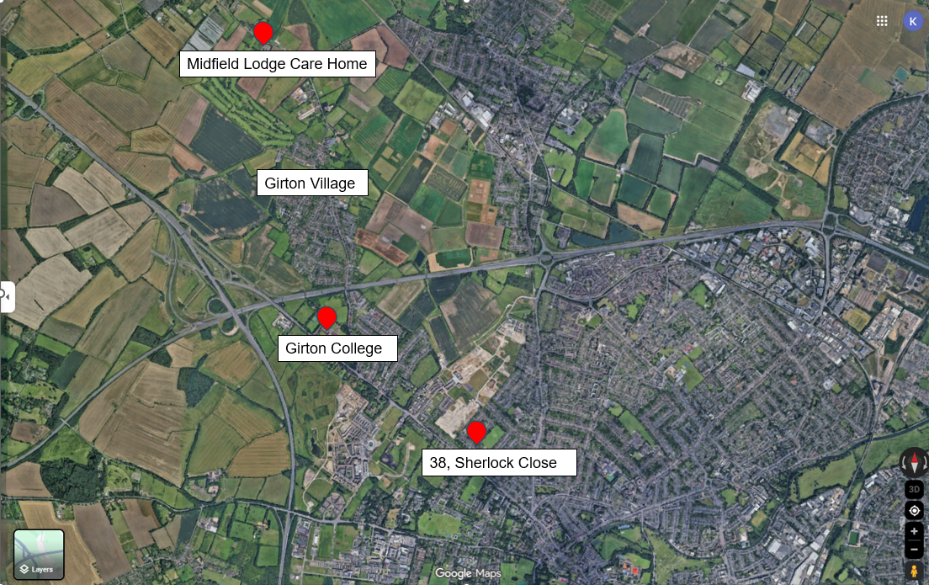
Mary’s Homes
Reflection:
Why do you think Mary lived either in or close to Girton College for the rest of her life?
(68 years in total)
Notes:
Image: https://www.google.com/maps/d/edit?mid=10TlGA7YJt_51CXzkzFgDXwIvzyI6fvI&usp=sharing

Slide 29
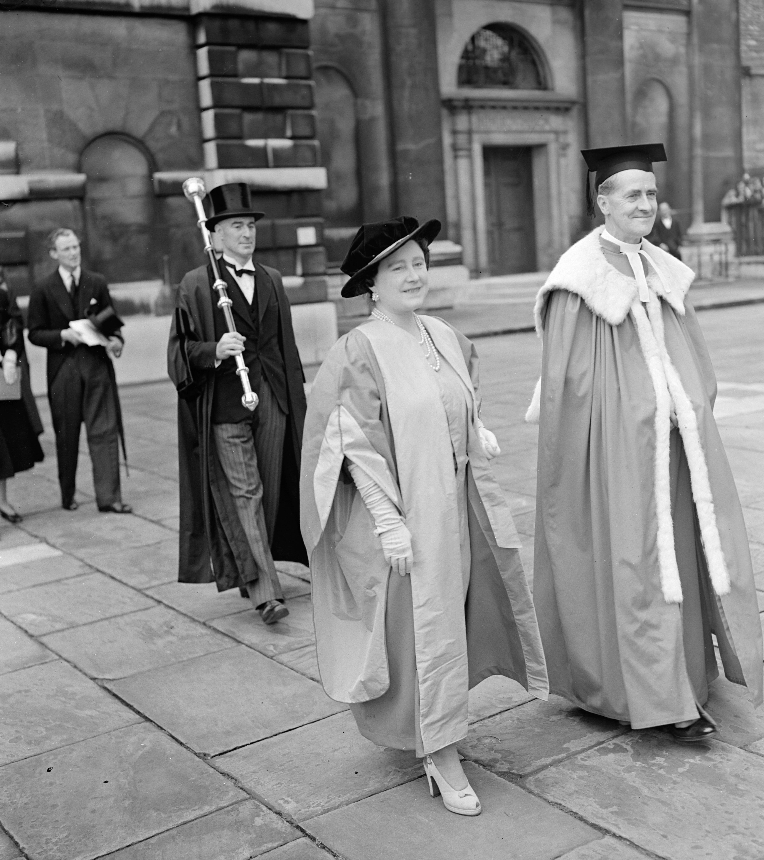
Barriers for Women
Mary faced unfair rules: women weren’t treated equally.
When she was young, women at Cambridge couldn’t even get degrees.
When she wanted to go to evening classes that went on until 11pm, Mary had to get special permission to be out after 11pm!
Mary helped change things by setting an example of what women could do.
In 1948 The Queen Mother (King Charles III‘s grandmother ) was the first woman to get a degree at Cambridge university
Notes:
Image: ©Alamy Ref: 2Y71RBT
https://www.alamy.com/queen-receives-honorary-degree-at-cambridge-university-her-majesty-the-queen-visited-cambridge-university-where-she-received-the-honorary-degree-of-doctor-of-law-the-conferring-of-the-degree-marks-the-initiation-of-the-new-status-of-women-in-the-university-picture-shows-hm-the-queen-and-vice-chard-in-the-procession-to-the-senate-prof-ceraven-house-cambridge-where-she-received-her-degree-october-21-1948-image623916156.html?imageid=07EE6D4C-B717-439A-9FFA-7188F0C907D2&pn=1&searchId=dadc49399b6f2ea3019bde0697014d96&searchtype=9
Teacher Notes:
Mary went to university at a time when few women did.
Maths was also a dominated by men.
Very few women managed to become a respected mathematician at the highest level
When she was older, Mary herself reflected that … ‘I regret to say that my impression when I began in research was that, in general, less qualified men were tolerated and employed quite a lot in the University of Cambridge, which eliminated some quite good women’.
Mary Cartwright was very hard-working and efficient.
As well as teaching, she had a lot of other responsibilities. She was the head of a college and a member of various university committees
This reduced her time for research and she believed this stopped her promotion to professor
Was she given more than her fair share of administrative work because she was a woman?
As mistress of Girton for twenty years (1948-1968), Mary saw women continue to fight for their place at the University of Cambridge.
In 1948, Cambridge awarded its first degree to a woman and Girton became an official Cambridge college.
Until 1972, only 2 out of 29 colleges accepted women – Girton and Newnham.
103 people are in the List of Cambridge mathematicians on Wikipedia. Some are very famous – Isaac Newton, Alan Turing and Stephen Hawking.
There is only ONE woman – Dame Mary Cartwright https://en.wikipedia.org/wiki/List_of_Cambridge_mathematicians

Slide 30
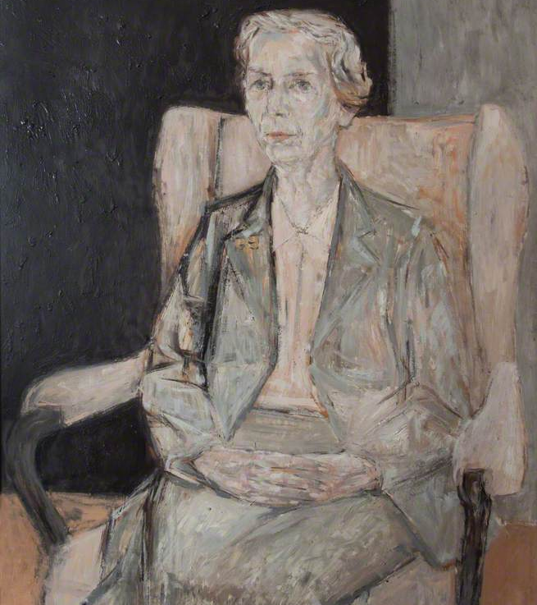
Recognition – ‘Firsts’
Mary was the:
First woman mathematician in the Royal Society and the first woman to serve on its council .
First woman President of the London Mathematical Society.
First woman to win some of the top maths medals.
First woman appointed to Septem Viri, a Cambridge University Court on all matters related to university staff.
Dame Mary Cartwright by Hans Schwarz
Notes:
Image: © the artist's estate. Image credit: Girton College, University of Cambridge https://artuk.org/discover/artworks/dame-mary-cartwright-195230
Teacher Notes:
Cartwright was recognised both during and after her lifetime.
She was the first woman mathematician to become a Fellow of the Royal Society (1947); the first woman to serve on its council (1955–57); and the first to receive its Sylvester Medal (1964).
She was also the first woman to act as President of the London Mathematical Society (1961–63), receiving its highest honour, the de Morgan Medal, in 1968.
Mary Cartwright was awarded honorary degrees from the Universities of Edinburgh, Leeds, Hull, Wales, Oxford, and Brown(USA).
In 1969, she was made a Dame Commander of the Order of the British Empire.
The London Mathematical Society holds a yearly Mary Cartwright Lecture in her honour.

Slide 31
Who Was Mary Cartwright?
Mary:
Was brilliant and determined, but she did not like to ‘blow her own trumpet’.
Loved learning, history, music, and painting.
Had a sharp sense of humour and didn’t like too much fuss.
Dame Mary Cartright
Notes:
ImageDame Mary Lucy Cartwright, by Elliott & Fry, bromide print, 1950, NPG x86637
Teacher Notes:
Mary Cartwright was known for getting straight to the point—whether in maths or everyday life.
She was interested in lots of things beyond mathematics, including history, painting and music.
People who knew her said she had a sharp, witty sense of humour, even in her 90s.
She did not like to ‘blow her own trumpet’ and said there were to be no eulogies* at her funeral *A eulogy is a speech given at a funeral or memorial service that praises and celebrates the life of the person

Slide 32
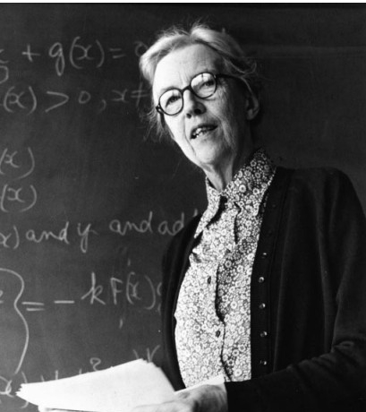
Why She Matters
Mary Cartwright ‘opened doors’ and ‘paved the way’ for future women in maths.
Her work led to ideas scientists still use today.
She proved that with hard work, anything is possible.
Dame Mary Cartwright
Notes:
Image: https://mathshistory.st-andrews.ac.uk/LMS/cartwright_lms_obit.pdf
Teacher Notes:
In the 1930s, Mary and E. F. Collingwood discovered new ideas about how certain maths patterns behave.
In World War Two, Mary Cartwright and J.E. Littlewood solved the problems with radar
Her work on how things move and behave in unpredictable ways was groundbreaking.
Mary didn’t stop doing amazing maths as she got older.
She wrote a book about her mathematical work and in 1959,
She received obituaries in national newspapers the recognised her brilliance as a mathematician, and as one of the founders of the important field of chaos theory.
The Daily Telegraph described her as ‘one of the most eminent British mathematicians of the [twentieth] century’.
The Guardian hailed her as an inspiration to generations of women

Slide 33
What makes Mary Cartwright significant?
Sort the cards that follow into two piles
Pick your top 3 (or 5) and put them into a diagram to show which you think were the most important
Contributions to mathematics and science | A female pioneer

Slide 34
Cards to print out
RADAR During World War II, Mary and J. E. Littlewood studied radar systems used to detect enemy ships and planes. They discovered that shorter radio waves became unpredictable — and proved it was a maths problem, not broken equipment causing issues. Engineers used their findings to fix the issues and make radar better. | Chaos Theory Mary and J.E. Littlewood, discovered that tiny changes can cause big, surprising results - an idea now called the butterfly effect. Their work influenced later mathematicians who developed the Chaos Theory into an important part of Maths and Science used in Weather prediction, the Stock market and Medicine. | Cartwright's Theorem: Mary solved a very tricky maths problem now called Cartwright’s Theorem. It helps mathematicians understand how certain number patterns behave. And is very important in advanced mathematics.
The first female mathematician elected as a Fellow of the Royal Society: (1947) and the first woman to serve on its Council. | The first woman to receive the Sylvester Medal (1964) and the De Morgan Medal (1968). | The first woman to obtain a first-class degree in mathematics from Oxford University (1923).
Leadership: Served as the first female President of the London Mathematical Society (1961–1963). | As Mistress of Girton College, Cambridge (1949–1968), she was a prominent leader and mathematician, navigating a male-dominated field. | The first woman appointed to Septem Viri, a Cambridge University Court on all matters related to University staff.

Slide 35
Mary Cartwright’s achievements
Contributions to mathematics and science | A female pioneer
Cartwright's Theorem: Mary solved a very tricky maths problem now called Cartwright’s Theorem. It helps mathematicians understand how certain number patterns behave. And is very important in advanced mathematics. RADAR: During World War II, Mary and J. E. Littlewood studied radar systems used to detect enemy ships and planes. They discovered that shorter radio waves became unpredictable — and proved it was a maths problem, not broken equipment causing issues. Engineers used their findings to fix the issues and make radar better. Chaos Theory: Mary and J.E. Littlewood, discovered that tiny changes can cause big, surprising results - an idea now called the butterfly effect. Their work influenced later mathematicians who developed the Chaos Theory into an important part of Maths and Science used in Weather prediction, the Stock market and Medicine. | Oxford University: The first woman to obtain a first-class degree in mathematics (1923). The Royal Society: The first female mathematician elected as a Fellow (1947) and the first woman to serve on its Council. Academic Leadership: As Mistress of Girton College, Cambridge (1949–1968), she was a prominent leader and mathematician, navigating a male-dominated field Leadership: Served as the first female President of the London Mathematical Society (1961–1963) and as the Mistress of Girton College, Cambridge, for nearly 20 years. Major Medals: The first woman to receive the Sylvester Medal (1964) and the De Morgan Medal (1968). Septem Viri: The first woman appointed to a Cambridge University Court on all matters related to University staff.

Slide 36

Think back to what makes a person significant?
Did they:
make big changes in their lifetime?
make a lot of people’s lives better or worse?
change the way people think about something?
have a lasting impact on their locality, the country or the world?
set a really good/bad example to people about how to live and behave?
Why might we describe Mary Cartwright as a significant person?

Slide 37

How do we remember and celebrate significant people?

Slide 38
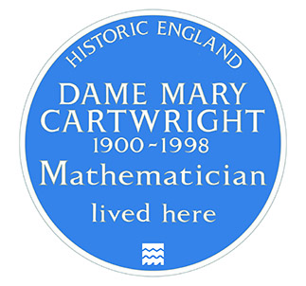
A Blue Plaque to Mary Cartwright
Mary’s plaque
We have learnt why Mary Cartwright and 38 Sherlock Close, are historically significant.
What is a blue plaque?
Blue plaques are placed on buildings connected to significant people. Until 2024 there was an “official” Blue Plaque Scheme, which ran in London. Local councils and organisations also ran their own schemes. In Feb 2024 Historic England took responsibility for a national blue plaque scheme. Their plan is to place blue plaques across the country to celebrate “people throughout history who have made significant and positive contributions to human welfare or happiness.”
Mary
Notes:
Image: © Historic England
Image: © National Portrait Gallery, London - Dame Mary Lucy Cartwright by Walter Stoneman, half-plate glass negative, May 1947, NPG x188708

Slide 39
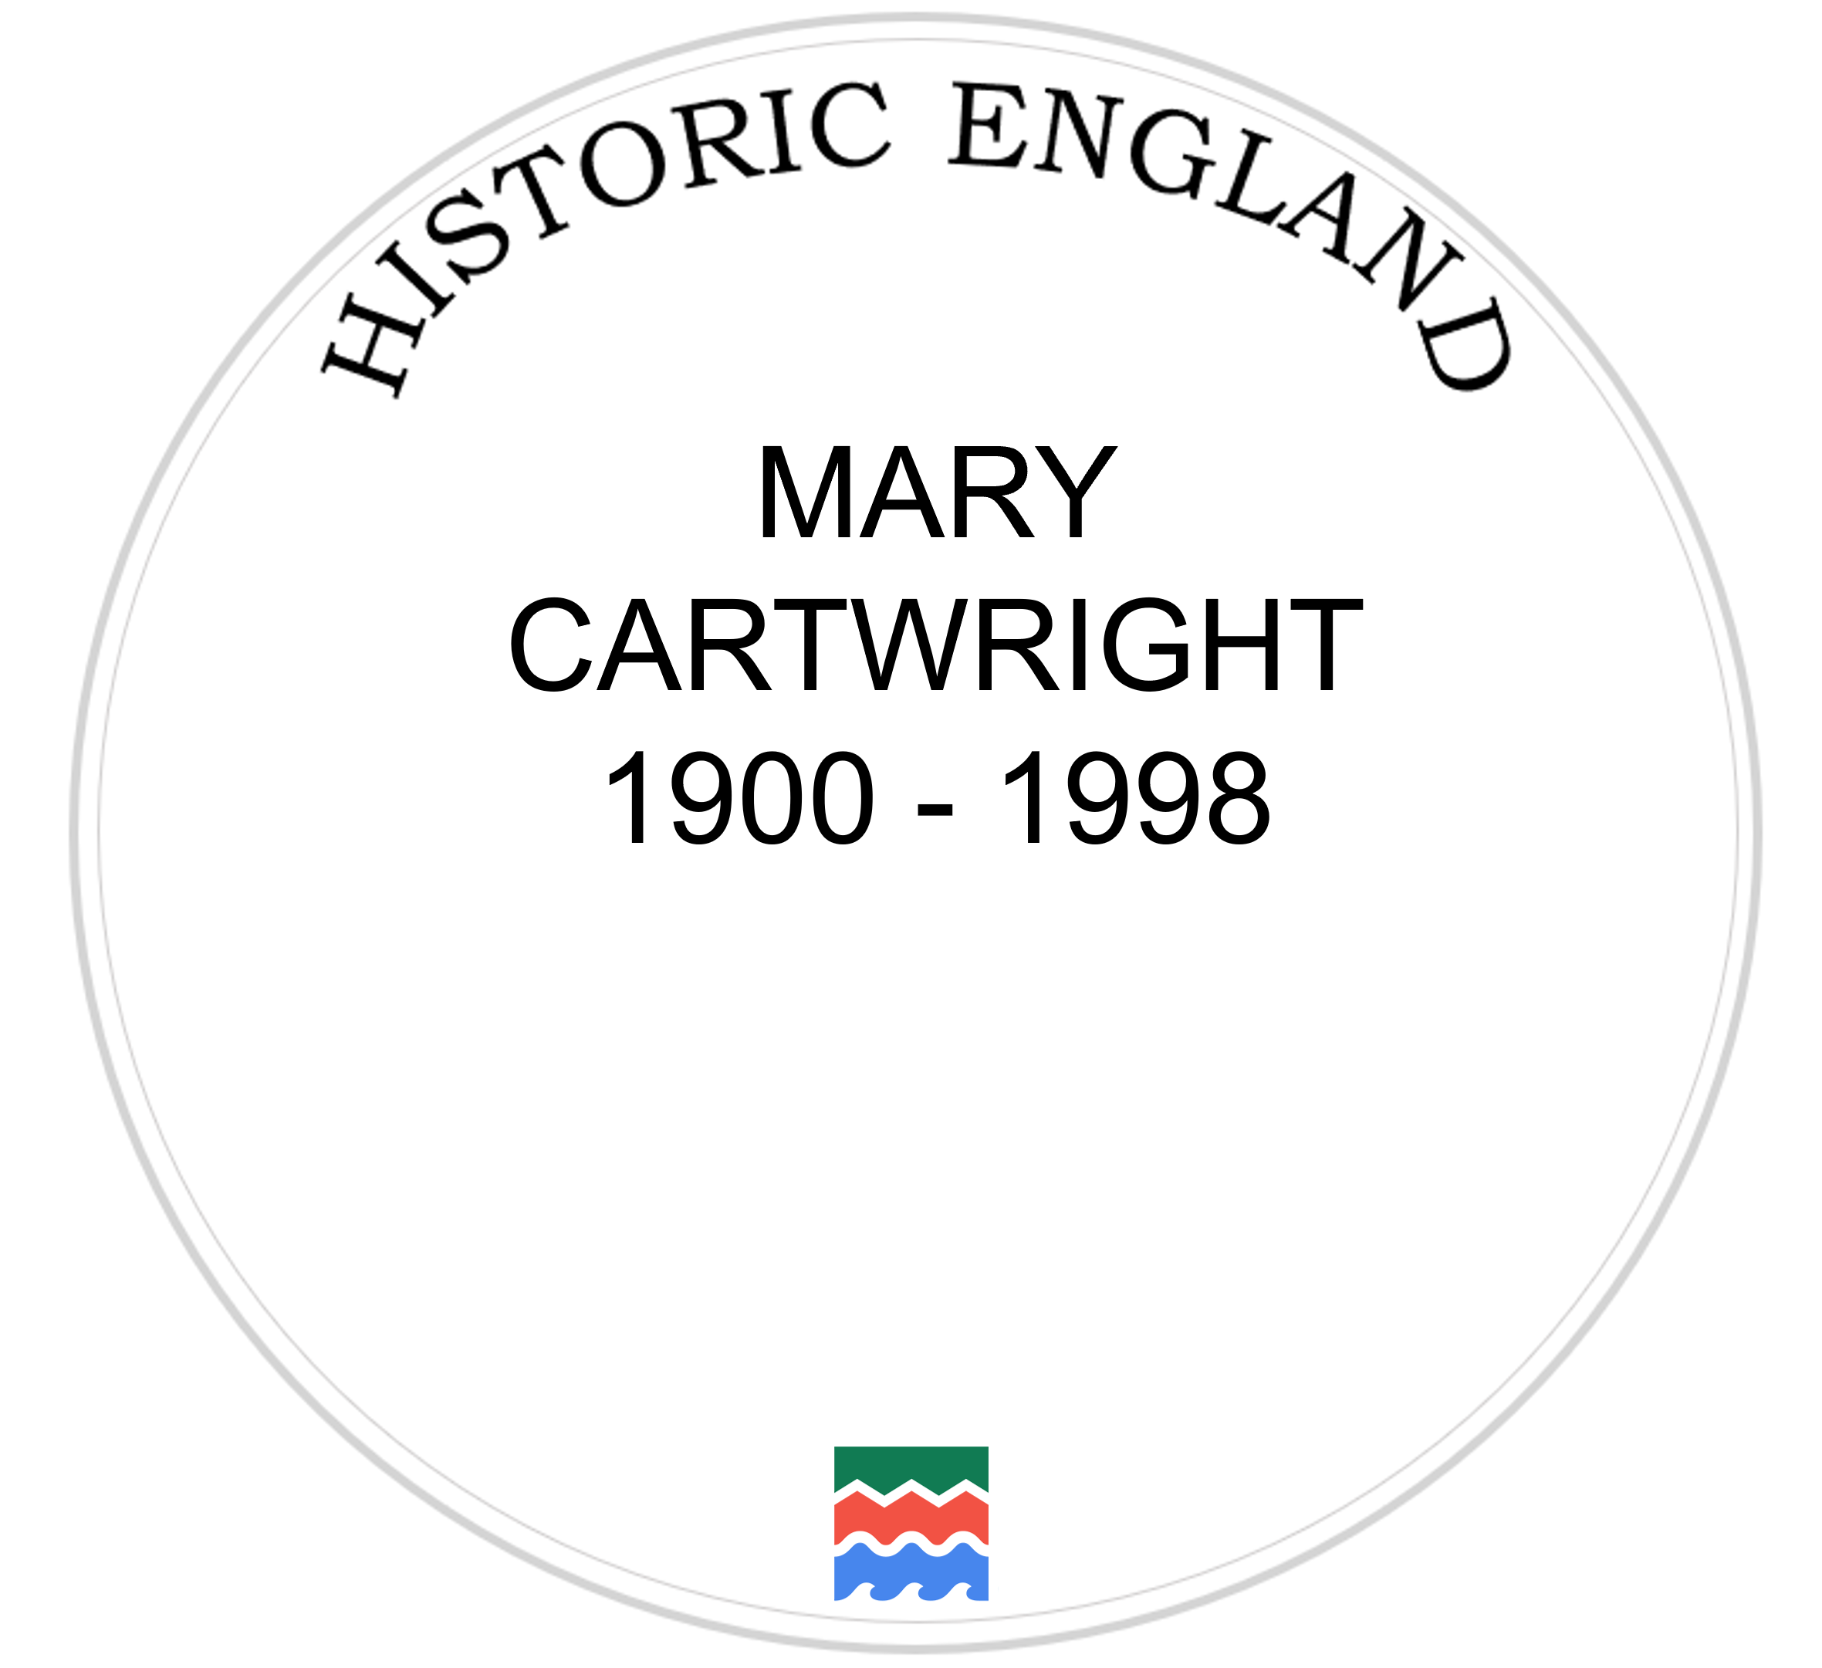

Your Task
On the template you have been given, design your own plaque celebrating why Mary Cartwright is such a significant person. Make sure you….
1) Complete the sentence:
Mary Cartwright is significant because….
You might like to write one or a couple of sentences.
Write
2) Draw a picture to illustrate your plaque. You might like to draw the inside or outside of one of the places using the descriptions from the previous slides for inspiration!
Draw

Slide 40

George Harrison Plaque
MARY
CARTWRIGHT
1900 - 1998

