Slide 1
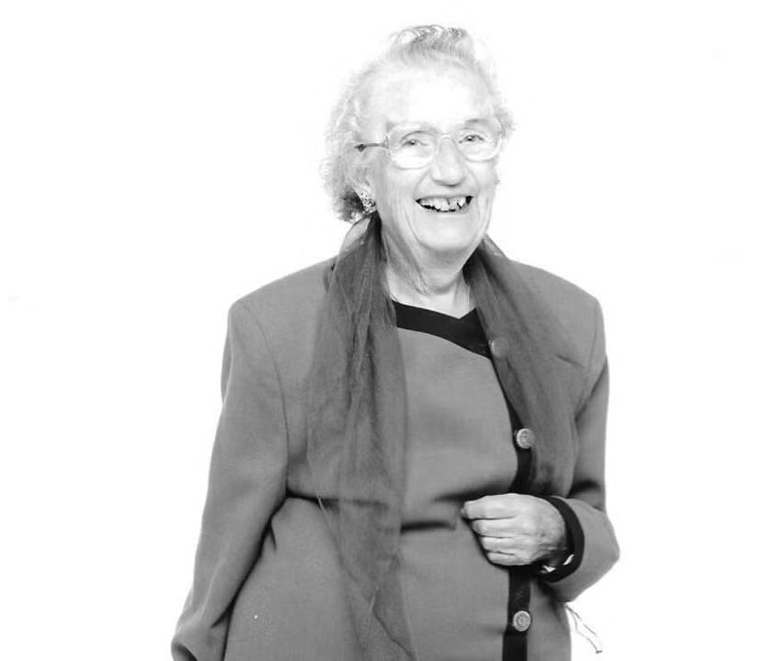
How can we celebrate significant, local people and places: Cary Grant
How can we celebrate significant, local people and places: Judy Fryd, 8 Westfield Avenue, Harpenden.
Notes:
Image: Judy Fryd © MENCAP

Slide 2
How can we celebrate significant, local people and places: Judy Fryd, 8 Westfield Avenue, Harpenden
Key Stage 2
To learn about significant historical events, people and places in their own locality
To study an aspect of history dating from a period beyond 1066 that is significant in the locality
To understand historical concepts such as significance, and to make connections and draw contrasts with previous learning
To understand the methods of historical enquiry, including how evidence is used rigorously to make historical claims

Slide 3
How to use this PPT
How to use this PPT
Contents
Pupils will start by thinking about criteria we can use to decide if someone is significant.
They will then use a building to start their enquiry in to Judy Fryd, building on this with a range of additional historical sources to help them answer the question: What makes Judy Fryd a significant person?
As a final task they will design their own plaques to Judy Fryd.
What makes a person significant?
How can we find out about local significant people?
What can a building tell us?
Meet Judy Fryd & her family
A campaign for change
What makes Judy Fryd a significant person?
A Blue Plaque for Judy Fryd
Task – Design a Blue Plaque

Slide 4


What makes a person significant?
Consider
Questions to ask about a person.
Did they:
make big changes in their lifetime?
make a lot of people’s lives better or worse?
change the way people think about something?
have a lasting impact on their locality, the country or the world?
set a really good/bad example to people about how to live and behave?

Slide 5







How can we find out about local significant people?
Speak
Ask people who might know about them
Use books and the internet to research them
Research
Investigate
Find buildings and places connected to them
Who is local to me?

Slide 6


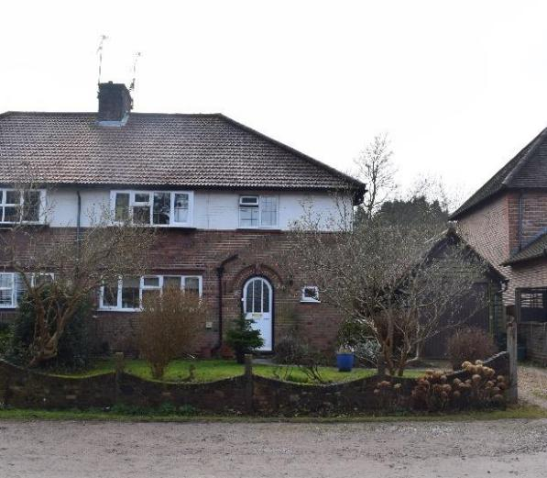
8 Westfield Avenue, Harpenden 1
Investigate
This is 8 Westfield Avenue, Harpenden.
It is connected to Judy Fryd; our local, significant person.
Find Westfield Avenue on Google Maps.
How many miles away is it from your school?
How long would it take you to walk or drive?
Would you say this building is local to your school?
8 Westfield Avenue, Harpenden
Notes:
Image: 8 Westfield Avenue, Harpenden © Historic England

Slide 7

What can a building tell us?
History detectives!
Complete the inference grid on the next page to explore what this building can tell you…..

Slide 8



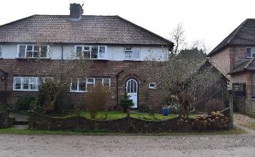
Inference chart
(I think….because)
Notes:
Image: 8 Westfield Avenue, Harpenden © Historic England

Slide 9
Inference chart – print version
Notes:
Image: 8 Westfield Avenue, Harpenden © Historic England

Slide 10
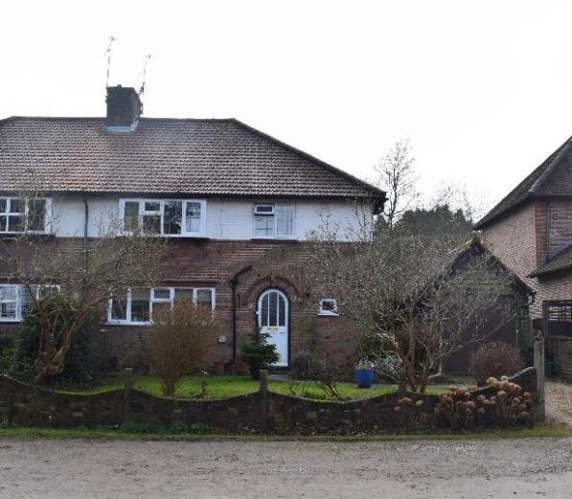

8 Westfield Avenue, Harpenden 2
8 Westfield Avenue looks like an ordinary semi-detached house, on an ordinary street.
But it is actually very special….
Semi-detached: One of two houses joined together as a pair.
8 Westfield Avenue, Harpenden
Notes:
Image: 8 Westfield Avenue, Harpenden © Historic England

Slide 11
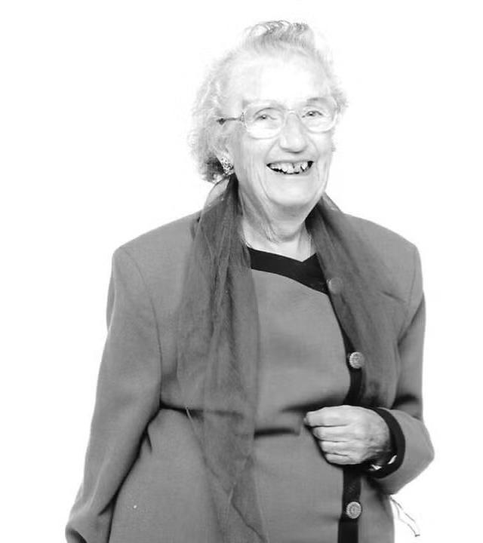
Meet Judy Fryd
The lady in the picture is called Judy Fryd.
As part of this enquiry, we’ll find out what she did and why she might be considered to be a significant person.
Notes:
Image: Judy Fryd © MENCAP

Slide 12
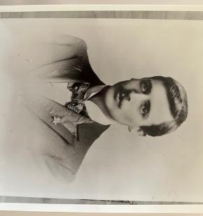

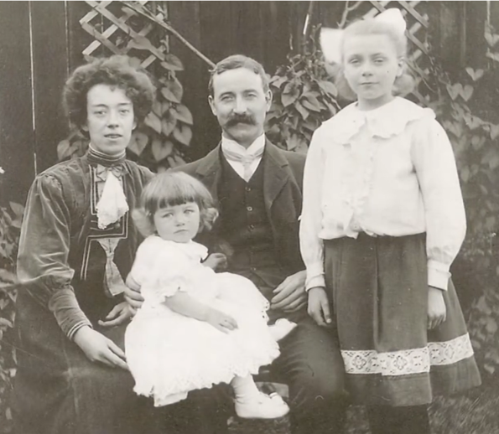
Judy Fryd - Childhood
Judy was born on 31 October 1909 in London.
Her full name was Caroline Joyce Manning, but she later chose Judy as her nickname.
She had an older half-sister, Annie & later a younger brother, Richard, born in 1912.
Her father was a letter sorter at the General Post Office.
ACTIVITY:
Can you use the dates Judy and Richard were born to work out roughly when this photo was taken?
Judy her with mum, dad & half-sister Annie
Notes:
Image: Fryd Family

Slide 13
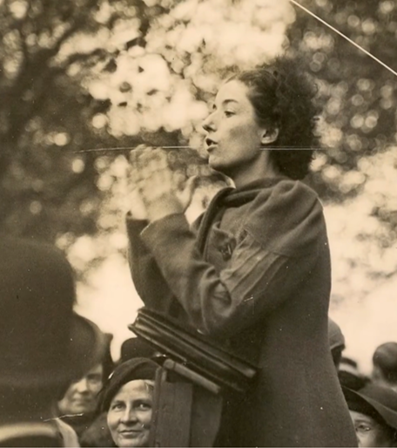
Judy Fryd – Early life
When she was a teenager, she was interested in politics and joined a youth group for the Labour Party.
After school, Judy worked as a secretary.
She joined a union, speaking on a soapbox at Speakers’ Corner in Hyde Park about secretarial work and women in the labour force – campaigning to make things better and fairer.
ACTIVITY:
Even today people can still go to Speakers’ Corner to express their views on a topic they’re passionate about.
What would you speak about?
Judy at Speakers’ Corner
Notes:
Image: Fryd Family

Slide 14
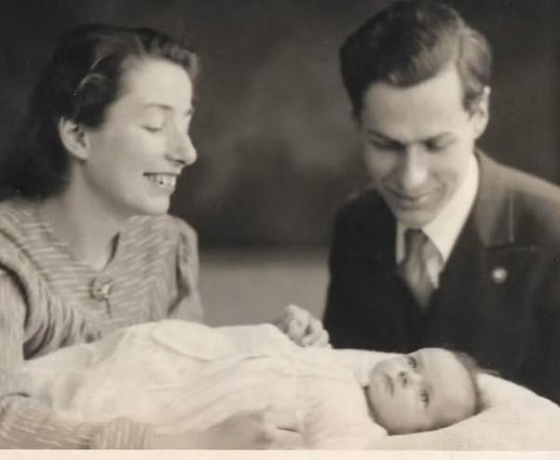
Judy Fryd – Marriage & family
Judy then went to study economics and political science at Ruskin Hall (now Ruskin College) in Oxford.
She met fellow student John Fryd at Ruskin Hall, and they married in 1936 in London.
Their first child, Felicity (‘Filly’), was born in 1938, then Patricia (‘Pat’) in 1940, Peter in 1942 & Linda in 1945.
Judy, John & baby Filly
Notes:
Image: Fryd Family

Slide 15
8 Westfield Avenue, Harpenden 3
In 1941 Judy and her family moved to 8 Westfield Avenue, Harpenden.
Filly was now 3 and though she’d learned lots of words, Judy noticed that she didn’t use them like other children.
She didn’t talk, ask questions, or share information. Filly became quiet and shy.
8 Westfield Avenue, Harpenden
Notes:
Image: Fryd Family

Slide 16
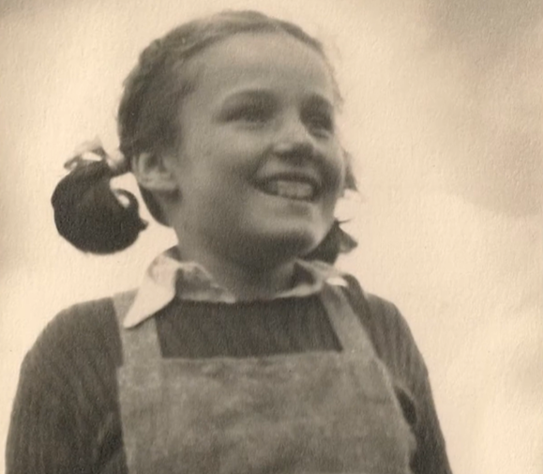
Filly’s early life
Her mum took her to doctors, but they did not understand her well.
One test said she wasn’t smart, but her mum knew she was. At the time, schools didn’t know how to support children like Filly.
Judy read everything she could to try to understand and help Filly.
Filly at approximately 8 years old
Notes:
Image: Filly at around 8 years old - Fryd Family

Slide 17
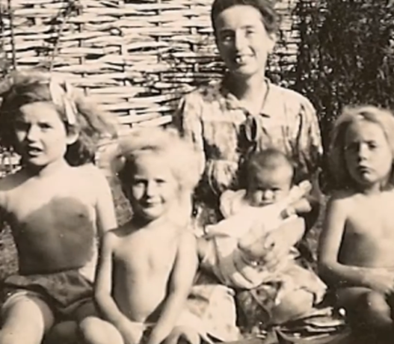
Judy’s campaign for change – Nursey World Letter
Judy read a letter in a magazine called ‘Nursery World’. It asked mums to share their dreams and hobbies.
She wrote back, saying she liked politics and wanted to help her community.
She talked about how hard it was to balance this with caring for a child with learning needs.
ACTIVITY:
Could you write a letter sharing your dreams or hobbies with other children?
Judy and her four children
Notes:
Image: Fryd Family

Slide 18

Judy’s campaign for change – A group for parents
Another mum suggested parents should work together to help each other.
Judy loved the idea and started a group for parents.
She led the group, and she later wrote its first newsletter, calling out for other readers and parents to contact her.
ACTIVITY:
Do you know of any other ways people have campaigned for change to make the world a fairer place?
A person typing a newsletter
Notes:
Image: Extract from Nursery World in 1946

Slide 19
Judy’s campaign for change – A growing group
At first, the association was small and run by Judy from her home in Harpenden.
It helped families feel supported and fought for practical help for children with learning disabilities.
The group grew, adding new branches in different areas. The newsletter, became The Parents’ Voice.
8 Westfield Avenue, Harpenden
Notes:
Image: 8 Westfield Avenue, Harpenden © Historic England

Slide 20
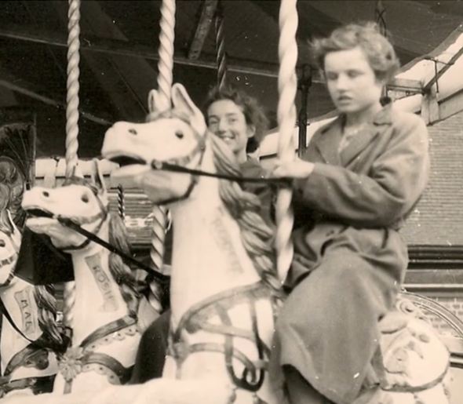
Judy’s campaign for change – Filly’s childhood
Judy kept teaching Filly at home. She could read, write a little and do some maths.
However, what she really loved was music and dancing! She had a beautiful voice and would twirl around as her mum played the piano.
Sadly, Filly sometimes did risky things, and at the age of 12 she had to go into a special residential hospital.
ACTIVITY:
What different ways do you use to express yourself?
Filly on a fairground ride
Notes:
Image: Fryd Family

Slide 21
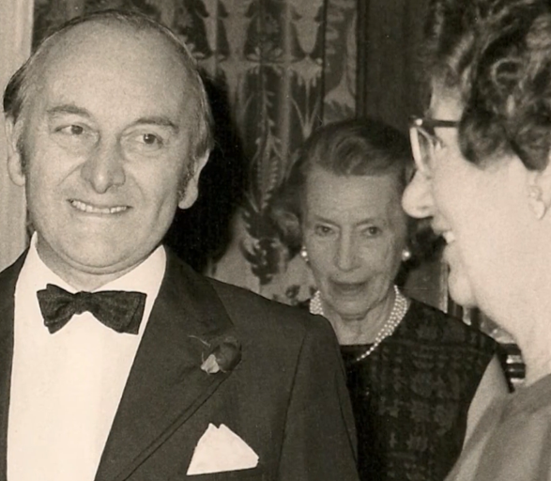
Judy’s campaign for change – A change of name
By 1953, the association had around 7,000 members and thirty branches.
It had become a national association with supporters all over the country.
Judy travelled around the country, visiting new branches and talking at conferences to help raise awareness.
Judy campaigning
Notes:
Image: Fryd Family

Slide 22
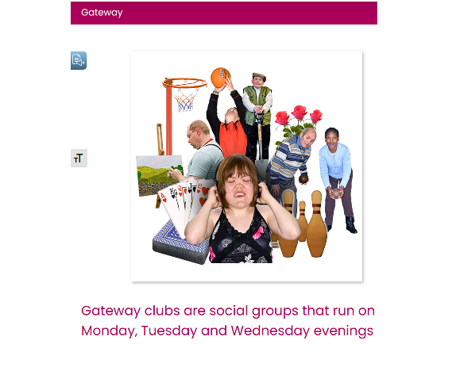
Judy’s campaign for change – Helping adults too
In 1958, a study showed children learned better in a home-like place rather than in a hospital.
In 1963, the society opened a centre to train adults with learning disabilities, helping them get jobs.
By 1966, the society had 30,000 members and started ‘Gateway’ clubs for sports and fun activities for over 18s too.
ACTIVITY:
Who or what would you like to create a new club for?
Gateway clubs still run today
Notes:
Image: Screenshot for Sheffield Mencap website

Slide 23

Judy’s campaign for change – more names
By 1969 people had started calling the society ‘Mencap’.
In 1981 it got royal support and from the 1990s onwards the society made sure people with learning disabilities were fully involved in how it was run.
Judy died in 2000 and in 2002 the society officially became the Royal Mencap Society.
Notes:
Image: Mencap logo

Slide 24
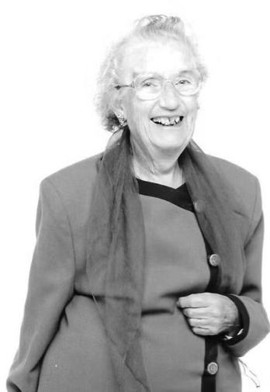
Judy’s campaign for change – summary
1946 – founded a society to help people with learning disabled (LD) children
1950 – started a newsletter to help other parents of LD children
1958 – proved LD children learned better in a home-like setting
1963 – the society started supporting LD adults to get jobs
1966 – involved in helping LD adults and setting up Gateway clubs
1970 – involved in a new law which meant all LD children had the right to go to school by changing national attitudes to LD children
1980s – a new law so all LD young people had a right to Higher Education
1990s – two new laws guaranteeing the rights of all LD people
Notes:
Image: Judy Fryd © MENCAP

Slide 25
Judy’s campaign for change – A legacy
Judy lived at the same house in Harpenden for nearly 60 years!
Everything she did to help people with learning disabilities was done whilst she lived there.
She was an important part of her local community, as well as carrying out her national activities.
8 Westfield Avenue, Harpenden
Notes:
Image: 8 Westfield Avenue, Harpenden © Historic England

Slide 26
What makes a person significant? - revisit
ACTIVITY:
Look again at the 5 criteria.
Was Judy a significant person?
Questions to ask about a person.
Did they:
make big changes in their lifetime?
make a lot of people’s lives better or worse?
change the way people think about something?
have a lasting impact on their locality, the country or the world?
set a really good/bad example to people about how to live and behave?

Slide 27
What makes a person significant? 2
Judy made a big change by …………………………………………………………………………...
Judy made a lot of people’s lives better by ……………………………………………………………………………
Judy changed the way people thought about ……………………………………………………………………………
Judy had a lasting impact on her locality, country or the world by ……………………………………………………………………………
Judy set a really good example about how to live and behave by …………………………………………………………………………….

Slide 28
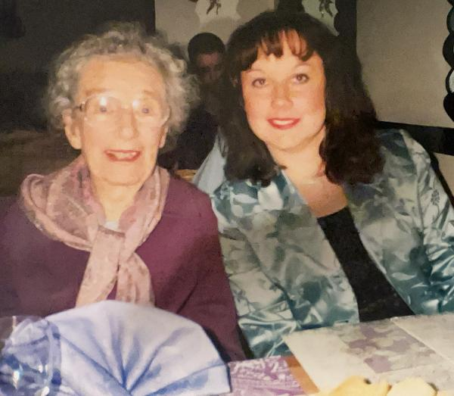
What makes Judy Fryd a significant person?
She started the worlds first support group for parents of children with learning disabilities
She promoted the use of scientific methods to help understand and prove how best to help children with learning disabilities
She spent more than 50 years trying to improve the lives of people with learning disabilities
Judy and her granddaughter
Notes:
Image: Fryd Family

Slide 29
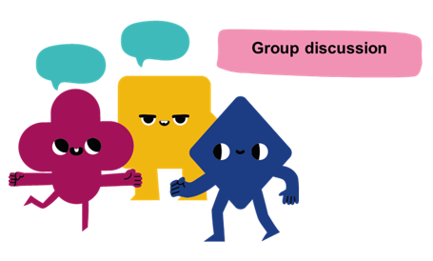
How do we remember and celebrate significant people?

Slide 30
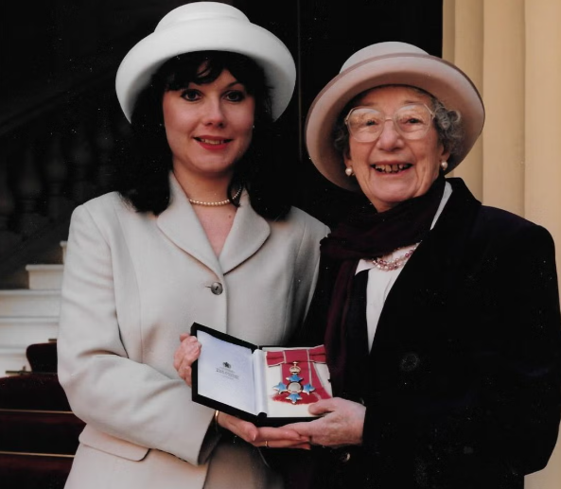
Recognition – Orders of Merit
In 1967, she was given an MBE, a special award from the King or Queen for doing amazing work to help her community and country.
In 1996, for her continuing her outstanding work, it was upgraded to a CBE – the highest of the three orders.
Judy Fryd collecting her CBE with her granddaughter Elly Downes
Notes:
Image: Fryd Family

Slide 31
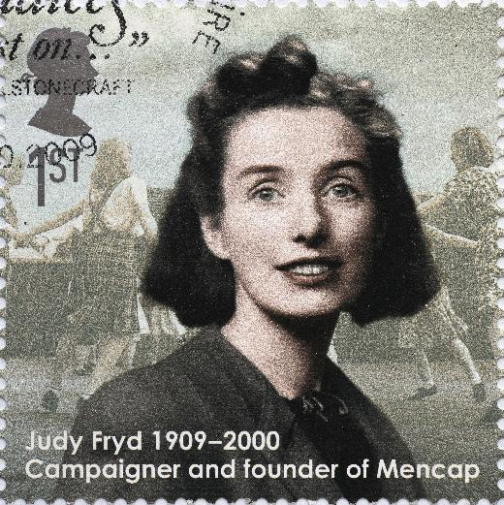
Recognition – Postage Stamp
In 2009 the Royal Mail issued a stamp to honour Judy Fryd.
It recognized her efforts in challenging societal prejudice and improving education for children with learning disabilities.
It was part of a set called "Eminent Britons“, which honoured 10 people.
She was one of only two women selected.
Notes:
Image: Royal Mail Postage Stamp © Alamy Ref: 2RXC6TD

Slide 32
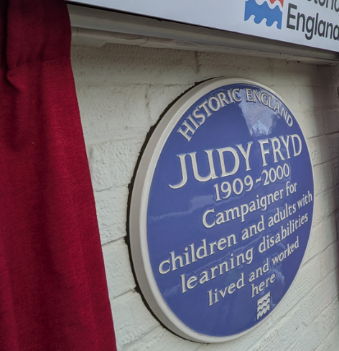
A national blue plaque to Judy Fryd
We have learnt all about why Judy Fryd, and 8 Westfield Avenue, are historically significant. To celebrate and mark Judy Fryd, on 6 March 2026, a national blue plaque was unveiled on outside 8 Westfield Avenue.
What is a national blue plaque?
National blue plaques are placed on buildings connected to significant people. Until 2024 there was an “official” blue plaque scheme, which ran in London. Local councils and organisations also ran their own schemes. In February 2024, Historic England took responsibility for a national blue plaque scheme. Their plan is to place blue plaques across the country to celebrate “people throughout history who have made significant and positive contributions to human welfare or happiness.”
Judy’s plaque
Notes:
Image 1: Blue Plaue. © Historic England

Slide 33
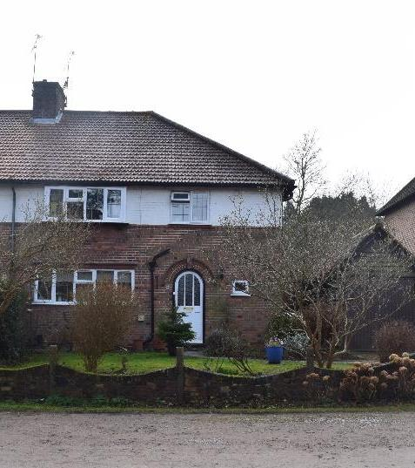

Why 8 Westfield Avenue?2
The national blue plaque on the external wall of 8 Westfield Avenue is only the 8th blue plaque to be placed as part of Historic England’s new scheme!
Historic England say that national blue plaques should be placed on buildings that “have had a significant influence in forming a person’s character or shaping their activities”.
Think
Why might you say that 8 Westfield Avenue meets that description?
Notes:
Image: 8 Westfield Avenue, Harpenden © Historic England

Slide 34


Your Task – Part 1
On the template you have been given, design your own plaque celebrating why Judy Fryd is such a significant person. Make sure you….
Judy
Fryd
1909 - 2000
Complete the sentence:
Judy Fryd is significant because….
You might like to write one or a couple of sentences.
Write
Notes:
Image: © Historic England

Slide 35

Your Task – Part 2
Draw a picture to illustrate your plaque.
Instead, or as well as writing a sentence, you might like to draw a picture to celebrate Judy!
Judy
Fryd
1909 - 2000
Draw
Notes:
Image: © Historic England

Slide 36
George Harrison Plaque
Judy
Fryd
1909 - 2000
Notes:
Image: © Historic England

