Slide 1
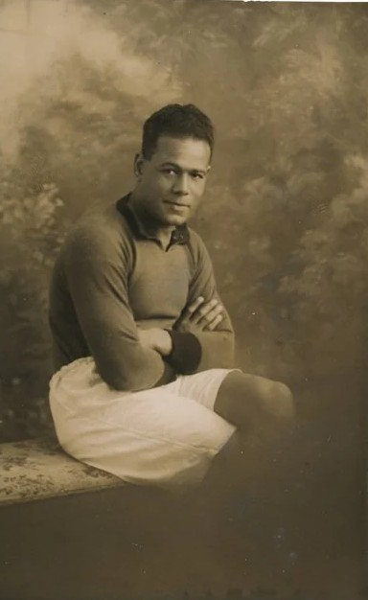
Local Significant People
Jack Leslie
Notes:
Portrait of Jack Leslie. Courtesy of Leslie family.

Slide 2
Local Significant People: Jack Leslie
Key Stage: 2 - History & Geography
To learn about significant historical events, people and places in their own locality
To study an aspect of history dating from a period beyond 1066 that is significant in the locality
To gain historical perspective by placing their growing knowledge into different contexts, understanding the connections between local, regional, national and international history
To understand how localities have changed through time
To recognise the significance of a local historical figure

Slide 3
Content Warning
This presentation covers some topics that may be sensitive and could be upsetting. These include, but are not limited to:
References to the British Empire
References to the racial prejudice experienced by Jack and others​

Slide 4

What makes a person significant?
Questions to ask about a person.
Did they:
make big changes in their lifetime?
make a lot of people’s lives better or worse?
change the way people think about something?
have a lasting impact on their locality, the country or the world?
set a really good/bad example to people about how to live and behave?
Notes:
For this activity we’re using Ian ‘Dawson’s Model’ for significance criteria.

Slide 5








How can we find out about local significant people?
?
Ask people who might know about them
Use books and the internet to research them
Find buildings and places connected to them
Who’s local to me?

Slide 6
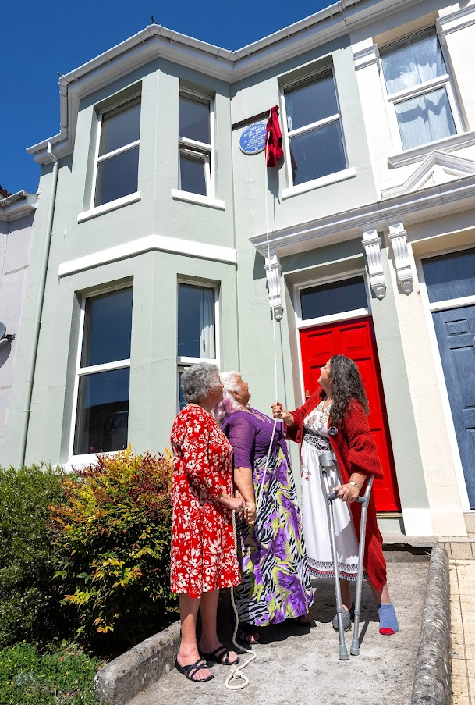


This is 8 Glendower Road in Plymouth. It is connected to Jack Leslie; our local, significant person.
Investigate
Find Glendower Road on Google Maps.
How many miles away is it from your school?
How long would it take you to walk or drive?
Would you say this building is local to your school?
Notes:
Image ©Licensed to Parsons Media. 16/05/2025. Plymouth, United Kingdom. Jack Leslie Blue Plaque Unveiled. Glendower Road. Historic England unveil a Blue Plaque for Jack Leslie English professional footballer in Plymouth. Jack Leslie’s three granddaughters Lesley Hiscott, Lyn Davies and Gillian Carter attended the ceremony.

Slide 7

What can a building tell us?
History detectives!
Complete the inference grid on the next page to explore what this building can tell you…..

Slide 8



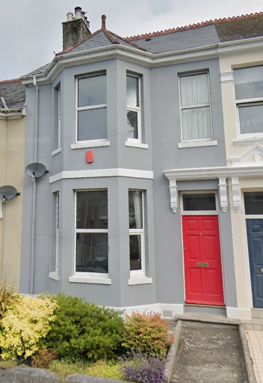
What can buildings tell us?
(I think….because)
Notes:
Image: © Google Maps 2024

Slide 9
What can this building tell us?
What questions do you want to ask?
What can you infer? (I think…because…)
What can you see?
Notes:
Image: © Google Maps 2024

Slide 10
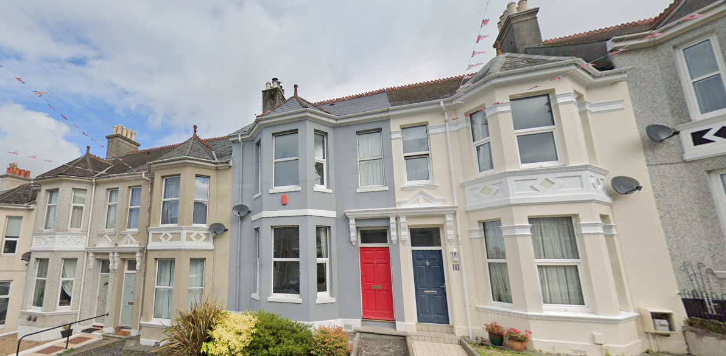

12 Arnold Grove
This is 8 Glendower Road.
8 Glendower Road looks like an ordinary terraced house, on an ordinary street in Plymouth.
But it is actually very special….
Terraced House - One of a row of three or more houses joined together.
Notes:
Basic info about types of house here https://www.primaryhomeworkhelp.co.uk/houses/modern.htm
Built 1890s – more detailed info and teaching resources here: https://historicengland.org.uk/education/schools-resources/teaching-activities/street-spotters-guide/
Image: © Google Maps 2024

Slide 11
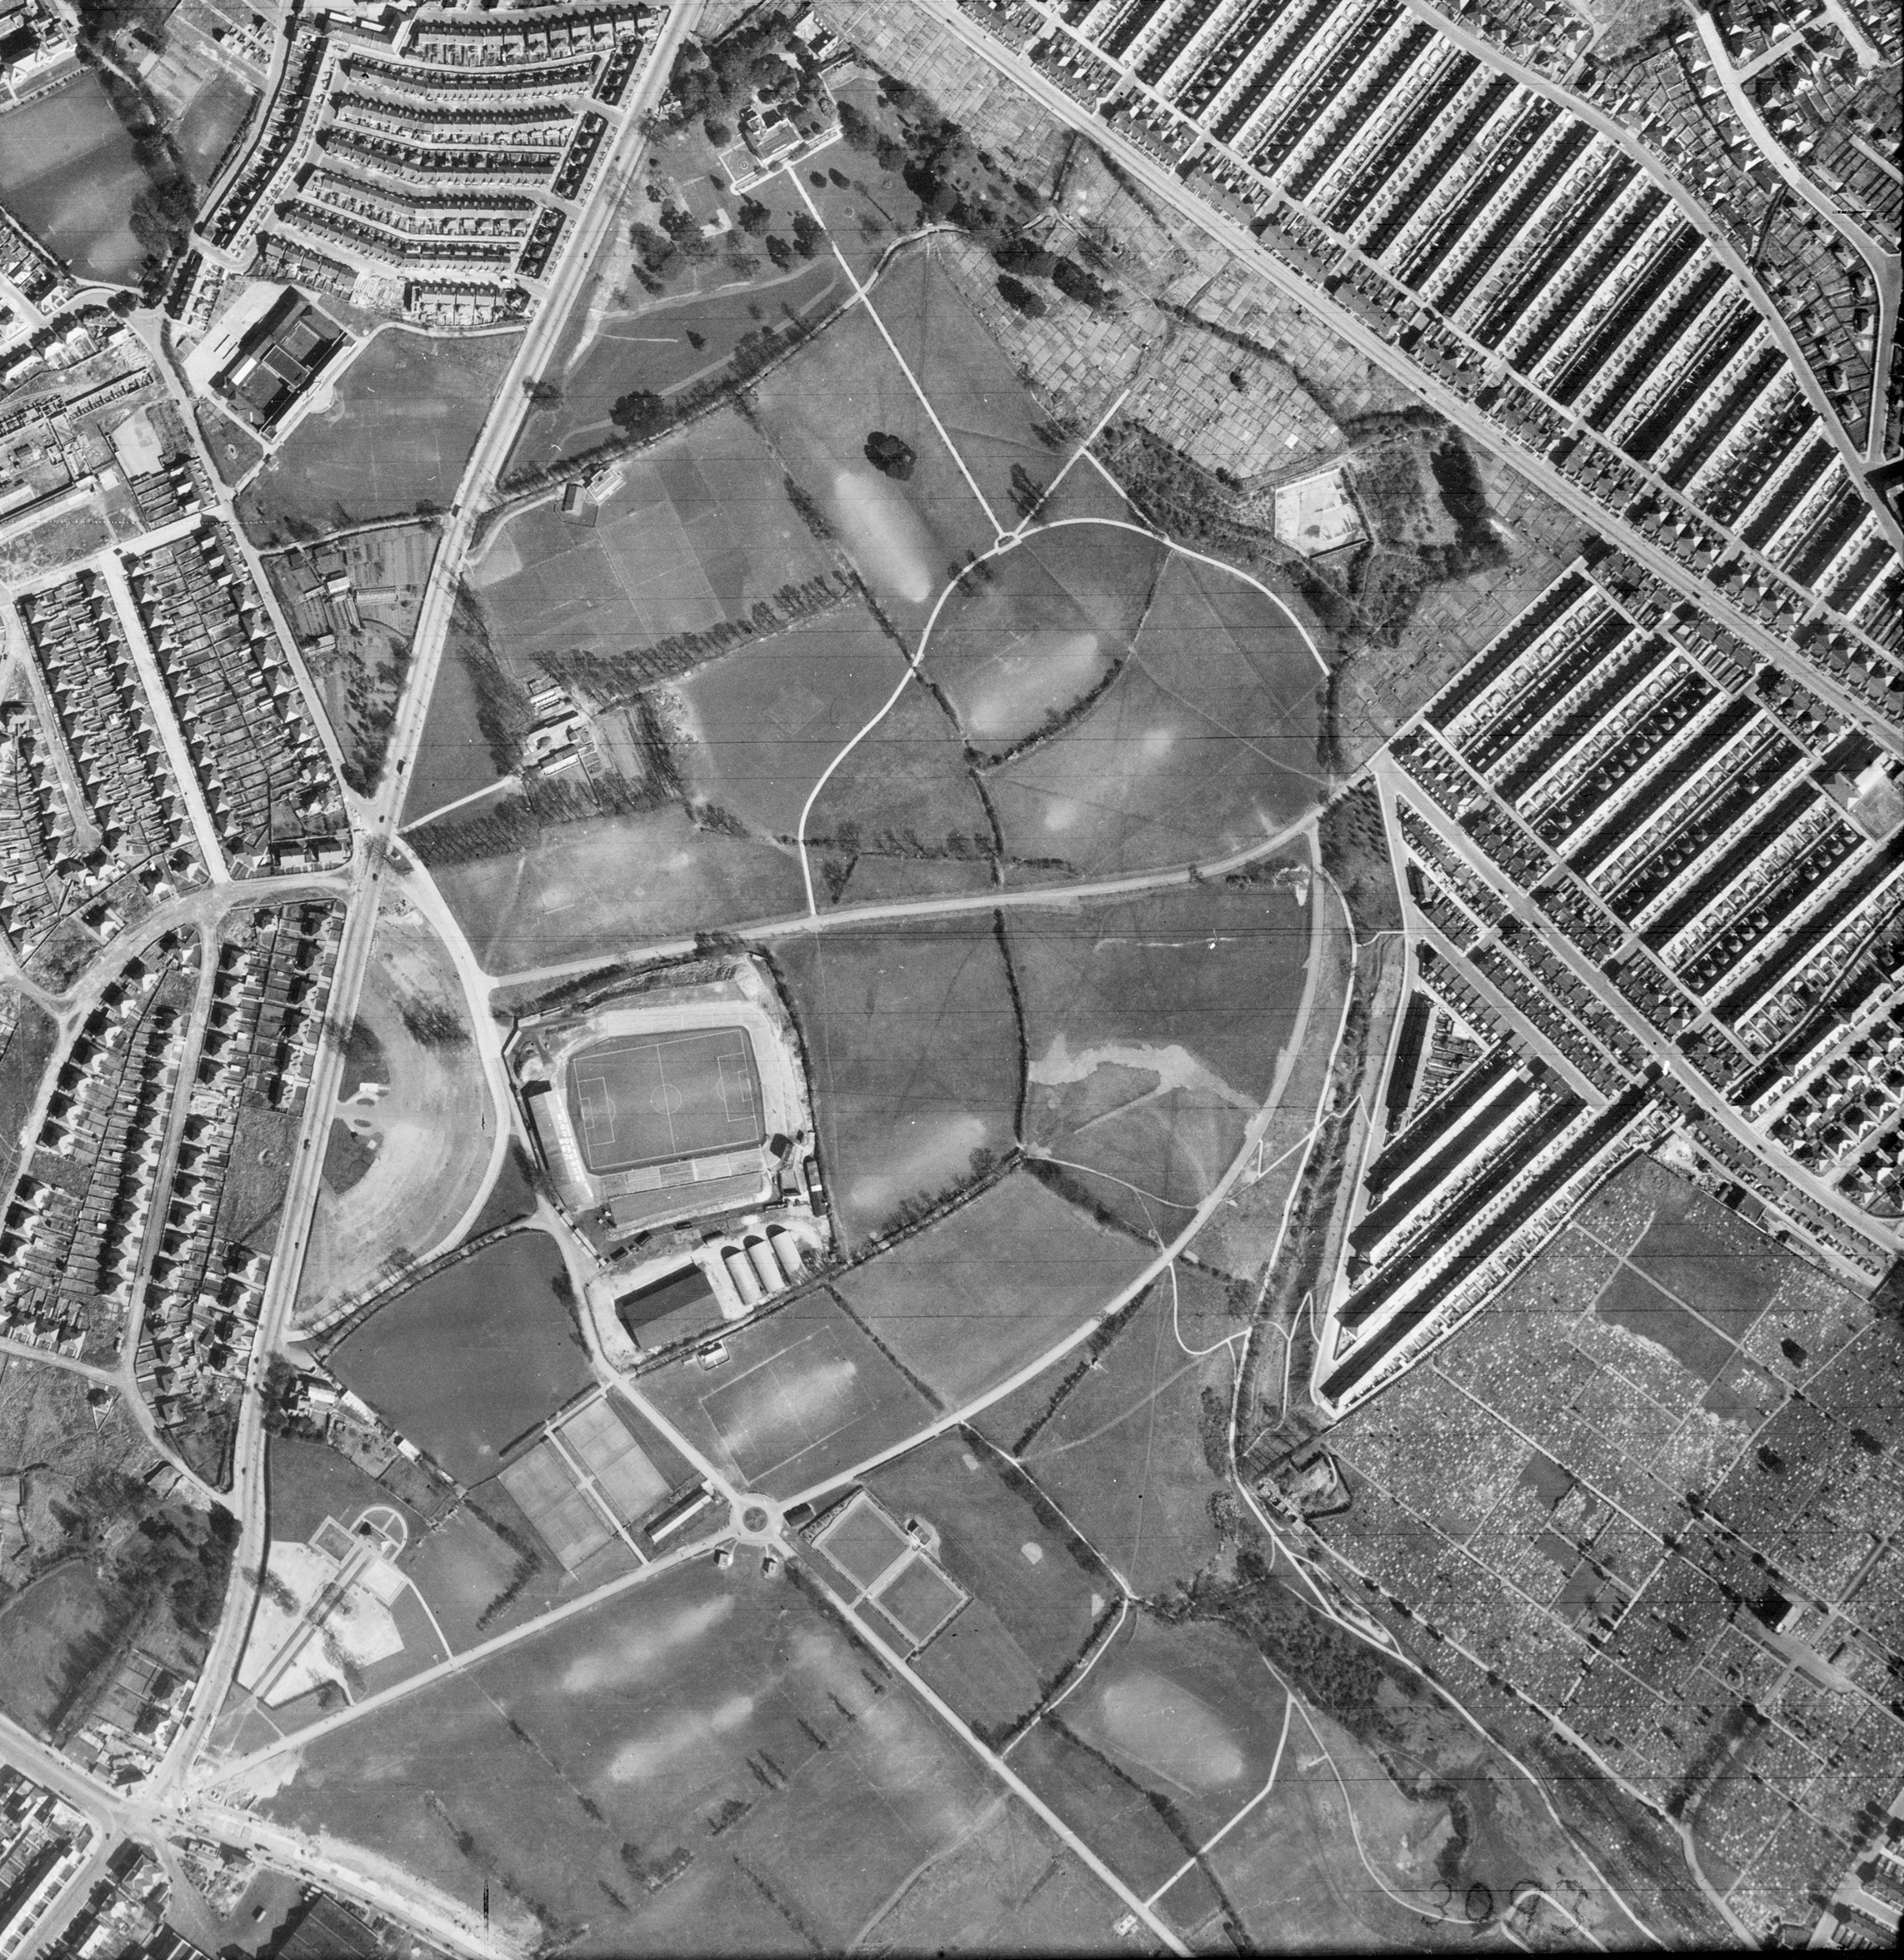


8 Glendower Road, Plymouth
8 Glendower Road was the home of Jack Leslie.
He lived there from 1925 until 1935
Do you know anything about him?
Have you heard of Jack Leslie?
Glendower Road in 1945
Notes:
Image: Source: Historic England Archive (Authorised use only) Ref: raf_cpe_uk_2521_rp_3195 Date: 23 March 1948

Slide 12
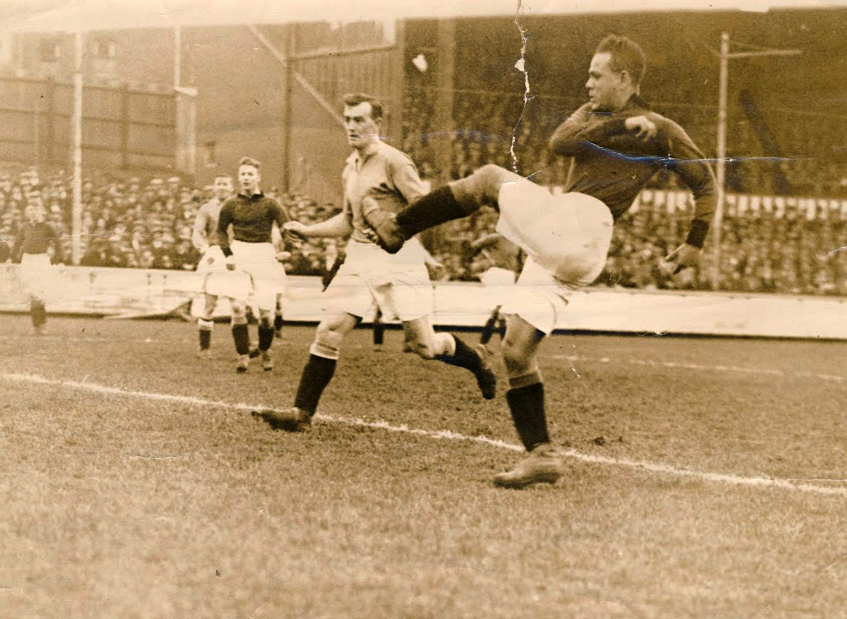
What can you tell from this picture?
Notes:
Image: Jack Leslie kicking the ball (c) Western Morning News.

Slide 13
Inference Square?
(I think….because)
Notes:
Image: Jack Leslie kicking the ball (c) Western Morning News.

Slide 14
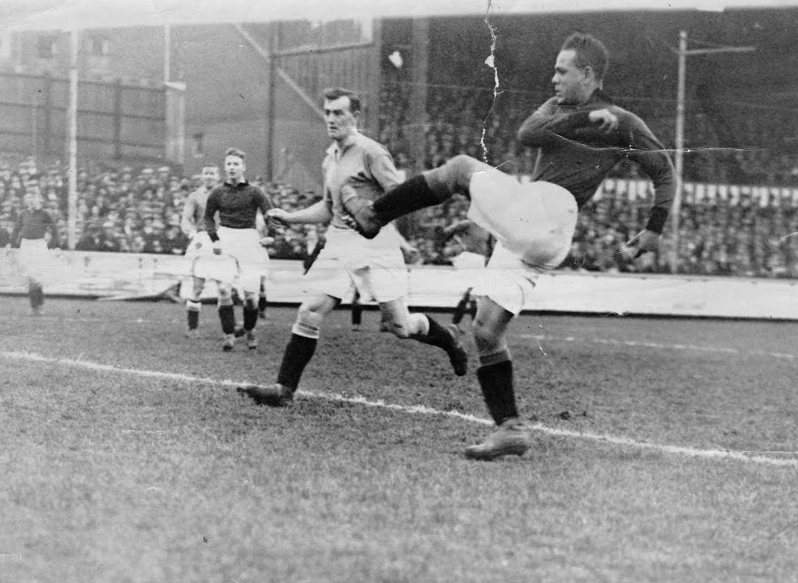
What can this photograph tell us?
What questions do you want to ask?
What can you infer? (I think…because…)
What can you see?
Notes:
Image: Jack Leslie kicking the ball (c) Western Morning News.

Slide 15
What makes Jack Leslie significant?
His football career | A black pioneer
Jack started his career with non-league Barking Town Whilst there he represented Essex on a football tour in France At the age of 20 he signed to play for Football League Club Plymouth Argyle He played 384 games for Plymouth scoring 133 goals | Jack was the first black player to captain Plymouth Argyle Jack was the first black football player to ever be selected to play for England.

Slide 16
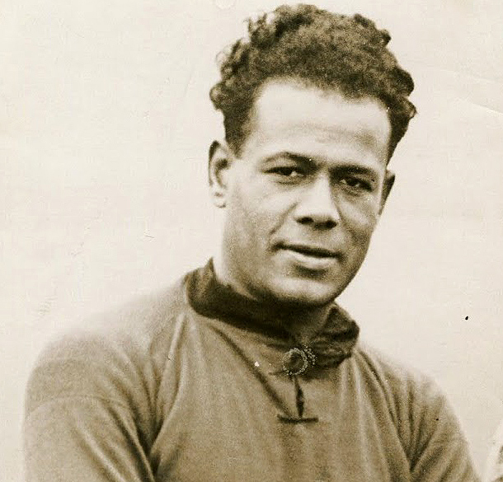
Meet Jack Leslie
Jack Leslie was born on August 17, 1901, in Canning Town, East London.
His father, John Francis Leslie, was a seaman. He was born in Jamaica in 1863.
His mother, Annie Regler was a seamstress from Islington in London.
Jack Leslie
Notes:
Portrait of Jack Leslie. Courtesy Leslie Family.

Slide 17
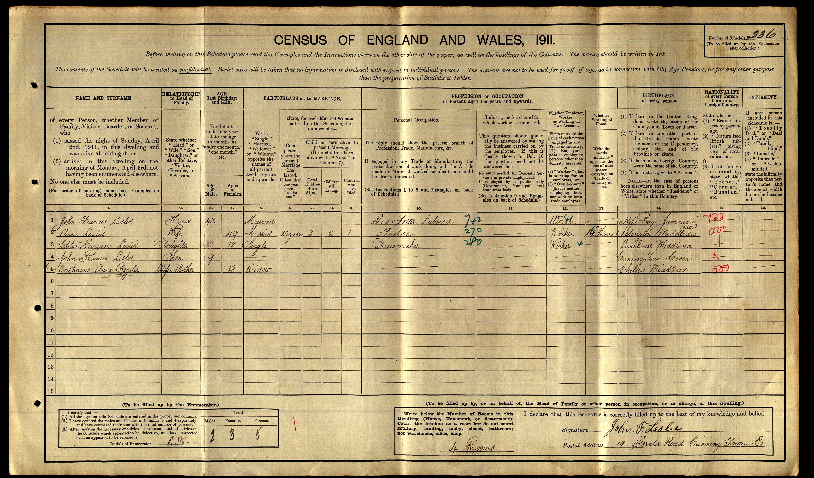
The 1911 Census shows 9-year-old Jack, living at 12 Gerald Road Canning Town, with his parents, older sister, Letitia and his grandmother.

Slide 18
Transcription of the 1911 census
Name | Relationship to head of household | Martial Status | Age | Occupation | Where born
John Francis Leslie | Head | Married | 43 | Gas fitter, labourer | Hope Bay, Jamaica
Ann Leslie | Wife | Married | 49 | Tailoress | Islington, Middlesex
Letitia Leslie | Daughter | Single | 18 | Dressmaker | London, Middlesex
John Francis Leslie | Son |  | 9 |  | Canning Town, Essex
Catherine Ann Regler | Mother-in-law | Widow | 88 |  | Chelsea, Middlesex
Before he worked in the Beckton Gas works, Jack’s father (also called Jack) was a merchant seaman and spent long periods away at sea which is probably why Jack’s sister has a big age difference to Jack.

Slide 19
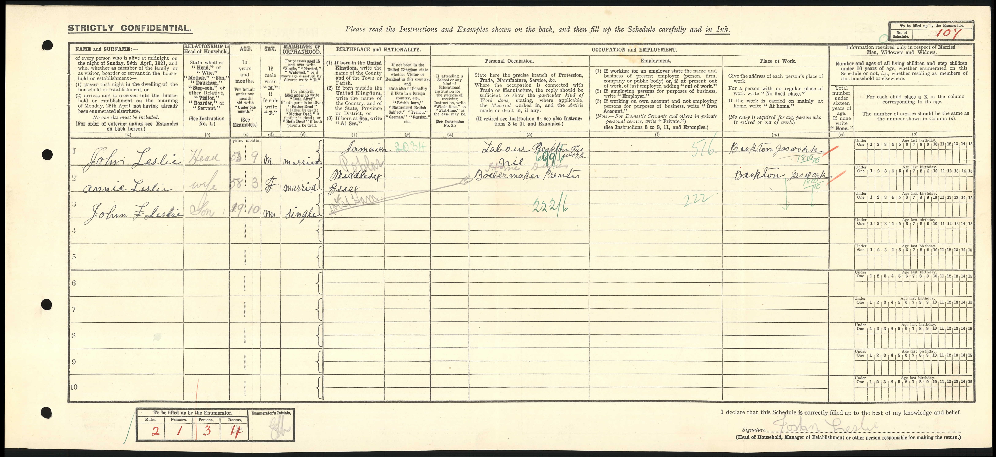
In 1921, Jack was working at Beckton Gas Works and playing football part –time for Barking Town

Slide 20
Transcription of the 1921 census
Name | Relationship to head of household | Martial Status | Age | Occupation | Where born
John Leslie | Head | Married | 53 | Labourer, Beckton Gas works | Jamaica
Anien Leslie | Wife | Married | 58 | Tailoress | Middlesex
John Francis Leslie | Son | Single | 19 | Boiler maker, Beckton Gas works | Essex, West Ham

Slide 21
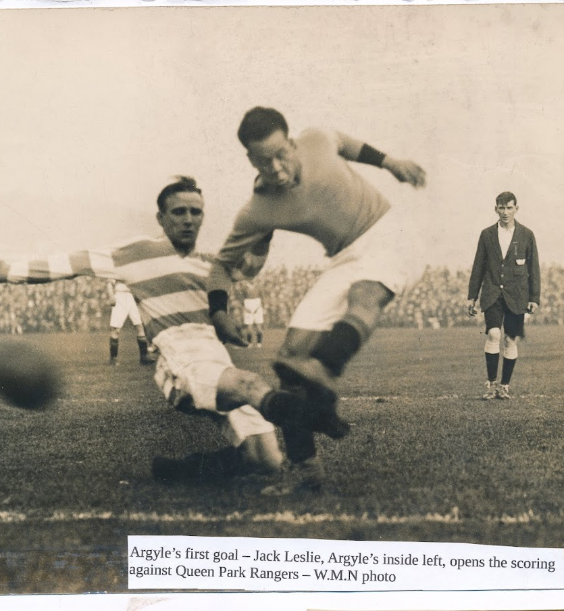
A big move to Plymouth
Reflection:
How easy a decision do you think it would have been for Jack to leave his London home and move to Plymouth?
His performances for Barking Town attracted interest from professional clubs across the country.
He was recruited by Plymouth Argyle’s ambitious manager, Bob Jack in 1921.
Jack was tempted to go to Plymouth by postcards showing beautiful sea views and beaches shown to him by Bob Jack.
Jack Leslie
Notes:
Jack Leslie scoring a goal against Queens Park Rangers (c) Western Morning News.

Slide 22
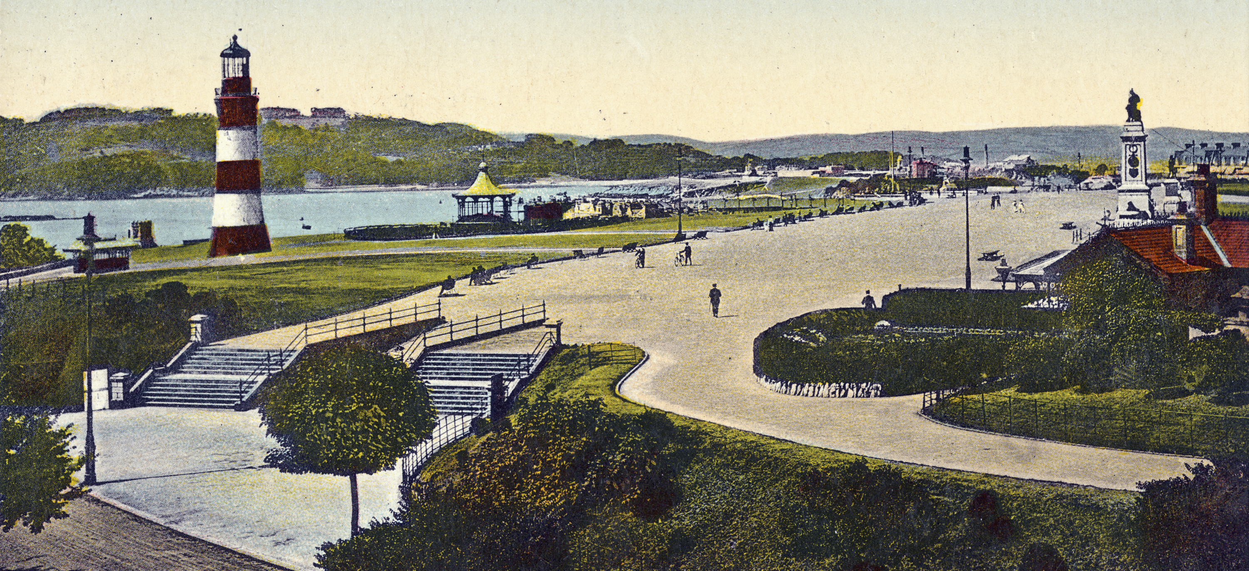
A postcard of Plymouth Hoe in the 1930s.
Reflection:
Compare this image to the following ones of Canning Town and the Beckton Gas Works in the 1930s. Why do you think Jack was tempted to go to Plymouth?
Notes:
Image: Source: Historic England Archive Ref: PC06901 Date: 1920-1930 https://historicengland.org.uk/images-books/photos/item/PC06901

Slide 23
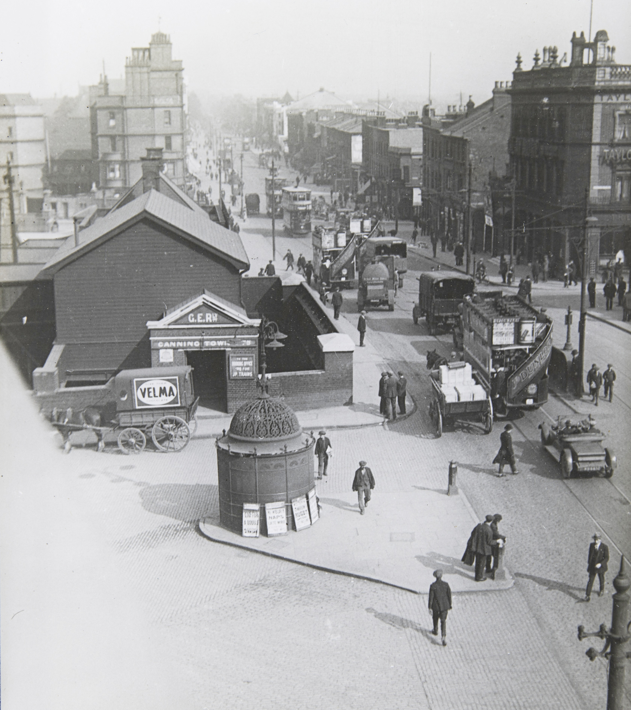
Canning Town in the 1920s
Notes:
Image: Source: Historic England Archive Ref: MOT01/01/14 Date: 1920s https://historicengland.org.uk/images-books/photos/item/MOT01/01/14

Slide 24
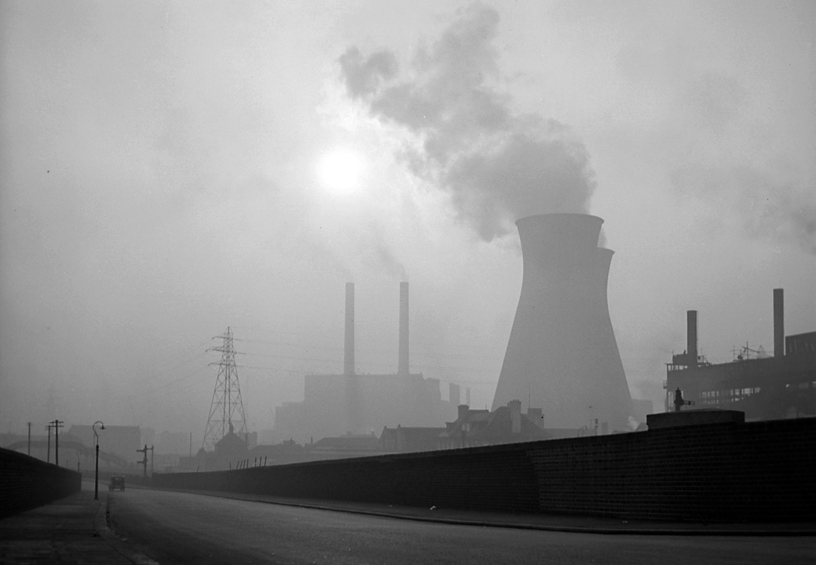
Beckton Gas Works (taken in the 1950 or 60s)
Notes:
Image: Source: Historic England Archive Ref: AA001609 Date: 1951-65 - https://historicengland.org.uk/images-books/photos/item/AA001609

Slide 25
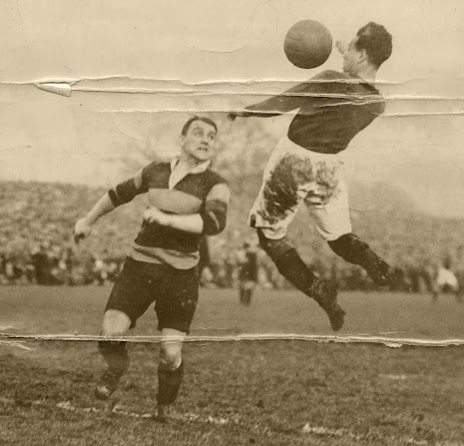
Jack soon established himself as a goal-scoring inside-forward for Plymouth Argyle
Reflection:
How much money might a footballer earn today? How might their lifestyle differ from Jack’s?
As a junior player, Jack would have been earning about £5 or £6 a week.
It was not a huge salary, but he would have been a bit better off than many of the Plymouth fans who worked in the dockyards, and it was a decent wage compared to what he and his mates were earning at Beckton Gas works.
Jack jumping for a ‘header’
Notes:
Jack Leslie in action. (c) Western Morning News

Slide 26
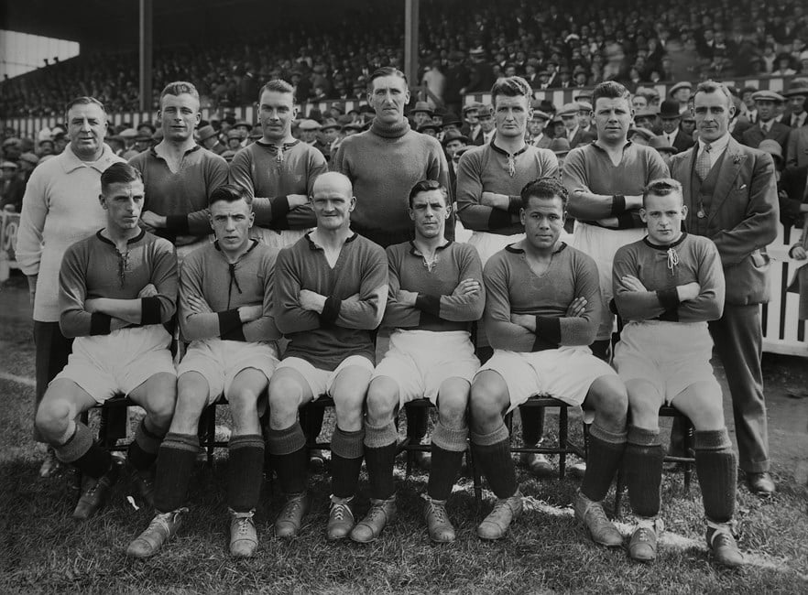
Plymouth Argyle Men’s Football Team 1923
Notes:
1927 / 1928 season - Plymouth Argyle team group Back (left to right): J Haynes (trainer) Frederick McKenzie Robert 'Bob' Preston Frederick Craig Frederick Titmuss (2 England caps) Alex Hardie James 'Jimmy' Logan Front: Alfred Matthews Francis 'Frank' Sloan Moses Russell (captain; 23 Wales caps) Frederick Forbes Jack Leslie Samuel 'Sammy' Black Plymouth Argyle - 1927/28. © Colorsport/Shutterstock

Slide 27
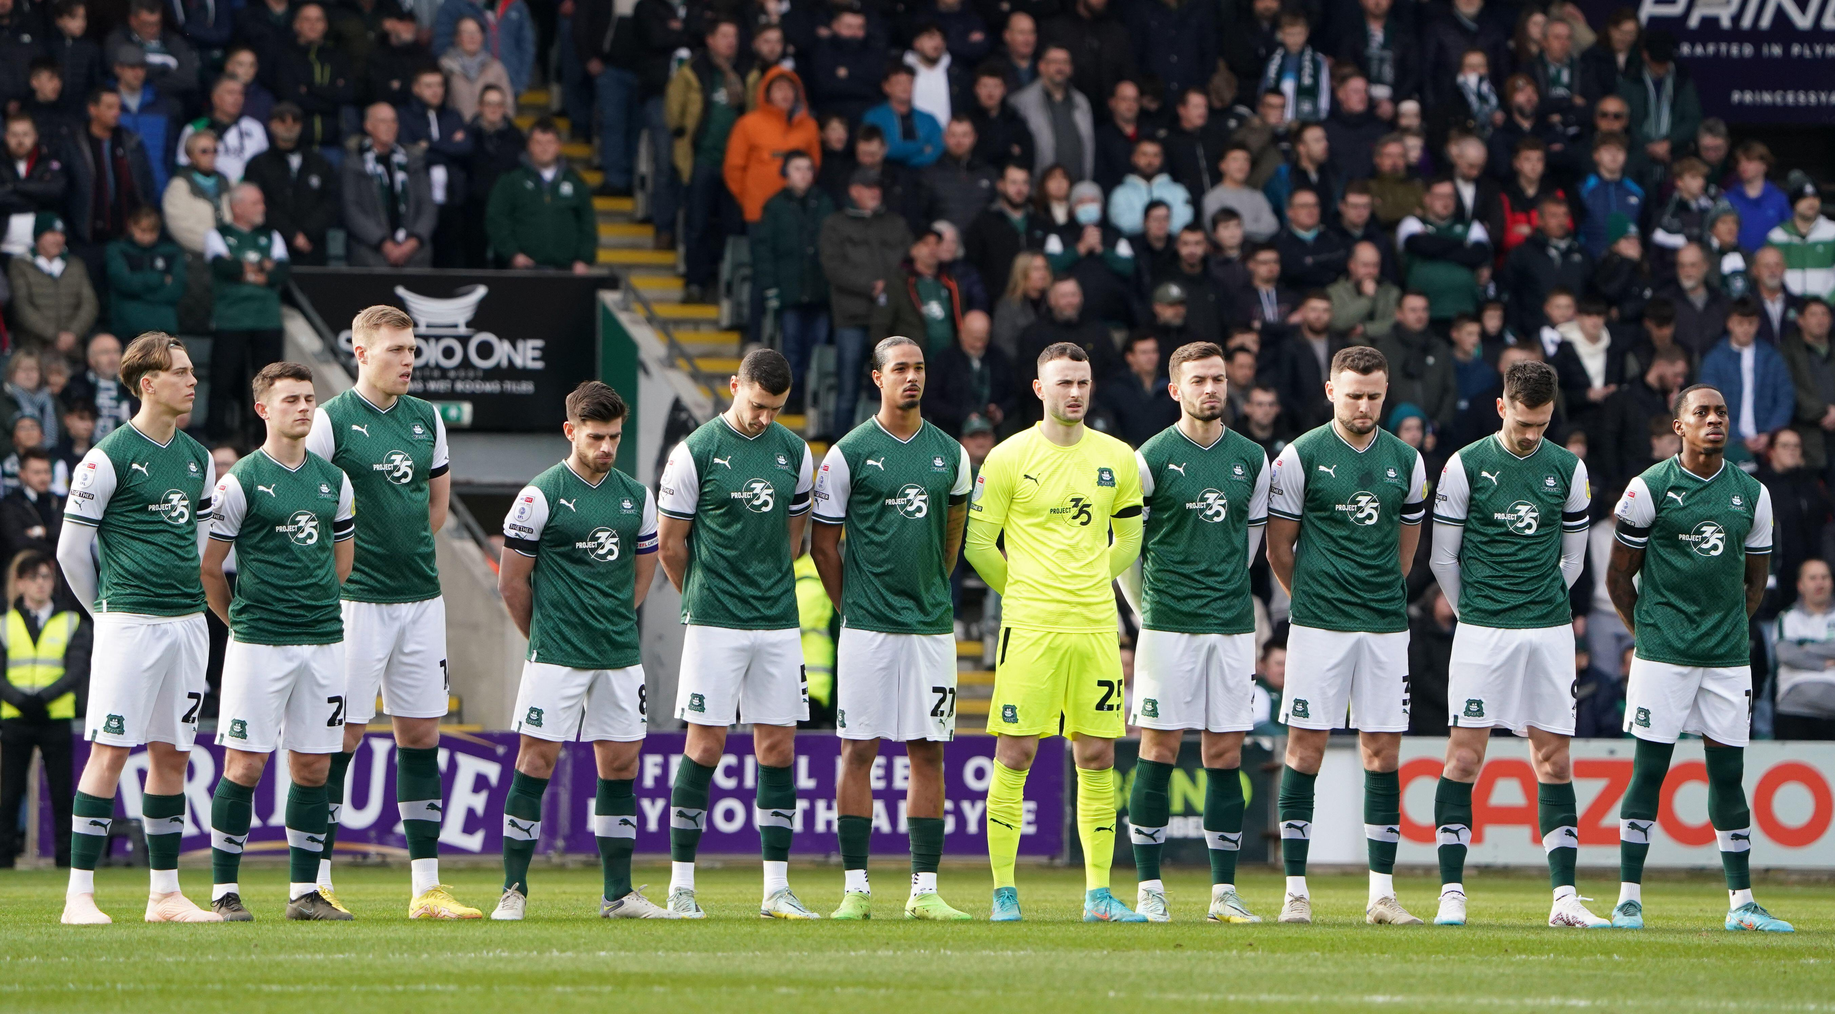
Plymouth Argyle Men’s Football Team 2023
Reflection:
How is the men’s team similar 100 years after Jack’s time? How is it different?
Notes:
© Alamy Ref: 2N95B2H

Slide 28

8, Glendower Road
Reflection:
Why do you think the Leslie’s lived so near Plymouth Argyle’s stadium, Home Park?
In 1925, newly married Jack moved into 8 Glendower Road with his wife Lavinia (Win) Garland.
They lived there for the next 10 years with their daughter Evelyn.
Home Park stadium & 8 Glendower Road, Plymouth
Notes:
Image: Source: Historic England Archive (Authorised use only) Ref: raf_cpe_uk_2521_rp_3195 Date: 23 March 1948

Slide 29
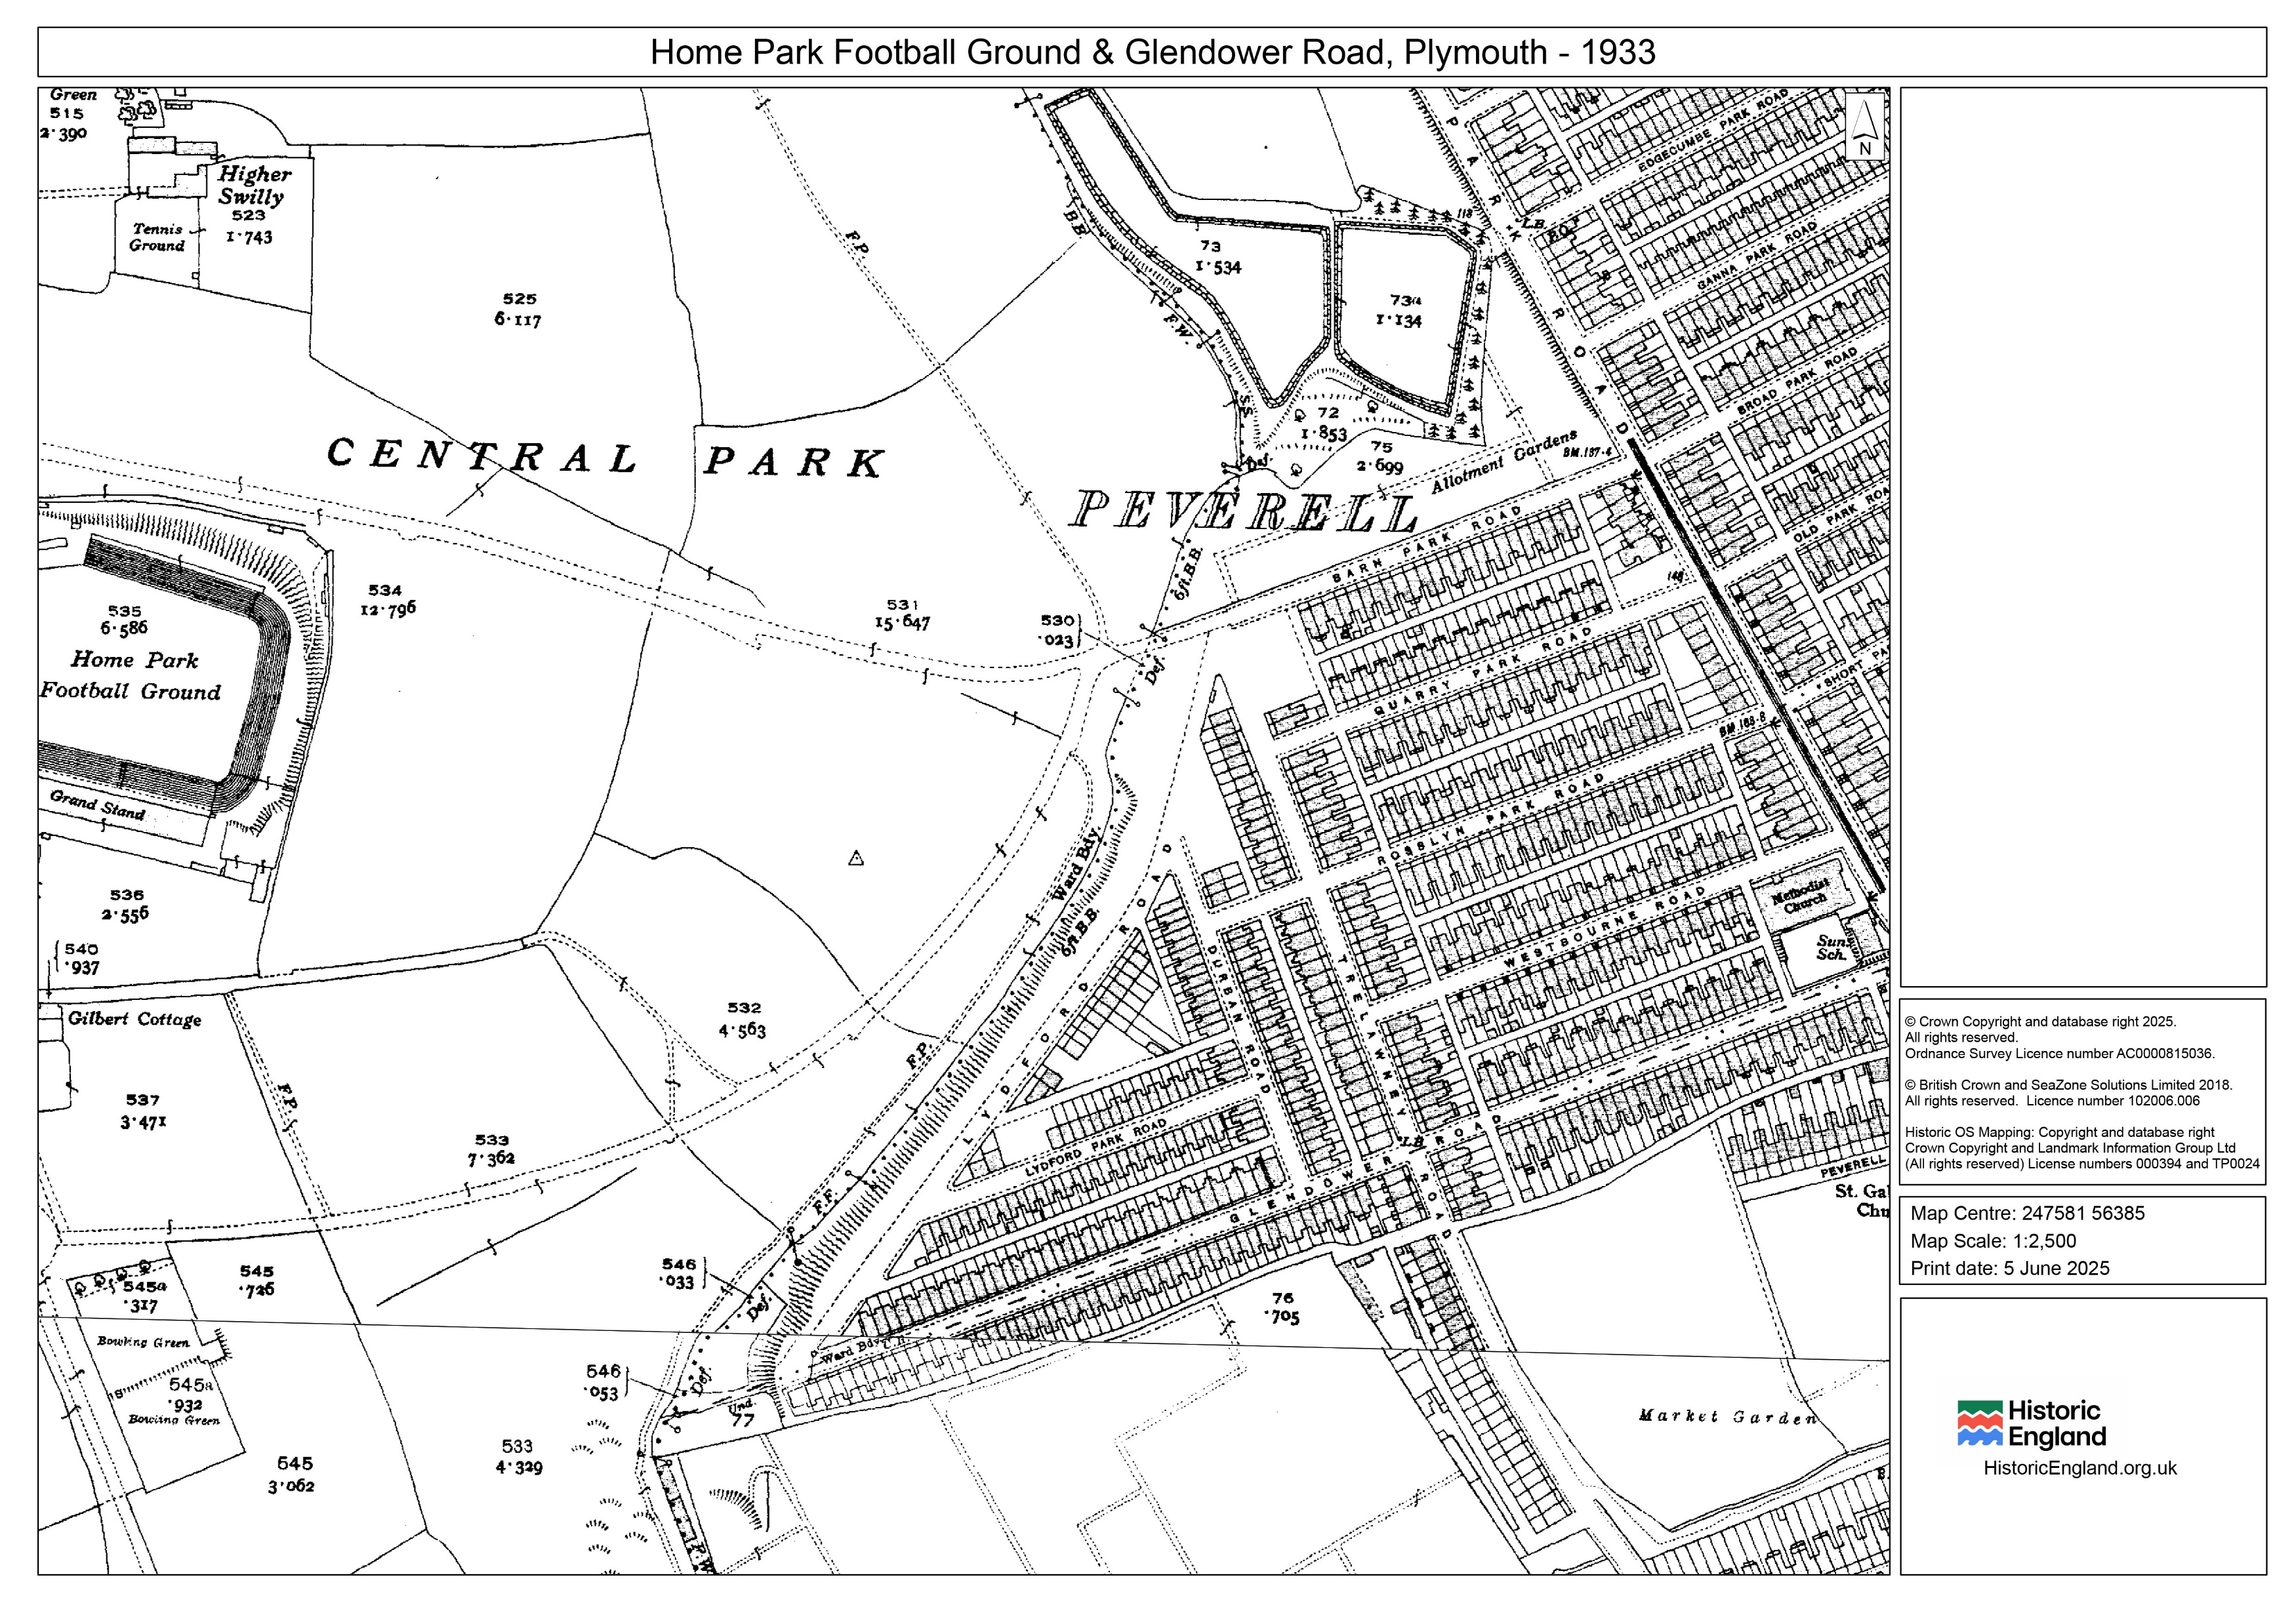
Home Park 1933
Home Park
8 Glendover Road
Notes:
Crown Copyright – licence as shown on right of image

Slide 30
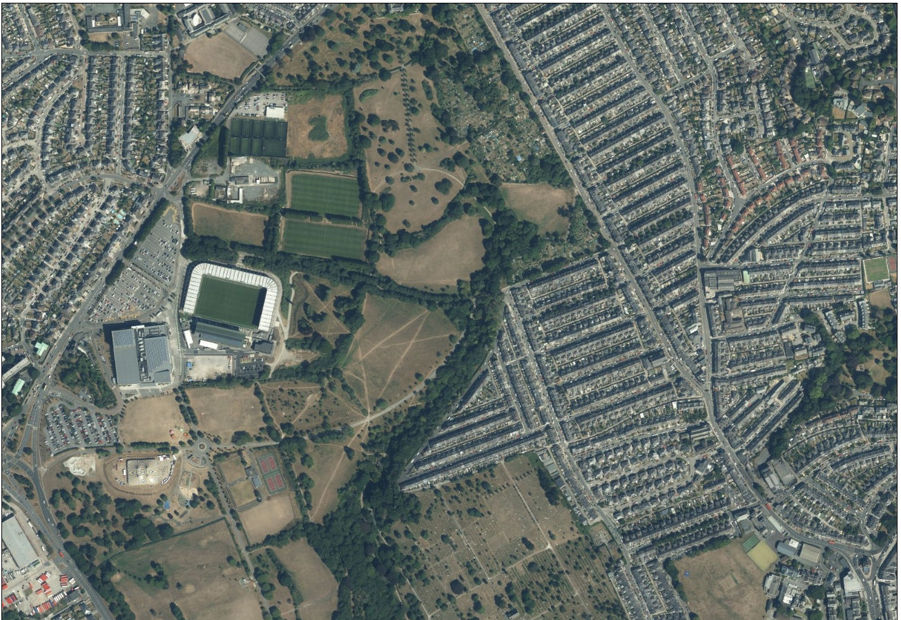
Home Park 2025
Reflection:
How has the area near Jack’s home changed in 100 years? What has stayed the same?
Home Park
8 Glendower Road
Notes:
© Google Maps 2025

Slide 31
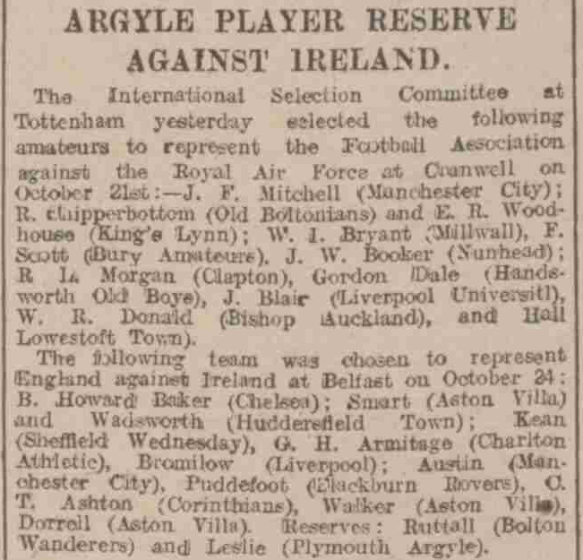
Selection for England
On 6 October 1925, newspapers reported that Jack had been selected by the Football Association (FA) as a reserve for England in their game against Ireland on October 23rd.
Reflection:
How do you think Jack felt, being selected to play for England?
Western Morning News 6th October 1925

Slide 32
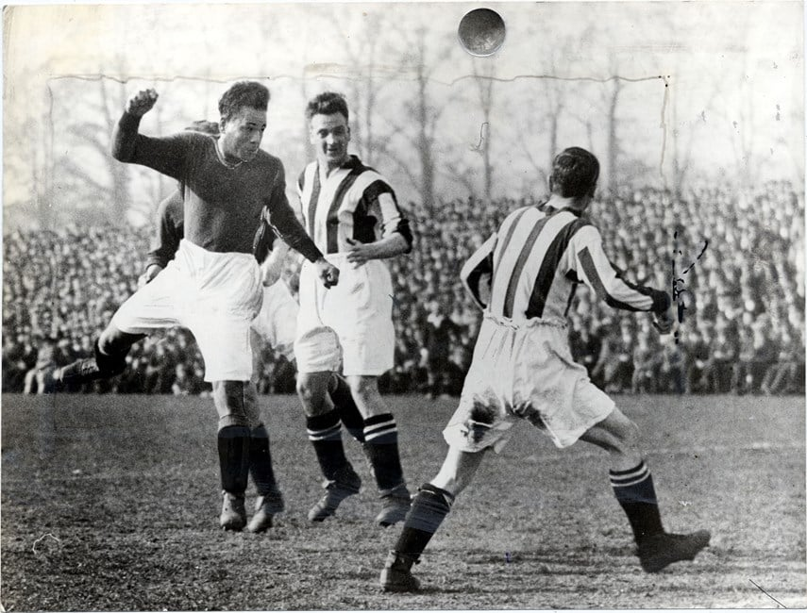
Great excitement
There was great excitement in the city of Plymouth, with one of their players selected to play for England, even though Plymouth Argyle were a lower division side.
Jack playing football
Notes:
© Monty Fresco/Daily Mail/Shutterstock

Slide 33
Why was Jack’s name removed from the selection list?
Yet joy quickly turned to disappointment when his name quietly disappeared from the team sheet. The England selectors replaced him as a reserve just 3 days before the match.
The FA denied that Leslie had ever been called up, despite the evidence of the team list that had been published, and the local football journalist 'Pilgrim' hinted that racism was behind his de-selection.
Reflection:
It is widely thought that the FA deselected Jack when they found out that he was black. Something that the FA denied at the time.
Jack in Plymouth Argyle kit
Notes:
Portrait of Jack Leslie. Courtesy of Leslie family.

Slide 34
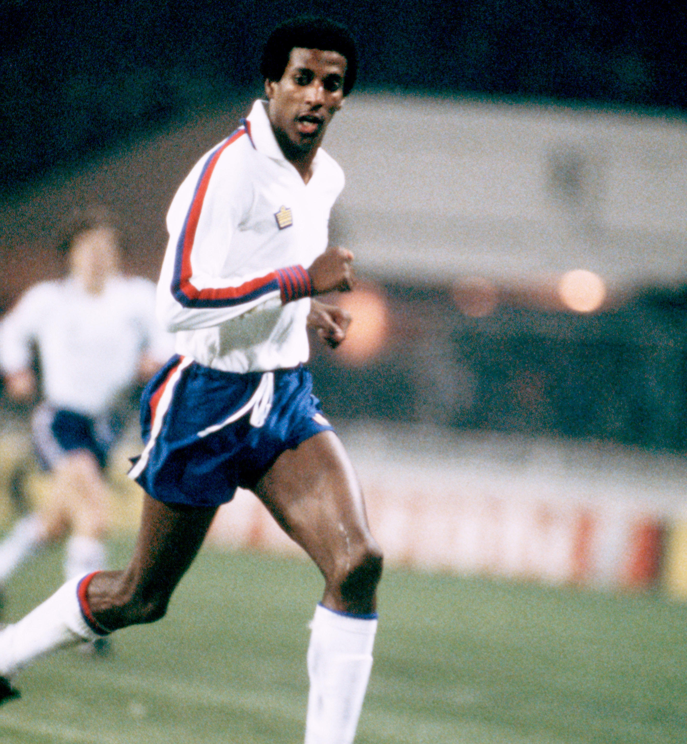
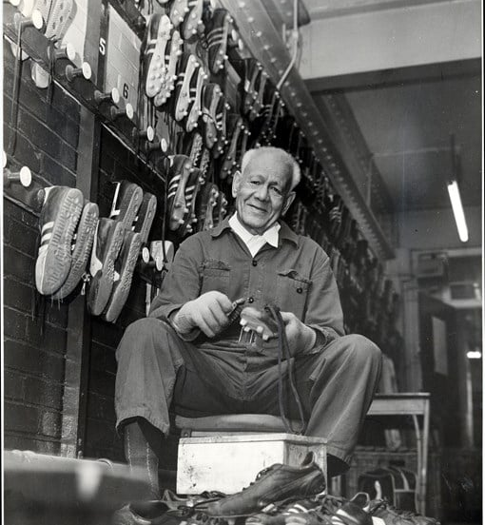
Viv Anderson
Reflection:
What do you think Jack’s feelings were when Viv Anderson made his debut for England?
In November 1978 Viv Anderson of Nottingham Forest became the first black footballer to represent the England Men’s team
By this time, Jack was working in the boot-room at West Ham United back in East London.
Notes:
© Alamy Re: G9AT98 © Monty Fresco/Daily Mail/Shutterstock

Slide 35
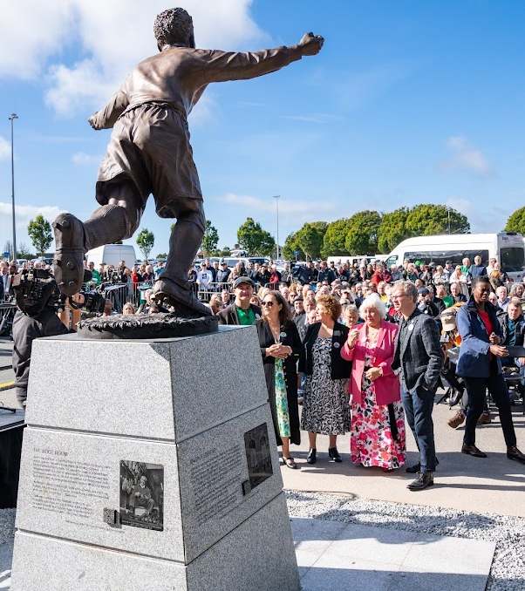
A statue for Jack
In October 2022, a statue for Jack was unveiled by his granddaughters, Lesley Hiscott, Lyn Davies and Gillian Carter at Home Park Stadium, Plymouth
Notes:
Statue of Jack Leslie - unveiled on 7 October 2022 at Home Park (Plymouth Argyle FC stadium), Plymouth. (c) Matthew Ellacott / The Jack Leslie Campaign

Slide 36
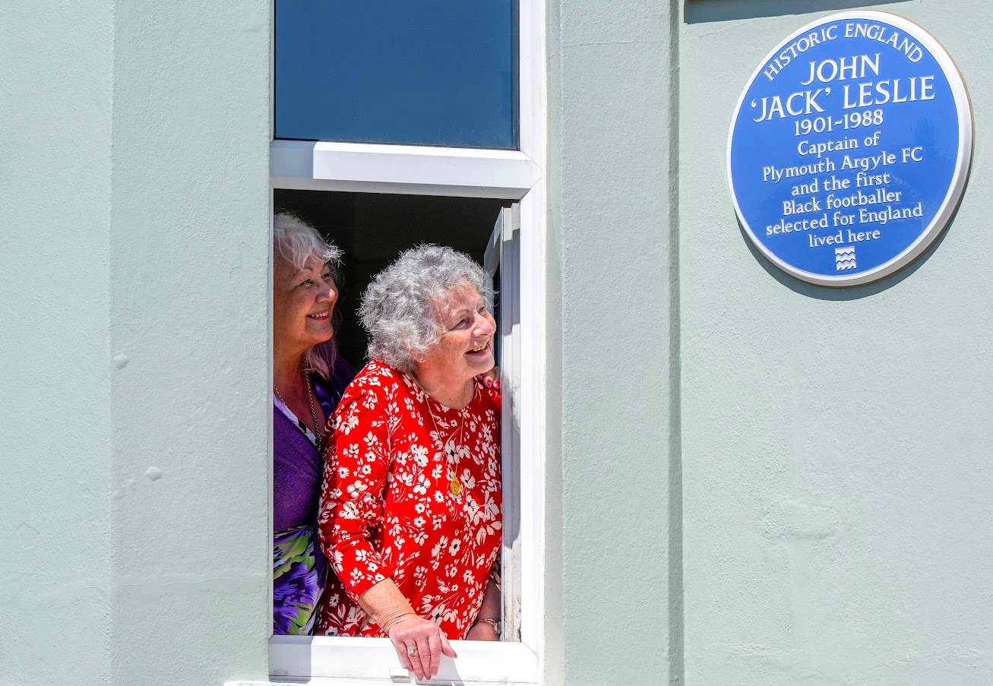
They were also there to unveil the plaque on his old house in Glendower Street in May 2025
Notes:
Images ©Licensed to Parsons Media. 16/05/2025. Plymouth, United Kingdom. Jack Leslie Blue Plaque Unveiled. Glendower Road. Historic England unveil a Blue Plaque for Jack Leslie English professional footballer in Plymouth. Jack Leslie’s three granddaughters Lesley Hiscott, Lyn Davies and Gillian Carter attended the ceremony. Shared by HE Comms.

Slide 37
What makes Jack Leslie significant?
Questions to ask about Jack.
Did he:
make big changes in his lifetime?
make a lot of people’s lives better or worse?
change the way people think about something?
have a lasting impact on his locality, the country or the world?
set a really good/bad example to people about how to live and behave?
Notes:
For this activity we’re using Ian ‘Dawson’s Model’ for significance criteria.

