Slide 1
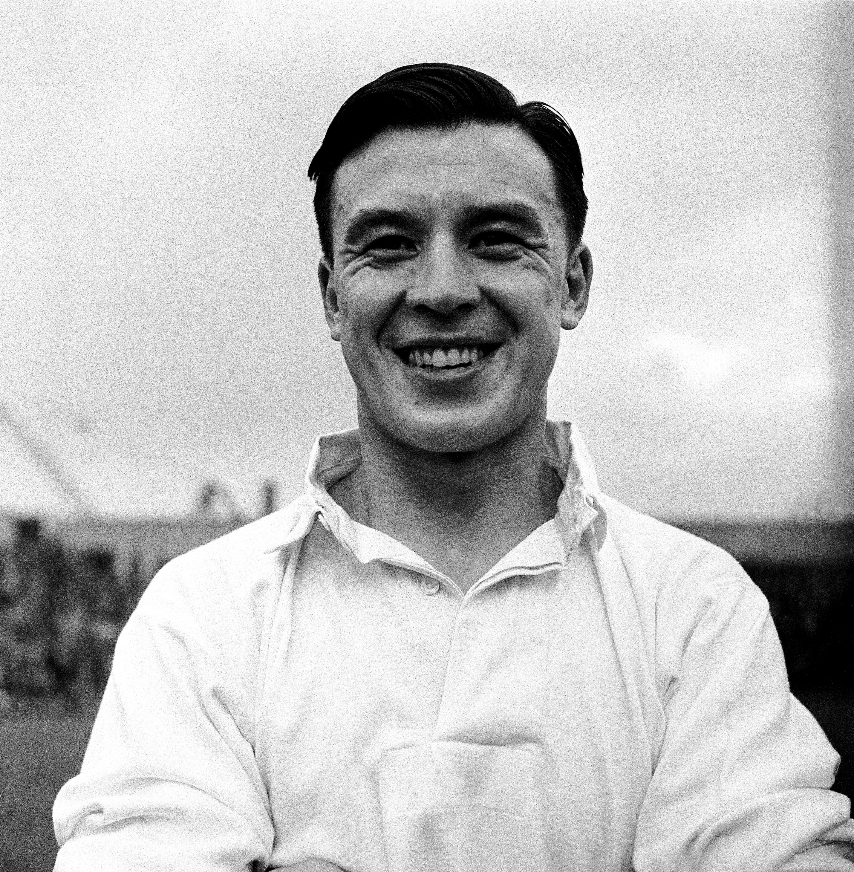
Local Significant People
Frank Soo
Notes:
Image: © Alamy Ref: G9HAEA

Slide 2
Local Significant People: Frank Soo
Key Stage: 2 - History & Geography
To learn about significant historical events, people and places in their own locality
To study an aspect of history dating from a period beyond 1066 that is significant in the locality
To gain historical perspective by placing their growing knowledge into different contexts, understanding the connections between local, regional, national and international history
To understand how localities have changed through time
To recognise the significance of a local historical figure

Slide 3

What makes a person significant?
Questions to ask about a person.
Did they:
make big changes in their lifetime?
make a lot of people’s lives better or worse?
change the way people think about something?
have a lasting impact on their locality, the country or the world?
set a really good/bad example to people about how to live and behave?
Notes:
For this activity we’re using Ian ‘Dawson’s Model’ for significance criteria.

Slide 4
How can we find out about local significant people?
?
Ask people who might know about them
Reflection:
Which of these do you think gives us the most reliable evidence? Why?
Use secondary evidence such as books and the internet
Find buildings and places connected to them
Who’s local to me?
Use primary evidence such as newspapers and census records

Slide 5

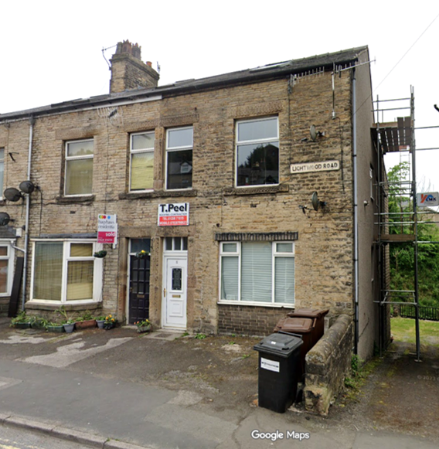
An ordinary terraced house?
Investigate
This is 11 Lightwood Road, Buxton.
It is connected to our local, significant person.
Find 11 Lightwood Road, Buxton on Google Maps.
How many miles away is it from your school?
How long would it take you to walk or drive?
Would you say this building is local to your school?
11 Lightwood Road
Notes:
Image: © Google Maps 2026

Slide 6

What can a building tell us?
History detectives!
Complete the inference grid on the next page to explore what this building can tell you…..

Slide 7
What can buildings tell us?
(I think….because)
Notes:
Image: © Google Maps 2026

Slide 8
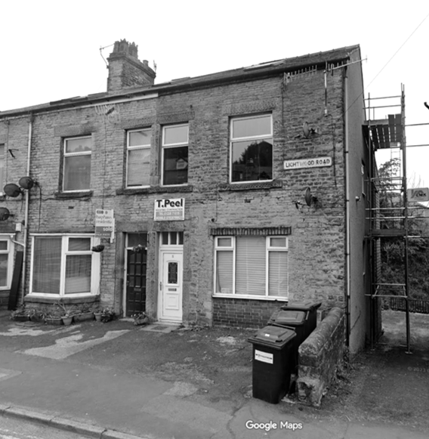
Print out inference square
Notes:
Image: © Google Maps 2026

Slide 9
11 Lightwood Road, Buxton
Investigate
This is 11 Lightwood Road, Buxton.
11 Lightwood Road looks like an ordinary terraced house, on an ordinary street in Buxton.
But it is actually very special….
Terraced house - One of a row of three or more houses joined together
11 Lightwood Road
Notes:
Image: © Google Maps 2026

Slide 10
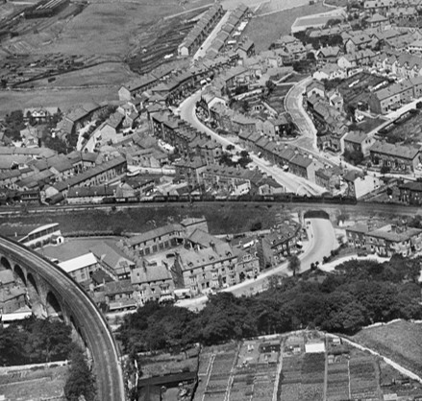
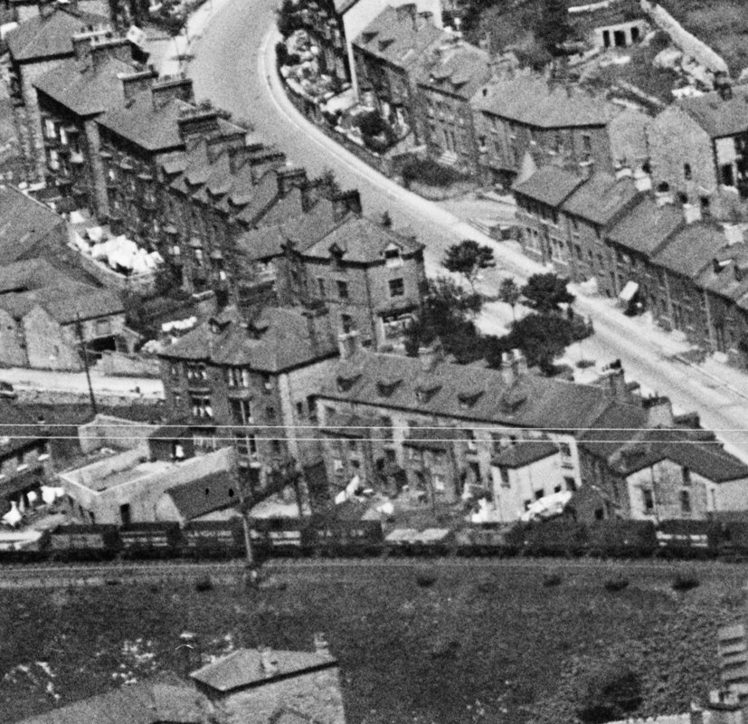
11 Lightwood Road, Buxton
11 Lightwood Road was the home of our significant local person, Frank Soo
He was born here in March 1914 and his family lived there until 1918.
Have you heard of Frank Soo?
Do you know anything about him?
Aerial view of Lightwood Road
Notes:
Image: © Historic England Archive Ref: raf_58_4438_f21_0033 - https://historicengland.org.uk/images-books/archive/collections/aerial-photos/record/raf_58_4438_f21_0033

Slide 11
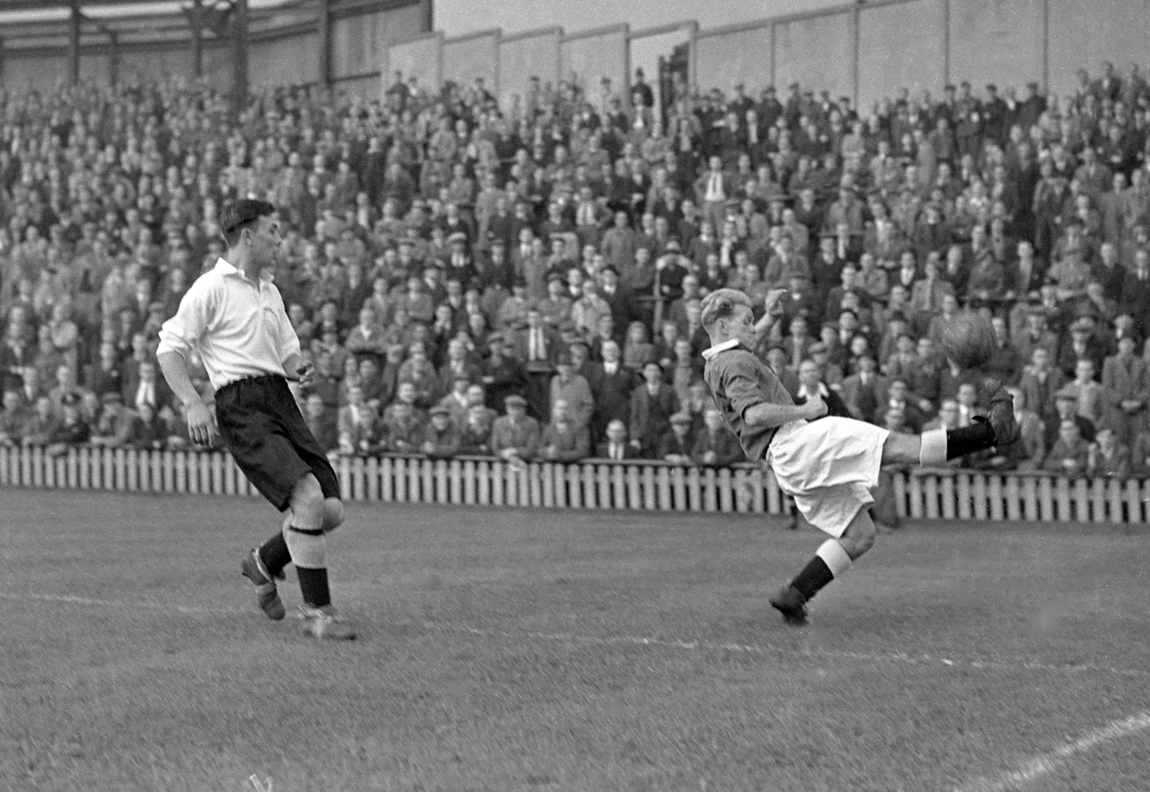
What can you tell about him from this picture?
Notes:
Image: © Alamy Ref: GA1AK9

Slide 12
Notes:
Image: © Alamy Ref: GA1AK9

Slide 13
Notes:
© Alamy Ref: GA1AK9

Slide 14
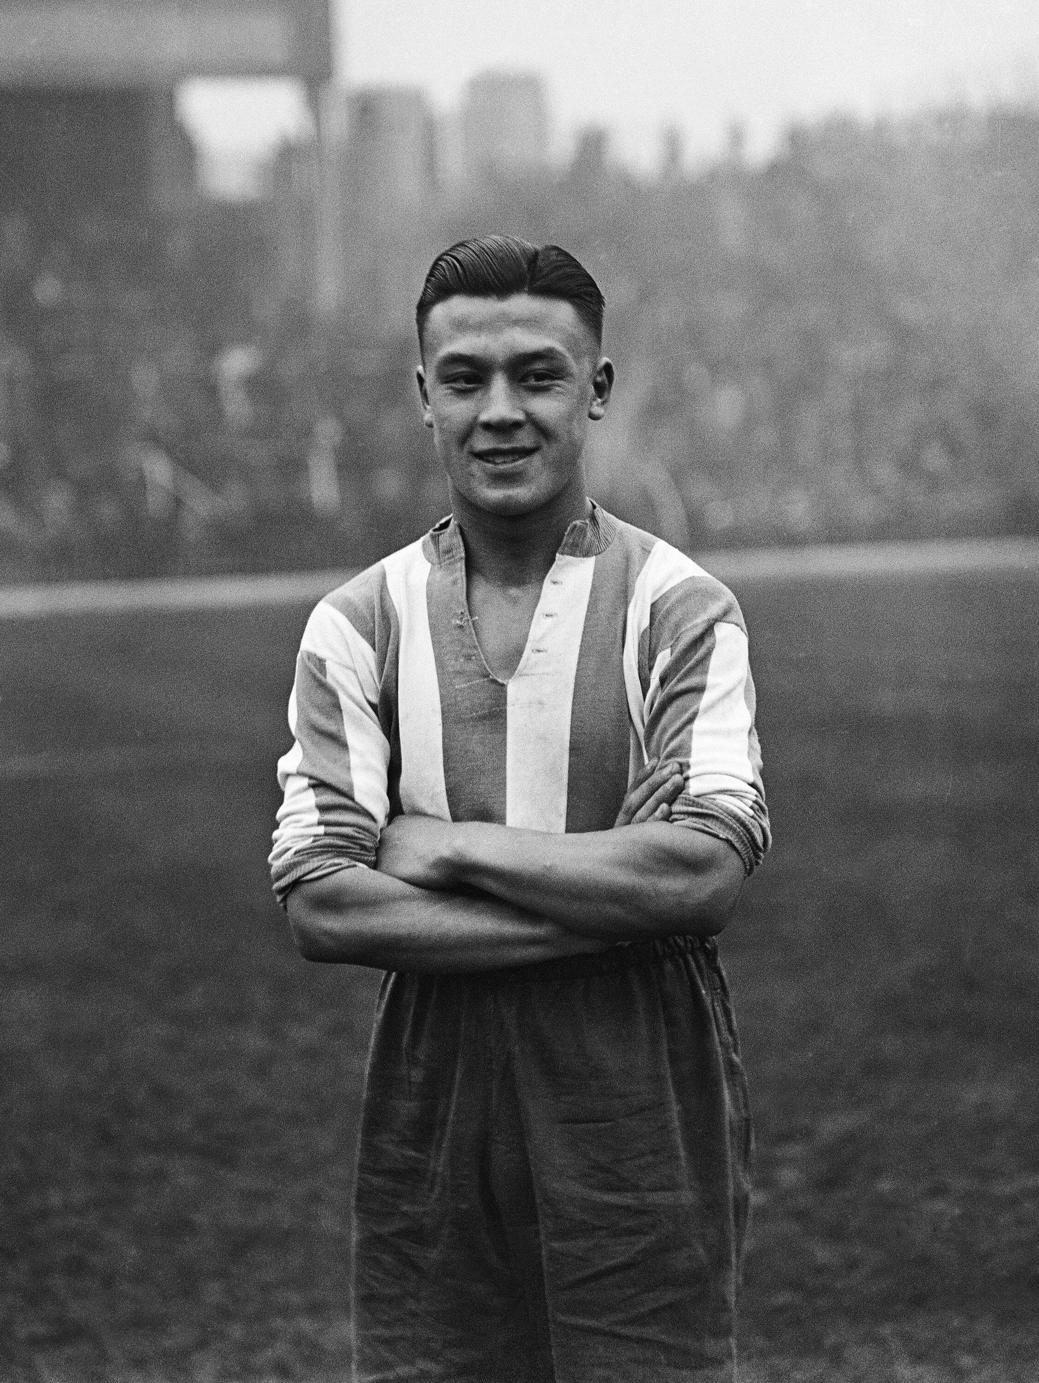
Meet Frank Soo
Frank was born on 8 March 1914 at what is now 11 Lightwood Road, Buxton.
He was one of seven children.
His family had a laundry business.
His father came from China and his mother was English.
Frank Soo in 1933
Notes:
Image: © Alamy Ref: 2NDPHDX

Slide 15
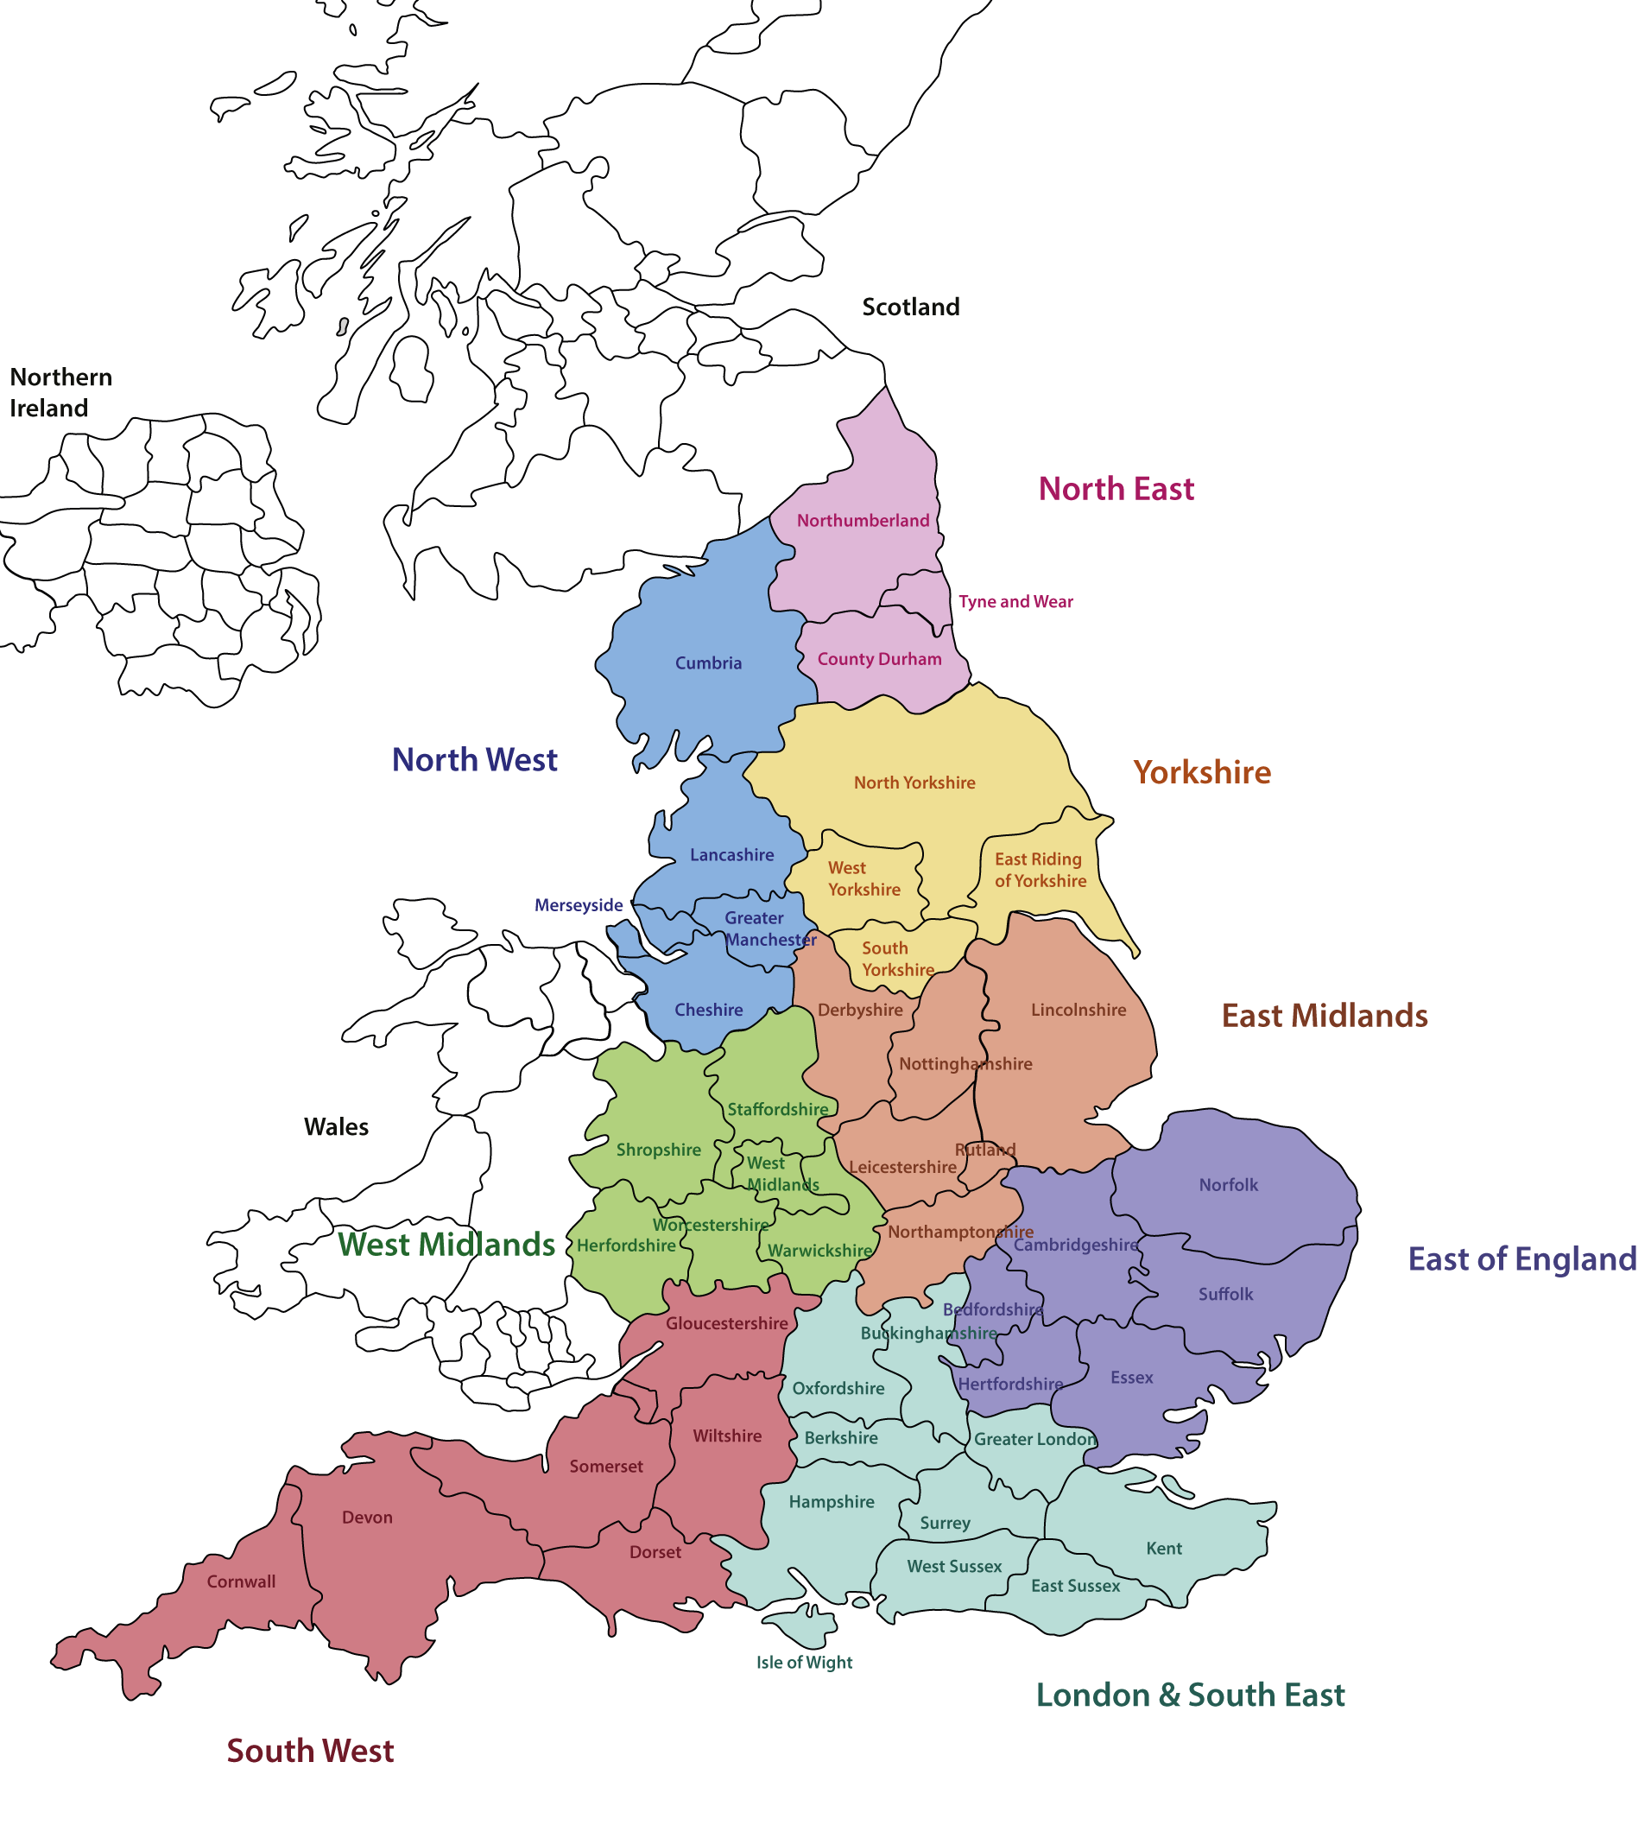
Early Life
Frank’s family moved a lot during his early life.
He lived in:
Buxton
Sheffield
Liverpool
Frank loved playing football!
Reflection:
How might moving a lot have affected Frank’s childhood?
Notes:
Image: © Historic England

Slide 16

Football Career
In 1932, aged 18, Frank started his football career when he signed for amateur side Prescot Cables.
He quickly became team captain.
In 1933 he was signed by Stoke City, making him a professional footballer.
It also made him the first ever player of Chinese/Asian heritage in the English league.
He was made captain for the 1938-9 season. He did not miss a single league game that year.
Notes:
Image: © Alamy Ref: CW2PG3

Slide 17

Player’s Pay
When Frank started as a footballer in, he earned about £2.50 a week and the average weekly wage men earned was also about £2.50 a week.
Today, top footballers earn thousands of pounds a week – John Stones and Marc Guehi both earn £250,000 a week.
That’s a whopping 100,000 times more!
Today (2026) the average weekly wage is about £700.
So, while Frank earned the same as everyone else, professional footballers now earn around 350 times MORE!
Was being a footballer a good job in the 1930s?
Explain your answer?
Footballers John Stone & Marc Guehi in 2026
Notes:
Image: © Alamy Ref: 3DPET0R

Slide 18
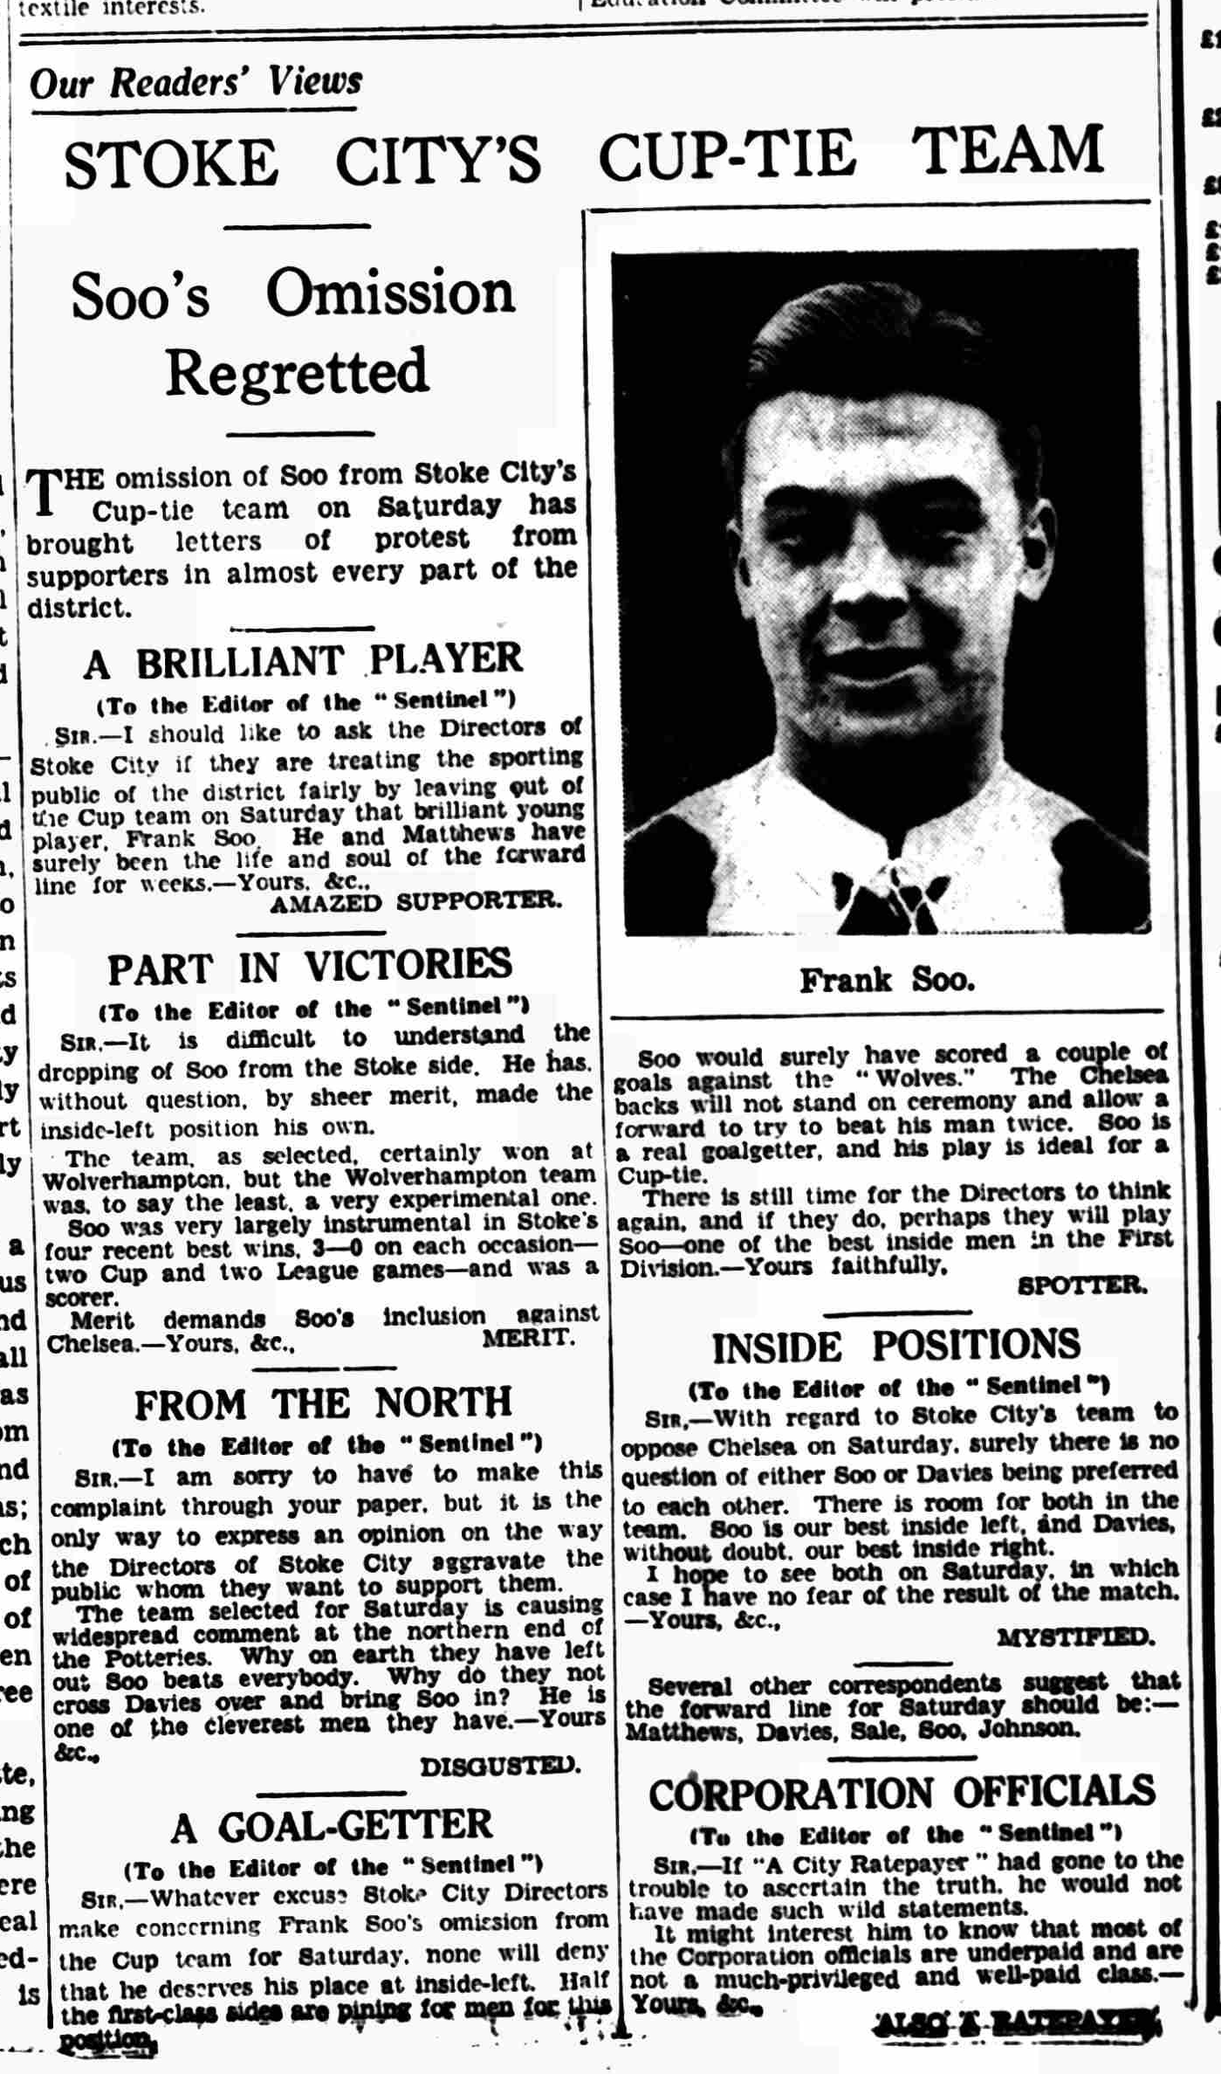


Fan Letters: The Evening Sentinel, 15th February 1934
These letters were written to a local newspaper when it was announced that Frank Soo had not been picked to play in an important cup-tie match.
In small groups you will each be given one of the letters to analyse.
Use your evidence to complete these sentences:
Our letter tells us that Frank Soo was… as a footballer because…
Our letter tells us that the fan thought Frank Soo was… because…
Our letter suggests that Frank Soo should / should not have been selected because…
Notes:
Staffordshire Sentinel - Thursday 15 February 1934
Image © Reach PLC. Image created courtesy of THE BRITISH LIBRARY BOARD.
https://www-britishnewspaperarchive-co-uk.eu1.proxy.openathens.net/viewer/BL/0000525/19340215/112/0006

Slide 19
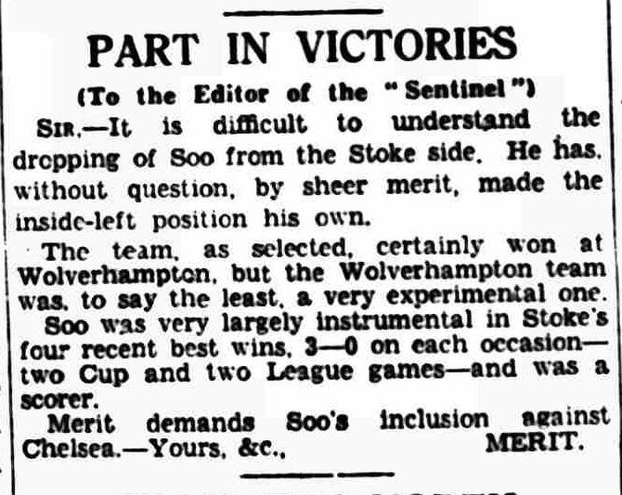
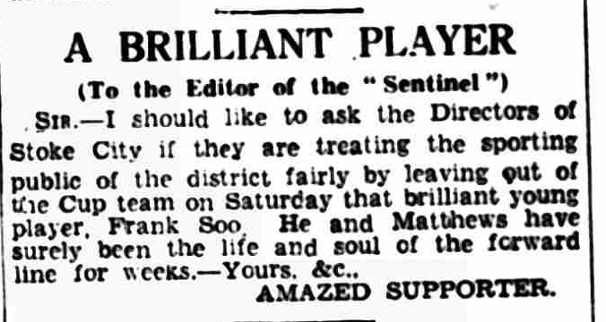
Letters from 15th February 1934
Sir – It is difficult to understand the dropping of Soo from the Stoke side. He has, without question, by sheer merit, made the inside-left position his own.
The team, as selected, certainly won at Wolverhampton, but the Wolverhampton team was, to say the least, a very experimental one.
Soo was very largely instrumental in Stoke’s four recent best wins, 3-0 on each occasion- two Cup and two League games-and was a scorer.
Merit demands Soo’s inclusion against Chelsea. – Yours, &c., MERIT
Sir – I should like to ask the Directors of Stoke City if they are treating the sporting public of the district fairly by leaving out of the Cup team on Saturday that brilliant young player, Frank Soo. He and Matthews (Stanley Matthews) have surely been the life and soul of the forward line for week. – Yours, &c., AMAZED SUPPORTER
Notes:
Teacher Notes – differentiation of letter length and vocab

Slide 20
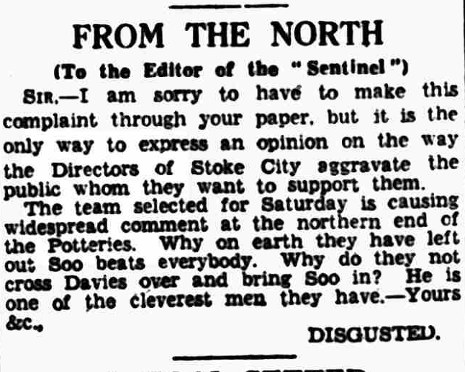
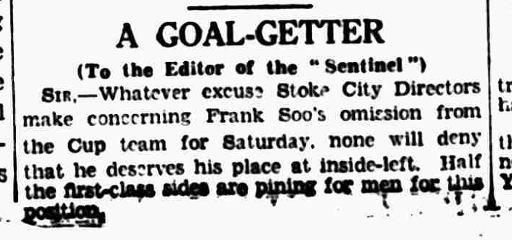
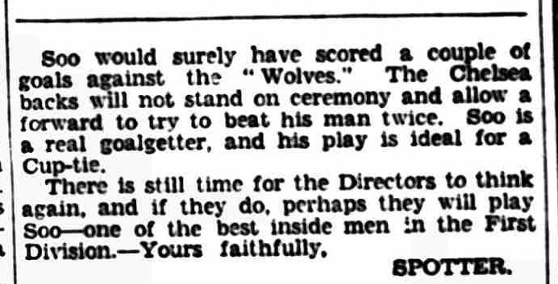
Letters from 15th February 1934
Sir – I am sorry to have to make this complaint through your paper, but it is the only way to express an opinion on the way the Directors of Stoke City aggravate the public whom they want to support them.
The team selected for Saturday is causing widespread comment at the northern end of the Potteries. Why on earth they have left out Soo beats everybody. Why do they not cross Davies over and bring Soo in? He is one of the cleverest man they have. – Yours, &c., DISGUSTED

Slide 21
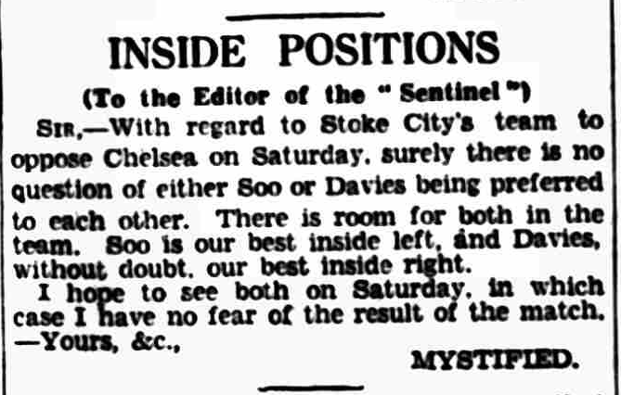
Letters from 15th February 1934
Sir – Whatever excuse Stoke City Directors make concerning Frank Soo’s omission from the Cup team for Saturday, non will deny that he deserves his place at inside-left. Half the first-class sides are pining for men for this position.
Soo would surely have scored a couple of goals against the “Wolves”. The Chelsea backs will not stand on ceremony and allow a forward to try to beat his man twice. Soo is a real goalgetter, and his play is ideal for a Cup-tie.
There is still time for the Directors to think again, and if they do, perhaps they will play Soo – one of the best inside men in the First Division. – Yours, &c., SPOTTER
Sir – With regard to Stoke City’s team to oppose Chelsea on Saturday, surely there is no question of either Soo or Davies being preferred to each other. There is room for both in the team. Soo is our best inside left, and Davies, without doubt, our best inside right.
I hope to see both on Saturday, in which case I have no fear of the result of the match. – Yours, &c., MYSTIFIED

Slide 22


Class Discussion
Each group can now share their sentences with the whole class.
Use the Source Analysis Grid to record everyone’s findings.
Have a whole class discussion reflecting on how the letters can help us consider if Frank as a significant individual.

Slide 23
Source Analysis Grid: Fan’s letters to local newspaper
What things does the fan say? | What does this tell us about Frank as a footballer? | What does this tell us about Frank as a person?

Slide 24
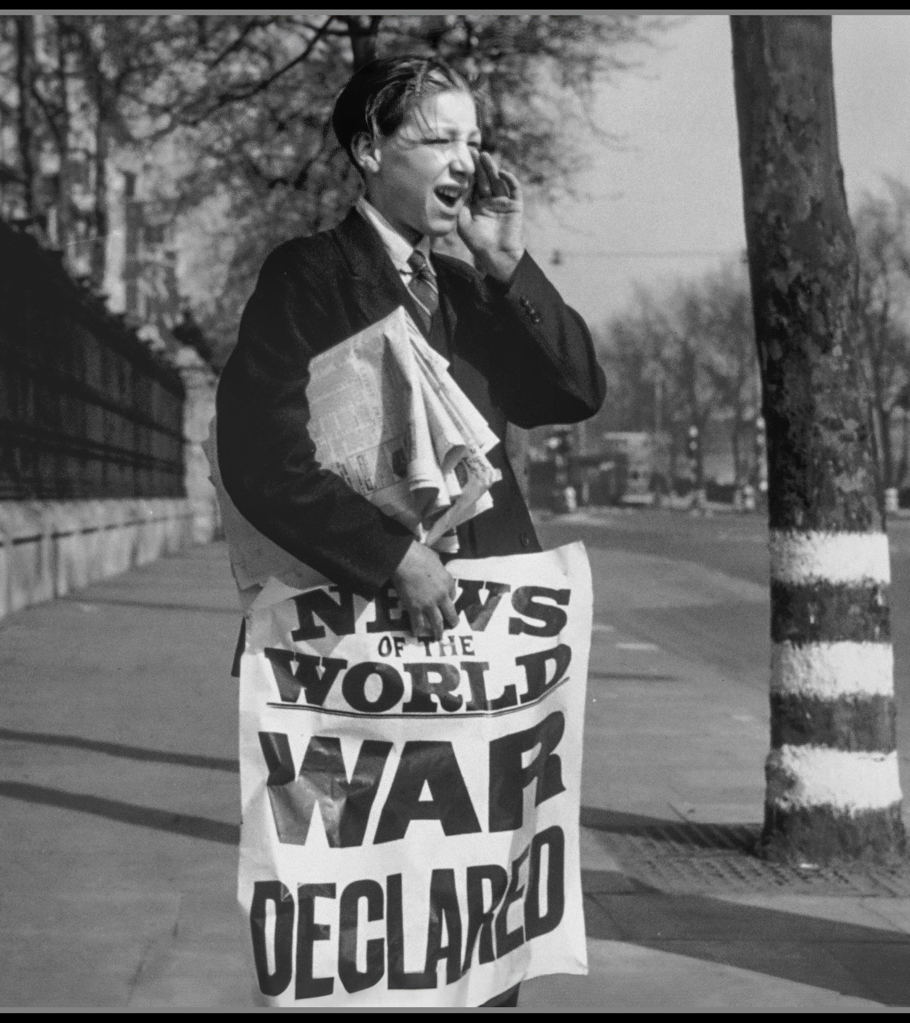
World War Two Declared!
On Sunday 3 September 1939, the UK declared war on Germany.
Children were evacuated to the countryside.
Many men joined the army, navy or RAF and women took on their roles in factories.
Food and clothes were rationed.
Cities were bombed during the Blitz.
Normal life (including sport) was disrupted.
Notes:
Image: © Alamy Ref: 2X23FHP

Slide 25
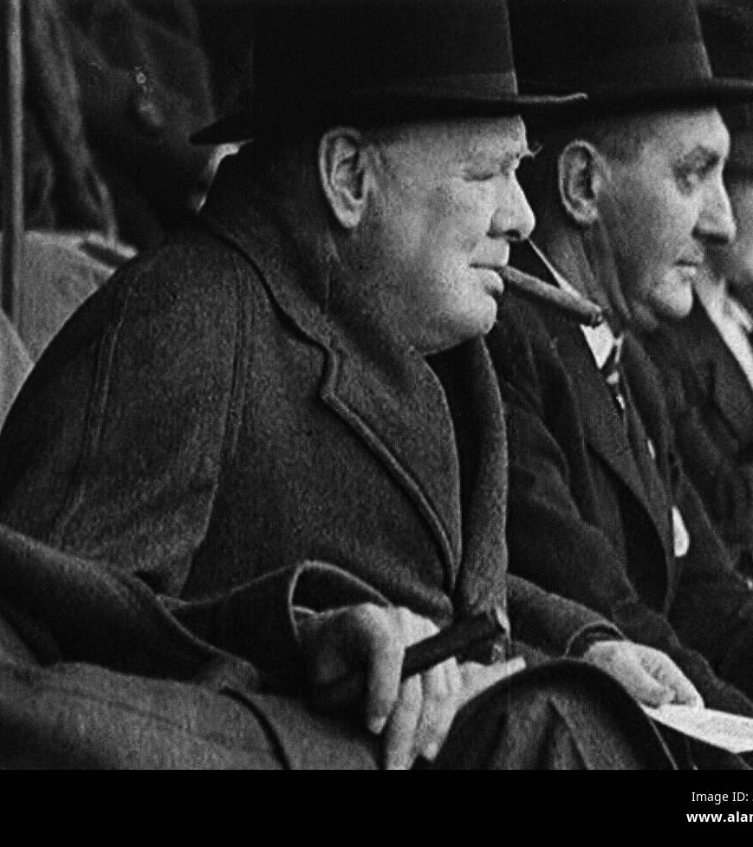
Football in World War Two
Reflection:
Why do you think it was important for some games to carry on?
The Football League was stopped and reorganised.
Teams played in regional leagues instead – as petrol was rationed, so they couldn’t travel as far.
Players often joined the armed forces, so couldn’t play any more either.
Many players became ‘guest players’ for different clubs, just so some games could carry on.
Winston Churchill watches a football match, Wembley, 1941

Slide 26
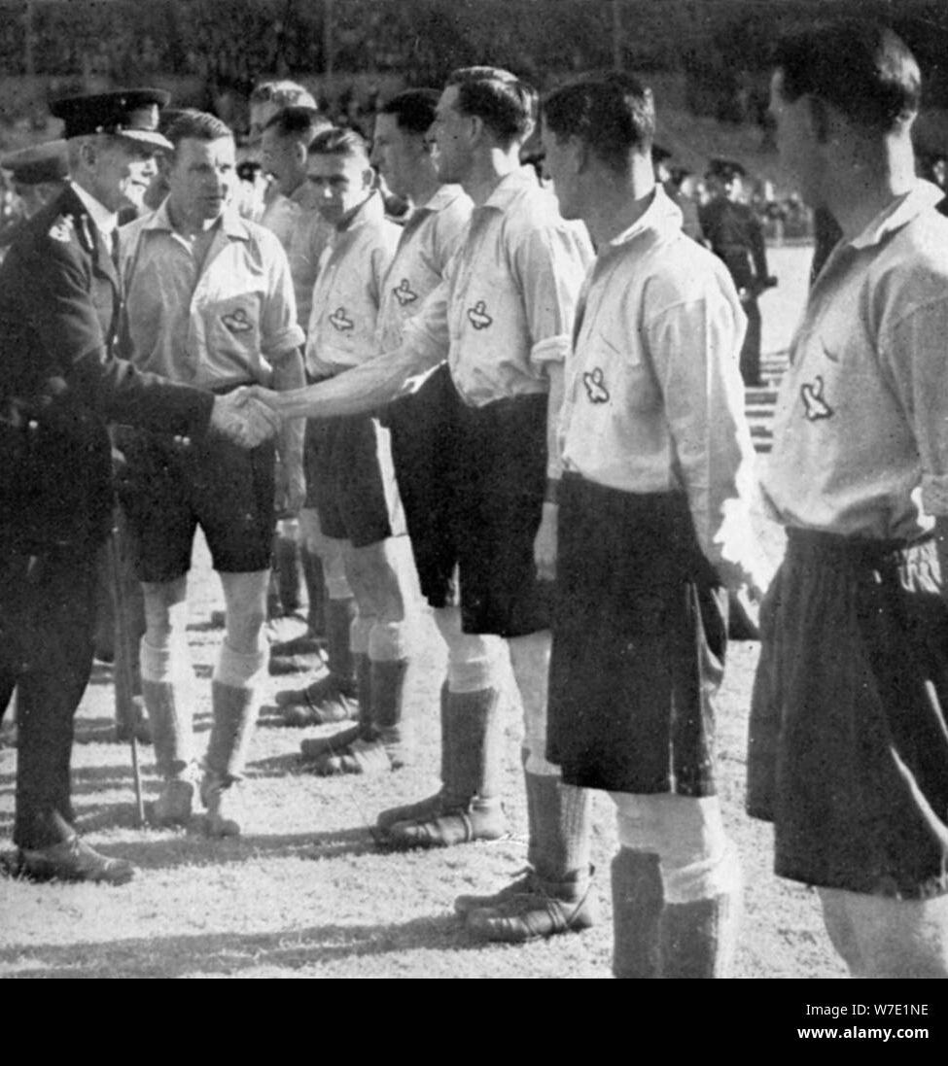
Frank Joins Up
Frank joined the RAF in 1941, where he trained ground crew.
He played as a guest for other clubs in the league, including Stoke, Everton, Liverpool and Millwall.
He also played for the RAF, becoming captain of both the Royal Air Force and Forces XI teams.
RAF vs Metropolitan Police football match, Wembley, 1942

Slide 27
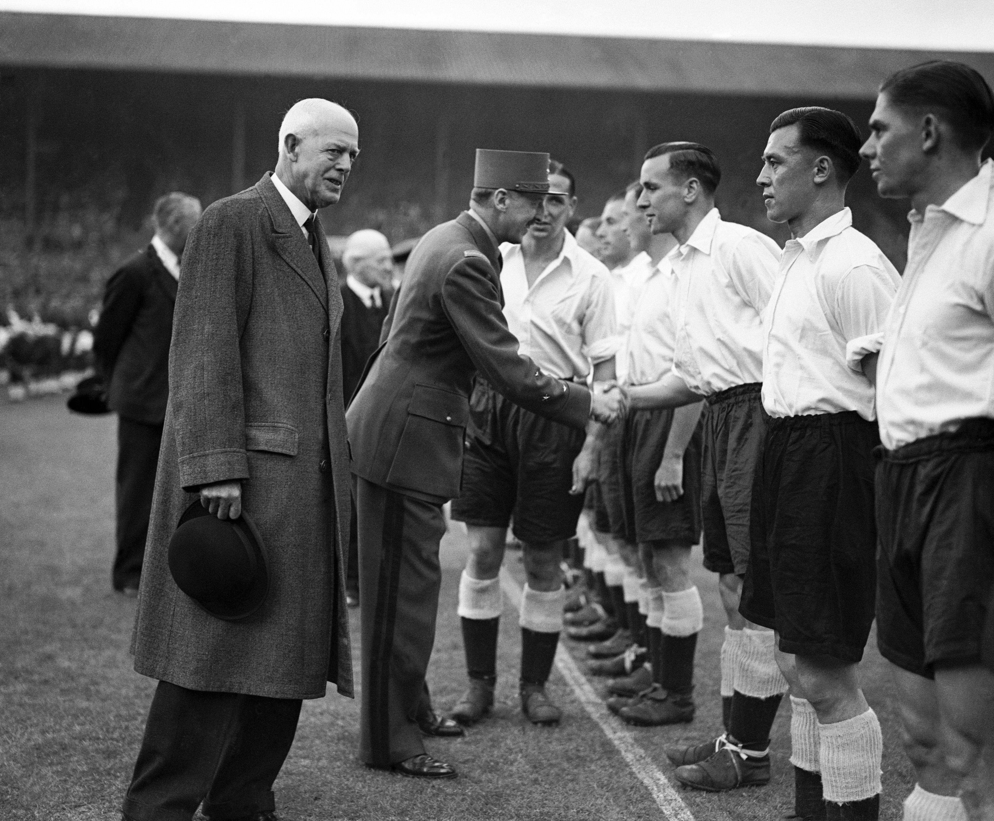
England Call Up
Even before the war, there had been calls for Frank to be given a place in England’s national team.
His first match for England was against Wales on 9 May 1942.
Between 1942 and 1945, Frank played nine times for England.
However, due to the war, these matches were not official, so he never got an official England cap.
This match made Frank Soo the first non-white or Asian person to play for England!
England v France, pre-game handshakes, Wembley, 1945
Notes:
Frank Soo (second from right) waits to shake hands with General Koenig, the French Governor of Paris, before England's 2-2 draw against France at Wembley in 1945

Slide 28
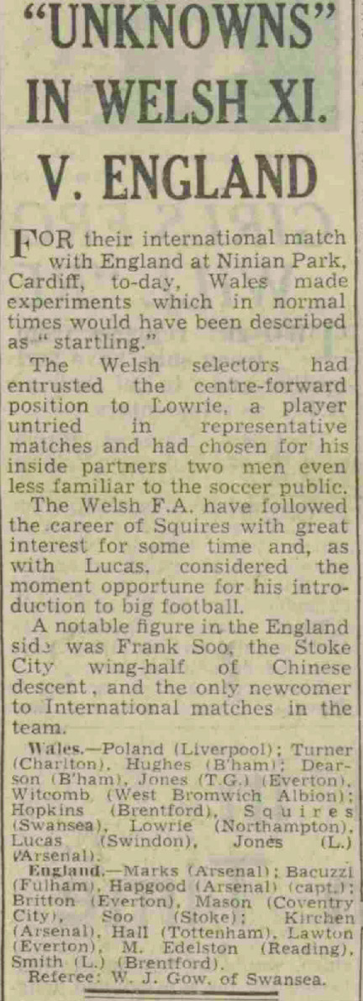
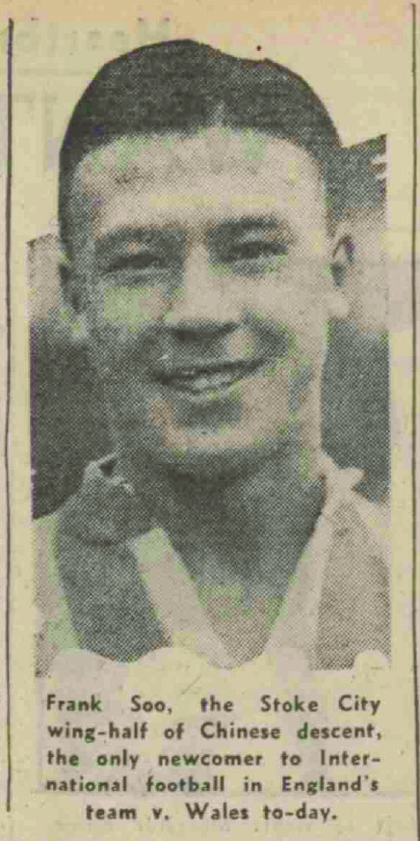
Frank’s Heritage
Reflection:
Are you surprised
that the journalist
mentioned Frank’s
ethnicity? Why?
This photo was published in the Evening Dispatch​ on 9th May 1942 – the same day as Frank’s first match playing for England.
It related to an article titled ‘ “Unknowns” in Welsh XI. V. England’.
The article talked mostly about players in the Welsh team but did also ‘note’ Frank’s inclusion in the England Team.
Notes:
Evening Dispatch - Saturday 9th May 1942
Image © Reach PLC. Image created courtesy of THE BRITISH LIBRARY BOARD.
https://www-britishnewspaperarchive-co-uk.eu1.proxy.openathens.net/viewer/BL/0000671/19420509/079/0004

Slide 29

Frank’s life after the war
When the war ended, he was 31, making him old for a professional.
He left Stoke City in 1945, and it is a credit to his hard work, fitness and talent that he continued playing for other clubs until 1950.
He then became a manager, working mostly with Scandinavian Clubs.
He return to England in the 1980s and died 1991.
Djurgårdens IF won the Swedish league title in 1955 with Frank as their manager
Notes:
Image: Djurgårdens IF, Public domain, via Wikimedia Commons - https://commons.wikimedia.org/wiki/File:Djurgardens_IF_logo.svg

Slide 30
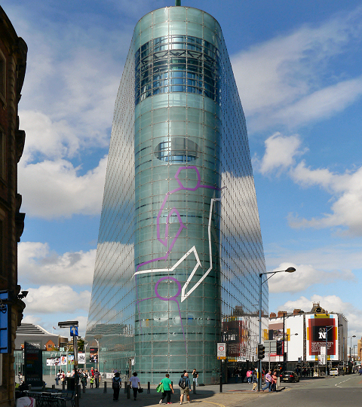
Hall of Fame
In 2024, Frank was inducted into the National Football Museum Hall of Fame.
Tim Desmond, CEO of The National Football Museum, added:
“We are delighted to induct Frank Soo into our Hall of Fame, celebrating not only his achievements on the pitch but also his role as a pioneer for being England’s first-ever player of Asian descent…..His story is incredibly inspiring, and we hope this induction contributes to his legacy.”
National Football Museum, Manchester
Notes:
Image: David Dixon / The National Football Museum, Manchester - https://commons.wikimedia.org/wiki/File:Urbis_Olympics.jpg

Slide 31
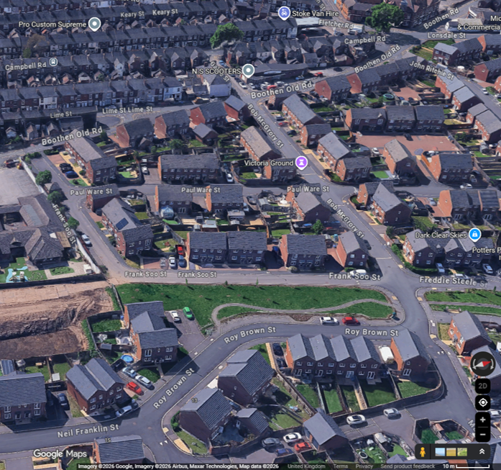
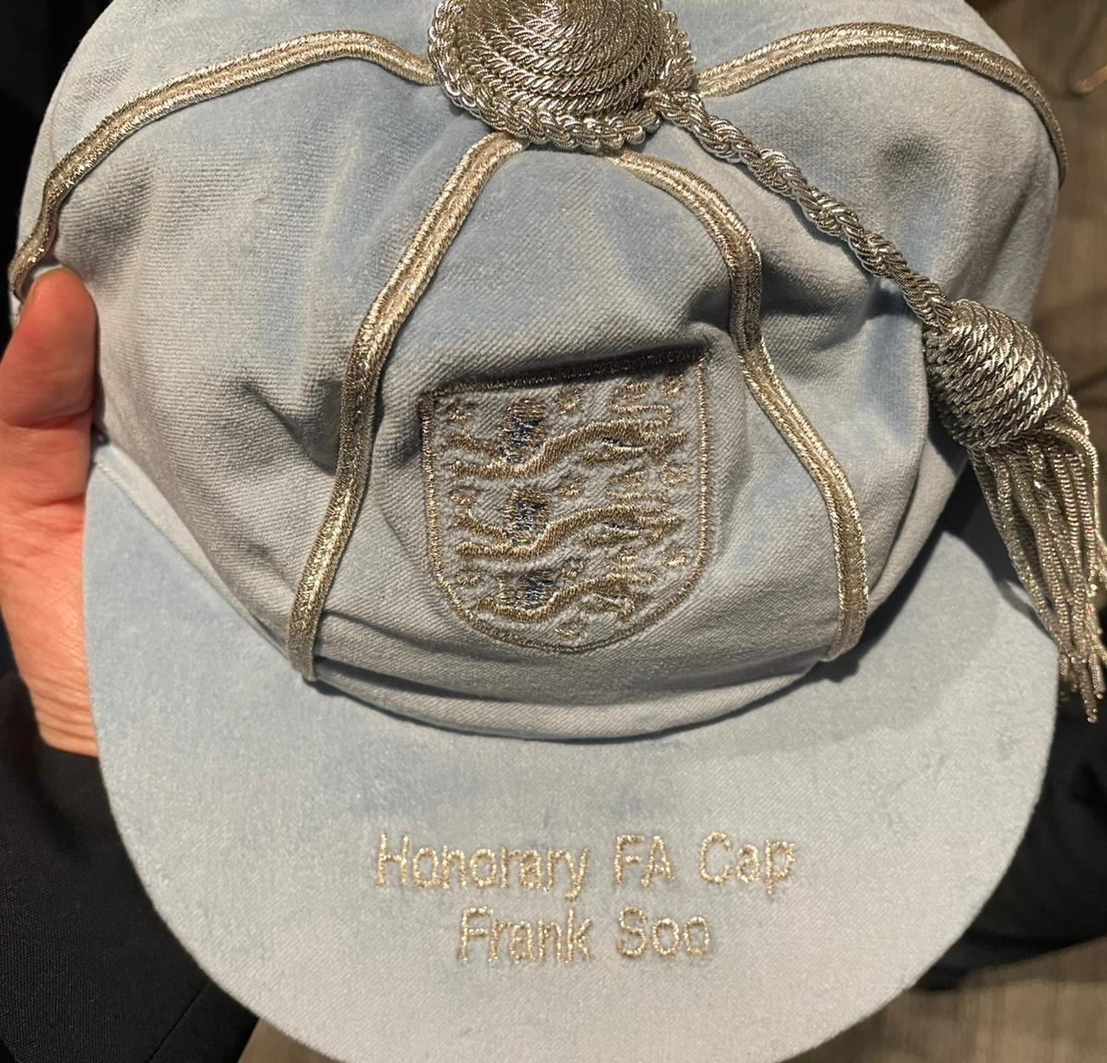
Frank’s Legacy
Frank Soo Street
There is a street named after him in Stoke-on-Trent – next to Stoke City’s old Victoria Ground football.
There is also a Google Arts & Culture online exhibition – Frank Soo: The Forgotten Footballer
In 2025 Frank Soo was awarded a posthumous honorary England Cap.
Frank's Honorary Cap
Notes:
Image 1: © Google Maps 2026
Image 2: © Alan.zp.lau, CC BY-SA 4.0, via Wikimedia Commons - https://commons.wikimedia.org/wiki/File:Frank_Soo%27s_Honorary_England_Cap.jpg

Slide 32

Think back to what makes a person significant?
Did they:
make big changes in their lifetime?
make a lot of people’s lives better or worse?
change the way people think about something?
have a lasting impact on their locality, the country or the world?
set a really good/bad example to people about how to live and behave?
Why might we describe Frank Soo as a significant person?

Slide 33
Why is Frank Soo significant?
Use this to help you write your answer:
Frank Soo is significant because…
One reason he is important is…
This is important because…
Another reason is…
This shows that…
Today, we remember him because…
Frank Soo
Notes:
Image: © Alamy Ref: 2NDPHDX
Structure scaffold (for those who need more support)
Challenge (greater depth)
Was he recognised enough at the time?
Why might his story have been forgotten?
Why is it important to remember him now?

Slide 34
Why is Frank Soo significant?
Key ideas you could include:
First player of East Asian heritage in top-level English football
Played for England (during World War 2)
Successful footballer and captain
Faced challenges and possible unfair treatment
Remembered today (Hall of Fame, foundation, honorary cap, street name)
England v France, pre-game handshakes, Wembley, 1945
Notes:
Structure scaffold (for those who need more support)
Challenge (greater depth)
Was he recognised enough at the time?
Why might his story have been forgotten?
Why is it important to remember him now?

Slide 35

How do we remember and celebrate significant people?

Slide 36
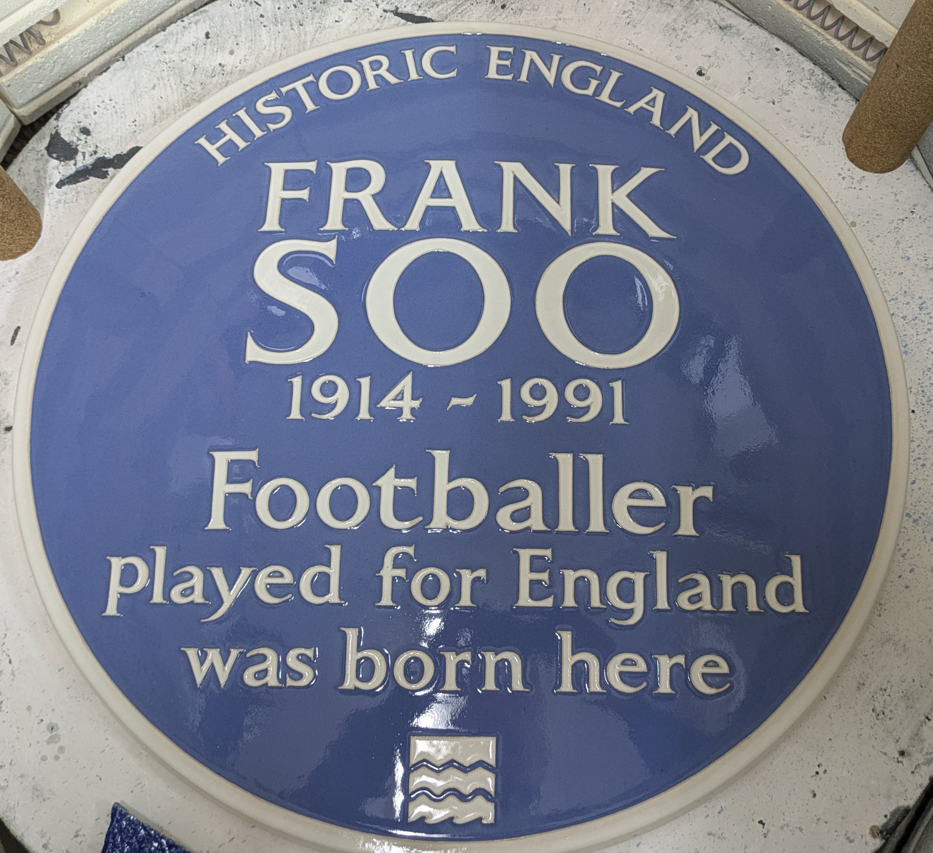
A Blue Plaque to Frank Soo
Frank’s plaque
We have learnt why Frank Soo and 11 Lightwood Road are historically significant.
What is a blue plaque?
Blue plaques are placed on buildings connected to significant people. Until 2024 there was an “official” Blue Plaque Scheme, which ran in London. Local councils and organisations also ran their own schemes. In Feb 2024 Historic England took responsibility for a national blue plaque scheme. Their plan is to place blue plaques across the country to celebrate “people throughout history who have made significant and positive contributions to human welfare or happiness.”
Frank
Notes:
Images from HE website

Slide 37




Your Task
On the template you have been given, design your own plaque celebrating why Frank Soo is such a significant person. Make sure you….
1) Complete the sentence:
Frank Soo is significant because….
You might like to write one or a couple of sentences.
Write
FRANK
SOO
1914 - 1991
2) Draw a picture to illustrate your plaque. You might like to draw the inside or outside of one of the places using the descriptions from the previous slides for inspiration!
Draw

Slide 38
George Harrison Plaque
FRANK SOO
1914 - 1991

Slide 39

Extension Activity 2nd Newspaper article
This is an additional newspaper article talking about Frank’s skills as a footballer and captain.
It could be used as well as or instead of the first newspaper activity, which has the series of much shorter fan letters.

Slide 40
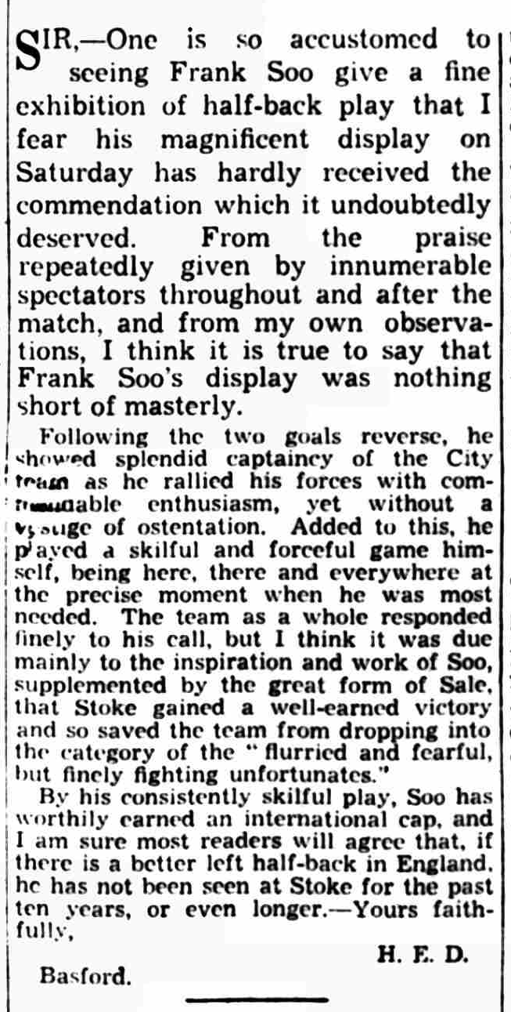
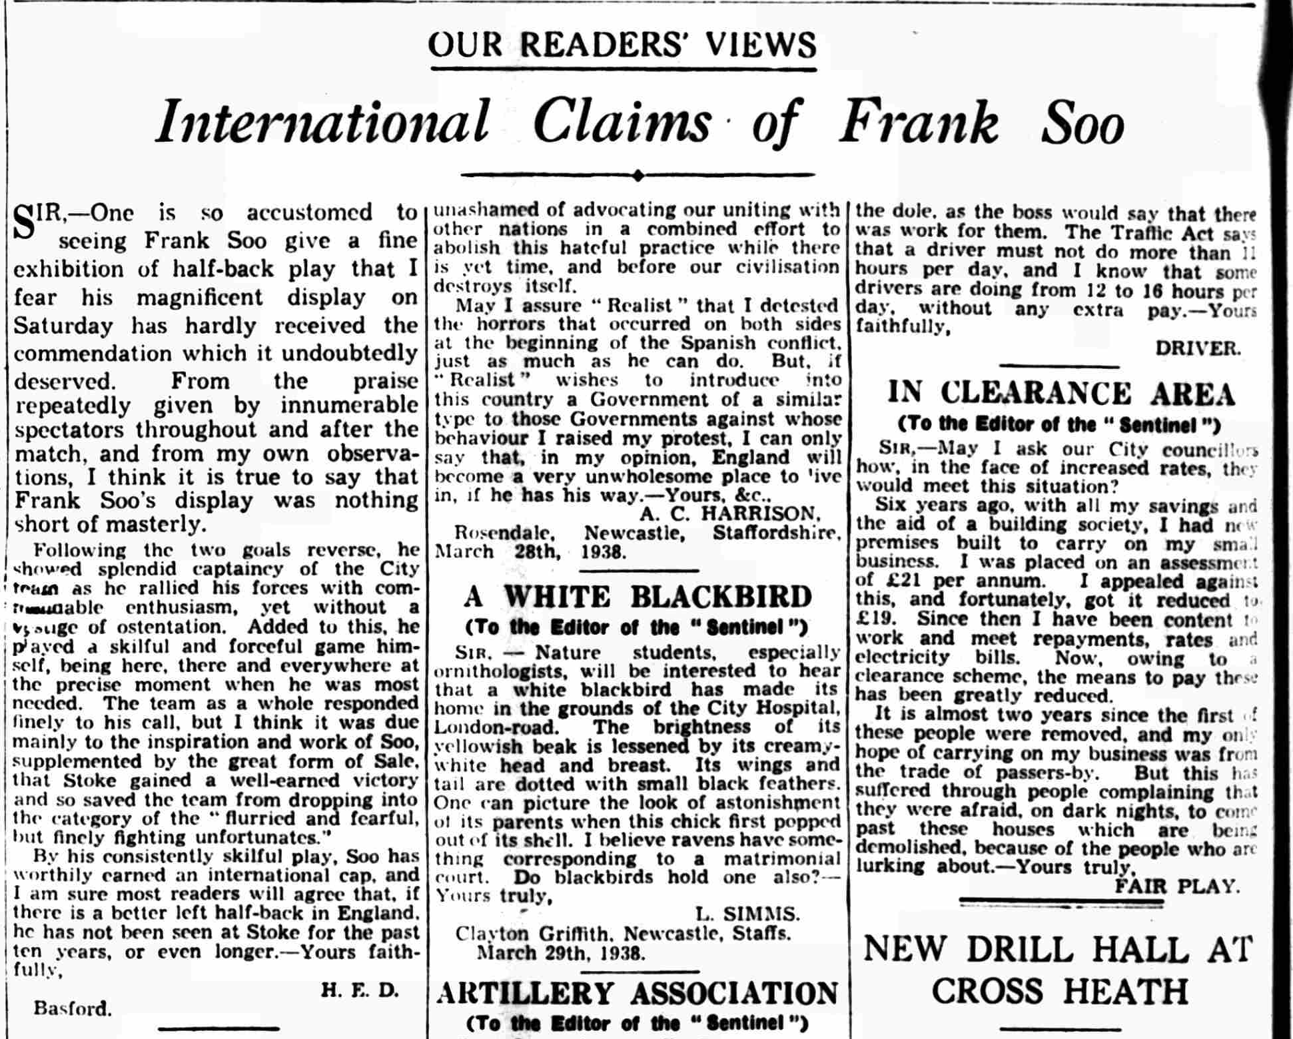
Fan Letter - The Evening Sentinel, 29th March, 1938
When this letter from a fan was published in the newspaper Frank had been playing for Stoke City for over 4 years and was the acting team captain.
Read the article carefully. What positive phrases can you spot about Frank?
Discuss as a class or in groups. You may want to highlight them on a copy of the article.
Notes:
Staffordshire Sentinel - Tuesday 29 March 1938
Image © Reach PLC. Image created courtesy of THE BRITISH LIBRARY BOARD.
https://www-britishnewspaperarchive-co-uk.eu1.proxy.openathens.net/viewer/BL/0000525/19380329/104/0006

Slide 41
Article from ‘The Evening Sentinel’, March 29th 1938

Slide 42
A Popular Player - The Evening Sentinel March 29th 1938
What positive phrases did you spot about Frank? Here are a few:
“…his magnificent play on Saturday has hardly received the commendation it undoubtedly deserved”
“Frank Soo’s play was nothing short of masterly”
“…he showed splendid captaincy”
“…he rallied his forces with commendable enthusiasm”
“… He played a skilful and forceful game himself being here, there and everywhere at the precise moment when he was most needed”
“By his consistently skilful play, Soo has worthily earned an international cap”

Slide 43
Source Analysis Grid: Fan’s letter to local newspaper
What things does the fan say? | What does this tell us? | What questions do you have?

Slide 44
Source Analysis Grid: Fan’s letter to local newspaper
What things does the fan say? | What does this tell us? | What questions do you have?

