Slide 1
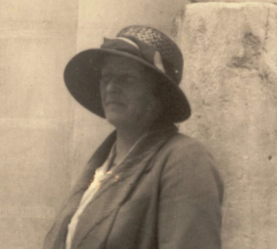
Local Significant People
Dorothea Bate
Education
Notes:
Image: © National Museum of Archaeology/Heritage Malta

Slide 2
Local Significant People: Dorothea Bate
Key Stage: 2 - History
To learn about significant historical events, people and places in their own locality
To study an aspect of history dating from a period beyond 1066 that is significant in the locality
To gain historical perspective by placing their growing knowledge into different contexts, understanding the connections between local, regional, national and international history

Slide 3

What makes a person significant?
Questions to ask about a person.
Did they:
make big changes in their lifetime?
make a lot of people’s lives better or worse?
change the way people think about something?
have a lasting impact on their locality, the country or the world?
set a really good/bad example to people about how to live and behave?
Notes:
For this activity we’re using Ian ‘Dawson’s Model’ for significance criteria.

Slide 4
How can we find out about local significant people?
?
Ask people who might know about them
Use books and the internet to research them
Find buildings and places connected to them
Who’s local to me?

Slide 5
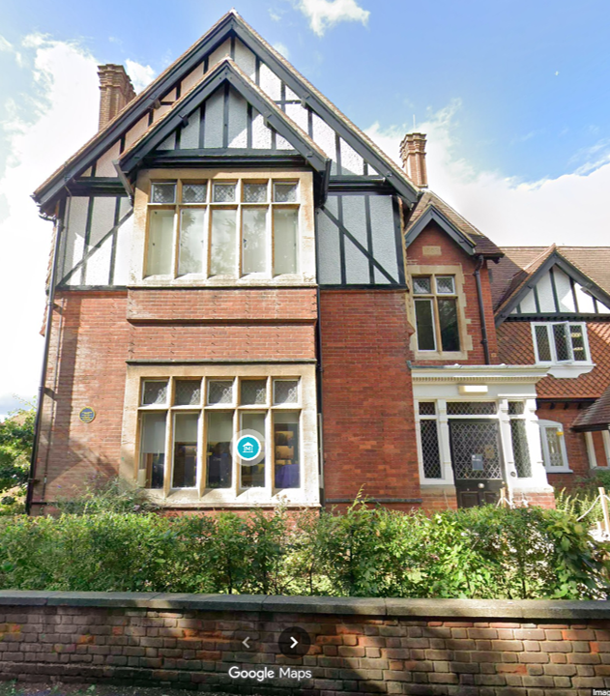
Is this a house or …?
This is the Natural History Museum at Tring. It is connected to Dorothea Bate; our local, significant person.
Find, the Natural History Museum at Tring on Google Maps.
How many miles away is it from your school?
How long would it take you to walk or drive?
Would you say this building is local to your school?
The old house as seen from Park Street
Notes:
Image: © Google Maps 2026

Slide 6
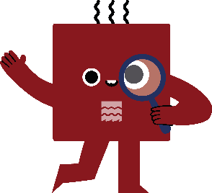
What can a building tell us?
History detectives!
Complete the inference grid on the next page to explore what this building can tell you…..

Slide 7
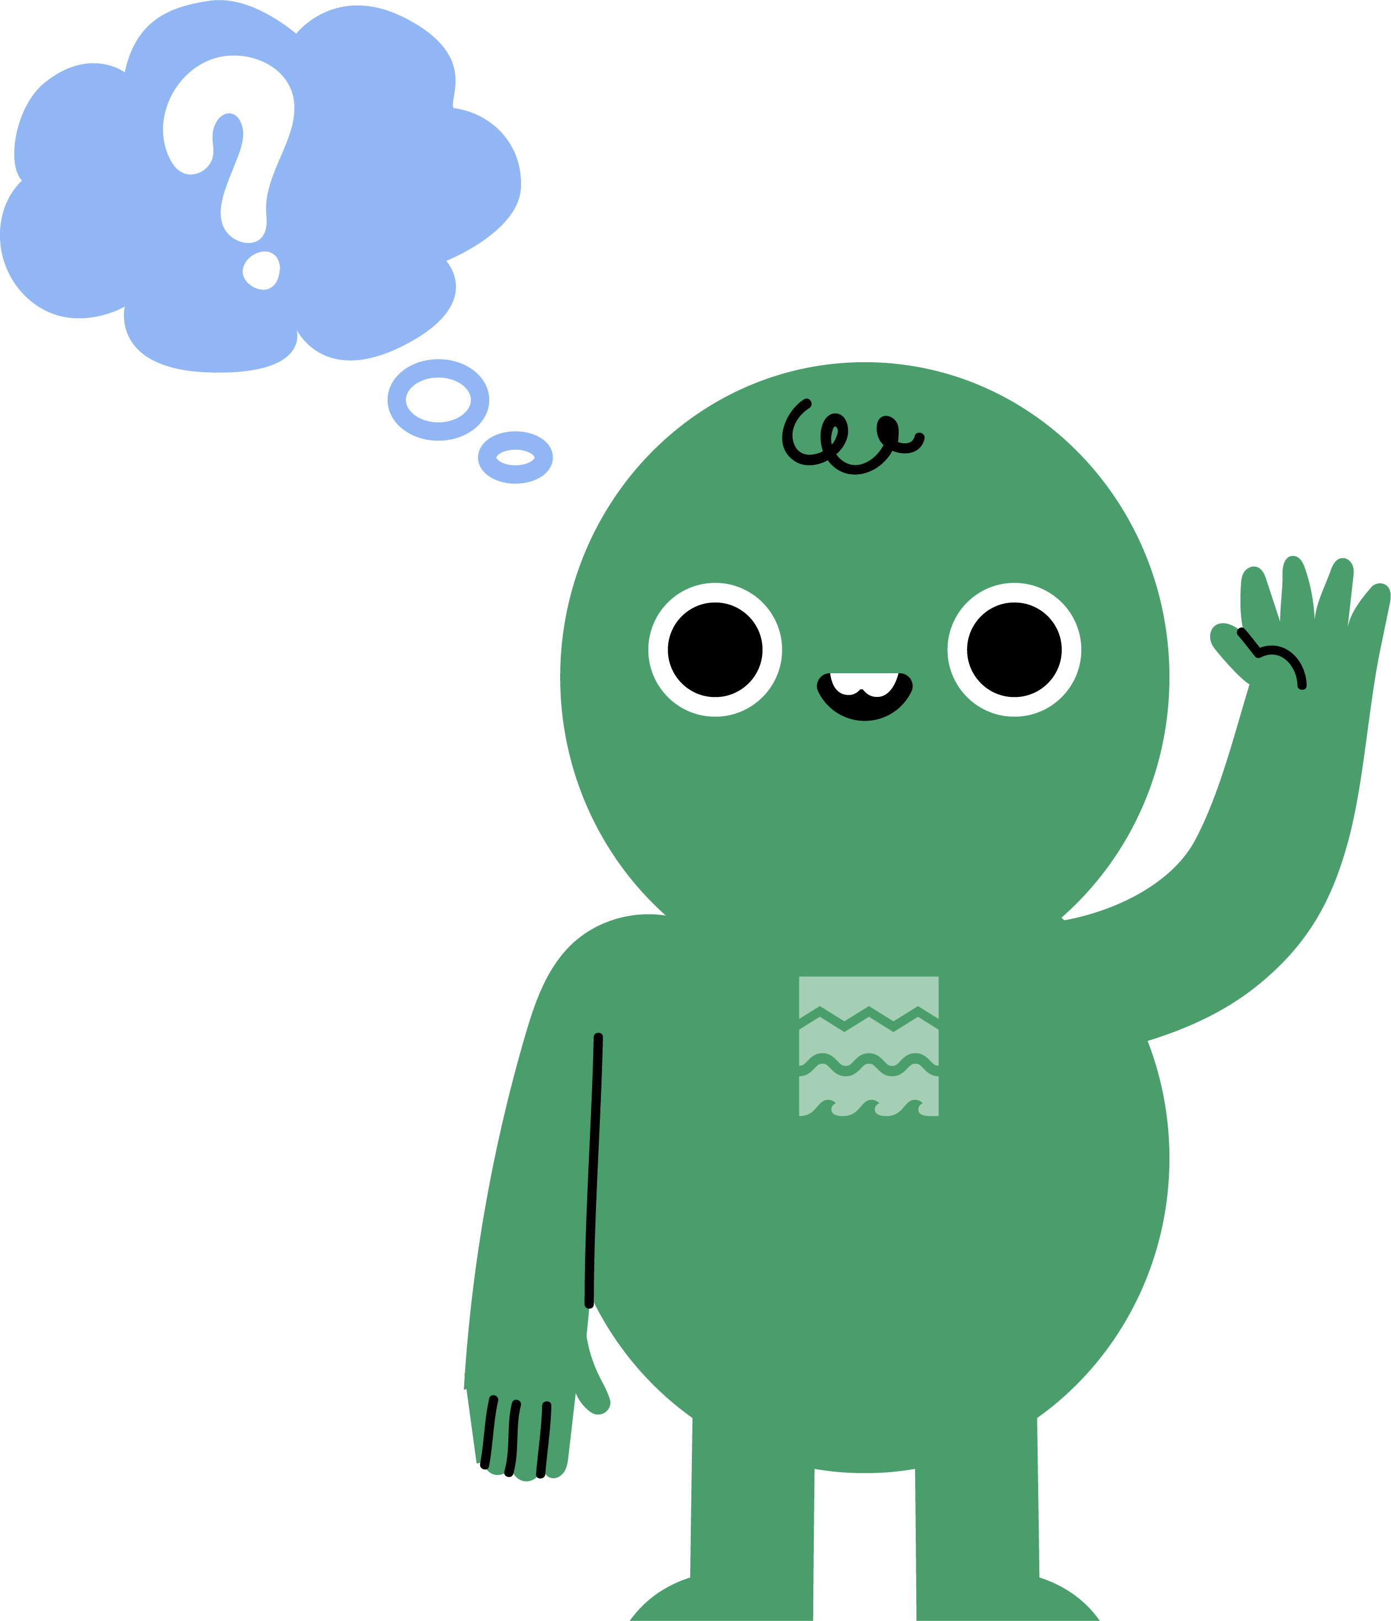

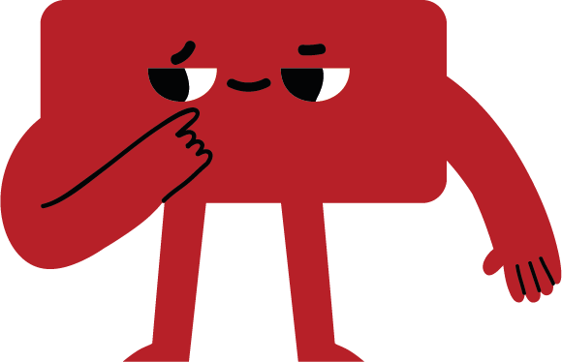
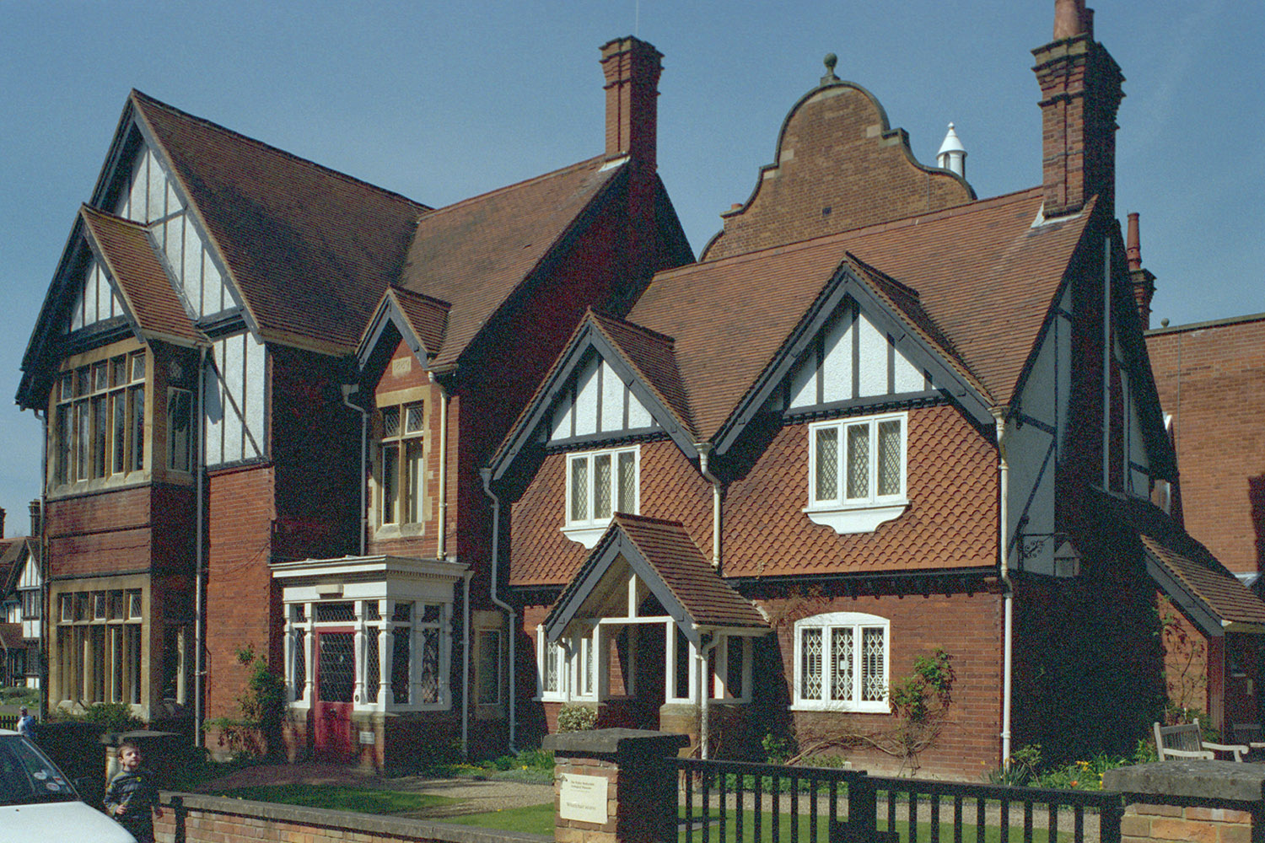
What can buildings tell us?
(I think….because)
Notes:
Image: © Susan Hall. Source: Historic England Archive Ref: IOE01/01942/19 Date: 3 Apr 2002 - https://historicengland.org.uk/images-books/photos/item/IOE01/01942/19

Slide 8
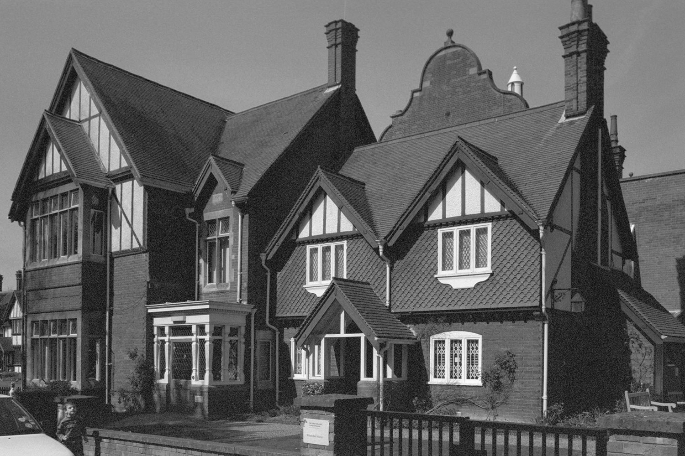
Print out inference square
Notes:
Image: © Susan Hall. Source: Historic England Archive Ref: IOE01/01942/19 Date: 3 Apr 2002 - https://historicengland.org.uk/images-books/photos/item/IOE01/01942/19

Slide 9
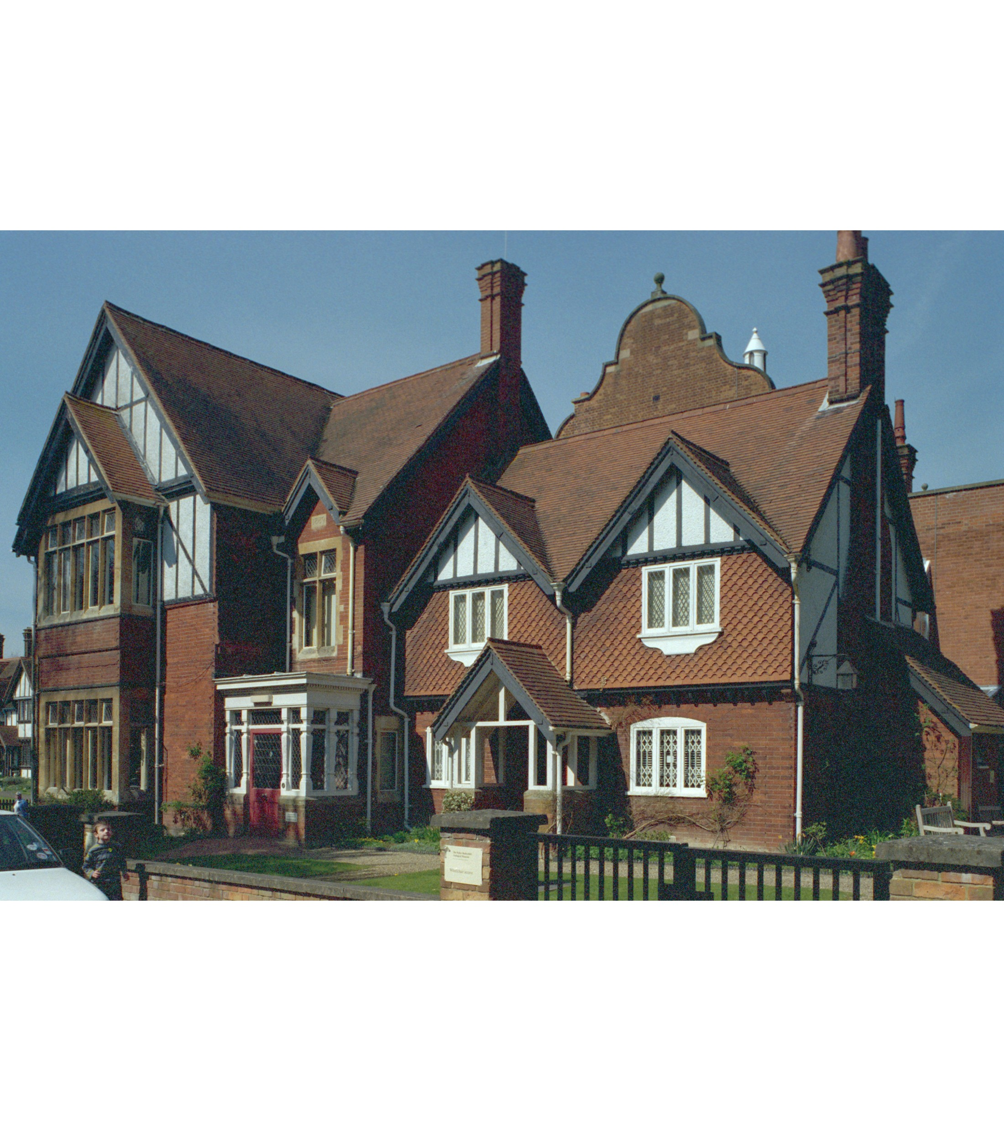
Park Street, Tring
These buildings on the corner of Park Street and Akeman Street in Tring look like houses from the late 19th and early 20th centuries
But they are actually very special….
Domestic Revival: the ⁠Natural History Museum at Tring is a textbook example of domestic revival architecture, built in the 'Old English’ & ‘Mock Tudor’ style.
Tring Natural History Museum
Notes:
Image: © Susan Hall. Source: Historic England Archive Ref: IOE01/01942/19 Date: 3 Apr 2002 - https://historicengland.org.uk/images-books/photos/item/IOE01/01942/19
Teacher Notes
The Natural History Museum at Tring. The Natural History Museum at Tring - formerly the Walter Rothschild Zoological Museum - was constructed in 1889 to a design by William Huckvale (1848-1936) to house the private collection of mounted specimens and library collected by Lionel Walter (2nd Baron) Rothschild. First opened to the public in 1892, the Museum is home to one of the finest collections of stuffed mammals, birds, reptiles and insects in the United Kingdom; its extensive library is available to researchers. The Museum is located in Akeman Street, Tring, and is well worth a visit (at the time of writing, admission is free).
The Museum's main entrance (now in Akeman Street) was originally in Park Street, shown here. The end of the exhibition hall is on the right of the picture

Slide 10
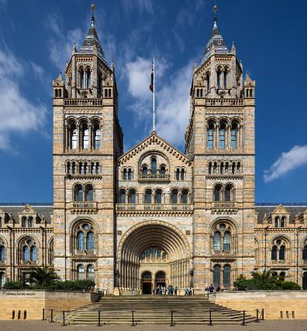
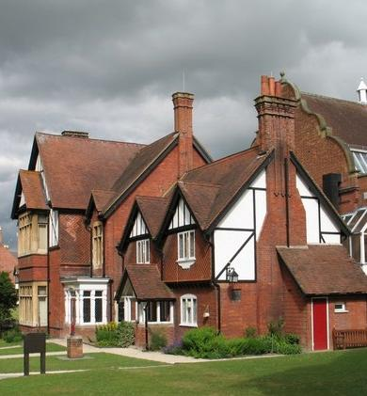
The Natural History Museum
Why do the two buildings look so different?
The Natural History Museum was built between 1873 and 1881 in South Kensington, London, featuring Romanesque architecture, terracotta details, and nature carvings.
In 1937, the Natural History Museum took over the site in Tring along with its collections.
Notes:
Image: © Christine Matthews
https://commons.wikimedia.org/wiki/File:Entrance_to_Natural_History_Museum,_Cromwell_Road,_London_SW7_-_geograph.org.uk_-_1034304.jpg
Image: © Ian Petticrew
File:The Natural History Museum at Tring - geograph.org.uk - 1484434.jpg
https://commons.wikimedia.org/wiki/File:The_Natural_History_Museum_at_Tring_-_geograph.org.uk_-_1484434.jpg
Teacher Notes AI generated
Vocabulary: Natural History Museum - A natural history museum is a scientific and educational institution that studies, collects, and displays objects from the natural world. These items include fossils, animals, plants, rocks, minerals, and human cultural artifacts. Their goal is to show the history of life and the earth.
The Natural History Museum in London is a world-famous centre for science and a stunning Romanesque building. It traces its roots back to 1753 from Sir Hans Sloane's collection, opened in South Kensington in 1881, and today holds over 80 million specimens with free public entry.
History
1753 Origins: Started with the personal collection of doctor Sir Hans Sloane, bought by the government to form the early British Museum.
1860s Move: Biologist Richard Owen pushed for a new, separate home as the items grew too large for cramped basement rooms.
1881 Opening: The landmark terracotta building on Cromwell Road, designed by architect Alfred Waterhouse, opened to the public.
1963–1992 Independence: Officially split from the British Museum in 1963 and took on the clear name "Natural History Museum" in 1992.
Description
Architecture: Built with patterned terracotta tiles featuring exterior carvings of living animals on the left and extinct animals on the right.
Hintze Hall: The grand central entrance featuring "Hope," a massive suspended blue whale skeleton.
Collections: Houses millions of items covering botany, entomology, mineralogy, palaeontology (including famous dinosaur fossils), and zoology.

Slide 11
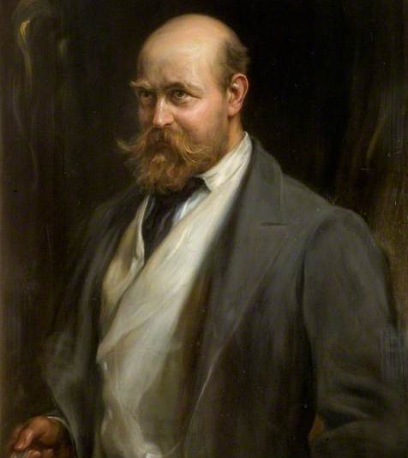
Lionel Walter Rothschild
In 1868 Lionel Walter Rothschild was born into the famous Rothschild banking family.
As a child he was fascinated by nature, not money, and began collecting insects at his home, Tring Park.
At 10 he started his first museum in a garden shed.
Lionel Walter Rothschild
Notes:
Image: © Jozsi Arpád Koppay, Public domain, via Wikimedia Commons
Lionel Walter Rothschild (1868–1937)
https://commons.wikimedia.org/wiki/File:Lionel_Walter_Rothschild_%281868%E2%80%931937%29.jpg
Teacher Notes
Lionel Walter Rothschild (1868–1937) was a prominent British zoologist, banker, and politician best known for amassing the largest natural history collection driven by a single person, founding the Tring Museum, and receiving the historic Balfour Declaration.
Zoology
Gathered over 2 million butterflies, 300,000 bird skins, and thousands of other mammals and insects.
Studied Zoology at Cambridge Uni
Opened his private museum in Hertfordshire in 1892, which later became part of the Natural History Museum.
Kept giant tortoises and zebras, famously training the latter to pull a carriage.
Politics
Associated with Zionism and supported the founding of Israel
Balfour Declaration: Received the 1917 letter from Arthur Balfour expressing British support for a Jewish national home in Palestine.
Served as a Conservative Member of Parliament for Aylesbury from 1899 to 1910.
Acted as a leading figure in the British Jewish community
The Rothschild family is a wealthy Ashkenazi Jewish noble banking dynasty founded by Mayer Amschel Rothschild in 18th-century Frankfurt, Germany. Key aspects of their history and legacy include:
Mayer Amschel Rothschild (1744–1812) was a coin and antique dealer in the Frankfurt ghetto before becoming a court agent to the Landgraves of Hesse-Kassel. Sent to establish banking houses in five major European financial centres—London, Paris, Vienna, Naples, and Frankfurt.
Created Europe's first cross-border banking network, financing sovereign governments, major infrastructure, and railways.
Only the British and French branches continue today, operating financial advisory firms like Rothschild & Co.
Known historically for extensive art collections, wine production (such as Château Lafite Rothschild), and charitable foundations.
The family's 19th-century wealth and Jewish heritage made them frequent targets of persistent, antisemitic conspiracy theories falsely alleging secret control over global economies, governments, and world events

Slide 12
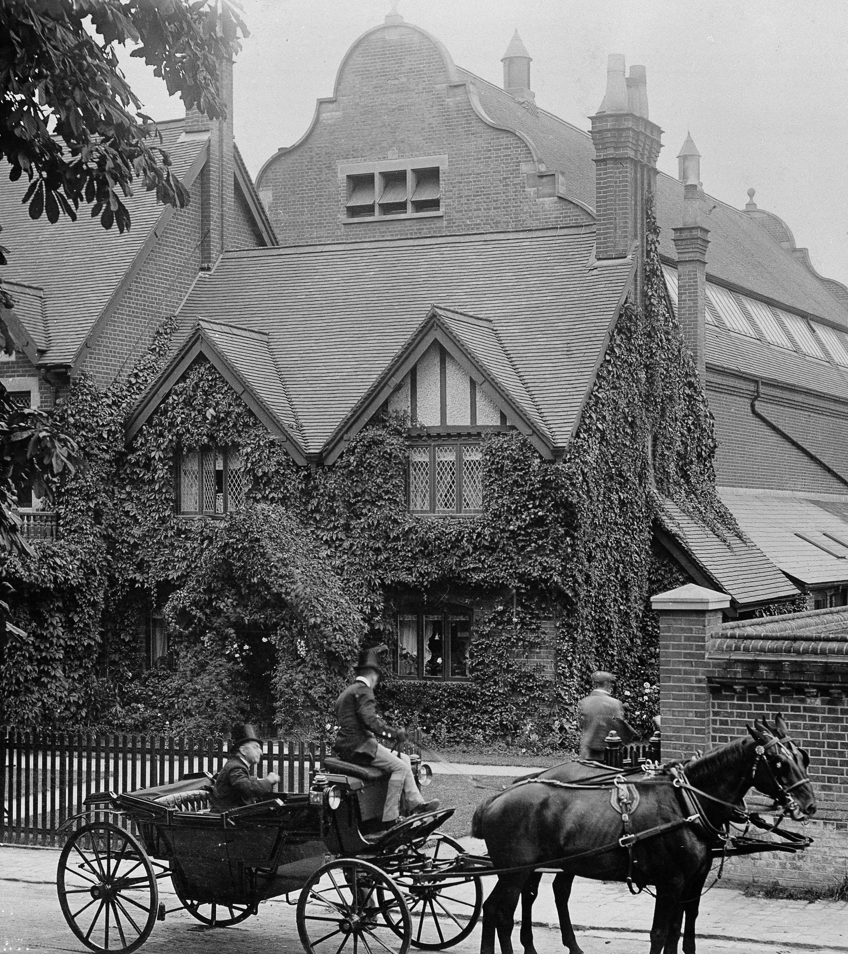
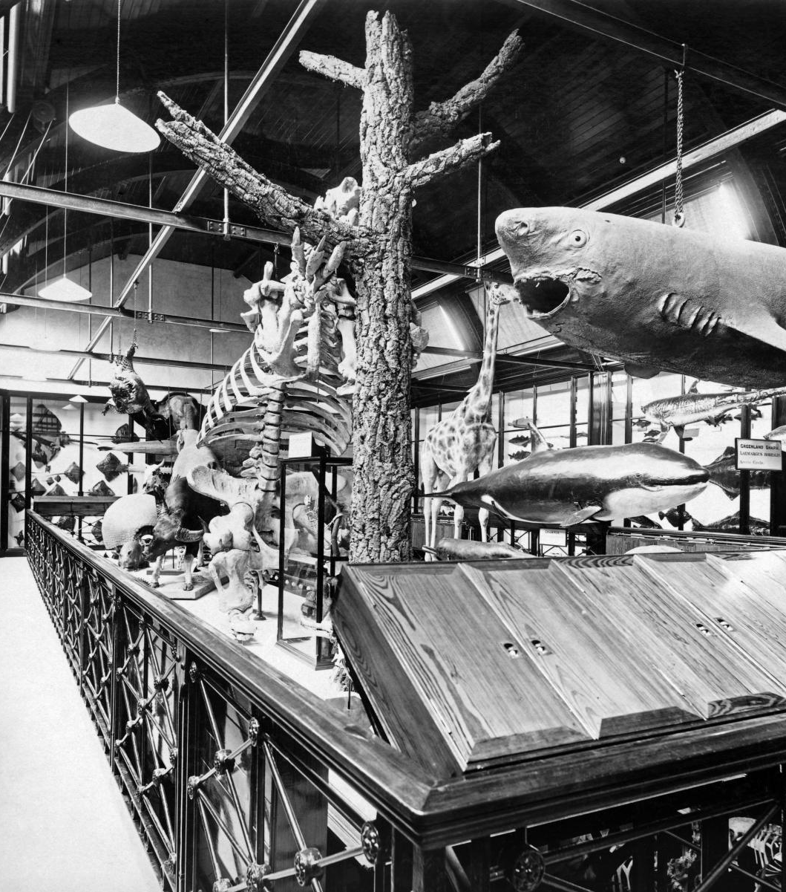
A Private Museum
People outside Walter’s Zoological Museum
As his collection grew, his father built him his own museum for his 21st birthday in 1889.
It then opened to the public in 1892 as Walter’s Zoological Museum.
It was filled with amazing natural history specimens for people to see.
It’s now the Natural History Museum at Tring.
Find out more about Walter Rothschild.
Notes:
Image: © Alamy Ref: DTF210
Image: Source: Historic England Archive Ref: BL11794 Date: 1892 - https://historicengland.org.uk/images-books/photos/item/BL11794
Teacher Notes
Zoological - relating to animals or the scientific study of animals

Slide 13
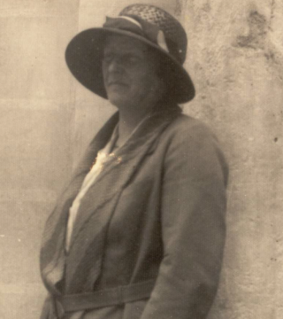
Meet Dorothea Bate
Dorothea Minola Alice Bate was born on 8 November 1878 at Napier House, Carmarthen, Wales.
Her father had been in the military; he then became a police superintendent.
She had an older sister and a younger brother.
Dorothea Bate
Notes:
Image: © National Museum of Archaeology/Heritage Malta
Teacher Notes
Dorothea Minola Alice Bate was born on 8 November 1878 at Napier House, Carmarthen, Wales, a second daughter to Henry Reginald Bate of County Wexford, Ireland, and Elizabeth Fraser Bate née Whitehill. Her father had been in the military; he subsequently became a police superintendent. By 1881, the two-year-old Bate was living with her parents and sister, Lily (later called Leila), at Green Hall, Carmarthen. By 1891, the family had moved to Newcastle in Emlyn, Carmarthenshire. Bate was then twelve. She now had a younger brother Thomas, aged nine, as well as her elder sister.

Slide 14
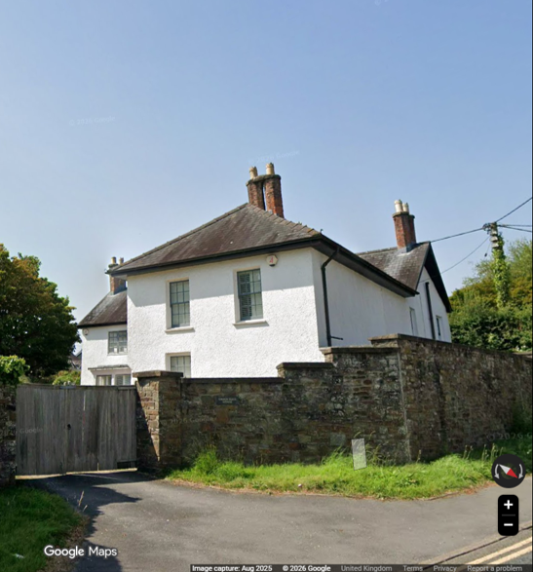
Dorothea’s childhood homes
By 1881, two-year-old Dorothea was living with her parents and three-year-old sister, Lily (later called Leila), at Green Hall, Carmarthen.
By 1891, the family had moved to Newcastle Emlyn, Carmarthenshire.
Dorothea was now 12 had a younger brother Thomas, aged nine, as well as her elder sister.
Napier House, Carmarthen, Wales.
Notes:
Image: © Google Maps 2026
Teacher notes:By 1881, the two-year-old Bate was living with her parents and sister, Lily (later called Leila), at Green Hall, Carmarthen. By 1891, the family had moved to Newcastle in Emlyn, Carmarthenshire. Bate was then twelve. She now had a younger brother Thomas, aged nine, as well as her elder sister.

Slide 15
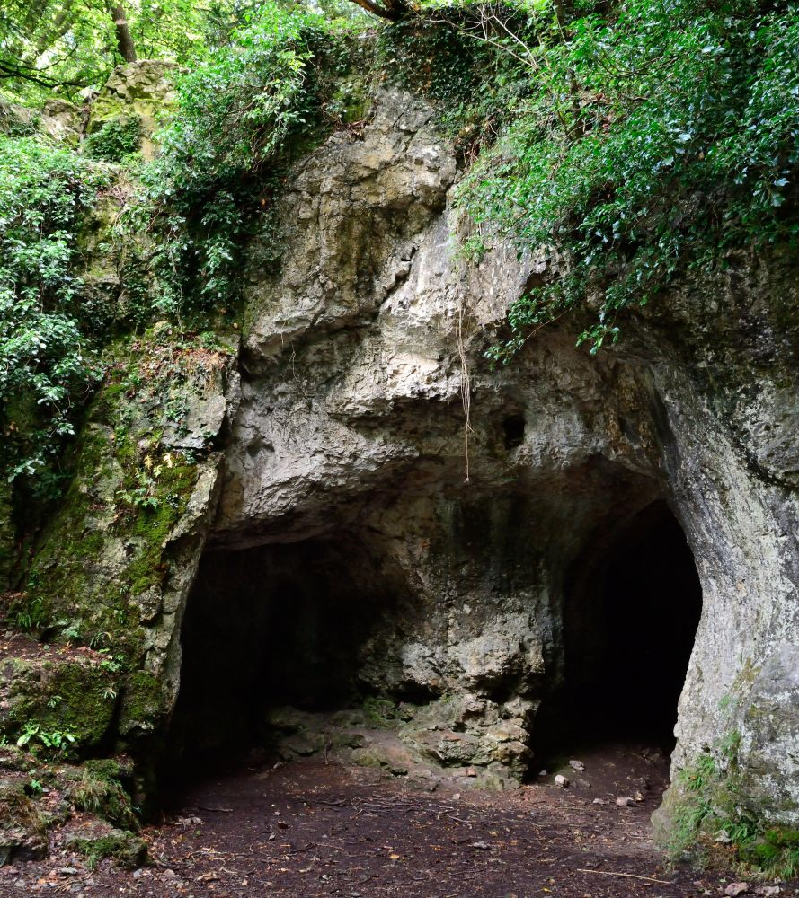
Dorothea’s Childhood
In 1898, the family moved to Bicknor Court, Coleford, Gloucestershire, a large Tudor stone manor house in a pretty rural location near the Wye Valley.
Dorothea was free to explore the countryside and limestone caves at Little Doward.
It was here she began to collect fossils.
King Arthurs Cave, Lords Wood The Doward, Symonds Yat
Notes:
Image: ©Alamy Ref: H5308
Teacher Notes:
Fossils - the preserved remains, impression, or trace of a living thing from a past geological age, typically more than 10,000 years old
Dorothea’s first fossil discoveries were made in the caves of the cliffs above the River Wye. She uncovered 15 species of mammals and birds dating back around 10,000 years to the Pleistocene Epoch.

Slide 16
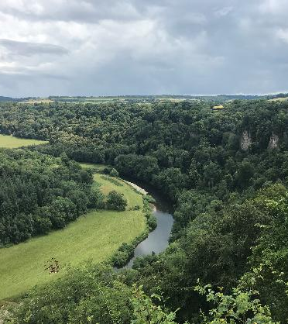
Dorothea’s Education
She only went to school for a short time. She joked that her education had been ‘temporarily interrupted by a period at school’.
She learned mostly at home and through reading and exploration.
Her father encouraged her to watch birds, fish, and study nature in the countryside.
She had no school qualifications or university degree when she started her career.
River Wye viewed from Yat Rock
Notes:
Image: © H8062la, CC BY-SA 4.0, via Wikimedia Commons
https://commons.wikimedia.org/wiki/File:River_Wye_viewed_from_Yat_Rock.jpg
Teacher Notes
The Wye Valley features a rich geological and palaeontological record, famous for Pleistocene mammal remains found in limestone cave systems like King Arthur's Cave near Symonds Yat. These caves preserve bones from Ice Age species including woolly mammoths, woolly rhinos, lions, and hyenas, alongside early human artifacts. The meandering river carved deep gorges into the limestone and sandstone layers, exposing ancient marine and riverine strata.
Noted 20th-century palaeontologist Dorothea Bate famously studied the bone caves of the Wye Valley, analysing how Ice Age climate shifts impacted local animal species
Key Sites
King Arthur's Cave: Located in the Doward hills, it contains a deep stratigraphic record of Late Pleistocene animal life and Paleolithic human occupation.
Merlin’s Cave: Another nearby site in the Lower Wye Gorge with significant multi-period mammal excavations.

Slide 17
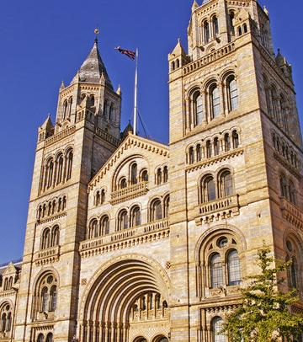
A job at the Natural History Museum
In 1898, 19-year-old Dorothea travelled to the Natural History Museum in London and talked her way into a job.
There were virtually no women scientists at the time. In fact, women weren’t allowed to become official members of the scientific staff until 1928 – 30 years later!
Her first job was sorting animal skins. She impressed the staff and became an unpaid assistant at the museum.
What does this suggest about Dorothea’s character?
Entrance to Natural History Museum, Cromwell Rd, London
Notes:
Image: © Christine Matthews / Entrance to Natural History Museum, Cromwell Road, London SW7
https://commons.wikimedia.org/wiki/File:Entrance_to_Natural_History_Museum,_Cromwell_Road,_London_SW7_-_geograph.org.uk_-_1034304.jpg
Teacher Notes
To make sense of her early collections of birds and small mammals, the young Bate travelled to London in 1900 to visit Dr Richard Bowdler Sharpe, then in charge of the Bird Room in the Department of Zoology at the Natural History Museum. With unusual directness for a woman of the time, she asked him for work behind the scenes in the department. With some reluctance, Bowdler Sharpe gave her a task of sorting and categorising some animal skins. Her diligence and skill impressed him, earning her a place as an unpaid assistant and beginning a life-long association with the museum. Bate learnt how to compare her findings with those in the museum’s collections, how to mend excavated bones, and how to identify fossils by cross-referencing with the museum’s records. She published her first scientific paper in 1901 in the Geological Magazine, ‘A short account of a bone cave in the Carboniferous limestone of the Wye Valley’, which documented her findings on small Pleistocene mammals.

Slide 18
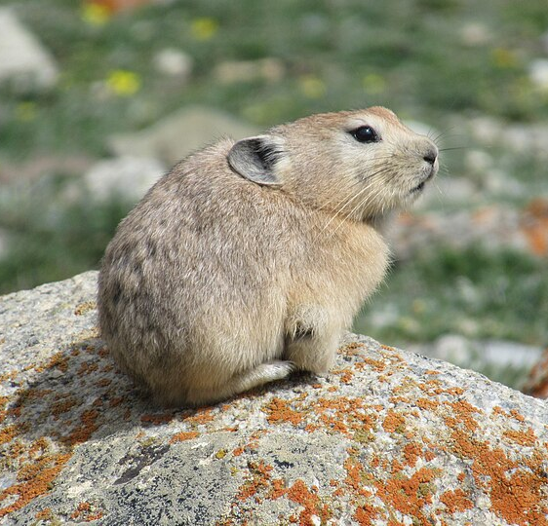
Published scientific papers
Working at the Natural History Museum brought her into contact with other scientists.
In 1901, she published her first scientific paper, describing the fossils of small prehistoric mammals (lemmings, pikas, and voles) she had found in a cave near her family home in the Wye Valley.
A person who studies fossils is called a palaeontologist.
A Pika
Notes:
Image: © Tiziana Bardelli, CC BY-SA 4.0, via Wikimedia Commons
https://commons.wikimedia.org/wiki/File:Pika_-_Ladakh_-_2017-08-06_-_TB.jpg
Teacher Notes
Palaeontologist - a scientist who studies fossils to learn about ancient life and the history of Earth. They look at the remains of plants, animals, and other living things to see how life changed over millions of years

Slide 19
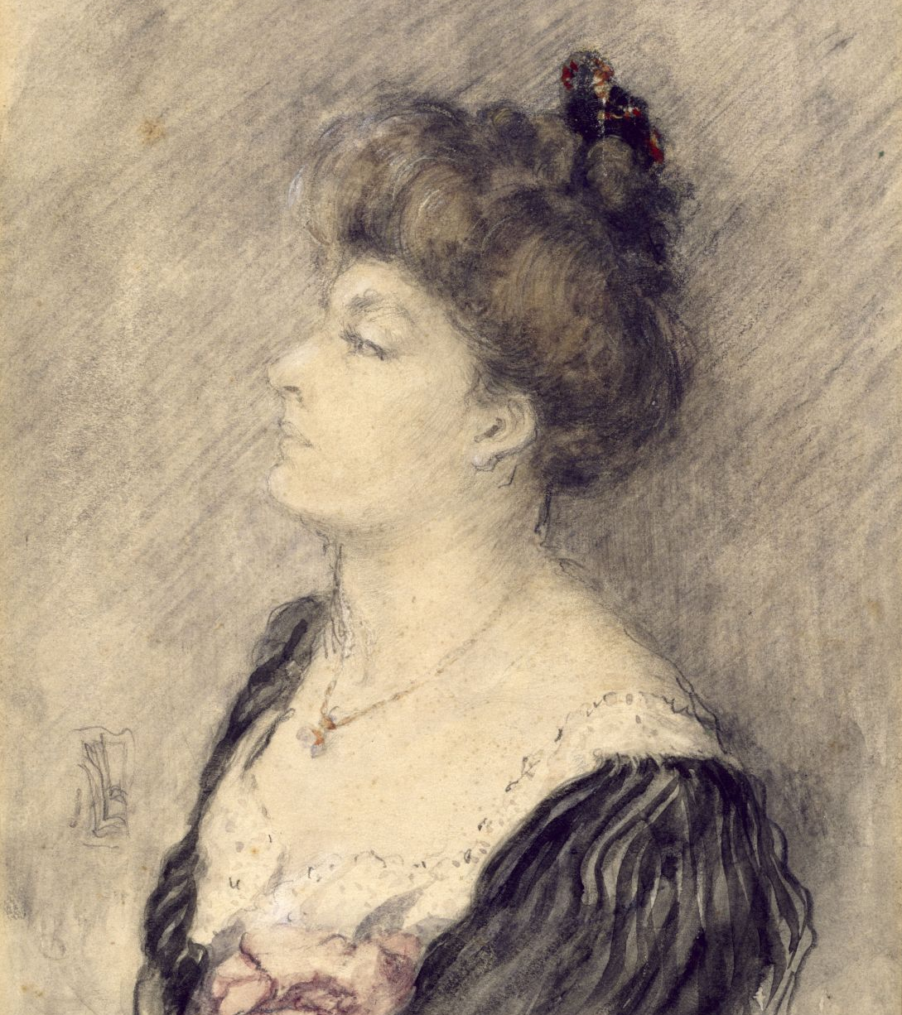
Dorothea’s place in the family
In 1912, aged 34, Dorothea had to return to her family. Her brother had broken his leg. She looked after him and her parents for about 18 months.
She was later disinherited by her parents to provide a dowry for her brother to marry a wealthy woman.
This meant that she had very little money of her own to pay for her fossil hunting expeditions.
What does this suggest about Dorothea’s family and their attitude towards women?
Dorothea Minola Alice Bate (1879-1951)
Notes:
Image: © Alamy DTGDHW
Teacher Notes
By 1900 formal dowries and bride prices were largely obsolete, replaced by modern companionate marriage and voluntary financial arrangements. While the upper and middle classes historically used marriage portions or legal marriage settlements, legal reforms like the Married Women’s Property Acts of 1870 and 1882 meant money or property brought into a marriage was handled differently. A dowry is most often money, goods, or property that a bride's family gives to the groom or his family upon marriage. It is used to help the new couple set up their home, but in some cultures and modern contexts, it has led to serious social and financial pressures.
Understanding Dowry
Definition: Money, goods, or estate that a woman brings to her husband or his family in marriage.
Intended Function: It acts as a safety net or an advance inheritance for the bride, who historically could not inherit land.
Modern Challenges: In some cultures, it has evolved into a transactional demand made by the groom’s family, leading to extreme financial pressure, abuse, or legal bans (e.g., in India).]
Understanding Bride Price
Definition: A payment made by the groom or his kin to the kin of the bride in order to ratify the marriage.
Intended Function: It acknowledges the economic value of the bride to her family (in terms of agriculture, housework, and childbearing) and legally seals the alliance between families.
Modern Challenges: Commercialization can sometimes lead to women being treated as property, making divorce difficult since the bride's family must return the price if the marriage dissolves.
In early 20th-century England, a massive increase in unmarried women—often called spinsters—occurred because World War I and the 1918 flu killed a vast number of young men. Many single sisters lived together, sharing homes and pooling modest wages from new jobs in teaching, nursing, or civil service.

Slide 20
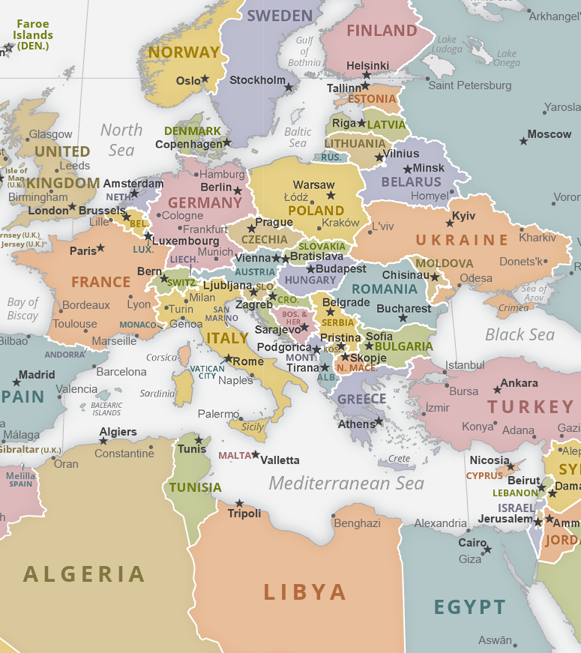
Exploring the Mediterranean Islands 1901-1911
Dorothea explored Mediterranean islands such as Cyprus, Crete and the Balearics between 1901 and 1911.
Travelling mostly on her own, Dorothea searched caves and difficult places for fossils and collected over 200 animal specimens for the Natural History Museum.
Notes:
Image: © CIA World Factbook, Public domain, via Wikimedia Commons
https://upload.wikimedia.org/wikipedia/commons/6/6a/CIA_WorldFactBook-Political_world.pdf
Teacher Notes
Between 1901 and 1911, Dorothea Bate explored the Mediterranean islands of Cyprus, Crete and the Balearic Islands, discovering many fossils of extinct animals. Several of these discoveries were completely new to science.
Bate often worked in challenging conditions, travelling through rough terrain and searching remote caves for fossils and animal bones using simple equipment such as hammers, nets and collecting boxes.
One of her most important discoveries was the Cretan dwarf hippopotamus, a prehistoric species found on the island of Crete. Her research helped scientists learn more about extinct animals and how species adapted to island environments.
While working in Crete, Bate met leading archaeologists, including Sir Arthur Evans, who was excavating the ancient city of Knossos. These connections helped her develop her research and deepen her understanding of the ancient past.
Dorothea Bate's determination, independence and scientific discoveries made her one of the most important fossil hunters of her time.

Slide 21
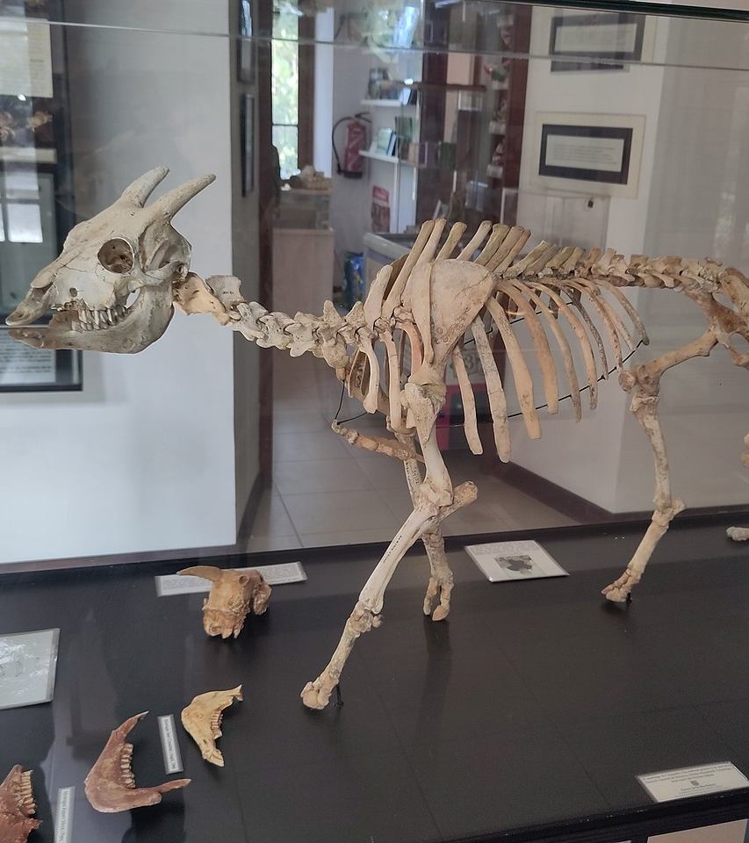
Island Gigantism and Dwarfism
She discovered fossils of animals that are now extinct.
These include tiny elephants, dwarf hippopotamuses, and a strange goat-like animal called Myotragus.
Many of the fossils she found had never been seen by scientists before.
Myotragus balearicus
Notes:
Image: © Joan Gené, CC BY-SA 4.0, via Wikimedia Commons
https://commons.wikimedia.org/wiki/File:S%C3%B3ller._Museu_Balear_de_Ci%C3%A8ncies_Naturals._Myotragus_balearicus_(cropped).jpg
Teacher Notes
Island Gigantism and Dwarfism - or the island rule—describe how isolated island environments cause small animals to evolve much larger bodies (gigantism) and large animals to evolve much smaller bodies (insular dwarfism) compared to their mainland relatives
In 1901, Dorothea Bate funded her own move to Cyprus, where she explored caves independently and discovered fossils of extinct animals, including a dwarf hippopotamus. In 1902, with support from the Royal Society, she identified and described a new species of dwarf elephant, Elephas Cypriotes, publishing her findings for the scientific community.
Bate's work provided important evidence for island dwarfism and gigantism, where animals on isolated islands evolve to become unusually small or large. Her discoveries included tiny elephants, mammoths, squirrel-sized dormice, and Myotragus, an unusual goat-like animal from the Balearic Islands.
Myotragus was specially adapted to island life, with sturdy legs for climbing rocky terrain, forward-facing eyes, and distinctive large, continuously growing front teeth similar to those of rodents.
Dorothea often travelled alone, employing local guides and labourers to assist with navigation, translation, and excavation. When excavations became difficult, she sometimes used gunpowder or dynamite, which were accepted archaeological methods at the time.
Alongside her fossil discoveries, Bate collected over 200 specimens of living birds, mammals, and insects, which she sent to the Natural History Museum. Her research on both extinct and living species helped scientists better understand animal evolution and island ecosystems.
On Crete, she also discovered fossils of the Cretan dwarf hippopotamus, adding to her reputation as one of the leading fossil hunters of her time.

Slide 22
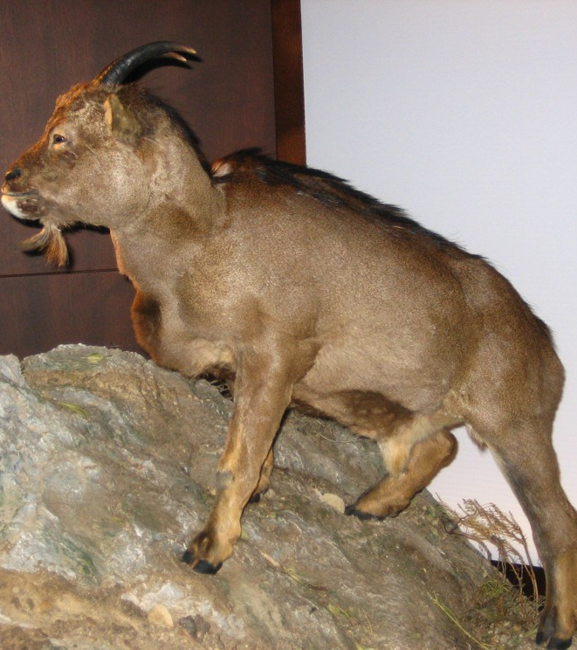
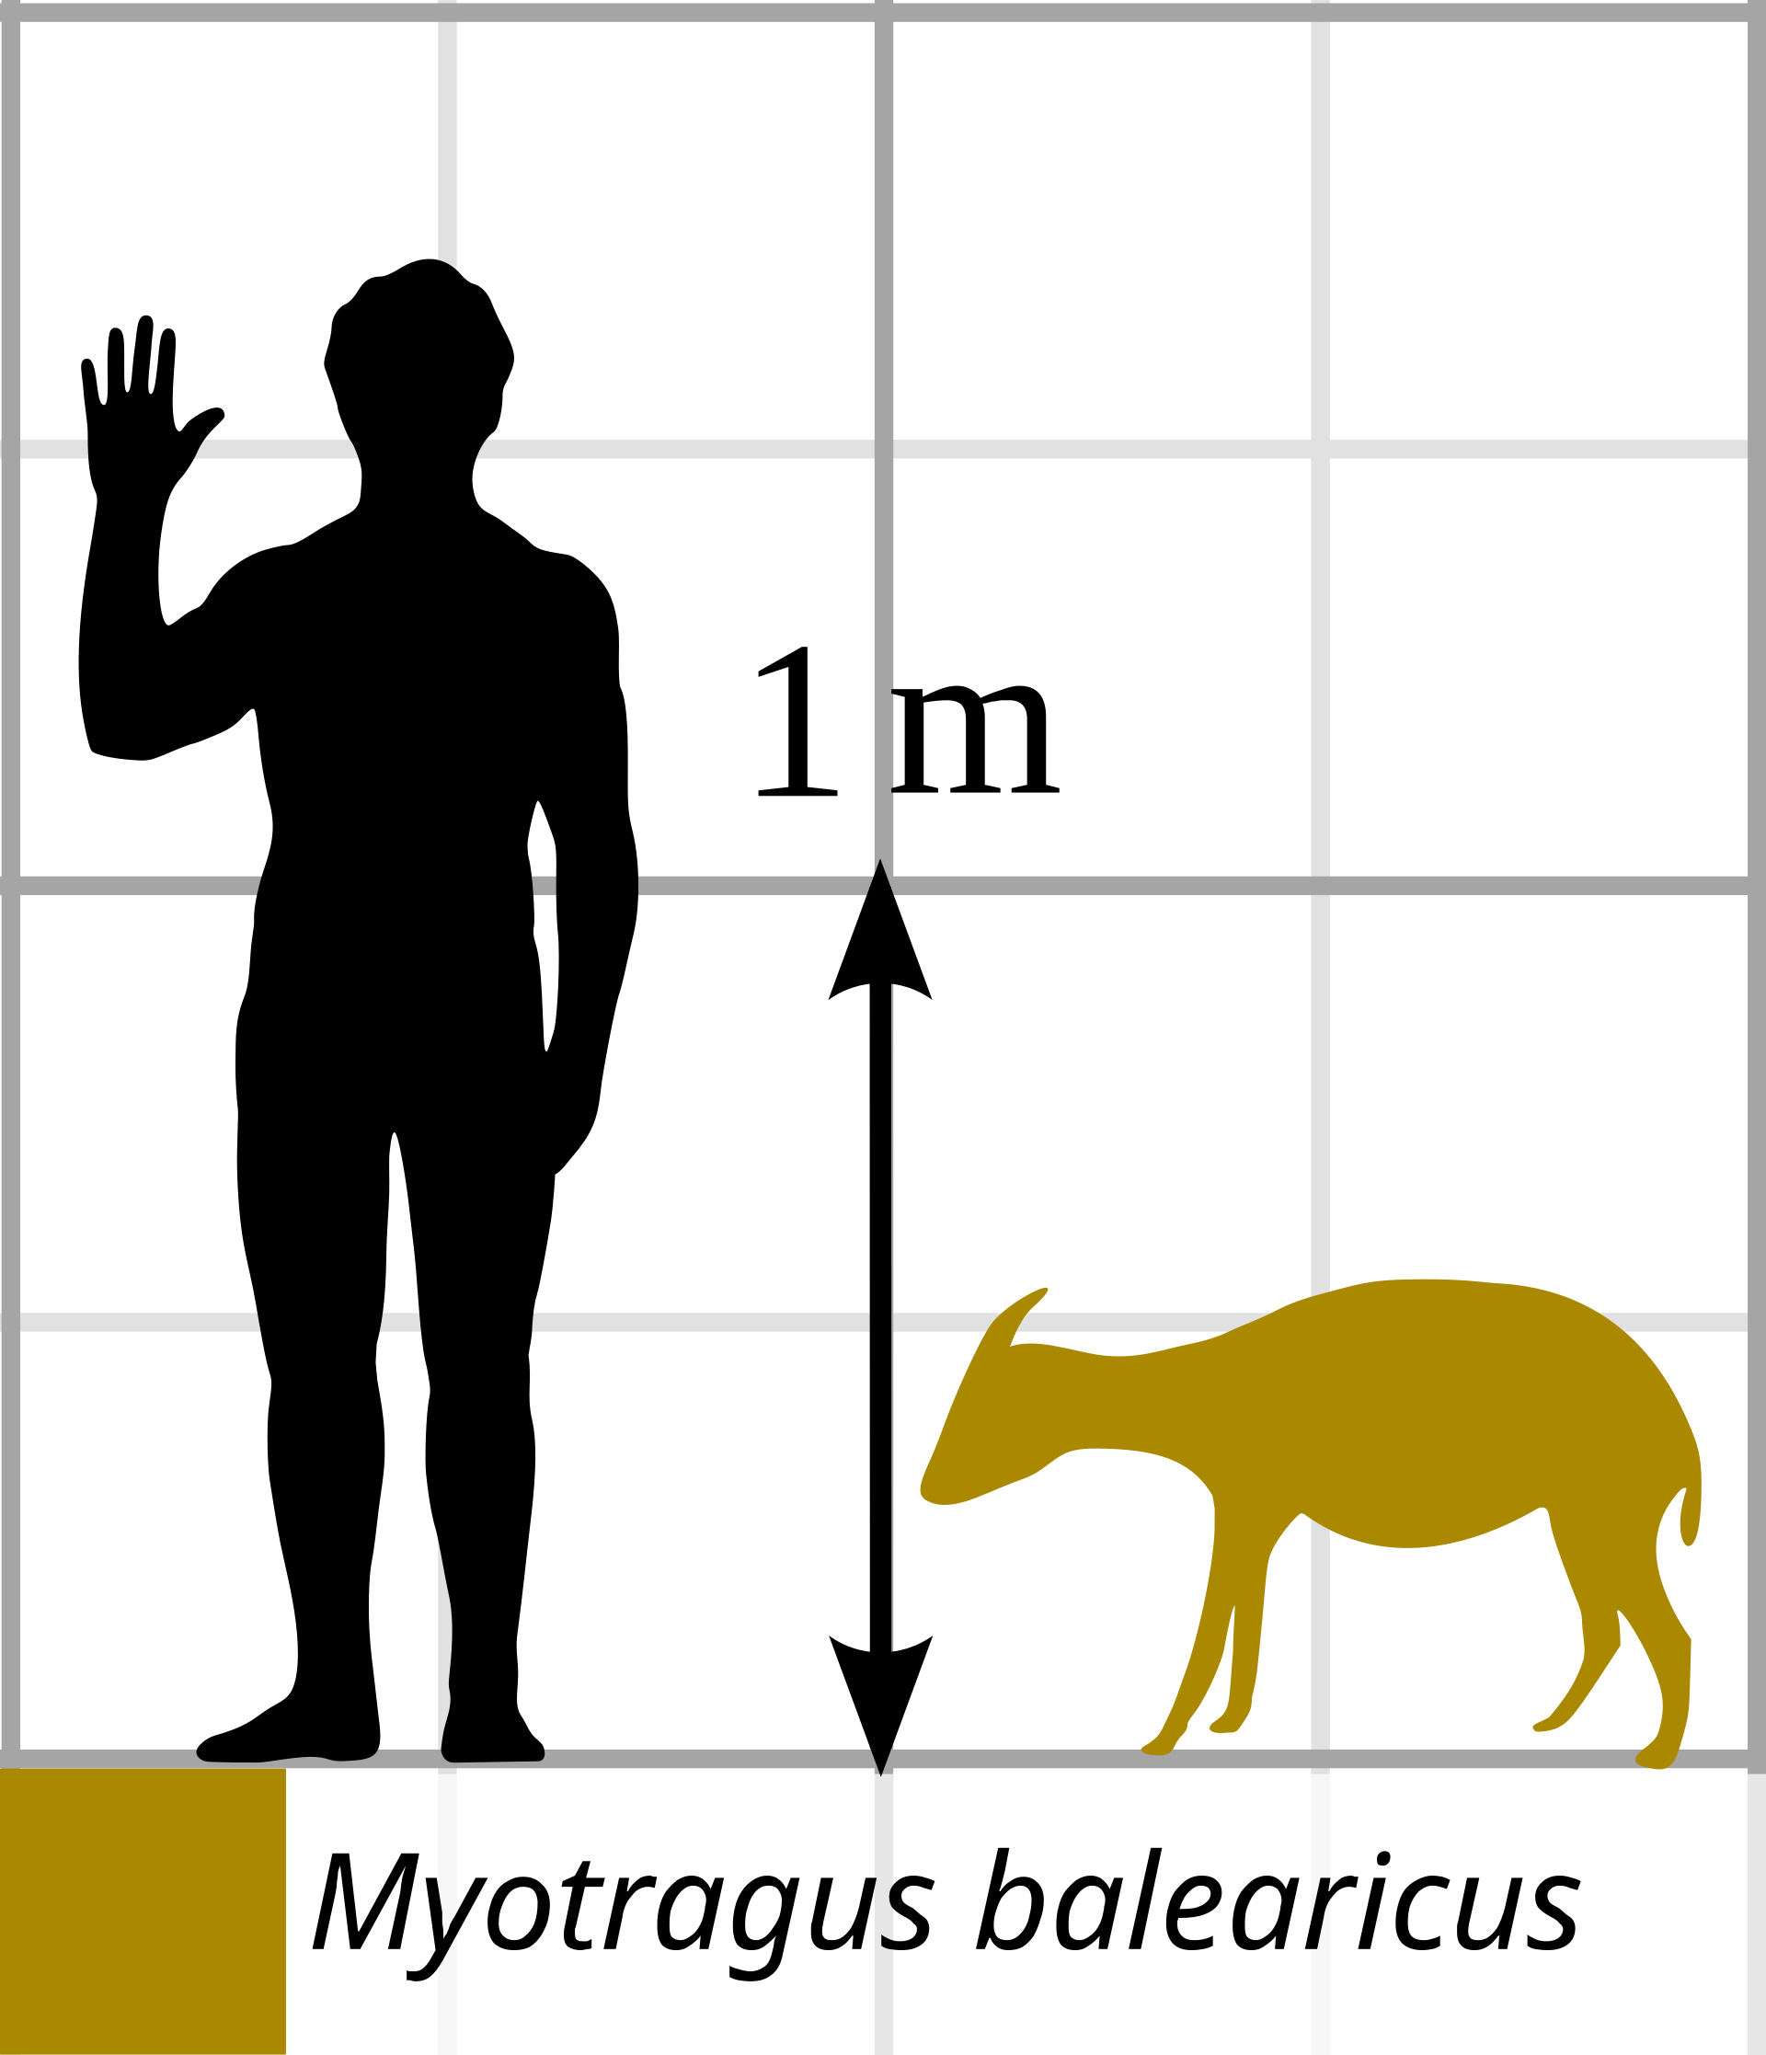
Island Gigantism and Dwarfism
Her discoveries helped scientists understand how animals changed over time on islands, sometimes becoming much bigger or much smaller than their relatives living elsewhere.
Myotragus balearicus reconstruction
Notes:
Image: © Xavier Vázquez, Public domain, via Wikimedia Commons
https://commons.wikimedia.org/wiki/File:Myotragus_balearicus.JPG
Hemiauchenia, CC BY 4.0, via Wikimedia Commons
https://commons.wikimedia.org/wiki/File:Myotragus_balearicus_size_comparison.svg
Teacher Notes
In 1901, Dorothea Bate funded her own move to Cyprus, where she explored caves independently and discovered fossils of extinct animals, including a dwarf hippopotamus. In 1902, with support from the Royal Society, she identified and described a new species of dwarf elephant, Elephas Cypriotes, publishing her findings for the scientific community.
Bate's work provided important evidence for island dwarfism and gigantism, where animals on isolated islands evolve to become unusually small or large. Her discoveries included tiny elephants, mammoths, squirrel-sized dormice, and Myotragus, an unusual goat-like animal from the Balearic Islands.
Myotragus was specially adapted to island life, with sturdy legs for climbing rocky terrain, forward-facing eyes, and distinctive large, continuously growing front teeth similar to those of rodents.
Dorothea often travelled alone, employing local guides and labourers to assist with navigation, translation, and excavation. When excavations became difficult, she sometimes used gunpowder or dynamite, which were accepted archaeological methods at the time.
Alongside her fossil discoveries, Bate collected over 200 specimens of living birds, mammals, and insects, which she sent to the Natural History Museum. Her research on both extinct and living species helped scientists better understand animal evolution and island ecosystems.
On Crete, she also discovered fossils of the Cretan dwarf hippopotamus, adding to her reputation as one of the leading fossil hunters of her time.

Slide 23
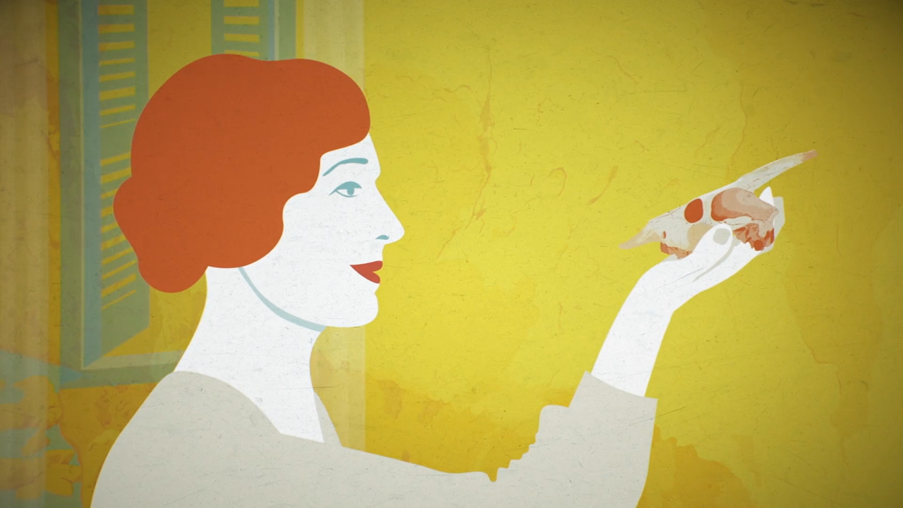
Trailer for film: Dorothea and the Myotragus
Notes:
https://vimeo.com/465350678 - This is a trailer in English about a series of cartoon-style films about Dorothea published by the Council of Mallorca, Department of Citizen Participation and the Presidency Island Directorate for Equality
https://www.youtube.com/playlist?list=PLAPTDGp3kT2TSo7NbcP3eQcH1tcOA7qXw - This is a link to all 4 films in the ‘Dorothea Rocks’ series, to watch them with English subtitles, go into the setting and turn on Catalan subtitles – you’ll then get an option for Auto-translate. Select this option then pick ‘English’ from the list of languages available.

Slide 24
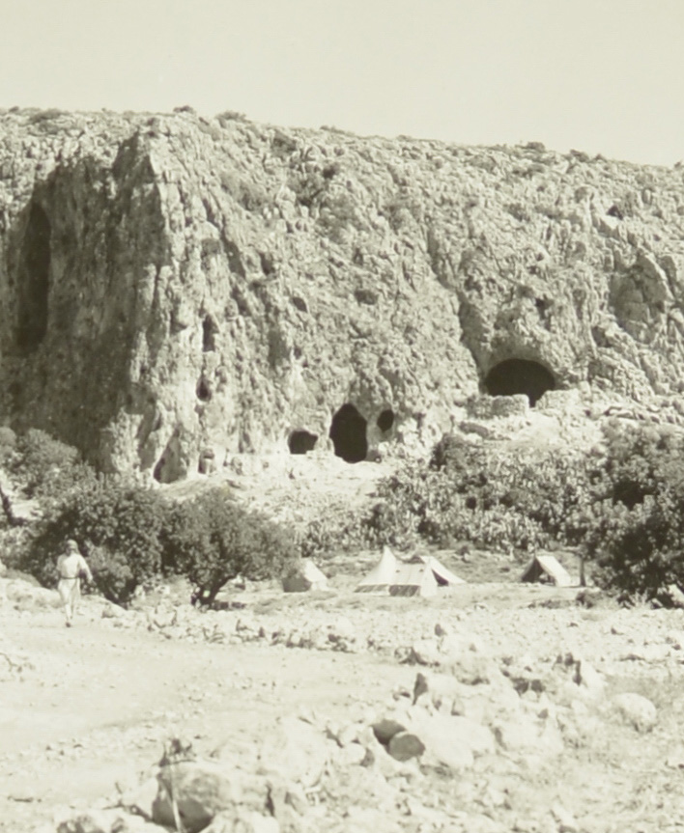
Wadi el-Mughara Caves
In the late 1920s and 1930s, Dorothea worked with an archaeologist called Dorothy Garrod.
They explored caves in an area that is now part of Israel.
Dorothea studied the bones of animals that had lived thousands of years ago.
She helped discover the fossils of animals that no longer exist, including an extinct elephant, an early horse, a giant tortoise, and a hippopotamus.
Find out more about Dorothy Garrod.
Wadi el-Mughara Caves
Notes:
Image: © Israel Antiquities Authority, CC BY-SA 4.0, via Wikimedia Commons
https://commons.wikimedia.org/wiki/File:Wadi_el-Mughara_historic_photos_11.jpg
Teacher Notes
Archaeologist - a scientist or researcher who studies human history, prehistory, and past cultures. They do this by finding, digging up, and examining physical remains like tools, pottery, buildings, and graves
The Caves of Nahal Me’arot / Wadi el-Mughara ("Caves Creek"), named here by the Hebrew and Arabic name of the valley where they are located, are a UNESCO Site of Human Evolution in the Carmel mountain range near Haifa in northern Israel. The four caves were proclaimed a site of "outstanding universal value" by UNESCO[1] in 2012. They are protected within a nature reserve. The caves were used for habitation by hominins and prehistoric humans and contain unique evidence of very early burials, at the archaeological site of el-Wad cave in the Nahal Me'arot Nature Reserve.
https://www.prm.ox.ac.uk/event/pioneer-of-prehistory
Dorothy Annie Elizabeth Garrod, CBE, FBA (5 May 1892 – 18 December 1968) was an English archaeologist who specialised in the Palaeolithic period. She held the position of Disney Professor of Archaeology at the University of Cambridge from 1939 to 1952, and was the first woman to hold a chair at either Oxford or Cambridge.
Before the modern State of Israel was established in 1948, the region was administered by the British as Mandatory Palestine (1920–1948). Before British rule, the area was part of the Ottoman Empire for four centuries (1516–1918).
Historical Names of the Region
Mandatory Palestine: The official geopolitical entity under British administration following World War I.
The Ottoman Empire: The imperial power that governed the entire Levant region until 1917–1918.
Syria Palaestina / Palestine: The name applied to the broader geographical region by the Roman Empire from the 2nd century CE onward, which was retained through successive Arab, Crusader, and Ottoman eras.
Judea / Kingdom of Israel: Ancient names for the historical Jewish kingdoms and Roman provinces in the same geographic area during biblical and classical antiquity

Slide 25
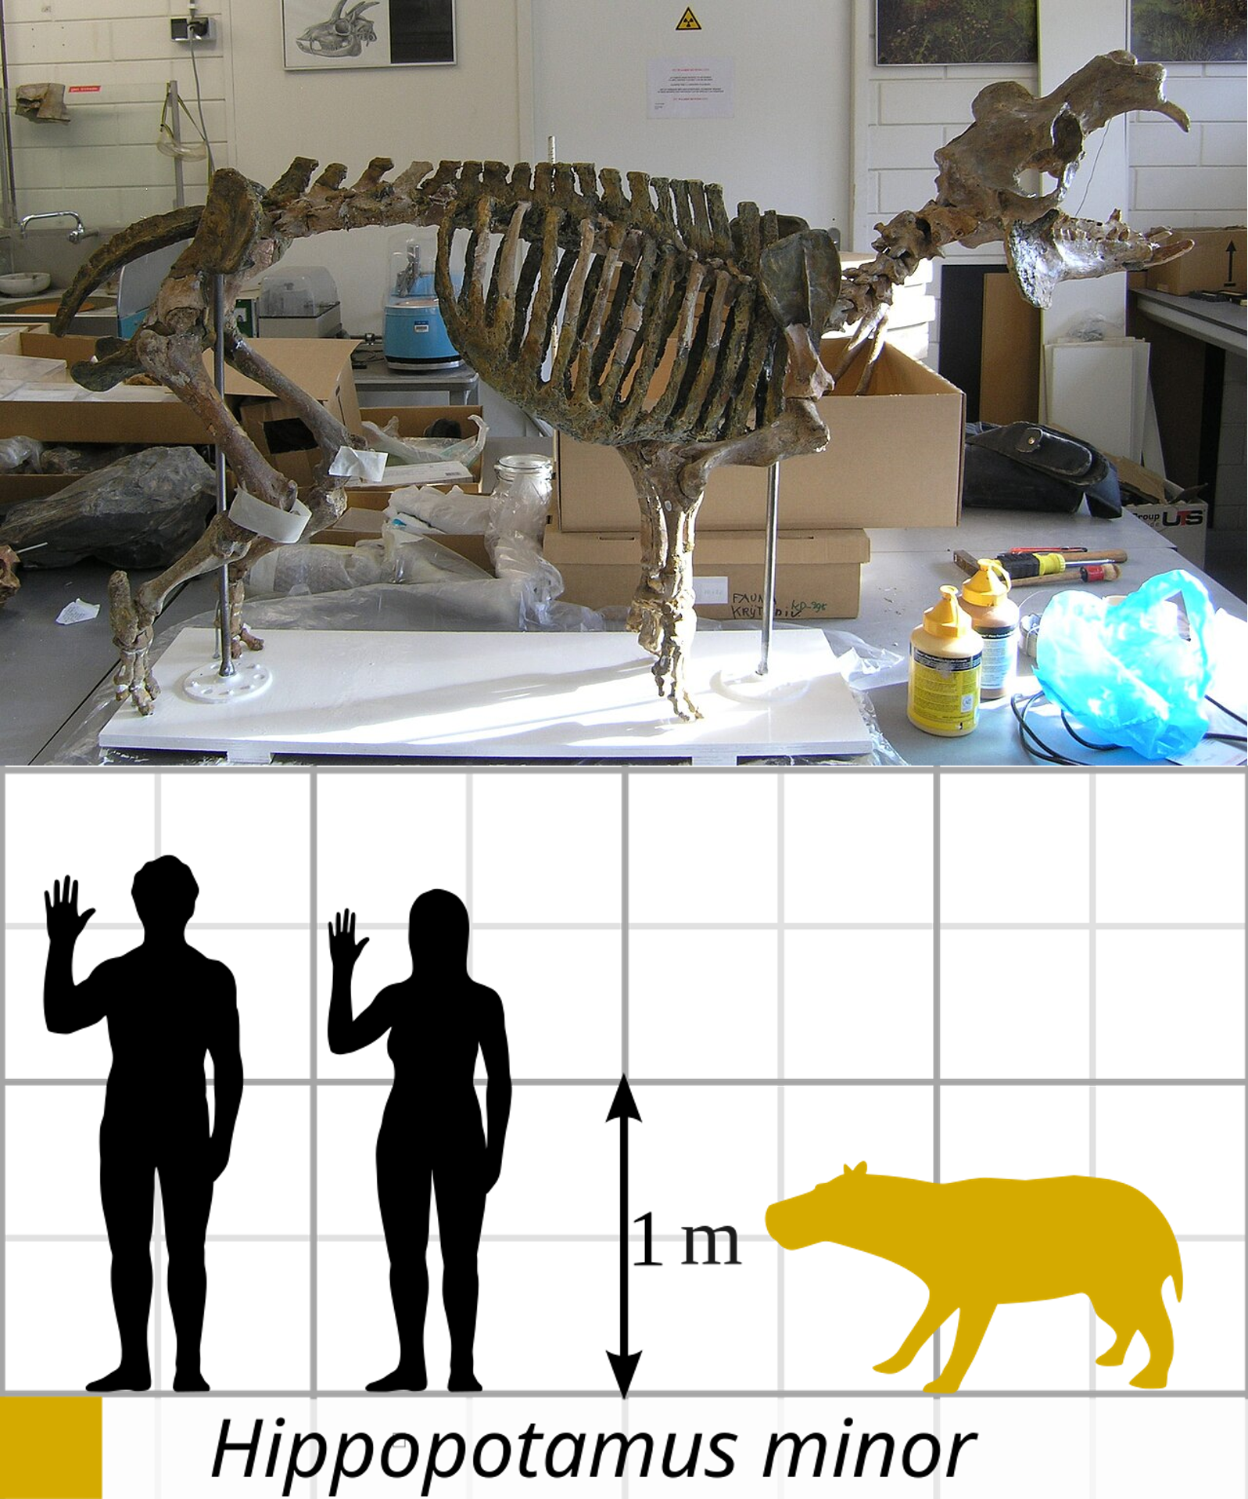
Archaeozoology – also known as zooarchaeology
Comparing animal bones from different layers of rock showed how changes in the environment and climate affected the animals hunted by early humans.
Dorothea published her important research in 1937.
Dorothea’s work paved the way for the field of archaeozoology, the study of animal remains to learn how people and animals lived together in the past.
Notes:
Image: (Top) © GeorgeLyras at English Wikipedia, CC BY-SA 3.0, via Wikimedia Commons - https://commons.wikimedia.org/wiki/File:Hippo-Cyprus.JPG
Image: (Bottom) © Hemiauchenia, 4444hhhh/Piranga94, CC BY 4.0, via Wikimedia Commons - https://commons.wikimedia.org/wiki/File:Cypriot_pygmy_hippo_size_comparison.svg
Teacher Notes
Archaeozoology is the study of animal remains from old digging sites, focusing on what people ate, how they tamed animals, and past human life. It looks at items like bones, teeth, and shells to learn about history.
Diet and Food: Finding out what meat or fish people ate by looking at cut marks on bones.
Domesticated Animals: Learning when wild animals like sheep, cows, or dogs became pets or farm animals.
Environment: Using tiny shells or animal clues to see what the weather and land were like long ago.
Rituals: Finding out if groups used certain animals for art, religion, or special ceremonies
With over 80 published scientific papers, and many more unpublished, Bate bridged the established science of palaeontology (the study of extinct animals through fossils) with zoology (the study of living creatures). Today, this blended field of study has evolved into archaeozoology or zooarchaeology, a sub-discipline of archaeology that focuses on the analysis of faunal remains (teeth, bone, horn, keratin and soft tissue) from archaeological sites. The discipline has advanced technologically and theoretically, but many practitioners acknowledge that they are building on the legacy of Dorothea Bate.

Slide 26
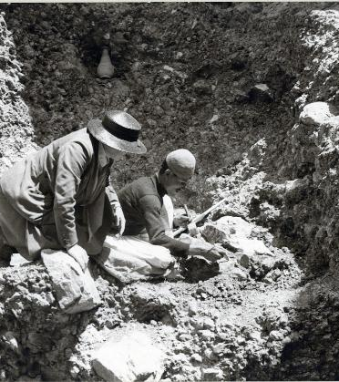
Bethlehem
In 1934, Dorothea was asked to examine a collection of fossil bone fragments from a site near Bethlehem.
Her excavations uncovered animal fossils that dated back 1.8 million years, including elephants, horses rhinoceroses and giant tortoises.
She excavated alongside Elinor Gardner, a geoarchaeologist. Both women had no choice but to accept British archaeologist James Starkey as the head of the excavation.
Clearing gravels and clays from the Bethlehem bone bed
Notes:
Image: From the Library and Archives, NHM London
Teacher Notes
Geoarchaeologist - a scientist who uses the methods and ideas of earth sciences—like geology, geography, and soil science—to study archaeological sites. They look at dirt, rocks, and land layers to figure out how ancient people lived and how the Earth changed around old human settlements
From 1935 to 1937, Dorothea excavated a hilltop site in Bethlehem, uncovering animal fossils that dated back 1.8 million years. These included elephants, rhinoceroses, giant tortoises, and the early horse Hipparion.
Dorothea’s attention was turned to Bethlehem in 1934, when the Palestinian Department of Antiquities asked her to examine a collection of fossil bone fragments. She identified the finds as being from an extinct elephant species – the first to be discovered in Palestine.
Dorothea described the first finding at the site, but the land had been claimed by British archaeologist James Starkey. To retain her stake in the research, she had to collaborate. She excavated alongside fellow female scientist Elinor Gardner, with Starkey heading the operation.
Dorotha Bate discovered this dwarf elephant tooth, possibly from the Middle or Late Pleistocene. It was one of the first pieces of evidence that miniature elephants once lived on Cyprus.
Their work in Bethlehem was cut short when Starkey was shot and killed in 1938, on his way to the opening of the Palestinian Museum of Archaeology – now the Rockefeller Museum. An armed group had accused him of being Jewish.
After this, the Natural History Museum refused to grant Dorothea permission to travel as the region was too unsettled and the Second World War was brewing.
Today the region is still unstable, and the original site built over. Dorothea’s work in the 1930s remains the only insight into life in the Bethlehem region 2.5 million years ago.

Slide 27
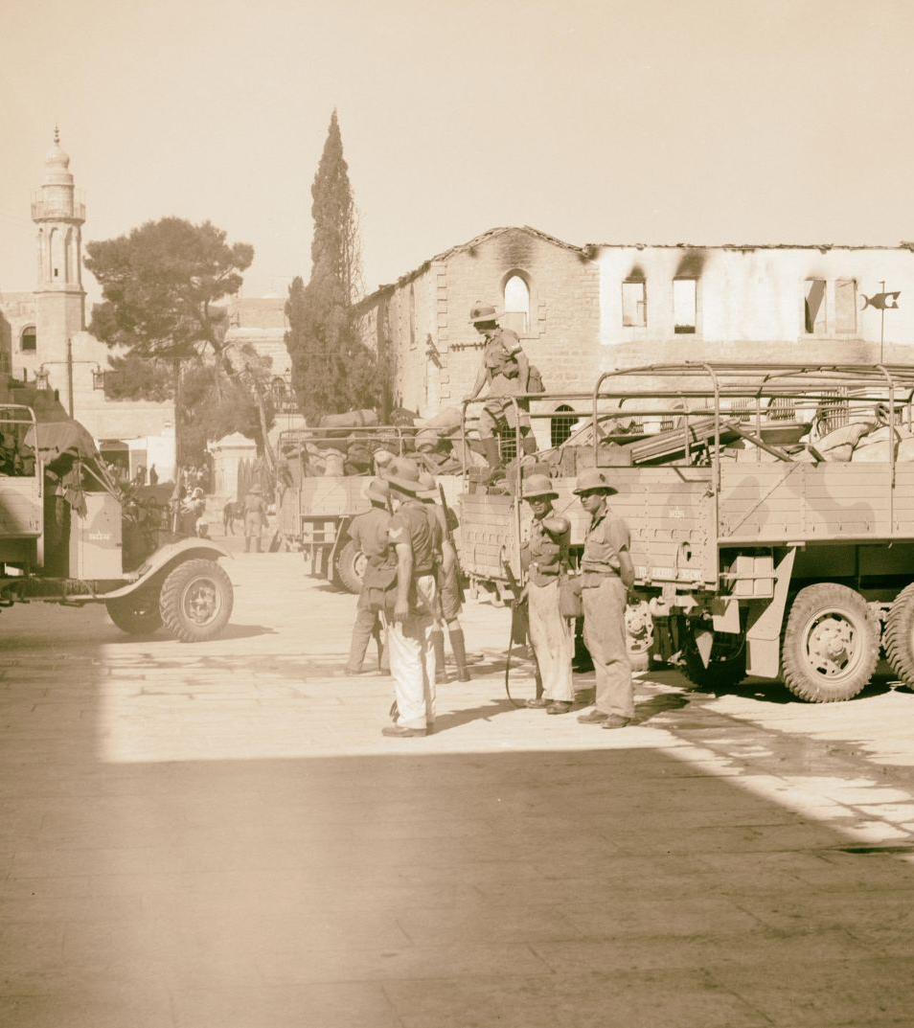
War and Unrest
In 1938, the Natural History Museum refused to let Dorothea travel to the region as it was becoming too dangerous.
Today the region is still unstable, and the original site has since been built on.
Dorothea’s work in the 1930s remains the only insight into life in the Bethlehem region millions of years ago.
Arrival in Bethlehem of the Worcestershire Regiment, 1938
Notes:
Image: © Alamy Ref: PR2KEC
Teacher Notes
In the late 1930s and 1940s, Mandatory Palestine experienced the 1936–1939 Arab Revolt against British rule and Jewish immigration, severe conflict during World War II over strict British immigration caps, a post-war Jewish insurgency against Britain, the 1947 UN Partition Plan, and the end of the mandate on May 14, 1948, which led to the 1948 war and the creation of Israel

Slide 28
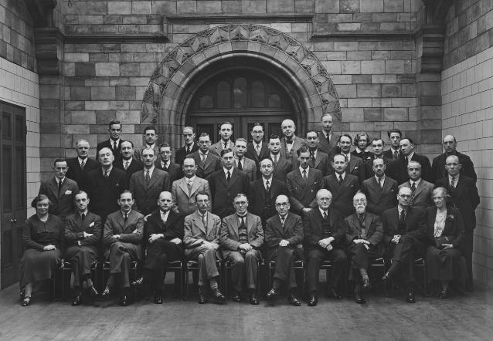
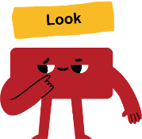

Women at the Natural History Museum
Dorothea was one of the first women working as a scientist at the Natural History Museum.
Men vastly outnumbered women as official employees.
It was not easy for Dorothea, or the other women dedicated to science at a time when the field was overwhelmingly male.
Geology Department Natural History Museum 1938
Look closely at the photo. Dorothea is here. What do you notice about the people in the photo?
Notes:
Image: From the Library and Archives, NHM London
Teacher Notes:
Geology - the scientific study of Earth, its solid materials, rock structures, and the physical processes that shape them over time
When she arrived at the Museum in 1898, there were one or two women in unofficial scientific roles:
the botanist Anne Lorrain Smith (1854–1937), had been there since 1889 and palaeontologist Helen Muir-Wood (1895–1968), who became Curator of Brachiopods in 1920, a post she held until 1965.
entomologist Emily Bowlder Sharpe (1868–c.1928) and zoologists Isabella Gordon (1901–1988) and Sidnie Manton (1902–1979), who both worked at the museum in the late 1920s.
By 1938, Anna Hastings (1902–1977) and Ethelwynn Trewavas (1900–1993) had joined the Department of Zoology, and Jessie Sweet (1901–1979), had joined the Department of Mineralogy.
Men, however, continued to vastly outnumber women as official employees.
Historical Milestones for Women at the Museum
1927: The museum appointed its first women to official curatorial roles (two in Zoology and one in Entomology), nearly a decade after civil service rules began allowing women into scientific positions.
1900s–1950s: For decades, female employment was largely concentrated in supportive or subordinate capacities such as library cataloguing, specimen mounting, illustrating, and administrative typing.
Modern Era: Recent ⁠Gender Pay Gap Reports confirm that women have firmly formed the majority of the overall workforce across all pay quartiles in recent years, stabilizing at a consistent 61% female to 39% male ratio.

Slide 29
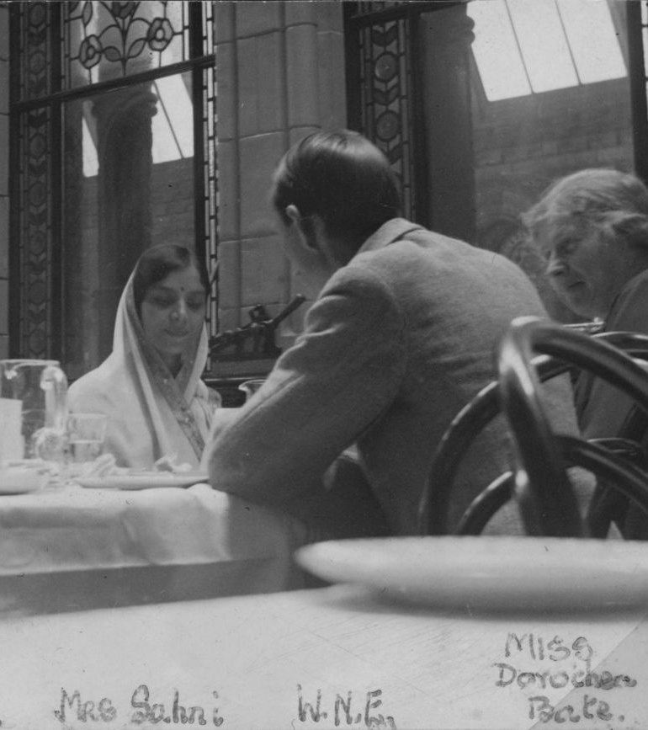
Savitri Sahni
This 1935 photo shows Dorothea having lunch at the Natural History Museum in London with several visitors, including Savitri Sahni.
Savitri became an important member of India’s scientific community as head of the Birbal Sahni Institute.
She was the first president of the Paleobotanical Society of India and received the Padma Shri award.
After she died, her home became a museum, and her money supports science research, talks and awards.
Dorothea Bate at lunch with colleagues including Savitri Sahni Natural History Museum 1935
Notes:
Image: ©Alamy Ref: DTF8PR
Teacher Notes:
Paleobotanical - the scientific study of ancient plants using plant fossils and remains
Find out more about Savitri Sahni here: https://www.bsip.res.in/en/bsip_institute_mrs_savitri_sahni

Slide 30
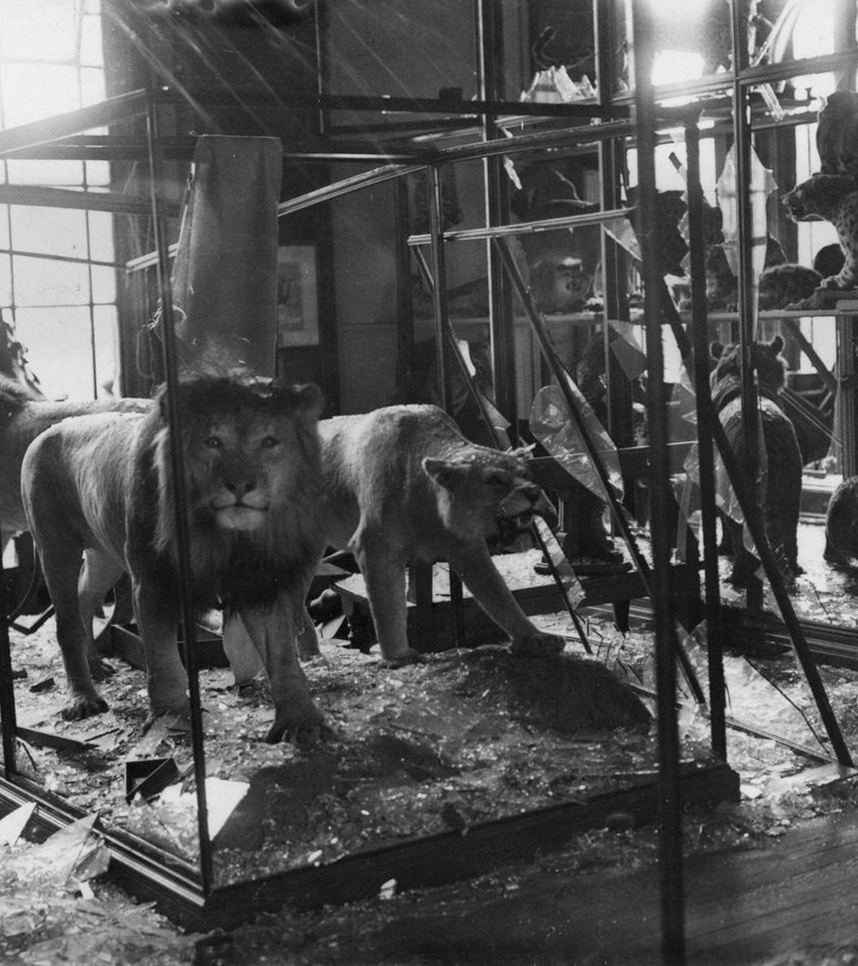
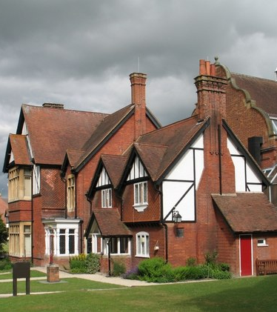
The Move to Tring
The Natural History Museum had taken over the museum in Tring and its collections in 1937 when Lionel died.
During the Second World War, much of the collection was moved here to be out of London, away from air raids.
On 11 July 1944, a bomb exploded outside the museum in London. It was so powerful that it smashed almost all the glass windows and display cases in the museum's west wing.
Dorothea also moved from London to its Zoological branch at Tring.
Tring Natural History Museum
Notes:
Image (first): © Christine Matthews
https://commons.wikimedia.org/wiki/File:Entrance_to_Natural_History_Museum,_Cromwell_Road,_London_SW7_-_geograph.org.uk_-_1034304.jpg
Image (fly-in): ©Alamy Ref: 2X0PM26
Teacher notes
During the Second World War the Museum supplied government and military departments with expertise on the obstacles posed by the natural world. For example, the Ministry of Supply's Assistant Director of Explosives wrote to the Museum's Zoology Department asking how to discourage field mice from 'nibbling the lengths of detonating fuse (sic) in open fields'. The Museum also received enquiries regarding explosives, carbon monoxide poisoning, mustard gas and types of rock resistant to landmine detectors.
At 4.30am on 9 September 1940, two incendiaries and an oil bomb hit the roof of the Botany Department in the east wing.
Between September 1940 and April 1941, the Museum was severely damaged in several air raids. On the morning of 9 September 1940, two incendiaries and an oil bomb went through the roof of the east wing and into the Botany Department. Along with structural damage, many specimens and books were harmed or destroyed.
A large proportion of the Museum's exhibits had been evacuated to country houses before the war, although some sandbagged skeletons remained in their display cases. Removing the exhibits was a huge operation, with plans drawn up from as early as 1933. Over this period, the Museum's chief librarian established a serial publication called Tin Hat, to which Museum staff were encouraged to anonymously submit humorous articles as a means of keeping up morale.
The Library and Archives also holds archival records of Museum Members who were involved in active and volunteer service. The documents outline the role they played within the Museum and provide brief biographies of their lives.
A war diary, documenting the chronology of the Museum from August 1939 to April 1945, also features in the collections.

Slide 31
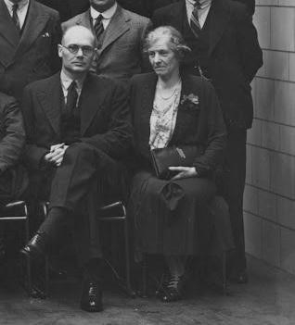
Officer in Charge
In 1948, Dorothea Bate was formally appointed Officer in Charge at Tring, just before she reached the age of seventy.
Although still under the Museum in London, she effectively ran the Tring museum.
She was responsible for moving the fossils safely from London to Tring.
As Officer in Charge, she made sure the museum was well maintained, and the displays were well presented.
Dorothea at the NHM London in 1938
Notes:
Image: From the Library and Archives, NHM London
Teacher notes
The Natural History Museum at Tring (formerly the Walter Rothschild Zoological Museum) transitioned from a post-war national outpost into a modern public attraction managed by the Natural History Museum, London, blending its original Victorian taxidermy displays with updated community programs and research facilities.
Key Milestones (1948 to Present)
1948–1951: Pioneering fossil hunter Dorothea Bate served as the officer-in-charge at Tring, helping direct its scientific footprint after the war.
1969–1971: The public galleries underwent a major modernization program while preserving the distinct, atmospheric Victorian style of Walter Rothschild’s original private collection.
1971: A new dedicated Bird Section building opened on-site, allowing major portions of Rothschild's insect collections to transfer permanently to South Kensington.
2007: The site was officially renamed the Natural History Museum at Tring to better reflect its direct administrative connection to London.
Today: Operates as a free-entry regional museum housing world-class taxidermy, hosting family events, toddler times, and educational workshops

Slide 32
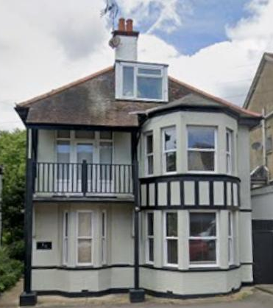
Working until the end
It was a stressful time, and Dorothea was in poor health. Nevertheless, she continued to work as so many fellow archaeologists relied on her expertise in identifying and dating fossils.
In January 1951, Dorothea went to Westcliff-on-Sea. She was suffering badly from the effects of cancer.
There, she died from a heart attack on 13th January 1951. She was cremated soon afterwards.
31 Ailsa Road, Westcliff-on-Sea, Essex.
Notes:
Image: © Google Maps 2026
Teacher notes
In 1948, Bate was formally appointed Officer in Charge at Tring, just before she reached the age of seventy. Although accountable to the Director of the Museum in London, Bate effectively ran the Tring outpost following the departure of her predecessor, James Edgar Dandy, being responsible for the safe transference of collections from London as well as overseeing the maintenance and presentation of the museum. It was a stressful time, and she was in poor health during this period. Nevertheless, she continued to receive many specimens from fellow archaeologists, who relied on her expertise in identifying and dating them.
In January 1951, now suffering badly from the effects of cancer, Bate went to stay with a couple, the Gunsons, fellow Christian Scientists, at their house at Westcliff on Sea, Essex, where she had first gone to recuperate in 1948. There she died from a heart attack on 13th January 1951. She was cremated at Golders Green crematorium soon afterwards.

Slide 33
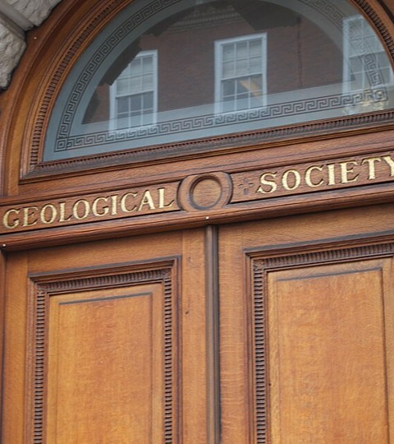
Recognition
During her lifetime, Dorothea was seen as an expert in fossil mammals all around the world.
However, until 1948, she never held an official paid post at the Natural History Museum.
She was elected an Honorary Lady Member of the British Ornithologists' Union in 1910 and was made a Fellow of the Geological Society (May 1940).
No universities or other societies recognised her.
Notes:
Image: © Alan Levine from Strawberry, United States, CC BY 2.0, via Wikimedia Commons
https://commons.wikimedia.org/wiki/File:Geological_Society_of_London.jpg
Teacher notes
Ornithologist – ornithology is the scientific study of birds. As a branch of zoology, it covers everything from bird behavior and ecology to evolution, anatomy, and migration patterns

Slide 34
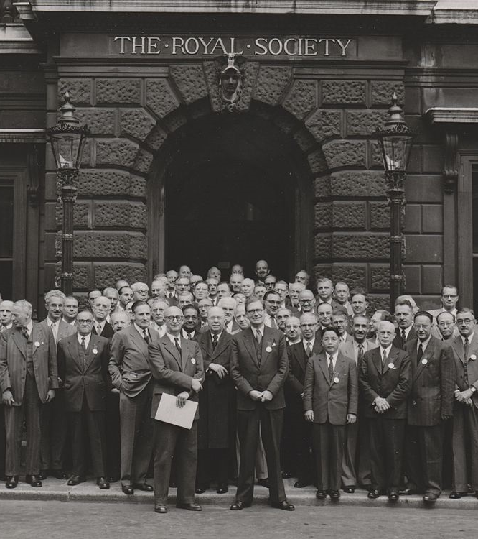
Funding
Dorothea Bate was not wealthy, had little formal education and hardly any support from British institutions.
She funded her early expeditions through her savings, piece-rate work from the Natural History Museum and family connections, with only a few small grants from organizations like The Royal Society.
Despite her achievements, Dorothea still had to be nominated for these grants by a man.
Look closely at the photo. What do you notice about the people in this photo?
The Royal Society 1952 London
Notes:
Image: ©GFHund, CC BY-SA 3.0, via Wikimedia Commons
https://commons.wikimedia.org/wiki/File:The_Royal_Society_1952_London_no_annotation.jpg
Teacher Notes:
She was awarded a Royal Society grant to support her early expedition in 1902, and the prestigious Wollaston Donation Fund from the Geological Society in 1940 for her work on mammalian palaeontology
The ⁠Royal Society is the independent scientific academy of the United Kingdom and the oldest continuously existing scientific academy in the world. Founded on November 28, 1660, and granted a royal charter by King Charles II, it supports top scientists, publishes research, and provides science policy advice.

Slide 35
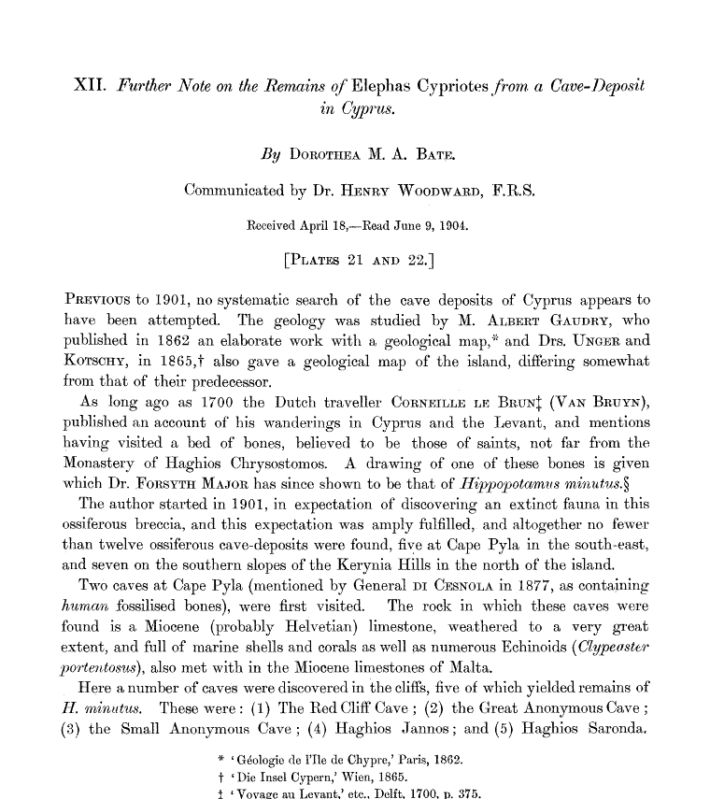
Legacy Impact
With over 80 published scientific papers, and many more unpublished, her ideas, writing and collections have lived on, inspiring and informing new generations of scientists.
Her work created archaeozoology that focuses on the animal remains (teeth, bone, horn, keratin and soft tissue) from archaeological sites.
Since 2025, the Dorothea Bate Medal has been awarded to those who make a notable contribution to the science of archaeozoology.
A paper written by Dorothea
Notes:
Image: © The Royal Society (U.K.) via https://royalsocietypublishing.org/rstb/article/197/225-238/347/41404/XII-Further-note-on-the-remains-of-elephas
Teacher Notes:
With over 80 published scientific papers, and many more unpublished, Bate bridged the established science of palaeontology (the study of extinct animals through fossils) with zoology (the study of living creatures). Today, this blended field of study has evolved into archaeozoology or zooarchaeology, a sub-discipline of archaeology that focuses on the analysis of faunal remains (teeth, bone, horn, keratin and soft tissue) from archaeological sites. The discipline has advanced technologically and theoretically, but many practitioners acknowledge that they are building on the legacy of Dorothea Bate. She was credited in a footnote in a recent article on the subject by Nimrod Marom from the University of Haifa, Israel, who wrote: ‘Classical examples for the use of indicator taxa include the fluctuations in the frequencies of fallow deer and gazelle which suggested to Dorothea Bate (1932) the regression and transgression of forested habitats in Palaeolithic Mount Carmel…’.

Slide 36
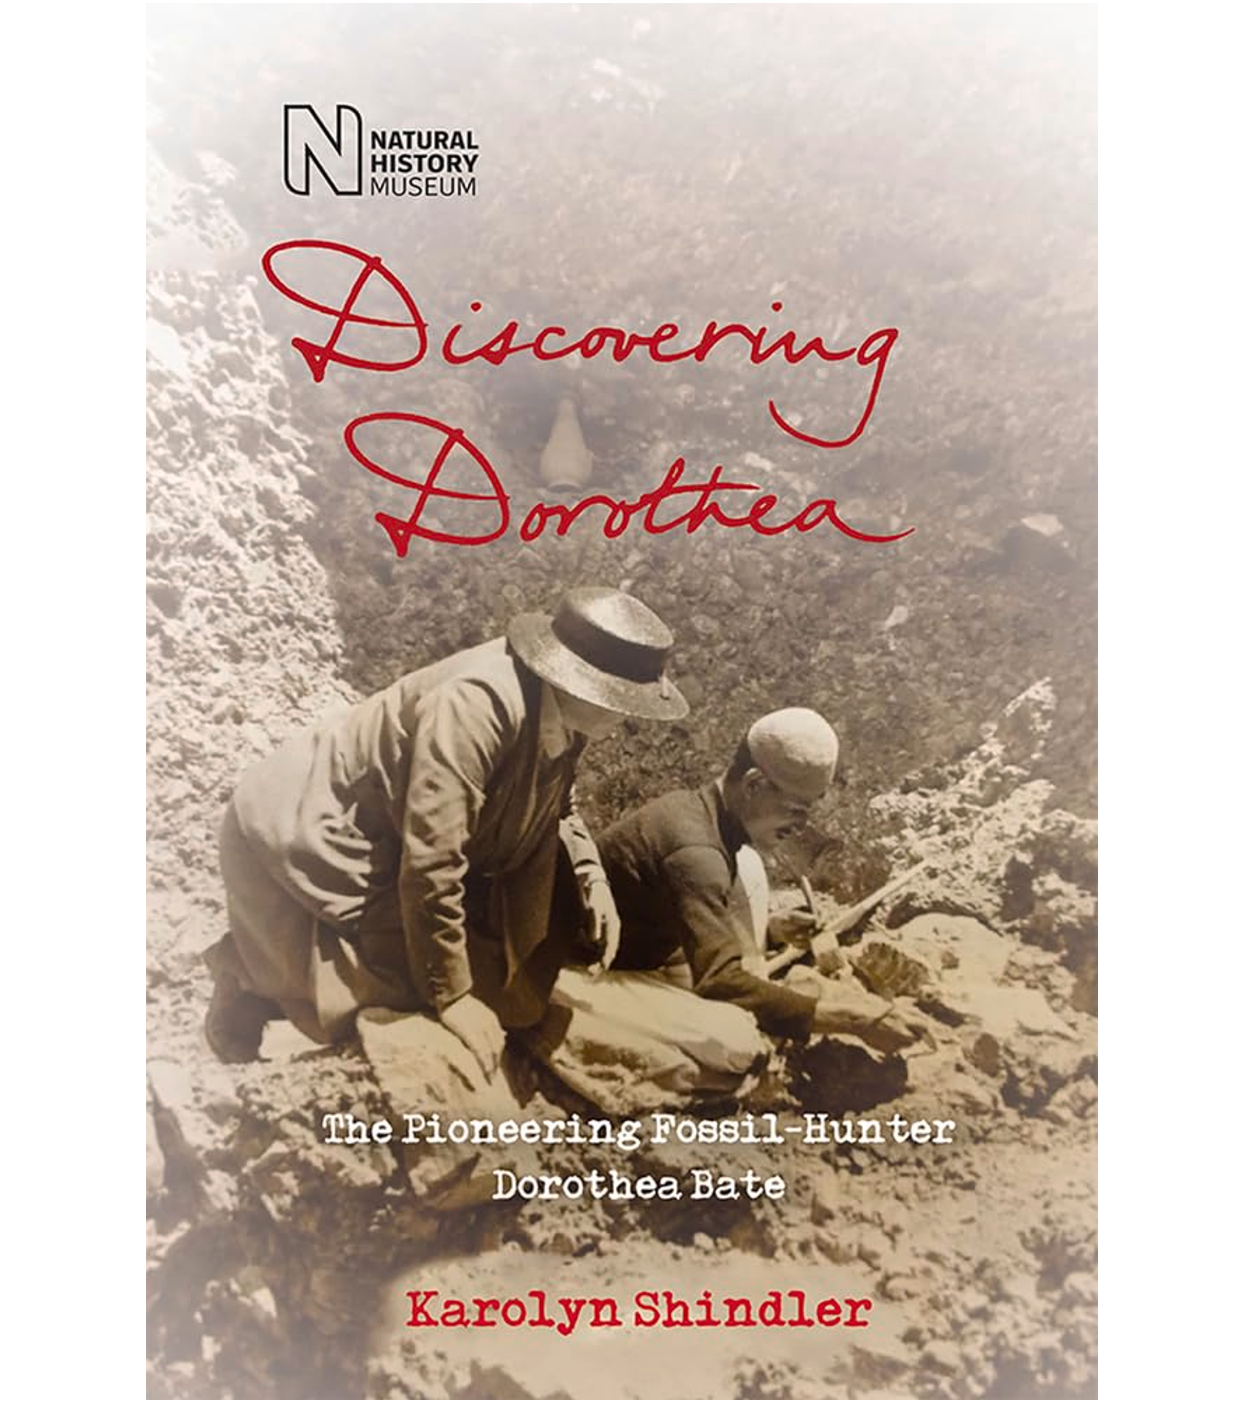
Historical Reputation
In the words of her biographer Karolyn Shindler, Dorothea ‘devoted her life to discovery and enriched our knowledge of the natural world’.
She believes that for too long Dorothea has been overlooked and that she deserves wider recognition of her achievements in palaeontology and archaeozoology.
To address this Karolyn wrote a book about her: ‘Discovering Dorothea – The life of the pioneering fossil-hunter Dorothea Bate’ .
Notes:
Image: © The Trustees of the Natural History Museum, London
https://blackwells.co.uk/bookshop/product/Discovering-Dorothea-by-Karolyn-Shindler/9780565094379

Slide 37
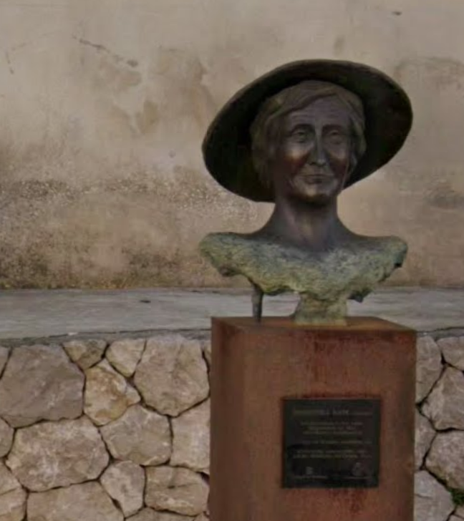
Later Recognition
Since 2016, the Insular Directorate of Equality in Mallorca have been working with the aim of “recovering from oblivion women who have left their mark”.
Mallorca was one of the islands in the Balearics where Dorothea worked.
In December 2018, a bust of Dorothea was unveiled in on the island, which recognises her discovery of the Myotragus.
Dorothea bust, Plaça de L'Orient, Capdepera, Mallorca
Notes:
Image: © Google Maps 2026

Slide 38
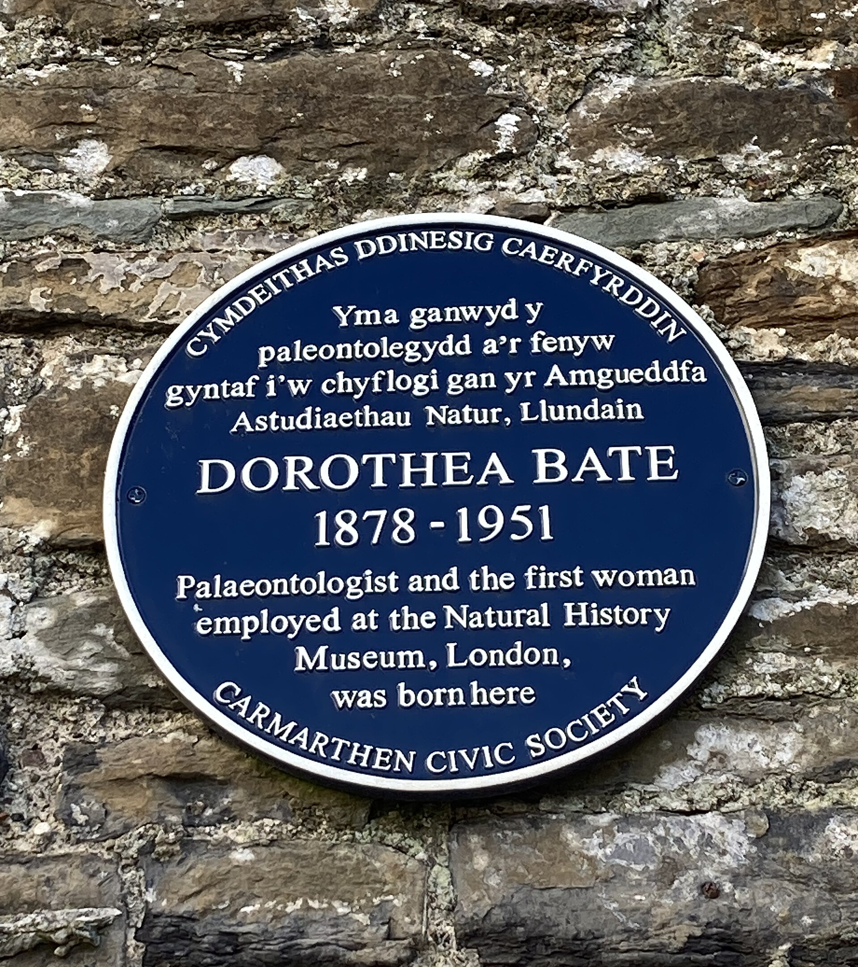
Not her first Blue Plaque
In December 2017, over 60 years since her death, Dorothea’s life and work was celebrated with a prestigious blue plaque on her birthplace, Napier House in Carmarthen, Wales.
The plaque, planned by the Carmarthen Civic Society, is dedicated to her groundbreaking work in palaeontology.
Dr Victoria Herridge, a palaeobiologist who has worked with Dorothea’s collections at the Natural History Museum and attended the plaque’s unveiling, commented:
“It’s recognition. It shows that someone has done something of value – even if you don’t know who they are,” she said.
“It could be an inspiration to young girls that might walk past and see it.”
Welsh Blue Plaque
Notes:
Image: © MumphingSquirrel, CC BY-SA 4.0, via Wikimedia Commons - https://commons.wikimedia.org/wiki/File:Dorothea_Bate%27s_blue_plaque_on_Napier_House,_Spilman_Street,_Carmarthen.jpg
Teacher Notes:
Dr Victoria Herridge, a palaeobiologist who has worked with Dorothea’s collections at the Natural History Museum in her study of dwarf elephants and mammoths, attended the plaque’s unveiling, commented:.
“It’s recognition. It shows that someone has done something of value – even if you don’t know who they are,” she said.
“It could be an inspiration to young girls that might walk past and see it.”
Dr Herridge is co-founder of TrowelBlazers, an organisation dedicated to telling the stories of pioneering women in palaeontology, geology and archaeology, and addressing gender disparity in these fields today. https://trowelblazers.com/

Slide 39
Barriers Dorothea faced in her career
Money
Lack of formal education
A Woman in the world of science
Lack of support
Health
Despite her scientific achievements, she struggled financially throughout much of her career. Although her family was not poor, they prioritised supporting their son and provided no financial help for her education or research. She largely funded her work herself through savings and modest museum income, while friends and local supporters often helped with accommodation. The few grants she received were secured only when male colleagues applied on her behalf.
Dorothea had little formal education. What little schooling she had was not very high quality; she did not attend university or achieve any academic qualifications. She did become a lady member of the Geology society in 1940 but most recognition came after her death.
She could not become a scientific staff member of the museum, as this was forbidden for women until 1928. Until her appointment as Officer in Charge at Tring Museum in 1948, she never held an official paid post at the Natural History Museum. At 70 years of age, after 50 years at the Museum, she was finally given official employment and managerial responsibility of the Natural History Museum at Tring (50km from London).
As well as minimal financial support from British institutions, she received little formal recognition during her lifetime. The only society that did was the Geology society in 1940, although she was allowed to be an honorary lady member of the Union of Ornithologists in 1910.
She overcame bouts of poor health and depleted funds to carry out her work—whether scientific or administrative in nature—to the best of her considerable abilities. She died on 13, January 1951, working until just before her death.

Slide 40


Who Was Dorothea Bate?
She worked indefatigably and many eminent scientists relied on her expertise
What can we discover about the sort of person Dorothea was?
She was driven by her passionate curiosity about the natural world which lasted her lifetime
Activity:
Highlight the words that describe Dorothea’s character
Her output reflects her passion, competence and innovative thinking as a palaeontologist
She overcame bouts of poor health and depleted funds to carry out her work…to the best of her considerable abilities
She worked until just before her death aged 72

Slide 41
Who Was Dorothea Bate?
She worked indefatigably and many eminent scientists relied on her expertise
Highlight the words that describe Dorothea’s character
She was driven by her passionate curiosity about the natural world which lasted her lifetime
Her output reflects her passion, competence and innovative thinking as a palaeontologist
She overcame bouts of poor health and depleted funds to carry out her work…to the best of her considerable abilities
She worked until just before her death aged 72

Slide 42
Who Was Dorothea Bate?
She worked indefatigably and many eminent scientists relied on her expertise
What can we discover about the sort of person Dorothea was?
She was driven by her passionate curiosity about the natural world which lasted her lifetime
Her output reflects her passion, competence and innovative thinking as a palaeontologist
She overcame bouts of poor health and depleted funds to carry out her work…to the best of her considerable abilities
She worked until just before her death aged 72
Notes:
Teacher Notes:
Indefatigable: Showing persistent determination and energy without becoming tired.
Eminent: Highly respected, distinguished, or well-known in a particular field.
Passionate: Having a lot of enthusiasm, commitment, or excitement for something.
Curiosity: A strong desire to learn, explore, or understand new things.
Competence: The ability to perform a task effectively and skillfully.
Innovative: Introducing new ideas, methods, or solutions in a creative way.

Slide 43
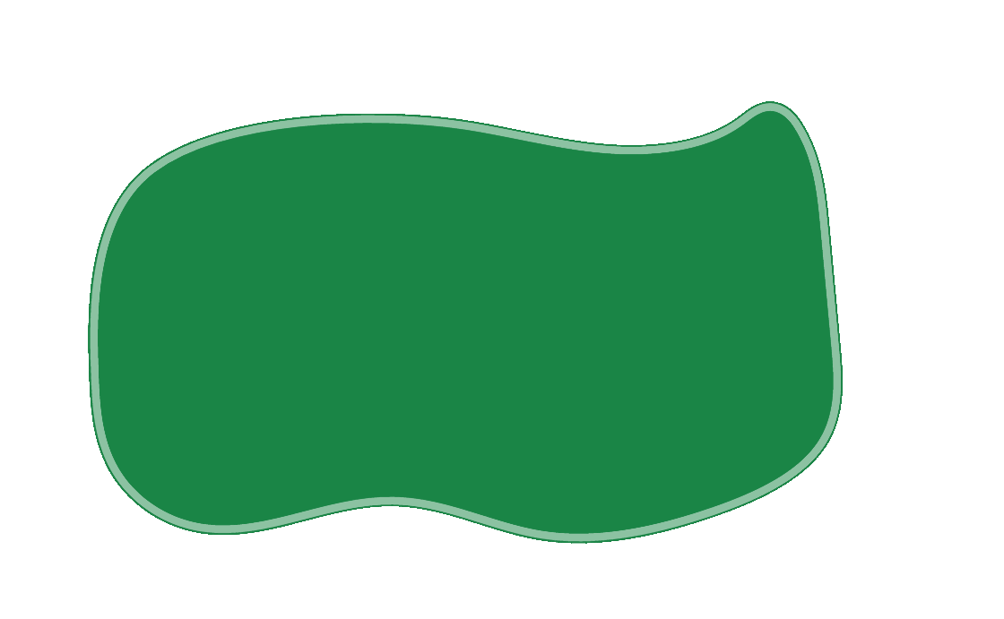



Four Maxims – Dorothea lived by these 4 sayings:
A maxim is a short statement that expresses a general truth, rule of behaviour, or principle for living
Blessed are those who expect nothing, for they will not be disappointed
The Lord helps those who help themselves
If you want something done right, do it yourself
Never refuse a cover letter

Slide 44
What makes Dorothea Bate significant?
Sort the cards that follow into two piles
Pick your top 3 (or 5) and put them into a diagram to show which you think were the most important
Contributions to science | A female pioneer

Slide 45
Cards to print out
Dorothea Bate is recognized as a pioneer of archaeozoology – the study of animal bones from archaeological sites. | Her research transformed understanding of extinct mammals | She was one of the first woman to work as a scientist at the Natural History Museum
Her research reports on the fossils are still being used today. | Advanced the study of evolution, helping scientists understand how environments shape animal species over time. | She built an international reputation through determination, fieldwork, and expertise despite having little formal education.
Her work showed that animals on islands often evolve in unexpected ways, providing powerful evidence for evolutionary change. | Bate is also important as an example of how scientific discovery can challenge assumptions. | She broke barriers for women in science at a time when scientific careers were largely closed to women.

Slide 46
Dorothea Bate’s achievements
Contributions to science | A female pioneer
Dorothea Bate is recognized as a pioneer of archaeozoology – the study of animal bones from archaeological sites
She was one of the first woman to work as a scientist at the Natural History Museum
She built an international reputation through determination, fieldwork, and expertise despite having little formal education
Her research transformed understanding of extinct mammals
Advanced the study of evolution, helping scientists understand how environments shape animal species over time
She broke barriers for women in science at a time when scientific careers were largely closed to women
Her work showed that animals on islands often evolve in unexpected ways, providing powerful evidence for evolutionary change
Dorothea is also important as an example of how scientific discovery can challenge assumptions
Her research reports on the fossil faunas are still being used today

Slide 47

Think back to what makes a person significant?
Did they:
make big changes in their lifetime?
make a lot of people’s lives better or worse?
change the way people think about something?
have a lasting impact on their locality, the country or the world?
set a really good/bad example to people about how to live and behave?
Why might we describe Dorothea Bate as a significant person?

Slide 48
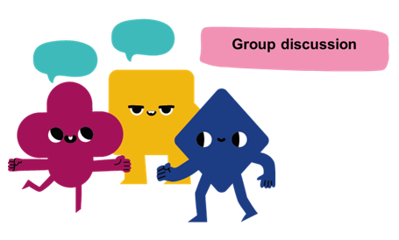
How do we remember and celebrate significant people?

Slide 49
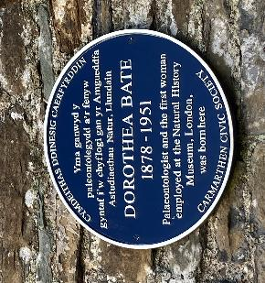
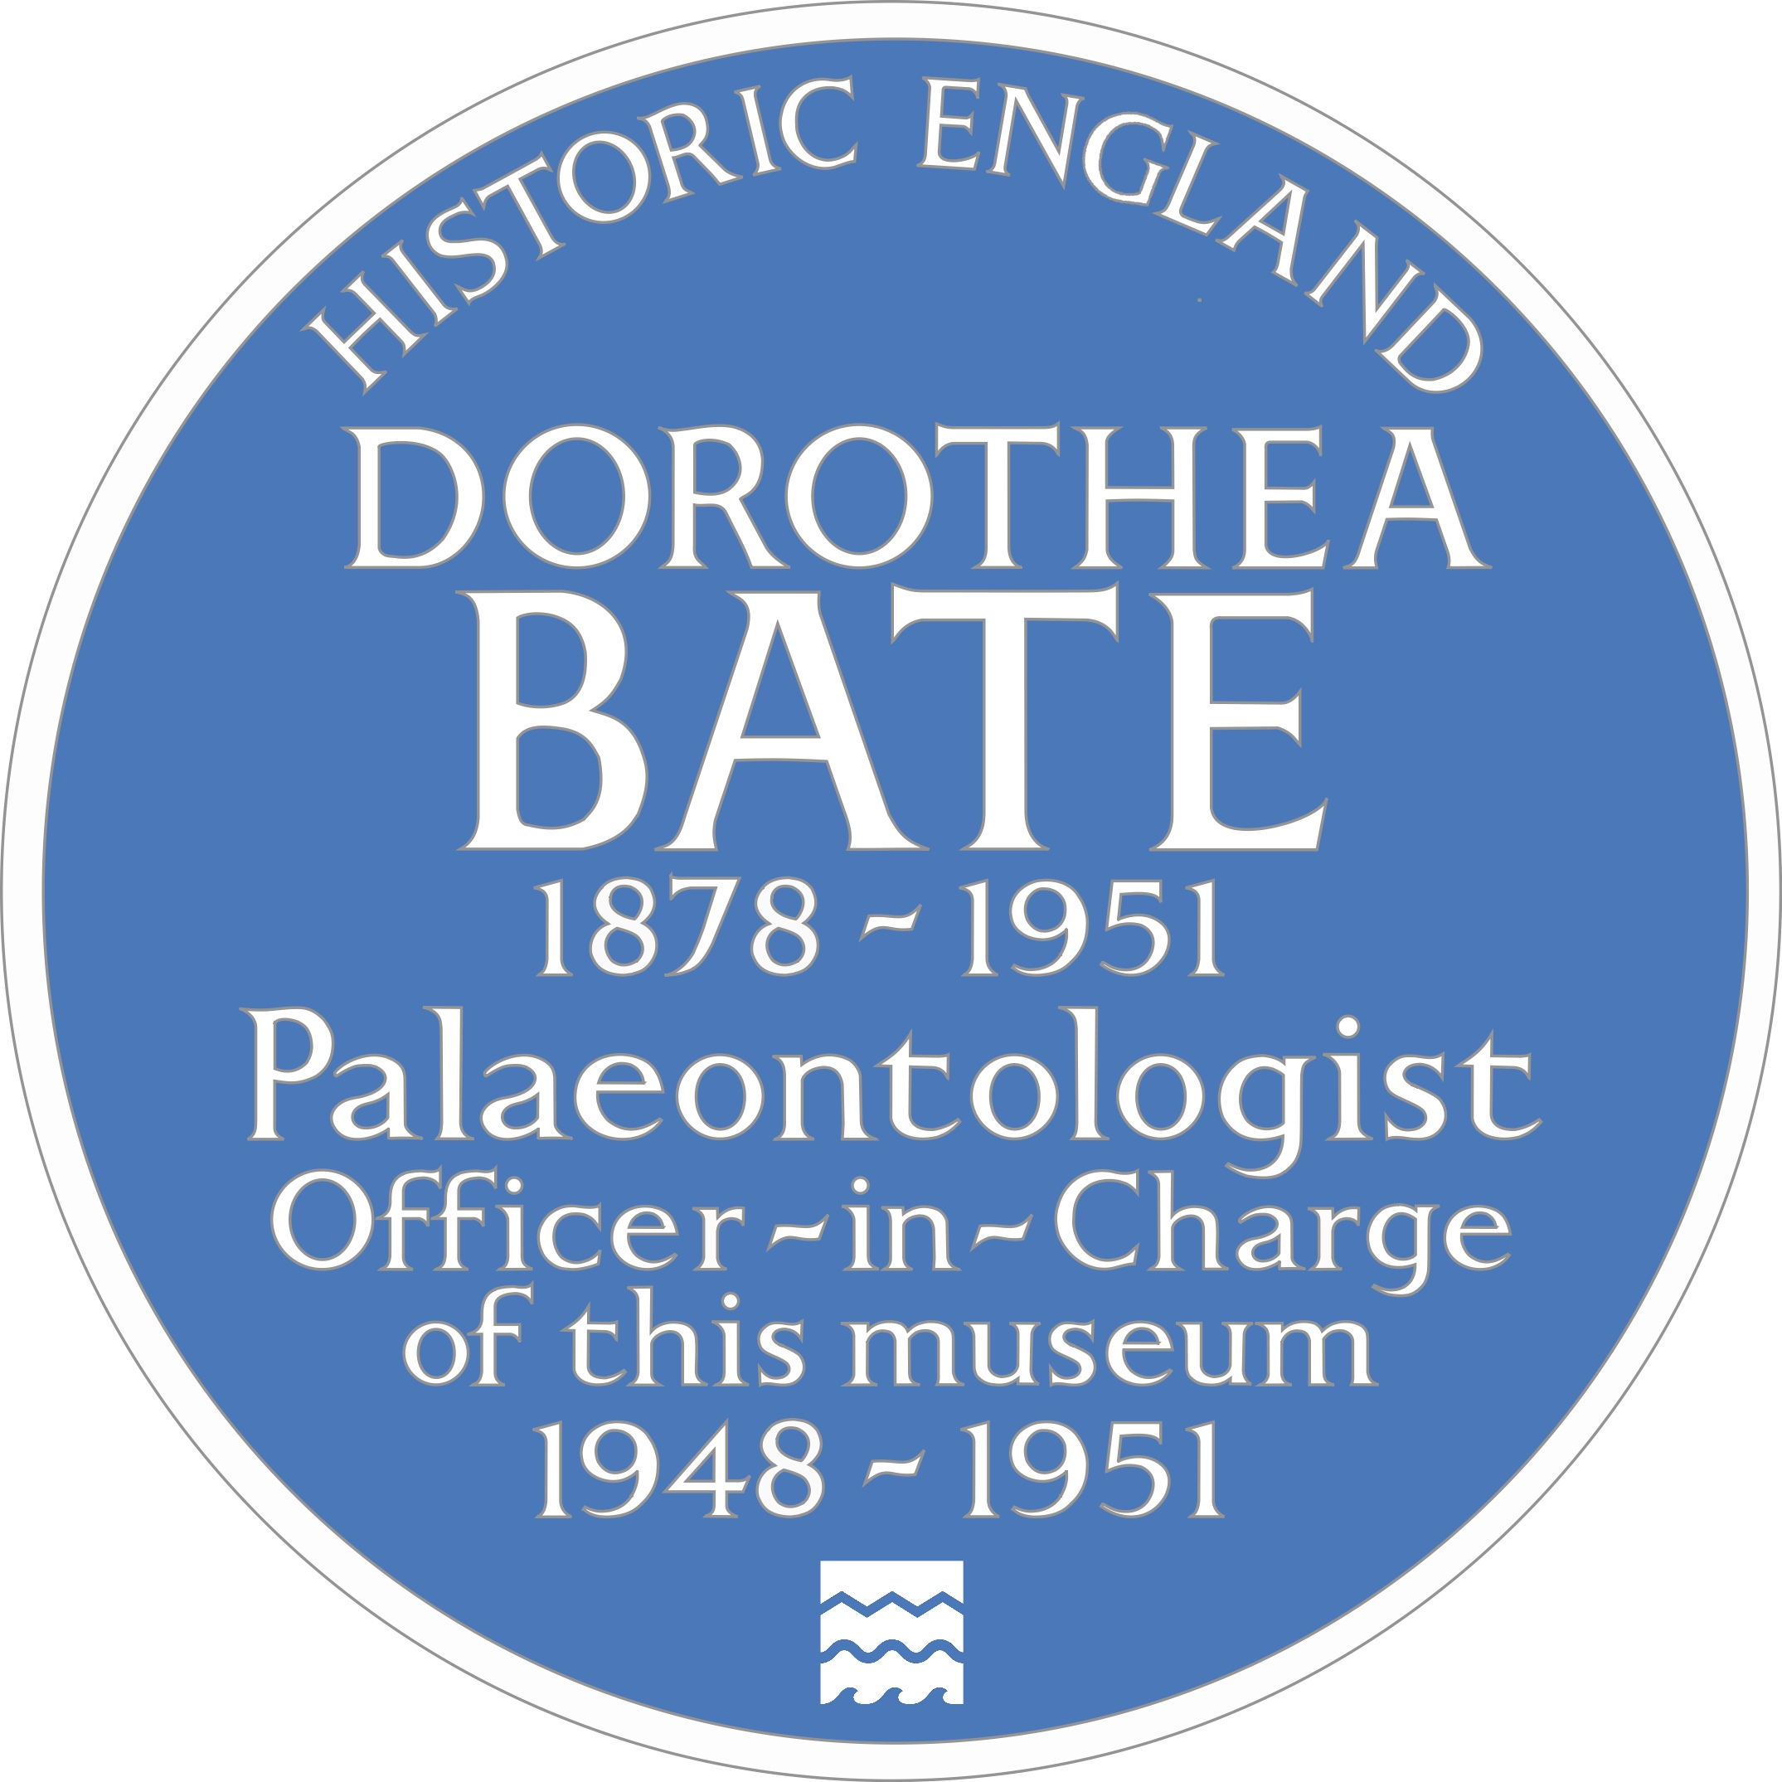
A Blue Plaque to Dorothea Bate
Dorothea’s Welsh plaque
We have learnt why Dorothea and the buildings on Park Street, are historically significant.
What is a blue plaque?
Blue plaques are placed on buildings connected to significant people. Until 2024 there was an “official” Blue Plaque Scheme, which ran in London. Local councils and organisations also ran their own schemes. In Feb 2024 Historic England took responsibility for a national blue plaque scheme. Their plan is to place blue plaques across the country to celebrate “people throughout history who have made significant and positive contributions to human welfare or happiness.”
Dorothea’s English plaque
Notes:
Image: © MumphingSquirrel, CC BY-SA 4.0, via Wikimedia Commons - https://commons.wikimedia.org/wiki/File:Dorothea_Bate%27s_blue_plaque_on_Napier_House,_Spilman_Street,_Carmarthen.jpg
Image: © Historic England

Slide 50
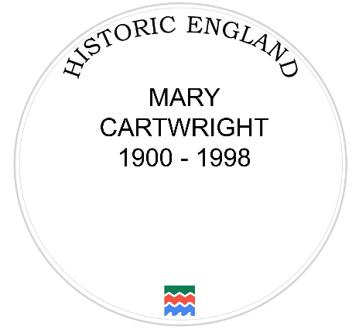


Your Task
On the template you have been given, design your own plaque celebrating why Dorothea Bate is such a significant person. Make sure you….
1) Complete the sentence:
Dorothea Bate is significant because….
You might like to write one or a couple of sentences.
Write
DOROTHEA
BATE
1878 - 1951
2) Draw a picture to illustrate your plaque. You might like to draw the inside or outside of one of the places using the descriptions from the previous slides for inspiration!
Draw

Slide 51
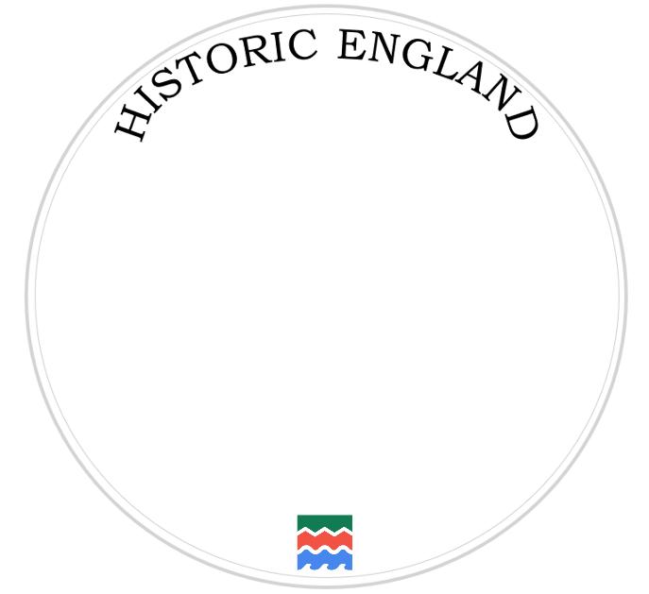
George Harrison Plaque
DOROTHEA BATE
1878 - 1951

