Slide 1

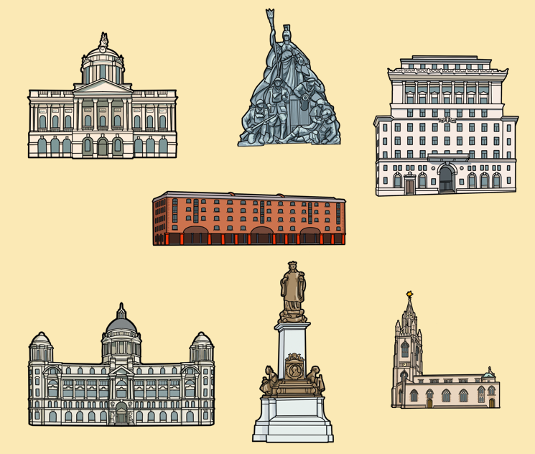



What can Liverpool's buildings tell us about the city's links to the British Empire?
What can Liverpool's buildings tell us about the city's links to the British Empire?
Introductory Lesson: Empire, the British Empire and Liverpool
A resource created by Liverpool Hope and John Moores University, in partnership with the International Slavery Museum.

Slide 2
How to use this PPT
This PowerPoint is part of the Teaching Activity: ‘What can Liverpool's buildings tell us about the city's links to the British Empire?’. We encourage teachers to use this PPT in class, before taking pupils on the history trail: ‘We Need to Walk About Empire’.
The purpose of this PPT is to develop pupils' understanding of the concept of empire, and the scale and impact of the British Empire, in order that pupils better understand the themes and information encountered on the trail. This PPT can also be used to introduce pupils to the sites they will visit.
Teachers can use all, or some of the slides, and can edit them to meet the needs of pupils. Teachers may wish to further explore the themes introduced in this PPT.
Please see notes under slides for helpful links.
Information for Teachers
History Trail: 'We Need to Walk About Empire'
  Teachers’ trail script
  Trail map & worksheet
Post Trail Recap and Reflect PPT
Post Trail Suggested Activities PPT
Post trail supporting resources:
  'We Need to Walk About Empire' StoryMap
  Buildings: Colour, cut & build Activity Sheet
Please refer to the ‘Information for Teachers’ document before using this PPT, and the other resources provided.

Slide 3
A note for teachers
Please be aware that the topics and information in this enquiry are likely to have a different impact on both teachers and pupils depending on their connections to countries that were once part of the British Empire and/or their experiences of past or ongoing oppression.
This PPT contains information about the enslavement of African people, and the use of indentureships imposed on people from India. Whilst this is not the main focus of this PPT, or this enquiry, we cannot consider the impact of the British Empire, without acknowledging that these things happened.
If you wish to explore these themes in greater depth, we encourage you to refer to the document Unlocking Perceptions , created by the Understanding Slavery Initiative which offers insight to anyone planning to develop programmes of study about the history and legacies of the transatlantic slave trade. Please also note that several appropriate learning resources, schemes of work and lesson plans, relating to transatlantic slavery, can be downloaded from the website Understanding Slavery.
Please refer to the ‘Information for Teachers’ document before using this PPT and the other resources provided.

Slide 4
What can Liverpool's buildings tell us about the city's links with the British Empire?
Key Stage 2
To allow pupils to develop an age and phase appropriate knowledge and understanding of the concept of empire
To introduce pupils to the impact of the British Empire on Britain
To support pupils to begin to make links between the growth of Liverpool and the British Empire

Slide 5
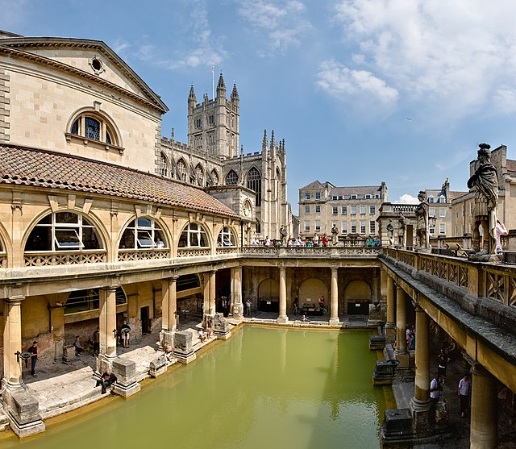
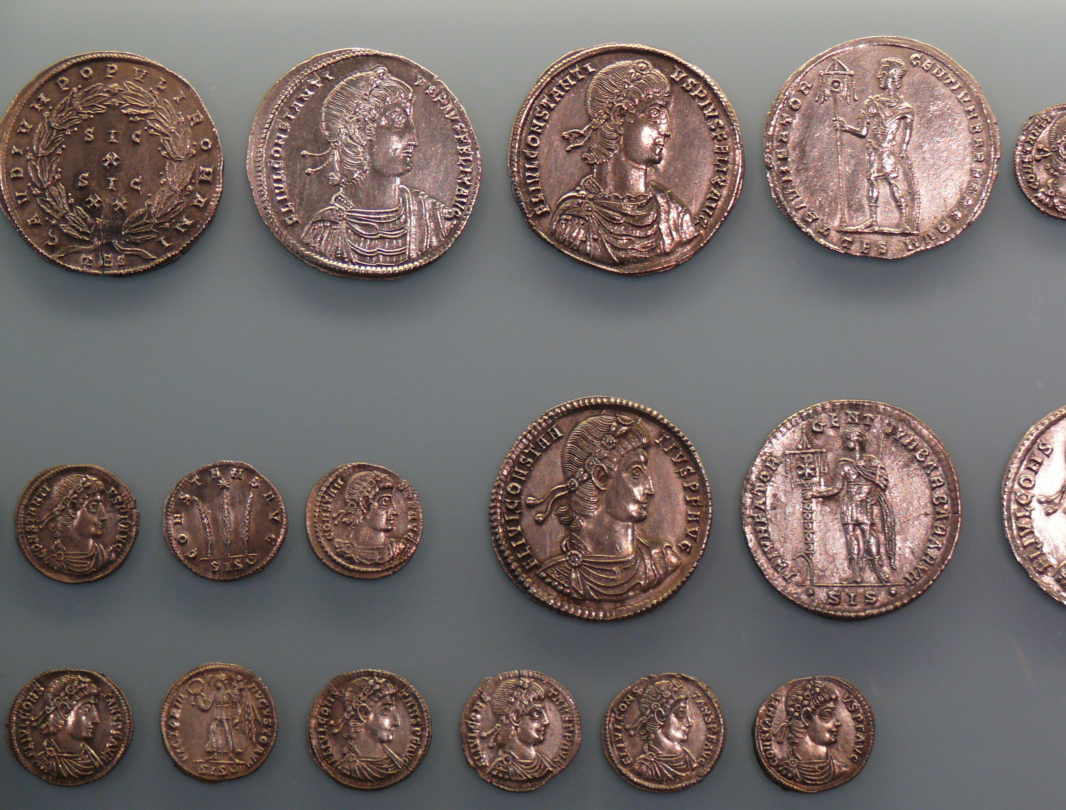

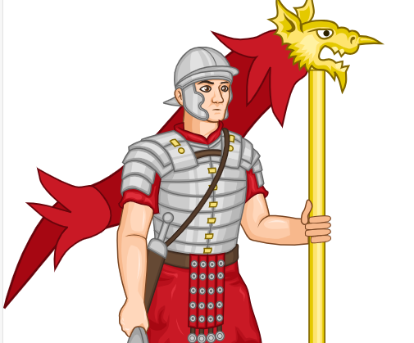
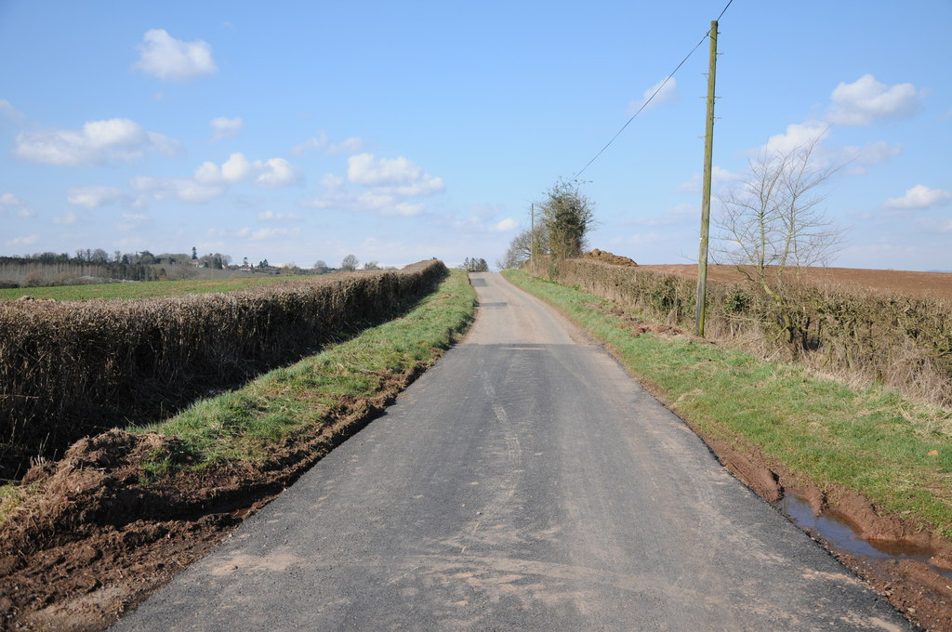
What do these things have in common?
What do these things have in common?
Notes:
Roman Baths By Diliff (with modifications by uploader; see original) - Own work, CC BY 2.5, https://commons.wikimedia.org/w/index.php?curid=1250046
Soldier By User:Di (they-them) - This vector image includes elements from this file:, CC BY-SA 4.0, https://commons.wikimedia.org/w/index.php?curid=84510932
Roman road By Roman Road by Philip Halling, CC BY-SA 2.0, https://commons.wikimedia.org/w/index.php?curid=116986045
Coins By Ad Meskens - Own work, CC BY-SA 3.0, https://commons.wikimedia.org/w/index.php?curid=9717895

Slide 6

The Roman Empire
Roman Baths
The Roman Empire
Roman coins
Roman soldier
Roman road
Notes:
Roman Baths By Diliff (with modifications by uploader; see original) - Own work, CC BY 2.5, https://commons.wikimedia.org/w/index.php?curid=1250046
Soldier By User:Di (they-them) - This vector image includes elements from this file:, CC BY-SA 4.0, https://commons.wikimedia.org/w/index.php?curid=84510932
Roman road By Roman Road by Philip Halling, CC BY-SA 2.0, https://commons.wikimedia.org/w/index.php?curid=116986045
Coins By Ad Meskens - Own work, CC BY-SA 3.0, https://commons.wikimedia.org/w/index.php?curid=9717895

Slide 7
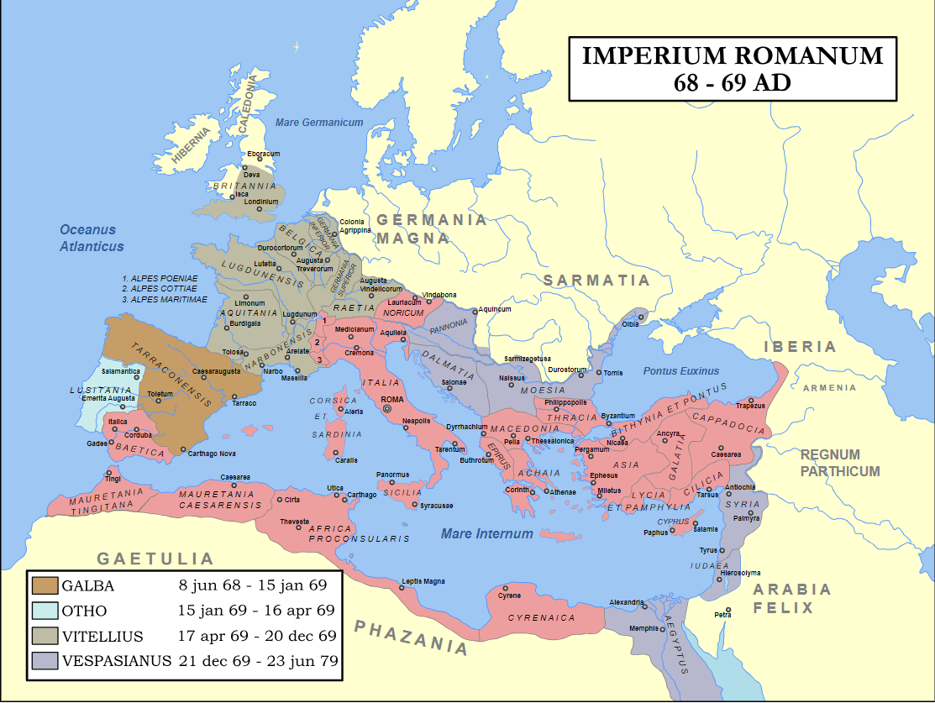
What is an empire?
An empire is a group of countries ruled by a single other country or government.
(Sanghera, 2023, p.10)
Map of Roman Empire during 69AD
Notes:
Map of the Roman Empire during 69AD, the Year of the Four Emperors. Coloured areas indicate provinces loyal to one of four warring generals. By Steerpike and ArdadN - Combination of Roman Empire 69AD.PNG and Roman Empire 120.svg, CC BY-SA 3.0 nl, https://commons.wikimedia.org/w/index.php?curid=5649786
Quote taken from the 2023 children's book Stolen History by Sathnam Sanghera that provides an accessible and engaging introduction to the British Empire. Sanghera also wrote the book Empireland, which is targeted at adult readers.
You may wish to discuss with pupils the imbalance of power within an empire. One country is more powerful than the other. It is not an equal relationship. This may be particularly relevant if your school considers "power" as a substantive concept or curriculum "thread".

Slide 8
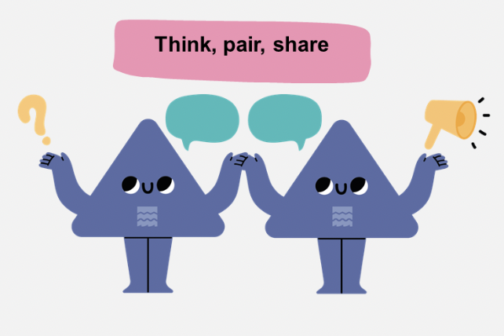
What is an empire? (2)
Have you learnt about any other empires?
How would you describe an empire to someone who had never heard the word?
What do different empires have in common with each other?

Slide 9
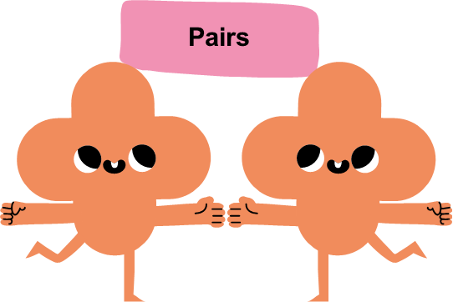
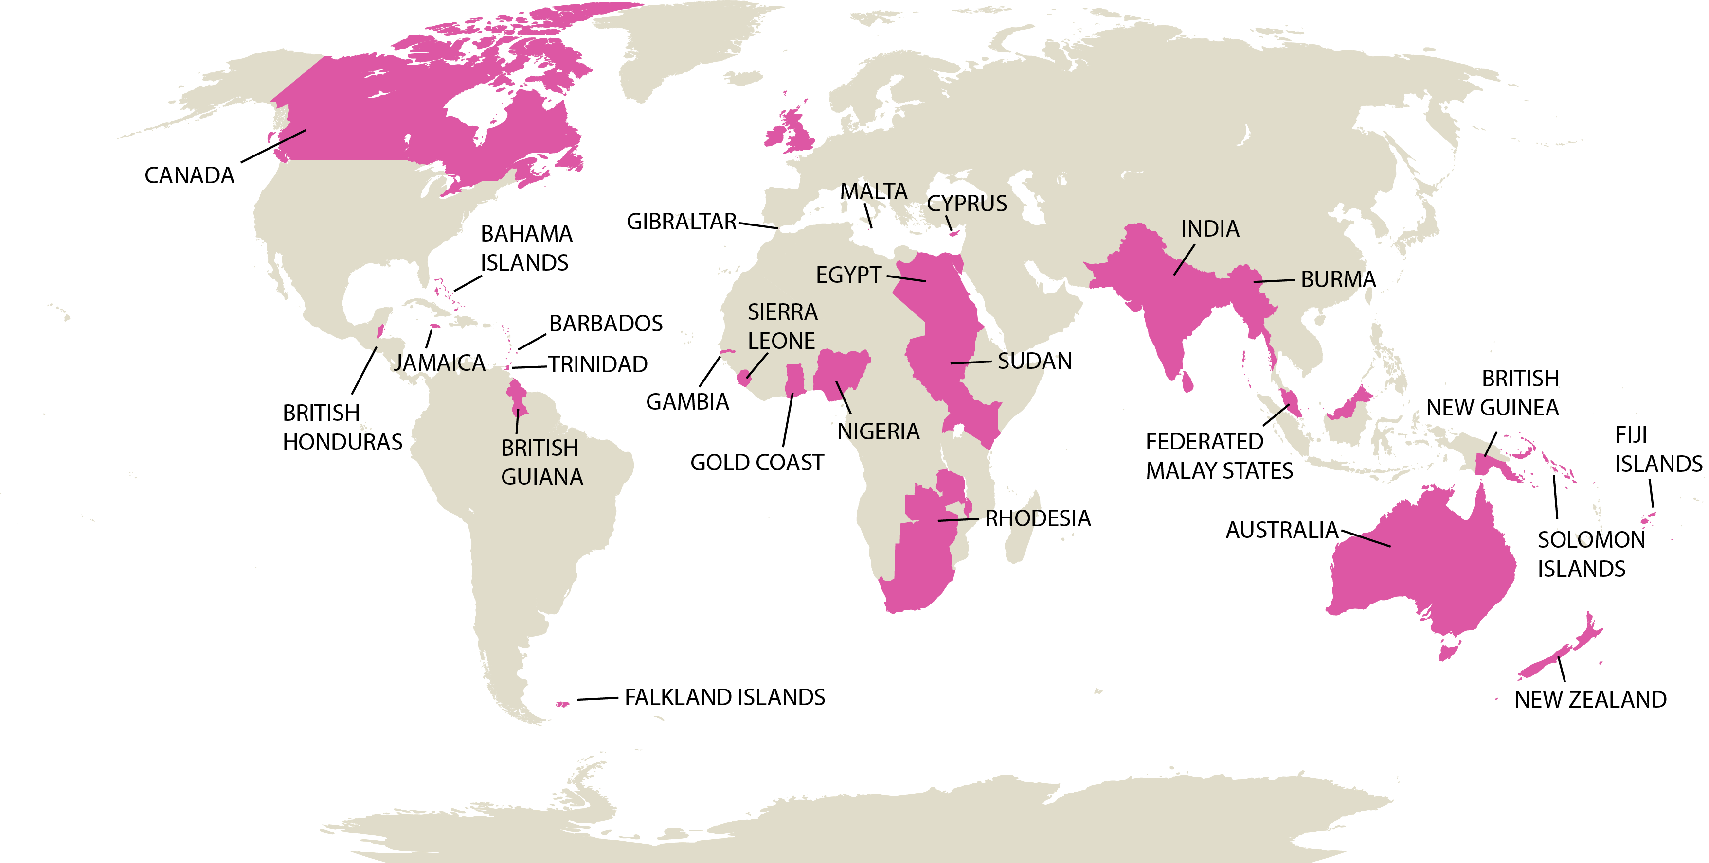
What does this map of the world show?
What does this map show?
What questions do you have?

Slide 10
This is a map showing the countries that were once part of the British Empire.
The British Empire
describes all the places in the world that Britain once ruled or
controlled in some way.​

Slide 11
When was the British Empire?
The British Empire began in the late 1500s when Queen Elizabeth I was on the throne.
By 1913, it was the biggest empire that the world has ever known. Britain ruled over more than 25%, one quarter, of the world’s total population.
Notes:
A possible starting point for exploring the growth, size and impact of the British Empire is https://www.bbc.co.uk/bitesize/articles/zpjv3j6 . The information here may be considered oversimplified. You may also wish to download the free "The British Empire Experiences of African and Caribbean People" information cards from the Black Curriculum website. These are targeted at KS3 but provide some really useful, and more detailed information.

Slide 12
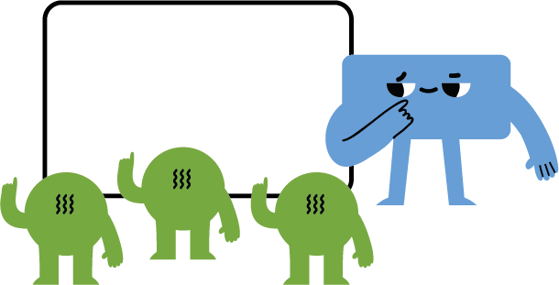
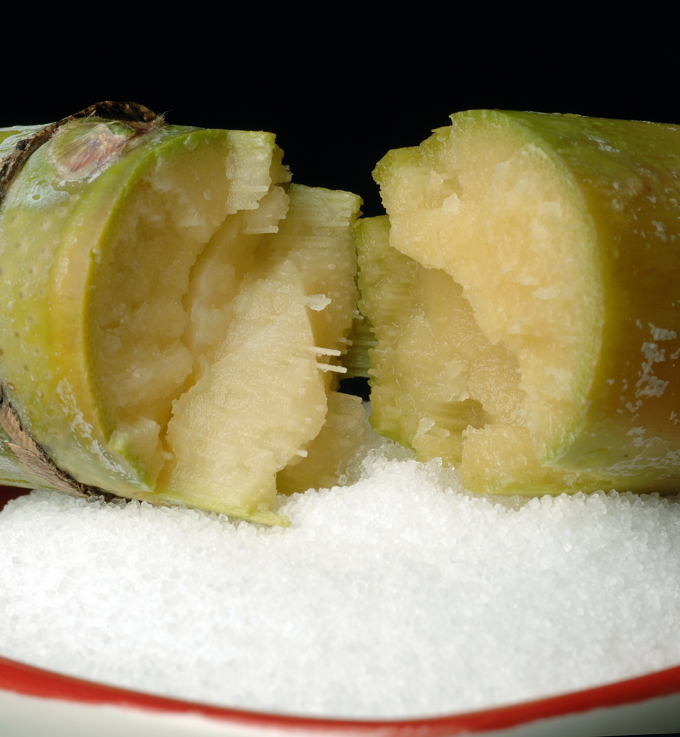
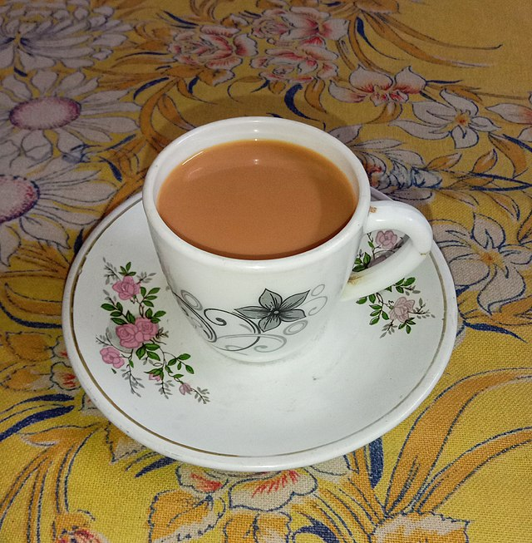
What does a cup of tea (with sugar) have to do with the British Empire?
Class discussion
Notes:
Tea By Billjones94 - Own work, CC BY-SA 4.0, https://commons.wikimedia.org/w/index.php?curid=106673883
Sugar By CSIRO, CC BY 3.0, https://commons.wikimedia.org/w/index.php?curid=35495994

Slide 13


What does a cup of tea have to do with the British Empire?
Tea originally came to Britain from China in the 1600s. It became fashionable when the royal family started to drink it, though at first, it was expensive, so it was only a drink for the rich!
Sugar first came to Britain from the Middle East in the 11th century but, like tea, at first it was an expensive luxury.
In the 1600s Britain started to grow sugar cane in places like the Caribbean which were part of the British Empire.
In the 19th century, a man called Robert Fortune smuggled some tea plants out of China. He took them to India, part of the British Empire, and grew tea there.
Tea became cheaper and more people in Britain started to drink it!
Sugar became popular for sweetening tea and for all sorts of other sweet treats!
Notes:
Please note. The takeaway here is that Britain and its empire can not be separated. Even things that we think of as quintessentially "British", like a cup of tea, are symbolic of the connections between the colonies and the British Isles that made up "Britain" for several hundred years.

Slide 14
How was tea and sugar grown in the British Empire?
From the 1600s sugar was grown on plantations in the Caribbean.
Plantation owners were British. Some of them were from or lived in Liverpool.
Enslaved African men, women and children were made to work on the plantations.
They had been forcibly taken by ship to the Caribbean by British, in many cases by Liverpudlian slave traders or ship's captains.
Enslaved African people lived and worked in appalling conditions. They were not paid. When they tried to resist their enslavement, they were severely punished.
Plantation:
A large farm where things like sugar and tea were grown in large quantities.
Notes:
Please be aware that this is a highly sensitive and difficult topic to teach and learn about. Teachers may wish to refer to the document Unlocking Perceptions , created by the Understanding Slavery Initiative which offers insight to anyone planning to develop programmes of study about the history and legacies of the transatlantic slave trade. Please also note that a number of appropriate learning resources, schemes of work and lesson plans, relating to transatlantic slavery, can be downloaded from the website Understanding Slavery.

Slide 15
How was tea and sugar grown in the British Empire?
Tea growing began on a large scale in India in the 1830s.
l
In 1833, slavery was abolished in the British Empire.
,
Many Indian people were forced into indentured labour by the British who owned the tea plantations.
[
Indentured labourers - Indian men, women and children who worked under appalling conditions for free, or for very little money, and were not allowed to leave.
l
Indentured labourers from India were also sent to work on sugar plantations.
l
They were often promised a small amount of land once their contract had ended but this usually didn't happen.
Indentured labourers:
People who were made to sign contracts binding them to work for a plantation owner for many years.

Slide 16

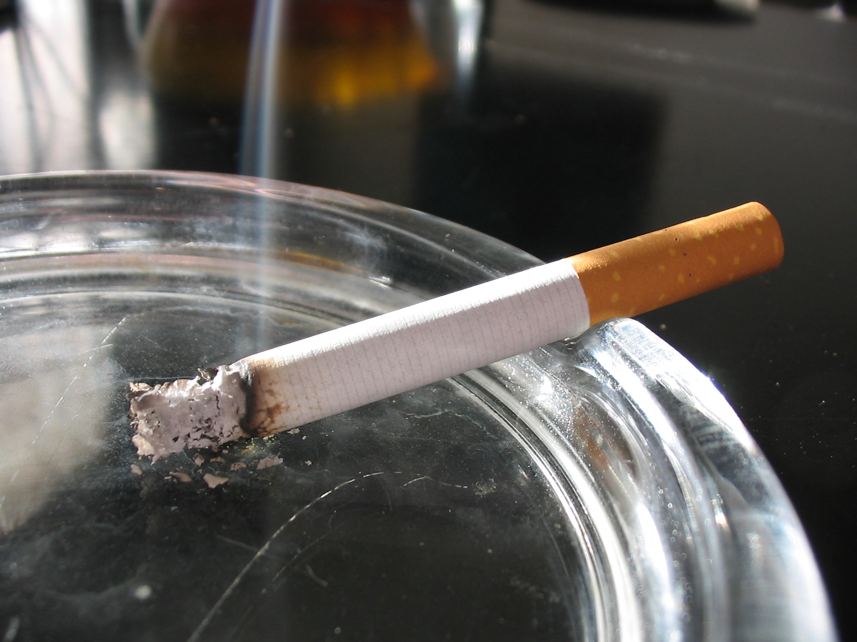

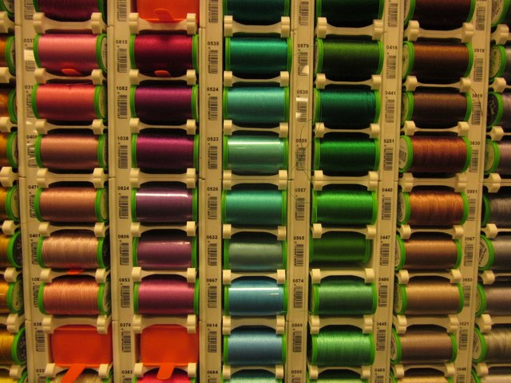
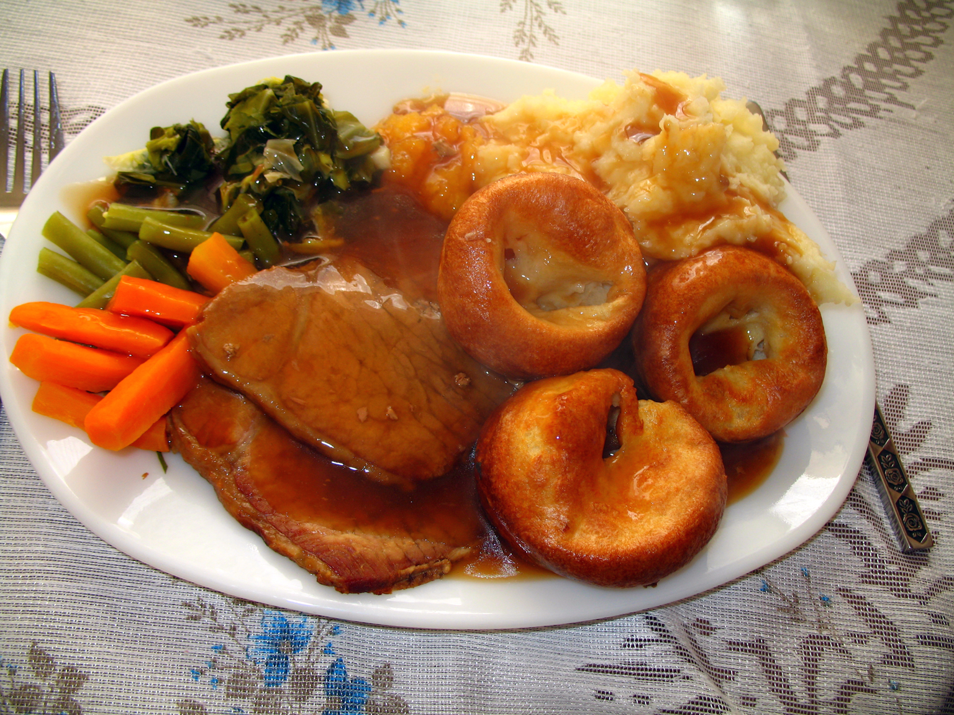

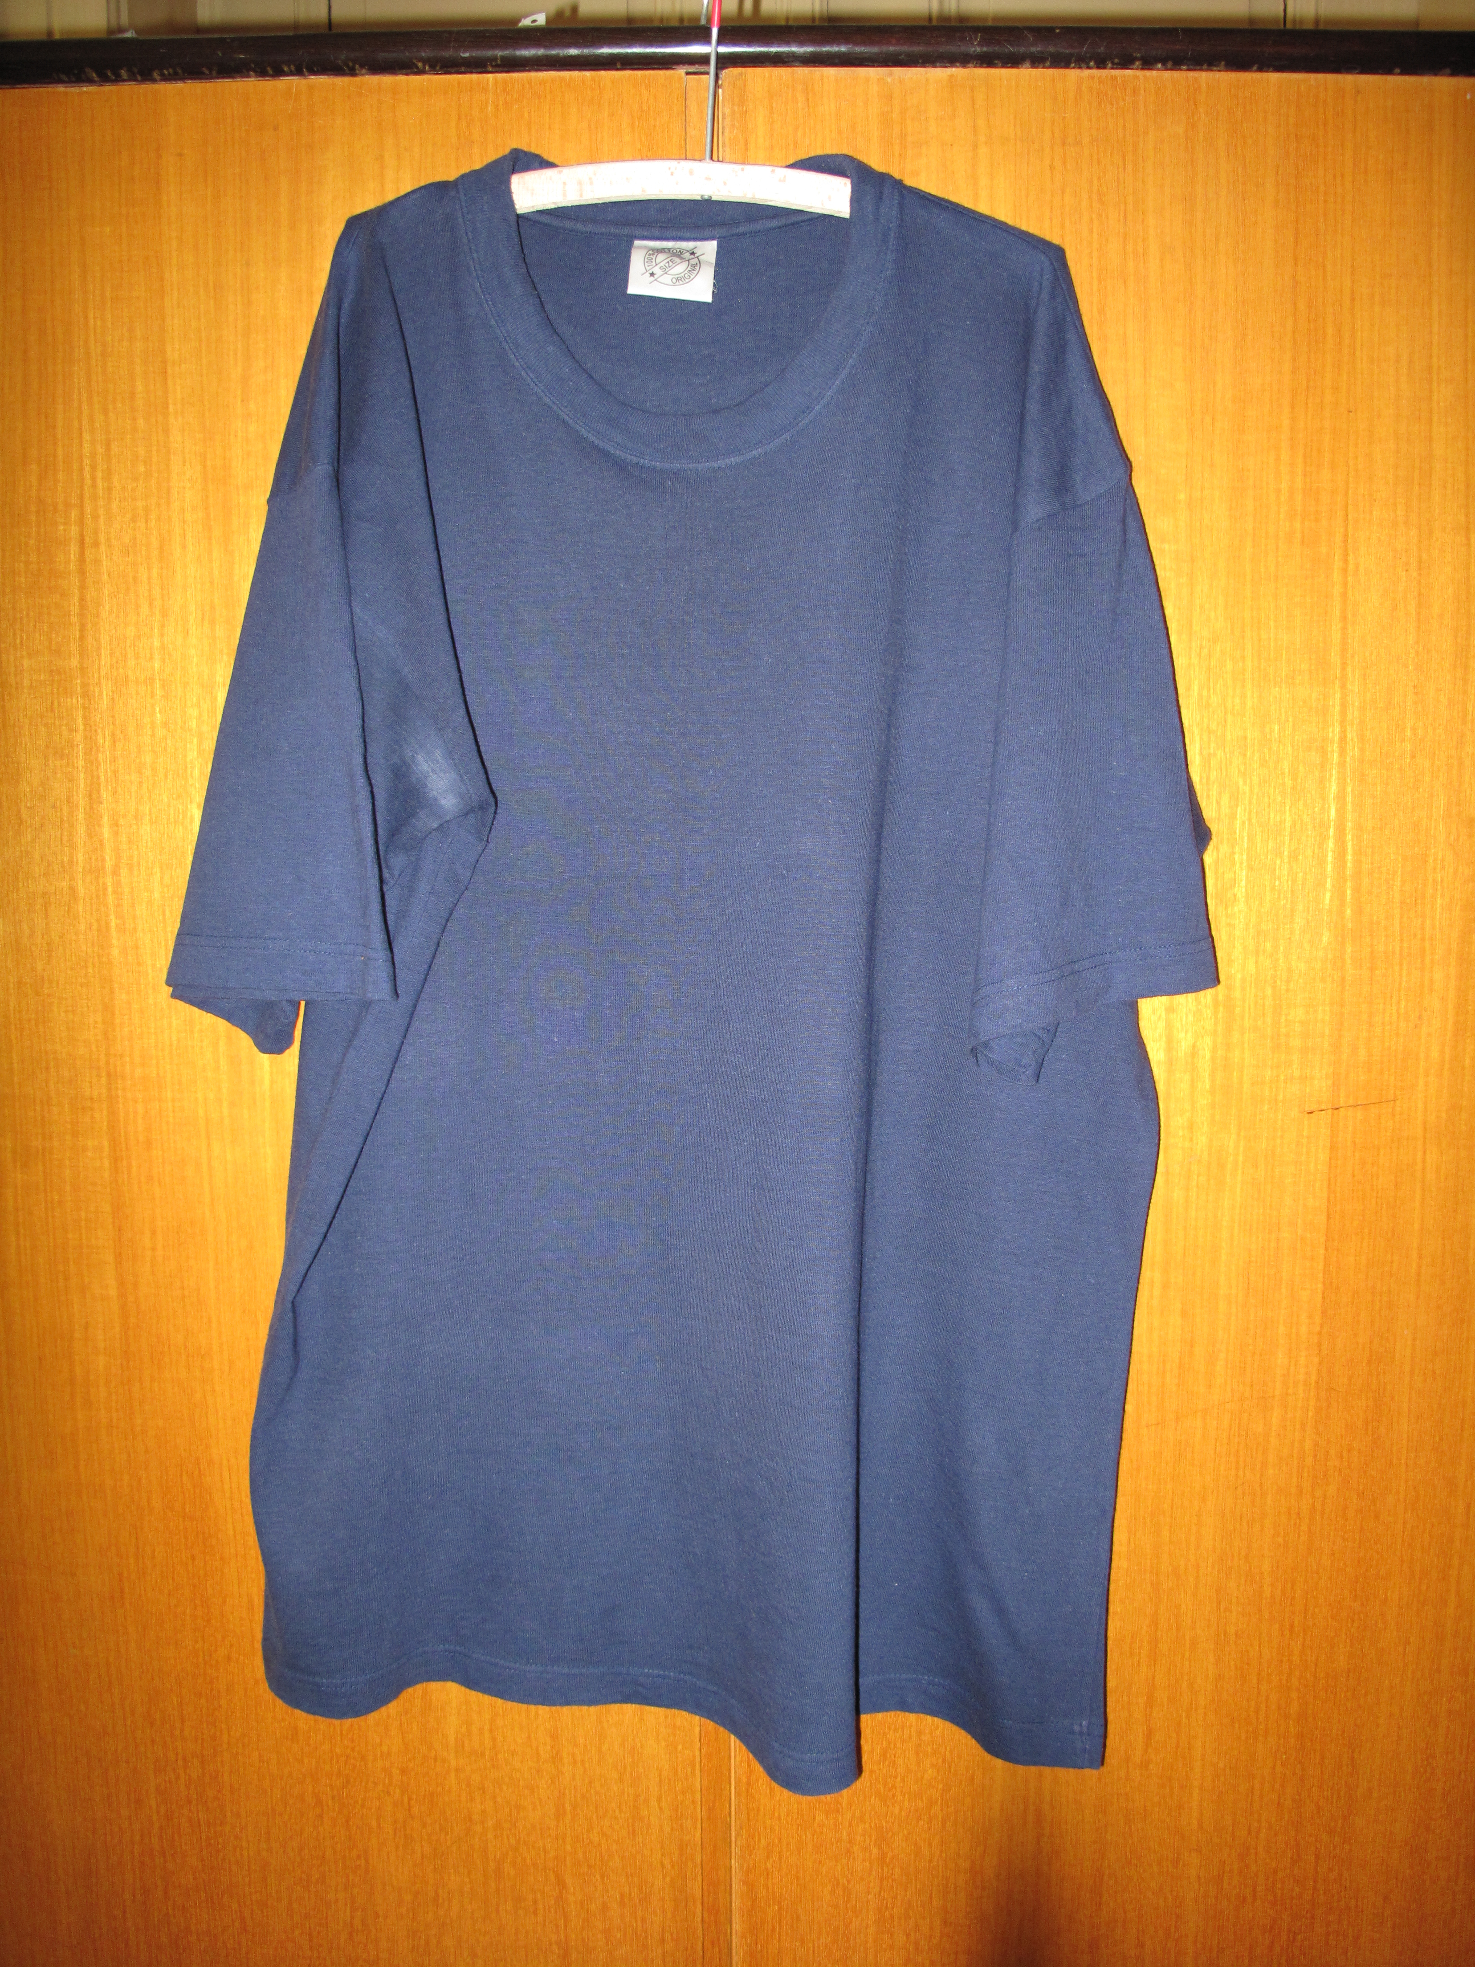
Which of these products do you recognise?
What do they have in common?
Notes:
Chocolate By formulatehealth - https://www.flickr.com/photos/189590028@N07/50399755978/, CC BY 2.0, https://commons.wikimedia.org/w/index.php?curid=97084158
Cigarette By © 2005 by Tomasz Sienicki [user: tsca, mail: tomasz.sienicki at gmail.com] - Photograph by Tomasz Sienicki / Own work, CC BY-SA 3.0, https://commons.wikimedia.org/w/index.php?curid=172810
Cotton T shirt By Juan de Vojníkov - Own work, CC BY-SA 3.0, https://commons.wikimedia.org/w/index.php?curid=10435995
Cotton reels By Cotton reels, Trago Mills by Derek Harper, CC BY-SA 2.0, https://commons.wikimedia.org/w/index.php?curid=116667644
Coffee By shixugang - https://pixabay.com/en/coffee-coffee-beans-afternoon-tea-563797/ archive copy, CC0, https://commons.wikimedia.org/w/index.php?curid=46261327
Beef By by robbie jim - https://www.flickr.com/photos/robs-pics/326678449/, CC BY 2.0, https://commons.wikimedia.org/w/index.php?curid=3098177

Slide 17
Where do these products come from?
Lots of the raw ingredients in products we think of as British, or that British people have come to love – chocolate (cocoa), coffee, cigarettes (tobacco), cotton and silk clothes, even many meats for our Sunday roast – first came to Britain, in large amounts, from countries in the British Empire.
Most of these raw ingredients were made by enslaved people and/or by indentured labourers.
Notes:
Chocolate By formulatehealth - https://www.flickr.com/photos/189590028@N07/50399755978/, CC BY 2.0, https://commons.wikimedia.org/w/index.php?curid=97084158
Cigarette By © 2005 by Tomasz Sienicki [user: tsca, mail: tomasz.sienicki at gmail.com] - Photograph by Tomasz Sienicki / Own work, CC BY-SA 3.0, https://commons.wikimedia.org/w/index.php?curid=172810
Cotton T shirt By Juan de Vojníkov - Own work, CC BY-SA 3.0, https://commons.wikimedia.org/w/index.php?curid=10435995
Cotton reels By Cotton reels, Trago Mills by Derek Harper, CC BY-SA 2.0, https://commons.wikimedia.org/w/index.php?curid=116667644
Coffee By shixugang - https://pixabay.com/en/coffee-coffee-beans-afternoon-tea-563797/ archive copy, CC0, https://commons.wikimedia.org/w/index.php?curid=46261327
Beef By by robbie jim - https://www.flickr.com/photos/robs-pics/326678449/, CC BY 2.0, https://commons.wikimedia.org/w/index.php?curid=3098177

Slide 18
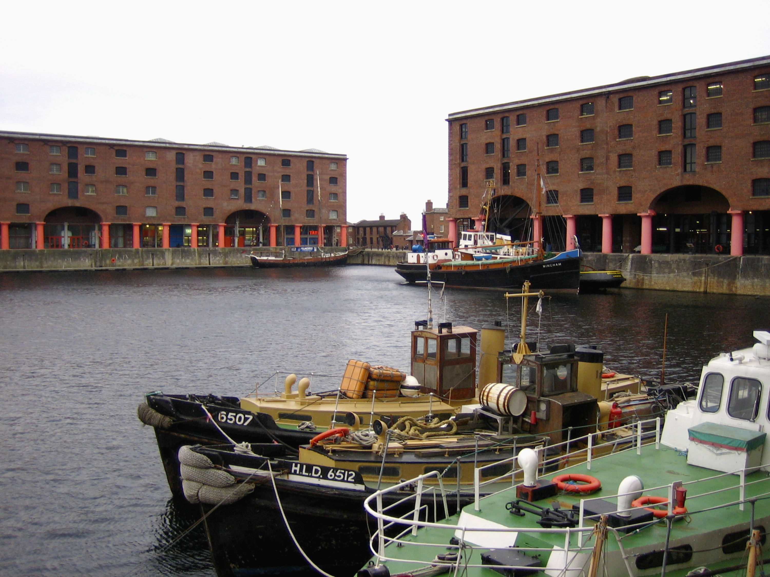
What does the British Empire have to do with Liverpool?
Notes:
Image: © Historic England Archive Ref: DP039520 Date: 7 Feb 2006 - https://historicengland.org.uk/images-books/photos/item/DP039520

Slide 19
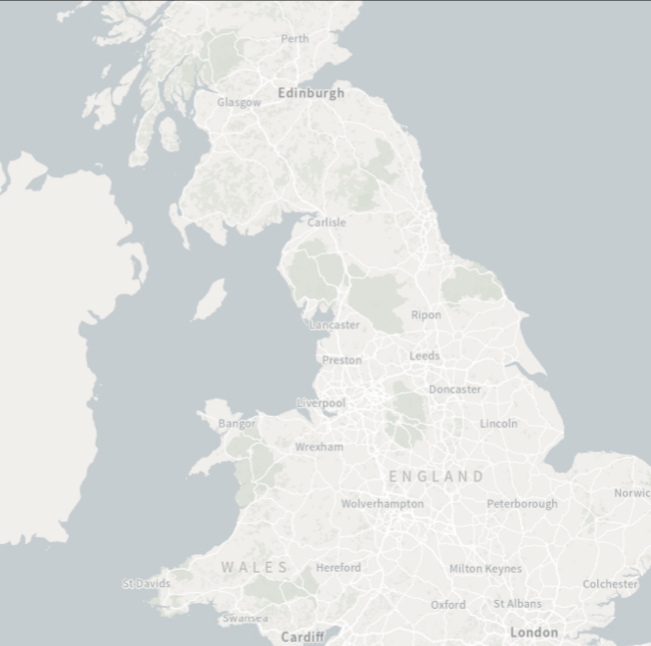
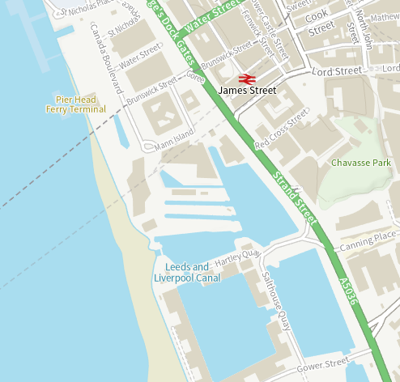


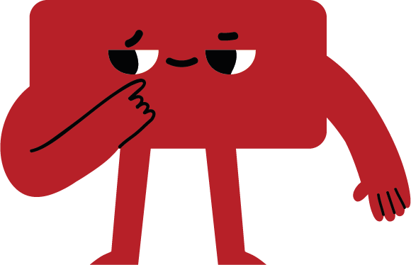
What can Liverpool's buildings tell us about the city's links with the British Empire?
Liverpool was a very important city in the British Empire. We are going to go on a history trail around the dock area of Liverpool, on the banks of the River Mersey to find out how and why.
We are going to explore what the places on the following slides reveal about Liverpool's links with the British Empire.
Look
Do you know/recognise the buildings on the following slides?
Do you know anything about them?
Notes:
Modern Ordnance Sur vey mapping: © CrownCopyright and database right 2024. All rights reserved. Ordnance Survey Licence number AC0000815036. Historic Ordnance Survey mapping: ©and database rightCrown Copyright and Landmark InformationGroup Ltd (All rights reserved 2024) Licence numbers 000394 and TP0024. © Historic England.

Slide 20
Albert Dock
1846
Notes:
Image: © Historic England Archive Ref: DP039520 Date: 7 Feb 2006 - https://historicengland.org.uk/images-books/photos/item/DP039520

Slide 21
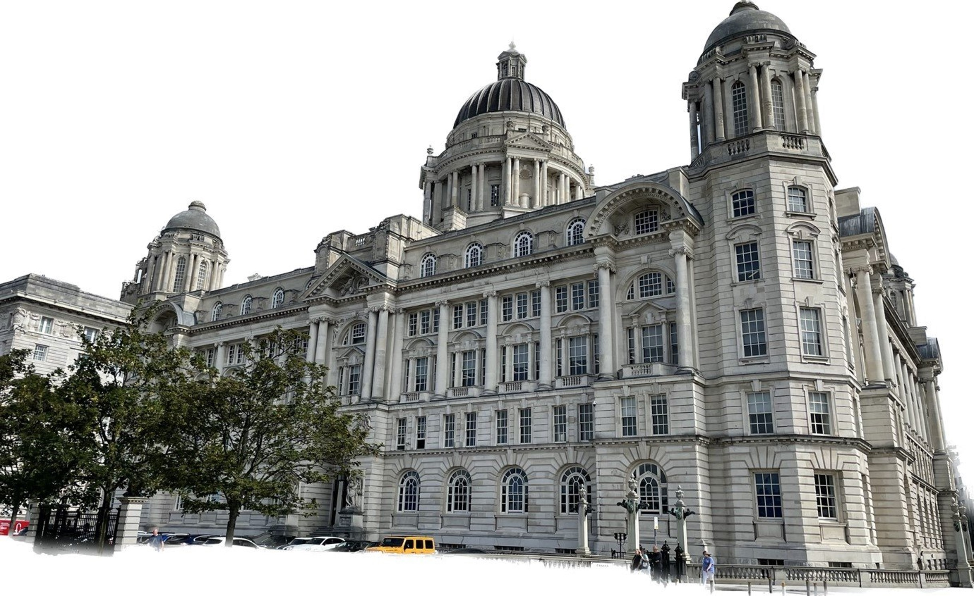
Port of Liverpool Building
1907
Notes:
Image courtesy of Jake Madgewick 2023

Slide 22
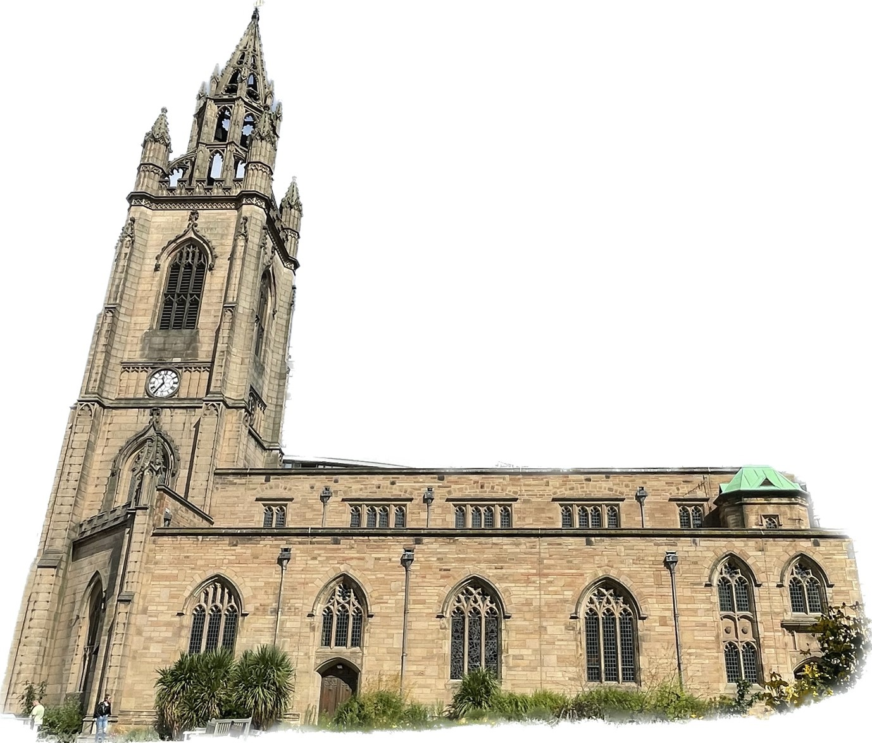
Church of Our Lady and St. Nicholas
1775
Notes:
Image courtesy of Jake Madgewick 2023
There has been a church on this site for over 800 years. The church building that we see today on this site dates from 1775, when it was rebuilt in its current style. The new tower and lantern was added in 1815.

Slide 23
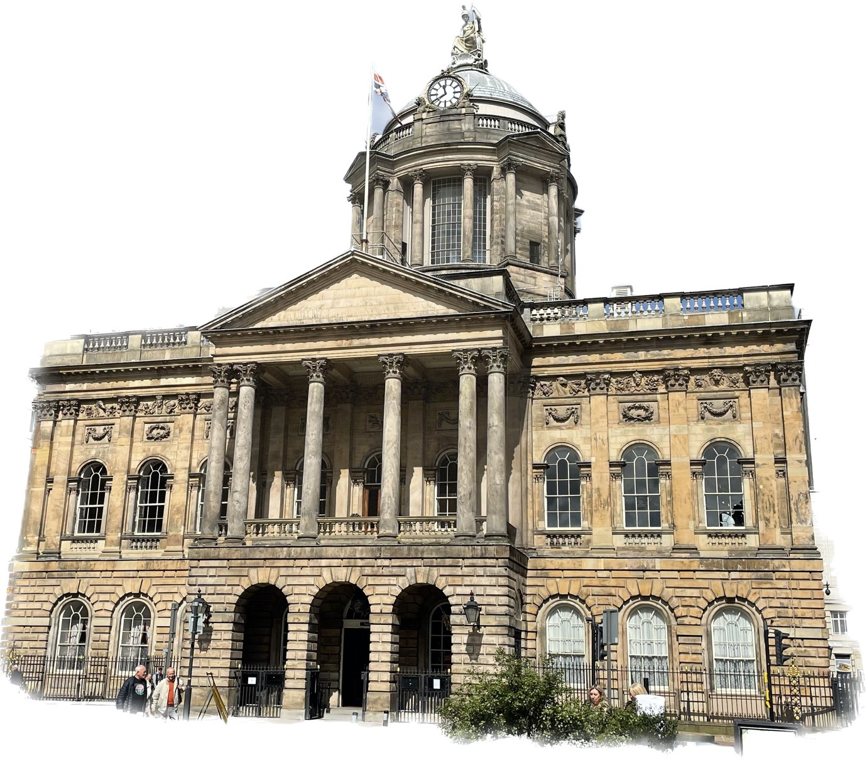
Liverpool Town Hall
1759
Notes:
Image courtesy of Jake Madgewick 2023

Slide 24
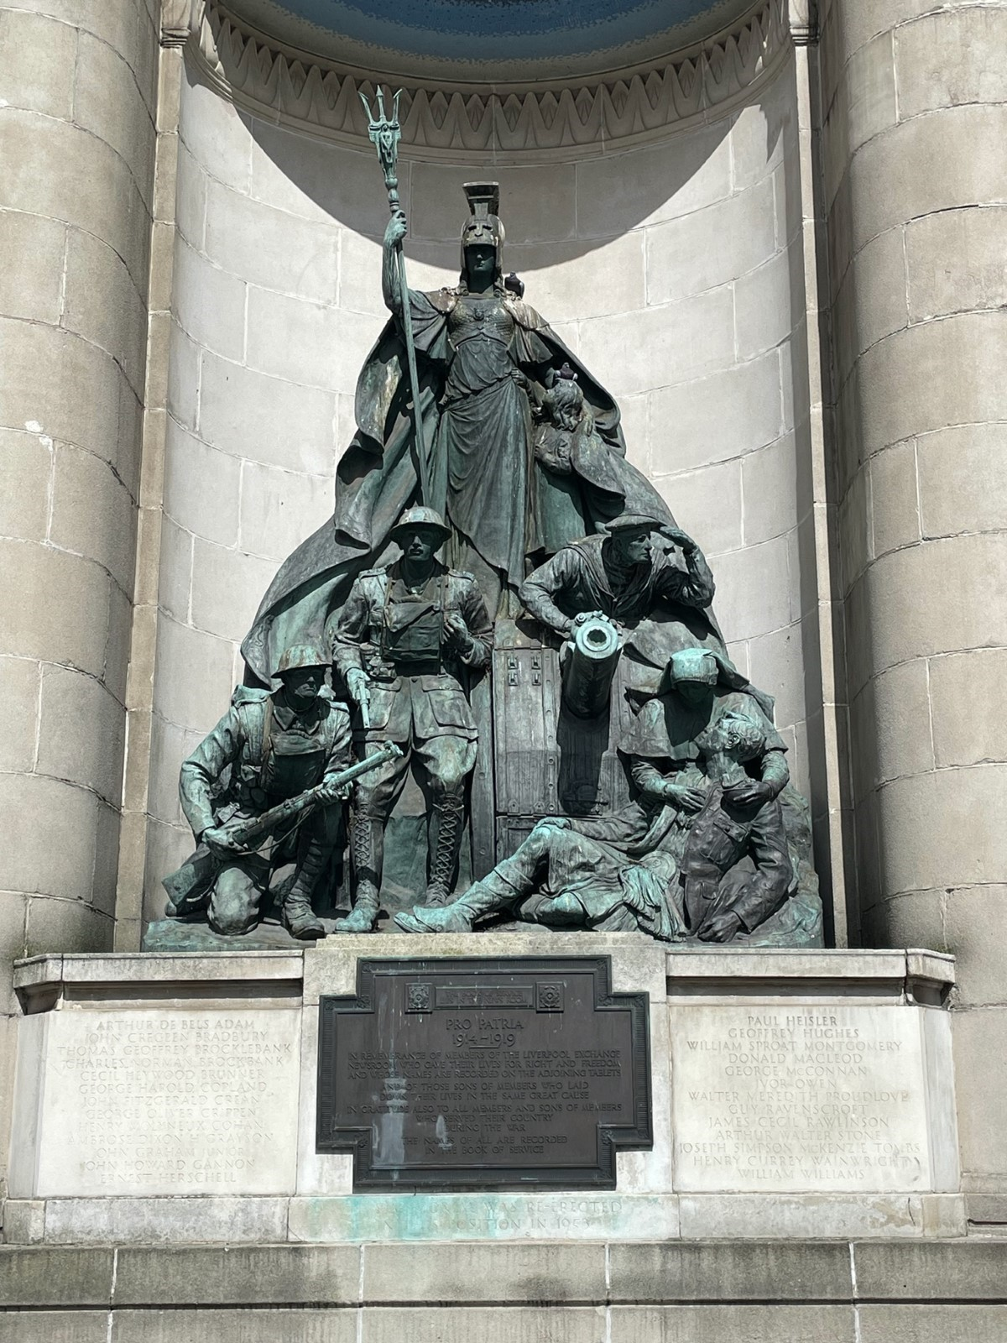
Exchange Flags and First World War Memorial
1924
Notes:
Image courtesy of Jake Madgewick 2023

Slide 25
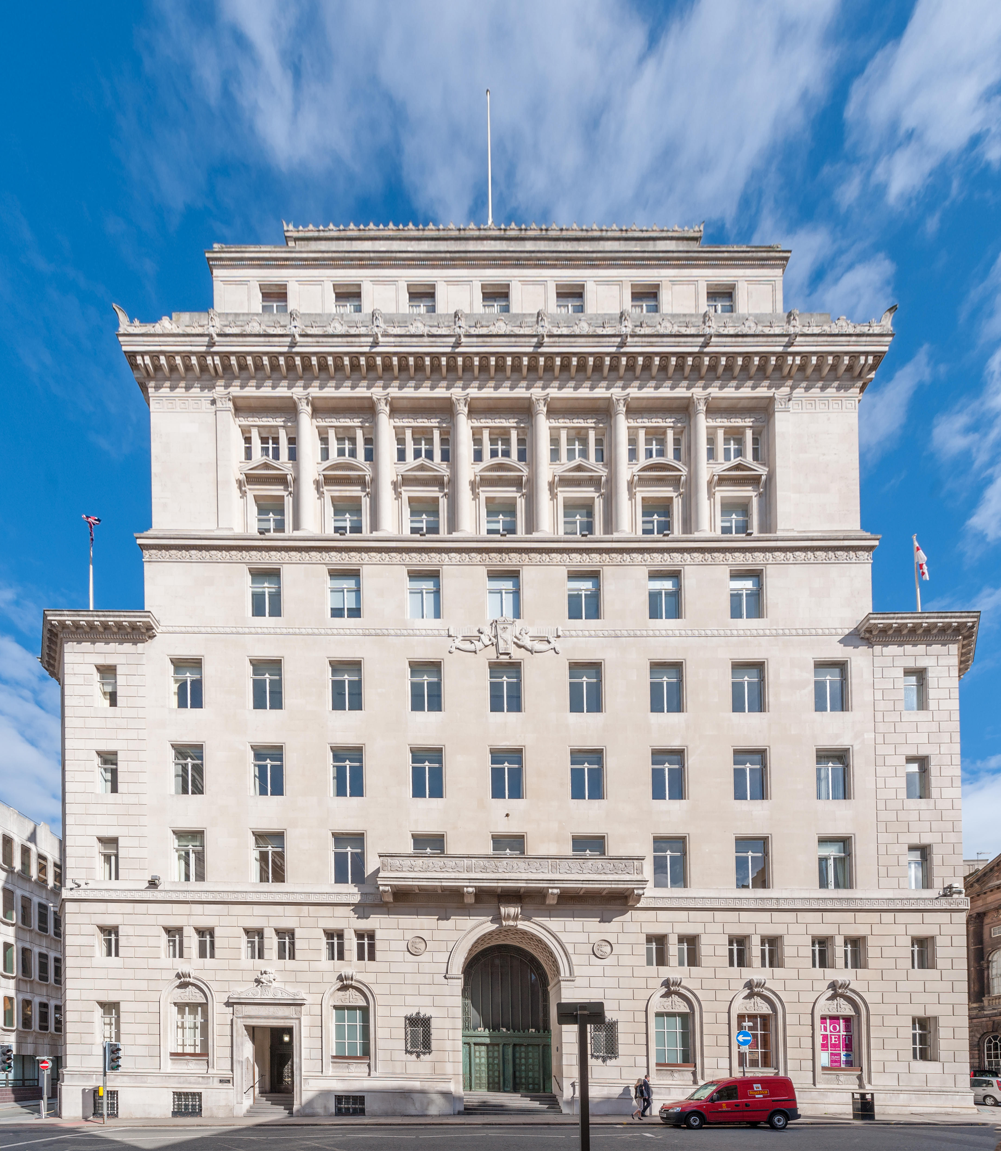
Martins Bank Building, Water Street
1924
1932
Martins Bank Building, Water Street
Notes:
Alamy RX3CAD

Slide 26
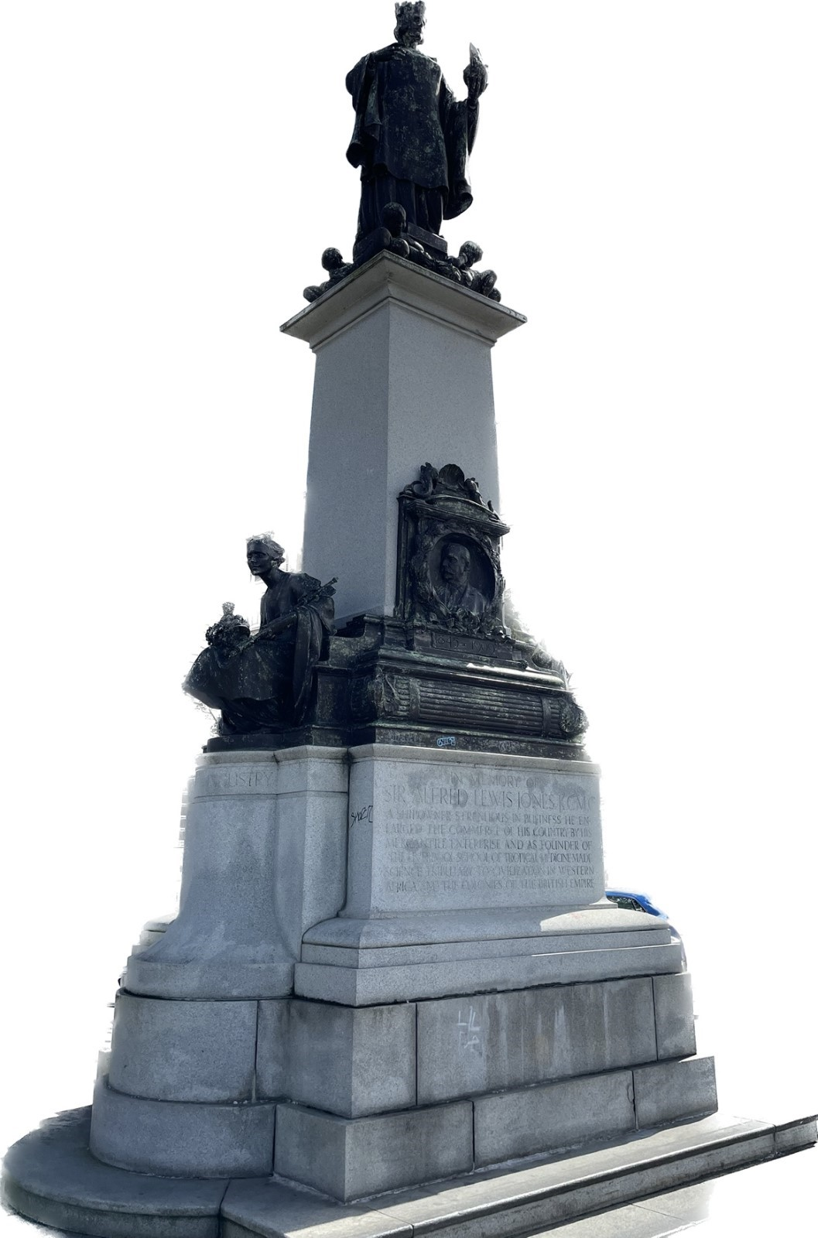
Alfred Lewis Jones Memorial
1913
Notes:
Image courtesy of Jake Madgewick 2023

Slide 27
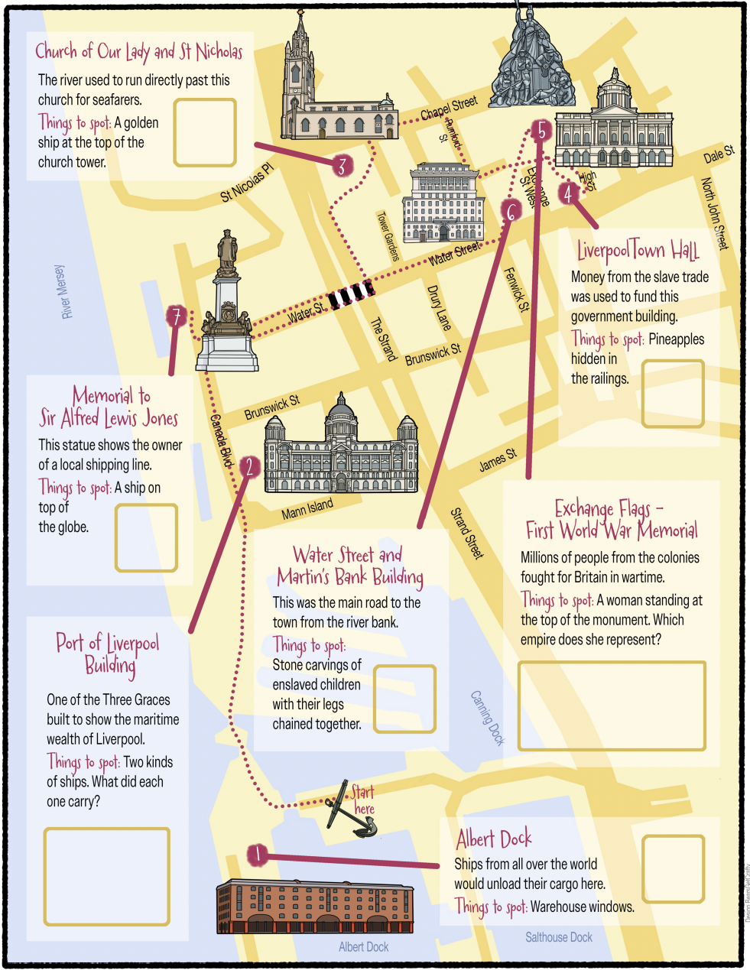

We Need to Walk About Empire History Trail
As you take part in the history trail, you will visit the places you have just seen. They are marked on the map opposite.
You will be given a copy of this map. For each place you visit, complete the activity and write your answer in the box.
Consider
What does each site tell you about Liverpool's links with the British Empire?

Slide 28
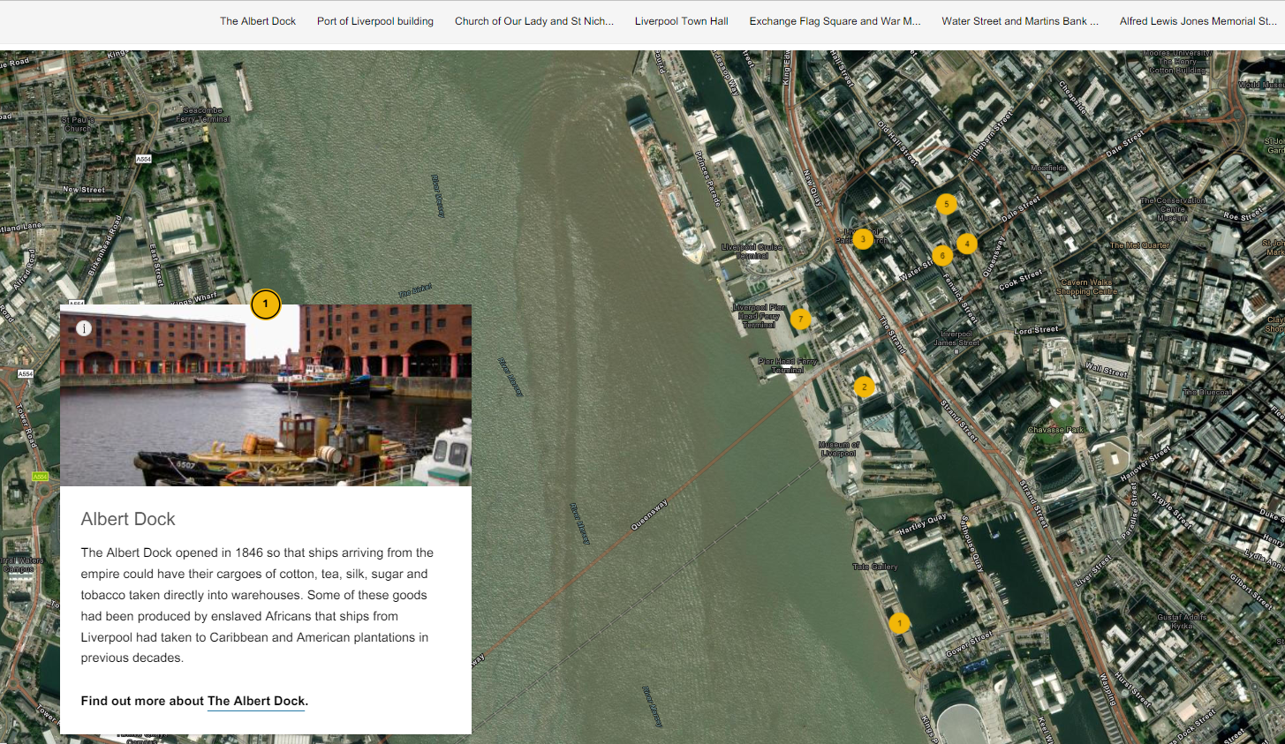
We Need to Walk About Empire: StoryMap
If you can’t walk the trail in person, you could explore the sites using the StoryMap: ‘We Need to Walk About Empire’.
Consider
What does each site tell you about Liverpool's links with the British Empire?

