Slide 1
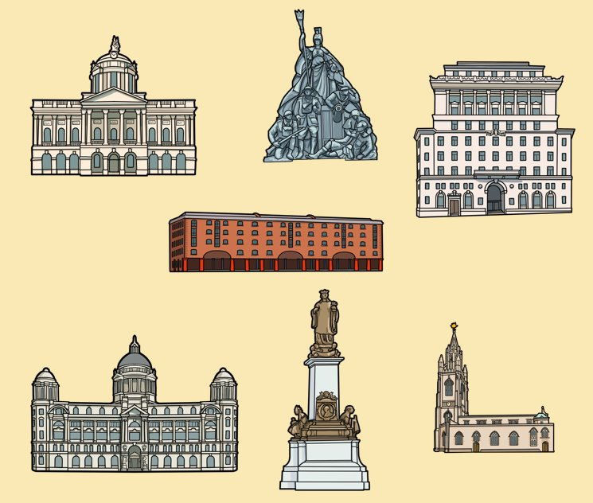



What can Liverpool’s buildings tell us about the city's link with the British Empire?
Post trail activities to explore the sites on the trail in greater depth
A resource created by Liverpool Hope and Liverpool John Moores University, in partnership with the International Slavery Museum, Liverpool.
Notes:
Drawings courtesy of Bears Get Crafty

Slide 2

How to use this PPT
Accompanying Resources
Information for Teachers
History Trail: 'We Need to Walk About Empire'
  Teachers’ trail script
  Trail map & worksheet
Post Trail Recap and Reflect PPT
Post Trail Suggested Activities PPT
Post trail supporting resources:
  We Need to Walk About Empire StoryMap
  Buildings: Colour, cut & build Activity Sheet
This PowerPoint is part of the learning resource: ‘What can Liverpool's buildings tell us about the city's link with the British Empire?’. We envisage that teachers will use this PPT, after they have taken pupils on the history trail: ‘We Need to Walk About Empire’.
In this PPT, teachers will find suggested activities which will allow pupils to explore the sites on the trail in greater depth.
The suggestions in this PPT are a starting point only. Teachers are encouraged to use the website links provided (see notes section below each slide), as well as their own research and planning, to further develop these ideas into teaching activities.
Please refer to the ‘Information for Teachers’ document before using this PPT and the other resources provided.

Slide 3
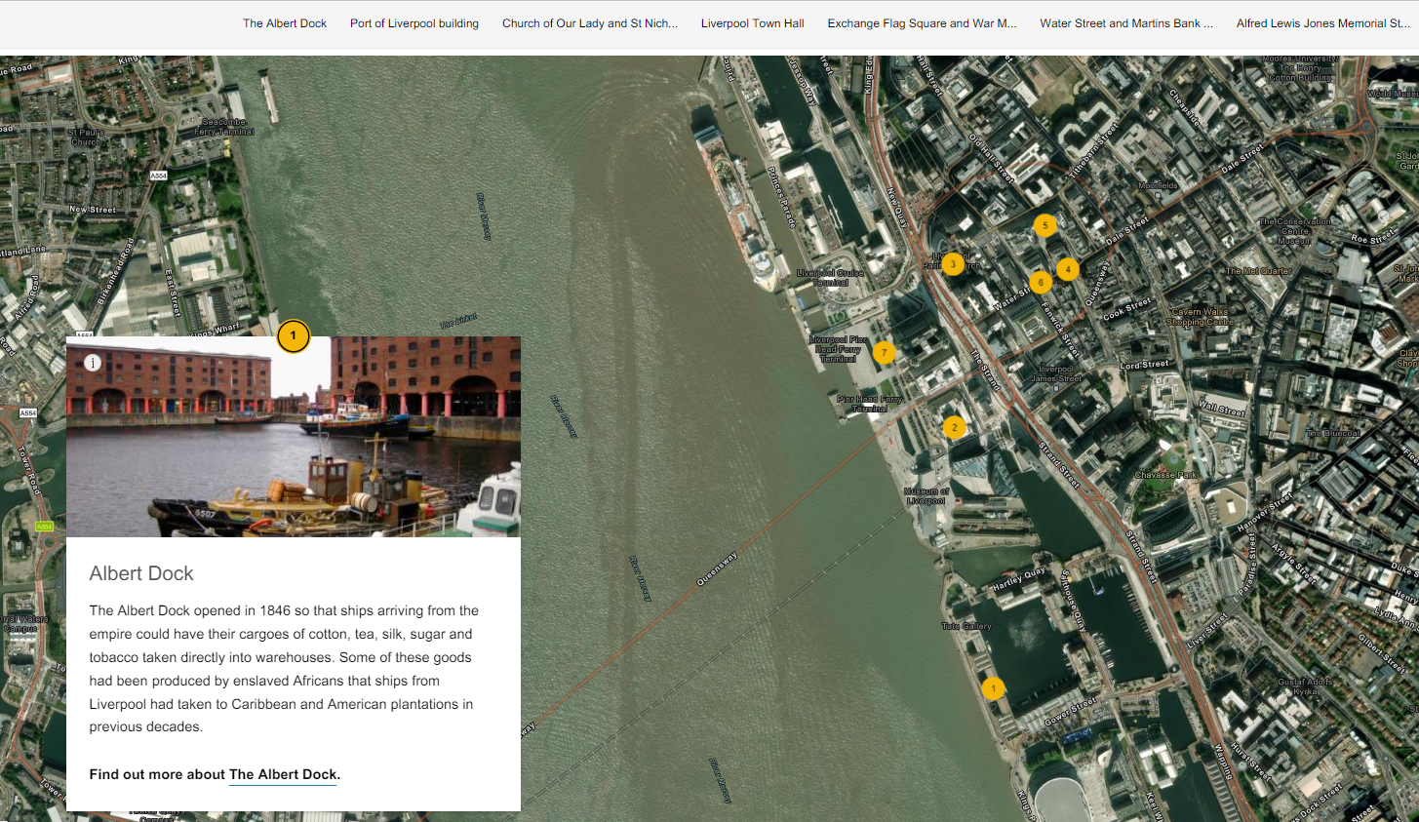


‘We Need to Walk About Empire’ StoryMap
Use the StoryMap, ‘We Need to Walk About Empire’ to revisit the sites on the history trail with your class.
Look
We Need To Walk About Empire StoryMap
Have a look at the additional images of each site on the StoryMap.
Do they help to understand the site even better?

Slide 4
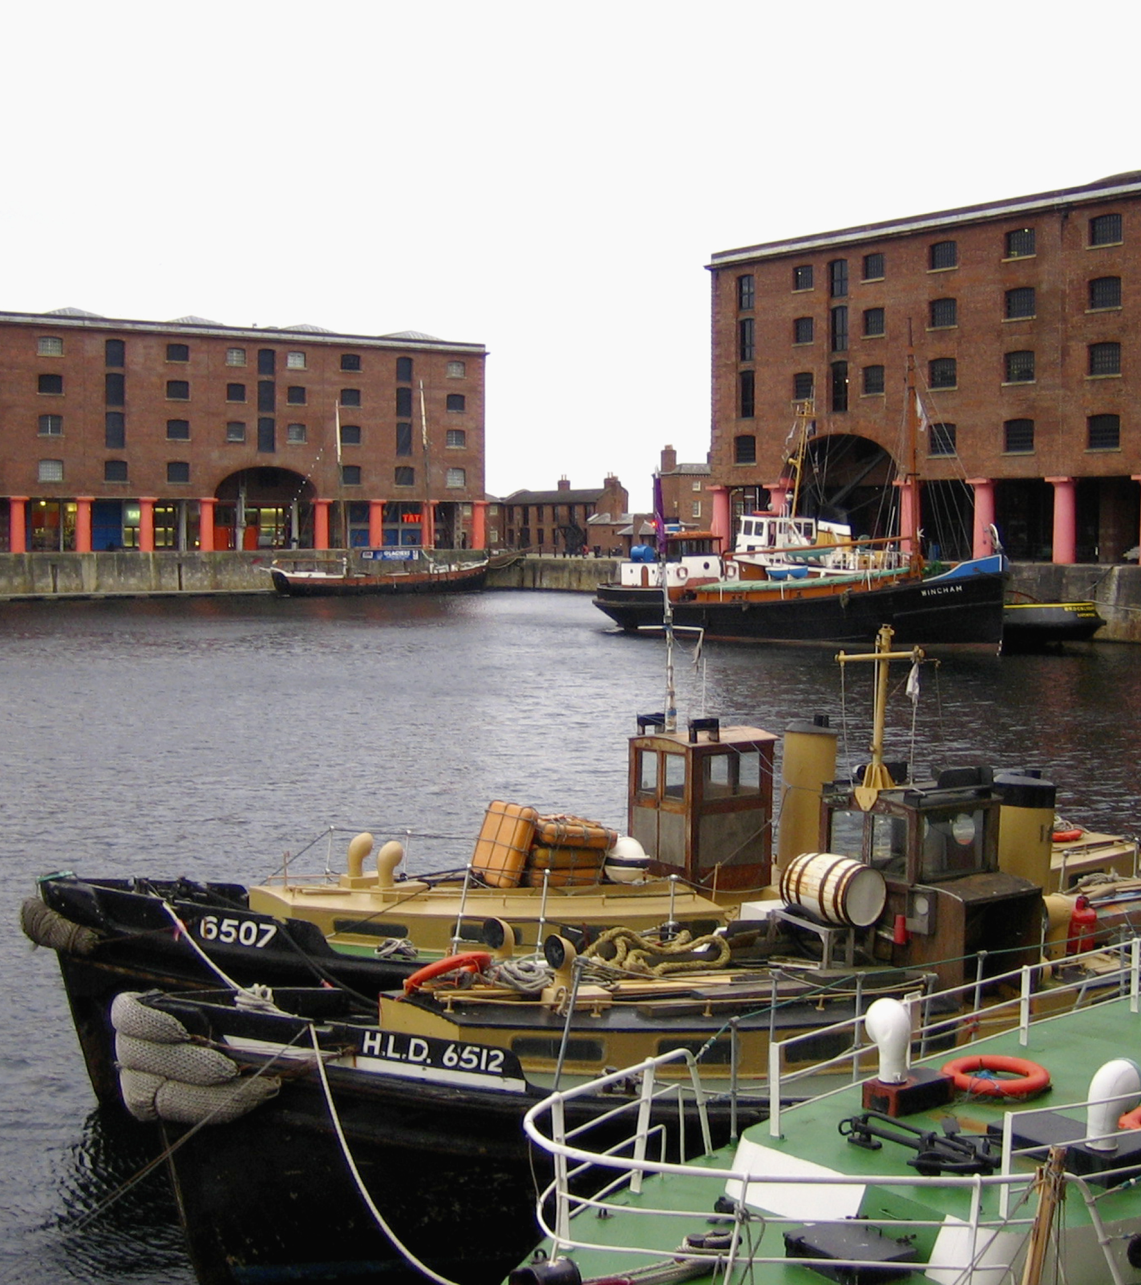
The Albert Dock
On the trail we found out about the Albert Dock and its links with the British Empire.
In 1870 a journalist called William Allingham visited Albert Dock. He described the huge variety of items that were shipped into Liverpool, which came from all over the British Empire.
Read the extract from the article, on the next slide, carefully.
Underline in one colour the items he mentions. Have you heard of them all?
In another colour, underline the countries he mentions.
Can you find the countries he mentions on a map of the world?
Can you mark which items came from which countries on your map.
The Albert Dock
Notes:
Image: Historic England Archive
Note. William Alingham went on to describe the finished products that were shipped out from Liverpool to other parts of Britain and the world.
“Hence radiate to all corners of the globe, bales of cotton goods, linen, woollen, bulks of machinery, inexhaustible leather and hardware, salt and soap, coals and iron, copper and tin.’
You might like to read the extract above and discuss these products. What were they used for? Where in Britain were these products were manufactured?

Slide 5
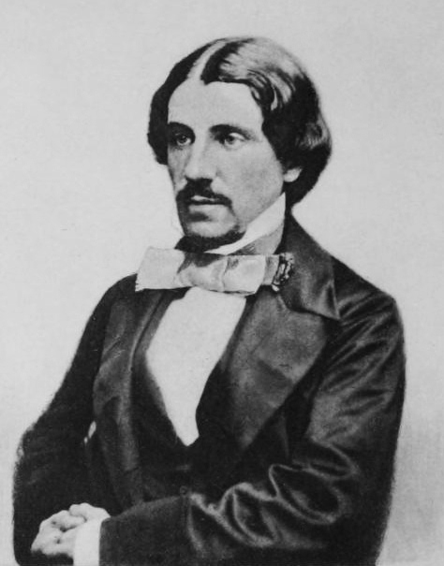
Activity sheet
“Hither converge in ceaseless streams the cotton of America, India, Egypt, the wool of the Australian plains, the elephants’ tusks and palm oil of African forests, the spermaceti of Arctic seas, the grain from the shores of Mississippi, St Lawrence, Elbe, Loire, Danube, Vistula, and many another stream, the hides of South America, the sugar, copper, tobacco, rice, timber, guano, &c., of every land the sun’s eye looks upon.”
Extract from a description of the items that were shipped into Albert Dock from all over the British Empire, by William Allingham
Items described
Can you find the countries he mentions on a map of the world?
Can you mark which items came from which countries on your map.
Countries that the items came from
Notes:
Image By Emery Walker - engraving from William Allingham, A Diary, Published 1908 Macmillan London, Public Domain, https://commons.wikimedia.org/w/index.php?curid=11558232
William Allingham was a poet, diarist and editor.

Slide 6
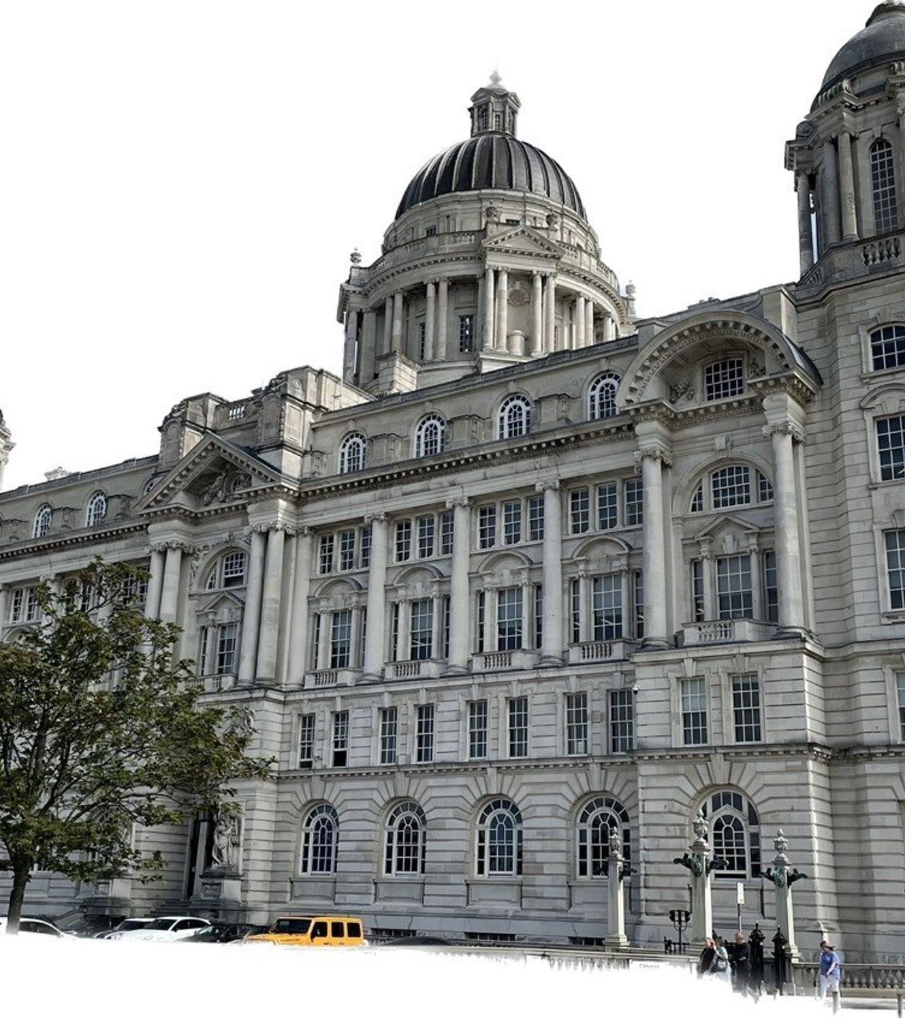
Port of Liverpool Building
When we visited the Port of Liverpool Building, we found out that more than 247,000 outbound passengers travelled through Liverpool in 1904, twice the amount of London, Southampton, and Queenstown, in New Zealand, combined!
However, Liverpool was not only a port of departure. Over the centuries, many people from across the empire arrived in Liverpool to live.
Find out more about James Clarke (1886 -1946) who was one such person, who made his life in Liverpool.
Why might he be described as a significant individual for Liverpool?
The Port of Liverpool Building
Notes:
Image courtesy of Jake Madgewick 2023
The following websites may be helpful:
https://www.liverpoolmuseums.org.uk/stories/dont-dip-if-you-cant-see-jim-story-of-james-Clarke
https://vimeo.com/298447623
It is also worth doing your own research using the internet and the library as many other resources are available.
If allowing pupils to independently research this topic please consider a pre prepared list of appropriate websites.

Slide 7
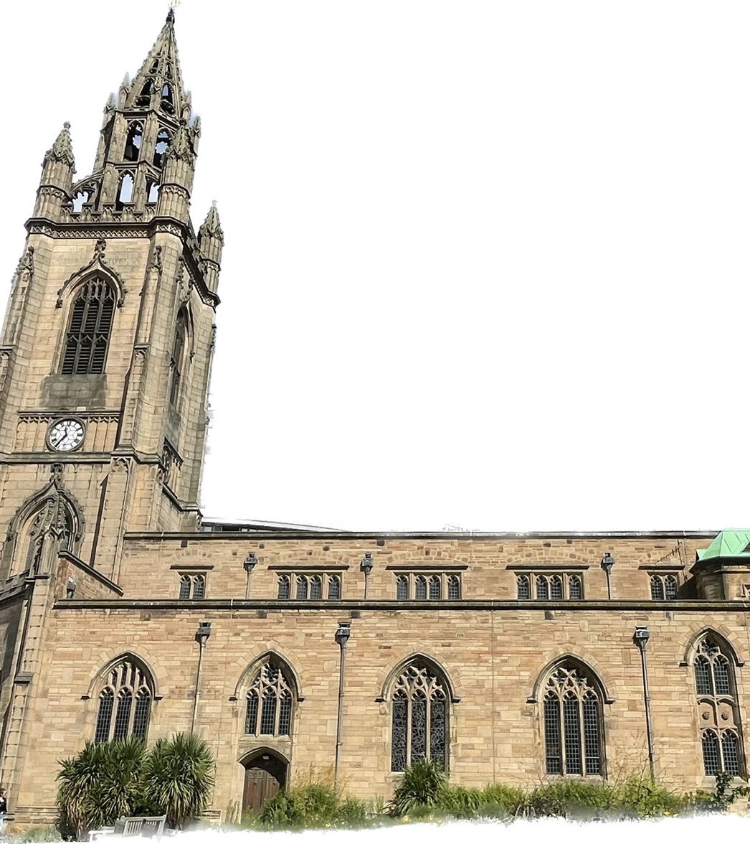
Church of Our Lady and St Nicholas
In the grounds of the Church of Our Lady and St Nicholas we found the commemorative plaque to recognise the burial place of an enslaved man known only as Abell.
Find out more about Abell and the memorial stone.
Church of Our Lady and St Nicholas
Notes:
Image courtesy of Jake Madgewick 2023
The following website may be helpful:
https://www.cultureliverpool.co.uk/news/liverpool-commemorates-the-citys-first-black-citizen/
It is also worth doing your own research using the internet and the library as many other resources are available.
If allowing pupils to independently research this topic please consider a pre prepared list of appropriate websites.

Slide 8
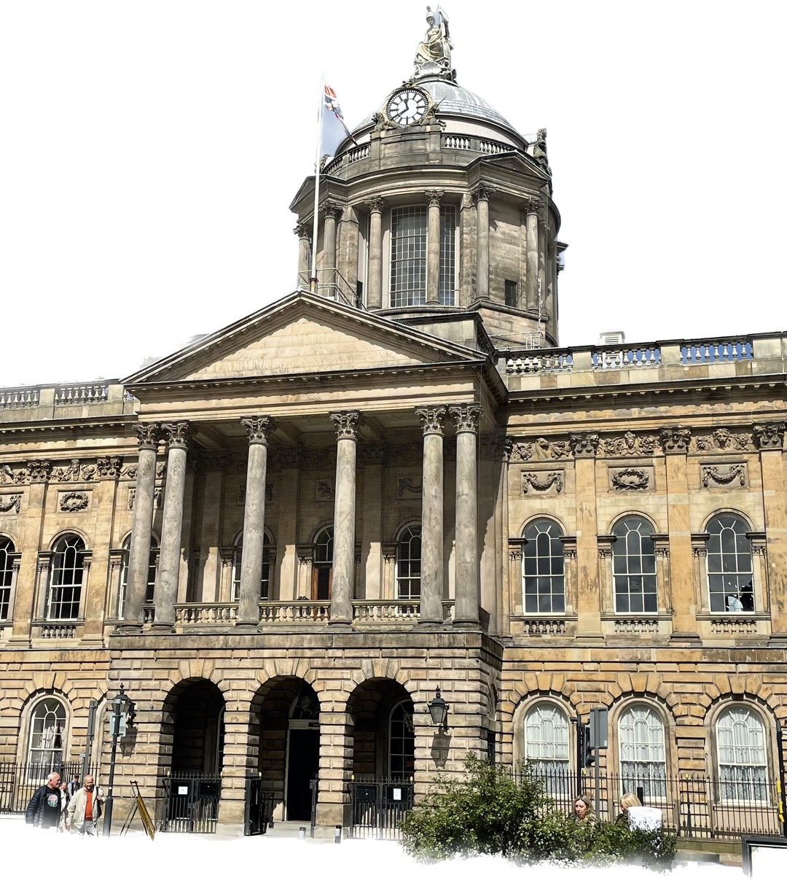
Town Hall
At the town hall, we discovered that all the mayors of Liverpool between 1787 and 1807 were involved in the transatlantic slave trade.
Find out the names of the mayors of Liverpool from 1787 – 1807 on the Liverpool Town Hall website.
Research some of the names to find out more about their involvement in the transatlantic slave trade.
How many former mayors can you find that have streets in Liverpool named after them?
Liverpool Town Hall
Notes:
Image courtesy of Jake Madgewick 2023
The following website may be helpful:
https://historicengland.org.uk/research/inclusive-heritage/the-slave-trade-and-abolition/read-the-signs/
It is also worth doing your own research using the internet and the library as many other resources are available.
If allowing pupils to independently research this topic please consider a pre prepared list of appropriate websites.

Slide 9
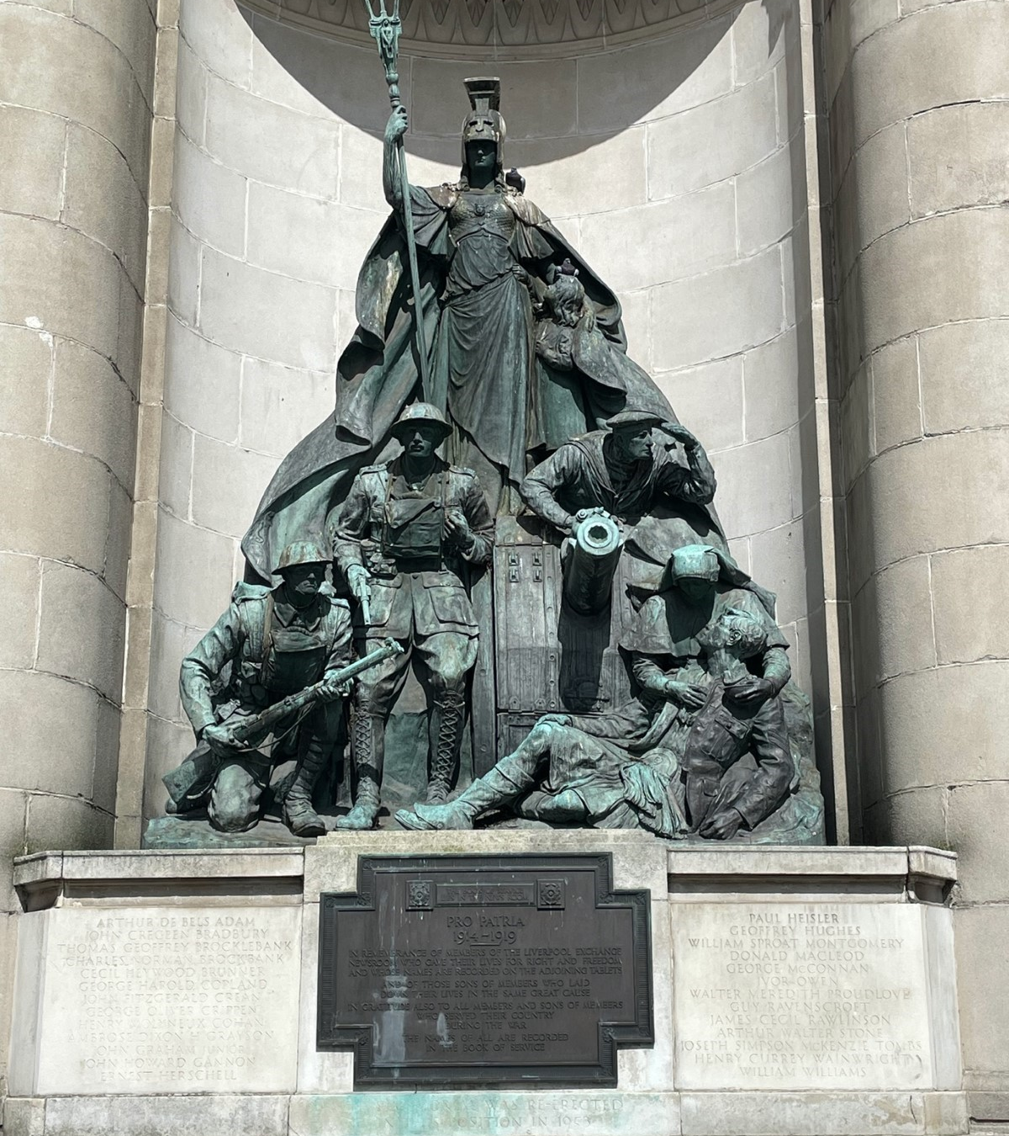
War Memorial at Exchange Flags Square
When we visited the war memorial at Exchange Flags Square, we found out about soldiers from countries in the British Empire who fought in the First World War.
Find out more about soldiers from countries in the British Empire who fought in the First World War.
Where were they from?
What were their experiences in the war?
First World War Memorial, Exchange Flags Square
Notes:
Image courtesy of Jake Madgewick 2023
The following websites may be helpful:
https://www.iwm.org.uk/history/the-black-british-soldiers-who-were-deliberately-forgotten
https://www.bbc.co.uk/bitesize/articles/z749xyc#zc8vvwx
It is also worth doing your own research using the internet and the library as many other resources are available.
If allowing pupils to independently research this topic please consider a pre prepared list of appropriate websites.

Slide 10
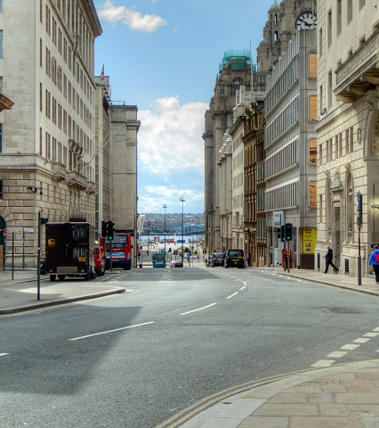
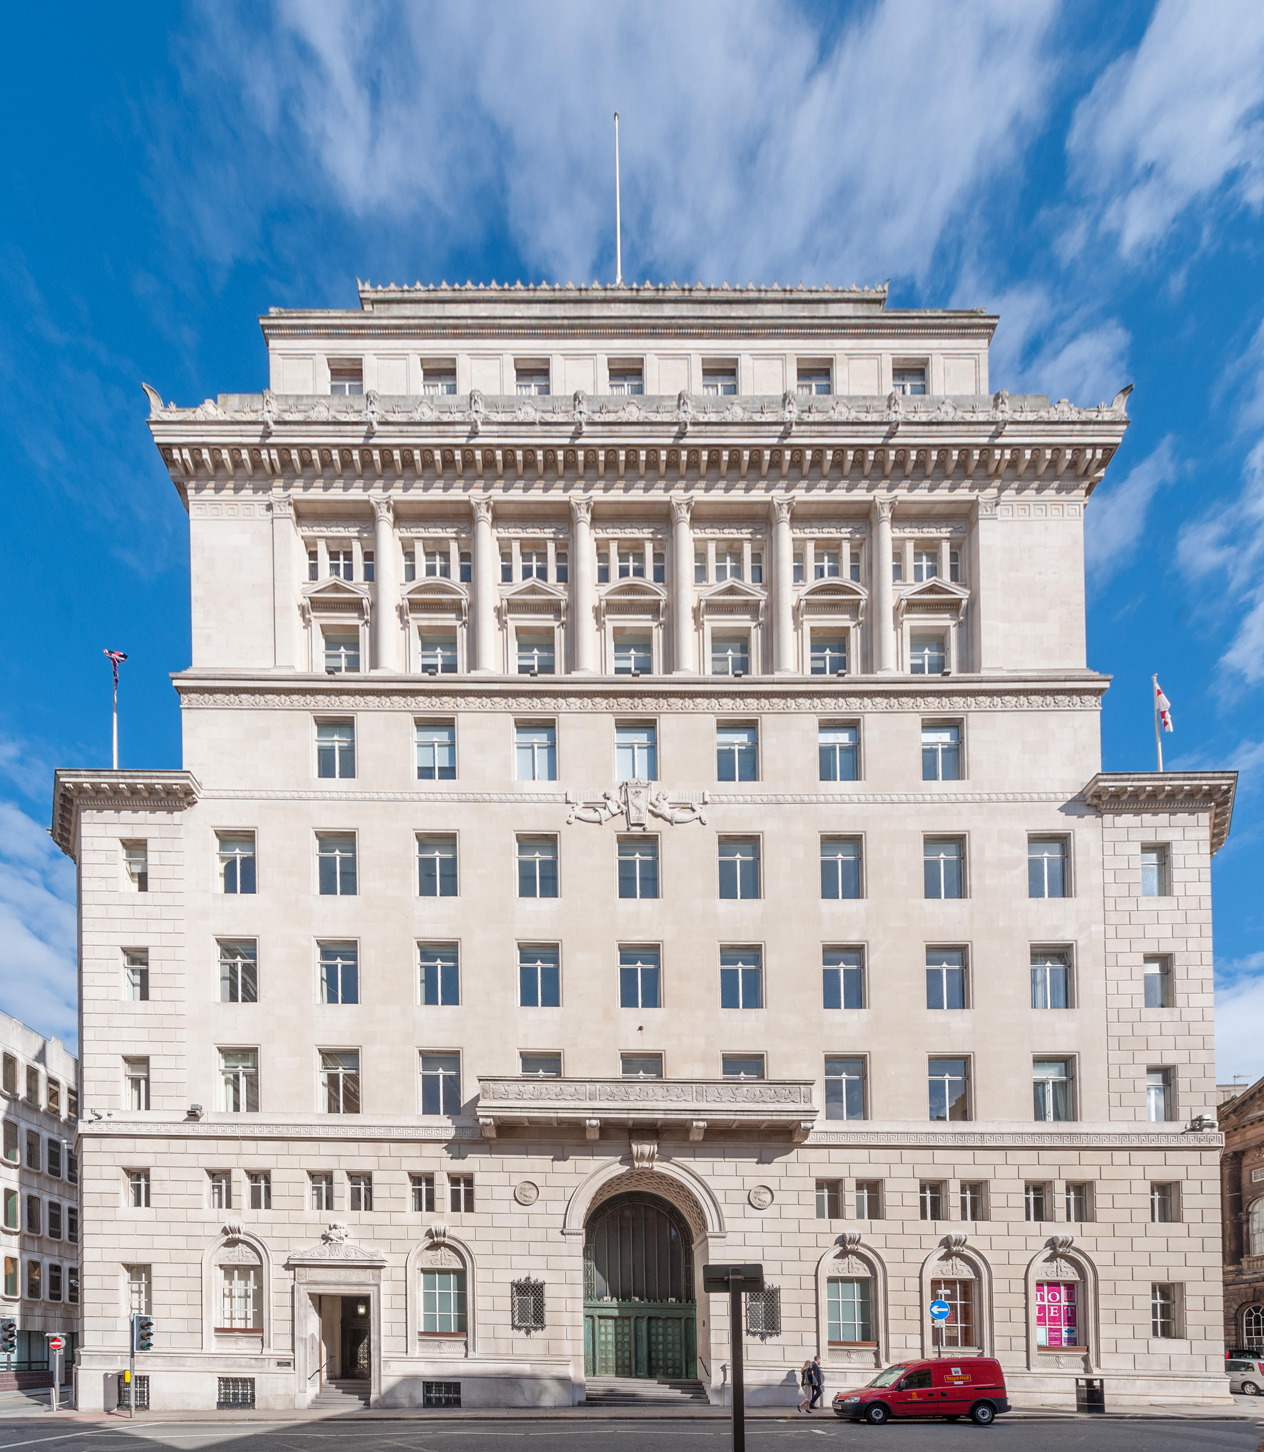
Water Street (and the Martins Bank building)
Just before we walked down Water Street, we talked about the buildings on this street that have names linked to the British Empire.
Also in Liverpool are many streets named after people who made their money through involvement in the British Empire and Transatlantic Slavery.
Use the webpage Read The Signs to explore other street names in Liverpool connected to the trade in enslaved African people.
Water Street (and St Martins Bank, bottom right)
Notes:
Water Street Image: By Liverpool, Water Street by David Dixon, CC BY-SA 2.0, https://commons.wikimedia.org/w/index.php?curid=129003785
St Martin’s Bank. Copyright Alamy
You may also be interested to use the Historic England Legacies of Slavery and Abolition webpage to find out about other sites in England with links to slavery and abolition.
If allowing pupils to independently research this topic please consider a pre prepared list of appropriate websites.

Slide 11
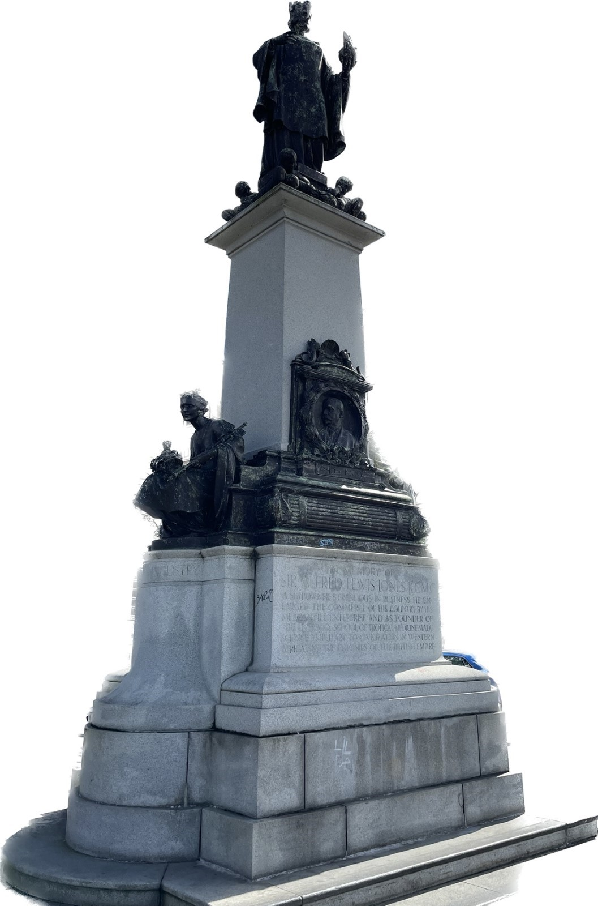
Alfred Lewis Jones Memorial
On the trail we visited a memorial statue remembering Alfred Lewis Jones.
There are many other statues on Liverpool’s waterfront, remembering other groups of people connected to the British Empire.
See what you can find out about the following memorials and what they tell us about the British Empire:
  Liverpool’s Naval Memorial
  Memorial to Chinese seafarers
Alfred Lewis Jones Statue
Notes:
Image courtesy of Jake Madgewick 2023
Naval Memorial features names of the merchant navy who died in active service during World War One. This includes seafarers with names that are identifiably of non-European heritage (e.g. Arab, Indian, Chinese).
Memorial to Chinese seafarers who were forcibly repatriated from Britain after World War Two.
The following websites may be helpful:
https://www.cwgc.org/visit-us/find-cemeteries-memorials/cemetery-details/2048704/liverpool-naval-memorial/
https://www.iwm.org.uk/memorials/item/memorial/62862
It is also worth doing your own research using the internet and the library as many other resources are available.
If allowing pupils to independently research this topic please consider a pre prepared list of appropriate websites.

Slide 12
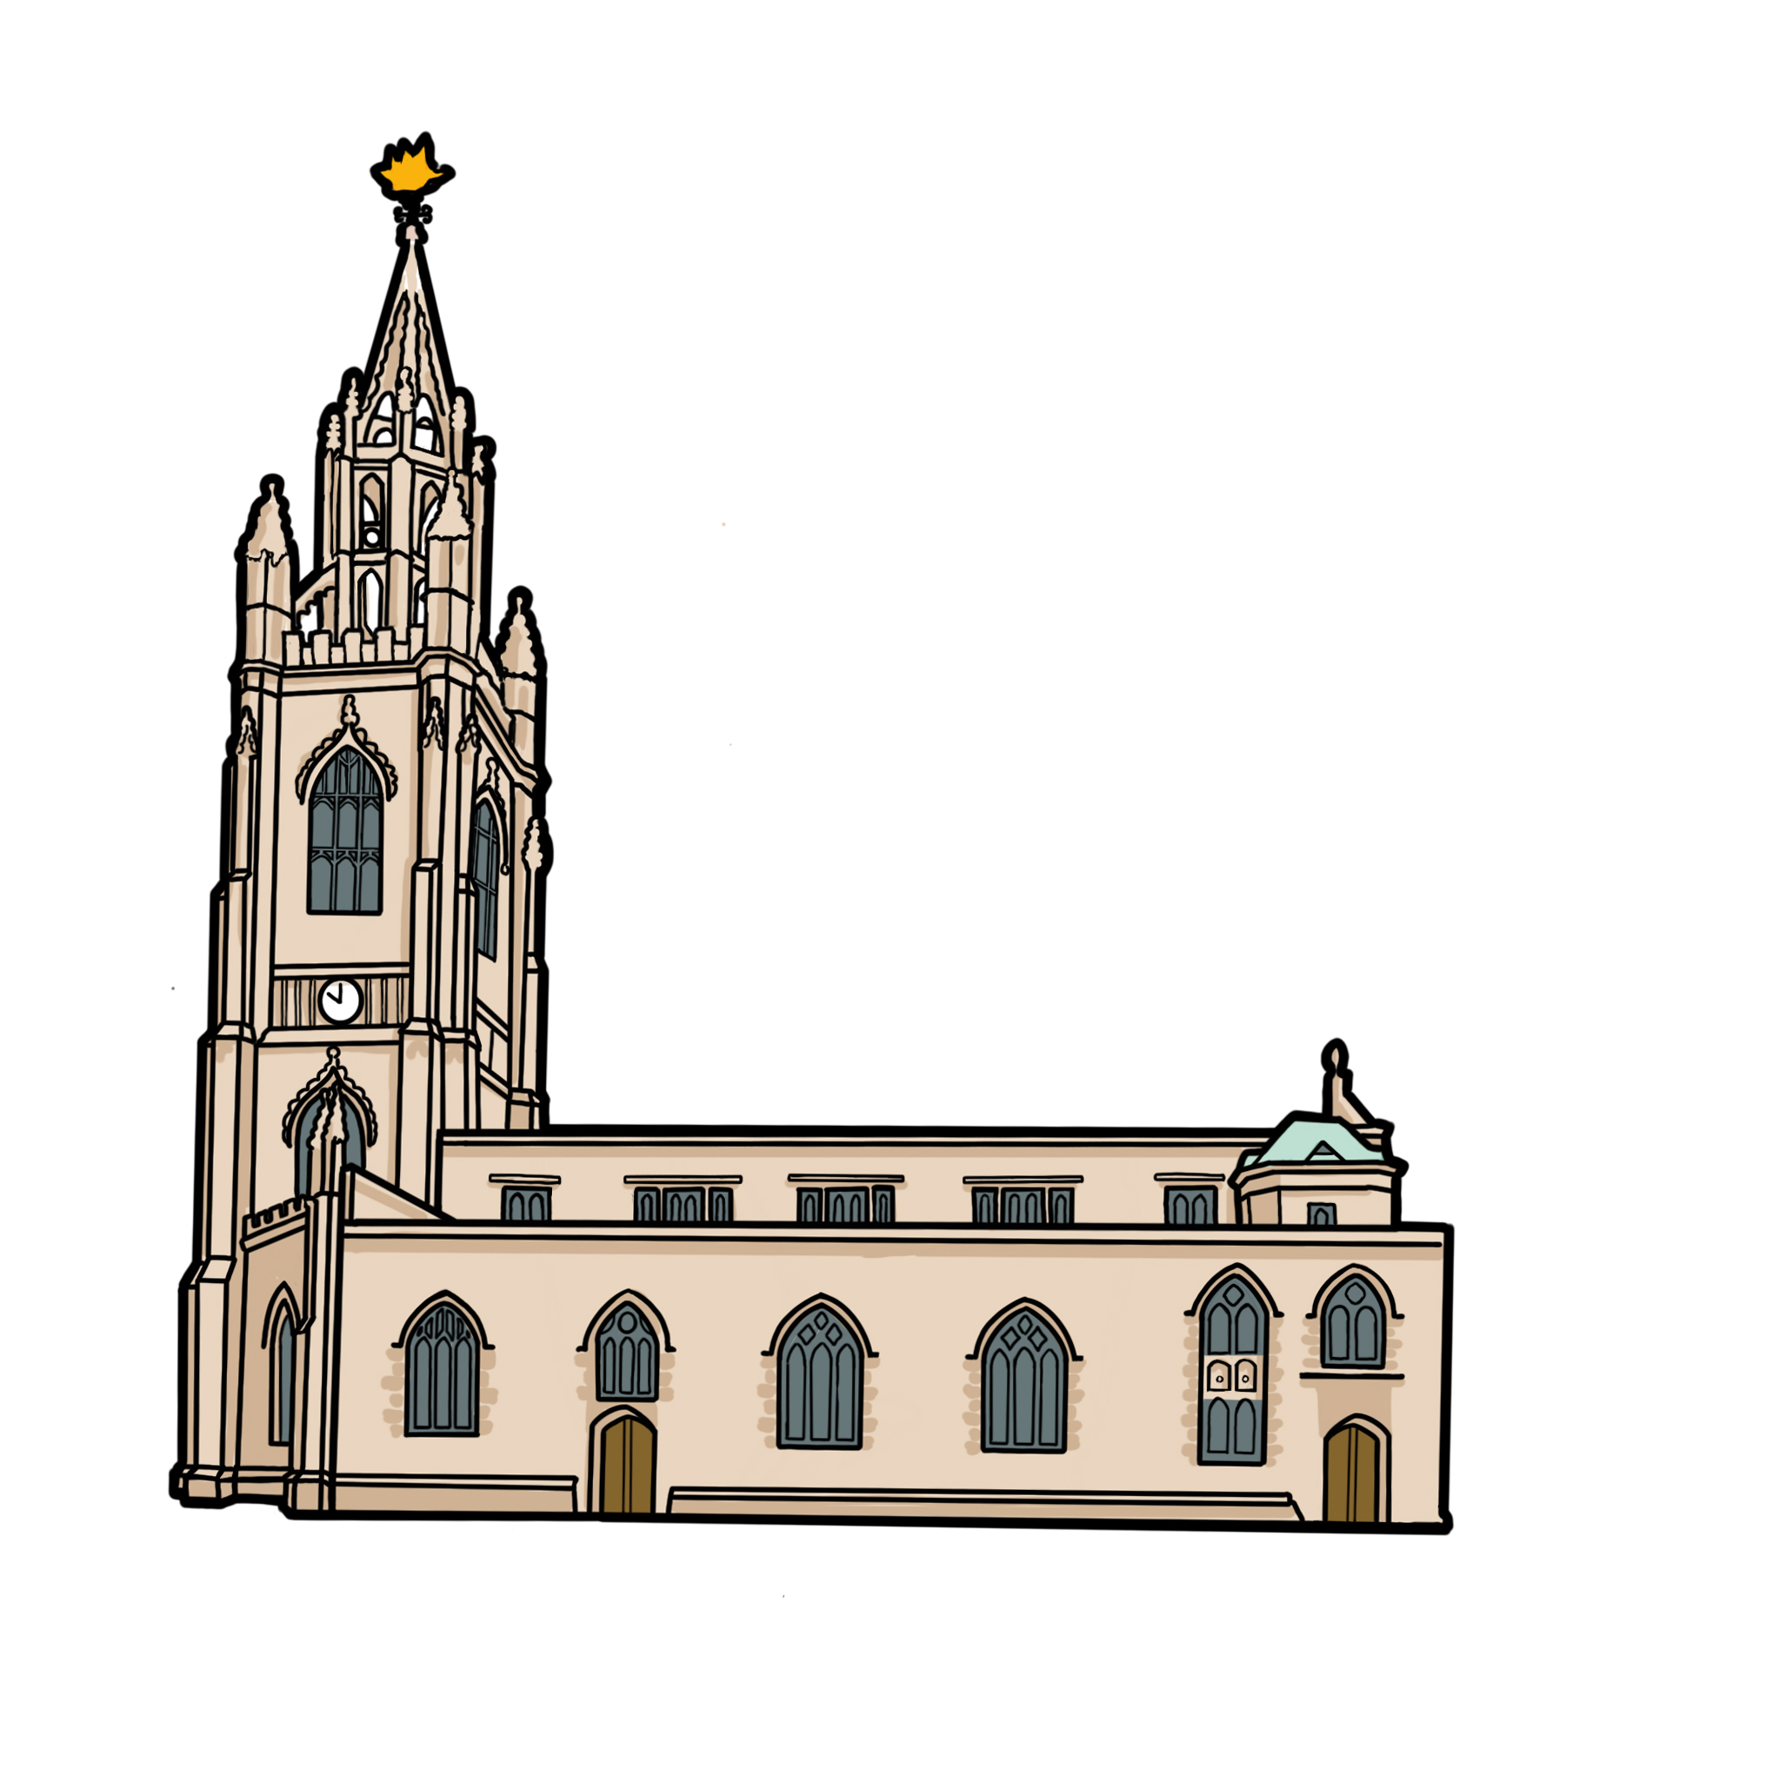

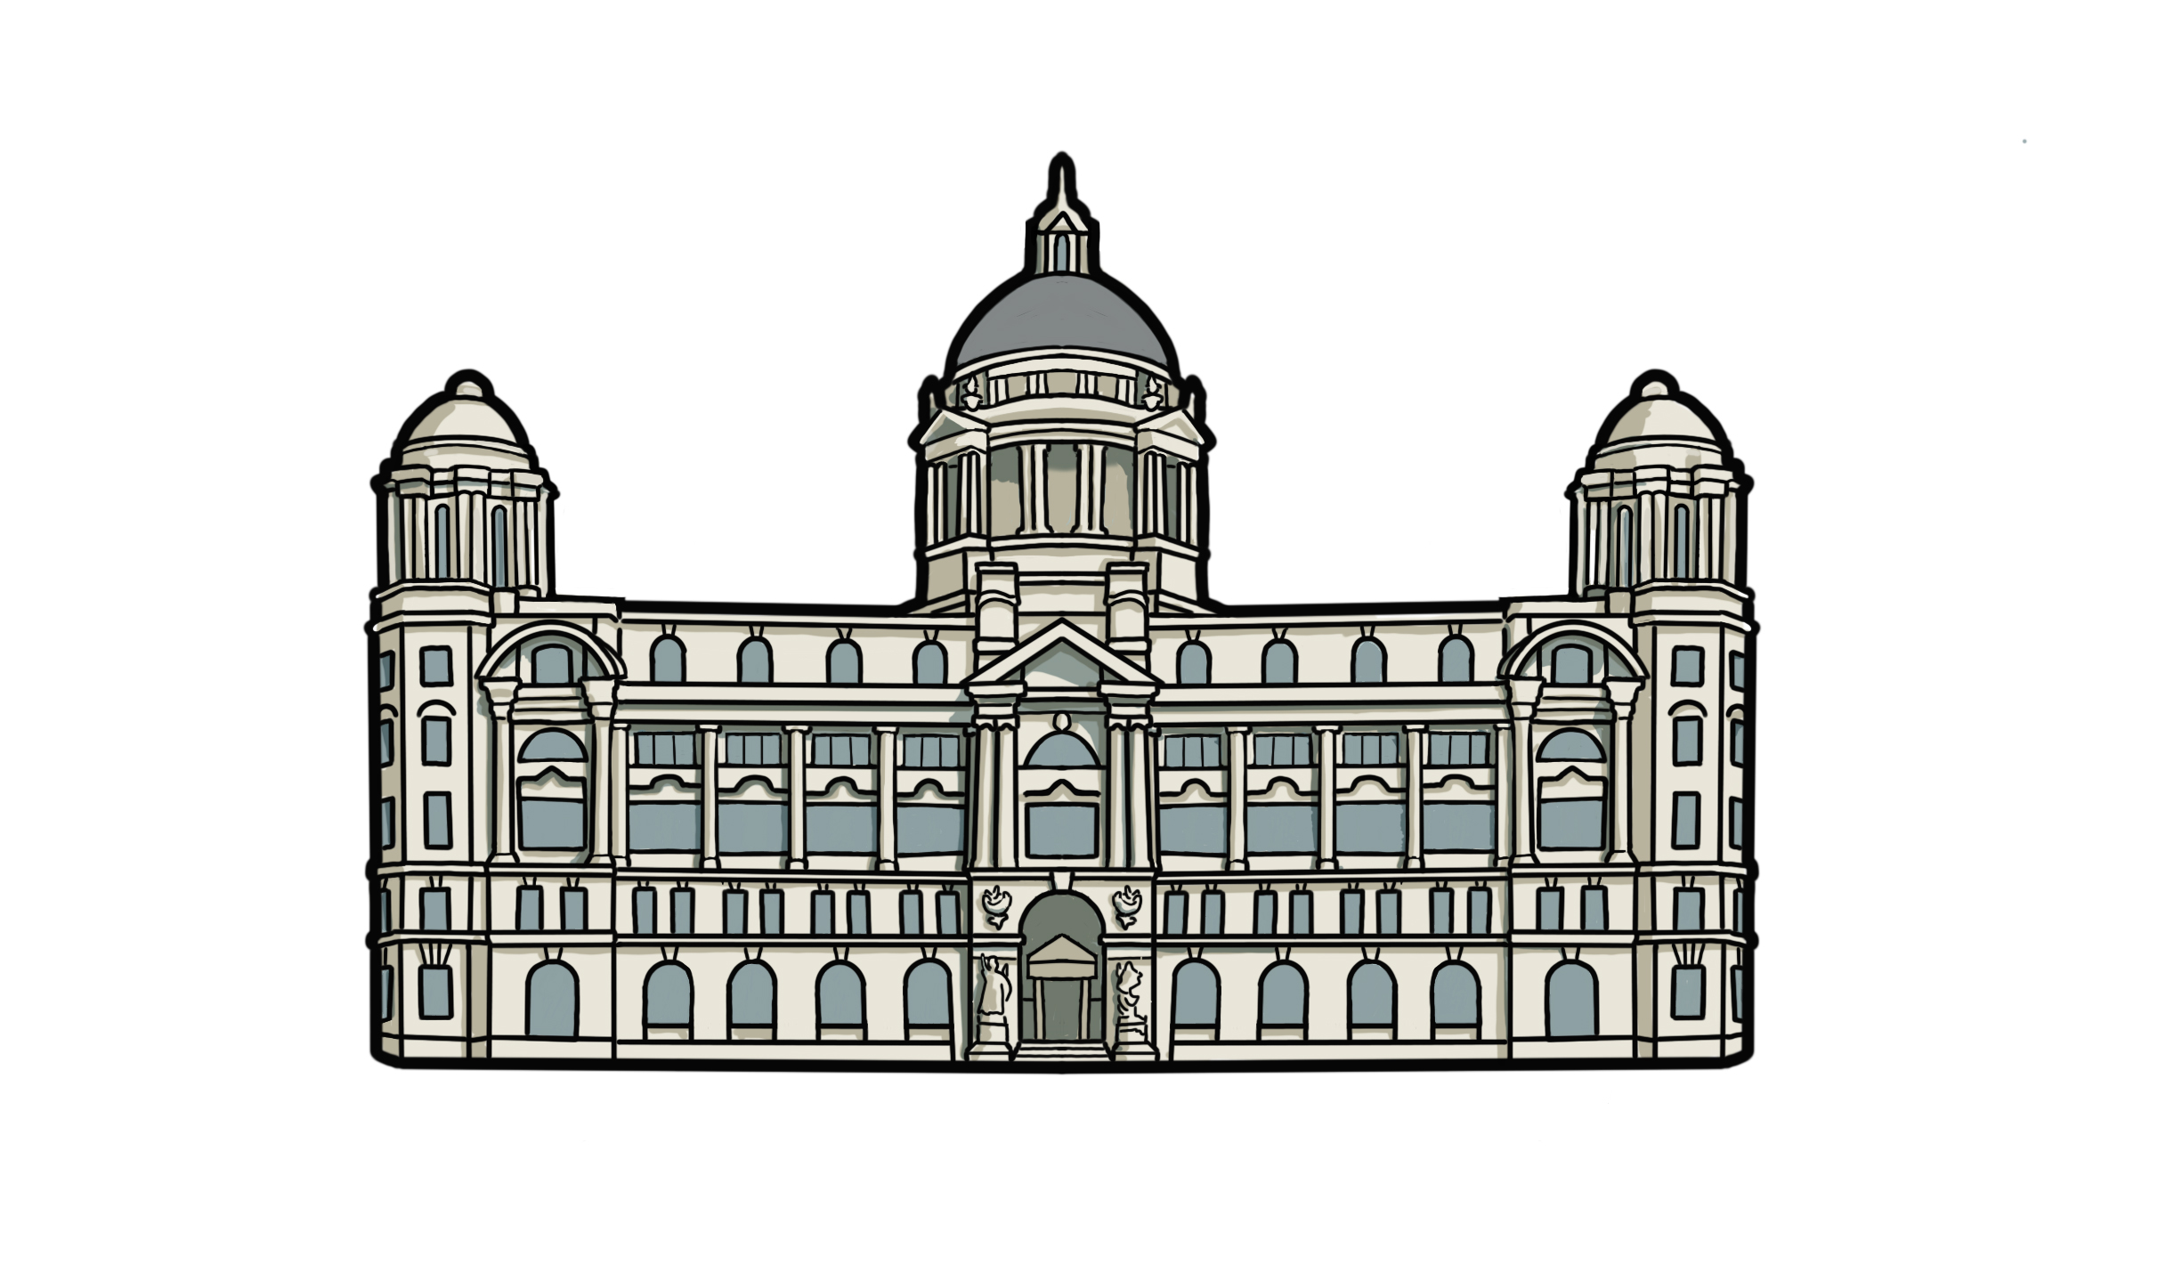

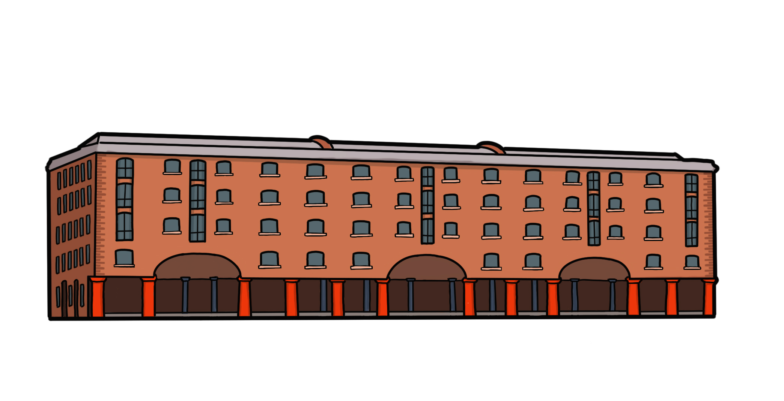
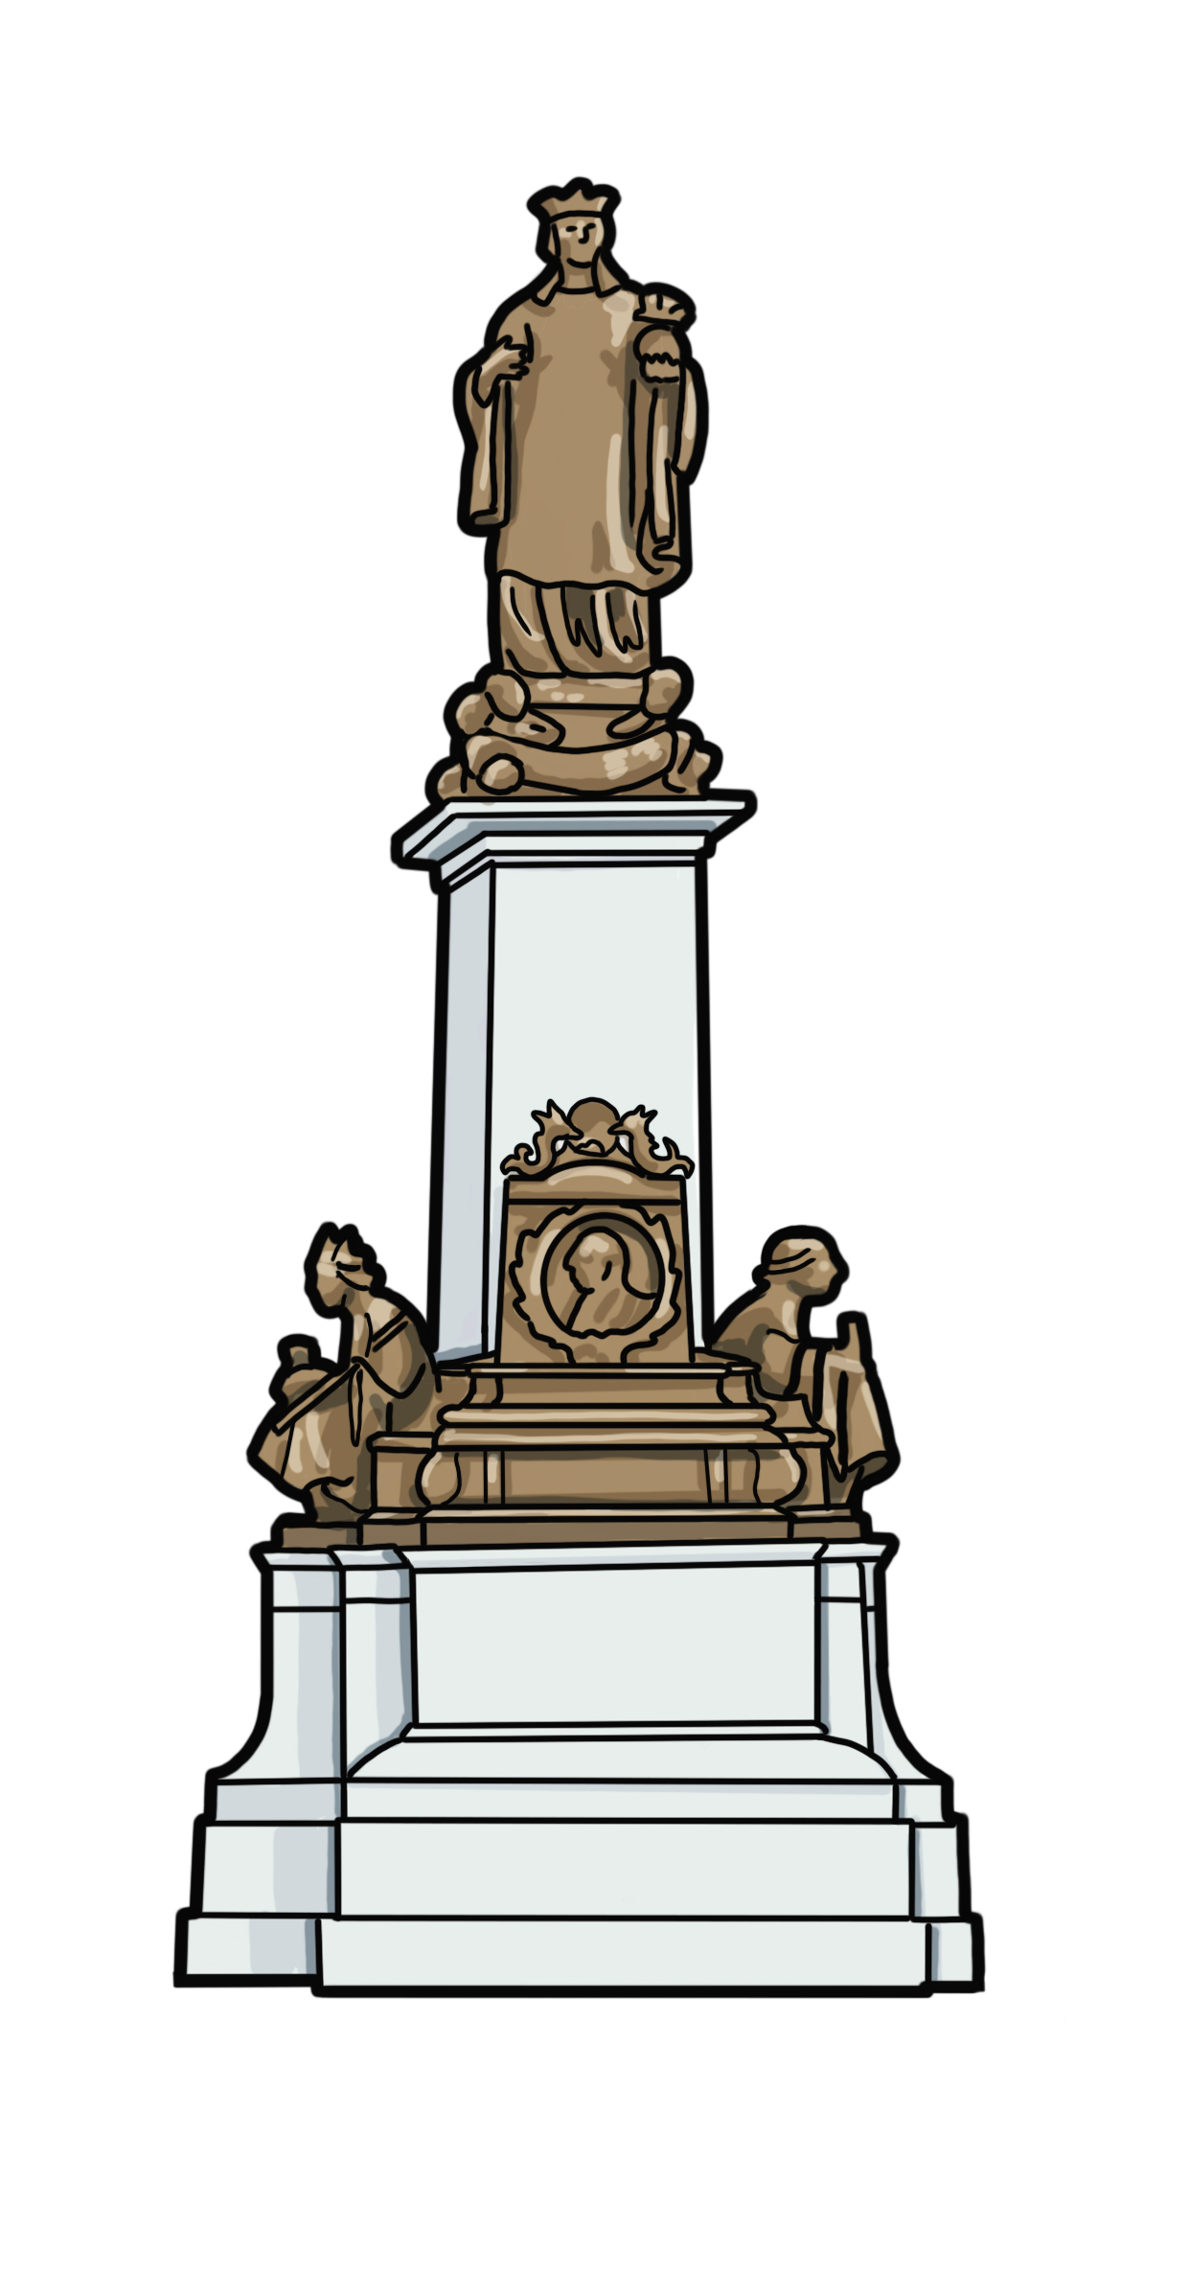
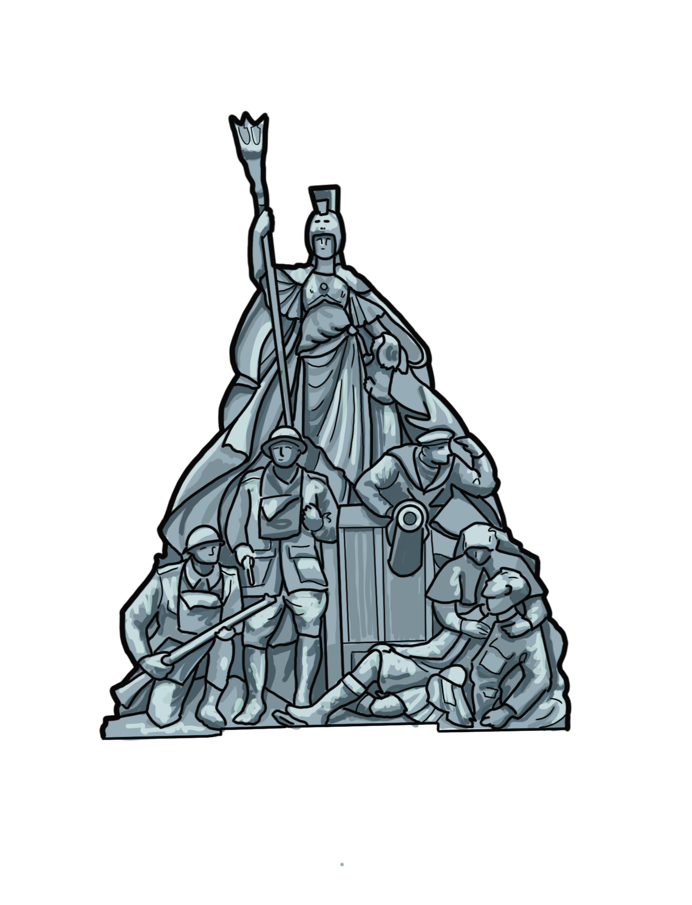
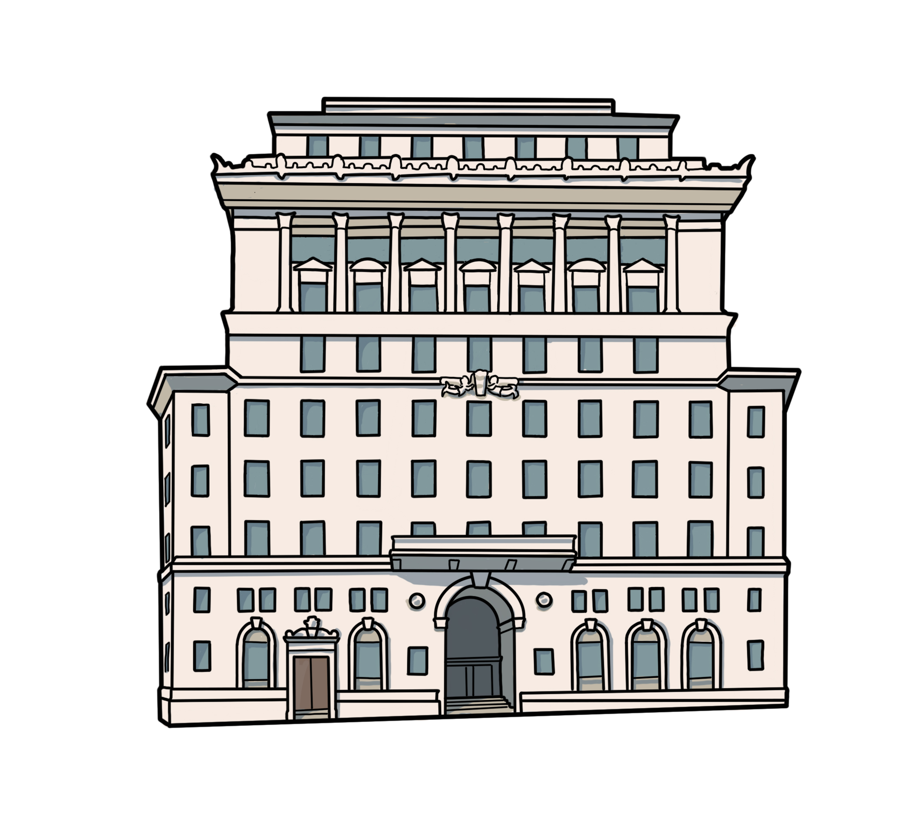
Exploring the chronology of the sites on the trail.
Cut out the images and labels from the next slide.
Match the images with their correct name and date
Can you place them in the correct chronological order, on the timeline provided?
1775
1759
1907
1846
1932
1913
1924
Notes:
Drawings courtesy of Bears Get Crafty

Slide 13
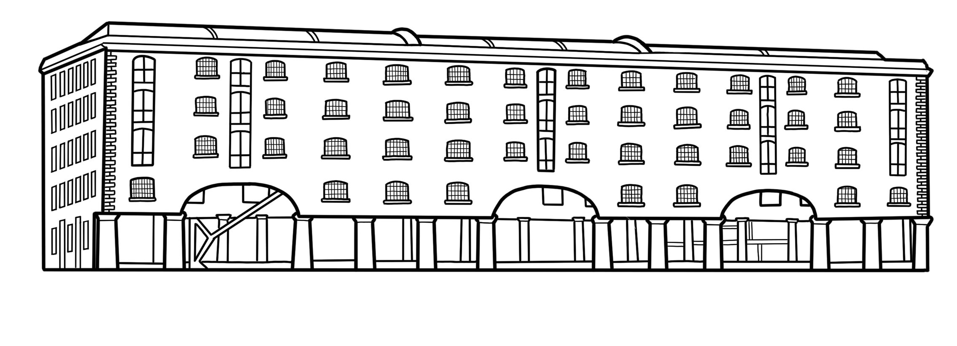
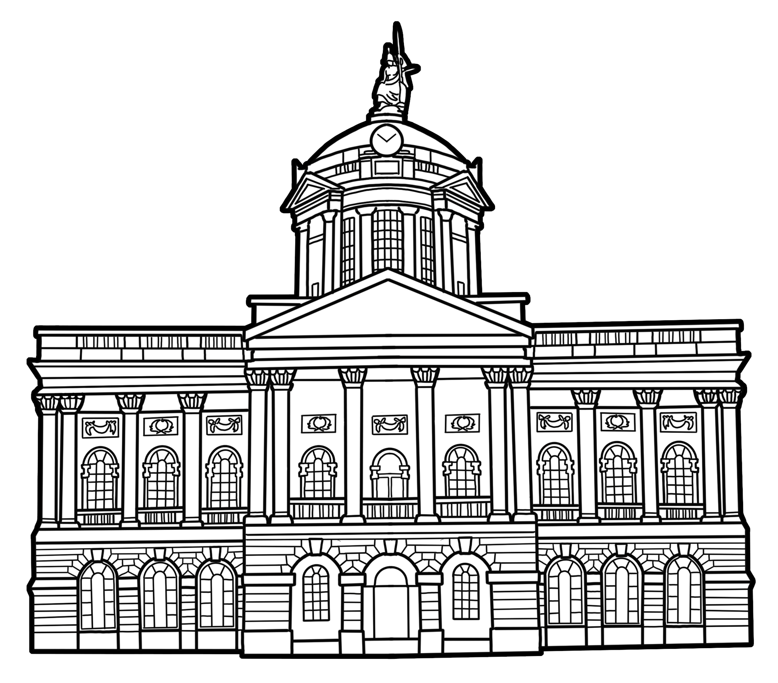
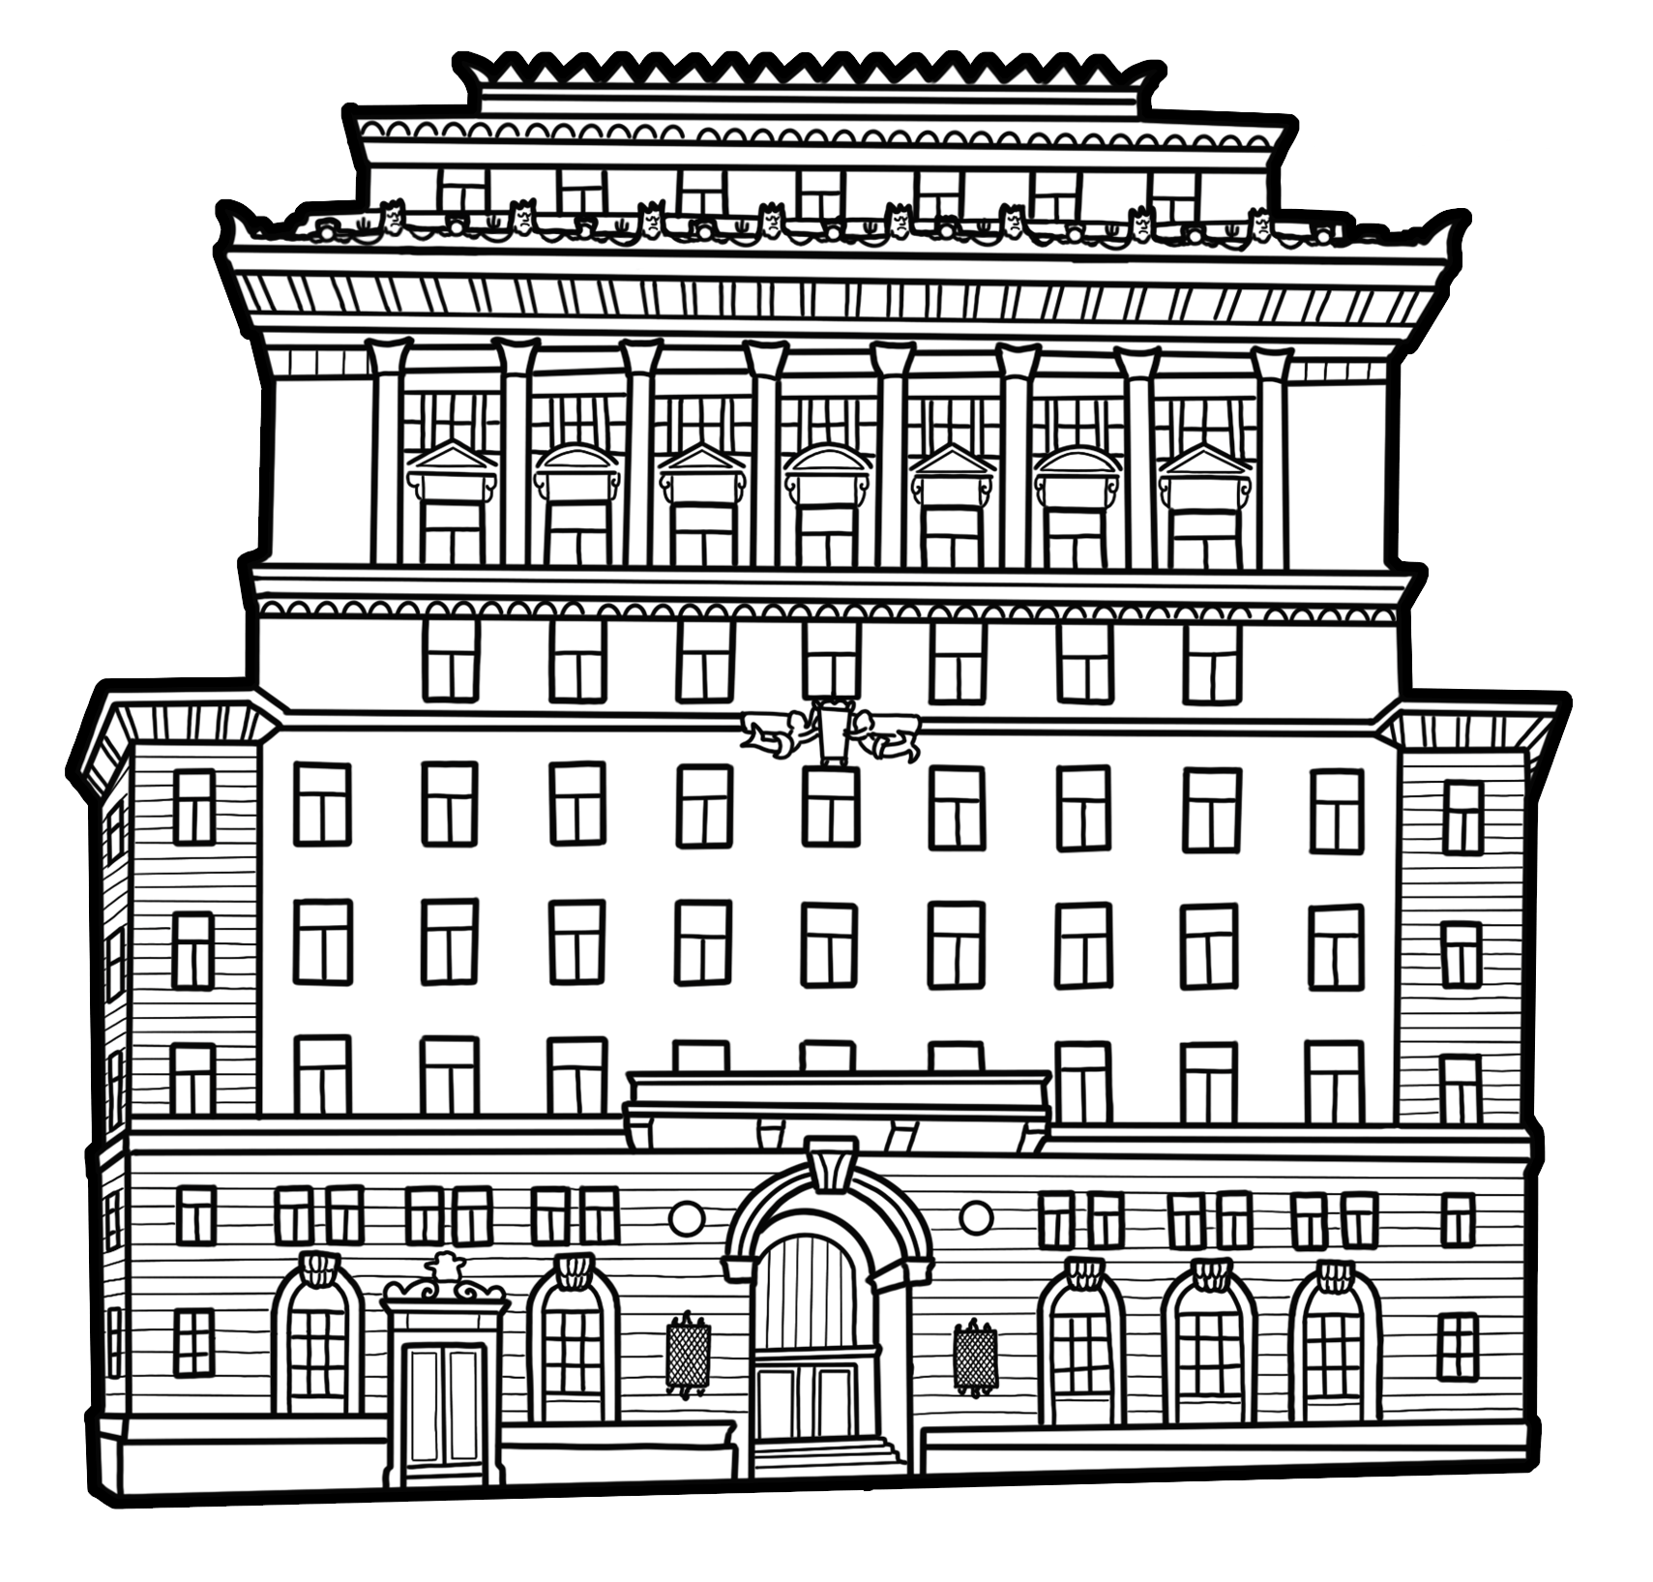
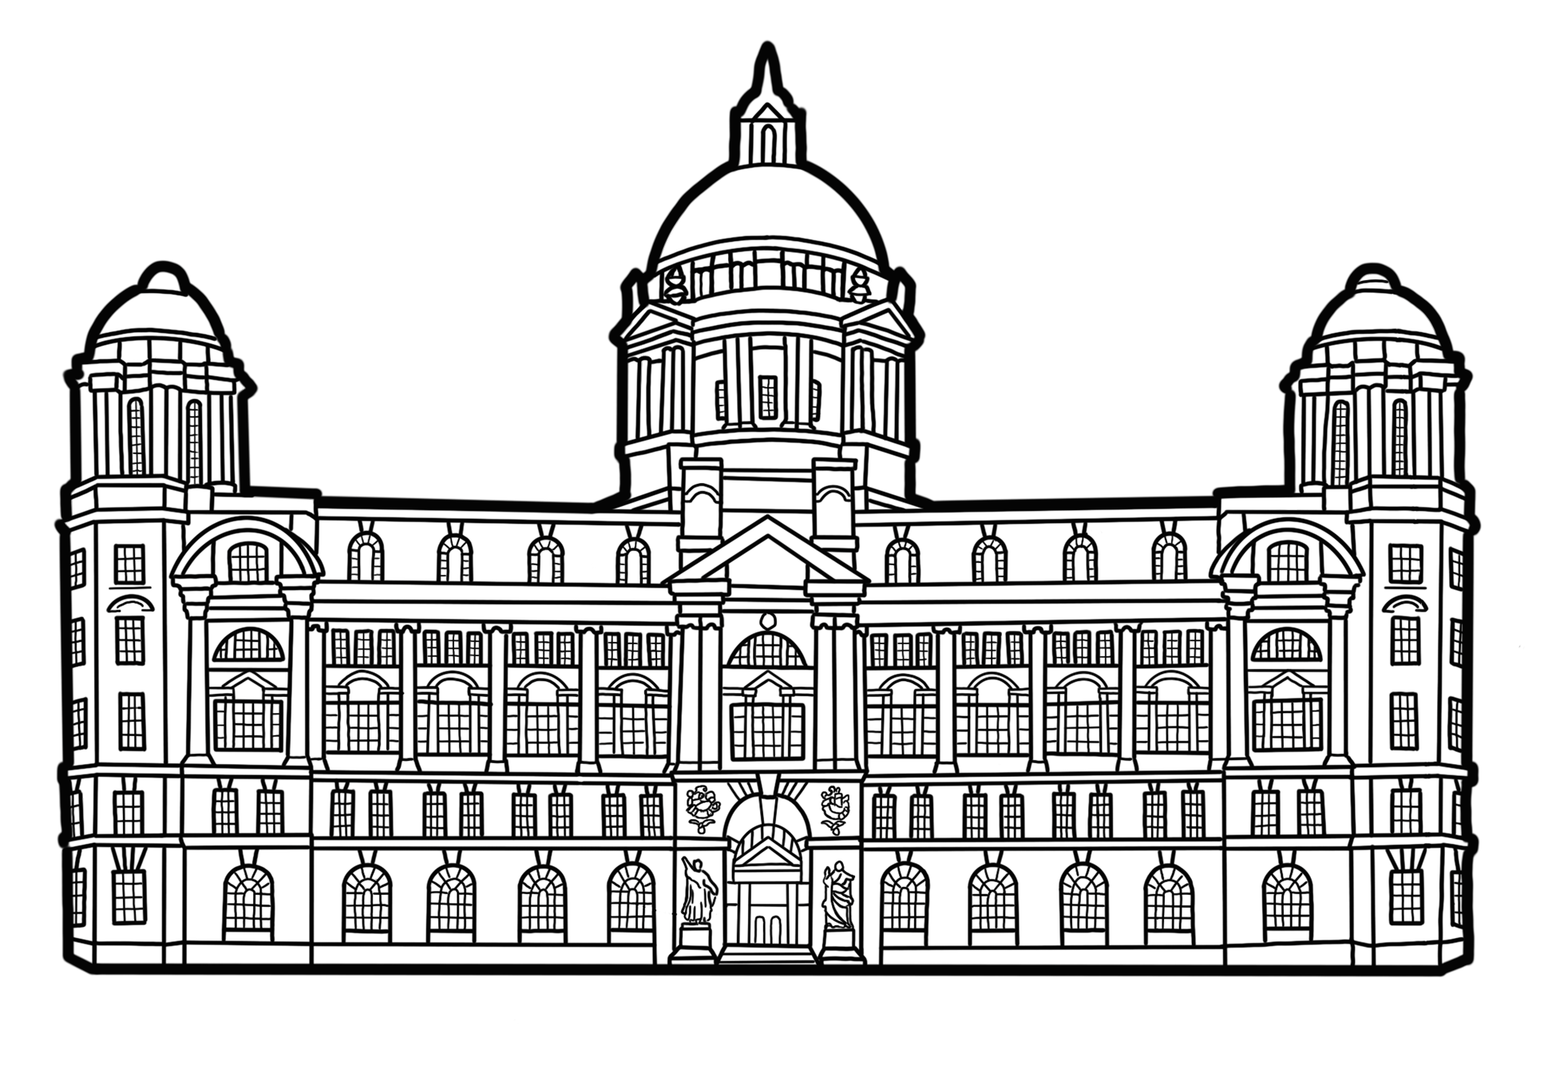
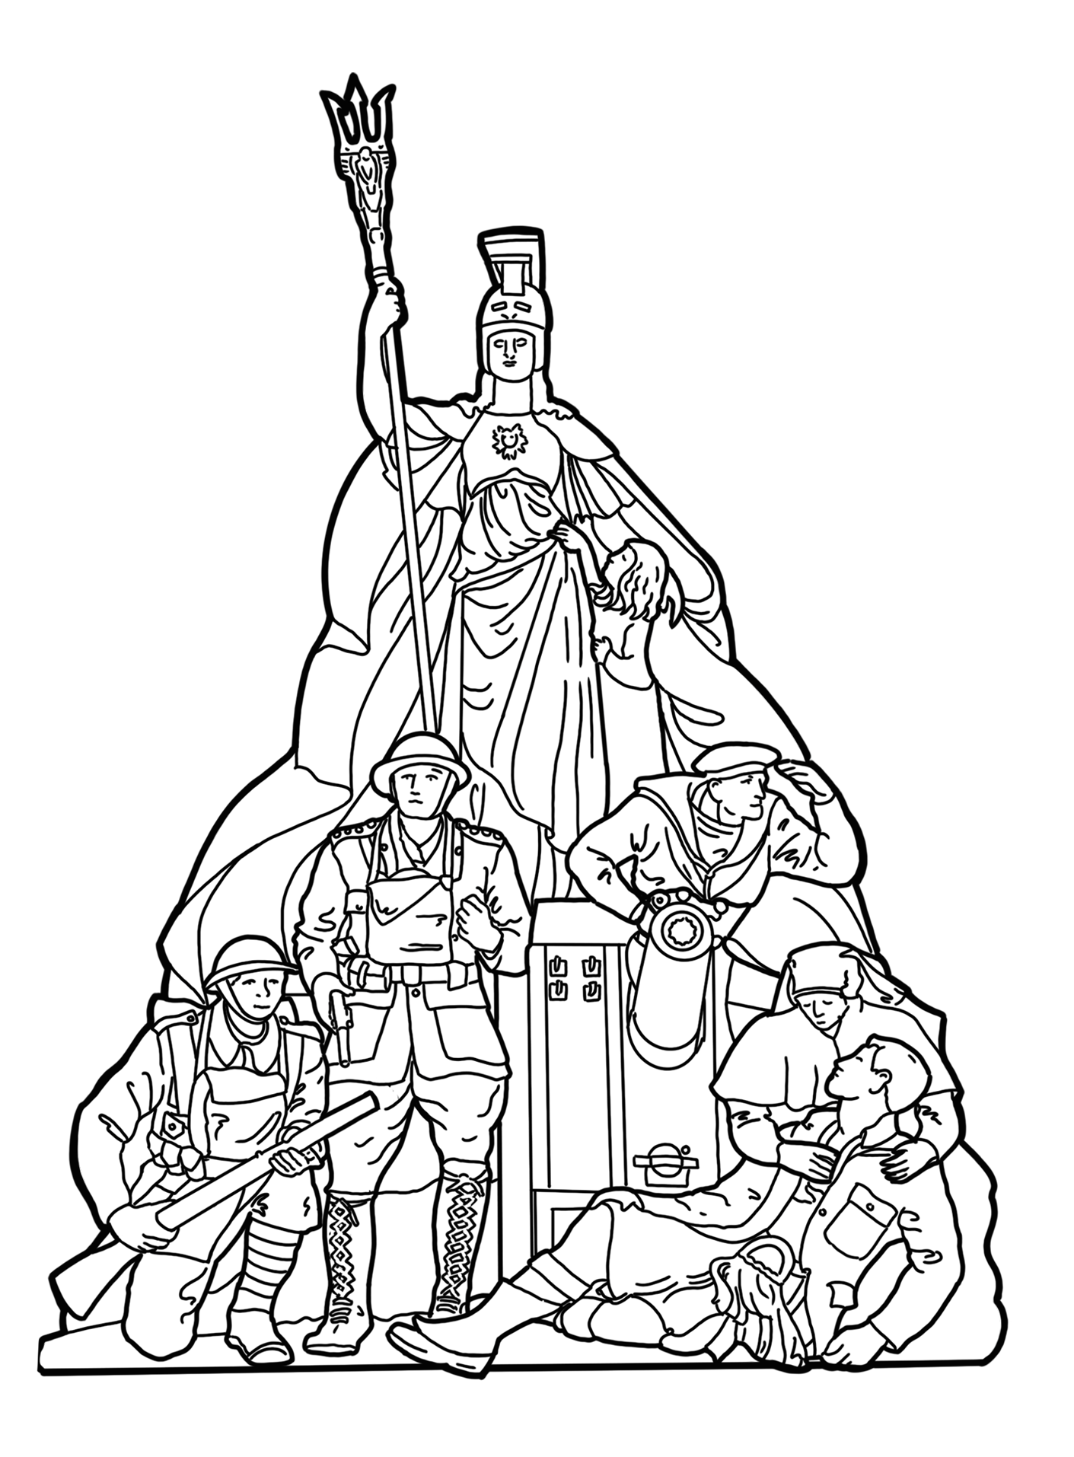
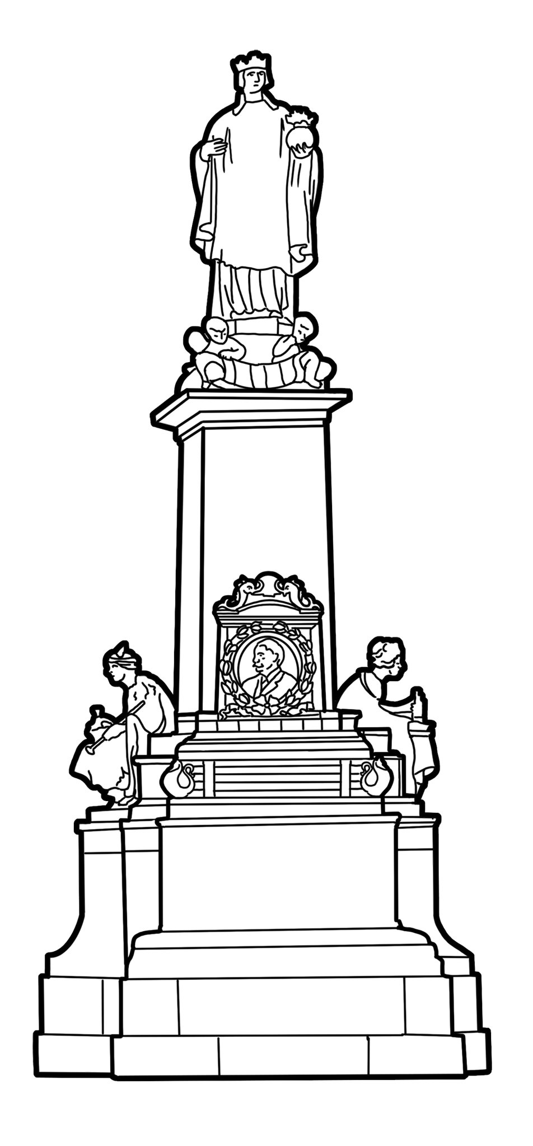
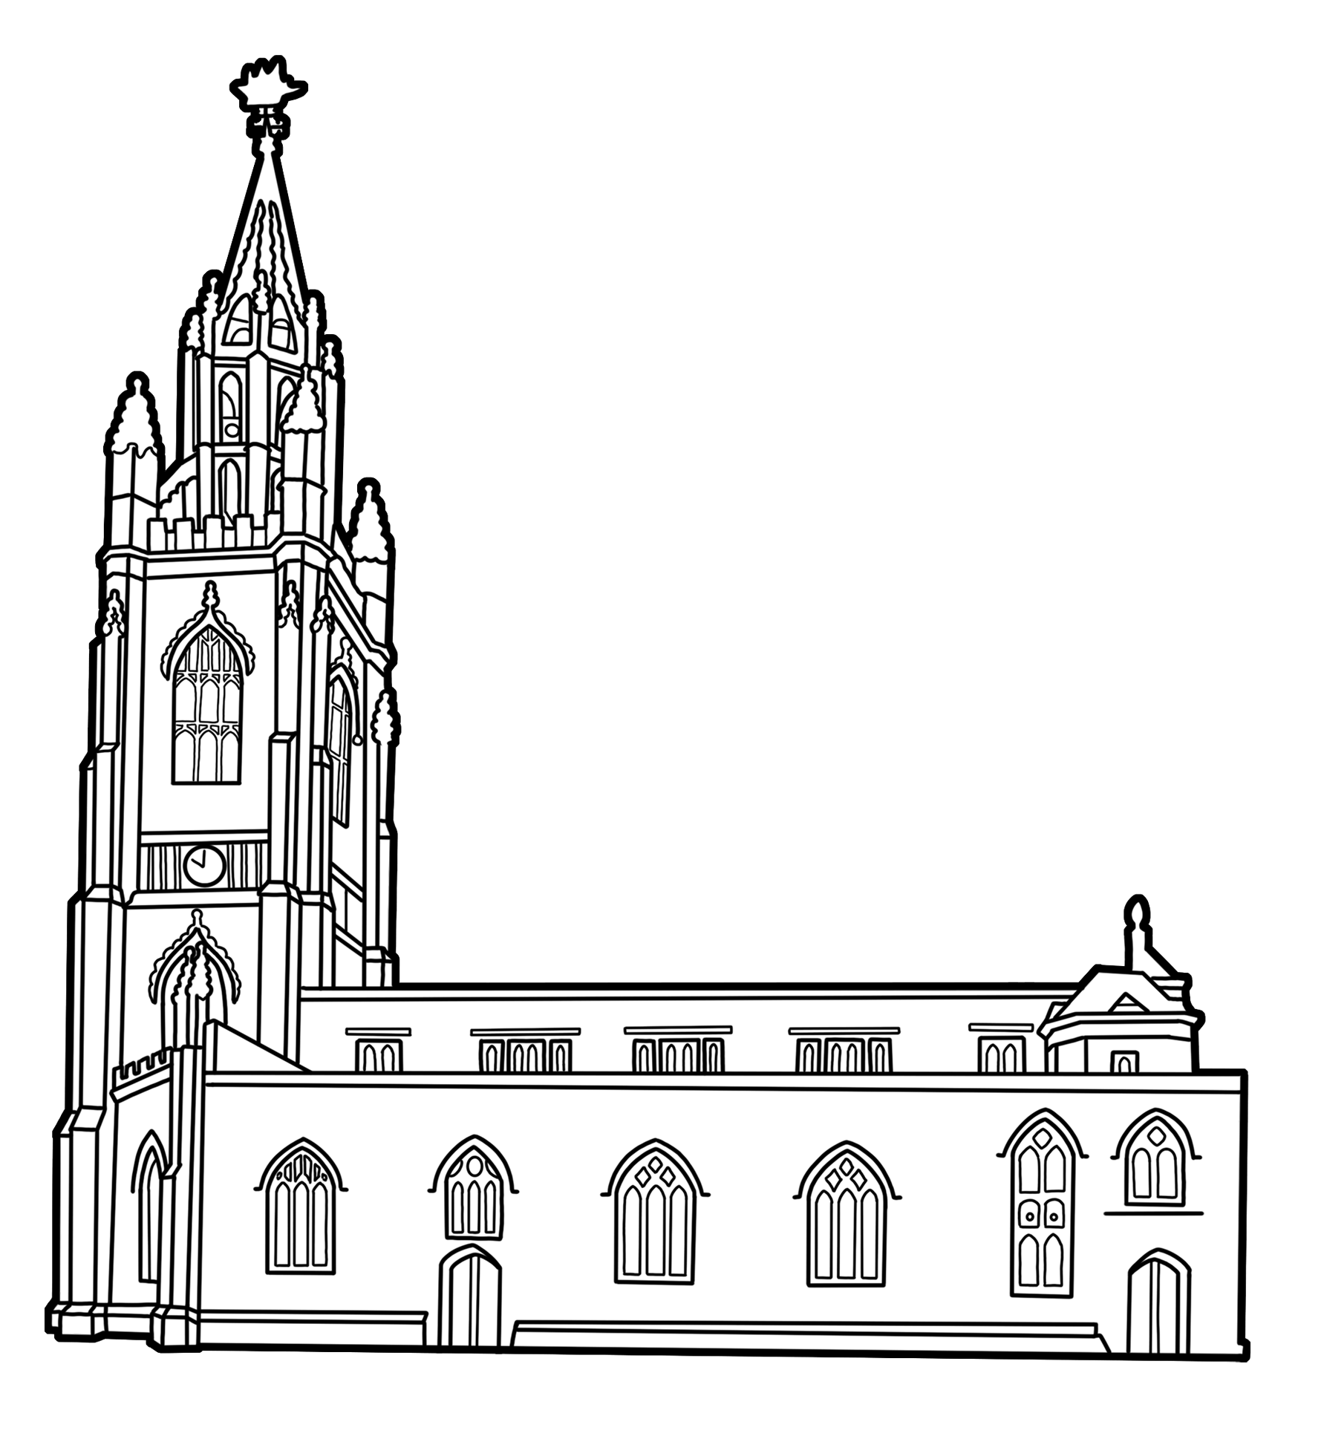
Buildings to use on timeline
Albert Dock, 1846
Alfred Lewis Jones Memorial, 1913
War Memorial, 1924
Liverpool Town Hall, 1759
Church of Our Lady and St Nicholas, 1775
Port of Liverpool Building, 1907
Martins Bank Building, 1932
Notes:
Drawings courtesy of Bears Get Crafty

Slide 14
When were the sites on the trail built?
1750
1950
1800
1850
1900

Slide 15


When were the sites on the trail built? 2
The Martins Bank Building, 1932
Liverpool Town Hall, 1759
Albert Dock, 1846
Alfred Lewis Jones Memorial, 1913
1950
1800
1850
1900
1750
Church of Our Lady and St Nicholas, 1775
Port of Liverpool Building, 1907
War Memorial, 1924
Think
Do you notice anything interesting about when these buildings were built?
Notes:
Drawings courtesy of Bears Get Crafty

Slide 16
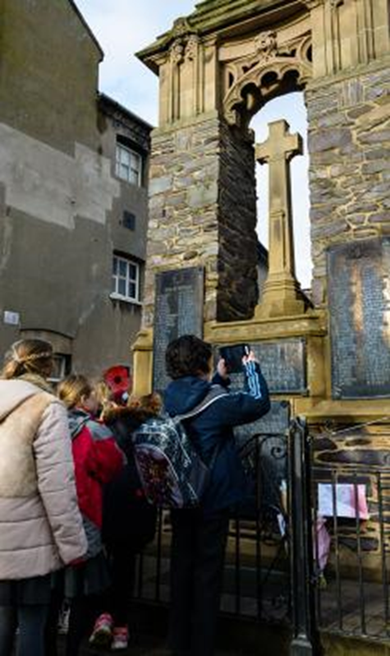
Listed Buildings and The Missing Pieces Project
Many of the sites mentioned on the ‘We Need to Walk About Empire’ trail are listed. This means that they are nationally important structures. They must be preserved, and they cannot be knocked down.
You can find out more about why the sites have been listed on the National Heritage List for England website. The links to each site are below:
Merseyside Maritime and International Slavery Museum Albert Dock
Port of Liverpool Building
Church of Our Lady and St Nicholas
Town Hall
War Memorial, listed as part of Exchange Buildings
The Martins Bank Building, Water Street
Alfred Lewis Jones Memorial
Why not take part in Historic England’s
Missing Pieces Project?
Add the information you have found out about each site to its list entry. Upload written work, photos or artwork.​
Notes:
Image: Historic England
Please note, many other structures and buildings on Albert Dock are also listed. Depending on your focus, you may like to visit the following list entries and upload information here:
Dock Traffic Office - https://historicengland.org.uk/listing/the-list/list-entry/1356264
Edward Pavillion - https://historicengland.org.uk/listing/the-list/list-entry/1068410
Atlantic Pavillion - https://historicengland.org.uk/listing/the-list/list-entry/1205175
Britannia Pavillion - https://historicengland.org.uk/listing/the-list/list-entry/1068409

