Slide 1
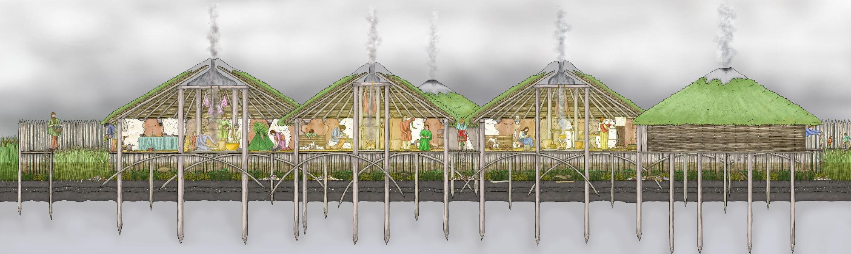
Life at Must Farm

Slide 2
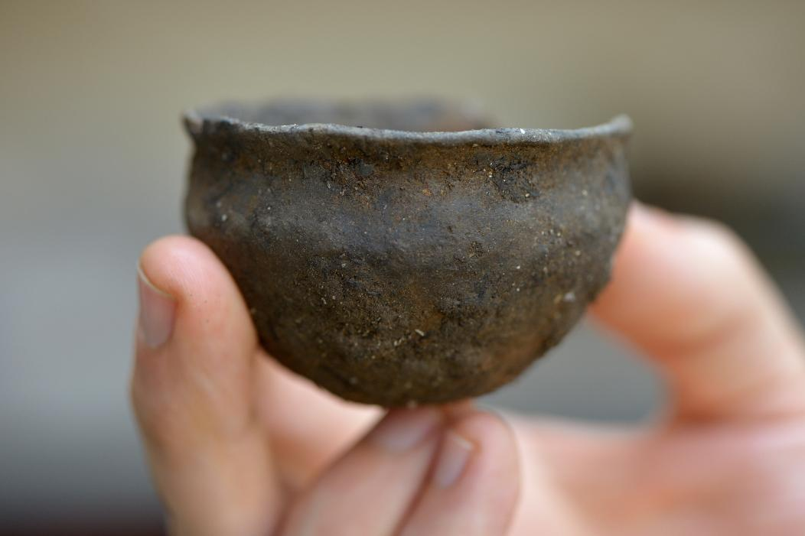
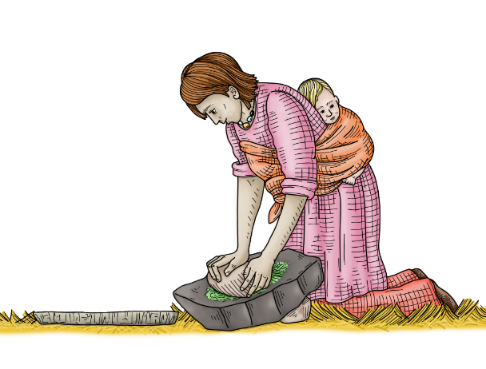
Everyday Bronze Age life
Archaeologists are really interested in understanding how people lived their lives in the past.
This means looking at the things people did every day. For example, cooking meals, making objects and looking after animals.
However, it is very rare to find prehistoric sites that are well-preserved enough to find out these important details.
A Bronze Age pot

Slide 3
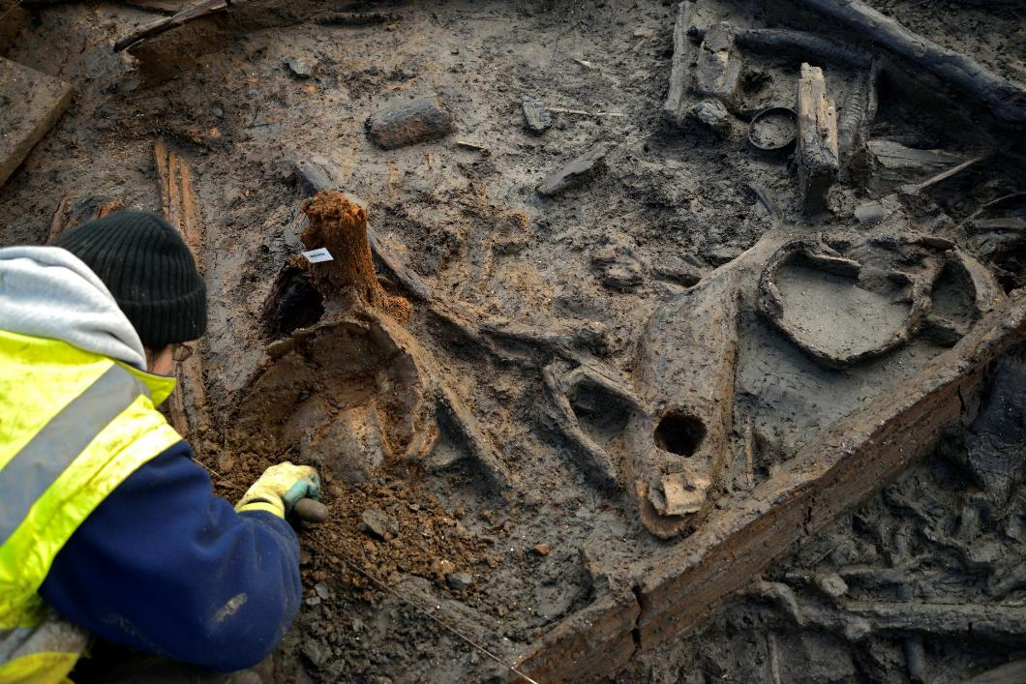
Must Farm’s houses
The village at Must Farm burnt down suddenly and its objects were very well-preserved. This meant that a moment in time was protected under the ground.
These special conditions were exciting as they let archaeologists see lots of small details about how people were living in the Late Bronze Age.
Sites like Must Farm are rare. But archaeologists think the objects and things people did would have been the same in other homes 3,000 years ago.
Finding artefacts at Must Farm

Slide 4
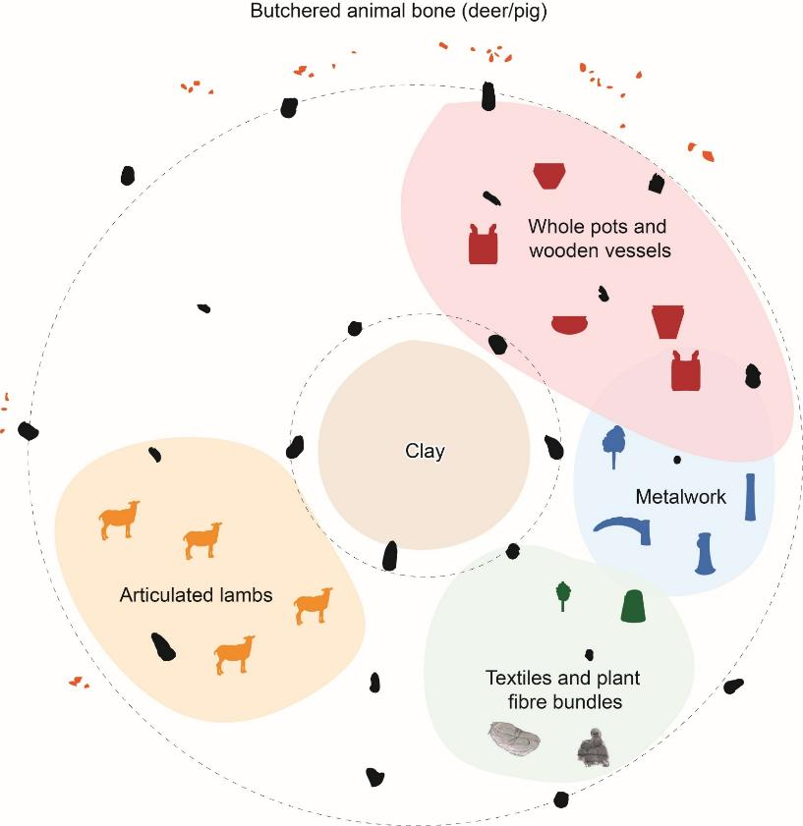
Looking inside Bronze Age homes
Sleeping area
Kitchen
When Must Farm’s houses burnt down, they fell into the river below in a special way.
The objects inside stayed grouped together in the same way they would have been in each house.
This meant that archaeologists could still see how people would have used different spaces inside the homes.
Storage
Textile area
Sheep “pen”

Slide 5
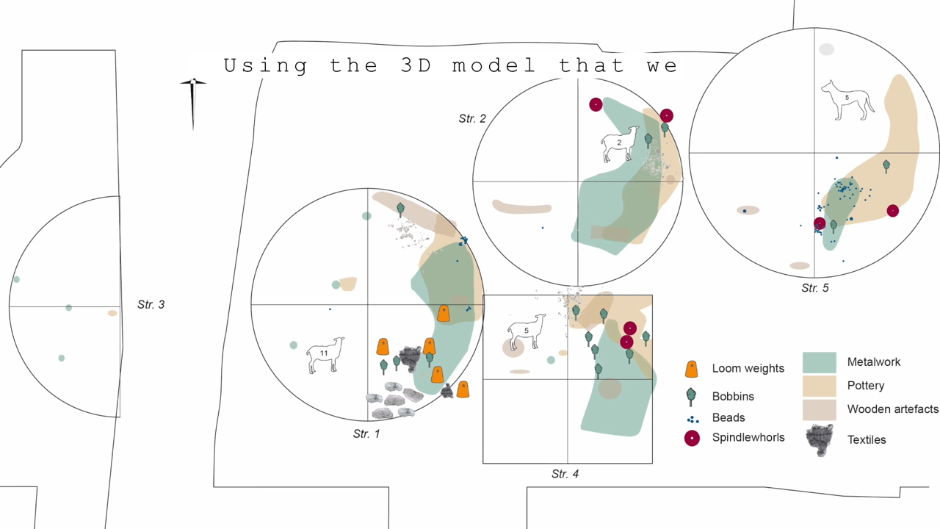
What was it like inside the houses?
Notes:
https://vimeo.com/1045053069#t=4m03s&end=4m28s

Slide 6
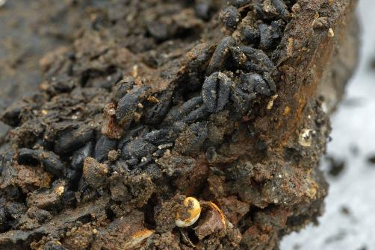
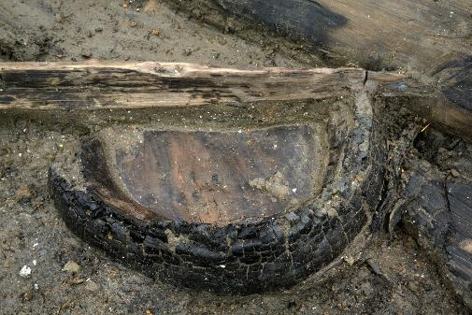
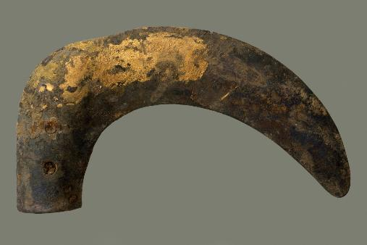
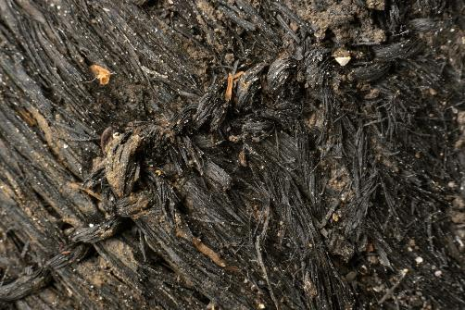
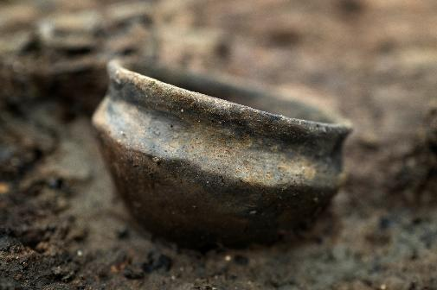
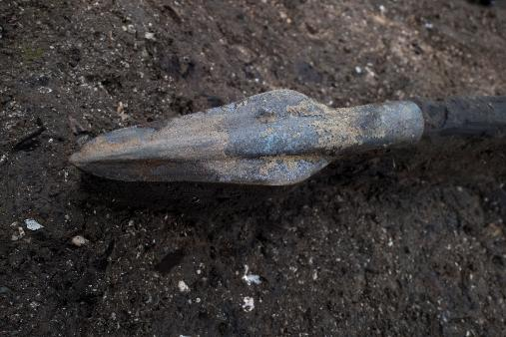
What objects were inside a Must Farm House?
Food and ingredients
Wooden buckets
Tools
Textiles
Pots and jars
Weapons

Slide 7
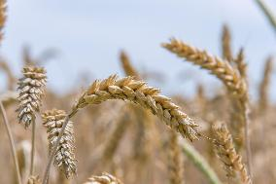

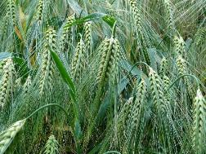
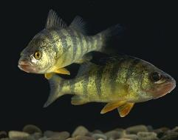
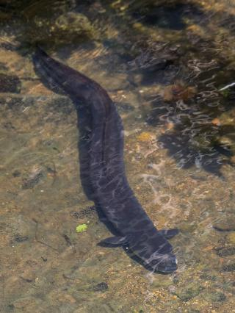
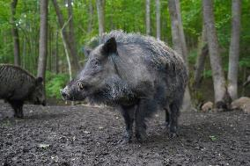
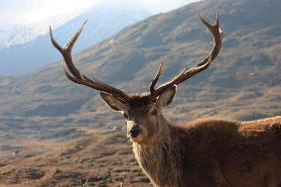
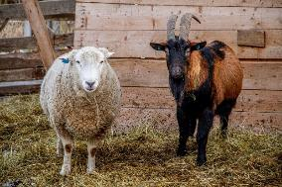

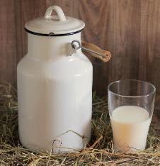
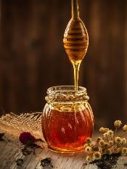
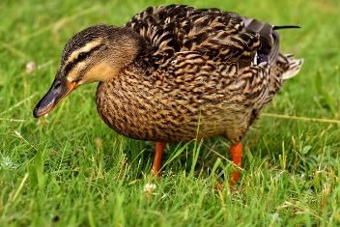
What were people eating at Must Farm?
Seeds
Wheat
Flax
Barley
Fish
Perch
Meat
Wild boar / pig
Pike
Eel
Red deer
Sheep / goat
Food and ingredients archaeologists think people
were eating at Must Farm
Other
Milk
Honey
Duck

Slide 8
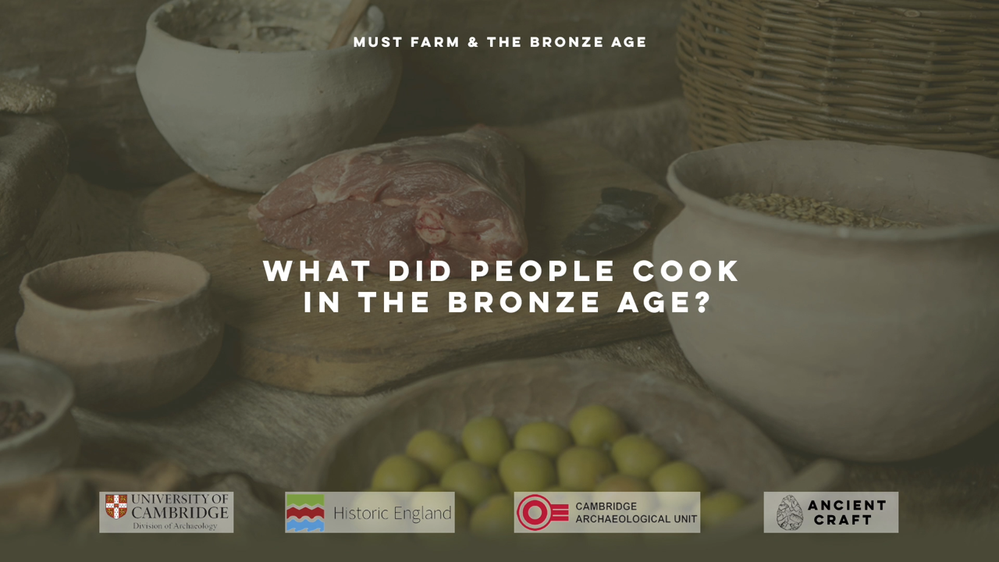
What did people cook in the Bronze Age?
Notes:
https://vimeo.com/1045260274#t=3m55s&end=5m25s

Slide 9
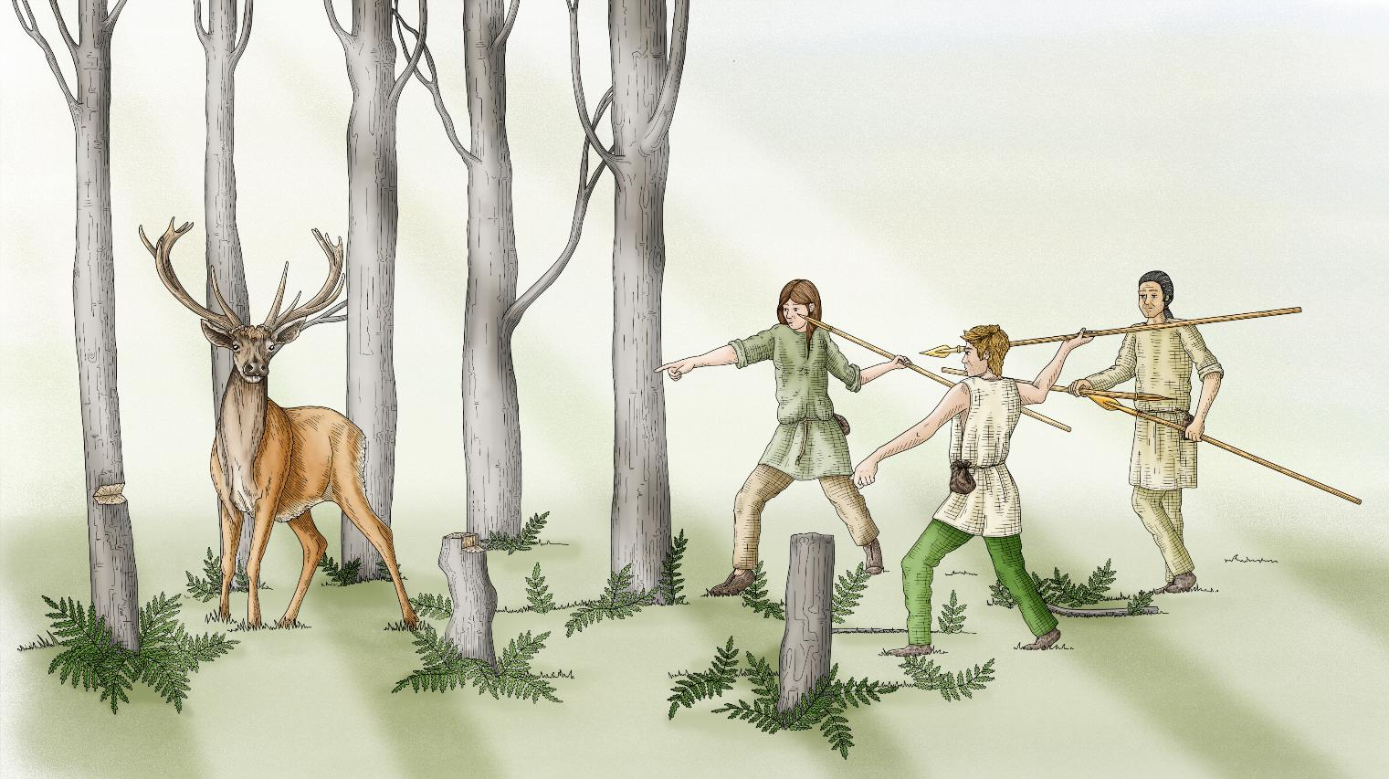
Hunting at Must Farm
The people living at Must Farm would have hunted wild animals for their meat.
Lots of wild boar and red deer bones were found showing these animals were commonly eaten.
People would also have hunted birds including ducks, coots and probably herons and swans.

Slide 10
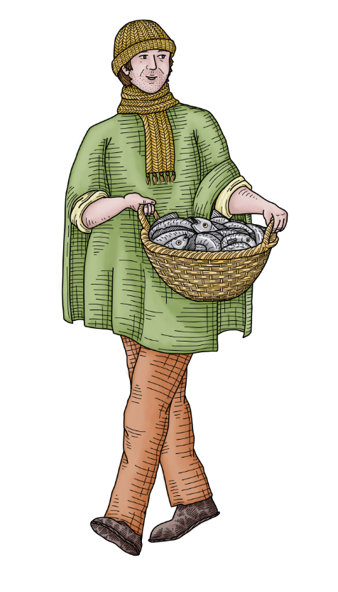
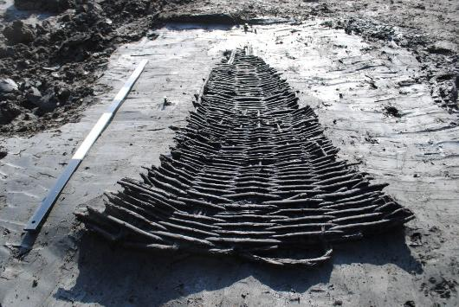
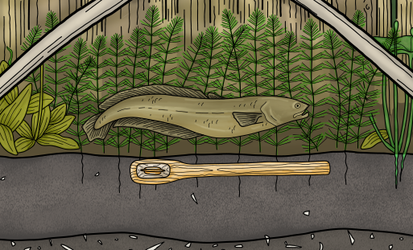
Fishing
Archaeologists found evidence from Must Farm that people were fishing and eating fish from the river they were living above.
Bones and teeth from pike, a type of fish, were found in preserved human poos called coprolites.
One of the houses contained a fishing net that could have been used to catch pike, perch and carp.
Fish trap from the river
A fish

Slide 11
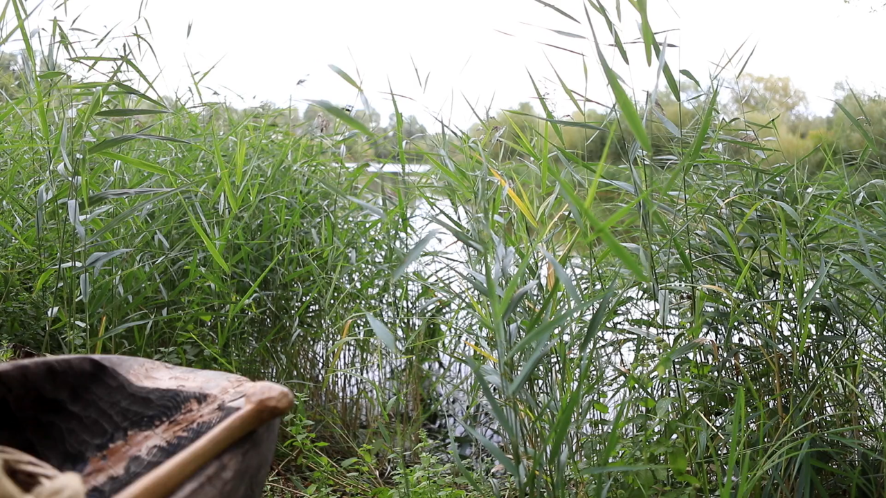
Fish and fishing at Must Farm Bronze Age village
Notes:
https://vimeo.com/1045260274#t=8m05s&end=8m58s

Slide 12
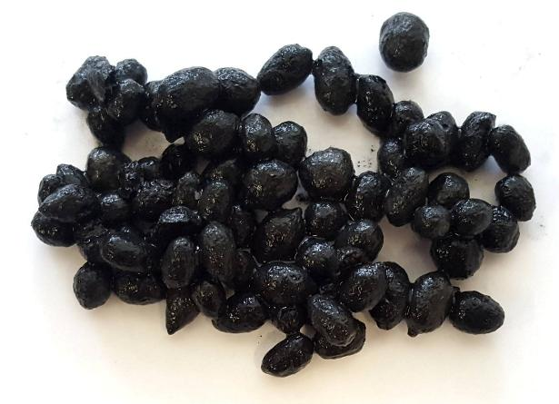
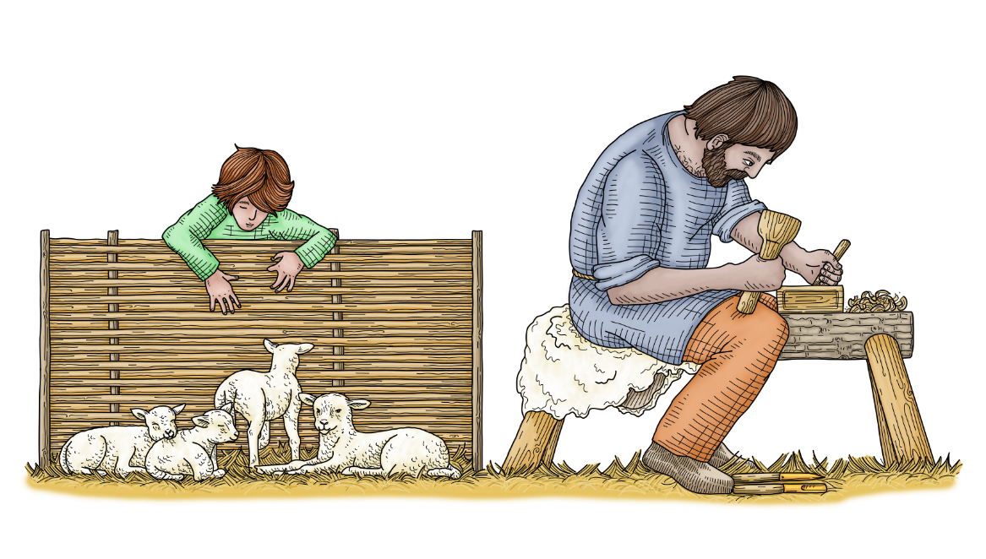
Farmed Animals
Evidence from Must Farm shows that young sheep/lambs were living inside the houses.
Older sheep weren’t kept at the village and probably lived on higher ground near the village.
Looking into the preserved poo from the young sheep/lambs shows that they were being fed a special diet of plants while living in the houses.

Slide 13
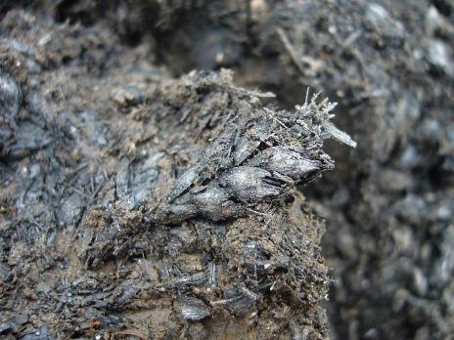
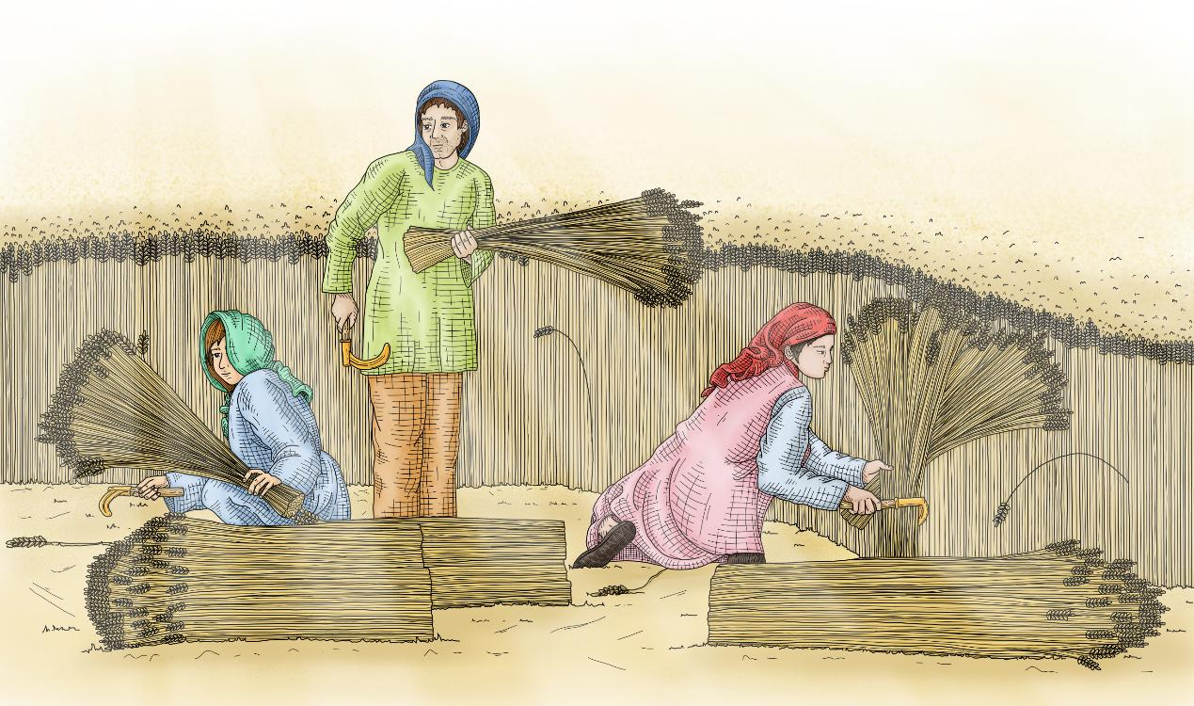
Plants
Cereals, like wheat and barley, are the most common plant foods that were found at Must Farm.
People would have grown and harvested these cereals on higher ground away from the settlement where the ground was drier.

Slide 14
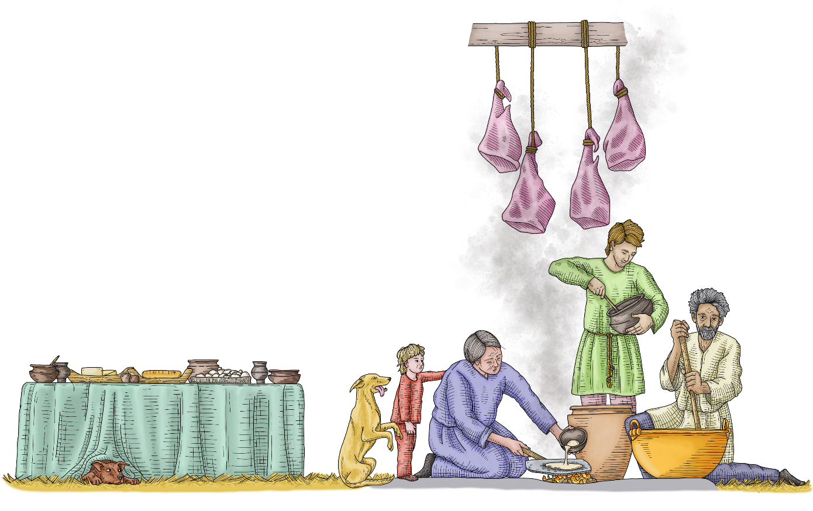
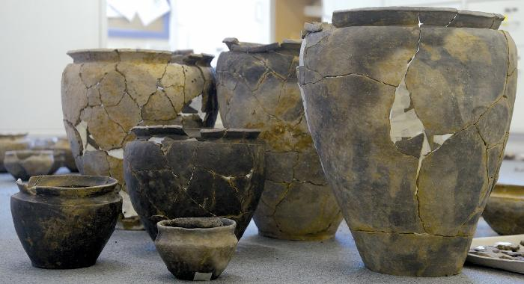
Food-related finds
Almost 200 artefacts used in preparing food and cooking were found at Must Farm.
These included pots, chopping boards, spatulas for stirring and even a ladle!
The preservation was so good that amazingly even food survived! This let archaeologists understand how people made meals in the Late Bronze Age.
Pots from Must Farm

Slide 15
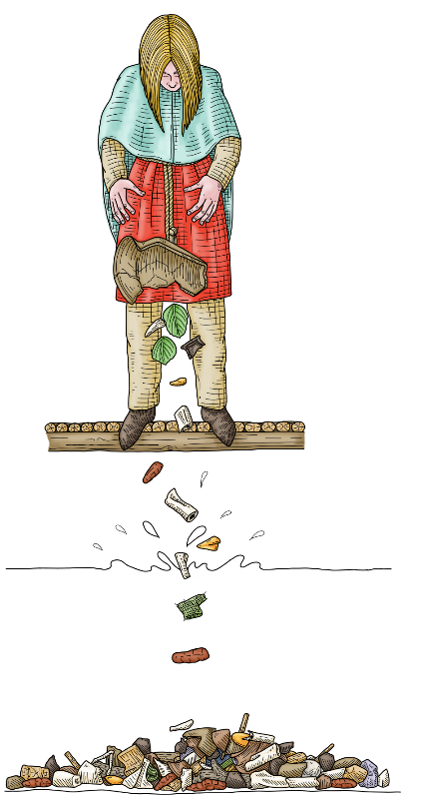
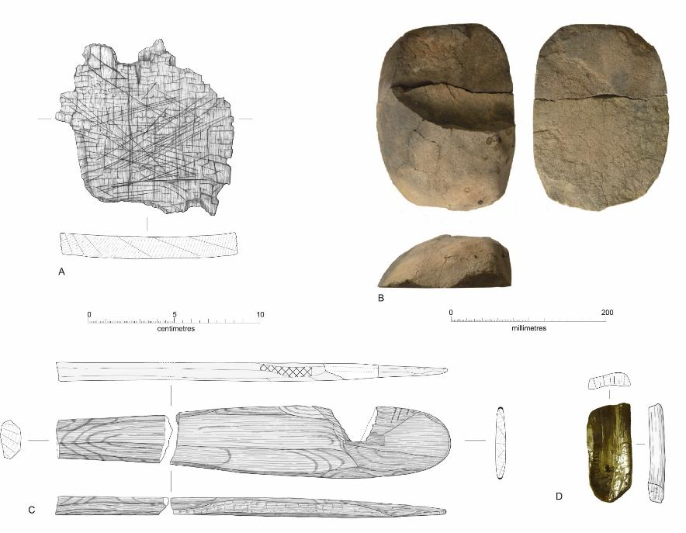
Preparing food
Chopping board
The damp conditions in the houses from living over a river would mean that food would have spoiled easily, so it was probably prepared quickly before being eaten.
Grind stone
Cereals may have been stored in the dry, smoky roof spaces in the houses which could have given them a flavour.
Meat would have been roughly prepared as bits of chewed animal bone were found inside human coprolites.
Spatula
Scoop
Artefacts for cutting, grinding, stirring and scooping food

Slide 16
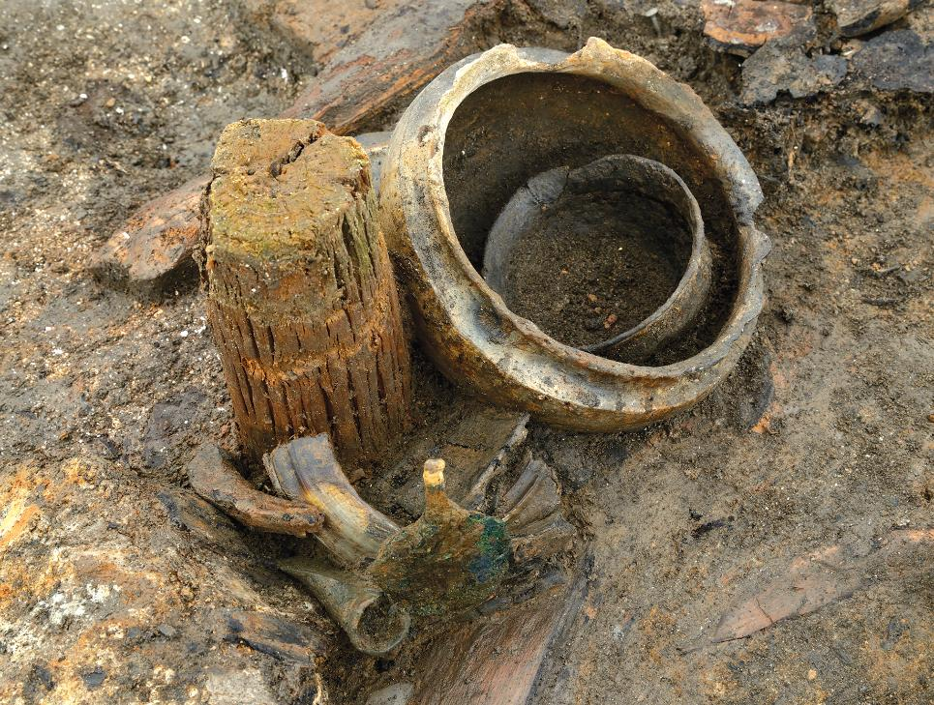
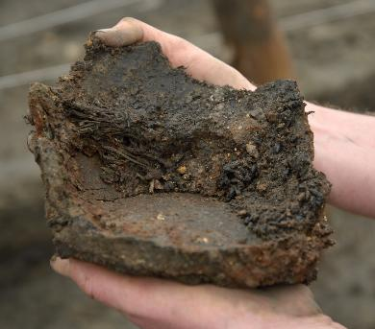
Meals and recipes
Pots from Must Farm
The preservation at Must Farm was so special that archaeologists found food or traces of food in 76 different pots!
Using scientific techniques specialist archaeologists can study the food crusts and traces of food left behind in bowls, jars and cups.
This gives us an idea of the different meals people were eating in the Late Bronze Age.
People at Must Farm were eating porridges, stews, doughs and possibly drinking a thick drink made from grain.
Food preserved inside a pot

Slide 17
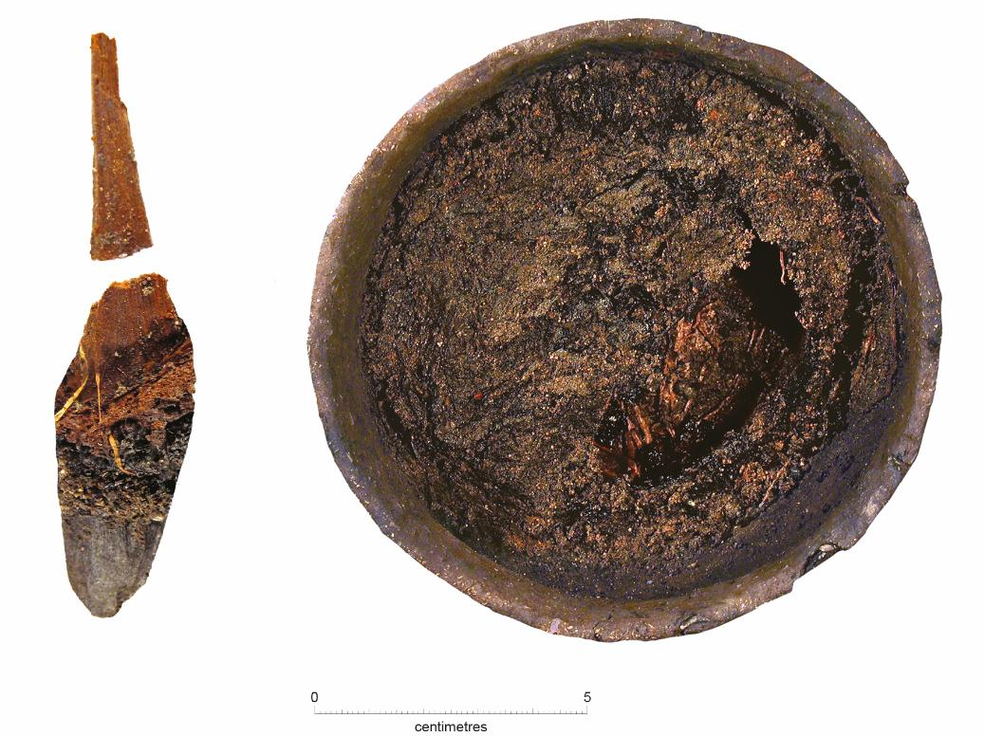
Must Farm’s Pot 44
One of the most amazing finds from one of the houses at Must Farm was a bowl called Pot 44.
This pot was still half full of a thick porridge. It was made from a mixture of ground wheatmeal and animal fats, probably from a sheep/goat or a red deer.
The wooden spoon or spatula that was used to stir the porridge was found still inside the bowl.
Spoon
Bowl of food

Slide 18
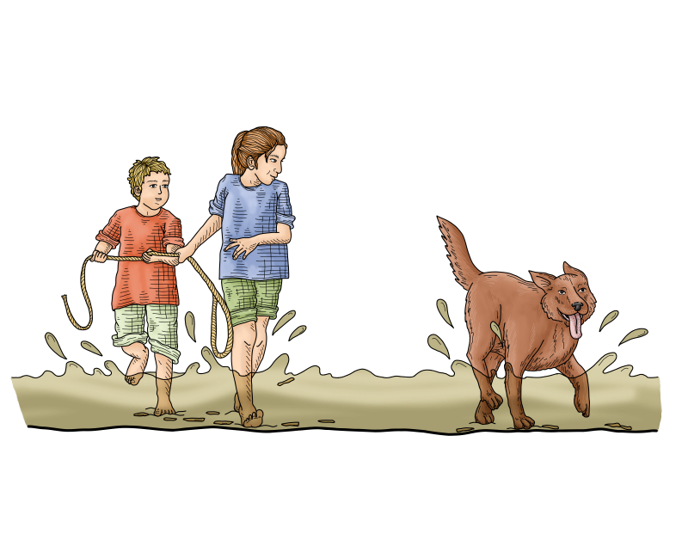
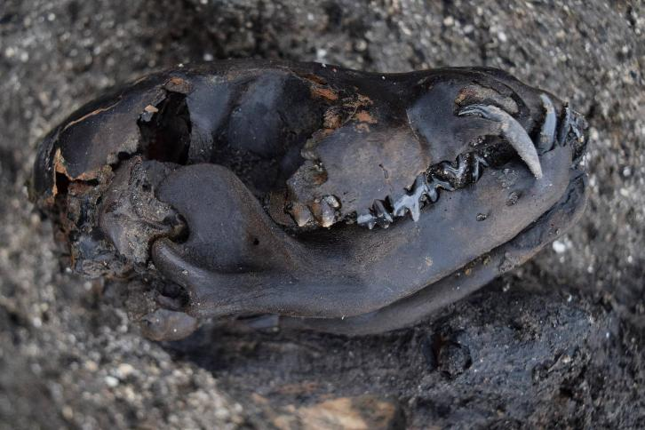
Dogs
The people at Must Farm were living with pet dogs.
Dogs lived in at least one of the houses, Roundhouse 5, but not in the same homes as the young sheep/lambs.
Preserved dog poo shows that the dogs would have been eating leftover food, food waste products and grass leaves.
The skull of a dog discovered during the dig at Must Farm

Slide 19

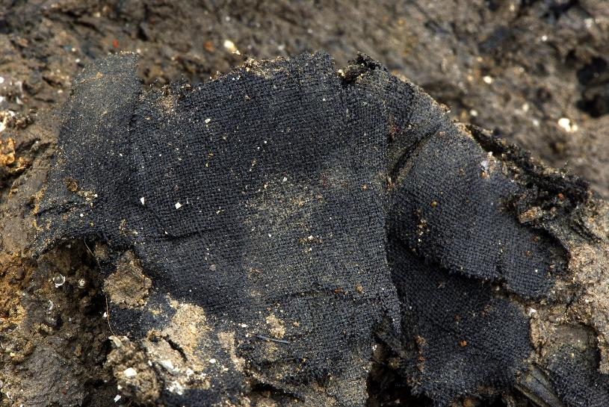
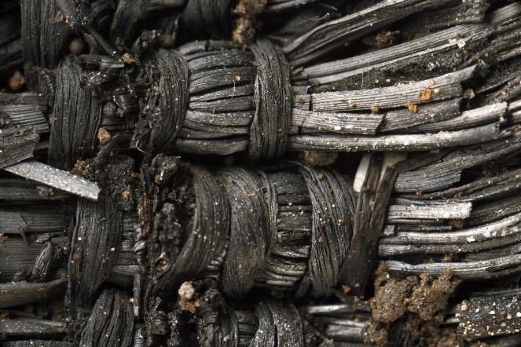
Textiles at Must Farm
Textiles are threads and fabrics that can be made from plant or animal fibres.
It is very rare to find textiles from the Bronze Age but at Must Farm over 150 fibres and fabrics were discovered.
All Must Farm’s textiles were made from plant fibres including flax and lime bast (part of the bark of the lime tree).
A finely woven piece of textile
Textile known as twining

Slide 20
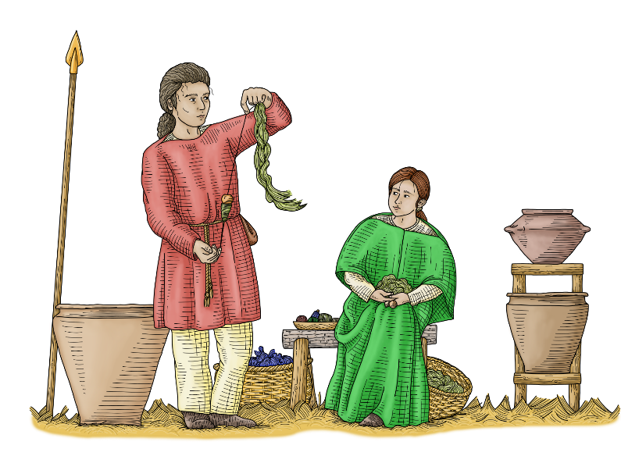
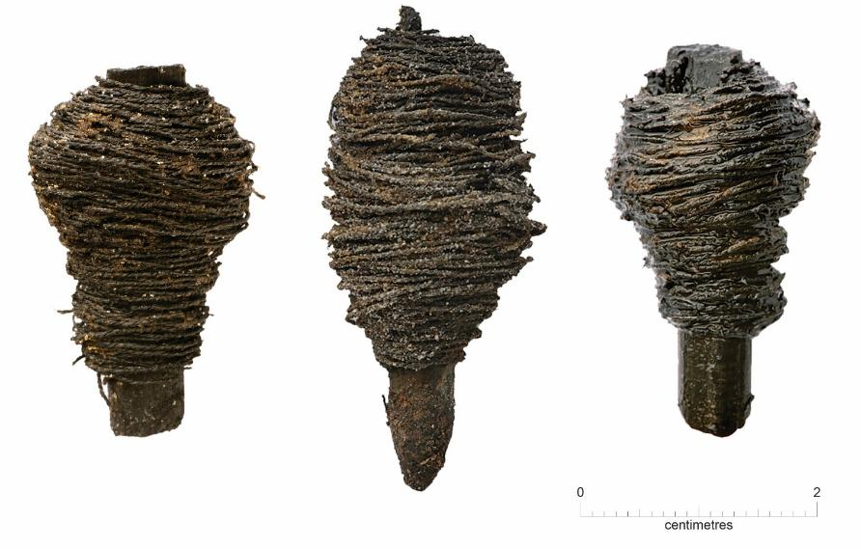
Fibres and threads
At Must Farm archaeologists found 35 bundles of fibres that had been gathered ready to be spun together to make threads.
They also found tiny “bobbins”, small sticks that had thread wrapped around them.
There were even little balls of thread that had survived the fire and 3,000 years in the ground!
Bobbins of thread

Slide 21
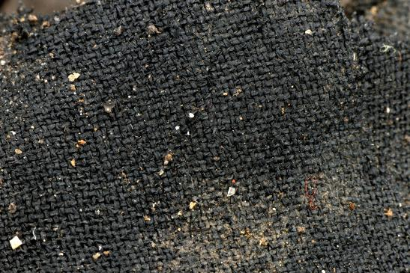
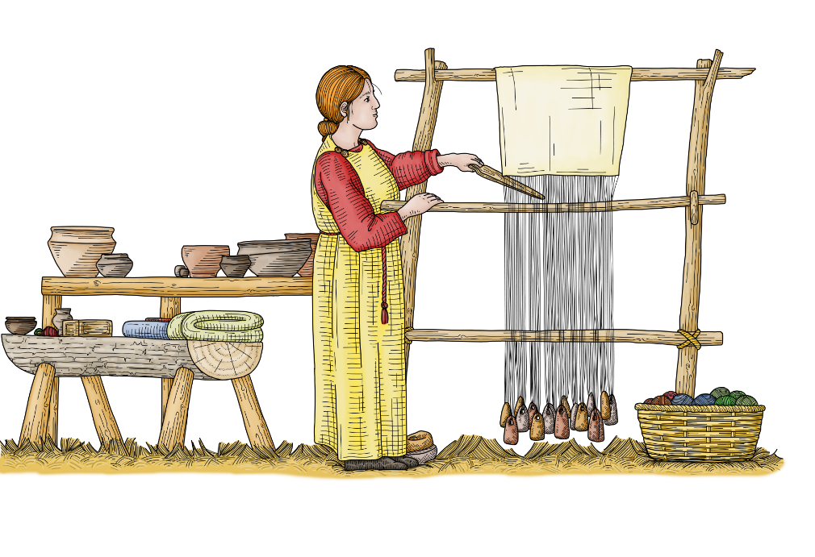
Textiles and weaving
None of the pieces of textile that were found at Must Farm could be identified as artefacts (like items of clothing).
Lots of the pieces were very well made and some of the best in Europe at this time.
Loom
One textile was a very finely woven piece of cloth that had been folded several times. Using a microscope to look at it showed it might never have been used.
Evidence suggests that Roundhouse One would have had a loom inside that could have been used to weave the textiles from the threads.

Slide 22
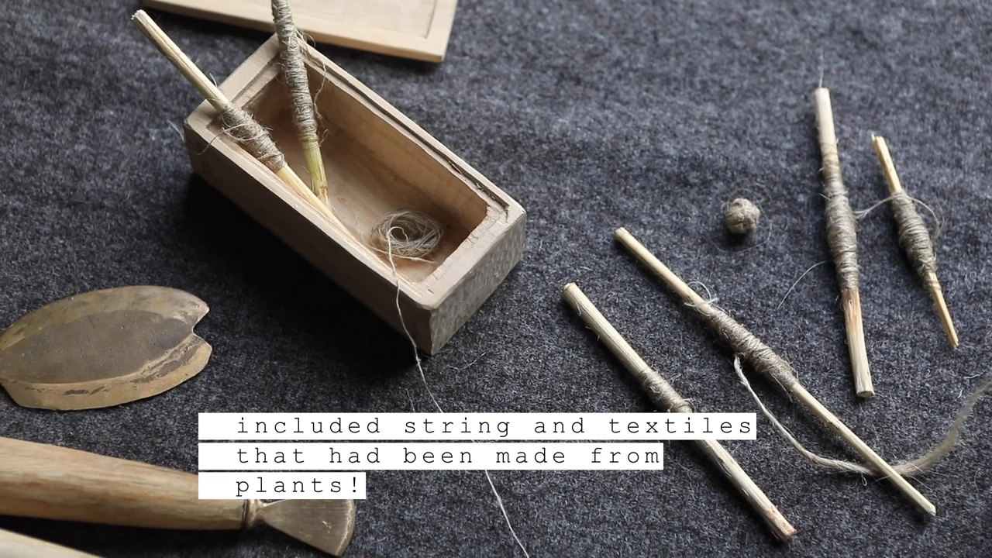
How were textiles and fabric made?
Notes:
https://vimeo.com/1045083703#t=3m28s&end=3m52s

Slide 23
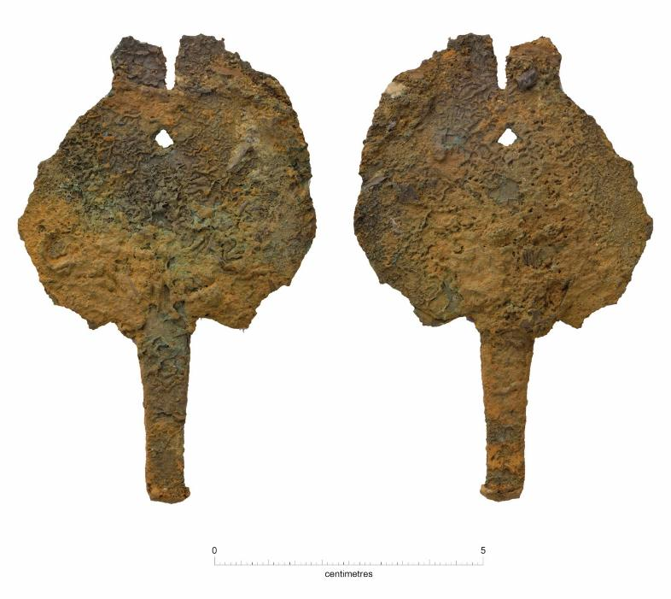
Understanding an artefact
What do you think this artefact might have been used for? The scale shows how big it is.
Bronze razor
Clue: it is made from Bronze and has sharp edges.
This object is Bronze Age razor! Archaeologists usually think these would have been used for shaving.
However, the razors at Must Farm were found very close to textiles. Could they have been used to cut threads and fabric?
What do you think the razor was used for?

Slide 24
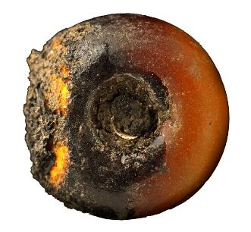


A Bronze Age necklace
This is the necklace from Must Farm as archaeologists found it in the ground. The glass beads had been damaged in the fire.
Most of the artefacts from Must Farm are quite plain and not very decorative.
However, archaeologists found beads and even a whole necklace.
The necklace was found inside Roundhouse One and was made from 21 different beads.
Amber bead
Reconstruction of the necklace

Slide 25

Beads and Trading
The beads were made from lots of different materials including glass, amber, tin, shale and siltstone.
Using scientific techniques archaeologists were able to see where the beads came from.
Glass beads: Iran or Egypt
Amber: Denmark
Tin : Europe/Switzerland
This tells us that the beads and the materials to make them were being traded during the Bronze Age. The glass beads from Iran would have travelled 4,500km to reach Must Farm!

Slide 26

Beads at Must Farm Bronze Age village
Notes:
https://vimeo.com/1045260274#t=9m13s&end=9m30s

Slide 27


Weapons
Nine spears and some broken swords were discovered at Must Farm.
It is quite unusual to find weapons in houses in the Bronze Age.
Many Bronze Age weapons are usually found placed in rivers and lakes. These might be offerings to gods or goddesses or were left as part of rituals.
Because Must Farm is better preserved than most Bronze Age homes, does this mean that most houses would have had weapons?
Spear
Archaeologists do find evidence of fighting during this time. Could the weapons have been for defending the village?
Sword

Slide 28


Must Farm’s spears
The nine spears that were found at Must Farm are exciting as many still had their wooden shafts attached.
The spear shafts at Must Farm were very long. Some of the spears would have been 2.6m to 3.4m in length. Can you imagine trying to use a spear that big?
Spear
The spears seem to have been stored together in groups outside the houses.
Spears can be used as weapons for fighting, for hunting animals or both. What do you think the spears at Must Farm were used for?

Slide 29

Weapons at Must Farm Bronze Age village
Notes:
https://vimeo.com/1045053069#t=7m36s&end=8m00s

Slide 30


Recycling
An exciting discovery at Must Farm was that people were recycling some of their objects.
One of the houses had a wooden bucket that was being used to collect broken pieces of metal including old spearheads, broken sword pieces and bits of bronze.
Bucket with bronze pieces
These appear to have been collected together ready to be melted down and made into new objects. This bucket of bronze pieces seems to be like our recycling bins today!

Slide 31




Sleeping
Some areas of Must Farm’s roundhouses have less artefacts in them. Archaeologists think that these might have been places for sleeping.
Pieces of wooden frames, badly damaged by the fire, might have been part of beds.
Plants like bracken seem to have been collected to be used as flooring and bedding.
Sleeping area
Bracken and ferns

Slide 32


Travel and transport – boats?
In a different part of the river over which the Must Farm village was built, archaeologists found prehistoric logboats.
While no complete logboats were found at the village, a wooden pole that was found there would probably have been used for punting.
Boats would have been useful for moving through the wet and marshy Fens, letting people use the rivers like roads for travelling, as well as for fishing.

Slide 33

Using log boats
Notes:
https://vimeo.com/1045260274#t=9m21s&end=9m45s

Slide 34


Travel and transport – wheels
Inside one of the buildings at Must Farm, archaeologists found two wooden cartwheels.
These would have been part of a cart that was probably pulled by oxen and used to move things more easily.
Somebody very good at woodworking would have made the wheels as they were complicated and needed lots of skill to create.
An interesting question is why two wheels were found in a building over a river.
Might they have been being made or repaired at the time of the fire?

Slide 35


The Must Farm fire
The Must Farm fire
Evidence shows that the village at Must Farm would have only lasted around a year before it burnt down in a big fire.
Afterwards it doesn’t look like anyone tried to come back to take anything that had survived the fire from the river.
After the fire around 850BC Must Farm was abandoned and slowly buried at the bottom of the river.
Some of the wooden timbers used to make the houses at Must Farm after they had been burnt and fallen into the river.

Slide 36

What caused the Must Farm fire?
Archaeologists have different theories about the fire at Must Farm. They must use the evidence they found to suggest ideas about what might have happened.

Slide 37


Possible causes of the fire that destroyed Must Farm
Notes:
https://vimeo.com/1045053069#t=6m00s&end=8m15s

Slide 38

The Must Farm fire – one theory
The Must Farm fire – one theory
One idea is that the fire at Must Farm might have started in one of the houses by accident.
Archaeologists know the buildings had fires inside them that were used for cooking.
The houses were built very close together and their roofs were touching, so if a fire started in one by accident it would be easy to spread to the others.
But if it was an accident why didn’t the people that lived there try and recover any of their objects?

Slide 39

The Must Farm fire – another theory
Another theory was that the Must Farm could have been deliberately burnt down, possibly in an attack.
Spears and sword fragments were found at Must Farm, and it had a big wooden fence built around it. This evidence could suggest that the people living at the site were worried about attacks.
While there was no evidence anybody was killed in the fire, perhaps the village was burnt down, and they were driven away.

Slide 40

The Must Farm fire – what do you think?
The Must Farm fire – what do you think?
Archaeologists will probably never know exactly what happened at Must Farm. Even with this much well-preserved material, it is difficult to understand what caused the fire and what happened to the people who lived there.
What do you think caused the Must Farm fire? Can you use evidence to support your theory?

Slide 41




Find out more by watching the Must Farm videos
Notes:
https://vimeo.com/1045083703#t=3m54s&end=4m28s

