Slide 1
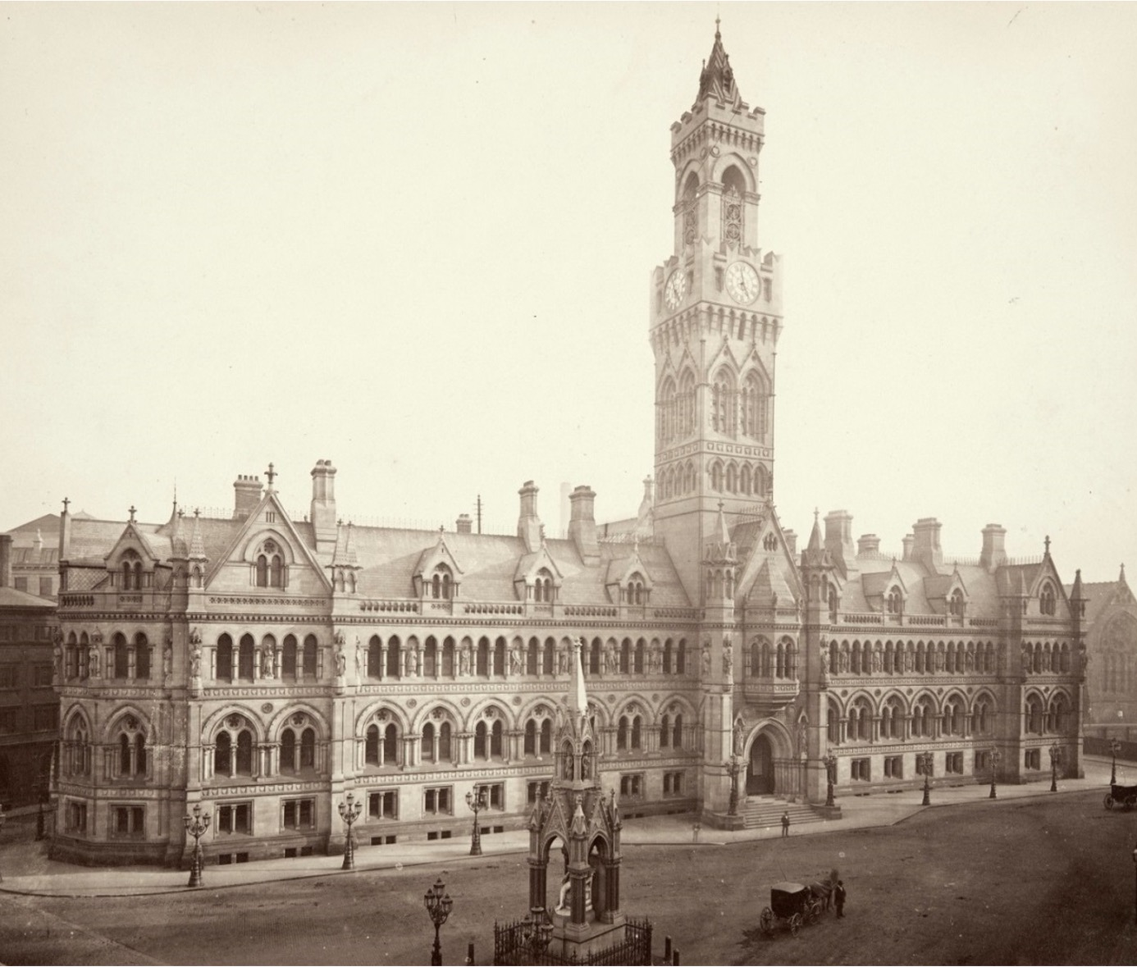
Knowing Bradford: How can buildings tell a story?
Knowing Bradford: How can buildings tell a story?

Slide 2
Knowing Bradford: How can buildings tell a story? 1
Key Stage 2: History, Drama, English
Learning Aims and Outcomes
Pupils will:
To know more about the built environment and how it relates to the heritage and story of a place.
To raise awareness of Bradford’s industrial and cultural heritage.
To investigate why key historical sites in a local area are important.
To create opportunities for cross curricular thinking and learning relating to the local built environment.
To think about, describe and explain how we can care about historic sites in our local area and can continue to use them in the future.
Notes:
This PowerPoint relates to the Teaching Activity - Knowing Bradford: How can buildings tell a story?
This PowerPoint supports a script developed by Irene Lofthouse as part of the ‘Knowing Bradford’ project. The aim of the project is to explore the history of Bradford places and people with students, through the mediums of drama, literacy, art, historical enquiry and presentations.
The script is designed to be inter-active, so that when performed in schools, students are able to become one of the characters. It is also designed to enable students to perform it themselves, or to use it as a template to create their own versions.
There is also an accompanying Activity Pack to further explore Bradford’s history, with activities linked to scenes in the script and the images in this PowerPoint.

Slide 3
How to use this PPT
The images in this PPT are intended to be used with the Knowing Bradford Play Script and Activity Pack to help students visualise the locations mentioned.
There are also a series of ‘Tasks’ for students to recall the historical facts that they learn whilst listening to or acting out the Play Script. These can be done together as a class using the slides, or using the printable worksheets.
Knowing Bradford – Play Script
Knowing Bradford – Activity Pack
Images of locations
Tasks
Printable version of ‘Tasks’.
Notes:
This PowerPoint supports a script developed by Irene Lofthouse as part of the ‘Knowing Bradford’ project. The aim of the project is to explore the history of Bradford places and people with students, through the mediums of drama, literacy, art, historical enquiry and presentations.
The script is designed to be inter-active, so that when performed in schools, students are able to become one of the characters. It is also designed to enable students to perform it themselves, or to use it as a template to create their own versions.
There is also an accompanying Activity Pack to further explore Bradford’s history, with activities linked to scenes in the script and the images in this PowerPoint.

Slide 4

Scene 1
City Hall

Slide 5
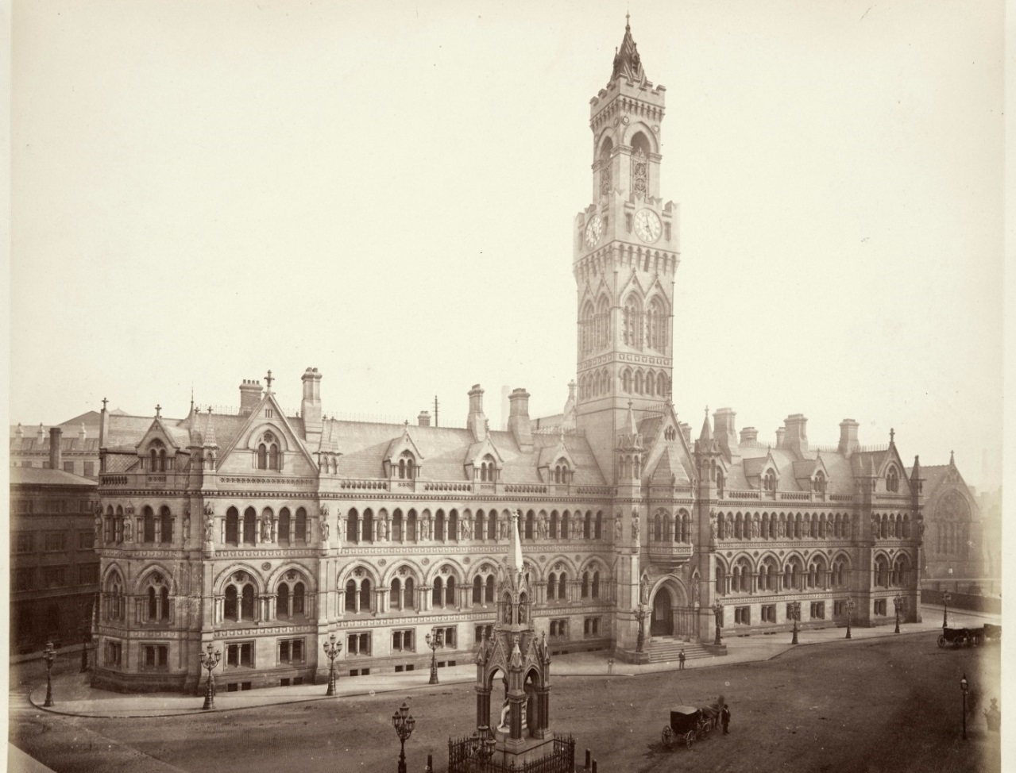
Picture 1 – City Hall, Bradford
Notes:
Images: © Historic England Archive Ref:BL00866, Taken: 1875
https://historicengland.org.uk/images-books/photos/item/BL00866

Slide 6
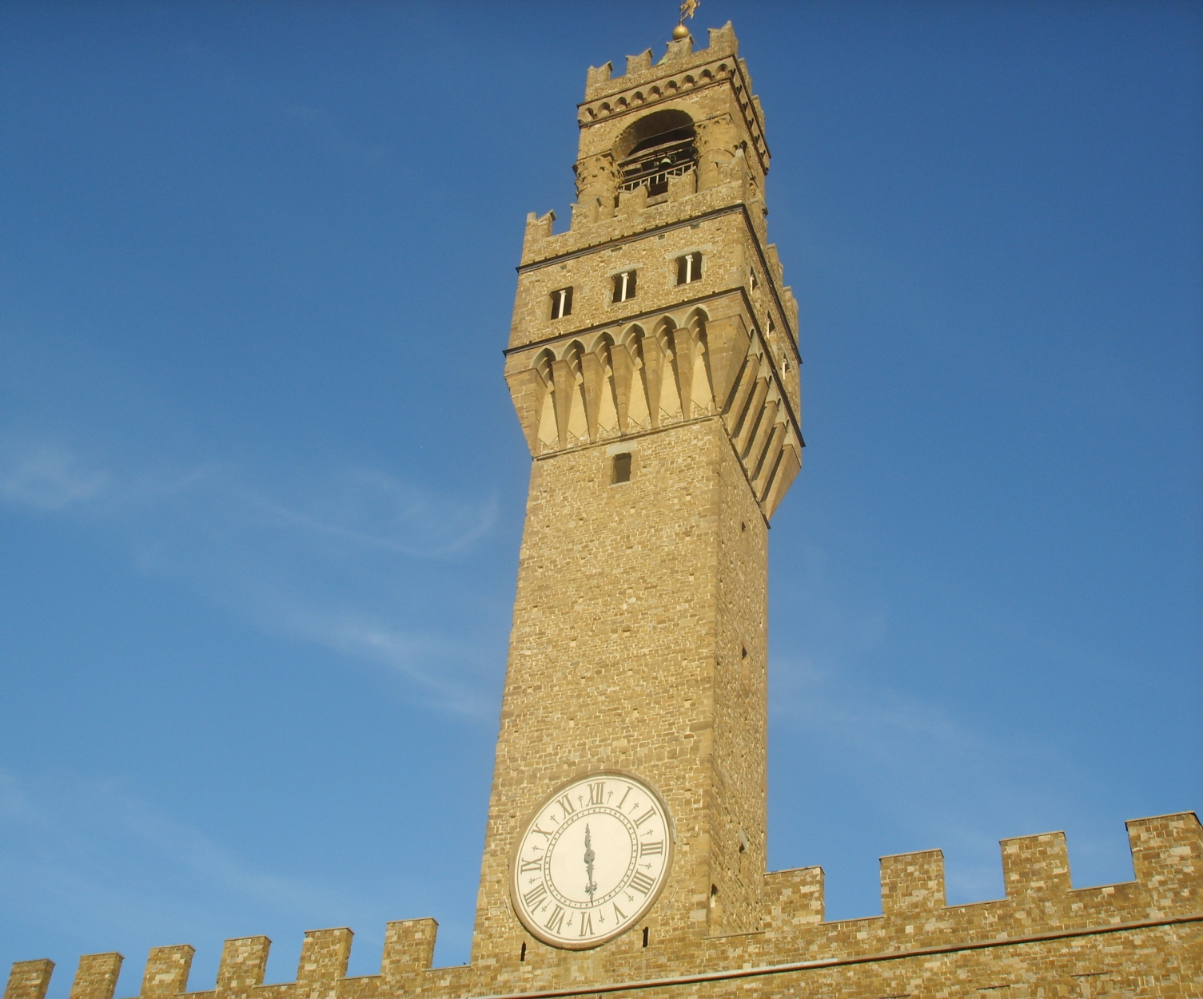
Picture 2 – Palacio Vecchio, Florence
Notes:
Images: © Sailko, CC BY-SA 3.0 <http://creativecommons.org/licenses/by-sa/3.0/>, via Wikimedia Commons
https://commons.wikimedia.org/wiki/File:Palazzo_vecchio,_torre_di_arnolfo.JPG

Slide 7
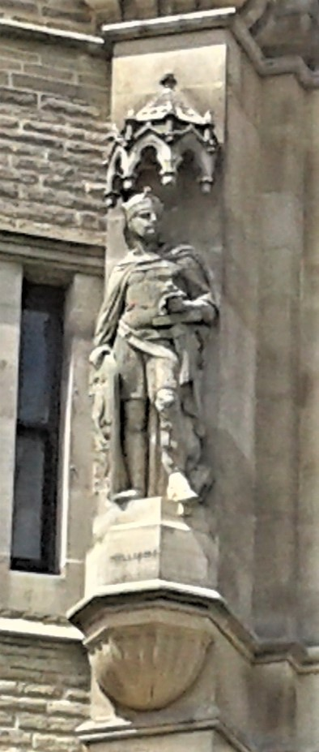
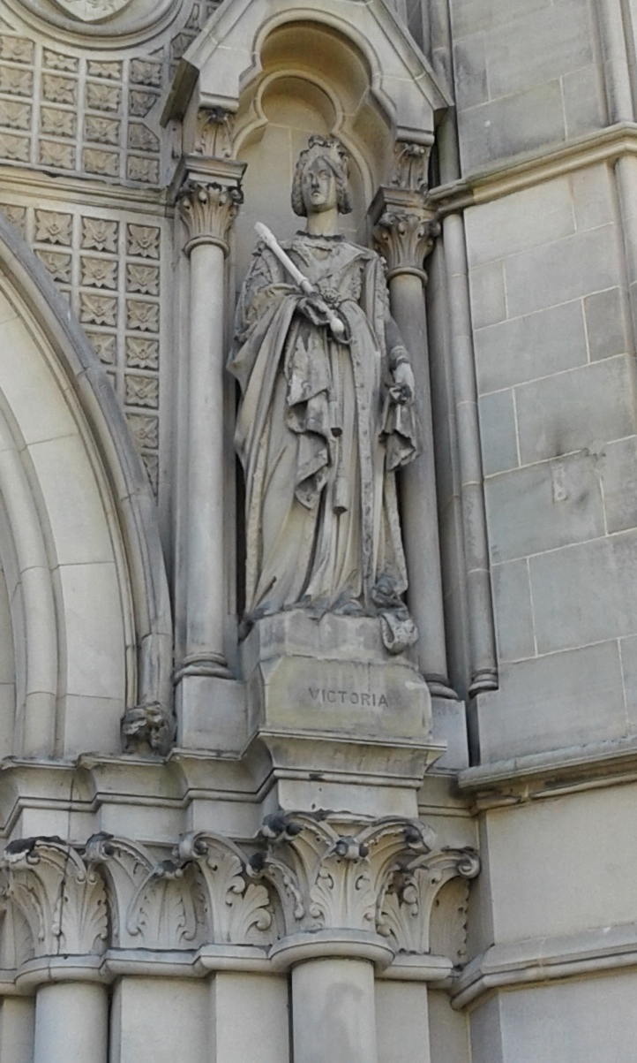
Picture 3 – Statues on City Hall, Bradford
Notes:
Images: © Irene Lofthouse

Slide 8
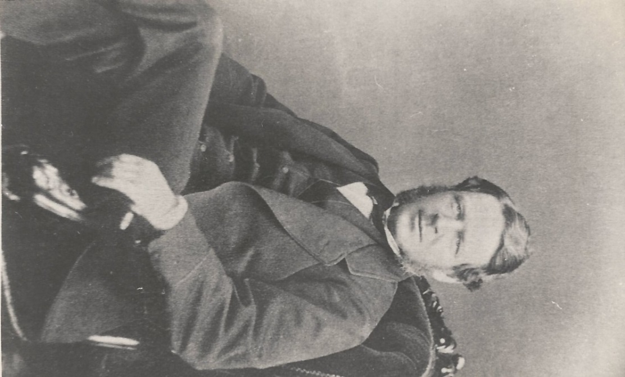
Picture 4 – Lord Mayor Thompson
Notes:
Image: © 2012 - 2020 Aireborough Historical Society
https://www.aireboroughhistoricalsociety.co.uk/yeadon/mathew-william-thompson.aspx

Slide 9
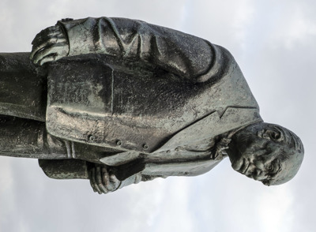
Picture 5 – Winston Churchill
Notes:
Images: © Historic England Archive Ref:DP164321, Taken: 5 Nov 2014
https://historicengland.org.uk/images-books/photos/item/DP164321
https://thumbs.smartframe.io/27025fea9afa38753501b02dbd8a40f2/2a7c2805fec9d52977318676a52e4501/dp164321.jpg

Slide 10
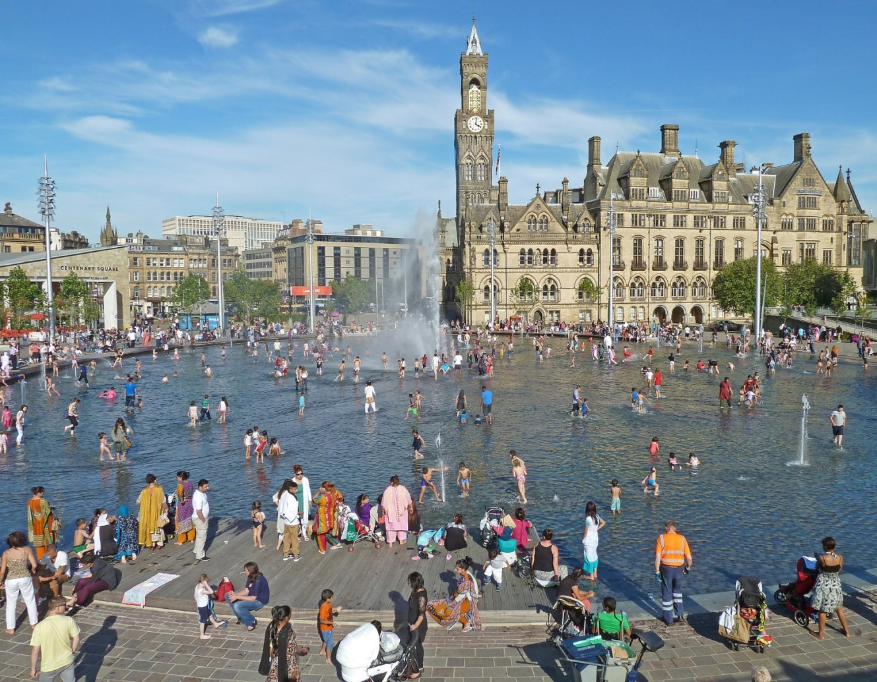
Picture 6 – City Park and Mirror Pool, Bradford
Notes:
Images: © Historic England Archive Ref:DP164321, Taken: 5 Nov 2014
https://historicengland.org.uk/images-books/photos/item/DP164321
https://thumbs.smartframe.io/27025fea9afa38753501b02dbd8a40f2/2a7c2805fec9d52977318676a52e4501/dp164321.jpg

Slide 11
TASK: City Hall Re-cap 1
1. What was the clock tower inspired by?
2. Who can be a Lord Mayor?
3. How many statues are there on City Hall?
15 25 35
What names and facts can you remember from City Hall?
Here are some questions that you could do in pairs.
Some answers can be written in your own words.
Some questions need factual answers.
Pairs
Notes:
Answers: 1. Palazzo Vecchio, 2. Anyone can be Lord Mayor , 3. 35,

Slide 12
TASK: City Hall Re-cap 2
4. Name two TV shows which have been filmed there:
a)
b)
5. Where can you find fountains nearby?
6. How old is City Hall? (2024)
151 years 121 years 111 years
Notes:
Answers: 4a. Emmerdale, 4b. Coronation Street, 5. Mirror Pool , 6. 151

Slide 13
TASK: City Hall Re-cap 3
7. What is the name of someone who designs buildings?
8. Of the thirteen bells, one is very heavy. What weight is it?
7 tons 17 tons 27 tons
9. Where was the stone for the statues quarried?
a) Bolton Quarries
b) Cliff Wood Quarries
c) Canal Road Quarries
Notes:
Answers: 7. Architect , 8. 17, 9. b

Slide 14
City Hall Re-cap
1. What was the clock tower inspired by?
2. Who cab be a Lord Mayor do?
3. How many statues are there on City Hall?
15 25 35
4. Name two TV shows which have been filmed there:
a)
b)
5. Where can you find fountains nearby?
6. How old is City Hall? (2024)
151 years 121 years 111 years
7. What is the name of someone who designs buildings?
8. Of the thirteen bells, one is very heavy. What weight is it?
7 tons 17 tons 27 tons
9. Where was the stone for the statues quarried?
a) Bolton Quarries
b) Cliff Wood Quarries
c) Canal Road Quarries
Notes:
Answers: 1. Palazzo Vecchio, 2. Anyone can be Lord Mayor , 3. 35, 4a. Emmerdale, 4b. Coronation Street, 5. Mirror Pool , 6. 151, 7. Architect , 8. b, 9. b

Slide 15
Scene 2
Alhambra Theatre

Slide 16
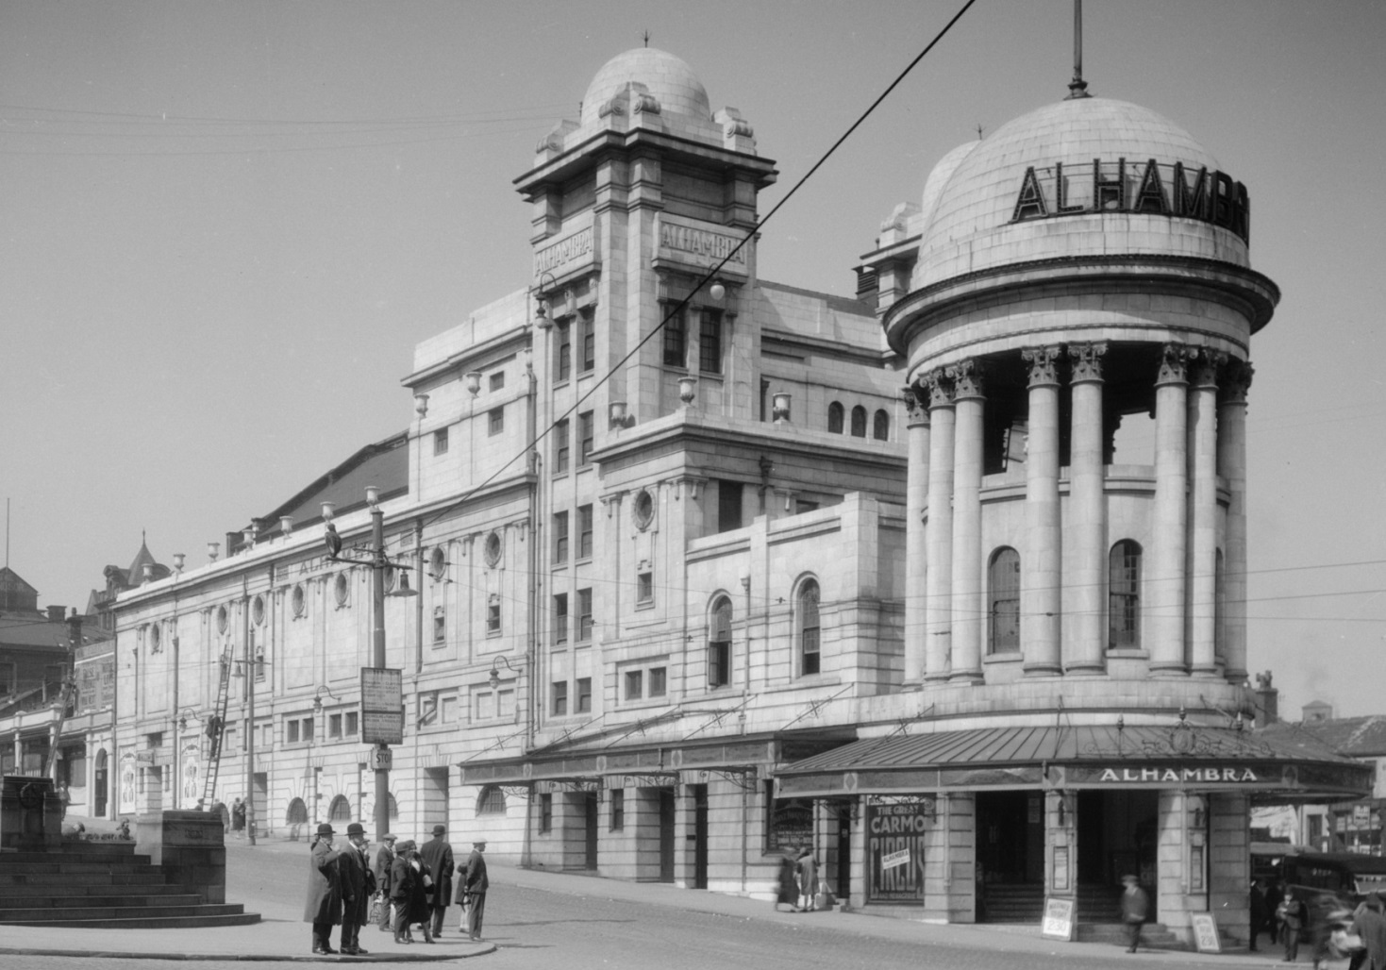
Picture 7 – The Alhambra, Bradford
Notes:
Images: © Historic England Archive Ref:WSA01/01/G0410, Taken: 1925-1950
https://historicengland.org.uk/images-books/photos/item/WSA01/01/G0410
Images: © Historic England Archive Ref:BL00866, Taken: 1875
https://historicengland.org.uk/images-books/photos/item/BL00866

Slide 17
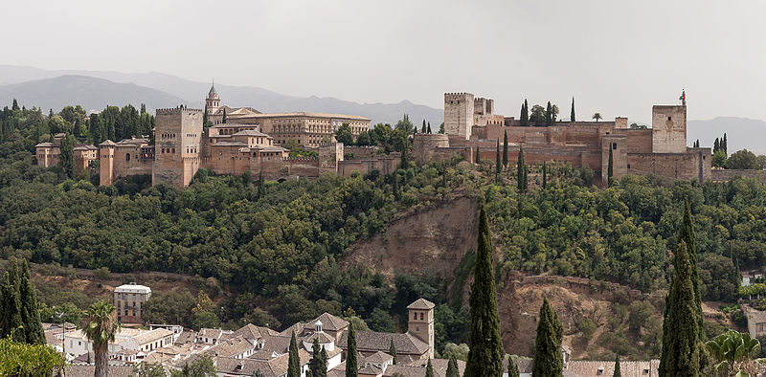
Picture 8 – The Alhambra, Spain
Notes:
Images: © Mgimelfarb, CC BY-SA 4.0 <https://creativecommons.org/licenses/by-sa/4.0>, via Wikimedia Commons
https://commons.wikimedia.org/wiki/File:Alhambra_Granada_Spain.jpg

Slide 18
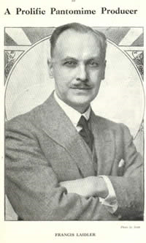
Picture 9 – Francis Laidler
Notes:
Images: Source: http://its-behind-you.com/francislaidler.html

Slide 19
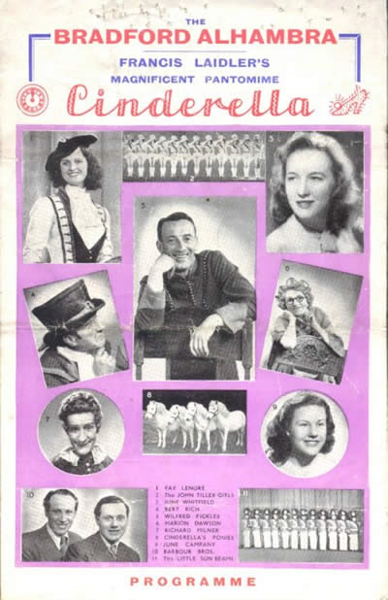
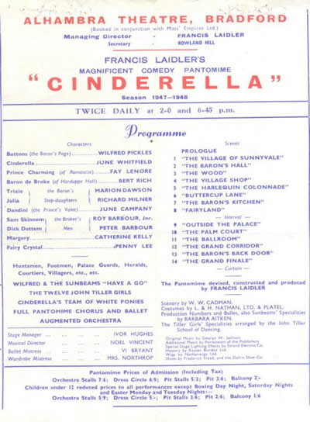
Picture 10 – Past Panto Programme
Notes:
Images: Source: http://its-behind-you.com/francislaidler.html

Slide 20
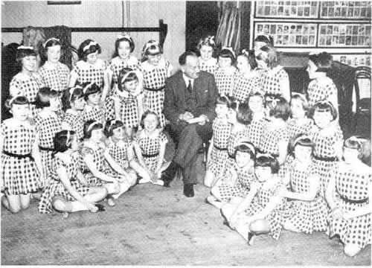
Picture 11 – Sunbeams
Notes:
http://www.its-behind-you.com/images/IBYSunbeam.jpg
Images: Source: http://www.its-behind-you.com/chorus.html

Slide 21
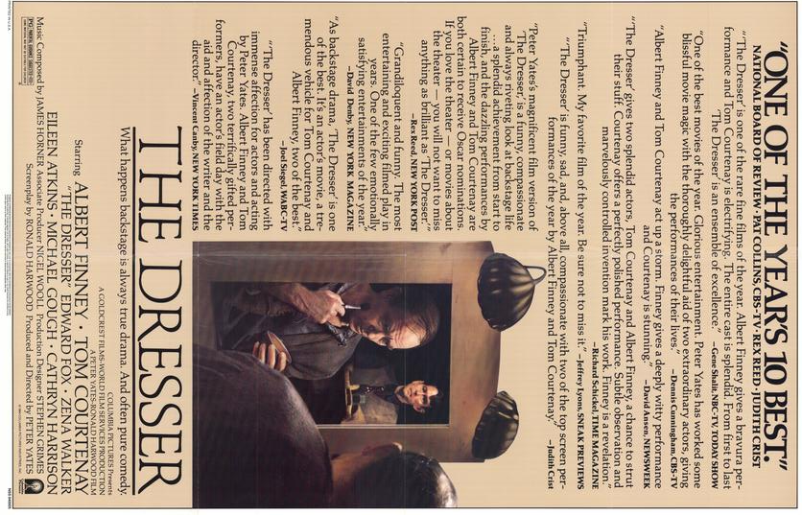
Picture 12 – The Dresser
Notes:
Images: https://www.joblo.com/movie-posters/1983/the-dresser/image-25423

Slide 22
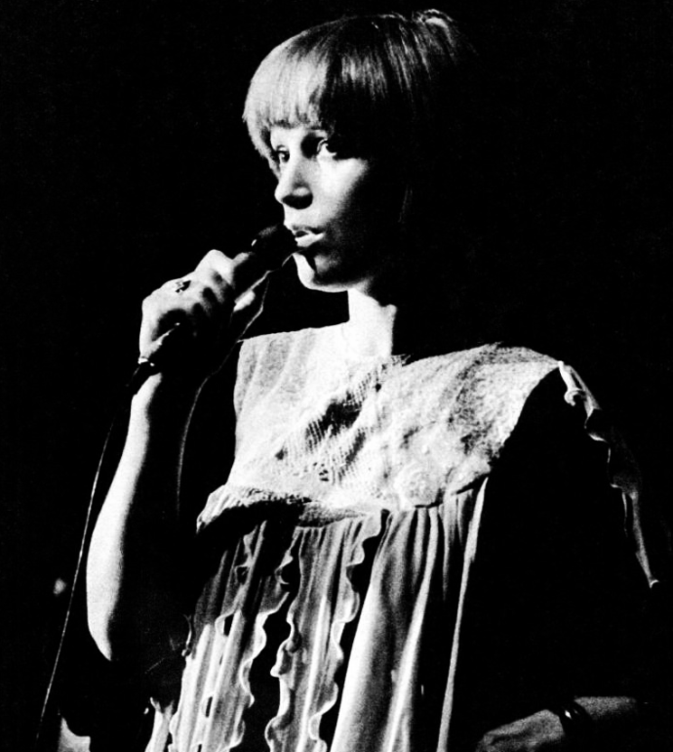
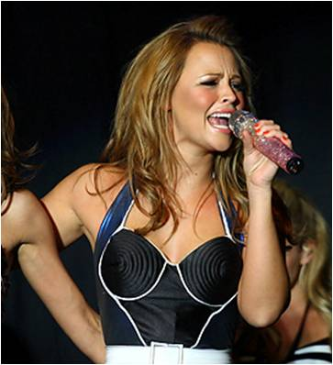
Picture 13 – Bradford Singers
Kimberley Walsh
Kiki Dee
Notes:
Images: Image: © SATURDAYmight., CC BY 3.0 <https://creativecommons.org/licenses/by/3.0>, via Wikimedia Commons https://commons.wikimedia.org/wiki/File:Kimberley_Walsh_2008.jpg
© MCA Records, Public domain, via Wikimedia Commons https://commons.wikimedia.org/wiki/File:Kiki_Dee_(1974).png

Slide 23
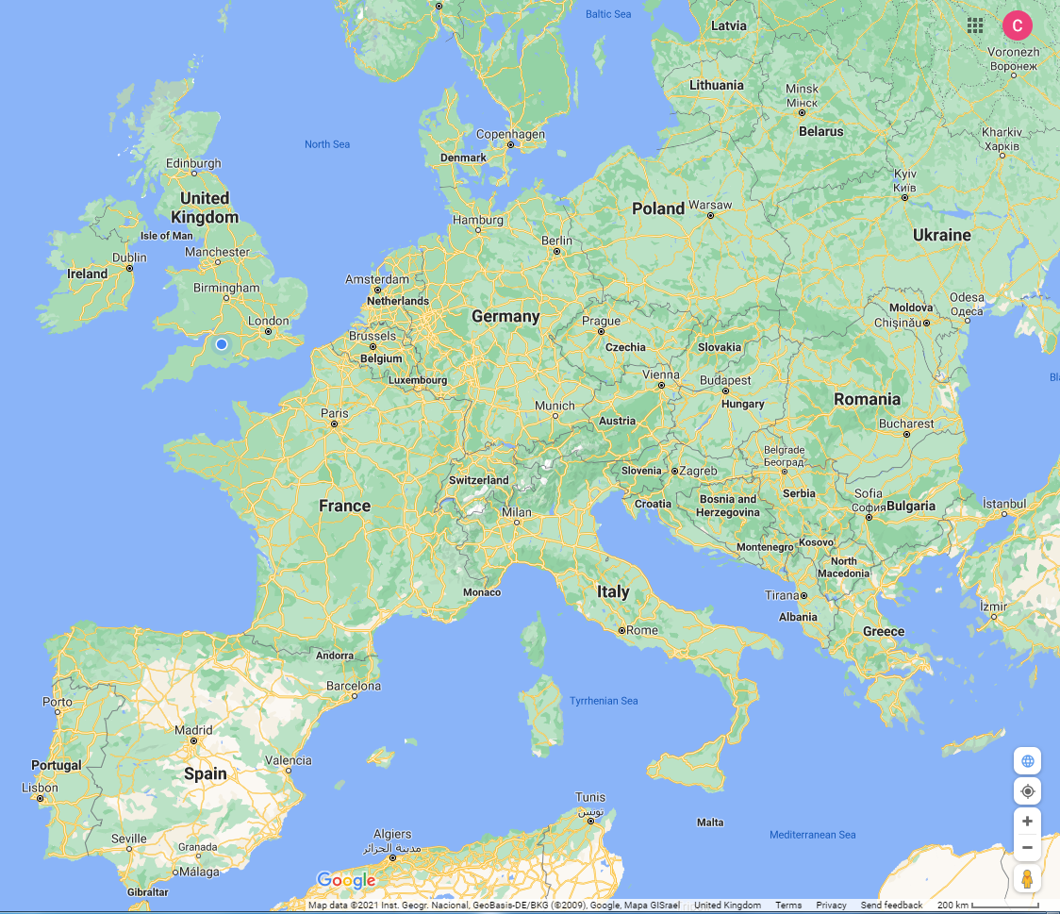
TASK: Alhambra Re-cap 1
Use an online map to find Spain. Then find Granada.
Circle it, like this:
This is where the palace that gave it’s name to the Alhambra Theatre can be visited.
Then find Bradford and circle it too.
Now draw a line to connect them.

Slide 24
TASK: Alhambra Re-cap 2
Who and what can you remember from The Alhambra?
Can you match the names and statements together?
Here’s an example:
Mr Chadwick Architect
Now have a go at the list on the next slide.

Slide 25
TASK: Alhambra Re-cap –Match the name
Name Statement
Mr Laidler Music Hall song
Sunbeams A singer from Bradford
Mr Watson A city in Spain
Kiki Dee First opened in 1980s
‘Moving pictures’ Cost £20, 000
Alhambra Theatre Architect
Billy Pearce Owner of the Alhambra Theatre
Henery the Eighth Is in many Pantos
Granada Dance and sing
Science Museum First shown 1914

Slide 26
Alhambra Re-cap
Find and circle Grenada on the map.
Put a dot roughly where Bradford is and draw a line between Bradford and Grenada.
Who and what can you remember from The Alhambra?
Can you match the names and statements together?
Name Statement
Mr Laidler Music Hall song
Sunbeams A singer from Bradford
Mr Watson A city in Spain
Kiki Dee First opened in 1980s
‘Moving pictures’ Cost £20, 000
Alhambra Theatre Architect
Billy Pearce Owner of the Alhambra Theatre
Henery the Eighth Is in many Pantos
Granada Dance and sing
Science Museum First shown 1914

Slide 27
TASK: Alhambra Re-cap answers
Name Correct statement
Mr Laidler Owner of the Alhambra Theatre
Sunbeams Dance and sing
Mr Watson Architect
Kiki Dee A singer from Bradford
‘Moving pictures’ First shown 1914
Alhambra Theatre Cost £20, 000
Billy Pearce Is in many Pantos
Henery the Eighth Music Hall song
Granada A city in Spain
Science Museum First opened in 1980s

Slide 28
Scene 3
The Midland Hotel

Slide 29
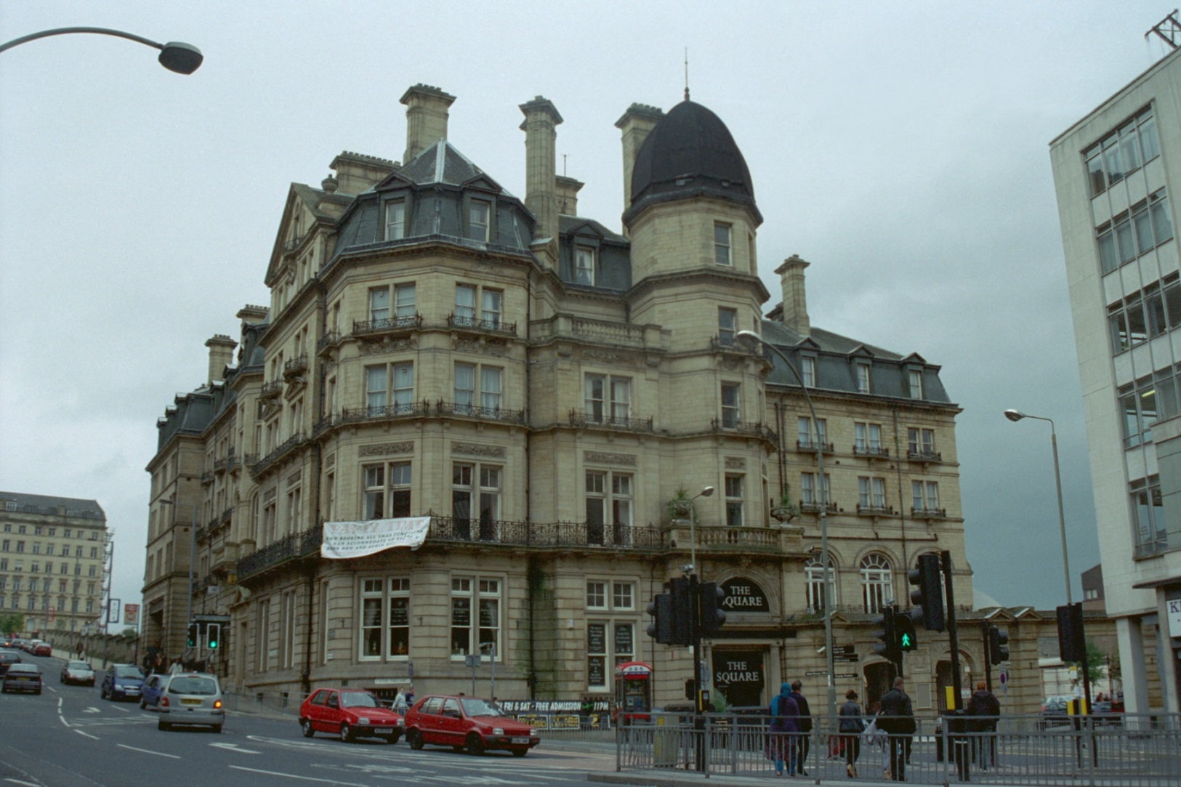
Picture 14 – Midland Hotel
Notes:
Images: © IoE Mr Martin Palliser. Source Historic England Archive Ref:IOE01/05665/29, Taken: 25 Oct 2001
https://historicengland.org.uk/images-books/photos/item/IOE01/05665/29

Slide 30
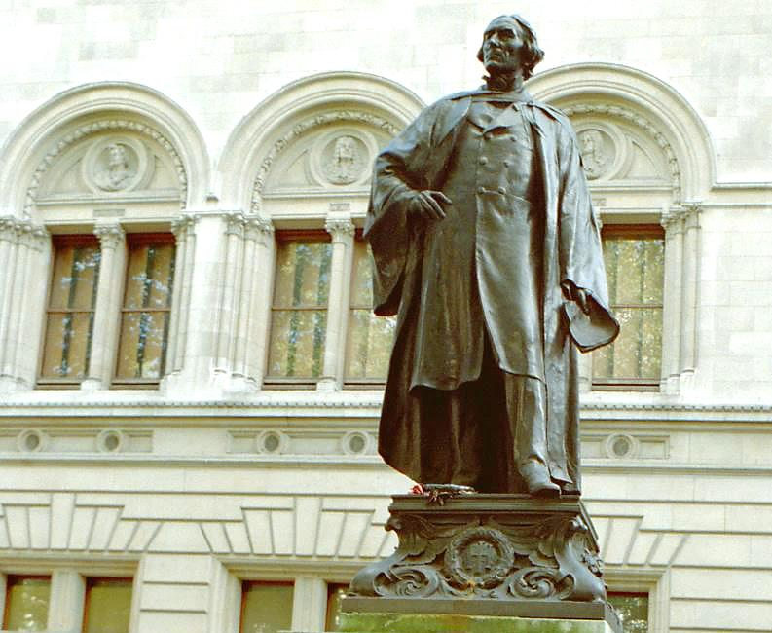
Picture 15 – Henry Irving
Notes:
Images: © IoE Mrs Marion Davies. Source Historic England Archive Ref:IOE01/02577/20, Taken: 17 Oct 2000
https://historicengland.org.uk/images-books/photos/item/IOE01/02577/20

Slide 31
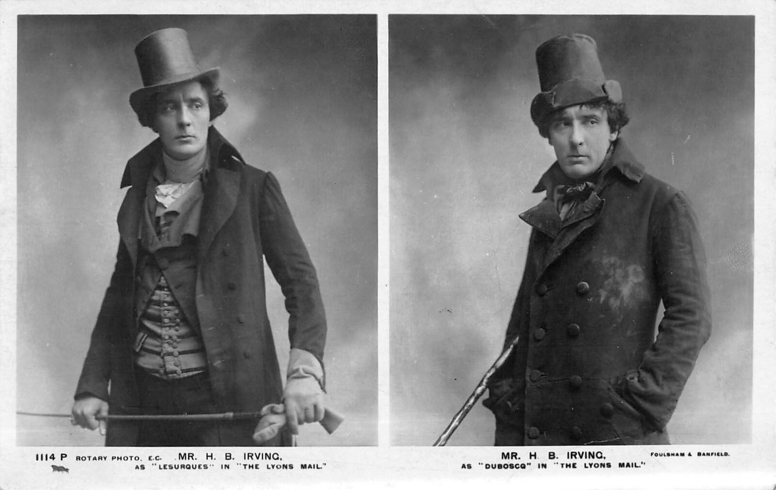
Picture 16 – Henry Irving
Notes:
Images: © Foulsham & Banfield (1906), Public domain, via Wikimedia Commons
https://commons.wikimedia.org/wiki/File:H_B_Irving_Lyons_Mail.jpg

Slide 32
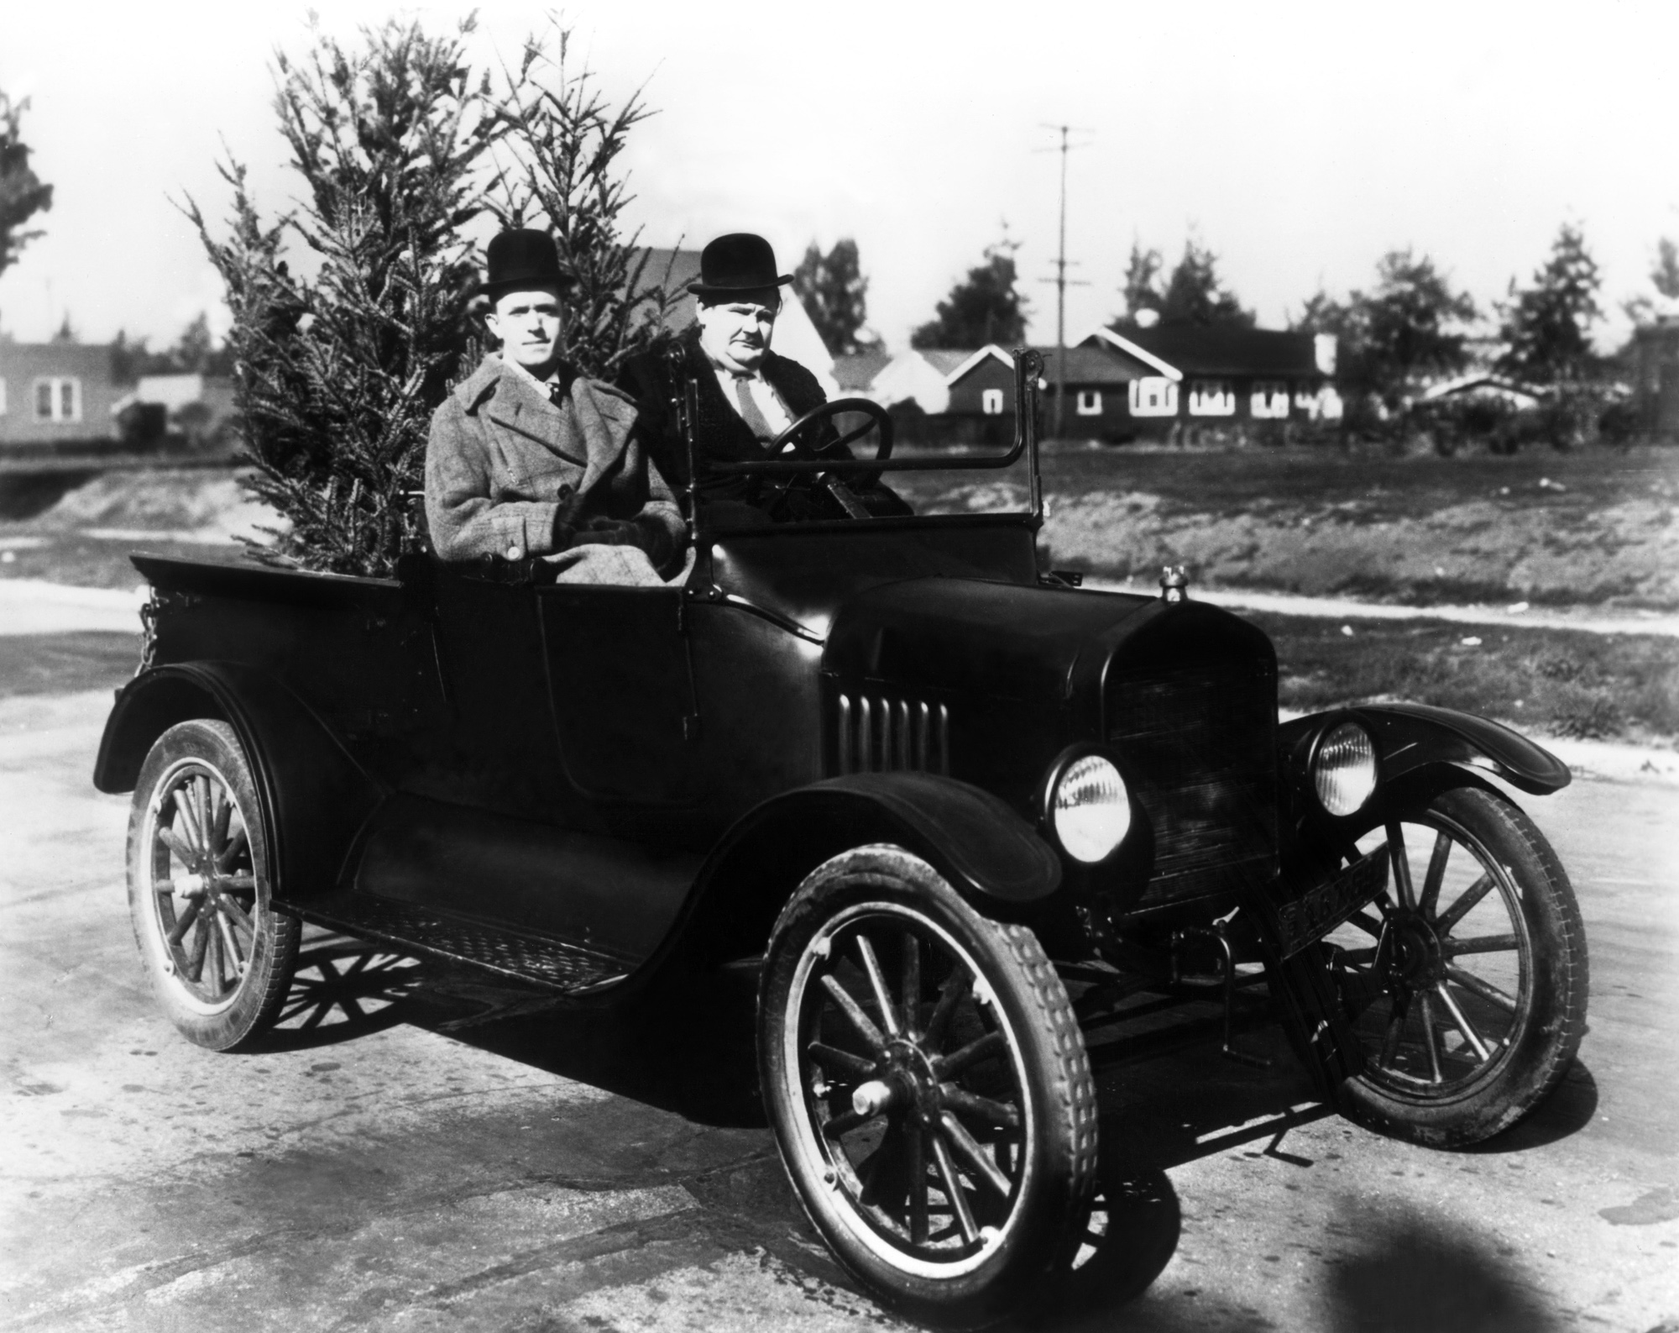
Picture 17 – Laurel and Hardy
Notes:
Images: Insomnia Cured Here, CC BY-SA 2.0 <https://creativecommons.org/licenses/by-sa/2.0>, via Wikimedia Commons https://commons.wikimedia.org/wiki/File:Laurel_%26_Hardy_in_Big_Business_(1929).jpg

Slide 33
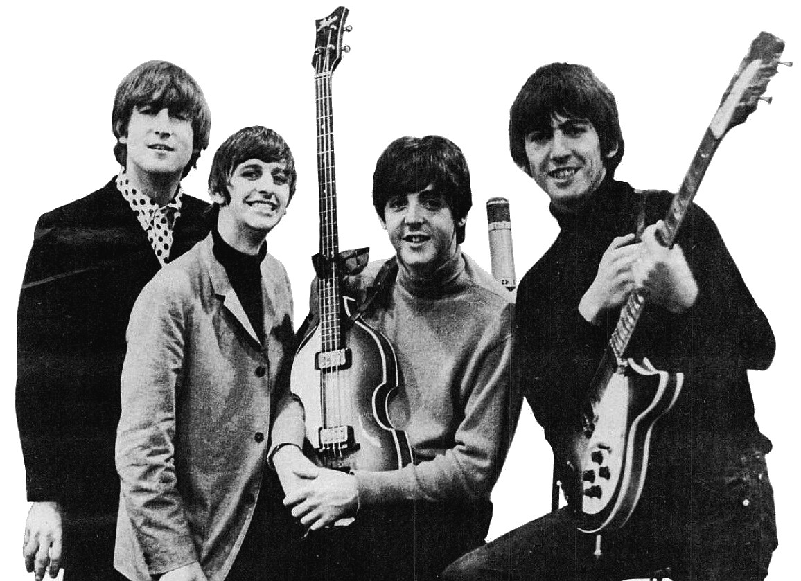
Picture 18 – The Beatles
Notes:
Images: EMI., Public domain, via Wikimedia Commons
https://commons.wikimedia.org/wiki/File:Beatles_ad_1965_just_the_beatles_crop.jpg

Slide 34
Scene 4
Bradford Playhouse

Slide 35
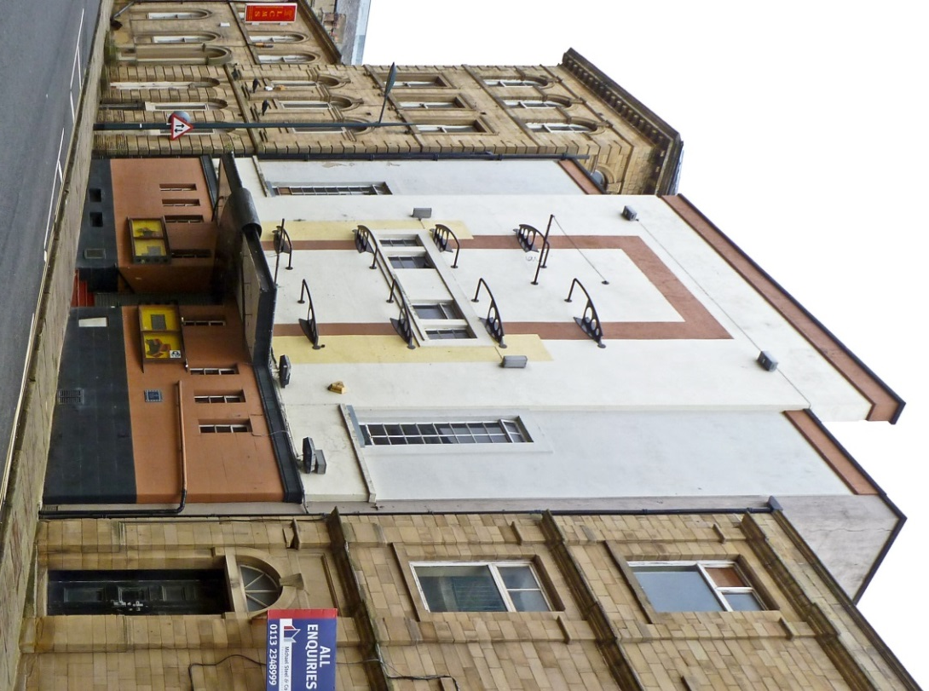
Picture 19 – Bradford Playhouse
Notes:
Image: © Tim Green from Bradford, CC BY 2.0 <https://creativecommons.org/licenses/by/2.0>, via Wikimedia Commons https://commons.wikimedia.org/wiki/File:Bradford_Playhouse_(7222490672).jpg

Slide 36
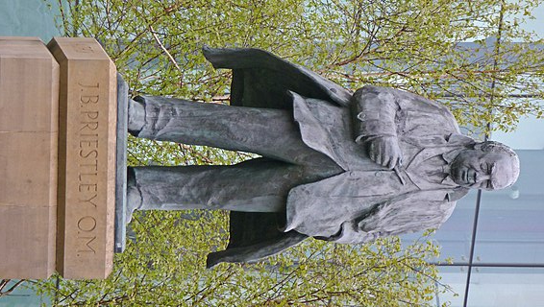
Picture 20 – JB Priestley
Notes:
Image: © Tim Green from Bradford, CC BY 2.0 <https://creativecommons.org/licenses/by/2.0>, via Wikimedia Commons
https://commons.wikimedia.org/wiki/File:Statue_of_JB_Priestley_in_Bradford.jpg

Slide 37
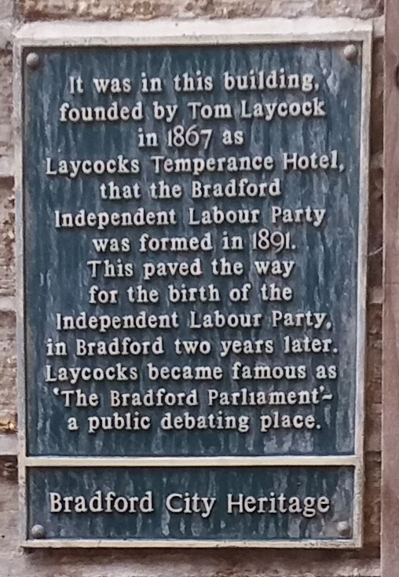
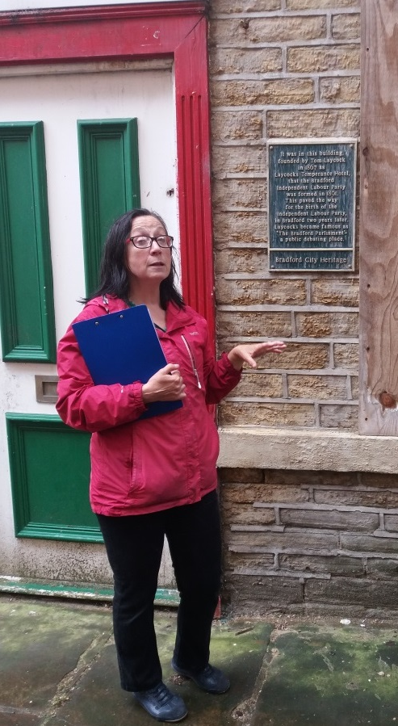
Picture 21 – Plaque for Independent Labour Party
Notes:
Images: © Irene Lofthouse

Slide 38
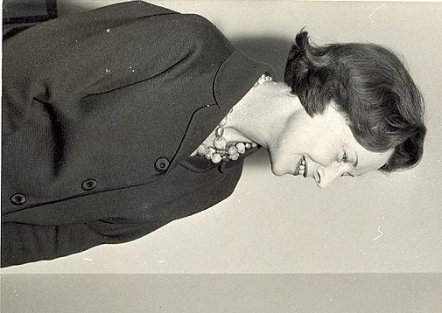
Picture 22 – Barbara Castle
Notes:
Image: © National Archives of Malawi, CC BY-SA 4.0 <https://creativecommons.org/licenses/by-sa/4.0>, via Wikimedia Commons https://commons.wikimedia.org/wiki/File:Mme_Barbara_Castle,_Ministre_britannique_du_d%C3%A9veloppement_outre-mer.jpg

Slide 39
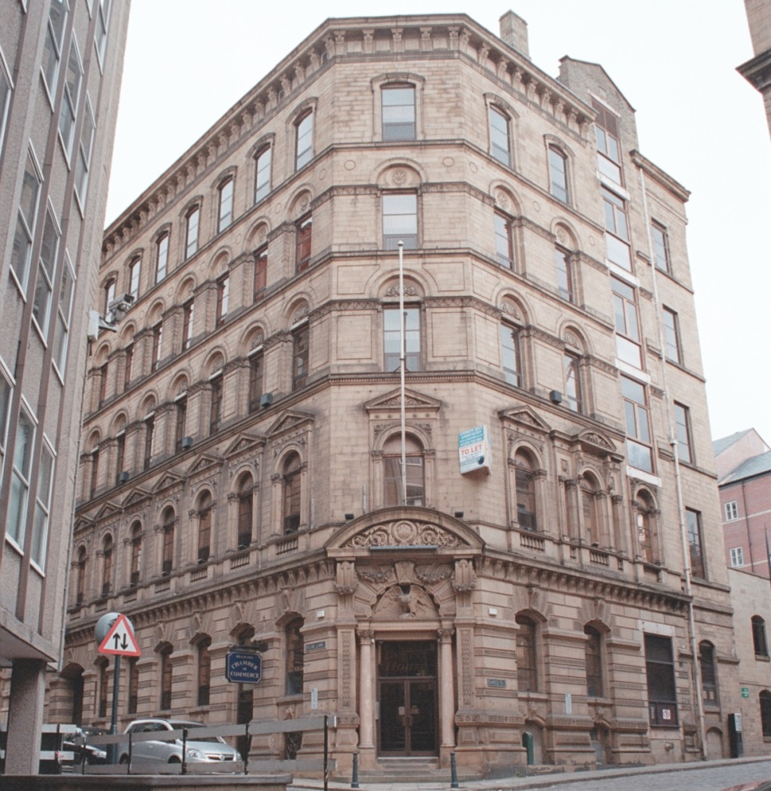
Picture 23 – Little Germany
Notes:
Image: © IoE Mr Nigel Wood. Source Historic England Archive Ref: IOE01/16978/04, Taken: 1 Nov 2007
https://historicengland.org.uk/images-books/photos/item/IOE01/16978/04

Slide 40
Scene 5
Wool Exchange and Salts Mill

Slide 41
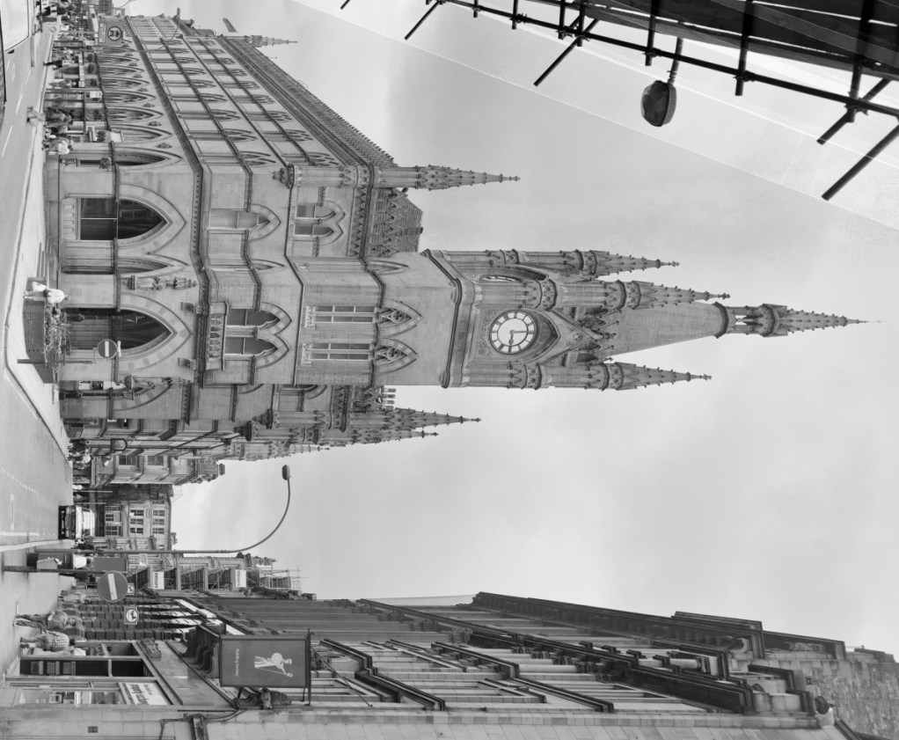
Picture 24 – The Wool Exchange
Notes:
Image: © Crown Copyright. Historic England Archive Ref: BB89/01721, Taken: Aug 1988
https://historicengland.org.uk/images-books/photos/item/BB89/01721

Slide 42
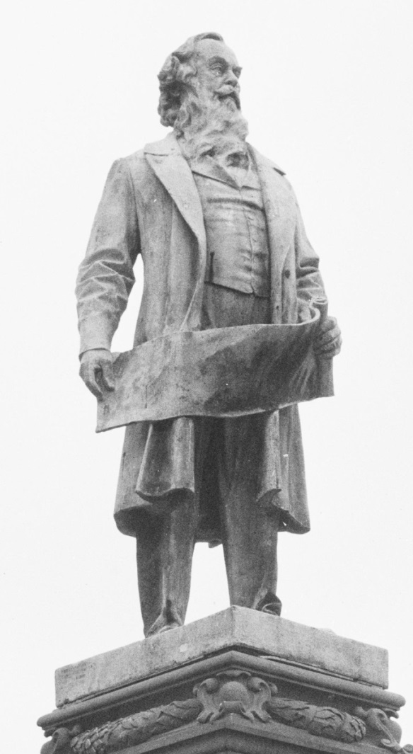
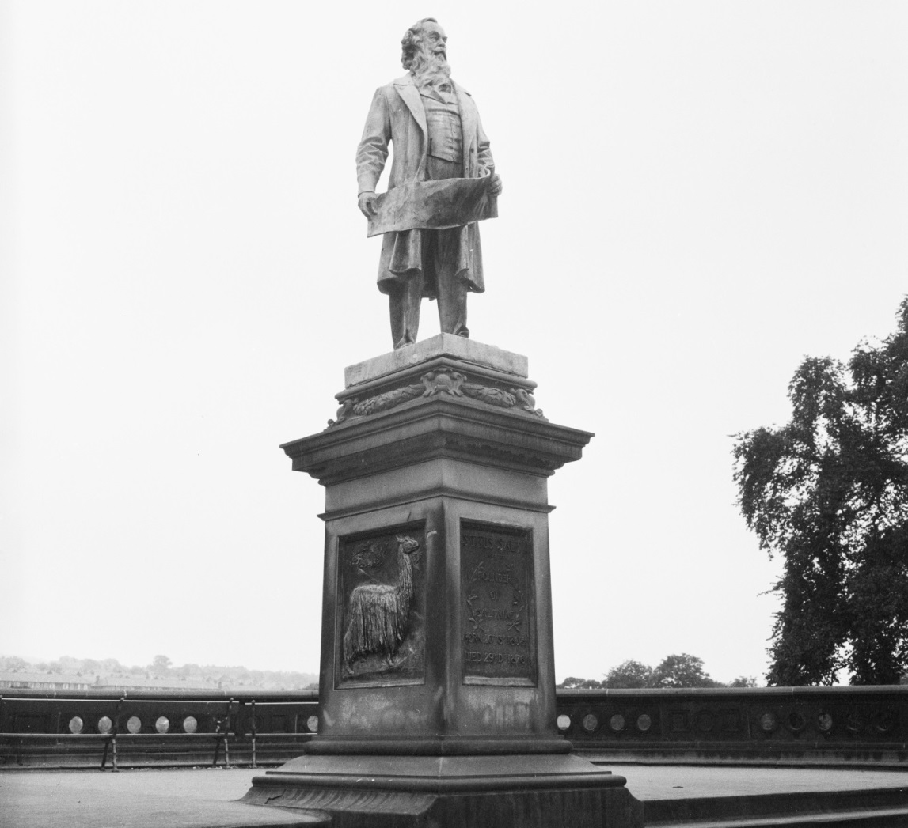
Picture 25 – Titus Salt
Notes:
Image: © Historic England Archive Ref: DES01/01/0589, Taken: 1966 – 1974
https://historicengland.org.uk/images-books/photos/item/DES01/01/0589

Slide 43
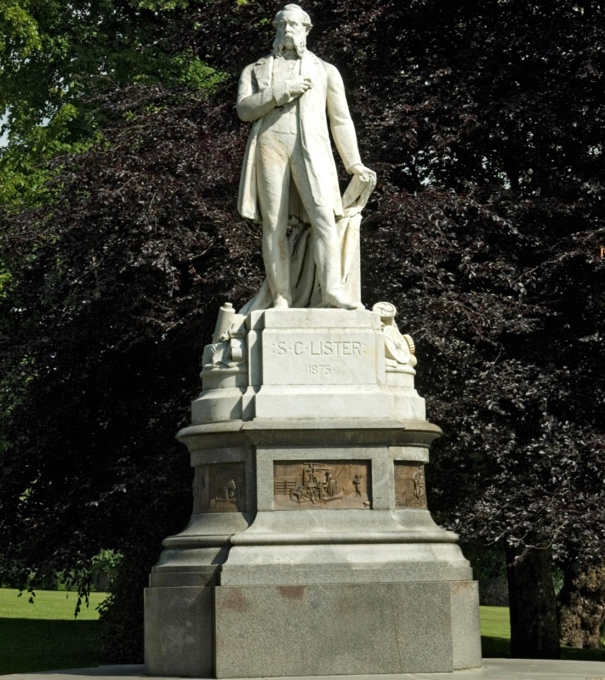
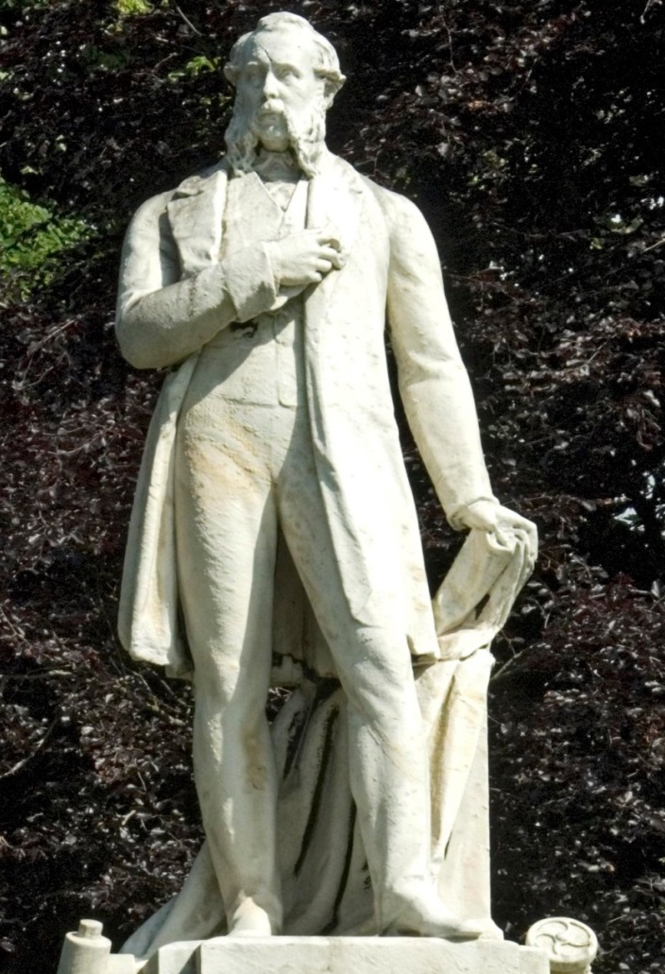
Picture 26 – Samuel Lister
Notes:
Image: © Historic England Archive Ref: DP071607, Taken: 11 Jun 2009
https://historicengland.org.uk/images-books/photos/item/DP071607

Slide 44
Picture 27 – Saltaire
Notes:
Image: © Historic England Archive Ref: DP071607, Taken: 11 Jun 2009
https://historicengland.org.uk/images-books/photos/item/DP071607

Slide 45
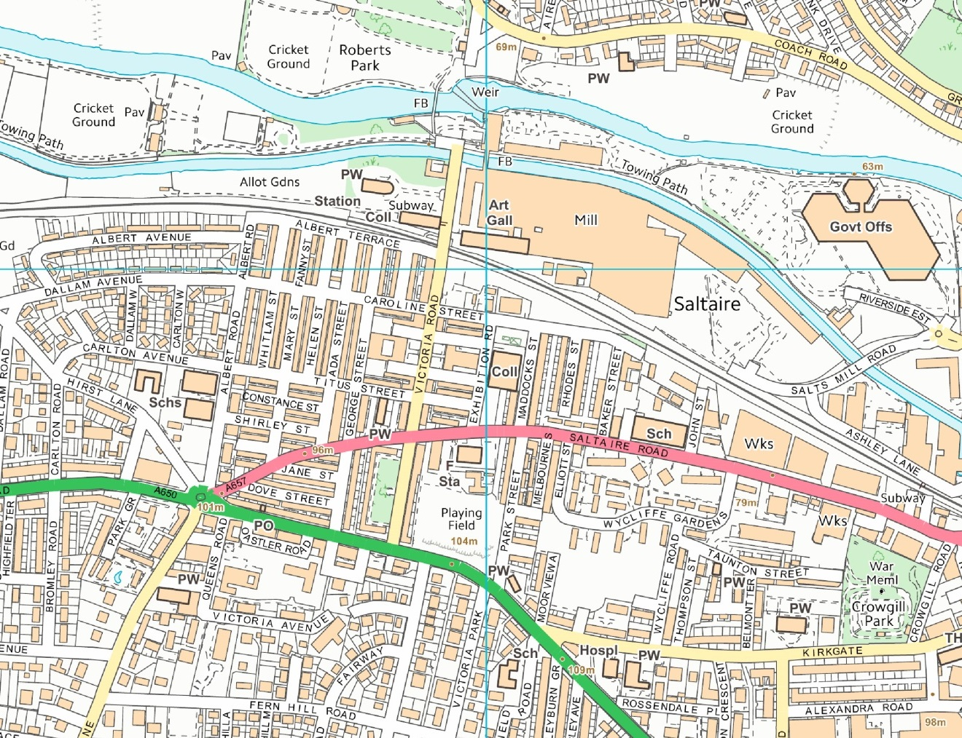
Picture 28 – Modern Map of Saltaire
Notes:
Image: © Crown Copyright and database right 2020. Supplied by Historic England under Ordnance Survey Licence number 100024900

Slide 46
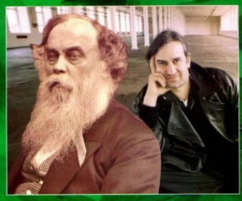
Picture 29 – Jonathan Silver
Notes:
Image: Permission to use the screen shot of book ‘Salt and Silver’ given by Zoe Silver

Slide 47
Scene 6
Manningham Lane and Drummond Mill

Slide 48
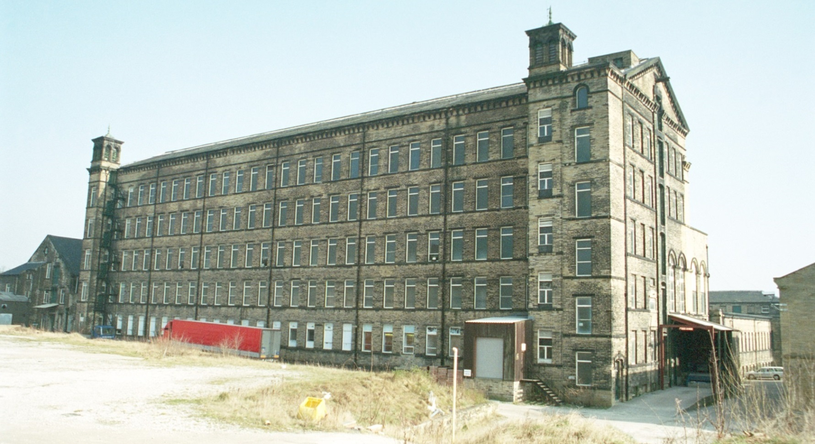
Picture 30 – Drummond Mill
Notes:
Image: © IoE Mr J A Lowes. Source Historic England Archive Ref: IOE01/10234/06 Taken: 16 Mar 2003
https://historicengland.org.uk/images-books/photos/item/IOE01/10234/06

Slide 49
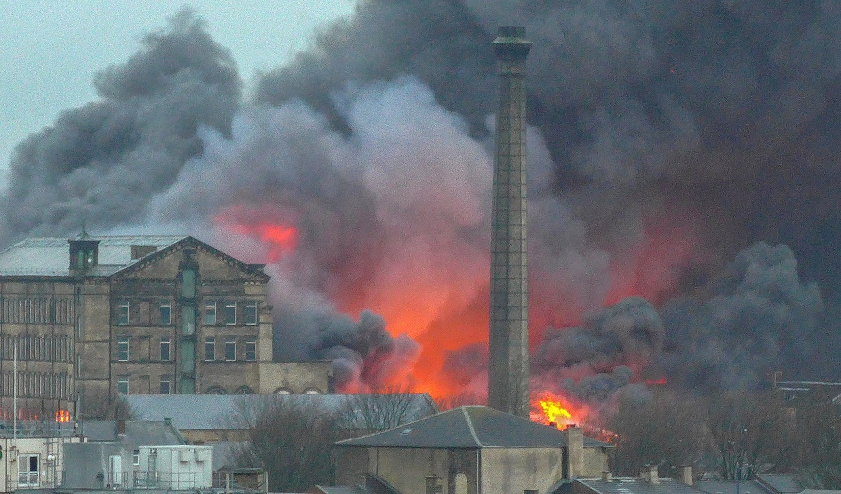
Picture 31 – Drummond Mill
Notes:
Image: © Tim Green from Bradford, CC BY 2.0 <https://creativecommons.org/licenses/by/2.0>, via Wikimedia Commons https://commons.wikimedia.org/wiki/File:Drummond_Mill_Fire_(24306234169).jpg

Slide 50
Scene 7
Sport

Slide 51
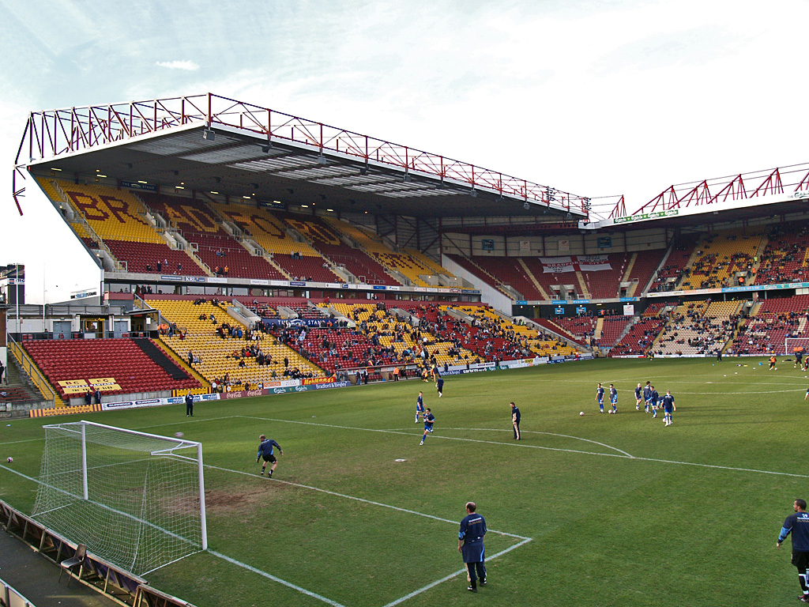
Picture 32 – Valley Parade
Notes:
Image: © David Ingham, CC BY-SA 2.0 <https://creativecommons.org/licenses/by-sa/2.0>, via Wikimedia Commons https://commons.wikimedia.org/wiki/File:Valley_Parade,_Bradford.jpg

Slide 52
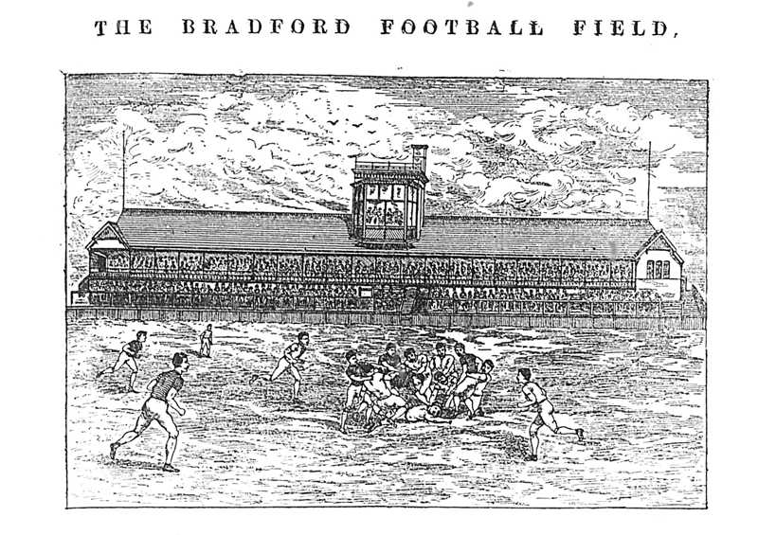
Picture 33 – Bradford Park Avenue
Notes:
Source: http://www.bradfordfc.org.uk/html/park_avenue.html

Slide 53
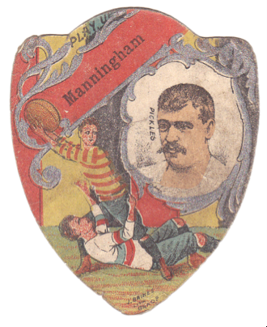
Picture 34 – Manningham FC (Rugby Football)
Notes:
Source: https://www.playingpasts.co.uk/articles/football/the-origins-of-professional-football-in-bradford/

Slide 54
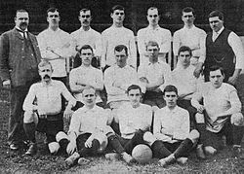
Picture 35 – Bradford City 1903/04
Notes:
Source: https://www.playingpasts.co.uk/articles/football/bradford-city-afc-held-back-by-history/

Slide 55
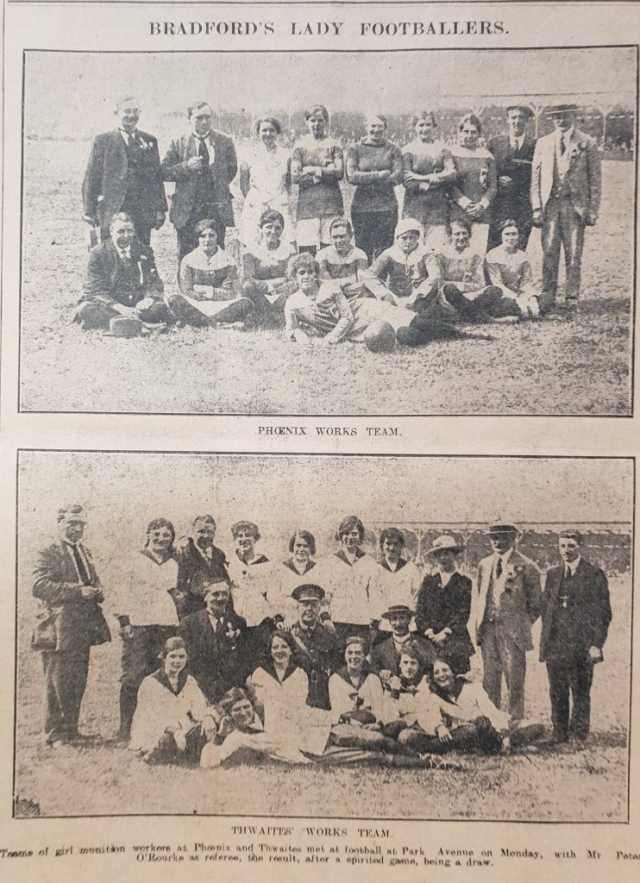
Picture 36 – Female Footballers
Notes:
Source: https://bradfordsporthistory.com/2018/09/24/21-october-2018/

Slide 56
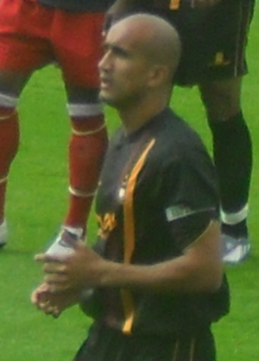
Picture 37 – Bradford Sports People
Zesh Rehman
Notes:
Image: © Mattythewhite, CC BY-SA 3.0 <https://creativecommons.org/licenses/by-sa/3.0>, via Wikimedia Commons https://commons.wikimedia.org/wiki/File:Zesh_Rehman_York_City_v._Bradford_City_1.png

Slide 57
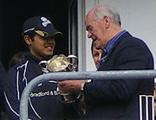
Picture 38 – Bradford Sports People
Brain Close & Azeem Rafeeq
Notes:
Image: © Mdcollins1984, CC BY-SA 3.0 <https://creativecommons.org/licenses/by-sa/3.0>, via Wikimedia Commons
https://commons.wikimedia.org/wiki/File:Azeem_rafiq_and_brian_close.jpg

Slide 58

TASK: Sport Re-cap
1. What was Bradford City’s first name?
a) Manningham RC
b) Manningham CF
c) Manningham FC
2. Where did the women’s teams come from?
a) Hospitals & laundries
b) Breweries & mills
c) Laundries & mills
How much can you remember about Sports in Bradford?
Here are some questions that you could do in pairs.
Some answers can be written in your own words.
Some questions need factual answers.
Group discussion
Notes:
Answers: 1.c, 2. b,

Slide 59
TASK: City Hall Re-cap
3. Who was the first South Asian captain of Bradford City?
a) Zak Rahman b) Zesh Rahimi c) Zesh Rahman
4. Which is the correct nickname for Bradford City?
a) Roosters b) Bantams c) Broilers
5. What sport did Harvey Smith win awards for?
a) Canoeing b) Horse riding c) Cricket
Notes:
Answers: 3. c, 4. b, 5. b

Slide 60
Sport Re-cap
1. What was Bradford City’s first name?
a) Manningham RC
b) Manningham CF
c) Manningham FC
2. Where did the women’s teams come from?
a) Hospitals & laundries
b) Breweries & mills
c) Laundries & mills
3. Who was the first South Asian captain of Bradford City?
a) Zak Rahman
b) Zesh Rahimi
c) Zesh Rahman
4. Which is the correct nickname for Bradford City?
a) Roosters
b) Bantams
c) Broilers
5. What sport did Harvey Smith win awards for?
a) Canoeing
b) Horse Riding
c) Cricket
Notes:
Answers: 1.c, 2. b, 3. c, 4. b, 5. b

Slide 61

More resources
MORE RESOURSCES AT
HistoricEngland.org.uk/Education
contact@historicengland.org.uk

