Slide 1

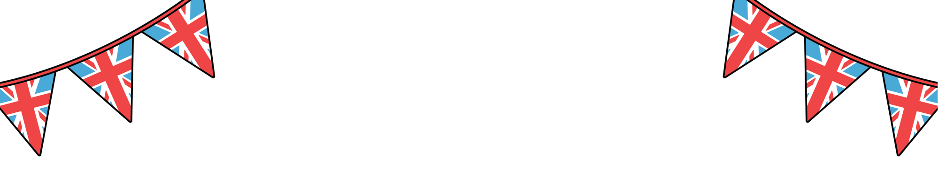
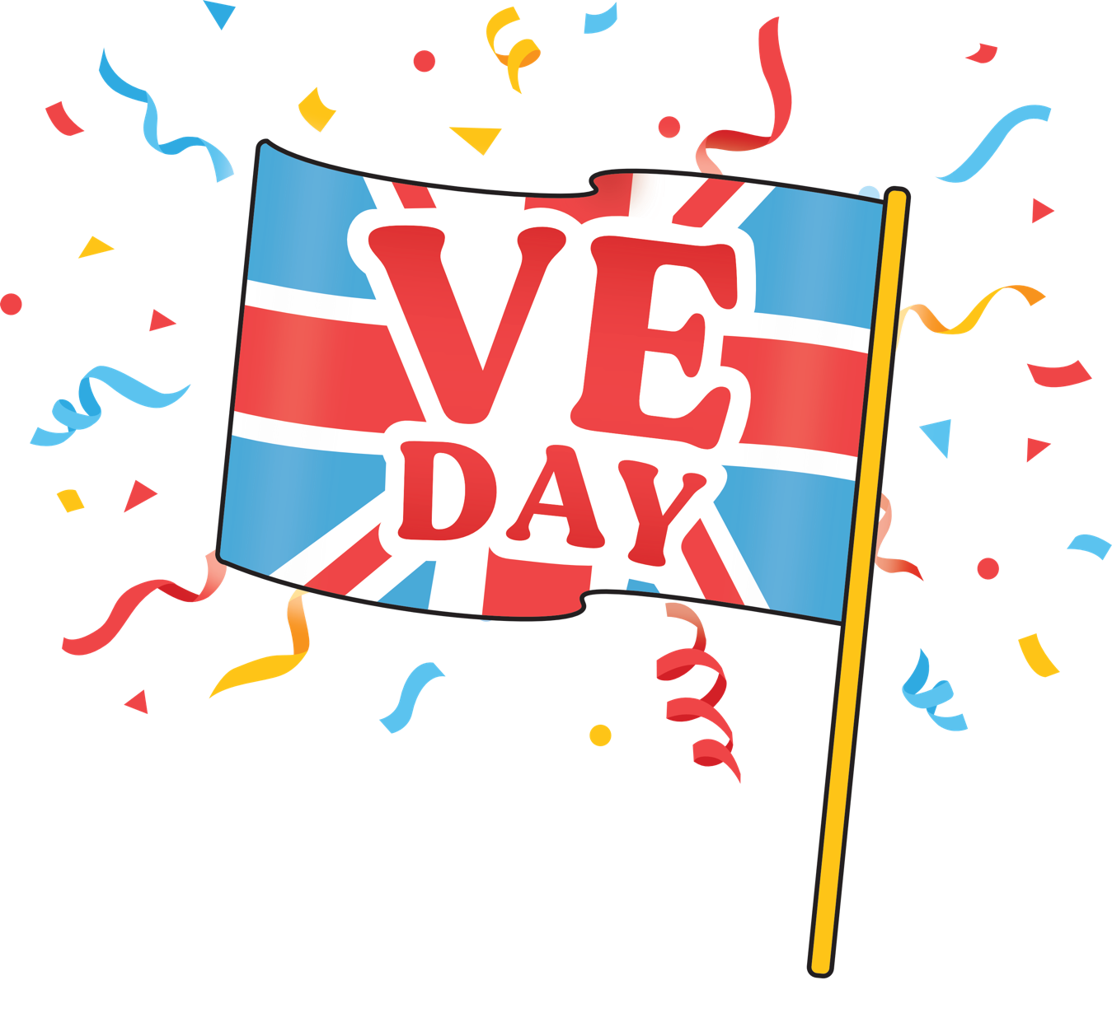

How was VE Day celebrated in Britain and around the world?

Slide 2

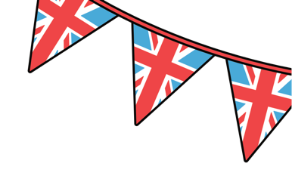
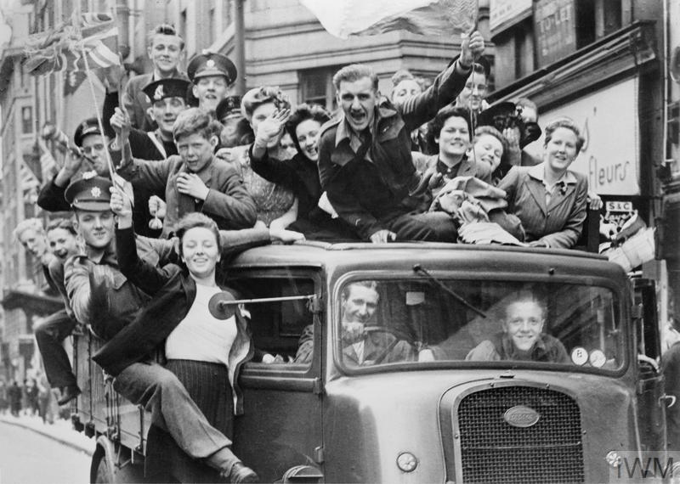
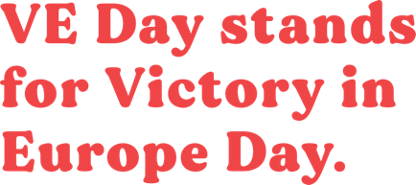
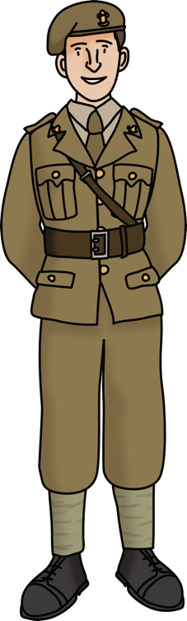
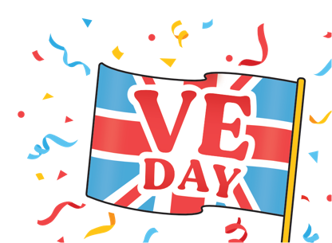
VE Day stands for Victory in Europe Day
© IWM (HU 41808)
It was first celebrated on the 8th of May, 1945 to mark the end of World War 2.

Slide 3

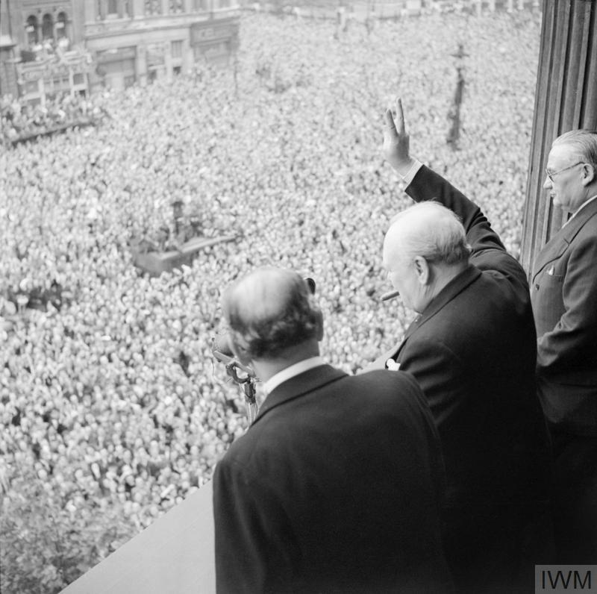
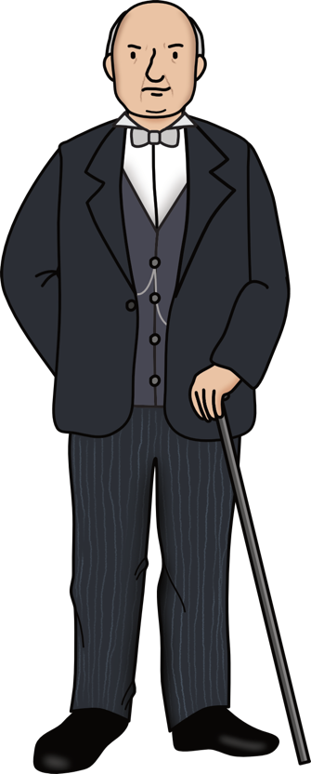
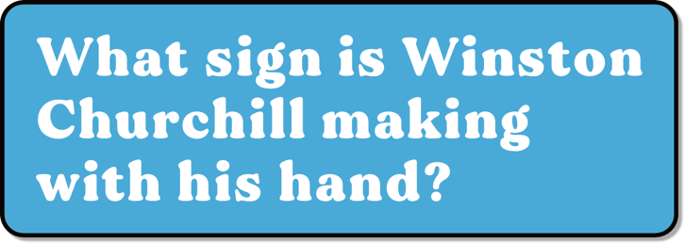
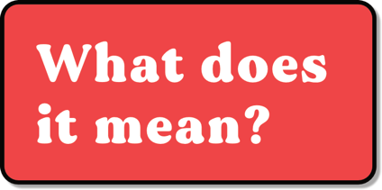
How did people celebrate?
© IWM (H 41849)
Winston Churchill declared a public holiday.
Thousands of people travelled to London to celebrate.
What sign is Winston Churchill making with his hand?

Slide 4

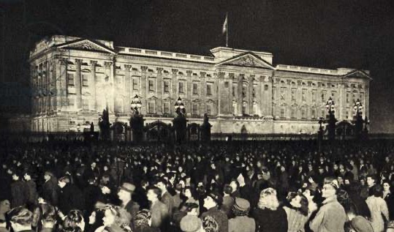

National Celebrations
© Getty
Huge crowds - with lots of people dressed in red, white and blue - gathered outside Buckingham Palace in London.
© Bridgeman
They cheered as King George VI
and his family, including Princess Elizabeth (later queen) and Princess Margaret, came out onto the balcony to greet everybody.

Slide 5
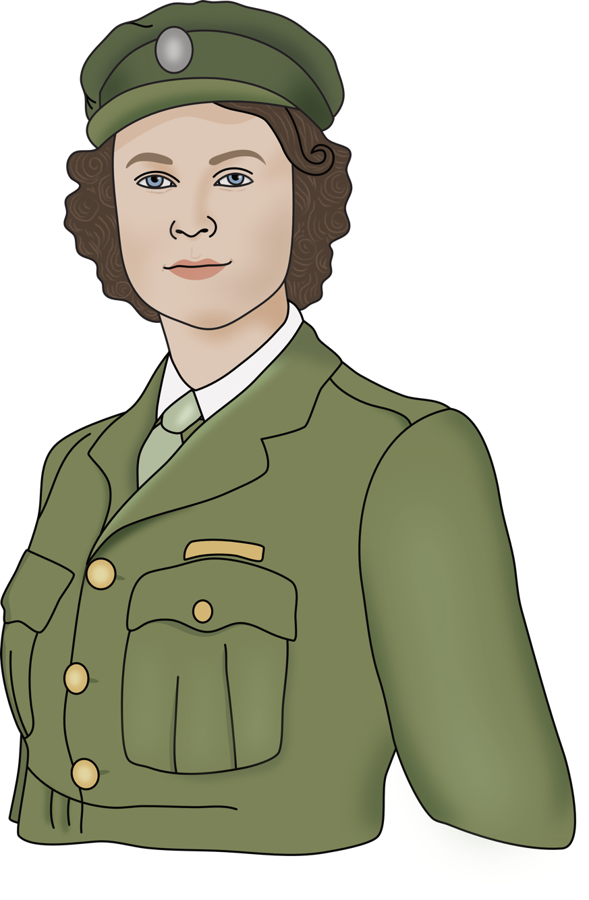
Princess Elizabeth
© Getty
Princess Elizabeth and her sister were allowed to leave the palace and celebrate with crowds outside, although they had to do it secretly.

Slide 6
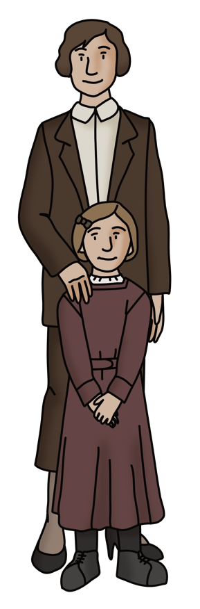
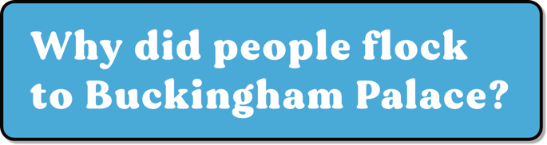
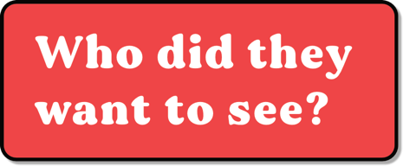
Crowds outside Buckingham Palace
© Bridgeman

Slide 7

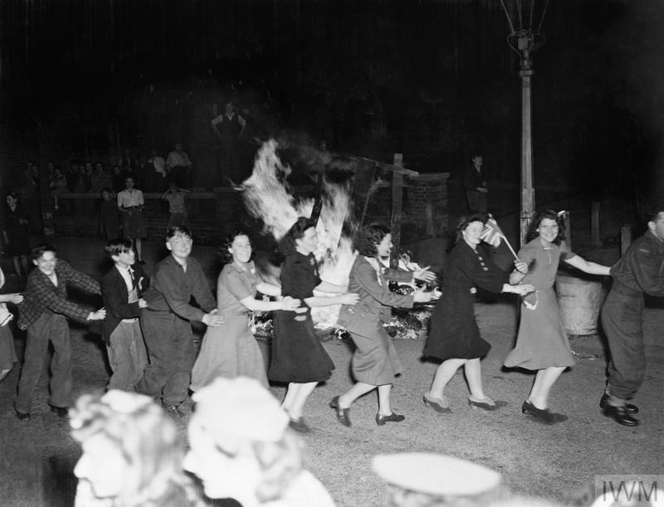

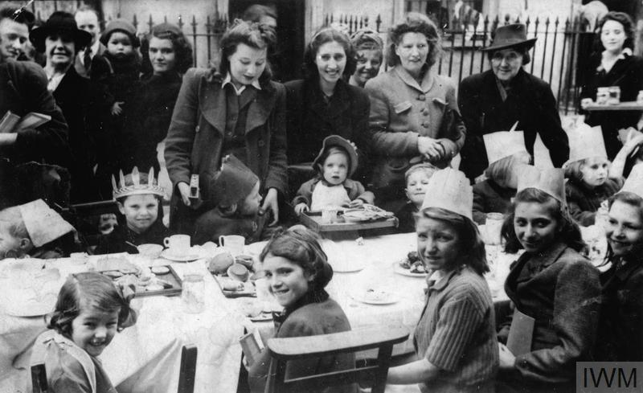
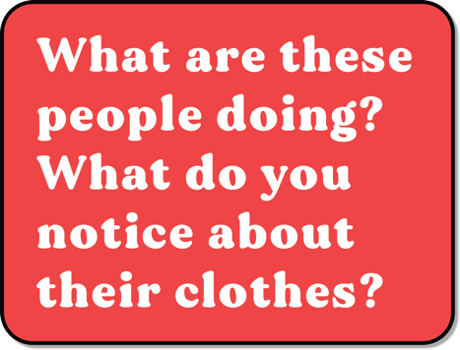
Street parties and celebrations all over the country - London
© IWM (EA 65881)
© IWM (HU 92607)

Slide 8


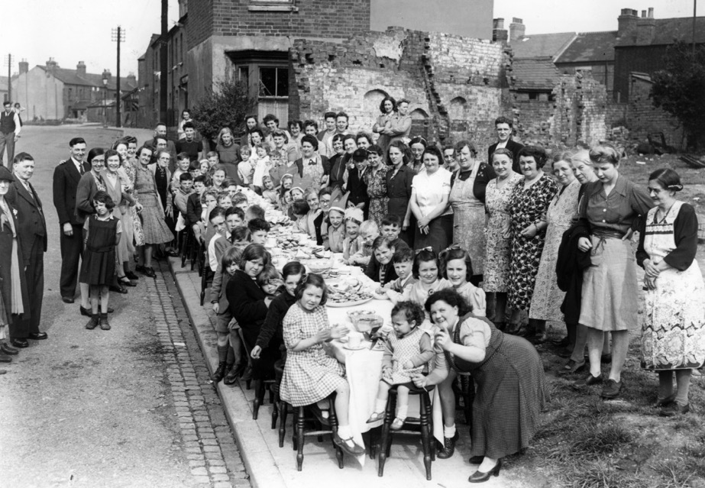
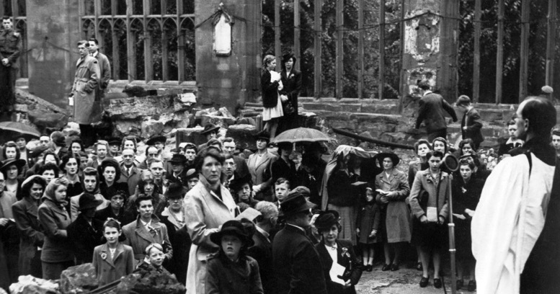
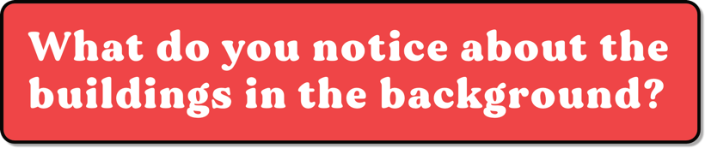
Black and white photo of women and children sat and gathered round a long table outside in the street. Some of the children are wearing crowns and party hats. Question box: Street parties and celebrations all over the country - Coventry
Coventry was
bombed heavily
during World War 2. Lots of people were killed and buildings were lost or badly damaged.
Special services were held in the ruins of the Coventry Cathedral on VE day.
It was visited by thousands of people.
© Mirrorpix (00123895)
© Mirrorpix (01418284)

Slide 9
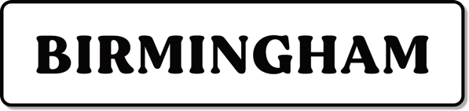
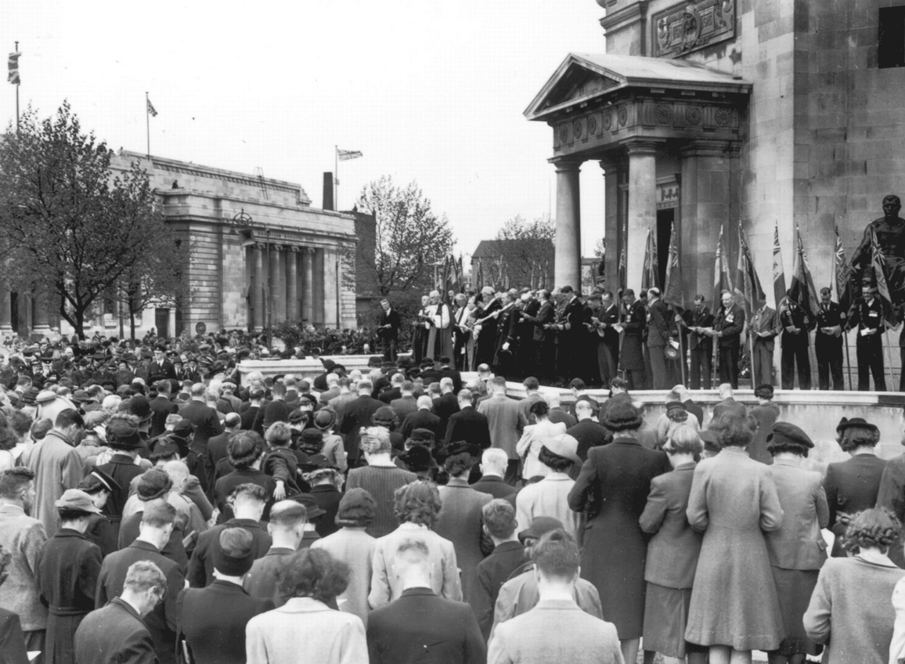
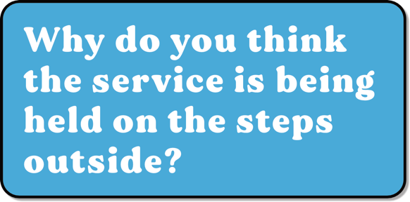
Street parties and celebrations all over the country - Birmingham
© Birmingham Mail
A special service was held at the Birmingham Hall of Memory.

Slide 10
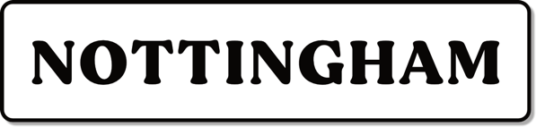
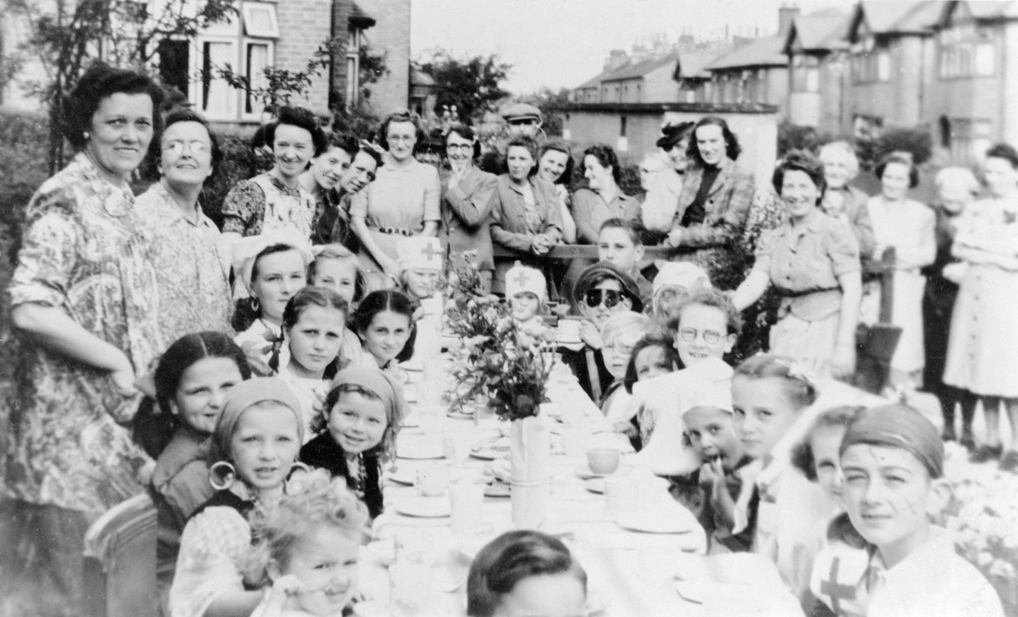
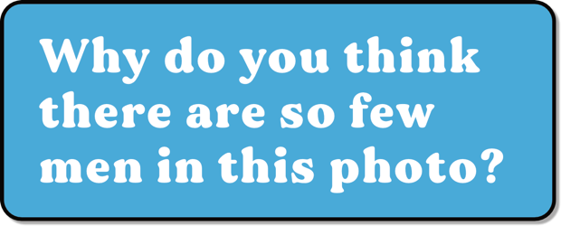
Street parties and celebrations all over the country - Nottingham
Street parties were held across the region.
© Alamy DDYJ8K

Slide 11

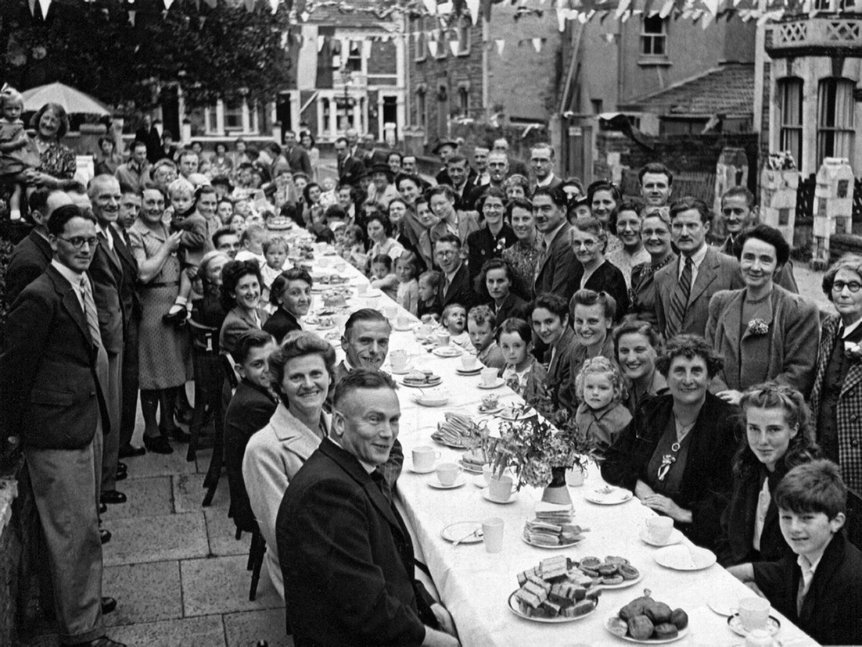
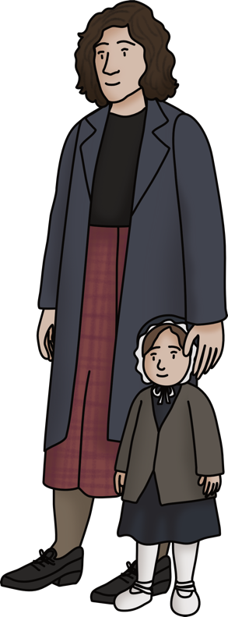
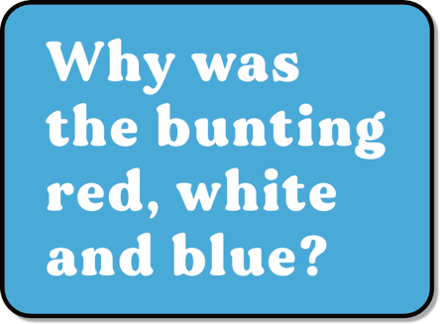
Street parties and celebrations all over the country - Bristol
Streets were decked out with red, white and blue bunting and flags.
© Alamy AF7HMP

Slide 12

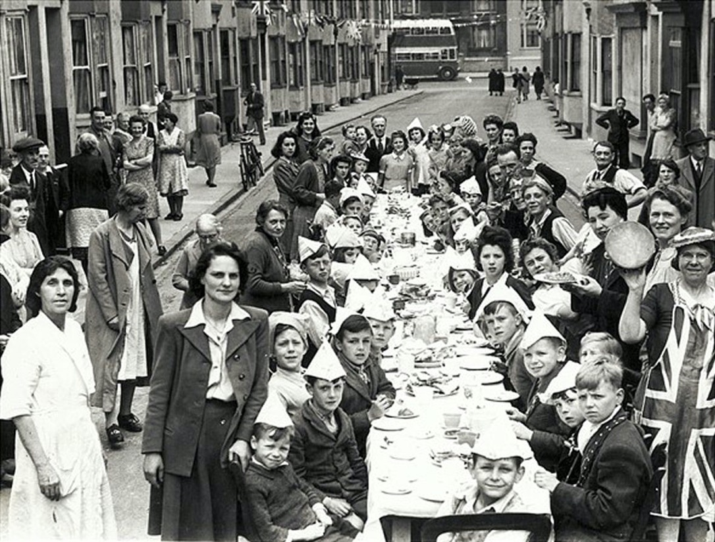
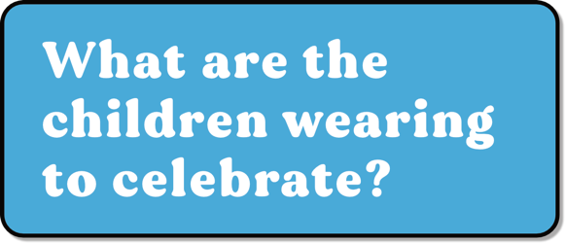
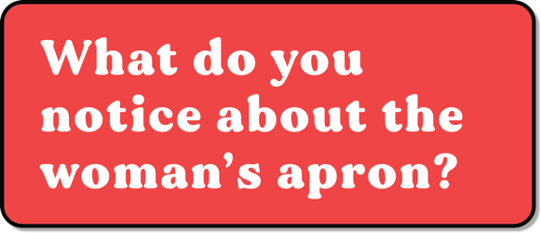
Street parties and celebrations all over the country – Brighton 1
©Royal Pavilion and Museums Brighton and Hove

Slide 13
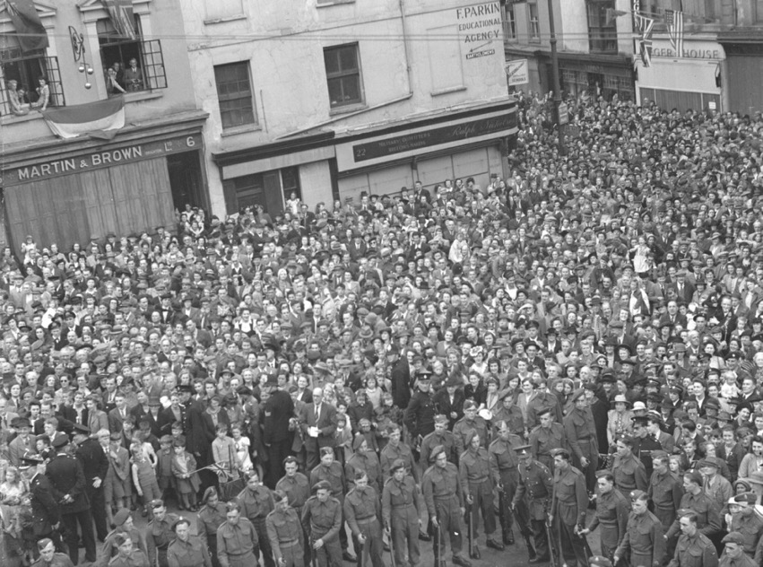
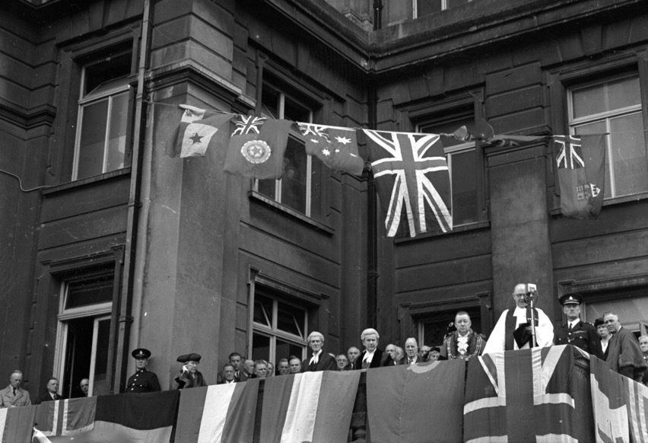

Street parties and celebrations all over the country – Brighton 2
Crowds gathered outside the Town Hall in Brighton to witness the Mayor of Brighton on the flag-covered balcony giving a speech, proclaiming the end of the War in Europe.
©Royal Pavilion and Museums Brighton and Hove
©Royal Pavilion and Museums Brighton and Hove

Slide 14
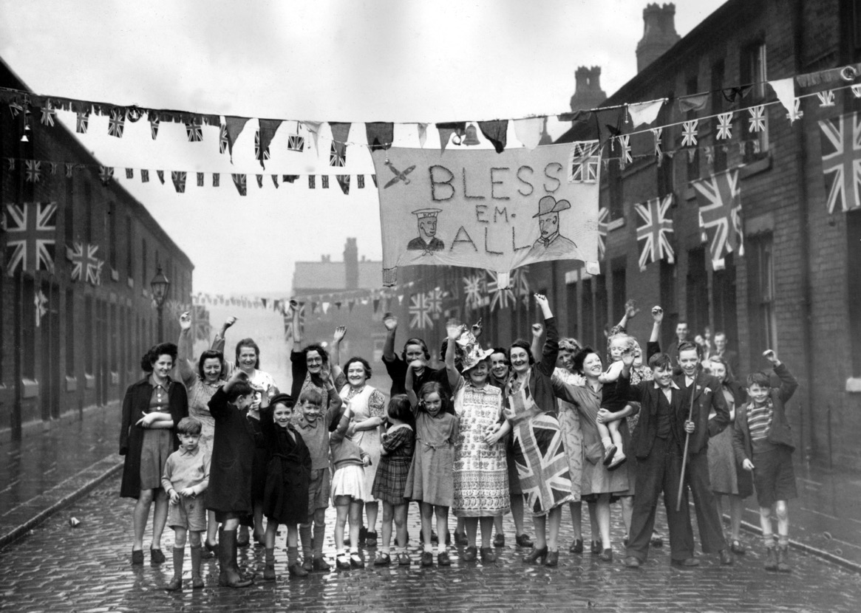

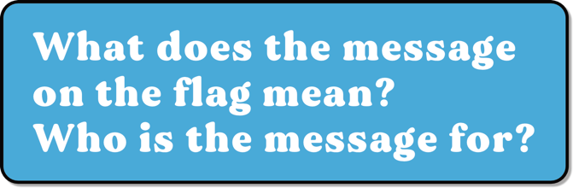
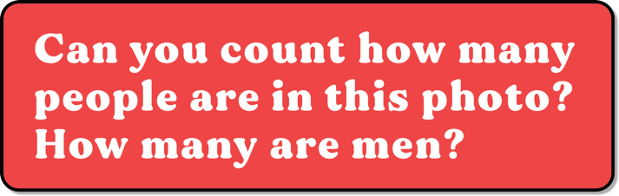

Street parties and celebrations all over the country – Manchester
© Mirrorpix (00094625)

Slide 15

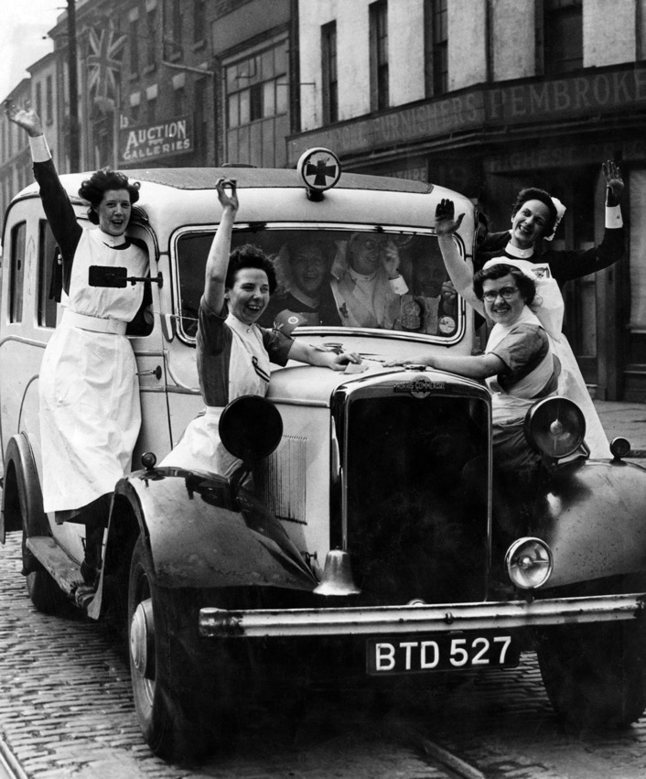

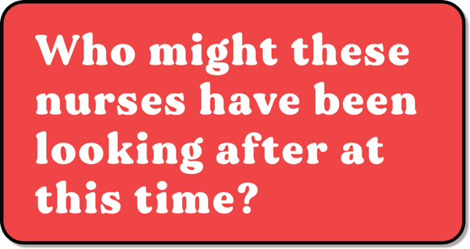
Street parties and celebrations all over the country – Liverpool
© Mirrorpix (01208346)

Slide 16
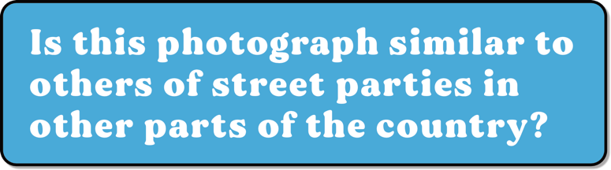

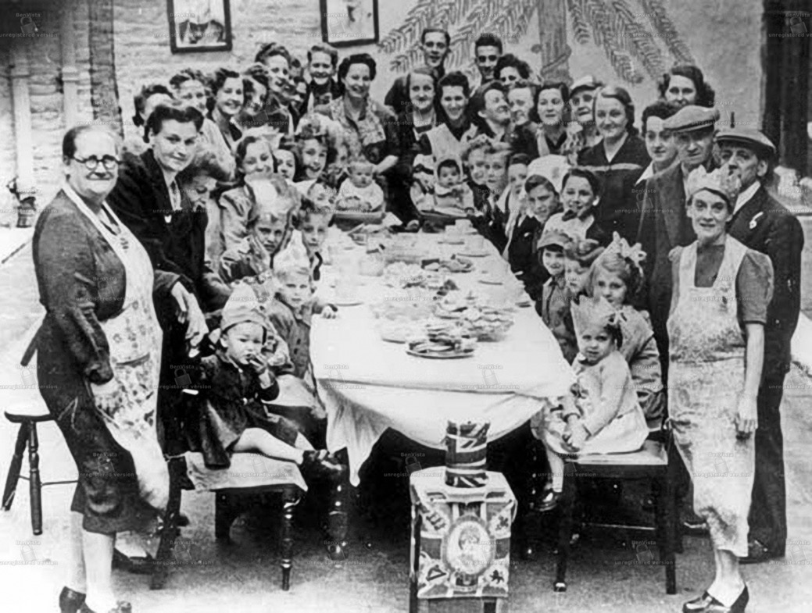



Street parties and celebrations all over the country – Sheffield
This photograph was taken in 1945.
©BY-NC-2.0 philatkin via Flikr

Slide 17

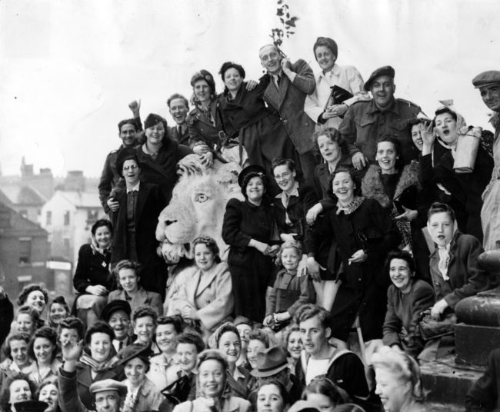
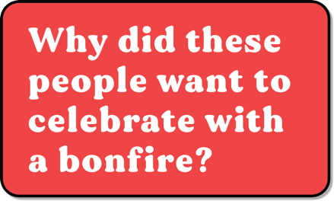
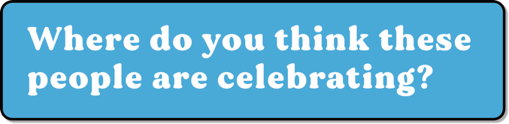
Street parties and celebrations all over the country – Leeds
There are statues of lions outside the Town Hall in Leeds.
© BY-NC-SA
© BY-NC-SA
During the war lights were kept low at night, so enemy planes couldn’t see where to drop bombs.

Slide 18
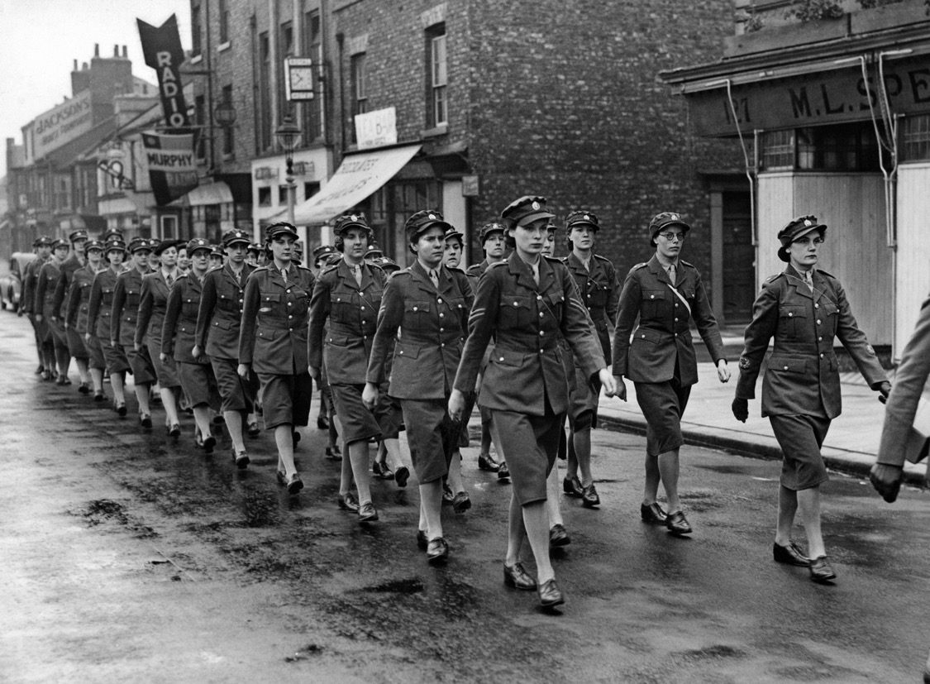

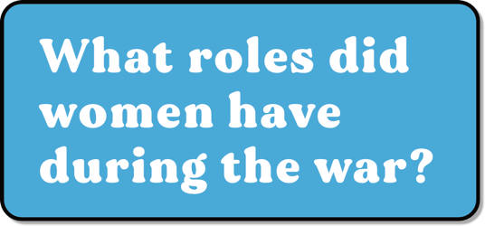
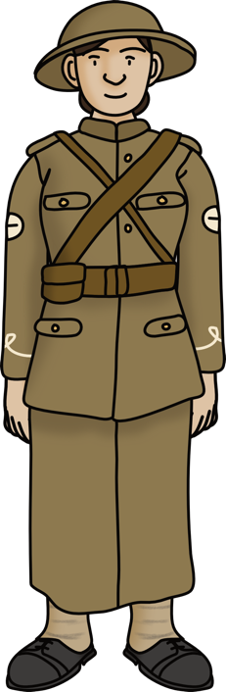
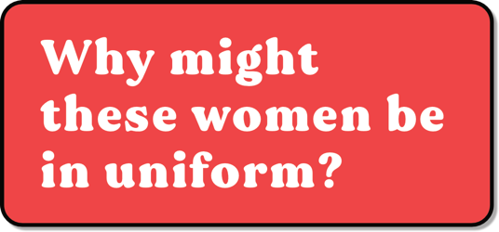
Street parties and celebrations all over the country – Teesside
A Victory Parade.
© Mirrorpix (00752797)

Slide 19




Street parties and celebrations all over the country – Newcastle
Food was rationed during the war.
© Mirrorpix (00474057)

Slide 20






Street parties and celebrations all over the country – France
People flock to the Champs Elysees in Paris to celebrate VE day.
© Alamy W7EEYA
Colour photographs from the Second World War were rare because the process was relatively new and more expensive.
© Usis-Dite/Bridgeman Images

Slide 21



Street parties and celebrations all over the country – Empire
Children parade in Kalimpang, India.
© National Army Museum
Crowds come to watch the VE day parade in Nairobi.
© Alamy

Slide 22





Around the world – USSR & USA
© Alamy
Fireworks over the Kremlin in Moscow.
© Bridgeman

Slide 23


VJ Day
The war wasn’t over for everyone on VE Day. Many servicemen continued to fight in East Asia and the Pacific for another 3 months against the Japanese Army. Japan surrendered on 14th of August 1945. This became known as VJ Day - Victory over Japan.
Why do you think some people did not feel like celebrating?
During the war 384,000 service people were killed in combat, and 70,000 civilians died at home.
Who do you think these children might be thinking about?
Everett Collection Inc / Alamy Stock Photo
Allied servicemen & women celebrate in Japan

Slide 24


How was VE Day celebrated in Britain and around the world? 2

