Slide 1
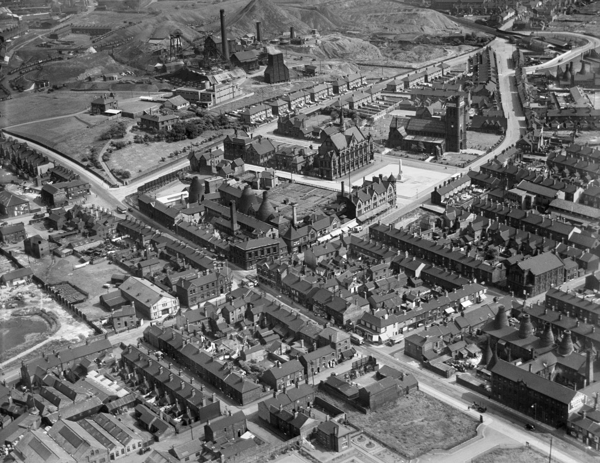
How to explore different types of photographs in Aerial Photo Explorer
How to…..
Explore the different types of photographs in Aerial Photo Explorer
Notes:
Image: EPW054092 © Historic England Archive
How to explore the different types of photograph in Aerial Photo Explorer.

Slide 2
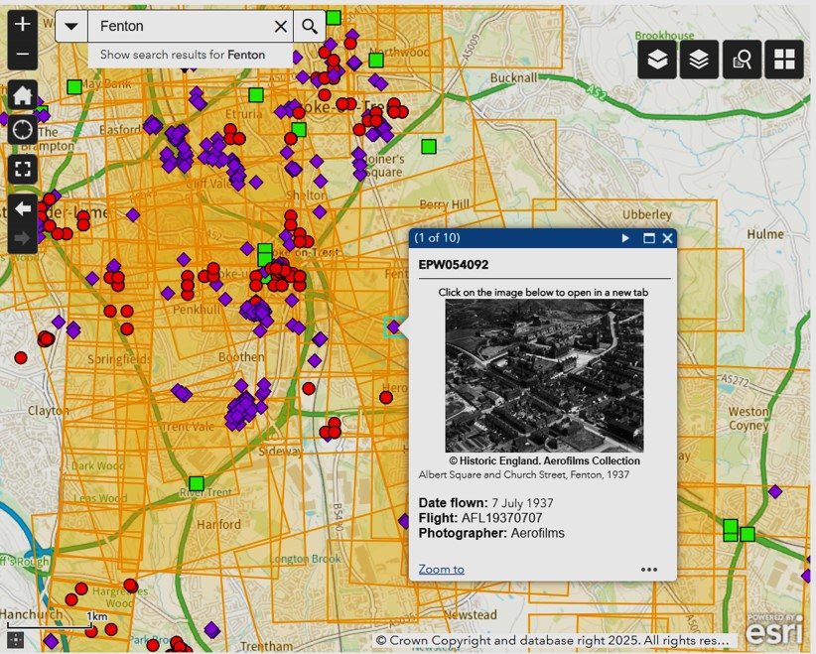
How to explore the different types of photographs in Aerial Photo Explorer
This guide will:
Help you to understand the different collections and types of Archive photos you can see on the the Aerial Photo Explorer website
Demonstrate the difference between oblique and vertical photos
Notes:
This guide will help you to understand the different collections and types of Archive photos you can see on the Aerial Photo Explorer website.
It will help to demonstrate the difference between oblique and vertical photos.

Slide 3
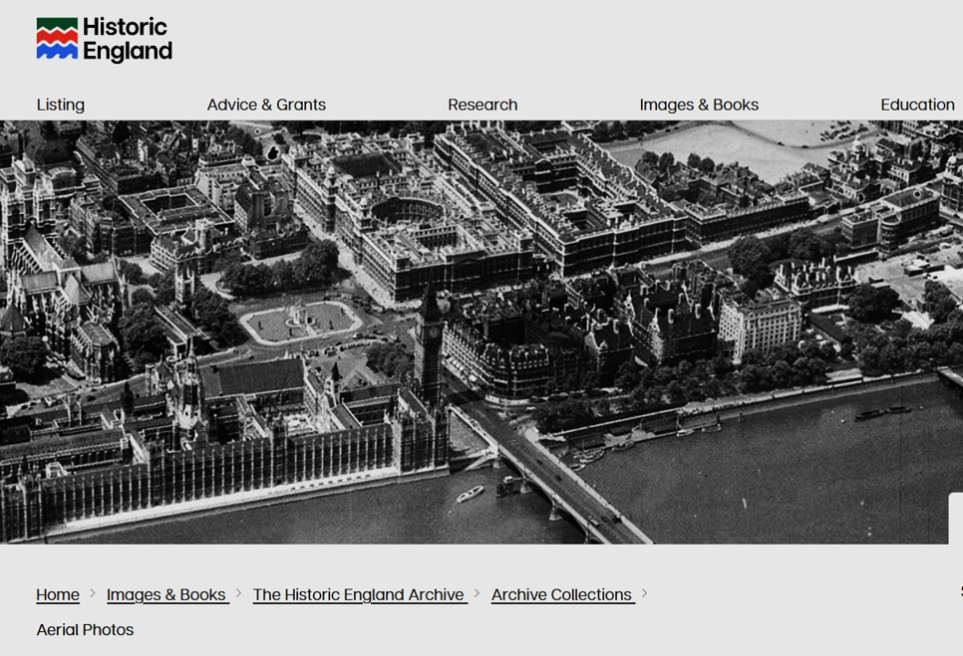
To find the Aerial Photo Explorer website
To start:
In your browser search for: https://historicengland.org.uk/images-books/archive/collections/aerial-photos/
You will see the main Historic England website banner.
https://historicengland.org.uk/images-books/archive/collections/aerial-photos/
Notes:
To start with, search in your web browser using this URL web address for the Aerial Photo Explorer website.
You will see the Historic England logo and website banner.

Slide 4
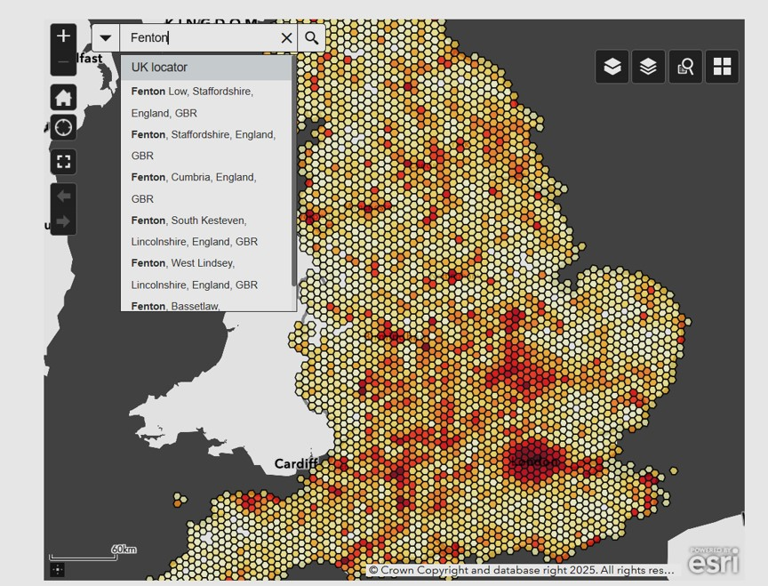

Search for a postcode or area
Scroll down and you will see the search bar.
In the Search bar, enter the name of the area you want to look at, or postcode.
https://historicengland.org.uk/images-books/archive/collections/aerial-photos/
Notes:
To get started, type the name of the place you want to look at into the search bar in the top left-hand corner of the map.
In this example we are looking for Fenton, in Stoke-on-Trent. Then press enter.

Slide 5
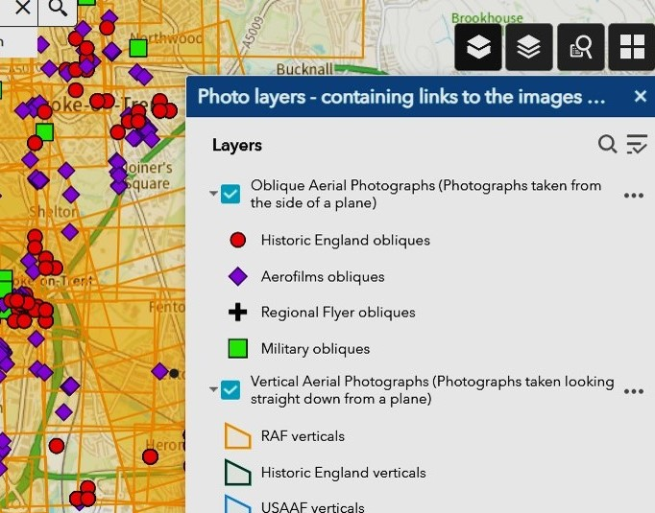

The different coloured symbols in Aerial Photo Explorer
You will see different symbols on the map. These relate to the different photograph collections - types of photos - that are held Historic England’s Archive.
Click on the double book layer icon to see the photo layer key.
The key shows which symbol is which photo type.
Many are Aerofilms photos (purple diamonds). Some collections were taken by individual photographers (black crosses). Some are from military collections, such as RAF and USAAF (green squares). The red dots are all photos taken more recently (mostly in the 2000s) by Historic England aerial photographers.
The light orange grids are vertical photos.
Grid shapes (mostly orange) are vertical photos.
Coloured marker shapes denote oblique photos.
Notes:
You will see different symbols on the map.
You can click on the double book icon to find out what they mean.
These relate to the different photograph collections that are held in the Historic England Archive
Click on the double book layer icon to see which is which
Many photographs were taken by Aerofilms. These are represented by purple diamonds and are often oblique photos.
Some photos may be from local or regional collections, often the collated work of individual photographers. These are denoted by black crosses.
Some photos, denoted my green squares, are from military collections (green squares) – most are from the Second World War period and were taken by the RAF or US Air Force.
The red dots are all photos taken more recently, mostly in the 2000s, by Historic England photographers.
All the grid shapes (mostly orange) are vertical photos.
All the coloured marker shapes denote oblique photos.

Slide 6
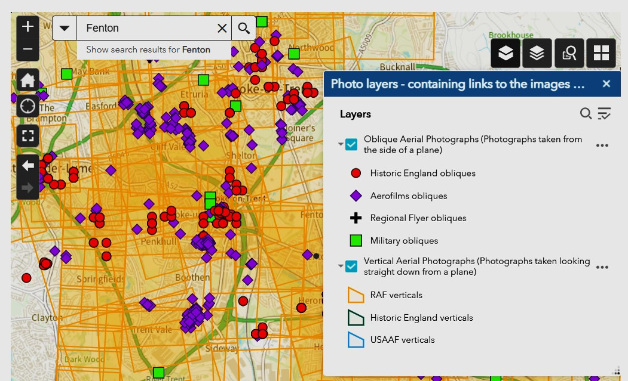
What are obliques and verticals?
Oblique photographs are taken by a photographer, usually at an angle. These can show buildings and details clearly, though it is not always as easy to orientate alongside a map.
Vertical photographs are taken using a fixed camera under the plane, so the photo image is more like a ‘bird’s eye’ and will resemble a map from that time - like a modern-day satellite view - though individual buildings may not be so clear.
Notes:
There are two main categories of photos on Aerial Photo Explorer: Obliques and verticals.
Oblique photographs are taken, by a photographer, at an angle.
This means that buildings can be very clear and recognisable, with a more ‘3D’ image.
Verticals are taken by a camera, fixed underneath the aircraft. They can closely resemble maps and the viewer can often identify specific buildings using maps from the time.
Where possible, it is good to use a combination of both oblique and vertical photos, if studying a particular area. It allows you to get the wider picture, whilst enabling a study of details.

Slide 7
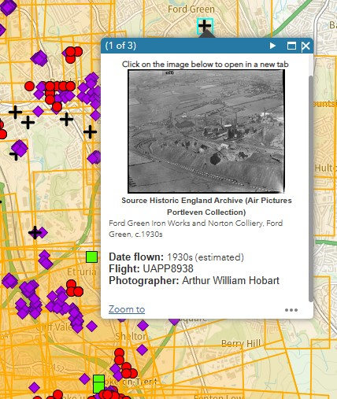
Oblique photos
To open an oblique photo find the place you want to look at and click on the nearest red, purple, green or black cross symbols.
In this example, we click on a black cross.
A thumbnail image will appear, with information about the location and date of the photo. We are also told the specific collection it is from - Air Pictures Portleven Collection - and the photographer – Arthur William Hobart.
We can learn more about this collection here:
Click on the thumbnail to open the full photo.
Air Pictures Portleven Collection
Notes:
To open an oblique photo, find the place you are wanting to look at and open the nearest red, purple, green or black cross symbol. In this example, we click on a black cross.
A thumbnail will appear, with information about the location and date of the photo. We are also told the specific collection it is from - Air Pictures Portleven Collection - and the photographer – Arthur William Hobart.
The Historic England website has more about Arthur Hobart and the Portleven Collection on another webpage.
Click on the thumbnail to open the full photo

Slide 8
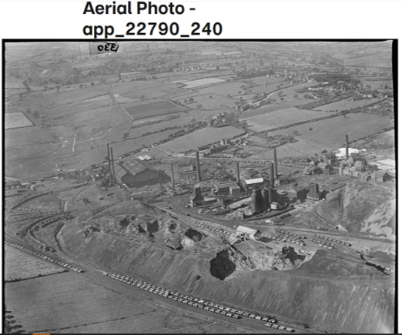
Studying an oblique photo
Now we can study the full photo.
These oblique photos can give us a very clear view of life in an area, in a particular time.
This example shows us the Ford Green Iron Works and Norton Colliery, Stoke-on-Trent, in the 1930s.
We can see individual colliery buildings, and the mineral railway serving it, very clearly. The photo illustrates the size of the colliery and its impact on the local landscape.
Ford Green Iron Works and Norton Colliery, Ford Green, c.1930s
Notes:
Image: app_22790_240 (Air Pictures Portleven Collection) Arthur William Hobart © Historic England Archive
All rights reserved. Ordnance Survey Licence number AC0000815036 © Crown Copyright and database right 2025.
We click on the thumbnail to get the full photo.
These oblique photos can give us a very clear view of life in an area, at the time they were taken.
This photo of, taken by Arthur Hobart, gives us a very clear view of Ford Green Iron Works and Norton Colliery in the 1930s. We can see individual buildings, the mineral railway and impact of this industrial complex in an otherwise rural landscape.

Slide 9
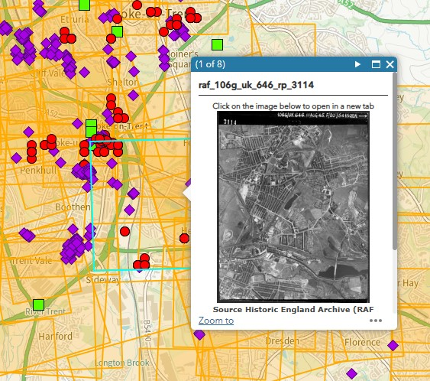

Opening a vertical photo
To open a vertical photograph find the place you want to look at and click on the map .
Make sure you are clicking inside an orange grid (or a green or blue one).
When you click on the map a thumbnail photo will appear.
A blue rectangle will also appear, showing the area covered by the photo.
A thumbnail image will appear.
Click on the thumbnail to open the photograph.
Notes:
To open a vertical photograph find the place you want to look at and click on the map .
Make sure you are clicking inside an orange grid (or a green or blue one).
When you click on the map a thumbnail photo will appear.
A blue rectangle will also appear, showing the area covered by the photo.
A thumbnail image will appear.
Click on the thumbnail to open the photograph.

Slide 10
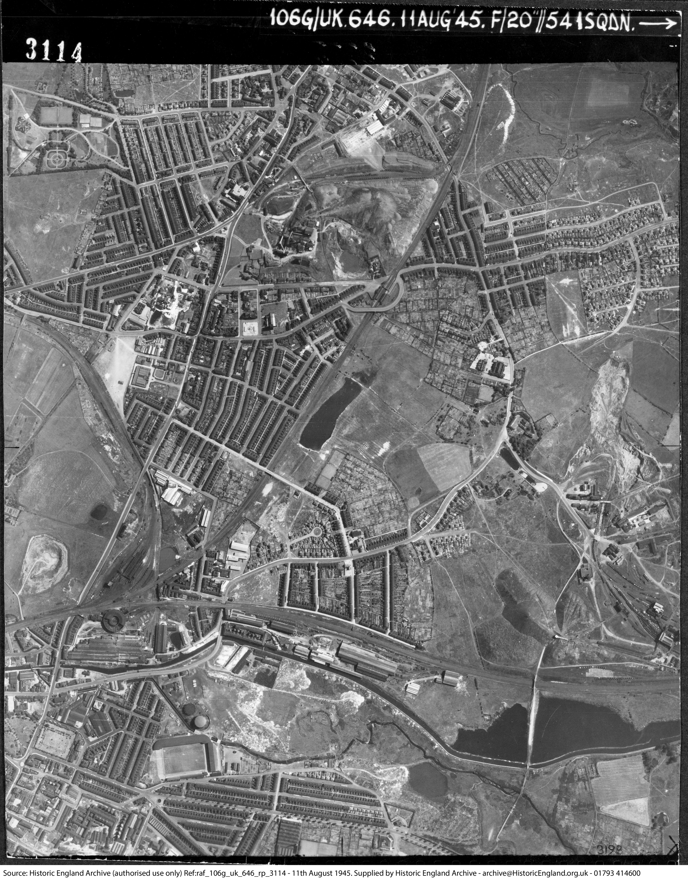
Studying a vertical photo
The vertical photographs are excellent for providing a wider context and helping you look at change and continuity in an area, picking out familiar streets, notable buildings, green spaces, industrial and historical sites and other landmarks.
It is important to note that, sometimes, the vertical photo is not correctly aligned with a map - for example, it may appear to be upside down.
Fenton, August 1945
Notes:
Image raf_106g_uk_646_rp_3114 © Historic England
Vertical photographs can be excellent for providing a wider context and helping you to start looking at change and continuity in the area, by picking out familiar streets, green spaces, such as park, industrial and historical sites and other landmarks.
It’s important to note that, sometimes, the vertical photo may not be correctly aligned with a map. For example, it may be the wrong way round. It will be presented in the way the phot was taken.

Slide 11
Using a map to help study a vertical photo
Tip: It helps to have a modern map and some historical maps of the area, to refer to, when viewing these photos. Online maps, such as Google, are great for this.
Unlike maps, aerial photos don’t always have ‘north’ at the top. To help with orientating the photos, you may find it useful to see our ‘How to orientate photos when using Aerial Photo Explorer’.
Fenton, August 1945
Notes:
Image raf_106g_uk_646_rp_3114 © Historic England
Tip: It helps to have a modern map and some historical maps of the area, to refer to, when viewing these photos.
To help with orientating the photos, you may find it particularly useful to see our ‘How to orientate photos when using Aerial Photo Explorer’.
You may also like to see our other guides on Aerial Photo Explorer

