Slide 1
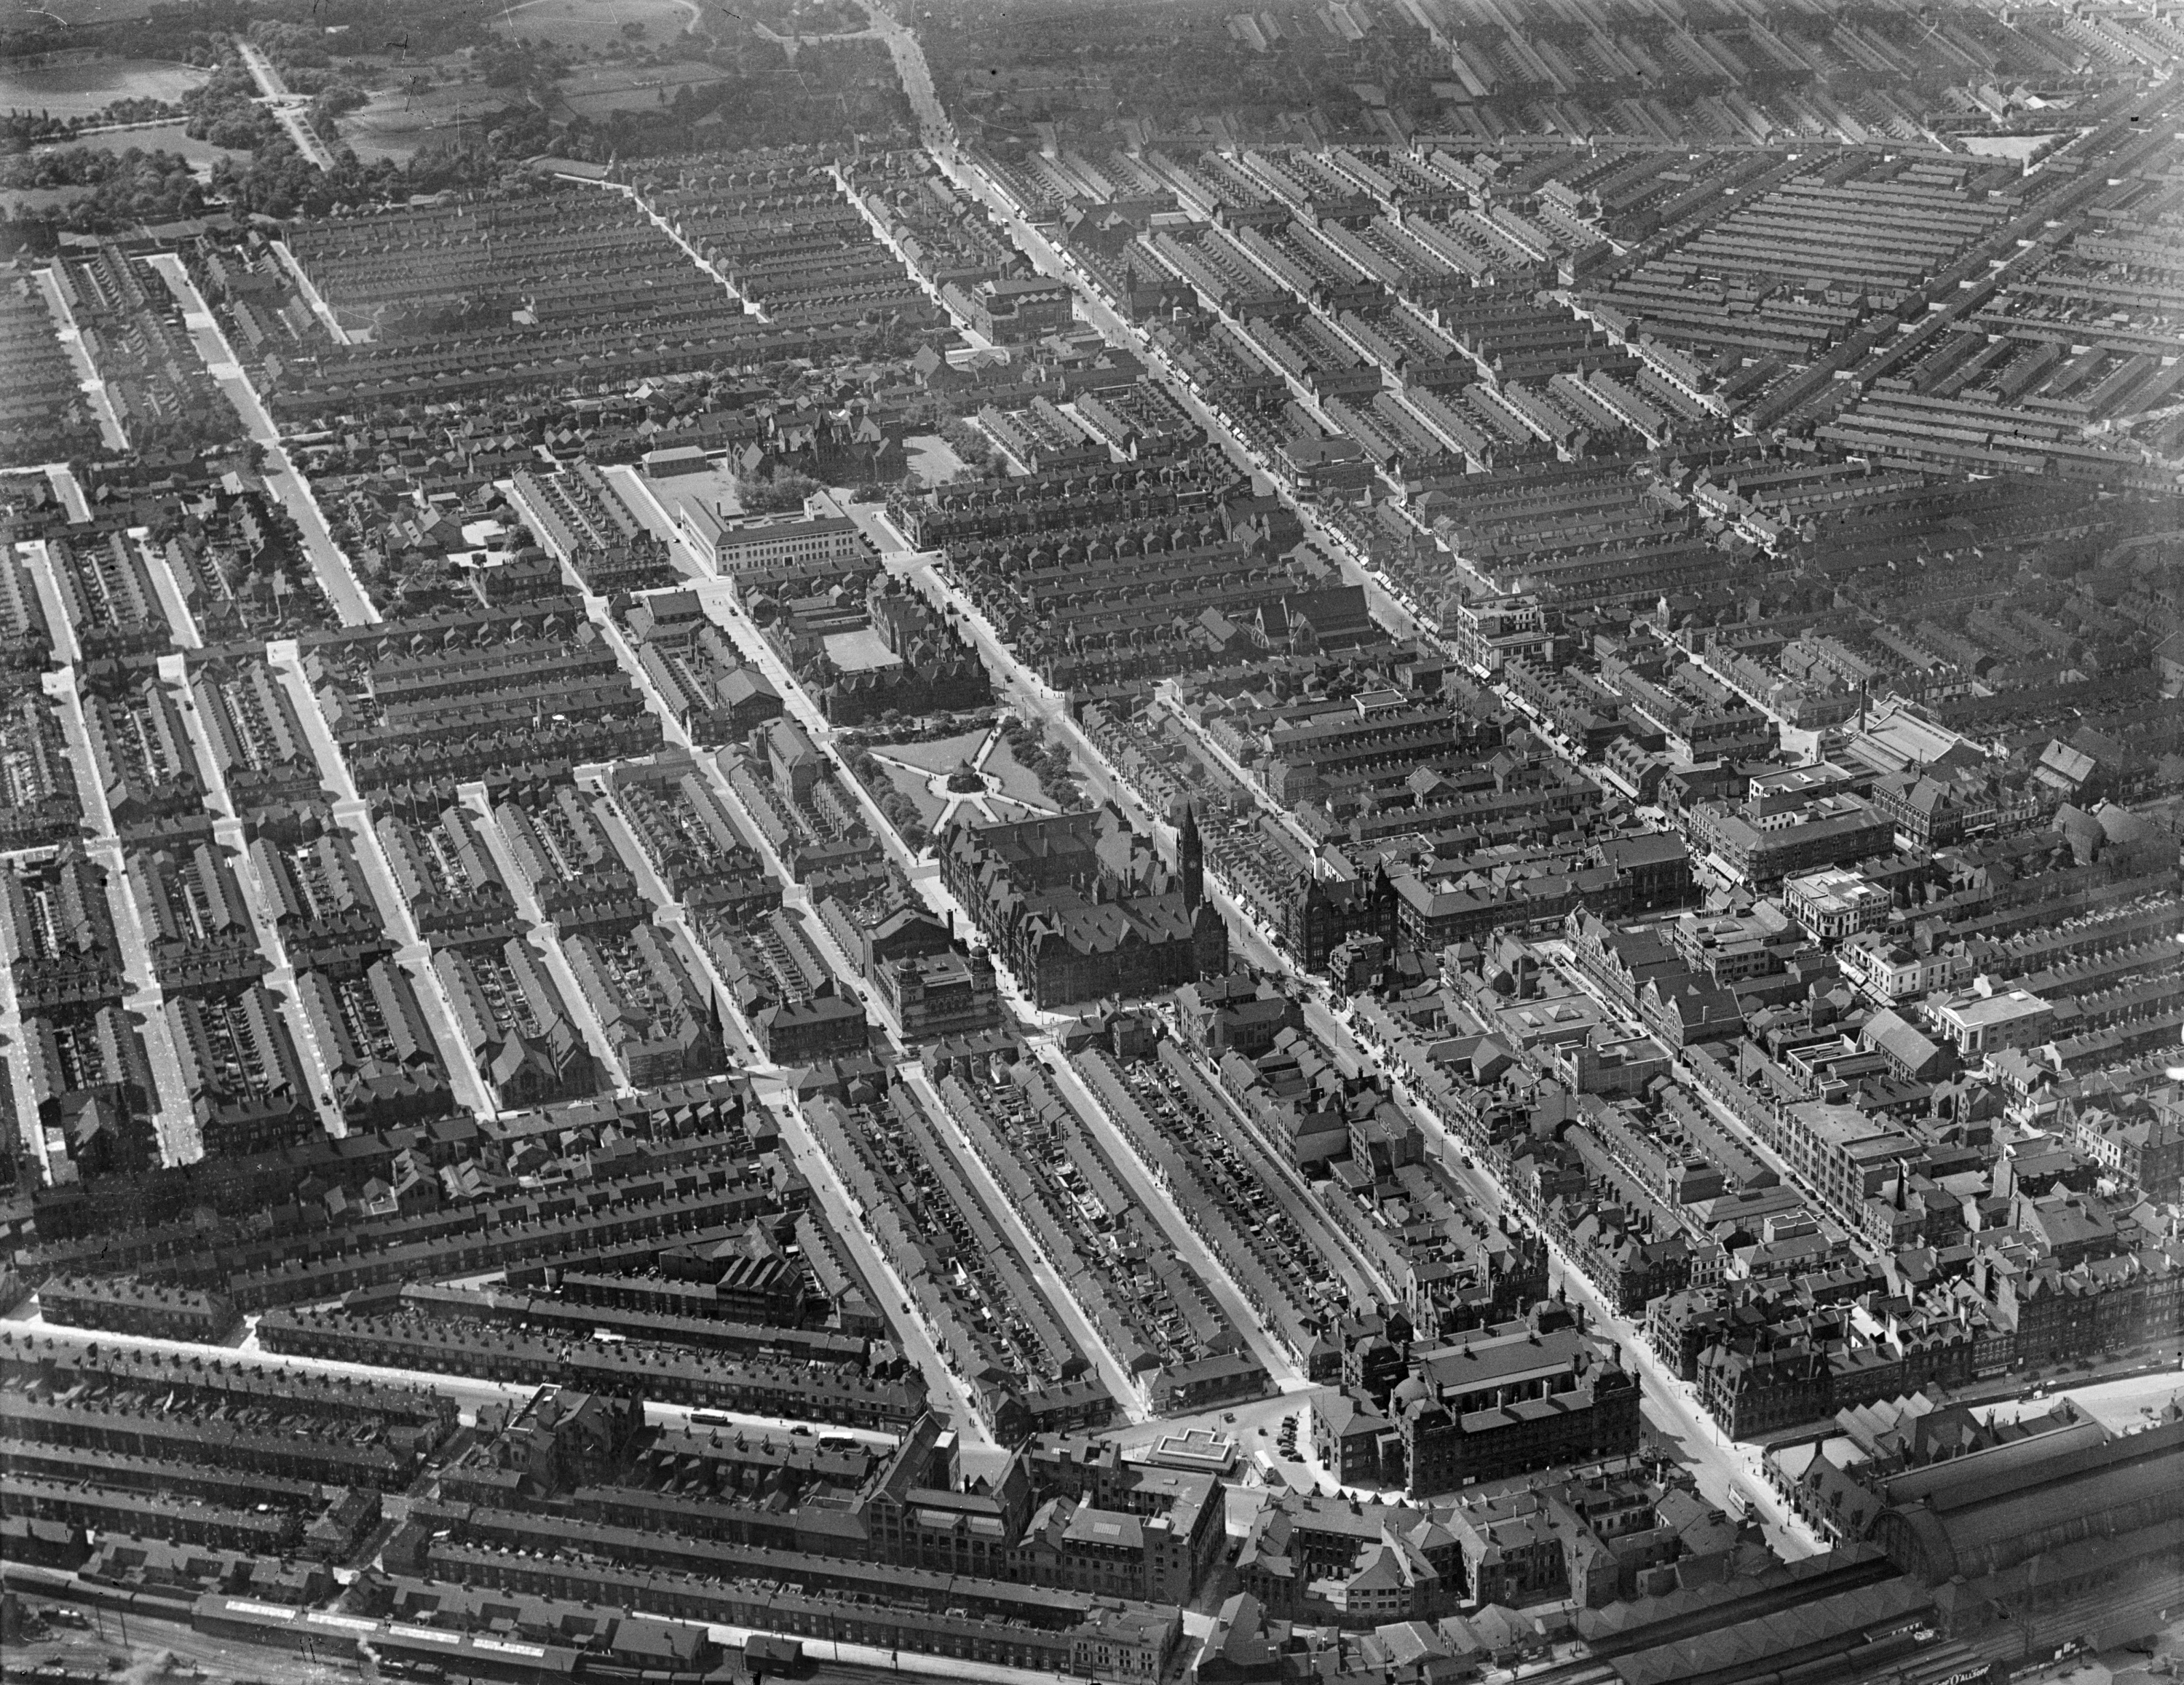
How to orientate photos when using Aerial Photo Explorer
How to…..
Orientate photos when using Aerial Photo Explorer
Notes:
Image: ©EPW054092 Middlesbrough Town Hall 1932 © Historic England Archive
Orientate photos when using Aerial Photo Explorer

Slide 2
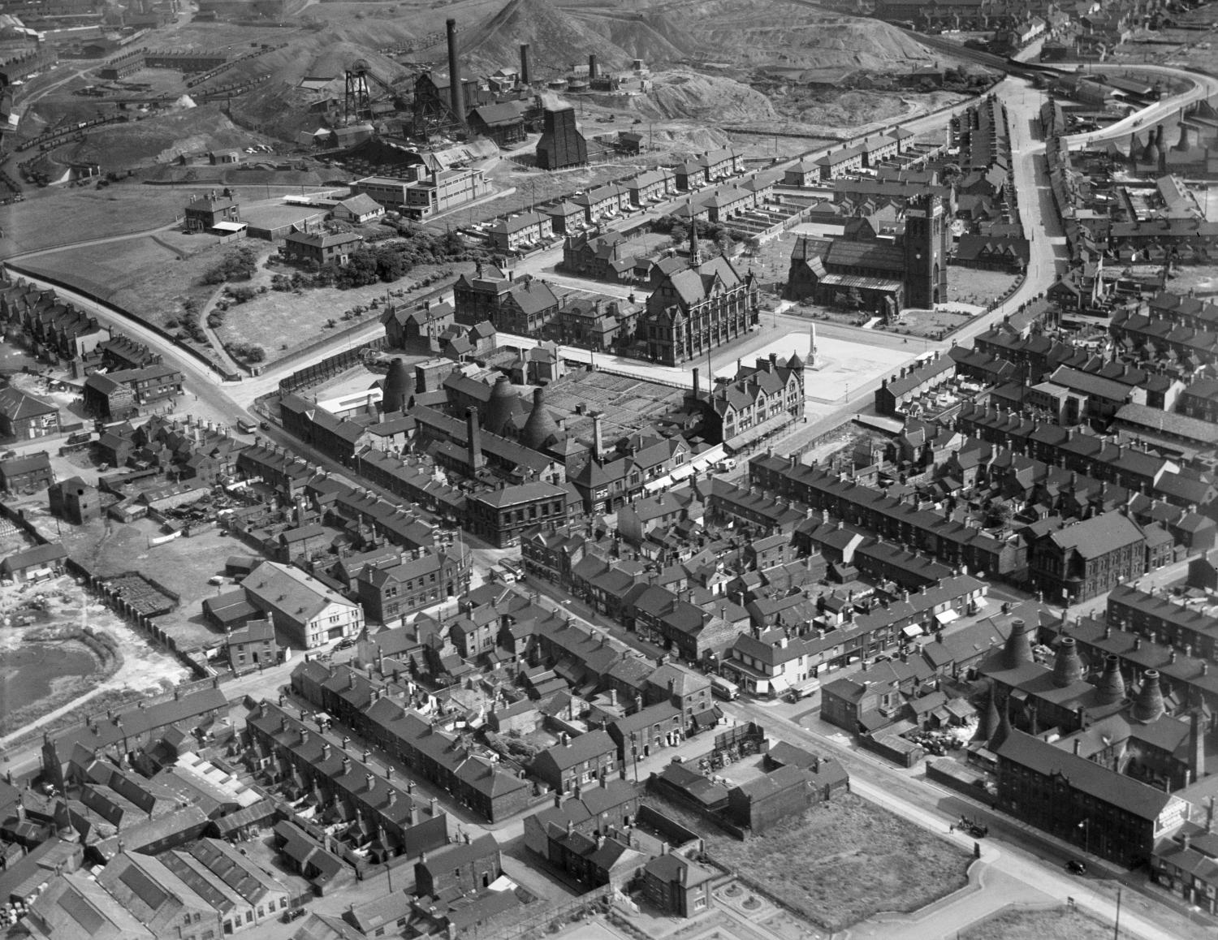
How to orientate photos when using Aerial Photo Explorer
This guide will:
Help you to understand how to orientate the photos on Aerial Photo Explorer by using Google maps
Demonstrate that, by orientating photos correctly, you can identify individual buildings and look at change and continuity, in a particular area, more confidently
It may help if you study the other guides in the series Aerial Photo Explorer before you work through this guide and you may also like to watch Using Aerial Photographs
Fenton, July 1937 © Historic England
Fenton July 1937
Fenton July 1937
Notes:
Image: Fenton July 1937 ©EPW054092 Historic England Archive
This guide will:
Help you to understand how to orientate the photos on Aerial Photo Explorer by using Google maps
Demonstrate that, by orientating photos correctly, you can identify individual buildings and look at change and continuity, in a particular area, more confidently
As this guide presumes some confidence with using Aerial Photo Explorer, it may help if you study the guides in the How to Use Aerial Photo Explorer series, before working through this guide. You may also find it useful to view our film ‘Using Aerial Photographs’.

Slide 3
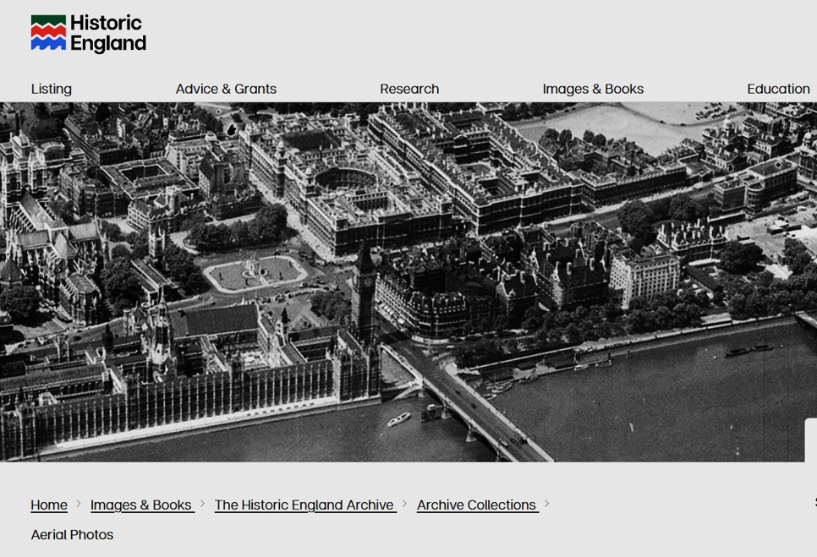
To find the Aerial Photo Explorer website
To start:
In your browser search for: https://historicengland.org.uk/images-books/archive/collections/aerial-photos/
You will see the main Historic England website banner. Scroll down to find the search map.
In this guide, it is assumed you already know how to search for a photo of your location.
If not, we suggest using the Guides mentioned on the previous slide.
https://historicengland.org.uk/images-books/archive/collections/aerial-photos/
Notes:
Image: Screenshot from Historic England’s Aerial Photo Explorer webpage
In your browser, search for his URL address.
You will see the main Historic England website banner. Scroll down to find the search map.
In this particular guide, it is assumed you already know how to search for - and find - a photo of your location.
If not, we suggest using the other How to use Aerial Photo Explorer guides.

Slide 4
The importance of orientating aerial photos
Sometimes, it can be difficult to orientate photos on Aerial Photo Explorer, especially if they are oblique, or verticals that are not taken from an angle that conveniently aligns exactly with a map of the same area.
If we can orientate the photos correctly, we can identify specific buildings and details more confidently and make more observations about change and continuity.
Using maps helps us to do this.
We shall use this photo of Middlesbrough Town Hall, 1932, as an example.
To help us, we will also open a second tab to view a Google map of the same area.
Middlesbrough Town Hall, July 1932
Aerial Photo - EPW038954 Flight: AFL193207
© Historic England
Middlesbrough Town Hall, July 1932
Notes:
Image: Middlesbrough Town Hall, July EPW038954 © Historic England Archive
It is important to be able to orientate aerial photos.
Sometimes, it can be difficult to orientate photos on Aerial Photo Explorer, especially if they are oblique, or verticals that are not taken from an angle that conveniently aligns exactly with a map of the same area.
If we can orientate the photos correctly, we can identify specific buildings and details more confidently and make more observations about change and continuity.
Using maps helps us to do this.
We shall use this photo of Middlesbrough Town Hall, 1932, as an example.
To help us, we will also open a second tab to view a Google map of the same area.

Slide 5
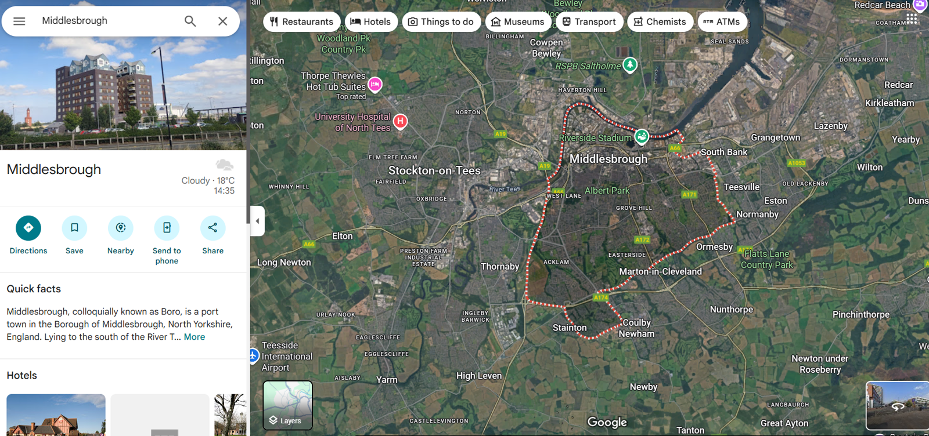
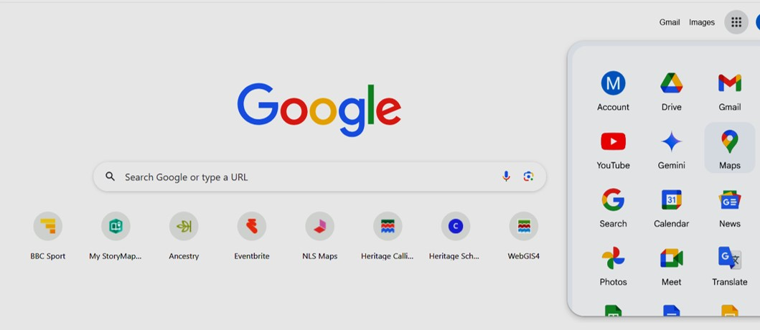


How to open a map on Google Maps
First, On your Google browser click on the 9-dot square icon in the top right of your screen.
Then click the Maps icon to open the maps app.
Then, in the top-left corner search for your place – in this example Middlesbrough.
A large satellite view of Middlesbrough will appear.
Notes:
Images: (l) screenshot of Google browser home page; (r) screenshot of maps search bar and satellite map view of Middlesbrough
How to open a Google map.
First, On your Google browser click on the 9-dot square icon in the top right of your screen.
Then click the Maps icon to open the maps app.
Then, in the top-left corner search for your place – in this example Middlesbrough.
A large satellite view of Middlesbrough will appear.

Slide 6
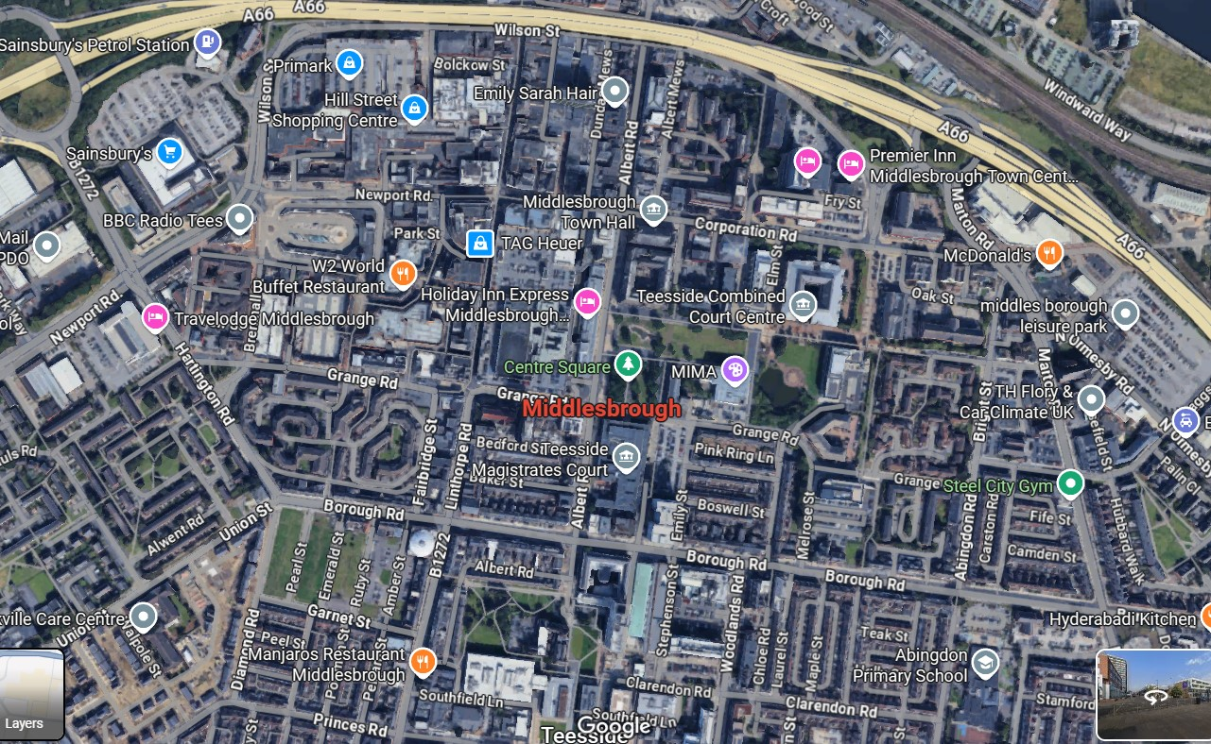
Google Maps: Zoom into your area of interest
Once you have the map of your general area, zoom in to the particular area you want to be looking at, to help orientate and interpret the photo.
Zoom in, using the left-hand button on your mouse or the + and - icons in the bottom right of the screen.
In this example we want the area including, and around, Middlesbrough Town Hall.
Notes:
Image: Screenshot of Google map of Central Middlesbrough
Once you have the map of your general area, zoom in to the particular area you want to be looking at, to help orientate and interpret the photo.
Zoom in, using the left-hand button on your mouse or the + and - icons in the bottom right of the screen.
In this example we want the area including, and around, Middlesbrough Town Hall.

Slide 7

Comparing the two images
Now you have the map of the same area in the photo, compare the two images, looking for similarities and markers.
The images look similar, with grid-like streets. We want to identify where specific buildings are.
First, we focus on the street patterns and buildings around Middlesbrough Town Hall.
Notes:
Images: (l) Screenshot of Google satellite view of Central Middlesbrough; (r) screenshot of a section of Middlesbrough Town Hall, July EPW038954 © Historic England Archive
Now you have the map of the same area in the photo, compare the two images, looking for similarities and markers.
The images look similar, with grid-like streets. Now we want to identify where specific buildings are.
Focus first on the layout of the streets and buildings around Middlesbrough Town Hall.

Slide 8
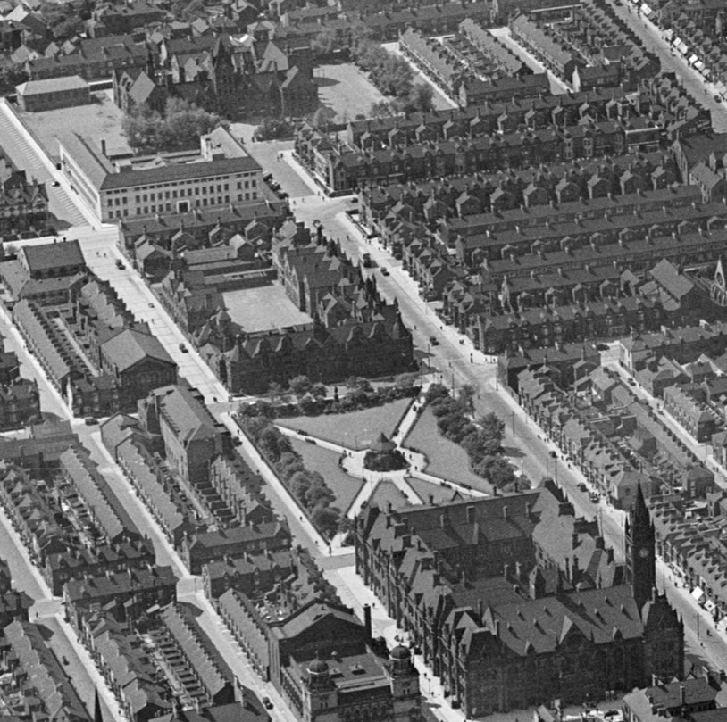
Focus on a specific area and group of buildings
We can also identify individual buildings starting with:
the Town Hall itself
The Empire Theatre
Victoria Square
The Hugh Bell School
Constantine Technical school building
High School a little further back
We can see if we can find any of these on the Google map or satellite view.
At the moment, our Google map is a flat 2D image. We want to compare it to a 3D oblique image from 1932.
So we need to return to our Google tab and create a 3D Google map.
Notes:
Image: Section of photo of Middlesbrough Town Hall, July 1932 EPW038954 © Historic England Archive
We can also identify individual buildings starting with:
the Town Hall itself and others nearby, including:
The Empire Theatre, Victoria Square, the Hugh Bell School, with Constantine Technical school building (the more modern-looking white building just behind) and High School a little further back.
We can see if we can find any of these on the Google map or satellite view.
At the moment, our Google map is a flat 2D image. We want to compare it to a 3D oblique image from 1932.
So we need to return to our Google tab and create a 3D Google map.

Slide 9
Orientating the two images
Although we can see the similarities of the two images, it is clear that the two views are not both from the same direction.
We want the images to be the same orientation so that we can compare them properly.
As we cannot turn the aerial photo, we want to rotate the Google satellite view in a 3D view.
Notes:
Images: (l) Screenshot of Google satellite view of Central Middlesbrough; (r) screenshot of a section of Middlesbrough Town Hall, July EPW038954 © Historic England Archive
Although we can see the similarities of the two images, it is clear that the two views are not both from the same direction.
We want the images to be the same orientation so that we can compare them properly.
As we cannot turn the aerial photo, we want to rotate the Google satellite view in a 3D view.

Slide 10
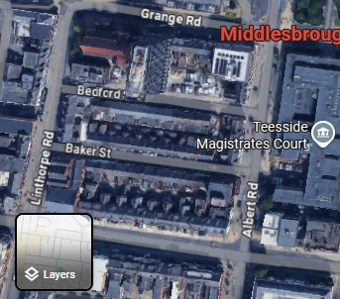
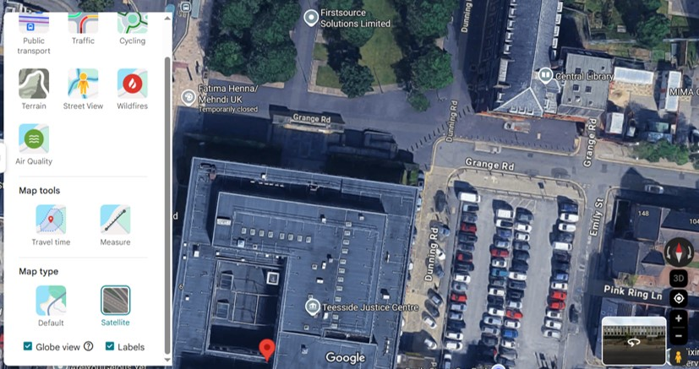
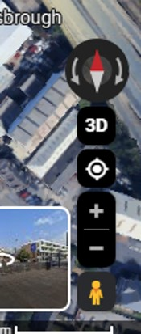


How to create a 3D (oblique) image view in our Google map
First, click on the ‘Layers’ box on the bottom left corner of the map.
Then, from the options, click on ‘More’
Then select ‘Globe View’.
Then check the ‘3D’ icon appears on the bottom right-hand side of the screen (click on ‘2D’ and it should become ‘3D’).
Notes:
Images: Cropped sections of screenshot of Google maps satellite view of Central Middlesbrough and selected screen icons
First, click on the ‘Layers’ box on the bottom left corner of the map.
Then, from the options, click on ‘More’
Then select ‘Globe View’.
Then check the ‘3D’ icon appears on the bottom right-hand side of the screen (click on ‘2D’ and it should become ‘3D’).

Slide 11
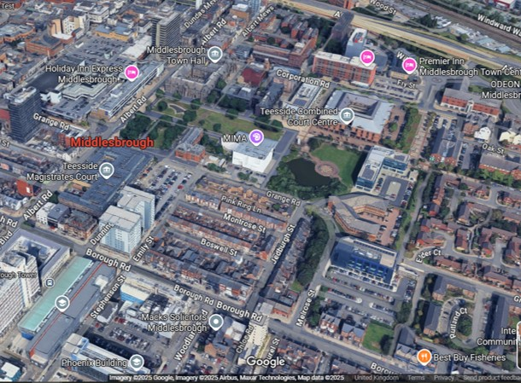
How to create a 3D a Google map view by tilting and turning
Now use your keyboard and mouse: Ctrl & left-click
Hold one finger on the Ctrl button and then slowly drag the cursor using the mouse, whilst holding the left-click button.
If you do not have a mouse device, use the mousepad. Use one finger to press Ctrl, whilst pressing the left side of the mousepad. Move your finger, whilst maintaining contact with the mousepad, to rotate the 3D image.
You will see that you can turn the map around and tilt it. Once you turn the map around, try to achieve, as close as possible, the same angle as the 1932 photo.
If you simply want to shift the map sidewards, take you finger off the Ctrl and left-click buttons.
Satellite view of Central Middlesbrough
Notes:
Image: Screenshot of Google satellite view of Central Middlesbrough;
Now use your keyboard and mouse: Ctrl & left-click
Hold one finger on the Ctrl button and then slowly drag the cursor using the mouse, whilst holding the left-click button.
If you do not have a mouse device, use the mousepad. Use one finger to press Ctrl, whilst pressing the left side of the mousepad. Move your finger, whilst maintaining contact with the mousepad, to rotate the 3D image.
You will see that you can turn the map around and tilt it. Once you turn the map around, try to achieve, as close as possible, the same angle as the 1932 photo.
If you simply want to shift the map sidewards, take you finger off the Ctrl and left-click buttons.

Slide 12
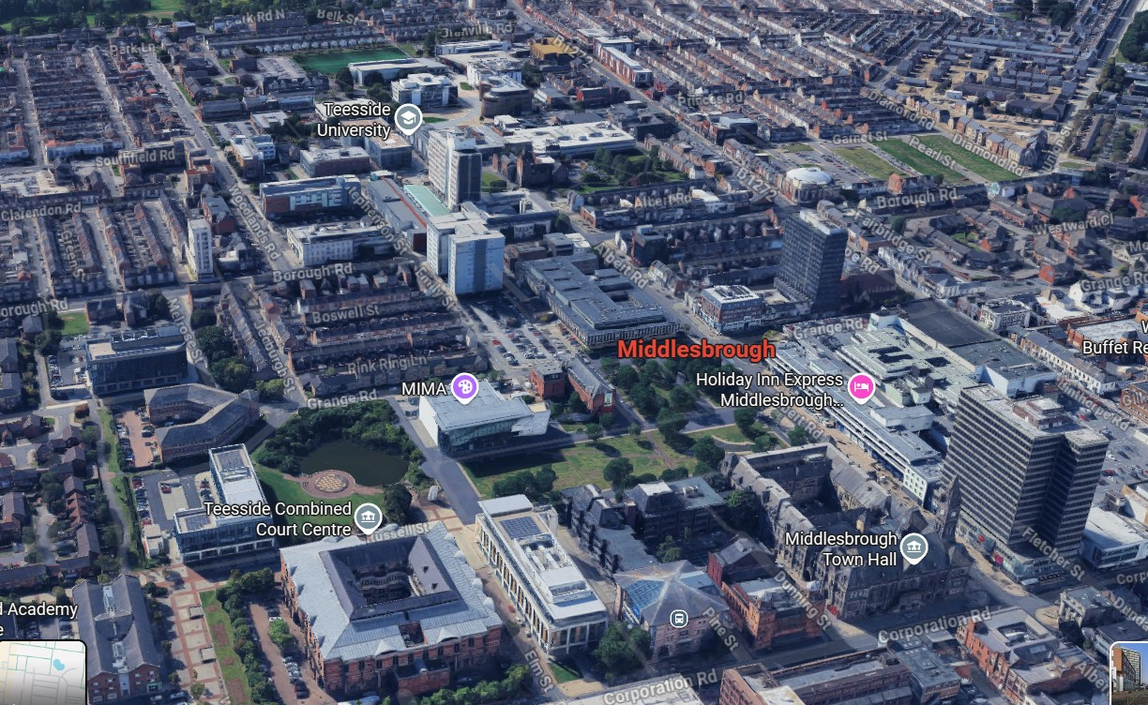
Identifying markers on aligned map and photo
Middlesbrough Town Hall, July 1932
Notes:
Images: (r) Section of photo of Middlesbrough Town Hall, July 1932 EPW038954 © Historic England Archive; (l) Screenshot of Google satellite view of Central Middlesbrough
We now have our modern image (right) at a very similar angle to the 1932 photo.
Now we have orientated the photo, we can quicky identify markers and individual buildings.

Slide 13
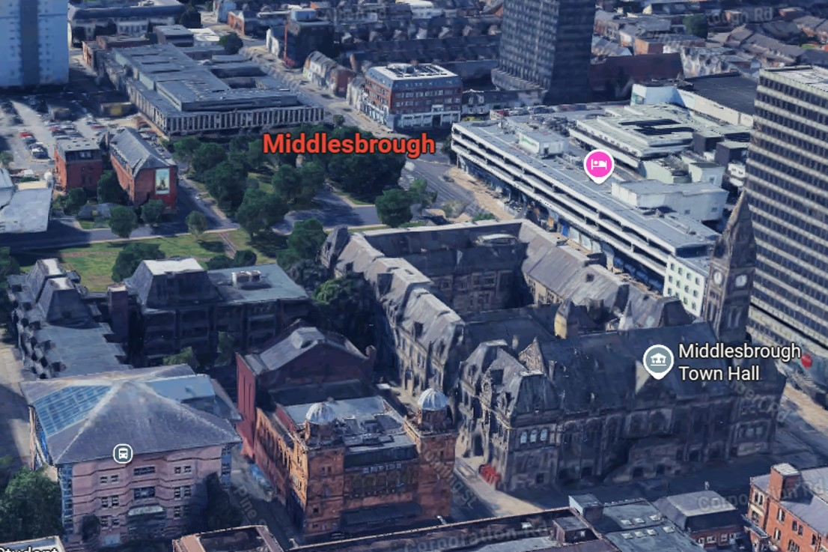
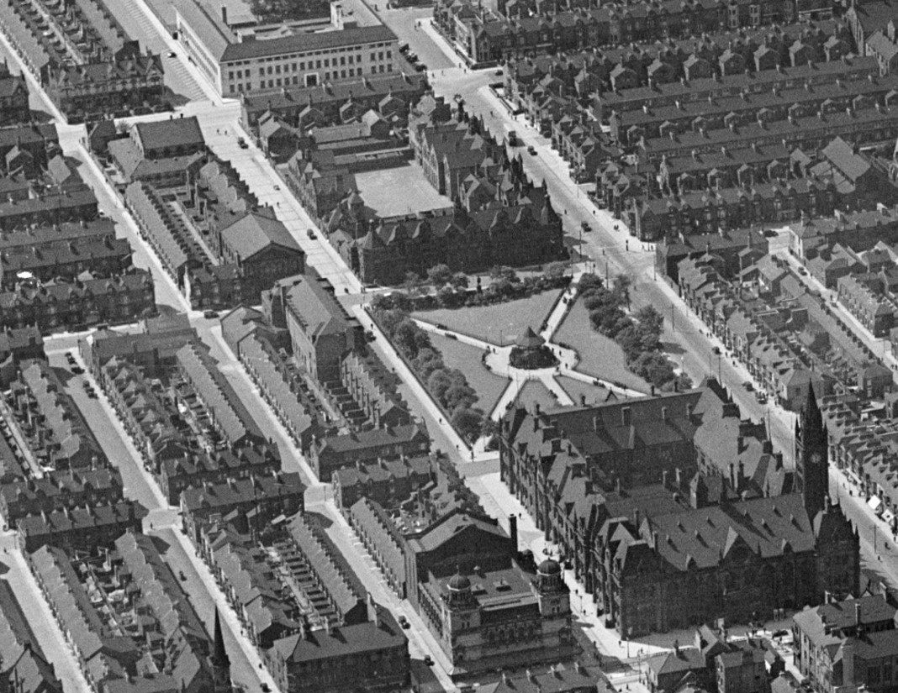
Change & Continuity around the Town Hall
Some individual buildings are still very similar to how they were in 1932, such as the Town Hall and Empire Theatre. The Hugh Bell School is no longer there – the site is now the Teesside Magistrate’s Courts. The Cleveland Centre, on the right of the Google image, has replaced several streets.
Notes:
Images: (r) Section of photo of Middlesbrough Town Hall, July EPW038954 © Historic England Archive; (l) Screenshot of Google satellite view of Central Middlesbrough
We can start looking at change and continuity around the Town Hall.
Some individual buildings are still very similar to how they were in 1932, such as the Town Hall and Empire Theatre. The Hugh Bell School is no longer there – the site is now the Teesside Magistrate’s Courts. The Cleveland Centre, on the right of the Google image, has replaced several streets.

Slide 14
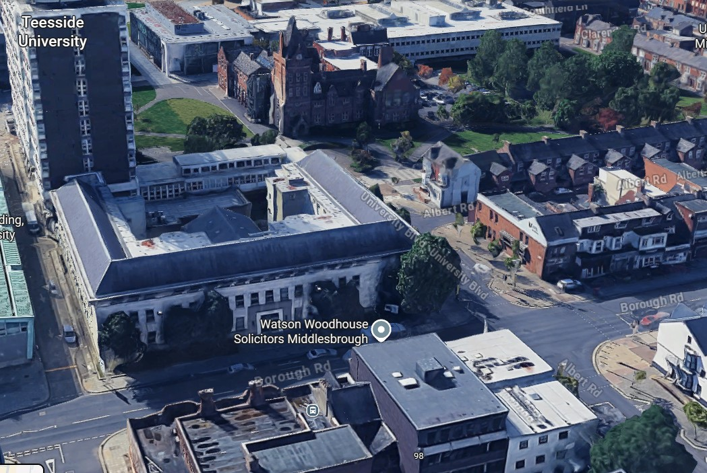
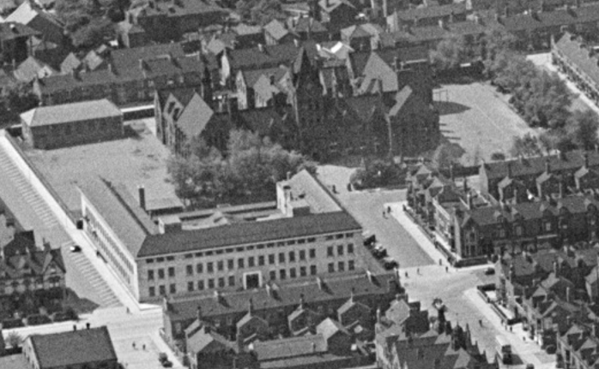
Change & Continuity in Central Middlesbrough
We can quickly identify other examples of change and continuity, using these photos, including the impact of Teesside University on the re-shaping of Middlesbrough Town Centre. From this point we can cross-reference with the map to identify and locate other examples.
Notes:
Images: (r) Section of photo of Middlesbrough Town Hall, July EPW038954 © Historic England Archive; (l) Screenshot of Google satellite view of Central Middlesbrough
We can quickly identify other examples of change and continuity, using these photos, including the impact of Teesside University on the re-shaping of Middlesbrough Town Centre. From this point we can cross-reference with the map to identify and locate other examples.

Slide 15
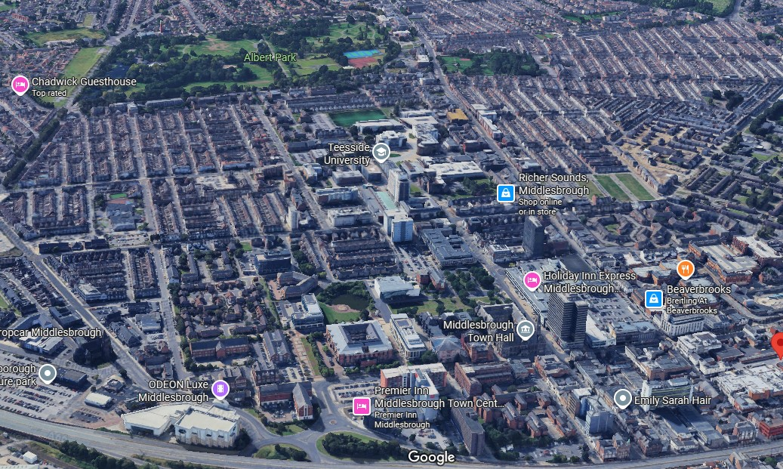
Change and continuity: seeing the bigger picture
If we look at a wider view, we can identify similar street patterns. These help us to identify areas that have changed significantly and those that have stayed largely the same.
Notes:
Images: (r) Screenshot of Google satellite view of Central Middlesbrough; (l) Section of photo of Middlesbrough Town Hall, July EPW038954 © Historic England Archive
If we look at a wider view, we can identify similar street patterns. These help us to identify areas that have changed significantly and those that have stayed largely the same.

Slide 16
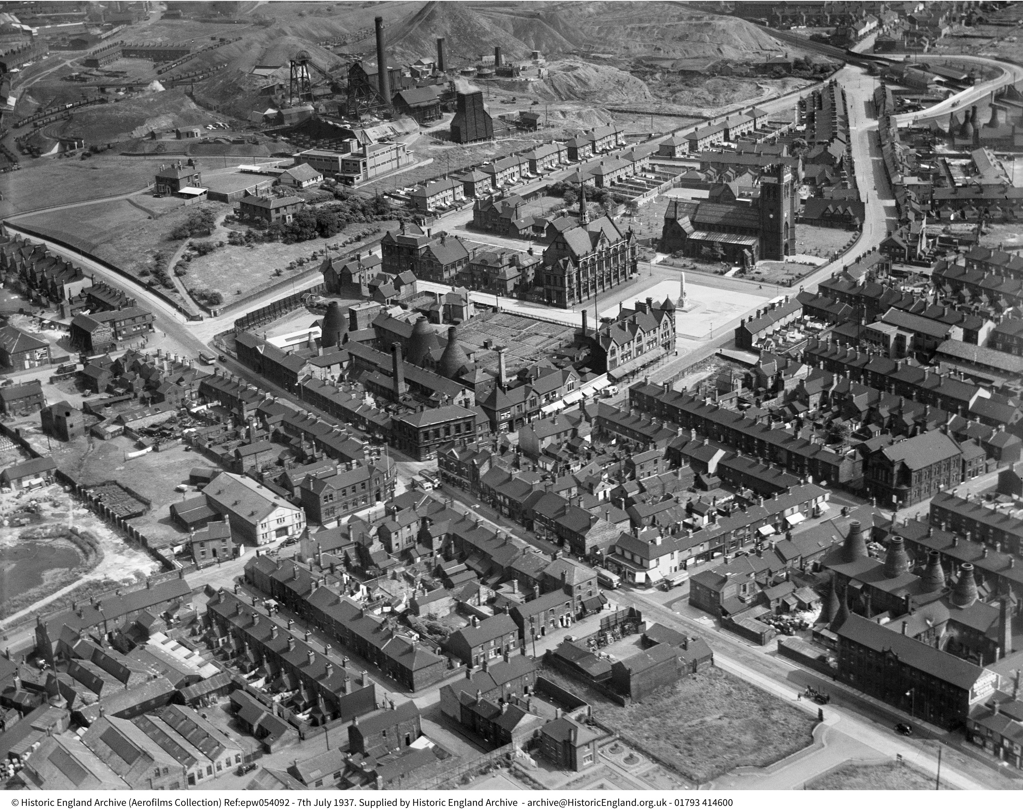
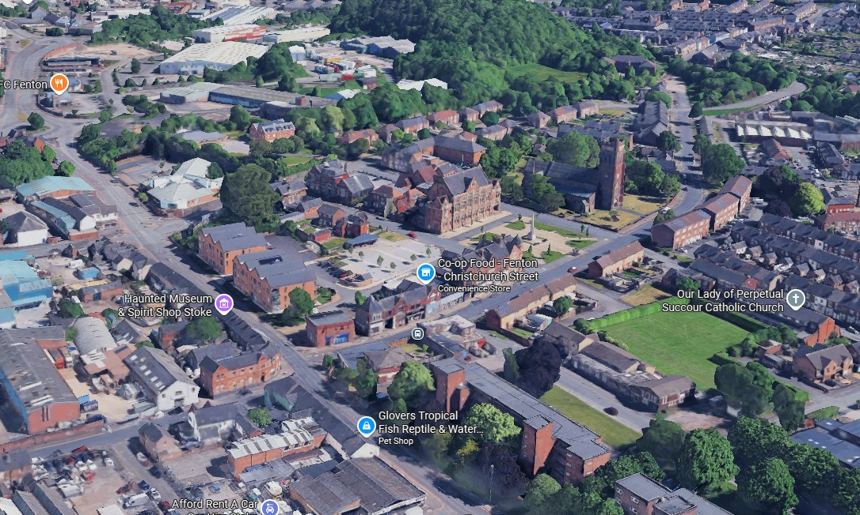
Fenton Modern and 1937
In this example of Fenton, with the 1937 oblique photo on the right, we can identify street patterns and key buildings, such as the Town Hall, Cinema, Library, War Memorial.
Fenton July 1937
We can also see some significant changes such as the pot banks no longer being extant and the land that was Glebe Colliery is now an industrial estate and Glebedale Park.
Notes:
Images: (l) Screenshot of 3D Google satellite map of Fenton; (r) Fenton July 1937 ©EPW054092 Historic England Archive
We can arrange other oblique photos in a similar way to help us look at change and continuity.
In this example of Fenton, with the 1937 oblique photo on the right, we can identify street patterns and key buildings, such as the Town Hall, Cinema, Library, War Memorial.
We can also see some significant changes such as the pot banks no longer being extant and the land that was Glebe Colliery is now an industrial estate and Glebedale Park.

Slide 17
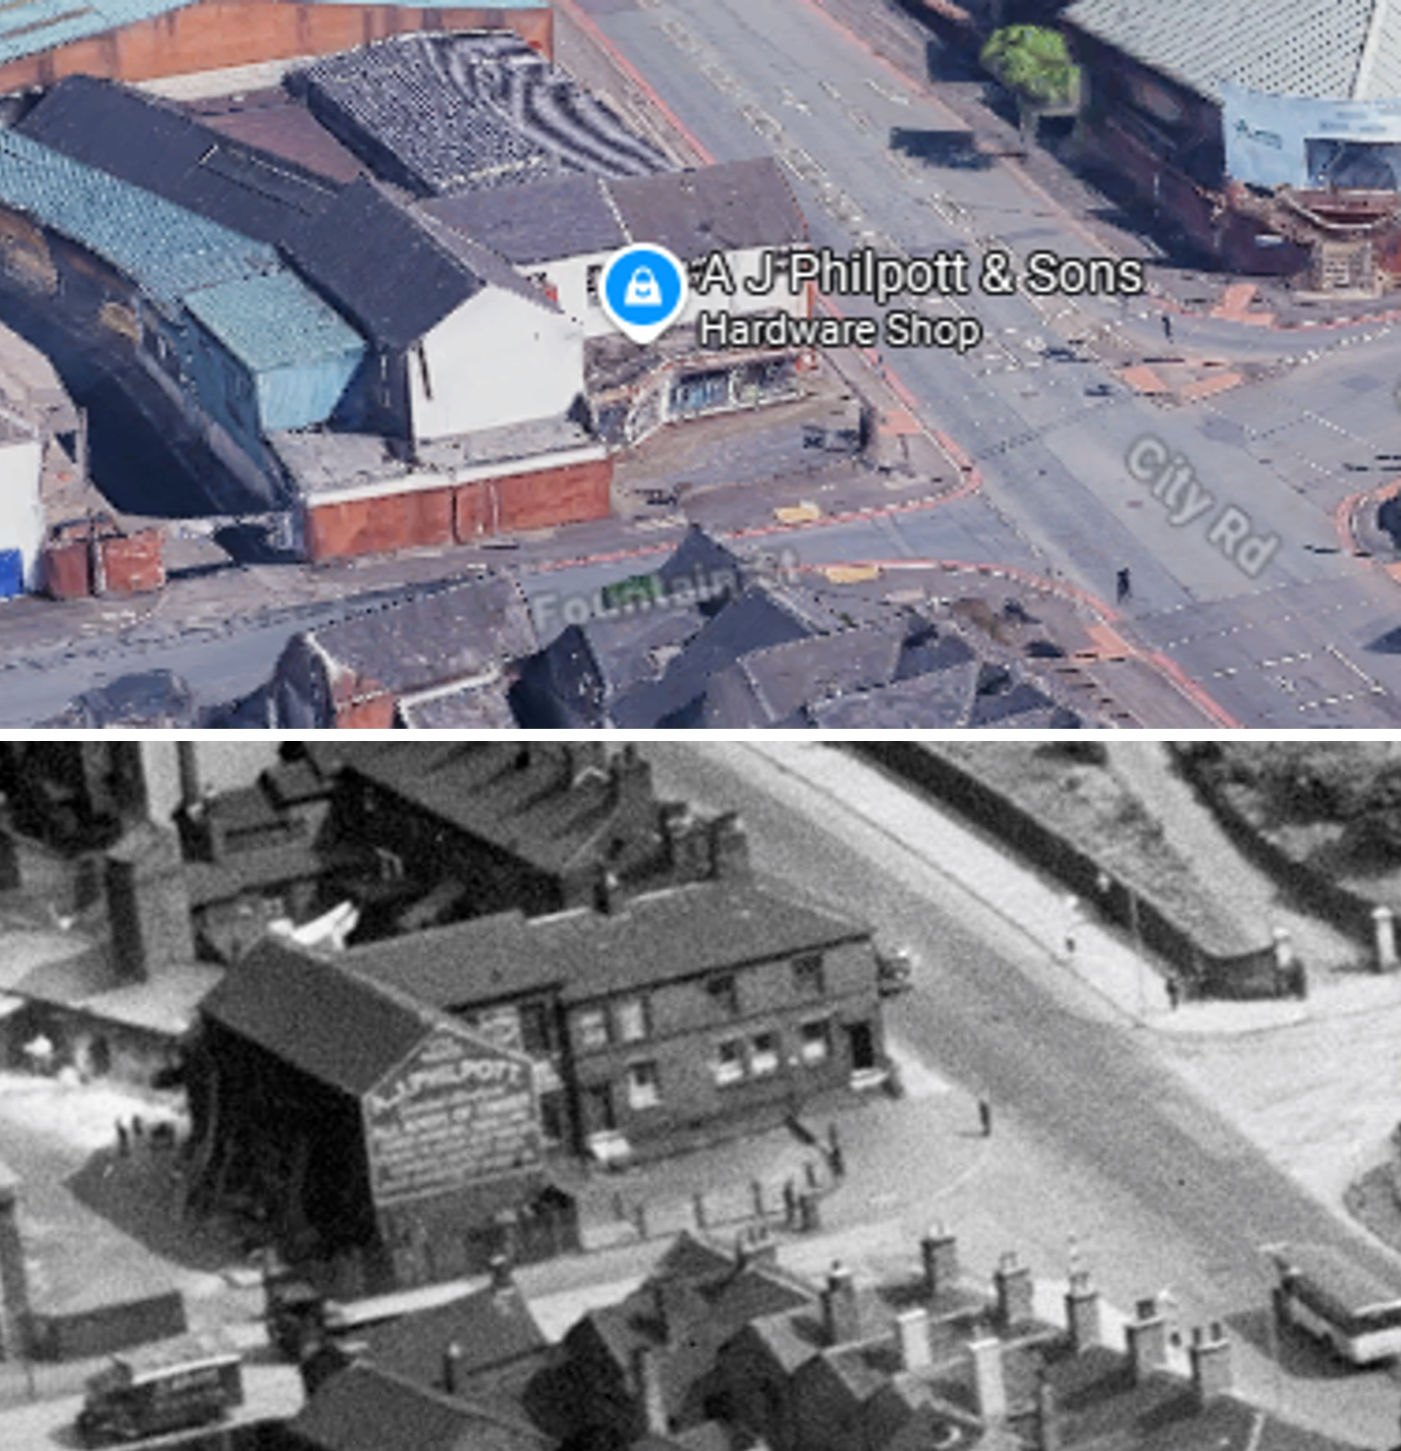
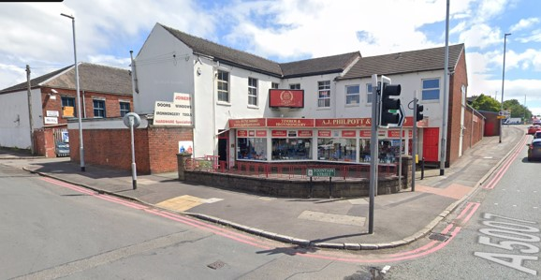
Focusing on details in photos and Google street view
We can get clues and leads from the photos, which we can follow up using Google maps and then other websites. In this Fenton example, we can zoom in and identify AJ Philpott’s shop in 1937, by the sign on the wall. A family-run hardware store, it is still going strong in 2025 and part of the area’s heritage.
Fenton, July 1937 © Historic England
Notes:
Images: (l) Screenshot of 3D Google street view of corner of Fountain St & City Rd, Fenton; (r) combined photo of zoomed in satellite view of corner of Fountain St & City Rd, Fenton and equivalent detail from photo of Fenton July 1937 ©EPW054092 Historic England Archive

Slide 18
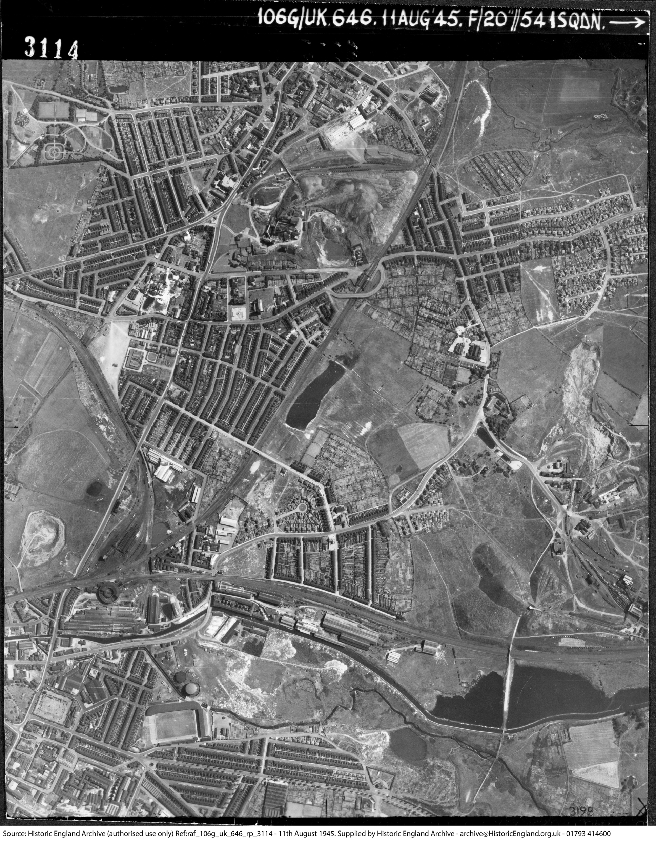
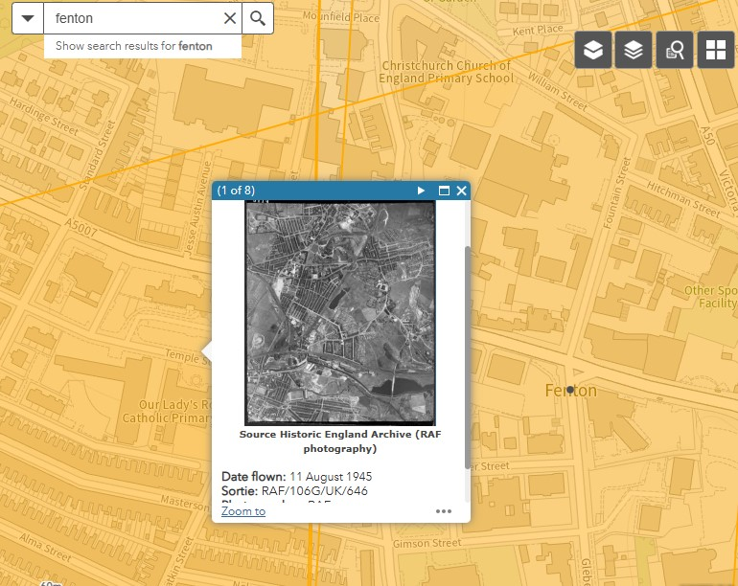
How to orientate vertical photos using Google Maps
Sometimes, the vertical photo on Aerial Photo Explorer might not orientate correctly with the map. We cannot rotate the photos but we can rotate Google Maps. Using a similar approach as we have with the obliques, we can orientate the vertical photo.
Fenton, 11th August 1935
Notes:
Images: (l) Screenshot of thumbnail photo from Historic England’s Aerial Photo Explorer; (r) Fenton, 11th August 1935 RAF/106G/UK/646 © Historic England
Sometimes, we can spot that the vertical photo on Aerial Photo Explorer might not be orientate correctly with the map. We cannot rotate the photos on Aerial Photo Explorer but we can do so with Google Maps.
We can use a similar approach with the verticals, as we have with the obliques, to help us to orientate the photo.

Slide 19
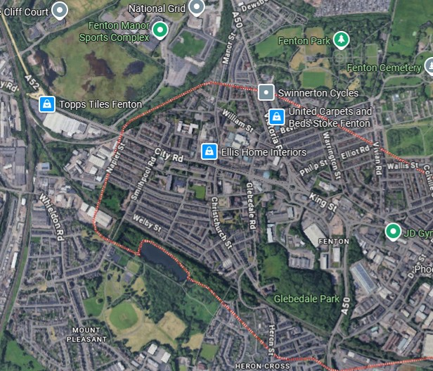
Orientating the Google satellite view in 2D to align with the photo
The map and photo show the same area but they do not align. The map needs to be rotated. Identifying distinctive shapes helps us. We use the same approach as with oblique photos in slides 5, 6 and 11 but do not need to use 3D for verticals. Using 2D, we can rotate the Google map but do not need to tilt it.
Fenton, 11th August 1945
Notes:
Images: (l) screenshot of Google satellite view of Fenton, Stoke-on-Trent; (r) Fenton, 11th August 1945 RAF/106G/UK/646 © Historic England Archive
The map and photo show the same area but the map needs to be rotated. Identifying distinctive shapes helps us. We use the same approach as with the oblique photos in slides 5, 6 and 11 but we do not need to use 3D for verticals. Using 2D, we can rotate the Google map but, this time, we do not need to tilt it.

Slide 20
Using shapes to orientate and rotate maps in 2D
The distinctive shapes on the 1945 photo help us to orientate the Google map. In this example, Fenton Park and the street patterns, such as triangles, provide helpful markers. In this case we need to rotate the map 90⁰ anti-clockwise.
Fenton, 11th August 1945
Notes:
Images: (l) screenshot of Google satellite view of Fenton, Stoke-on-Trent; (r) Fenton, 11th August 1935 RAF/106G/UK/646 © Historic England Archive​
​
Using a modern image of Fenton, we can use some of the shapes on the 1945 map to help us orientate the Google map. In this case we need to rotate it 90⁰ anti-clockwise. In this example Fenton Park and distinctive street patterns - in this case some triangles, angles and clusters of small parallel streets - give us helpful marker shapes.

Slide 21
Comparing the correctly aligned map and photo
With the map and photo now correctly aligned, we can study both to look at change and continuity.
Fenton, 11th August 1935
Notes:
Images: (l) screenshot of Google satellite view of Fenton, Stoke-on-Trent; (r) Fenton, 11th August 1935 RAF/106G/UK/646 © Historic England Archive
Now that you have aligned the map with the photo, and can identify specific details, you can used the photos to look at change and continuity in a particular area.
To look more at how to explore change and continuity, see ‘How to Use Aerial Photo Explorer to study how a site changes over time’ and you can watch our film Using Aerial Photographs

