Slide 1
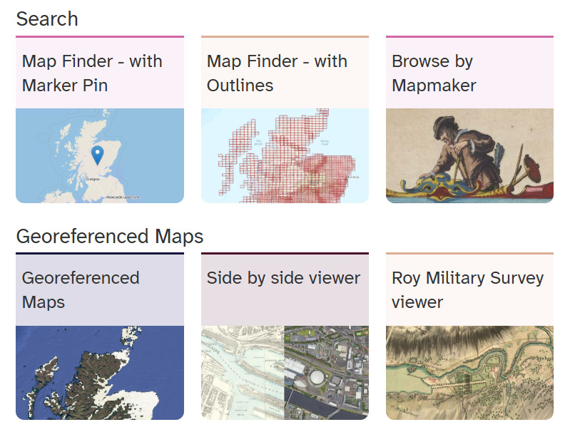
How to find and use old maps on the National Library of Scotland website
How to find and use old maps on the National Library of Scotland website
https://maps.nls.uk/

Slide 2

Find the NLS website
Go to: https://maps.nls.uk/ then select ‘Map Finder – with Marker Pin’

Slide 3
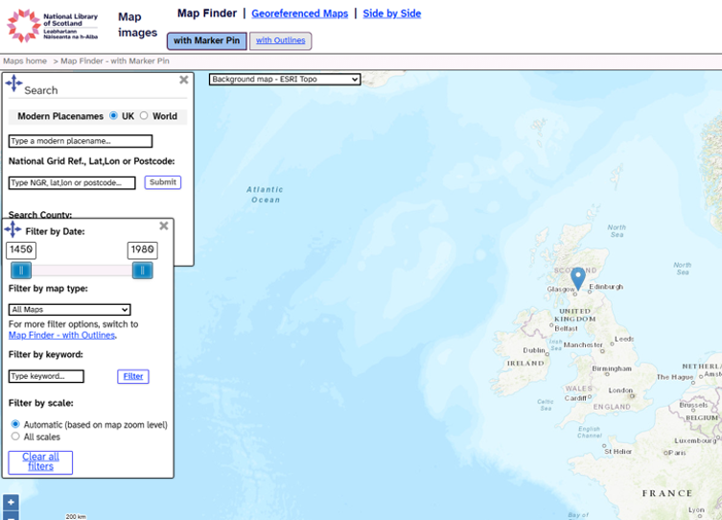
Type a modern placename in the Search box
Choose the correct place from the dropdown menu when it appears

Slide 4
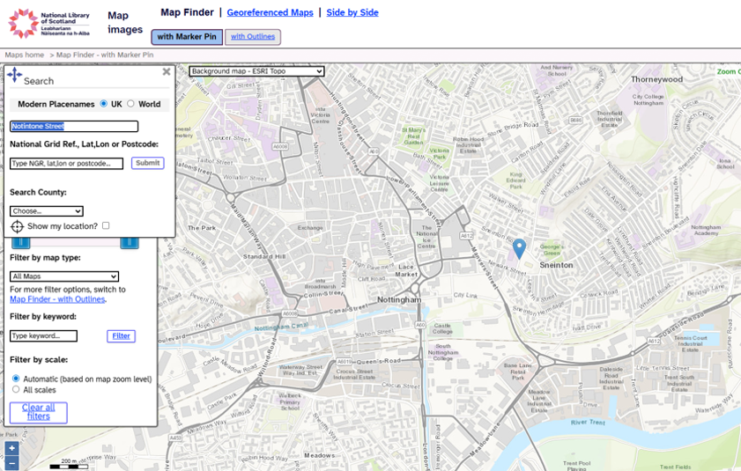
When you click on a place a marker will appear
Then click on ‘Side by Side’ at the top of the page

Slide 5
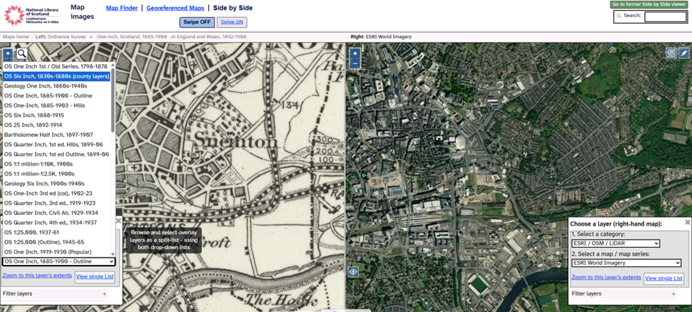
The page will be split in two, a marker appears on both sides
To get an even better map, change the old map to a Six-Inch map on the drop-down menu

Slide 6
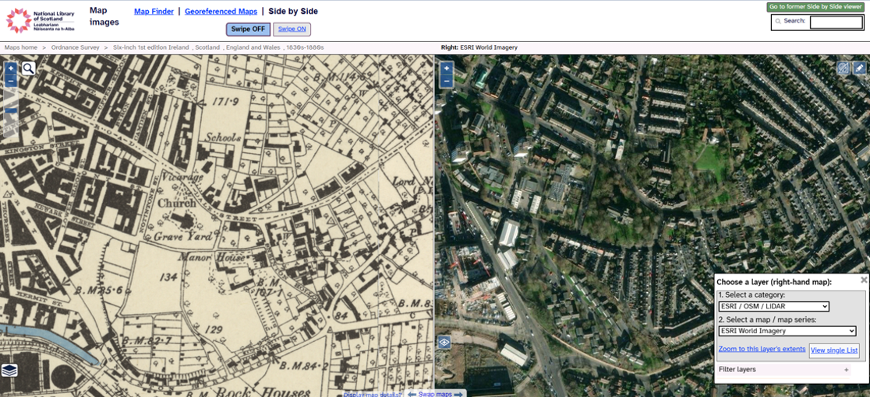
Use your mouse or the + - icons to zoom in and out
Your curser should appear on both sides of the screen

Slide 7
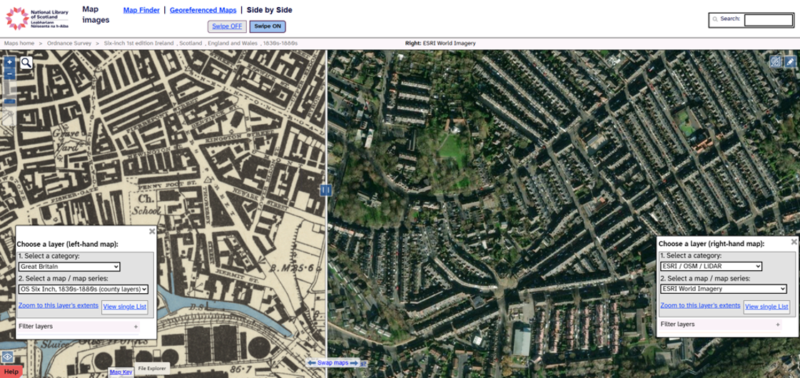
If you prefer, you can use the swipe function
Click the ‘Swipe ON’ button at the top of the page

Slide 8
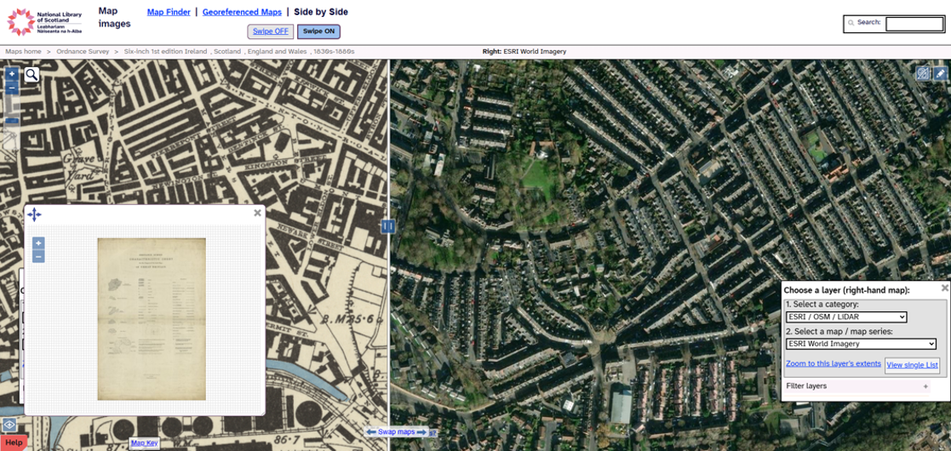
To find the date of the old map, click ‘map key’
It is at the bottom of the page on the left

Slide 9
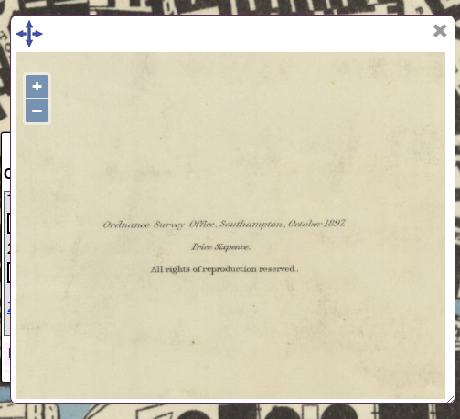
Zoom in to the bottom of the page and find the date
This map was published in October 1897

Slide 10


Have fun exploring your area.
What has changed? What is still the same?
Change
over time
Similarities &
differences

Slide 11
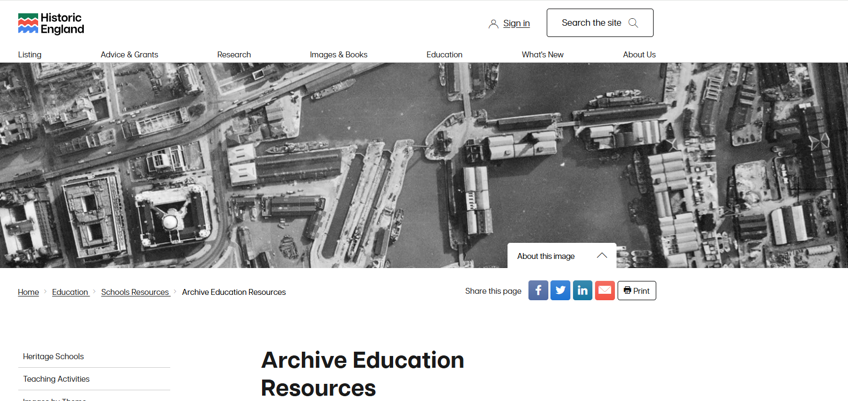
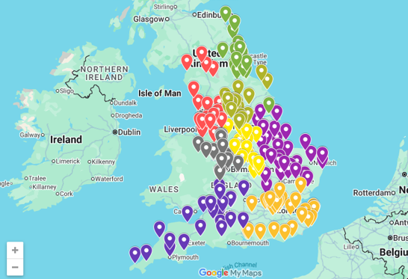
Find out more about Historic England’s old map and aerial photo collections in our Archive Resource Packs

