Slide 1
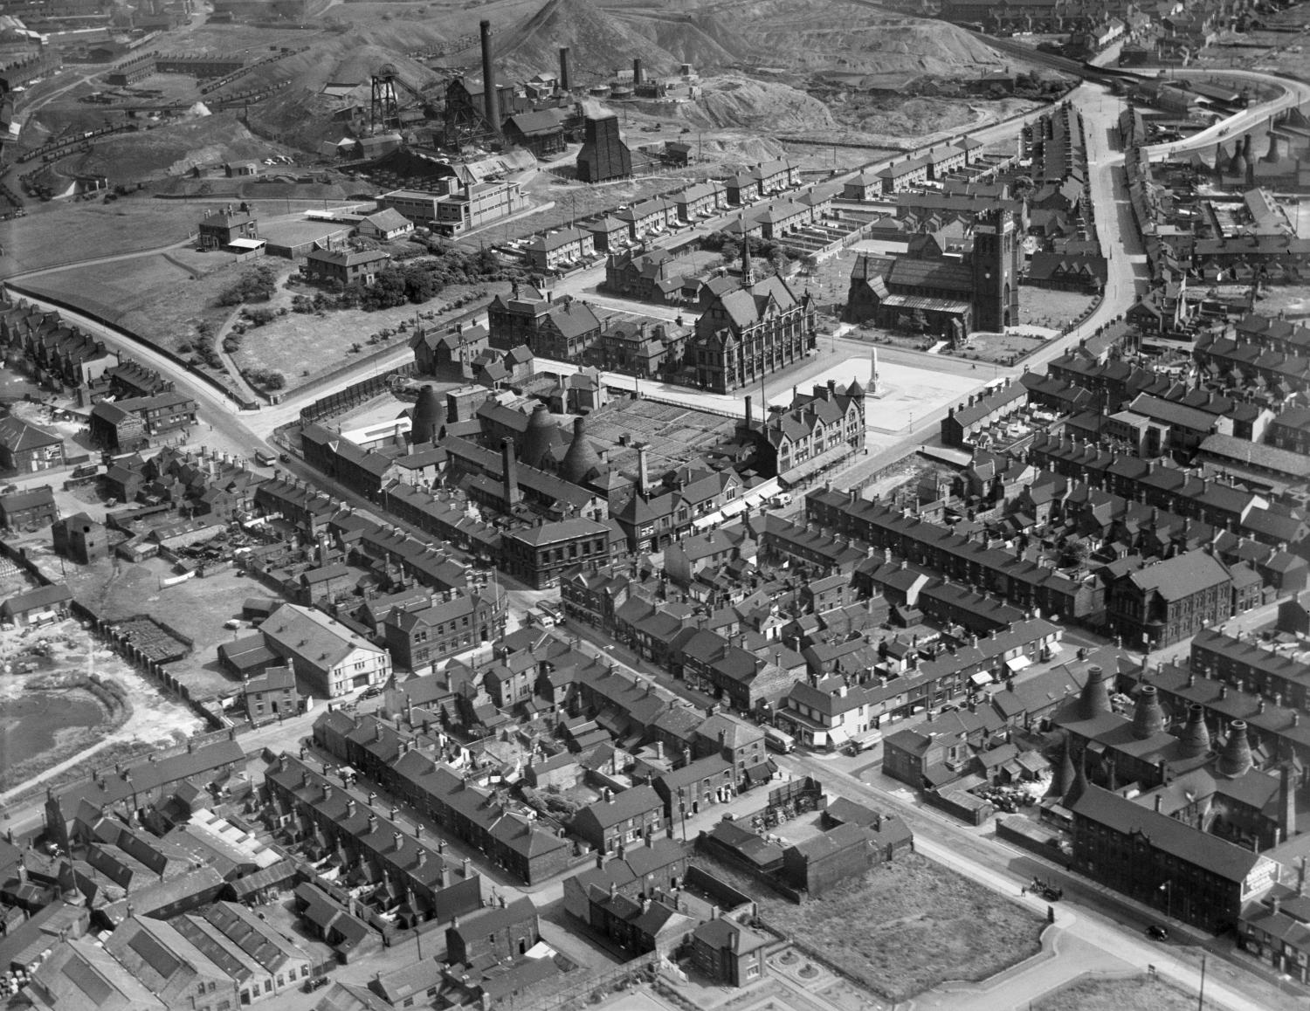
How to explore different layers in Aerial Photo Explorer
How to…..
How to explore the different layers in Aerial Photo Explorer
Notes:
Image: Fenton July 1937 ©EPW054092 Historic England Archive

Slide 2
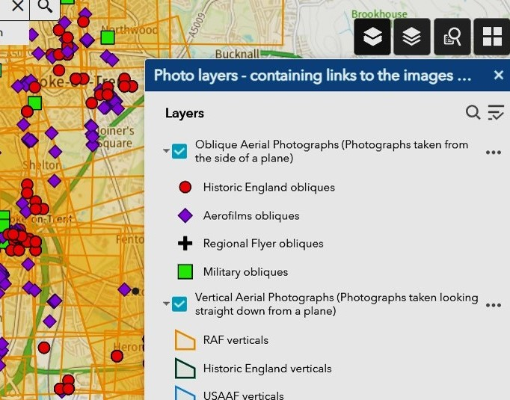
How to use different layers in Aerial Photo Explorer
This guide will:
Help you to understand how to use different layers to enhance your experience of Aerial Photo Explorer
Help you to select the most appropriate base map to help you find photos of your target area
Help you to find photos of specific locations, that are in built-up areas, more confidently
You can find more guides in our 'How To Use Aerial Photo Explorer' section
Notes:
Image: Screen shot of Historic England’s Aerial Photo Explorer map with the symbols and key for the different layers
This guide will help you to understand how to use the different layers, in order to enhance your experience of Aerial Photo Explorer
Help you to select the most appropriate base map to help you find photos of your target area
Help you to find photos of specific locations, that are in built-up areas, more confidently

Slide 3
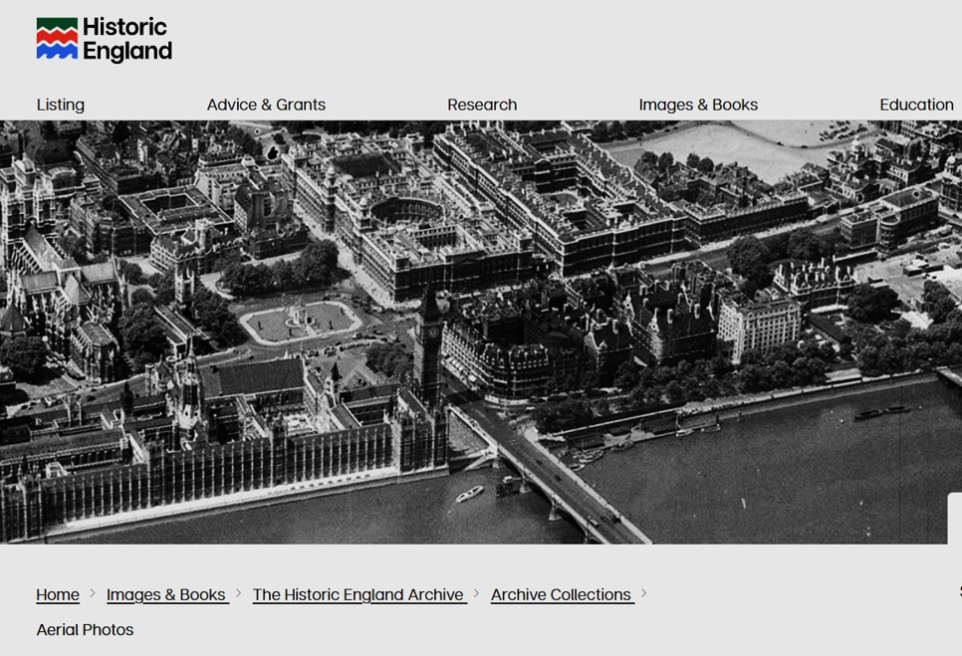
To find the Aerial Photo Explorer website
To start:
In your browser search for: https://historicengland.org.uk/images-books/archive/collections/aerial-photos/
You will see the main Historic England website banner.
https://historicengland.org.uk/images-books/archive/collections/aerial-photos/
Notes:
Image: (l) Screenshot of Historic England’s Aerial Phot Explorer webpage banner
To start with, search in your web browser using this URL web address for the Aerial Photo Explorer website. You will see the Historic England logo and website banner.

Slide 4


Different coloured symbols in Aerial Photo Explorer
You will see different symbols on the map. These relate to the different photograph collections that are held in the Historic England Archive.
Click on the two-book 'photo layers' icon to see what the symbols represent.
Many photographs were taken by the Aerofilms company. Some collections are photos taken by individual photographers.
The red dots are all photos taken more recently (mostly in the 2000s) by Historic England photographers.
All the yellow, blue or green grid shapes are vertical photos.
All the coloured marker shapes denote oblique photos
Notes:
Image: Screen shot of Historic England’s Aerial Photo Explorer map with the symbols and key for the different layers
You will see different symbols on the map. These relate to the different photograph collections that are held in the Historic England Archive
Click on the double book 'photo layers' icon to see what the different symbols represent.
Many oblique photographs were taken by the Aerofilms company. These are denoted by the purple diamonds. Some photos were taken by individual photographers and have come from local collections. These are denoted by the black crosses. The green squares are military photos, mainly taken by the RAF or US Air Force around during, and just after, the Second World War.
The red dots are all photos taken more recently (mostly in the 2000s) by Historic England photographers. The different coloured grids are vertical photos mainly from RAF or USAAF collections or are more recently taken Historic England photos.

Slide 5
De-Selecting layers of vertical or oblique photos
If you only want to see oblique markers, then uncheck the vertical aerial photographs box.
This can help when there are a lot of vertical grid markers.
De-selecting them can make it a bit easier to be precise about identifying a specific location.
To find out more about oblique and vertical aerial photographs you can view our 'How to explore different types of aerial photographs’ guide.
Notes:
Image: Screen shot of Historic England’s Aerial Photo Explorer map with the symbols and key for the different layers
You can remove some of these symbols from the screen to make the view less busy.
For example, if you only want to see oblique markers, uncheck the vertical aerial photos box.
To find out more about oblique and vertical aerial photographs you can view our 'How to explore different types of aerial photographs’ guide

Slide 6
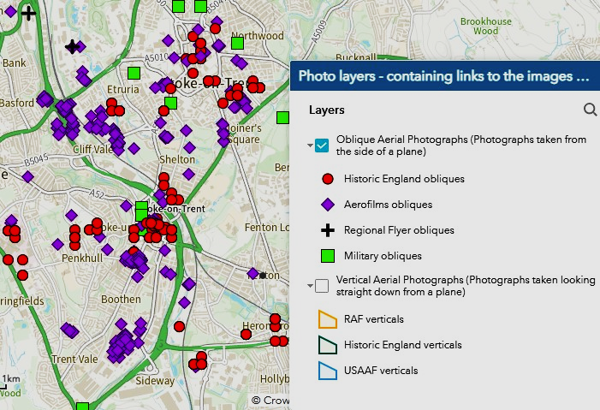
Selecting oblique photos only
With the vertical aerial photo box now unchecked, you only see the red, purple, green and black symbols.
This can make it easier to find the precise area you are looking for.
Now we can choose to click on any of the coloured symbols, to see an oblique photo.
Alternatively, you may uncheck the oblique box, so you just see the vertical grids more clearly.
Notes:
Image: Screen shot of Historic England’s Aerial Photo Explorer map with the symbols for oblique photos
Now that you have unchecked the vertical photo layer box, the map appears less busy with orange and you can just see the red, purple, green and black symbols. This can make it easier to close in on the area you want to focus on. You can then select which symbol you want to click on to open an oblique photo.

Slide 7
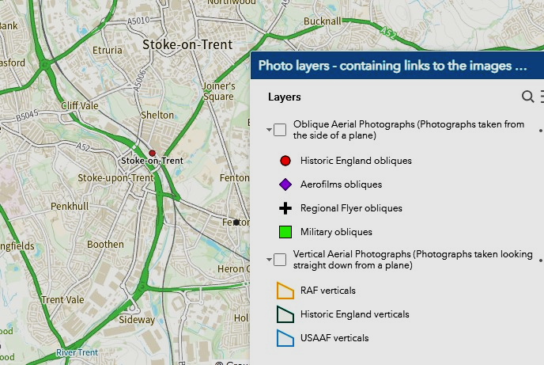
De-selecting both oblique and vertical photos
When the area you are looking at is very ‘busy’ with grids and markers – usually large towns and cities – you may find it useful to uncheck both sets of photos.
This leaves you with just the map. This can make it even easier to identify the precise location for where you want to find photos.
You may then zoom into the map to an exact location.
Notes:
Image: Screen shot of Historic England’s Aerial Photo Explorer map without any symbols and key for the different layers
If there are lots of photos of your area, the map can appear very busy – often in large towns or industrial areas. To help even further you can de-select both types of photos by unchecking both the oblique and vertical boxes. This leaves you with just the map, which should make it easier for you to identify the precise location you want to study. You can then zoom in to an exact location.

Slide 8
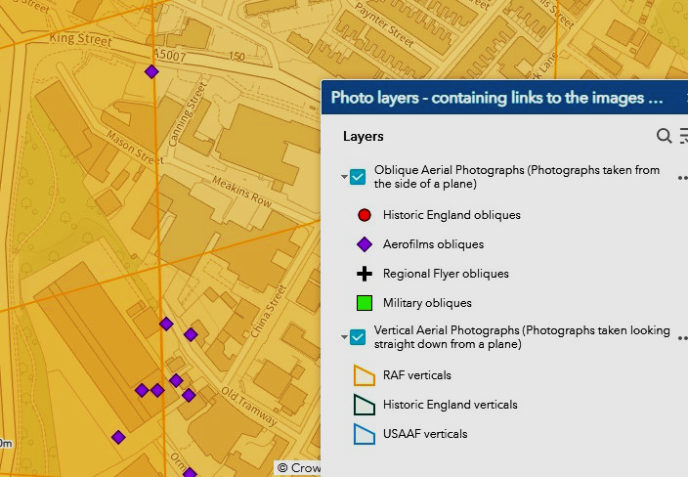
Re-selecting both oblique and vertical photos
Once you have identified your exact area of interest and zoomed in on the map, you can then re-check both boxes.
The grid markers and symbols will re-appear, and you can be more confident about which you need to click to get the photos you will be most interested in.
You can then click on an orange grid - for a vertical - or a coloured symbol - for an oblique photo - knowing it will feature the location you are interested in.
Notes:
Image: Screen shot of Historic England’s Aerial Photo Explorer map with the symbols and key for the different layers
Once you have identified the exact area you want to focus on, you can re-check one or both of the sets of photos and see what photos are available for your area.
The grid markers and symbols will re-appear, and you can be more confident about which you need to click to get the photos you will be most interested in.
You can then click on an orange grid - for a vertical - or a coloured symbol - for an oblique photo - knowing it will feature the location you are interested in.
You can then click on an orange grid - for a vertical - or a coloured symbol - for an oblique photo - knowing it will feature the location you are interested in.

Slide 9
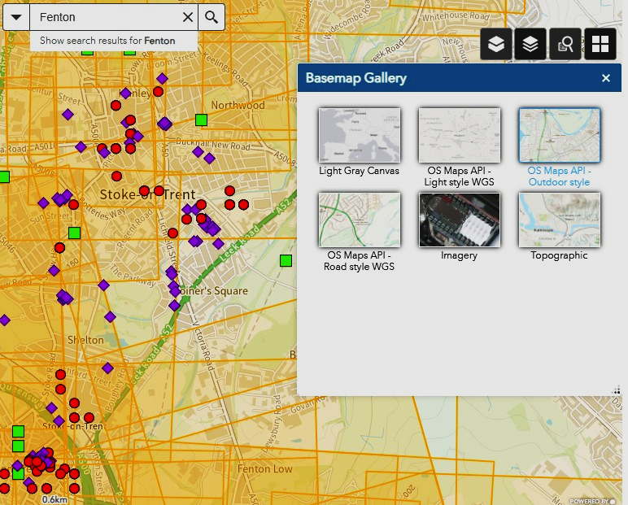
How to change base maps
You may find you would prefer to use a different base map, when searching for photos.
If you want to change the base map, click on the 4 square icon, for the Basemap Gallery on the right- hand side of the map.
The default base map for aerial photographs is OS MAPS API Road style.
You can change this if you find another type of basemap easier to use.
Notes:
Image: Screen shot of Historic England’s Aerial Photo Explorer map with the symbols and key for the different basemaps
Another way to help you to use the map search is to change the base map itself.
You may find you would prefer to use a different base map, when searching for photos.
If you want to change the base map, click on the 4 square icon, for the Basemap Gallery on the right- hand side of the map.
The default base map for aerial photographs is OS MAPS API Road style.
You can change this if you find another type of basemap easier to use.

Slide 10
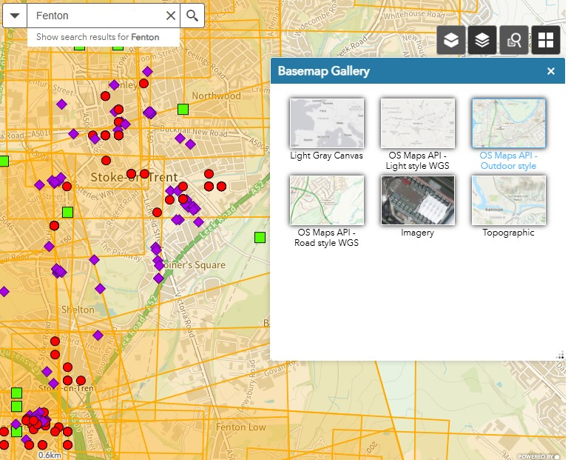
Changing the base map to Imagery
You may like to use Imagery, so that you have a modern satellite view, to help you identify the exact location you want to look at
Click on the 4 square icon on the right hand side of the map
Then click on ‘Imagery’
This will give you a satellite view as your base map
Notes:
Image: Screen shot of Historic England’s Aerial Photo Explorer map with the symbols and key for the different basemaps
You may like to use Imagery, so that you have a modern satellite view, to help you identify the exact location you want to look at
Click on the 4 square icon on the right hand side of the map
Then click on ‘Imagery’
This will give you a satellite view as your base map

Slide 11
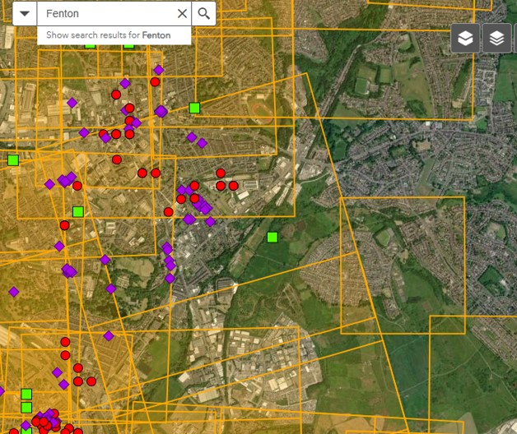
Using the Imagery base map
For example, you may prefer a satellite view to a map – there may be some local features that are easier to identify on this type of basemap
When you select the Imagery basemap, you get a satellite view.
This looks quite different, and you may prefer to use this to help you identify your specific chosen location or even individual streets or buildings
Notes:
Image: Screen shot of Historic England’s Aerial Photo Explorer map with the symbols and gridlines
For example, you may prefer a satellite view to a map – there may be some local features that are easier to identify on this type of basemap
When you select the Imagery basemap, you get a satellite view.
This looks quite different, and you may prefer to you this to help you identify your specific chosen location or even individual streets or buildings

Slide 12
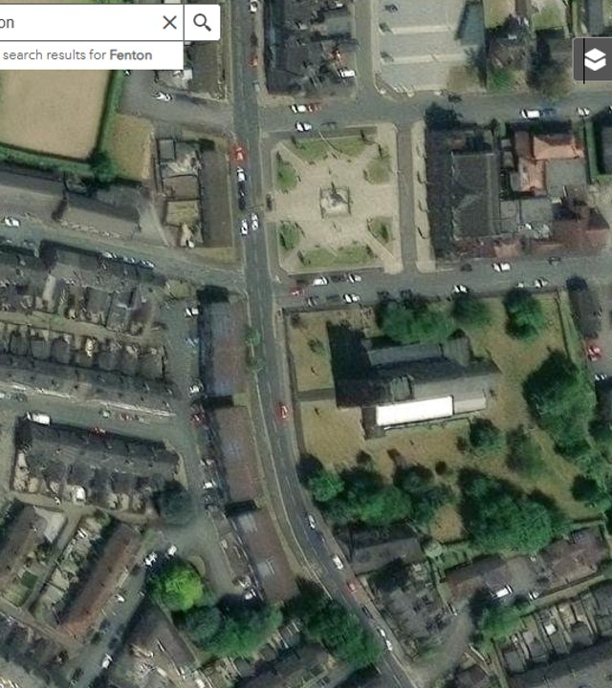
Using the Imagery base map and unchecking photo layers
Of course, you could also uncheck the oblique and vertical photos and zoom in very close. This gives a really clear view so you can look at very specific streets and buildings.
This allows you to enhance your search.
Then you can re-check the required boxes to make the grids and symbols re-appear to ensure you get the photos you are looking for.
You can find more guides in our 'How To Use Aerial Photo Explorer' section
Notes:
Image: Screen shot of Historic England’s Aerial Photo Explorer basemap in Imagery view
Of course, you could also uncheck the oblique and vertical photos and zoom in, to help you even further
Then you can re-check the required boxes to make the grids and symbols re-appear to ensure you get the particular photos you are looking for.
We can then find an appropriate photo for this area

Slide 13
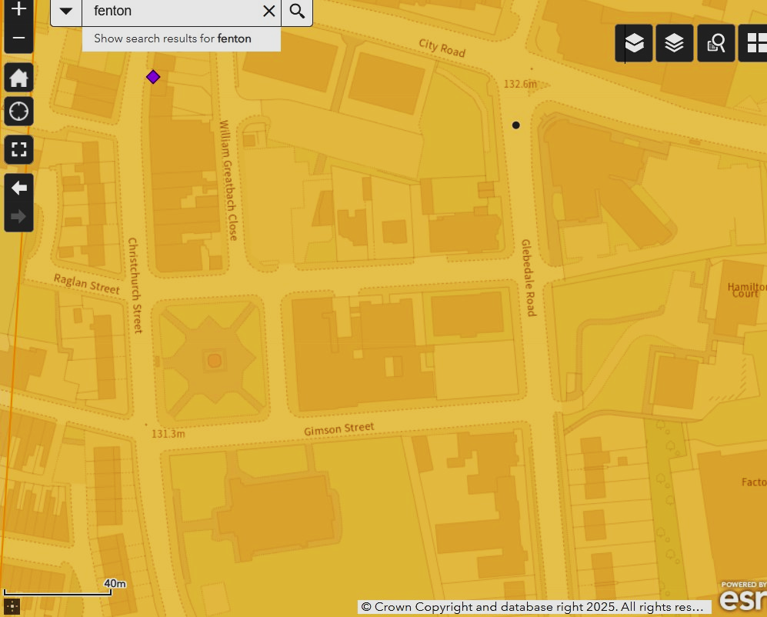
Re-checking oblique and vertical photos on map
When we re-check the oblique and vertical photos, we can see we have a choice of each for this specific area
There is a purple symbol, showing there is an oblique Aerofilms photo and there is a vertical photograph
We can click on the purple symbol to see what the photo is
This approach is especially useful when looking at large towns and cities where you may have lots of grids and symbols in a small area of the map.
Notes:
Image: Screen shot of Historic England’s Aerial Photo Explorer map with the symbols and gridlines

Slide 14
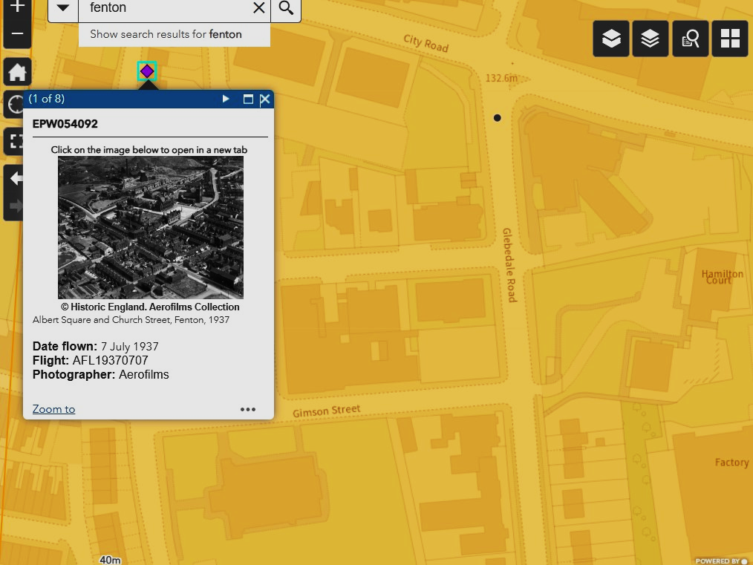
Fenton 1937
Here we see an oblique photo, showing Fenton in July 1937
We can click on the thumbnail image to open the photograph fully
Notes:
Image: Screen shot of Historic England’s Aerial Photo Explorer map with the symbols and gridlines

Slide 15
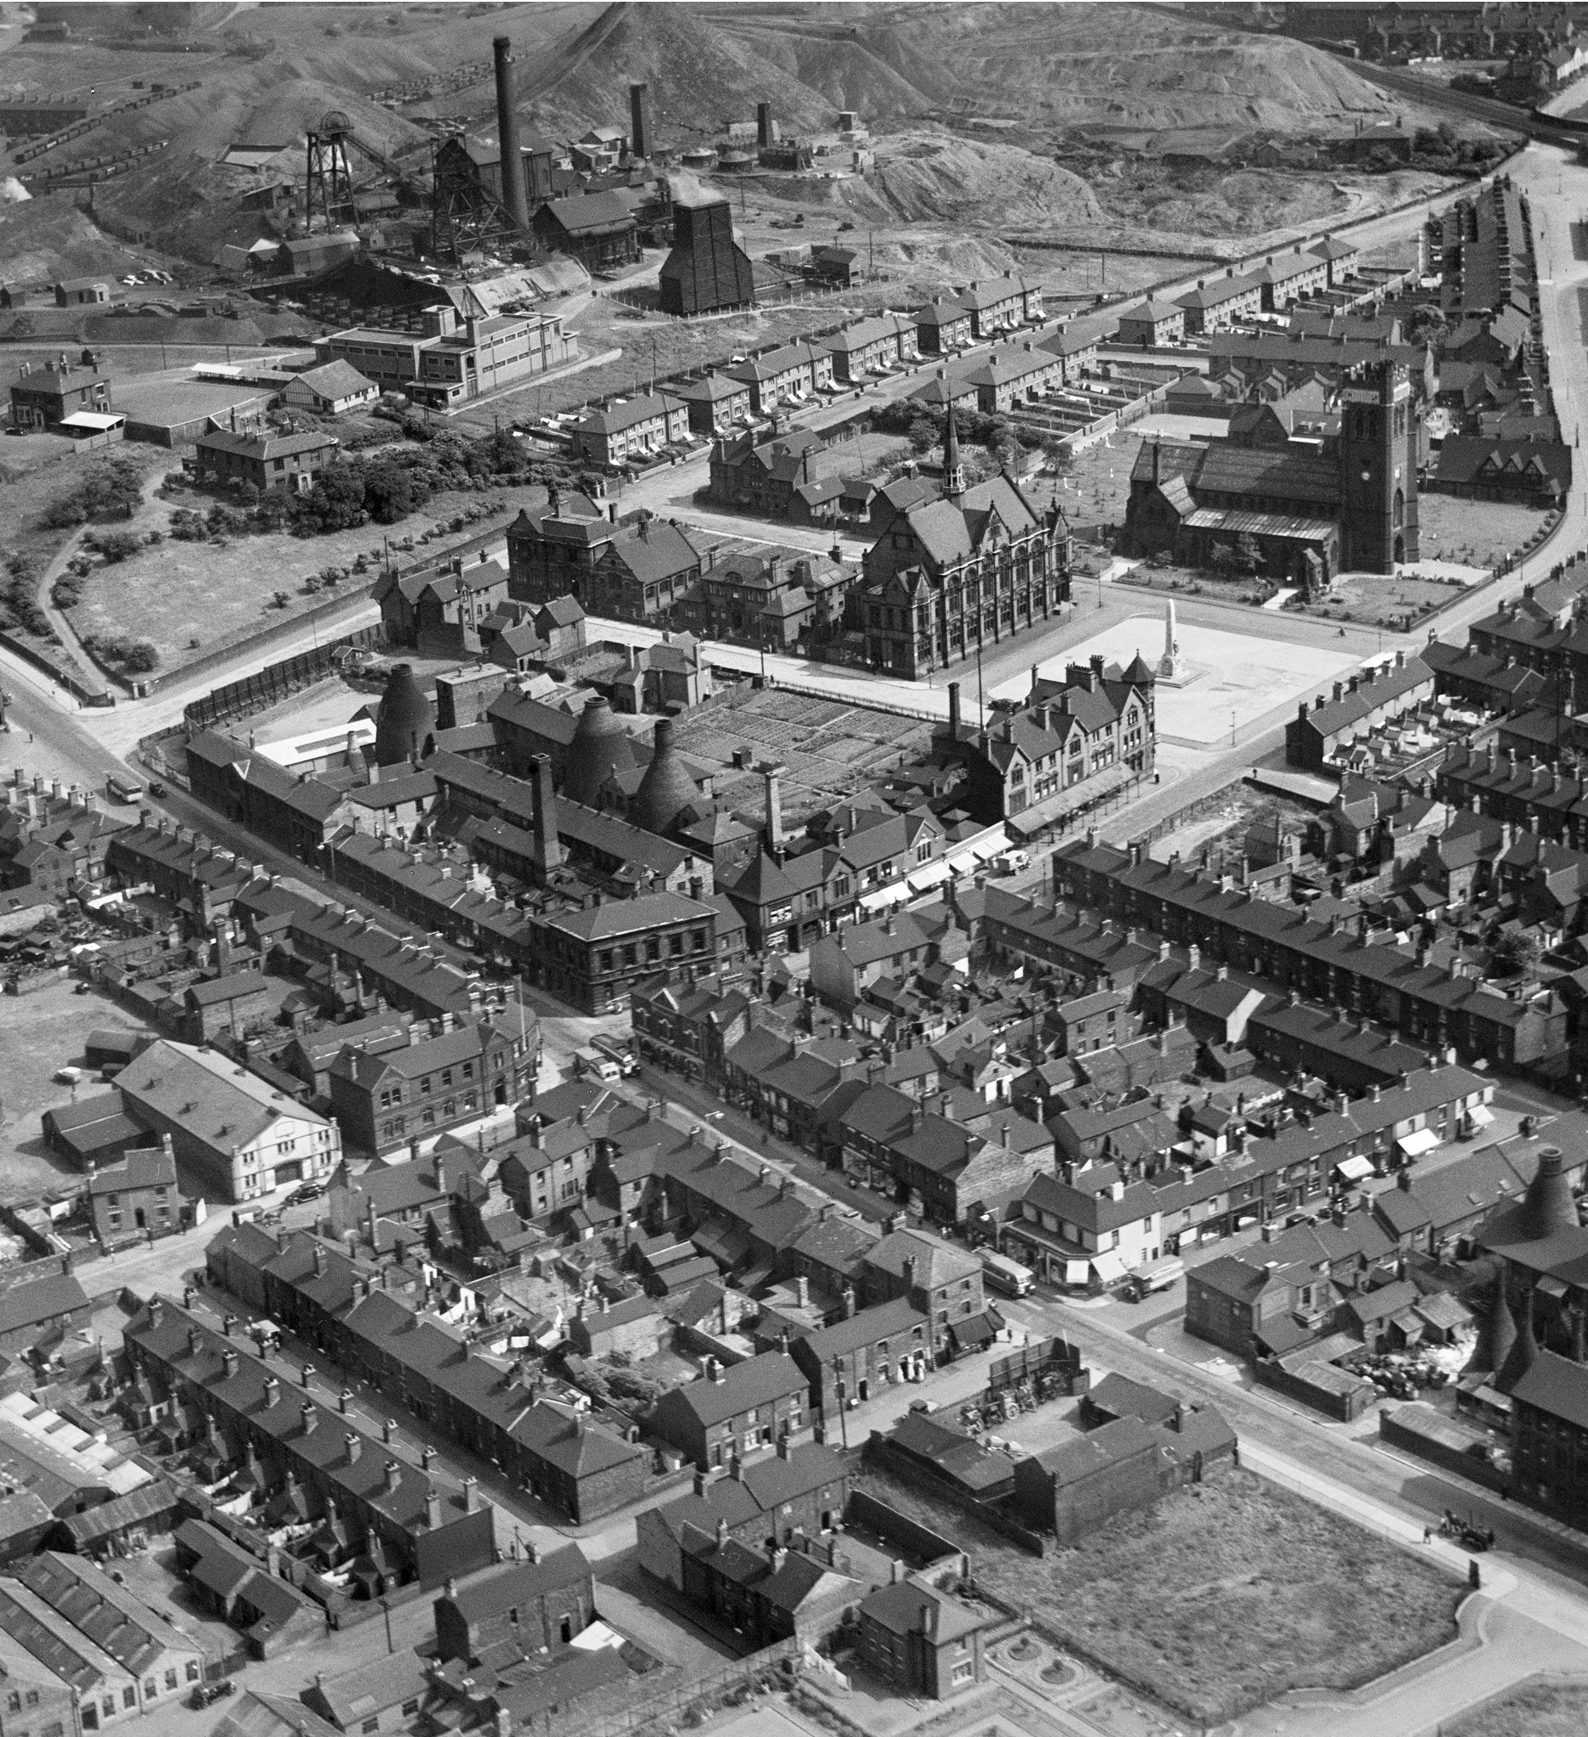
Fenton, July 1937
This is a brilliantly sharp image, showing the exact area we want to view
It is an excellent example of the Archive photos that you can find on Aerial Photo Explorer
It is very clear and detailed, showing:
Glebe Colliery
Fenton Town Hall
Fenton War Memorial
Fenton Library
Christ Church
Sutherland Pottery
Fenton School of Art
Fenton Workingman’s Club & Institute
Cinema
Fenton, July 1937
Notes:
Image: Fenton July 1937 ©EPW054092 Historic England Archive
This is a brilliantly sharp image, showing the exact area we want to view
It is an excellent example of the Archive photos that you can find on Aerial Photo Explorer
It is very clear and detailed, showing:
Glebe Colliery
Fenton Town Hall
Fenton War Memorial
Fenton Library
Christ Church
Sutherland Pottery
Fenton School of Art
Fenton Workingman’s Club & Institute
Cinema

Slide 16
Selecting a vertical photo on using the orange grids
We can also look at a vertical photo
We can click anywhere on the orange grid to get a thumbnail of the aerial photo
Notes:
Image: Screen shot of Historic England’s Aerial Photo Explorer map with the symbols and gridlines

Slide 17
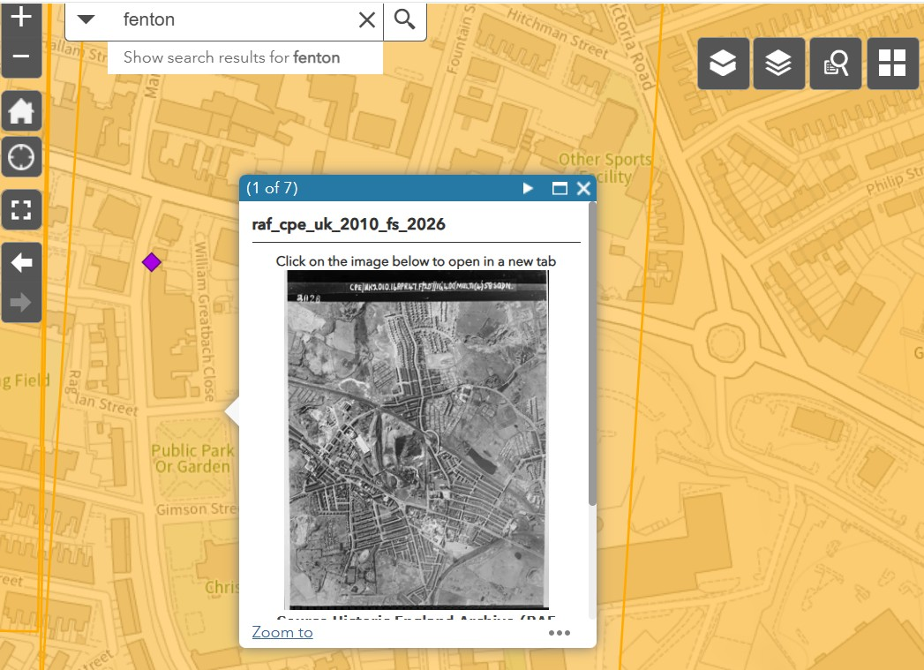
Selecting a vertical photo on the map
When the thumbnail appears we can click on it to open the full photo
Notes:
Image: Screen shot of Historic England’s Aerial Photo Explorer map with the symbols and gridlines with thumbnail photo

Slide 18
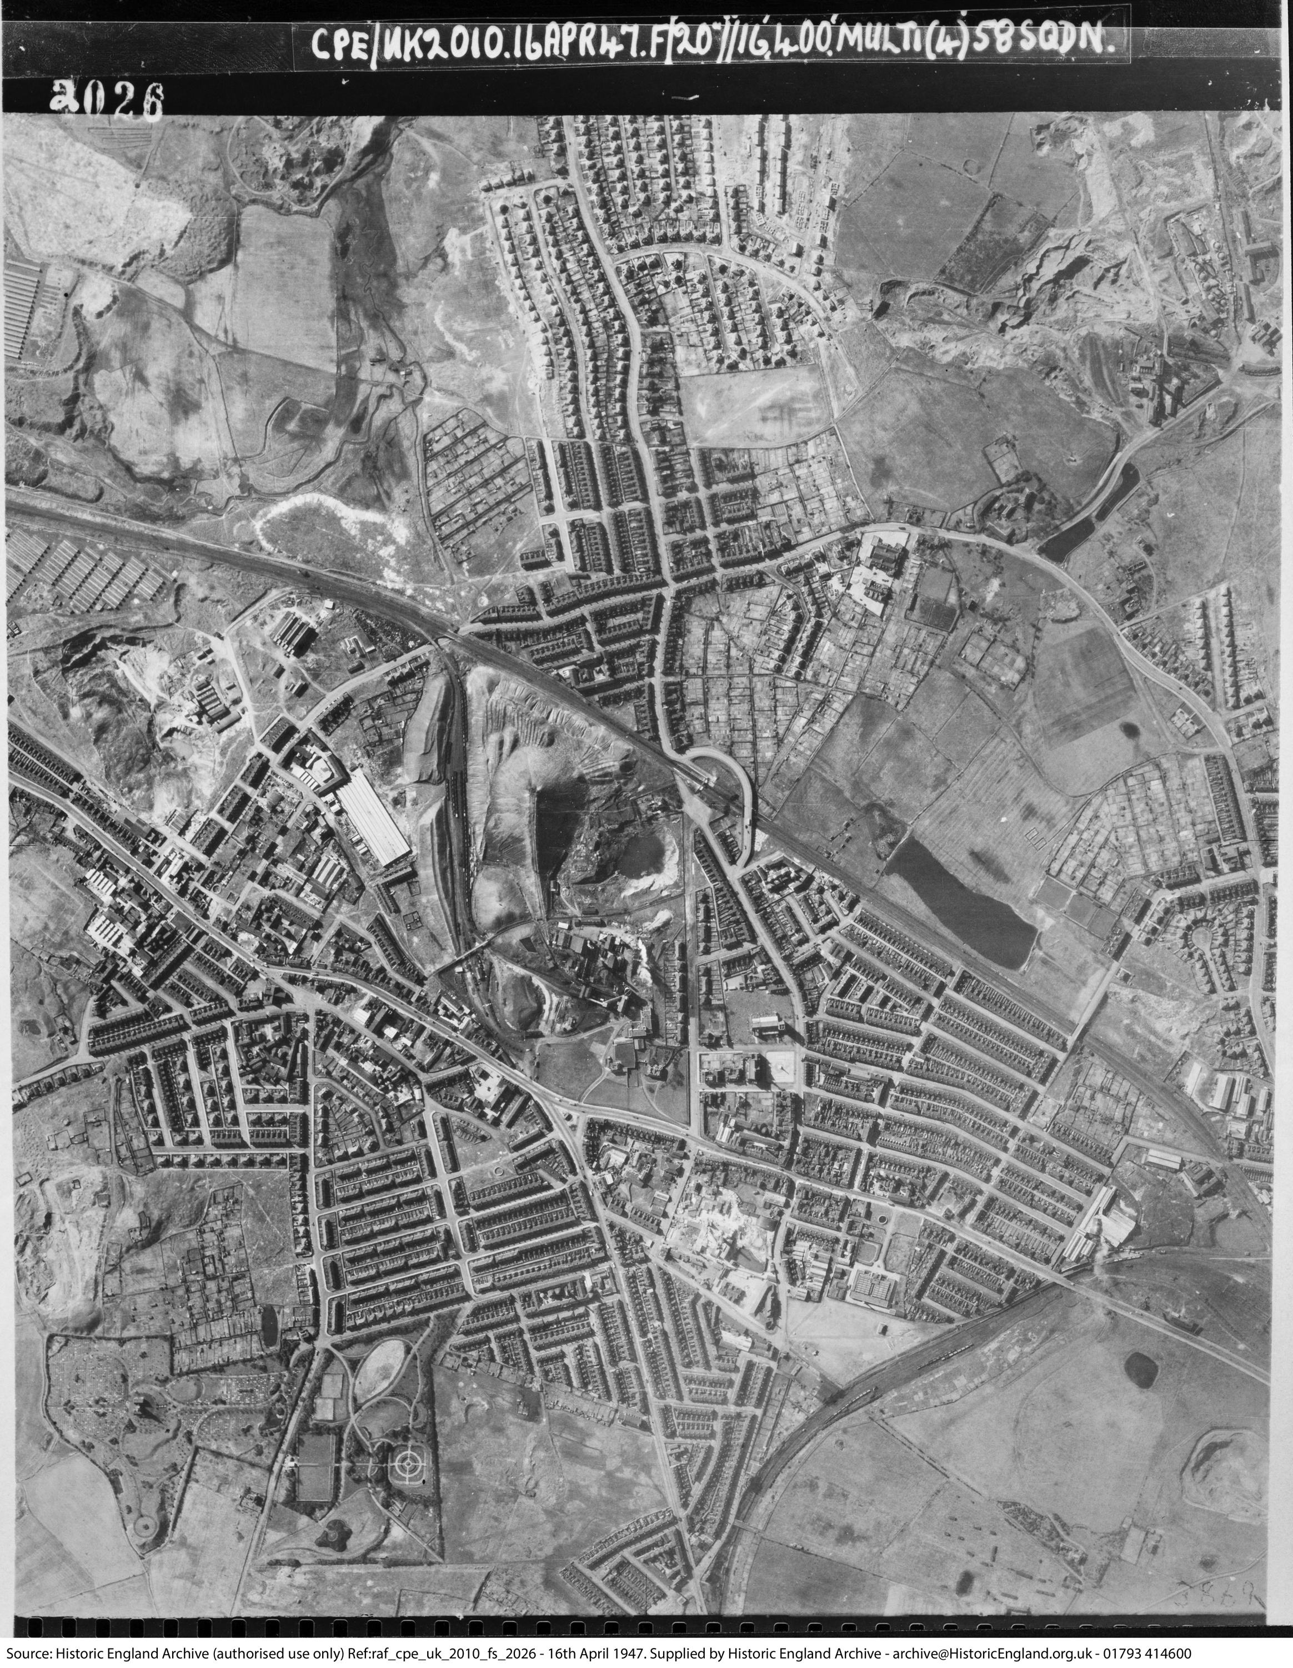
Studying the vertical photo
This photo shows us a bird’s eye view of a wider geographical area, including the buildings that we have looked at on the oblique photo from July 1937
Thus, we may often get the big picture from the vertical photo and more detail from the oblique photo
Fenton, April 1947
Fenton, April 1947
Notes:
Image: Fenton, April 1947 ref raf_cpe_uk_2010_fs_2026 (C) Historic England Archive

