Slide 1

How to…..
Use a historical directory to find a street in a town or city location.

Slide 2
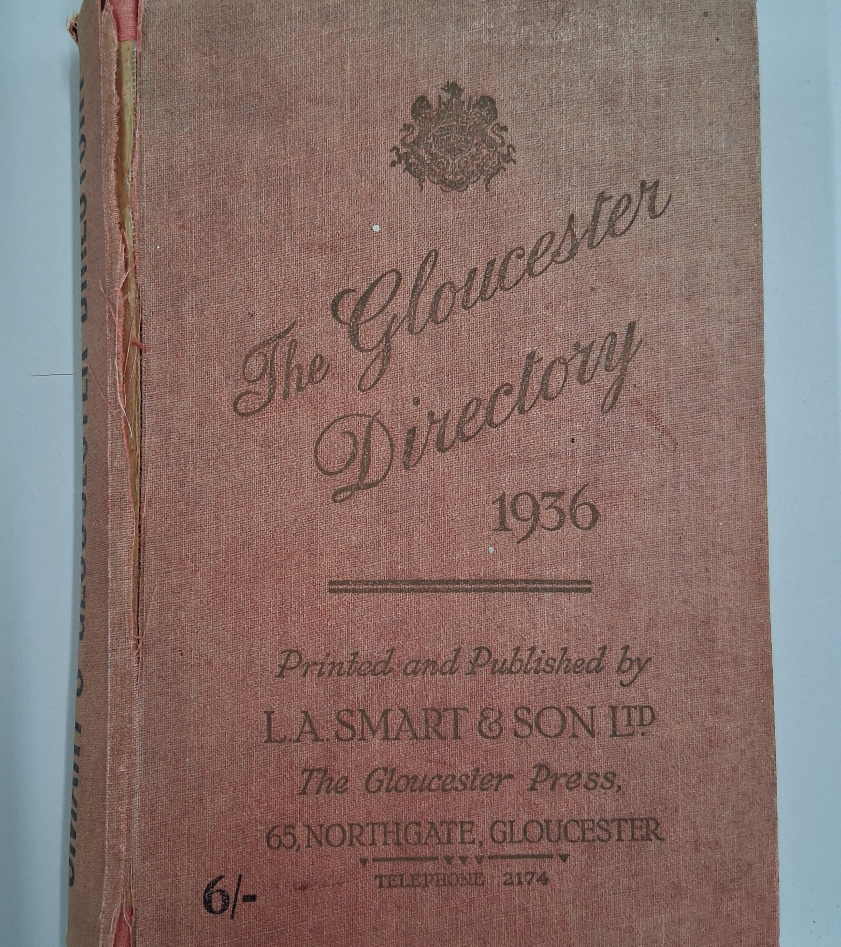
How to use a Historical directory
This guide will:
Show where and how to access historical directories
Show how to search for a street in your local area
Suggest ideas for additional activities and next steps

Slide 3
Historical Directories (Trade Directories)
These are a published book, listing details about people, businesses, & institutions in a specific area at a particular time.
They often include names, addresses, occupations, and advertisements, making them valuable sources for historical research.
A Kelly’s Directory
Notes:
Image: Commons Creative Licence by withassociates Source: Flickr Date: 26 April 2009
https://www.familysearch.org/en/wiki/File:1963_Kelly%27s_Directory_of_Torquay_and_Paignton.jpg

Slide 4
Why use Historical Directories with young people?
Real-Life Connections – they can explore familiar places and see how their local area has changed over time
Primary Source Analysis – they encourage critical thinking by using authentic historical documents
Understanding Social History – they show how occupations, businesses, and demographics have evolved over time, so they can be compared to life today
Developing Research Skills – they are a great for developing research skills
Engagement & Curiosity – they bring history to life by linking it to their community and family heritage
By using historical directories, young people can gain a deeper appreciation of their local history and develop valuable historical inquiry skills.

Slide 5
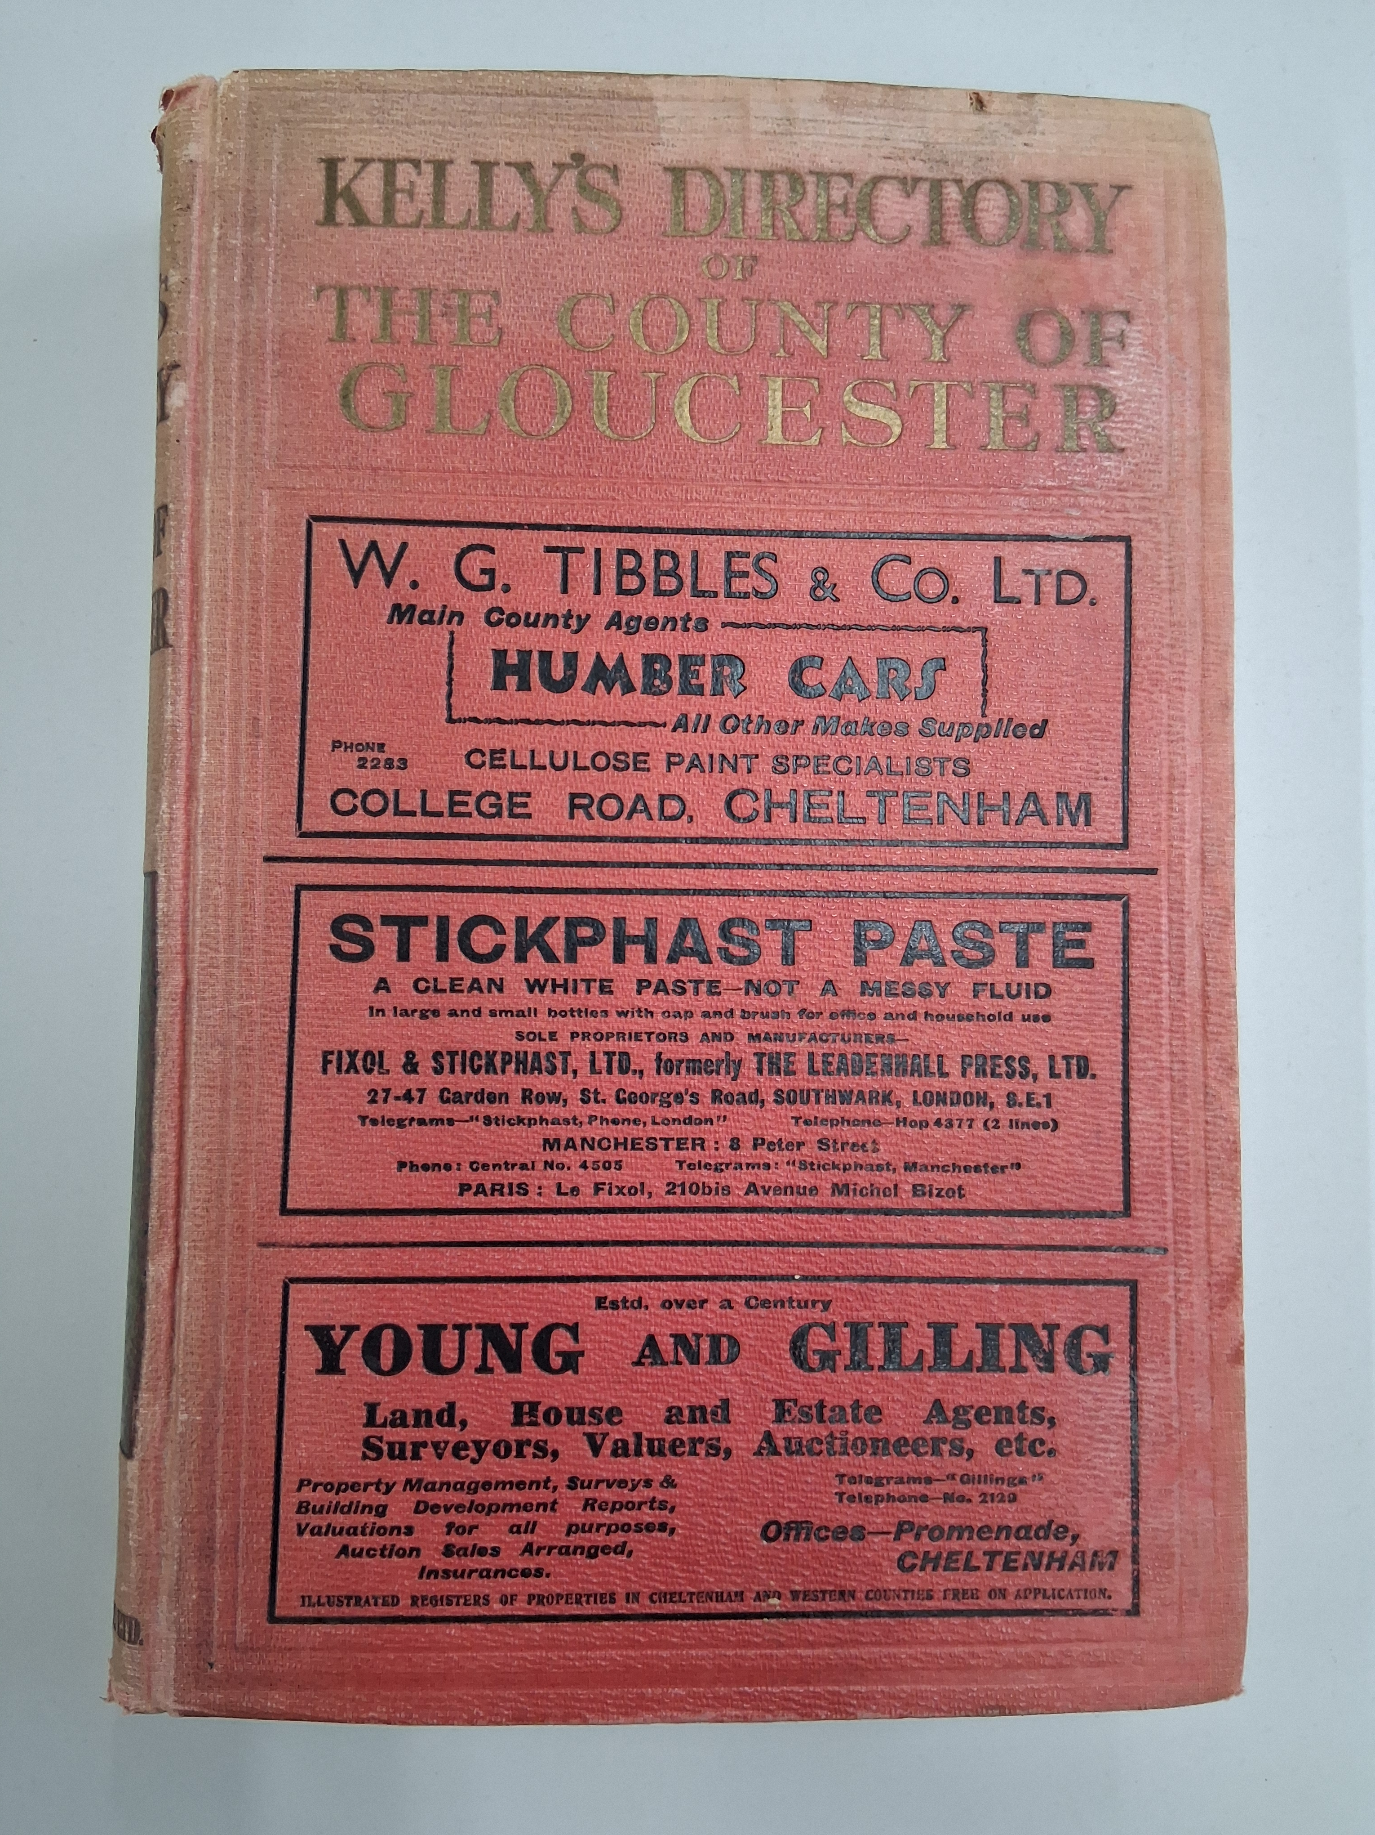
Different publishers – broadly similar content
Several publishers of similar directories, these are just a few:
Kelly’s (most generally used)
Slaters (eg Manchester & Lancs)
Pigot’s
White’s
Post Office (London)
Buchanan’s (Leicestershire)

Slide 6
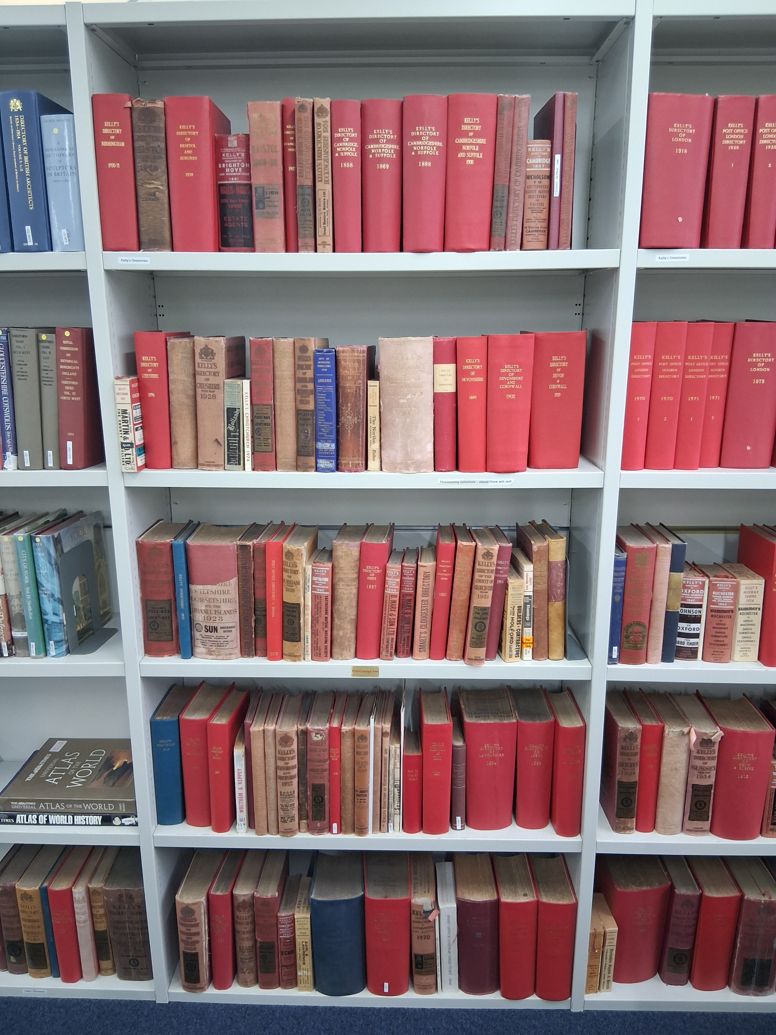
Where can you find Historical Directories?
University of Leicester Special Collections online
Ancestry (subscription required or use for free in a library)
Local History websites
All Local Archives – you can browse and / or ask for copies of specific pages
Directories in an archive

Slide 7
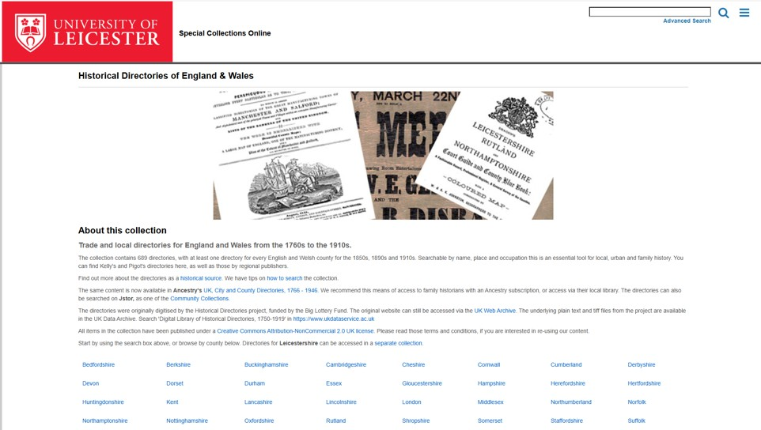

University of Leicester Special Collections online
Historical Directories of England & Wales - Special Collections
Some directories that are over 100 years old have been digitised by the University of Leicester. They can be accessed and searched for free at this site.
Notes:
Some directories that are over 100 years old have been digitised by the University of Leicester and can be accessed and searched for free at this site. https://leicester.contentdm.oclc.org/digital/collection/p16445coll4

Slide 8
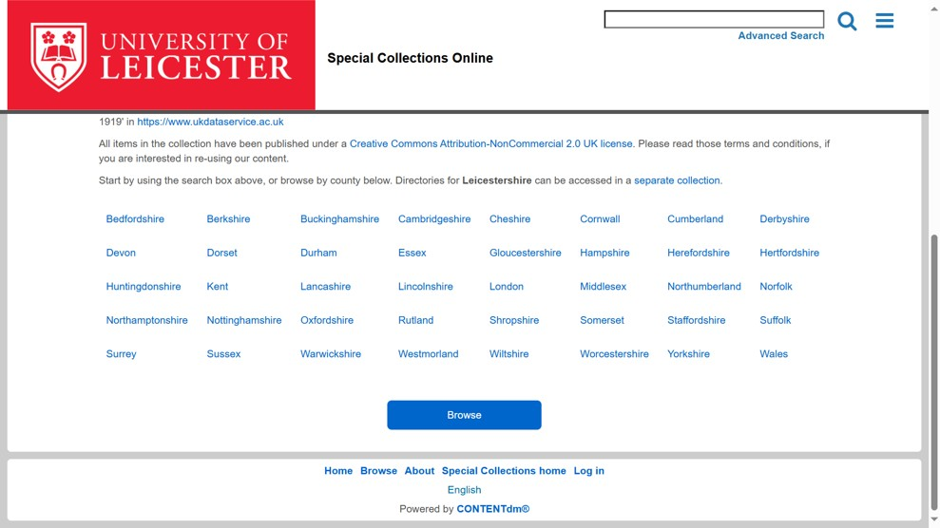

Step 1: Select the county
For this example, we’ll use Cannon Street, a street in Bristol, in the historic county of Gloucestershire.
By following the same steps, you will be able to find the directory page for your street.
Step 1 is to select the county from the home page.
Notes:
For this example, we’ll use a street in Bristol, in the historic county of Gloucestershire.
By following the same steps, you should be able to find the directory page for your street.
Step 1 is to select the county from the home page.

Slide 9
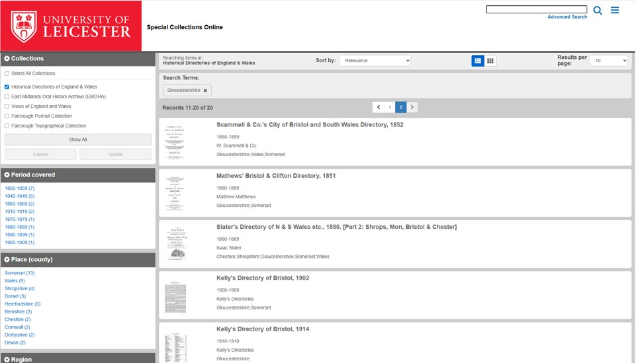
Step 2: Select the directory
This will take you to a list of the available directories for that county. You can scroll through them using the scroll bar on the right or use the Period Covered to find a specific date.
We’re going to select Kelly’s directory of Bristol from 1902.
Notes:
This will take you to a list of the available directories for that county. You can scroll through them using the scroll bar on the right or use the Period Covered to find a specific date. We’re going to select Kelly’s directory of Gloucestershire from 1902.

Slide 10
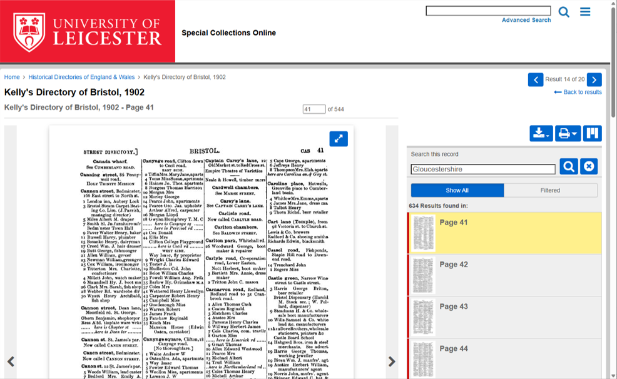
Step 3: Find the alphabetical list of streets
The pages of a directory will be an alphabetical index of streets.
By clicking on the pages on the right-hand side you can scroll find the page that contains the entry for your street – like turning the pages of a book.
In this case, Cannon Street is on page 41
Notes:
The pages of a directory will be an alphabetical index of streets.
By clicking on the pages on the right-hand side you can scroll find the page that contains the entry for your street – like turning the pages of a book.
In this case, Cannon Street is on page 41

Slide 11
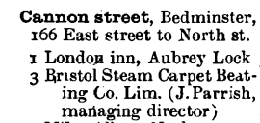
Step 4: Confirm it’s the correct street
If there is more than one street with the same name you can use the information about adjoining streets to check you have the correct street.
In this case the 166 East Street is the adjoining street to the Cannon Street we’re looking for.
Notes:
If there is more than one street with the same name you can use the information about adjoining street to check you have the correct street.
In this case the 166 East Street is the adjoining street to the Cannon Street we’re looking for.

Slide 12
Step 5: download the page as a PDF
To download this page as a PDF, click on the blue download button. You will be asked whether you wish to download this single page (This Item) or the entire directory (All).
In this instance, we will download just the Cannon Street page.
Notes:
To download this page as a PDF, click on the blue download button. You will be asked whether you wish to download this single page (This Item) or the entire directory (All). In this instance, we will download just the Mangotsfield page.

Slide 13
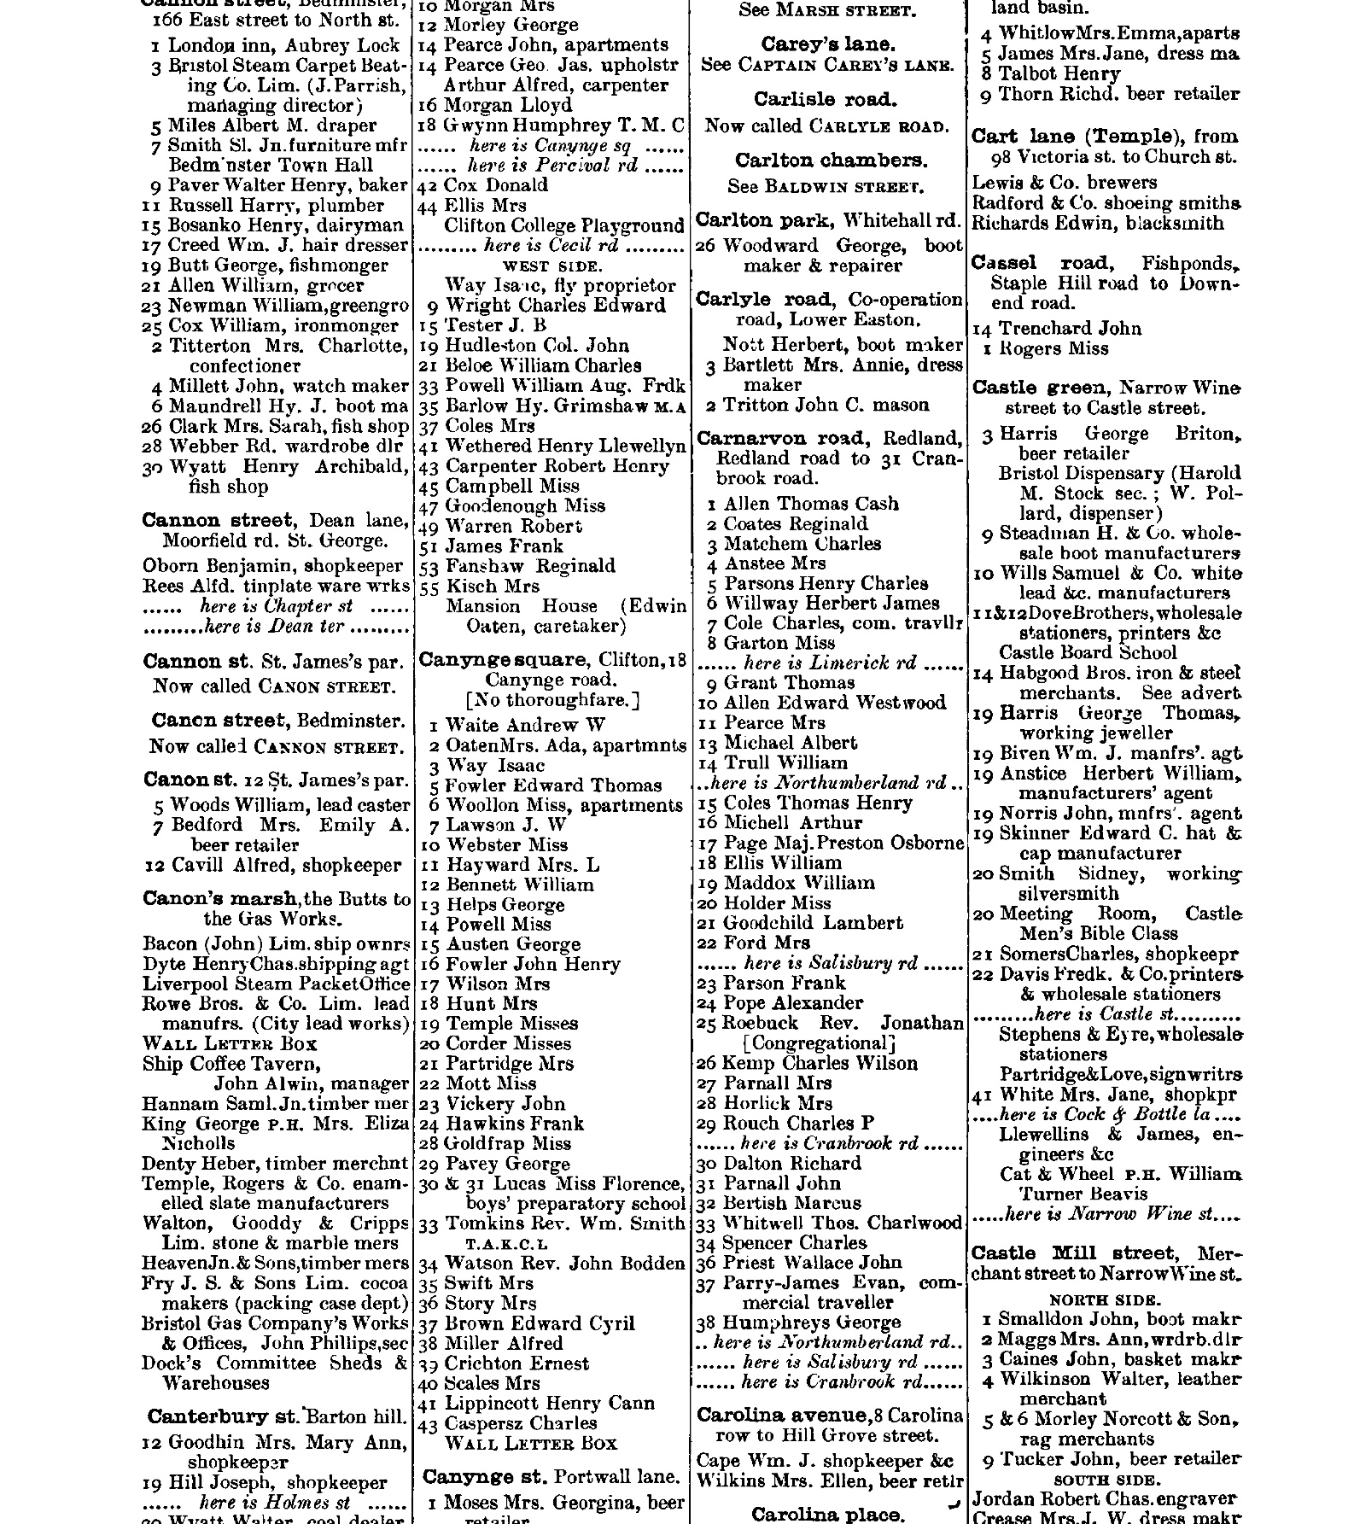
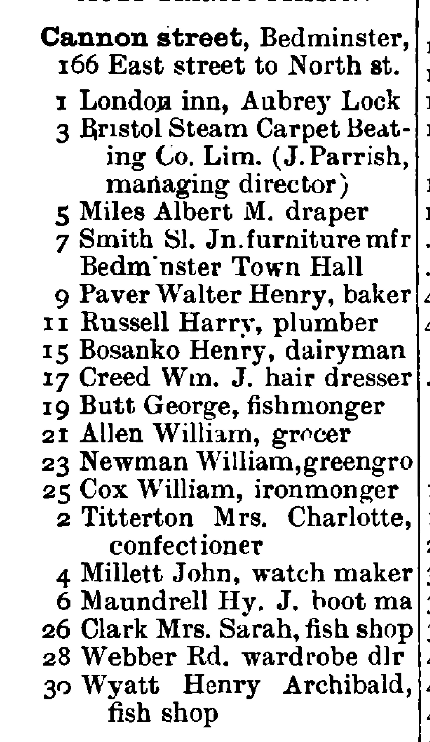
Step 6: using the PDF
This PDF page now gives you a list of people and often the jobs that they did.
You could then look at the jobs and compare them to jobs today.
You could also decide to research specific people in more detail on a census website such as Ancestry or Find My Past.

Slide 14
Example activity: Jobs of the Past
Look at the historical directory and find five different jobs that existed in 1902.
Job Title | What do you think they did?
Which of these jobs still exist today? __________________________________
Which job do you think was the most important in 1897? Why?
Notes:
Teacher Notes:
Encourage students to compare their findings with modern-day jobs.
Discuss why some jobs have disappeared and others have remained.
Use Google Maps to see how the area looks now and compare it with 1911 listings.

Slide 15
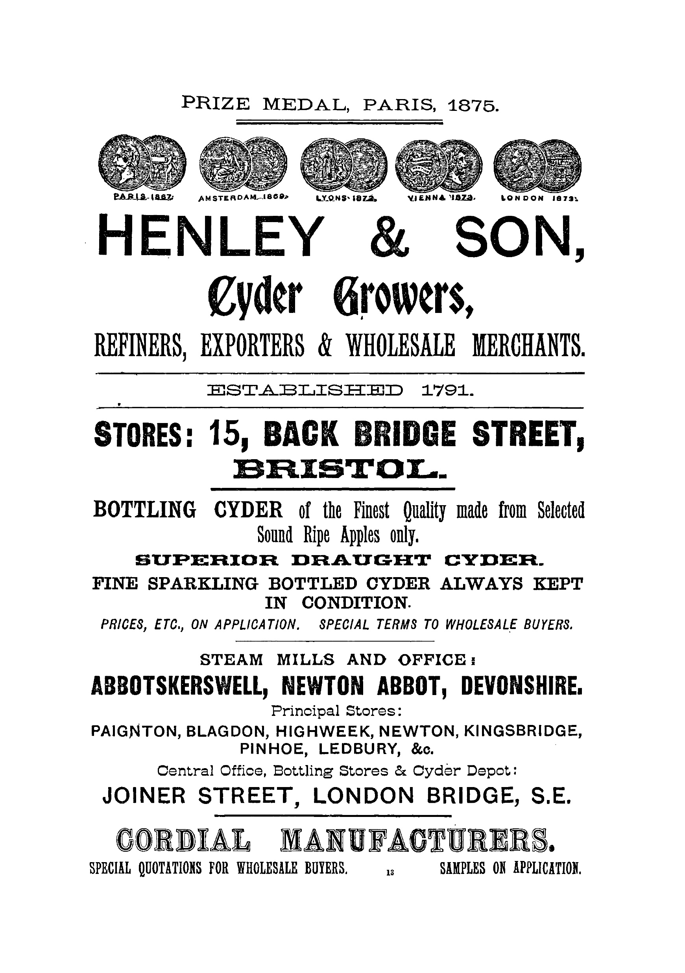
Using Advertisements
Adverts, such as this 1897 one, within the directories also provide valuable insights into:
Understanding the local economy – Shows what goods and services were available and popular at different times.
Changes in society – Highlights shifts in industries, technology, and consumer habits.
Visual engagement – Pupils can analyse language, design, and imagery to understand historical marketing strategies.
Personal connections – They may recognise old businesses, family names, or landmarks, making history more relatable.
An advert from a directory

Slide 16
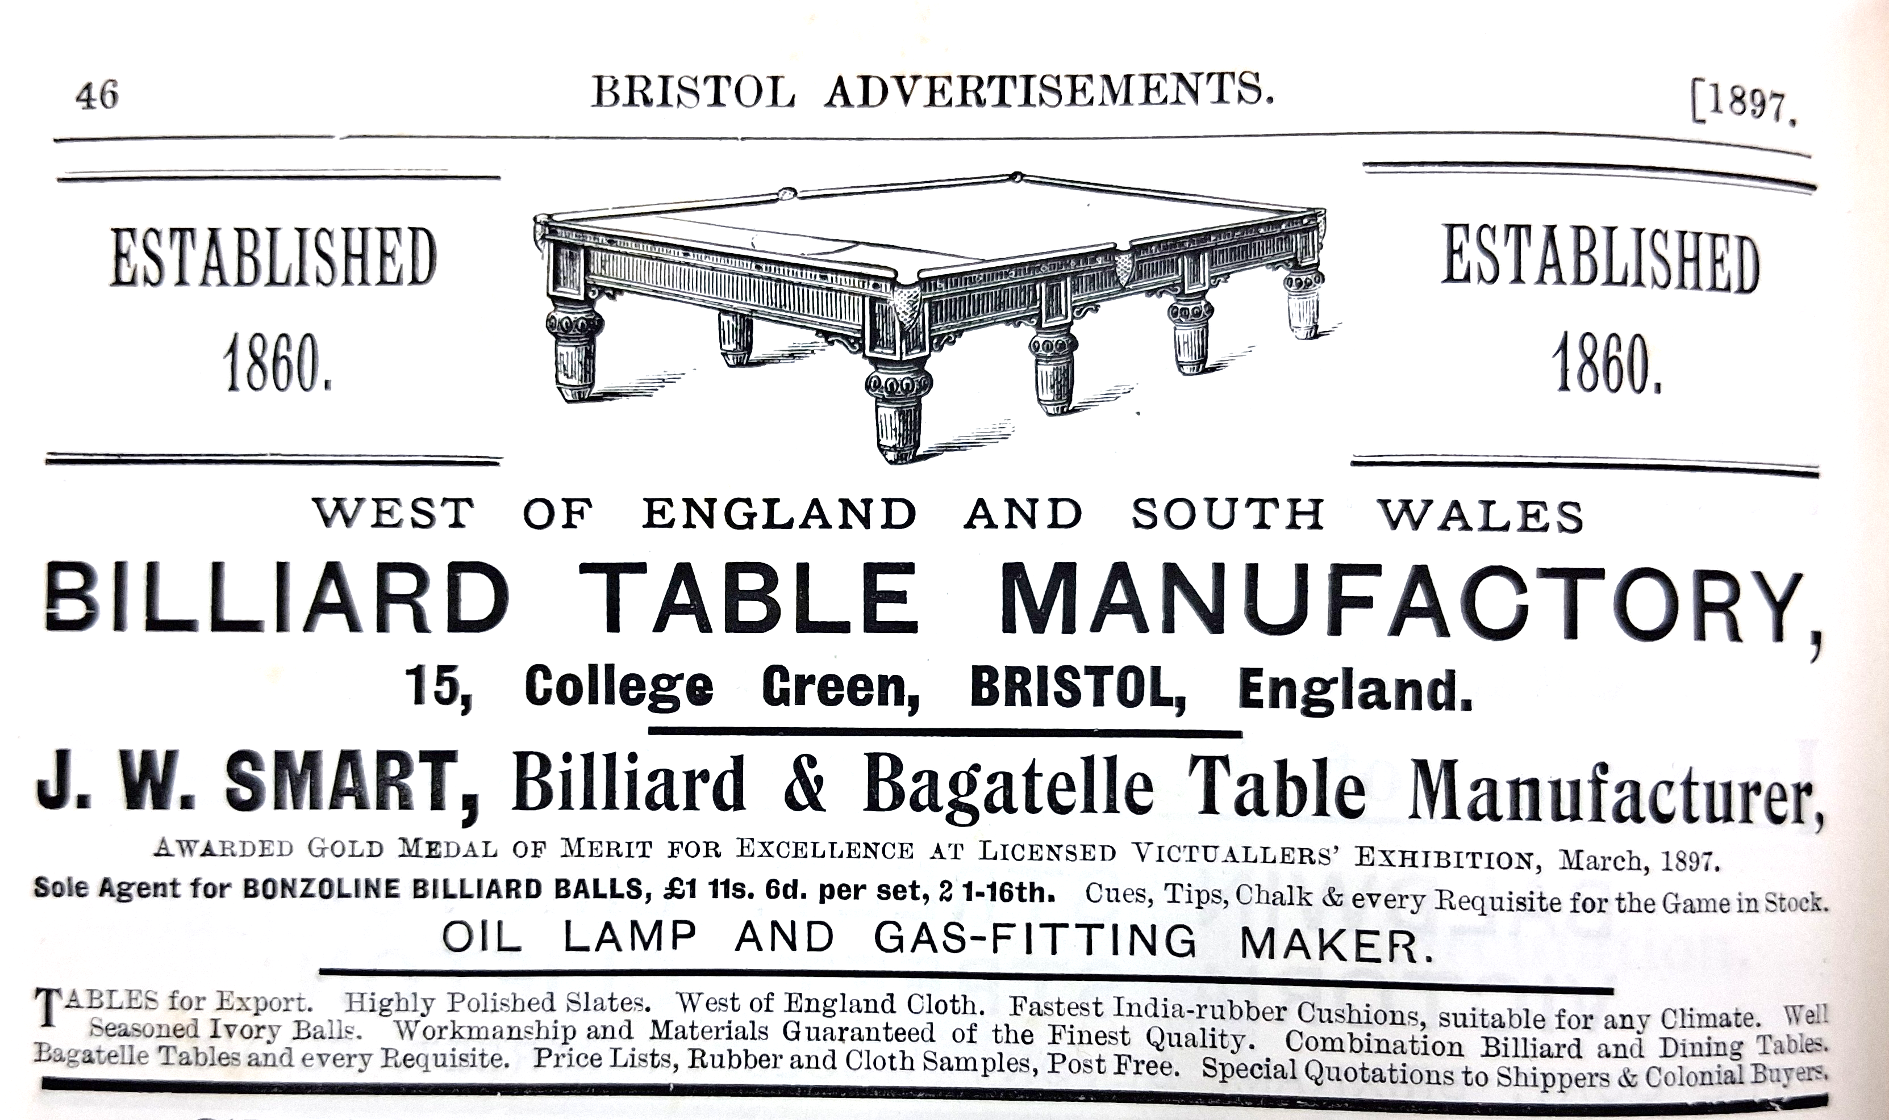

Example activity: carefully examine the advert and label its different parts
Look for and mark elements such as the title, product description, persuasive writing techniques, image or illustration, manufacturer’s name, and the shop or branch address.
Discuss how each part contributes to making the advert effective.
Class discussion
Notes:
Introduction As a class, carefully examine the advert and label its different parts. Look for and mark elements such as the title, product description, persuasive writing techniques, image or illustration, manufacturer’s name, and the shop or branch address. Discuss how each part contributes to making the advert effective.

Slide 17

Find more resources on the Historic England Website
www.historicengland.org.uk/education

