Slide 1

How to…..
Use a historical directory to find your local town or village.

Slide 2
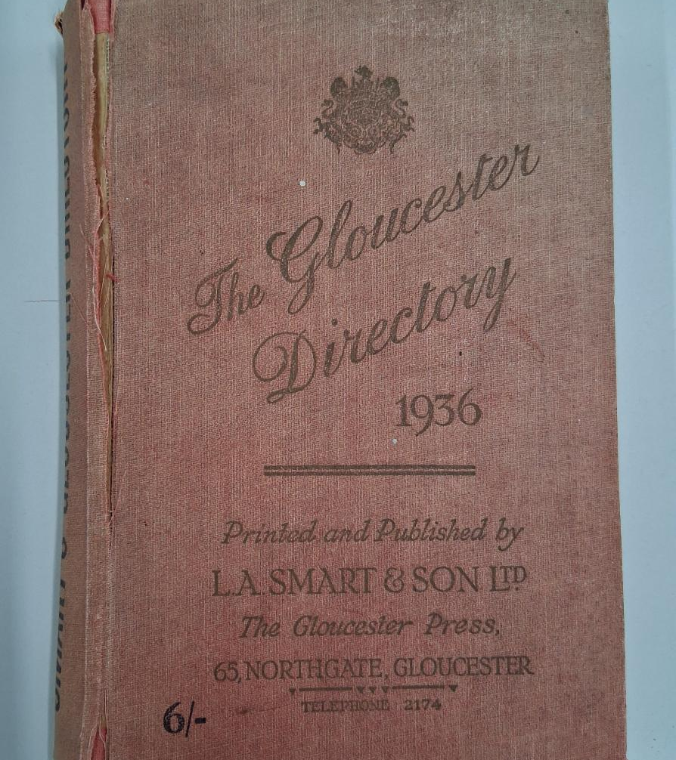
How to use a Historical Directory
This guide will:
Show where and how to access historical directories
Show how to search for a small town or village in your local area
Suggest ideas for additional activities and next steps

Slide 3
Historical Directories & Trade Directories
These are a published book, listing details about people, businesses, & institutions in a specific area at a particular time.
They often include names, addresses, occupations, and advertisements, making them valuable sources for historical research.
A Kelly’s Directory
Notes:
Image: Commons Creative Licence by withassociates Source: Flickr Date: 26 April 2009
https://www.familysearch.org/en/wiki/File:1963_Kelly%27s_Directory_of_Torquay_and_Paignton.jpg

Slide 4
Why use Historical Directories with young people?
Real-Life Connections – they can explore familiar places and see how their local area has changed over time
Primary Source Analysis – they encourage critical thinking by using authentic historical documents
Understanding Social History – they show how occupations, businesses, and demographics have evolved over time, so they can be compared to life today
Developing Research Skills – they are a great for developing research skills
Engagement & Curiosity – they bring history to life by linking it to their community and family heritage
By using historical directories, young people can gain a deeper appreciation of their local history and develop valuable historical inquiry skills.

Slide 5
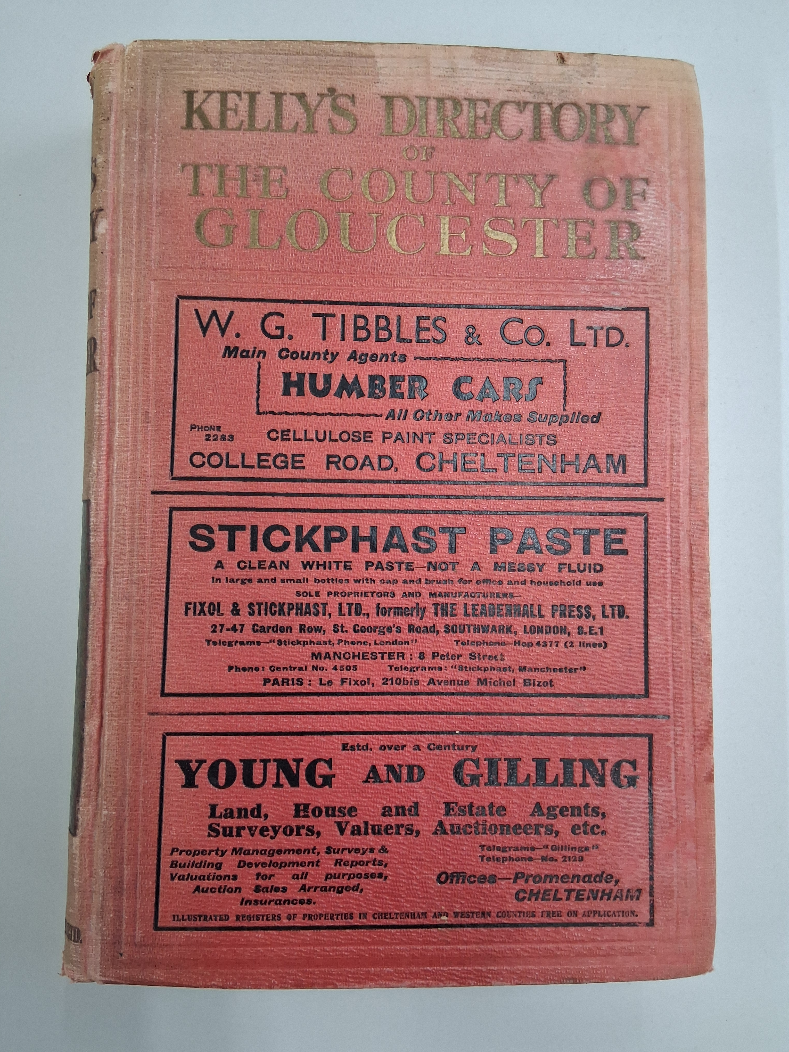
Different publishers – broadly similar content
Several publishers of similar directories, these are just a few:
Kelly’s (most generally used)
Slaters (eg Manchester & Lancs)
Pigot’s
White’s
Post Office (London)
Buchanan’s (Leicestershire)

Slide 6
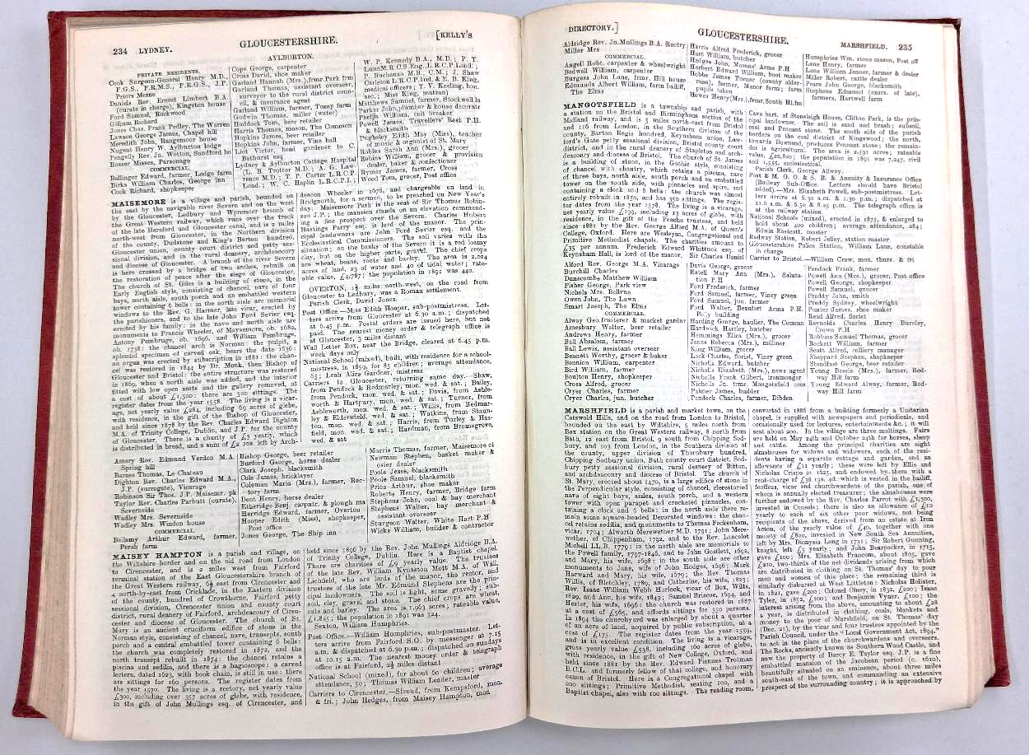
Kelly’s Directory layout

Slide 7
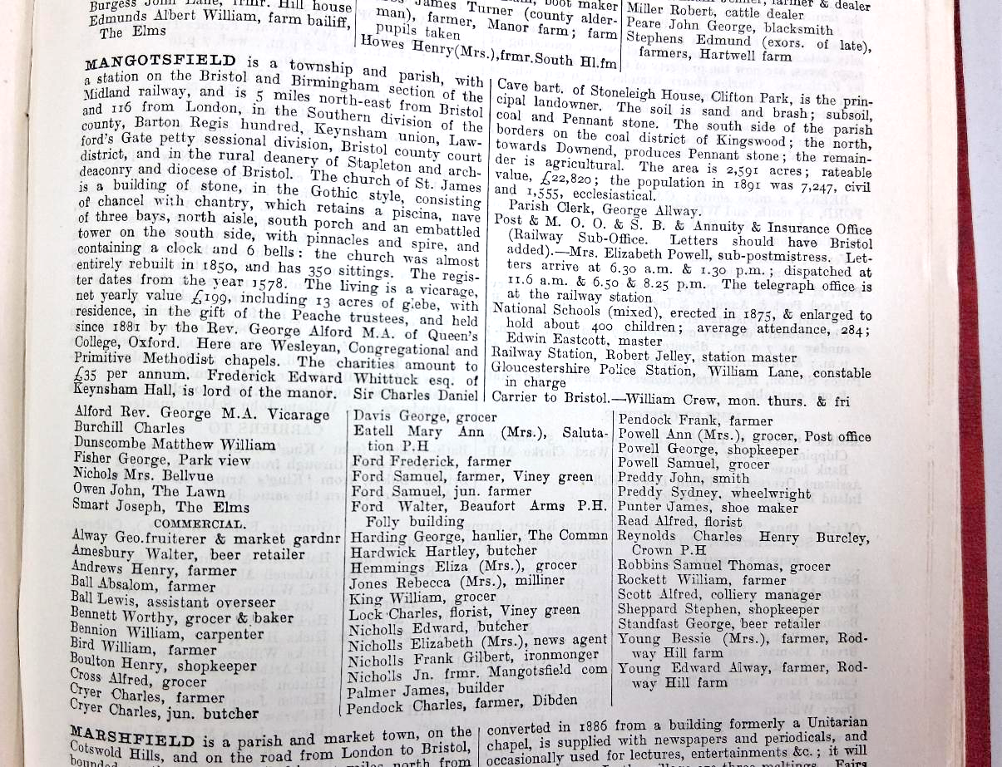

Kelly’s Directory layout - explained
General information about the history of the village
General information about public services such as postal, schools, railways, police, local government and other officials.
All of which give names that you could then look up in census records
List of Private Residents
List of Commercial Residents
Notes:
People had to pay to be included in the directory – so most people with a business (commercial) paid, so people would know about their business. Some ‘Private’ people also paid to be in as they felt they were important enough that anyone visiting the town might want to contact them.

Slide 8
Where can you find Historical Directories?
University of Leicester Special Collections online
Ancestry (subscription required or use for free in a library)
Local History websites
All Local Archives – you can browse and / or ask for copies of specific pages
Directories in an archive

Slide 9
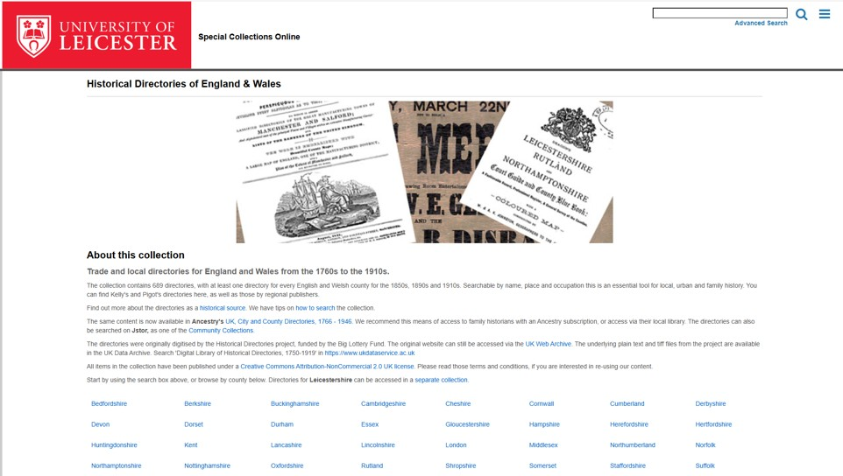

University of Leicester Special Collections online
Historical Directories of England & Wales - Special Collections
Some directories that are over 100 years old have been digitised by the University of Leicester. They can be accessed and searched for free at this site.
Notes:
Some directories that are over 100 years old have been digitised by the University of Leicester and can be accessed and searched for free at this site. https://leicester.contentdm.oclc.org/digital/collection/p16445coll4

Slide 10
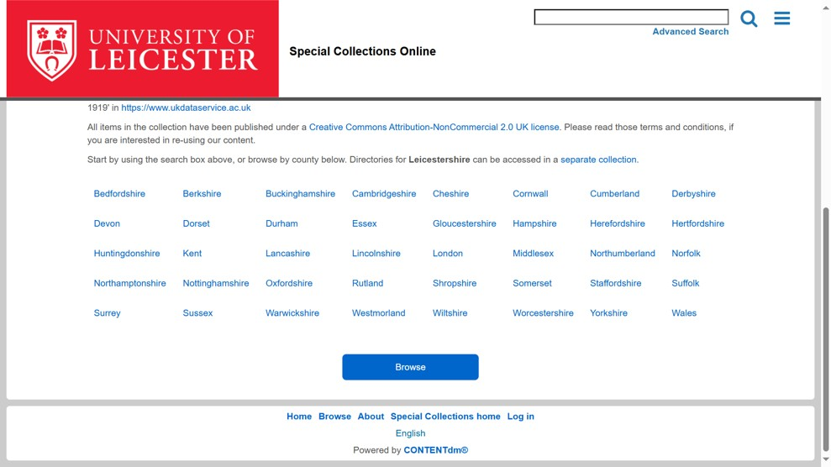
Step 1: Select the county
We’ll use the village of Mangotsfield in Gloucestershire as an example.
By following the same steps, you should be able to find the directory page for your village.
Step 1 is to select the county from the home page.
Notes:
I will take you through how to find the village of Mangotsfield in Gloucestershire as an example. By following the same steps, you should be able to find the directory page for your village.
Step 1 is to select the county from the home page.

Slide 11
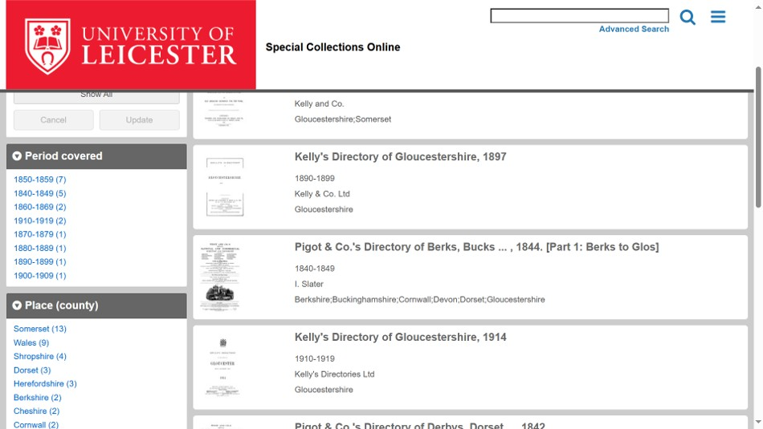
Step 2: Select the directory
This will take you to a list of the available directories for that county. You can scroll through them using the scroll bar on the right or use the Period Covered to find a specific date.
We’re going to select Kelly’s directory of Gloucestershire from 1897.
Notes:
This will take you to a list of the available directories for that county. You can scroll through them using the scroll bar on the right or use the Period Covered to find a specific date. We’re going to select Kelly’s directory of Gloucestershire from 1897.

Slide 12
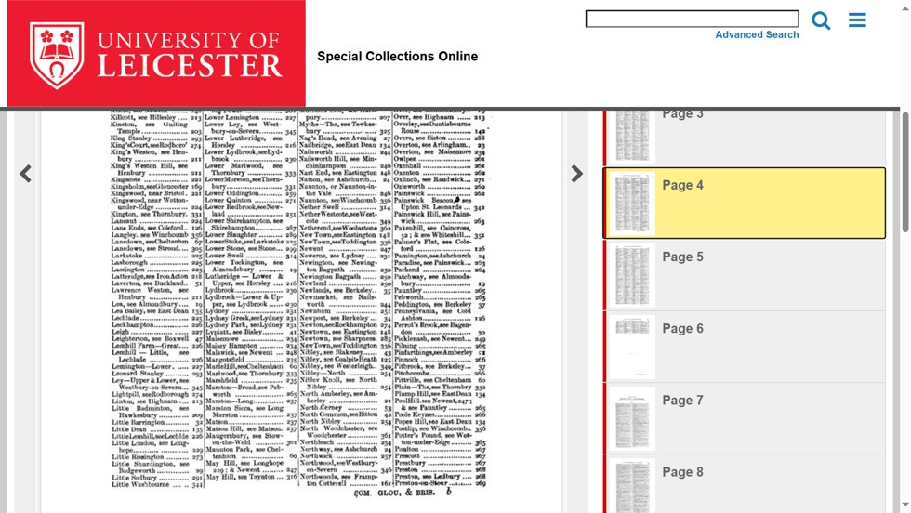
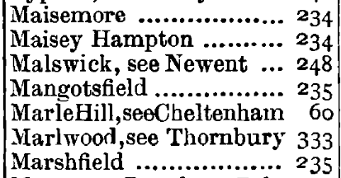
Step 3: Find the alphabetical index of locations
The first few pages of a directory will be an alphabetical index of locations. By clicking on the pages on the right-hand side you can find the page that contains the entry for your location.
In this case, page 4 has Mangotsfield in the second column, it tells us that the page in the directory for Mangotsfield is 235.
Notes:
The first few pages of most directories will be an alphabetical index of locations. By clicking on the pages on the right hand side you can find the page that contains the entry for your location. In this case, page 4 has Mangotsfield in the second column, it tells us that the page in the directory for Mangotsfield is 235.

Slide 13
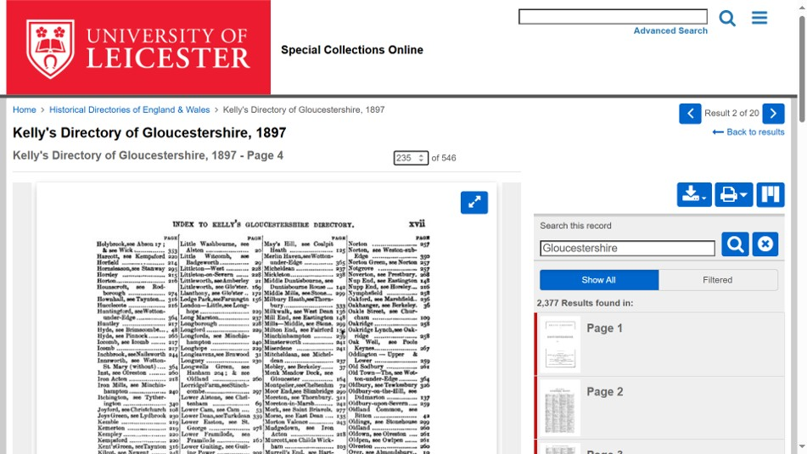
Step 4: Enter the page number
Step 4 is to put this page number into the small box above the page and then press Enter
Notes:
Step 4 is to put this page number into the small box above the page and then press Enter.

Slide 14
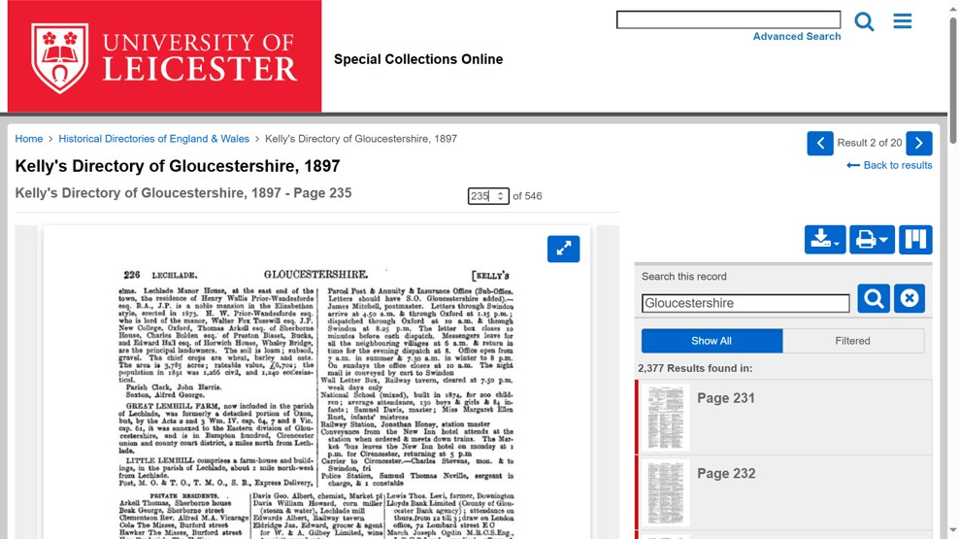
Step 5: Check the page number
If this doesn’t take you directly to the correct page (as in this example for Mangotsfield) look at the page number in the top left (in this case 226).
This tells us that we are 9 pages short of the Mangotsfield page.
Notes:
If this doesn’t take you directly to the correct page (as in this example for Mangotsfield) look at the page number in the top left (in this case 226). This tells us that we are 9 pages short of the Mangotsfield page.

Slide 15

Step 6: Adjust the number
We add this 9 to the number in the box making 244 (235 + 9) and press Enter again
Notes:
We add this 9 to the number in the box making 244 (235 + 9) and press Enter again.

Slide 16
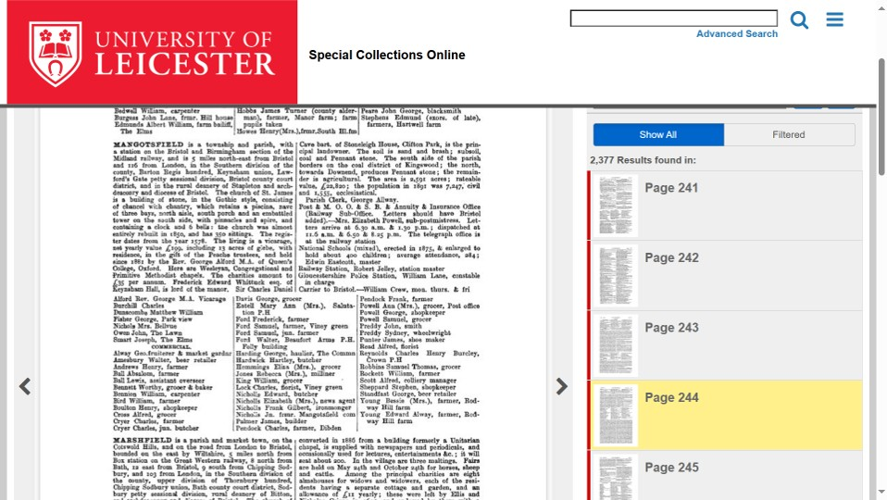
Step 7: Find the page with the village and its residents
This takes us directly to the Mangotsfield page.
Notes:
This takes us directly to the Mangotsfield page

Slide 17
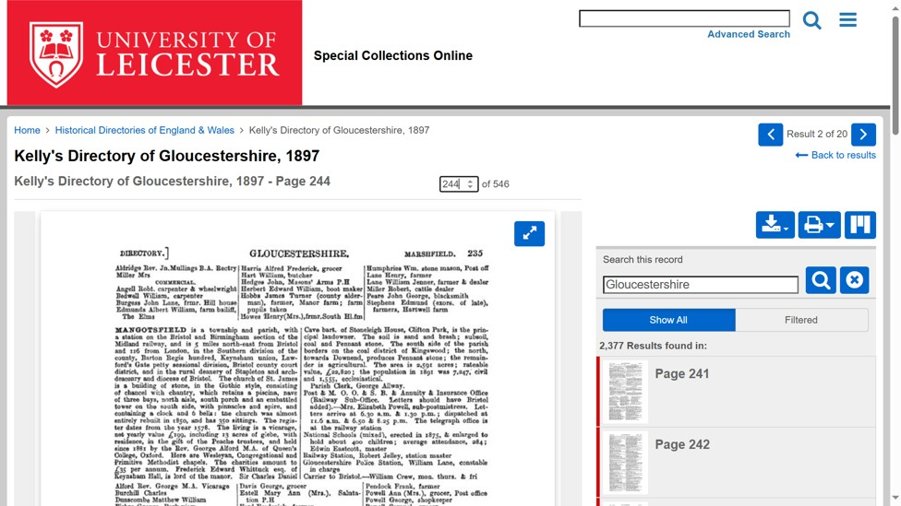
Step 8: download the page as a PDF
To download this page as a PDF, click on the blue download button. You will be asked whether you wish to download this single page (This Item) or the entire directory (All).
In this instance, we will download just the Mangotsfield page.
Notes:
To download this page as a PDF, click on the blue download button. You will be asked whether you wish to download this single page (This Item) or the entire directory (All). In this instance, I will download just the Mangotsfield page.

Slide 18
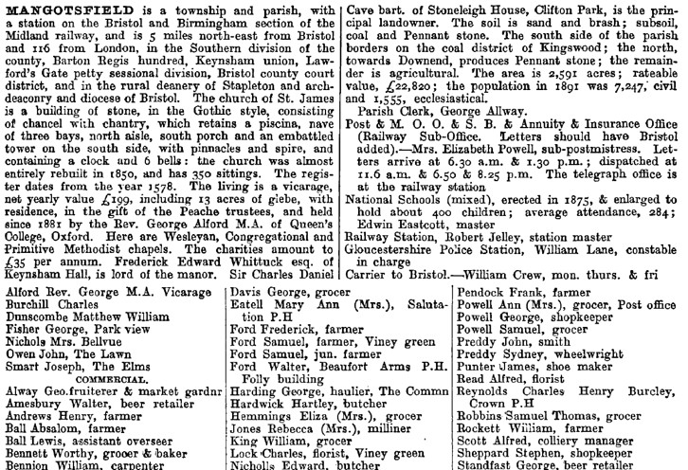
Step 9: Open the page as a PDF
This PDF page now gives you a short summary of the history of the area from the time, information about schools, places of worship, post office deliveries and possibly railway stations.
You will also find list of some local residents and trades people.
.
Notes:
This PDF page now gives you a short summary of the history of the area from the time, information about schools, places of worship , post office deliveries and possibly railway stations.
You will also find list of some local residents and local trades people.

Slide 19
Example activity: Jobs of the Past
Look at the historical directory and find five different jobs that existed in 1897.
Job Title | What do you think they did?
Which of these jobs still exist today? __________________________________
Which job do you think was the most important in 1897? Why?
Notes:
Teacher Notes:
Encourage students to compare their findings with modern-day jobs.
Discuss why some jobs have disappeared and others have remained.
Use Google Maps to see how the area looks now and compare it with 1911 listings.

Slide 20
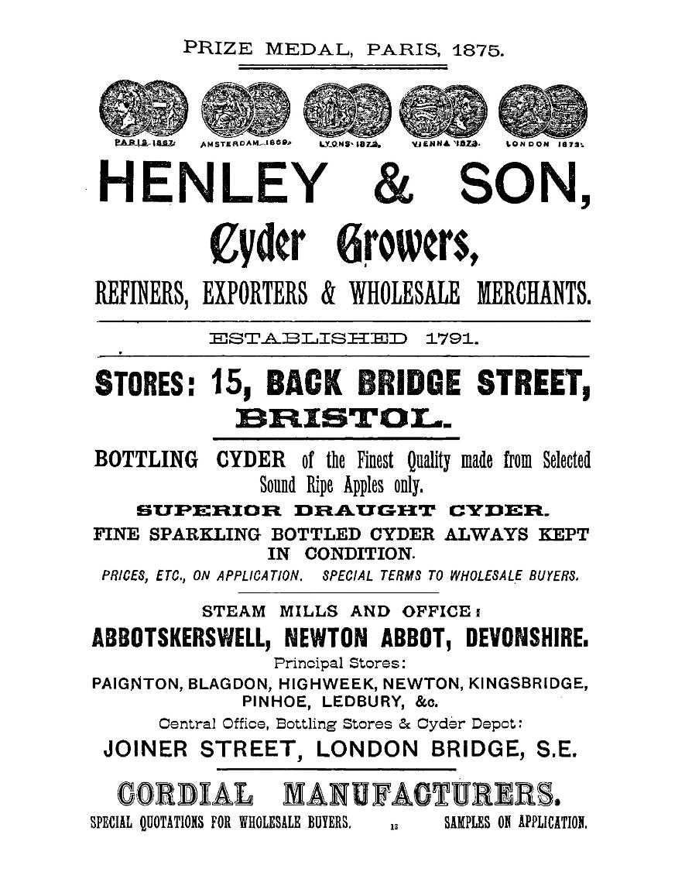
Using Advertisements
Adverts, such as this 1897 one, within the directories also provide valuable insights into:
Understanding the local economy – Shows what goods and services were available and popular at different times.
Changes in society – Highlights shifts in industries, technology, and consumer habits.
Visual engagement – Allows analysis of language, design, and imagery to understand historical marketing strategies.
Personal connections – They may recognise old businesses, family names, or landmarks, making history more relatable.

Slide 21
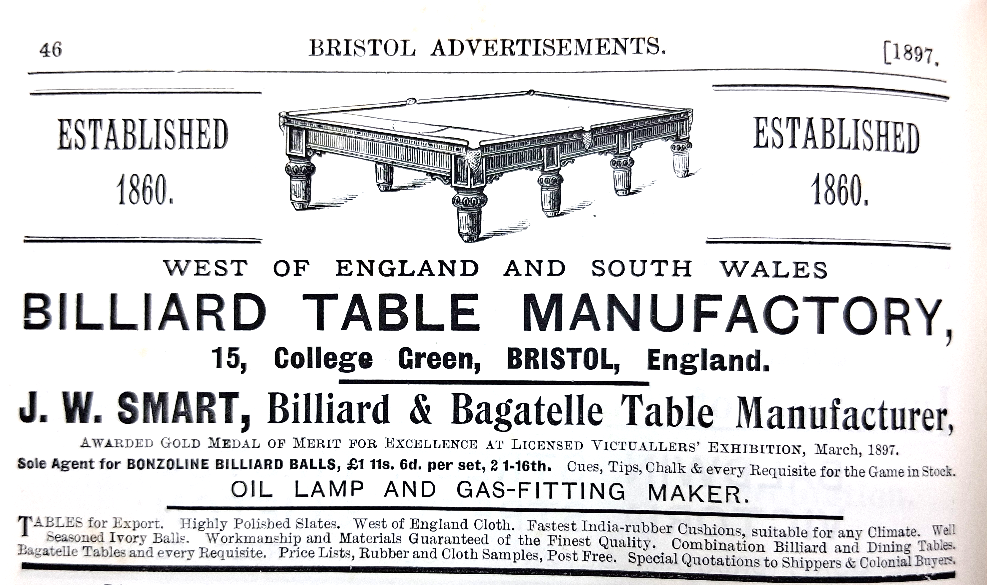

Example activity: carefully examine the advert and label its different parts
Look for and mark elements such as the title, product description, persuasive writing techniques, image or illustration, manufacturer’s name, and the shop or branch address.
Discuss how each part contributes to making the advert effective.
Class discussion
Notes:
Introduction As a class, carefully examine the advert and label its different parts. Look for and mark elements such as the title, product description, persuasive writing techniques, image or illustration, manufacturer’s name, and the shop or branch address. Discuss how each part contributes to making the advert effective.

Slide 22

Find more resources on the Historic England Website
www.historicengland.org.uk/education

