Slide 1
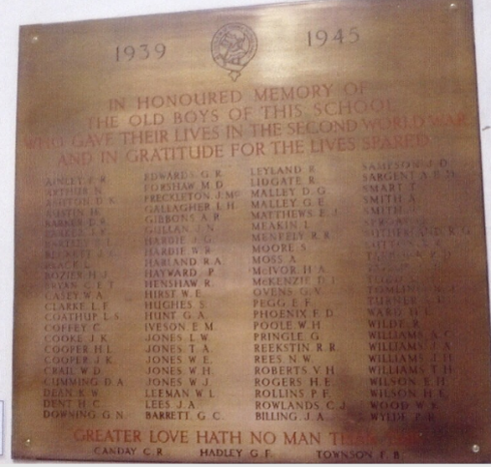
How to find your local war memorial
How to…..
Find out more about a serviceperson listed on a local memorial
Notes:
Image: © IWM (WMR-2529)

Slide 2
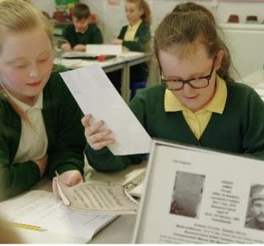
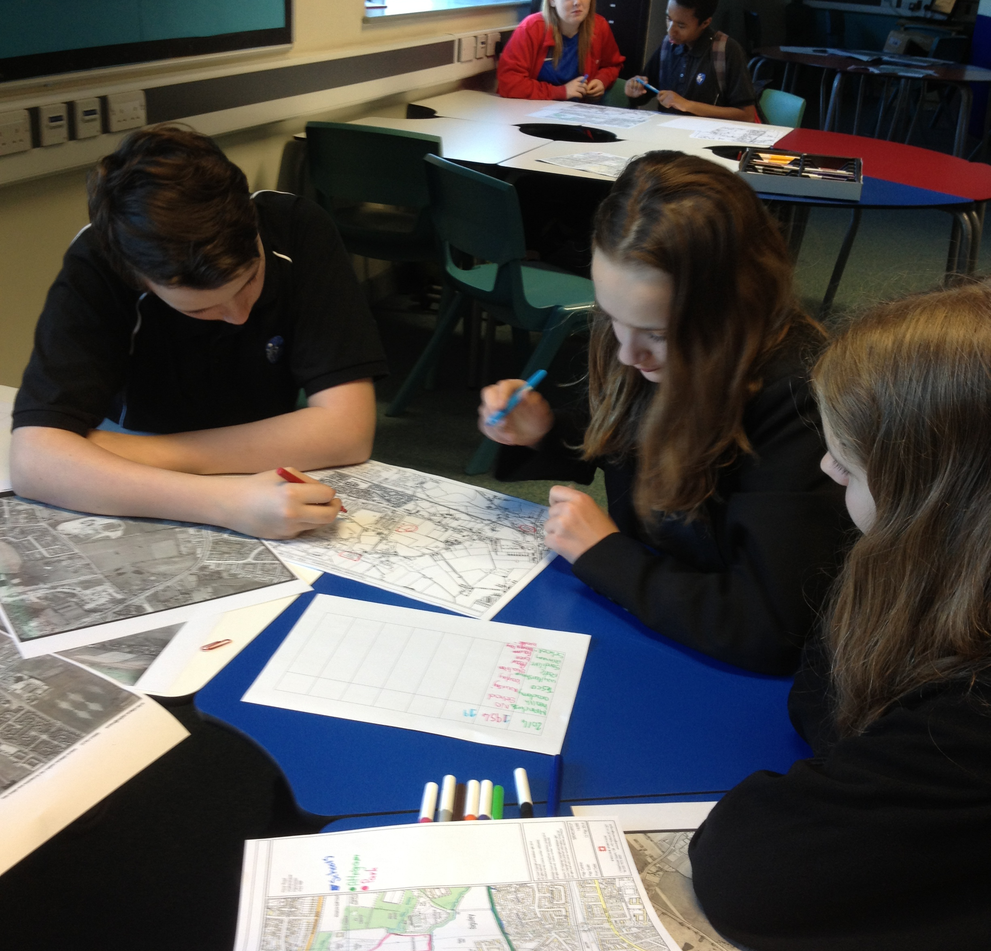
Find out more about a service person listed on a local memorial
This guide will:
Showcase websites on which you may find information about a local serviceperson.
Suggest activities to support young people in using the information or carrying out research themselves.
Young researchers
This guide follows on from How to use the Commonwealth War Graves Commission website to research a serviceperson remembered on a local memorial. It is the final guide in the series:
How to investigate your local war memorial
Young researchers
Notes:
Images: © Historic England

Slide 3

Case study: William Anthony Casey, Birkenhead Institute School, World War 2 Memorial
In the previous guide, we explored how you can use the CWGC website to find information about one or more serviceperson listed on a local war memorial.
In that guide we explored the info provided about William Anthony Casey who is listed on Birkenhead Institute School WW2 memorial.
Find your nearest war memorial using the guide “How to find your local war memorial”
Notes:
Image: © IWM (WMR-2529)

Slide 4
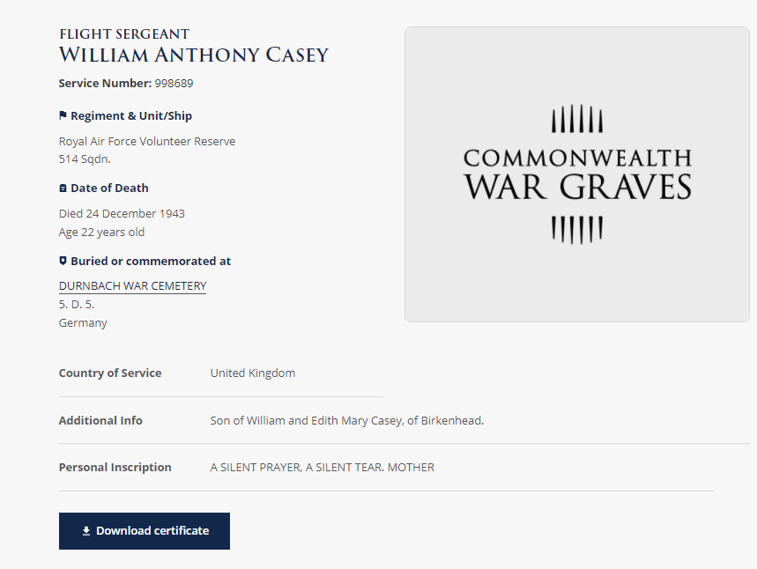

William Anthony Casey on the Commonwealth War Graves Commission Website
Service Number
Full name and rank
Who he served with
Age and date of death
Where he is buried and what plot
Find out more using the guide “How to use the Commonwealth War Graves Commission website to research a serviceperson remembered on a local memorial.”
Family details.
Notes:
Image: Screenshot CWGC website https://www.cwgc.org/

Slide 5
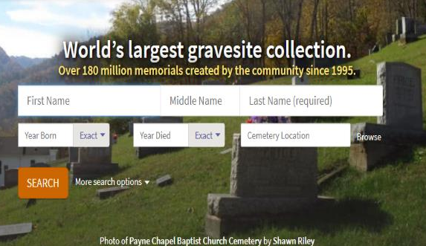
Finding out more: Your serviceperson’s headstone (or name on a memorial)
Find A Grave is a website providing images of thousands of headstones and names on memorials.
Type in the name of your serviceperson and any other details known and click on search.
If you don’t find a photo for your serviceperson, you can request for one to be taken. You will be notified when it has been uploaded
Notes:
Find A Grave website.
In the previous session we found out that WA Casey is buried and remembered at Durnbach Military Cemetery in Germany and we saw a number of photos of the cemetery.
The Find a Grave website provides photographs of individual headstones of service people remembered in cemeteries across the world. In instances where the soldier’s name is inscribed on a memorial, photos of their inscribed name may also be available.
Note. The website is populated largely by volunteers and they do not cover all headstones and memorials.
You can make an email request for a photo of a particular gravestone if there isn’t one available.
Type in the name of your service person and any other details known and click on search
Image: Screenshot Find A Grave Website http://www.findagrave.com/

Slide 6
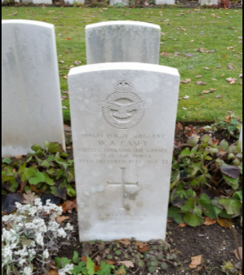
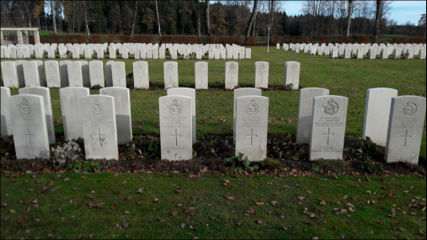
The headstone of William Anthony Casey
You may find someone has remembered your serviceperson on the Find A Grave website and even added extra information
Notes:
Images: Screenshots Find A Grave Website http://www.findagrave.com/

Slide 7
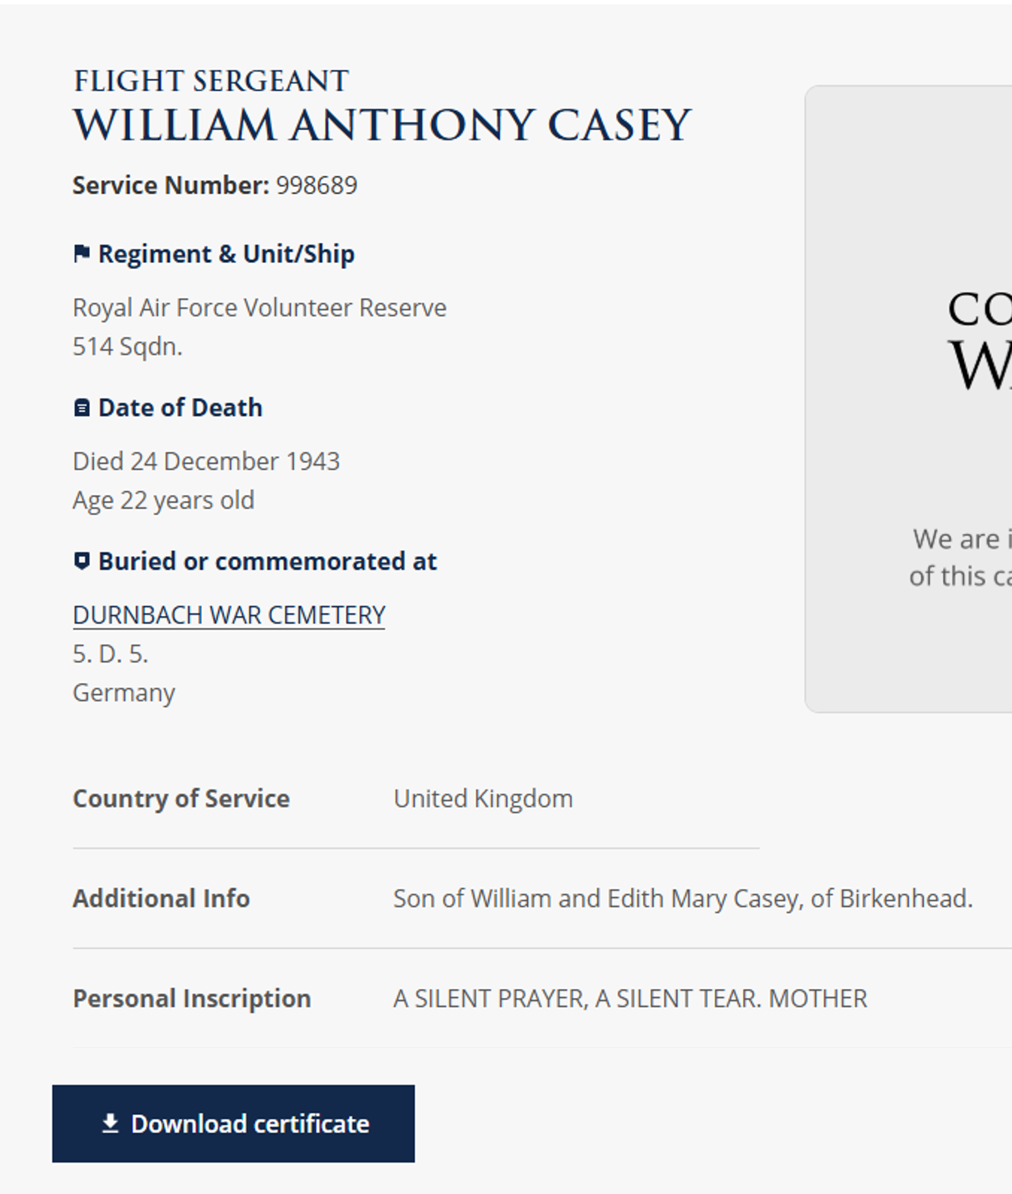
Websites to help us find out more about a serviceperson’s life before and during the war 1
A good starting place for finding out more about a serviceperson’s life before and during the war is a genealogy website such as Ancestry or Find My Past.
Use the information you have so far and carry out a general search….
Ancestry and / or Find My Past are free to use at libraries or visit Ancestry Classroom to explore free access.
Notes:
Image: Screenshot CWGC website https://www.cwgc.org/

Slide 8
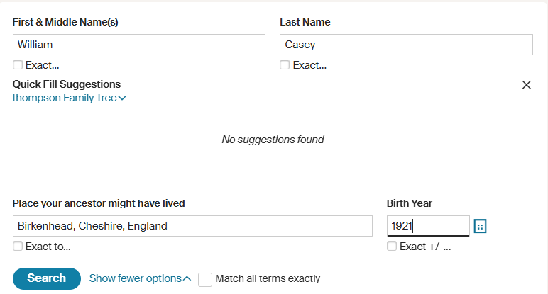
Find out more about your serviceperson’s life before and during the war 2
A search on Ancestry
Notes:
Image: Screenshot Ancestry website https://www.ancestry.co.uk/

Slide 9
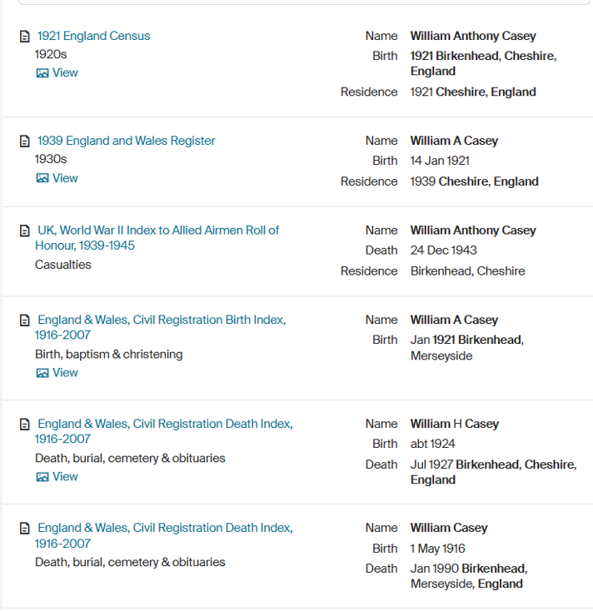
Find out more about your serviceperson’s life before and during the war: Ancestry Results 3
1921 Census
Discount results that do not relate to your service person.
Notes:
Scroll through and discount results that obviously do not relate to your service person.
Explore the other results!
Image: Screenshot Ancestry website https://www.ancestry.co.uk/

Slide 10
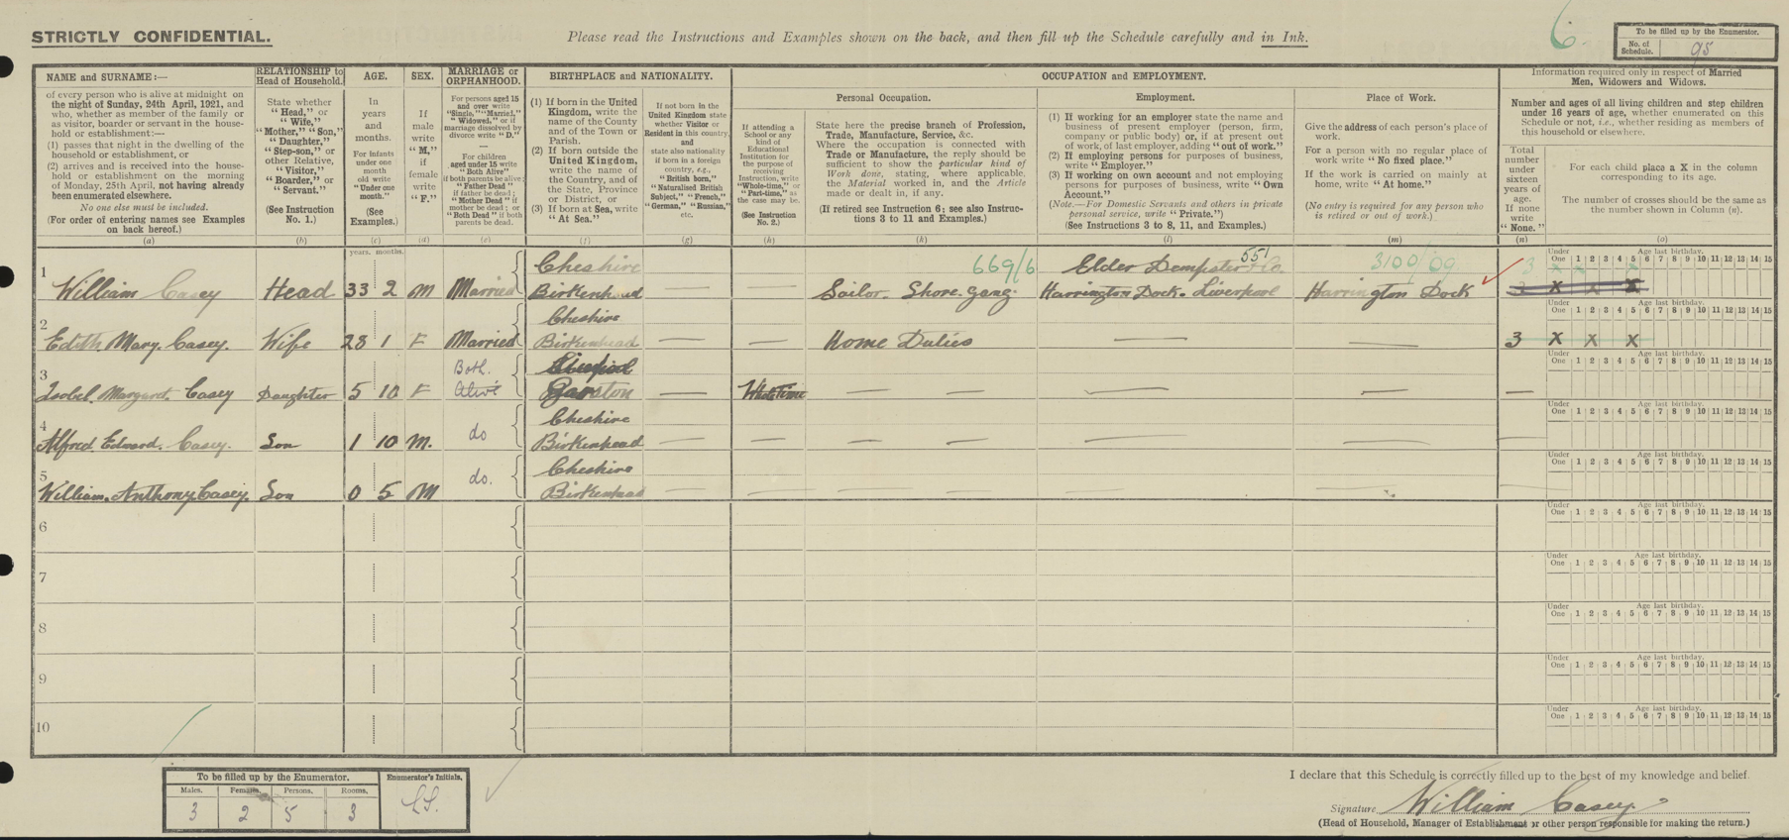
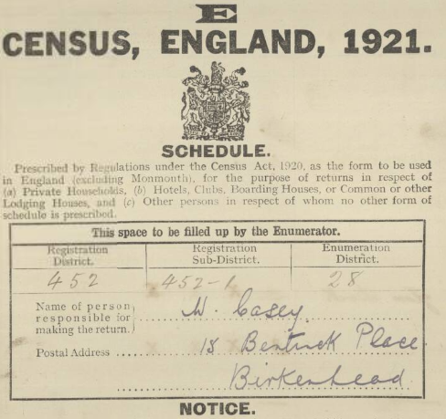
William Casey in the 1921 Census
The census is a survey conducted every 10 years that collects information about the people and households in the UK.
William Anthony is 5mths old. He is living with his parents and siblings at 15 Bentinck Place. His dad works for Elder Dempster Shipping Company as a Sailor Shore Gang.
Notes:
Image (SOURCE): The National Archives of the UK (TNA); Kew, Surrey, England; 1921 Census Returns; Reference: RG 15/17167, ED 28, Sch 95; Book: 17167
Note. 1931 Census largely destroyed by fire, 1941 census not taken due to WW2

Slide 11
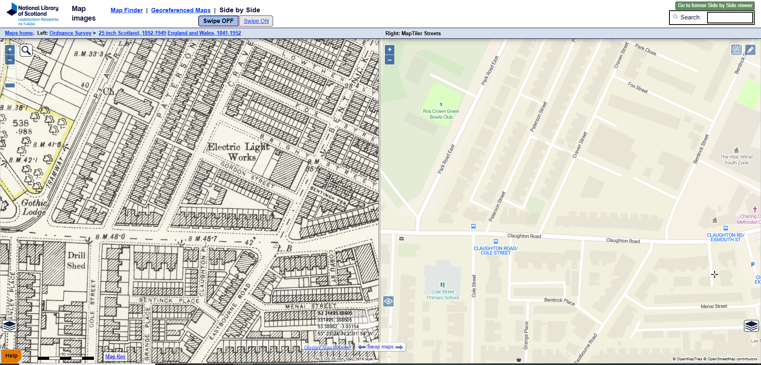
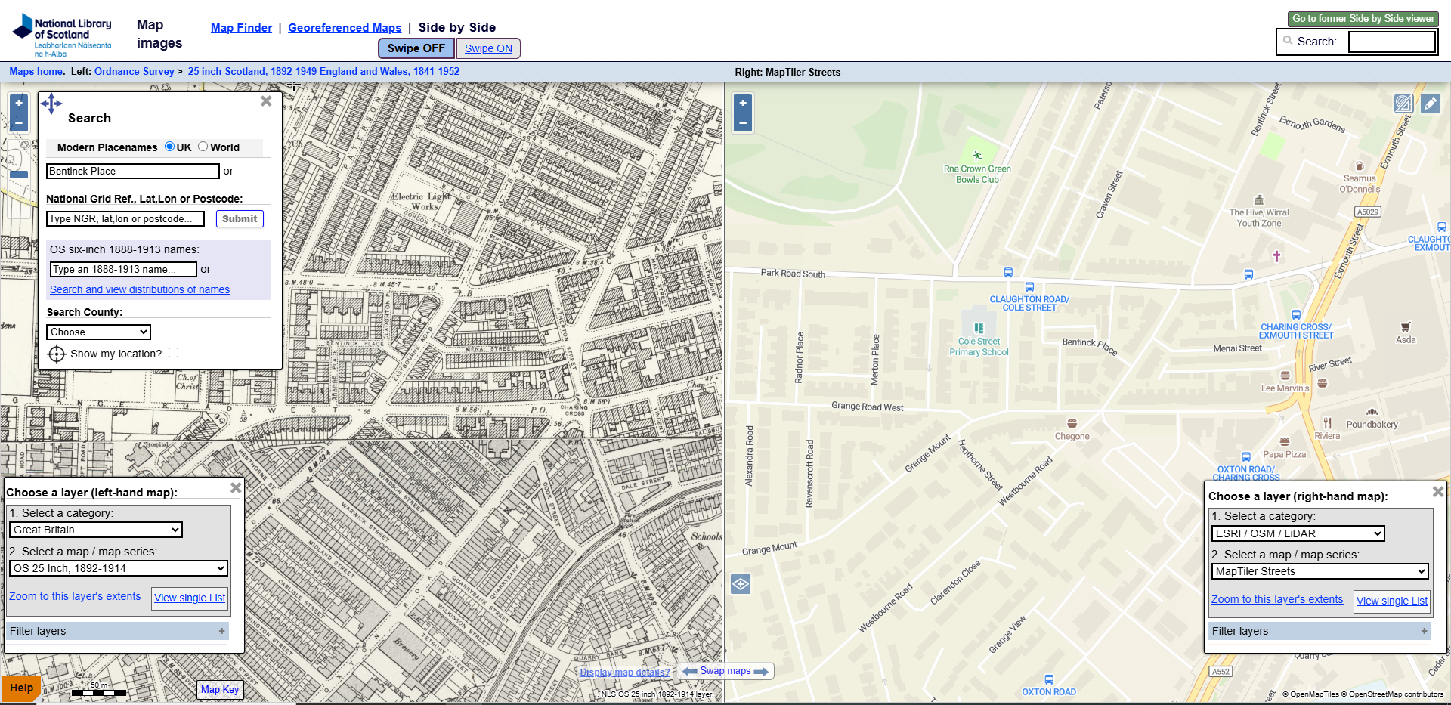
Where did your serviceperson live before the war? 1
Use National Library of Scotland to find old maps of the area in which your serviceperson lived.
Find out more about How to find and use old maps on the National
Library for Scotland website
Explore the area and try to find his street.
What was William Casey’s life like before the war?
Notes:
NMS is a free mapping tool which, despite its name features maps of all over the UK. You can visit the national maps Scotland website by following the link on the left of this slide and you can find out more about how to use the site by following the link on the right and accessing the HE guide.
Images: Screenshot from National Library of Scotland https://maps.nls.uk/geo/explore/side-by-side

Slide 12
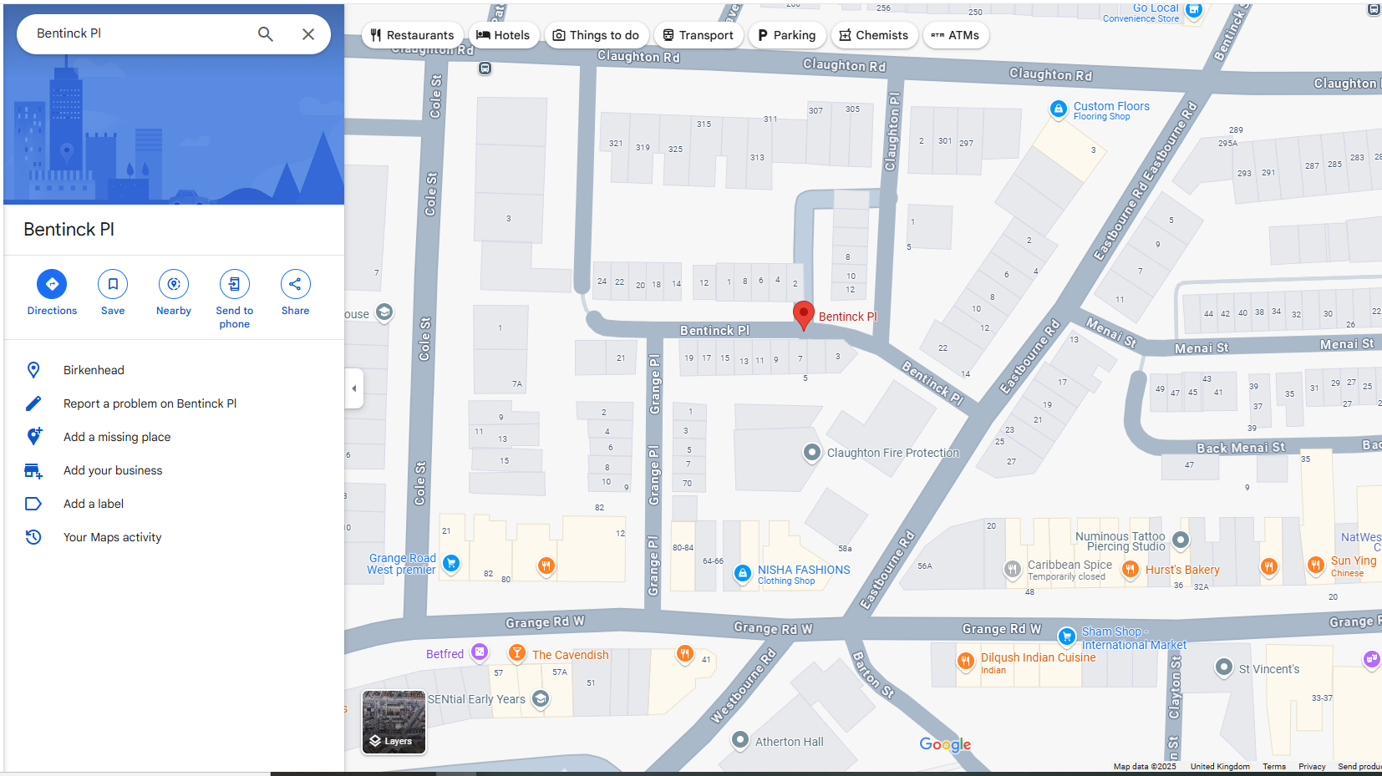
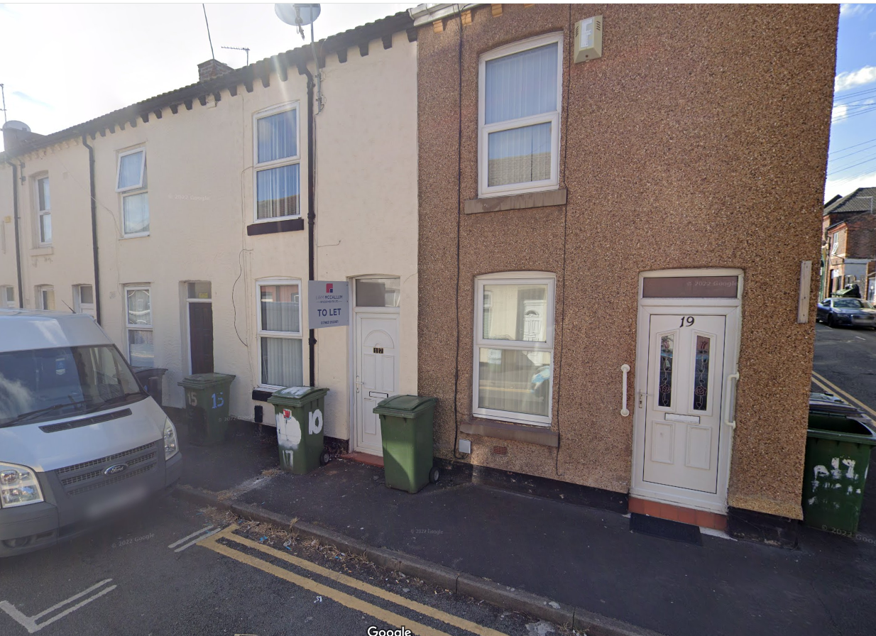
Where did your serviceperson live before the war? 2
Use Google Street View to find your serviceperson’s home today.
Notes:
Image 1: Screenshot Google Maps Map Data ©2025
Image 2: Screenshot Google Street View. Image Capture: May 2025 © Google

Slide 13
Find out more about your service person’s life before and during the war 4
Ancestry Results:
The 1939 Register
Notes:
Image: Screenshot Ancestry website https://www.ancestry.co.uk/

Slide 14
1939 England and Wales Register
Taken on 29 September 1939
Initially taken with aim of producing National Identity Cards.
Later developed further uses:
Ration books
Help record the movement of the population
From 1948, as the basis for the National Health Service Register.
The 1939 Register is a fantastic source for historians, especially considering the absence of 1931 and 1941 census records.
If your person doesn’t feature on the register, you could do a separate search for your person’s mother, father or spouse.

Slide 15
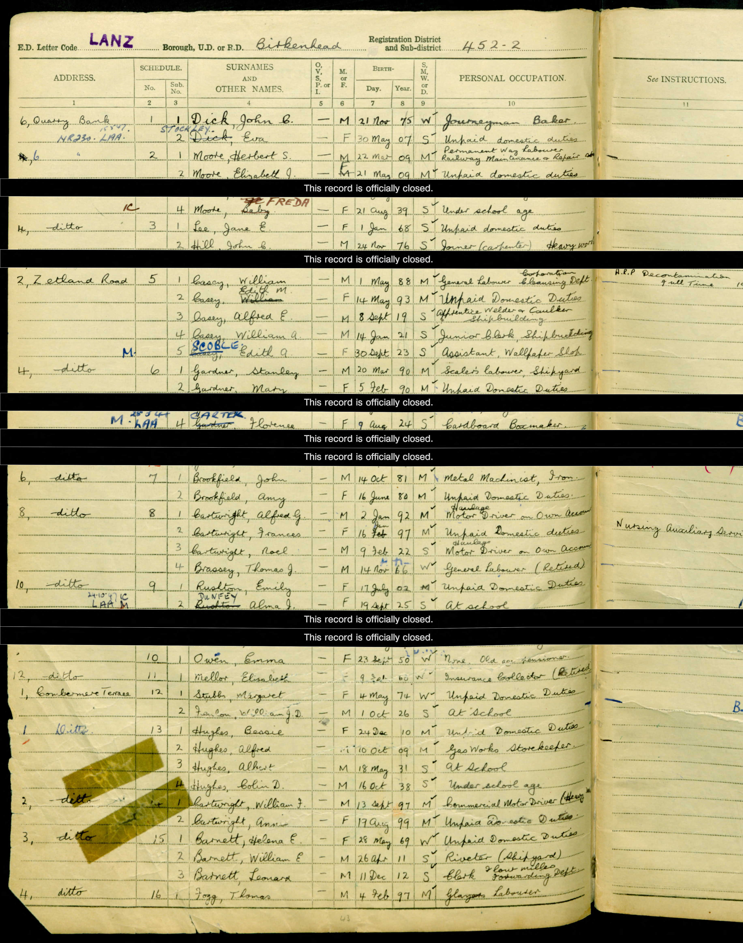
William Anthony Casey in the 1939 Register 1
The 1939 Register was taken on 29 September 1939. Its initial purpose was to collect data for National Identity Cards. It later provided information for ration books and, from 1948, was the basis for the National Health Service Register.
Names crossed out and others written in their place – movement of people / marriage. Edith A Casey becomes Scoble.
Extra info on right hand side provides information about war role where applicable. E.g. Frances Cartwright is part of the Nursing Auxiliary Service
Some records are redacted.
Notes:
Image (source): The National Archives; Kew, London, England; 1939 Register; Reference: RG 101/3919F
Note: Some records have been redacted to protect the privacy of those still alive
Names crossed out and others written in their place records movement of people / marriage etc. Edith A Casey becomes Scoble.
Extra info on right hand side provides information about war role where applicable. E.g. Frances Cartwright is part of the Nursing Auxiliary Service. The words “heavy worker” indicated that that person could receive extra rations

Slide 16
William Anthony Casey in the 1939 Register 2
2 Zetland Road (find address on some maps)
William (Jnr) is 18 years old. He a Junior Clerk in a shipbuilding company
Notes:
Image (source): The National Archives; Kew, London, England; 1939 Register; Reference: RG 101/3919F

Slide 17
Find out more about your serviceperson’s life before and during the war 5
Ancestry Results:
Allied Airmen Roll of Honour
Notes:
Image: Screenshot Ancestry website https://www.ancestry.co.uk/

Slide 18
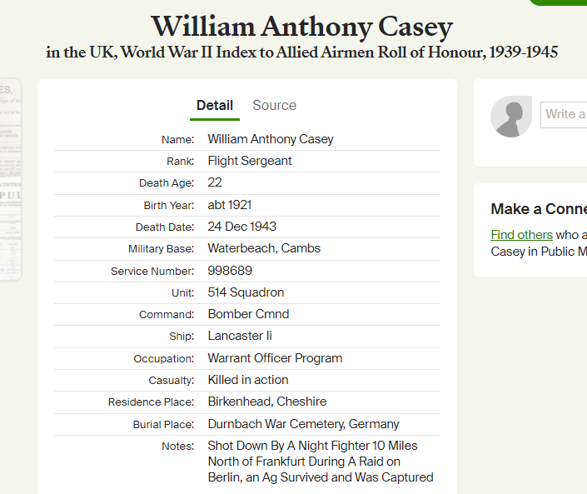
What was your serviceperson’s experience during WW2? 1
Allied Airmen Roll of Honour
Notes:
Image: Screenshot Ancestry website https://www.ancestry.co.uk/

Slide 19
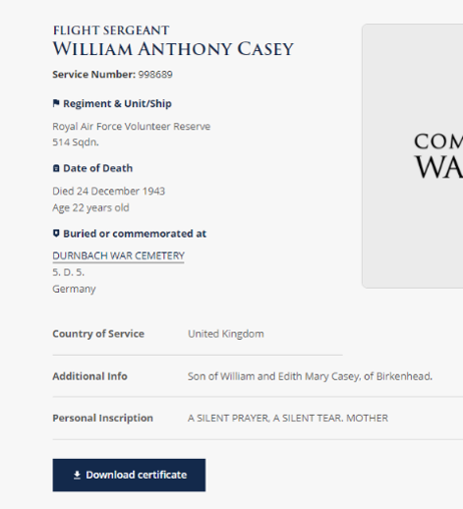
Other websites for exploring your serviceperson’s experience during WW2
RAF Volunteer Reserve in WW2 (Forces War Records)
International Bomber Command Centre
Bomber Command Losses database
RAF Commands
Or just carry out an internet search using the information you already know for your search terms!
Notes:
Image: Screenshot CWGC website https://www.cwgc.org/

Slide 20
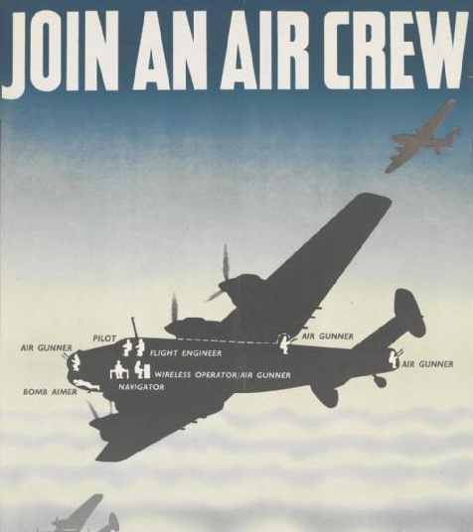
Royal Air Force Volunteer Reserve
Formed July 1936: a reserve of aircrew for use in the event of war.
Civilian volunteers 18 – 25.
Part-time training.
Returned to civilian job until called up for aircrew training.
During waiting period wore silver RAFVR lapel badge.
By end 1941: more than half Bomber Command aircrew were members of RAFVR.
RAF Recruitment Poster
Notes:
Image: By Foss, Jonathan (artist), William Brown and Co Ltd, London EC3 (printer), Her Majesty's Stationery Office (publisher/sponsor), Royal Air Force (publisher/sponsor) - http://media.iwm.org.uk/iwm/mediaLib//142/media-142728/large.jpgThis photograph Art.IWM PST 14630 comes from the collections of the Imperial War Museums., Public Domain, https://commons.wikimedia.org/w/index.php?curid=30842728

Slide 21
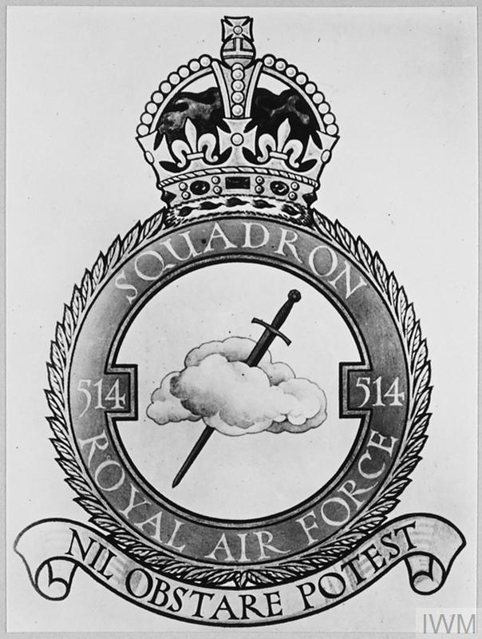
514 Squadron, WW2
No.514 Squadron was a Lancaster bomber squadron that formed part of Bomber Command, No 3 Group.
Based at Water beach, village in Cambridgeshire.
Formed late 1943.
Flew first operation on 3 November 1943.
Didn’t fly very much in winter 1943 as weather was poor.
September 1943-June 1944: Avro Lancaster II.
Notes:
Image IWM (CH 16919)

Slide 22
514 Squadron Losses, WW2
514 Squadron took part in 218 bombing raids .
Sixty-six aircraft were lost on the raids.
437 aircrew were killed flying with the Squadron.
Notes:
Men of 514 Squadron from http://www.514squadron.co.uk/Crew_photos.html

Slide 23
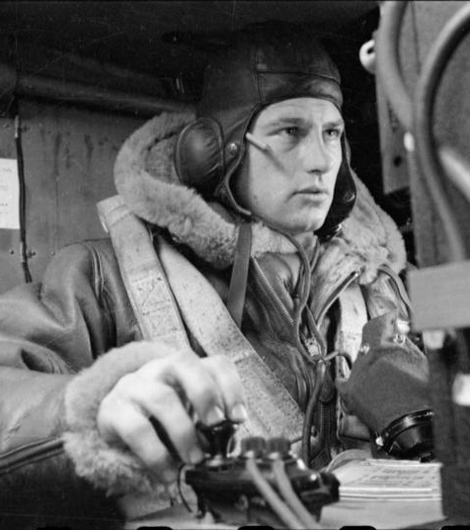
Life as an RAF Wireless Operator during WW2
Wireless operator
A Bomber Command aircrew operated as a team.
Wireless Operator / Air Gunner:
Wireless operator transmitted all messages to and from the aircraft to their base.
Fewer duties than the others as operations were conducted in wireless silence.
They also served as a reserve Air Gunner.
If the aircraft got into difficulties, he had to send out positional signals.
If the aircraft had to ditch into the sea, he had to remain at his post to send out a distress signal to improve the crew's chance of being located and rescued.
Find out more: Who's Who In An RAF Bomber Crew?
Notes:
Image: Image: IWM (D 6053)

Slide 24
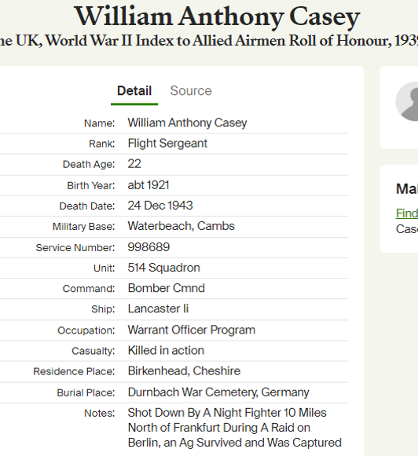
How did your serviceperson die?
What do we know so far?
Died 24th Dec 1943.
Shot down by a night fighter 10 miles North of Frankfurt during a raid on Berlin.
Allied Airmen Roll of Honour
Notes:
Image: Screenshot Ancestry website https://www.ancestry.co.uk/

Slide 25
It’s always worth a general internet search…. (1)
Website of the Aviation Heritage Museum:
  At 0037 hours on the morning 24th December 1943, Lancaster LL671 took off from Waterbeach detailed to bomb Berlin. The aircraft carried 1 x 4000lb bomb, 8 x 50lbs 30 secs, 6400 rounds of ammunition, 1900 gallons of petrol sufficient for 8 hours flying time, with the trip estimated to take 7 hours. Nothing was heard from the aircraft after take-off, and it failed to return to base. A report by a Missing Research & Enquiry team stated: “The aircraft crashed at Catheim in the district of Frieberg, Germany, presumably as a result of enemy action.” Catheim is approximately 10 miles north of Frankfurt.
  Six of the crew members were killed and one was taken prisoner.
  The crew members of LL671 were:
  Sergeant Roger William Basey (1319553) (RAFVR) (Air Bomber)
  Sergeant Leslie Frederick Bostock (1445497) (RAFVR) (Flight Engineer)
  Sergeant William Anthony Casey (998689) (RAFVR) (Wireless Air Gunner)
  Flight Sergeant Desmond Edwards (1315509) (RAFVR) (Navigator)
  Flight Sergeant Per Arne Thoedore Nelson (R/172037) (RCAF) (Rear Gunner)
  Pilot Officer Kenneth George Whitting (413058) (Pilot)
  Flight Sergeant John Edward Moloney (413635) (Mid Upper Gunner) PoW, Discharged from the RAAF: 6 November 1945
Notes:
Image 1: Screenshot Aviation Heritage Museum https://www.lincsaviation.co.uk/
Image 2: Screenshot 514 Squadron Website http://www.514squadron.co.uk/

Slide 26
It’s always worth a general internet search…. (2)
Website of 514 Squadron:
24-Dec-43 LL671 A2-B
Berlin – F/O Whitting
According to F/S Maloney, the only survivor, it is believed that F/O Whitting, the pilot, was killed during an attack on the aircraft. The aircraft crashed at Catheim, approx. 10 miles north of Frankfurt. This location has been difficult to verify; however, it is likely that LL671 was attacked by Ofw. Walter Mackens of 1./JG300 at 0250 hours or Oblt. Hans-Heinz Augenstein of 7./NJG1 at 0300 hours, both of these unidentified claims being in the Frankfurt area. The crew were on their first operation.
Maloney JE – POW Camp 4B, POW No. 269792
Crew:
F/O KG Whitting RAAF – Pilot, KIA
F/S D Edwards – Navigator, KIA
F/S RW Basey – Air Bomber, KIA
Sgt WA Casey – WOP/AG, KIA
F/S JE Moloney – MU Gunner, POW
Sgt PAT Nelson – Rear Gunner, KIA

Slide 27
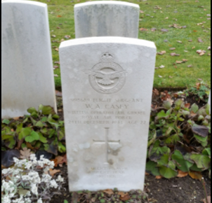
How is your serviceperson remembered? 1
Birkenhead Institute Memorial
You can sometimes find rolls of honour and / or obituaries in newspapers from the time.
Some are available online. British Newspaper Archives is the most comprehensive online source. You can search for free but there is a charge to view the articles..
Local libraries often have a good selection of local newspapers.
BNA TIP: Search for your serviceperson’s name then filter the results by date (around the time of death) and area (in which they lived)
TIP: Newspapers may report things well after the event. Search for at least a couple of weeks after the date your serviceperson died. You could also try the anniversary of the birthday if known.
Durnbach Cemetery
Notes:
Image 1: © IWM (WMR-2529)
Image 2: Find a Grave

Slide 28
How is your service person remembered?
In Loving Memory of Flt.-Sergt. William Anthony Casey (Tony) Killed in Action – December 1943, aged 22
Dear brother of Alfred, Peg, and Edith, Brother-in-law of Emily, Fred, and Wilf “Always in our thoughts.”
Dearly-loved second son of William and Edith Casey
22 Forrest Road, Claughton, Birkenhead
"Memory is the only friend that grief can call its own."
- Mum and Dad
"Devoted to duty he died not in vain, and in my memory will always remain."
- His pal, Corporal Maurice Rawsthorne (M.E.F.)
William is remembered in the Liverpool Echo on Saturday 23 December 1944, by his parents, siblings and his friend Corporal Maurice Rawsthorne.

Slide 29
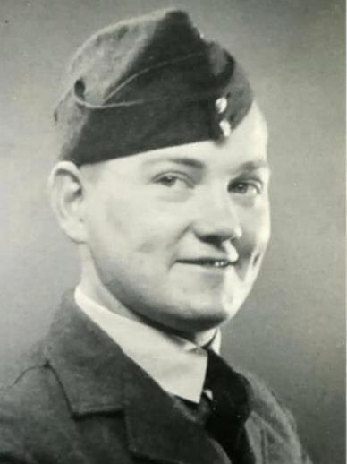
William Anthony Casey. 01/1921 – 24/12/1943 1
From images on www.findagrave.com
Notes:
Image: Find a Grave

Slide 30

William Anthony Casey. 01/1921 – 24/12/1943 2
Notes:
Image 1: © IWM (WMR-2529)
Image 2: Find a Grave

Slide 31
Summary
Exploring the stories of local servicepeople who fought and died in world wars
Connects young people to history, making the impact of war more meaningful and memorable.
Encourages empathy, reflection, and critical thinking about service, sacrifice, and the consequences of conflict.
Fosters a sense of community and identity, helping young people appreciate their heritage and the importance of remembrance.

Slide 32
Next steps: Support young people in finding out about your serviceperson
Young researchers
Use your research to create “service person information packs”, containing primary and secondary evidence about your serviceperson.
Allow the young people to explore the packs to build up a picture of a local person who fought and died in the war.
Young researchers
Notes:
Images: ©Historic England

Slide 33
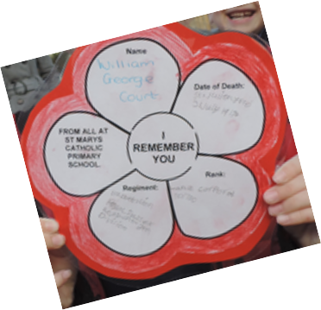
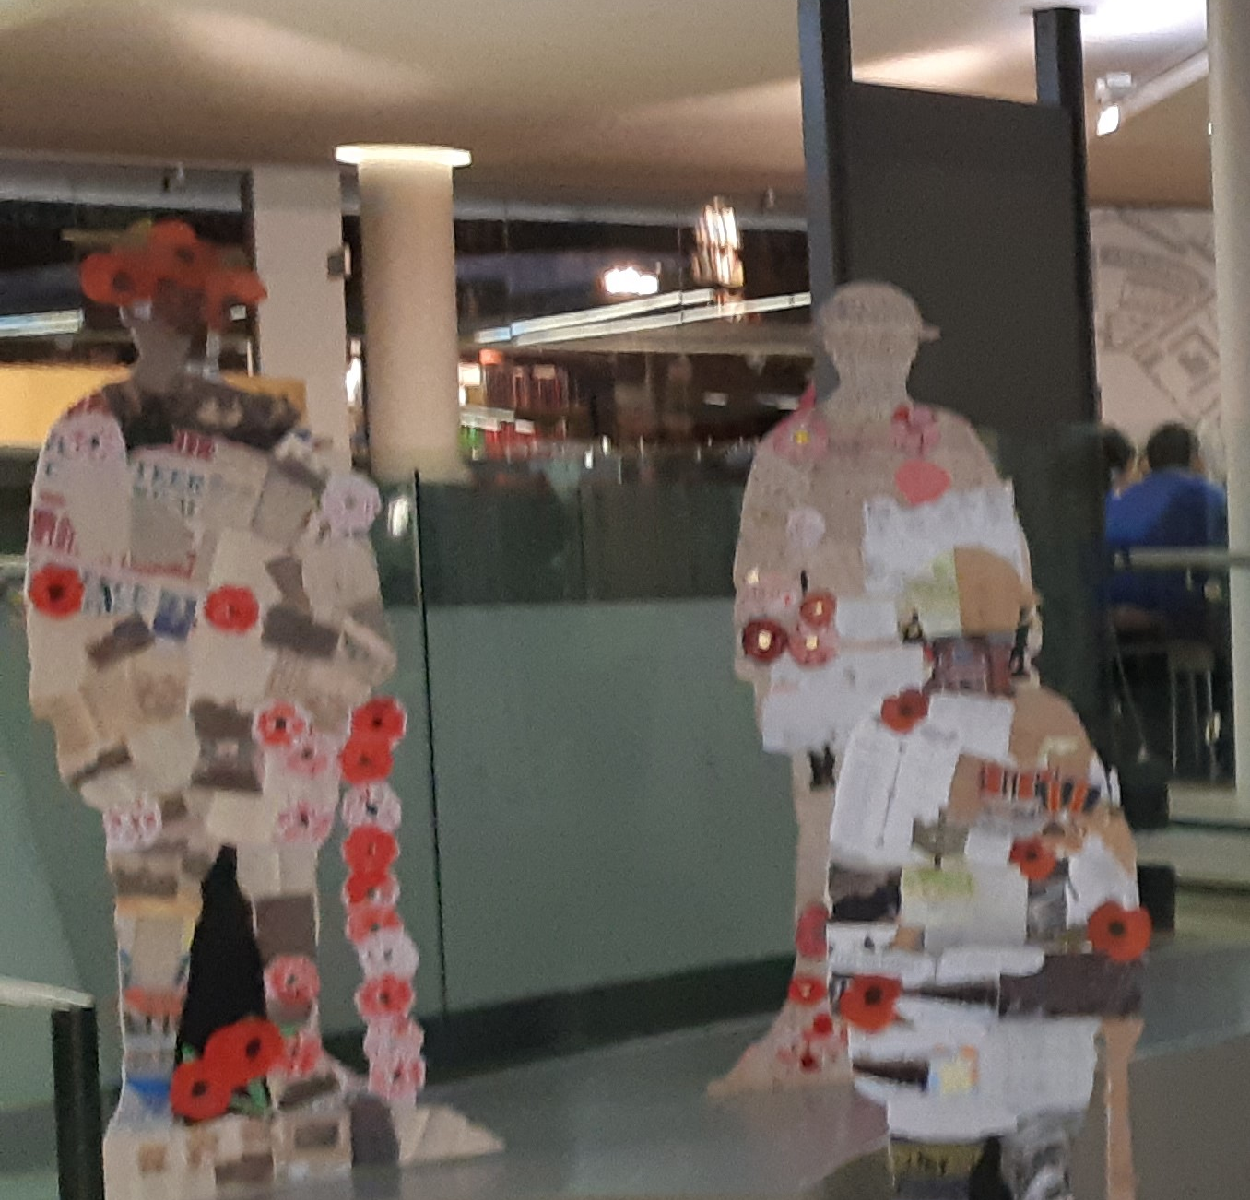
Next Steps: Remember your local serviceperson 1
“I Remember You” project
Remember the people listed on your memorial:
Hold a remembrance service for them at your local memorial.
Create a memorial display to tell others about your local serviceperson.
Remember your serviceperson by placing a virtual poppy on the British Legion’s Everyone Remembered website
WW1 Remembrance Exhibition
Notes:
Images: ©Historic England

Slide 34

Find more resources on the Historic England Website
www.historicengland.org.uk/education

