Slide 1
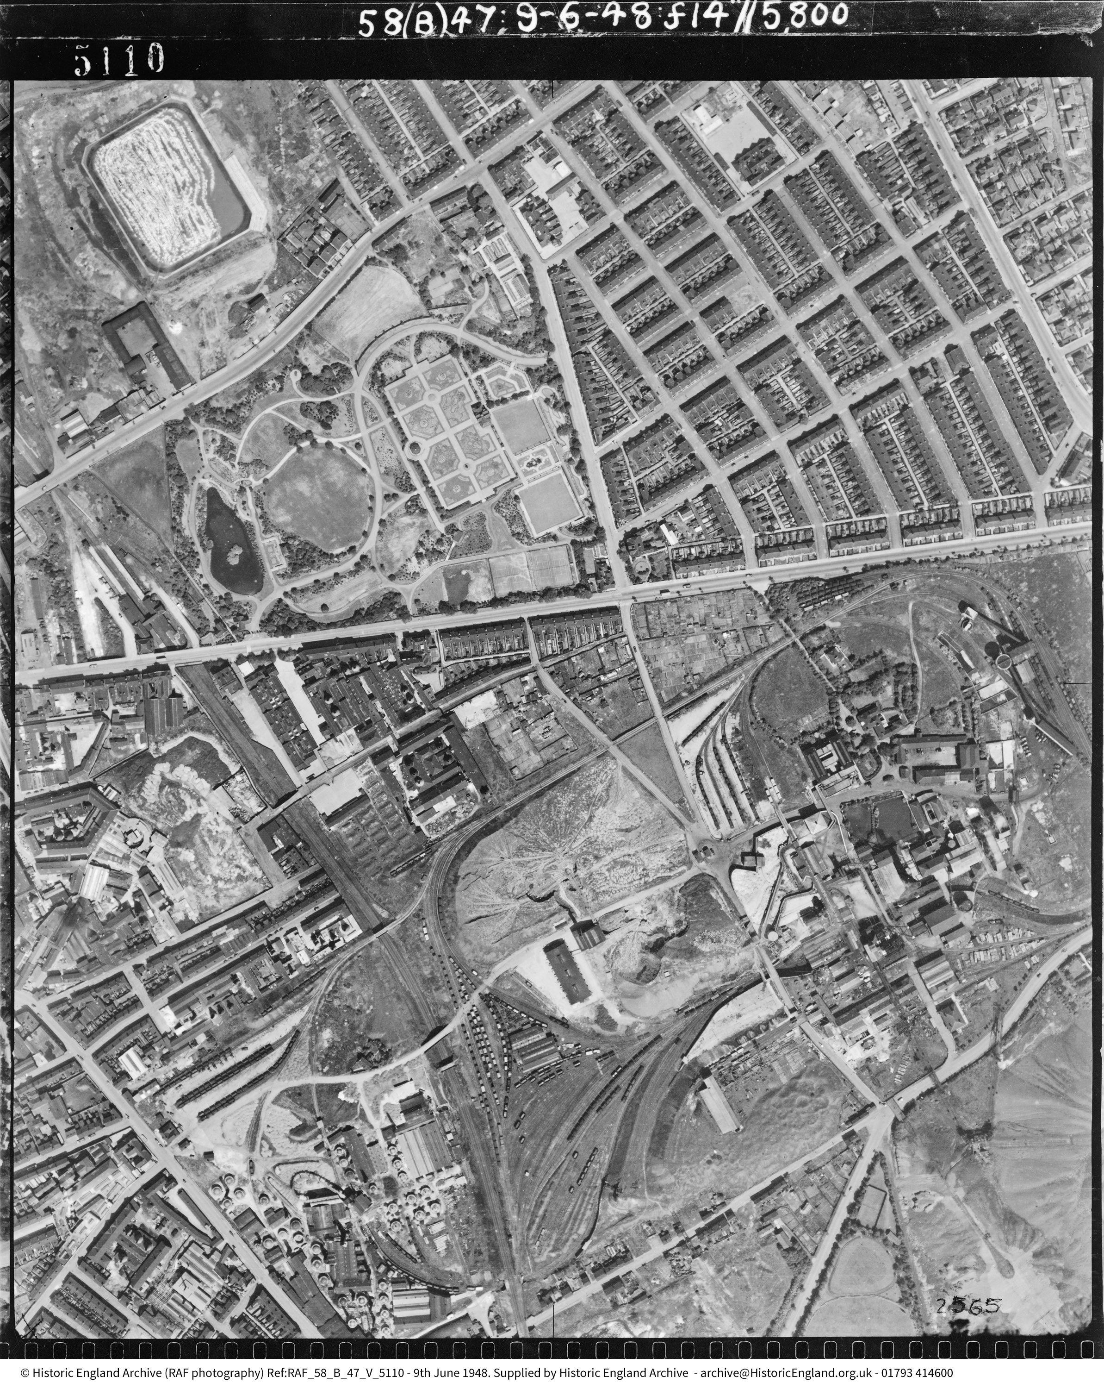
How to use Aerial Photo Explorer to study how a site can change over time
How to…..
Use Aerial Photo Explorer to study how a site changes over time
Notes:
Image: Vale Park, Burslem 9 June 1948 Ref: raf_58_b_47_v_5110 Sortie: RAF/58/B/47 © Historic England Archive
How to use Aerial Photo Explorer to study how a site changes over time

Slide 2
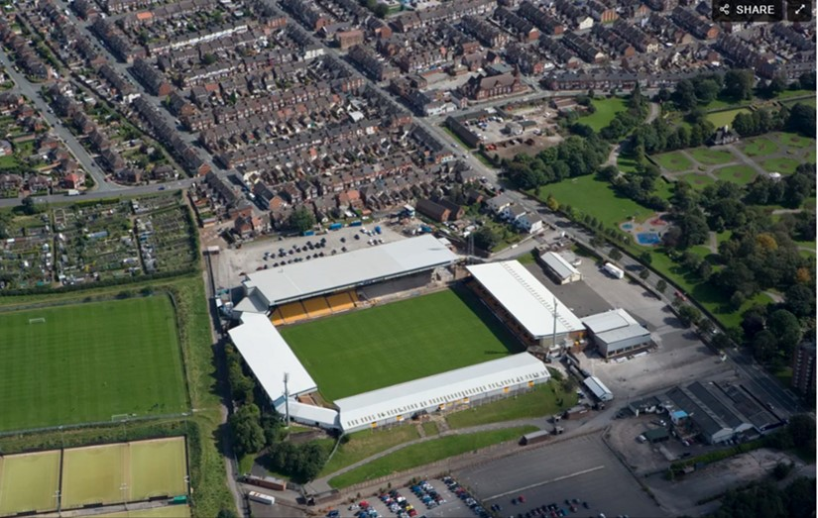
How to study how a site changes over time
This guide will:
Help you to use Aerial Photo Explorer to support a study of how a particular site can change over time
Consolidate your understanding of how to use the different types of photos in Aerial Photo Explorer
It may help if you study the guides in our How To Use Aerial Photo Explorer section
Vale Park, Burslem, 3 September 2007
Notes:
Image: Vale Park, Burslem, 3 September 2007 Photo Ref: 20669_028 Flight: N656 Photographer: David MacLeod © Historic England Archive
This guide will:
Help you to use Aerial Photo Explorer to support a study of how a particular site can change over time
Consolidate your understanding of how to use the different types of photos in Aerial Photo Explorer
It may help if you study the guides in our 'How To Use Aerial Photo Explorer' section

Slide 3
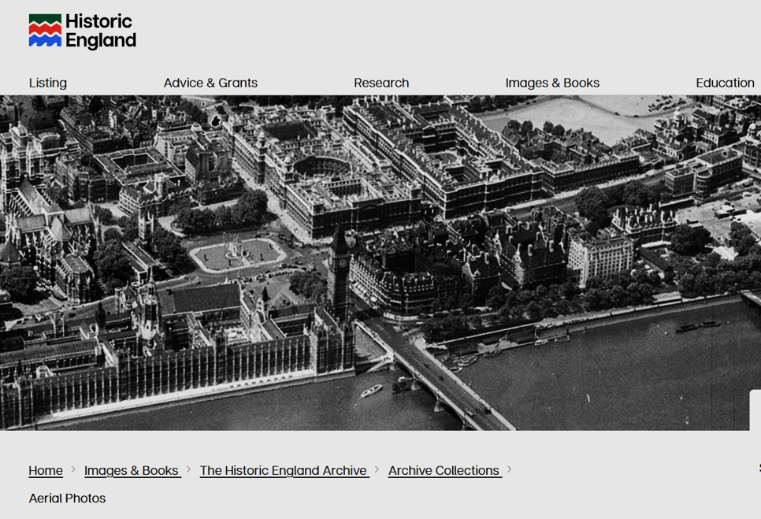
To find the Aerial Photo Explorer website
To start:
In your browser search for: https://historicengland.org.uk/images-books/archive/collections/aerial-photos/
You will see the main Historic England website banner. Scroll down to find the search map.
https://historicengland.org.uk/images-books/archive/collections/aerial-photos/
Notes:
Image: Screenshot of main banner on Historic England’s Aerial Photo Explorer webpage
To start:
In your browser search for this URL address.
You will see the main Historic England website banner. Scroll down to find the search map.

Slide 4
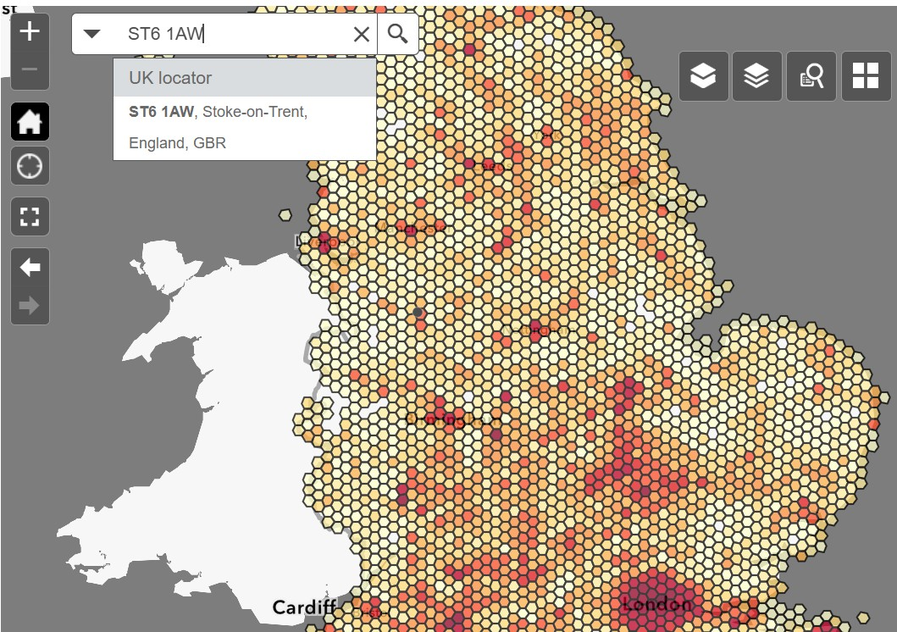

Site Example:
Vale Park, Burslem
On Aerial Photo Explorer, many sites have several images from different years. These help us build a picture of change over time for individual sites in our locality.
In this example, we will look at Vale Park Football Ground, Burslem, Stoke-on-Trent, home of Port Vale FC, to see how the site has changed over time.
We could simply search for ‘Burslem’. However, as we are looking for a specific site we can use the postcode of Port Vale FC: ST6 1AW.
By clicking on the offered ‘ST6 1AW, Stoke-on-Trent’ on the drop-down result, we are taken straight to the correct part of the map.
https://historicengland.org.uk/images-books/archive/collections/aerial-photos/
Notes:
Image: Screenshot of map and search bar on Historic England’s Aerial Photo Explorer webpage
On Aerial Photo Explorer, many sites have several images from different years. These help us build a picture of change over time for individual sites in our locality.
In this example, we will look at Vale Park Football Ground, Burslem, Stoke-on-Trent, home of Port Vale FC, to see how the site has changed over time.
We could simply search for ‘Burslem’. However, as we are looking for a specific site we can use the postcode of Port Vale FC: ST6 1AW.
By clicking on the offered ‘ST6 1AW, Stoke-on-Trent’ on the drop-down result, we are taken straight to the correct part of the map.

Slide 5
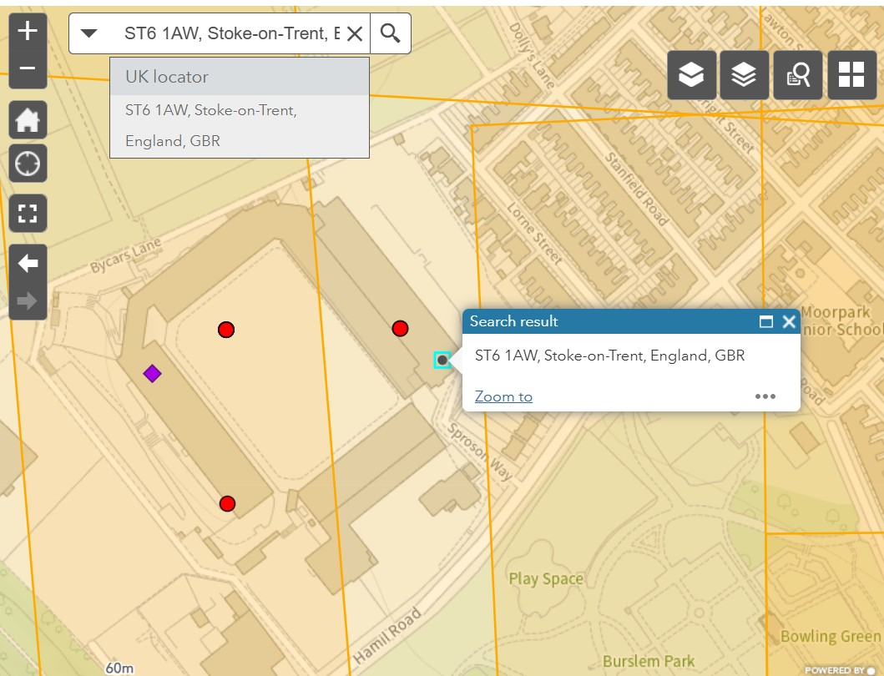
Search result:
Vale Park, Burslem
Because we have clicked on the drop-down result, the search results bring us directly to Vale Park.
We can see that there are several coloured symbols representing oblique photos and several orange grid lines, representing vertical photos of the area.
This shows us that we may find photos of Vale Park, from different time periods.
Notes:
Image: Screenshot of map and search bar on Historic England’s Aerial Photo Explorer webpage
Because we have clicked on the drop-down result, the search results bring us directly to Vale Park.
We can see that there are several coloured symbols representing oblique photos and several orange grid lines, representing vertical photos of the area.
This shows us that we may find photos of Vale Park, from different time periods.

Slide 6
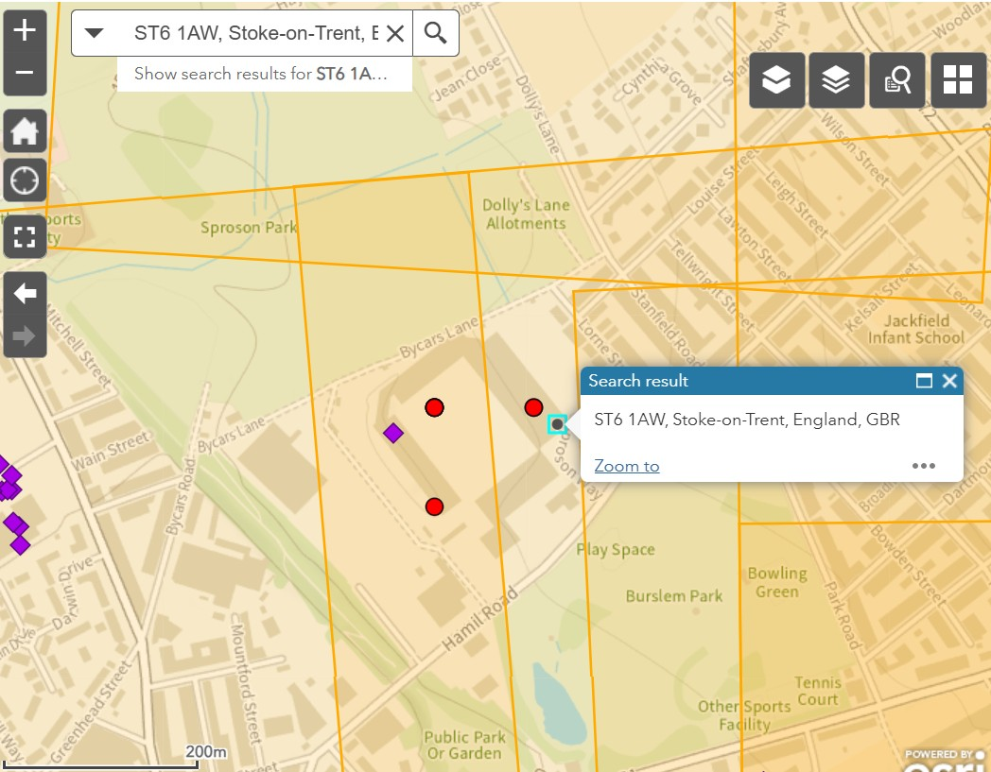
Zoom out from search result
If we click on the – icon in the top left-hand corner of the map, we can zoom out a little, just enough to see some of the area around Vale Park.
This allows us to see some of the shapes and features of the area around Vale Park Football Ground.
It may be even clearer if we choose the satellite view as our basemap.
https://historicengland.org.uk/images-books/archive/collections/aerial-photos/
Notes:
Image: Screenshot of map and search bar on Historic England’s Aerial Photo Explorer webpage
If we click on the – icon in the top left-hand corner of the map, we can zoom out a little, just enough to see some of the area around Vale Park.
This allows us to see some of the shapes and features of the area around Vale Park Football Ground.
It may be even clearer if we choose the satellite view as our basemap.

Slide 7
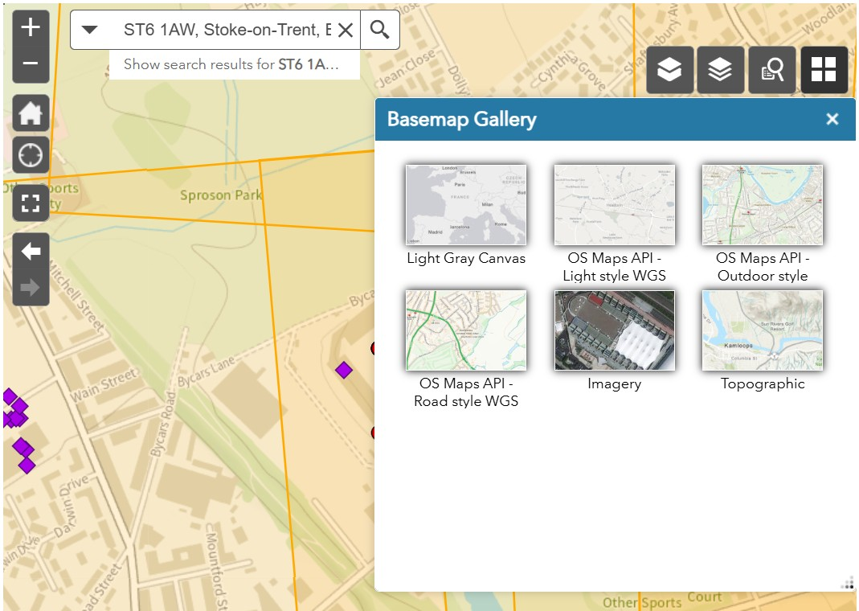
Choosing a new satellite view from basemap gallery
To get the satellite view, we click the 4-square icon in the top right-hand corner of the map.
This brings us the Basemap Gallery.
From this gallery, we select Imagery to get the satellite view.
Notes:
Image: Screenshot of map and basemap gallery on Historic England’s Aerial Photo Explorer webpage
These shapes will be even clearer if we use a satellite view.
To get the satellite view, we click the 4-square icon in the top right-hand corner of the map.
We select Imagery to get the satellite view.

Slide 8
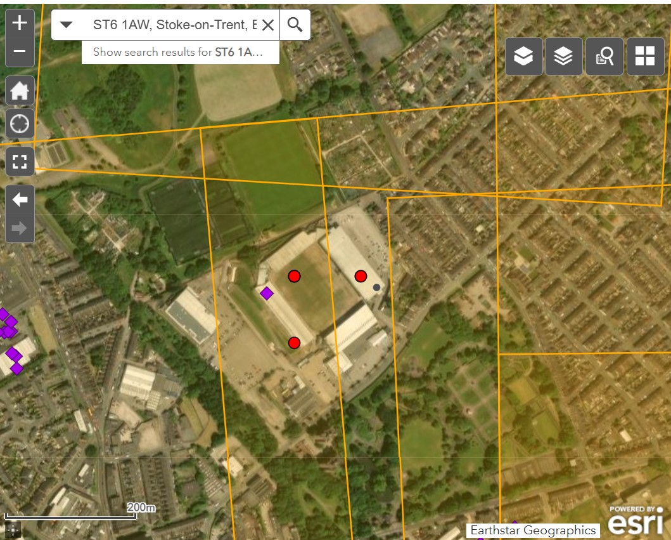
Vale Park in Imagery (satellite) basemap
It is important we get to know the modern view first, before we start looking at changes.
Now we have the satellite view of the area around Vale Park, the shapes and features are clearer and will be more similar to what we see in the photos.
This will help us to identify examples of change and continuity in the photos.
Notes:
Image: Screenshot of map in Imagery view on Historic England’s Aerial Photo Explorer webpage
Now we have the satellite view of the area around Vale Park, the shapes and features are clearer and will be more similar to what we see in the photos.
This will help us to identify examples of change and continuity in the photos.

Slide 9
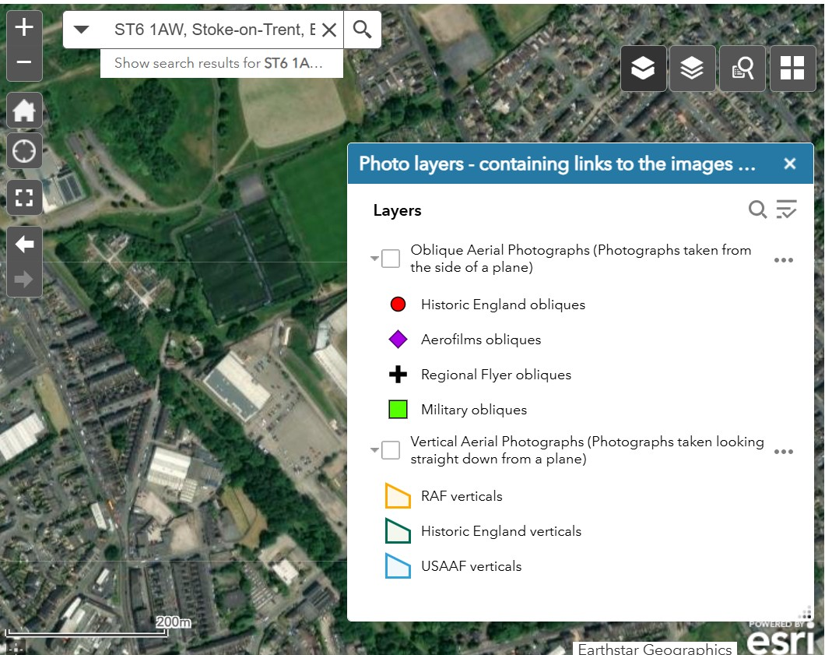
Unchecking the layers to hide symbols and grids
Once we have our satellite view, we may find it even more helpful to remove the symbols and photos from the map, temporarily, to make it easier to identify, and become familiar with, the key features around Vale Park.
This will help us to identify examples of change and continuity in the photos.
By clicking on the double-book icon in the top right corner we can uncheck both layers, to provide a clear satellite view.
Notes:
Image: Screenshot of map and photo layer gallery on Historic England’s Aerial Photo Explorer webpage
Unchecking the layers to hide symbols and grids
Once we have our satellite view, we may find even more helpful to remove the symbols and photos from the map, temporarily, to make it easier to identify, and become familiar with, the key features around Vale Park.
This will help us to identify examples of change and continuity in the photos.
Click on the double-book icon in the top right corner and simply uncheck both layers, to provide a clear satellite view.

Slide 10
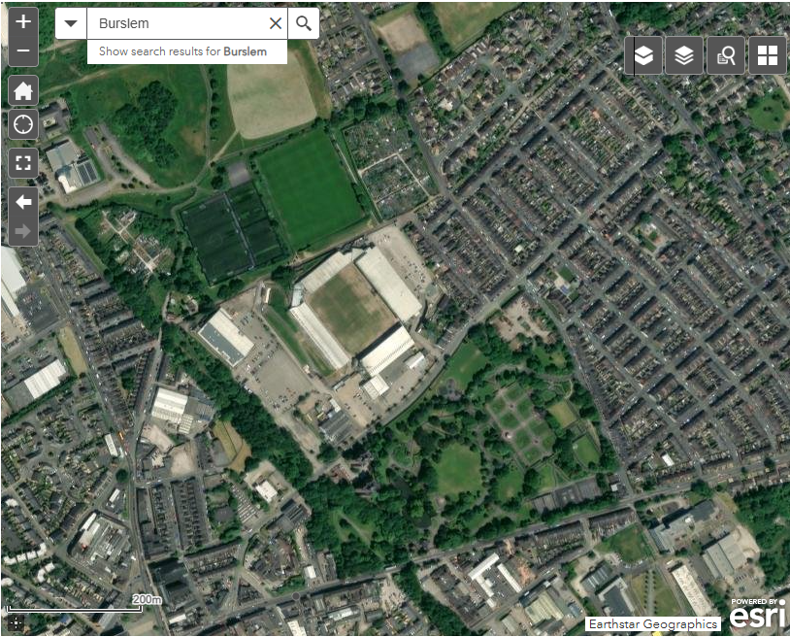
Looking at the features around Vale Park
Now that we have a clear modern view of our chosen site, we can see that:
Vale Park has 4 covered stands, with a large car park at the south-west end
The football ground is just north-west of Burslem Park
Immediately behind the north-east stand is a set of short parallel streets, bordered by two longer parallel roads
There is a sports pitch and allotments, just to the north
This will help us to orientate our view when looking at other photos
Notes:
Image: Screenshot of map in Imagery view on Historic England’s Aerial Photo Explorer webpage
Now that we have a clear modern view of our chosen site, we can see that:
Vale Park has 4 covered stands, with a large car park at the south-west end
The football ground is just north-west of Burslem Park
Immediately behind the north-east stand is a set of short parallel streets, bordered by two longer parallel roads
There is a sports pitch and allotments, just to the north
This will help us to orientate our view when looking at other photos

Slide 11
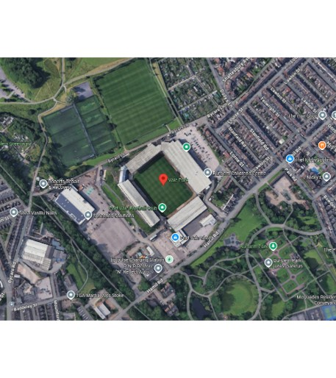
Using Google maps satellite view for reference
As we are still using our search map, it is helpful to have a separate, larger modern satellite view, which will we can zoom in and out of easily.
This will provide us with a steady reference point and will help us to compare and contrast the aerial photos to the most recent view.
Use another tab of your browser to open Google Maps. Search for Vale Park in Google maps (using the postcode) and use the satellite view.
Google satellite image of Vale Park 2025
Notes:
Image: Screenshot of Google map in satellite view
As we are still using our search map, it is helpful to have a separate, larger modern satellite view, which will we can zoom in and out of easily.
This will provide us with a steady reference point and will help us to compare and contrast the aerial photos to the most recent view.
Use another tab of your browser to open Google Maps. Search for Vale Park in Google maps (using the postcode) and use the satellite view.

Slide 12
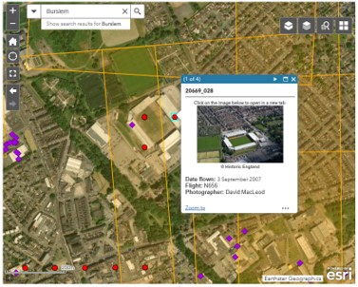
Re-select the different collections layers
We can see there are several symbols and grids. This means that it is likely that there are several photos from different time periods, which will enable us to view the site over different periods of time.
If we click on one of the 3 red dots, we can open the thumbnail image of a relatively recent photograph.
Notes:
Image: Screenshot of map in Imagery view, with thumbnail image, on Historic England’s Aerial Photo Explorer webpage ]]
We can see there are several symbols and grids. This means that it is likely that there are several photos from different time periods, which will enable us to view the site over different periods of time.
If we click on one of the 3 red dots, we can open the thumbnail image of a relatively recent photograph.

Slide 13
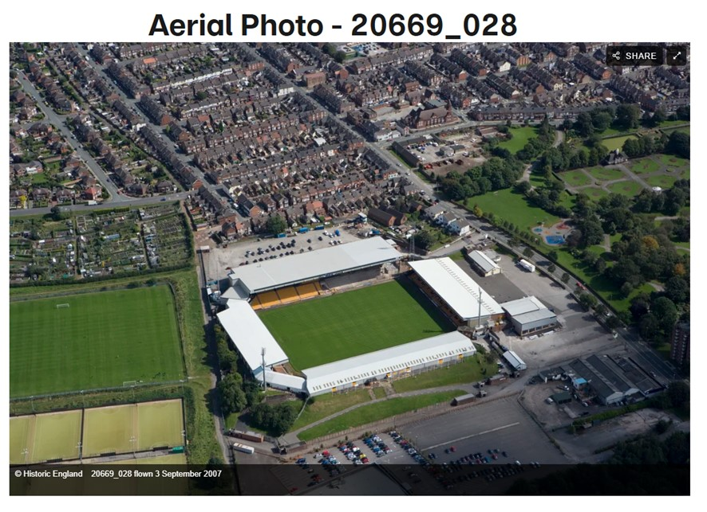
Modern Photograph of Vale Park
On this 2007 photo we can see the 3 sides clearly.
We can see:
part of Burslem Park (Grade II listed), including the play area, and the top of the ornately landscaped beds.
the training pitch and allotments, behind the ground
he distinctive pattern of streets just to the east of the ground
Vale Park, Burslem 3 September 2007
Notes:
Image: Vale Park, Burslem, 3 September 2007 Photo Ref: 20669_028 Flight: N656 Photographer: David MacLeod © Historic England Archive
On this 2007 photo we can see the 3 sides clearly.
We can see
part of the Garde II listed Burslem Park, including the play area, and the top of the ornately landscaped beds.
the training pitch and allotments, behind the ground
The distinctive pattern of streets just to the east of the ground

Slide 14
Modern Photograph
Vale Park, 2007
We know, from the search map, that the training pitches, next to the allotments, are immediately north of the ground.
Therefore, we can see that this 2007 photo is not orientated the same way as the map.
For guidance on how to orientate the photos alongside maps, seethe How to orientate Aerial Explorer photos guide.
Vale Park, Burslem, 3 September 2007
Notes:
Image: Vale Park, Burslem, 3 September 2007 Photo Ref: 20669_028 Flight: N656 Photographer: David MacLeod © Historic England Archive
From the search map, we know that the training pitches, next to the allotments, are immediately north of the ground.
Therefore, we can see that this 2007 photo is not orientated the same way as the map.
For guidance on how to orientate the photos alongside maps, see the guide How to orientate Aerial Photo Explorer photos using maps.

Slide 15
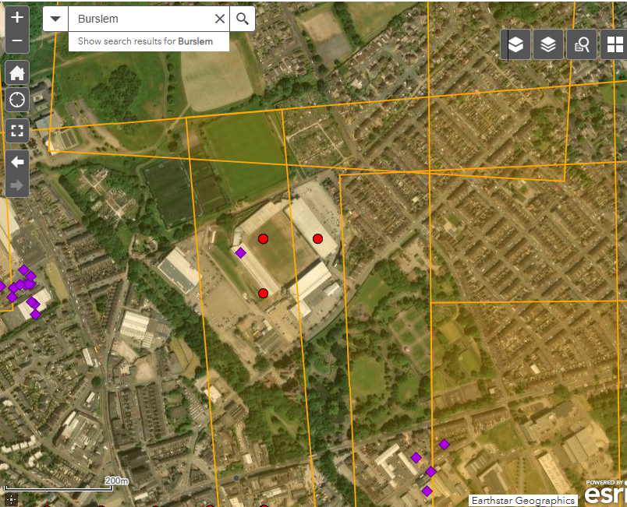
Finding more photos from different time periods
We would like to find more photos from earlier time periods.
If we return to our initial Aerial Photo Explorer tab, we can see that there is also a purple Aerofilms symbol and various orange grid lines.
Click on the purple symbol to get another oblique photo.
Notes:
Image: Screenshot of map in Imagery view, with thumbnail image, on Historic England’s Aerial Photo Explorer webpage
We would like to find more photos from earlier time periods.
If we return to our initial Aerial Photo Explorer tab, we can see that there is also a purple Aerofilms symbol and various orange grid lines.
Click on the purple symbol to get another oblique photo.

Slide 16
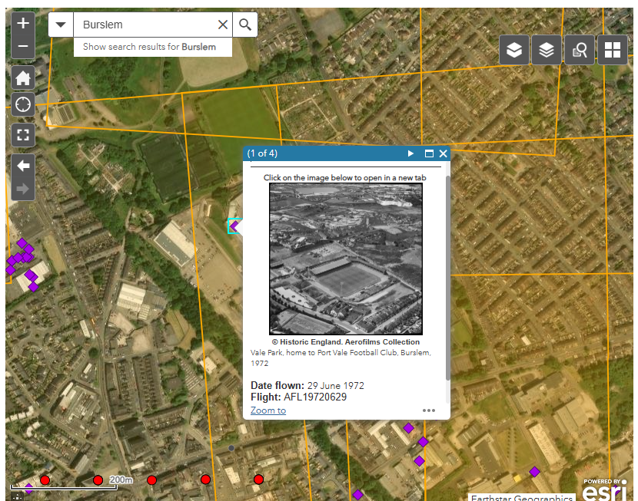
Photo of Vale Park in 1972
This brings us the thumbnail of Vale Park in 1972. If we click on this image, we will get the full photo.
Notes:
Image: Screenshot of map in Imagery view, with thumbnail image, on Historic England’s Aerial Photo Explorer webpage
This brings us the thumbnail of Vale Park in 1972. If we click on this image, we will get the full photo.

Slide 17
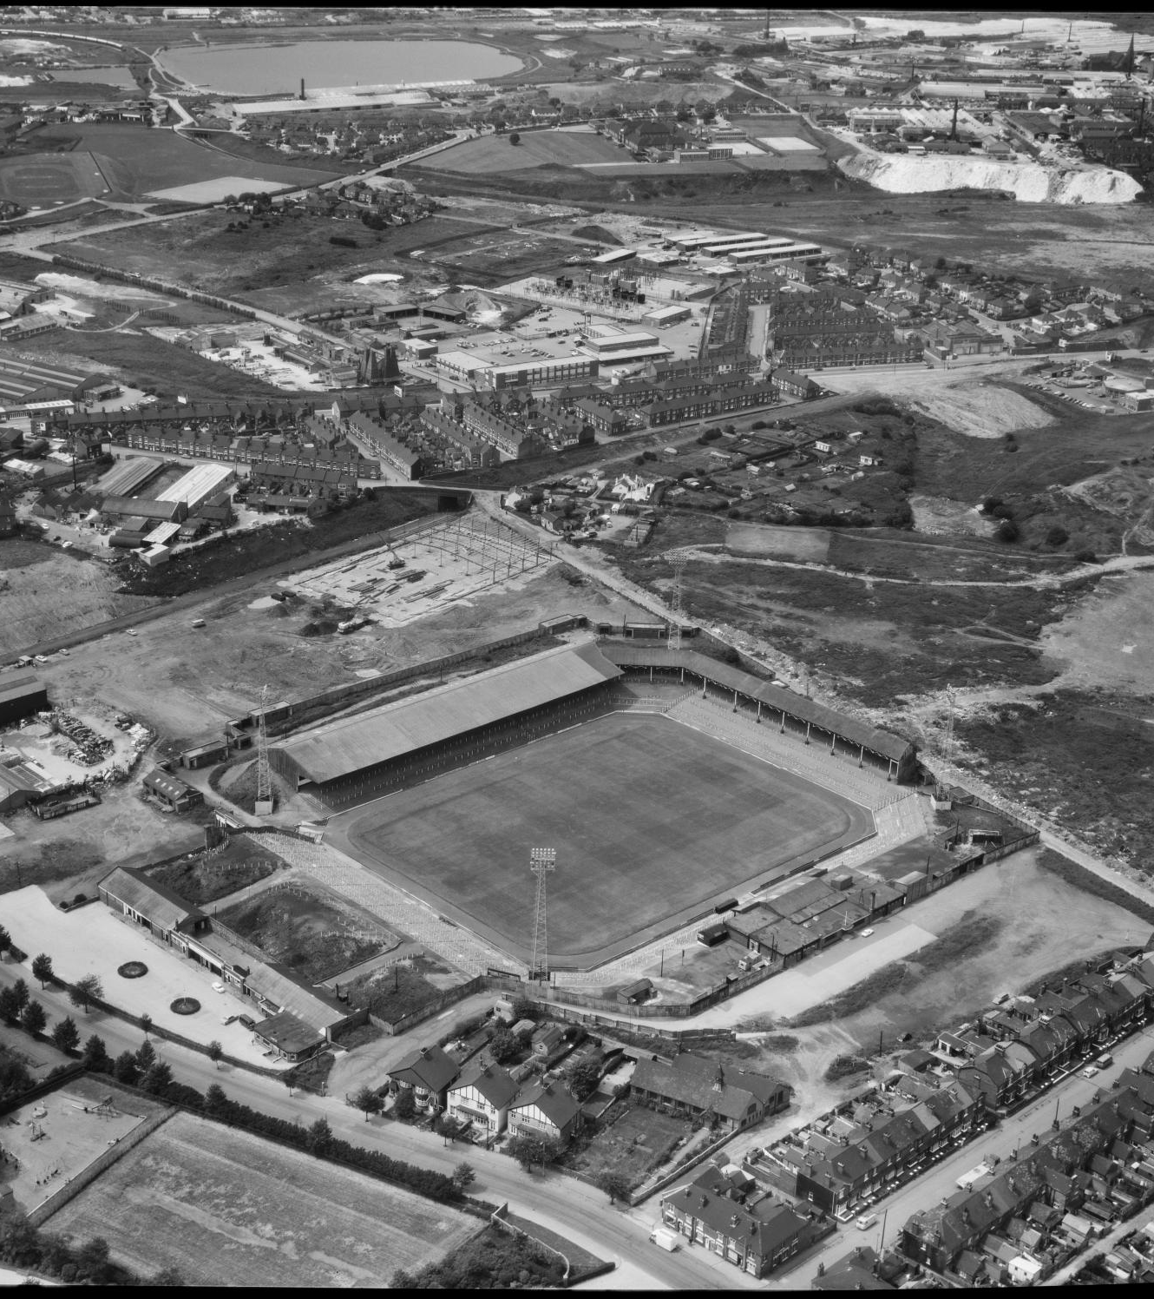
Studying Vale Park in June 1972
In this photo we can pick out lots of details. We can see that Vale Park is much less-developed in 1972. Only one side of the ground is fully under roof cover.
The photo doesn’t quite include the allotments, but we can certainly see that what is now a training pitch is still waste-ground in 1972.
A local industrial unit is still under construction at the west end of the ground.
We can even see the more traditional play equipment in the playground in Burslem Park.
Vale Park, Burslem, 29 June 1972
Notes:
Image: Vale Park, Burslem, 29 June 1972 Ref: EAW243358 Flight: AFL19720629 Photographer: Aerofilms © Historic England Archive
This photo is from June 1972. In this photo we can pick out lots of details. We can see that Vale Park is much less-developed in 1972. Only one side of the ground is fully under roof cover.
The photo doesn’t quite include the allotments but we can certainly see that what is now a training pitch is still waste-ground in 1972.
A local industrial unit is still under construction at the west end of the ground.
We can even see the more traditional play equipment in the playground in Burslem Park.

Slide 18
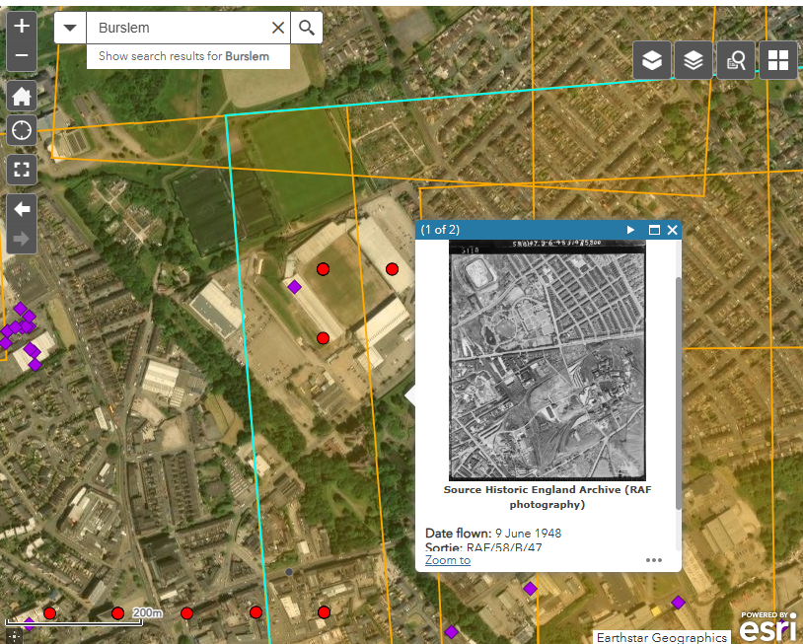
Finding Vertical Photos
It would be useful to look at a vertical photo.
If we return again to our initial Aerial Photo Explorer tab, we can see there are several orange grid lines, denoting vertical photos.
We can click on the nearest orange grid sections to get some vertical images.
By clicking on a grid just south of Vale Park, we can find a vertical photo from June 1948.
Notes:
Image: Screenshot of map in Imagery view, with thumbnail image, on Historic England’s Aerial Photo Explorer webpage
It would be useful to look at a vertical photo.
If we return again to our initial Aerial Photo Explorer tab, we can see there are several orange grid lines, denoting vertical photos.
We can click on the nearest orange grid sections to get some vertical images.
By clicking on a grid just south of Vale Park, we can find a vertical photo from June 1948.

Slide 19
Vale Park not yet built in June 1948
We can make out some of the local street shapes really clearly and the landscaped beds in Burslem Park are also familiar.
What makes this photo really interesting is that it shows us that, in 1948, Vale Park had not even been built. There are no stands, offices or car park and the pitch has not even been laid.
This shows significant change over several decades. We also see the wider context of the area, including the large colliery (Sneyd Colliery) to the south of Burslem Park.
It also raises the question of what the land was used for before it was a football ground
(To help find an earlier map of the area, you may want to look at the guide How to use NLS maps.
Vale , Burslem , June 1948
Notes:
Image: Vale Park, Burslem 9 June 1948 Ref: raf_58_b_47_v_5110 Sortie: RAF/58/B/47 © Historic England Archive
In this photo from June , 1948, We can make out some of the local street shapes really clearly and the landscaped beds in Burslem Park are also familiar.
What makes this photo really interesting is that it shows us that, by 1948, Vale Park had not even been built. There are no stands, offices or car park and the pitch has not even been laid.
This shows significant change over several decades. We also see the wider context of the area, including the large colliery (Sneyd Colliery) to the south of Burslem Park.
It also raises the question of what the land was used for before it was a football ground
(To help find an earlier map of the area, you may want to look at the guide How to use NLS maps.

Slide 20
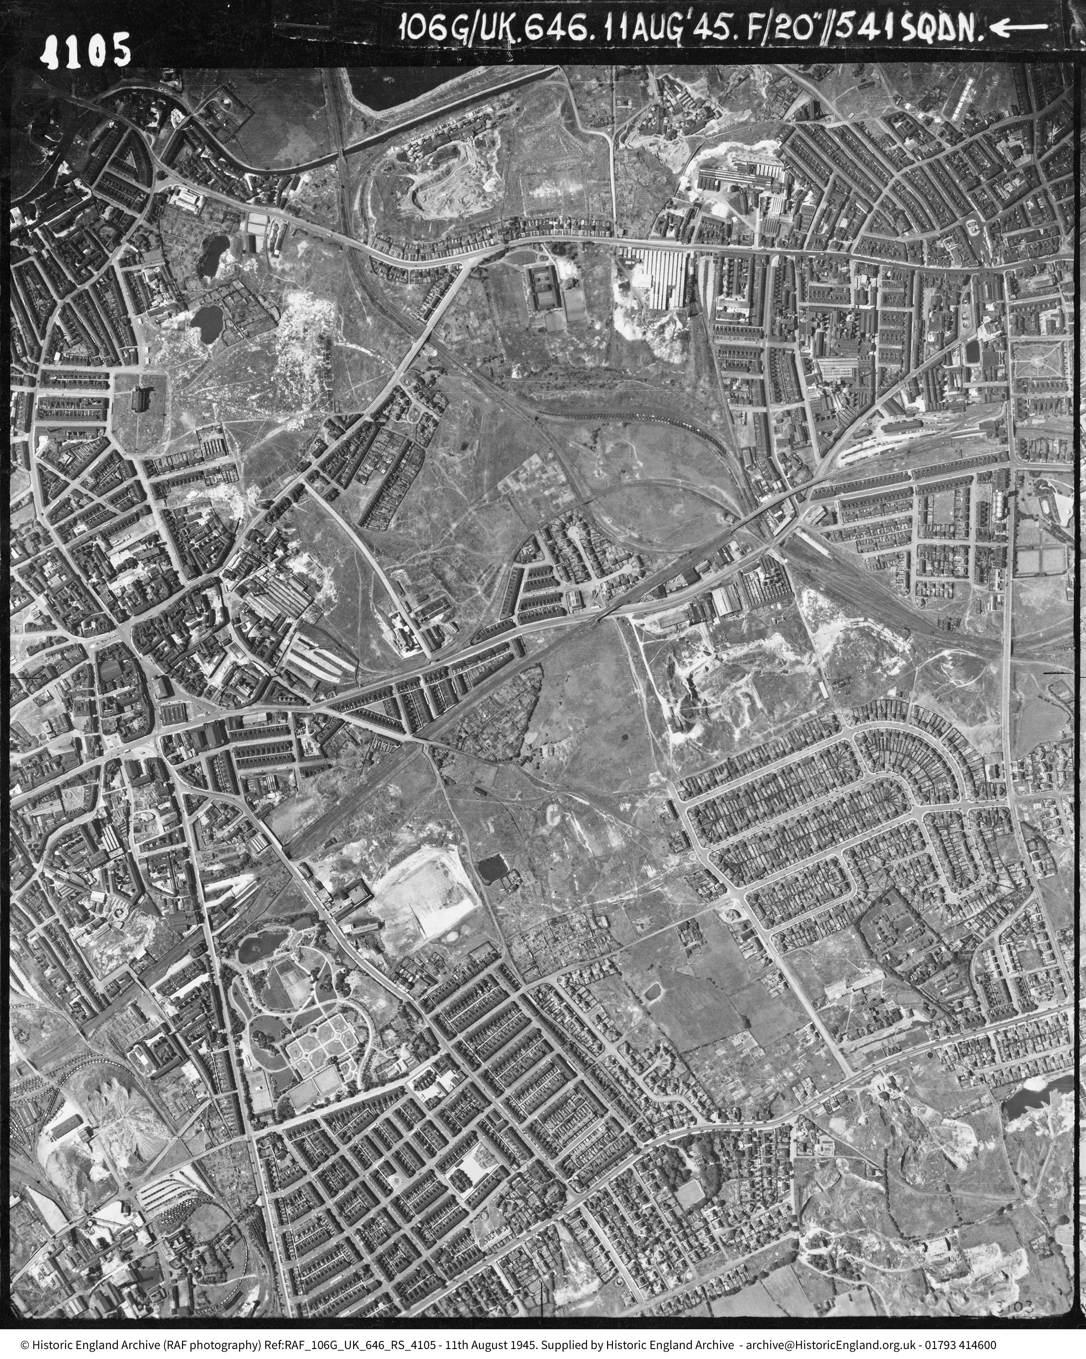
Was Vale Park built in August 1945?
Another vertical photo is from August 1945, 3 months after VE Day and just days before the end of the Second World War.
We can see the location of Vale Park but it looks very different in this photo, compared with most of the other photos.
We can zoom in for a closer look.
Burslem, 11th August 1945
Notes:
Image: Burslem, 11 August 1945 Ref: - raf_106g_uk_646_rs_4105 Sortie: RAF/106G/UK/646 © Historic England Archive
Another vertical photo is from August 1945, 3 months after VE Day and just days before the end of the Second World War.
We can see the location of Vale Park but it looks very different in this photo, compared with most of the other photos.
We can zoom in for a closer look.

Slide 21
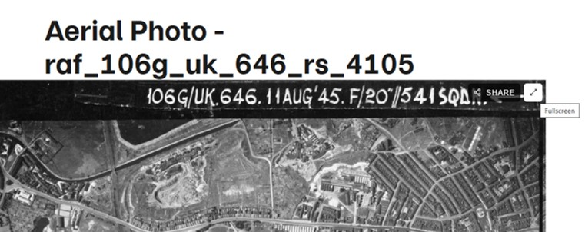
Vale Park in August 1945: selecting full screen
As with other photos, if we click on the double arrow full screen icon, we can zoom in and out to study the detail of the photo more easily.
Notes:
Image: section of photo: Burslem, 11 August 1945 Ref: - raf_106g_uk_646_rs_4105 Sortie: RAF/106G/UK/646 © Historic England Archive
As with other photos, if we click on the double arrow full screen icon, we can zoom in and out to study the detail of the photo more easily.

Slide 22
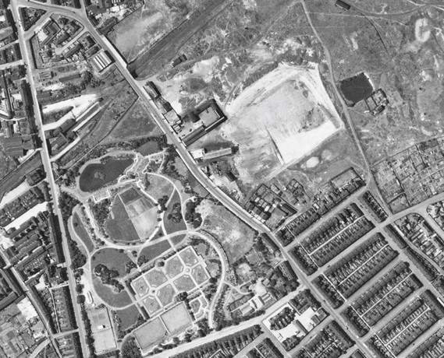
Vale Park in August 1945
We can see that what is now Vale Park did not exist as a football ground in 1945.
Although Vale Park has not been built by 1945, we can identify Burslem Park, the neighbouring streets and the allotments we saw in the original map search.
We can see that the land had some sort of industrial use. Bycars Lane runs behind the north of the current football ground.
A quick research inquiry tells us that Vale Park stands on what used to be Bycars Brickworks, which was associated with the Sneyd Colliery to the south.
So, quite quickly, these photos about one site, used together, have shown us a lot about change and continuity, over time.
Burslem, 11th August 1945
Notes:
Image: Section of photo: Burslem, 11 August 1945 Ref: - raf_106g_uk_646_rs_4105 Sortie: RAF/106G/UK/646 © Historic England Archive
We can see that what is now Vale Park did not exist as a football ground in 1945.
Although Vale Park has not been built by 1945, we can identify Burslem Park, the neighbouring streets and the allotments we saw in the original map search.
We can see that the land had some sort of industrial use. Bycars Lane runs behind the north of the current football ground.
A quick research inquiry tells us that Vale Park stands on what used to be Bycars Brickworks, which was associated with the Sneyd Colliery to the south.
So, quite quickly, these photos about one site, used together, have shown us a lot about change and continuity, over time. Whether we are looking at part of a city, a village or an individual building, Aerial Photo Explorer can provide valuable images that show us how a part of our locality has changed over time.

