Slide 1
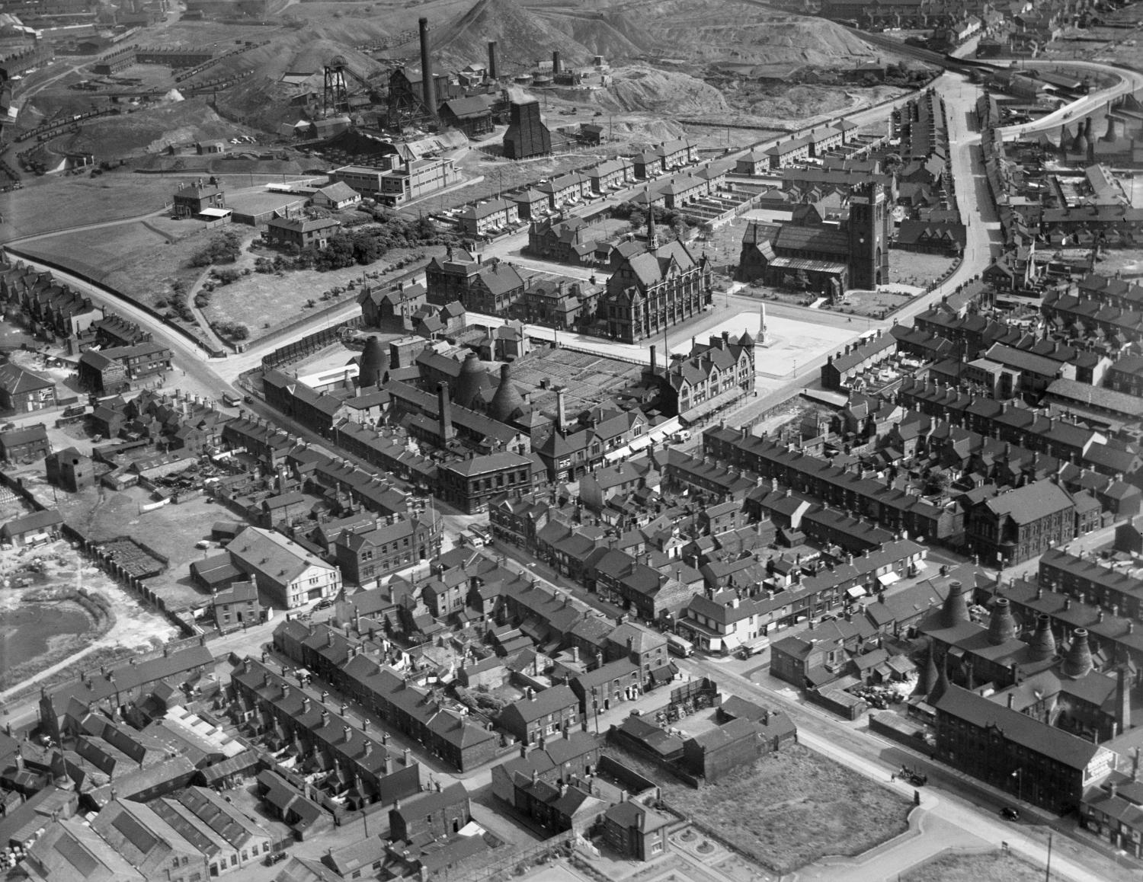
How to use Historic England’s Aerial Photo Explorer 1
How to…..
Find a photo of your local area using Historic England’s Aerial Photo Explorer
Notes:
Image: Fenton, July 1937, EPW054092 © Historic England Archive
How to find a photo of your local area using Historic England’s Aerial Photo Explorer

Slide 2
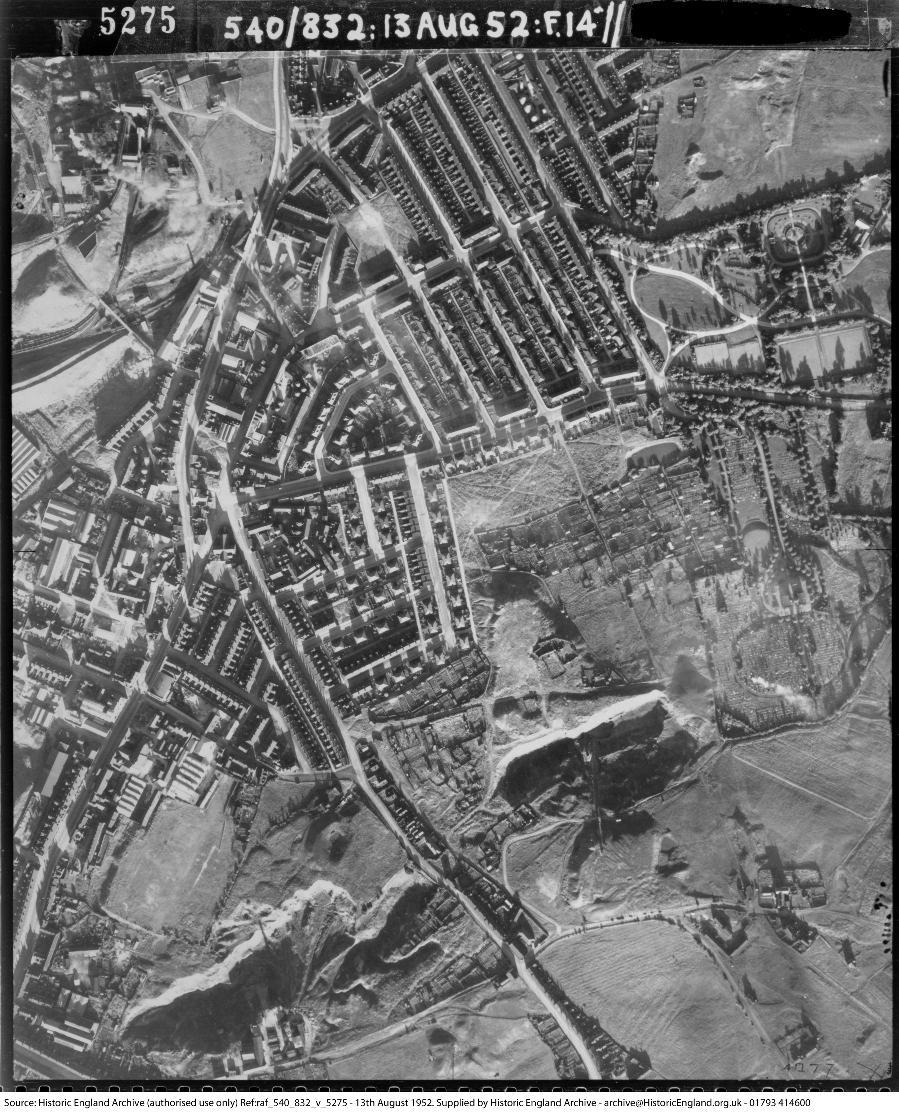
How to find a photo of your local area
This guide will:
Provide a starting point for using the Aerial Photo Explorer website
Show you to how to open an aerial photo from the Historic England Archive
Suggest ideas for additional activities and next steps
Fenton, Stoke-on-Trent, August 1952
Notes:
Image: Fenton, 1952 raf_540_832_v_5275 © Historic England
This guide will provide you with a starting point for using Historic England’s Aerial Photo Explorer.
It will show you how to open a photo from our Archive and, at end of this presentation, there will be suggestions for additional guides to help you enhance your use of Aerial Photo Explorer.

Slide 3
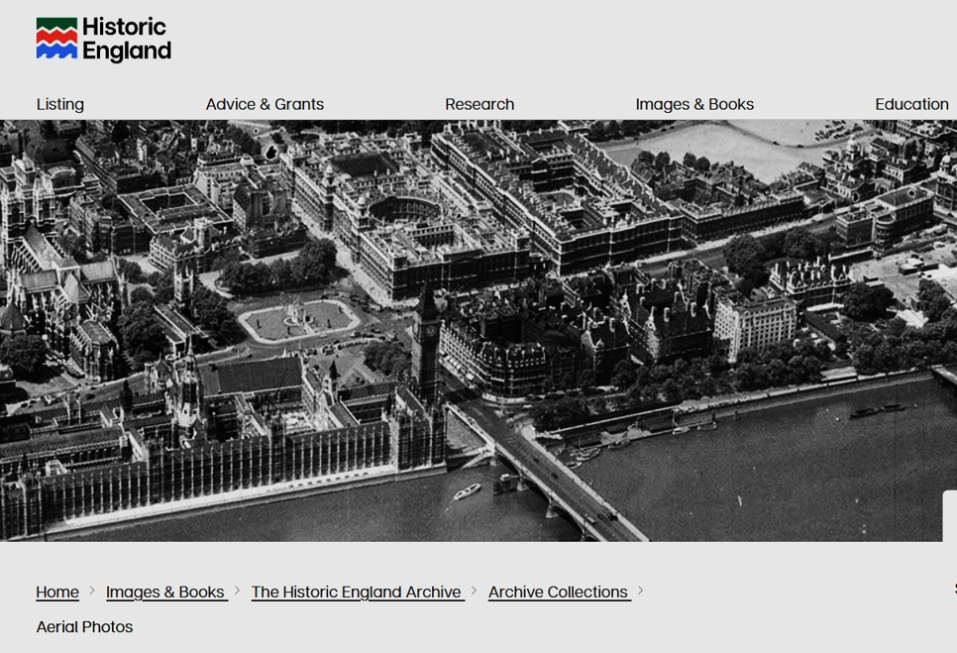
To find the Aerial Photo Explorer website
To start:
In your browser search for: https://historicengland.org.uk/images-books/archive/collections/aerial-photos/
You will see the main Historic England website banner.
https://historicengland.org.uk/images-books/archive/collections/aerial-photos/
Notes:
Image: Screenshot of main banner on Historic England’s Aerial Photo Explorer landing page
To start with, search in your web browser using this URL web address for the Aerial Photo Explorer website.
You will see the Historic England logo and website banner.

Slide 4
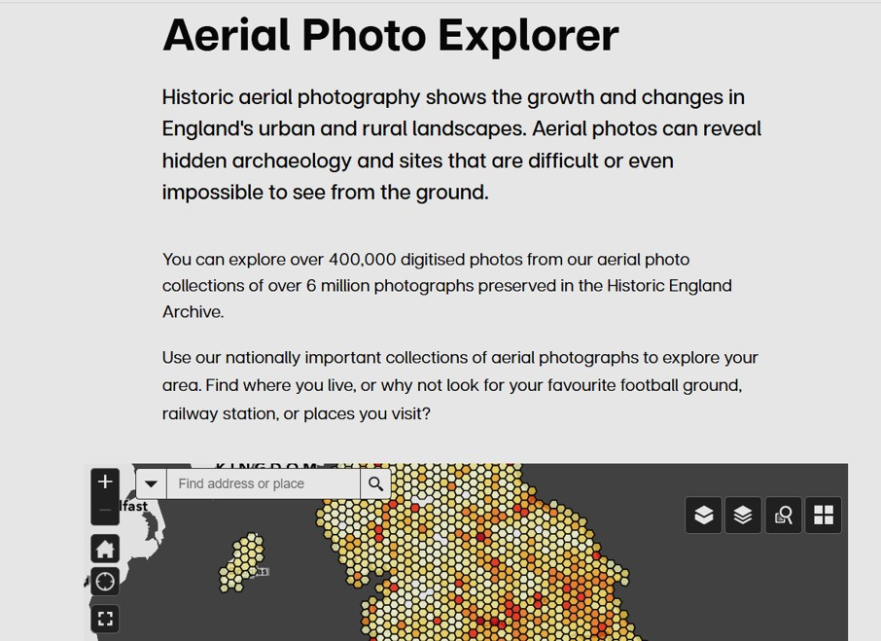
How to start a search for photos of your area
Scroll down and you will see the heading ‘Aerial Photo Explorer’ and the top of the search map.
This is how you will start your search for aerial photographs.
You will see the search bar in the top left-hand corner of the map.
https://historicengland.org.uk/images-books/archive/collections/aerial-photos/
Notes:
Image: Screenshot of introduction and search bar on map Historic England’s Aerial Photo Explorer
Scroll down the page and you will see the heading ‘Aerial Photo Explorer’, an introduction and a map.
In the top left-hand corner of the map, you will see the search bar.

Slide 5
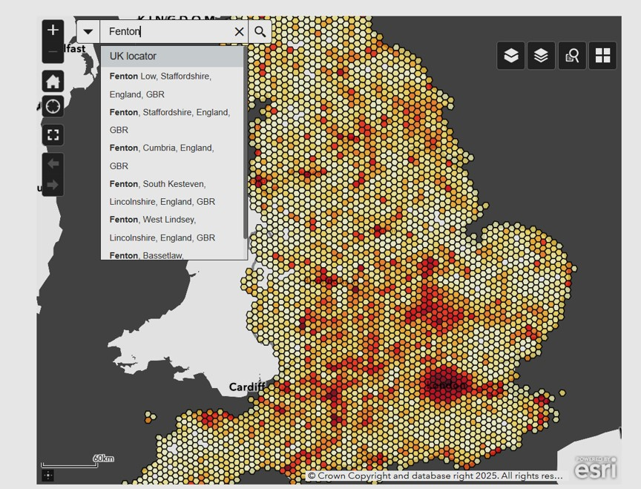

Search for an area
In this example we are using Fenton, Staffordshire.
In the Search bar, enter the name of the area you want to look at and press enter.
Alternatively, use a postcode, if you are looking for a specific street or building. There are two slides at the end of this PPT about postcode searches.
Notes:
Image: Screenshot of search bar and map on Historic England’s Aerial Photo Explorer web page
To get started, type the name of the place you want to look at into the search bar in the top left-hand corner of the map.
In this example we are looking for Fenton, in Stoke-on-Trent.
Then press enter.
Alternatively, use a postcode, if you are looking for a specific street or building. There are two slides towards the end of this PPT about postcode searches.

Slide 6
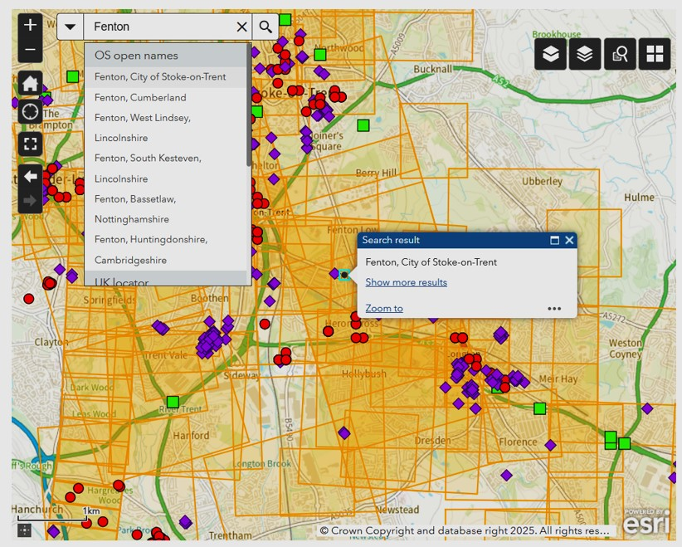
Selecting a photo
You will see a map with lots of orange grid lines and different coloured dots and marker shapes.
Find the specific area you wish to focus on and click on a yellow grid or coloured marker.
In this example we click on a purple diamond marker.
Notes:
Image: Screenshot of search bar and map on Historic England’s Aerial Photo Explorer web page
The map will automatically concentrate on the area you have typed in – in this example, Fenton.
You will see overlapping light orange rectangular grids and different coloured marker symbols in purple, red, green and, less often, black crosses.
Find the specific area you wish to focus on and click on a yellow grid or coloured marker.
In this example we click on a purple diamond marker.

Slide 7
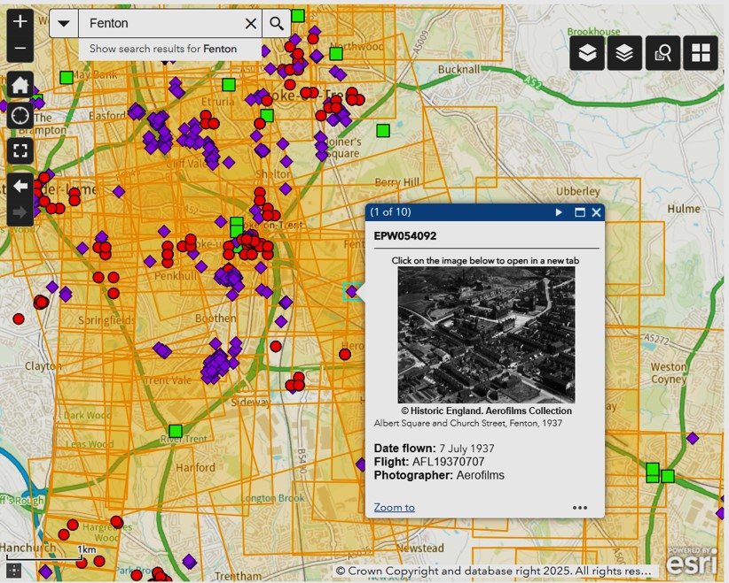
Information in the thumbnail photo image
You will get a thumbnail photo image with the date of the photograph, the Archive reference number and the photographer – this is usually Aerofilms, or a named individual.
It will often include the exact location covered by the photo. In this example, we learn that the focus of the photo is Albert Square and Church Street, Fenton.
Click on the thumbnail image to open the full image.
Notes:
Image: Screenshot of search bar and map on Historic England’s Aerial Photo Explorer web page
When you click on the symbol, a thumbnail photo image will appear immediately next to the location on the map.
The thumbnail image will contain the date of the photograph, the Archive reference number and the photographer – sometimes listed as ‘author’ – this is usually Aerofilms, or a named individual.
It will often also include the exact location covered by the photo. In this example, we learn that the focus of the photo is Albert Square and Church Street, Fenton.
Click on the thumbnail image to open the full image.

Slide 8
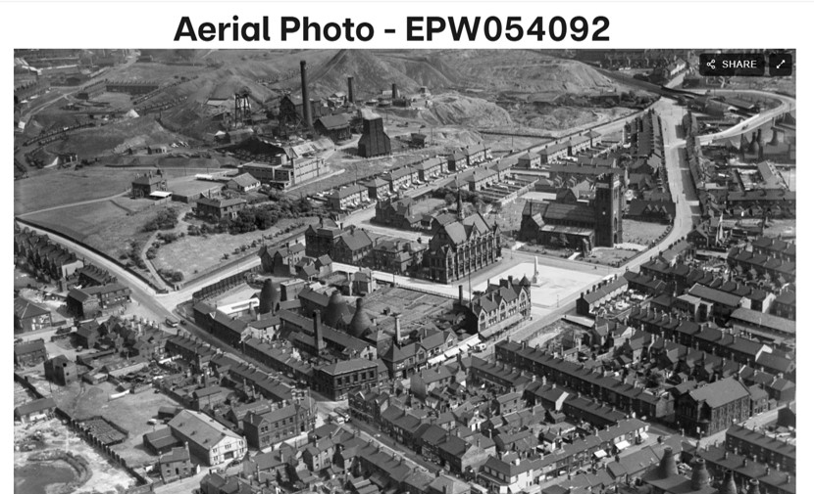
Opening the full photograph
When you click on the thumbnail image the full-sized photo will appear.
Fenton July 1937
Notes:
Image: Fenton, July 1937 EPW054092 © Historic England Archive
When you click on the thumbnail image, you will get the full photo image.

Slide 9
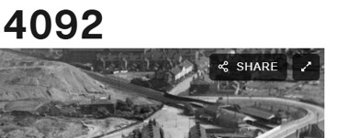
Enlarging the full photograph
To enlarge the image, click on the diagonal double arrow icon in the top left-hand corner of the photograph.
This will enlarge the photo to full screen mode.
Notes:
Image: section of Fenton, July 1937 EPW054092 © Historic England Archive
To emlarge the image fully, click on the diagonal double arrow icon in the top right hand corner of the photo.
This will expand the photo to full-screen mode.

Slide 10
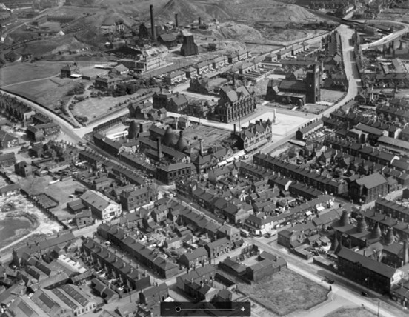
Enlarging and reducing the photograph
At the bottom of the image is a thick black line with – and + symbols. Click on these to achieve the maximum and minimum size.
This will help you to zoom in and focus on key details.
To move the image, you can drag it by holding down the left click button on your mouse, or by holding down your finger on the touchpad of your laptop.
Fenton July 1937
Notes:
Image: Fenton, July 1937 EPW054092 © Historic England Archive
Once you are in full screen mode, you can zoom in and out using the plus and minus icons at the bottom of the screen.
You will see these icons at the bottom of the image on the thick black line.
Click on these to achieve the maximum and minimum size.
This will help you to zoom in and focus on key details.
To move the image, you can drag it by holding down the left click button on your mouse, or by holding down your finger on the touchpad of your laptop.

Slide 11
Studying the full photograph
You can now study the details, individual buildings and street layout of the photograph
We can identify individual buildings, industrial sites and streets.
This is particularly helpful in looking at continuity and change in an area.
Just one photo can tell us so much about an area’s history.
Fenton July 1937
Notes:
Image: Fenton, July 1937 EPW054092 © Historic England Archive
You can now study the details, specific individual buildings and street layout of the photograph.
This photo alone tells us a lot about life in Fenton in 1937.

Slide 12
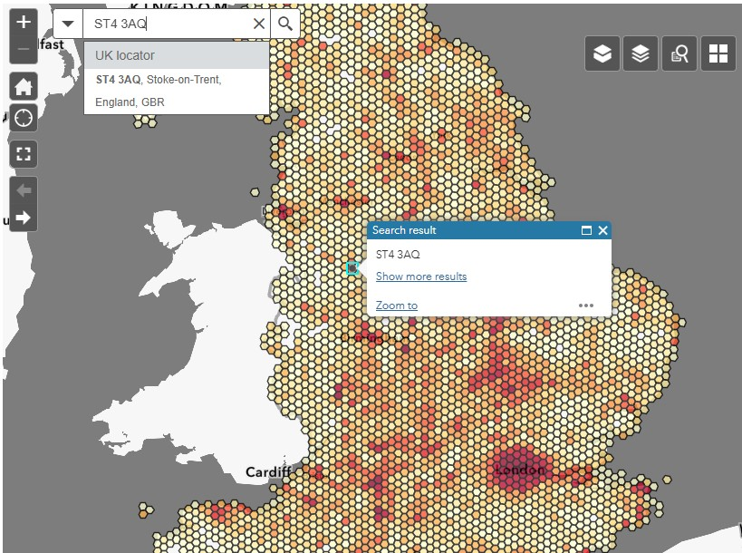
Search using a postcode
If you are wanting to look at a very specific site, such as a building or street, then you can search using a postcode, for a more accurate search.
In this example, we shall look for Christ Church, on Christchurch Street, Fenton, Stoke-on-Trent.
The postcode is ST4 3AQ
In the Search bar, enter the postcode.
You can then just press enter or click on the suggested ‘ST4 3AQ Stoke-on-Trent’ from the drop-down menu.
https://historicengland.org.uk/images-books/archive/collections/aerial-photos/
Notes:
Image: Screenshot of search bar and map on Historic England’s Aerial Photo Explorer web page
As mentioned earlier, an alternative way to search is to use a postcode.
If you are wanting to look at a very specific site, such as a building or street, then you can search using a postcode, for a more accurate search.
In this example, we shall look for Christ Church, on Christchurch Street, Fenton, Stoke-on-Trent.
The postcode is ST4 3AQ
In the Search bar, enter the postcode.
You can then just press enter or click on the suggested ‘ST4 3AQ Stoke-on-Trent’ from the drop-down menu.

Slide 13
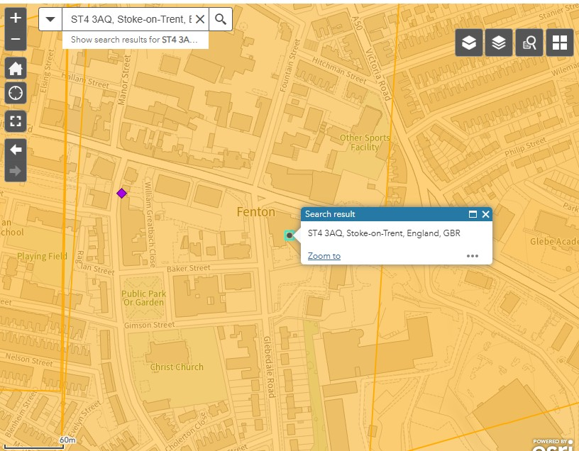
Postcode search results
If you click on the offered link, then you immediately get a precise, zoomed in location, like this image, locating Christ Church in Fenton.
This is really helpful in getting very specific locations. As it is so precise, you may wish to zoom out a little bit, using the symbols in the top left-hand corner, to see a slightly wider choice of symbols and grids to click on.
If you simply enter the postcode and immediately click, you get a wider map area, like the result shown in slide 6, with the precise location marked by a blue box.
Either way will help you find the relevant photos.
Notes:
Image: Screenshot of search bar and map on Historic England’s Aerial Photo Explorer web page
If you click on the offered link, then you immediately get a precise, zoomed in location, like this image, locating Christ Church in Fenton.
This is really helpful in getting very specific locations. As it is so precise, you may wish to zoom out a little bit, using the symbols in the top left-hand corner, to see a slightly wider choice of symbols and grids to click on.
If you simply enter the postcode and immediately click, you get a wider map area, like the result shown in slide 6, with the precise location marked by a blue box.
Either way will help you find the relevant photos.

Slide 14
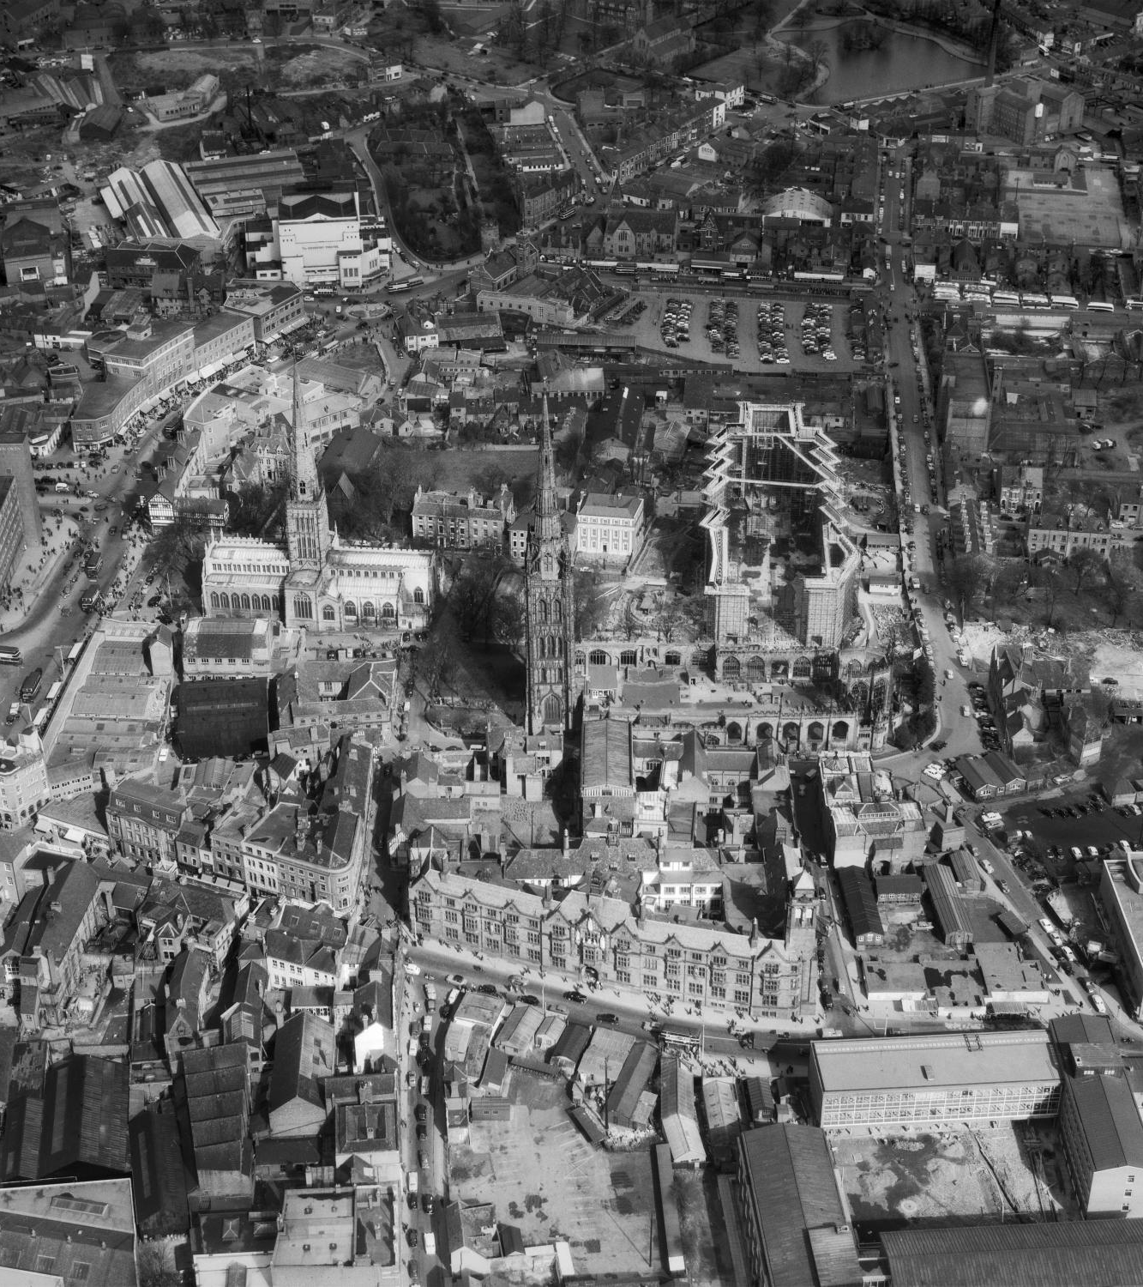
Other Aerial Photo Explorer Guides
You may also like to see our other guides on How to use Aerial Photo Explorer:
How to explore the different groups of photographs in Aerial Photo Explorer
How to Use Different Layers in Aerial Photo Explorer
How to orientate photos when using Aerial Photo Explorer
How to use Aerial Photo Explorer to study how a site changes over time
You may also like to see our Teaching Activity:
What can 1940s aerial photographs tell us about how the Second World War impacted our local area?
Coventry City Centre 28th March 1959
Notes:
Image: Coventry City Centre, 28 March 1959 Ref: EAW074516 Flight: AFL19590328
You may also like to see our other guides on How to use Aerial Photo Explorer:
You may also like to see our Teaching Activity:
What can 1940s aerial photographs tell us about how the Second World War impacted our local area?

