Slide 1
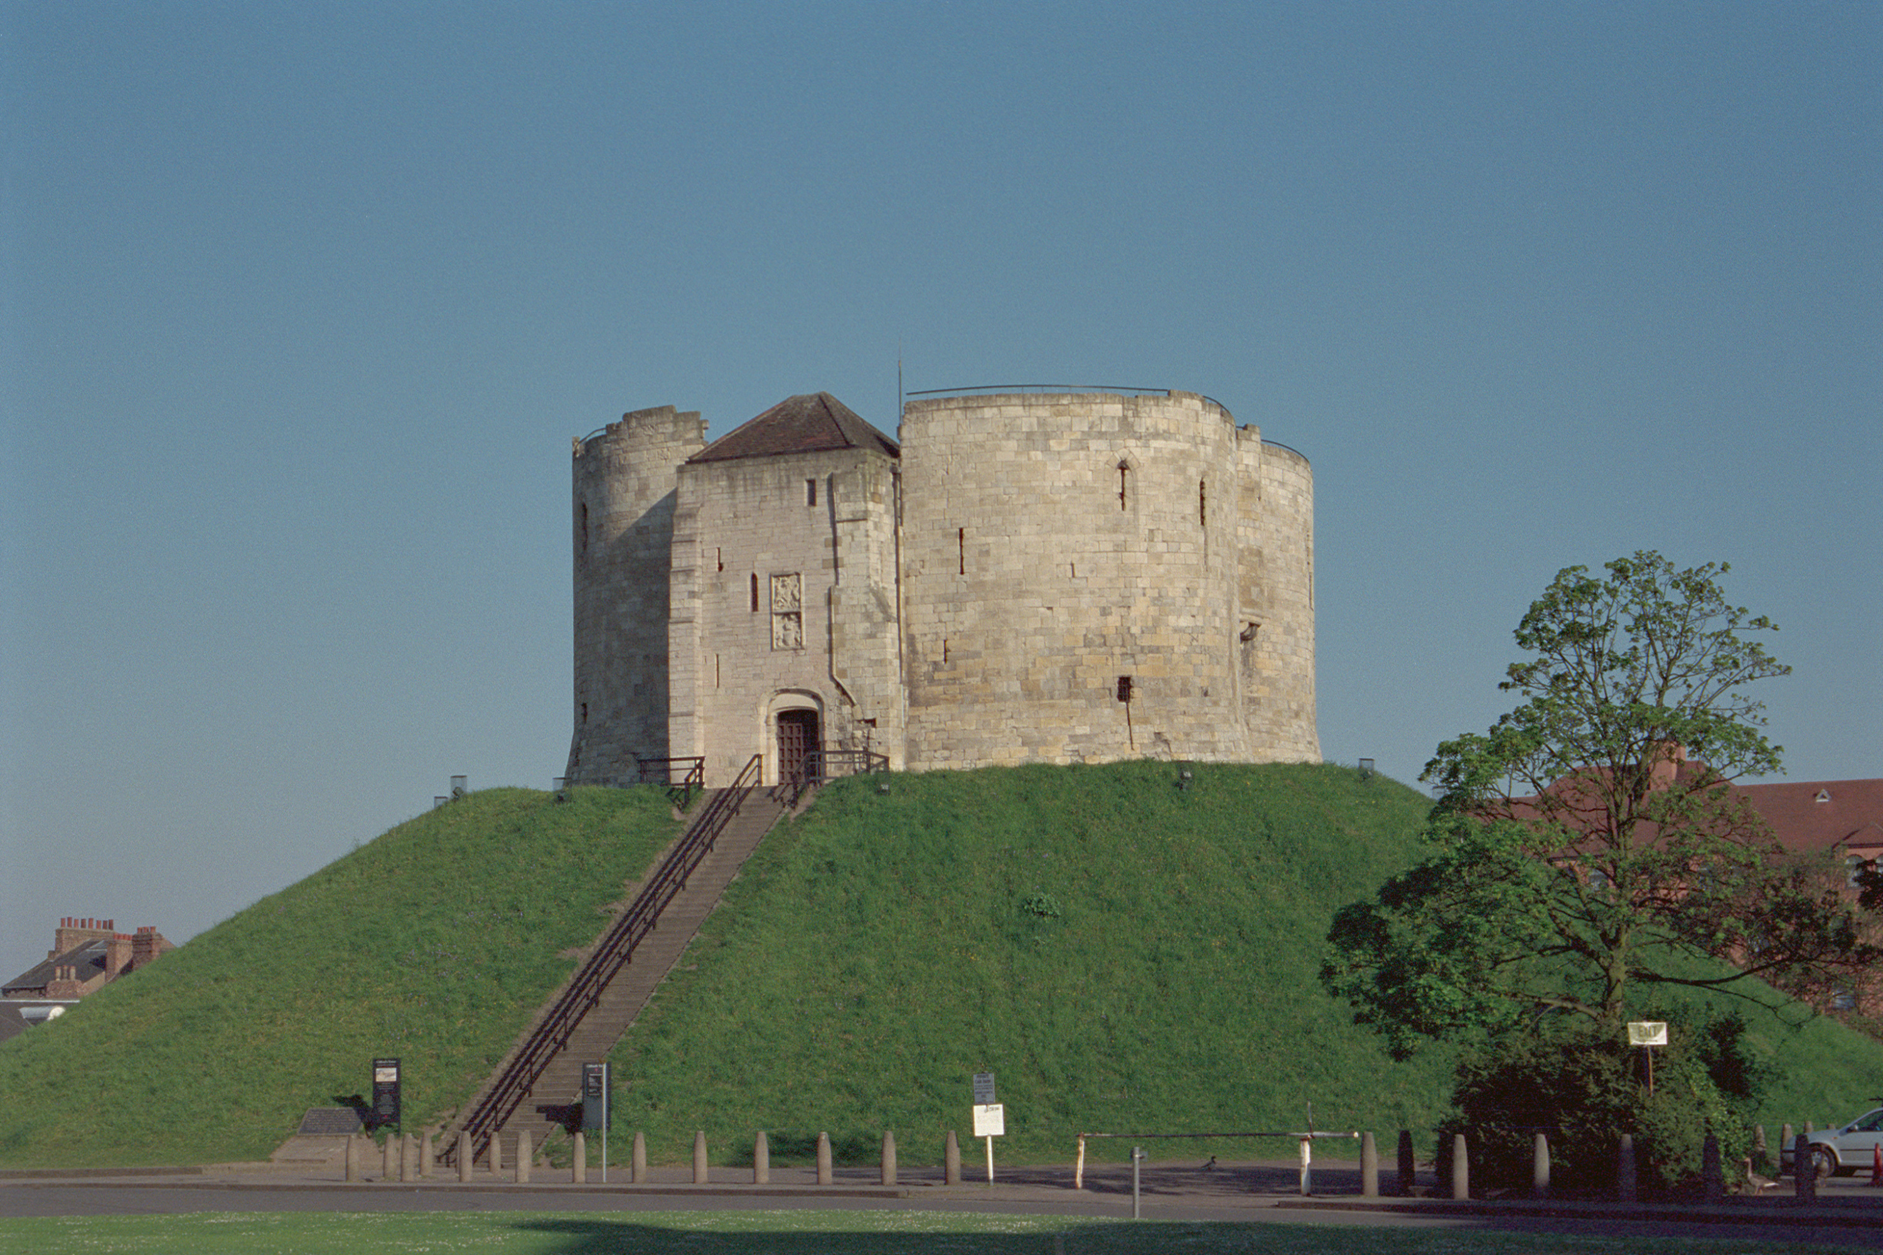
How did William the Conqueror secure his control over Saxon England?
Notes:
© Mr Martin Roberts. Source: Historic England Archive Ref: IOE01/04020/12 Date: 12 May 2001 - https://historicengland.org.uk/images-books/photos/item/IOE01/04020/12

Slide 2
How did William the Conqueror secure his control over Saxon England?
Key Stage 4: Norman England
Investigate the different ways in which William I secured the conquest
Describe & explain the different ways castles helped to consolidate Norman control of England
AQA – Norman England, c1066-c1100 – military innovations, including castles and establishing and maintaining control
EDEXCEL – Anglo-Saxon and Norman England, c1060-88 – Reasons for building castles; their key features and importance
OCR B – The Norman Conquest, 1065-1087 – The nature and purpose of Norman Castles in England to 1087

Slide 3

York Castle, known as Clifford's Tower
The first timber castle and the motte (mound) were built here by order of William the Conqueror in 1069
Notes:
© Mr Martin Roberts. Source: Historic England Archive Ref: IOE01/04020/12 Date: 12 May 2001 - https://historicengland.org.uk/images-books/photos/item/IOE01/04020/12

Slide 4
Step 1: Look carefully at the photograph of York Castle
Did you know?
A castle is defined as a fortified residence belonging to nobility
The first castles were built in France in the 10th century (900s)
Castles were introduced to England, along with the feudal system, by the French after the Norman Conquest of 1066
York Castle
Notes:
© Mr Martin Roberts. Source: Historic England Archive Ref: IOE01/04020/12 Date: 12 May 2001 - https://historicengland.org.uk/images-books/photos/item/IOE01/04020/12

Slide 5

STEP 2:Think about the different ways in which a castle could help William keep control over his new kingdom
Write a list of these different ways - you should split your list in to two categories, as in the table below, give each reason a number (NB: Need help getting started? Then use the hints on slide 7)
The PHYSICAL effects of castles | The PSYCHOLOGICAL effects of castles
1. 2. 3. | 1. 2. 3.

Slide 6
STEP 2:Think about the different ways in which a castle could help William keep control over his new kingdom (print out)
Write a list of these different ways - you should split your list in to two categories, as in the table below, give each reason a number (NB: Need help getting started? Then use the hints on the slide 7)
The PHYSICAL effects of castles | The PSYCHOLOGICAL effects of castles
1. 2. 3. | 1. 2. 3.

Slide 7






Hint: Castles…..
(Click on the ? to revel the hints)
Protected the
Norman lord
?
Provided work
for local people
?
Intimidated people
Provided a place
to keep soldiers
?
?
?
Deterred people
from attacking the
Norman Lord
Constantly reminded
people who was
in charge
?
?
Destroyed parts of
some existing towns
and villages
Altered the
local landscape
?

Slide 8


Step 3: Look at the following selection of castles
Can you find any that show examples of/represent your list of reasons?
- e.g. York Castle is an example of how castles made people feel that they were constantly being watched over
Look

Slide 9
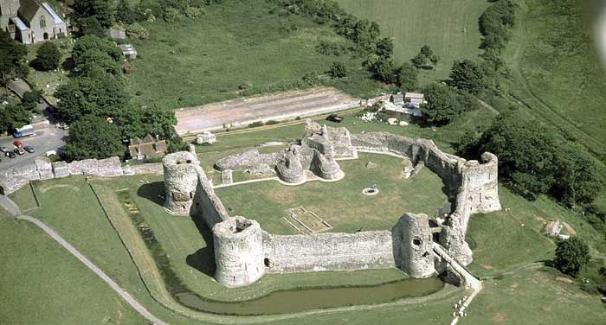

1. Pevensey Castle, Pevensey, East Sussex
An aerial view of
Pevensey Castle. The site was originally used as a Roman fort. After the Norman Conquest it was given to William the Conqueror’s
half-brother who used the Roman walls to
construct a castle.
Notes:
Photograph taken June 1989 © Crown copyright. Historic England Archive ref: nmr 4511/02 - https://historicengland.org.uk/services-skills/education/educational-images/pevensey-castle-pevensey-1903

Slide 10
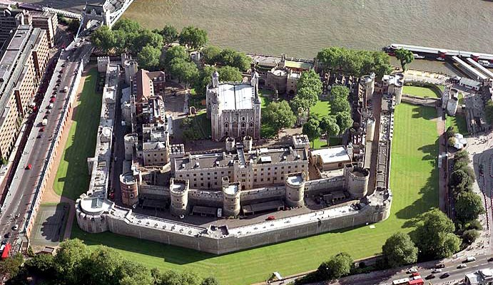
2. Tower of London, London
The River Thames
and the Tower of London. The main 'White Tower' was built in 1078 and from here the country was governed during the medieval period.
Notes:
Photograph taken August 2002 © Copyright Historic England Archive ref: NMR 21766/19 - https://historicengland.org.uk/services-skills/education/educational-images/tower-of-london-tower-bridge-and-the-greater-london-authority-offices-london-3603

Slide 11
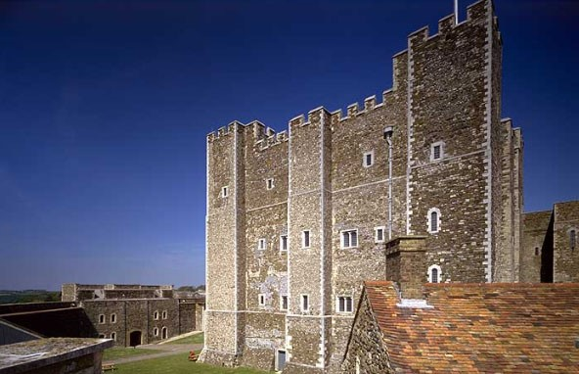
3. The Keep, Dover Castle, Dover, Kent
The strategic importance of Dover has long been recognised. The great Keep, built in the 1180s by King Henry II to provide both security and accommodation, was the strongpoint of the
medieval Castle.
Notes:
Photograph taken May 1997 © Copyright Historic England Archive Photo Library ref: k970499 - https://historicengland.org.uk/services-skills/education/educational-images/the-keep-dover-castle-dover-2313

Slide 12
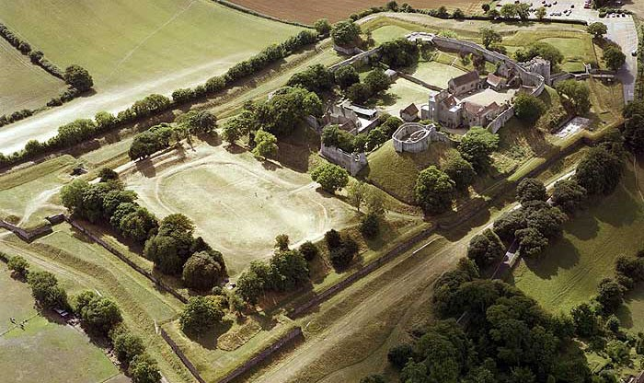
4. Carisbrooke Castle, Isle of Wight
Standing on a
partly-artificial elevation, Carisbrooke Castle occupies site of an earlier Saxon stronghold which replaced a Roman fort.
Notes:
Photograph taken September 2003 © Copyright Historic England Archive ref: nmr 23246/19 - https://historicengland.org.uk/services-skills/education/educational-images/carisbrooke-castle-carisbrooke-2214

Slide 13
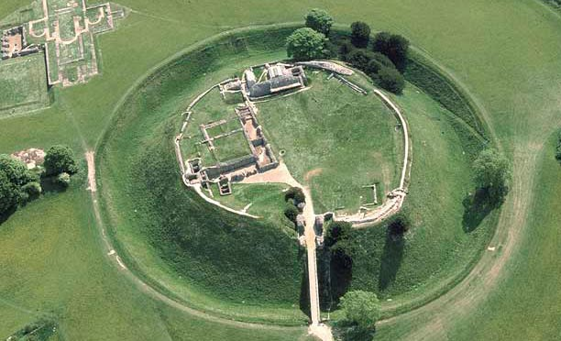
5. Old Sarum, Salisbury, Wiltshire
An aerial view of the Norman castle at Old Sarum, built on the site of an Iron Age hillfort. The castle declined in the 13th century when New Sarum (Salisbury) was founded nearby.
.
Notes:
Photograph taken May 1988 © Crown copyright. Historic England Archive ref: nmr 4117/14 - https://historicengland.org.uk/services-skills/education/educational-images/old-sarum-salisbury-3316

Slide 14
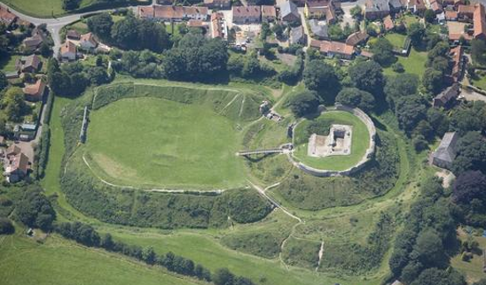
6. Castle Acre Castle, Norfolk
The castle was founded soon after the Conquest. In the 12th century it was converted into a stronger keep, defended by stone walls and ditched earthworks.
Notes:
Photograph taken 01 August 2001 © Damian Grady. Source Historic England Archive ref: 221880 - https://historicengland.org.uk/services-skills/education/educational-images/castle-acre-castle-castle-acre-9063

Slide 15
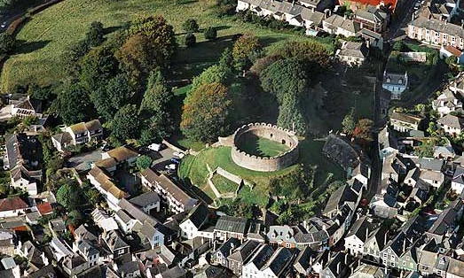
7. Totnes Castle, Totnes, Devon
A Norman motte-and-bailey castle was built to dominate the Saxon town.
The shell of the keep and curtain wall date from a 14th-century reconstruction of the castle.
Notes:
Photograph taken October 2005 © Copyright Historic England Archive ref: nmr 24090/19 - https://historicengland.org.uk/services-skills/education/educational-images/totnes-castle-totnes-1782

Slide 16
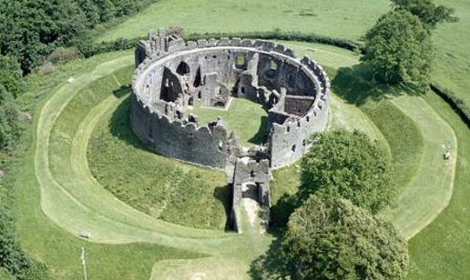
8. Restormel Castle, Lostwithiel, Cornwall
Built on a spur overlooking the River Fowey with an unusual circular keep (circa 1100), it is one of the oldest and best preserved Norman motte and bailey castles in Cornwall.
Notes:
Photograph taken 1951-1963 © Skyscan Balloon Photography. Source Historic England Archive Photo Library ref: K930337 - https://historicengland.org.uk/services-skills/education/educational-images/restormel-castle-lostwithiel-1114

Slide 17
Step 4: Using the completed table below, write a short paragraph answering the question:
How did William the Conqueror secure his position after the conquest of 1066?
Reason No. (from 1st table) | Name of castle | This castle represents this reason because...

Slide 18
Step 4: Using the completed table below, write a short paragraph answering the question: (print out)
How did William the Conqueror secure his position after the conquest of 1066?
Reason No. (from 1st table) | Name of castle | This castle represents this reason because...

Slide 19

Extension / Further Work
Extension / Further Work

Slide 20
Step 5: Were castles William's only way of securing power? 1
Use the 'students notes' provided below to discover more about castles and William's way of ruling England
William gained security in England by granting areas of land to trusted Norman nobles, who in return had to perform certain duties such as building and defending castles and providing knights for the king. This was all part of the Feudal System (see below)
In 1070 William founded Battle Abbey on the site of the Battle of Hastings. He also introduced 'tithes', a tax whereby the population had to pay one-tenth (a tithe) of their annual increases in profit to the church
William was crowned King of England on 25th December 1066 at Westminster Abbey, after defeating King Harold at the Battle of Hastings. This marked the start of Norman rule in England which lasted for nearly 100 years
The Normans imposed several major changes on the Anglo-Saxon way of life. The most notable were the introduction of Castles, the Feudal System and French as the official language at court
In 1086 William commissioned the Domesday Book

Slide 21
The Feudal System
The King owned all the land. He granted land to:
Tenants-in-chief (Barons and Bishops), who in return swore an oath of loyalty to the king. They agreed to build castles and provide knights for his army. The tenants-in-chief in turn granted land to:
Knights, who in return swore an oath of loyalty to them and promised to fight for the king’s army for 40 days a year. The knights in turn granted land to:
Peasants, who in return swore an oath of loyalty to them and had to provide free labour, food and services for the knight

Slide 22
Step 5: Were castles William's only way of securing power? 2
Use the 'students notes' provided below to discover more about castles and William's way of ruling England
The earliest castles were always designed with military needs in mind – attack and defence. However the surviving ruins show us they also had enough fireplaces and garderobes (toilets) to prove that they were also residential buildings designed to be lived in
Designs gradually changed over the centuries to provide better defensive or attacking solutions, such as adding projecting towers on the outer face of curtain walls that made them harder to scale and gave archers extra cover

Slide 23
Step 5: Were castles William's only way of securing power? 3
Use the 'students notes' provided below to discover more about castles and William's way of ruling England
The decline of castles began in the 16th century (1500s), as times changed there was less need for a noble to defend himself. There was also a split between a Lord’s residence and defence. Lords no longer felt the need to defend themselves in the same way as the early Norman barons had. Henry VIII was the first to build a series of coastal forts (which look very similar to castles) purely for defence, they were never designed for a lord or a king to live in permanently.

Slide 24

More resources
MORE RESOURSCES AT
HistoricEngland.org.uk/Education

