Slide 1
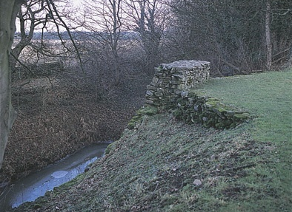
(1st Century BC) Late Iron Age Settlements
The northern Brigantes were the largest Iron Age tribe in Britain. Their lands stretched from the Pennines and North Yorkshire to Northumberland and southern Scotland.
The Brigantes built small, fortified hill crofts. Their principal fort (Stanwick near Richmond) is still visible and unique because of its vast scale and 5m high ramparts. It was probably once a ‘moot’ – a place where distant branches would meet to arrange marriages and exchange goods, livestock and tales.
Excavated artefacts include a well-preserved Iron Age sword in its ash wood scabbard (sheath) and the damaged skull of a severed head. In 1843, 140 metal artefacts – known as the ‘Stanwick Hoard’ – were discovered; the hoard included four sets of horse harness for chariots.
Image to fit in this box or smaller
Stanwick Camp, North Yorkshire.
[©Historic England Archive]
How typical were the Brigantes tribe?
Notes:
Stanwick - flourished up to AD 70 then declined after Roman power expanded
Stanwick has most extensive ramparts in Britain unique because of its vast scale More of a town than fort p31 Hey – excavations unearthed improrts from Italy Such as rare Samian pottery,amphorae and volcanic glass
Stanwick flourished up to AD 70 then declined after Roman power expanded.

Slide 2
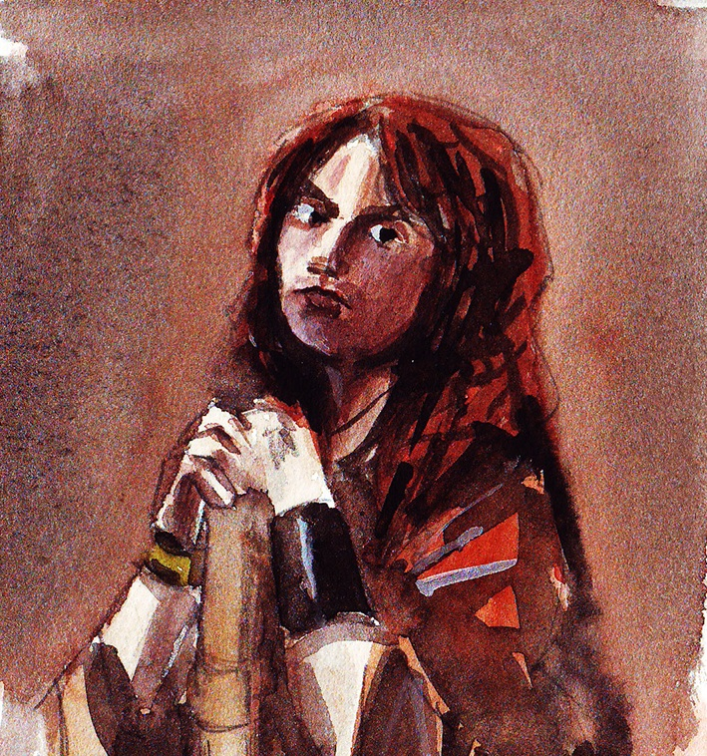
(1st Century AD) Queen Cartimandua
Yorkshire did not become part of the Roman Empire until AD 71.
The northern Brigantes’ Queen Cartimandua (unlike the Iceni’s Queen Boudicca and other tribal leaders) decided to cooperate with the Romans to retain her independence. When the defeated Welsh King Caratacus sought shelter, she handed him to the Romans. Many Brigantes disagreed with Cartimandua and civil war broke out between her and her husband, Venutius.
The pair were still quarrelling 18 years later. When Venutius looked like winning, Emperor Vespasian sent the Roman Governor of Britain (Petillius Cerealis) to take over the north of England. Ingleborough, possibly Britain’s highest hill fort, was built by the Brigantes during this unrest and the Romans started a fort and bridge on the River Tees at Piercebridge.
Artist impression of Cartimandua.
[Illustration by Keith Palmer]
Was Cartimandua’s decision to support
the Romans a good one ?
Notes:
138

Slide 3
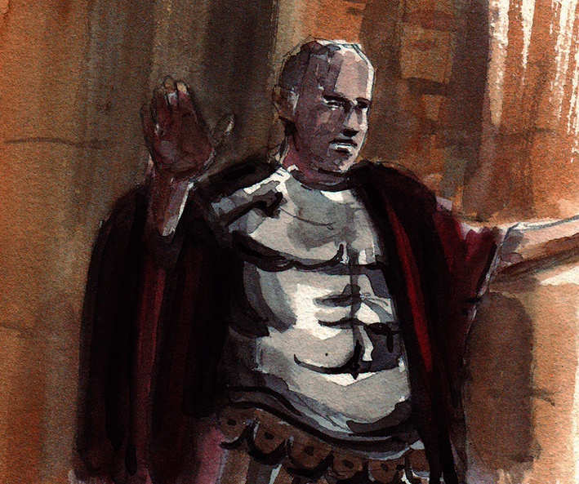
(2nd Century) Roman Roads
Agricola, Governor of Britain, ordered the building of a northern road network to allow soldiers to move rapidly between forts built at important junctions and river crossings. The main road in the North East was Dere Street (an Anglo-Saxon name).
Wade’s Causeway is a well-preserved road on the North Yorkshire Moors. The top section has eroded leaving bare foundation stones and water gullies. The road served Cawthorn Camp (which was built in the late 1st and early 2nd centuries) where there were two forts and a marching camp. The camp most likely housed road builders and Roman garrisons on military manoeuvres as it had a clear view of coastal signal stations. Well preserved ditches and banks stand as a reminder of Roman ingenuity.
Image to fit in this box or smaller
Artist impression of Agricola, Governor of Britain.
[Illustration by Keith Palmer]
Were roads more important to the Romans in Yorkshire than in the rest of the country?
Notes:
Read more: http://www.dailymail.co.uk/sciencetech/article-2027370/Lost-Roman-amphitheatre-hilltop-near-Yorkshire-village.html#ixzz3V8xO8nGX
Follow us: @MailOnline on Twitter | DailyMail on Facebook
The unearthed site includes the remains of a water-powered flour mill used to grind grain and produce food for the soldiers, clothes, food remains, graves and pottery.
It also contains evidence the Roman occupants might have worn socks, experts who analysed ancient sandals said.
The site was excavated as part of a £318 million Highways Agency scheme to upgrade the A1 between Dishforth and Leeming in North Yorkshire.
It is close to a ruined fort at Healam Bridge, which formed part of the Roman frontier 2,000 years ago.
It is thought the military outpost was used by the Roman Ninth Hispanic Legion, which disappeared some time in the 2nd Century AD.
Cultural heritage team leader Blaise Vyner said: "We know a lot about Roman forts, which have been extensively studied, but to excavate an industrial area with a mill is really exciting

Slide 4
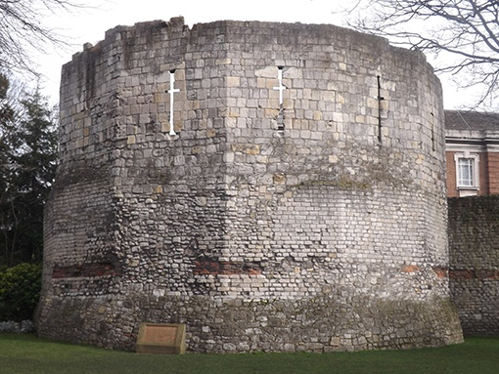
(3rd Century) Yorkshire
Roman Towns
Two thriving Roman towns grew in North Yorkshire: Aldborough (Isurium Brigantum) and York (Eboracum).
As the ‘capital’ of the Romanised Brigantes, Aldborough became a high status town. Two mosaic pavements still exist and a museum has an outstanding Roman collection.
York was the largest and most important town from where the Roman emperors governed. The first, Emperor Septimius Severus (208-11), the ‘African Emperor’, arrived with a huge number of civil servants, including the Praetorian Guard (special bodyguards).
The Multangular Tower in York’s Museum Gardens was probably built during Severus’s reign. It has 10 sides and is 9m high. Originally there were three towers on either side of a central gateway. It is one of Britain’s grandest examples of Roman military architecture.
The Roman-built Multangular Tower.
[Photograph by Keith Palmer]
Was this a good time for the people of North Yorkshire?
Notes:
133 3 words over

Slide 5
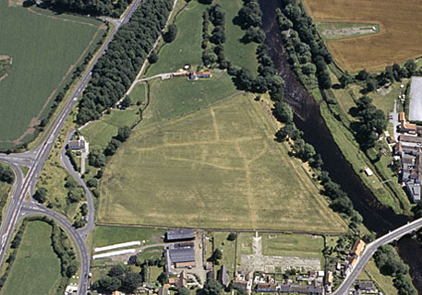
(4th Century) Roman Engineering
In AD 300 the Romans rebuilt the fort and bridge at Piercebridge. The river has since moved northwards and the remains are now visible, high and dry on the south bank.
The bridge is significant because so few have survived. The size and quality of stonework, along with evidence of building techniques, make Piercebridge key in studying Roman bridges and construction methods. It also helps us understand how the maintenance of supply routes for resources were crucial to the success of the Roman army, economy and administration. The site also includes a fort, villa, civilian settlement and Roman road.
This period also saw the construction of watch towers on the Yorkshire coast, such as at Filey and Scarborough, to guard against growing numbers of Germanic invaders.
Piercebridge Roman Fort and Bridge.
[© Historic England Archive]
Why might so few Roman bridges
have survived?
Notes:
Maybe the image of the remains of the bridge might be good here ?

Slide 6
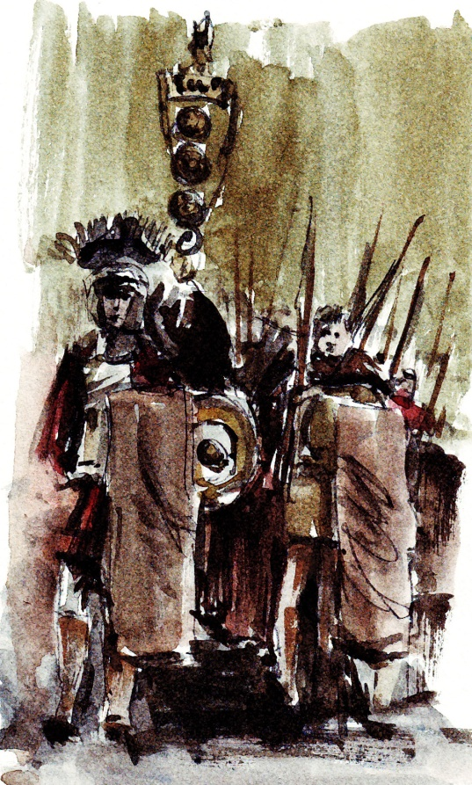
(5th Century) Collapse of an Empire
During the 5th century the Roman Empire began to collapse with legionaries departing to defend against the Visigoths who were attacking Rome. From northern Europe new invaders – collectively known as the Anglo-Saxons – began to reach Yorkshire shores.
Once again Yorkshire became mainly rural and the population shrank, partially due to plague and flooding in much of the Vale of York and Pickering. Roman forts and villas were abandoned and towns, such as Aldborough and Malton, became almost deserted with damaging economic consequences. However, in York and Catterick excavations suggest surviving activity well into the 5th century, with York possibly as an administrative centre.
The most abiding legacy of the Romans in Yorkshire was probably the road system which many modern routes follow today.
Roman legionaries leaving Britain.
[Illustration by Keith Palmer]
How does the Roman legacy in Yorkshire compare with the rest of the country?

Slide 7
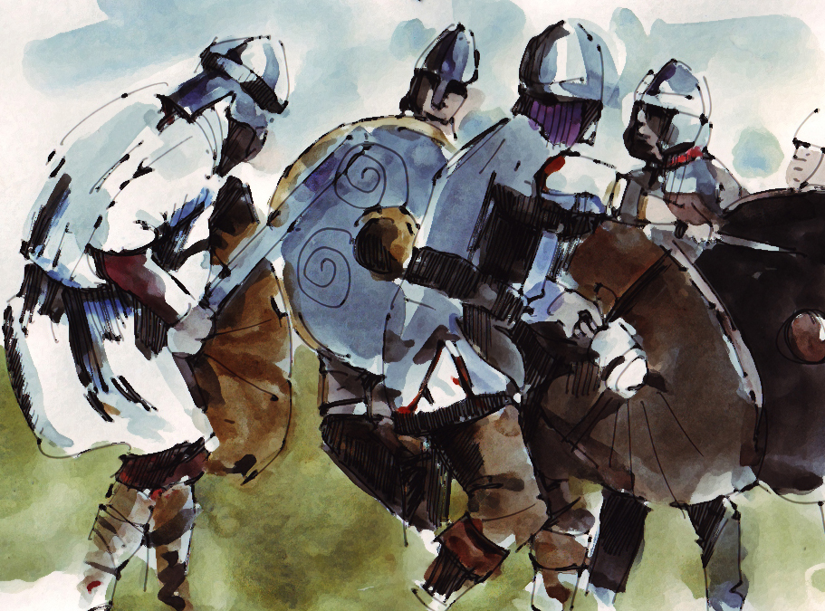
(6th Century) The Anglo-Saxons
By AD 600 the Angles of Deira had conquered the north and west of their new kingdom.
Taliesin of Rhegad, a British bard, wrote Y Gododdin, probably the oldest surviving poem in the British language. It tells of a great battle fought at Catraeth (Catterick) between the Angles and the British kingdoms of the north in which the victorious Angles created the new kingdom of Northumbria. Their leader, Aethelfrith, became the most important king in Britain.
Excavations at Catterick found an Anglian settlement and a cemetery with 44 human skeletons along with glass, amber, bronze necklaces, cloak fasteners, rings, buckles, knives, spearheads and a shield. In Upper Wharfedale, visible earthworks known as ‘Tor Dyke’ are thought to be the north-eastern boundary of the British kingdom of Craven.
Catraeth where Gododdin and his men perished.
[Illustration by Keith Palmer]
How do we know where the invaders settled in Britain?
Notes:
129

Slide 8
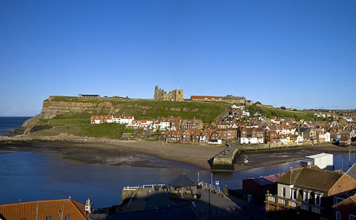
(7th Century) Christianity in North Yorkshire
In AD 627 Edwin, the Anglian King of Northumbria, converted to Christianity in a wooden church which was to become the predecessor of York Minster.
In the 7th and 8th centuries the headland of Whitby (Streaneshalch) was occupied by a large Anglian community. This was to become one of the most important religious centres in the Anglo-Saxon world. A monastery was founded here in AD 657 by Hilda, daughter of an Anglian nobleman, with the support of Oswiu, the ruler of Anglian Northumbria. During the Synod of Whitby in AD 664, the Celts and the Romans made a decision about the calculation for the date of Easter – a landmark in the history of Christianity in England.
Caedmon’s Cross at St. Hilda’s Church commemorates England’s first poet who lived at the abbey at this time.
Streaneshalch – known today as Whitby.
[Photograph ©Historic England]
How important is the Synod of Whitby to the town’s history today?
Notes:
131

Slide 9
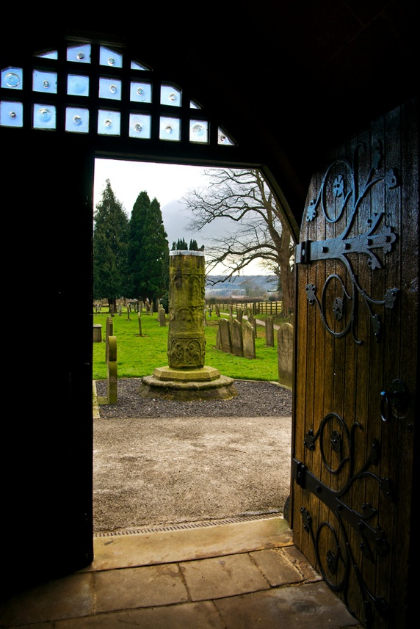
(8th Century) Anglian Settlements
Knowledge of Anglo-Saxon life in Yorkshire is patchy. The best evidence is found in Burdale on the Yorkshire Wolds, a well investigated archaeological landscape.
Evidence of religious practice is clearer. Within the grounds of St. Mary Masham stands a rare Anglo-Saxon cross-shaft with carvings suggesting that Masham was once an important monastic site. All Saints Church in Ilkley houses three cross-shafts, one of which has a cross-head from Middleton with carvings showing the four evangelists and the heads of their animal symbols. Their decoration is similar to that found on other late Anglo-Saxon sculptures in the Wharfe Valley at Kirby Wharfe, Collingham, Otley and Addingham. This suggests that the Roman road along the valley was important well into the 9th century.
Masham Churchyard Cross.
[Photograph by Chris Armstrong]
What do you think was the purpose of the large stone crosses?
Notes:
Added a couple od other sites

Slide 10
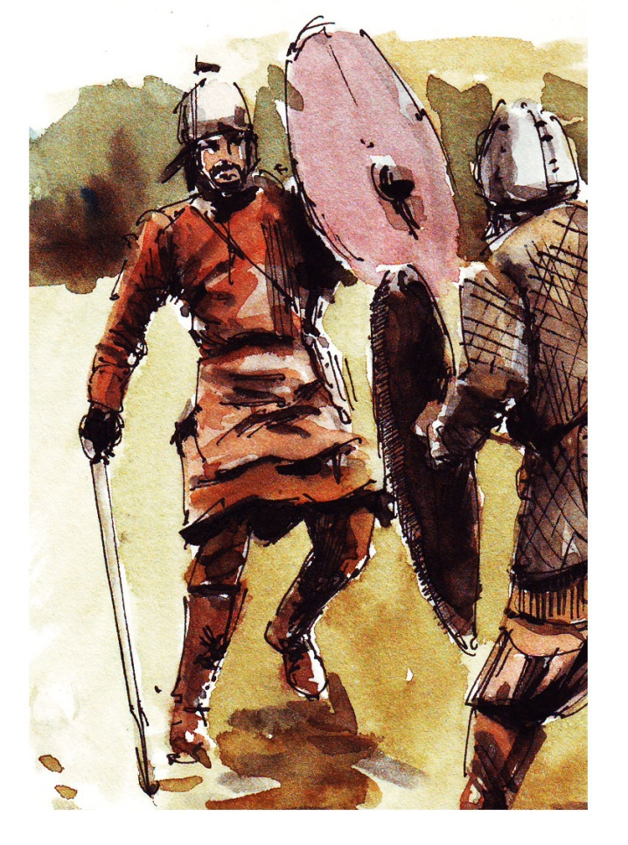
(9th Century) The Vikings Arrive
During AD 866 and 867, Vikings, led by Halfdan and Ivar the Boneless, attacked York slaughtering many Northumbrians. Two years later, King Alfred of Wessex agreed a truce with Viking King Guthrum. This divided England into the Anglo-Saxon south and the new Danelaw in the north. This was England’s first north-south divide.
Initially the Vikings were ruthless; in particular they plundered monastery estates. They gradually converted to Christianity, however. From around AD 882-95, York was ruled by the Viking Christian King Guthruth who was buried in York Minster.
Distinctive Viking artwork on hogback tombstones are found throughout Yorkshire and may originate from Danish settlers in the AD 870s. They are shaped like buildings with beasts clinging and biting the gable ends; 11 were found in St. Peter’s Church in Brompton.
Danes, Jutes and Norwegians can all be described as Vikings.
‘Viking’ really means ‘to go plundering’.
[Illustration by Keith Palmer]
Why might historians disagree on the exact dates for the hogback tombs?

Slide 11
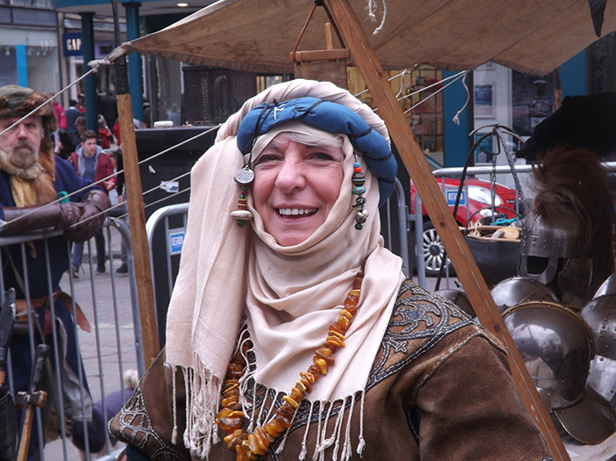
(10th Century) Viking Life and Influences
The Vikings made their greatest impact in North Yorkshire. Numerous settlements are indicated by place names ending in ‘by’, ‘thorpe’ or ‘thwaite’ and the survival of administration units, such as the ridings, wapentakes, and bierlows.
Archaeological discoveries in York (Yorvic) reveal a thriving trading centre where goods were imported from Norway, the Baltic and Europe. Excavations of workshops and the discovery of ornate artefacts provide evidence that the Vikings were not simply bloodthirsty plunderers but highly creative and skilled craftsmen. In fact, York’s layout has changed little and Viking street names, such as Coppergate and Micklegate, remain.
A hoard discovered in 2012 in a field near Bedale contains rare jewellery and artefacts. It includes a silver neck ring, one of the largest ever found, now on display in York Museum.
Viking day in York.
[Photograph by Keith Palmer]
What does the discovery of ornate Jewellery in York and Bedale tell us about the Vikings ?

Slide 12
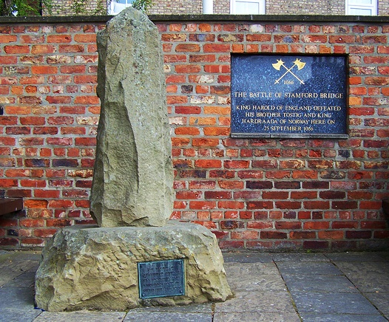
(11th Century) The Normans
The King of Norway landed in the north in AD 1066 to challenge the newly crowned Harold Godwinson for the throne of England. He was defeated in a bloody battle at Stamford Bridge (where two monuments now stand). This is thought to have signified the end of the Viking Age. Less than three weeks later, Harold was defeated at Hastings by the Normans. This ended the Anglo-Saxon era.
In AD 1069, the people of Yorkshire rose in rebellion. King William marched to York and built the first of many castles across Yorkshire. His men burned crops, slaughtered animals and destroyed farm tools. This 'scorched earth' policy was called the Harrying of the North; thousands died and hundreds of settlements lay desolate. According to the Domesday Book large areas of Yorkshire were still devastated in AD 1086.
Memorial, Stamford Bridge.
[Photograph by Keith Palmer]
Was the Battle of Stamford Bridge the real reason why William became king of England?

Slide 13
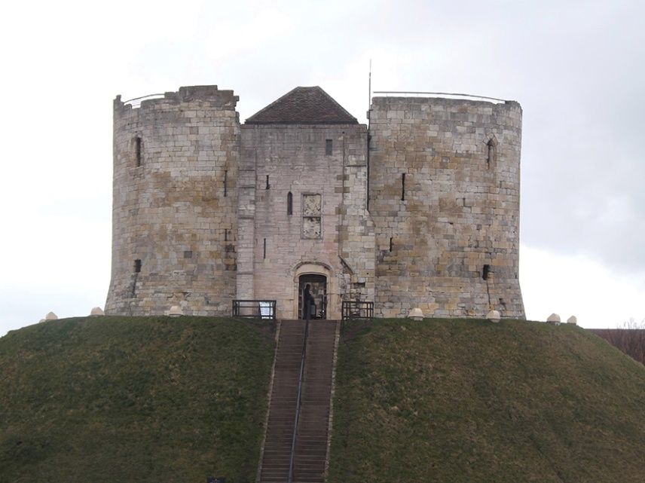
(12th Century) Recovery and Massacres
In the 12th century Yorkshire started to recover and prosper. Norman castles, such as at Richmond and Middlehamwere, were strengthened by adding stone keeps, gatehouses and curtain walls. Many towns, including Northallerton, Richmond and Scarborough, grew. Abbeys, monasteries and priories were built including Rievaulx Abbey, England’s first Cistercian abbey, and Fountains Abbey – one of the richest and best preserved ruined Cistercian monasteries in England.
However, the century is also known for the hostility shown against Jews and Muslims stoked by the Christian Crusades. England’s new King Richard I was about to set off on a Crusade when rioting spread throughout England. On March 16 1190 riots ended in the massacre of the entire Jewish community of York who had taken refuge in the royal castle where Clifford’s Tower now stands.
Clifford’s Tower, York.
[Photograph by Keith Palmer]
Which of Yorkshire’s ruined abbeys do you think retains the most of its original splendor?

Slide 14
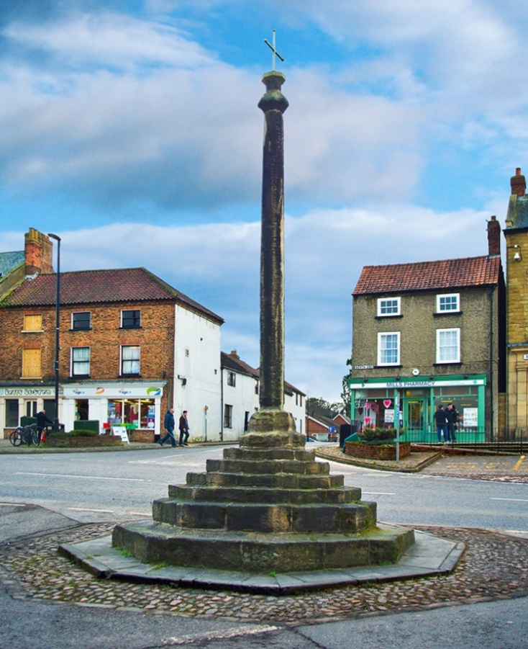
(13th Century) Growth and the Order of the Friars
By the end of the 13th century, Yorkshire was booming. The population had grown dramatically, farmland had been cultivated and towns prospered. The manufacture of cloth spread from York to Masham, Northallerton, Ripon, Selby, Whitby and Yarm. Market charters were granted, such as Easingwold in 1221, where the king was paid with a small horse, and Bedale where a market has been held since 1251.
In 1224 the Order of the Friars arrived, rapidly spreading across Yorkshire. Unlike monks, friars went out to preach. In York there were several orders: Franciscans (called Greyfriars because of their grey costumes), Dominicans (Blackfriars), Carmelites (Whitefriars) and Augustinians. A Franciscan friary bell tower in the friary gardens at Richmond, built by the Greyfriars, is their northernmost surviving monument.
Market cross in the centre of Bedale.
[Photograph by Chris Armstrong]
How important were charters to the success of Yorkshire’s towns in the
13th century ?

Slide 15
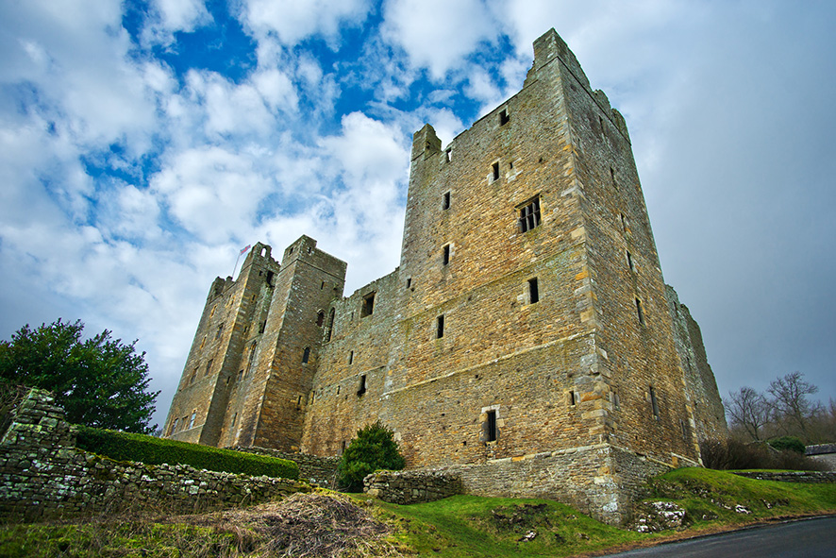
(14th Century) Raids and Plague
In the 14th century Yorkshire suffered from poor harvests, raids and plagues.
Scottish armies, encouraged by victory at Bannockburn, plundered deep into Yorkshire. In 1318 Robert the Bruce ransacked Northallerton; Knaresborough was nearly burned to the ground; the inhabitants of Ripon and monks of Fountains Abbey escaped only by paying fines.
In 1349 the arrival of the Black Death was devastating. It killed about a third of the population and left 171 villages deserted, most in the vales of York, Mowbray and Pickering.
The resulting labour shortage empowered workers to demand better conditions. The upper classes tried to reassert their power by building more castles. Castle Bolton was started in 1379 by Sir Richard le Scrope, Lord Chancellor to Richard II.
Castle Bolton, Wensleydale.
[Photograph by Chris Armstrong]
Was the Black Death any worse for the people of Yorkshire than anywhere else in the country ?
Notes:
130 words

Slide 16
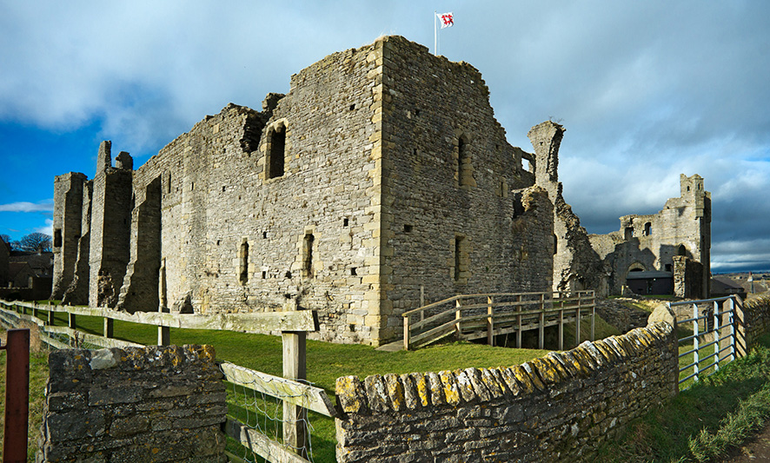
(15th Century) The War of the Roses
During the War of the Roses, east and west Yorkshire were overwhelmingly Lancastrian, whilst in the north loyalty was heavily divided. A decisive victory was won by the Yorkists in 1461 at Towton. It was possibly Britain’s largest and bloodiest battle. Later Richard III ordered burials at Saxton, where a memorial now stands. Legend has it that Lord Dacre was buried upright, astride his horse!
York witnessed many notorious moments including the spiking of leaders' heads from both sides.
At Middleham Castle, Richard Neville (Earl of Warwick) held both Edward IV and Henry VI prisoner and here a young Richard III learned the skills of war and met his future wife Anne, Warwick's daughter. Richard, later administered the North from Middleham on behalf of his brother King Edward 1V, raising its status.
Middleham Castle.
[Photograph by Chris Armstrong]
Does Richard Neville, Earl of Warwick
deserve his title ‘ King Maker’ ?
Notes:
Word count 132

Slide 17
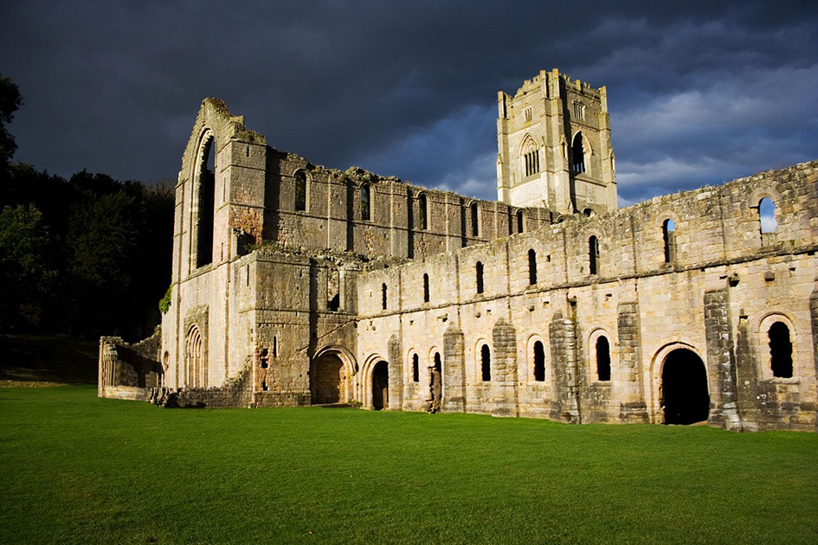
(16th Century) Dissolution of the Monasteries
Between 1536 and 1540 the dissolution (closure) of the monasteries had a permanent impact on the Yorkshire landscape. Thousands of monasteries were destroyed and sold to form the estates of the gentry and new industrialists. In all, 120 religious institutions in Yorkshire were closed including abbeys at Easby, Guisborough, Whitby and Rievaulx, and Fountains Abbey.
Dissolution provoked the Pilgrimage of Grace which began in Lincolnshire and spread to Yorkshire. Rebels controlled castles such as Skipton and Snape. The latter was the residence of Catherine Parr who was held captive here with her step-children (before she married Henry VIII).
Bolton Castle was offered as sanctuary for the Abbot Jervaulx but Henry had it torched. Henry managed to disperse the rebels with various promises – none of which he kept.
Fountains Abbey, North Yorkshire.
[© Historic England Archive]
How would the dissolution of the monasteries have affected the lives of ordinary citizens in Yorkshire?

Slide 18
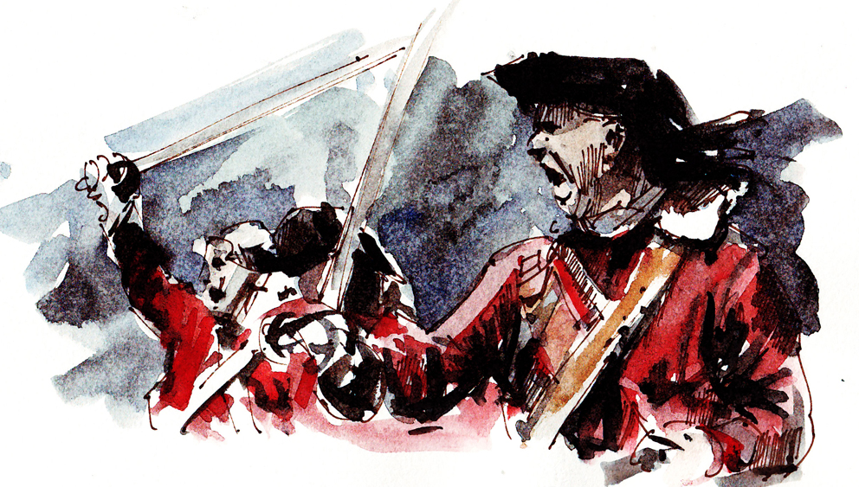
(17th Century) Civil War
When Charles I fell out with Parliament in 1642 he moved court to York. The ensuing Civil War saw many of Yorkshire’s great castles besieged.
Scarborough Castle suffered almost continuous fighting and the bloodiest sieges, changing hands seven times. Knaresborough Castle was destroyed by order of Parliament but its citizens petitioned for the keep to remain as a prison and looted the rest for building materials. Hence much of Knaresborough is built from ‘castle stone’. In Skipton, the Parliamentarian battery can still be seen overlooking the town.
The largest battle fought in England was at Marston Moor near York on 2 July 1644. It broke the power of the northern Royalists and cemented Cromwell's reputation as a commander. After York’s surrender, few Royalist strongholds remained in the north.
The bloody Battle of Marston Moor.
[Illustration by Keith Palmer]
Was the Civil War really important to
the people of Yorkshire?

Slide 19
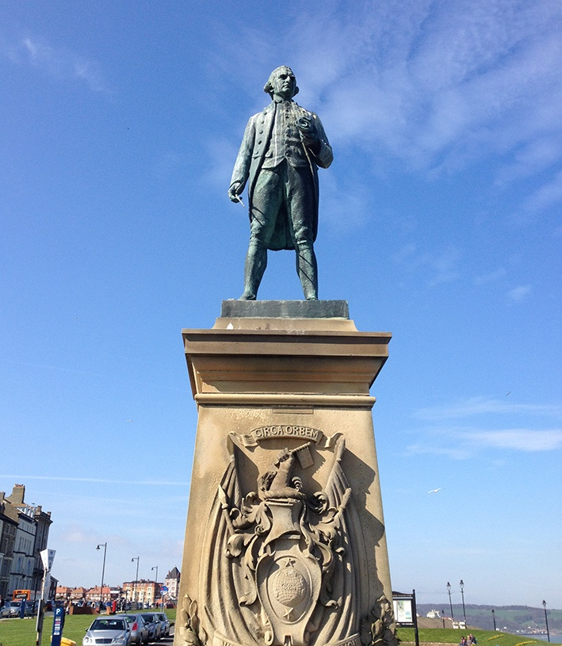
(18th Century) Exploration and Architecture
The spa towns of Harrogate and Scarborough flourished in the 18th century. Their mineral water was believed to cure illnesses. Harrogate became known as the 'The English Spa’ and as bathing became fashionable, Scarborough also developed as a seaside resort.
The explorer James Cook produced the first accurate map of the Pacific; his Whitby harbour-side house is now a museum.
This was an age of great architectural style: elegant brick buildings still characterise Stokesley, Bedale, York and Richmond. Richmond Playhouse (built by actor-manager Samuel Butler) survives as Britain’s most complete Georgian playhouse.
York Castle houses an effigy of Britain's most notorious highwayman, Dick Turpin, who was hung in York in 1739.
Captain Cook Memorial at Whitby, North Yorkshire.
[Photograph by Keith Palmer]
Where did Captain James Cook’s voyages of discovery and exploration take him?

Slide 20
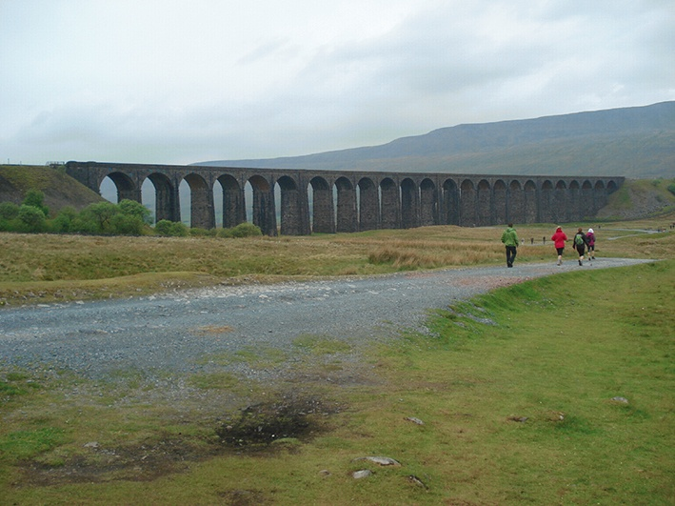
(19th Century) The Railways
During the 19th century, North Yorkshire remained mainly rural. Dominated by market towns and small industries it was overtaken in both population and wealth by the more industrialised south and west of the county.
The railways had a big impact in North Yorkshire. In 1821 permission for the world's first public railway (George Stephenson's Stockton to Darlington line) was given at the George and Dragon Inn, Yarm.
George Hudson, ‘the Railway King’, built 350 miles of line from Harrogate, York, Scarborough and Hull, creating a network more integrated than any other part of the country. The railways helped to reduce the isolation of remote areas. They also changed the Yorkshire landscape with embankments, cuttings, tunnels and grand viaducts, such as the one at Ribblehead designed by John Sydney Crossley.
Ribblehead, North Yorkshire
Image ©StockFreeImages.com
How did the railways impact on the landscape and lives of people in North Yorkshire?
Notes:
Needs labelling and provenance of photograph

Slide 21
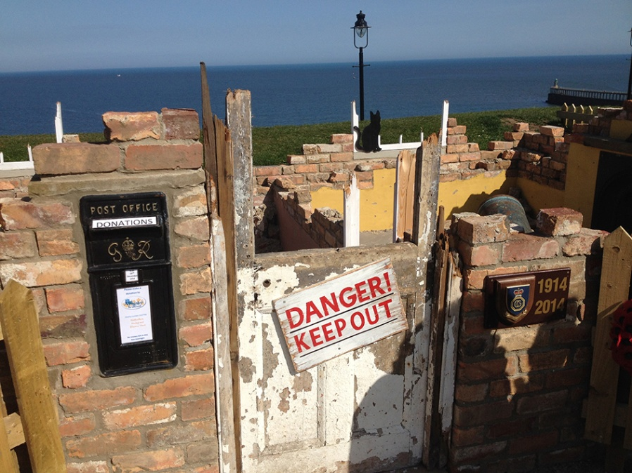
(20th Century) The Impact of
War in 1914
Yorkshire contributed significantly to the First World War, providing munitions and soldiers (there were 9,100 casualties). In 1914 German battleships turned their guns towards Hartlepool, Whitby and Scarborough. Buildings and homes were destroyed resulting in a public outcry and a major soldier recruitment drive under the slogan ‘Remember Scarborough’.
At Richmond Castle, prison cells were used to hold conscientious objectors – men who refused to fight on moral or religious grounds. Graffiti drawn by the Richmond Sixteen (who were among the first to defy conscription) can still be seen. Their experiences changed public attitudes.
War impacted on the growth of towns, as large garrisons were built in Ripon and Catterick. Today Catterick remains the largest British Army garrison in the world.
The new Centenary First War memorial in Whitby, North Yorkshire.
[Photograph by Keith Palmer]
Why do you think the Germans attacked the east coast in 1914?

