Slide 1
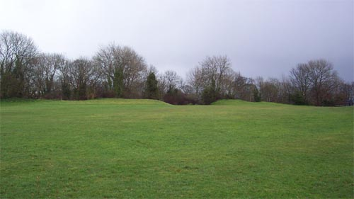
(100 BC) Clifton Down Camp
We do not have much evidence about the people living in the Bristol region before the Romans arrived. We do know from later Roman writing that a tribe called the Dobunni (possibly meaning ‘the victorious ones’) lived here.
Rarely has evidence of these peoples’ homes been found, but there are several hill-top enclosures in the area known as hill forts that date to the Iron Age. These hill forts probably had a variety of uses, such as tribal meeting places, lookout points or beacon sites where fires could be used to send warnings to other areas.
On either side of the Avon Gorge in Bristol there are three hill forts very close to each other: Clifton Down Camp on the Bristol side, Stoke Leigh Camp and Burghwalls in North Somerset.
Earthworks reveal the entrance to Clifton Down Camp.
[© Myers-Insole Local Learning CIC]
Why do you think the Dobunni built Clifton Down Camp on top of a hill?

Slide 2
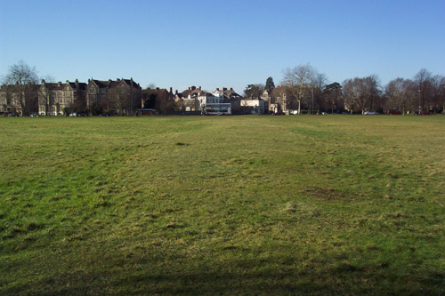
(AD 50) Roman Road
Before the Romans arrived the only roads would have been rough tracks across the countryside. Soon after the Roman invasion, soldiers built roads to link important settlements, forts and ports creating Britain’s first road network. These roads were straight and wide, allowing large numbers of troops to move quickly across the country.
Many Roman roads are still used today, or are visible in the landscape like on Durdham Down where a short length of original Roman road survives. Although now covered in grass, the curved surface (camber) of the road with parallel drainage ditches on either side can still be seen. This road, known as the Via Julia, was probably built in the second half of the 1st century AD and linked Aqua Sulis (Bath) and Abona (Sea Mills).
The Roman road on Durdham Down.
[© Myers-Insole Local Learning CIC]
What was the destination for the Roman soldiers on the road across Durdham Down?

Slide 3
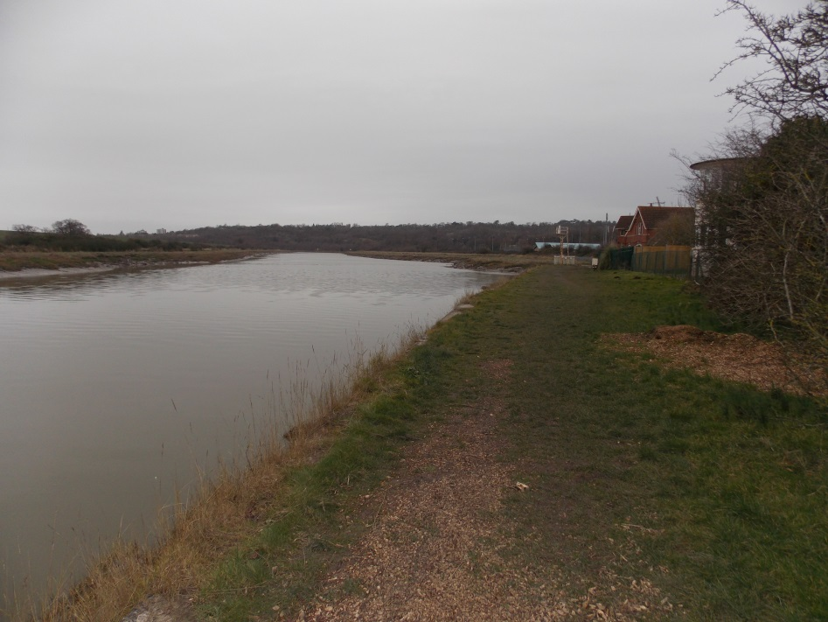
(AD 150) Abona
Bristol did not exist in the Roman period. At this time, the most important settlement in the area was Abona (Sea Mills) at the point where the River Trym meets the Avon at modern Sea Mills/Stoke Bishop. Archaeological evidence suggests that there was a village here before the Romans arrived, but by the end of the 2nd century the Romans had turned the village into a port.
Goods like wine, oil and pottery arrived at Abona by boat from Gaul (France) before being transferred to smaller river craft to be taken to places inland, such as Aqua Sulis (Bath).
During this period, Abona was probably also an important place for supplying the Roman legion at Caerleon in South Wales with food and materials.
The River Avon at Sea Mills. This would have been the quayside at Abona in the 2nd century.
[© Myers-Insole Local Learning CIC]
Why did the Romans decide to create the port at Abona?

Slide 4
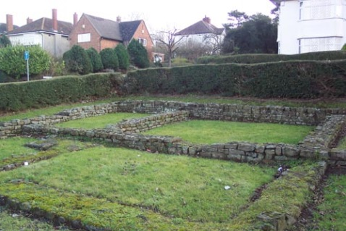
(AD 250) Stone Buildings at Abona
The first houses, shops and warehouses at Abona (Sea Mills) were built in timber. By the middle of the 3rd century these buildings were being replaced by the first stone buildings that we know of in Bristol. There have been several Roman buildings excavated at Abona, however, none of these had the mosaics or hypocausts (underfloor heating) that are often found in Roman villas. This suggests that though Abona was an important place of work, most of the houses were quite basic.
The only visible remains of Abona are the foundations of a stone building that was excavated in the 1930s at the junction of the Portway and Roman Way. It was probably a house, although we have little evidence to say what this building was used for.
The Roman building at Roman Way.
[© Myers-Insole Local Learning CIC]
How wealthy do you think the citizens of Abona were?

Slide 5
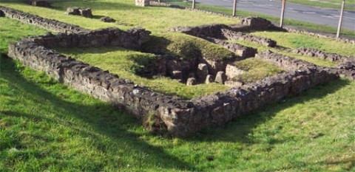
(AD 350) Kings Weston Roman Villa
By the middle of the 4th century wealthier people in Britain often enjoyed a luxurious lifestyle. These households lived in large buildings with mosaic floors and hypocausts (underfloor heating). They might also have had heated bath houses. The best example in Bristol is at Kings Weston where a villa with all these features was discovered in the late 1940s as Lawrence Weston was being built.
Other evidence from the surrounding area suggests that this villa was at the centre of a large agricultural estate with farm buildings and small fields (or paddocks) along what is now the Long Cross. These farmers probably used the nearby wetlands for grazing their cattle in summer then moved the herd to paddocks when the area flooded in the winter.
Kings Weston Roman Villa.
[© Myers-Insole Local Learning CIC]
How did everyone keep warm at Kings Weston Roman Villa?

Slide 6
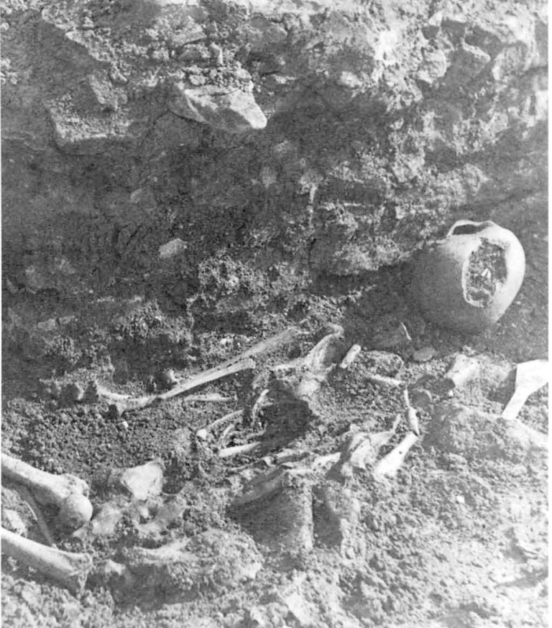
(AD 450) Murder Victim at Kings Weston Roman Villa
After the Romans left in the early 5th century we have very little information about life in Britain.
One of the few bits of information for this period that we have in Bristol comes from a skeleton, probably dating to the early 5th century, that was discovered at Kings Weston Roman Villa.
The evidence suggests that after the Romans had left and the villa was probably no longer occupied, this person was killed by a blow to the head from a heavy axe. We don’t know who this person was or why he was at the villa, but it probably indicates how lawless the land had become at this time, particularly as his body appears to have been abandoned rather than formally buried.
Skeleton found at Kings Weston Roman Villa.
[© Bristol and Gloucestershire Archaeological Society]
What do you think the story might be about the skeleton discovered at Kings Weston Villa?

Slide 7
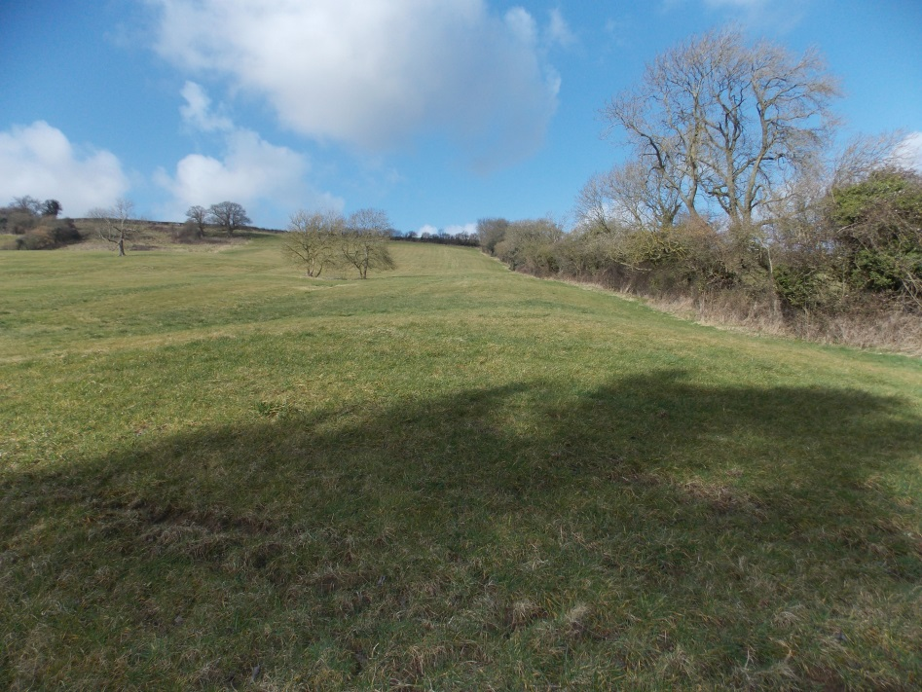
(AD 550) The Wansdyke
The first Saxon kingdoms were in the east of Britain, but these were gradually spreading west towards the Bristol region.
There is little evidence of early Saxon influence in Bristol, but the Wansdyke (in Somerset) is believed to date back to the 6th century. This is a long ditch and earth bank that runs from Savernake Forest in Wiltshire to Maes Knoll in the south of Bristol. It may have marked the boundary of an early Saxon kingdom.
The name ‘Wansdyke’ is believed to have come from ‘Woden’, the name of the principal Saxon god, and ‘dyke’ that comes from a Saxon word for a ditch and bank.
The western end of the Wansdyke near Maes Knoll.
[© Myers-Insole Local Learning CIC]
What clues are there to suggest that the Wansdyke has existed since Saxon times?

Slide 8
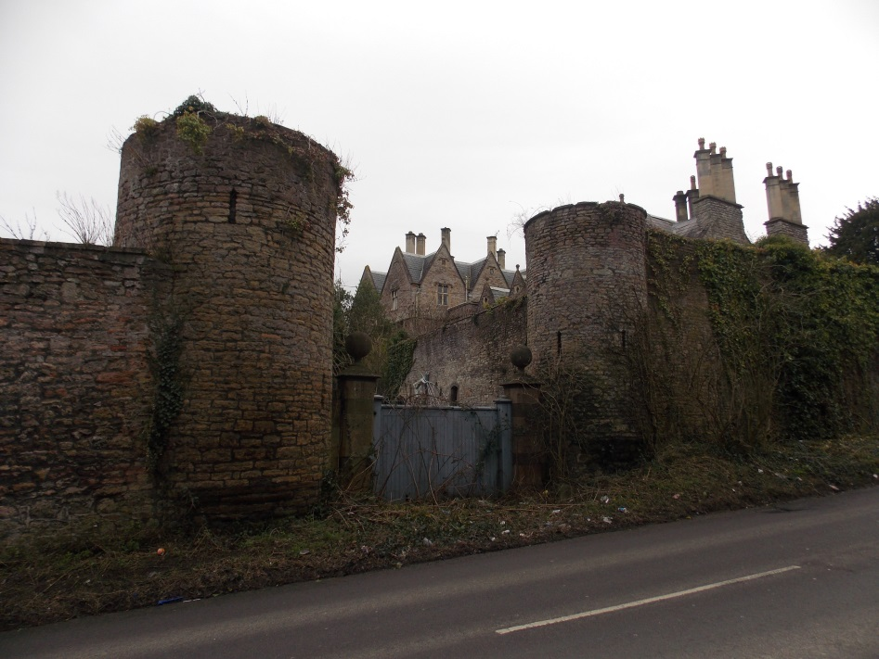
(AD 650) Henbury Manor
Much of the evidence for life in Britain in the early Saxon period comes from documentary records of land ownership. Christianity was gradually being re-established across Britain after the country had largely reverted to paganism when the Romans left. Early monasteries and churches became wealthy land owners and they often kept good records of their holdings.
In the late 7th century the area of Bristol lay within the Saxon kingdom of Mercia. A late 7th-century document records the King of Mercia granting the manor of Henbury to the Bishop of Worcester. This tells us that by this date there was an established farming settlement at Henbury and that this survived through the later medieval period to eventually become a modern suburb of Bristol.
17th-century Henbury Manor built on the site of the original Saxon manor house.
[© Myers-Insole Local Learning CIC]
What kind of a settlement was Henbury in the 7th century?

Slide 9
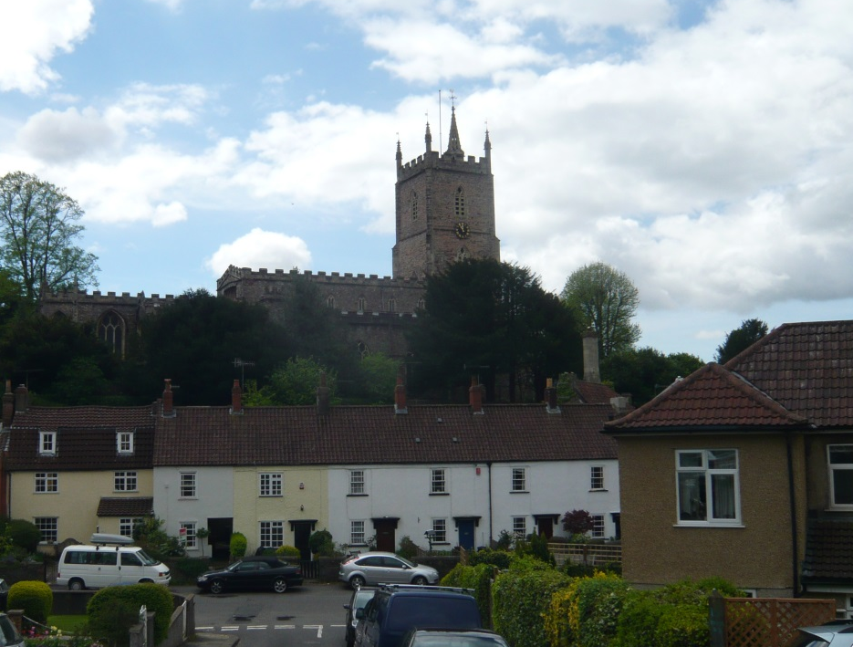
(AD 796) Westbury-on-Trym
We know from documentary sources that most of the Bristol region in the Saxon period was owned by the King of Mercia. These records also tell us that many of the smaller villages, which are now suburbs of the city, existed before Bristol was established.
The first reference to Westbury-on-Trym comes from a document that records a grant of land from Offa, King of Mercia, to a Saxon noble, Æthelmund. At this time it is believed that Westbury-on-Trym had a minster church (an important religious centre) probably on the site of the existing church. By the 10th century, this had developed into a monastery.
Westbury-on-Trym.
[© Myers-Insole Local Learning CIC]
What evidence is there to suggest that Westbury-on-Trym existed before Bristol?

Slide 10
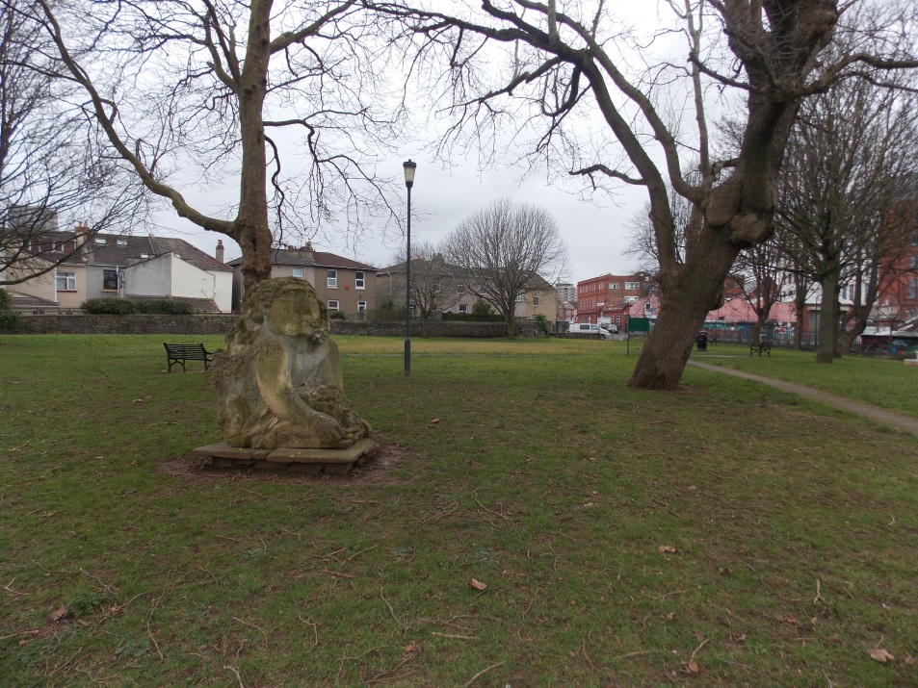
(AD 850) Bedminster
Place names help to provide an insight into Britain before the Normans arrived. The origins of a name can often be traced back to the Saxon period. We have no archaeological evidence yet, but we do know from documentary sources that the Church of St. John the Baptist in Bedminster existed before 1066. The name ‘Bedminster’ might suggest that there was a minster church, probably on the site of St. John’s, in the late Saxon period.
In the 9th century, minsters were important churches with associated religious settlements similar to monasteries. This tells us that Bedminster was likely to have been a village in this period centred close to the junction of the modern East Street, West Street and North Street.
St. John’s Churchyard, Bedminster – site of original Saxon minster church.
[© Myers-Insole Local Learning CIC]
What evidence is there that there was an important church in Bedminster?

Slide 11
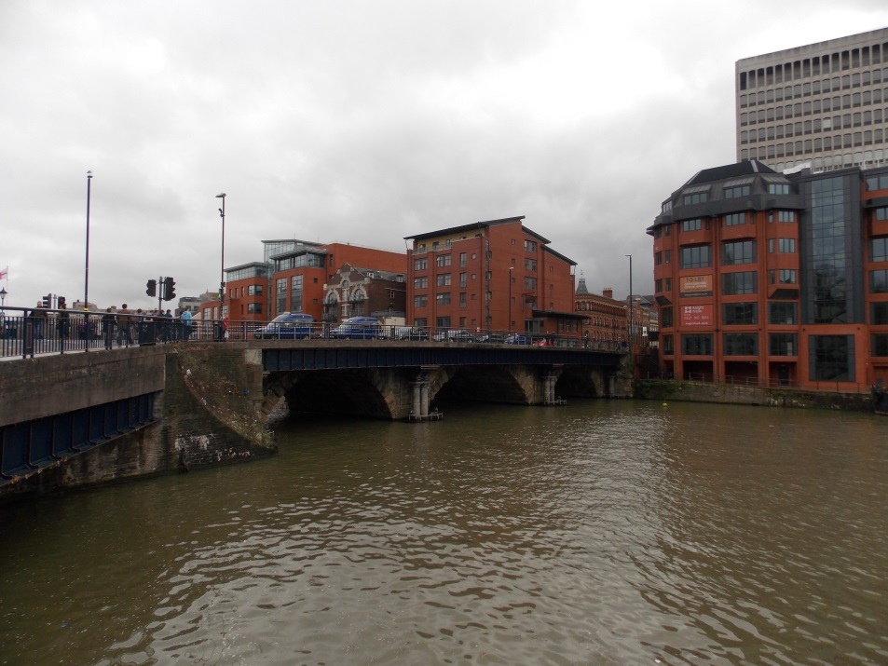
(AD 950) Bristol Bridge
Bristol was founded by AD 1000 and was originally known as Brigstow (market place by the bridge). An archaeological excavation in 2011 discovered a large ditch by the river in Redcliffe. It is thought that this might have been dug in the 10th century to help protect the original Bristol Bridge.
Bristol Bridge was the furthest downstream crossing point on the Avon at this time. This was also the furthest upstream that large merchant ships could reach at high tide. The combination of these two facts helped Bristol to become the region’s most important trading point, with the creation of a permanent market on the north side of the Avon.
Bristol Bridge – it was rebuilt in the 18th century on the site of the original bridge.
[© Myers-Insole Local Learning CIC]
Why was Bristol Bridge so important?

Slide 12
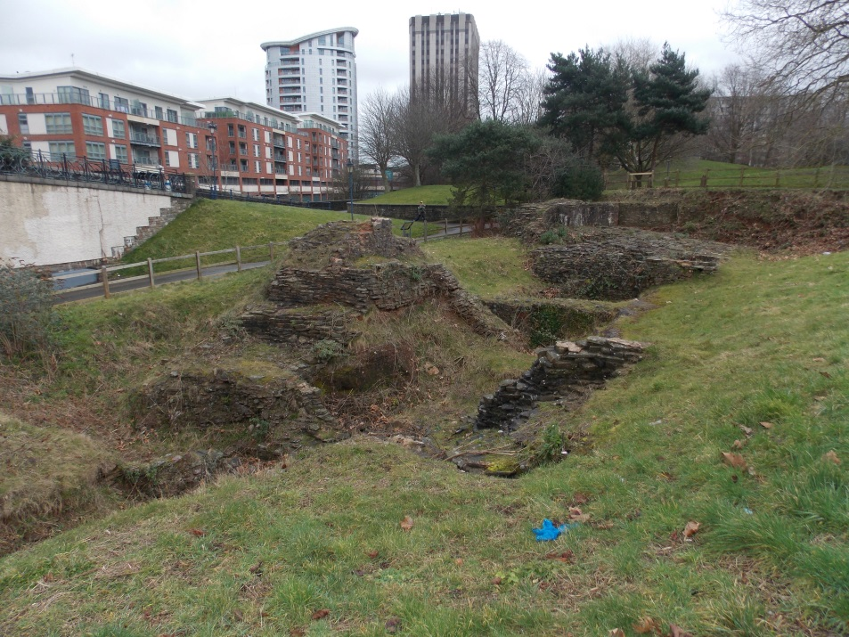
(AD 1070) Motte and Bailey Castle
Soon after the conquest in 1066, the Normans built a large castle on a narrow high point between the Avon and the River Frome to the east of the main Bristol town and market. Archaeological excavations have revealed that this first castle consisted of a large artificial mound known as a ‘motte’. On top of this mound was probably a timber fortification, and around the motte would have been a larger area, called a ‘bailey’, defended with further timber fortifications.
The position of the castle was important because it overlooked both rivers and helped to protect the town.
The motte and bailey castle was replaced by a stone castle in 1135, some of which can still be seen at Castle Park.
The remains of the castle keep at Castle Park – it is on the site of the original castle motte.
[© Myers-Insole Local Learning CIC]
Why do you think this site was chosen to build Bristol Castle?

Slide 13
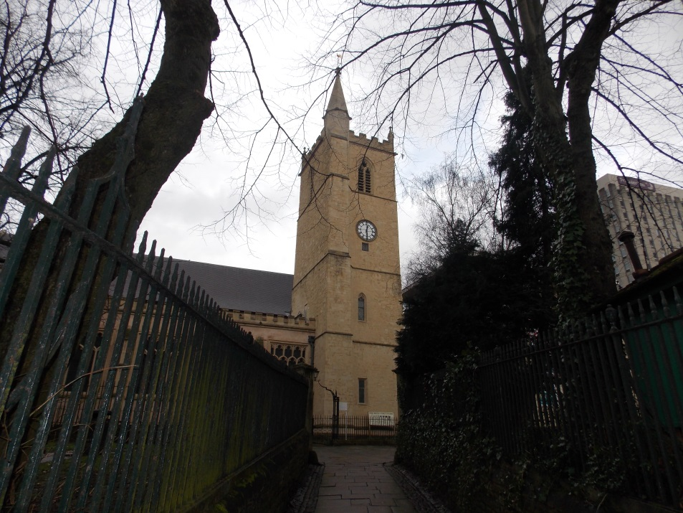
(1129) St. James’s Priory
The Church of St. James is the oldest surviving building in Bristol. It was built in 1129 as the church for a Benedictine priory. This was a community of monks who owned much of the land on the north side of the River Frome extending over the areas we now know as Kingsdown, Stokes Croft and St. Pauls.
As well as the church, the priory had dormitories where the monks slept, barns for storing food and a farm.
From the 12th century onwards, an annual fair was held in the area now called the Haymarket and Horsefair. St. James’s Fair attracted traders from across the region and beyond. It was one of the most important events held each year, helping to increase the wealth of the priory.
St. James’s Priory Church.
[© Myers-Insole Local Learning CIC]
Why was there an annual fair held at St. James’s Priory?

Slide 14
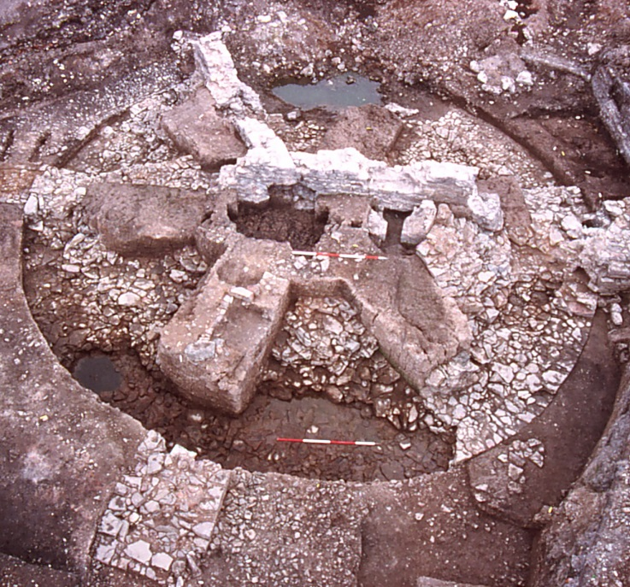
(1250) Portwall
By the 13th century Bristol had become a successful trading port. Most of the quaysides were along the River Frome, but because the river ran very close to the town and its defensive walls, the area remaining for the harbour was quite small.
In 1240, the decision was made to dig a new channel for the River Frome creating more quaysides so more ships could come into the port. By 1247 this was complete. It created the route that is now the city centre and is visible at St. Augustine’s Reach by the Watershed.
New town walls were built to enclose the expanded area of the town. The Portwall enclosed most of Redcliffe, and the Marsh Wall enclosed the area south of modern Baldwin Street.
Tower Harratz, part of the Portwall at Temple Quay during excavation in 1995.
[© Bristol City Council]
How did the diversion of the River Frome impact on Bristol?

Slide 15
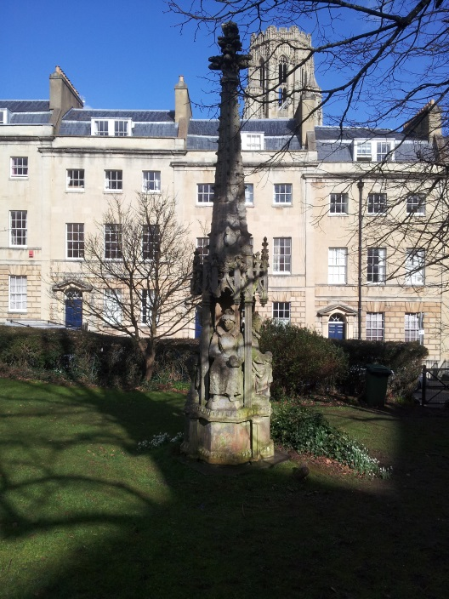
(1373) The High Cross
In the 14th century, Bristol had become one of the biggest and most successful towns in Europe. At the time, the town was part of the county of Gloucestershire, but as a result of its success, in 1373, Edward III granted a charter making Bristol a county; it was the first English town to receive this status.
To celebrate the granting of county status to Bristol, a new High Cross was erected at the centre of the town. This stone monument stood at the crossroads of High Street, Corn Street, Broad Street and Wine Street until it was removed in the 18th century and given to Stourhead Estate in Wiltshire where it still stands. A replica created in the 19th century can be seen at Berkeley Square.
Replica High Cross, Berkeley Square.
[© Myers-Insole Local Learning CIC]
Why is Bristol both a city and a county?

Slide 16
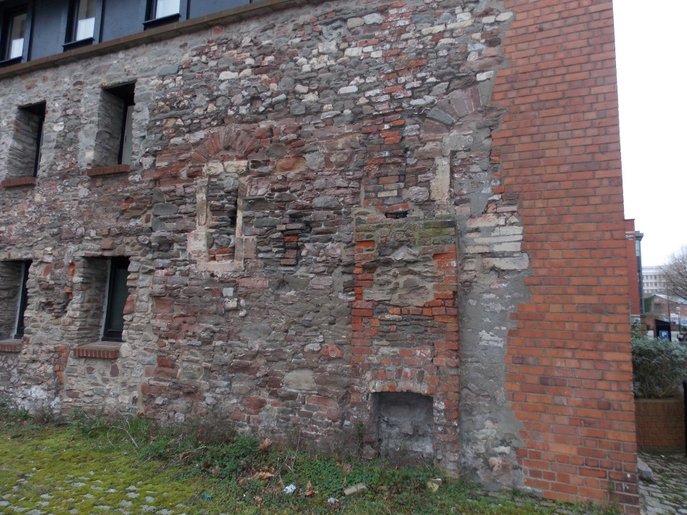
(1450) Canynges’ House
William Canynges was one of England’s most wealthy merchants in the 15th century. He made most of his money through exporting cloth to south-west Europe and had his own fleet of 10 ships. He was mayor of Bristol five times.
Canynges lived in a very large house in Redcliff Street that had its own hall and a tower to the rear overlooking the Avon. All that remains now are some decorative stonework from a ‘blind arcade’ near Redcliff Street and parts of the tower.
Over time the riverbank has moved westwards, partly as a result of people dumping their rubbish there. The river is now about 30m further away from Canynges’ tower with warehouses built along a 19th-century harbour wall.
The remains of Canynges’ Tower, Redcliff Back.
[© Myers-Insole Local Learning CIC]
What could Canynges see from his tower that is not visible today?

Slide 17
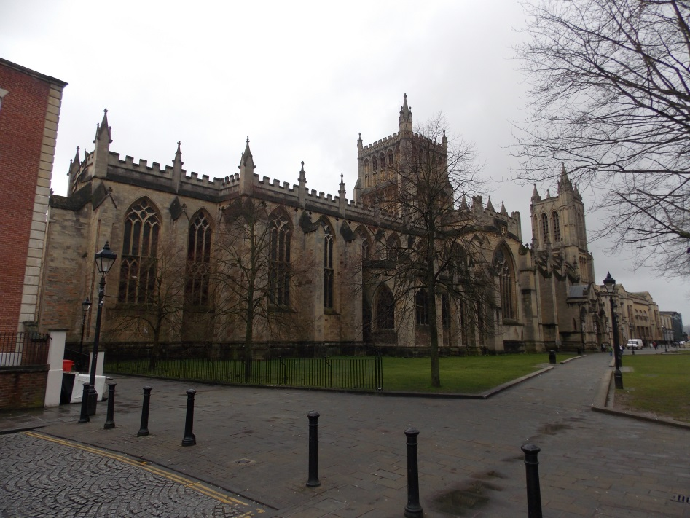
(1542) Bristol Cathedral
Parts of Bristol Cathedral date from the 12th century when it formed part of St. Augustine’s Abbey. This abbey housed many monks who owned lands across the region. After Henry VIII dissolved (closed) the monasteries in 1539, the abbey’s lands were taken by the king and redistributed to nobles and wealthy families.
The abbott was removed and the abbey became a cathedral in 1542, although it retained College Green and land around Canon’s Marsh. Paul Bush, a former royal household chaplain, was made the first Bishop of Bristol and was given a former abbey house to live in. This became known as the Bishop’s Palace and was destroyed during the Bristol Riots in 1831.
Bristol Cathedral.
[© Myers-Insole Local Learning CIC]
How did Henry VIII’s dissolution of the monasteries affect Bristol Cathedral?

Slide 18
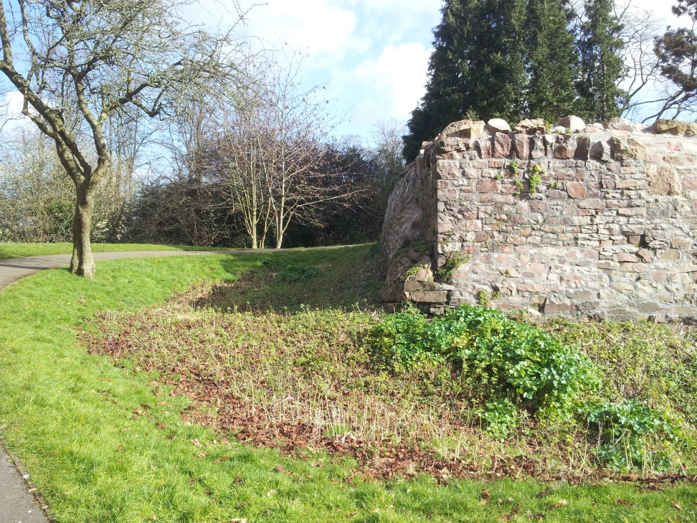
(1642) Brandon Hill Fort
During the English Civil War (1642-1646) Bristol was originally under Parliamentarian control. Several forts were built to defend the town, including one on top of Brandon Hill.
In 1643, the Royalist army led by Prince Rupert, nephew of Charles I, captured Bristol. They then refortified many defences and built a new fort (the Royal Fort) near the top of St. Michael’s Hill.
The city was attacked and captured in 1645 by the leader of the Parliamentarian army, Lord Fairfax. Prince Rupert was captured and banished from the country.
Several earthworks at Brandon Hill survive to give an indication of the defences but it is possible that many of the fortifications were never completed in that short timescale.
Part of Brandon Hill Fort. The stonework is probably Victorian in date, but on the site of the Civil War fort.
[© Myers-Insole Local Learning CIC]
Why do you think the Civil War fortifications were never completed?

Slide 19
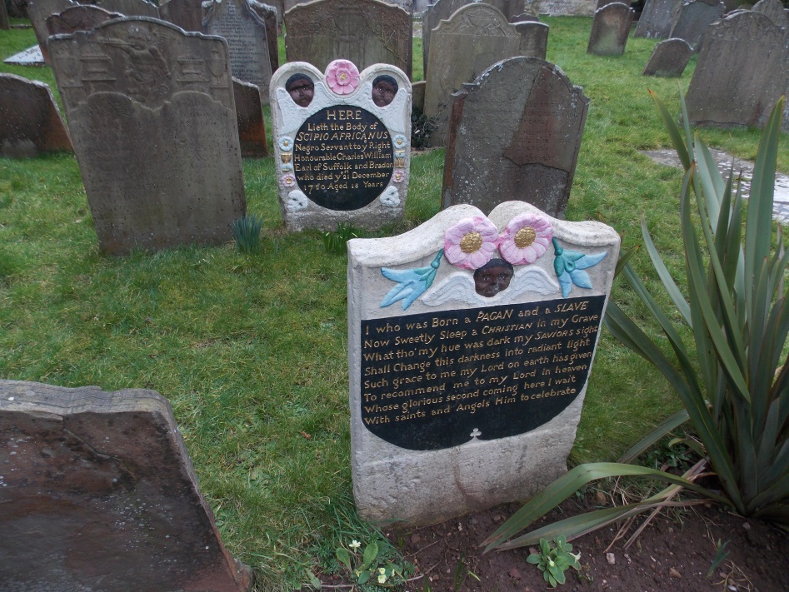
(1720) Slavery
Bristol’s involvement with the slave trade was at its peak in the 18th century. During this period many Bristolian merchants were making vast sums of money exporting goods like brass (that was being manufactured in the city) to West Africa. They exchanged these goods for captured Africans, then took these people to the Caribbean or America to be sold as slaves, before returning to Bristol with tobacco and sugar.
Few slaves came to Bristol, but the grave of Scipio Africanus (unlikely to have been his original name) in Henbury provides an insight into the attitudes of most Bristolians at the time. The gravestone promotes Christianity over other religions, there is more information about his master than Scipio, and there is a suggestion that Scipio’s skin colour would change in the afterlife.
Grave of Scipio Africanus, Henbury Churchyard.
[© Myers-Insole Local Learning CIC]
What attitudes can be inferred from the text on Scipio’s gravestone?

Slide 20
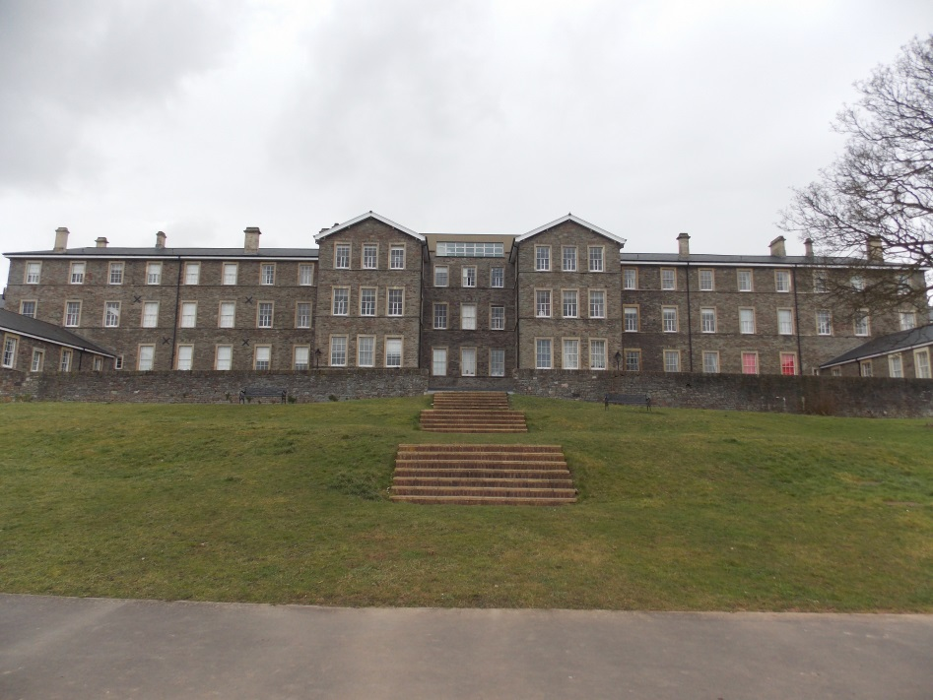
(1849) Muller’s Orphanage
In the 19th century, children from poor families were often forced into work at a very young age. There was usually a daily charge for going to school so many parents chose to send their children to work.
For orphans, life was particularly hard. There were no care institutions, so if children were not in employment they would likely end up in a workhouse. Here they would have to work in exchange for food and accommodation.
In 1832, George Muller established the first orphanage at his home in Wilson Street, St. Pauls. By 1849 Muller had built an orphanage for 300 children at Ashley Down. Here the orphans were educated and learned a trade. By 1870 there were five buildings on the site, housing 2,000 children.
Muller House, one of the five houses at Muller’s Orphanage, Ashley Down.
[© Myers-Insole Local Learning CIC]
Why was it better for children to go to Muller’s Orphanage than the workhouse?

Slide 21
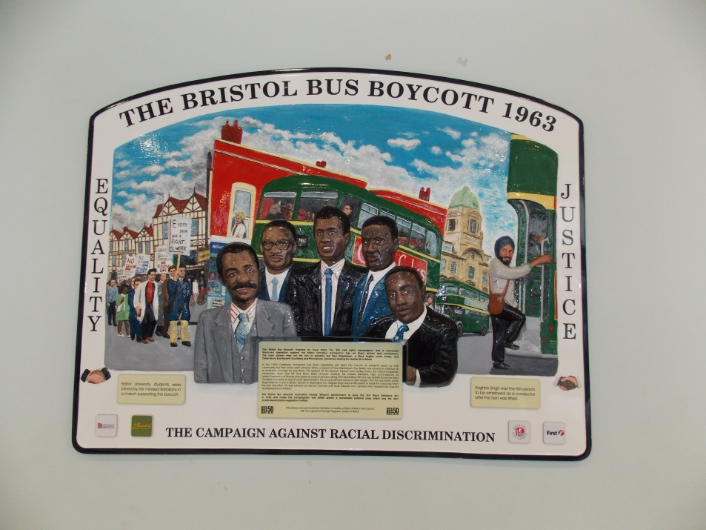
(1963) Bristol Bus Boycott
During the 1950s, people from the Caribbean were invited to work in cities like Bristol. Despite this, the Bristol Omnibus Company did not employ any black staff on its buses. At the time there were no laws against racial discrimination.
In 1963, a young Jamaican, Guy Bailey was refused an interview for a job as a bus conductor. Inspired by Rosa Parks in the United States, Paul Stephenson led the Bristol Bus Boycott Campaign. Through the support of the local African-Caribbean community, Bristol University students, Bristol East MP Tony Benn and Harold Wilson, the Bristol Omnibus Company was forced to employ black conductors and drivers.
The first Race Relations Act to begin to address racial discrimination was passed in 1965, largely as a result of the Bristol Bus Boycott.
Bus Boycott commemorative plaque in Bristol Bus Station.
[© Myers-Insole Local Learning CIC]
How did the Bristol Bus Boycott change race relations nationally?

