Slide 1






Evidence of WW2

Slide 2


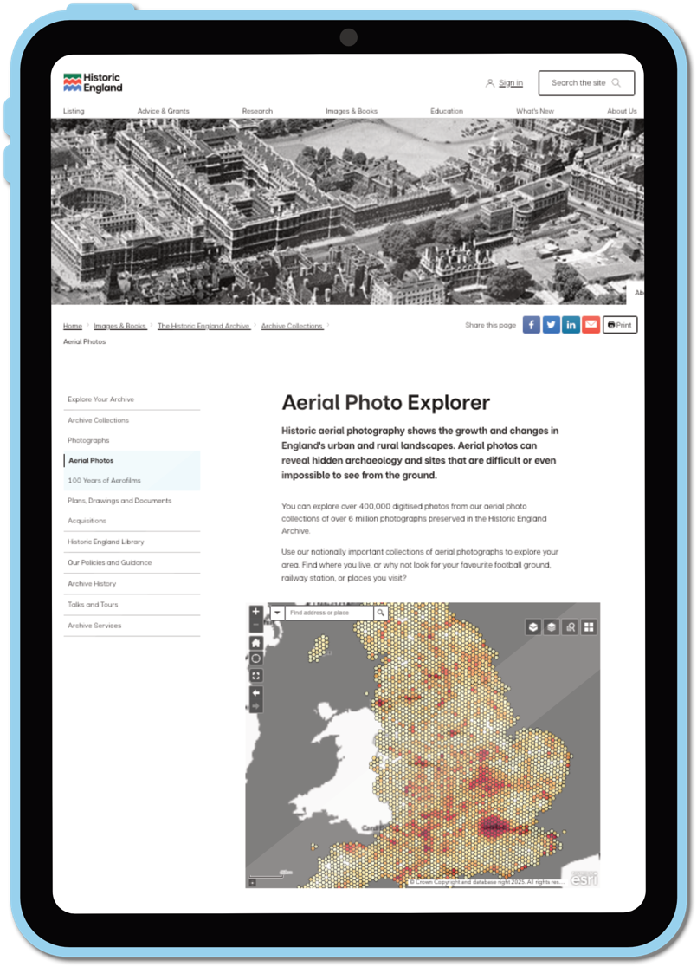

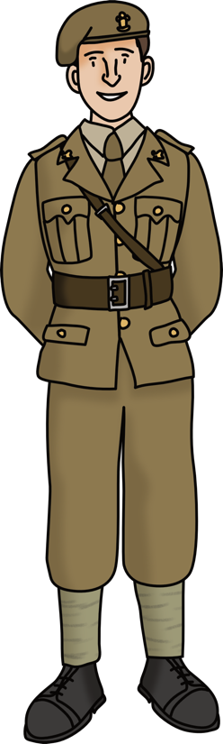


Aerial Photo Explorer
They date from the 1920s to the present day.
Thousands of them relate to World War 2, providing a major source of primary evidence about life on the Home Front.

Slide 3
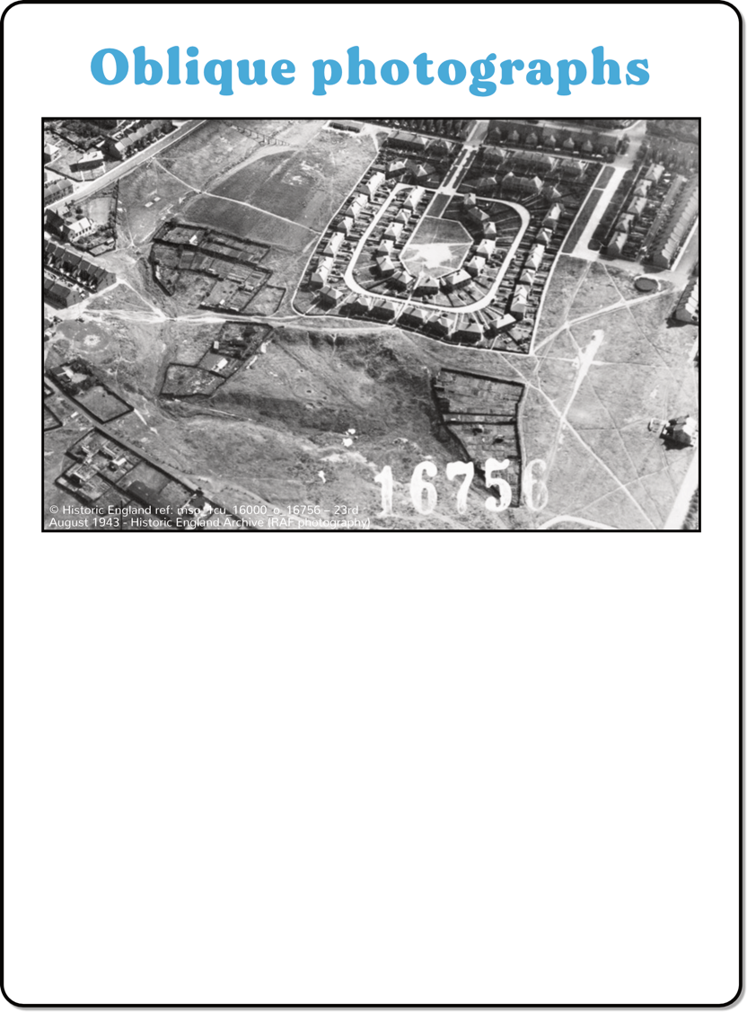
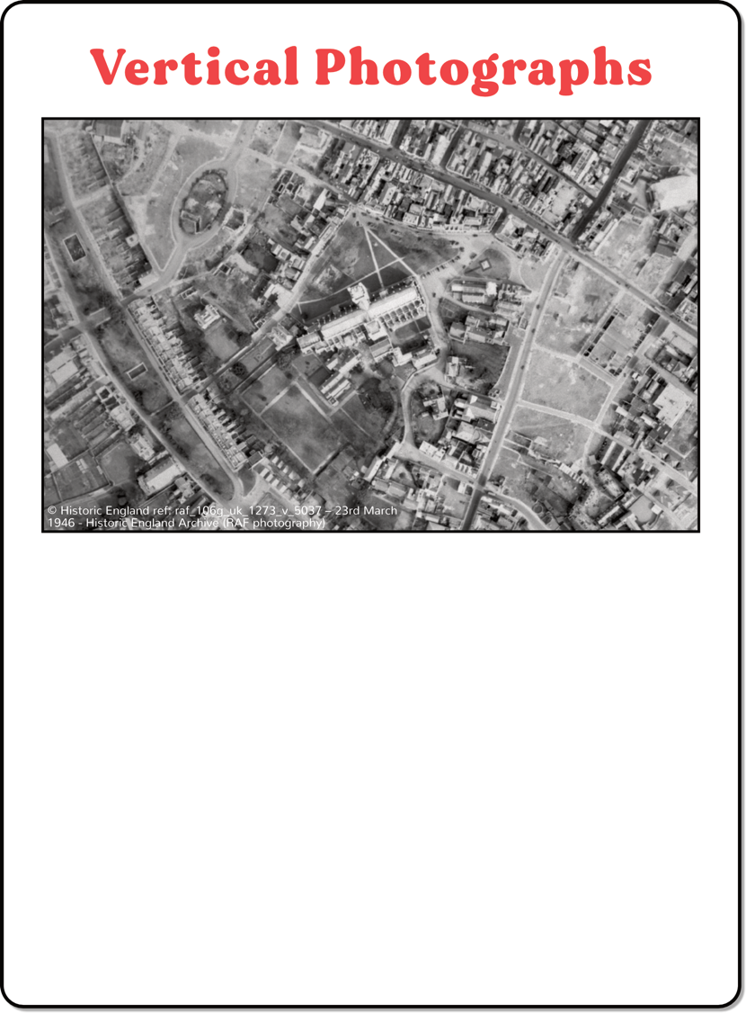

Veritical and Oblique photographs
Using the Aerial Photo Explorer, you can find aerial photographs of your area that were taken during or shortly after World War 2.
Vertical photographs were taken using a camera on the underside of a plane and show a bird’s eye view, much like you’d see when looking at a map.
Oblique photographs were taken by pointing a camera out of the window of
a plane and show a different angle.
They are useful for seeing the size of buildings in relation to one another.

Slide 4
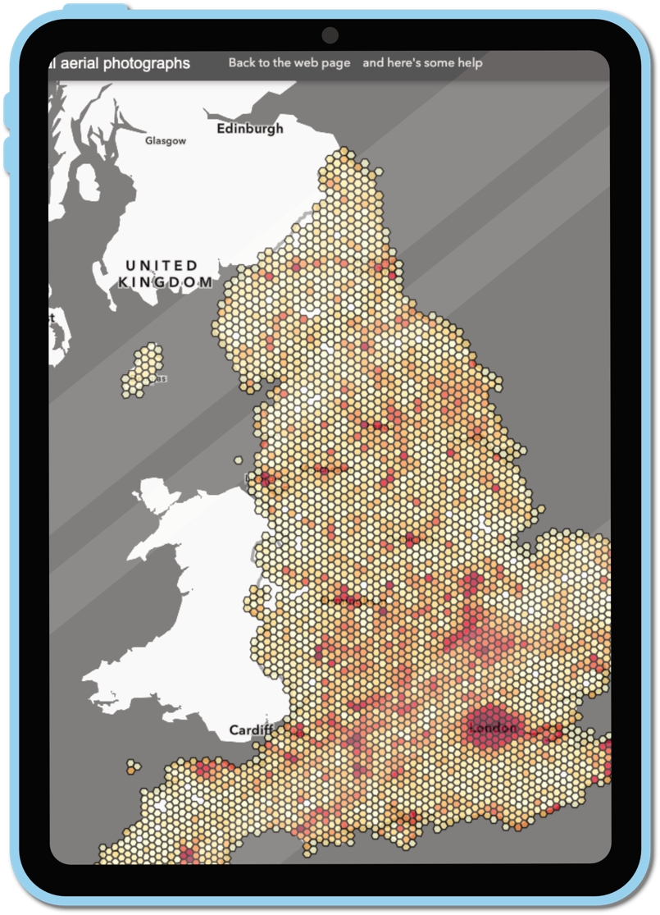
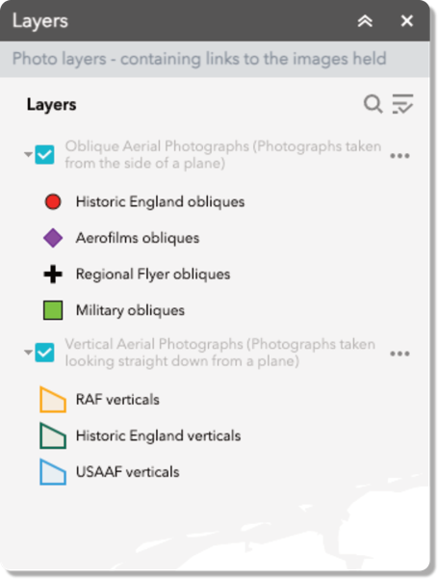

Using the Aerial Photo Explorer - 1
To search specifically for World War 2 photographs, we recommend turning off/unticking the Oblique Aerial Photographs layer.
The ‘orange’ RAF and ‘blue’ USAAF tiles are most likely to date from the 1940s.
After searching these you may wish to turn the obliques back on, to look at the ‘green’ military obliques.

Slide 5
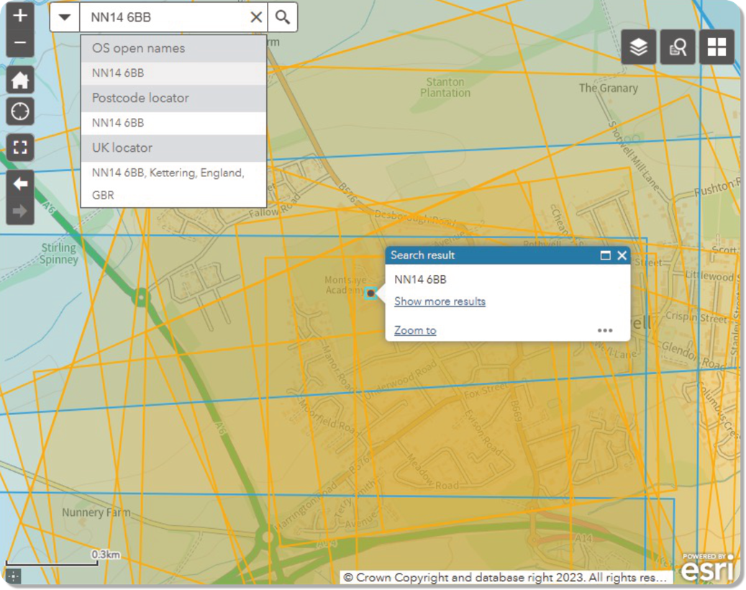
Using the Aerial Photo Explorer - 2
Put in a postcode or type in a place name to find the closest aerial photographs.

Slide 6
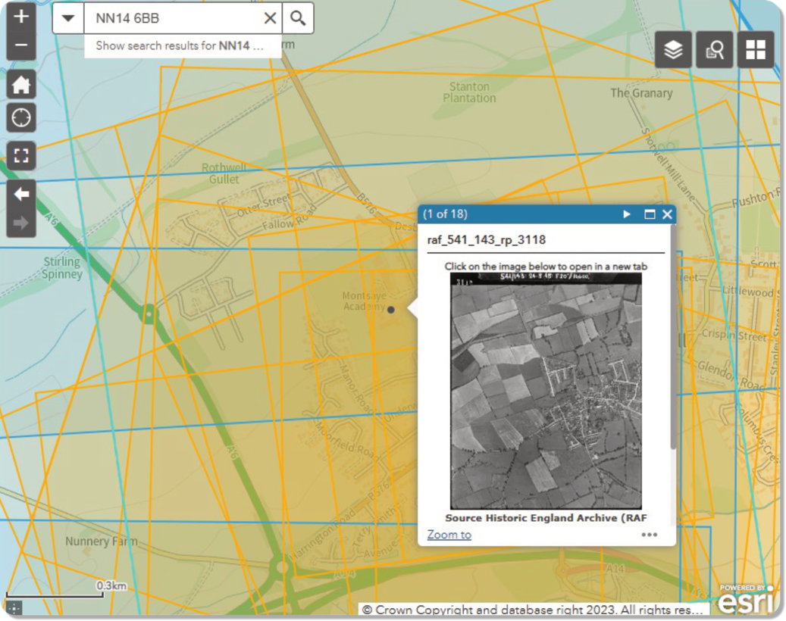
Using the Aerial Photo Explorer - 3
Put in a postcode or type in a place name to find the closest aerial photographs.
Click on the map in the area that you wish to explore.
A pop-up box will appear. The number in the top-left of the pop-up tell you how many images there are.
The arrow lets you scroll through them.
You can then click on any image to enlarge it and explore it in further detail.

Slide 7
















Can you find evidence of World War Two?
Click on one of the headings to learn more about what to look out for.

Slide 8


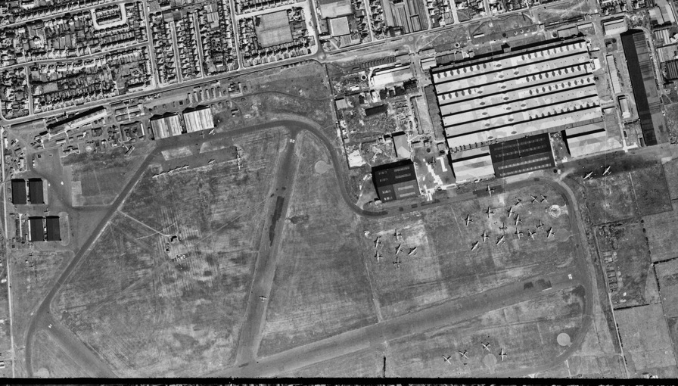
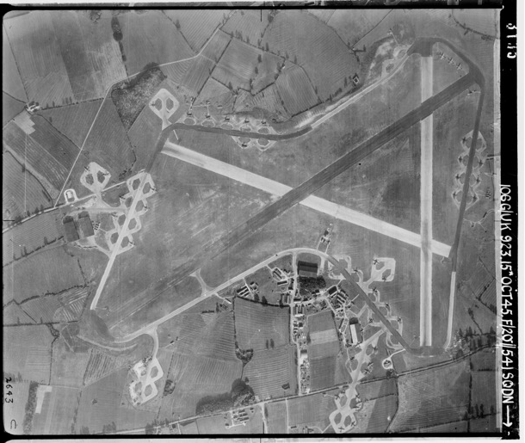
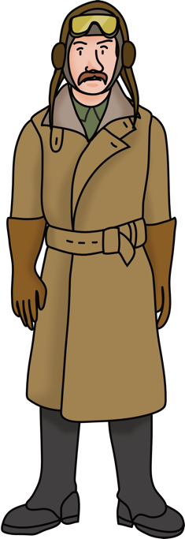

Airfields
During World War 2, there were 740 airfields or aerodromes around Britain.
They were very important during the Battle of Britain and as a base for bombing raids in Germany.
You can sometimes see the planes and the long, straight runways.
© Historic England ref: raf_106g_uk_923_rp_3135 – 15th October 1945
© Historic England ref: raf_106g_uk_625_rs_4061 – 10th August 1945
Blackpool Airfield (now Blackpool Airport)
Leicester Airfield
(now Leicester Airport)
Notes:
Image: raf_106g_uk_625_rs_4061 – 10th August 1945 - Historic England Archive (RAF photography)

Slide 9

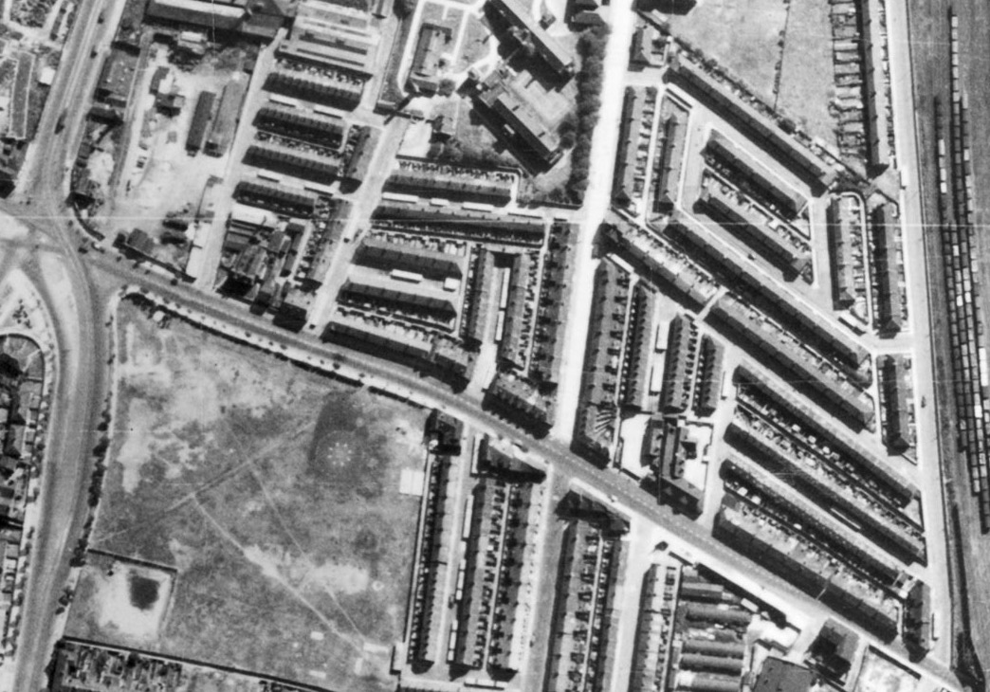
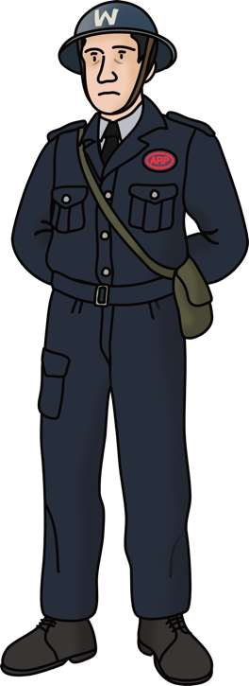
Air raid shelters
© Historic England ref: raf_106g_uk_626_rs_4165 – 10th August 1945
Due to the threat of air raids, shelters were built all over Britain.
Due to their size and the fact that they were covered in soil, the Anderson shelters that people built in their gardens are unlikely to be seen on aerial photographs.
The larger public air raid shelters, on the other hand, can be spotted.
Highlighted in yellow, you can see public air raid shelters on roads in Liverpool.

Slide 10

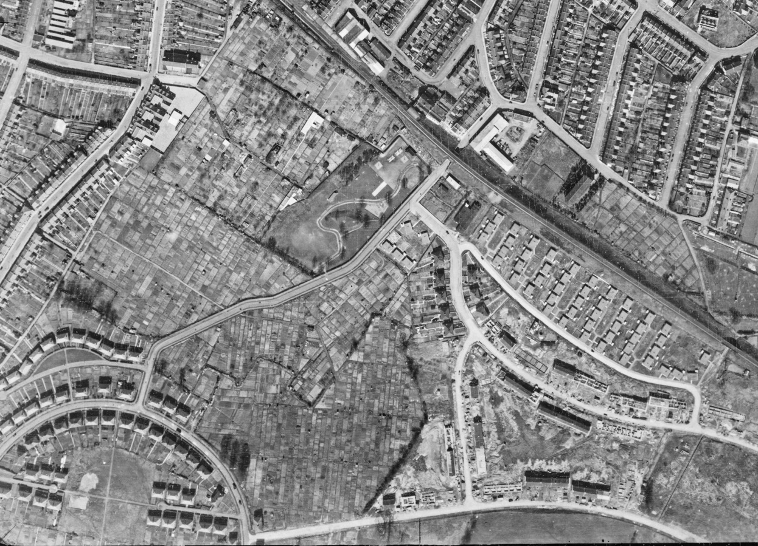
Allotments
Due to a food shortage, the government’s Dig For Victory campaign encouraged people to grow more fruit and vegetables.
Public spaces like parks and golf courses were turned into allotments.
Huge areas of allotments in the middle of a housing estate in Oldfield Park, Bath.
© Historic England ref: raf_cpe_uk_1988_v_5172 – 12th April 1947

Slide 11

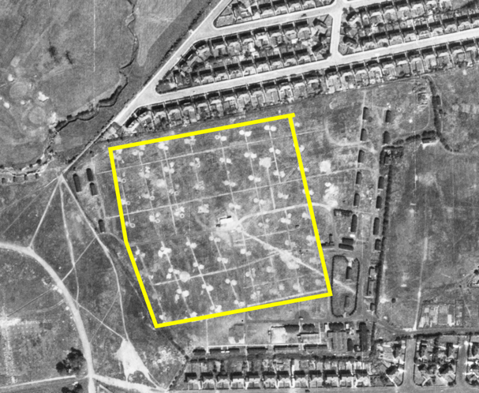
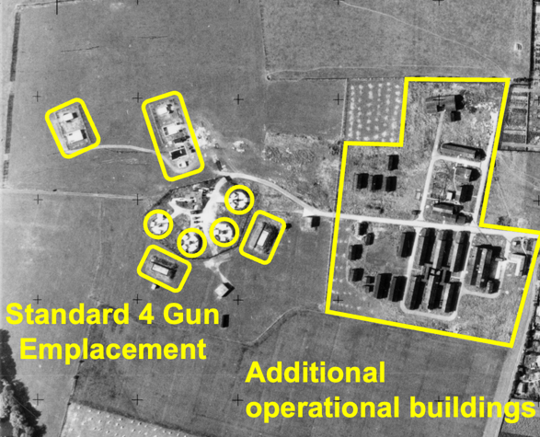
Anti-aircraft sites
Anti-aircraft (AA) sites were widespread due to the threat of bombing. There were three main types of anti-aircraft sites, heavy guns (HAA), light guns (LAA) and batteries (ZAA).
HAA sites are clearly seen on aerial photographs. This one is at Grangetown, Middlesbrough.
© Historic England ref: raf_106g_uk_622_rp_3332 - 10th August 1945
LAA sites used a range of weapons against low flying aircraft. They are rarely visible on aerial photographs.
© Historic England ref: os_52r49_v_040 – 23rd August 1952
ZAA sites are clearly seen on aerial photographs. They were a series of rockets laid out in a grid pattern. This one is at Radcliffe Park, Salford.

Slide 12
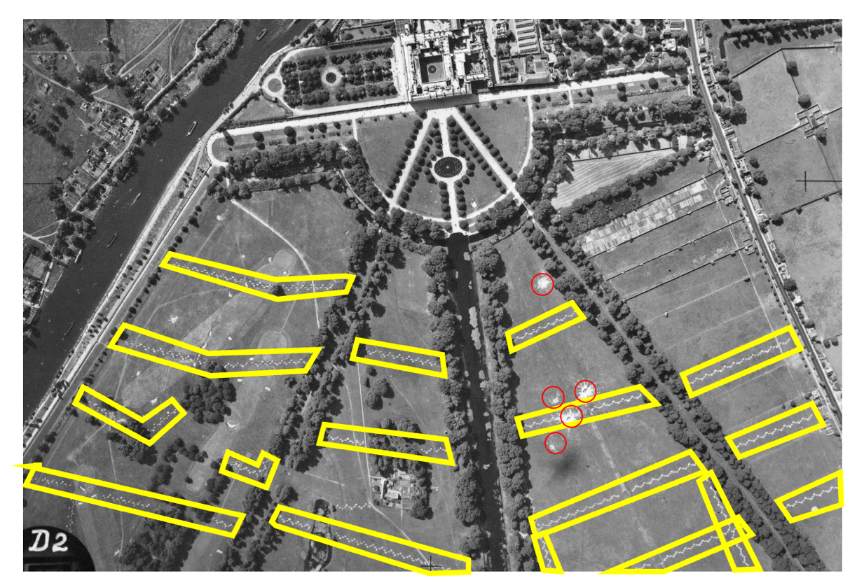
Anti-glider (landing) trenches
Anti-glider trenches can be seen on large areas of open land.
The zig-zag trenches were designed to stop enemy planes from landing.
This picture shows the anti-glider trenches on the parkland in front of Hampton Court in London.
The red areas show bomb craters.

Slide 13

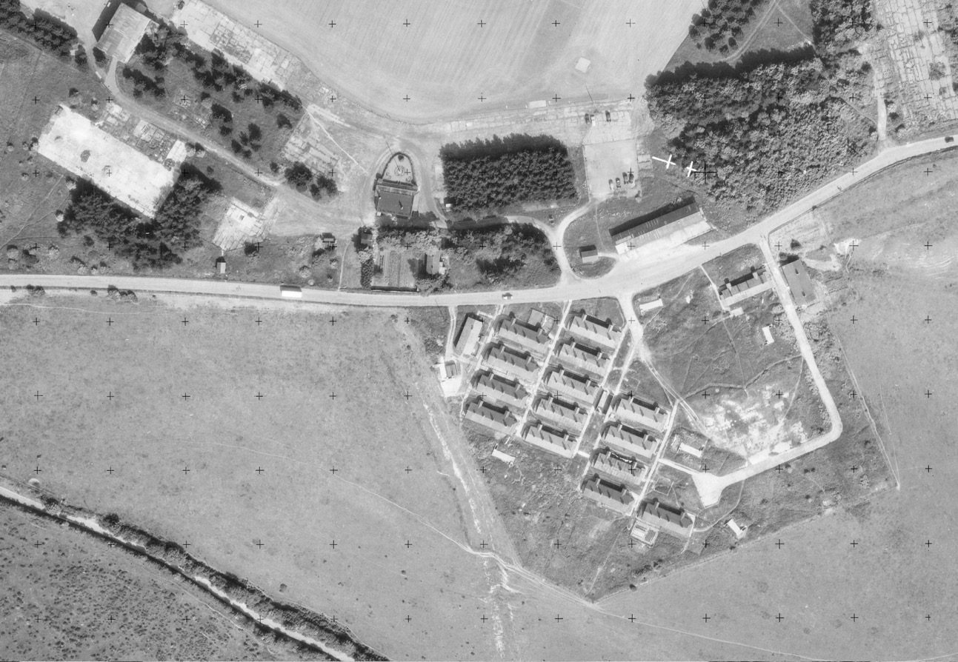
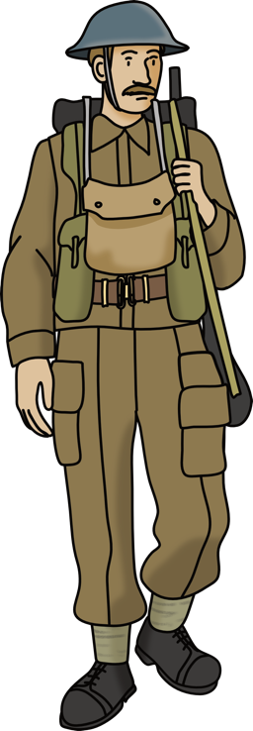
Barracks
© Historic England ref: os_53t77_v_032 – 10th June 1953
Lots of accommodation was built for soldiers during World War 2.
Army barracks, such as these ones in Dover, Kent can be seen from aerial pictures.

Slide 14

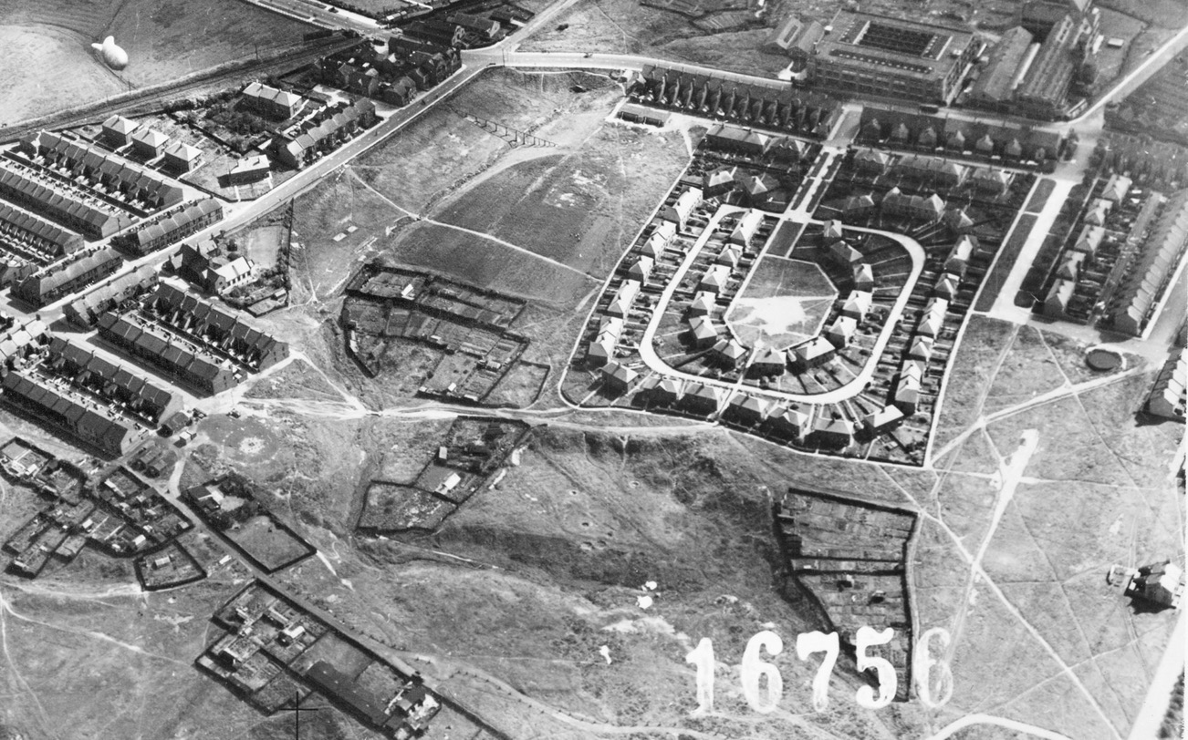
Barrage Balloons
© Historic England ref: mso_1cu_16000_o_16756 – 23rd August 1943
Barrage balloons (circled in yellow) were tied to the ground using long steel cables.
You can see the tether site (circled in orange) where the cable was attached to the ground. If a plane collided with the cable, it would be critically damaged.
Barrage balloons forced the German aircraft to fly above them meaning that their bombs were less accurate.
Wardley, Gateshead

Slide 15

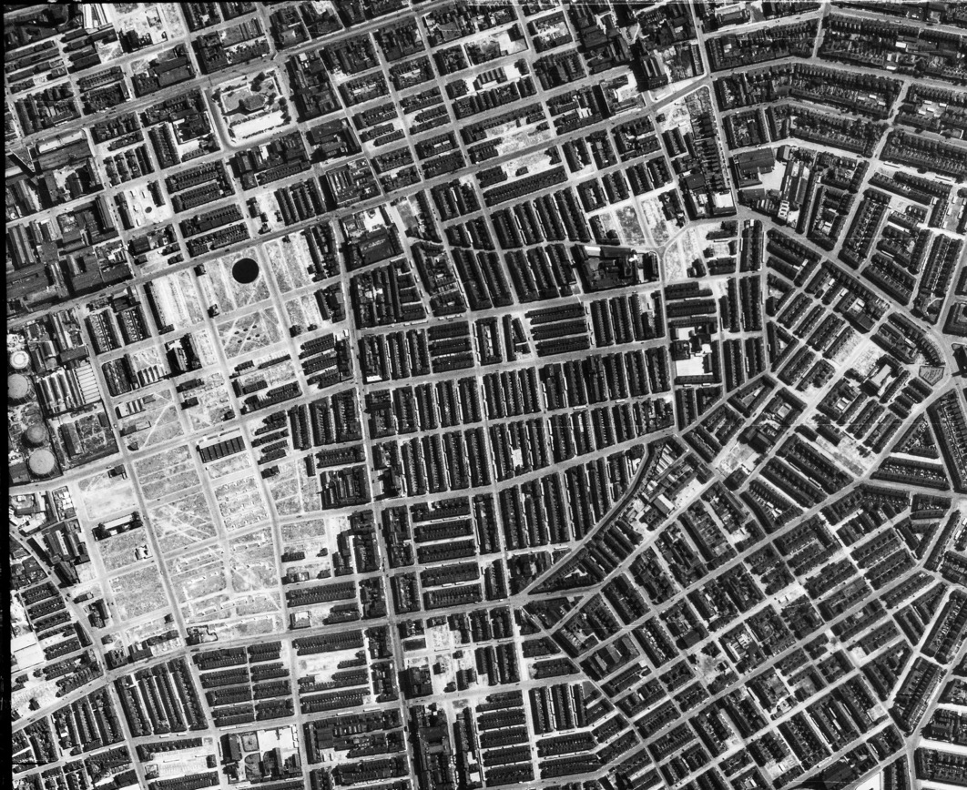

Bomb damage
There were frequent and heavy bombing raids carried out over Britain during World War 2.
This photograph from Rolls Crescent, Manchester shows the impact of bombing.
The areas that look white are the sites of buildings that have been demolished due to bomb damage
© Historic England ref: raf_106g_uk_622_rs_4375 – 10th August 1945

Slide 16

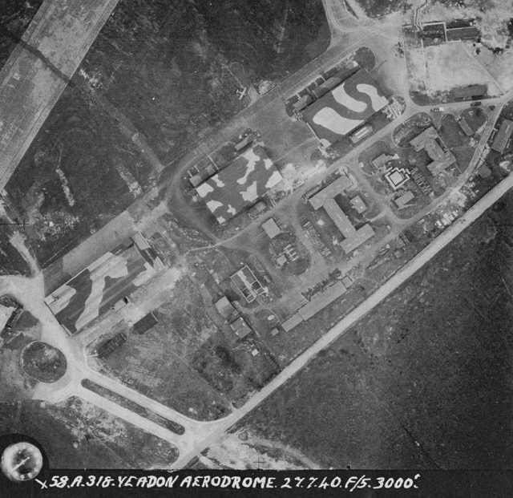
Camouflaged buildings
© Historic England ref: raf_58a_45_v_0318 – 27th July 1940
Something that can be, deliberately, difficult to spot are camouflaged buildings that were painted to try and hide them from the view of German bomber pilots.
These RAF aircraft hangars were at RAF Yeadon which is now Leeds Bradford Airport.

Slide 17

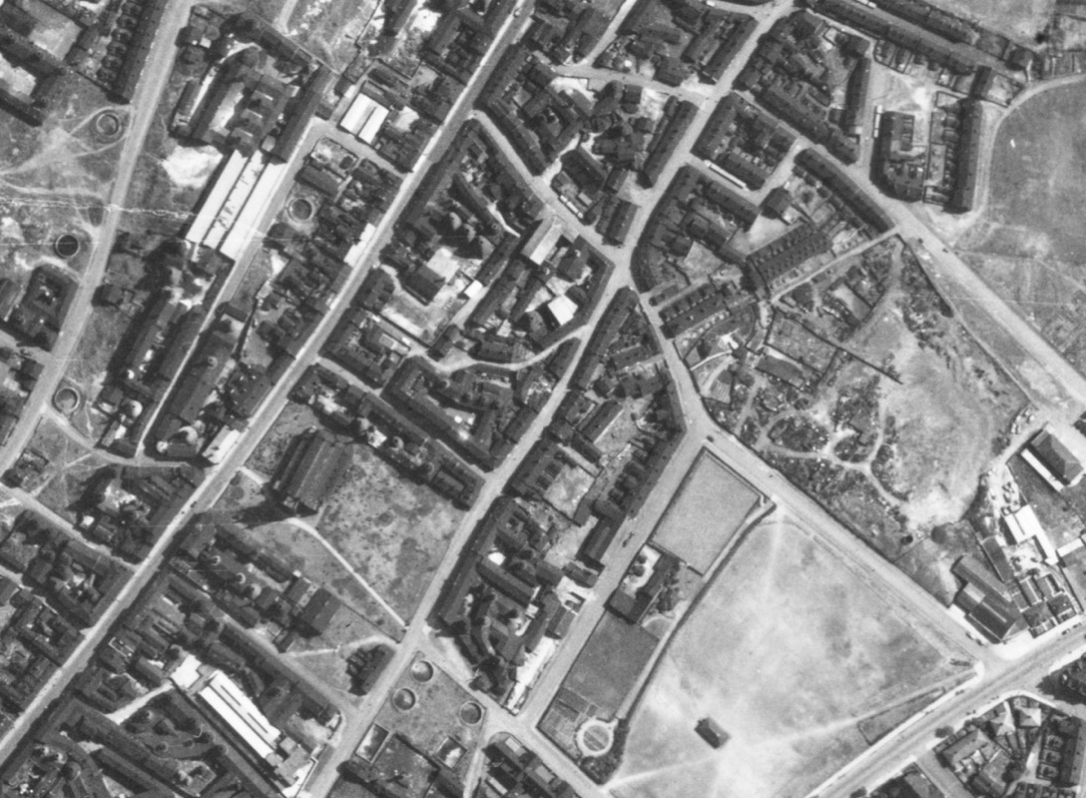
Emergency water supplies
Large tanks of water were created to store water that could be used to quickly extinguish fires.
These emergency water supplies can sometimes be spotted on 1940s aerial photographs.
Circled in yellow are emergency water supply tanks in Longton, Stoke-on-Trent.
© Historic England ref: raf_106g_uk_646_rs_4163 – 11th August 1945

Slide 18

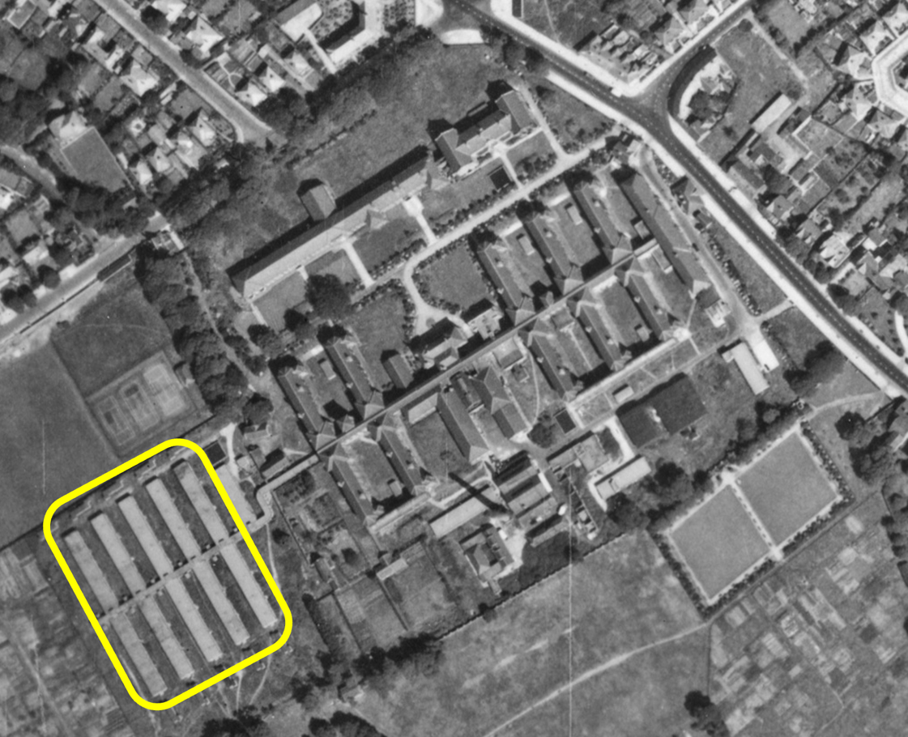
Hospitals
Additional hospital capacity was needed during the war to deal with casualties from air raids etc.
Extra buildings were added to hospitals and military hospitals were built.
In this photograph of Alder Hey Hospital in Liverpool, you can see the hutted accommodation that was added during the war.
© Historic England ref: raf_106g_uk_626_rs_4195 – 10th August 1945

Slide 19

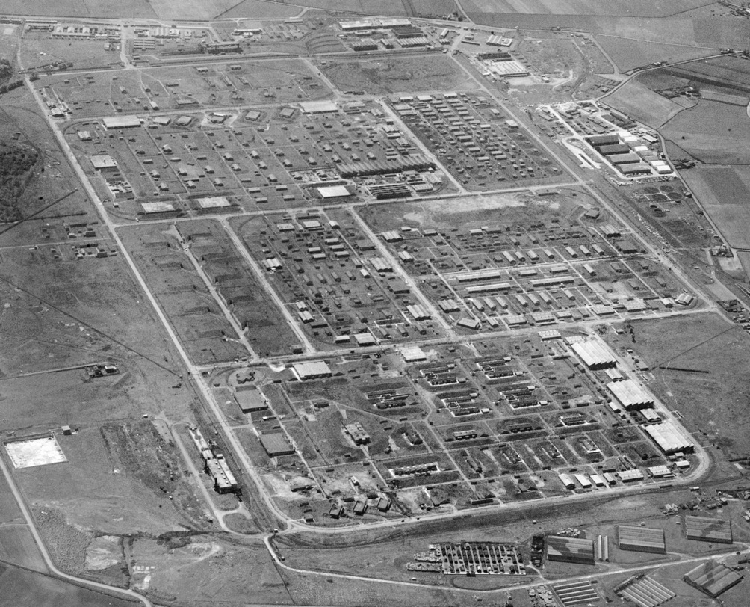
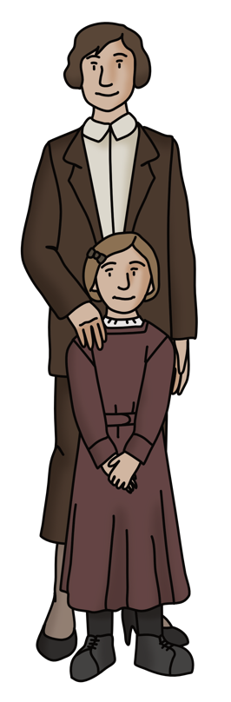
Munitions sites
© Historic England ref: EAW005653 – 15th May 1947
Munitions sites were factories where military weapons, ammunition, equipment and stores were produced.
From 1941 onwards, over one million British women worked in munitions factories until victory in 1945.
When completed ROF Kirkby had more than 1,000 buildings, 18 miles of roads, 23 miles of railway lines along with a station,
200 houses for key workers
and a YWCA hostel to
house 1,000 women.

Slide 20

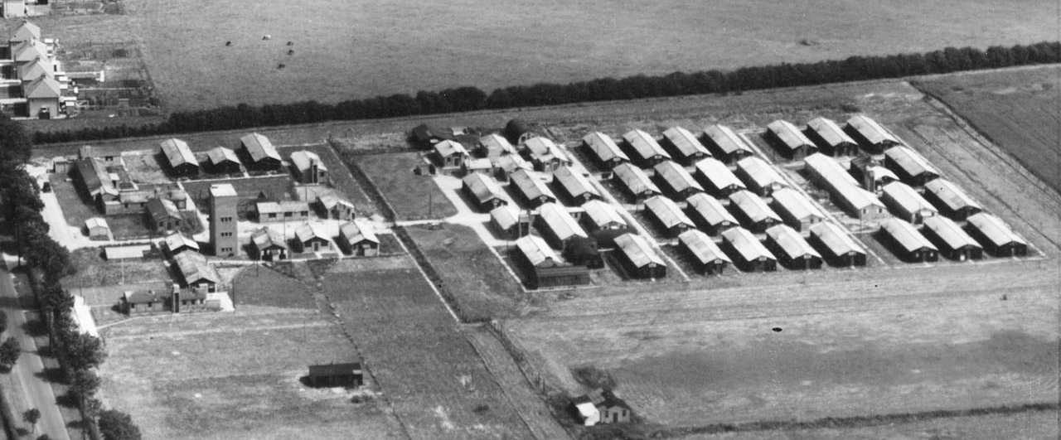
Prisoner of war camps
Most World War 2 prisoner of war (PoW) camps were in requisitioned buildings such as country houses, cotton mills and military camps.
This ‘Standard’ type German Working PoW Camp was in Stamford.
© Historic England ref: raf_540_62_sffo_0074 – 22nd July 1948

Slide 21

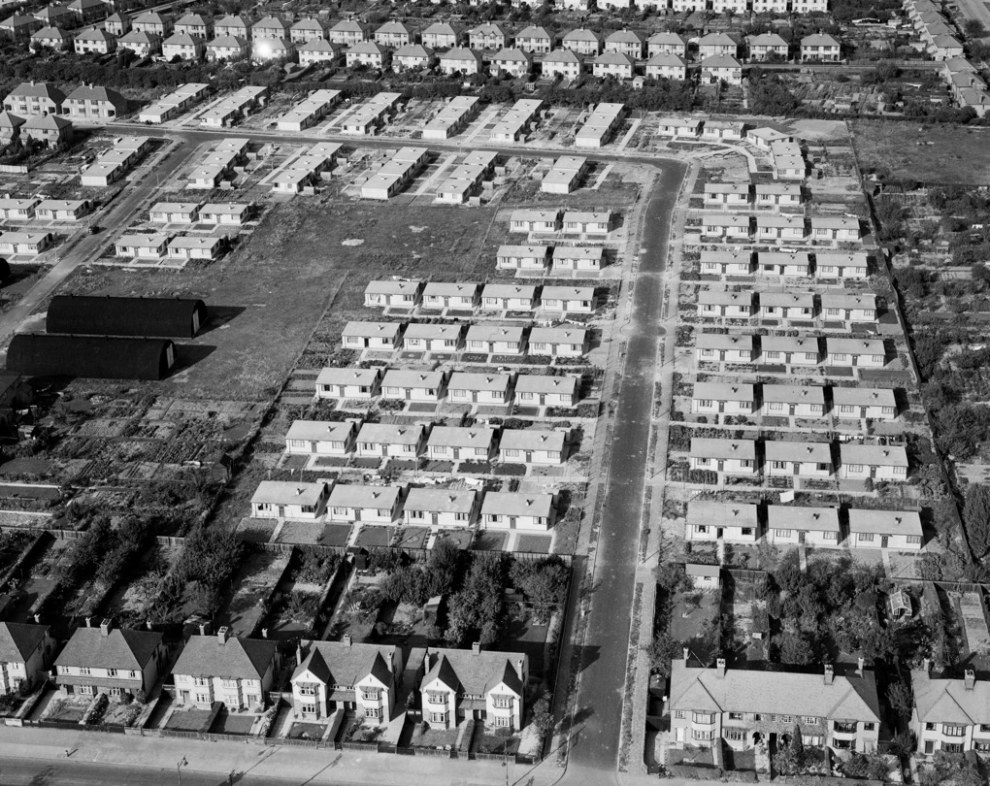
Pre-fabricated houses
Pre-fabricated houses were temporary homes that were built to quickly replace the homes destroyed by bombing.
They were made in factories and could be quickly assembled on site. Over 156,00 were built in 1946 and 1947.
The single storey pre-fabs on Lichfield Road, Cambridge can be seen in between the usual two storey houses on either side.
© Historic England ref: EAW002930 – 1st October 1946

Slide 22

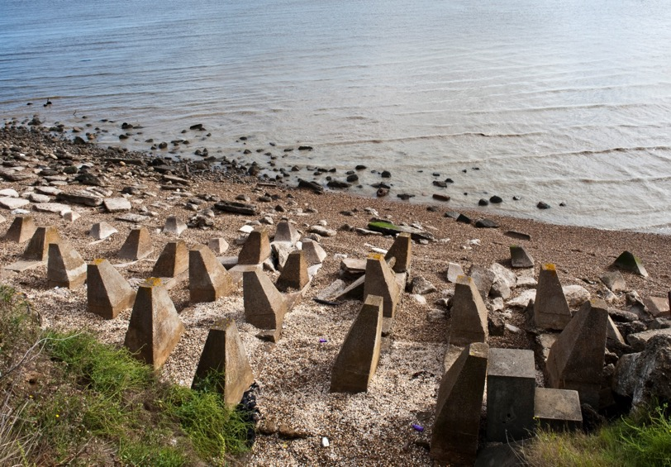
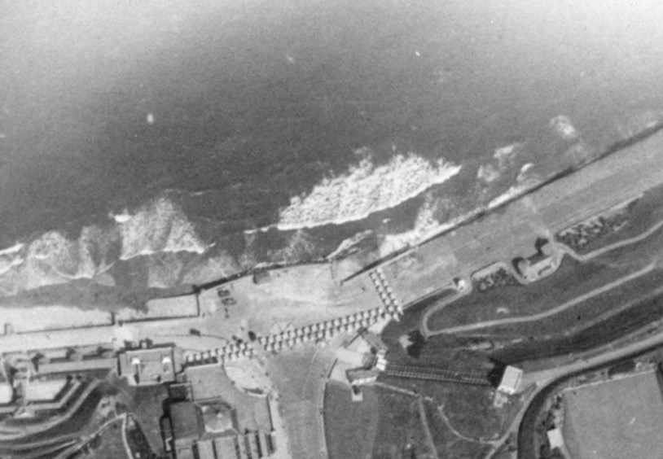
Seafront defences
Anti-tank defences were built on beaches that were potentially a landing place for German troops. Some can still be seen today.
Anti-invasion obstacles at Scarborough, North Yorkshire
Dragon’s Teeth – Isle of Grain, Kent
© Historic England ref: DP076219
© Historic England ref: raf_4h_br42_b_v_0092 – 1st August 1940

Slide 23

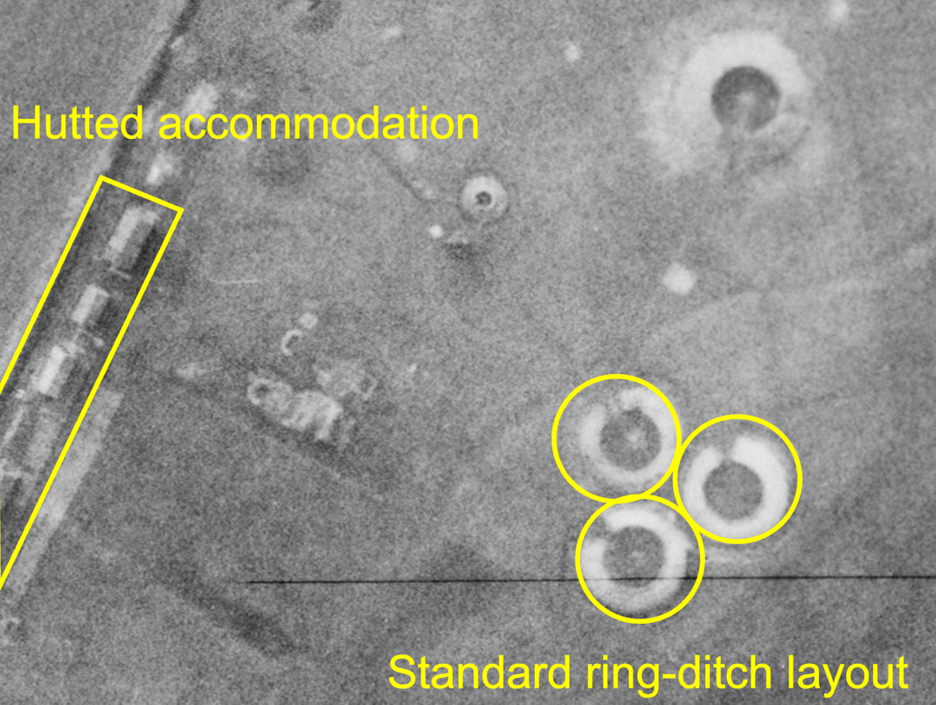
Searchlight batteries
© Historic England ref: raf_ac207_v_5050 – 24th February 1943
Searchlights were used to find enemy aircraft and reduce the amount of ammunition used to shoot them down.
This searchlight battery in Bedford shows the standard ring-ditch layout that you can look out for when looking for searchlight batteries in your area.

Slide 24



What can you find near you?

