Slide 1
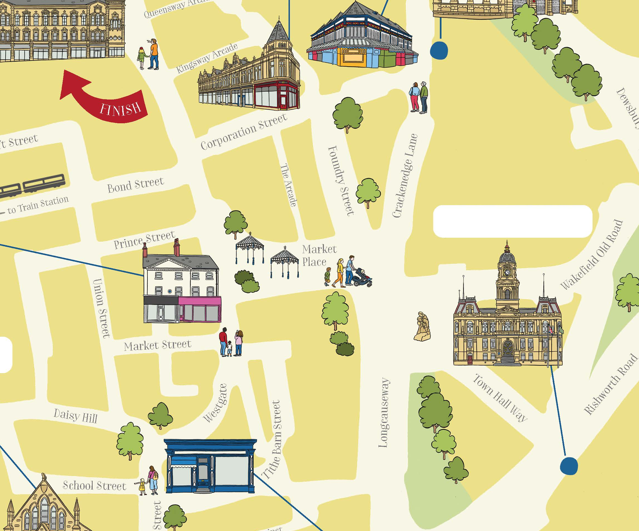
Dewsbury Beeline Heritage Trail

Slide 2
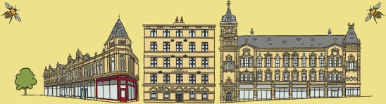
Additional resources to support this PowerPoint
Paper Trail Map​
Interactive Trail Map​
Cut-out models of the 10 trail buildings​
A short history of Dewsbury

Slide 3
What can the Beeline Heritage Trail tell us about the history and importance of Dewsbury?
History & Geography
To develop our local history skills by using buildings as historical evidence to find out about our area in the past​
To develop our geography skills by using maps to find out about our area in the past​
To investigate why key historical sites in our local area are important
This PPT is part of the Teaching Activity: What can the Beeline Heritage Trail tell us about the history and importance of Dewsbury?

Slide 4

Using the trail
1. Download the PDF version of the trail and take pupils out to explore the buildings on it OR use the online version to virtually explore the buildings and find out about them.
2. Use the ‘Take 10 Buildings’ slides to find out more about each building, to help pupils choose their favourite building.
3. Pupils use the cut-out and make models of the buildings to create an exhibition. This will allow them to show what they’ve learnt to other pupils/parents.
4. Use the ‘A short history of Dewsbury’ PowerPoint to help pupils put their favourite building into the wider context of Dewsbury’s history.

Slide 5
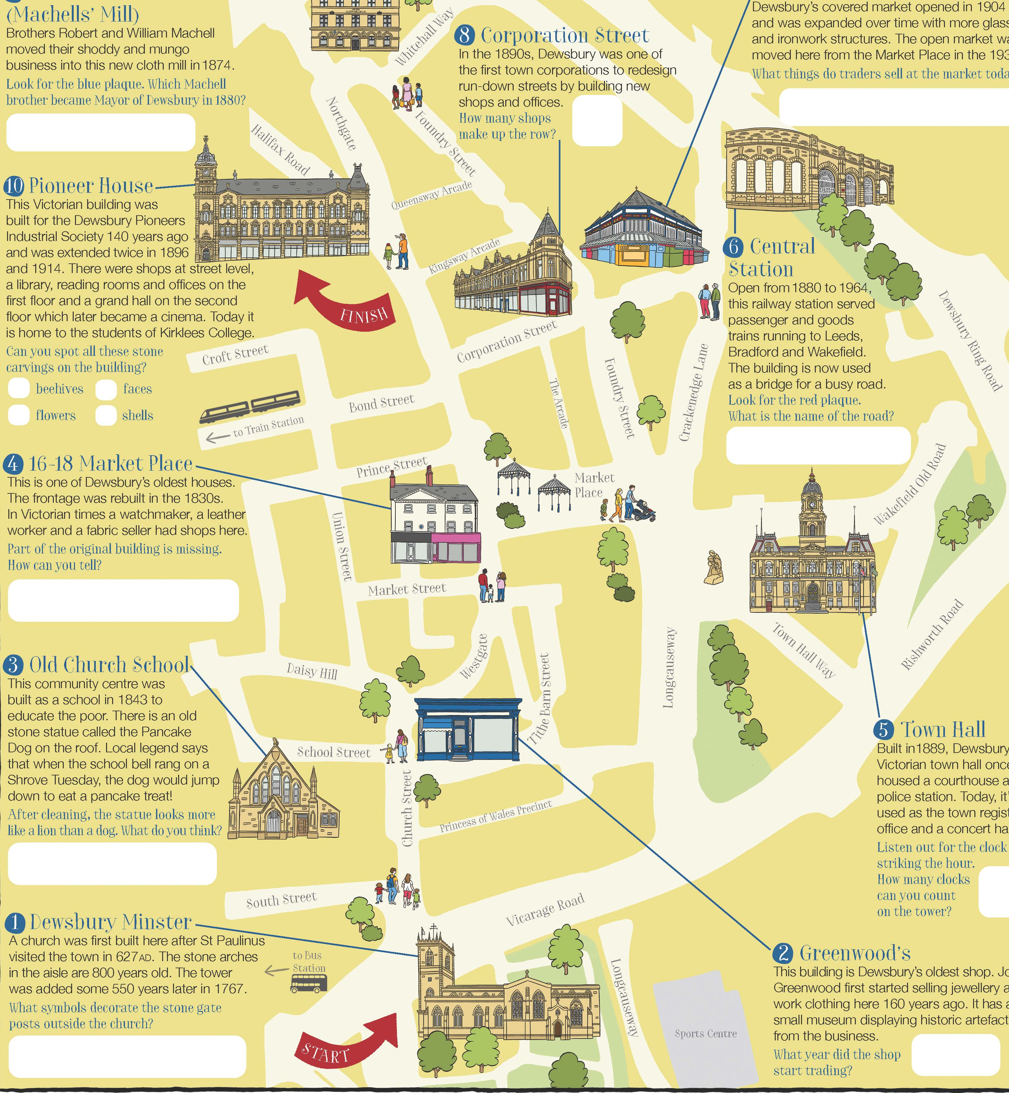
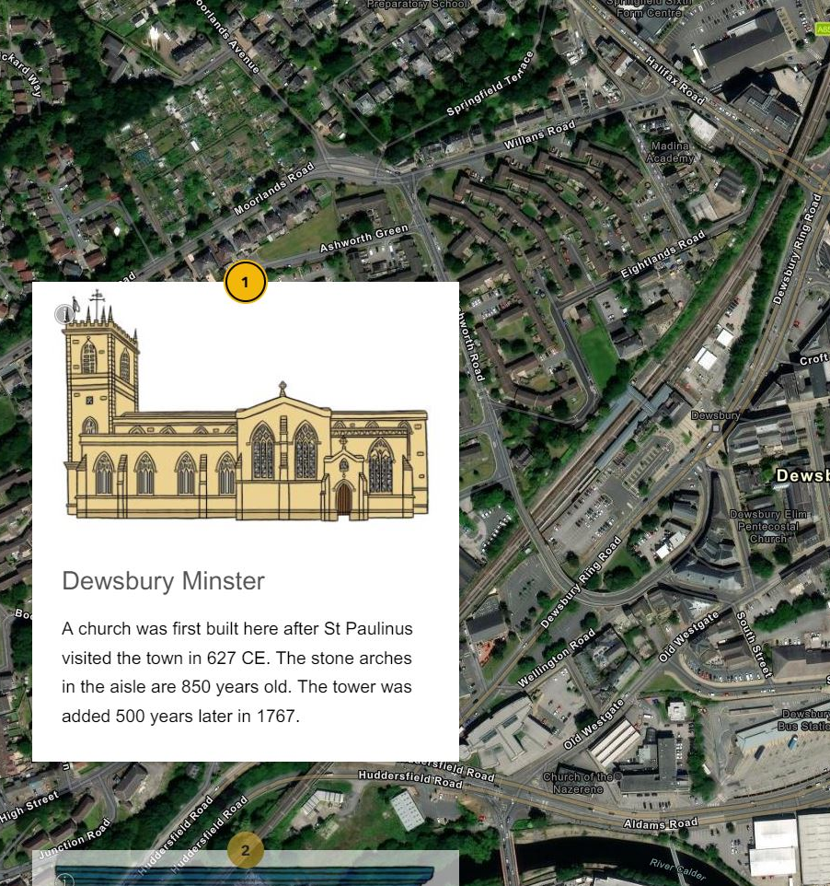


Using the trail
Follow the trail using either the online version
Look
Or by using the map in Drewsbury

Slide 6



Take 10 buildings
Now you’ve followed the trail it’s time to find out a bit more about each of the buildings.​
​This will help you to decide which is your favourite building!​
Remember, you’ll have to decide:​
Think
What makes my building special is…
It is my favourite because…

Slide 7
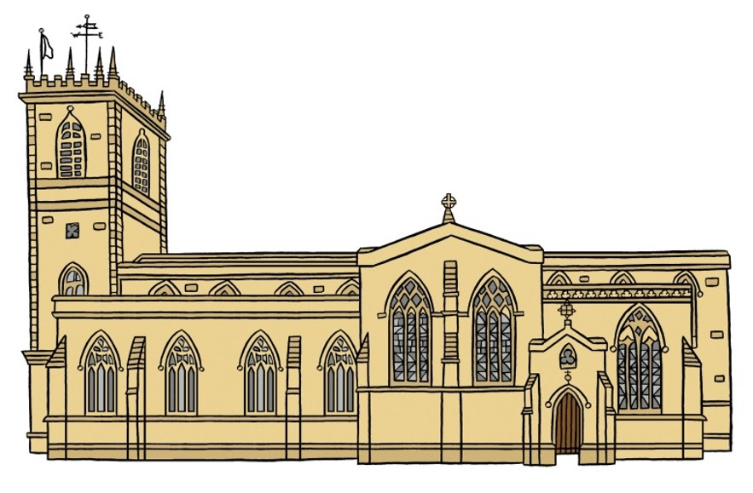
1. Dewsbury Minster

Slide 8


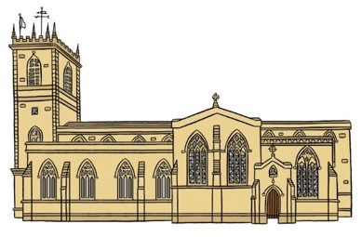



1. Dewsbury Minster
Patrick Brontë was the curate (parish priest) here from 1809 to 1811. He was the father of the world famous writers, the Brontë sisters.
The minster is built on a special site where Paulinus, a Roman missionary and the first Bishop of York, preached in 627.​
The first church was built here in 1220. Amazingly you can still see some of the stonework that dates back to the 1200s.
Much of the church was restored and rebuilt in 1895.​
In 1949 it became a Grade I* listed building. This means it’s one of the most important buildings in the whole country.​
The tower has a bell which rings on Christmas Eve, a tradition which dates from the 1400s.​

Slide 9
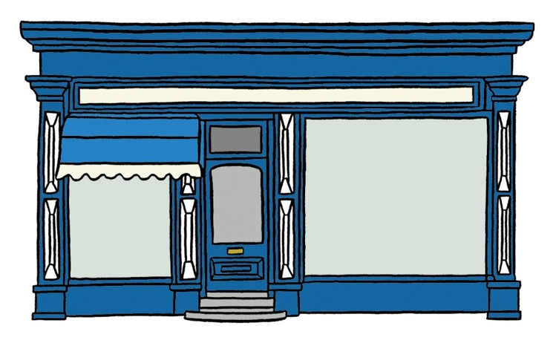
2. Greenwood’s

Slide 10
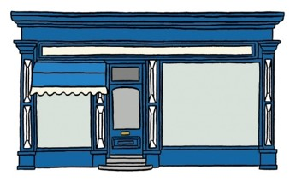
2. Greenwood’s
Dewsbury’s oldest shop was opened on Church Street by John Greenwood in 1856.
The shop now sells jewellery.​
It sold mostly workmen’s overalls, boiler suits, socks and caps of all types.
Inside it still has the original wooden counters and shelving from 1856.​
At one stage it also operated as a pawnbrokers, (people left valuables as a guarantee they would pay back the money they had borrowed).
Upstairs in the shop there is now Dewsbury’s smallest museum.​​

Slide 11
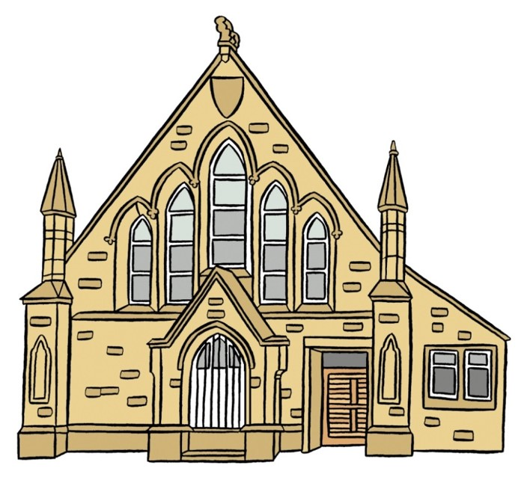
3. The Old Church School

Slide 12
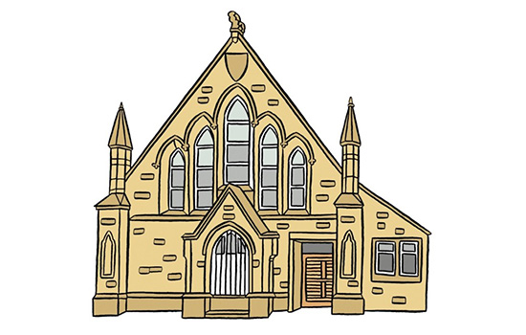
3. The Old Church School
​Its main aim at the time was that ‘the National Religion (Church of England) should be … the first and chief thing taught to the poor.’
The school was built in 1843 and was Dewsbury's second 'National School'.
When it first opened it was run by the local vicar.​
National Schools were the first elementary schools available for everyone.
There is a stone dog on the roof. It is known as the ‘Pancake Dog’. It was taken from the old vicarage in the 1880s. It is rumoured to jump down for a pancake when the bell is rung on Shrove Tuesday!​
The school was run by a charity, the National Society for the Education of the Poor.

Slide 13
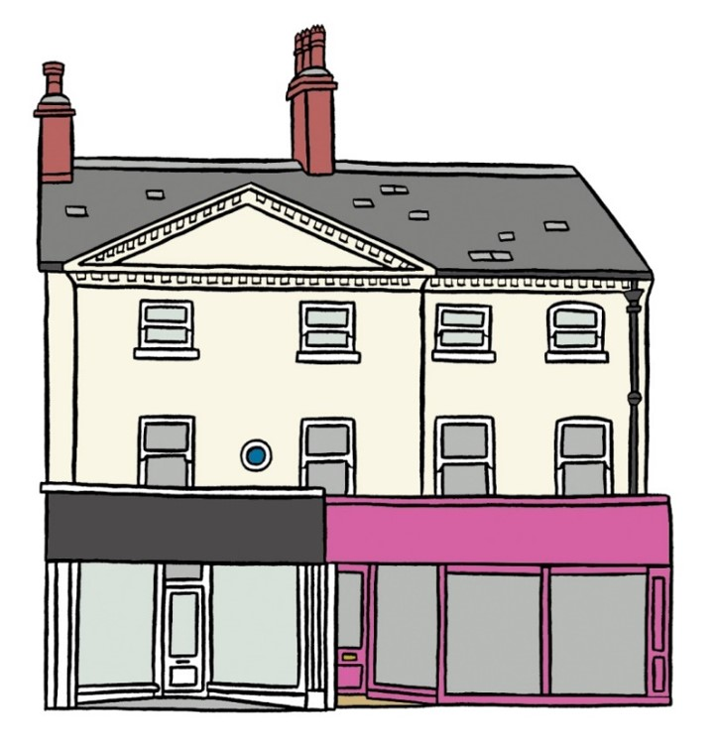
4. 16-18 Market Place

Slide 14

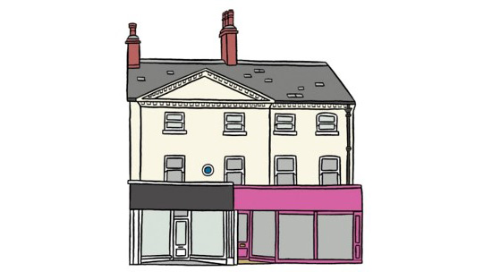
4. 16-18 Market Place
Did you know?
This is the oldest domestic building in the town. It was built in the late 1700s.
In Victorian times the shops on the ground floor were occupied by:​
a draper (selling cloth for making clothes)​
a currier (a craftsman who softened new leather)​
a watchmaker
Its façade (frontage) was rebuilt in the 1830s.
​Part of the building was turned into ‘The Picture House’ cinema around 1910. It showed films in black and white with no sound!

Slide 15
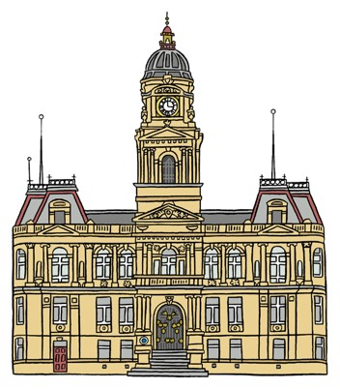
5. Dewsbury Town Hall

Slide 16
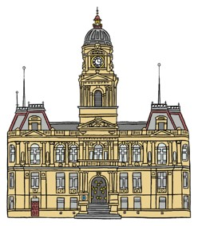
5. Dewsbury Town Hall
​​In January 1885 it was decided to build a new building, which would also show the town’s importance.
In the 1800s Dewsbury grew very quickly. This was because of the success of mills making shoddy and heavy woollen cloth.
Local architects Henry Holtom and George Arthur Fox designed the new Town Hall building.
​In 1862 Dewsbury Town Council was formed and meetings were held in a room on Bond Street.
The Town Hall was officially opened on Tuesday 17th September 1889 by the Mayor, Alderman John Walker JP.​
​Over time the number of town councillors grew. This meant more meeting space was needed.

Slide 17
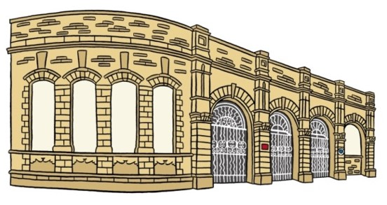
6. Central Station

Slide 18

6. Central Station
In 1923 it became part of London North Eastern Railways. Then, after nationalisation, part of British Rail from 1948 onwards.
At one time Dewsbury had three train stations.​
The station closed in 1964 and was left to decay.​
​Dewsbury Central was opened by the Great Northern Railway Company in 1874.
Today you can still see the remains of the grand building that once welcomed passengers. It has been incorporated into the ring road.​
​Trains ran to neighbouring towns and to London King's Cross. They carried both passengers and goods.

Slide 19
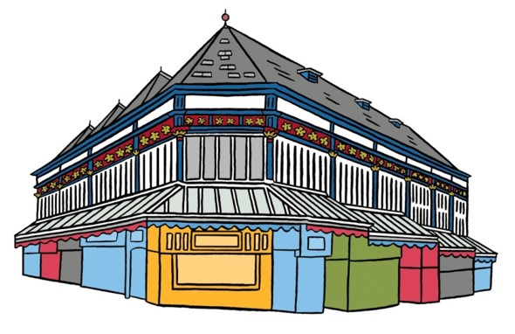
7. Dewsbury Market

Slide 20
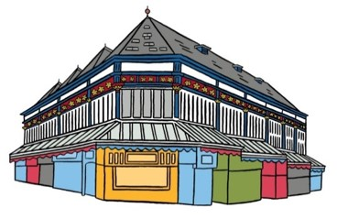
7. Dewsbury Market
In 1740 the market was re-established due to public demand.​
King Edward II granted a Market Charter to a part of Dewsbury, known as Thornhill, in 1318.​
The fabulous Victorian Market Hall was built in 1904. When the Market Hall’s stalls became full, the open market grew up around it. ​
It allowed a weekly market to be held, which mostly sold cloth. The market moved to the town centre.
Today’s market has around forty stalls. They sell food, clothes and household goods.​
When a plague swept through the area in 1583, the market was forced to close.

Slide 21
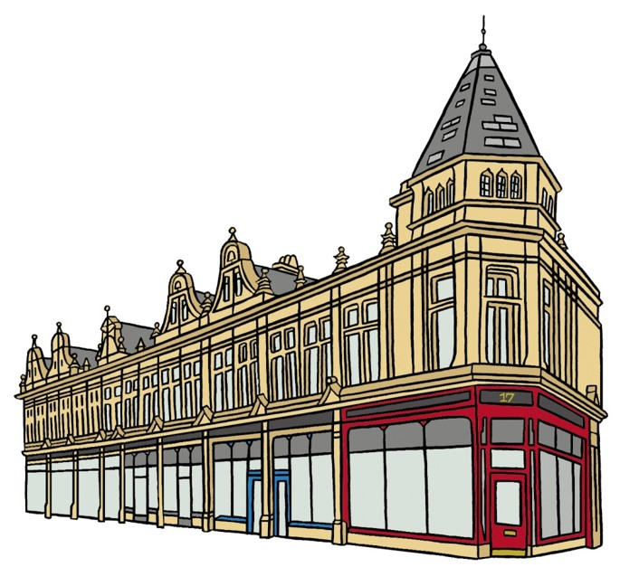
8. Corporation Street

Slide 22

8. Corporation Street
Dewsbury’s population grew from 4,566 in 1801 to over 30,000 in the 1890s. This meant there were 6 times more people living there.
It was built by Dewsbury Town Council.​
Its grand architecture was designed to make people feel proud of their town. This was called ‘civic pride’. ​ ​
It became necessary to develop ‘thoroughfares’. These were new roads which kept transport moving in the town.
Numbers 18 and 20 are now Grade II Listed Buildings. This means they are of national importance.
Corporation Street replaced a narrow alleyway called New Bridge Street.

Slide 23
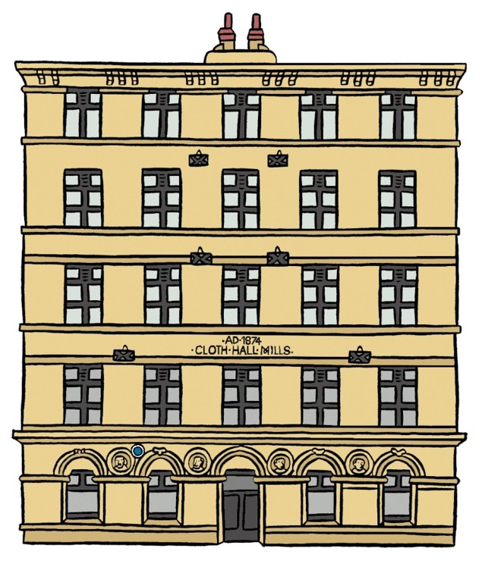
9. Cloth Hall Mills

Slide 24
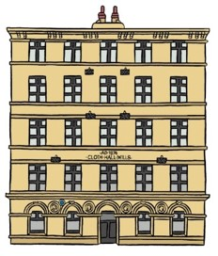
9. Cloth Hall Mills
The rags were ground up in a spiked machine then blended with some new wool to make a new piece of cloth.​
This mill was owned by William and Robert Machell. They moved their 'shoddy and mungo' business here from Bradford in 1874.
William Machell was Mayor of Dewsbury between 1880 and 1882.​
​'Shoddy and mungo' were types of cloth made using a process invented in Batley in 1813. It involved recycling old used cloth into new products.
Nearly 150 years later the mill still produces shoddy and mungo. Busts of William and Robert can be found just inside the entrance.​
Cloth rags were brought by canal to Savile Wharfe. The rags came from across the British Empire.

Slide 25
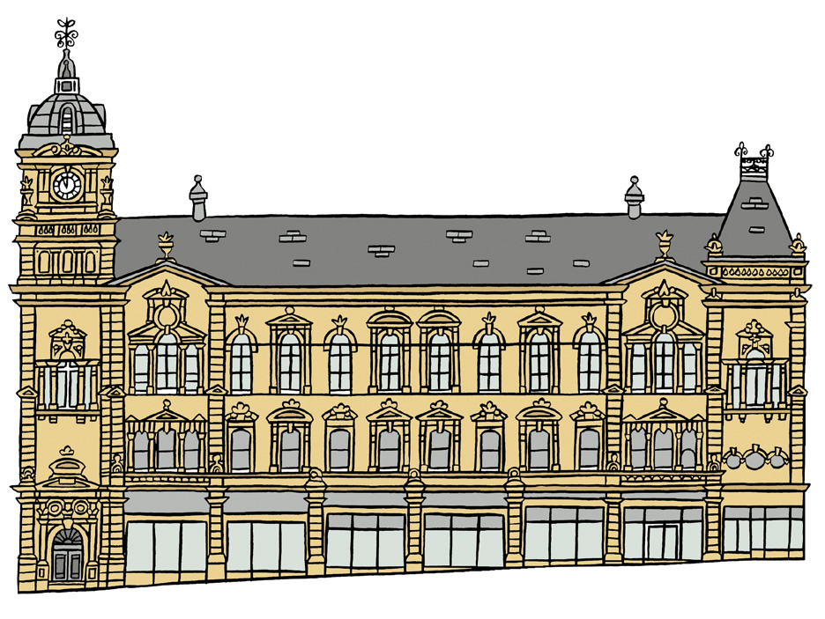
10. Pioneer House

Slide 26
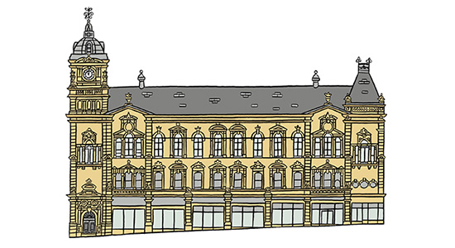
10. Pioneer House
It also had a library, conversation rooms and a concert hall. These were to provide places for ordinary workers to educate themselves.​
Pioneer House is named after the Rochdale Pioneers who started the Co-operative movement. ‘Co-ops’ kept prices fair for ordinary workers.​
​
In 1922 it became a cinema and then a snooker hall, before falling into disrepair.​
Local architects Henry Holtom and George Arthur Fox designed Pioneer House. It was opened in 1880.
Today, Kirklees College has transformed Pioneer House into a modern higher education teaching centre.​
They used the beehive as their symbol, which is why they are carved into the stonework. Bees were a symbol of hard work and industry.​
​

Slide 27



Take 10 buildings
Now you’ve followed the trail it’s time to find out a bit more about each of the buildings.​
It’s time to choose!
What makes my building special is…
It is my favourite because…

Slide 28

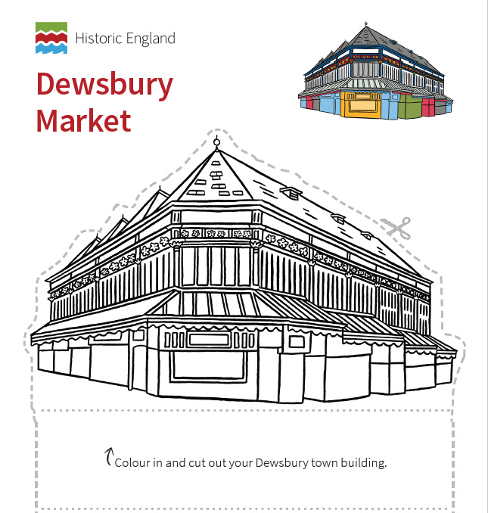
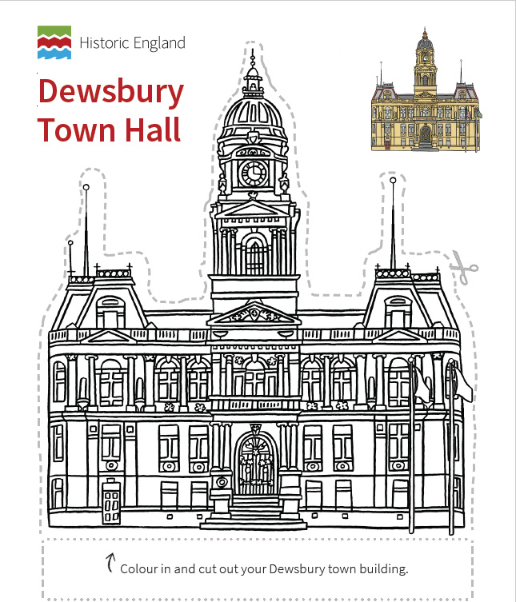
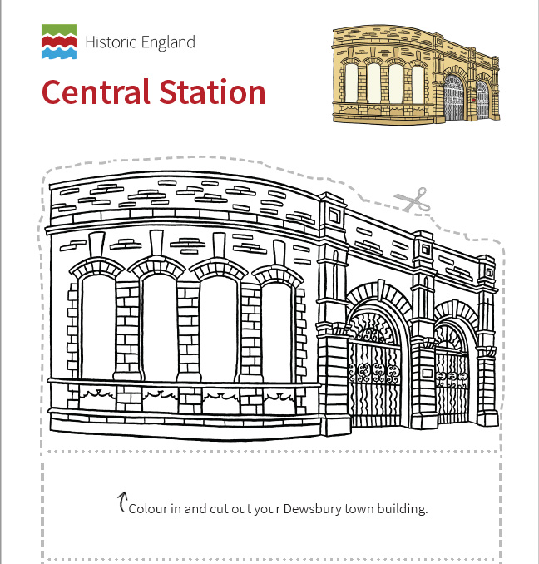
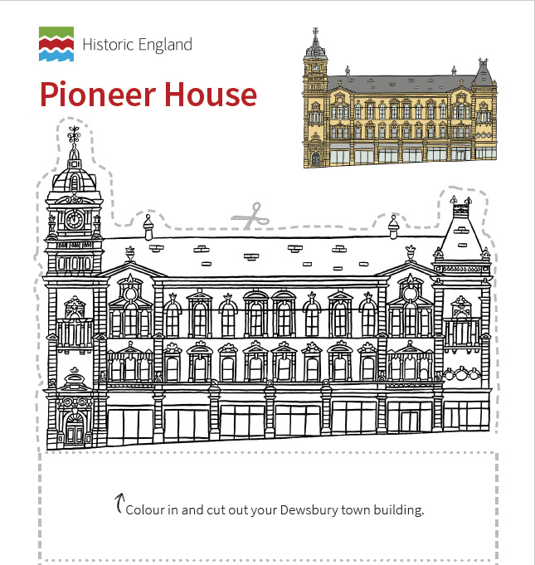
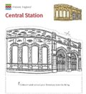


Get Creative
​Use the cut-out and make models of the buildings to create an exhibition.​
​
Find creative ways to show what you’ve learnt to other people.

Slide 29
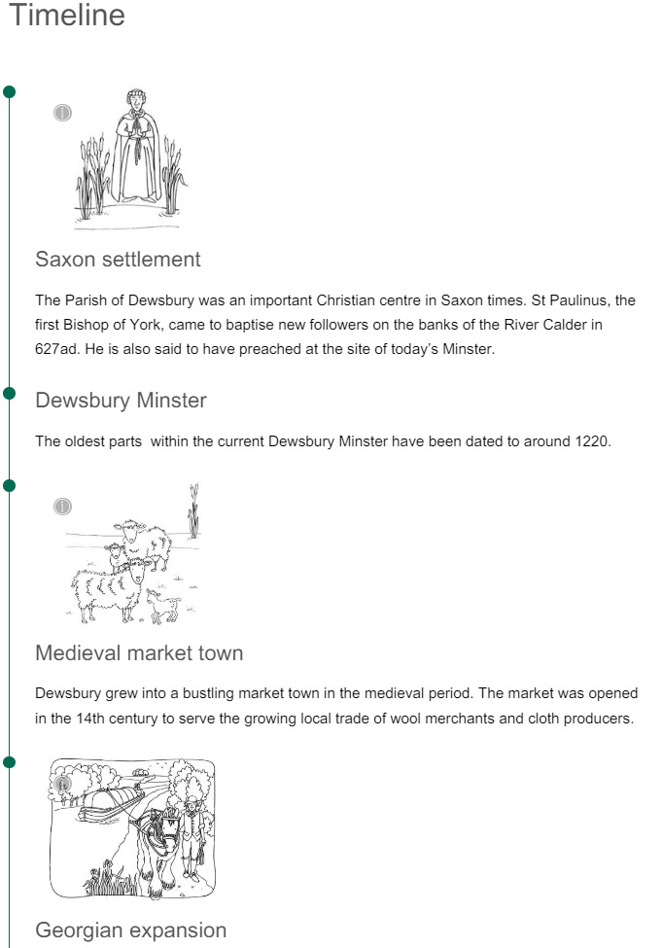


Wider Context
Use the timeline on the online trail and the A short history of Dewsbury PowerPoint to help pupils put their favourite building into the wider context of Dewsbury’s history.​
​After they’ve found out more, ask pupils if they would still choose the same buildings as their favourite?

