Slide 1

Lesson Two: Why has Bradford changed over time?
Key Stage 2: History
Learning Aims and Outcomes
Pupils will discuss how to label changes from the life of a sample individual
Pupils will sort cards explaining some changes in Bradford’s history, creating labels for different kinds of change
Pupils will discuss the terms “political, economic, social and religious change” and how these might apply to the labels they've created
Pupils will debate what type of change has had the most effect on Bradford as a whole
This activity relates to the Teaching Activity: Stories in Stone - How & why has Bradford changed over time?
Notes:
Learning Objective
To organise and categorise examples of change over time in a particular location
Learning outcomes: Pupils will have
Discussed how to label changes from the life of a sample individual
Sorted cards explaining some changes in Bradford`s history, deciding on possible labels for different kinds of change
Discussed the terms “political, economic, social and religious change”
Discussed how these might apply to the labels pupils suggested when sorting cards in to groups
Debated what type of change appears to have most effected Bradford as a whole

Slide 2
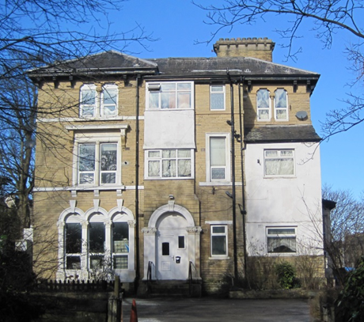
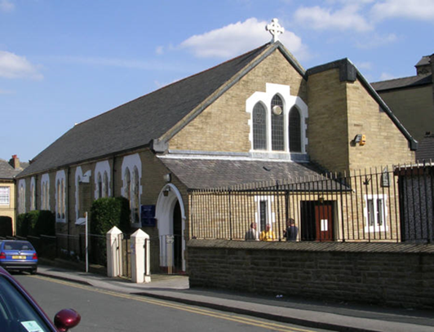
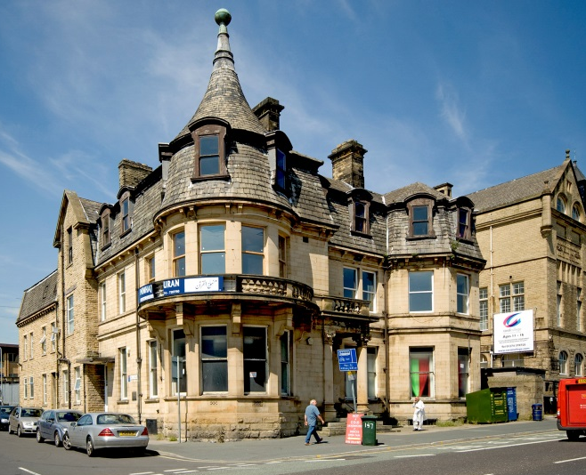
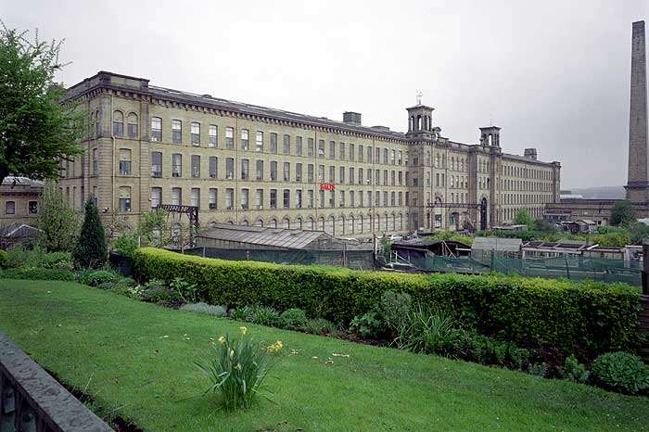
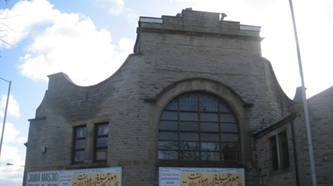
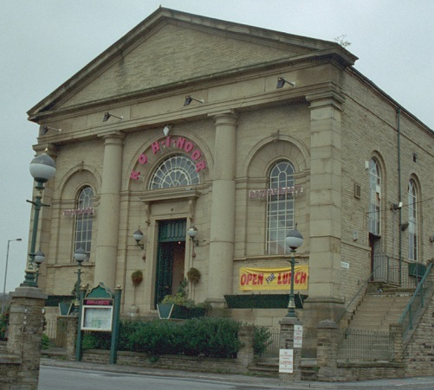
Why has Bradford changed over time?
Notes:
By organising and categorising examples of change over time in a particular location pupils will be able to make well reasoned decisions as to why Bradford has changed over time

Slide 3
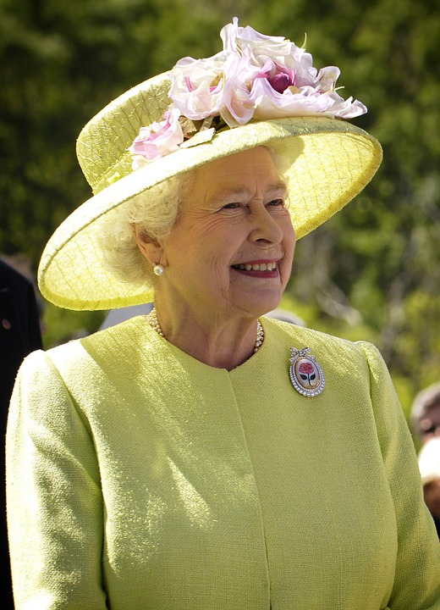



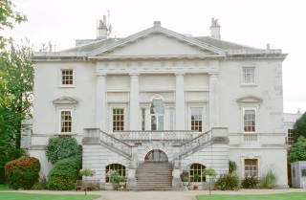
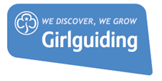

Timelines
Born
Moves house
Becomes a
Girl Guide
Has baby
Charles
Becomes
Queen
Second
World
War
ends
1926
1932
1937
1945
1948
1953
1926
1936
1939
1947
1952
Second
World
War
starts
Dad
dies
Marries
Phillip,
Duke of
Edinburgh
Dad
becomes
king
Moves house
Notes:
Starter Activity
Pick an individual and create a timeline of their life, you could use your own life, or the example here of Queen Elizabeth’s early life. Which ever you choose start by revealing the events on the timeline one-by-one. Ask pupils to guess who they think the timeline might be about.
Then give pairs a limited time to decide on labels for particular kinds of change e.g. is the change to do with moving from one place to another? What might the label be? “Moving”? , births, death and marriages might be ‘Family’, a war might be a ‘World event’ etc. Take suggestions in a whole class discussion.

Slide 4
Timeline Challenge
Can you make a Bradford timeline?
1800
1900
2000
1850
1950
Today
Start by laying out the 6 sheets of paper with dates on, leave a big gap between each sheet!
Look at your sheets of paper labelled A – U. Use the dates on them to start to make a timeline.
Don’t try to do them all at once – look at each sheet and ask yourself: ‘Does that come before or after’ another sheet on your timeline.
Good luck!
Notes:
Print out two sets of slides 5- 31. Divide the class into two teams (A & B). Show them this slide with the timeline on, then hand out the printed copies and set each team the challenge of making a Bradford timeline! You might want to rearrange the desks into two long rows or clear some space so pupils can use the floor to layout their sheets. Lead discussion taking comments from individuals and allow pupils to challenge each other’s views.

Slide 5
Timeline Challenge
1800
Notes:
Print out 2 copies of this slide

Slide 6
Timeline Challenge
1850
Notes:
Print out 2 copies of this slide

Slide 7
Timeline Challenge
1900
Notes:
Print out 2 copies of this slide

Slide 8
Timeline Challenge
1950
Notes:
Print out 2 copies of this slide

Slide 9
Timeline Challenge
2000
Notes:
Print out 2 copies of this slide

Slide 10
Timeline Challenge
Today
Notes:
Print out 2 copies of this slide

Slide 11
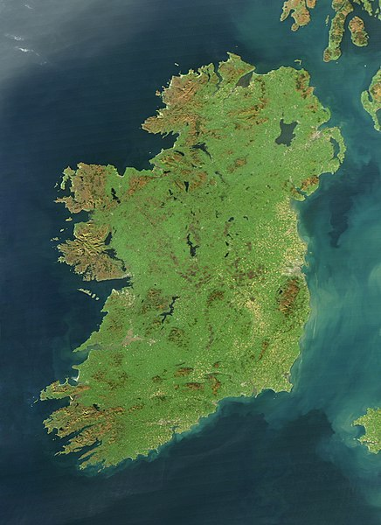
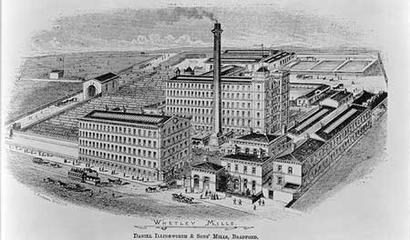
Timeline Challenge
A
Photo Credit; nasa.gov
BB88/04665
Historic England Archive
Between 1800 and the 1860s thousands of poor Irish people came to find work in Bradford. Some Irish workers and their children found work in Bradford mills and factories, trying to escape hunger and poverty Ireland.
Notes:
Print out 2 copies of this slide

Slide 12
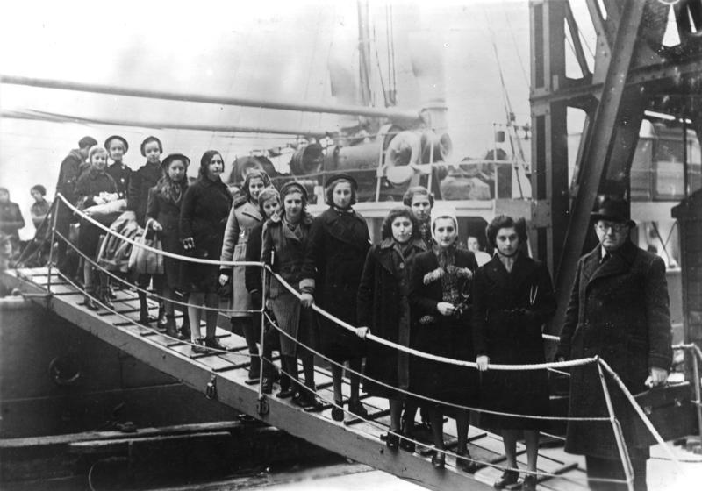
Timeline Challenge
B
Photo Credit: Bundesarchive
In 1939, just before the Second World War, hundreds of young Jewish children were rescued from the Nazis in Europe and brought to a new life in England. This was called the Kindertransport. Some came to Bradford.
(Between 1939-1945 the Nazis murdered six million Jewish people in Europe during the Holocaust)
Notes:
Print out 2 copies of this slide

Slide 13
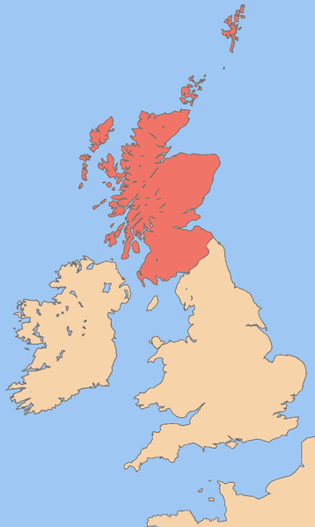
Timeline Challenge
C
Photo Credit: Rabk-talk
BB88/04665
Historic England Archive
Between 1818 and 1850, thousands of people came to find work in Bradford from all over England, Wales and Ireland. Some people came from Scotland too.
Notes:
Print out 2 copies of this slide

Slide 14
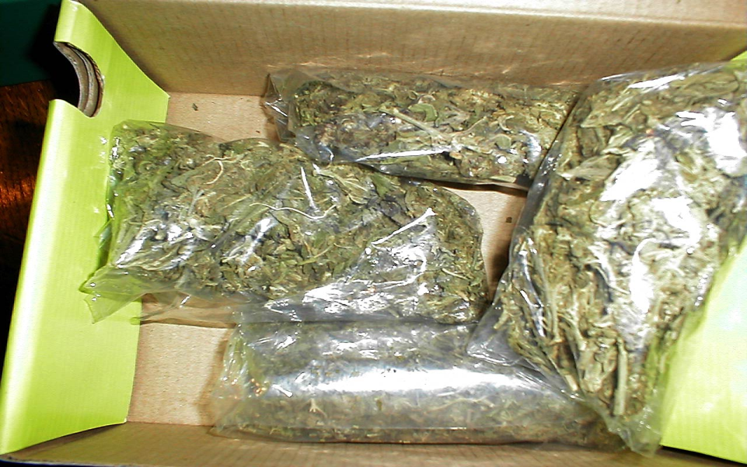
Timeline Challenge
D
Photo Credit: Public domain
Since the 1960s some Bradford people started using drugs which are against the law. The National Health Service has centres to help them stop using the drugs.
Notes:
Print out 2 copies of this slide

Slide 15

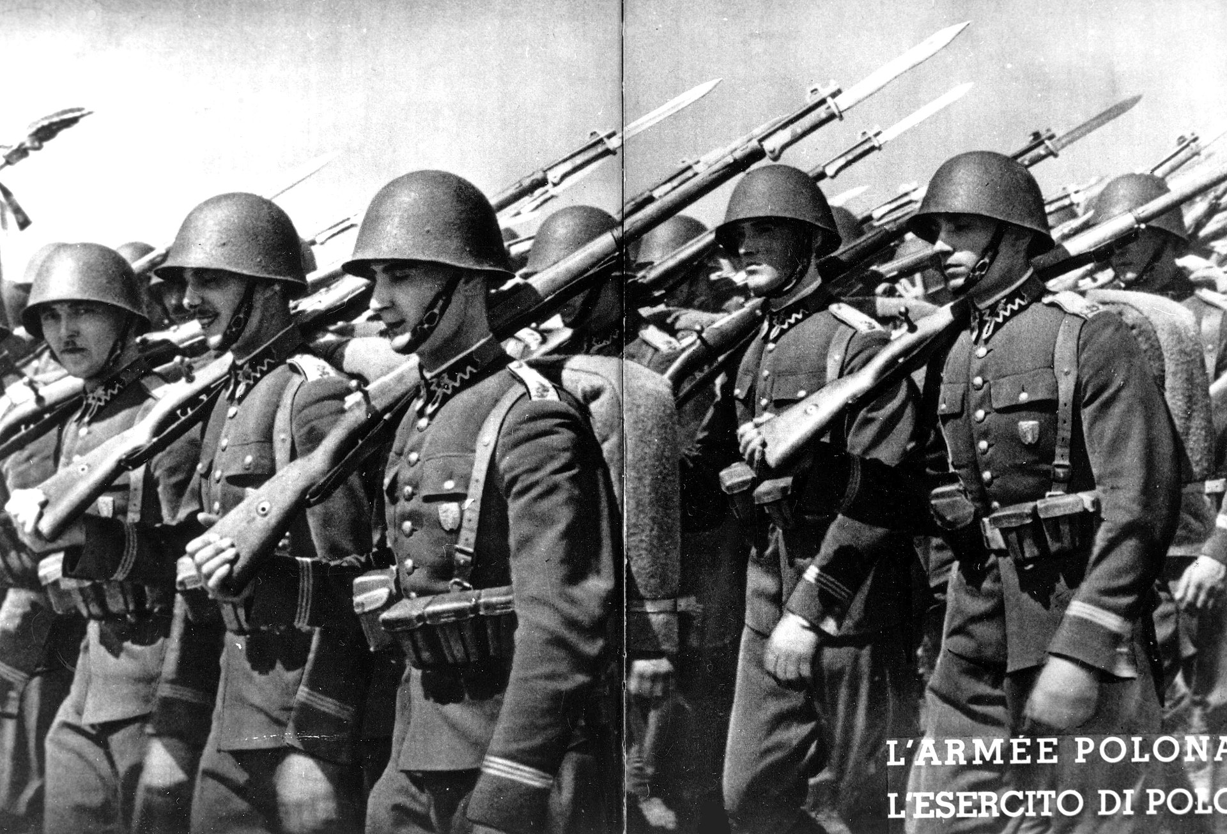
Timeline Challenge
E
Photo Credit : Museum of Warsaw
Photo Credit : Olek Remezs
After the Second World War (1939-1945), many Polish people came to live and work in Bradford (Britain needed extra workers then). Some had fought during the war on the side of the British. Most Poles could not go back to Poland because they might have been shot there or unfairly punished.
Notes:
Print out 2 copies of this slide

Slide 16

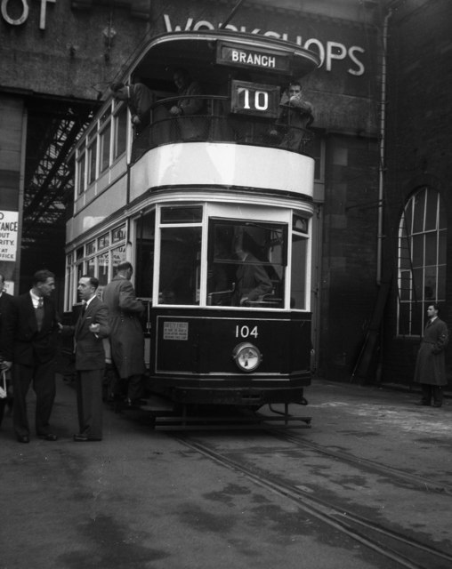
Timeline Challenge
F
Photo Credit: Dr Neil Clifton
Photo Credit: David Hillas
Between the 1940s and 1970s thousands of South Asian people came to live and work in Bradford (Britain needed extra workers then). Many were Muslims from Pakistan (once part of the old British Empire) looking for a better life. They needed mosques to worship in and liked to eat food they were used to.
Notes:
Print out 2 copies of this slide

Slide 17
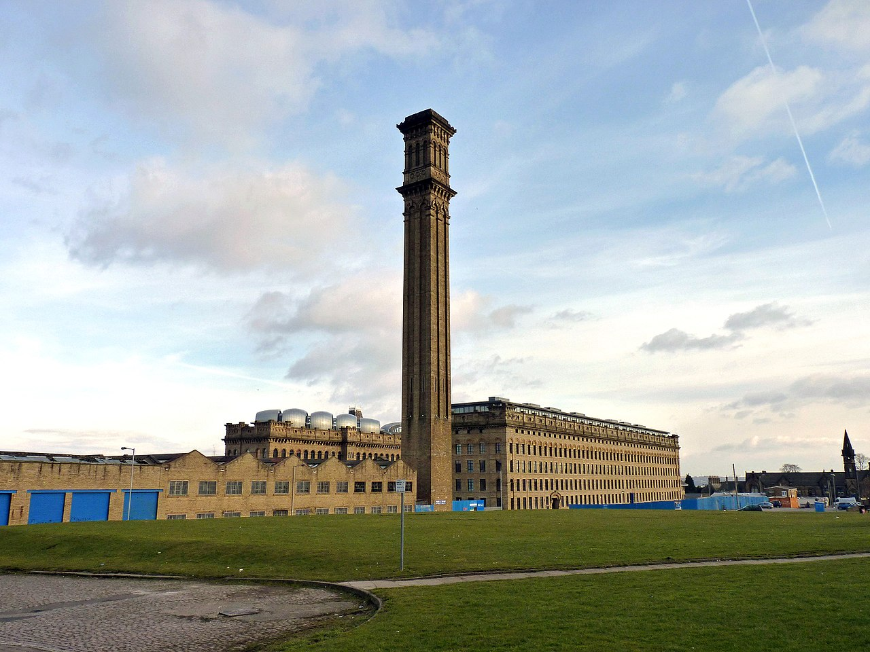
Timeline Challenge
G
Photo Credit: John Farnam
In the 1970s and 1980s lots of Bradford mills and factories closed down, leaving thousands of people out of work.
Notes:
Print out 2 copies of this slide

Slide 18
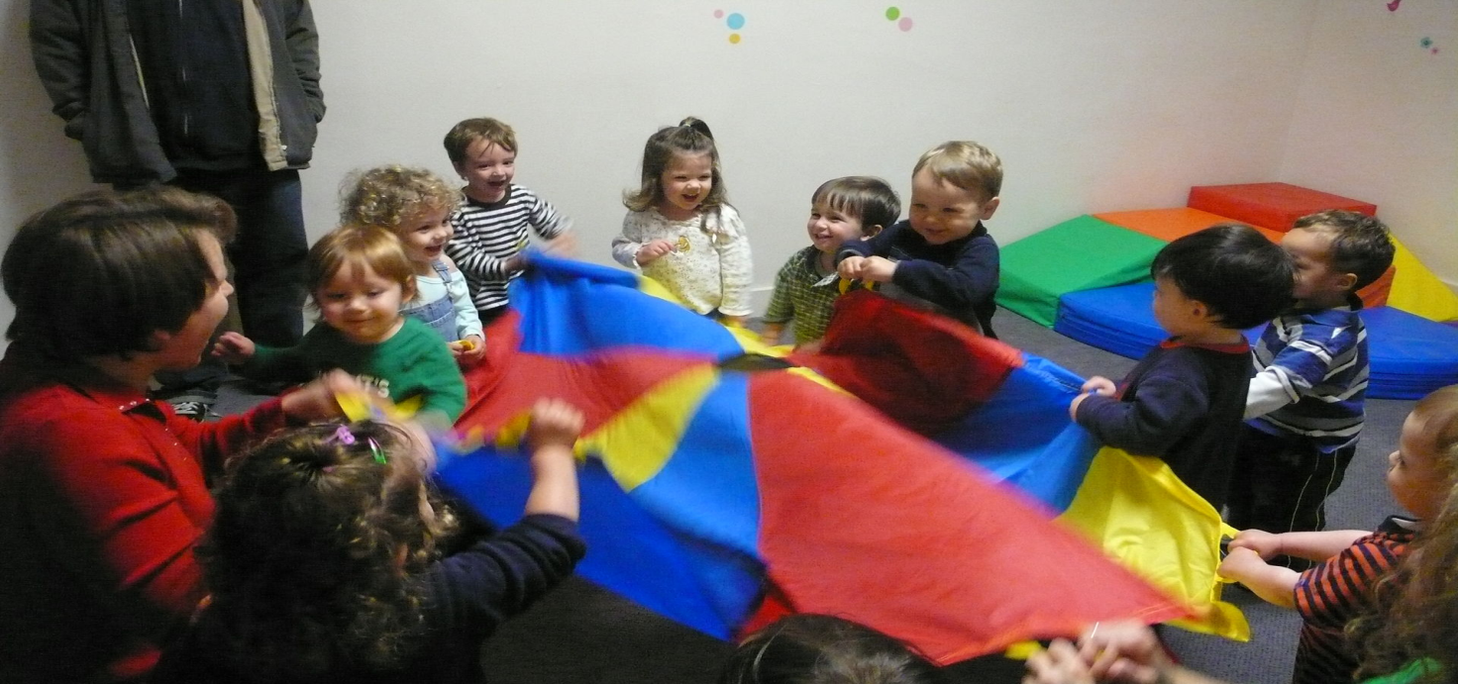
Timeline Challenge
H
Photo Credit; Grant Barrett
There are lots of growing families in Bradford. Many parents work and need somewhere to send their children during the day.
Notes:
Print out 2 copies of this slide

Slide 19

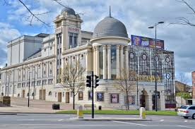
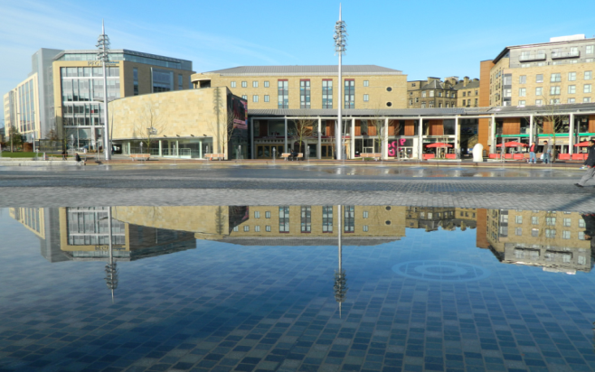
Timeline Challenge
I
Photo Credit: Bradford.buzz.com
From the 1980s Bradford restored some old buildings and built new ones to attract tourists and visitors.
Notes:
Print out 2 copies of this slide

Slide 20
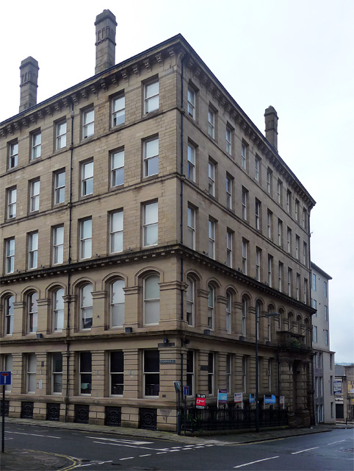
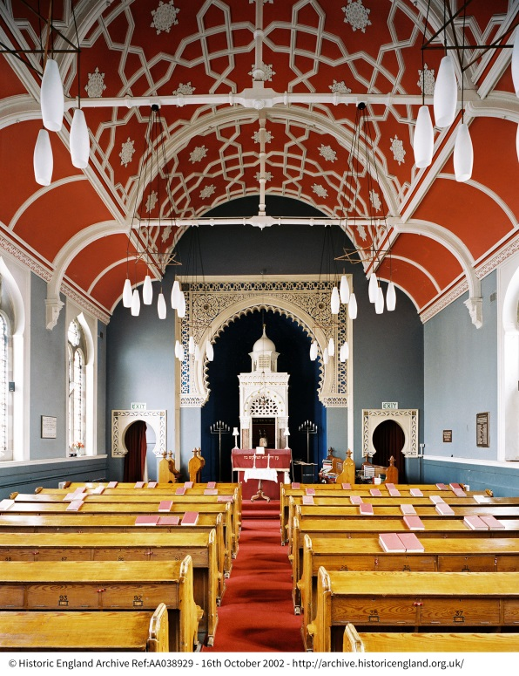
Timeline Challenge
J
Photo Credit: Stephen Richard
© Historic England Archive
In Victorian times (1837-1901) hundreds of Jewish people came to Bradford, mostly from Germany to find work and set up businesses.
Notes:
Print out 2 copies of this slide

Slide 21
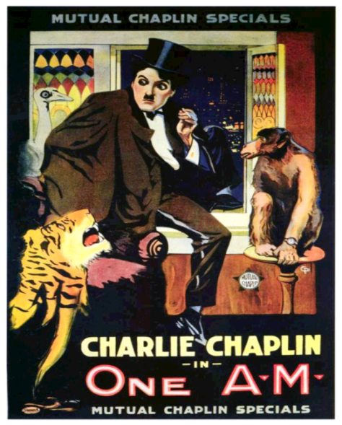
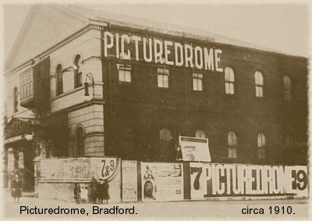
Timeline Challenge
Photo Credit: Colin Sutton
K
Photo Credit: Mutual Film Corporation
Most people in Bradford started going to watch films at cinemas from 1910. Between 1910 and the 1960s many people went once a week. This was before most houses had a television set. Between 1945 and 1962 22 cinemas in Bradford shut.
Notes:
Print out 2 copies of this slide

Slide 22
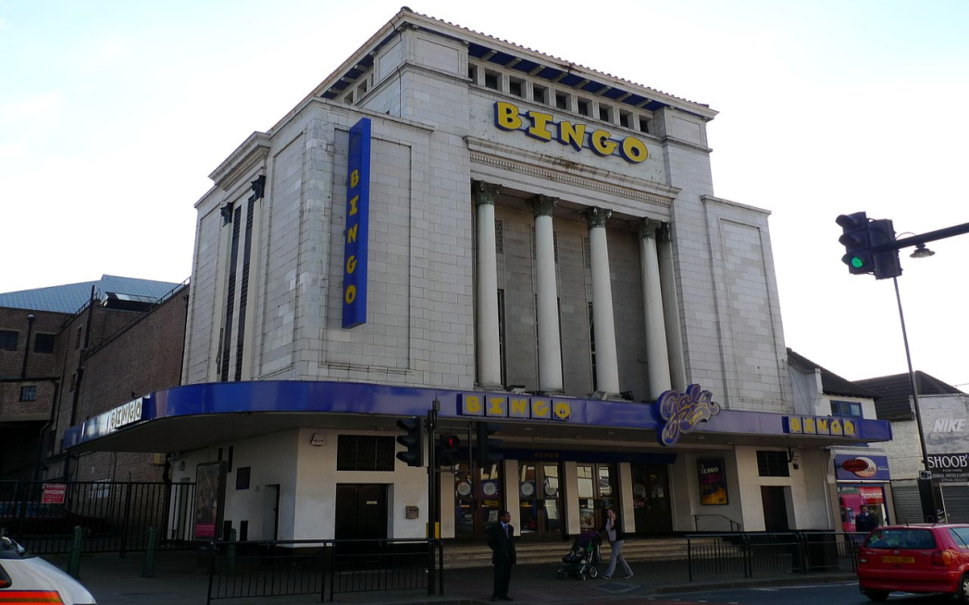
Timeline Challenge
L
Photo Credit: Ewan Munroe
Bingo is a form of gambling. Many people in Bradford enjoyed going out to play bingo with their friends between the 1950s and 2005. Old cinemas have sometimes been turned into bingo halls. Since 2005 lots of bingo halls have closed.
Notes:
Print out 2 copies of this slide

Slide 23
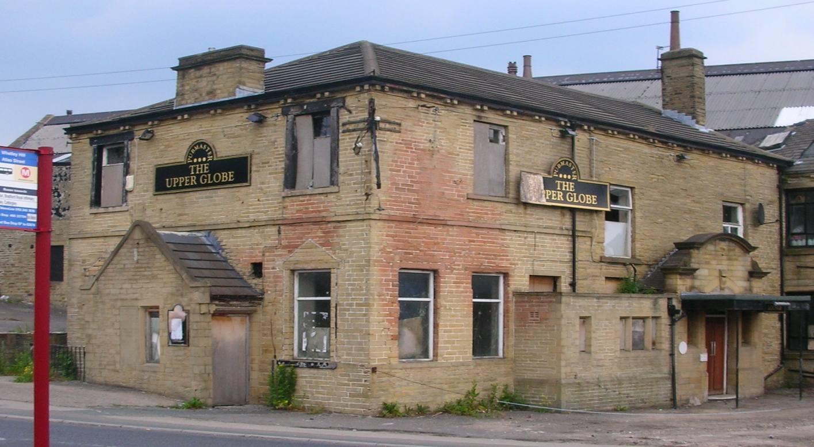
Timeline Challenge
M
Photo Credit:RSpiller
Some Bradford people like to drink alcohol in pubs. There used to be lots of pubs in Bradford but many have closed down.
Notes:
Print out 2 copies of this slide

Slide 24
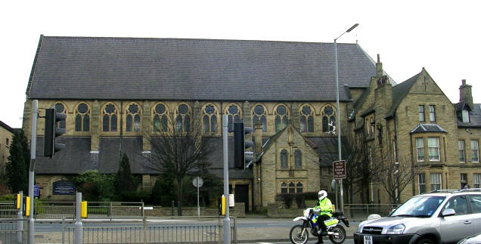
Timeline Challenge
N
Photo Credit: Betty Longbottam
Since the 1960s fewer people worship in Christian churches. Some Bradford churches have closed.
Notes:
Print out 2 copies of this slide

Slide 25
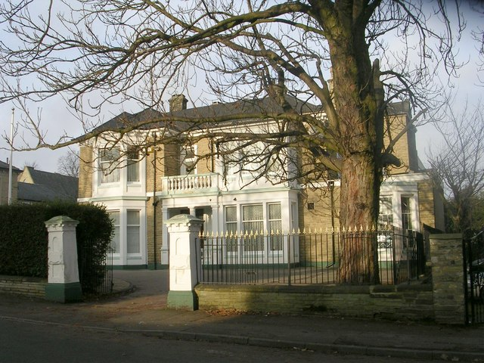
Timeline Challenge
O
Photo Betty Longbottom
In Victorian times (1837-1901) rich Bradford families lived in large houses in rich parts of Bradford like Manningham. Since then many richer people have moved out and poorer people have moved in. But lots of houses have been turned into flats that make them cheaper to run and rent out.
Notes:
Print out 2 copies of this slide

Slide 26
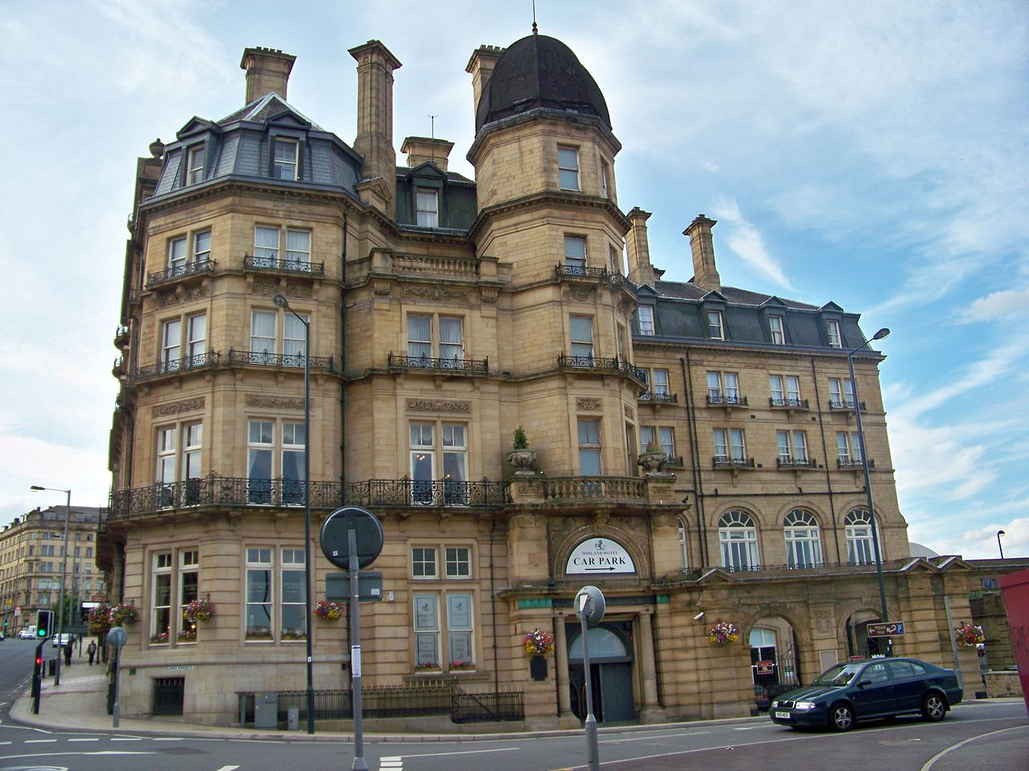
Timeline Challenge
P
Photo Credit: Mtaylor848
Hotels have opened and closed in Bradford since Victorian times (1837-1901), where people can stay the night if they are visiting.
Notes:
Print out 2 copies of this slide

Slide 27
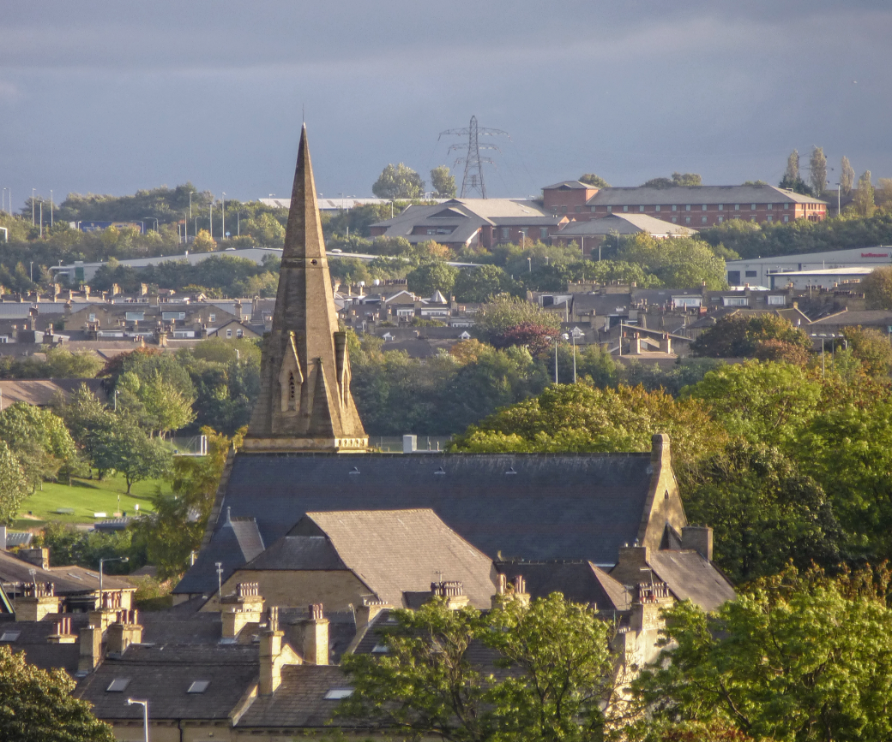
Timeline Challenge
Q
Photo Credit: Tim Green
In Victorian times (1837-1901) lots of Bradford people were Christians. As the city got bigger, new churches were built for them to worship in.
Notes:
Print out 2 copies of this slide

Slide 28
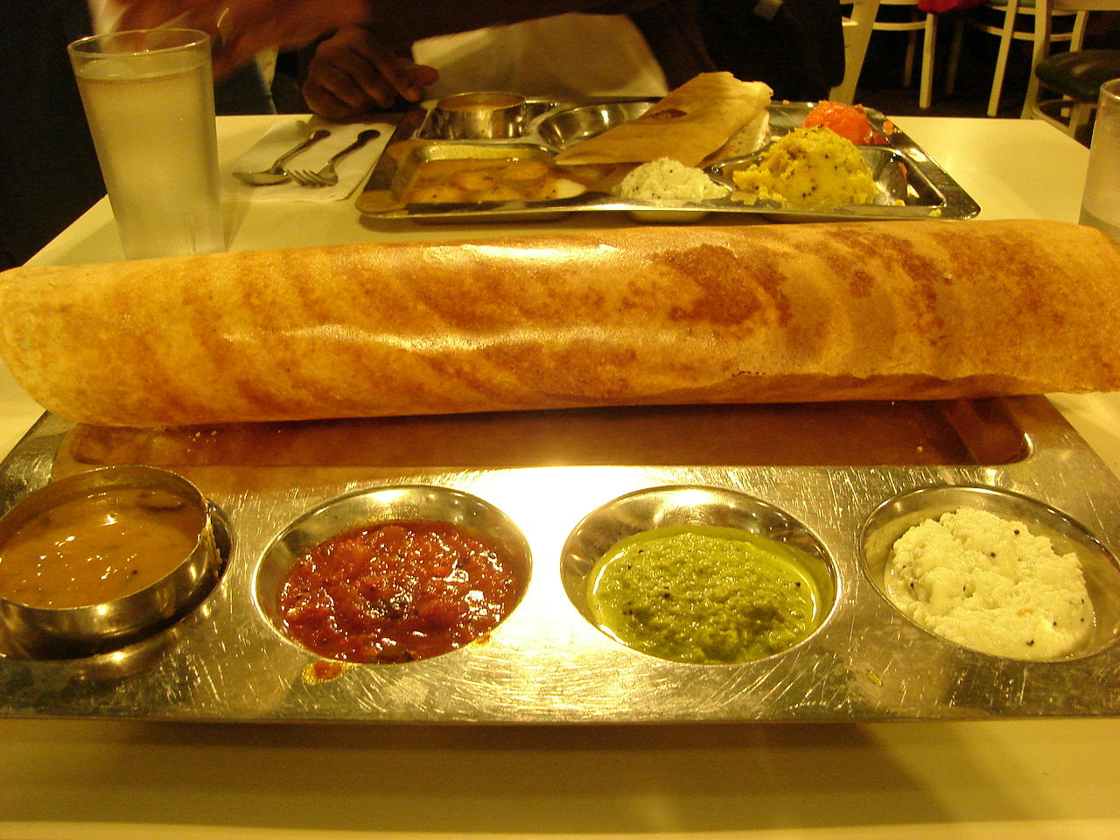
Timeline Challenge
R
Photo Credit: Mark Linksvayer
Since the 1960s lots of Bradford people have liked to eat in South Asian restaurants (not just South Asian people living in Bradford).
Notes:
Print out 2 copies of this slide

Slide 29
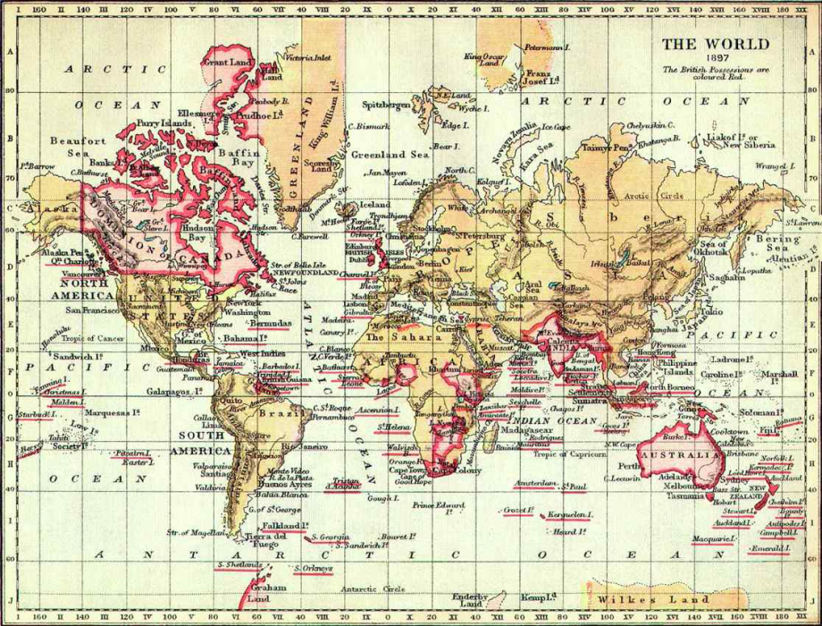
Timeline Challenge
S
Photo Credit: Cambridge University Library
After the Second World War (1939-1945) many countries became independent of the old British Empire. Between the 1940s and 1960s people from these countries were asked come to Britain and work (there were not enough workers then).
Notes:
Print out 2 copies of this slide

Slide 30





Timeline Challenge
T
Photo Credit: The Selfish Giant
Films were sometimes made in Bradford from around 1900.
Notes:
Print out 2 copies of this slide

Slide 31
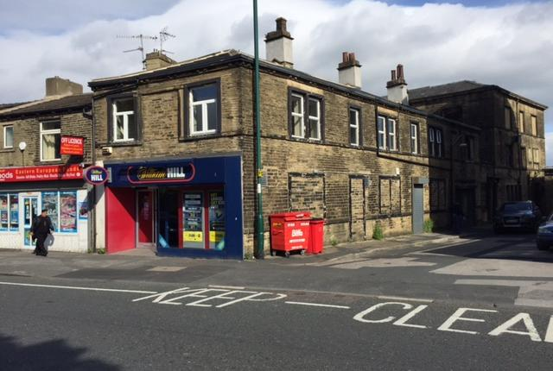
Timeline Challenge
U
Photo Credit: Geograph.UK
Some old Bradford buildings have been turned in to offices since the 1960s.
Notes:
Print out 2 copies of this slide

Slide 32
All sorted?
How else could sheets A – U be arranged?
Can you see any similarities between the different facts on each sheet
Discuss in your team how you might group different sets of facts together
Create your groups of sheets
Compare Team A’s groups with Team B’s
Discuss and explain your choices
Notes:
Having completed and discussed the options for laying out the timeline ask pupils to reorganise the cards in any other way or ways they can (if pupils finish quickly challenge them to find as many different ways of organising the cards as possible). Lead discussion inviting comments.

Slide 33
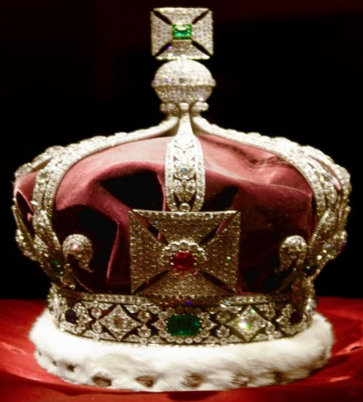
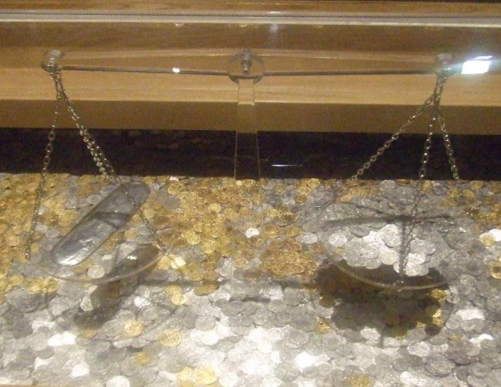
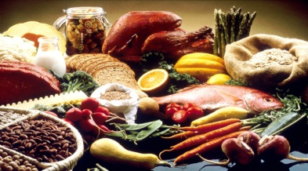
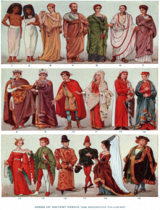
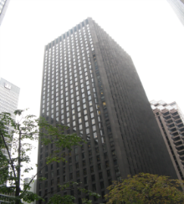
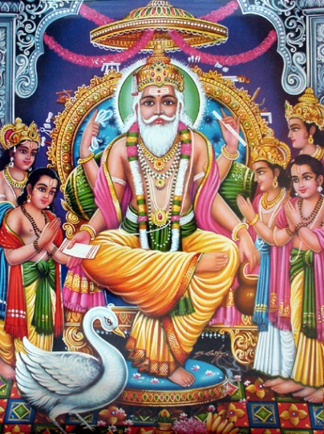
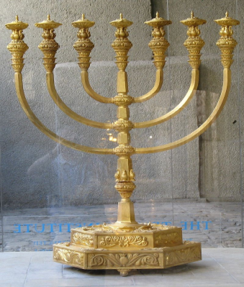
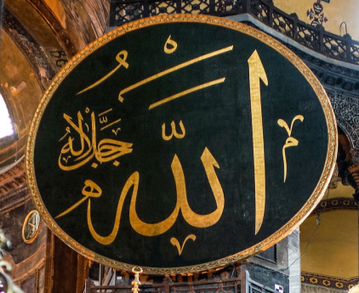
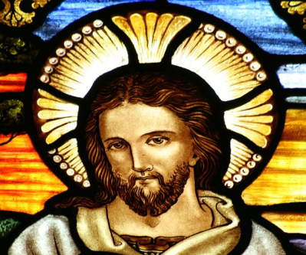
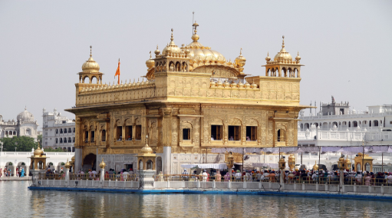
All sorted?
How would an historian sort them?
Political
Economic
Social
Photo Credit; Pietro and Silvia
Photo credit; DebashiM
Photo credit; DebashiM
Religious
Photo credit; Toby Hudson, Adam Kilczek, ariely, Oleg Yunakov
Notes:
Having heard and seen the pupils suggestions for how the facts could be grouped, explain how historians often group things into political, economic, social and religious changes. Hand out a copies of each of the following 4 slides, describing each of these terms. Then ask pupils to arrange the sheets into these 4 groups – explain that some sheets might go into more than one group – they could decide which is the ‘best fit’ group for that sheet, but also mark it with the colour of another of the groups. Once done discuss each team’s choices and debate which type of change they think have had the most effect on Bradford.

Slide 34
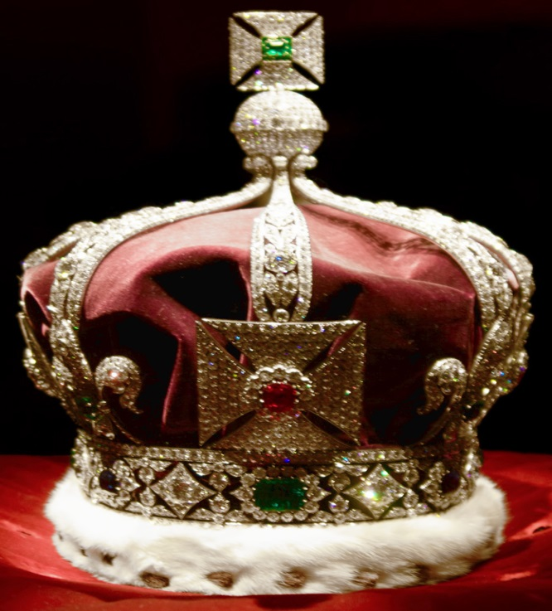
All sorted?
Change to do with Power and Control
(POLITICAL CHANGE)
Photo Credit; Pietro and Silvia
Notes:
Print out 2 copies of this slide

Slide 35
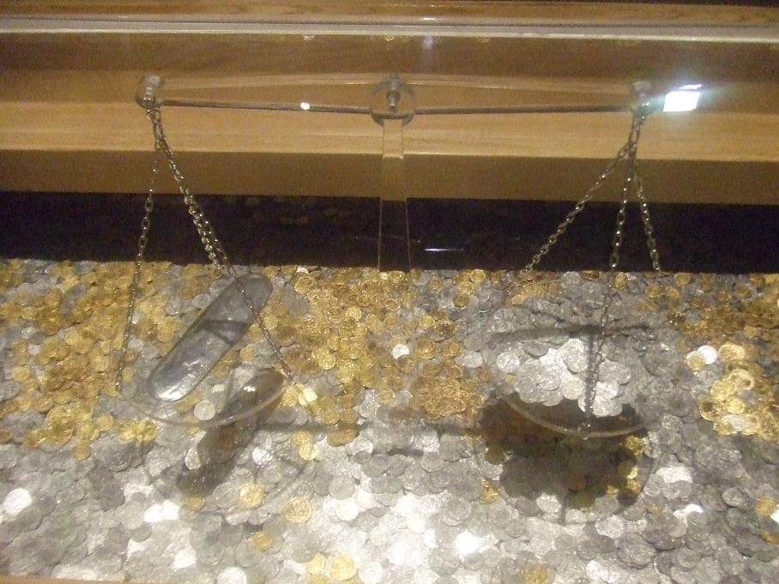
All sorted?
Change to do with money, making things, jobs, buying and selling
(ECONOMIC CHANGE)
Photo credit; DebashiM
Notes:
Print out 2 copies of this slide

Slide 36



All sorted?
Change to do with how people live
(SOCIAL CHANGE)
Photo credit; DebashiM
Notes:
Print out 2 copies of this slide

Slide 37
All sorted?
Change to do with religions
(RELIGIOUS CHANGE)
Photo credit; Toby Hudson, Adam Kilczek, ariely, Oleg Yunakov
Notes:
Print out 2 copies of this slide

Slide 38
Why has Bradford changed over time?
Notes:
Continue to Lesson 3 (https://historicengland.org.uk/content/docs/education/explorer/bradford-over-time-lesson-three
) – or if you don’t have time to do all three lessons return to the very first enquiry slide – ask pupils to use all they’ve learnt from the timeline and the sorting activity to write a short paragraph to try to explain why Bradford has changed over time.

Slide 39
Find more teaching resources at:
HistoricEngland.org.uk/Education

